Slide 1
EPIC Installation Schedule High Level Summary
1006 Beneficial Occupancy 10/2029
EPIC Cradle Installation 11/2029-2/2030
OHCal Barrel Installation (Bottom half) 3/2030-5/2030
SC-Magnet Install 8/2031
OHCal Barrel Installation (Top half) 9/2031-11/2031
Roll into IR 2/2032
Magnet Map 4/2032-6/2032
Roll out to Assembly Hall 6/2032
Barrel EMCal Assembly/Install/Test 6/2032-11/2032
Inner Detector Assembly/Install/Test (Si/TOF/MPGD) 11/2032-6/2033
RICH(D+PF) & E³MCal Assembly/Install/Test 6/2033-8/2033

Slide 2
EPIC Installation Schedule High Level Summary
Hadron End Cap Assembly/Install/Test 5/2030-11/2033
HEC Detector Install/Test 7/2030-11/2033
Electron End Cap Assembly/Install/Test 1/2031-7/2034
EEC Detector Install/Test 11/2033-7/2034
EPIC Installation complete 7/2034
Post-installation commissioning begin 7/2034

Slide 3
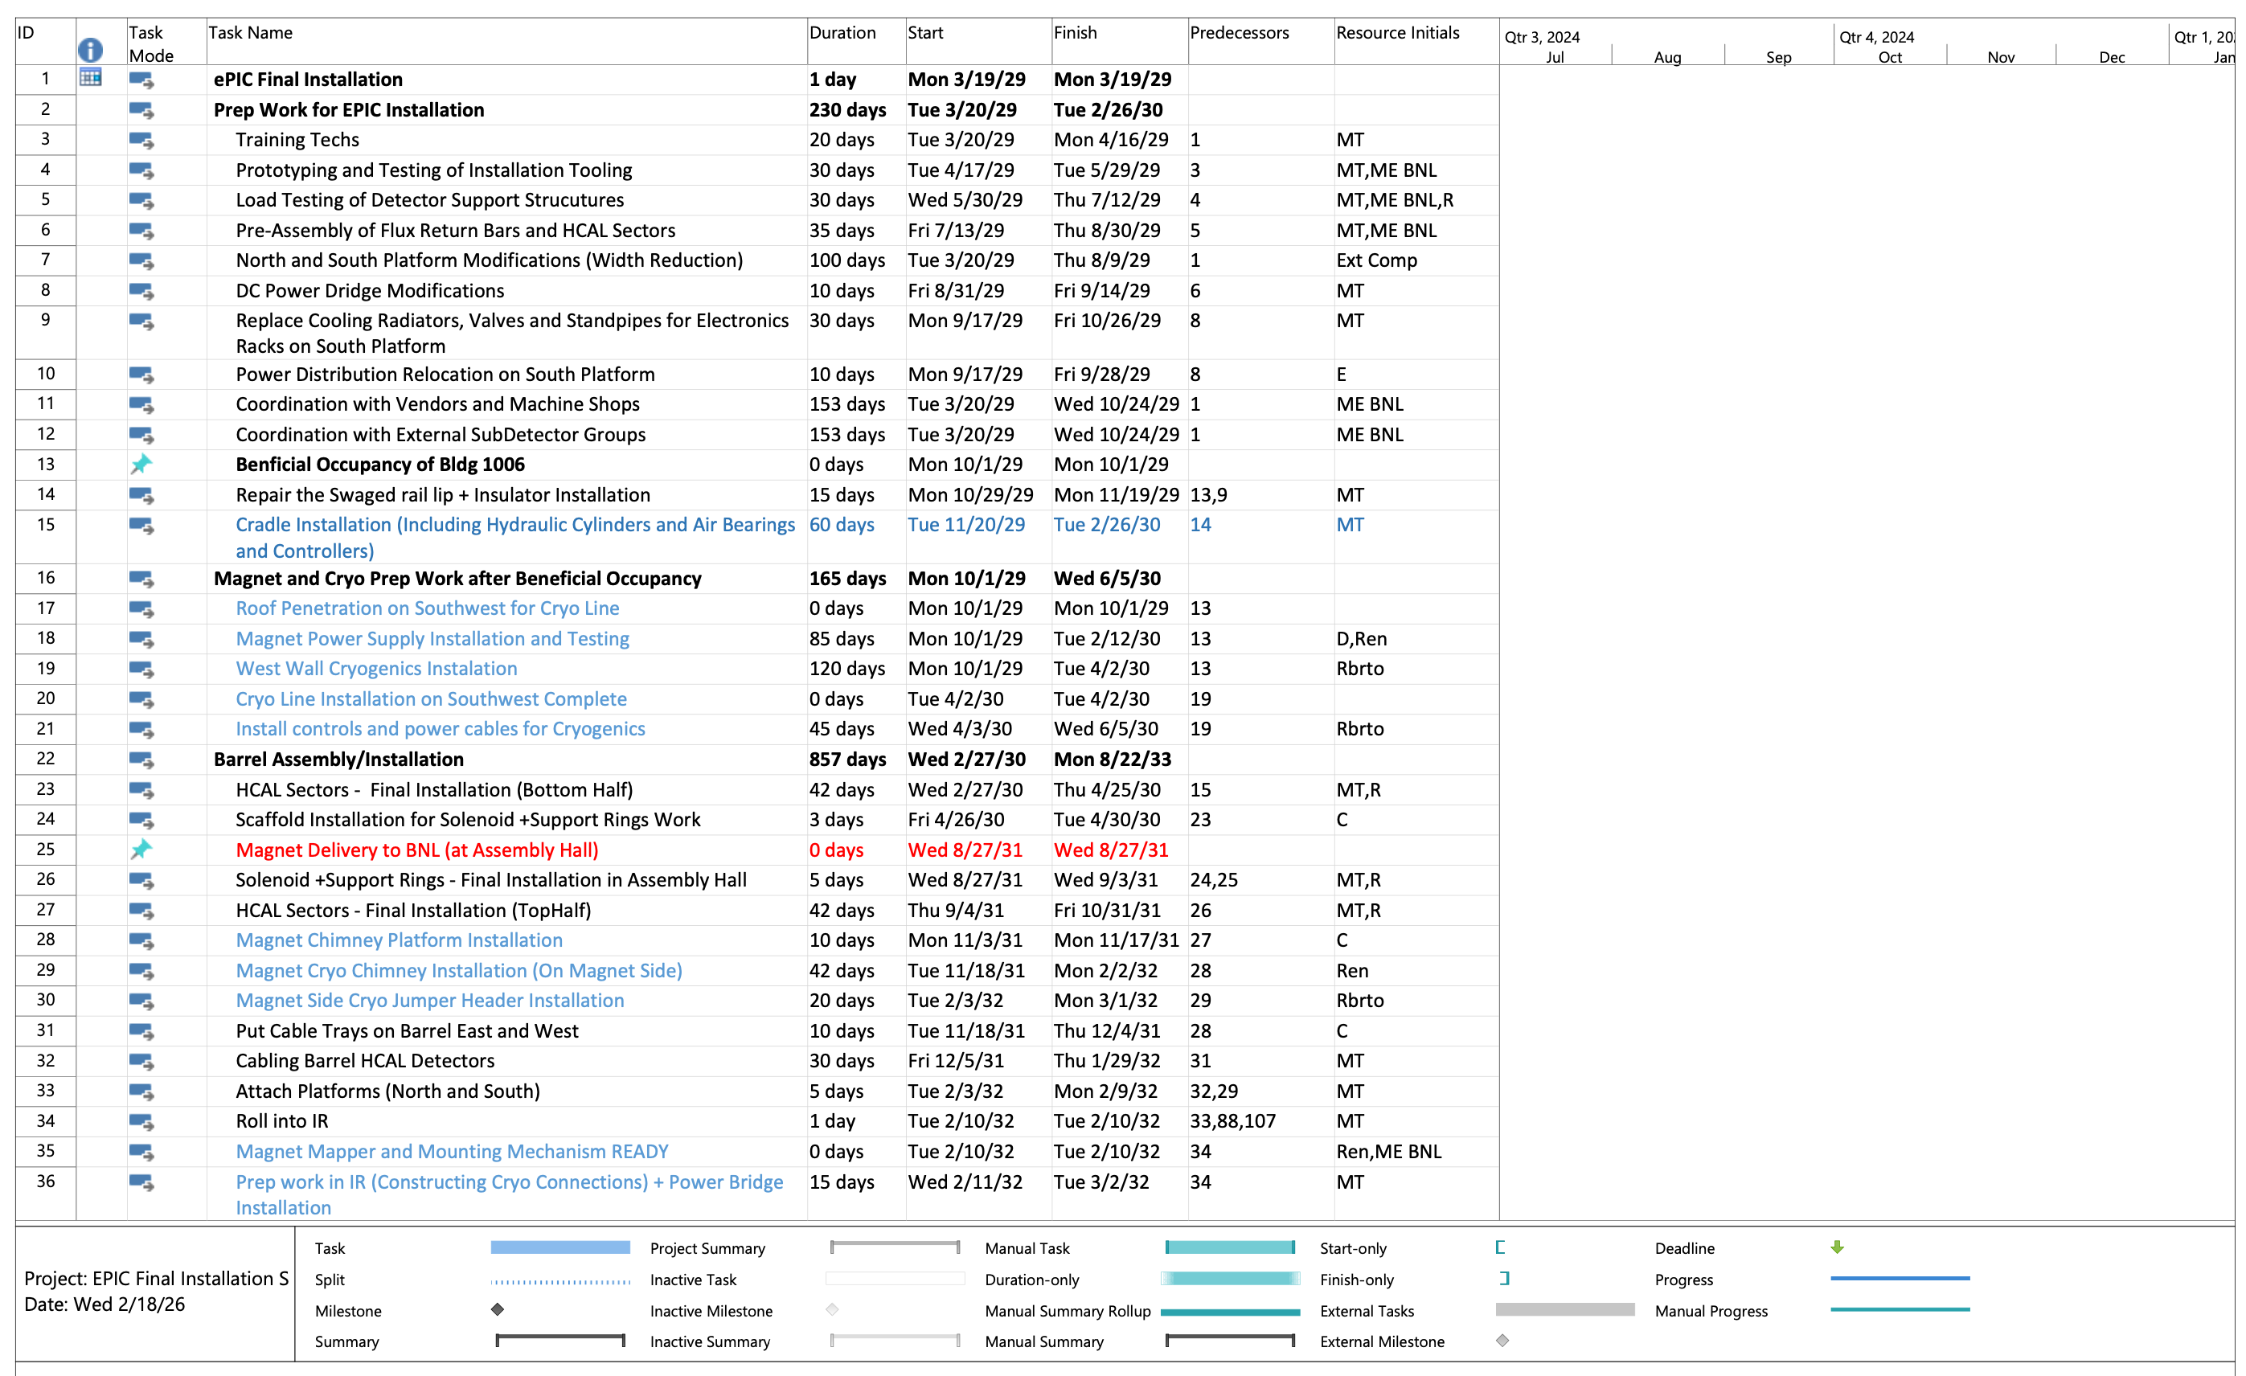
EPIC Installation Schedule

Slide 4
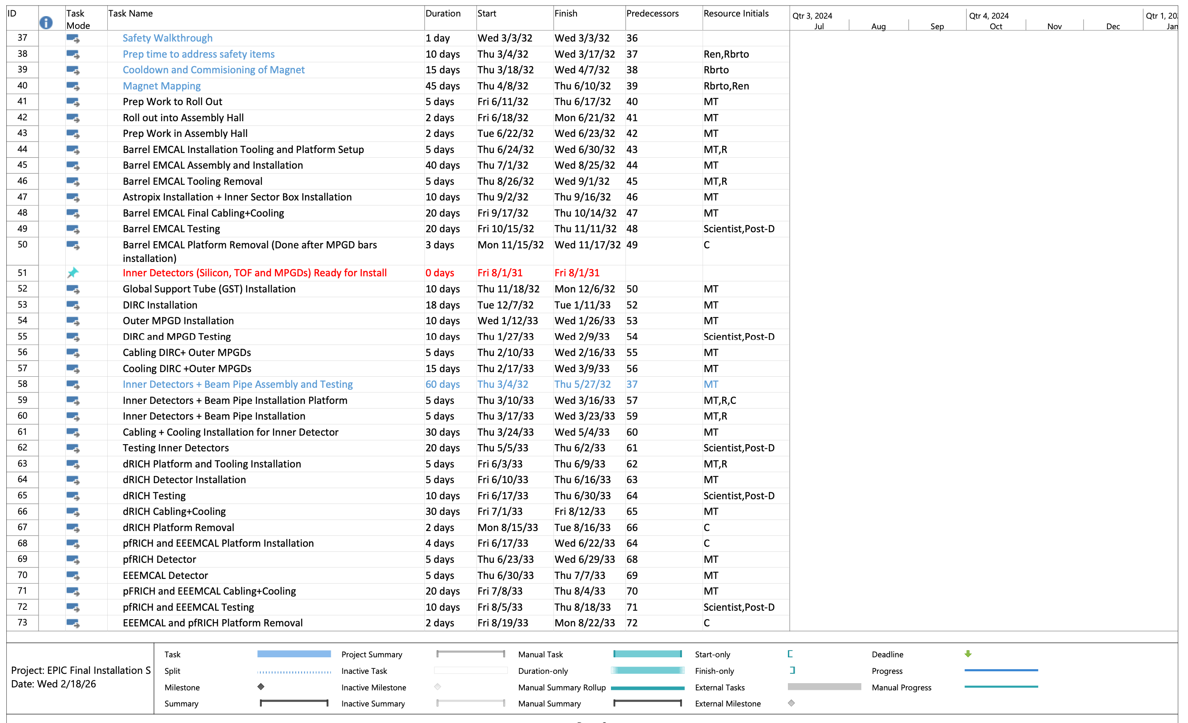
EPIC Installation Schedule

Slide 5
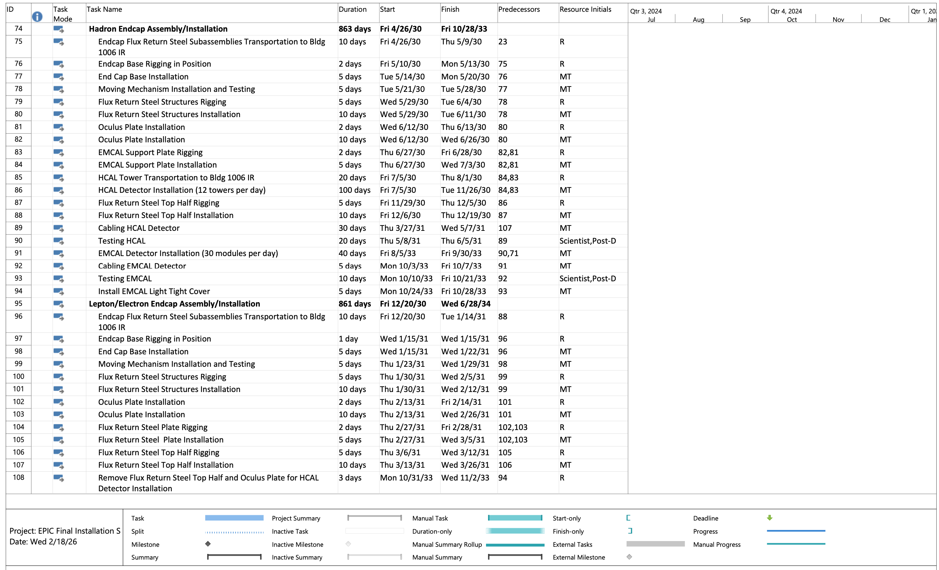
EPIC Installation Schedule

Slide 6
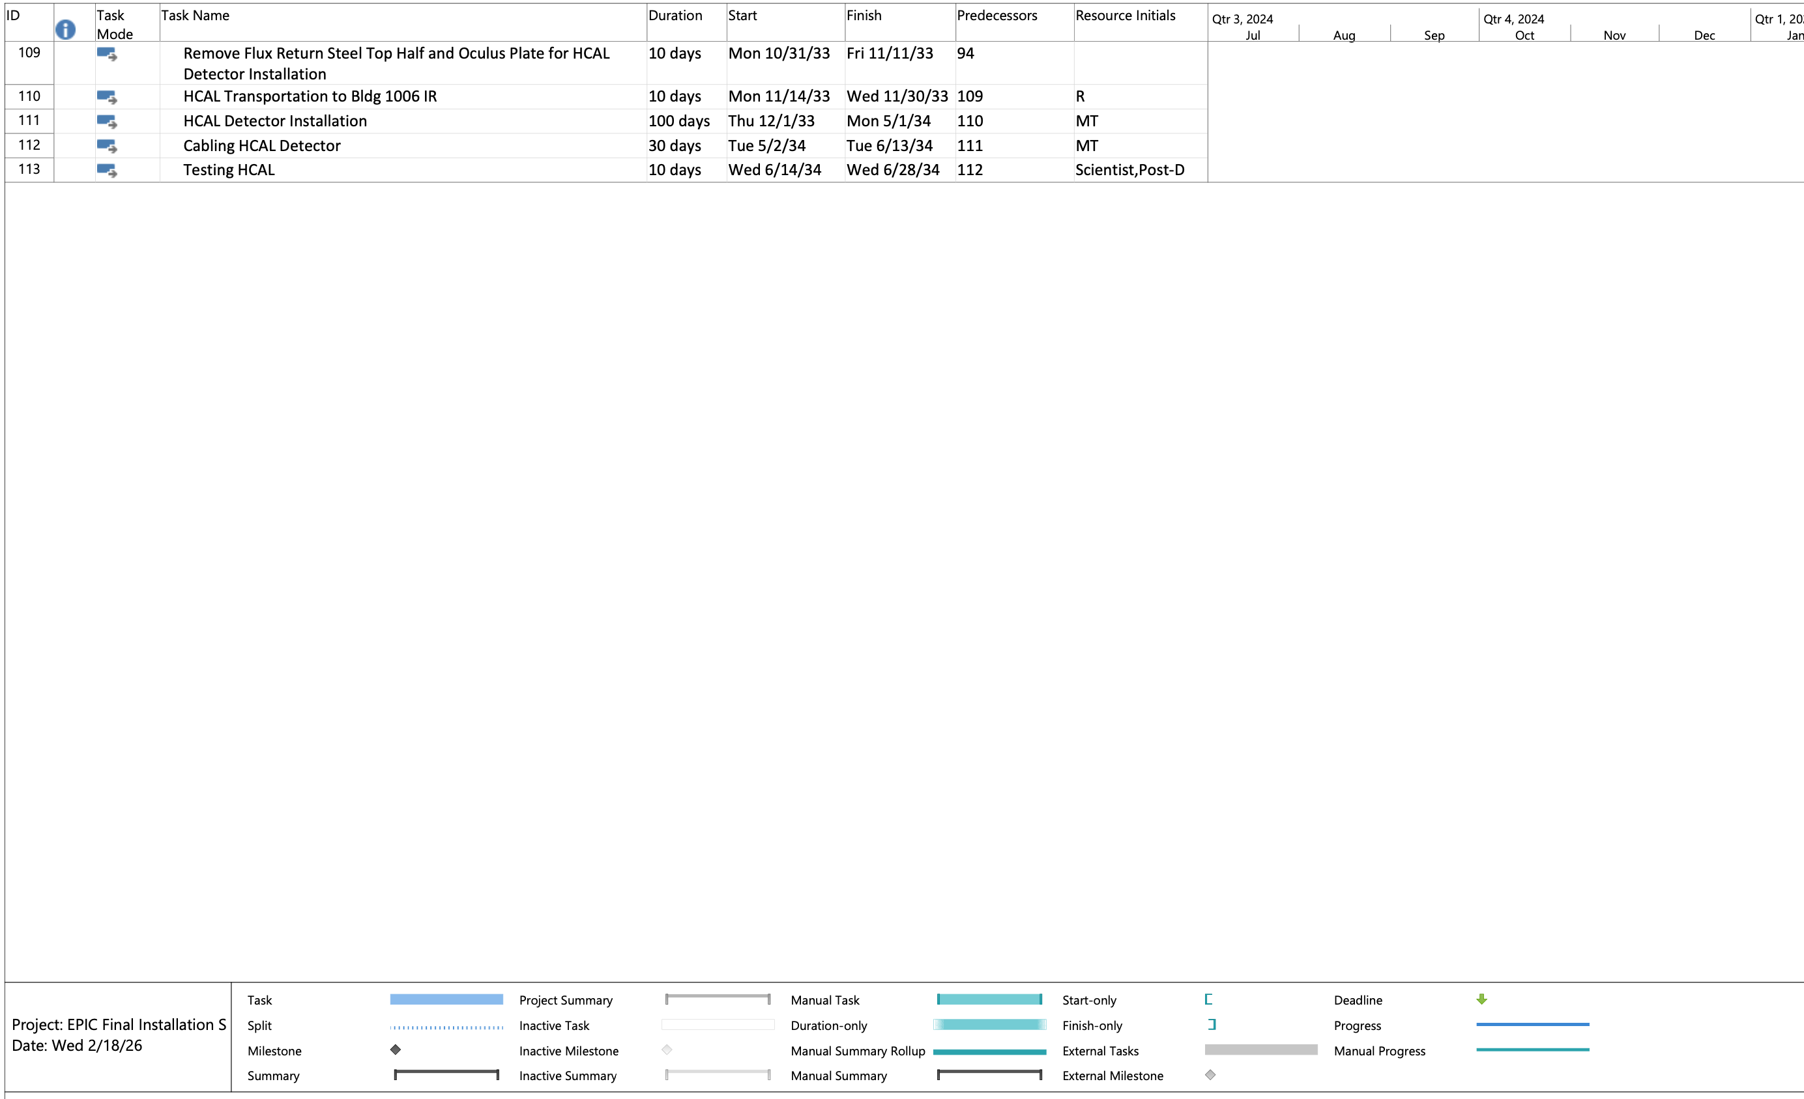
EPIC Installation Schedule

