Slide 1
Barrel Outer Tracker / MPGD (μRWELL)
Triple I Engineering Meeting Update (06/29/2026)
Seungjoon Lee (Jlab)

Slide 2
Update - Facility
Jlab MPGD Facility is moving foreword.
Major progress
  Ultrasonic water bath – Transformer (220V) Installed, no water yet (drainpipe not ready).
  Sanding station for detector frame – Installed, protocol (dust control) accepted by ES&H.
  - Fume hood for vacuum gluing – Installed, outside vent fan will be installed.
  - Nitrogen box for GEM foil test – Assembled.
  Deliver N₂ gas into Cleanroom – N₂ bottle space outside, delivered into clean room.
  GEM stretcher - Installed. preparing mockup test.

Slide 3
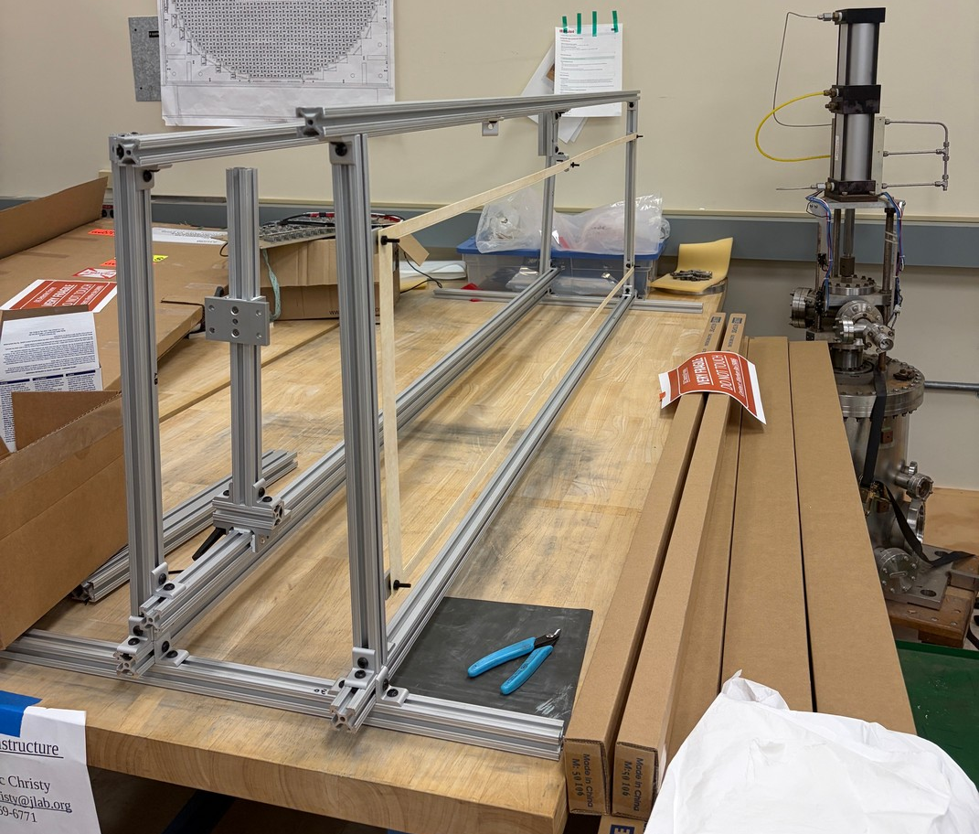
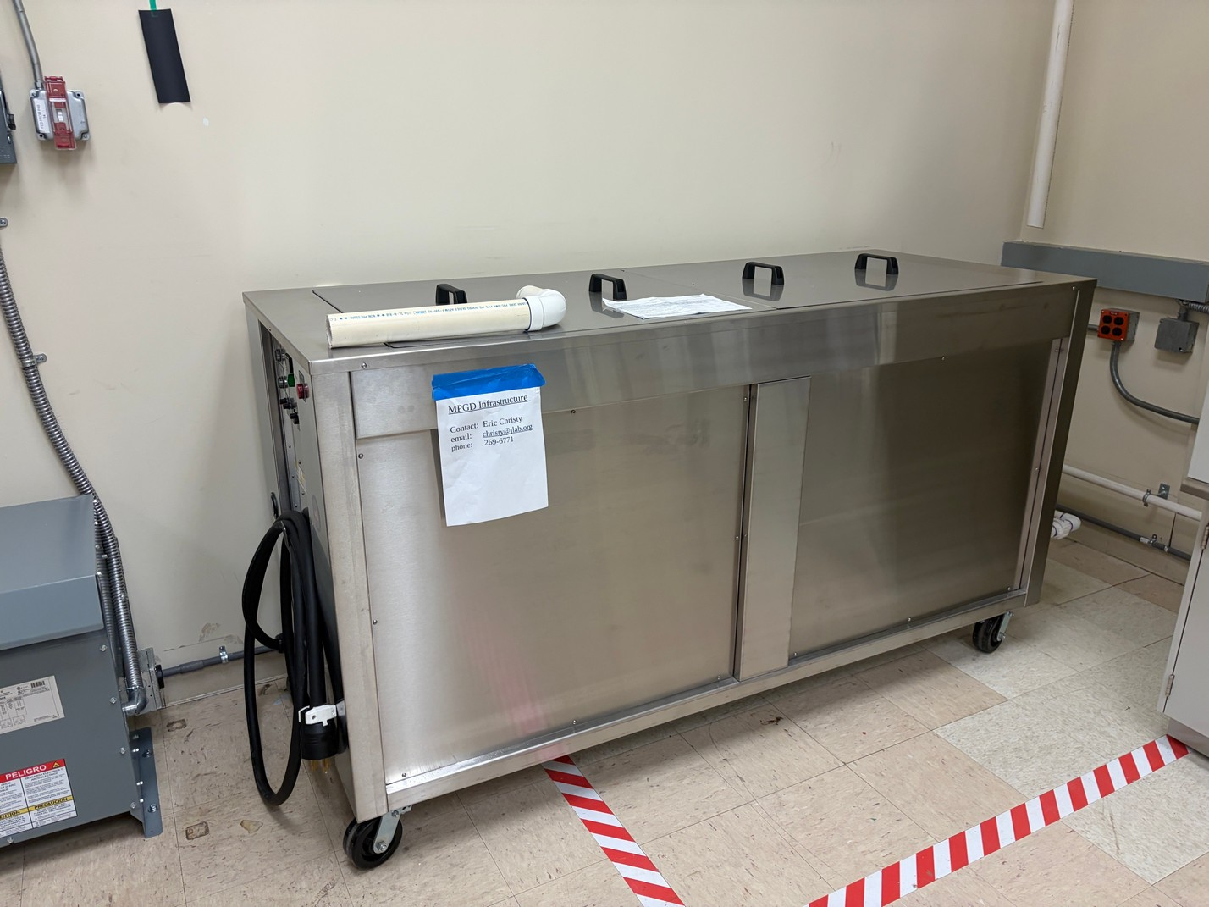
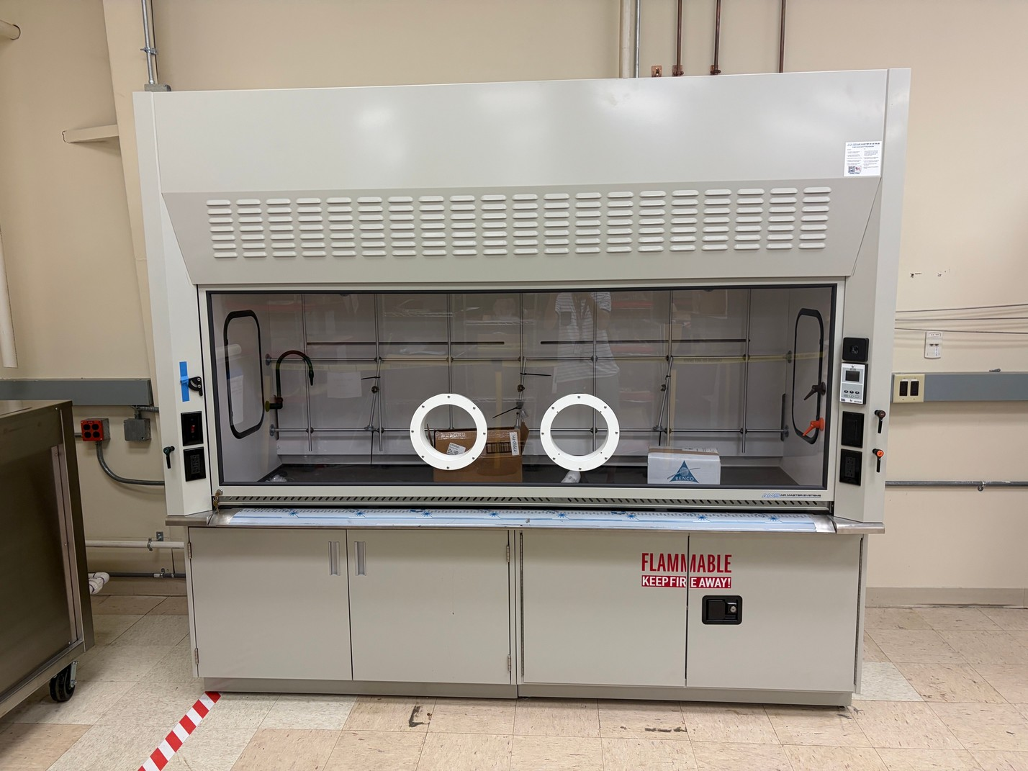
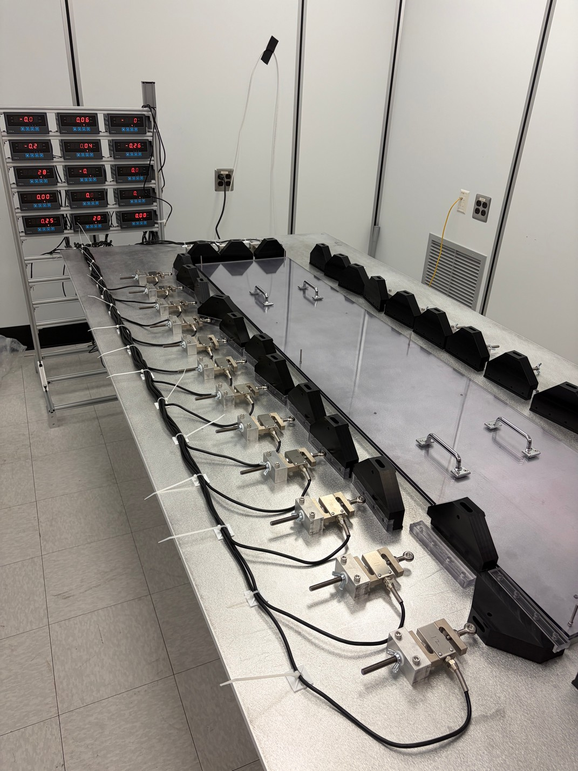
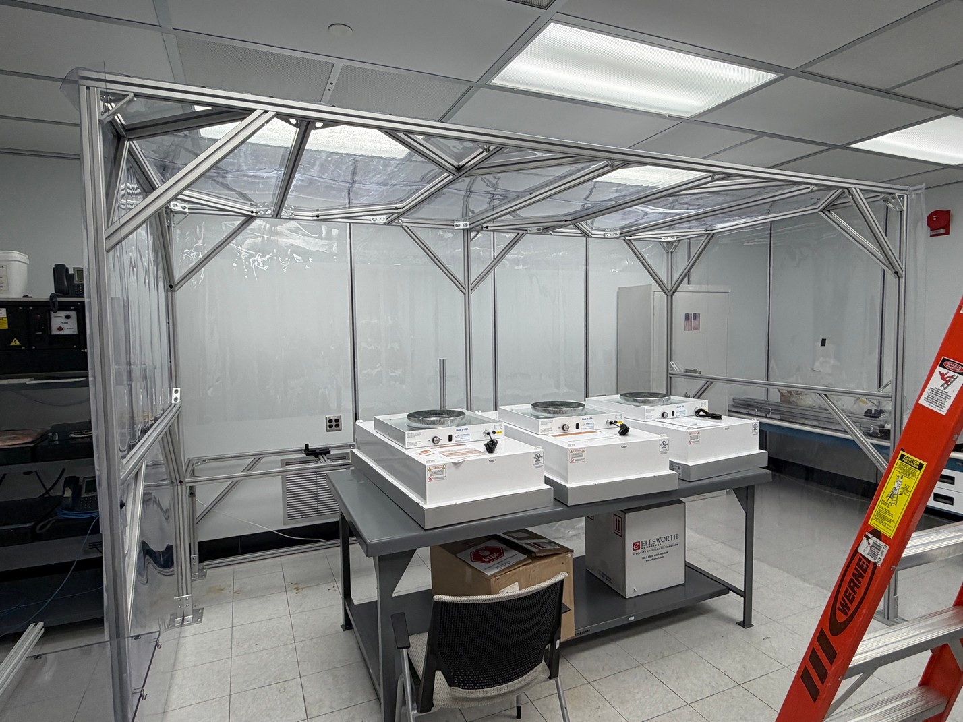
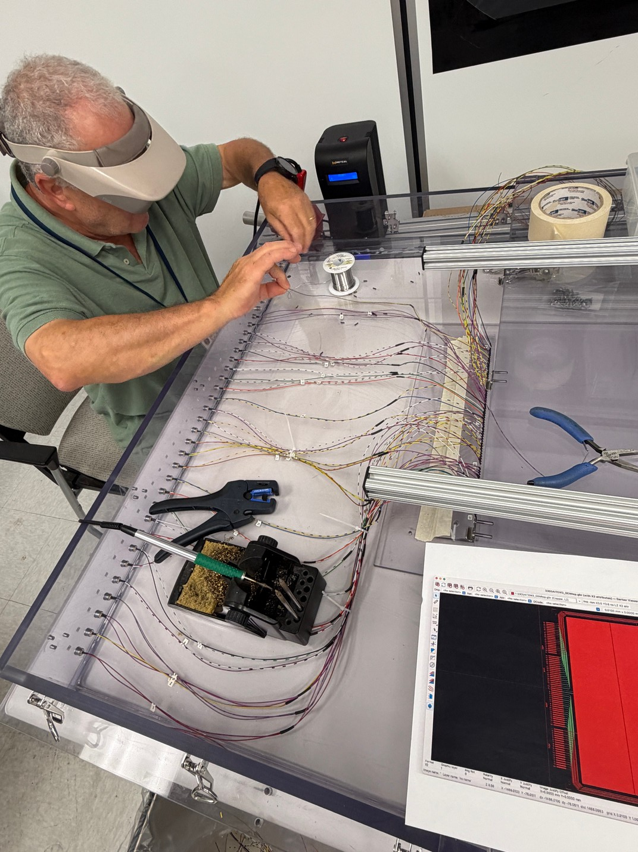
Photos
Sanding station
Ultrasonic Bath
Fume hood for Vacuum gluing
N₂ box for GEM foil test
GEM stretcher
uRWell assembly station (in progress)

Slide 4
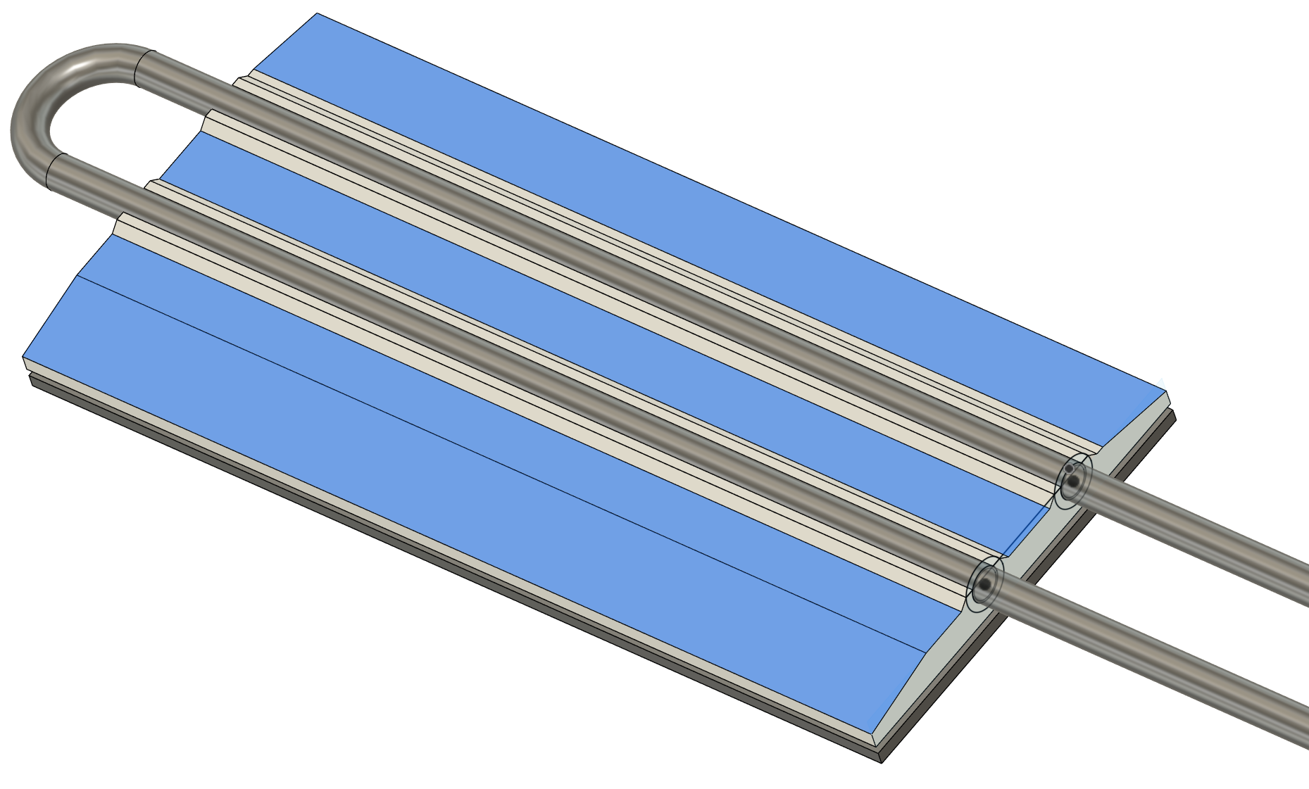
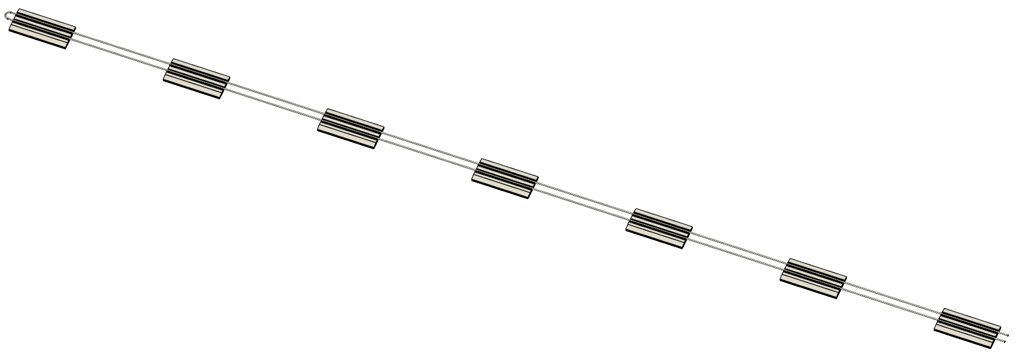
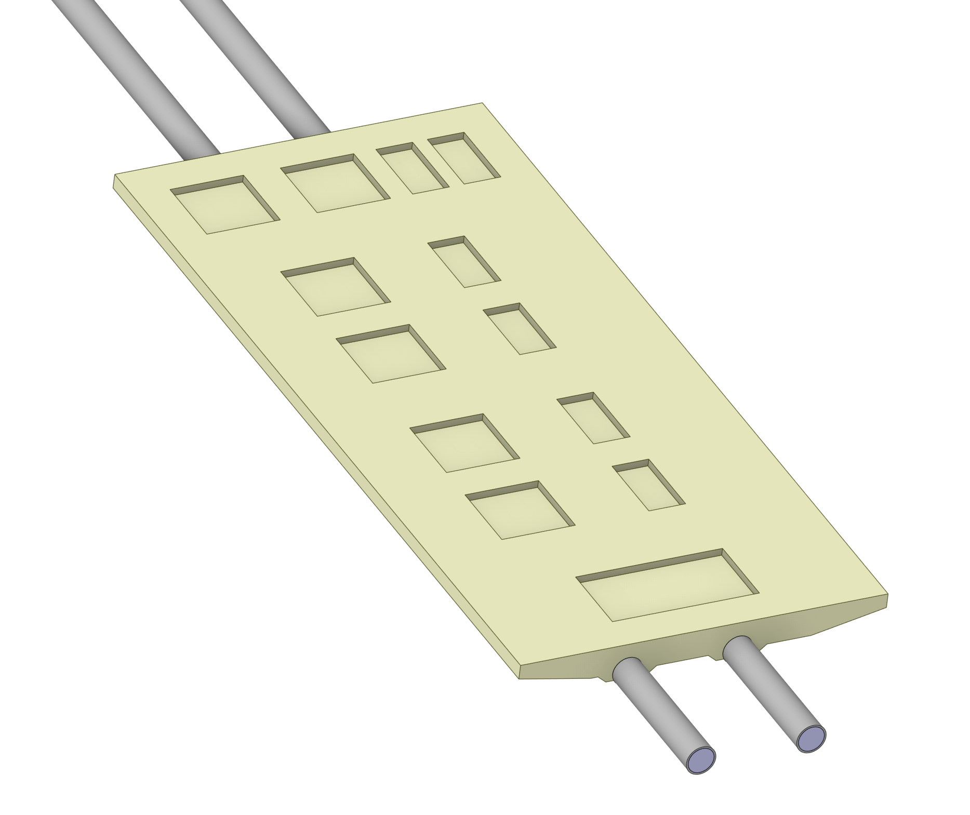
Update – Thermal study
Baseline thermal study is done.
Cooling plan
- 7 FEBs per one cooling loop
- 2 cooling loops per detector module
- 4 cooling loops per section (out of 12)
- all cooling service from east side
- 16W per FEB, 112W per cooling loop
- T_{in} = 22 ºC, T_{out} = 23.9 ºC
- Pipe ID = 3.5 mm, OD = 4 mm SS.
- Flow rate = 13.4 ml/s, Speed = 1.4 m/s
Pressure drop = 1.5 psi/m
6.3 W heat to the ambient air
Heat Load
Analytical calculation | 112 | W
CFD calculation | 105.7 | W
Difference | 6.3 | W

Slide 5
7 FEB Heat Load – modified design – without insulation
Temperature rise 2 C
Analytical calculation
CFD calculation
Number of FEB | 7
Single FEB | 15.5 | W
with margin | 16 | W
Total FEB | 112 | W
dT | 2 | C
Cp | 4181 | J/kg C
m | 0.01339 | kg/s
m | 0.01339 | l/s
m | 13.39 | ml/s
m | 0.013285 | kg/s
Cp | 4181 | J/kg C
inlet | 22 | C
outlet | 23.903 | C
dT | 1.903 | C
Total FEB heat load | 105.7 | W
Heat Load
Analytical calculation | 112 | W
CFD calculation | 105.7 | W
Difference | 6.3 | W
Tapered design
Velocity | 1.392 | m/s
Re | 5145 | Turbulent
Tube ID changed from 4.5 mm to 3.5 mm
OD changed from 5 mm to 4 mm
Inlet water Temperature | 22 | C
Ambient Temperature | 23.3 | C

Slide 6
Update – Thermal study
We will stop thermal simulation at this point.
We will continue to update when FEB components are made/updated.
There was an update on SALSA power estimation and power supply scheme.
Power consumption from 15.5 W to 18.5 W per FEB (20% increase)
Overall cooling scheme has not been changed.
Thermal simulation will be done with new numbers.

