Slide 1
Cooling Requirements
E.C. Aschenauer (BNL),
for the ME-Engineering group and Girish Gowda
ePIC TIC Meeting
July 6th, 2026

Slide 2
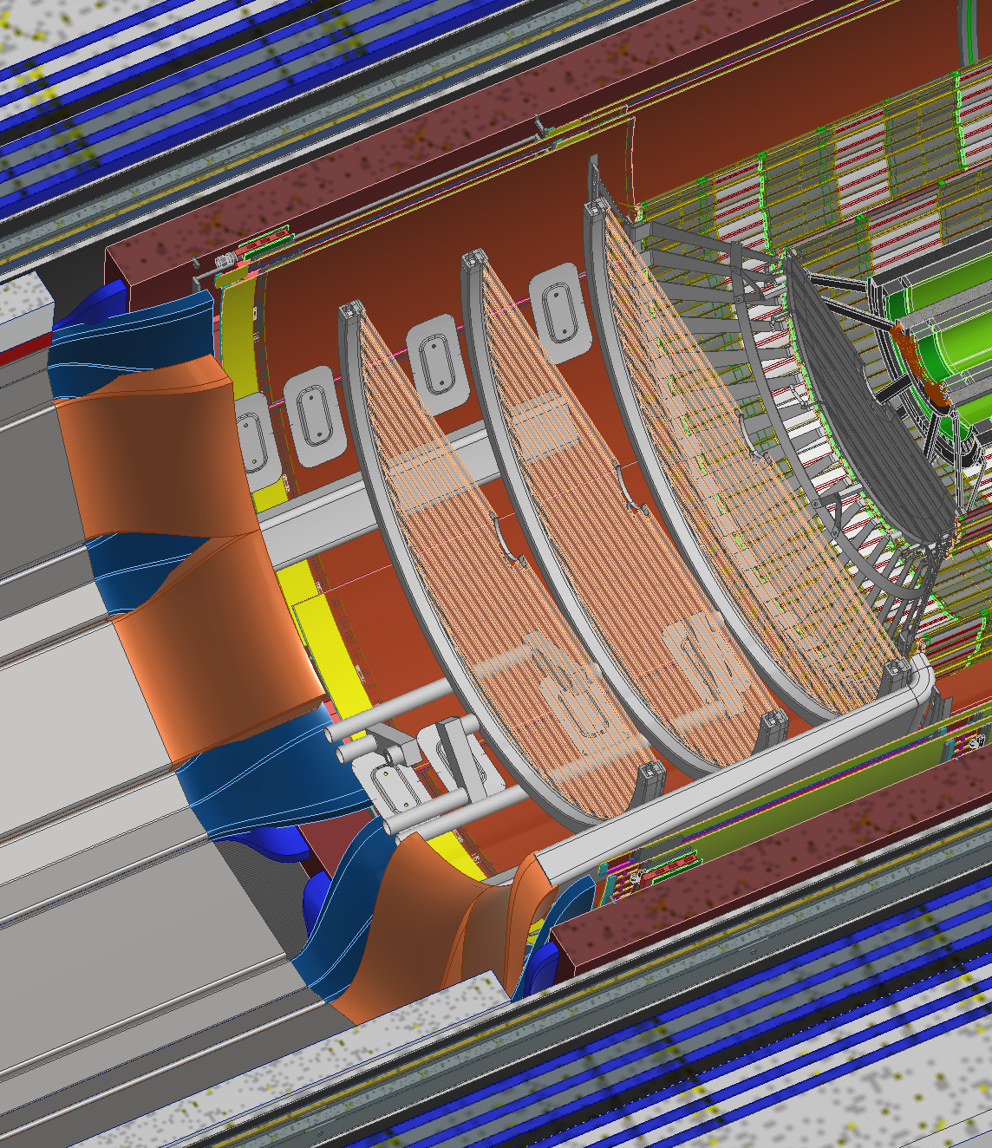
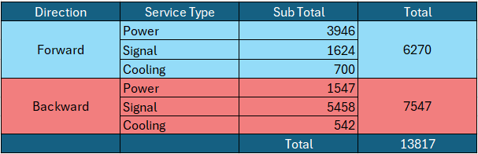
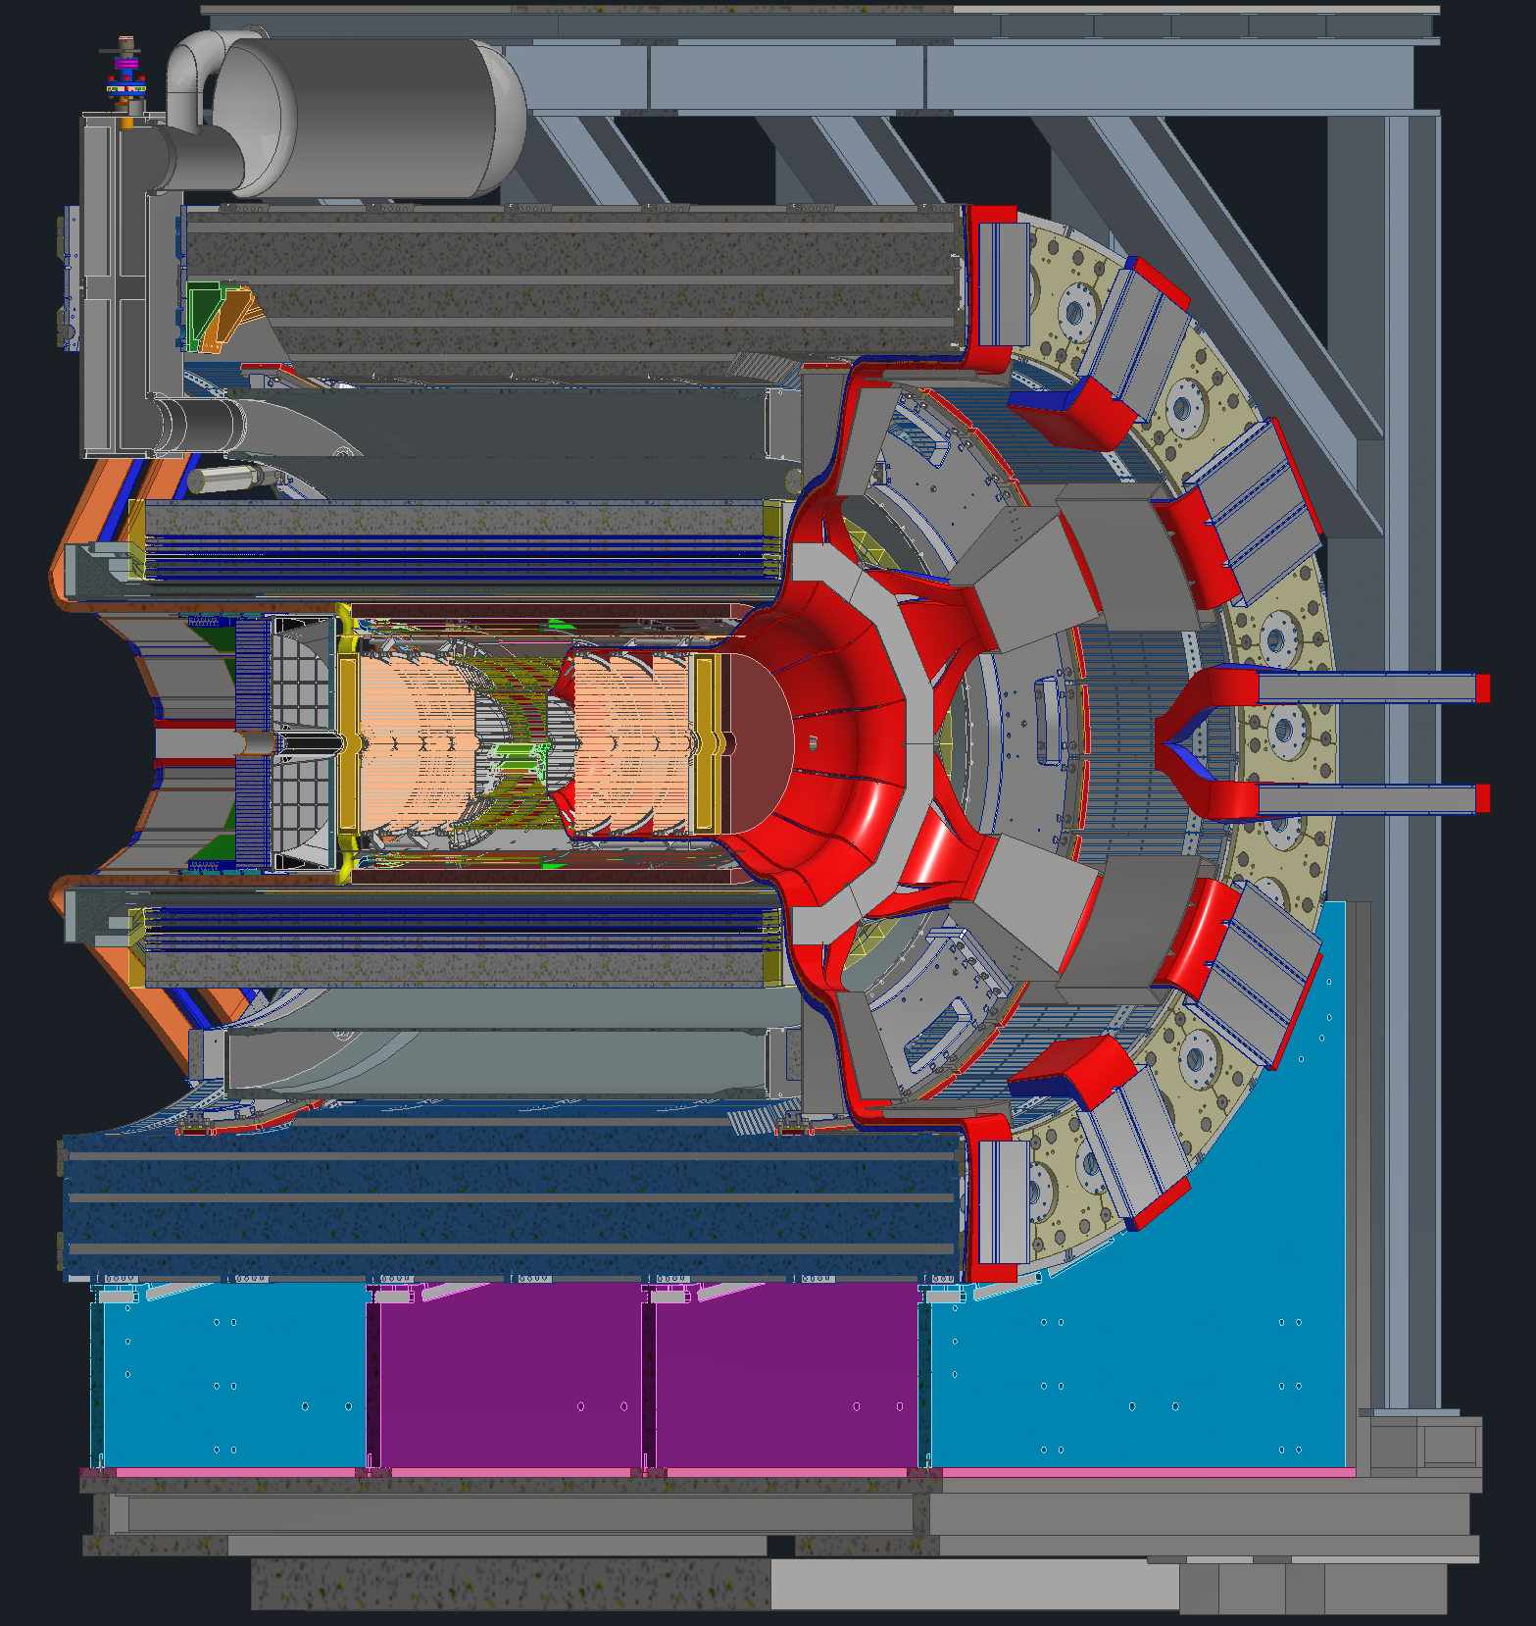
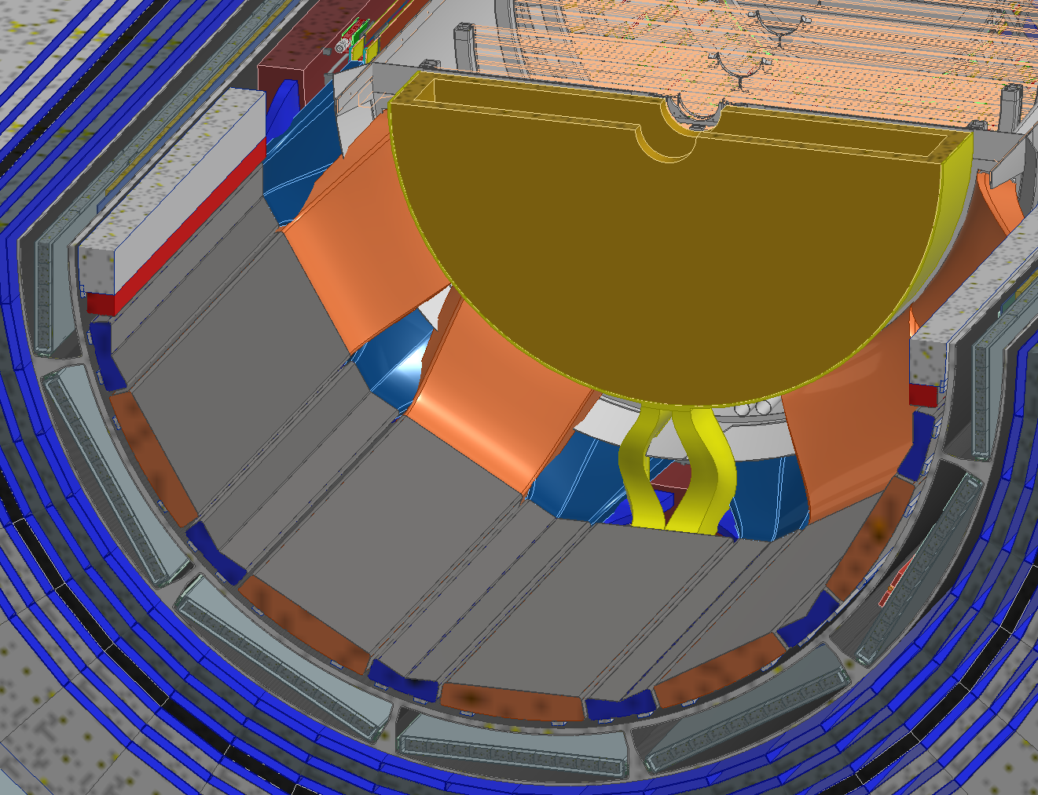
Why Do We need to Care
To keep our service space under control, it is crucial to have a very good understanding about our cooling needs
Still not defined as well as one needs.
ToF & CYMBAL Services
SVT & MPGD Disks Services
MPGD Disk Services

Slide 3
An Example What is needed

Slide 4
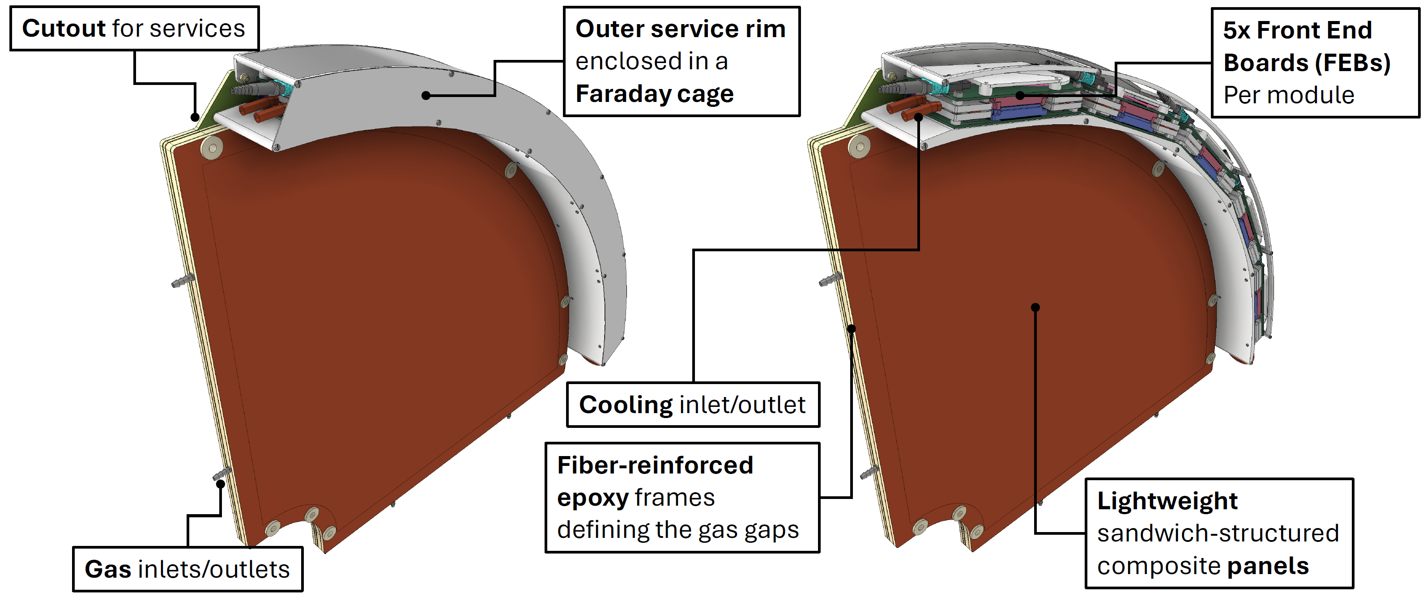
MPGD Endcap Disks: Module Design

Slide 5
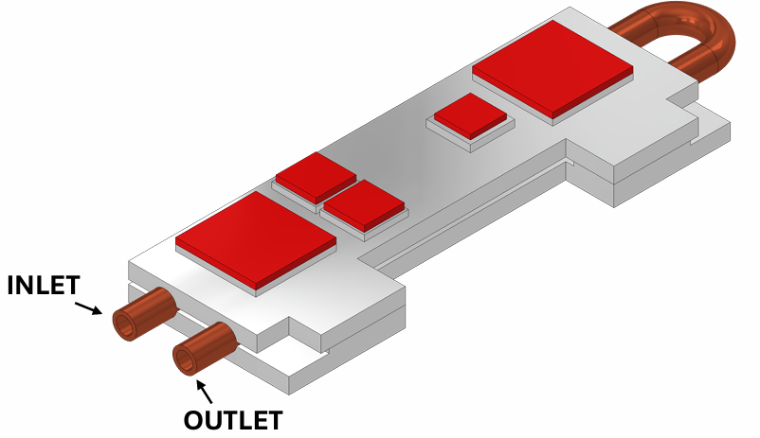
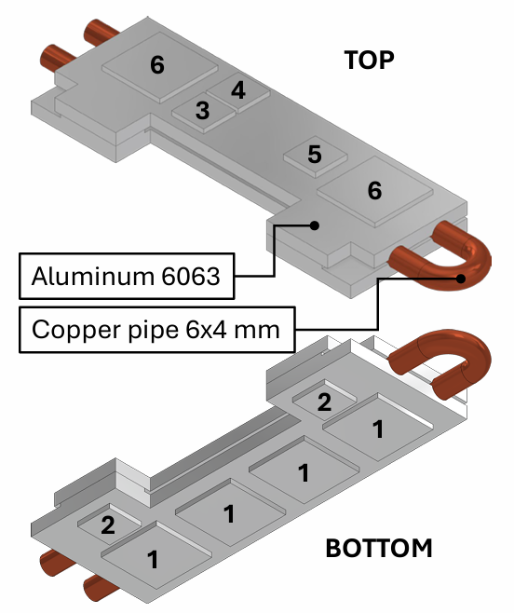
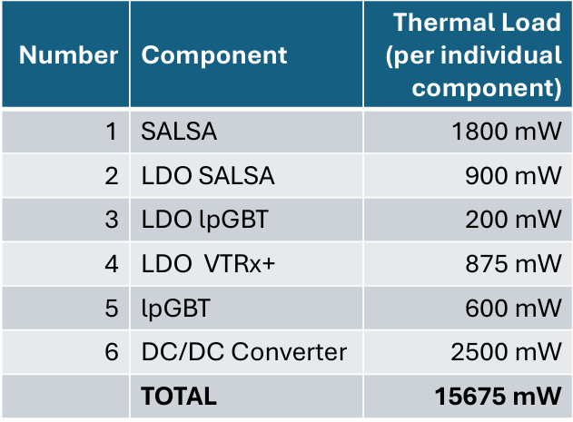
MPDG – Disk - Components
Single FEB model
The VTRx+ is not actively cooled
It should output around 175 mW

Slide 6
MPGD Endcap Disks Detector – Heat Load
Components Heat load data
Component | Power | Power | Volume | Volume | Volumetric Heat Flux
 | mW | W | mm^3 | m^3 | W/m^3
DC/DC | 2500 | 2.5 | 600 | 0.0000006 | 4166666.67
DC/DC | 2500 | 2.5 | 600 | 0.0000006 | 4166666.67
SALSA | 1800 | 1.8 | 433.5 | 4.335E-07 | 4152249
SALSA | 1800 | 1.8 | 433.5 | 4.335E-07 | 4152249
SALSA | 1800 | 1.8 | 433.5 | 4.335E-07 | 4152249
SALSA | 1800 | 1.8 | 433.5 | 4.335E-07 | 4152249
LDO SALSA | 900 | 0.9 | 150 | 0.00000015 | 6000000
LDO SALSA | 900 | 0.9 | 150 | 0.00000015 | 6000000
LDO lpGBT | 200 | 0.2 | 150 | 0.00000015 | 1333333
LDO VTRX | 875 | 0.875 | 150 | 0.00000015 | 5833333
lpGBT | 600 | 0.6 | 100.44 | 1.0044E-07 | 5973716
 | 15675 | 15.675
Note:
many subsystems till today
did not include all components,
for example, the DC-DC converters have been forgotten

Slide 7
ePIC Detector – MPGD Endcap Disks
Detailed Power Estimates :
Cooling Scope of Work :
Component | Power | Power
 | mW | W
DC/DC | 2500 | 2.5
DC/DC | 2500 | 2.5
SALSA | 1800 | 1.8
SALSA | 1800 | 1.8
SALSA | 1800 | 1.8
SALSA | 1800 | 1.8
LDO SALSA | 900 | 0.9
LDO SALSA | 900 | 0.9
LDO lpGBT | 200 | 0.2
LDO VTRX | 875 | 0.875
lpGBT | 600 | 0.6
FEB Heat Load | 15,675 | 15.675
FEB Heat Load in a single module | 78,375 | 78.375
Total Detector Heat Load | 1280 | 1280
Cooling media | Water
Inlet Temperature | 22 | C
Ambient Temperature | 23 | C
Tube diameter | 4 | mm
Tube material | Copper
Operating Temperature of SALSA | 25 | C
Maximum Temperature of SALSA | 35 | C
Temperature rise | 2 | C
Temperature stability | ± 3 | C
Flow rate of single module | 0.5 | lpm
Pressure drop of single module | 0.03 | bar
Heat dissipation to ambient from single module | 0.98 | W
Total Heat dissipation to ambient | 16 | W
Cooling loops | Parallel
Insulation requirement | No
Neighboring detectors | SVT, pfRICH, TOF
Number of FEBs in a module | 5
Total Number of Modules in detector | 16

Slide 8
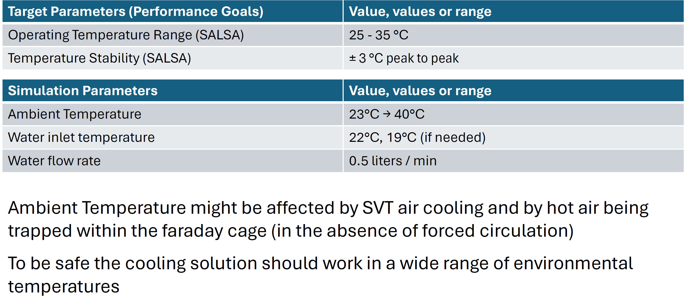
MPGD Endcap Disks Detector – Goals & Parameters
The correlation between detectors is why we need the full information from everybody

Slide 9
What is needed

Slide 10
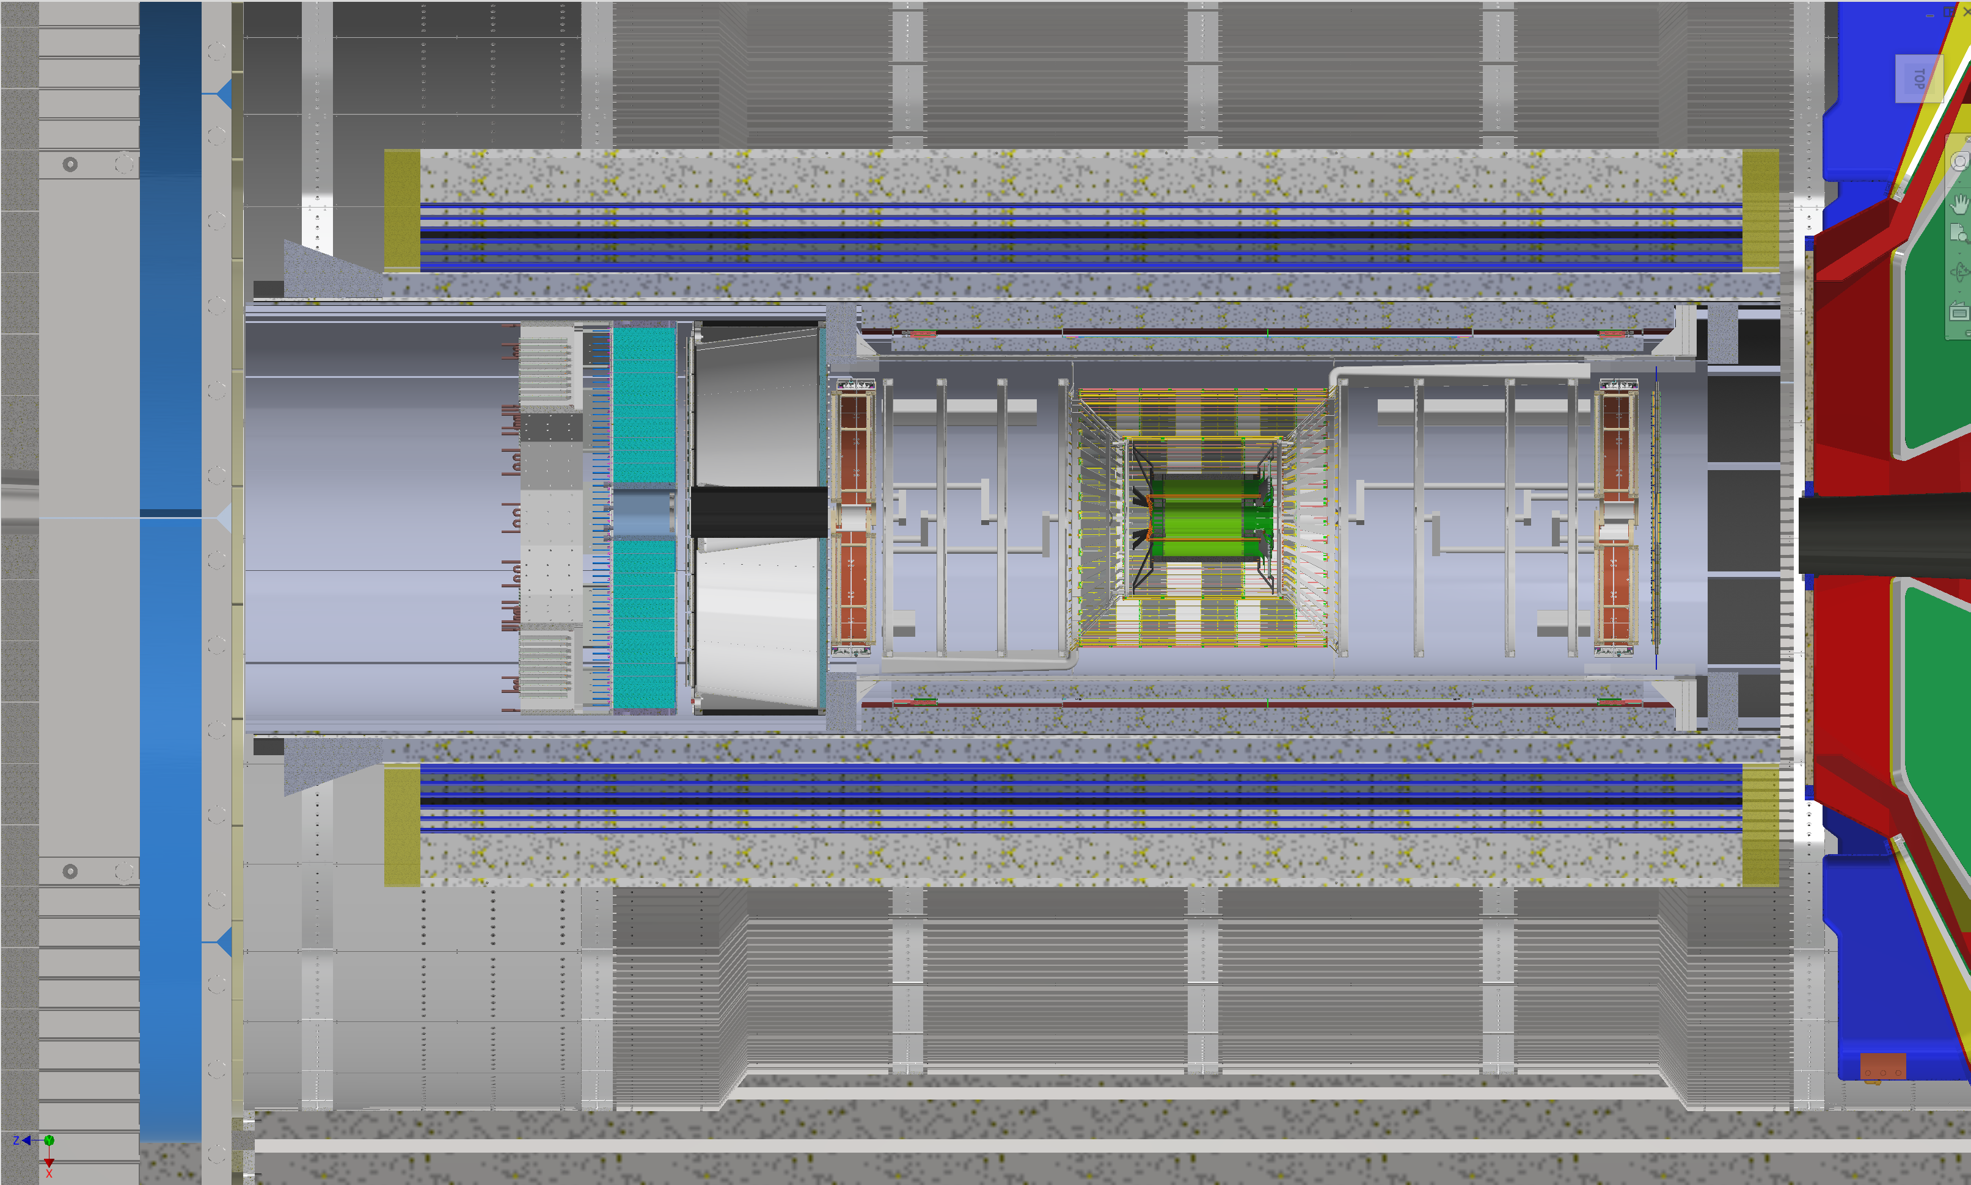
Layout – ePIC Detector Cooling
Barrel HCAL - Passive Air Cooling - Heat - 1280 W
Barrel EMCAL – Liquid Cooling – Heat - 2300 W
Passive Air Cooling – Heat - 2260 W
Forward EMCAL
Liquid Cooling
Heat
2633 W
Passive Air
Heat
796 W
Forward HCAL
Passive Air Cooling
Heat 1656 W
hpDIRC – Liquid Cooling – Heat - 749 W
Outer MPGD – Liquid Cooling – Heat 5380 W
EEEMCAL
Liquid Cooling
Heat -1000 W
Novec Cooling
Heat -100 W
pfRICH
Liquid Cooling
Heat
707 W
MPGD Disks
Liquid Cooling
Heat
1280 W
Cymbal – Liquid Cooling – Heat 2300 W
SVT Outer – Liquid – Heat -301 W
Active Air Cooling – Heat - 3218 W
Barrel TOF
Liquid Cooling
Heat - 21614 W
Forward TOF
Liquid Cooling
Heat
7105 W
dRICH
Silicon Oil Cooling
Heat
19968 W
SVT Inner – Liquid – Heat -385 W
Active Air Cooling – Heat - 211 W
SVT Disks – Liquid – Heat -655 W
Active Air Cooling – Heat – 5819 W

Slide 11
ePIC Detector – Cooling – Scope of Work
Updated CAD Model in Vault for global thermal model simulation
CAD Model Quality check with no interfering components for global thermal model simulation
Heat dissipation value to ambient from liquid cooling of electronics of the detectors
Confirm operating range - Minimum and Maximum Temperature of each detector
Confirm inlet temperature and ambient temperature of each detector considered
Confirm temperature stability of each detector
Confirm Tube diameter (ID & OD) and Tube Material of each detector
Cooling loops arrangement are in Serial or Parallel
Flow Rate and Pressure drop values of Thermal simulation of each detector
Confirm Power estimates with breakup of each detector
Confirm neighboring detectors impacted by heat dissipation
Confirm insulation requirement

Slide 12
Summary
If you get an email by Girish and/or the engineering team, please respond and update
Detector Parameters and Services per Subsystem.xlsx
Detector | Cooling | Cooling Data
SVT Outer | Water | Need updates for some information
SVT Inner | Water | Need updates for some information
SVT Disks | Water | Need updates for some information
EEEMCAL | Water | All information available
MPGD Endcap Disks | Water | All information available
Outer MPGD | Water | All information available
Cymbal | Water | Need updates for some information
Barrel TOF | Water | Need updates for most information
Forward TOF | Water | Need updates for most information
hpDIRC | Water | No information – only HRPPD data
pfRICH | Water | No information – only HRPPD data
Forward EMCAL | Water | All information available
Barrel EMCAL | Water | Need updates for some information
Platform Electronics & Racks | Water | Need updates for some information
Detector | Cooling | Cooling Data
SVT Outer | Active Air | All information available
SVT Inner | Active Air | All information available
SVT Disks | Active Air | All information available
Barrel EMCAL | Passive Air | Need updates for some information
Forward EMCAL | Passive Air | All information available
Barrel HCAL | Passive Air | Need updates for some information
Forward HCAL | Passive Air | No information – only PCB insert sensor data
EEEMCAL | Novec | All information available
dRICH | Silicon Oil | Need updates for most information

Slide 13


