Slide 1
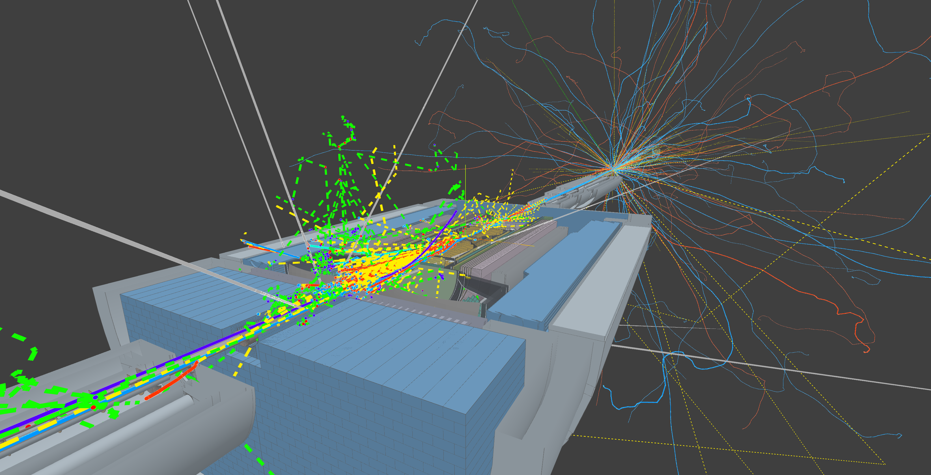

Streaming Readout AI Background Suppression
August 19 2026
Talk: Dmitry Romanov,
Team: Tanja Horn, Baptiste Fraisse, Avnish Singh, Rachel Montgomery, Antonio Perillo, Gary Penman, Chi Kin Tam,
and Meson Structure Functions team
Notes:
Tip: Keep titles under 60 characters for readability
To change the photo: Right-click on photo and select change photo

Slide 2
Our experience with Background Data
Primary Goal: Demonstrate that an AI-driven analysis of streaming-like frame-based data can:
1. Improve the identification of key physics events in high-background environments
2. Increase the throughput of scientific results
Key steps:
Train AI to clean the background data
Quantify the performance over traditional methods:
  Discriminate events in physics background
  Discriminate detector background
Integrate models within JANA2 / Epic reconstruction

Slide 3
Data processing progression and AI/ML
Readout
Synchronization
Formation
Pre-filtration
Tracking
PID
Calorimeters
Reconstruction
Electron finder
DIS calculation
Analysis
PRE
reconstruction
RECONSTRUCTION
POST
reconstruction
This talk
Quick review

Slide 4
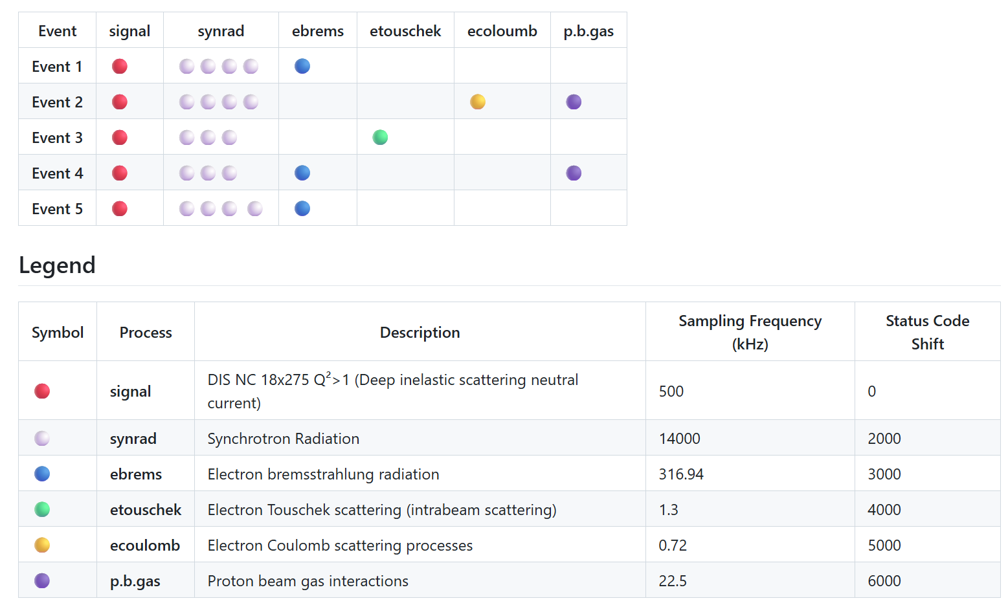
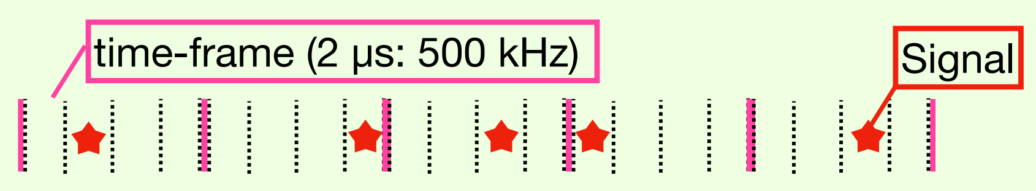
Physics + background data
Background mixed samples
Background wiki

Slide 5
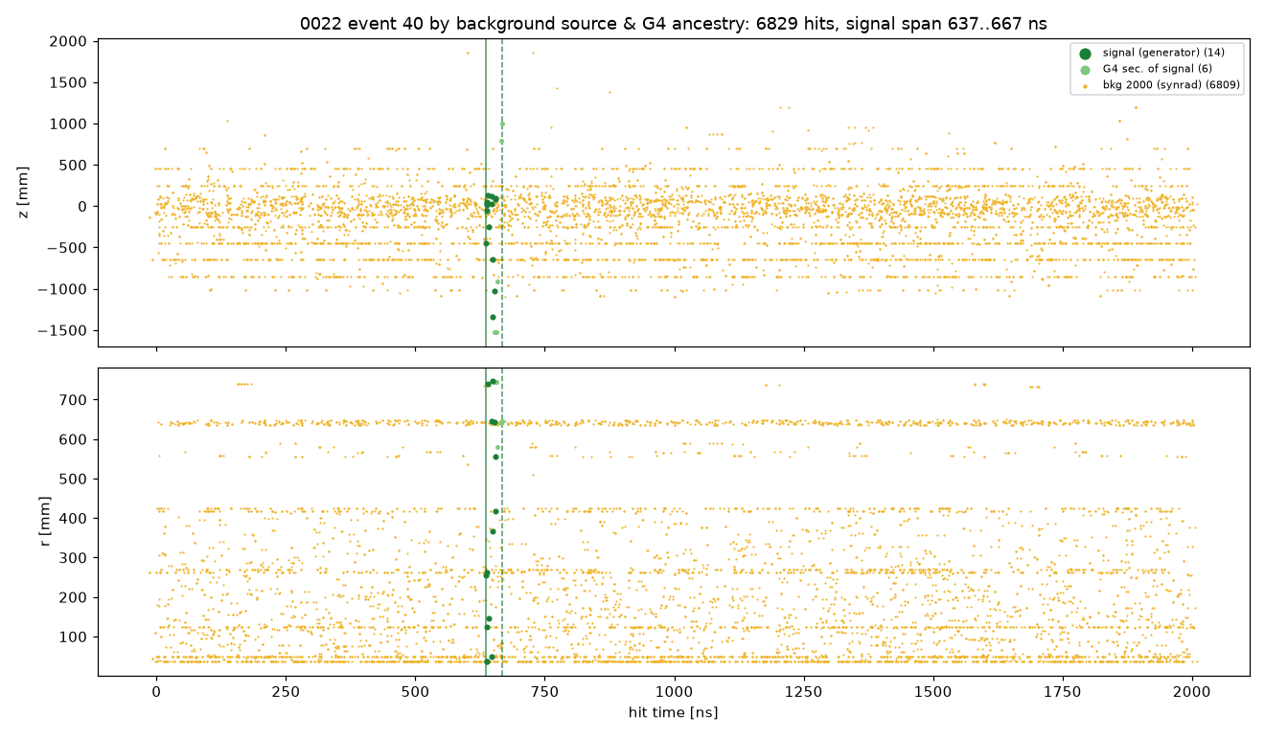
The most event looks like this

Slide 6
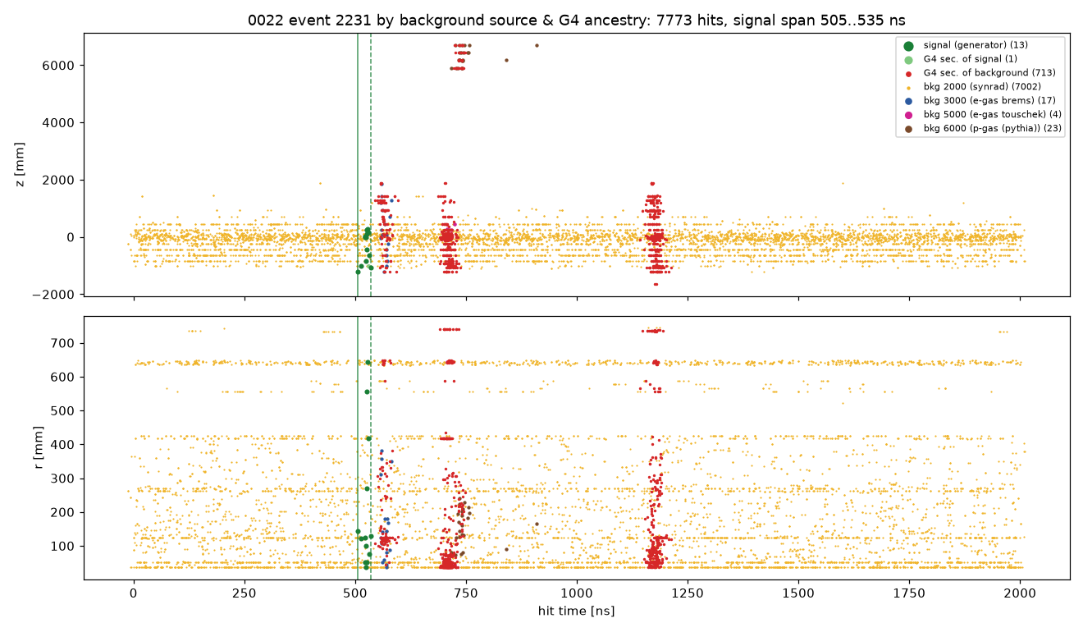
Very rare event with different backgrounds

Slide 7
What are those dots
Geant4 added
Signal
Background
Gean4 adds particles
status code 0 be it signal or background,
have to check where things come from

Slide 8
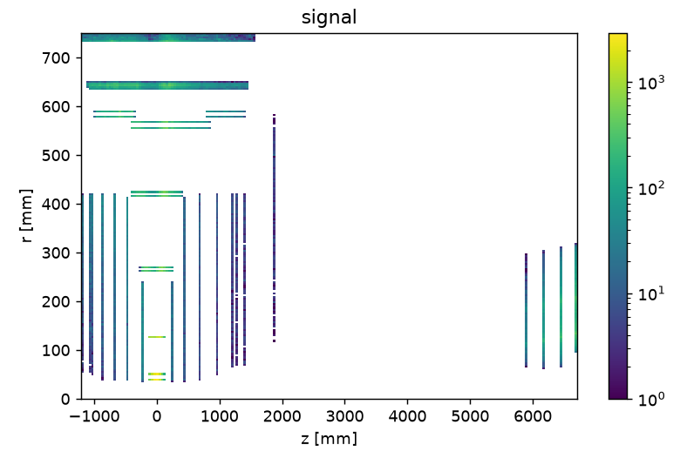
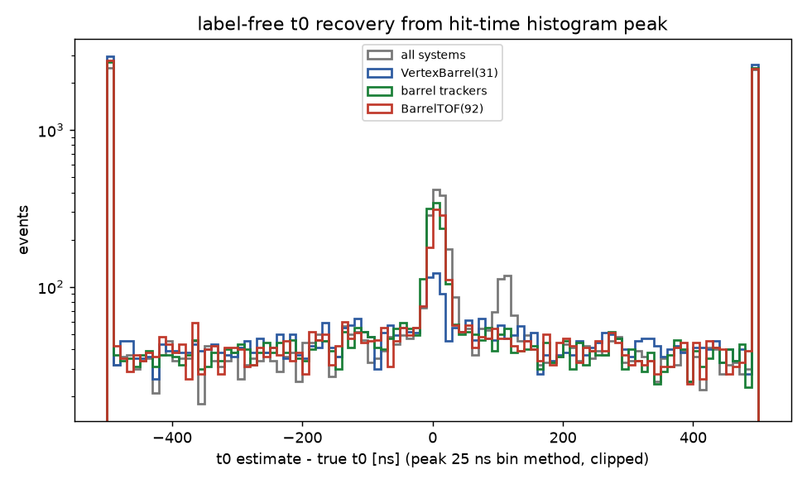
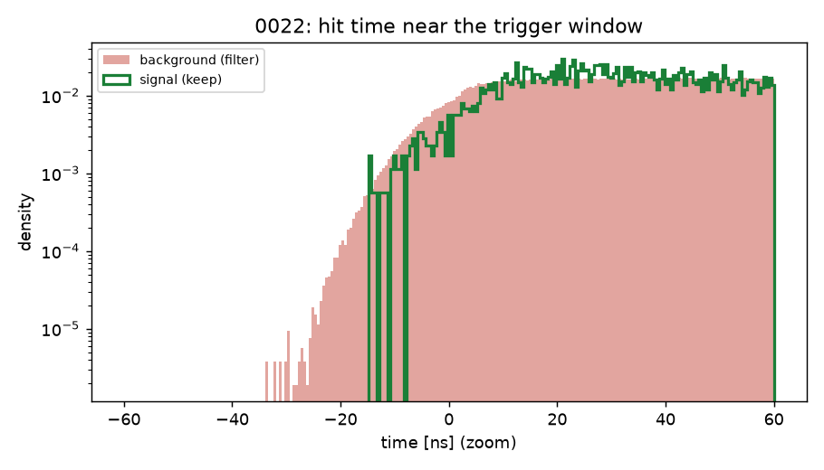
The data: a 2000 ns haystack, a 0.5% needle
• ~35M hits per file; signal is only ~0.5% of hits
• Background dominated by synchrotron-radiation haze
(97% of hits) plus beam-gas showers
• Beam-gas showers often outshine the ep burst in raw hit counts
• Per-hit inputs only: x, y, z, t, detector system id
• One interaction per frame, at a uniformly random t0
0022_time_zoom.png
2
Notes:
Left-bottom: zoom on the time axis around the interaction - signal hits (colored) sit inside a continuous background carpet. Top: detector occupancy in r-z; the synchrotron haze illuminates the whole tracker. The classification signal must come from five per-hit numbers.

Slide 9
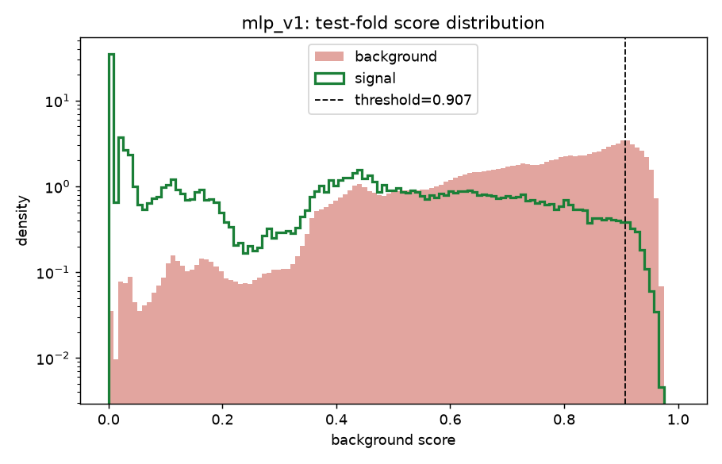
A naive per-hit DNN looks good…
• 13k-parameter MLP on (x, y, z, t, r + system embedding), scored per hit
• AUC 0.864; high rejection efficiency! (false)
• Score separation looks convincing
(This is example of of bad results but that looked promising in the beginning)
4
Notes:
First attempt: the obvious per-hit MLP. On global metrics it seems to work: clean-looking score separation (left) and a reasonable efficiency/rejection trade-off curve (right). Calibrated operating point: 98.8% efficiency, 14.1% rejection.

Slide 10
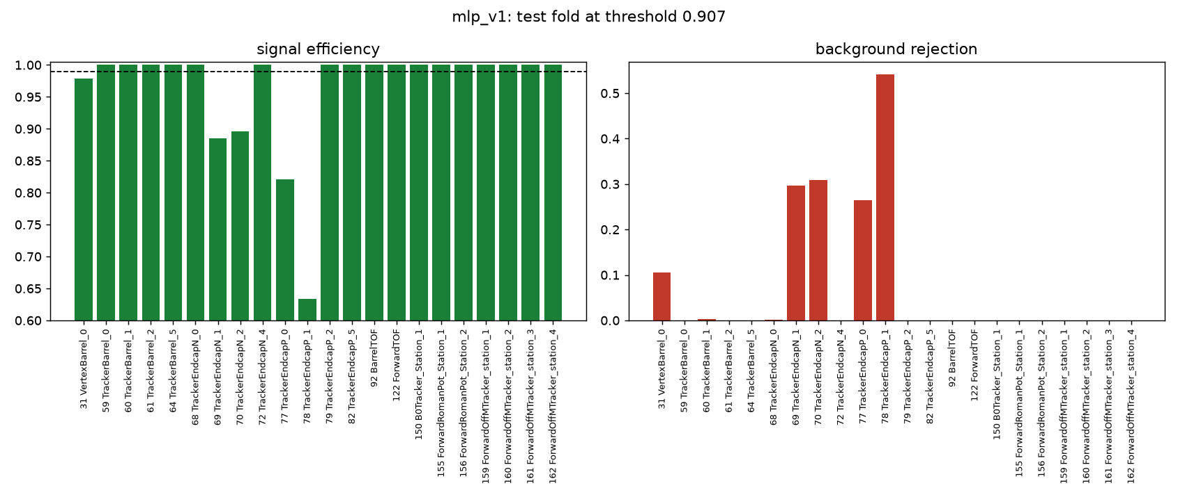
A naive per-hit DNN looks good…
• 13k-parameter MLP on (x, y, z, t, r + system embedding), scored per hit
• AUC 0.864; high rejection efficiency! (false)
• Score separation looks convincing
• A single global threshold silently kills 12–37% of signal in the inner tracker-endcap disks
– systems 69/70 (TrackerEndcapN) and 77/78 (TrackerEndcapP); the central barrel is fine
• Global metrics hide local damage
(This is example of of bad results but that looked promising in the beginning)
4
Notes:
First attempt: the obvious per-hit MLP. On global metrics it seems to work: clean-looking score separation (left) and a reasonable efficiency/rejection trade-off curve (right). Calibrated operating point: 98.8% efficiency, 14.1% rejection.

Slide 11
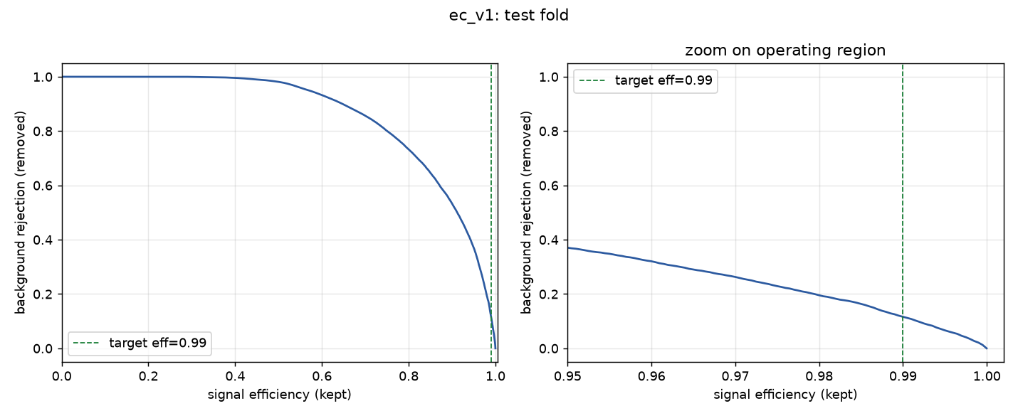
The per-hit ceiling: models doesn't help
Prioritize keeping signal over background rejection (around 99% or better)
20× bigger MLP: 14.4% rejection.
DeepSets with global event context: 13.6%.
No per-hit feature set gets further
Why: an individual signal hit and an individual background hit look IDENTICAL
Model | Signal efficiency | Background rejection
mlp_v1 (13k params) | 98.8% | 14.1%
mlp_v2 (273k params) | 98.8% | 14.4%
DeepSets (event context) | 98.8% | 13.6%
ec_v1_eff_rejection.png
Actually, Autoresearch loop with ~10 architectures
and hundreds of optimization time
(This is example of actually bad results)
6
Notes:
We threw capacity at it: a 20x bigger MLP gains 0.3 points; DeepSets that mixes in a learned global event summary actually does slightly worse. The ceiling is informational, not architectural: conditioned on its own coordinates, a hit carries almost no class information, because t is uniform for both classes over the 2000 ns frame. Right: the DeepSets efficiency/rejection curve - same wall.

Slide 12
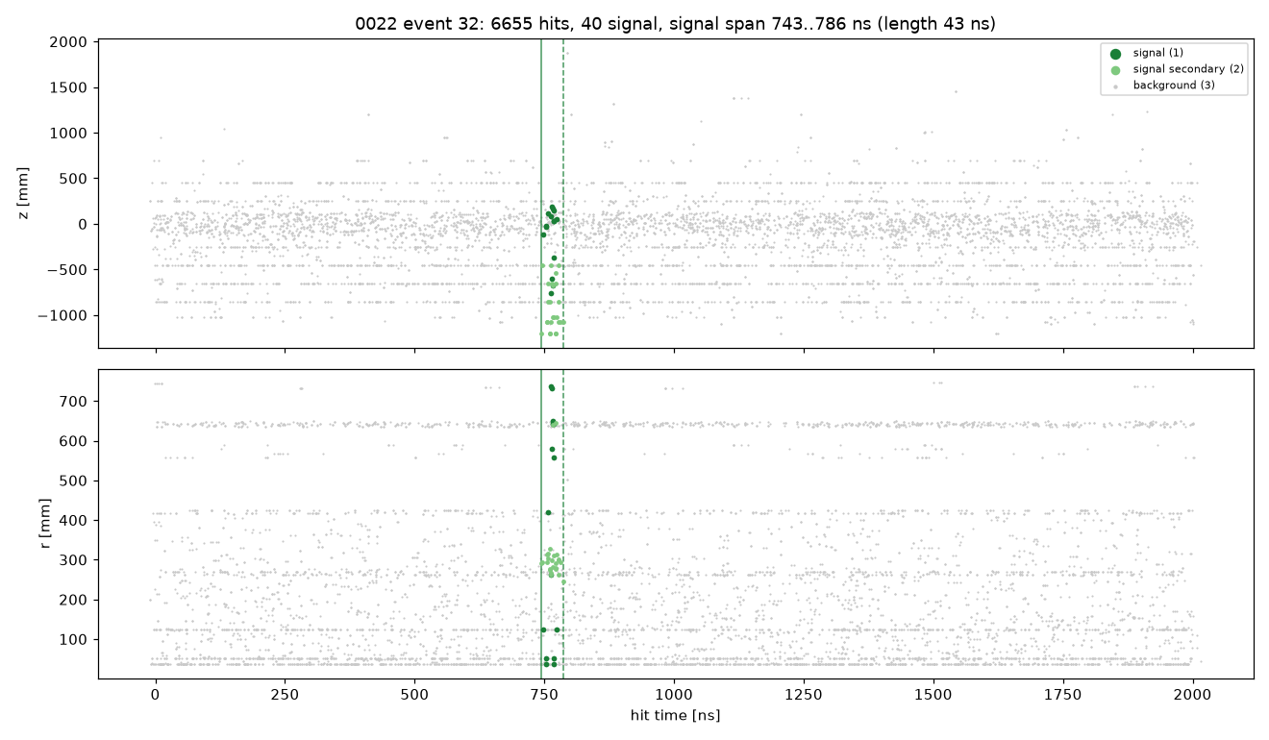
Hunt for ideal window finder begins!
• The target: ≥99% of signal hits must survive!
pipeline | signal efficiency | background rejection
Best per-hit classifier - no time window | 98.8% | 14.1%
PERFECT window, same hit models (the prize) | 99.0% | 97.5%
Apparently,
finding good window with signal:
Task, that we had to do in all streaming projects and prototypes
Allows to use complex networks
Gets near perfect results
7
Notes:
The running scoreboard, shown here for the first time and revisited as the story advances. Same four columns every time, same measurement: test frames, threshold calibrated for at least 99 percent signal-hit efficiency, background rejection read at that point. Right now only the first row is earned. The bottom row is not a result, it is the prize: give the SAME hit classifiers the true interaction time and they reject 97.5 percent of the background. The gap between 14 and 97 is the value of knowing when the collision happened.

Slide 13
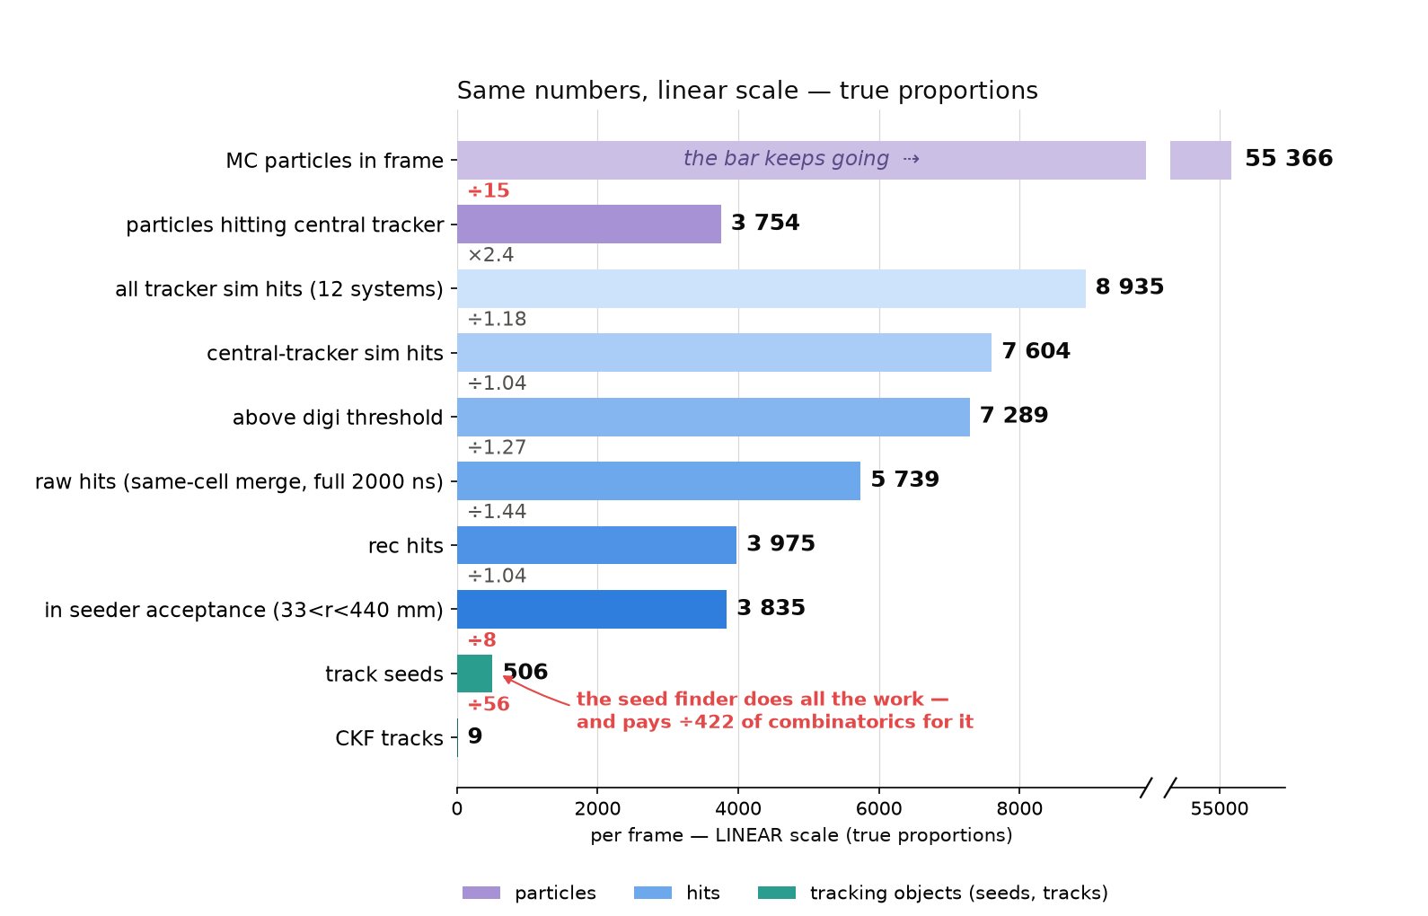
But how EICrecon tracking lives without windows?
• Stock chain never uses hit time:
– digitization integrates the full 2000 ns frame (same-cell hits merged)
– ACTS seeder reads only (x, y, z); seed time is hard-coded to 10 ns
– CKF fits 2 local coordinates; time is stored but unused
• The background killer is GEOMETRY: a seed triplet must fit a helix pointing to the beamline (|d0| < 3 mm, |z| < 250 mm, pT ≳ 100 MeV)
• Our time window supplies the one constraint the stock chain lacks - combinatorial seeds scale ~n³ in local hit density, so halving hits cut seeds 508 → 105
background_funnel_linear.png
28
Notes:
Same nine numbers as the previous slide, drawn without a log axis, because people read log scales badly - on the previous slide a 4 percent cut and a 56-fold cut occupy similar-looking steps. Here the scale is linear and true: the only bar that does not fit, the 55 366 MC particles, is cut in the middle and resumes on the right. Now the shape of the problem is visible. The detector and digitization chain reduces the background by a factor of two in total, and about half of that is same-cell merging, not physics. Nothing removes background in time, because stock EICrecon has no time cut anywhere. So roughly 3 800 hits per frame arrive at the ACTS seed finder, which tries helix triplets among them and ends with 9 tracks - a factor of 422, paid for with combinatorics that scale like the cube of the local hit density. That cubic is exactly why removing half the hits made tracking 6.5 times faster.

Slide 14
The framework at a glance
STAGE 1 — WINDOW FINDING
2000 ns frame
render 2-channel image
(z,t)+(r,t) · 64×88 · log occupancy
finder2d CNN
→ 88 per-bin logits
top-10 candidate windows
(−50 / +300 ns)
per candidate (×10)
chosen window
t0
combined selector
tiny MLP on 24 features
watt attention net
per-hit scores → 11 pooled features
wver attention net
window logit from raw hits
STAGE 2 — HIT REJECTION
in-window hits
watt per-hit scores → threshold
keep / filter decision
per hit
out-of-window hits
mlp fallback → threshold
Every box is a separate ONNX model · thresholds calibrated jointly on validation for ≥ 99% total signal efficiency
3
Notes:
Orientation slide before the chronological story. Stage 1 finds WHEN the interaction happened: the frame is rendered as a two-channel (z,t)+(r,t) image, the finder2d CNN produces 88 per-bin logits, and the top-10 bins become candidate windows (-50/+300 ns). Each candidate is examined by two attention nets - watt scores every hit and is pooled into 11 hand features, wver reads the raw hits and emits a window logit - and a tiny MLP on the combined 24 features picks the window. Stage 2 decides per hit: inside the window the watt scores are thresholded; outside it, a small MLP fallback. Every box is its own ONNX model; the thresholds are calibrated jointly on validation to guarantee >=99% total signal efficiency. The rest of the talk is how we got here.

Slide 15
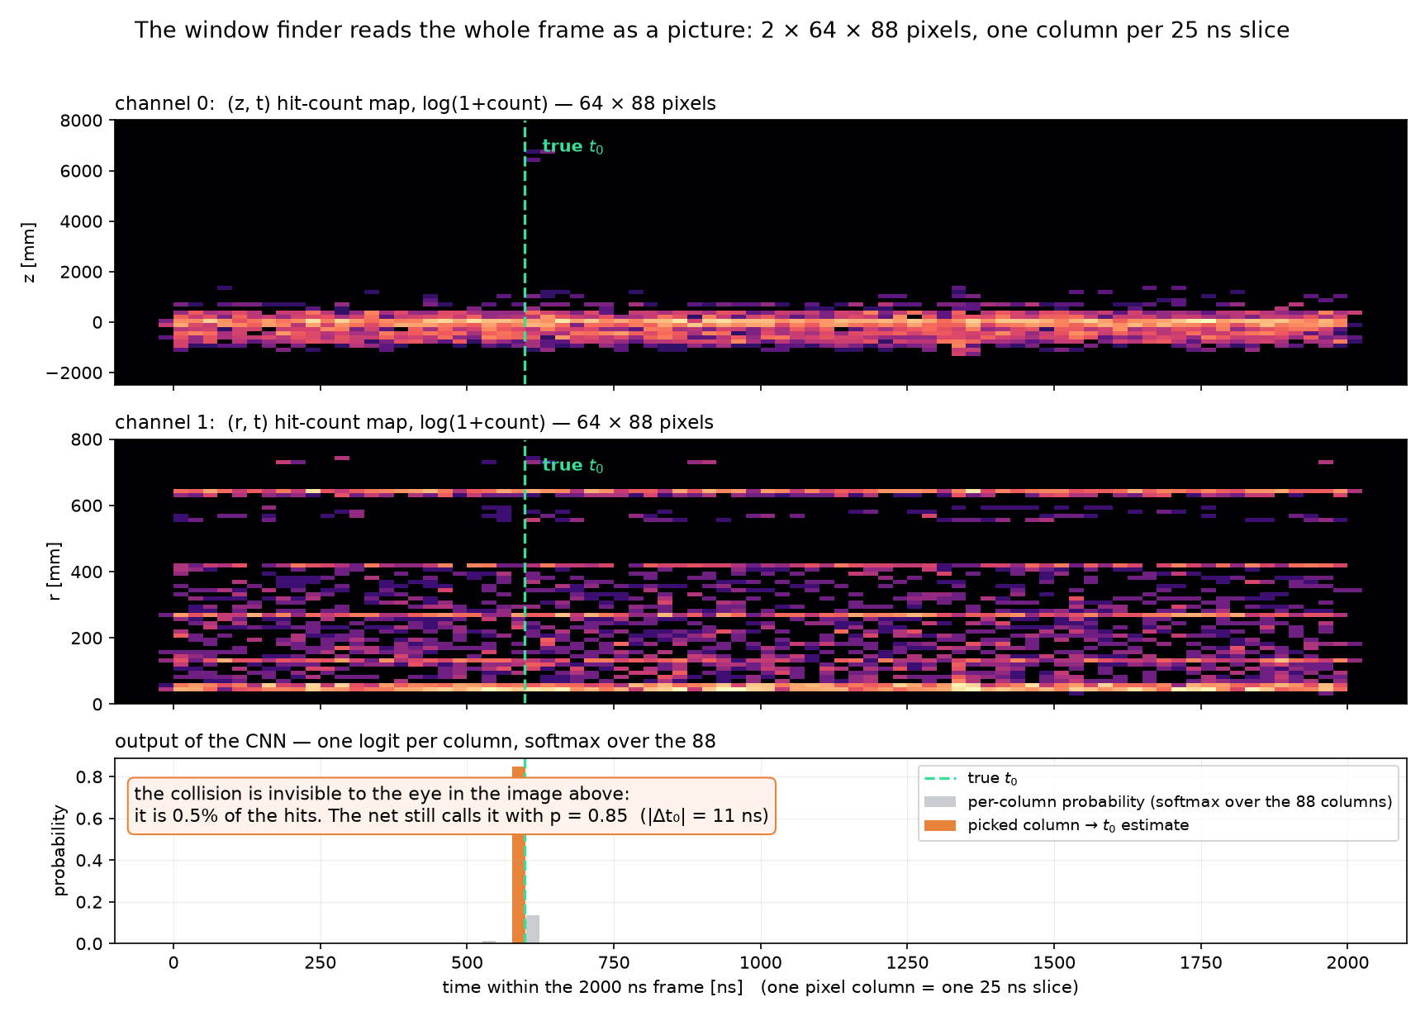
CNN to find window start
6
Notes:
We threw capacity at it: a 20x bigger MLP gains 0.3 points; DeepSets that mixes in a learned global event summary actually does slightly worse. The ceiling is informational, not architectural: conditioned on its own coordinates, a hit carries almost no class information, because t is uniform for both classes over the 2000 ns frame. Right: the DeepSets efficiency/rejection curve - same wall.

Slide 16
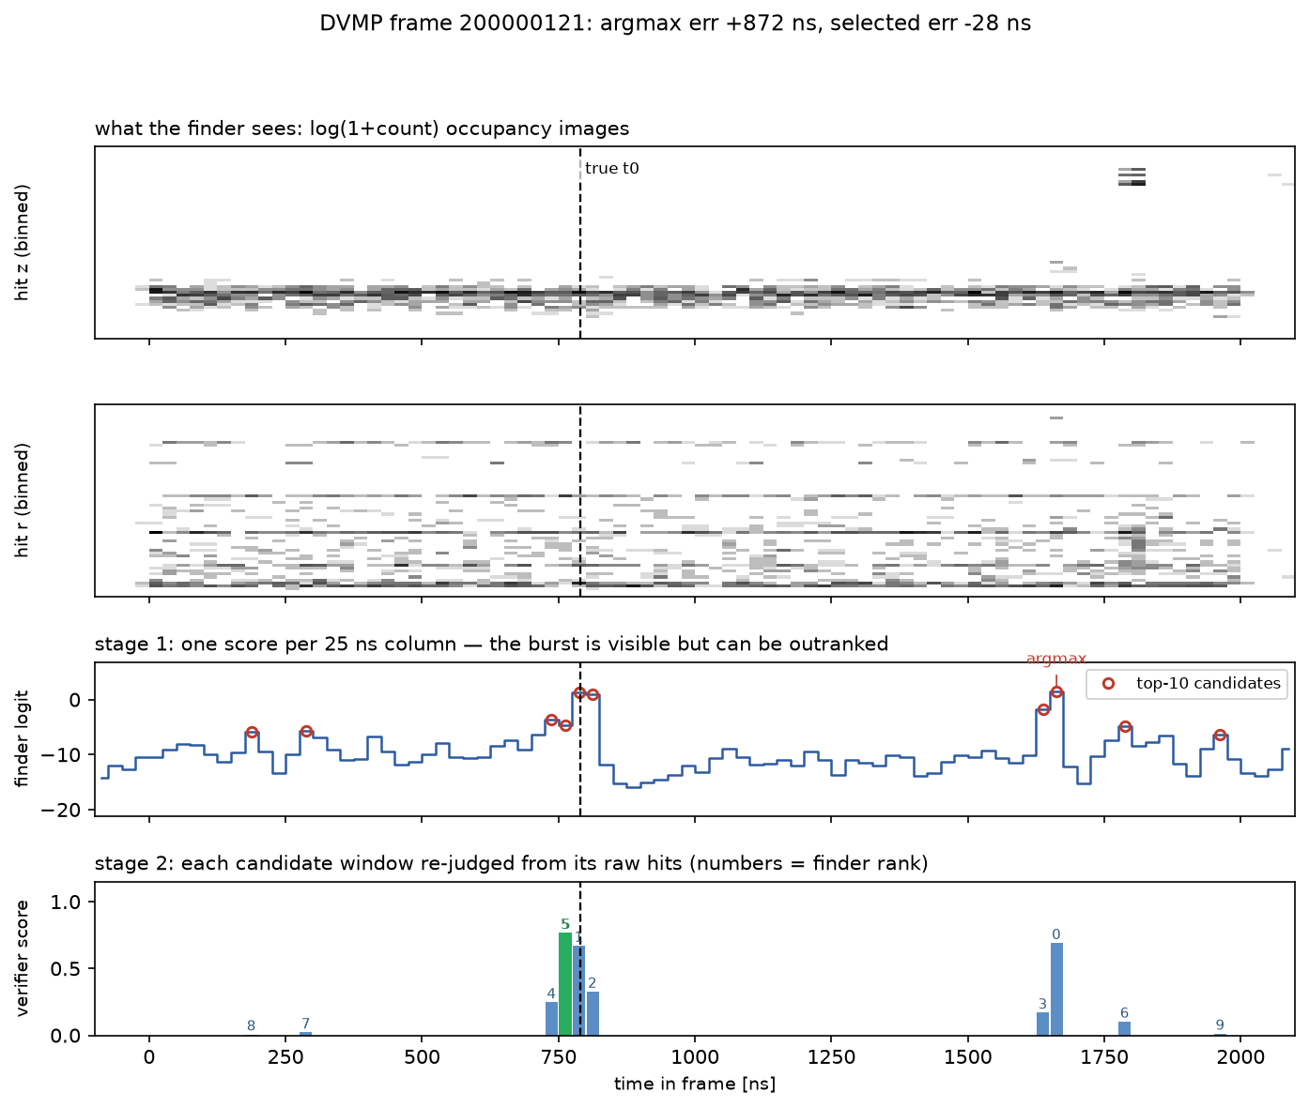
How window finder works overall
6
Notes:
We threw capacity at it: a 20x bigger MLP gains 0.3 points; DeepSets that mixes in a learned global event summary actually does slightly worse. The ceiling is informational, not architectural: conditioned on its own coordinates, a hit carries almost no class information, because t is uniform for both classes over the 2000 ns frame. Right: the DeepSets efficiency/rejection curve - same wall.

Slide 17
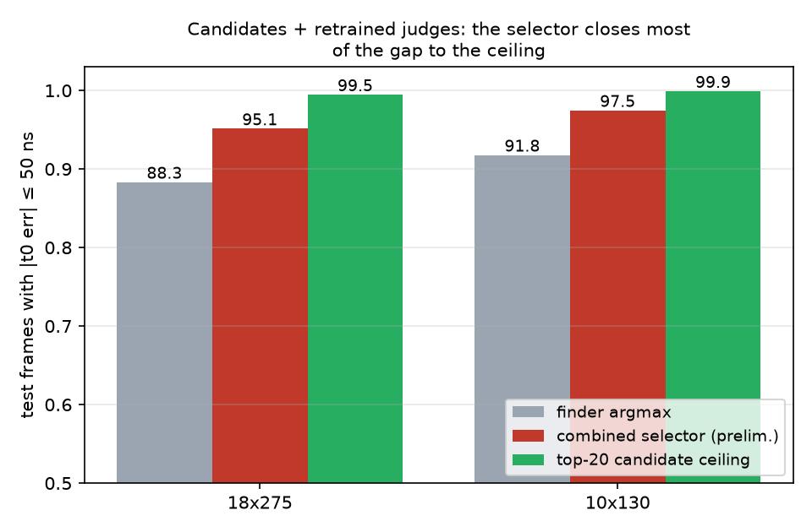
Current pipeline: 2D finder + combined selector
• 2D finder top-20 candidates:
- selector on 11 hand features
- - the logit of a learned window verifier (small attention net over each candidate window's raw hits)
• No margin gate needed — the combined selector never has to defer to the finder
• Test recall@50ns (preliminary) — 18x275: 95.1% (ceiling 99.5); 10x130: 97.5% (ceiling 99.9)
final_2presets.png
20
Notes:
The shipped pipeline: the 2D image finder proposes its top-20 time bins; the selector scores each candidate from 11 hand features (summaries of the per-hit attention scores, within-frame standardized) PLUS the logit of a learned window verifier - a small attention net that reads each candidate window's raw hits. Both judges were retrained in this pass: the per-hit scorer on all beam settings with deliberately wrong windows as hard negatives, and the verifier on the deeper 20-candidate lists it has to judge. Preliminary numbers from this run, energy presets: 18x275 recall@50ns 88.3 -> 95.1 percent against a 99.5 ceiling; 10x130 91.8 -> 97.5 against 99.9. The physics-process samples (DVMP, DIS-NC) are tracked in the internal reports until their statistics firm up.

Slide 18
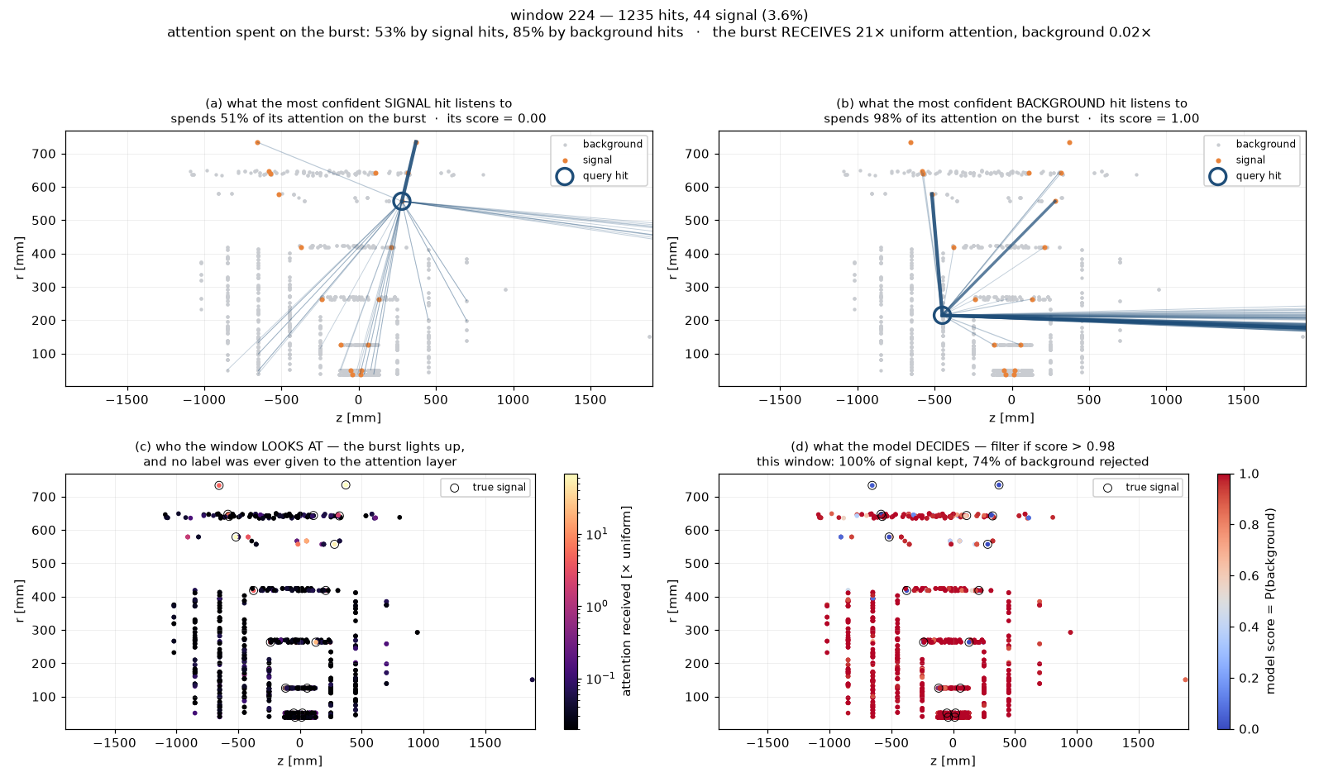
What attention actually looks at
11
Notes:
Self-attention over the in-window hit set: each hit emits a query, a key and a value; the attention weights are the softmax of scaled dot products; the update is residual. The story we used to tell was 'my neighbours vouch for me'. Re-running the trained model and keeping the softmax matrix (script 45) shows that is not what it learned: EVERY hit, signal or background, pours most of its attention onto the tiny burst - 18 to 22 times more than chance. The burst is a landmark, not a voting bloc; the right-hand panel shows that burst hits receive ~9x uniform attention while background hits get 0.05x, and nobody ever told the network which hits were signal. Deployment note: manual QKV instead of fused attention ops, so ONNX export works with a dynamic number of hits.

Slide 19
Why self-attention and not a traditional GNN?
• THE EIC CONSTRAINT: EICrecon runs ML through ONNX Runtime on CPU.
That is the target!
GNNs fight this runtime: per-event graph building at inference, plus scatter/gather message-passing ops that export poorly and run slowly (or not at all) in ONNX on CPU
attention is matmul + softmax first-class ONNX ops, fast on CPU, dynamic hit count for free; fast (~6ms on CPU)
• A kNN/radius graph is also the wrong bias for us: the coherence that identifies the ep burst is long-range; fixed spatial edges cut exactly those links
• Self-attention IS message passing on the complete graph with learned, input-dependent edge weights “which hits vouch for me” is learned, not engineered; the window keeps O(n²) cheap (n ≈ 1000)
Copresheaf Topological Neural Networks
per-region feature spaces + learnable transport maps; subsumes GNNs (incl. GAT), sheaf NNs, simplicial/cellular message passing — arXiv:2505.21251, Prop. 1 / Thm. 1 / Prop. 3
Graph neural networks (message passing)
features on nodes, messages along edges
Transformer / self-attention
= message passing on the COMPLETE graph; attention weights = learned soft edges
our WindowNet
2 attention blocks over the ~1000 in-window hits
each layer is (in theory) a special case of the one around it
33
Notes:
Why attention rather than the GNN pipelines common in HEP tracking. The decisive point for ePIC: the production runtime is ONNX on CPU inside EICrecon - GNNs fight that target (inference-time graph construction, scatter/gather ops with poor ONNX/CPU support), while attention is plain matmul+softmax and demonstrably runs at 6.6 ms/event in this very deployment. Also: no per-event graph construction, and the physics coherence we need is long-range - fixed kNN graphs cut the far-forward-to-barrel links that make the ep burst recognizable. Conceptually the choice is not exotic: self-attention is exactly message passing on a fully-connected graph with learned edge weights - a GNN without the graph engineering. And the nesting continues upward: copresheaf topological neural networks (Hajij et al. 2025, arXiv 2505.21251) subsume GNNs, graph attention, sheaf and simplicial networks as special cases - our model sits at the practical end of a well-understood theoretical hierarchy. Measured payoff of the attention blocks: in-window AUC 0.963 to 0.991 over the same encoder without them.

Slide 20
AdEICrecon (C++ / ONNX)
digitization → hit reconstruction
stock EICrecon, untouched: SimHits → RawHits → RecHits
AiAllTrackerRecHits — all 12 tracker collections
the 7 central ones + TOF, B0, Roman Pots, off-momentum. The models were trained with this far-forward context: it is what the finder image and the attention model read.
CentralTrackingRecHits
stock collector of the 7 central collections (SiBarrel / Vertex / Endcap, MPGDs)
AiAllTrackerRawHitAssociations
MC truth, read only in ideal-window mode (the upper bound run)
▸ the only place we touch the reconstruction
AiTrackerHitFilter — new ai_trkfilter plugin
one JANA factory, ONNX on CPU: stage 1 finder2d locates t₀ → stage 2 attention scores the in-window hits together, MLP the rest
windowMode = finder | ideal | off
context in — the filter sees the whole frame
AiSignalTrackingRecHits
subset collection: the hits the filter keeps
AiNoiseTrackingRecHits
persisted for analysis, not tracked
TrackSeeding + TrackerMeasurements → CKF → vertexing
tracking.cc InputTags rewired to the signal subset
same binary reverts to stock at runtime:
-Ptracking:CentralTrackSeeds:InputTags=CentralTrackingRecHits
weights ship locally: ai-trkfilter-models/ (1.1 MB of ONNX)
EICrecon branch: ai-trk-hits-filter
23
Notes:
How the proof-of-work lives inside EICrecon. The hit stream on the left is stock EICrecon and stays stock: digitization, hit reconstruction, and the standard collector that merges the seven central tracker collections into CentralTrackingRecHits. We insert exactly one factory after it. It also reads a second, wider input - all twelve tracker collections including TOF, B0 and the Roman Pots - because the models were trained with that far-forward context in the finder image; the truth associations are read only in ideal-window mode, which gives the upper bound. Output: two subset collections, signal and noise. Seeding and measurements now read the signal one; a single JANA parameter puts them back on CentralTrackingRecHits, which is exactly how the unfiltered baseline in the next tables was produced - same binary, same file, one flag.

Slide 21
Disclaimer!
The next results are preliminary!
Were not discussed with tracking group (yet, but will)
The EICrecon is used from 26.07-stable image
The data is the first background dataset from 26.07 campaign
epic:/RECO/26.07.0/epic_craterlake/Bkg_Exact1S_2us/GoldCt/10um/DIS/NC/
6
Notes:
We threw capacity at it: a 20x bigger MLP gains 0.3 points; DeepSets that mixes in a learned global event summary actually does slightly worse. The ceiling is informational, not architectural: conditioned on its own coordinates, a hit carries almost no class information, because t is uniform for both classes over the 2000 ns frame. Right: the DeepSets efficiency/rejection curve - same wall.

Slide 22
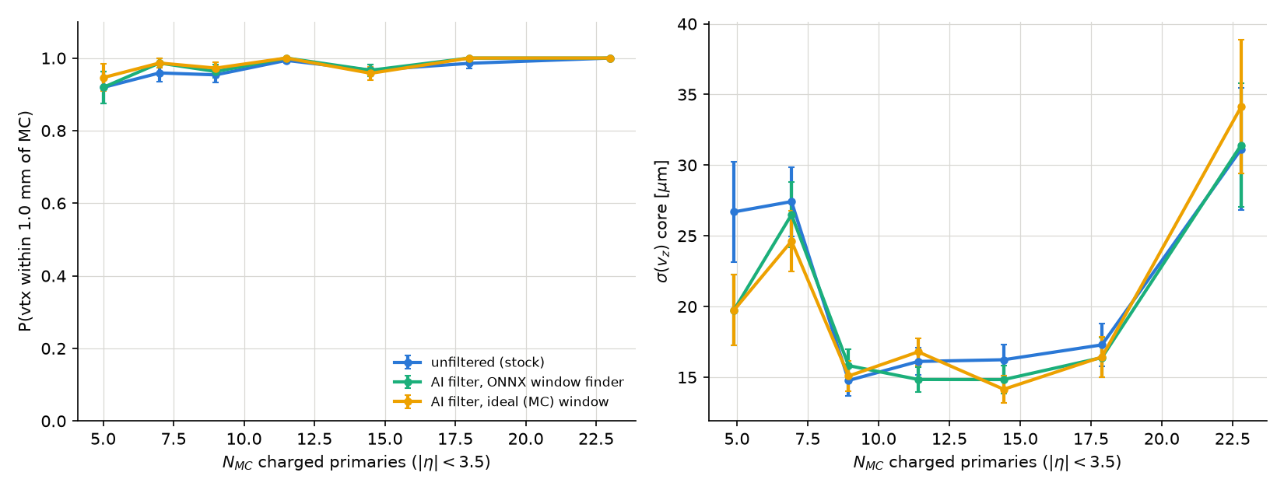
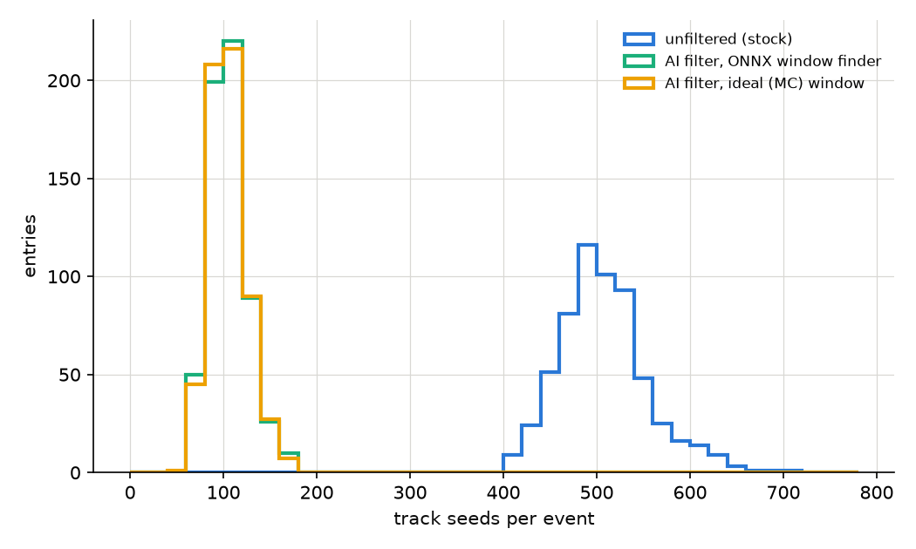
Same binary on the fresh 26.07.0 DIS campaign (10x275, minQ2=1000)
central tracking + vertexing | unfiltered | AI finder | AI ideal window
track seeds / event | 508 | 105 | 105
CKF tracks / event | 9.36 | 8.81 | 8.94
signal-track efficiency | 80.7% | 79.5% | 80.8%
track purity (signal fraction) | 92.1% | 96.4% | 96.5%
measurements / track | 6.42 | 6.51 | 6.52
σ(dp/p) signal tracks | 1.45 % | 1.45 % | 1.45 %
σ(DCA_r) signal tracks | 76.4 µm | 78.7 µm | 77.7 µm
vertex within 1 mm of MC PV | 96.8% | 97.8% | 98.0%
vertex σ(z) core | 17.9 µm | 17.2 µm | 17.0 µm
vertex_perf_vs_nmc.png
• Ran out of the box: 26.07.0 geometry kept the system-id map — no retraining, no re-export
• NC DIS has many charged primaries per event, so the tracking-WG vertex-efficiency-vs-N_MC view applies (right)
26
Notes:
Generalization check on the brand-new 26.07.0 campaign files: NC DIS at minQ2=1000 with machine background, a different physics process, different beam energy and a newer geometry release than anything the models saw in training. The same eicrecon binary and the same ONNX weights ran unmodified.

Slide 23
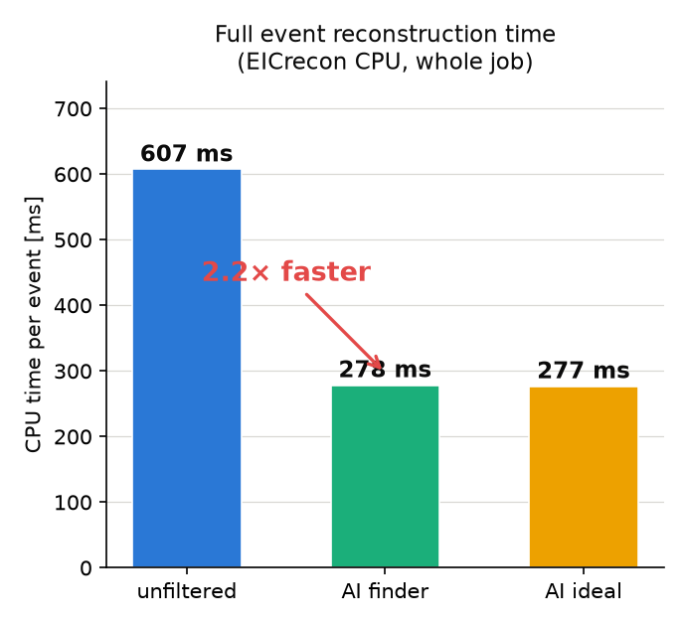
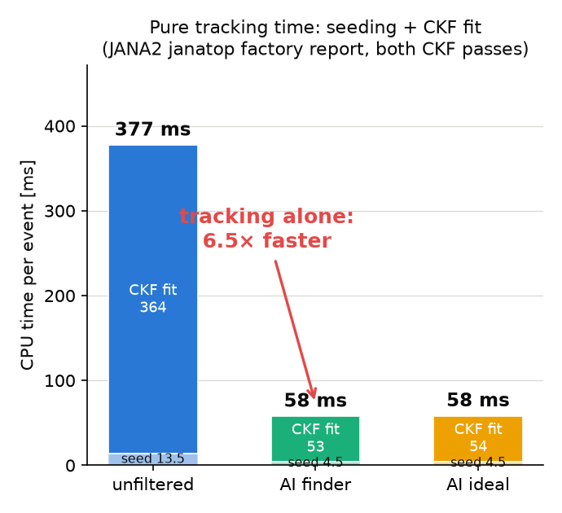
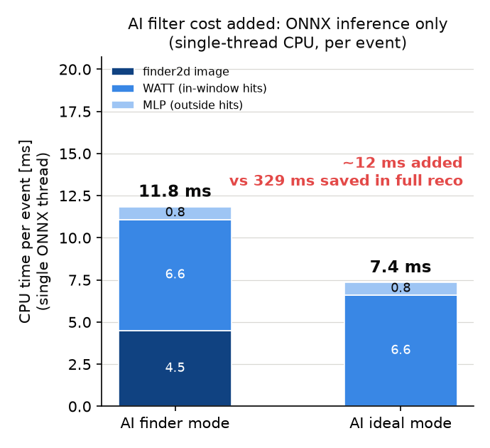
Tracking speedup
Full reconstruction, one CPU thread: 607 → 278 ms per event (2.2×).
Tracking itself: seeding + both CKF passes = falls 377 → 58 ms (6.5×): that is where the background was being paid for
The filter's own cost is 12 ms per event (image CNN 4.5 + attention 6.6 + MLP 0.8)
31
Notes:
The same measurement as the previous slide, one question per panel. Left: total reconstruction CPU per event, measured on the 10 000-frame k_lambda file - 607 ms unfiltered, 278 ms with the filter. Middle: pure tracking, isolated with JANA2's per-factory janatop report - seeding 13.5 to 4.5 ms and the CKF fit 364 to 53 ms, so tracking alone is 6.5 times cheaper; this is the honest 'where did the time go' panel, because everything else in reconstruction is unchanged. Right: what we ADD - three ONNX models on one thread, 12 ms per event in finder mode, 7 in ideal mode. Twelve milliseconds in, 329 out.

Slide 24
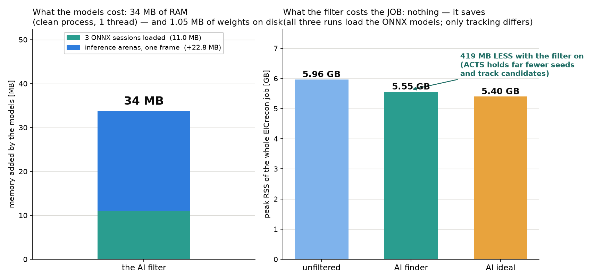
Memory footprint: the models add 34 MB
• The three models add 34 MB of RAM: 11 MB of loaded ONNX sessions + 23 MB of inference arenas. The weights are 1.05 MB on disk — small enough to ship inside the plugin, no model service needed
• And the job as a whole gets LIGHTER: peak RSS 5.96 → 5.55 GB, because ACTS no longer holds hundreds of background seeds and track candidates. Careful reading: all three runs load the ONNX models, so that 419 MB is tracking memory, not model memory
32
Notes:
Memory, the other half of the deployment cost. Left: what the models themselves add, measured by loading the three deployed ONNX files into onnxruntime in a clean process and running one realistic frame - 11 MB for the sessions, 23 MB of arenas during inference, 34 MB in total. The weights are 1.05 MB on disk, which is why they ship inside the plugin directory rather than through a model service. Right: the peak resident memory of the whole EICrecon job, from /usr/bin/time -v on the 10k-frame runs. It goes DOWN with the filter, from 5.96 to 5.55 GB. Be precise about why: the AI factory executes in all three variants, because its collections are always persisted, so the ONNX sessions are paid for in every bar. The 419 MB difference is memory that ACTS no longer needs for background seeds and track candidates. Net: the filter costs 34 MB and gives back 419.

Slide 25
Conclusions
• An AI background filter for streaming tracker data — built, validated, and running inside EICrecon
– keeps 99% of signal hits while rejecting background at the hit level; all models ONNX on CPU: ~1 MB of weights, +34 MB RAM, ~12 ms per frame
– the physics interaction is located inside the 2000 ns frame in 91.9% of events (from 16% at the start of this work)
• Reconstruction gets dramatically lighter and faster
– track seeds per event 577 → 148; fake tracks 25% → 9%; vertex resolution ~35% better
– pure tracking up to 6.5× faster (377 → 58 ms/event); whole reconstruction 2.2× faster — the 12 ms filter pays for itself 27 times over
• EICrecon integration is done, in upstream layout
– 4 files modified (+49 lines), 4 files added; outputs verified event-by-event; one flag switches filter / ideal-window / off
– ran unchanged on the fresh 26.07.0 DIS campaign: seeds 508 → 105, track purity 92 → 96.5%
40
Notes:
Conference wrap-up, slide one of two: what exists today. A complete two-stage filter - find the collision window in the streaming frame, then judge every hit with attention - deployed through ONNX inside EICrecon and validated on two physics campaigns. The numbers to remember: 99 percent signal-hit efficiency, seeds down 4x, fakes down to 9 percent, pure tracking up to 6.5x faster, full reconstruction 2.2x faster, and the whole model stack costs about a megabyte of weights and 12 milliseconds per frame on one CPU thread.

Slide 26
Outlook
• Finish the window hunt
– the candidate list already contains the right window in 99.6% of frames – high bounty for rare traning
– with a perfect window the same hit models reach ~98% background rejection
– finer than 25 ns time bins and a sub-bin t₀ regression for the frames whose signal is currently invisible in the image
• Add more data types
– calorimeter occupancy as extra image channels — the 2D finder design adds new detectors with zero structural change
• Close the loop in production
– recalibrate hit thresholds on the finder's own t₀ and re-measure end-to-end;
– agree the model-distribution convention with the ePIC software group and validate on a full campaign
• Other projects in progress:
– Physics background separation using PRE reconstruction data
– Physics background separation using POST reconstruction data
– Combinatorics suppression using AI/ML (based on FF Lambda reconstruction)
41
Notes:
Slide two: where this goes. The window finder's shortlist already contains the right answer in 99.6 percent of frames, so the remaining work is selection, not representation - and the payoff is quantified: 2.5 points of rejection per point of recall, with a 97.5-percent-rejection bound at a perfect window. The image design scales to more detectors by adding channels. And in production: recalibrate the thresholds on the finder's own t0, re-run the end-to-end benchmarks, and settle model distribution with the ePIC software group.

Slide 27

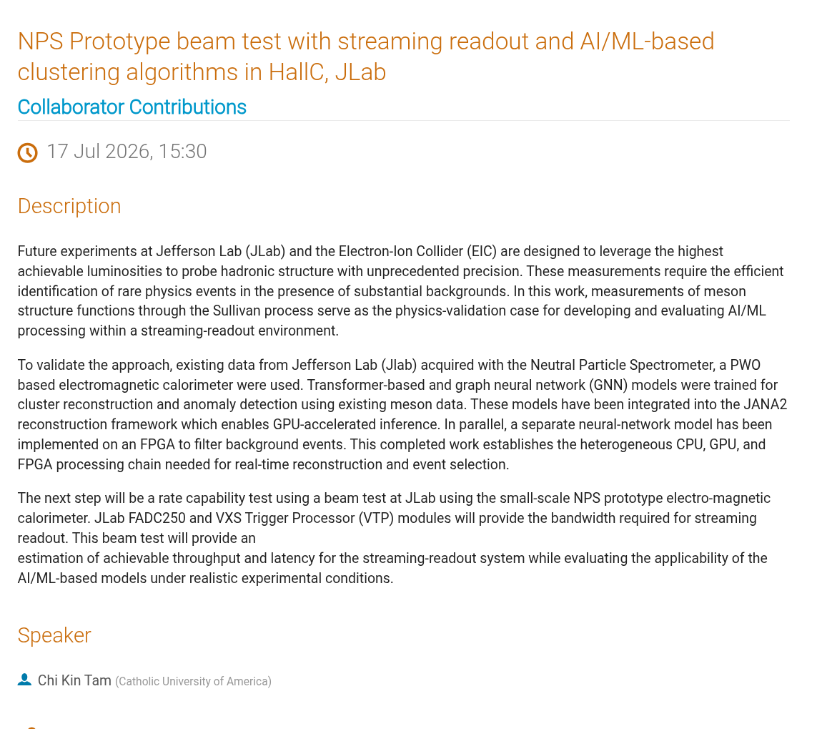
What about physics background?
What about GNN + attention on live experiment?
6
Notes:
We threw capacity at it: a 20x bigger MLP gains 0.3 points; DeepSets that mixes in a learned global event summary actually does slightly worse. The ceiling is informational, not architectural: conditioned on its own coordinates, a hit carries almost no class information, because t is uniform for both classes over the 2000 ns frame. Right: the DeepSets efficiency/rejection curve - same wall.

Slide 28
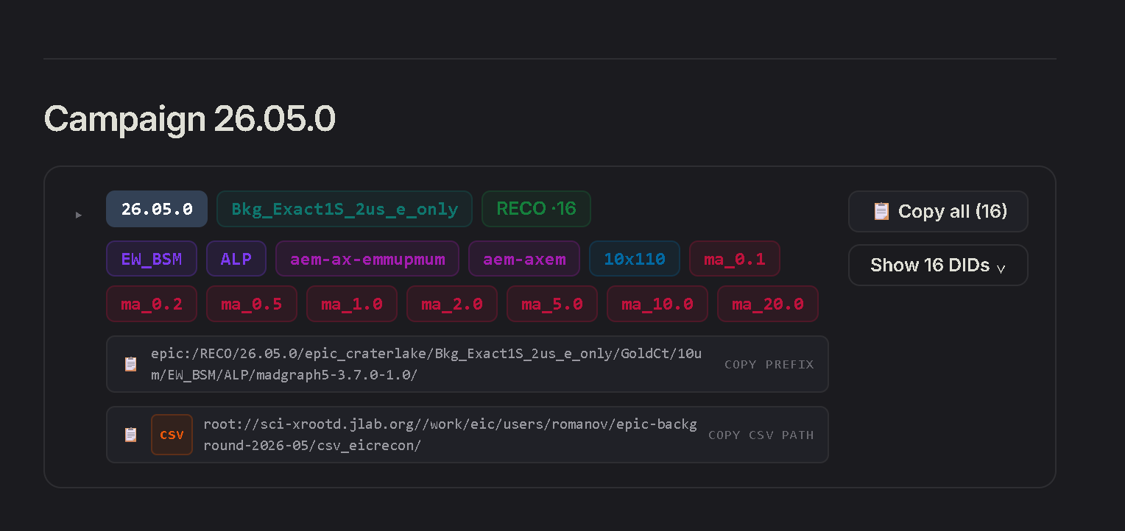
Try it by yourself?
https://eic.github.io/ai-epic-background/data.html
https://github.com/eic/example-background-data
AI/ML ready datasets with machine learning
6
Notes:
We threw capacity at it: a 20x bigger MLP gains 0.3 points; DeepSets that mixes in a learned global event summary actually does slightly worse. The ceiling is informational, not architectural: conditioned on its own coordinates, a hit carries almost no class information, because t is uniform for both classes over the 2000 ns frame. Right: the DeepSets efficiency/rejection curve - same wall.

Slide 29
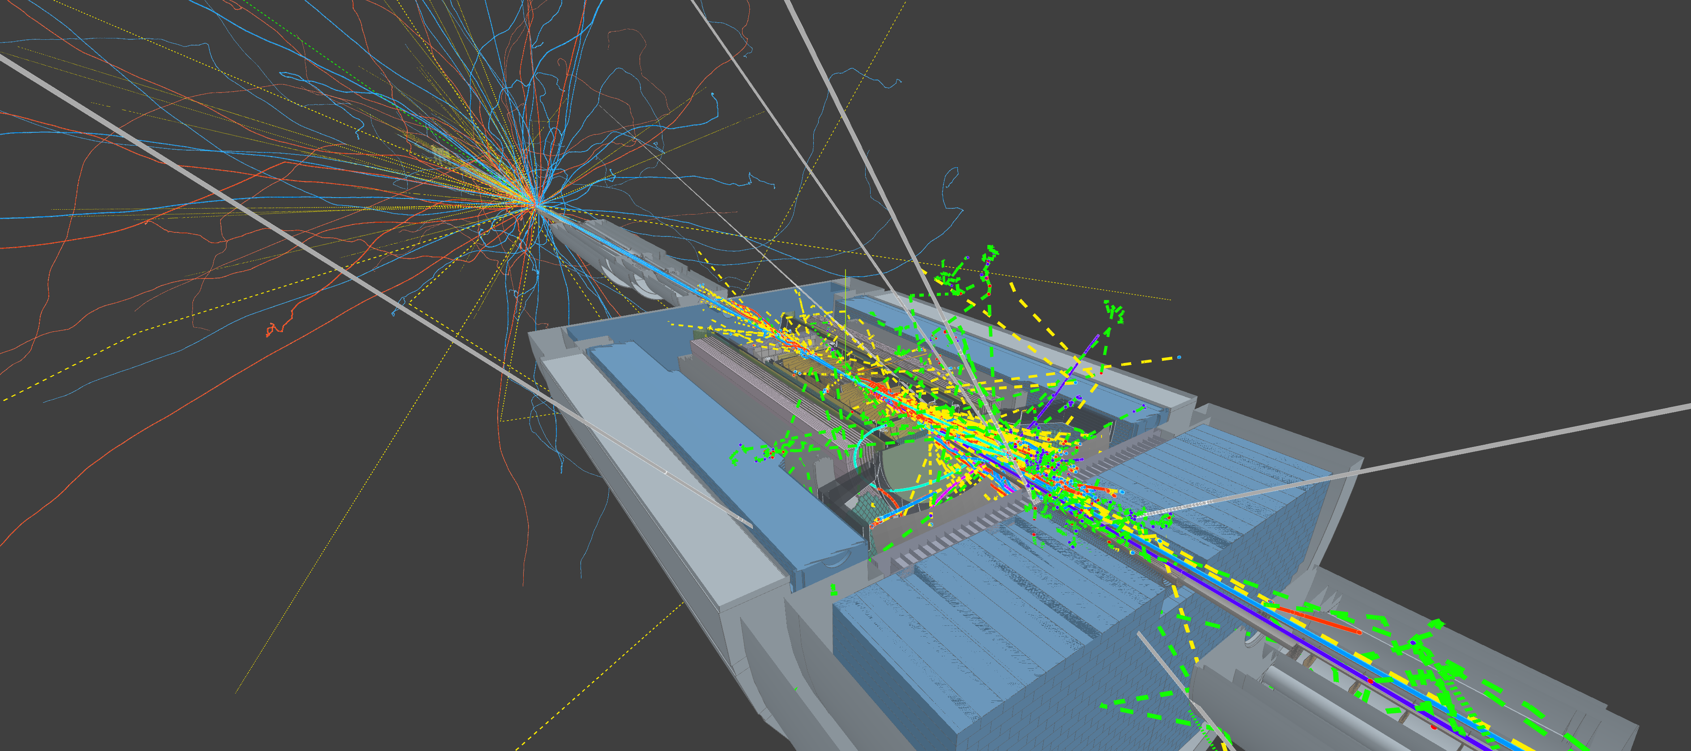

Firebird background examples
Go seeEIC.org -> Configure -> Examples -> “Event + Background ePIC Beam=10x100 (Large file)”
To animate full frame : Set End Time 2000, Animation speed 20

Slide 30
Questions, ideas, collaboration?

Slide 31
BACKUPS

Slide 32
Results in EICrecon — k_lambda 18x275, 10 000 frames
central tracking + vertexing | unfiltered | AI finder | AI ideal window
track seeds / event | 578 | 148 | 148
CKF tracks / event | 2.60 | 2.11 | 2.14
signal-track efficiency | 96.8% | 95.6% | 96.8%
track purity (signal fraction) | 74.3% | 90.2% | 90.3%
measurements / track | 6.66 | 7.23 | 7.23
σ(dp/p) signal tracks | 0.94 % | 0.94 % | 0.94 %
σ(DCA_r) signal tracks | 8.5 µm | 8.4 µm | 8.5 µm
vertex within 1 mm of MC PV | 82.8% | 87.0% | 88.9%
vertex σ(z) core | 10.0 µm | 6.5 µm | 6.6 µm
• Vertexing improves outright: +4-6 pp finding within 1 mm, vertex resolution ~35% sharper in x, y and z
• Track fit untouched (dp/p, DCA identical) — the filter removes hits, it does not distort surviving tracks; CKF even picks up MORE correct measurements per track (6.66 → 7.23)
• Ideal window costs zero signal efficiency — remaining 1.3 pp gap is window-finder recall
25
Notes:
Full-statistics EICrecon comparison on the k_lambda sample: 10000 frames, three runs of the same binary - stock wiring, the deployed ONNX window finder, and the MC-truth ideal window. Seeding load drops 3.9x, track purity jumps 74 to 90 percent, and the vertex numbers improve outright. The ideal-window column proves the hit classifier is lossless at track level when t0 is right.

Slide 33
Integration into EICrecon
BEFORE
tracker RecHits
CentralTrackingRecHits
seeding → CKF
tracks → vertices
AFTER one factory inserted
tracker RecHits
7 central collections
CentralTrackingRecHits
AI FILTER
ONNX
signal hits
subset
seeding → CKF → vertices
noise hits
persisted, not tracked
EICrecon branch: ai-trk-hits-filter
24
Notes:
The whole integration in one picture. Above: stock EICrecon - every reconstructed hit in the frame, background and signal alike, is offered to the ACTS seeder, which pays for it in combinatorics. Below: the same chain with one factory inserted; the hits it rejects are kept in a separate collection but never reach tracking. The three numbers under each lane are measured on the same 10 000-frame file with the same binary: seeds per event fall 4x, the fake-track fraction drops from a quarter to a tenth, and tracking itself gets 6.5x cheaper.

Slide 34
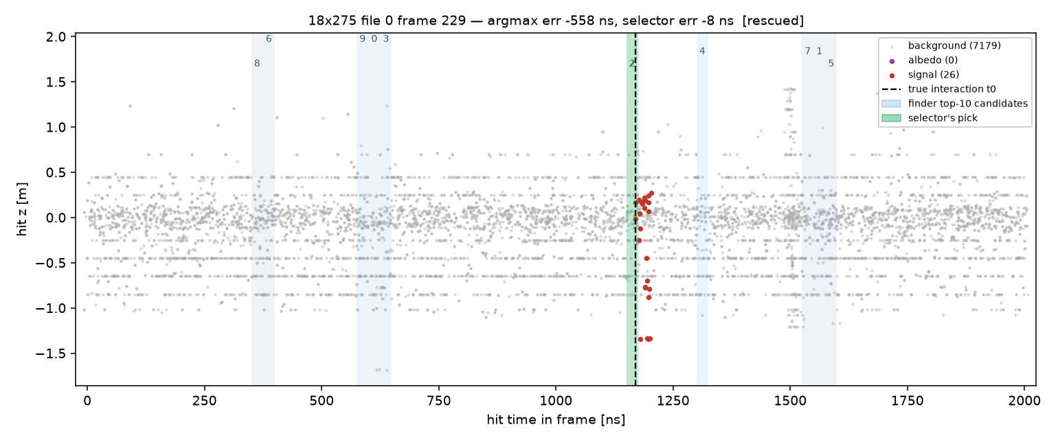
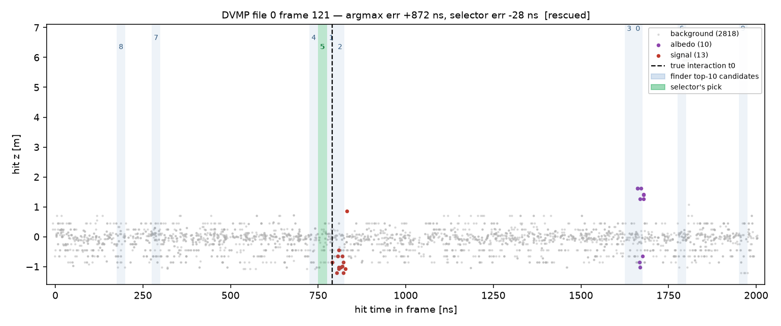
Watching the selection rescue real frames
• Blue bands: the finder's top-10 candidate windows (numbers = rank). Green: the verified pick. Dashed: the true interaction
rescued_18x275_229.png
rescued_DVMP_200000121.png
35
Notes:
Two real frames the finder's first guess got wrong. Top: the argmax landed 558 ns early on a bright background burst; the verified pick sits exactly on the 26-hit signal burst. Bottom: an exclusive-production frame with a 13-hit signal - the first guess was 872 ns late, drawn to an albedo cluster; the verifier recognized the true burst among the candidates at rank 5. This is the failure mode the candidates+verifier design exists for: the finder's mistakes are shallow, the right answer is almost always already on its shortlist.

Slide 35
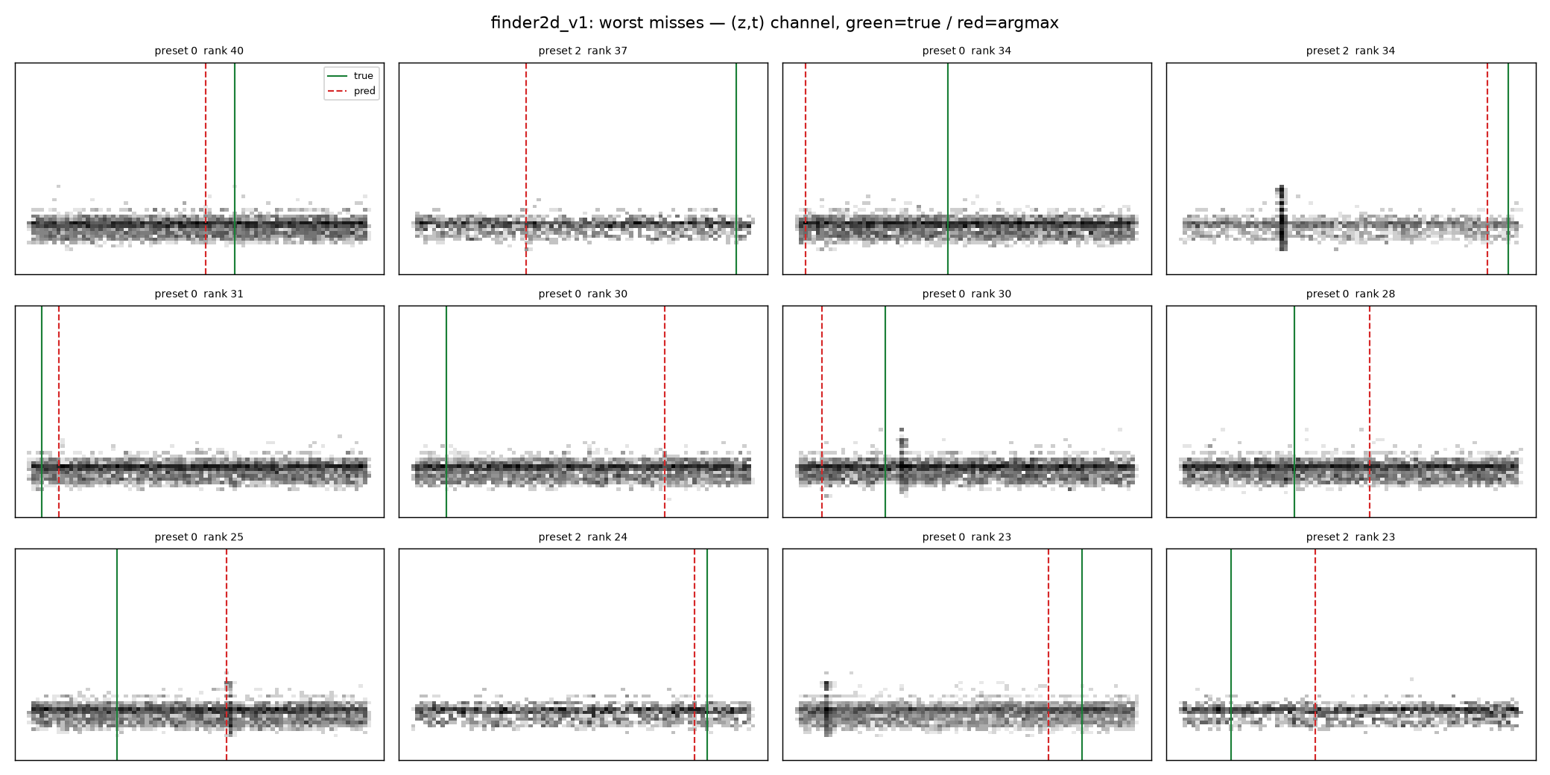
Why window finding is hard: the missed frames
• Gallery of frames the finder misses
• Worst cases: the signal burst is INVISIBLE in occupancy — dim few-track events — while bright background bursts distract elsewhere
finder2d_v1_miss_gallery.png
15
Notes:
Know your failures: a gallery of missed frames. In the worst of them the ep interaction produced only a couple of soft tracks - its time column is genuinely dim - while a beam-gas shower blazes somewhere else in the frame. Some misses look irreducible from occupancy alone; the question is how much geometry can claw back.

