Slide 1

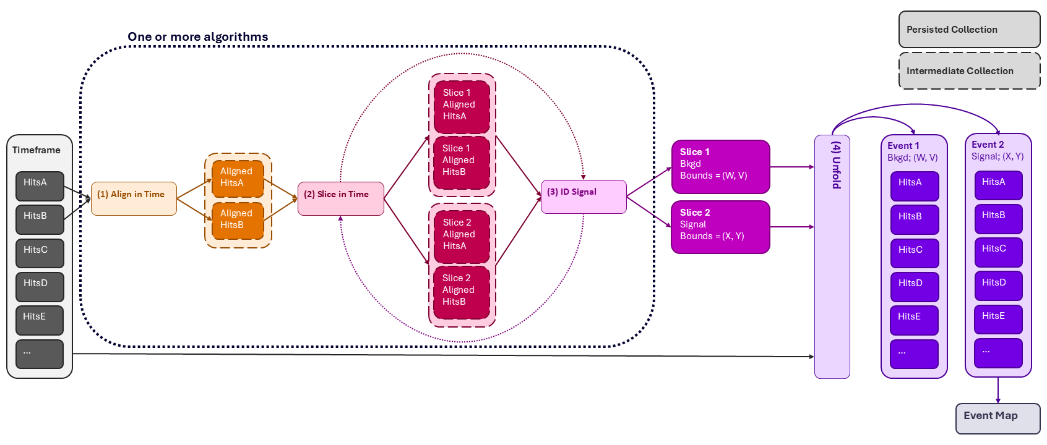
Timeslice Strawman V3 | Minimum-Viable Product
Above: updated timeslice strawman after feedback
  Dotted lines indicate areas to evolve after MVP (e.g. iterative slicing, separating pieces of splitting algo)
  Dashed lines indicate intermediate collections
  Slice signal/bkgd ID + bounds container still TBD
Minimum Viable Product (MVP): aligning & splitting are algorithm(-like)
  Alignment happens only on collections needed for splitting
  Splitting (slicing + signal/bkgd ID) happens in one algo, ingesting only needed collections & emitting slice bounds/IDs
  Unfolding happens outside splitting algo

Slide 2
Timeslice Strawman V3 | Target Interfaces
(1/2/3) Slign/Slice in Time + ID Signal
(4) Unfold
app->Add(JOmnifactory<MultiplicitySlicer>(
“SliceBounds”,
{“HitsA”, “HitsB”},
{“SliceBounds”},
{}, JEventLevel::Timeslice
));
app->Add(JSplitter(
{“SliceBounds”}, // how to slice
{“HitsA”, “HitsB”, “HitsC”, ...}, // what to slice
));

