Slide 1
Tracking resolution on surface of BTOF
2026/07/03
Ayuki Watanabe
Dept. of Phys., Tohoku Univ.

Slide 2
Purpose
Evaluate tracking resolution on surface of BTOF
  Using the simulation package
Notes:
EICrecon:v1.36.0-20-g0c03c13c-dirty
ePIC:26.04.0-15-g308efb360-dirty

Slide 3

Conditions
Version
EICrecon : v1.36.0
ePIC : 26.04.0
Generated particle
Single-particle : $π^{−}$
Distribution : uniform (flat in theta)
Momentum : 0.1 ~ 2.0GeV
Generation points : (0, 0, 0)
Number of events : 400000 (100000×4)
Multiplicity : 1
Seeds : 1, 2, 3, 4
Notes:
EICrecon:v1.36.0-20-g0c03c13c-dirty
ePIC:26.04.0-15-g308efb360-dirty

Slide 4
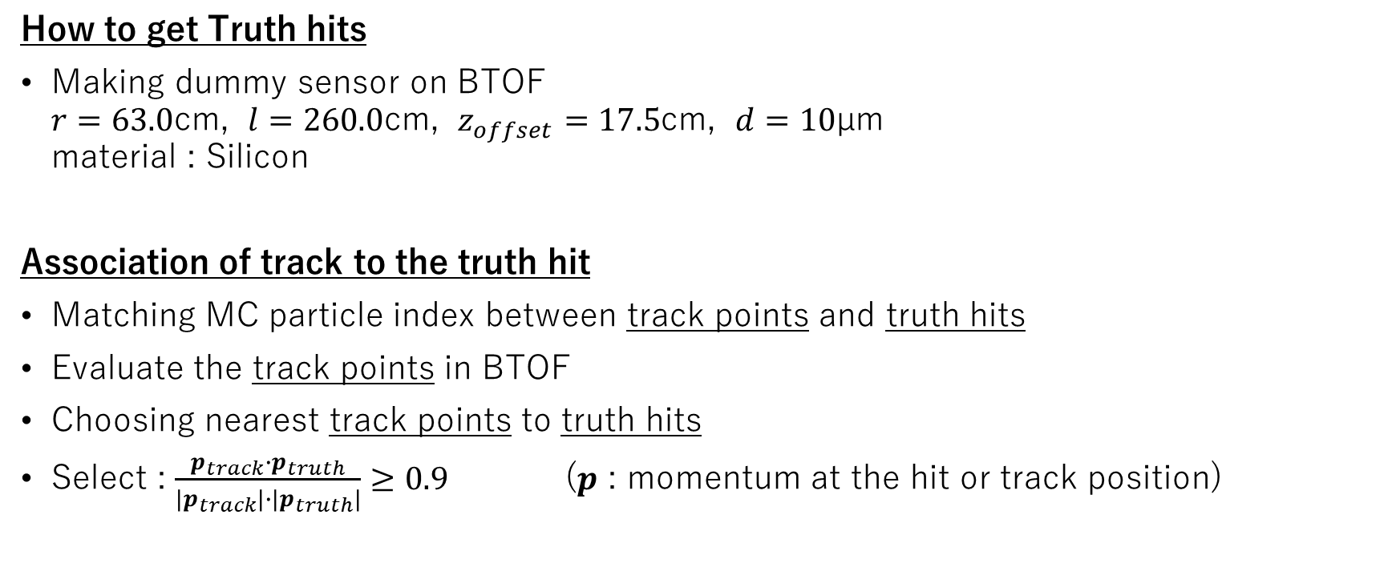
Event selection
How to get Truth hits
Making dummy sensor on BTOF
$r=63.0$cm, $l=260.0$cm, $z_{offset}=17.5$cm, $d=10$µm
material : Silicon
Association of track to the truth hit
Matching MC particle index between track points and truth hits
Evaluate the track points in BTOF
Choosing nearest track points to truth hits
Select : $\frac{p_{track}∙p_{truth}}{|p_{track}|∙|p_{truth}|}≥0.9$ ($p$ : momentum at the hit or track position)
Notes:
How to select appropriate combination of CentralTrackSegments points (track points) and Dummy sensor hits (truth hits)

Slide 5
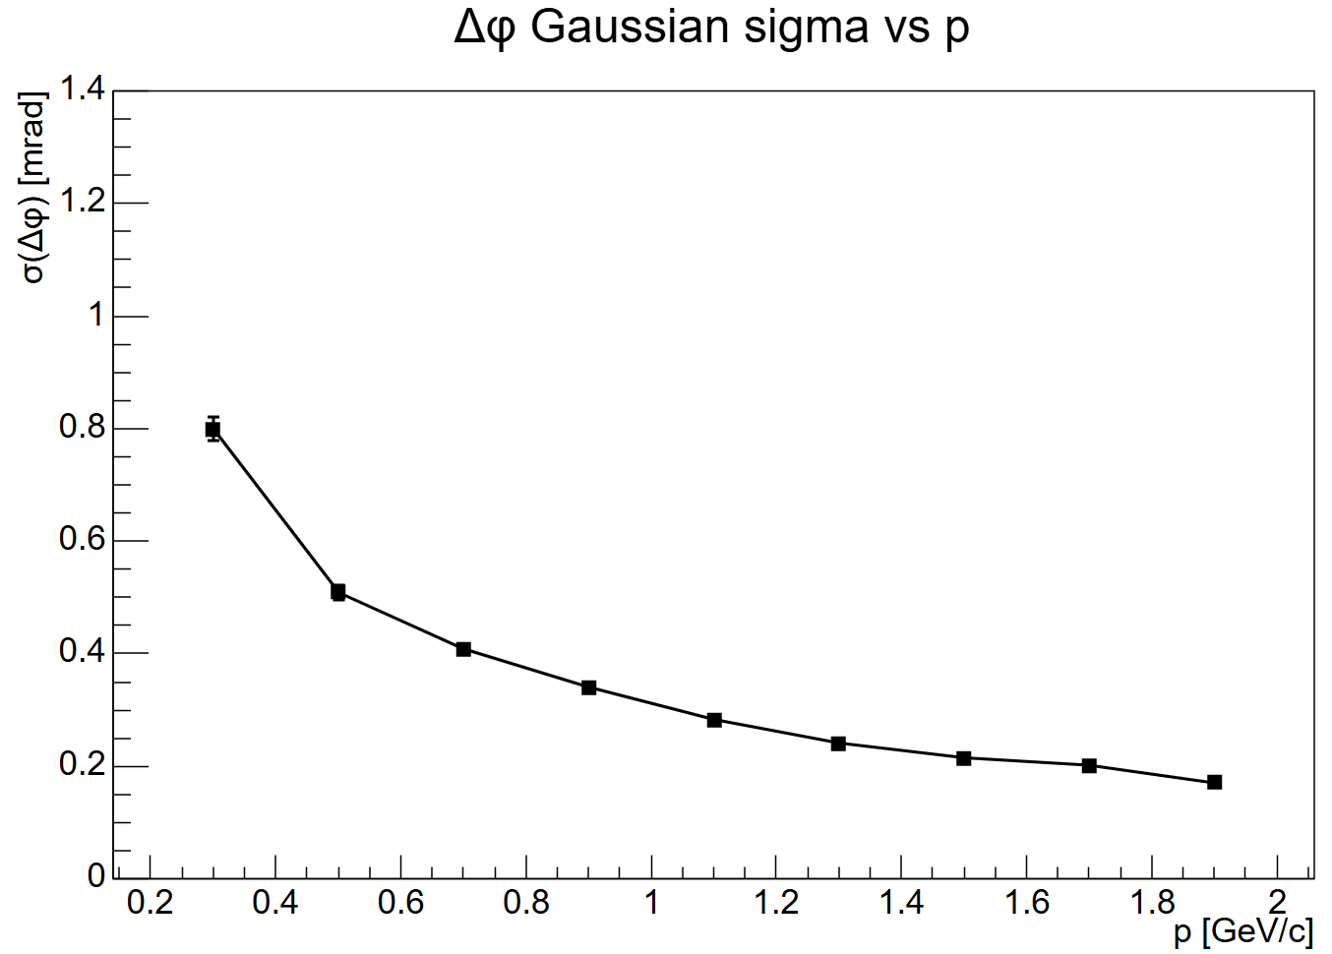


Results
Angular resolution ($φ$) as a function of momentum
no selection in $θ$.
note: $p$ is the momentum at hit point.
Sigma of $∆φ$ vs $p$

Slide 6
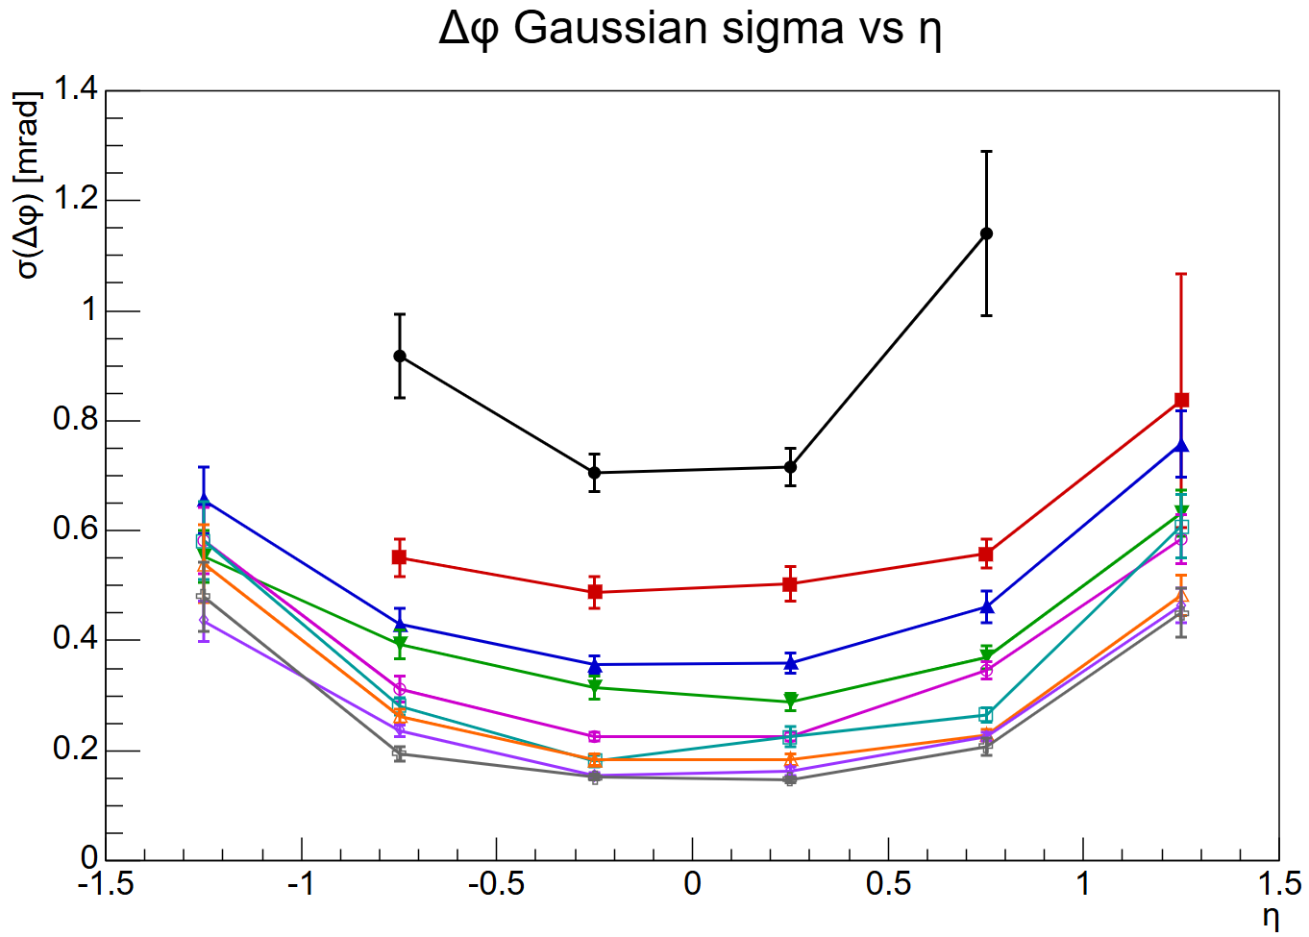











Results
Sigma of $∆φ$ vs $η$
Angular resolution as a
function of $η$ by each
momentum range
$0.2<p<0.4$ [GeV/c]
$0.4<p<0.6$ [GeV/c]
$0.6<p<0.8$ [GeV/c]
$0.8<p<1.0$ [GeV/c]
$1.0<p<1.2$ [GeV/c]
$1.2<p<1.4$ [GeV/c]
$1.4<p<1.6$ [GeV/c]
$1.6<p<1.8$ [GeV/c]
$1.8<p<2.0$ [GeV/c]
Notes:
ηの分解能

Slide 7
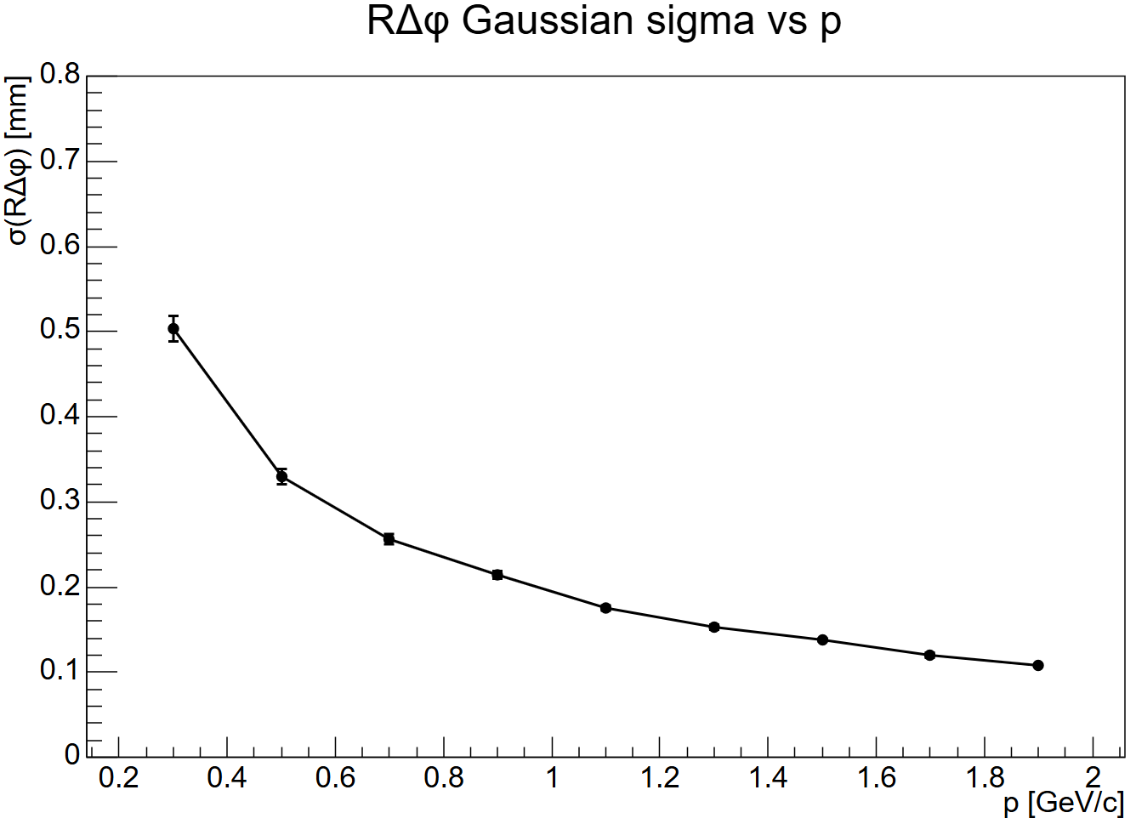


Results
Resolution ($R∆φ$) as a function of momentum
Sigma of $R∆φ$ vs $p$

Slide 8
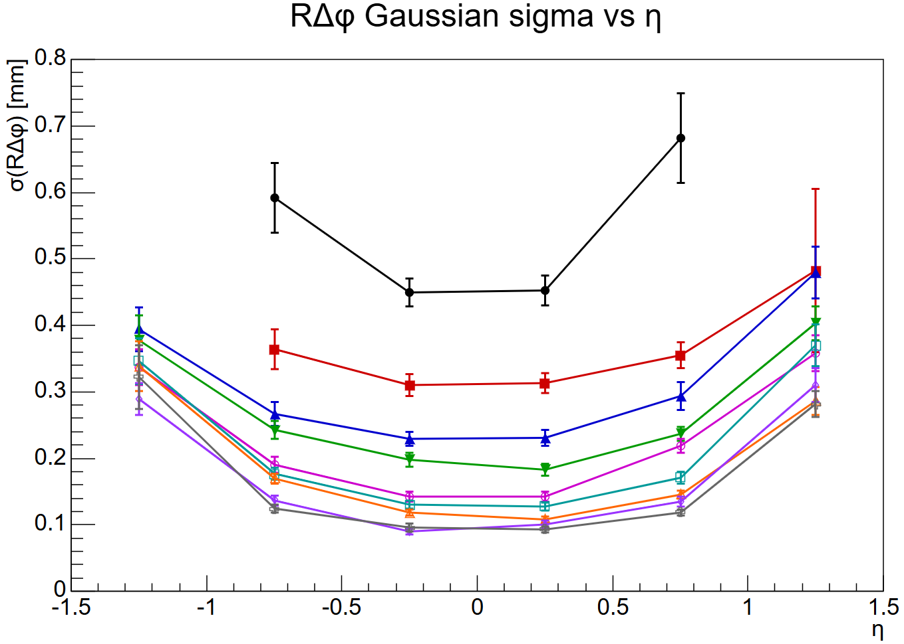


Results
Sigma of $R∆φ$ vs $η$
Resolution as a function of $η$
by each momentum range
$0.2<p<0.4$ [GeV/c]
$0.4<p<0.6$ [GeV/c]
$0.6<p<0.8$ [GeV/c]
$0.8<p<1.0$ [GeV/c]
$1.0<p<1.2$ [GeV/c]
$1.2<p<1.4$ [GeV/c]
$1.4<p<1.6$ [GeV/c]
$1.6<p<1.8$ [GeV/c]
$1.8<p<2.0$ [GeV/c]

Slide 9
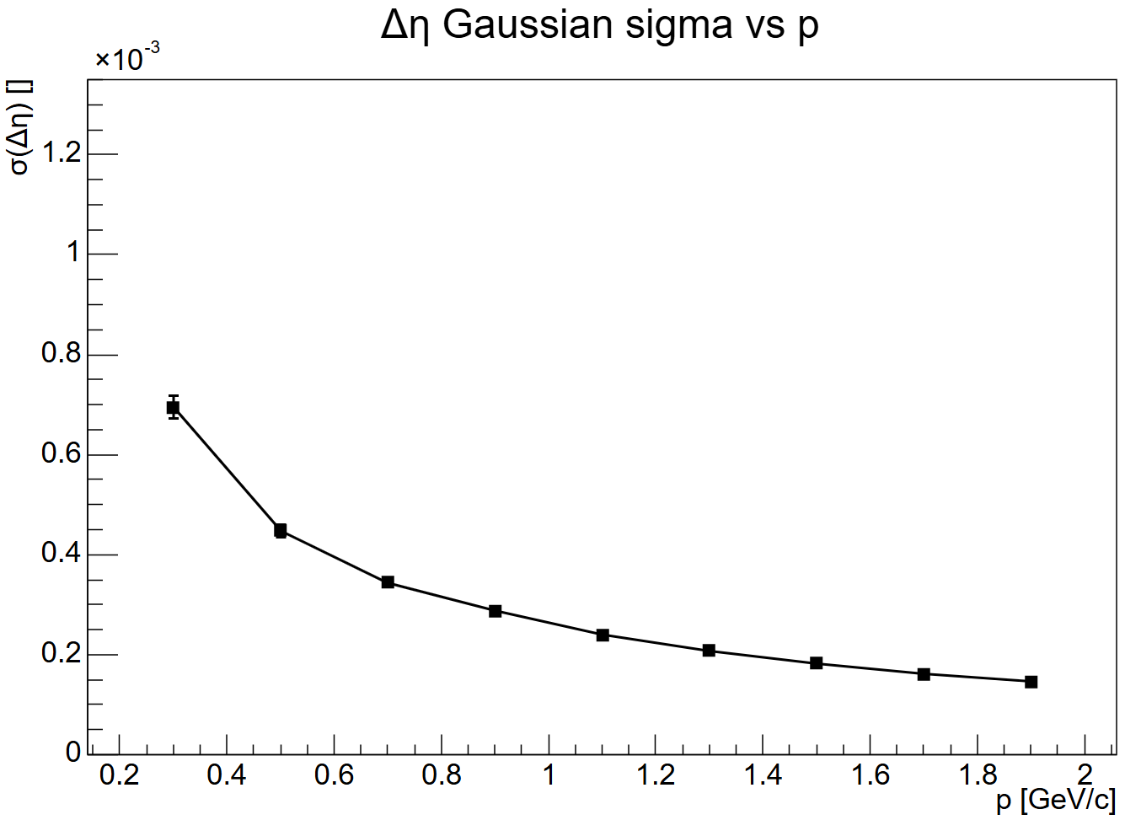


Results
$η$ resolution as a function of momentum
Sigma of $∆η$ vs $p$

Slide 10
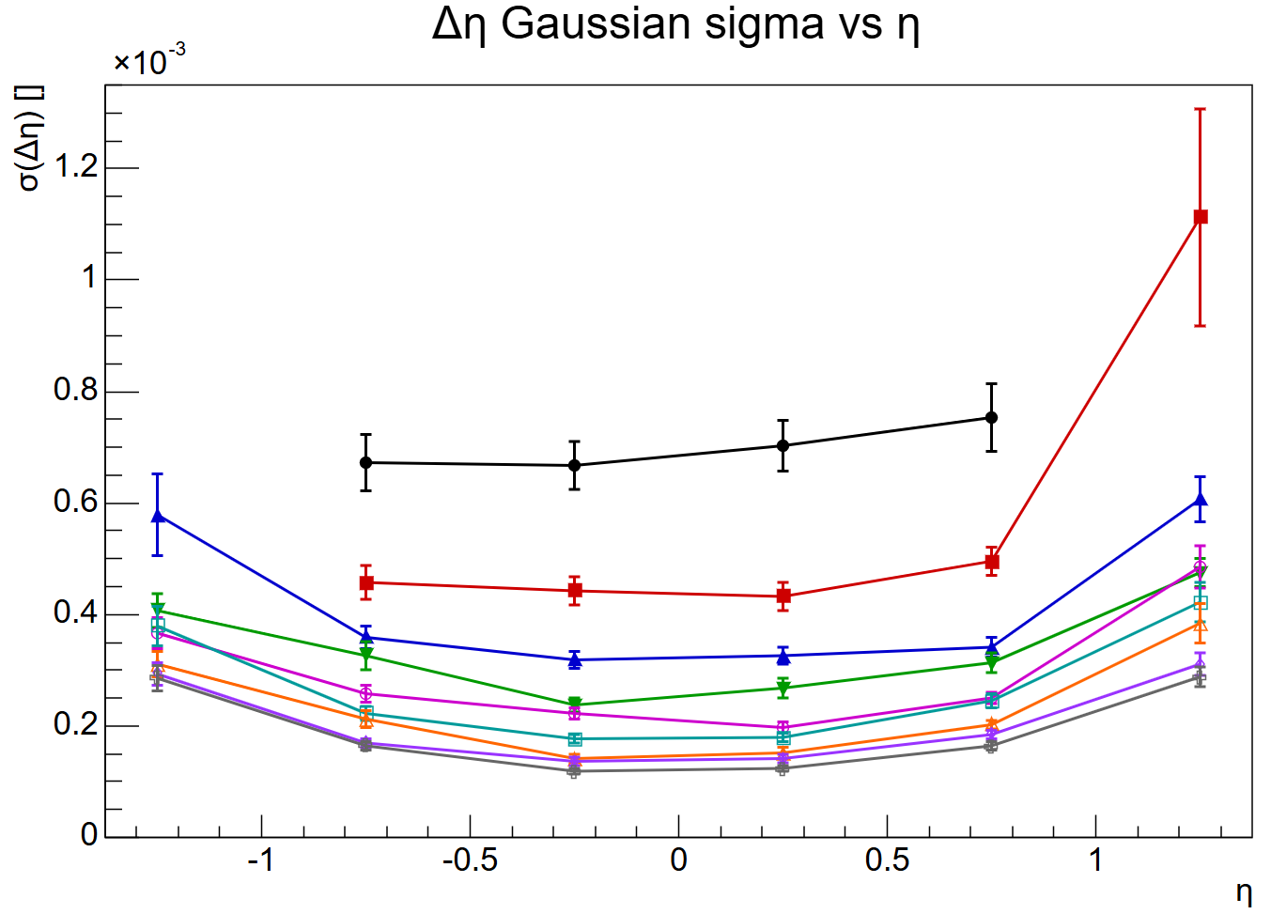


Results
Sigma of $∆η$ vs $η$
$η$ resolution as a function of
$η$ by each momentum range
$0.2<p<0.4$ [GeV/c]
$0.4<p<0.6$ [GeV/c]
$0.6<p<0.8$ [GeV/c]
$0.8<p<1.0$ [GeV/c]
$1.0<p<1.2$ [GeV/c]
$1.2<p<1.4$ [GeV/c]
$1.4<p<1.6$ [GeV/c]
$1.6<p<1.8$ [GeV/c]
$1.8<p<2.0$ [GeV/c]

Slide 11
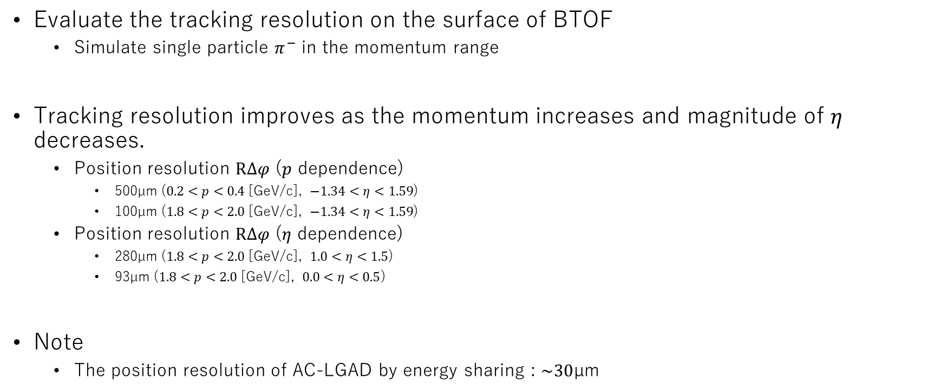
Summary and Conclusions
Evaluate the tracking resolution on the surface of BTOF
  Simulate single particle $π^{−}$ in the momentum range
Tracking resolution improves as the momentum increases and magnitude of $η$ decreases.
  Position resolution $R∆φ$ ($p$ dependence)
    500µm ($0.2<p<0.4$ [GeV/c], $−1.34<η<1.59$)
    100µm ($1.8<p<2.0$ [GeV/c], $−1.34<η<1.59$)
  Position resolution $R∆φ$ ($η$ dependence)
    280µm ($1.8<p<2.0$ [GeV/c], $1.0<η<1.5$)
    93µm ($1.8<p<2.0$ [GeV/c], $0.0<η<0.5$)
Note
  The position resolution of AC-LGAD by energy sharing : $\sim 30$µm
Notes:
Goal : e ratio が量れるか、material budget, degitization

Slide 12
Back up

Slide 13
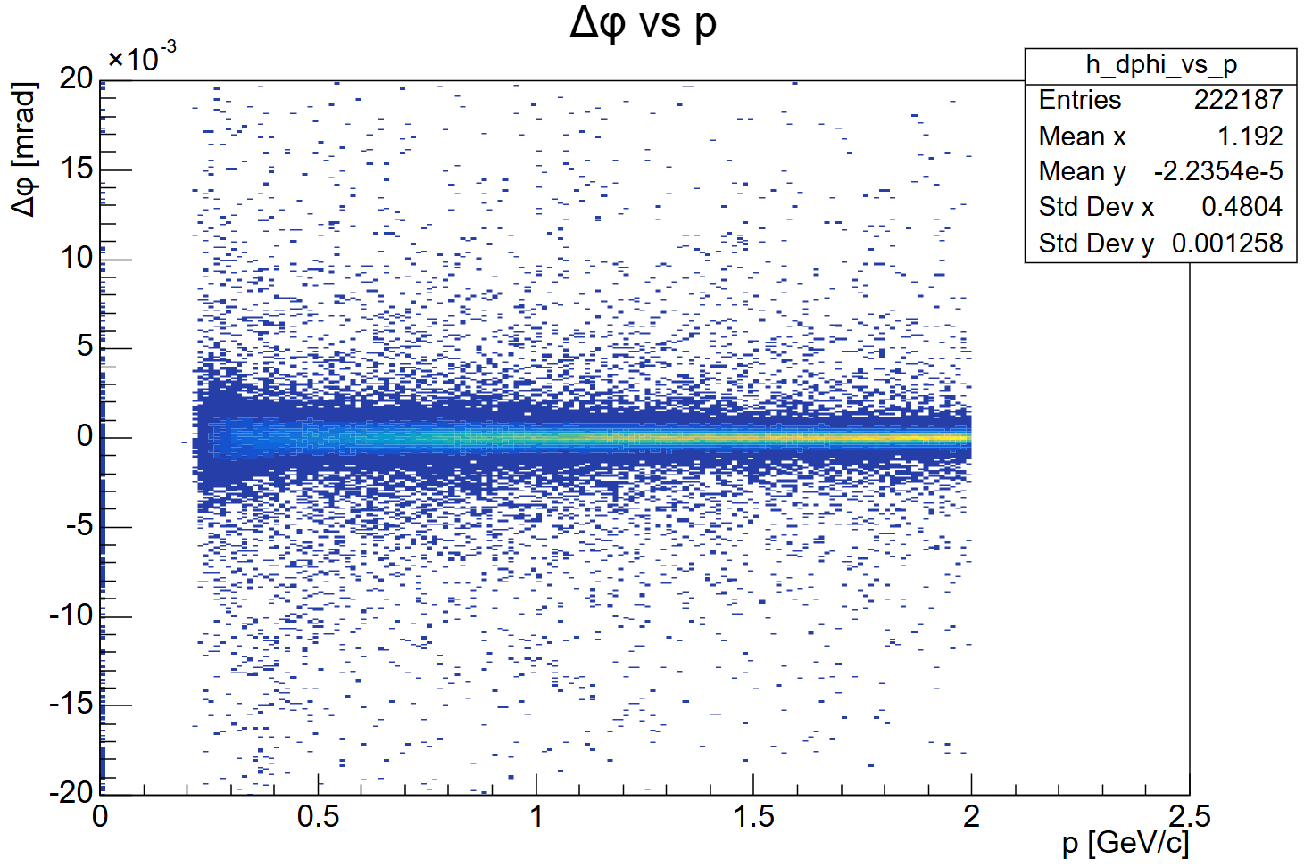


Slide 14
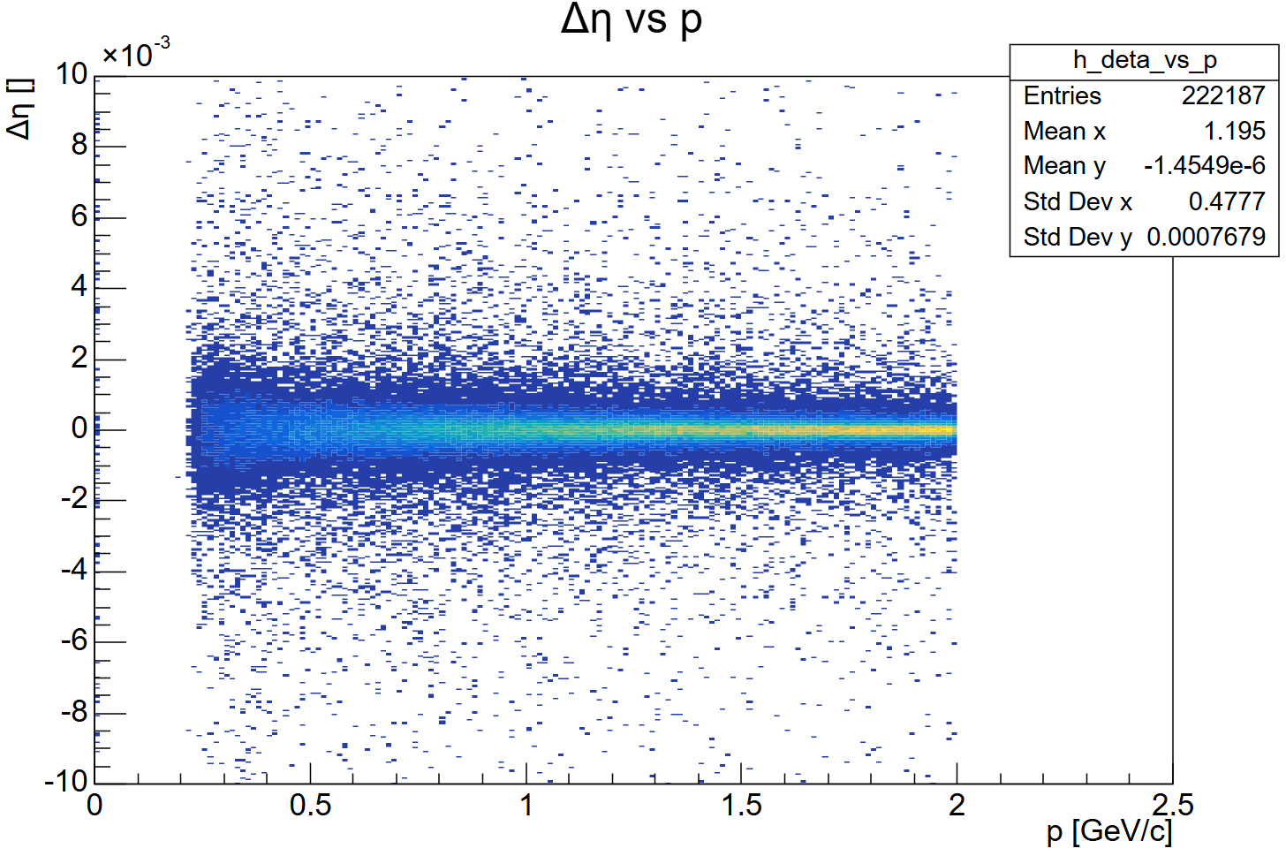

Slide 15

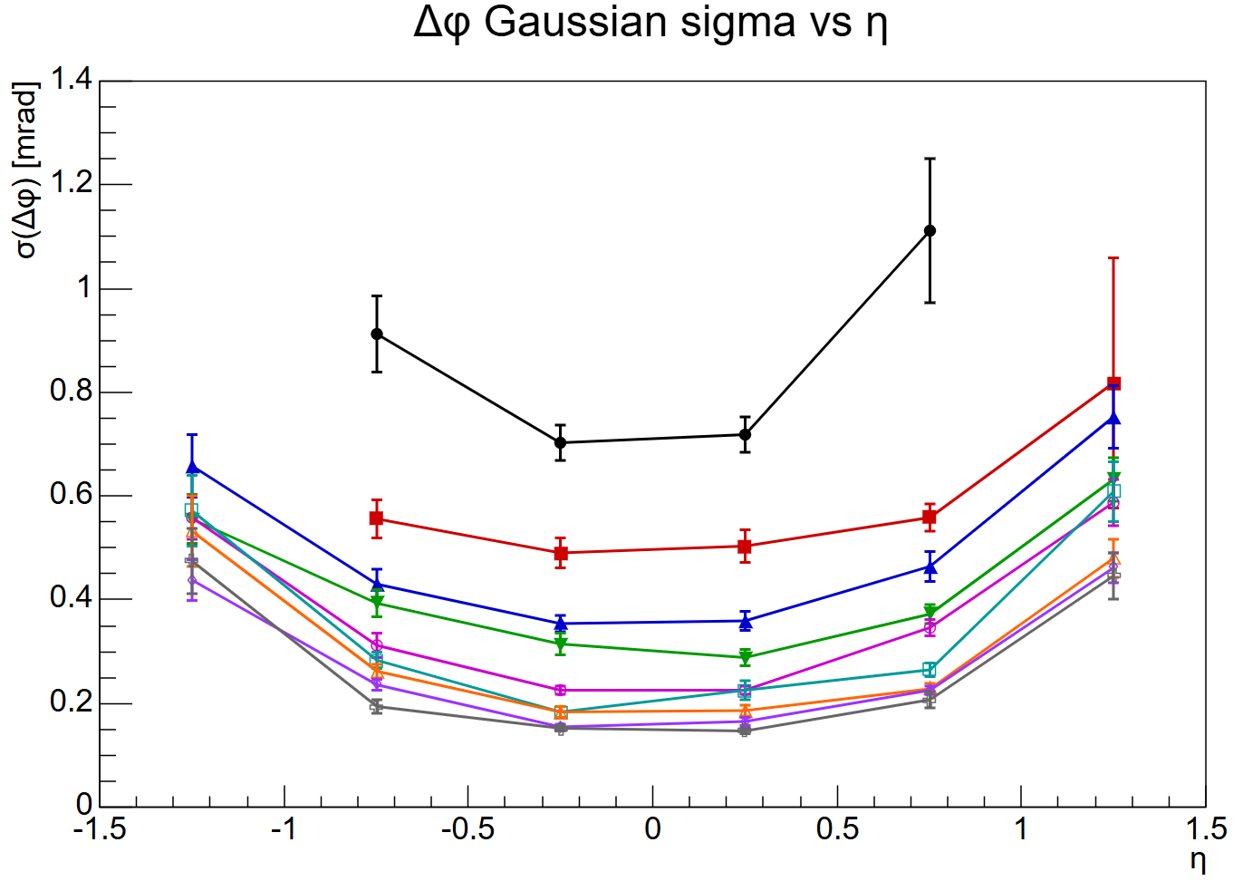
No BTOF hits for tracking

Slide 16

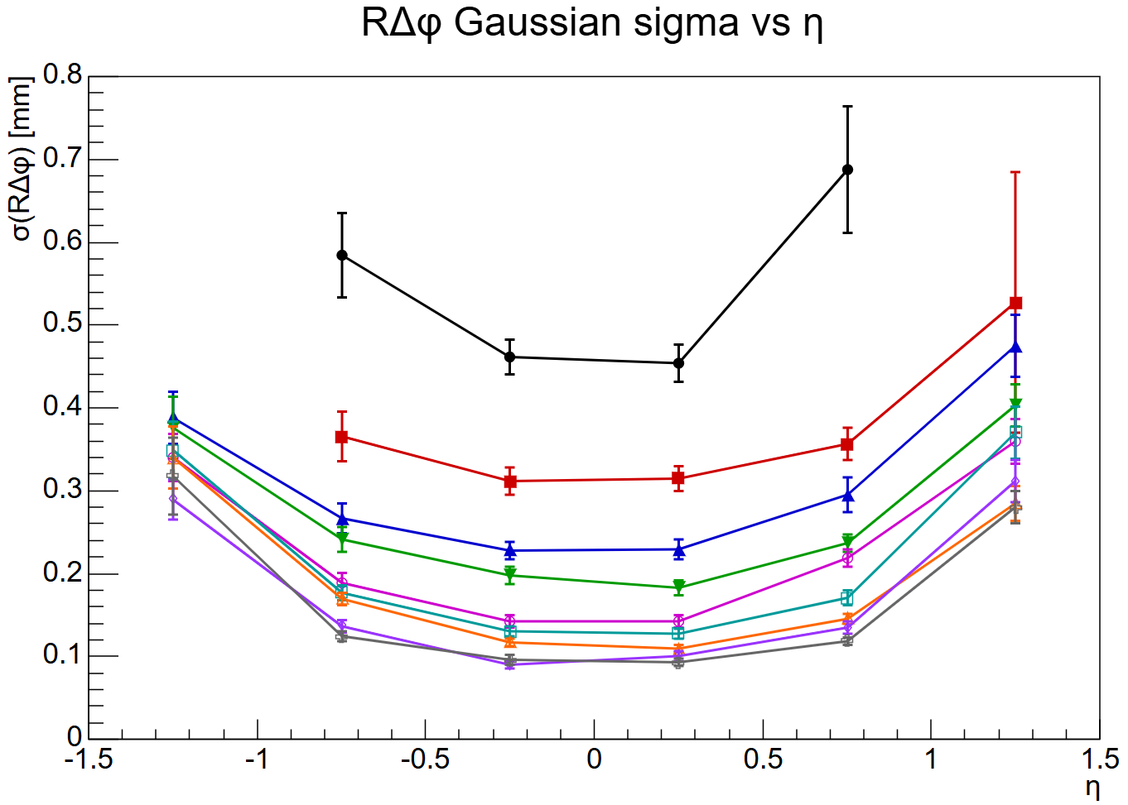
No BTOF hits for tracking

Slide 17
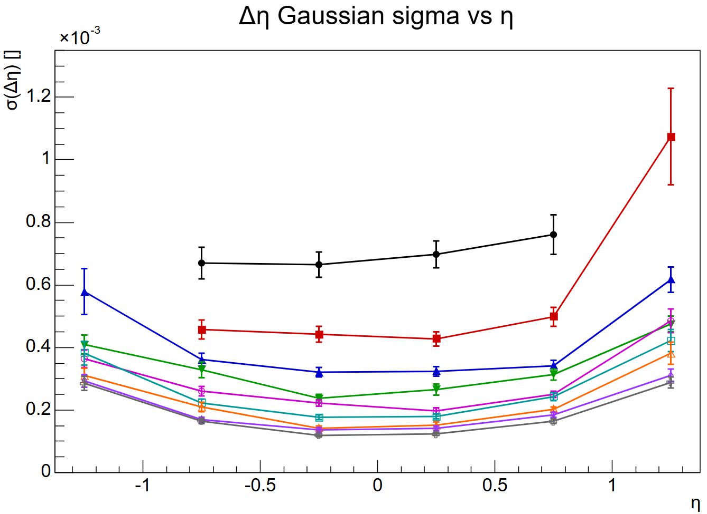
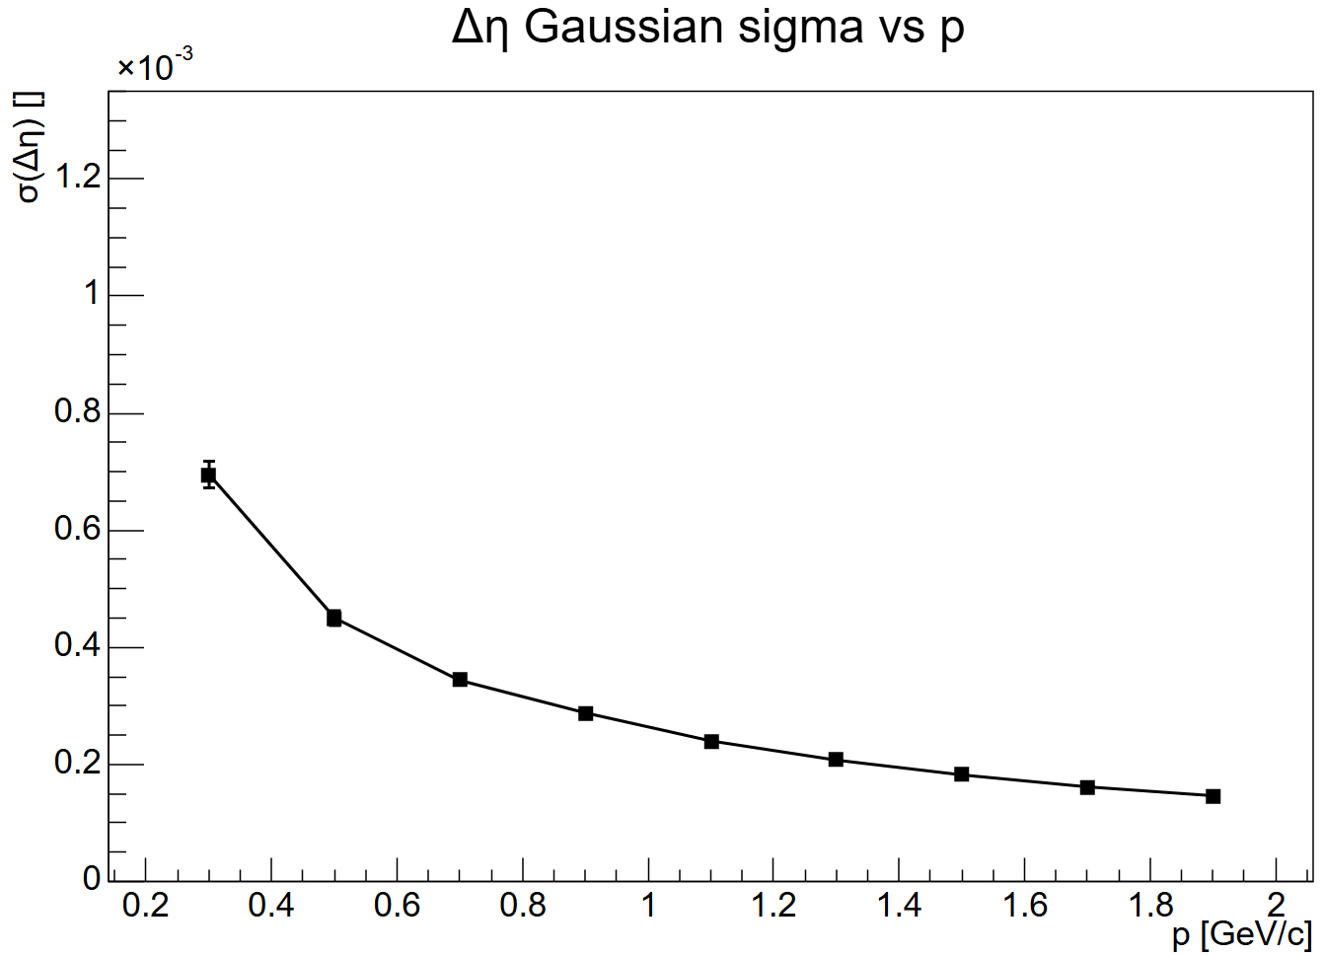
No BTOF hits for tracking

