Slide 1
ePIC SRO WG Meeting
Agenda:
  Intro (Me)
  EEMCal Calibrations (Carlos Munoz, Marco Battaglieri)
  3-year priority discussion (Me)
  https://docs.google.com/document/d/15rhR2xQ3NWUZkPrumIzsWtc-G9JrKH_CCKjchk3bQ_Y/edit?tab=t.0
Notes / Information:
  Meeting Notes: ePIC Streaming Computing WG Meetings - Google Docs

Slide 2
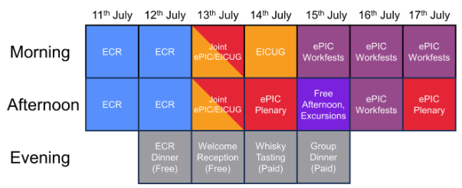
Collaboration Meeting

Slide 3
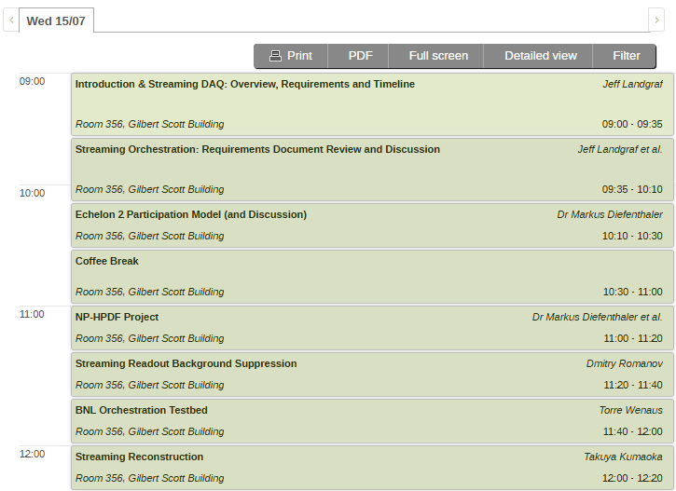
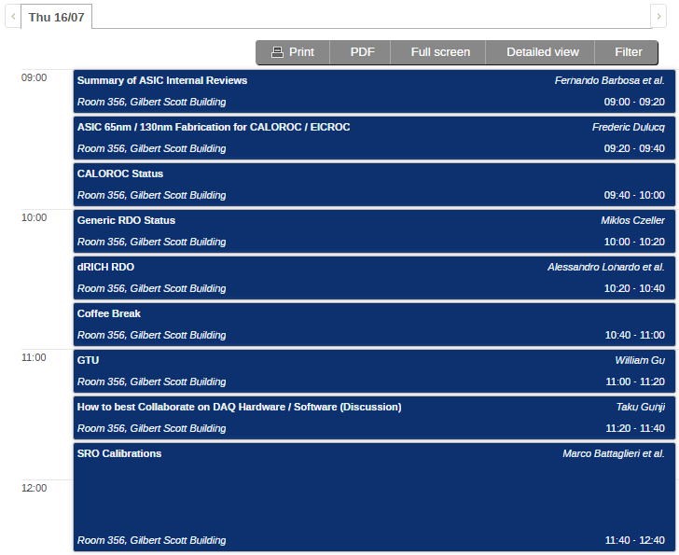
Collaboration Meeting
(Opposite Exclusive, Diffraction and Tagging)
(Opposite AI Workfest Session 1)

Slide 4
3-Year Priorities
- This is requested from software and computing (for end of June)
- These come from a review recommendations (Which review Markus?)
There was a guidance to aim for 3-priorities/year (to allow focus on most important issues)
Questions:
Do the priorities make sense
We need to define success metrics
Are and R&D Activitities or infrastructure investments needed to ensure success?

Slide 5
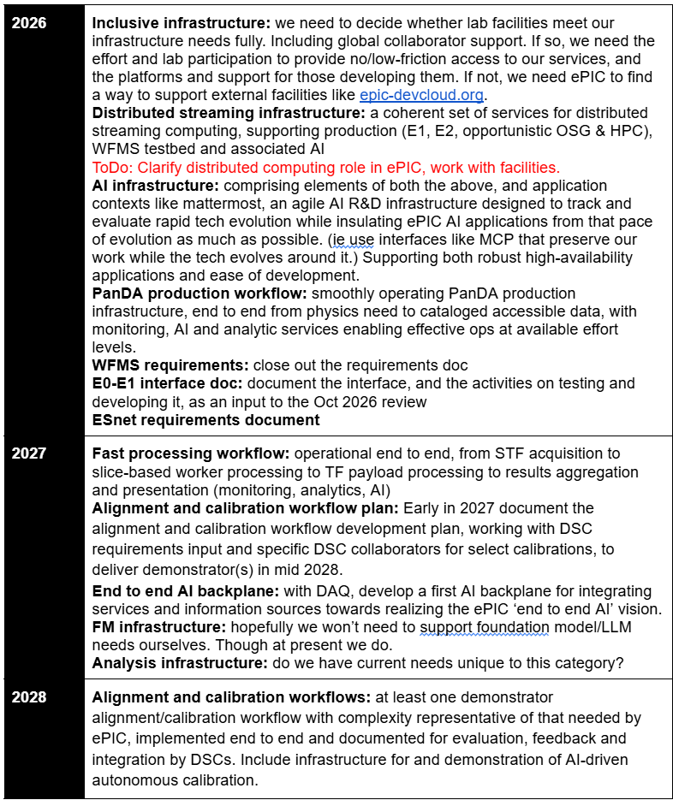
Important but is it SRO WG?
If so what is action item?
Does Current testbed effort satisfy this?
Perhaps change priority to “pursue development of…”
Is this separate point or clarification of Distributed Streaming Infrastructure point
Clarification is perhaps needed. This sounds like completed system to me which is not likely possible. Perhaps a toy model system containing all the components is possible?
We can strengthen this priority: “Determine LLM needs and whether they can be satisfied by lab resource, developed resource, or commercial resources.”

Slide 6
