Slide 1
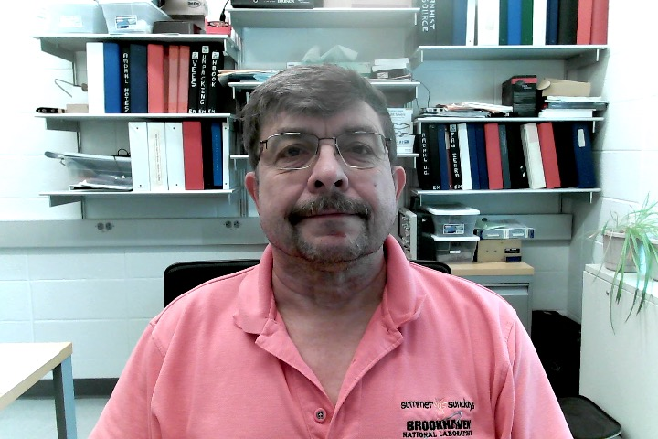
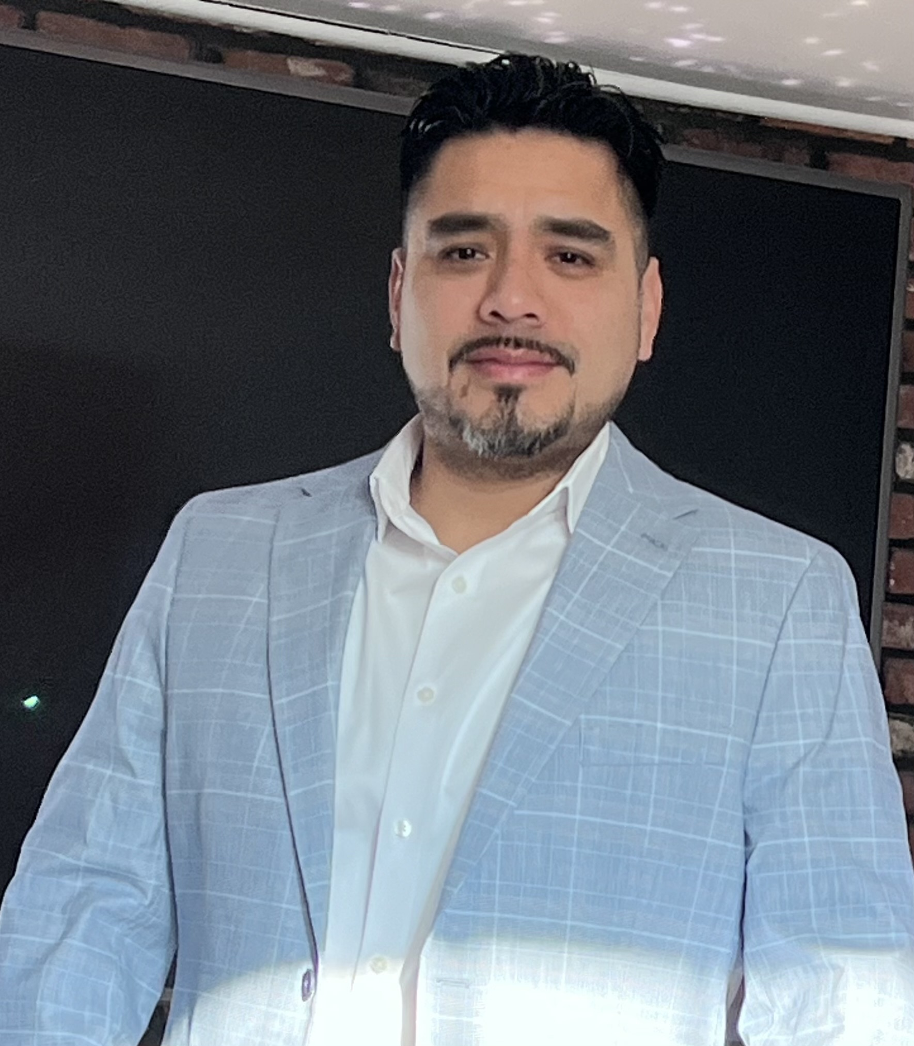
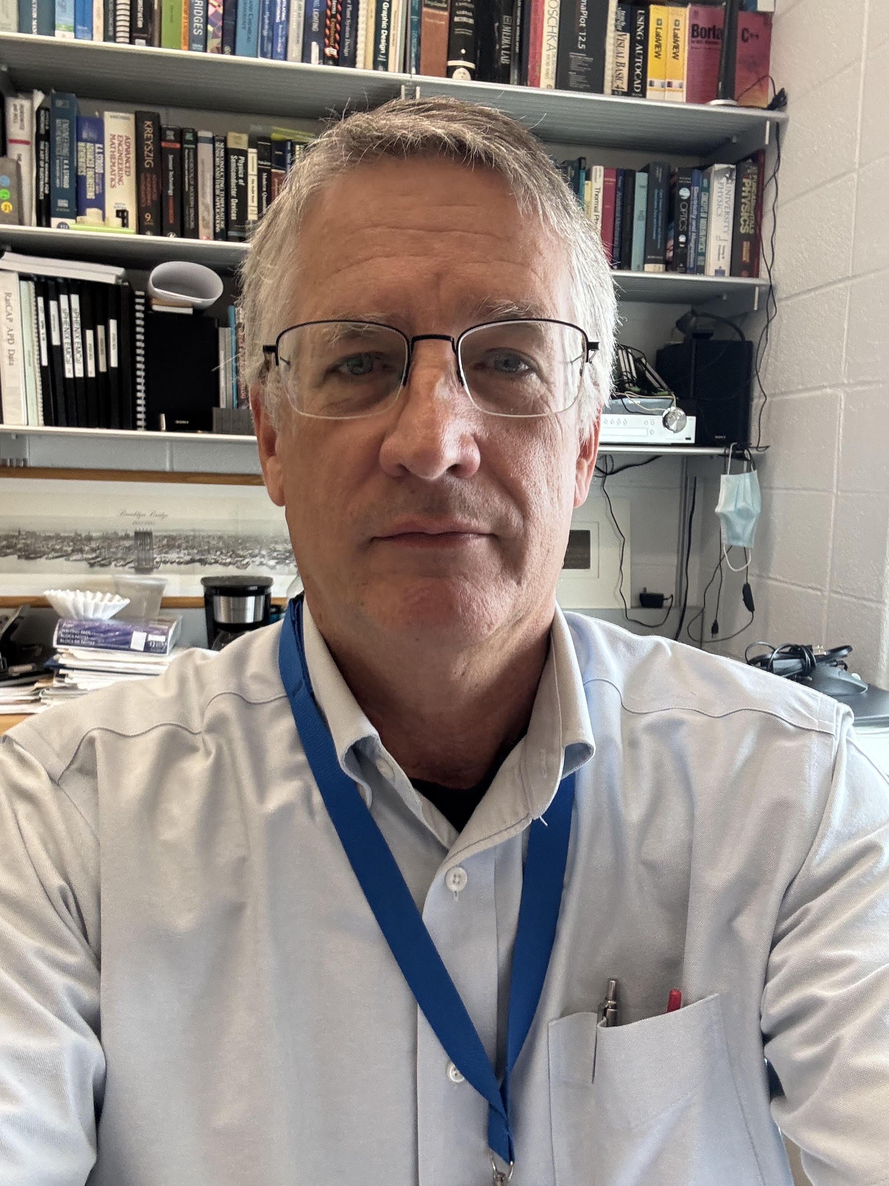
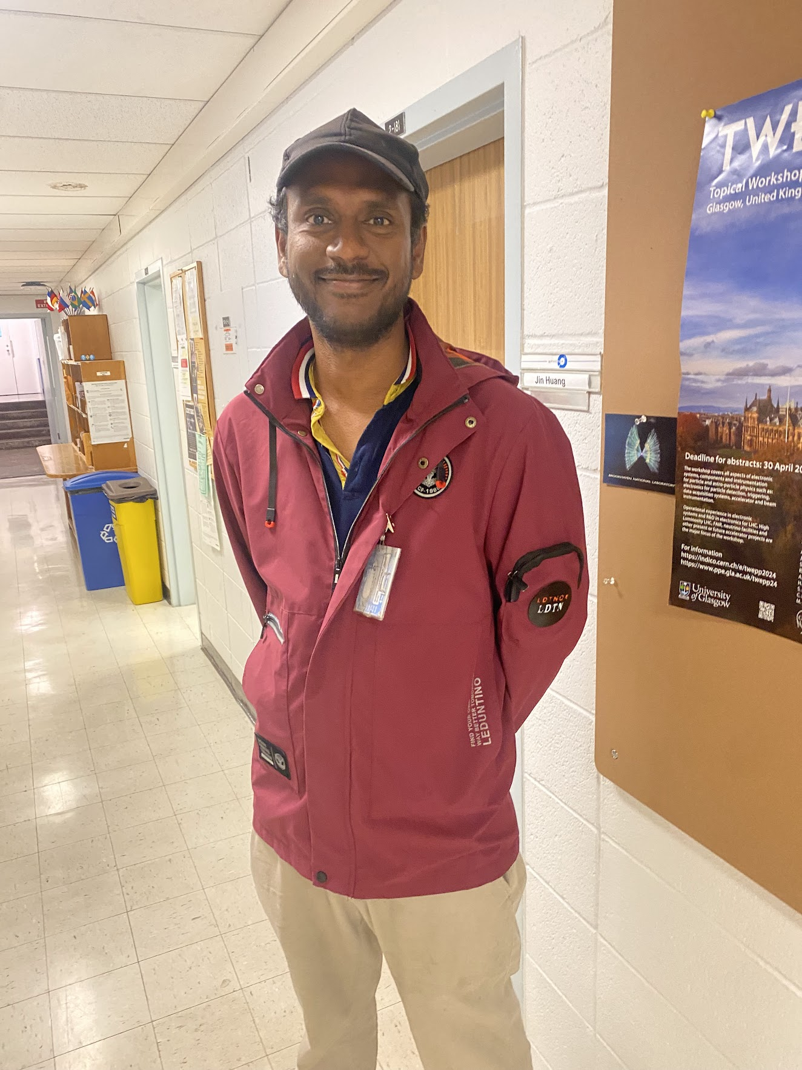
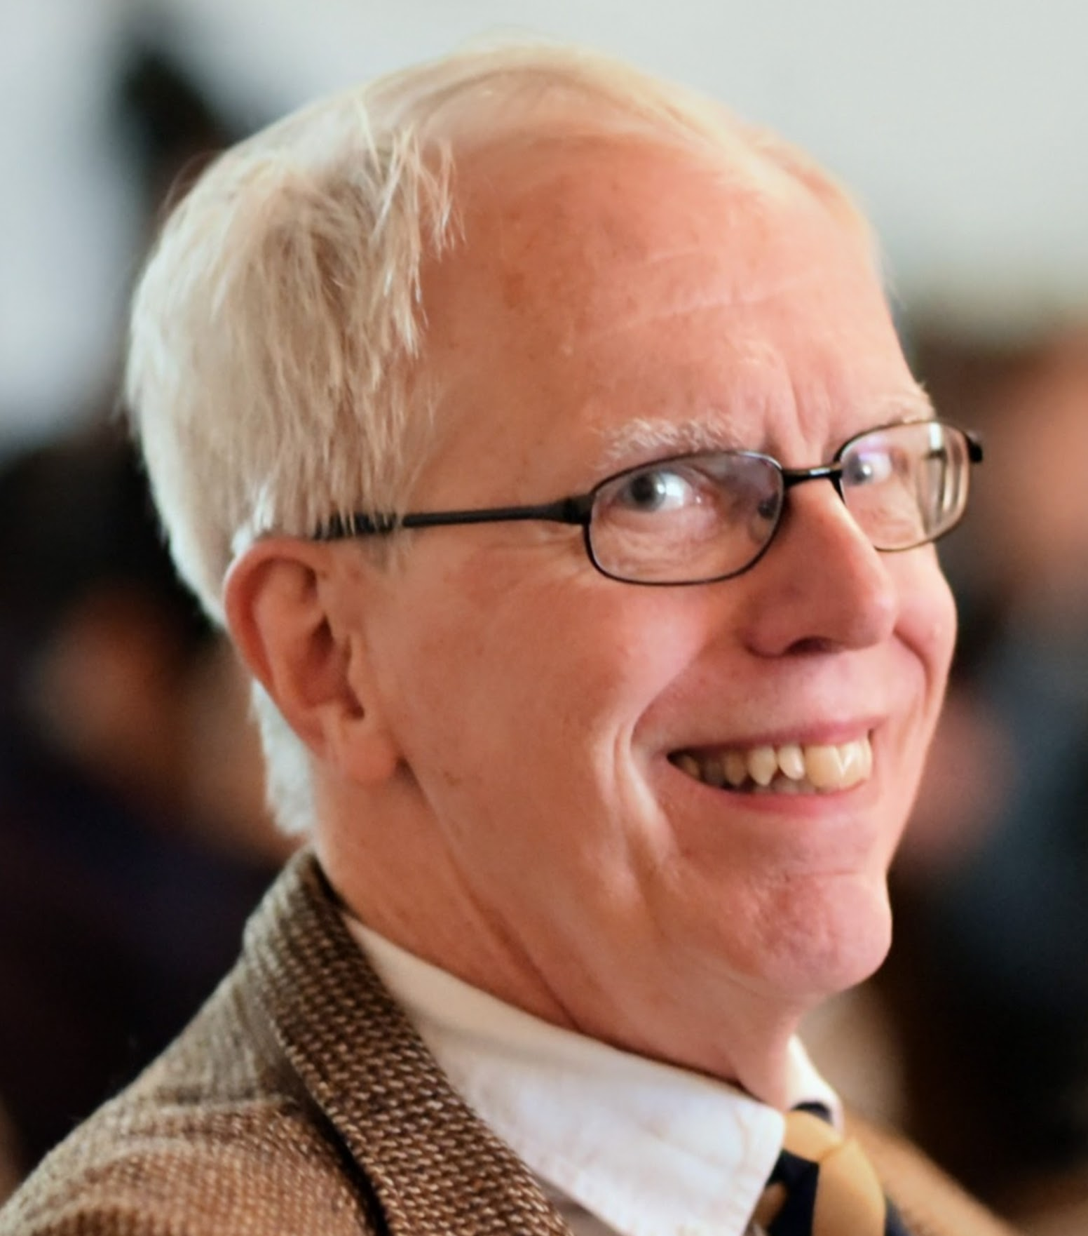
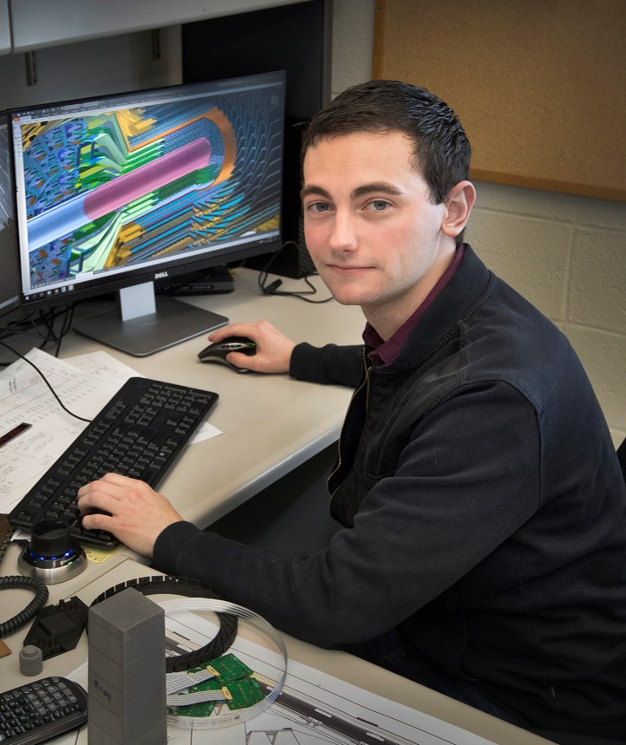
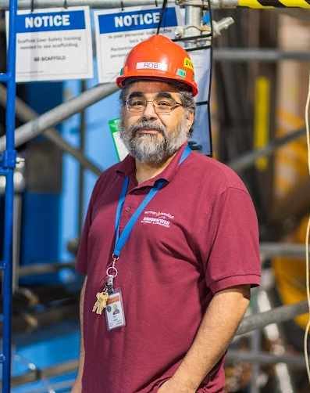
TC@BNL
An ePIC group has been formed in the BNL Physics Department under the leadership of Lijuan Ruan (former STAR group leader and spokesperson)
This group provides a home for Technical Coordination at the host laboratory
  John Haggerty, Deputy TC based at BNL, can call on local expertise in
    Mechanical engineering and design
    Electrical power distribution, grounding, code compliance
    Equipment and component acceptability
    Controls, interlocks, PLC’s
    Gas systems
    Cooling
    Lab space, provisioning, and safety
    1006 and 1008 R&R
Some of the participants in the BNL technical support to TC-Office

