Slide 1
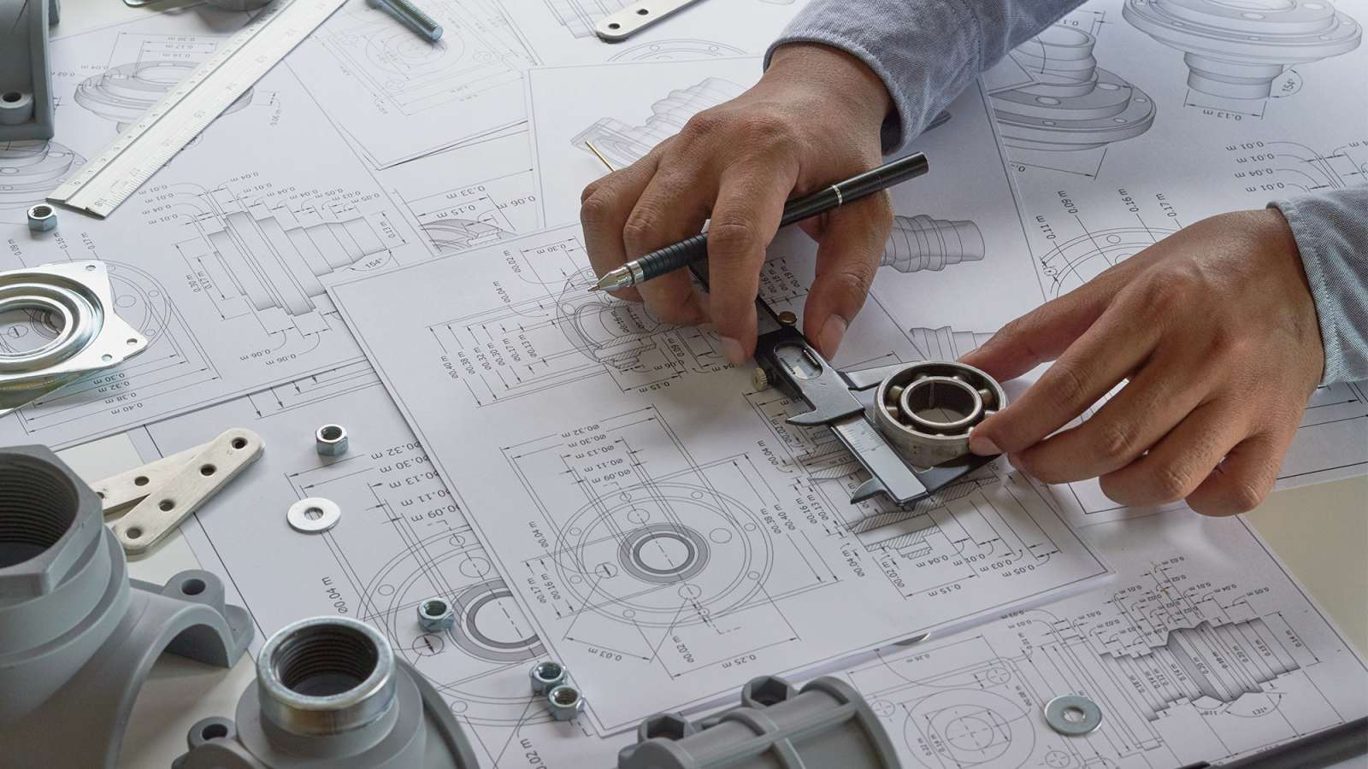
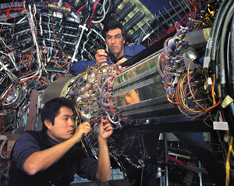
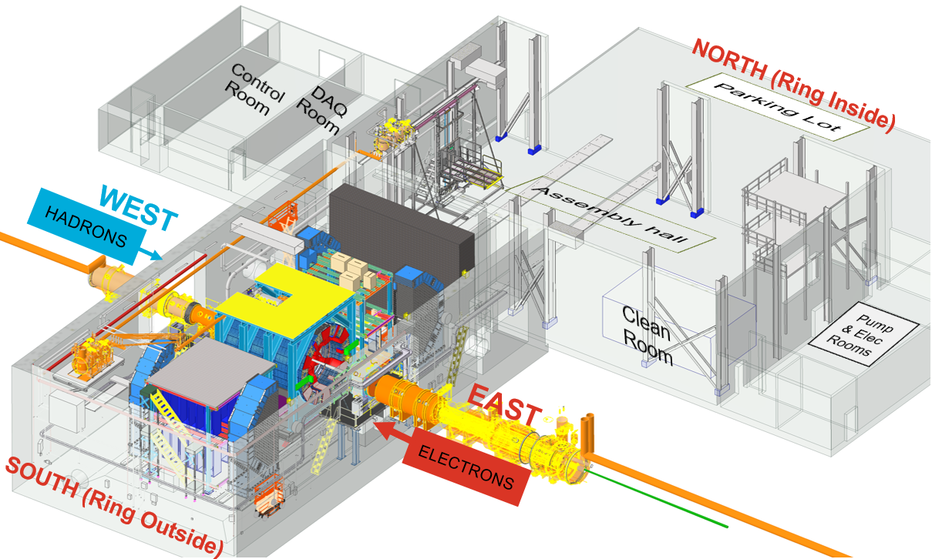
EPIC Triple I Team:
Charge #4
Rahul Sharma (BNL) – Chief Mechanical Engineer – 100%
Walt Akers (JLAB) – Systems Integration
Roland Wimmer (BNL) – Mechanical Engineer – 100%
Dan Cacace (BNL) – Mechanical Engineer – Endcap Structures and Flux Return Steel – 75% to 100%
Alex Eslinger (JLAB) – Mechanical Engineer – pfRICH Design
Alessandro Saputi (INFN/CERN) – dRICH Design and Installation
Ron Lassiter (JLAB) – Forward Detectors – Mechanical Engineer
Johnathan Smith (JLAB) – Mechanical Engineer
Andreas Jung (Purdue University) – Detector Scientist – AC LGAD and GST
Sushrut Karmarkar (Purdue University) – Mechanical Engineer – AC LGAD and GST
Ben Denos (Purdue University) – Mechanical Engineer – SVT and PST
Karim Hamdi (BNL) – Mechanical Designer – 100%
John Tuozzolo (BNL) – Mechanical Designer – 100%
Nathaniel Speece-Moyer (BNL) – Mechanical Engineer-100%
Seung Joon Lee (JLAB) – Detector Scientist
Julien Bettane ( IJC Lab – Orsay) – Mechanical Engineer – EEEMCAL
Joshua Crafts (CUA) – Postdoc – EEEMCAL
Tom O’Connor(ANL) – Barrel EMCAL Design
Kevin Bailey (ANL) – Barrel EMCAL Design
Girish Gowda (BNL) – CFD and Thermal Analysis Engineer – 100%

