Slide 1
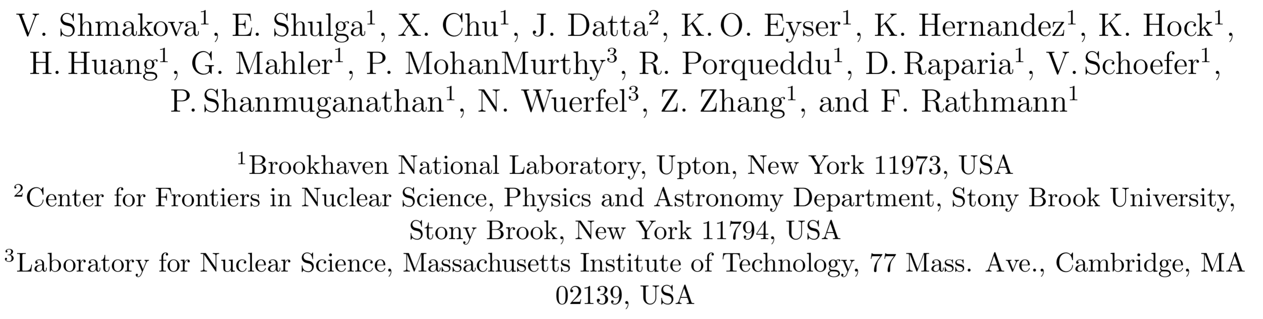

Connecting the Dots: Polarimetry from the BNL Booster to the EIC
July 2026 ePIC and EICUG meeting
E Shulga for the Booster polarimetry effort

Slide 2
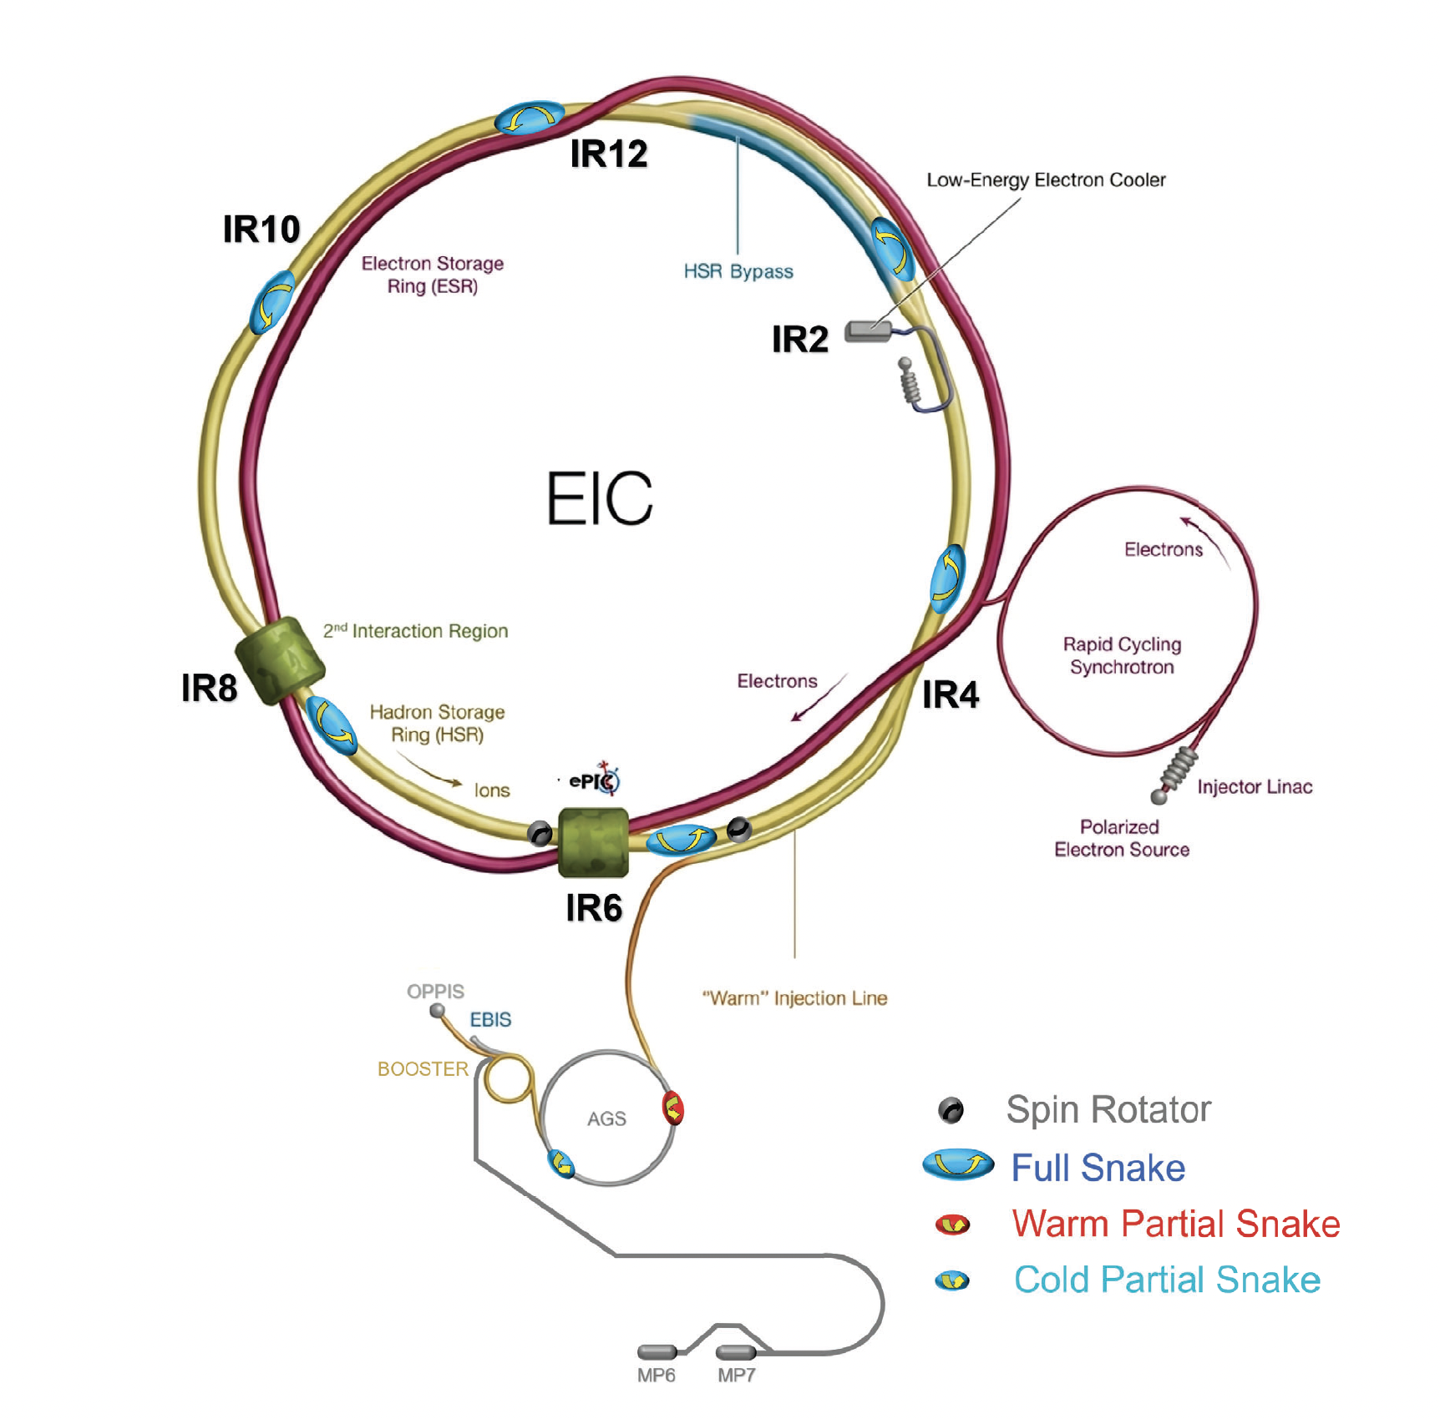
Motivation: A gap in the polarization diagnostics chain
The EIC physics program demands high, well-measured polarization at every stage of the injector chain.
RHIC completed its final run
  The complex now transitions to EIC construction see talk from Prashanth (link).
AGS enters multi-year refurbishment
  Extensive recabling and hardware upgrades; the AGS pC polarimeter is unavailable, Booster will operate.
No independent measurement in between
  Nothing bridges the 200 MeV Linac / EBIS sources and the AGS - the full Booster range is blind to depolarization effects.
Absolute Polarimeter (H jet)
pC Polarimeters
200 MeV Polarimeter
? ? ?
Linac
AGS Internal Polarimeter
AGS
Notes:
Booster will be running
Need EIC picture not RHIC

Slide 3
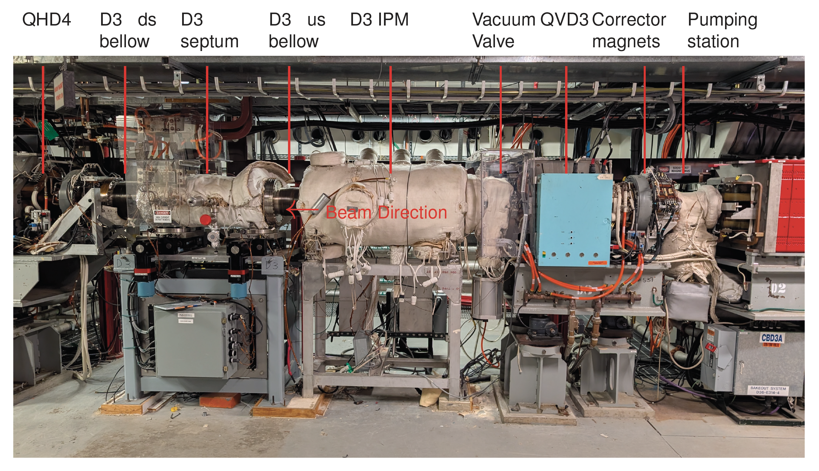
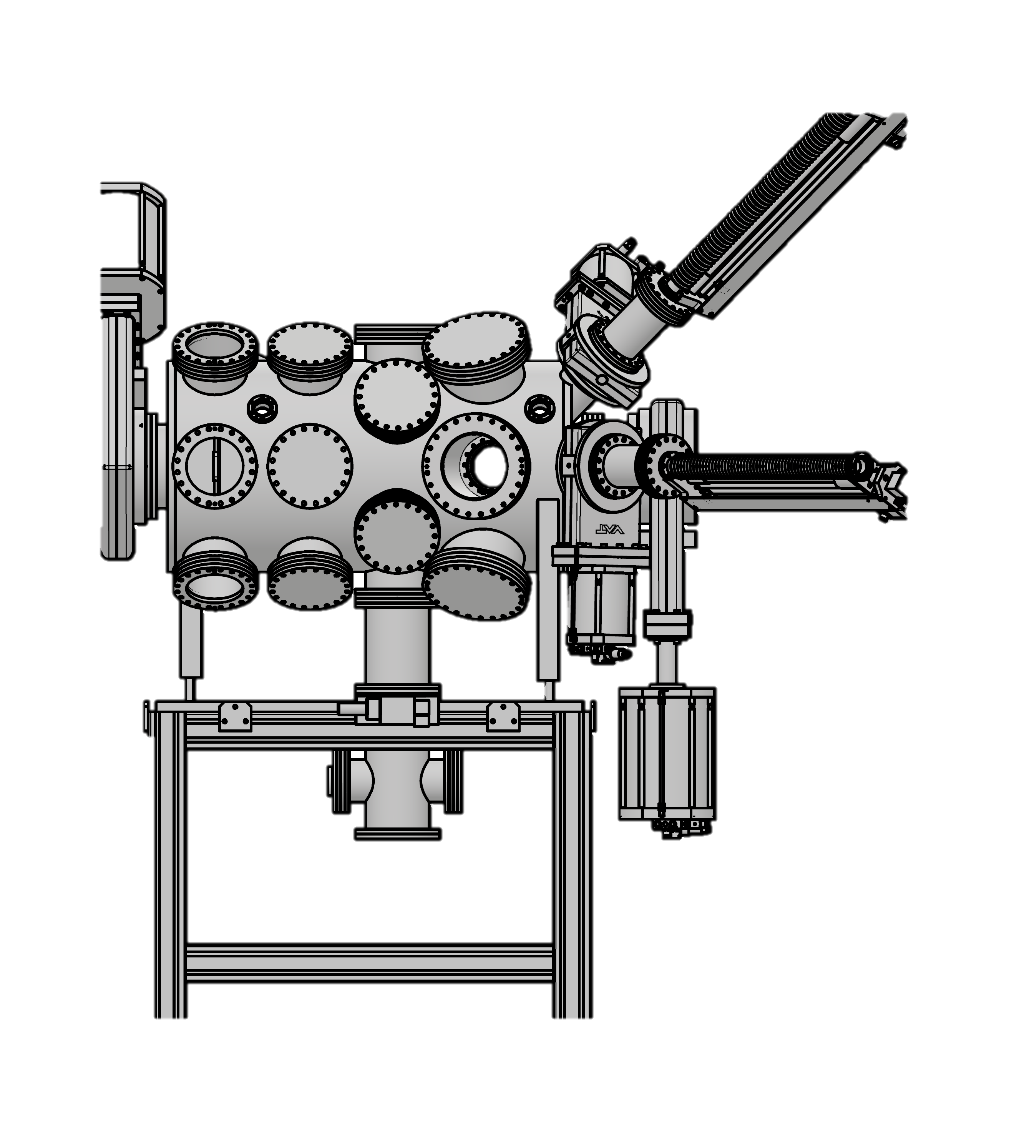
A recoil-carbon polarimeter at the Booster
Continuous, absolute polarization for both the polarized proton and polarized ³He beams - across the full acceleration cycle.
Elastic scattering
  pC and ³HeC from a thin internal carbon target; recoil ¹²C detected near θ_{C} ≈ 90°.
Fixed six-station ring
  Recoil kinematics scale smoothly with momentum - one geometry covers injection to extraction.
Absolute scale
  Well-established pC analyzing power; ³He scale anchored to a few percent via ramp-and-return.
Future-ready
  Same technique extends to d, ⁶Li, ⁷Li with detector upgrades - no geometry change.
Illustration from K. Hock
Notes:
No detectors to be shown
Back Up: target orientation

Slide 4
Beam parameters
Two species, one common working point → polarimeter suitable for p & ³He
200 MeV
2 MeV/u
≈ 7.5 T·m
≈ 75 ms
→ 1.5 GeV
→ 2.5 GeV/u
reference Bρ
ramp time
PROTON RANGE
³He RANGE
COMMON RIGIDITY
BOTH SPECIES
Quantity | Symbol | Proton beam | ³He⁺⁺ beam
Rest mass (MeV/c²) | m | 938.272 | 2808.391
Charge state | q | +1 | +2
Anom. mag. moment | G | +1.7928 | −4.1914
Injection energy | T_{inj} | 200 MeV | 2 MeV/u
Extraction energy | T_{extr} | 1500 MeV | 832 MeV/u
Extraction spin tune | Gγ | +4.659 | −7.917
Intensity / cycle | N_{cyc} | 3.4 × 10¹¹ | 1.0 × 10¹¹
Both beams evaluated at a common Bρ ≈ 7.5 T·m, which is approximation.
Notes:
Add comment: the values are approx.

Slide 5


Physics regime
Nuclear elastic scattering - not CNI, thus the analyzing power is higher → better measurement
Booster: recoil-carbon
AGS / RHIC: CNI
p ~ 0.6 – 2.3 GeV/c
Below the Regge/Pomeron regime → cross section varies rapidly, dominated by baryon & meson resonances
Elastic scattering with a measured analyzing power is the correct approach
Recoil ¹²C emerges near 90° with energy fixed by two-body kinematics → clean elastic tag
Valid only in the Regge regime, forward amplitude dominated by Pomeron exchange
Sets in above p ~ 1–2 GeV/c, where σ_{tot} and ρ vary smoothly
Not applicable at Booster energies
The Booster and AGS pC polarimeters are complementary by necessity → different reaction mechanisms

Slide 6
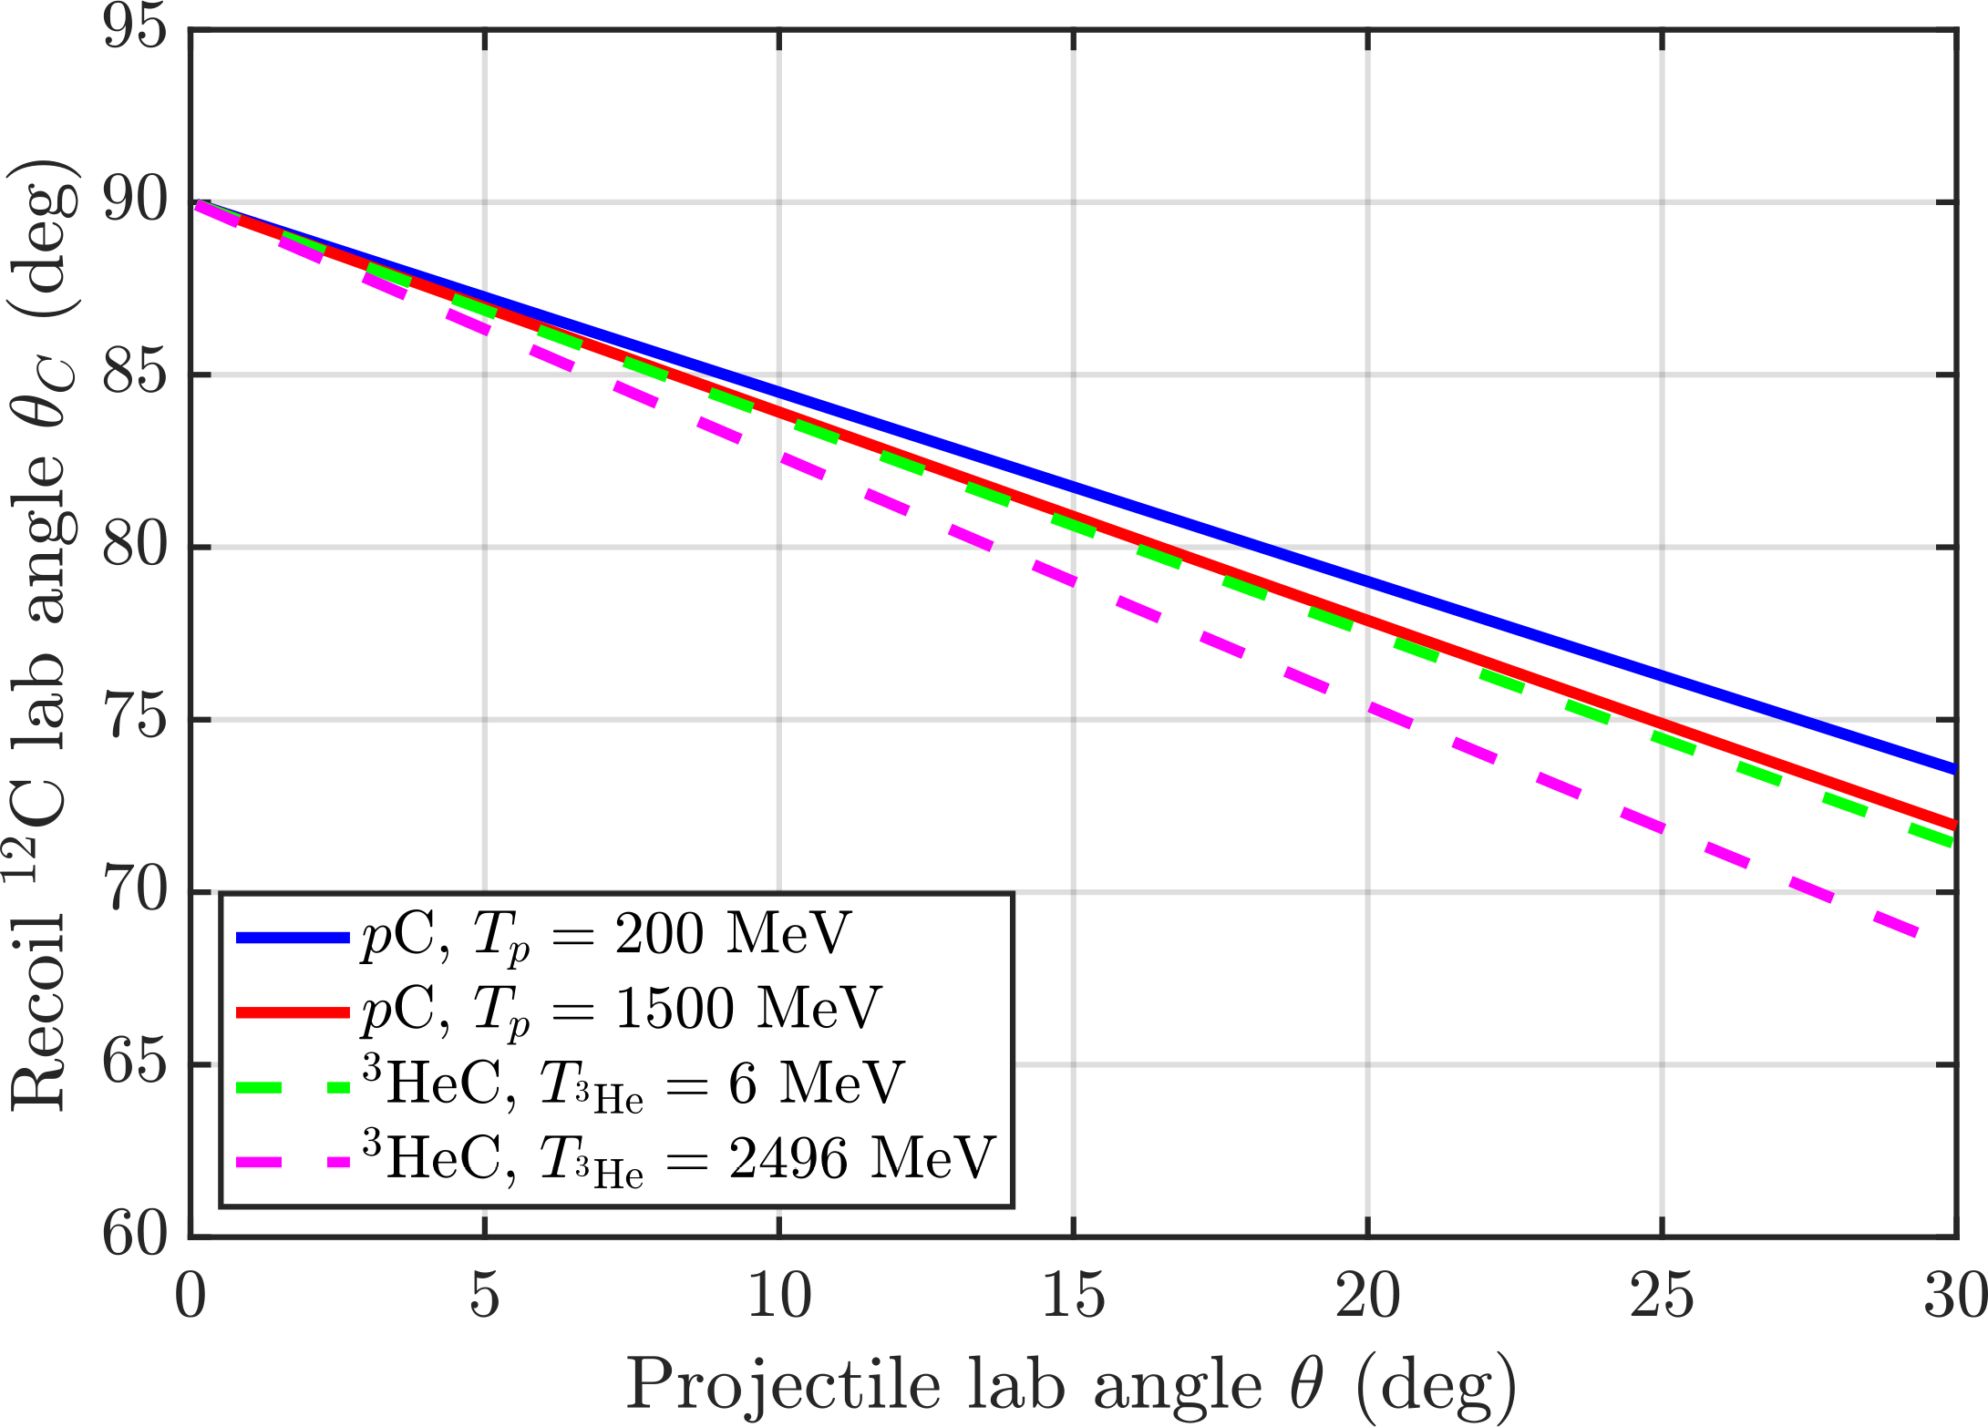
Kinematics
One fixed geometry covers the whole ramp:
Why it works
For all five light-ion species, recoil ¹²C emerges near 70°-90° for forward angles up to ~30°.
The dependence on beam energy across the ramp is weak.
A single recoil ring centred near 90° accepts every species, injection to extraction.
No mechanical adjustment during acceleration.
Billiard limit θ_{C} = 90° - θ/2 is recovered for a light projectile on heavy carbon.
Recoil ring acceptance (~70°–90° )

Slide 7
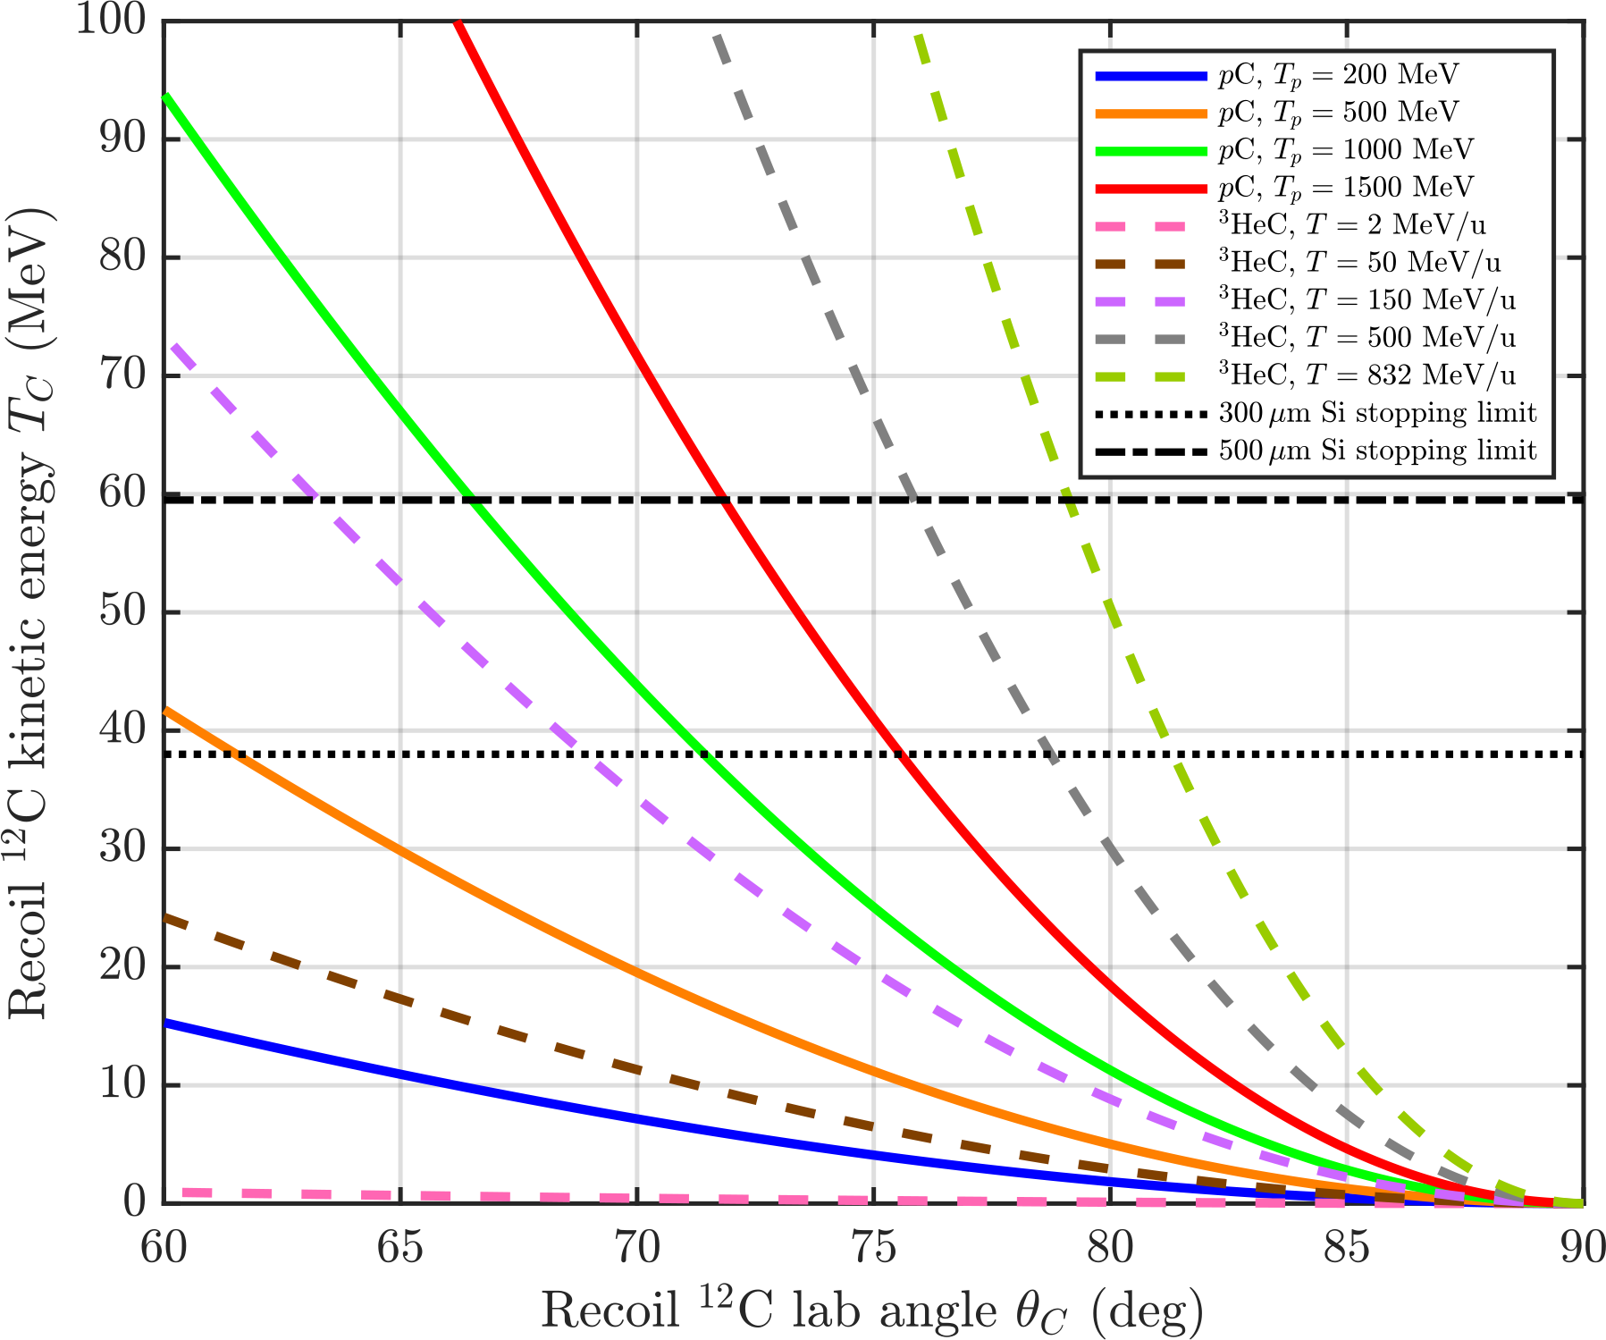
Detector requirements
Recoil energy sets the operating mode
pC - full stopping:
  500 µm Si fully stops recoil ¹²C over ~95% of the acceptance. Measured (T_{C}, θ_{C}) tags elastic events → recoil ring alone is sufficient
³HeC - ΔE mode:
  At extraction, recoils exceed the 59 MeV stopping limit. Detector runs as a ΔE element; forward coincidence restores selectivity
500 μm Si stop 59 MeV
300 μm Si stop 38 MeV
Notes:
Give more info about plot in words

Slide 8
Event Selection
Clean elastic tagging for each beam
pC — recoil ring alone
³HeC — forward coincidence
Two-body kinematics fully constrain the event through θ_{C} alone.
The pair (θ_{C}, T_{C}) on the elastic locus identifies elastic events.
Bonin/McNaughton parametrizations are inclusive — no elastic/inelastic separation needed.
Forward detector is an optional cross-check, not required.
³He binds by only 7.72 MeV — breakup is open at all Booster energies.
Breakup recoils mimic elastic (θ_{C}, T_{C}) — recoil signal alone is insufficient.
Coincident forward ³He enforces the two-body (θ, θ_{C}) locus.
ΔE in the forward pad separates intact ³He⁺⁺ (~10 MeV) from breakup p (~0.5 MeV).
Simulations/predictions for the ions are under development
Notes:
Simulations/predictions for the ions are under development

Slide 9
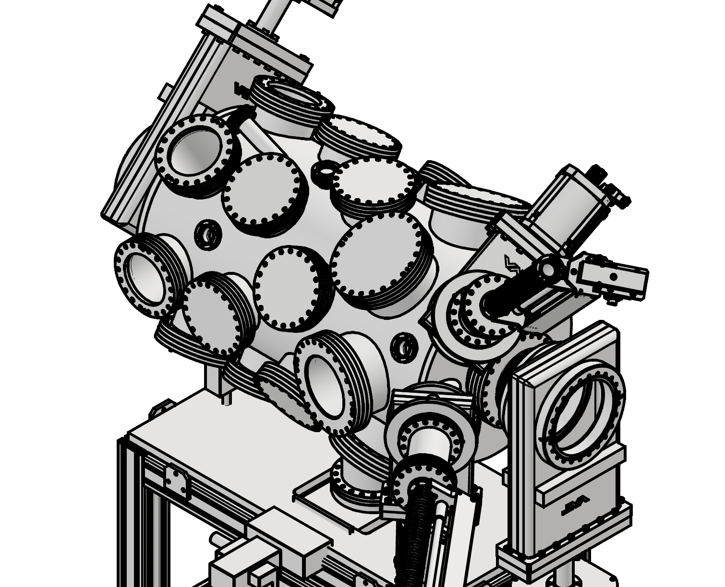
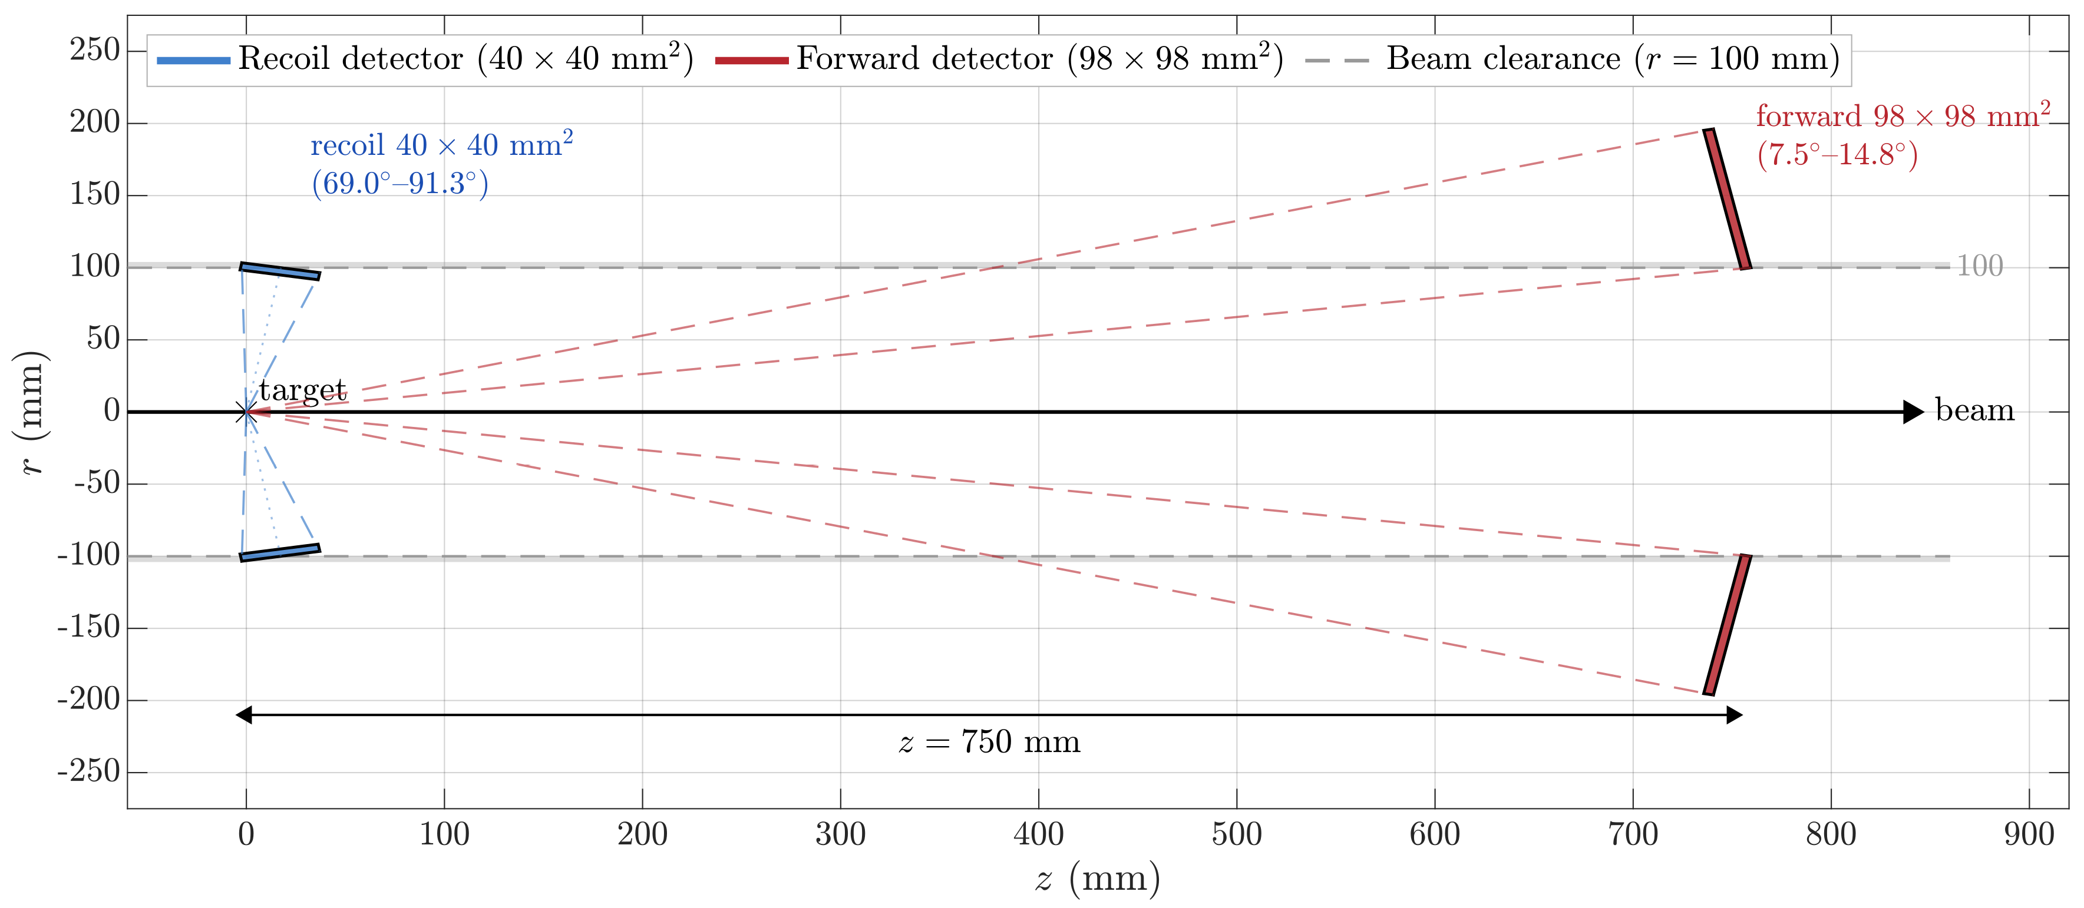
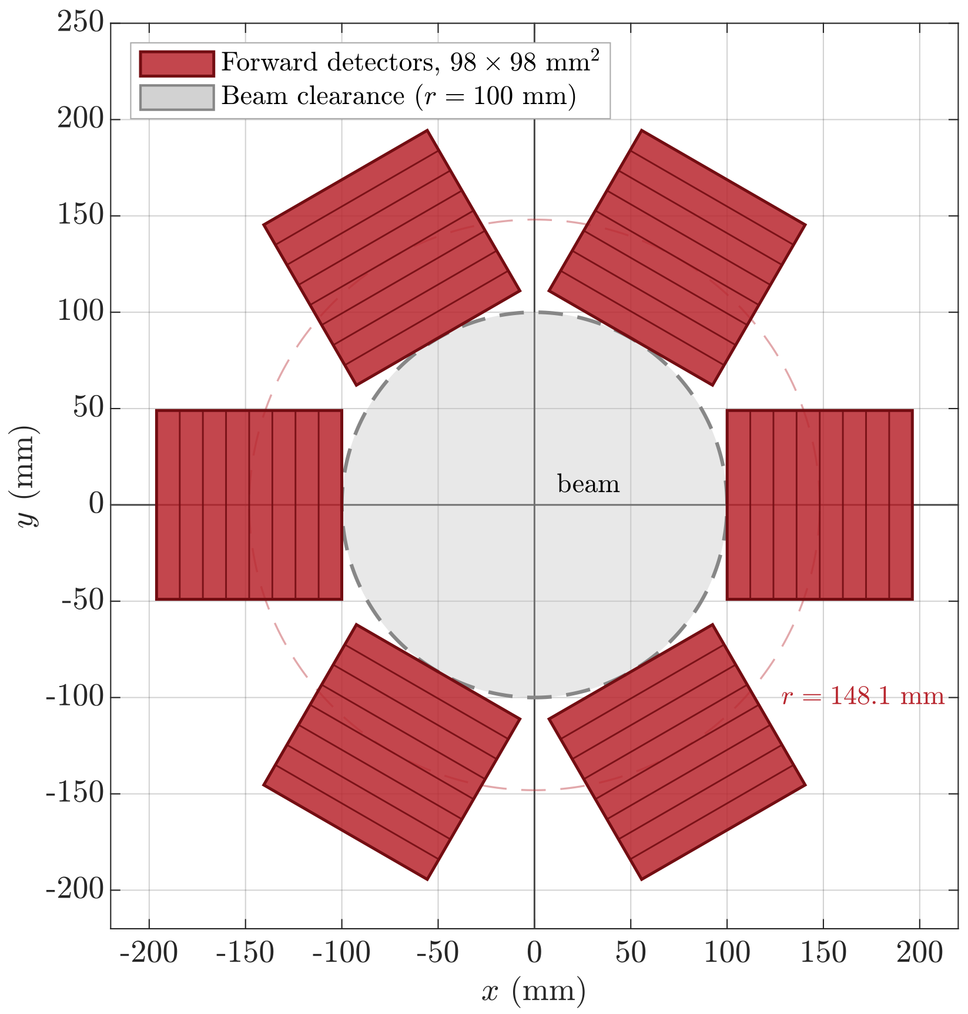
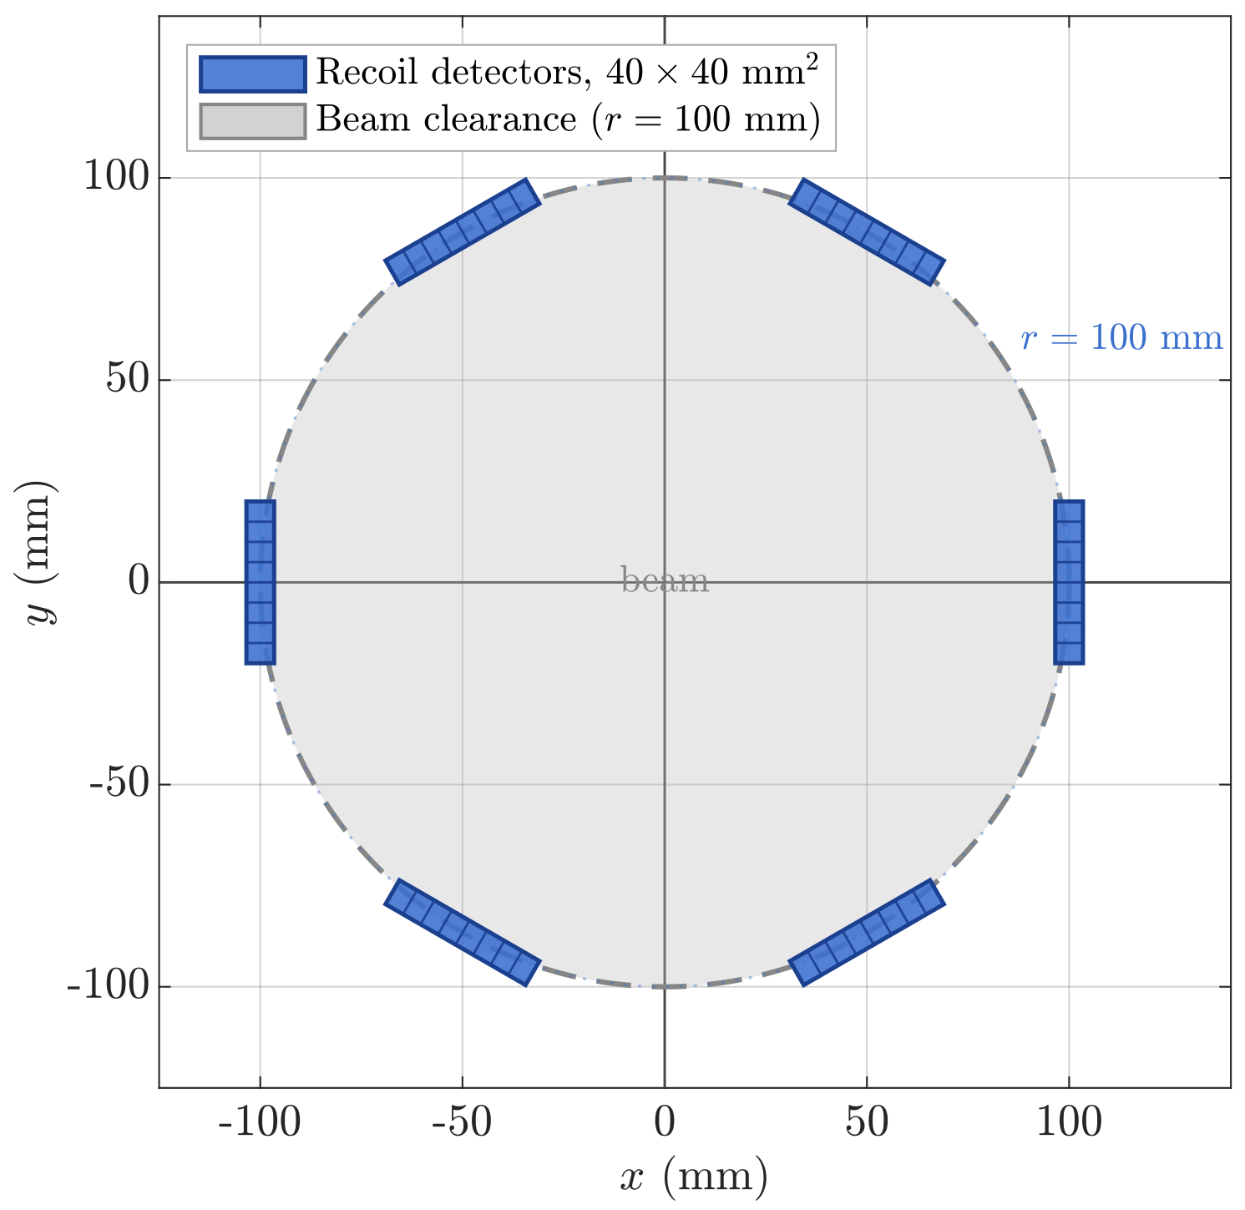
Detector setup
Two coaxial silicon rings, six shared stations
Forward detectors
Recoil ring
6 × silicon planes, ~40 × 40 mm², 500 µm thick
r = 100 mm, z = 17.4 mm → θ_{C} ≈ 80°
Coverage θ_{C} = 69.0°-91.3°; faces tilted to normal incidence
Radial strips resolve φ; θ_{C} ~ T_{C} - no polar segmentation needed
Recoil detectors
Forward ring
6 × Hamamatsu planes, 97 × 97 mm², 320 µm thick
z = 750 mm; θ = 7.5°–14.8°; inner edge r = 100 mm clearance
Same azimuth as recoil ring → direct coincidences
Essential for ³HeC; optional cross-check for pC

Slide 10
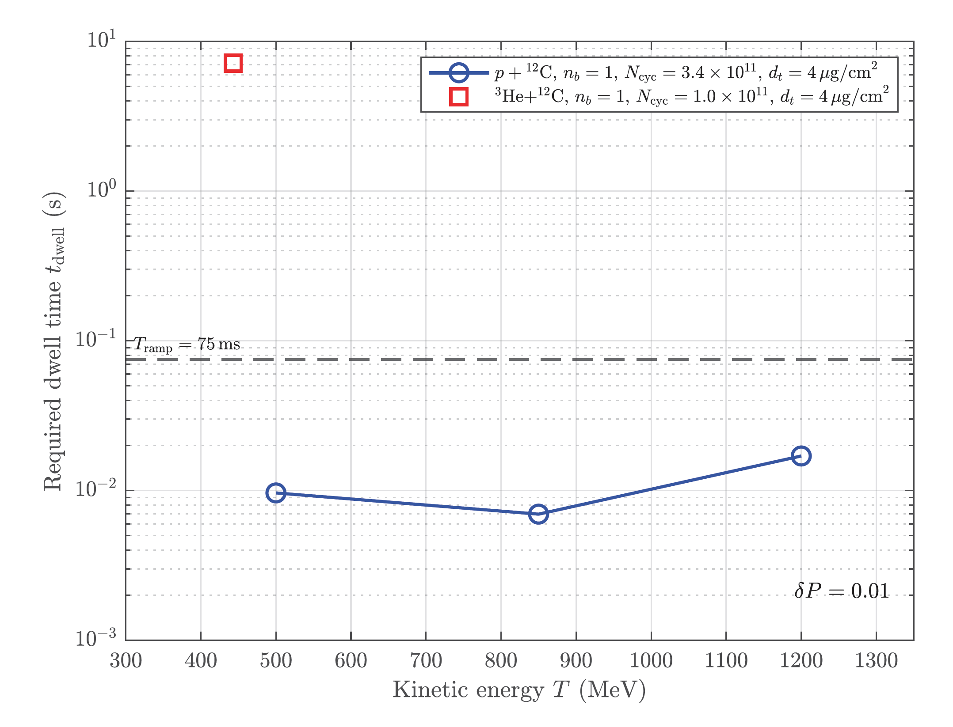
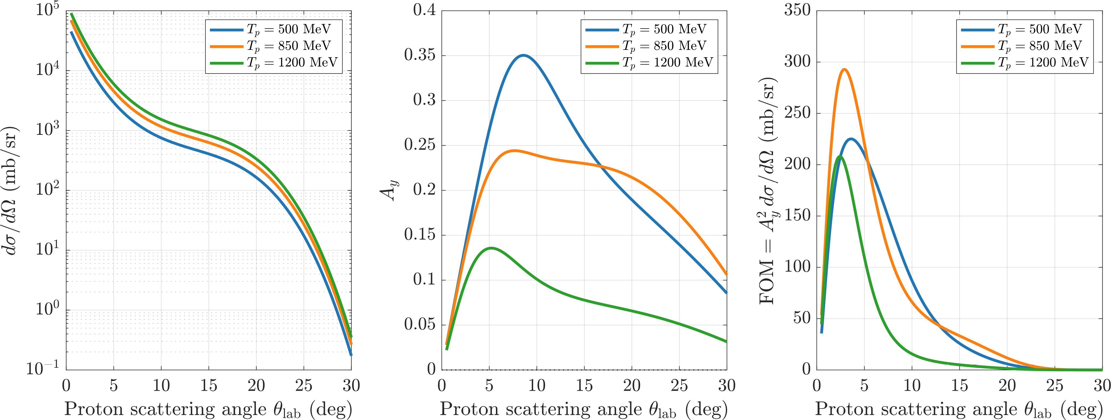
Performance
Statistically feasible within one ramp cycle
Figure of merit - Bonin parametrization
Required dwell time for δP = 0.01

Slide 11

Performance
The proton case is essentially solved
7–17 ms
3–10 MHz
w = 10 µm
4 µg/cm²
dwell time for δP = 0.01
well under the 75 ms ramp
per-station recoil rate
occupancy < 10⁻⁴
carbon strip width
matches RHIC CNI ribbons
target areal density
negligible beam-loss impact
Proton polarimetry is reached within a single ramp cycle over essentially the full energy range. The total uncertainty budget is therefore expected to be systematics-dominated from the outset.
Recoil ring runs in data-driven singles mode — pile-up is not a concern at beam center.

Slide 12
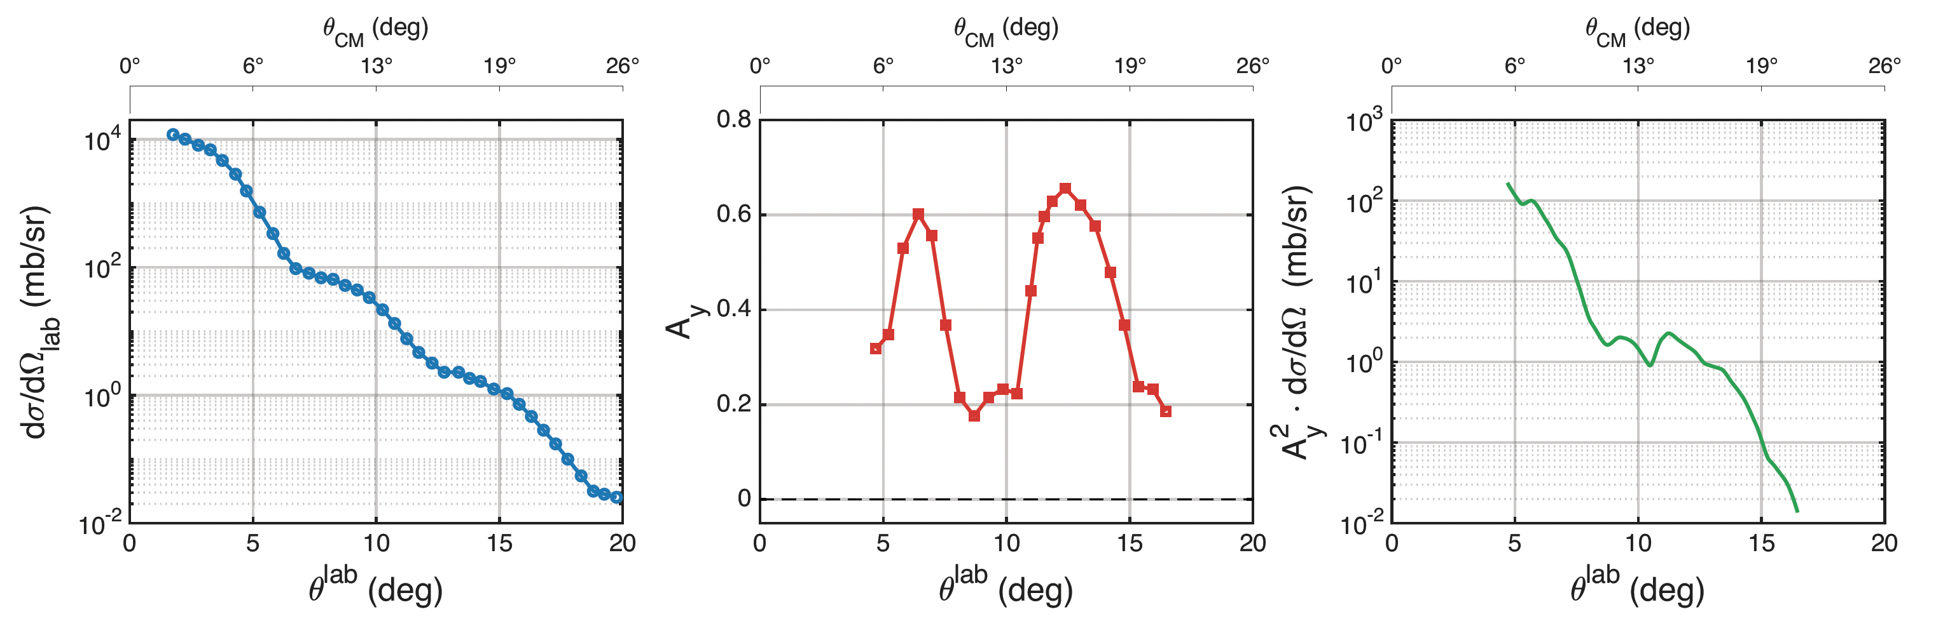
For Ions: Uncharted territory above 450 MeV
The sole experimental anchor is Kamiya et al. at 443 MeV - A_{y} reaches 0.63 near 6°-7°. Above 450 MeV, no ³He+C analyzing-power data exist anywhere.
No data, no model
Global ³He optical potentials (Trost, Pang) are calibrated only below ~220-250 MeV and cannot be extrapolated into the Booster range.
Longer dwell times
Coincidence-mode rates, smaller overlap, lower intensity & revolution frequency → dwell times ~3 orders above pC - many ramp cycles needed.
Peak migrates forward
The A_{y} maximum shifts from 6°–7° at 443 MeV toward 3°–4° at extraction - motivating an additional future far-forward ring.

Slide 13
Staged commissioning, versatile future
There are stages in the implementation of the setup
Staged commissioning
Same geometry, more species
Kinematics depend only on projectile-to-carbon mass ratio and rigidity.
Recoil ring only
1
Sufficient for pC polarimetry — event ID from recoil kinematics alone.
d
A_{y} & A_{yy} already measured; no depolarizing resonances crossed. Blank flanges provisioned at z = 400 mm.
Add forward ring
⁶Li
G ≈ deuteron value → favorable spin dynamics; data only to 150 MeV so far.
2
Enables ³HeC via forward coincidence + ΔE breakup rejection.
⁷Li
G ≈ proton value → proton-like resonance density; only unpolarized cross sections exist.
The two stages are mechanically independent - proton running proceeds while the forward ring is prepared.

Slide 14
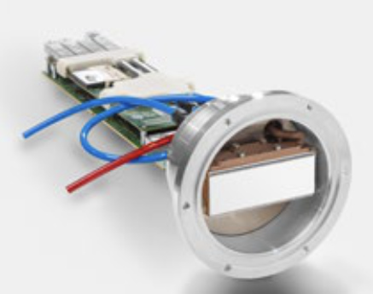
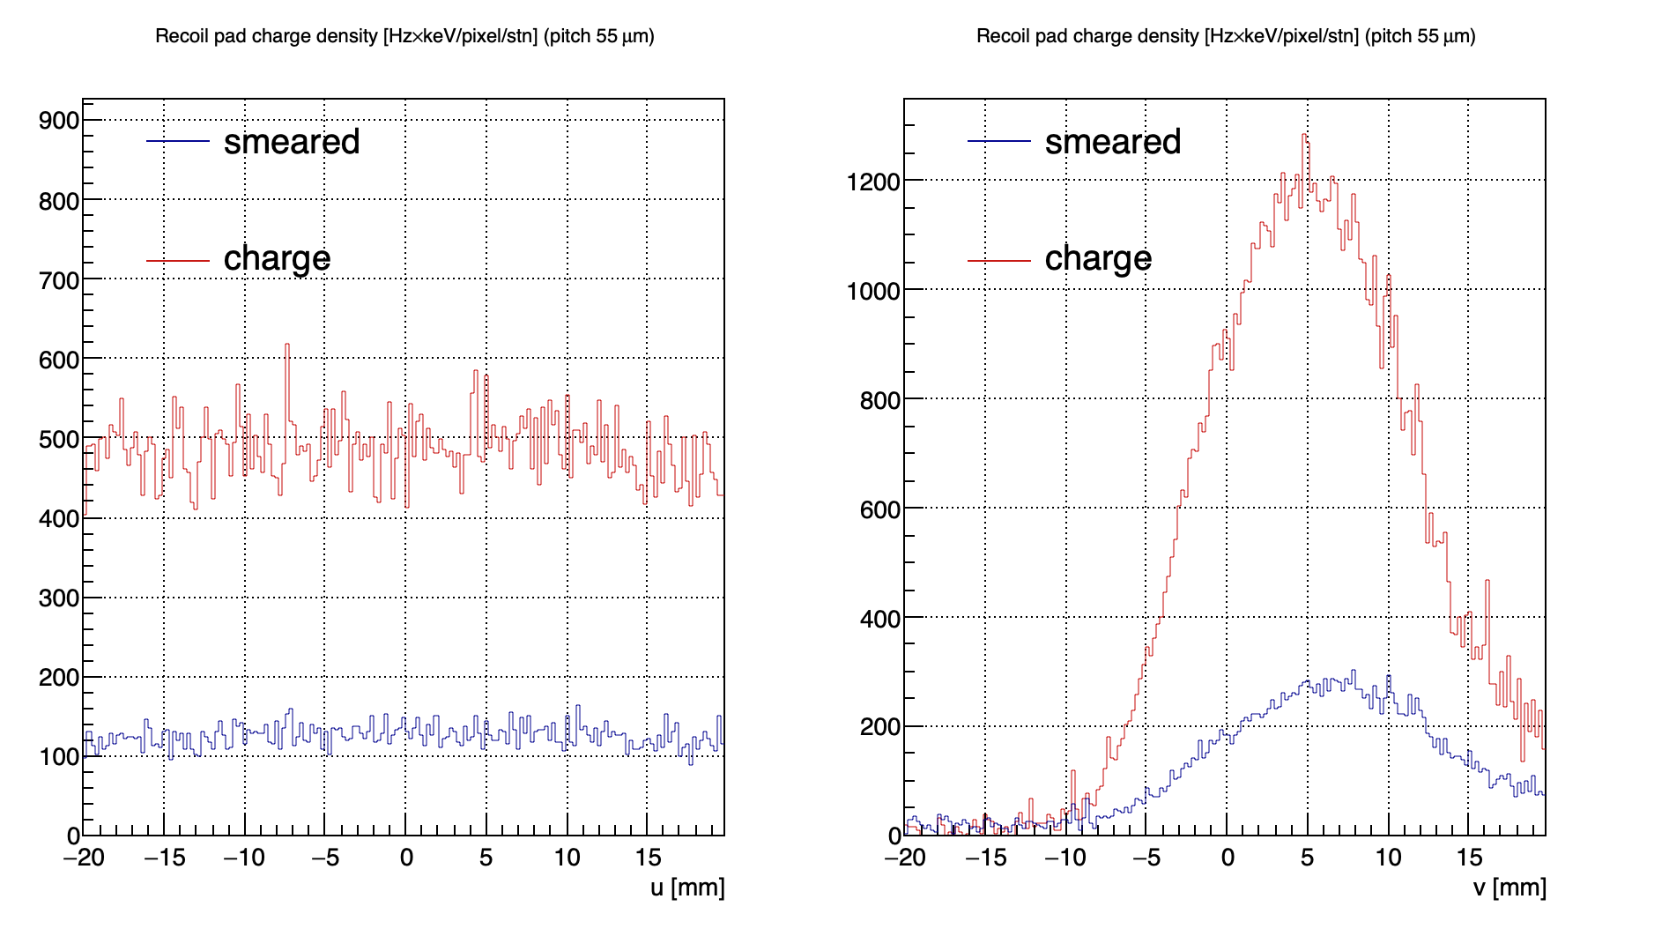
C-Recoil detector candidate
Installation of new vacuum chamber and first 2 C-recoil detectors is planned for the Summer of 2027
Main requirements:
Ultra High Vacuum <10⁻⁹ mbar
~ 4 cm by 4 cm
Provide precise ϕ and dE/dx measurement
~1 MHz top pixel rate
Should be ready by summer: 2 detectors, cooling, DAQ
Best candidate TimePix3 or 4 detectors variation, currently
working on procurement
Arb. unit
Arb. unit
pixels
recoil C

Slide 15
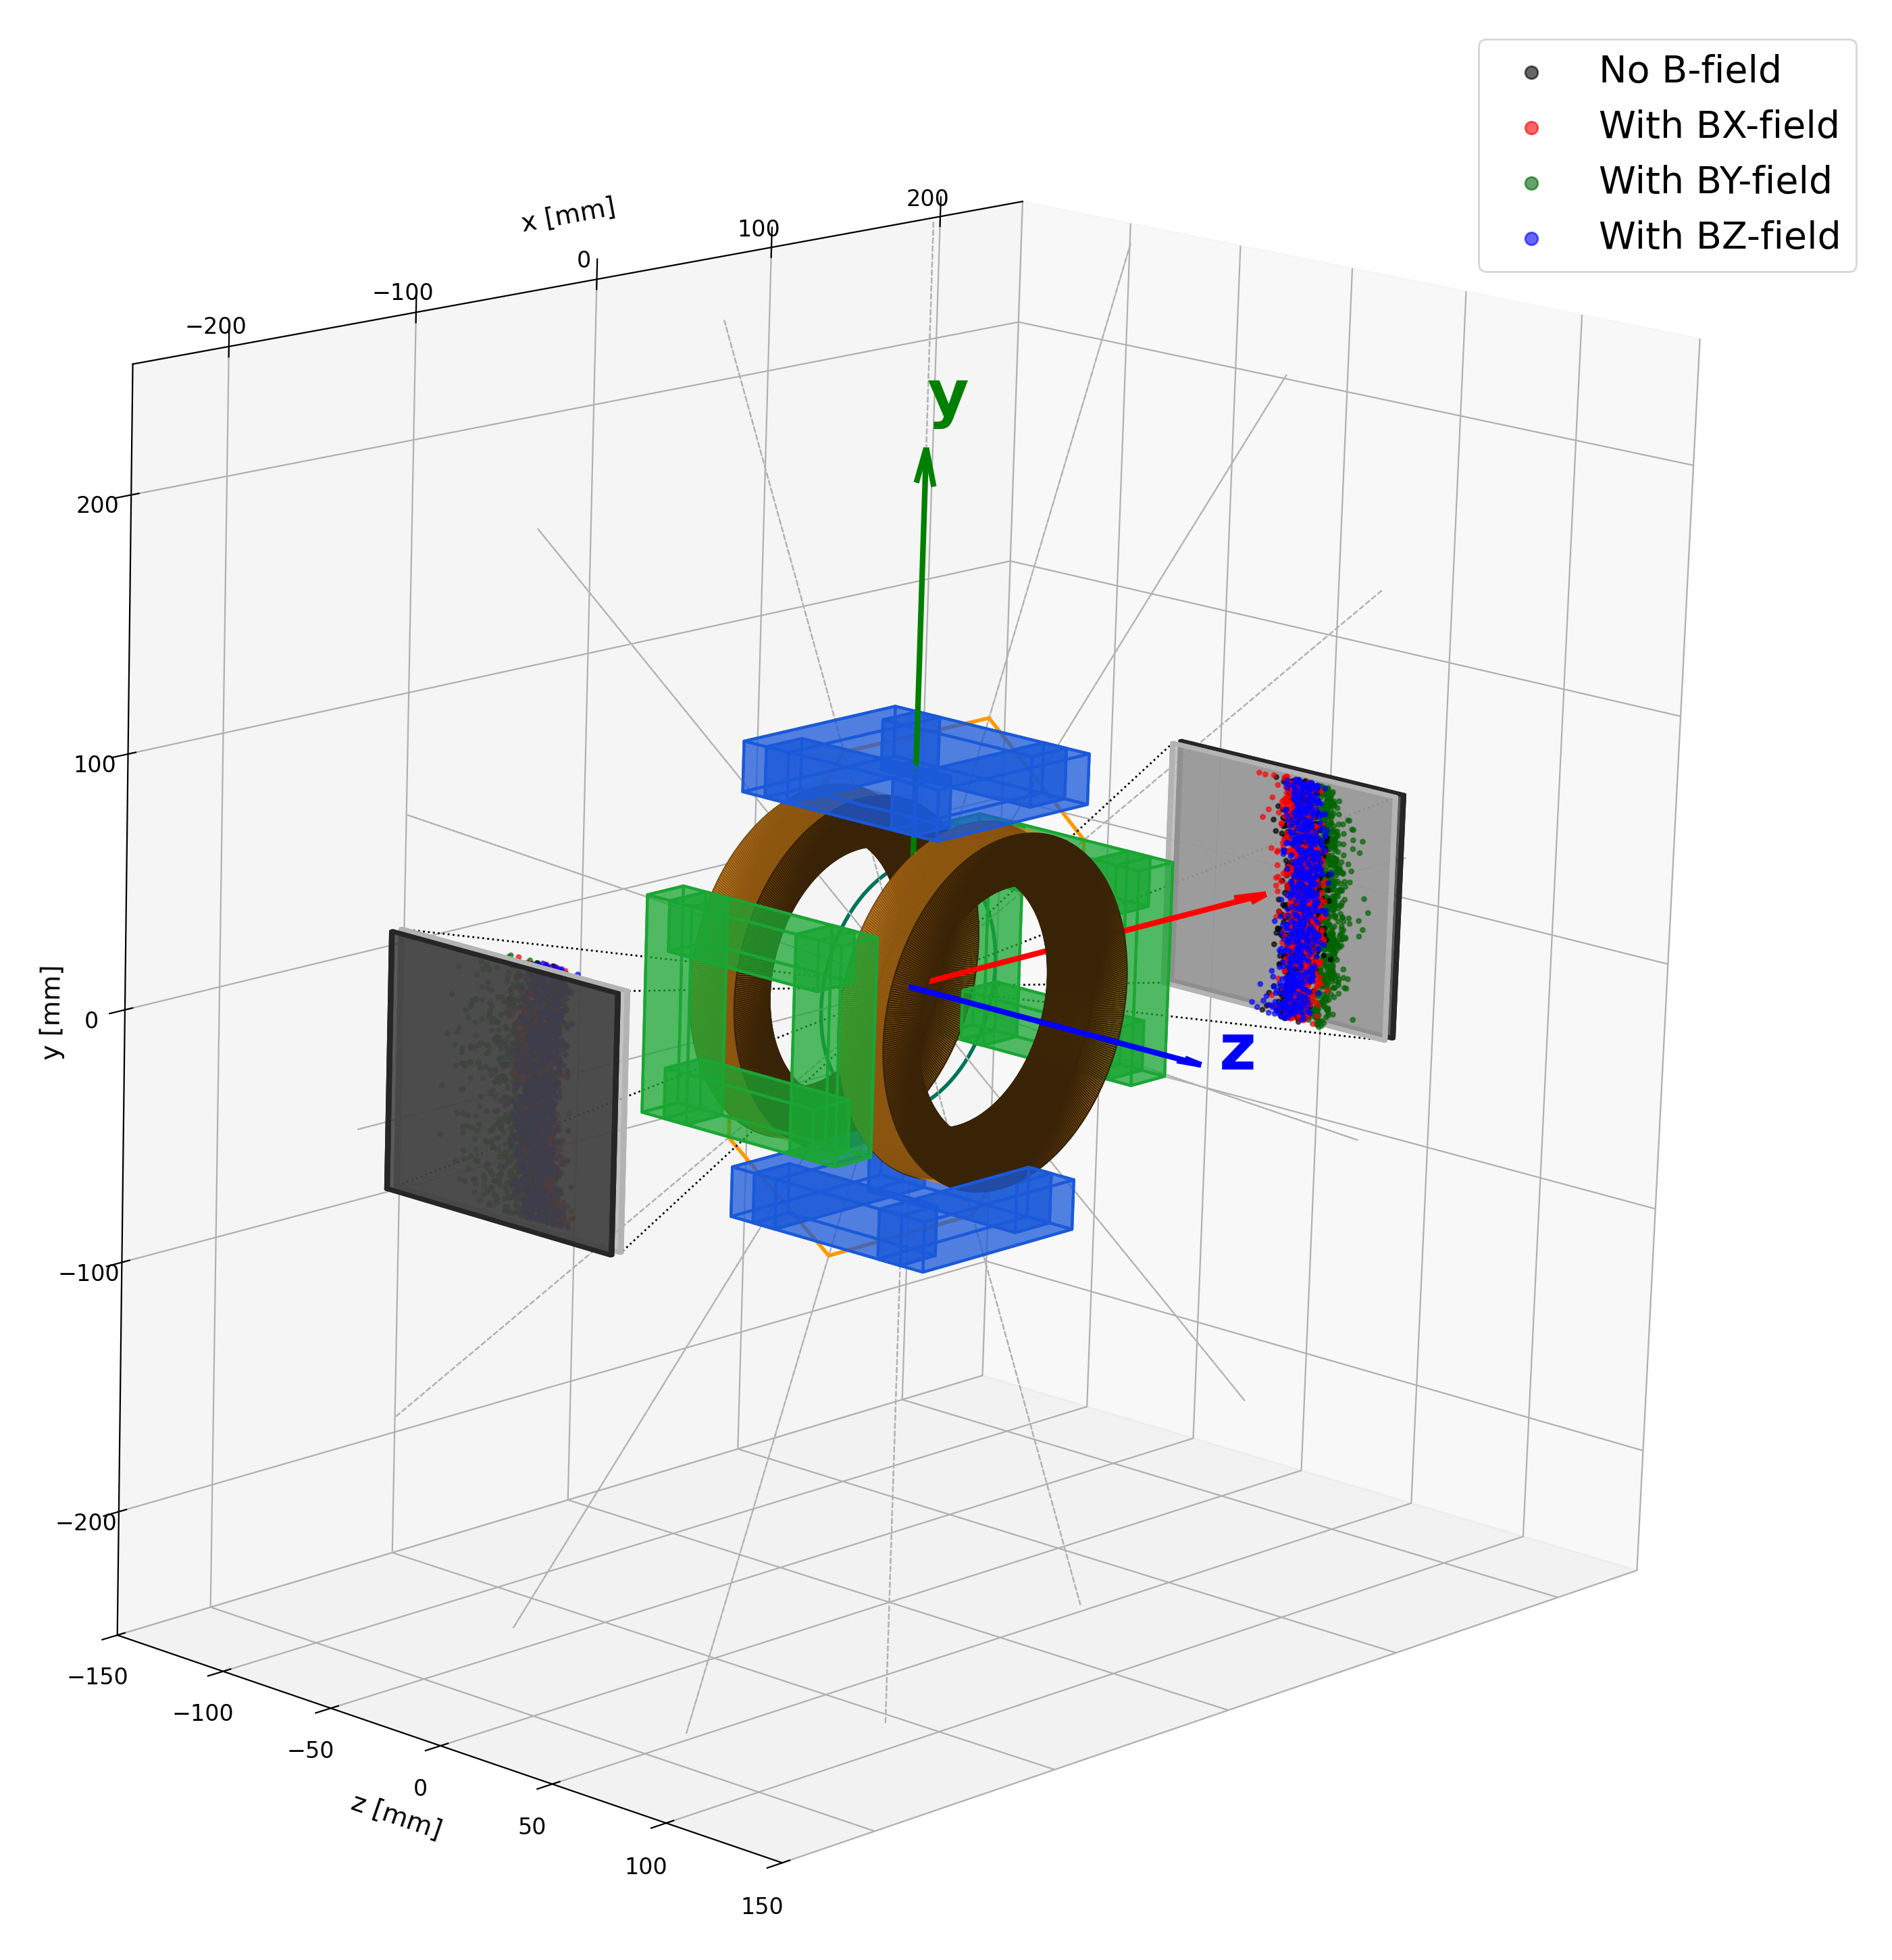
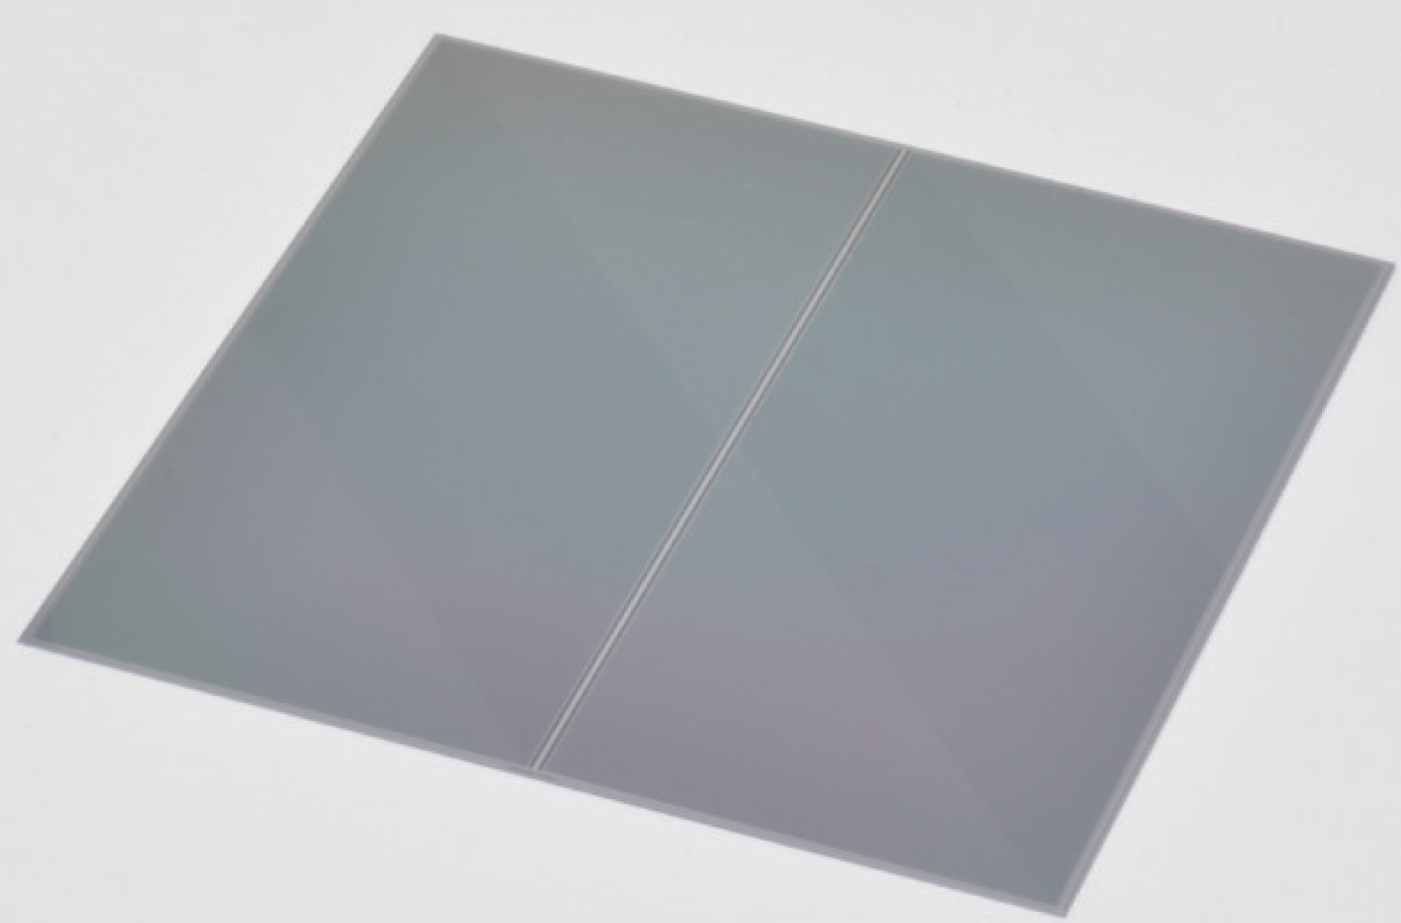
p-Forward detector development
This is going to be first development for future Hjet detectors (time scale ~2 years)
Main features:
Hamamatsu 1024-strip 300-500 um thick SSD
97mm by 97 mm
2 detectors, 2 layers each
Time resolution < 2ns (overkill, but required for Hjet)
Development lead by the instrumentation group at BNL
For more details see talk from Prashanth on Friday(link)
97 mm
97 mm
512 ch
512 ch

Slide 16




SUMMARY
The EIC physics program demands high, well-measured polarization at every stage of the injector chain.
One fixed six-station ring covers the full Booster ramp for p and ³He - no moving parts.
pC polarimetry reaches δP = 0.01 within a single ramp cycle; the proton case is systematics-limited.
³He scale anchored at 443 MeV and propagated by ramp-and-return to ~2% absolute across the ramp.
Extends to d, ⁶Li, ⁷Li with the same geometry — a versatile light-ion polarimeter for the EIC era.
Under active design - we welcome collaborators NOW.
Detector construction: current short-term plan includes 2 recoil detectors (1-st year) → 4 more needed in the 2–3-year range
DAQ and data analysis: development reconstruction algorithms and DAQ system for new detectors
Beam time: have many flanges which could be instrumented, new ideas are welcome

Slide 17
Back Up

Slide 18
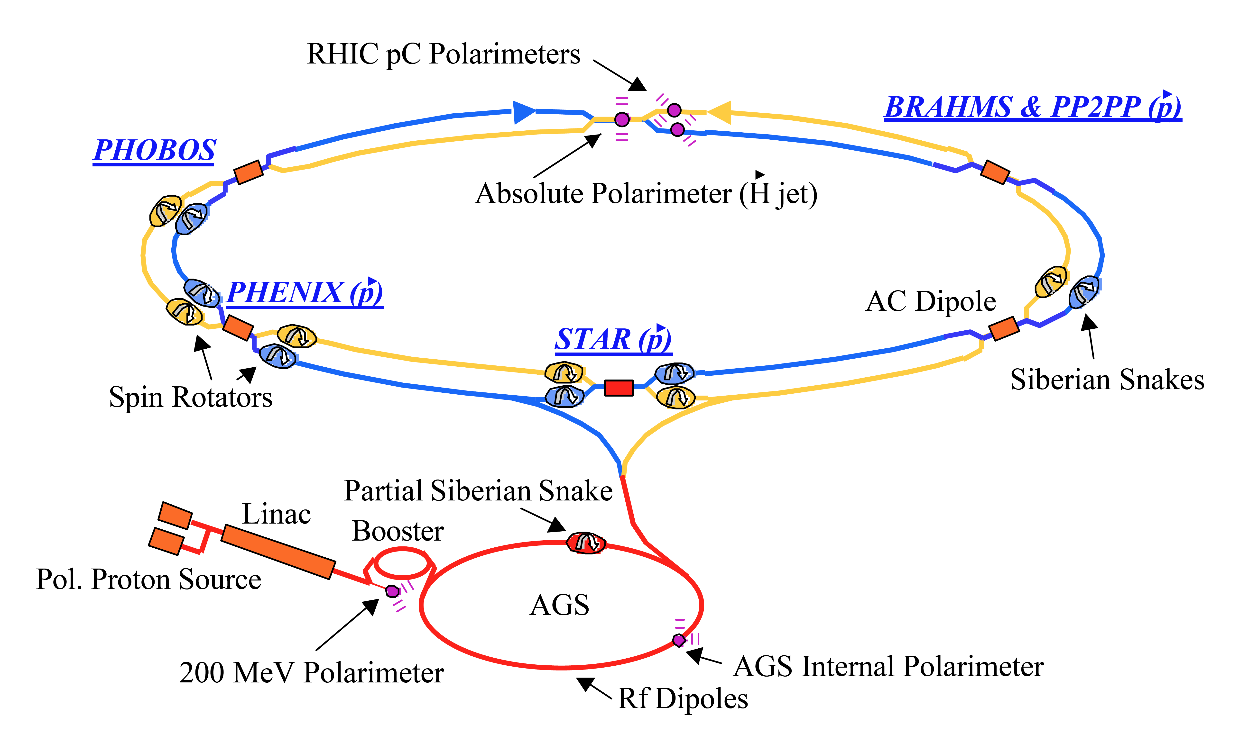
Motivation: A gap in the polarization diagnostics chain
The EIC physics program demands high, well-measured polarization at every stage of the injector chain.
RHIC completed its final run
  The complex now transitions to EIC construction see talk from Prashanth (link).
AGS enters multi-year refurbishment
  Extensive recabling and hardware upgrades; the AGS pC polarimeter is unavailable.
No independent measurement in between
  Nothing bridges the 200 MeV Linac / EBIS sources and the AGS - the full Booster range is blind to depolarization effects.
RHIC
sPHENIX
? ? ?
Linac
AGS
Notes:
Booster will be running
Need EIC picture not RHIC

Slide 19
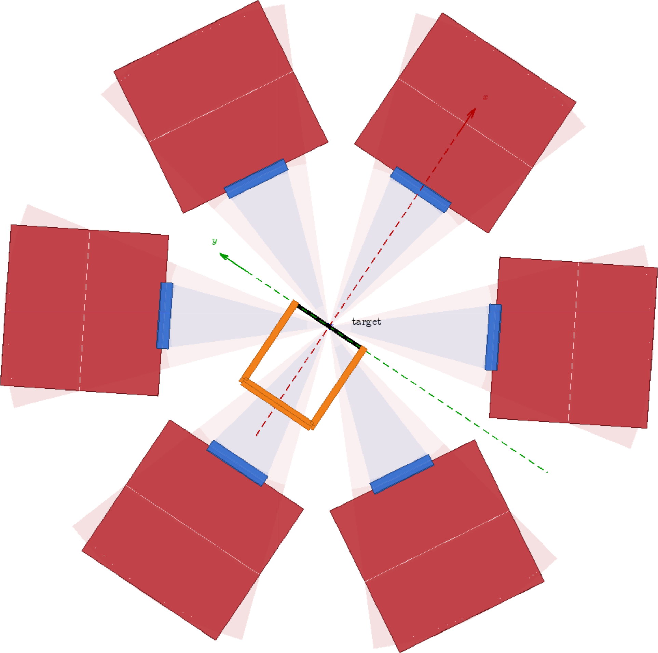
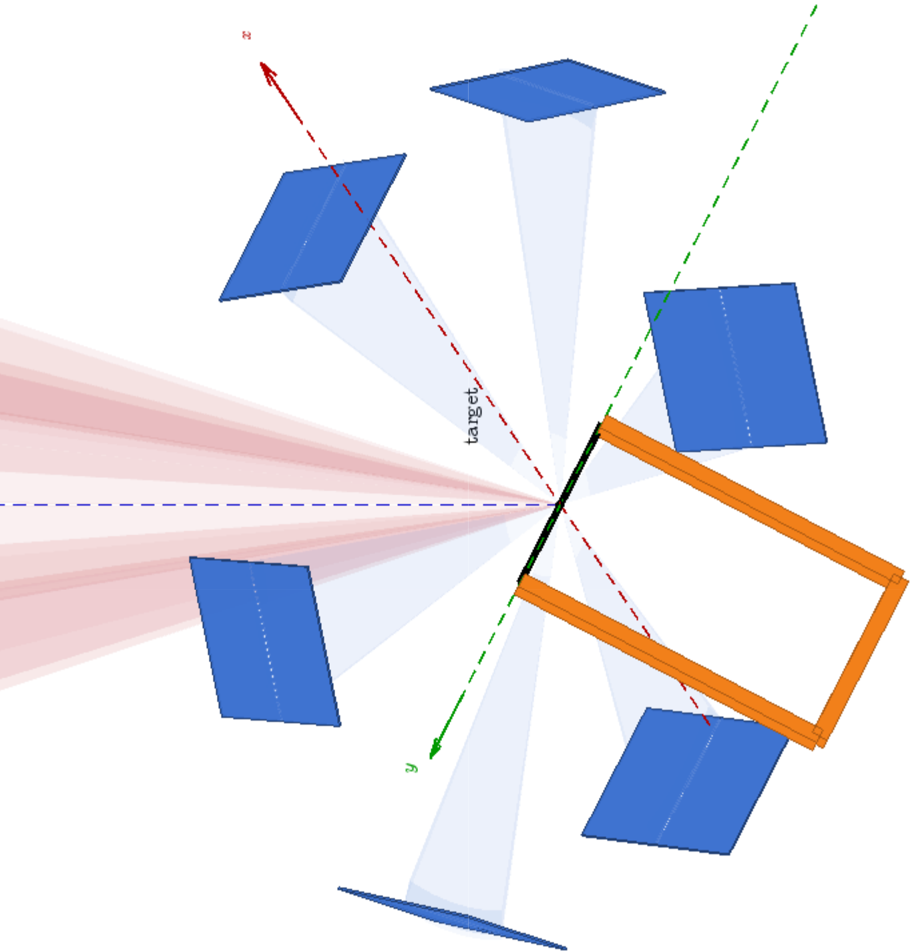
A recoil-carbon polarimeter at the Booster
Continuous, absolute polarization for both the polarized proton and polarized ³He beams - across the full acceleration cycle.
Elastic scattering
  pC and ³HeC from a thin internal carbon target; recoil ¹²C detected near θ_{C} ≈ 90°.
Fixed six-station ring
  Recoil kinematics scale smoothly with momentum - one geometry covers injection to extraction.
Absolute scale
  Well-established pC analyzing power; ³He scale anchored to a few percent via ramp-and-return.
Future-ready
  Same technique extends to d, ⁶Li, ⁷Li with detector upgrades - no geometry change.
Illustration from K. Hock
Notes:
No detectors to be shown
Back Up: target orientation

Slide 20
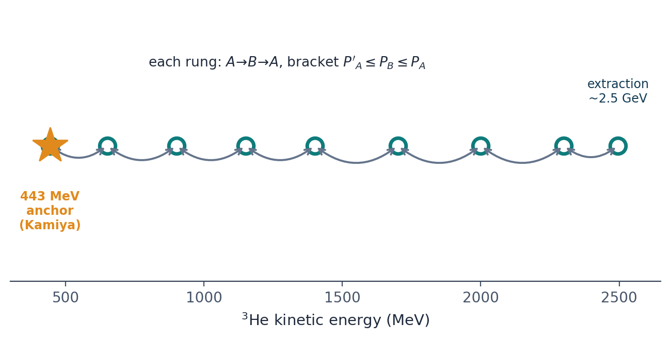
The polarimeter calibrates itself
Export the absolute polarization scale from the 443 MeV anchor to any ramp energy via a ramp-and-return ladder of short, self-validating round-trips.
How it works
Prepare at 443 MeV with known P_{A} → ramp to B → return, measure P′_{A}.
Depolarization can only reduce P, so P′_{A} ≤ P_{B} ≤ P_{A} brackets the target energy.
~100 MeV steps ensure ≤ 1 resonance per rung; each rung self-validates.
~20 rungs to extraction → σ ≈ 2% absolute, 4% relative near P = 0.5
Demonstrated at the IUCF Cooler Ring for pp analyzing-power measurements, 200 → 450 MeV.

