Slide 1
Status of HJET and pC Polarimeters
Prashanth
for the Polarimeter Group @ BNL
July 10-17th, 2026
ePIC/EICUG Meeting

Slide 2
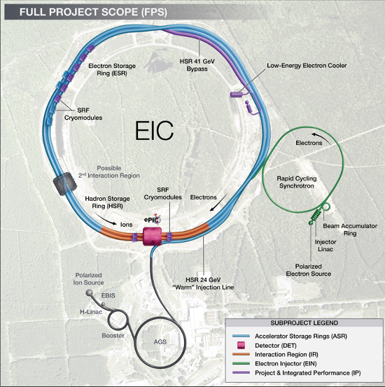
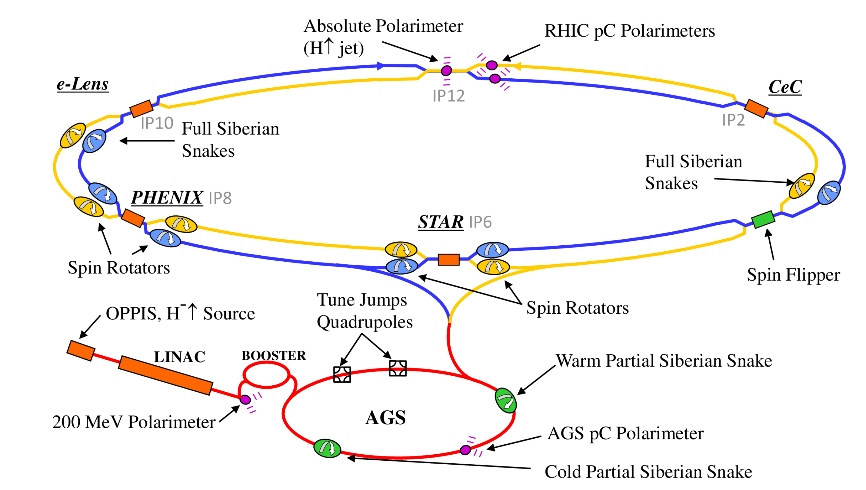
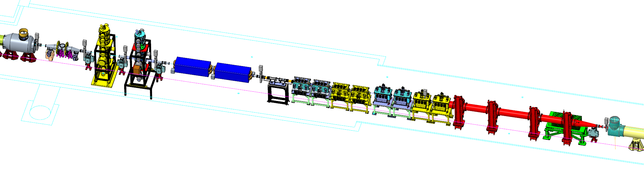
HJET & pC from RHIC to EIC
IP12
RHIC
IP4
HJET and pC polarimeters will be refurbished and upgraded for EIC use!
pC
3He Jet
Triplet (Q3)
HJet
2X Warm D0
HSR
3He is not on project

Slide 3
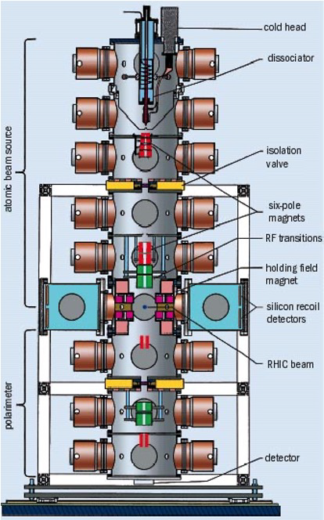
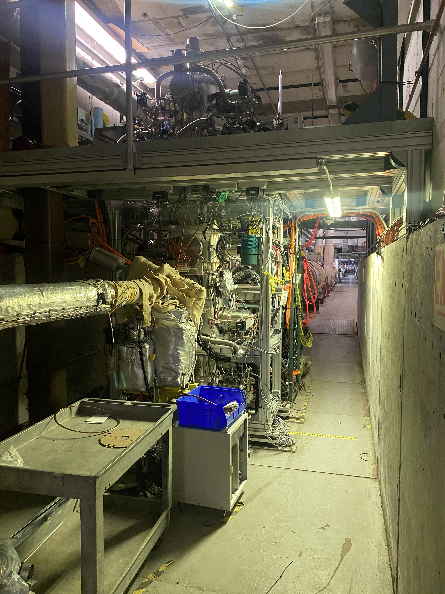
RHIC - HJET
Absolute beam polarimeter for RHIC polarized proton beams
Uses a polarized atomic hydrogen gas jet target intersecting the circulating proton beam
Relies on the precisely known polarization of the hydrogen target
Measures elastic proton–proton scattering in the Coulomb-Nuclear Interference (CNI) region
Achieves systematic uncertainties at the few-percent level
  Historically around 3–5%
  For EIC < 1% needed
pC polarimeters are calibrated against H-Jet
RHIC-HJET @ IP12

Slide 4
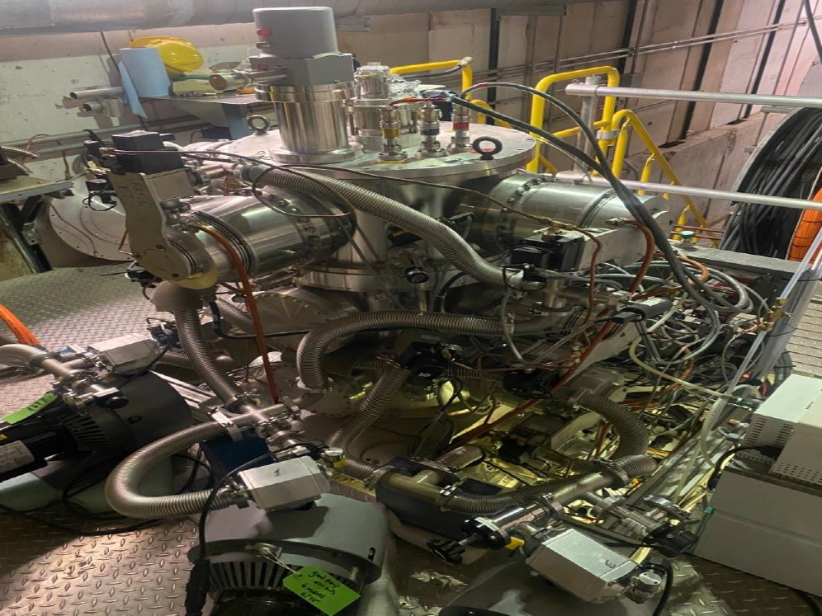
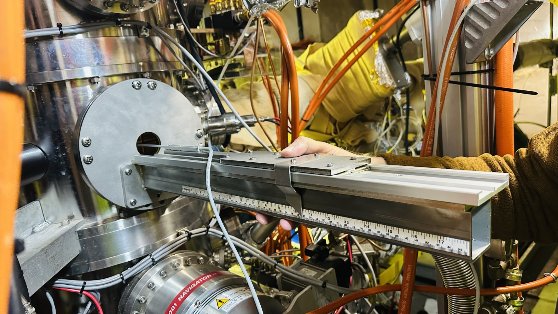
Ongoing Activities (After RHIC Shutdown)
Learn HJET operation and control systems from current experts
Repair cold head (Completed)
Perform magnetic field measurements of the HJET magnet system
Characterize RF units (Completed)
Electrical documentation and cable tracing (Completed)
Replace Atomic Beam Source (ABS) and Breit–Rabi Polarimeter (BRP) power supplies
Relocate HJET
  RHIC Tunnel 1012 → Physics High Bay → EIC Tunnel 1004
Upgrade High Bay
  Electrical infrastructure upgrade to support HJET operation
  Install mezzanine & soft-wall clean room

Slide 5
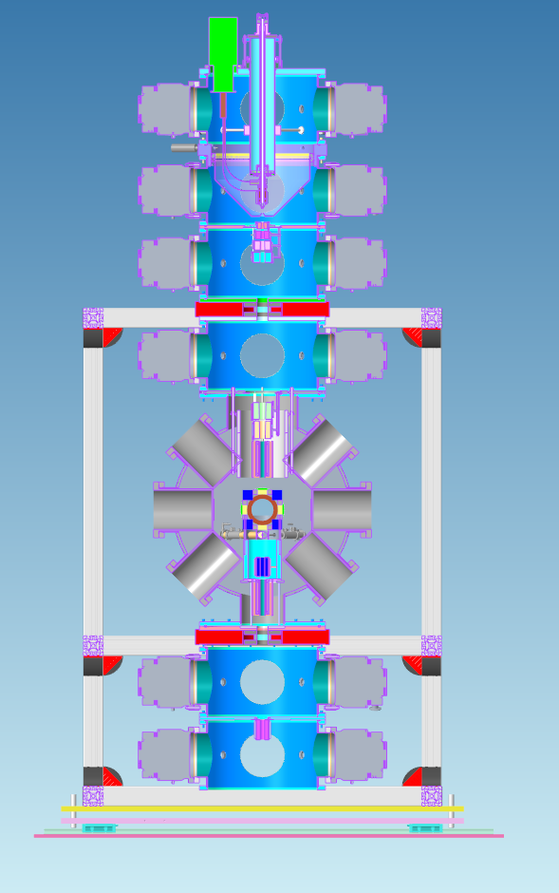
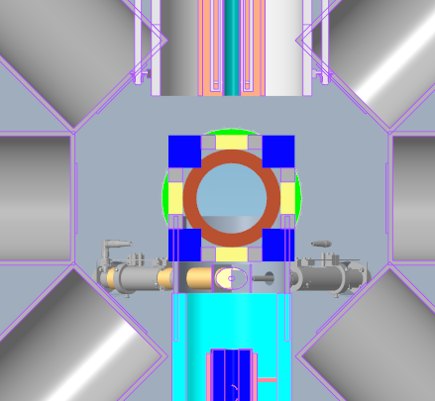
Planned Upgrades for the HJET
Detector System
  Measure full polarization vector, 𝑃 ⃗=𝑃𝑥,𝑃𝑦, (𝑃𝑧)
  Operate at 10× higher EIC bunch frequency
Atomic Beam Source
  Upgrade 120mT to 400 mT holding field
  New target chamber
BRP mass analyzer for improved H₂​ background subtraction
Controls
  Common EIC EPICS platform
  Updated Safety PLC and motion controls
2D-QMA ports
Goals for the upgrades: Achieve <1% absolute polarization uncertainty for EIC

Slide 6
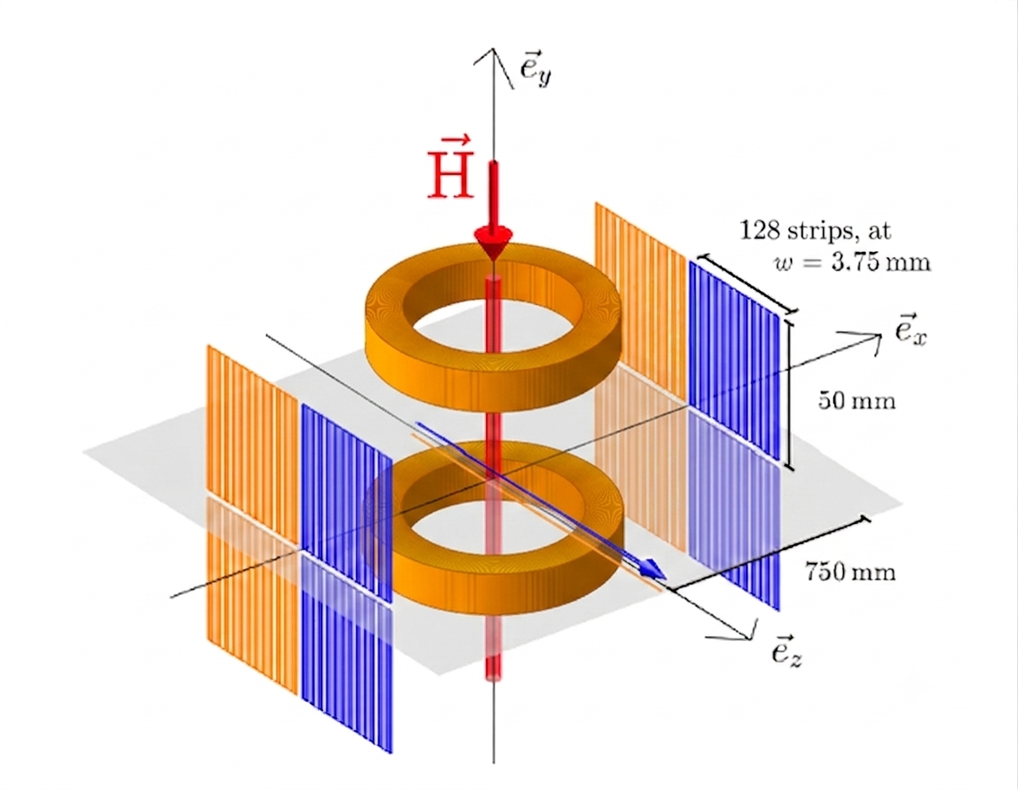
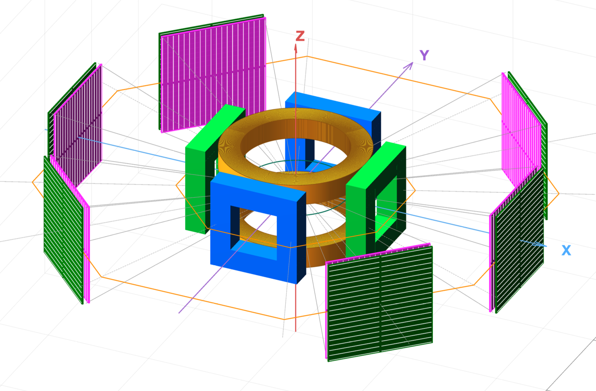
Upgrade to Detector and Holding Field Magnet
RHIC
Beam
H
EIC
220 mm
Beam
Holding field magnets
EIC bunch frequency (~90 MHz) is ~10× higher than RHIC, at current holding field 120 mT, hydrogen hyperfine transitions overlap populated beam harmonics
  Beam RF fields can drive resonant hyperfine transitions and depolarize the target
Increasing the holding field to ∼400 mT (100-400 mT tunable HTS)shifts all transitions away from populated EIC harmonics, providing a resonance-free operating region for HJET
Ref: arXiv:2508.01366 [physics.acc-ph]

Slide 7
Upgrade to Detector and Holding Field Magnet
RHIC
Beam
H
EIC
220 mm
Beam
Holding field magnets
Three-axis magnet:
  Measurement of all the beam polarization components
    RHIC only p_{y}
  Better suppression of systematic errors through field reversal
    Essential for achieving ΔP/P≈1%
  Separation of hydrogen hyperfine-state contributions
    HJET ABS typically injects: ∣1⟩+∣4⟩ or ∣2⟩+∣3⟩
    Reversing the guide field allows these contributions to be disentangled experimentally
  Full vector 𝑃𝑥,𝑃𝑦, (𝑃𝑧) polarimetry beyond the capabilities of the HJET
  Detectors much closer->higher statistics in shorter time
Improved Detector & Increased Beam Intensity → Measurement Time Reduced by ~20×

Slide 8
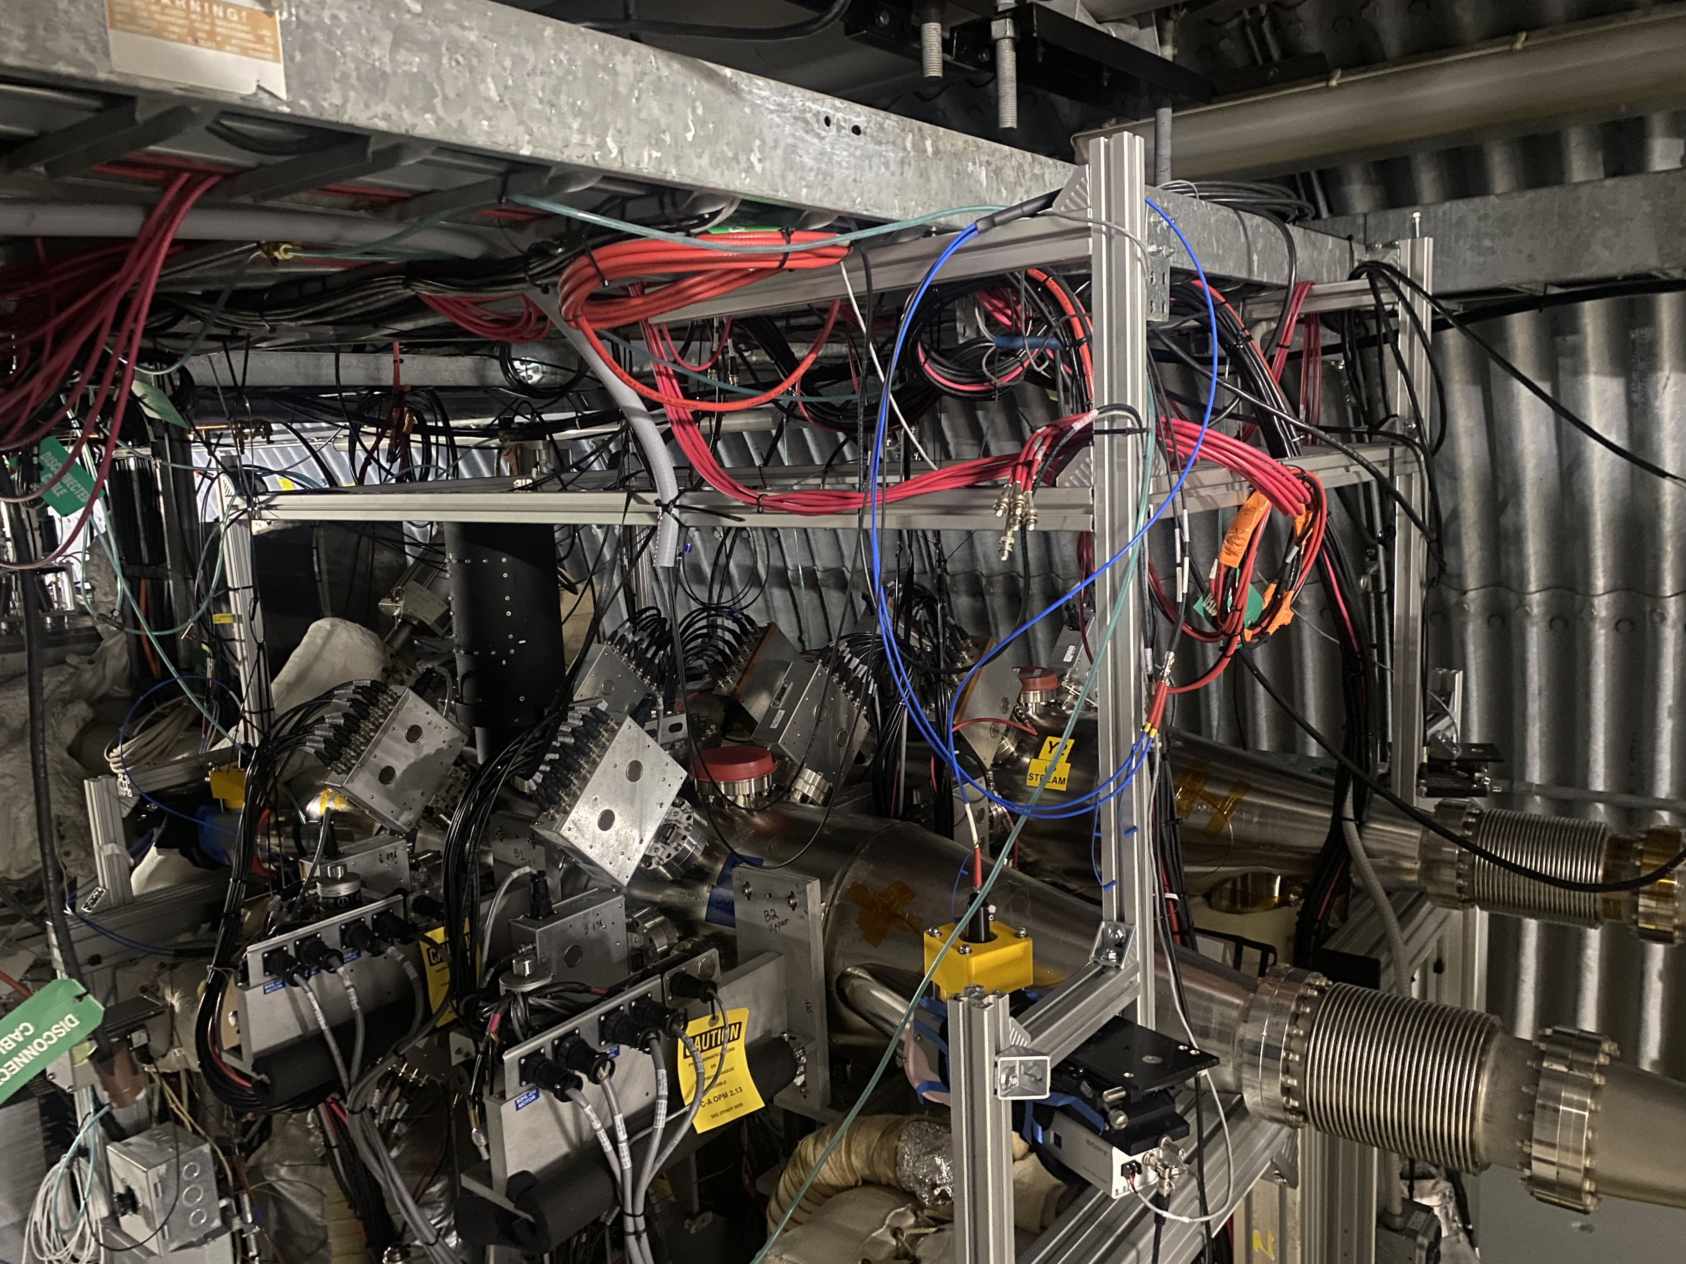
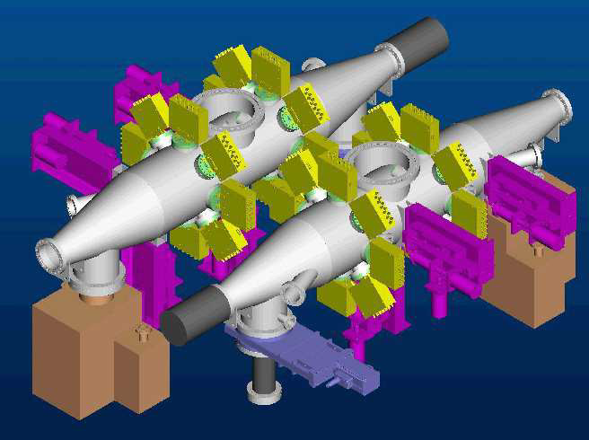
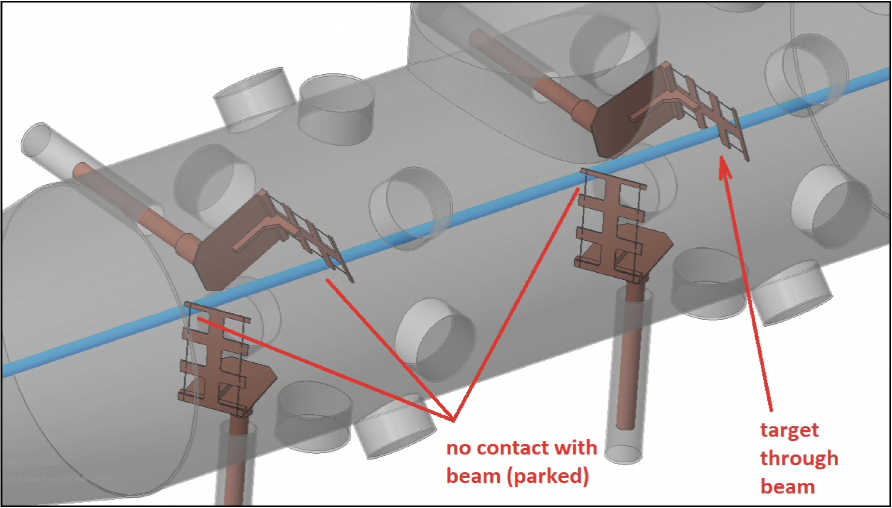
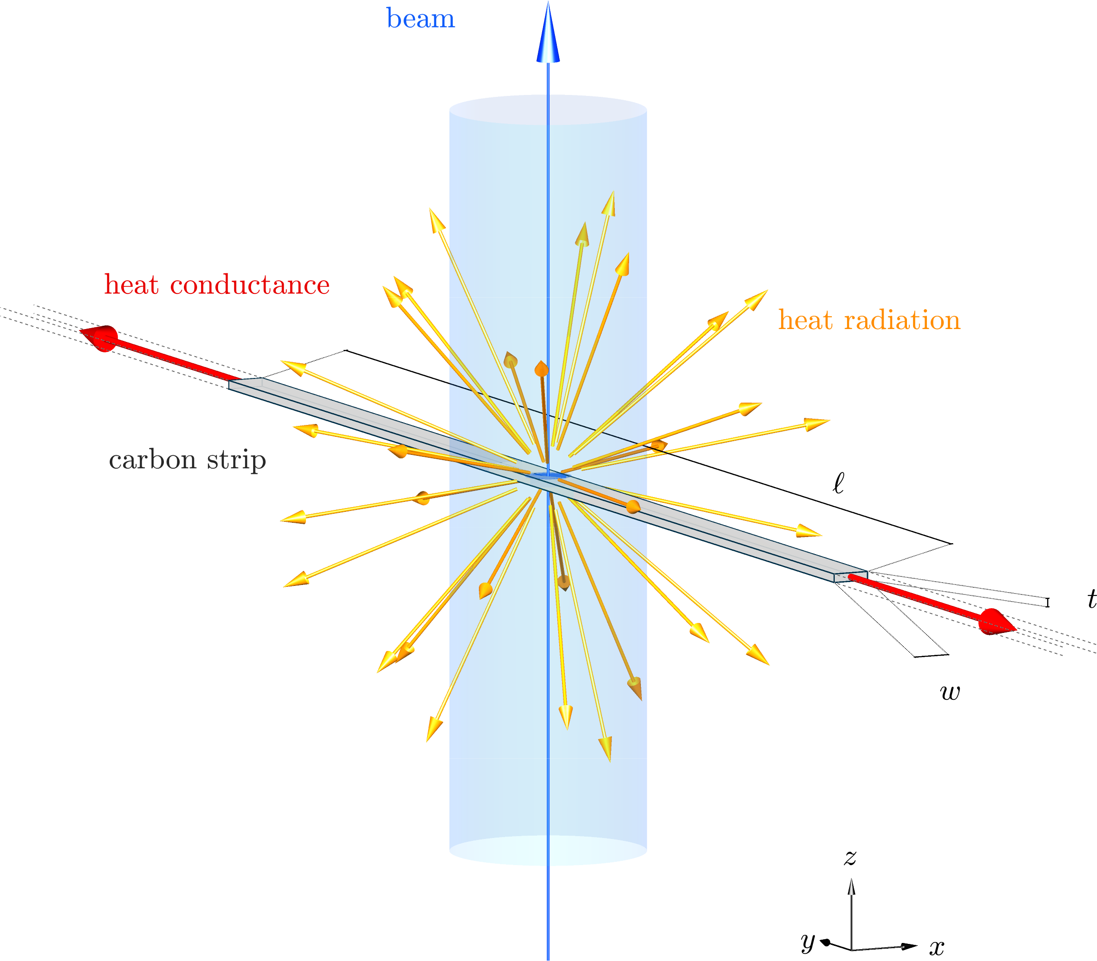
RHIC – pC Polarimeter
Fast relative polarimeter for continuous beam polarization monitoring
Calibrated by the HJET absolute polarimeter
Uses proton–carbon elastic scattering from a thin carbon ribbon target in the CNI region
Measures recoil carbon asymmetry with silicon detectors to determine beam polarization

Slide 9
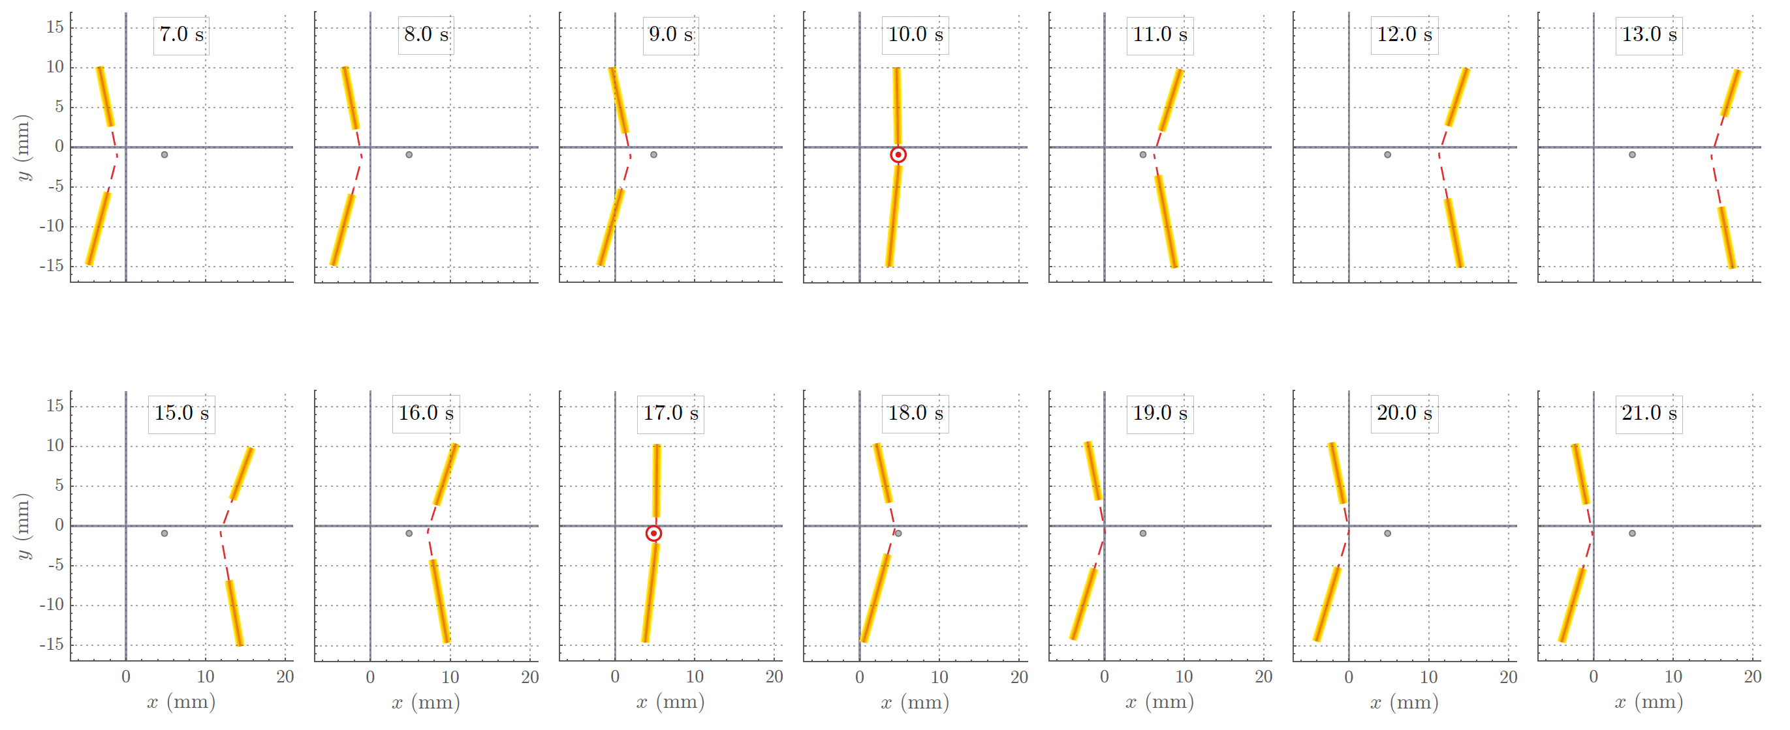
Thermal and Electromechanical Response of Ultra-Thin Carbon-Strip Targets
RHIC observations indicated that target behavior cannot be explained by beam heating alone
RF-induced strip-end heating and electromechanical effects also influence target lifetime
The coupled model explains multiple RHIC observations:
  Strip-end glow
  Strip deformation
  Target lifetime scale
C-strip response through the beam, Reconstructed from video frames
Physics included in the model
Included effect | Why it matters
Beam heating | Deposits energy and raises target temperature
Secondary-e^{n} escape | Reduces the fraction of deposited energy retained as heat
RF end heating | Produces additional heating away from the beam spot
Electrostatic forces | Pull the strip toward the beam during operation
Mechanical deformation | Changes the strip geometry and affects heating and lifetime
Reproduces the observed RHIC target-lifetime scale (15–120 predicted vs. 27–142 observed cycles)
Providing confidence for extrapolation to EIC beam conditions
Ref: arXiv:2606.29005 [physics.acc-ph]

Slide 10
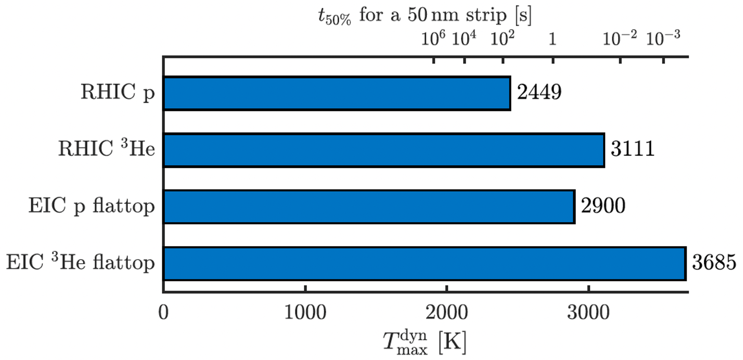
Implications for EIC Carbon-Strip Targets
Estimated time to remove 50% of a 50nm strip
Predicted peak target temperature increases from RHIC to EIC, reducing the allowable operating margin for carbon-strip targets
Higher beam intensity and cooled-emittance beams increase the local thermal load on the C-strip
  Motivates a re-evaluation of carbon-strip target survivability
Predicted peak temperature of the moving carbon strip
Existing carbon-strip optimization | Future target concepts
Faster scans Improved detector acceptance Optimized holder geometry Beam optics | Low-Z materials Renewable targets Moving ribbon/tapes Pellet targets Non-invasive polarimetry
Ref: arXiv:2606.29005 [physics.acc-ph]
Notes:
T50% -> the time required to remove 50% of the thickness of a 50 nm carbon strip if the strip were held continuously at that temperature.

Slide 11
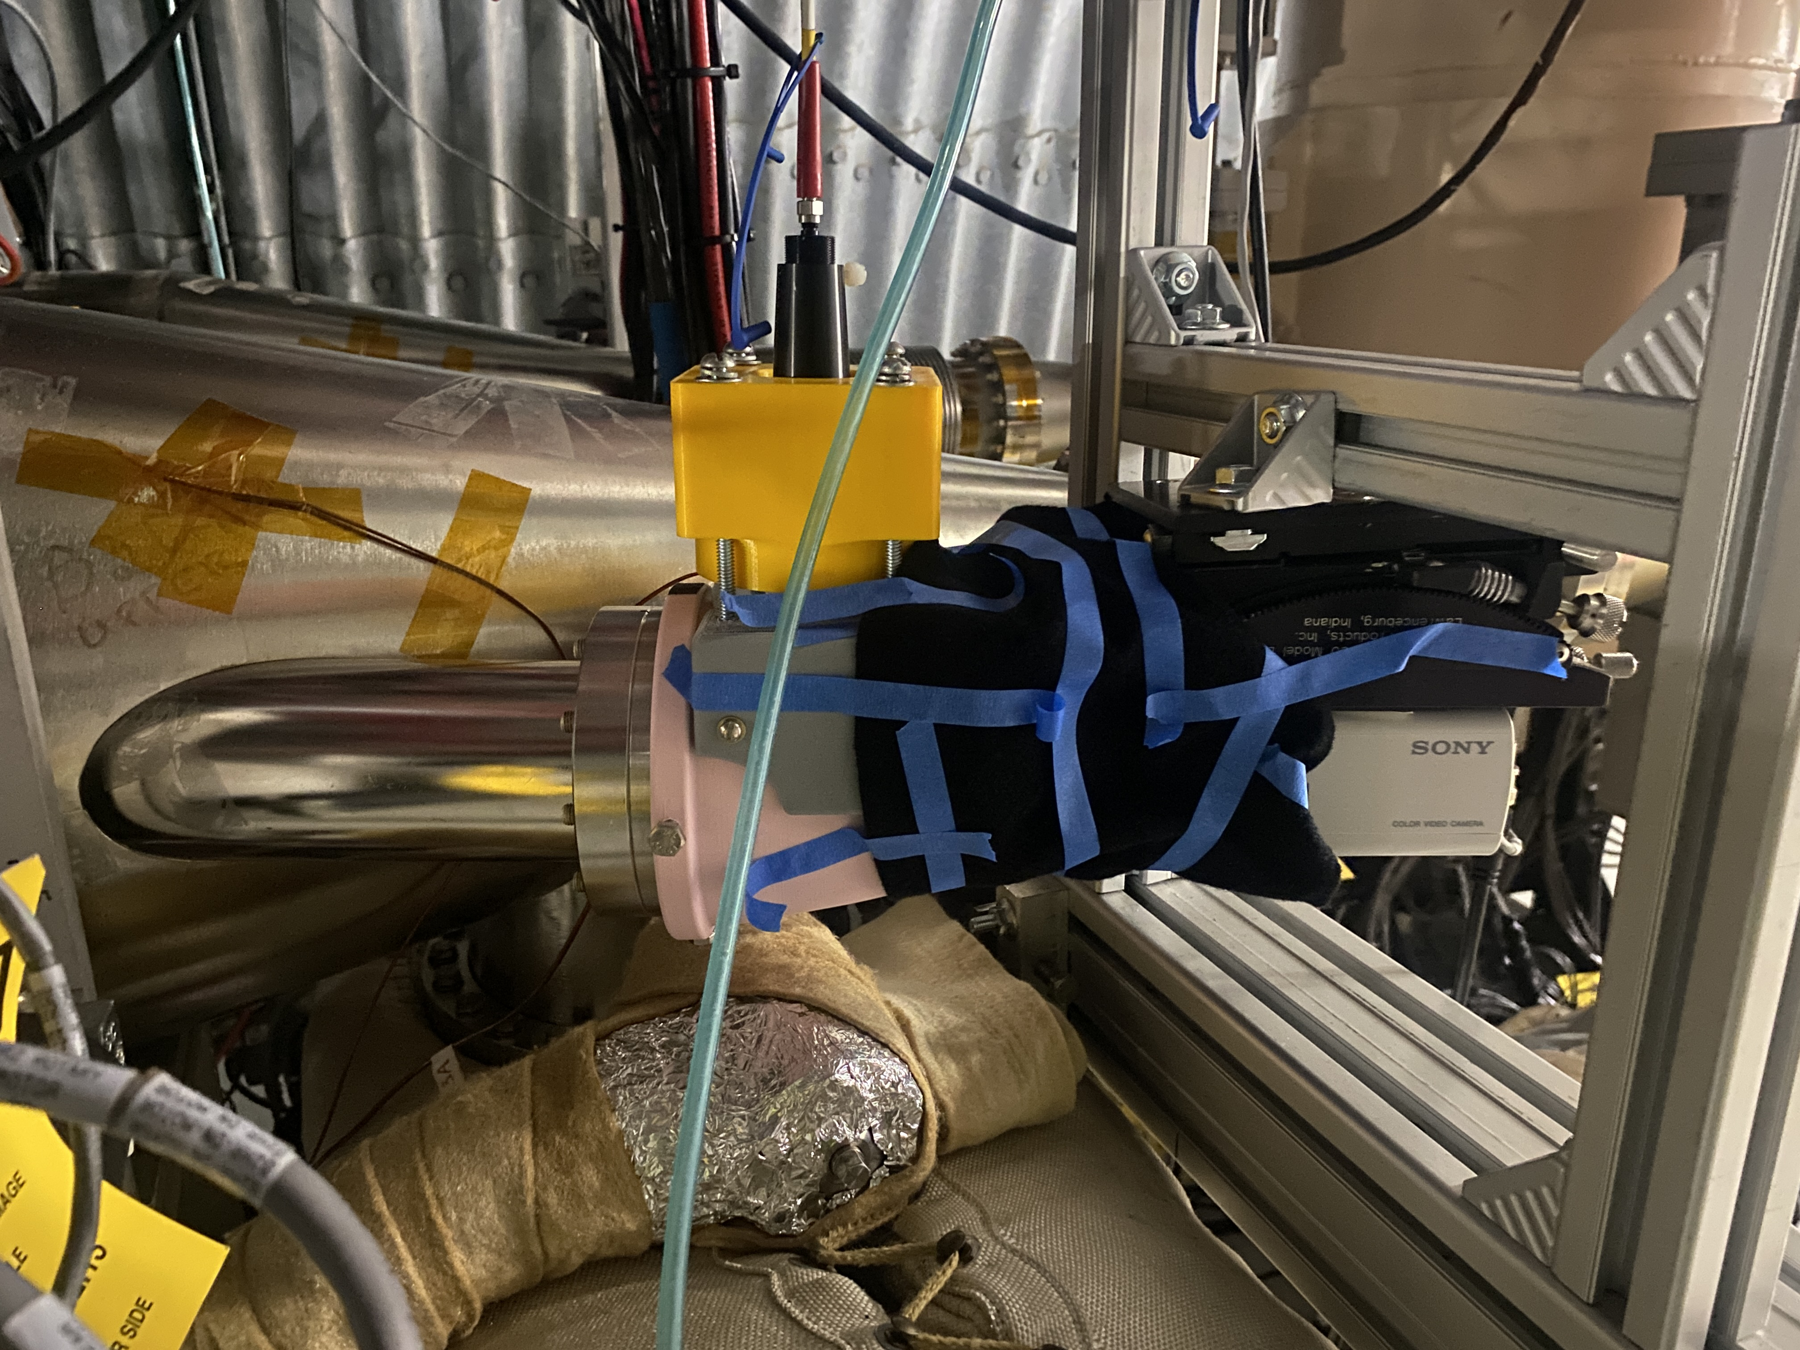
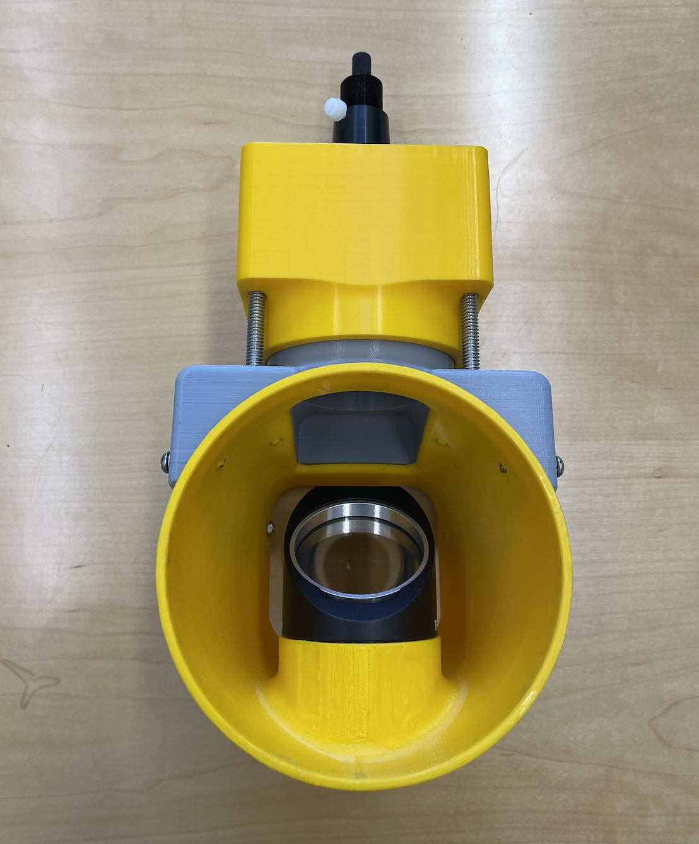
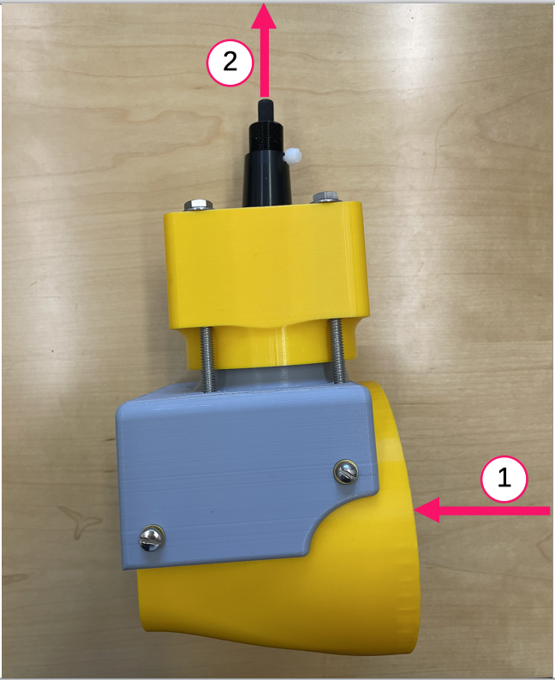
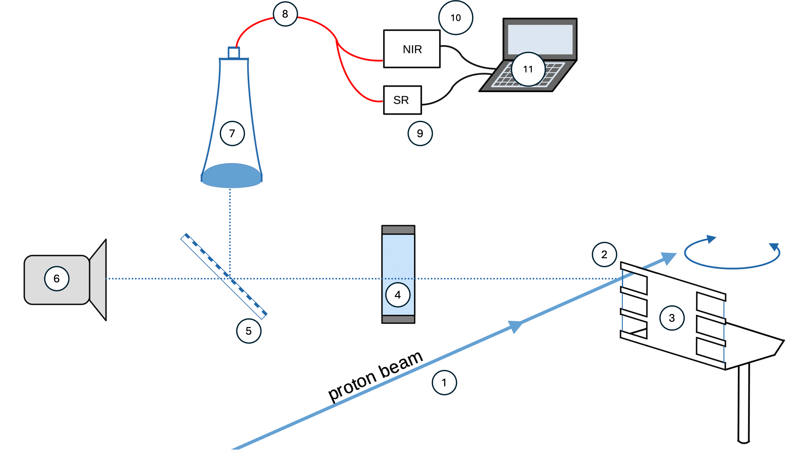
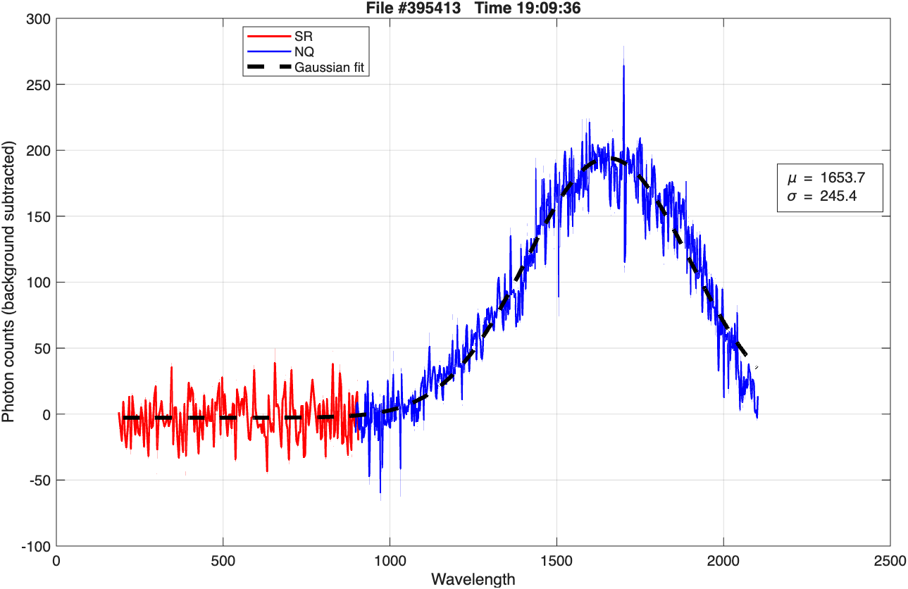
RHIC pC C-Strip Temperature Measurement
Light emitted by the carbon target is collected through existing fused-silica viewports
A semi-transparent (50/50) Polka-dot mirror directs half of the collected light to the existing camera and half to an optical collection system
A collimating lens collects the emitted light and couples it into bifurcated optical fibers for transmission to the electronics room (~100 m away)
The optical signal is split into visible and near-infrared spectrometers
  Spectral coverage ~200 nm to ~2100 nm
The measured light spectrum is compared with blackbody radiation spectra to estimate the temperature of the carbon target
Data analysis and calibration are in progress
peak ~1650 nm
Preliminary estimate: 1760 K (calibration in progress)

Slide 12
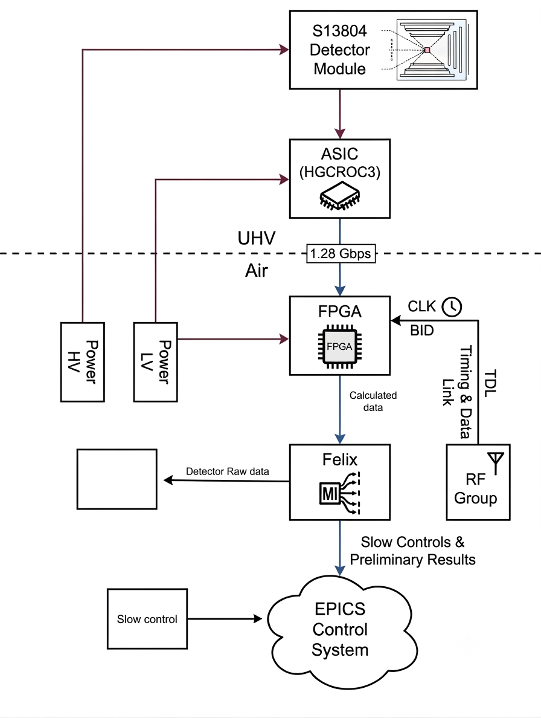
Detector Systems and DAQ
Hamamatsu S13804 is a large-area(97 × 97 mm²), single-sided silicon strip (Si width: 320 µm )detector with 1024 channels, providing high spatial resolution and fast readout for charged-particle detector
Common silicon strip detector technology proposed for HJET and pC (and Booster), enabling shared front-end electronics, DAQ, and calibration while improving detector performance
8 strips grouped together to form 128 channel
Two perpendicular detector planes provide the main position/energy measurement.
4-channel third layer acts as a veto layer to suppress punch-through and prompt background events
ASIC: HGCROC3
Custom FPGA board for signal conditioning, data handling & processing, clocking and synchronization
Version: 1.0
Kayla & John K

Slide 13
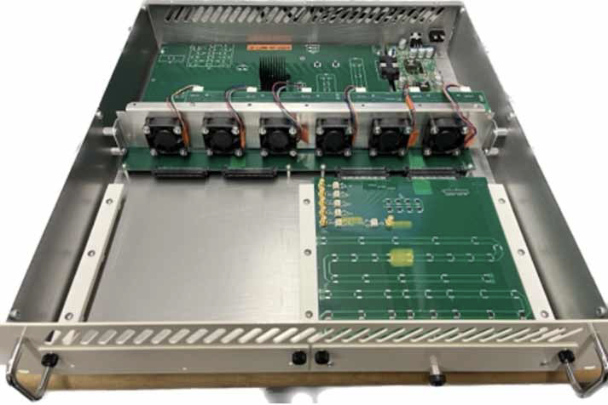
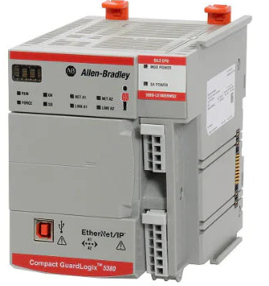
Control Systems (EPICS + PLC)
EIC control room talks to polarimetry equipment
Leverage the common platform developed by EIC Instrumentation for standardized controls, timing, networking
Migrating to a common controls architecture based on EPICS 7
Total number of process variables (PV) for HJET ~500 and pC ~200
Most of these PVs are slow ~ 0.1 s
All safety-critical and mission-critical functions will be implemented in Allen-Bradley Safety PLCs, ensuring reliable operation and independent protection from higher-level control systems
  No Personal protection
Mockup version of a common platform chassis
e.g.:AB GuardLogix

Slide 14
Organization
Project WBS 6.03.01.11
L3 Manager for the Polarimetry: Frank Rathmann
Members:
  Frank Rathmann
  Oleg Eyser
  Vera Shmakova
  Richard Porqueddu (ME)
  Kayla Hernandez (EE)
  Evgeny Shulga
  Prashanth Shanmuganathan
If this project interests you, please consider joining us. Whether you're looking for a two-month summer project, a longer research stay, or a postdoctoral opportunity, we'd be excited to work with you

