Slide 1
BIC Update
Triple I Engineering Meeting Update
Kevin Bailey & Tom O’Connor
July 20, 2026
BIC Sector Development Update

Slide 2
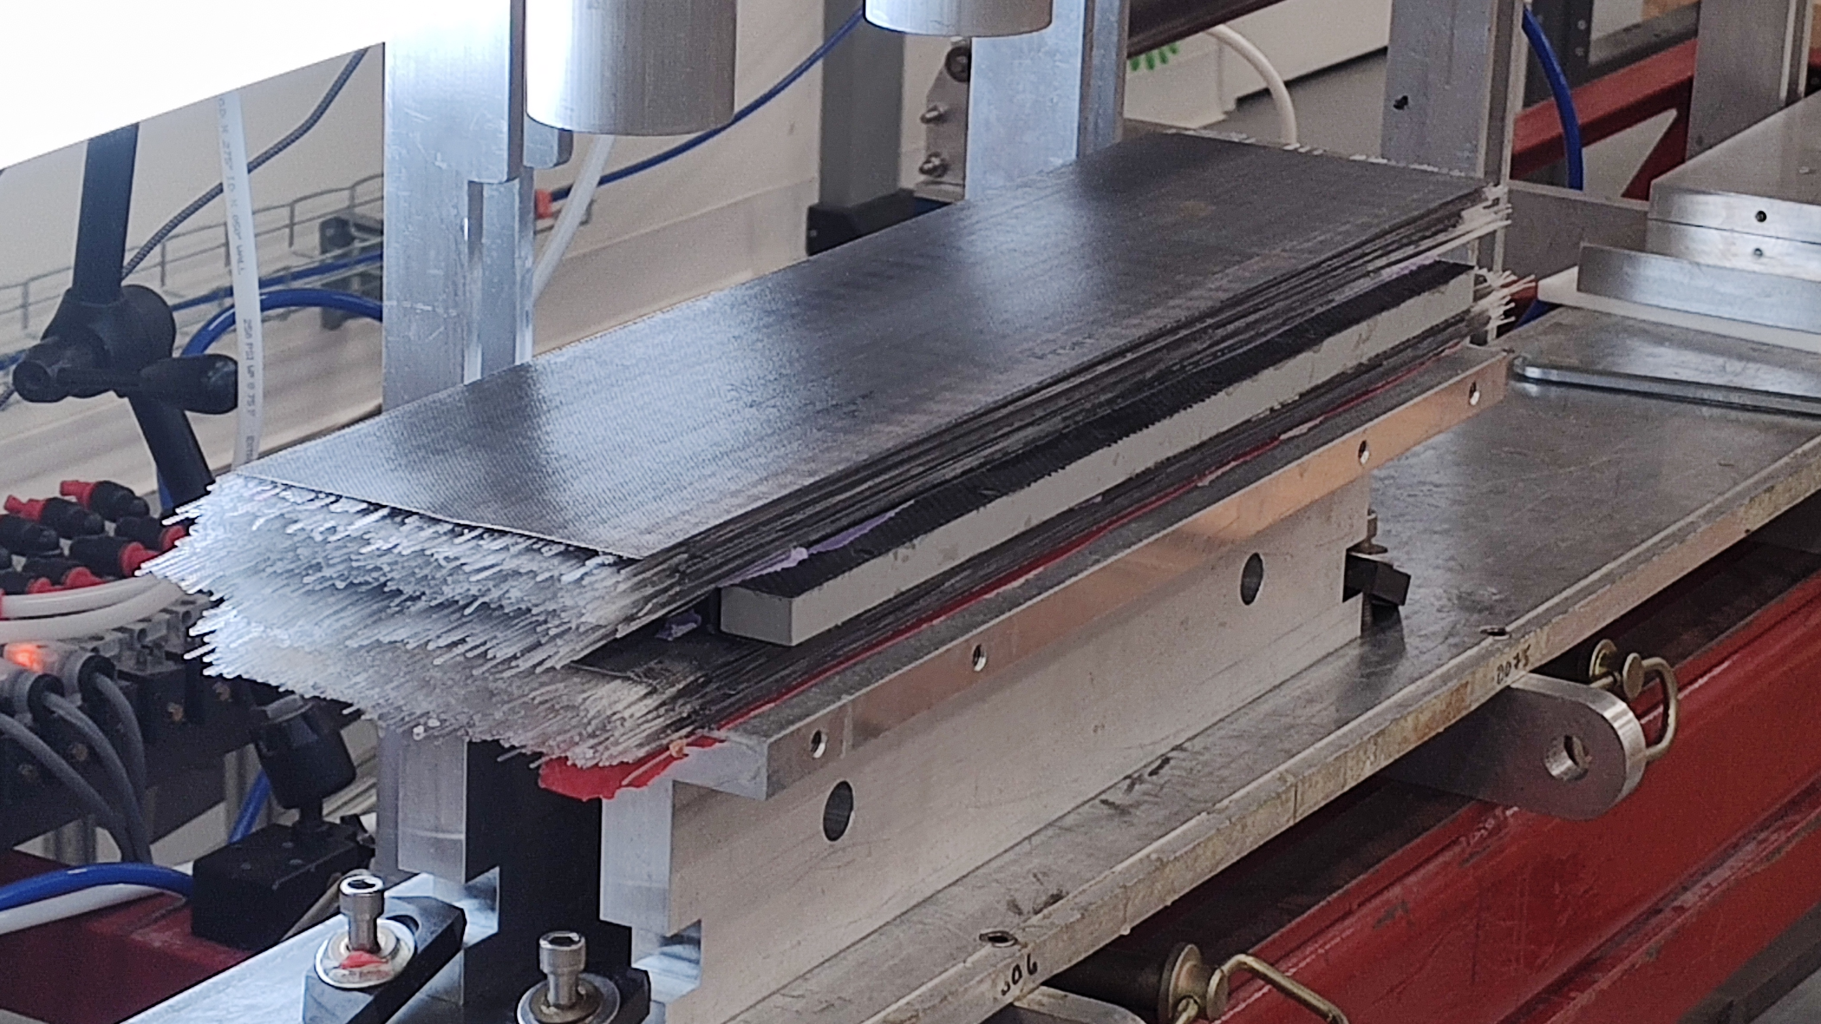
Updates since 6/29/26
No updates on sector and ESB cooling
Machine shops
  Located one shop interested in BIC Sector machining
  Several others to be contacted
Article Construction
  SFIL/Drawer/SFIL construction completed 0.5m.
    Ready for machiing
  1m SFIL preparation in progress.
    Two additional beam test SFiLs
    CMSC also scaling to 1m drawers
Process Development and New Workspace
  2nd Fiber Optic Test Station complete.

