Slide 1
BIC Update
Triple I Engineering Meeting Update
Kevin Bailey & Tom O’Connor
August 03, 2026
BIC Sector Development Update

Slide 2
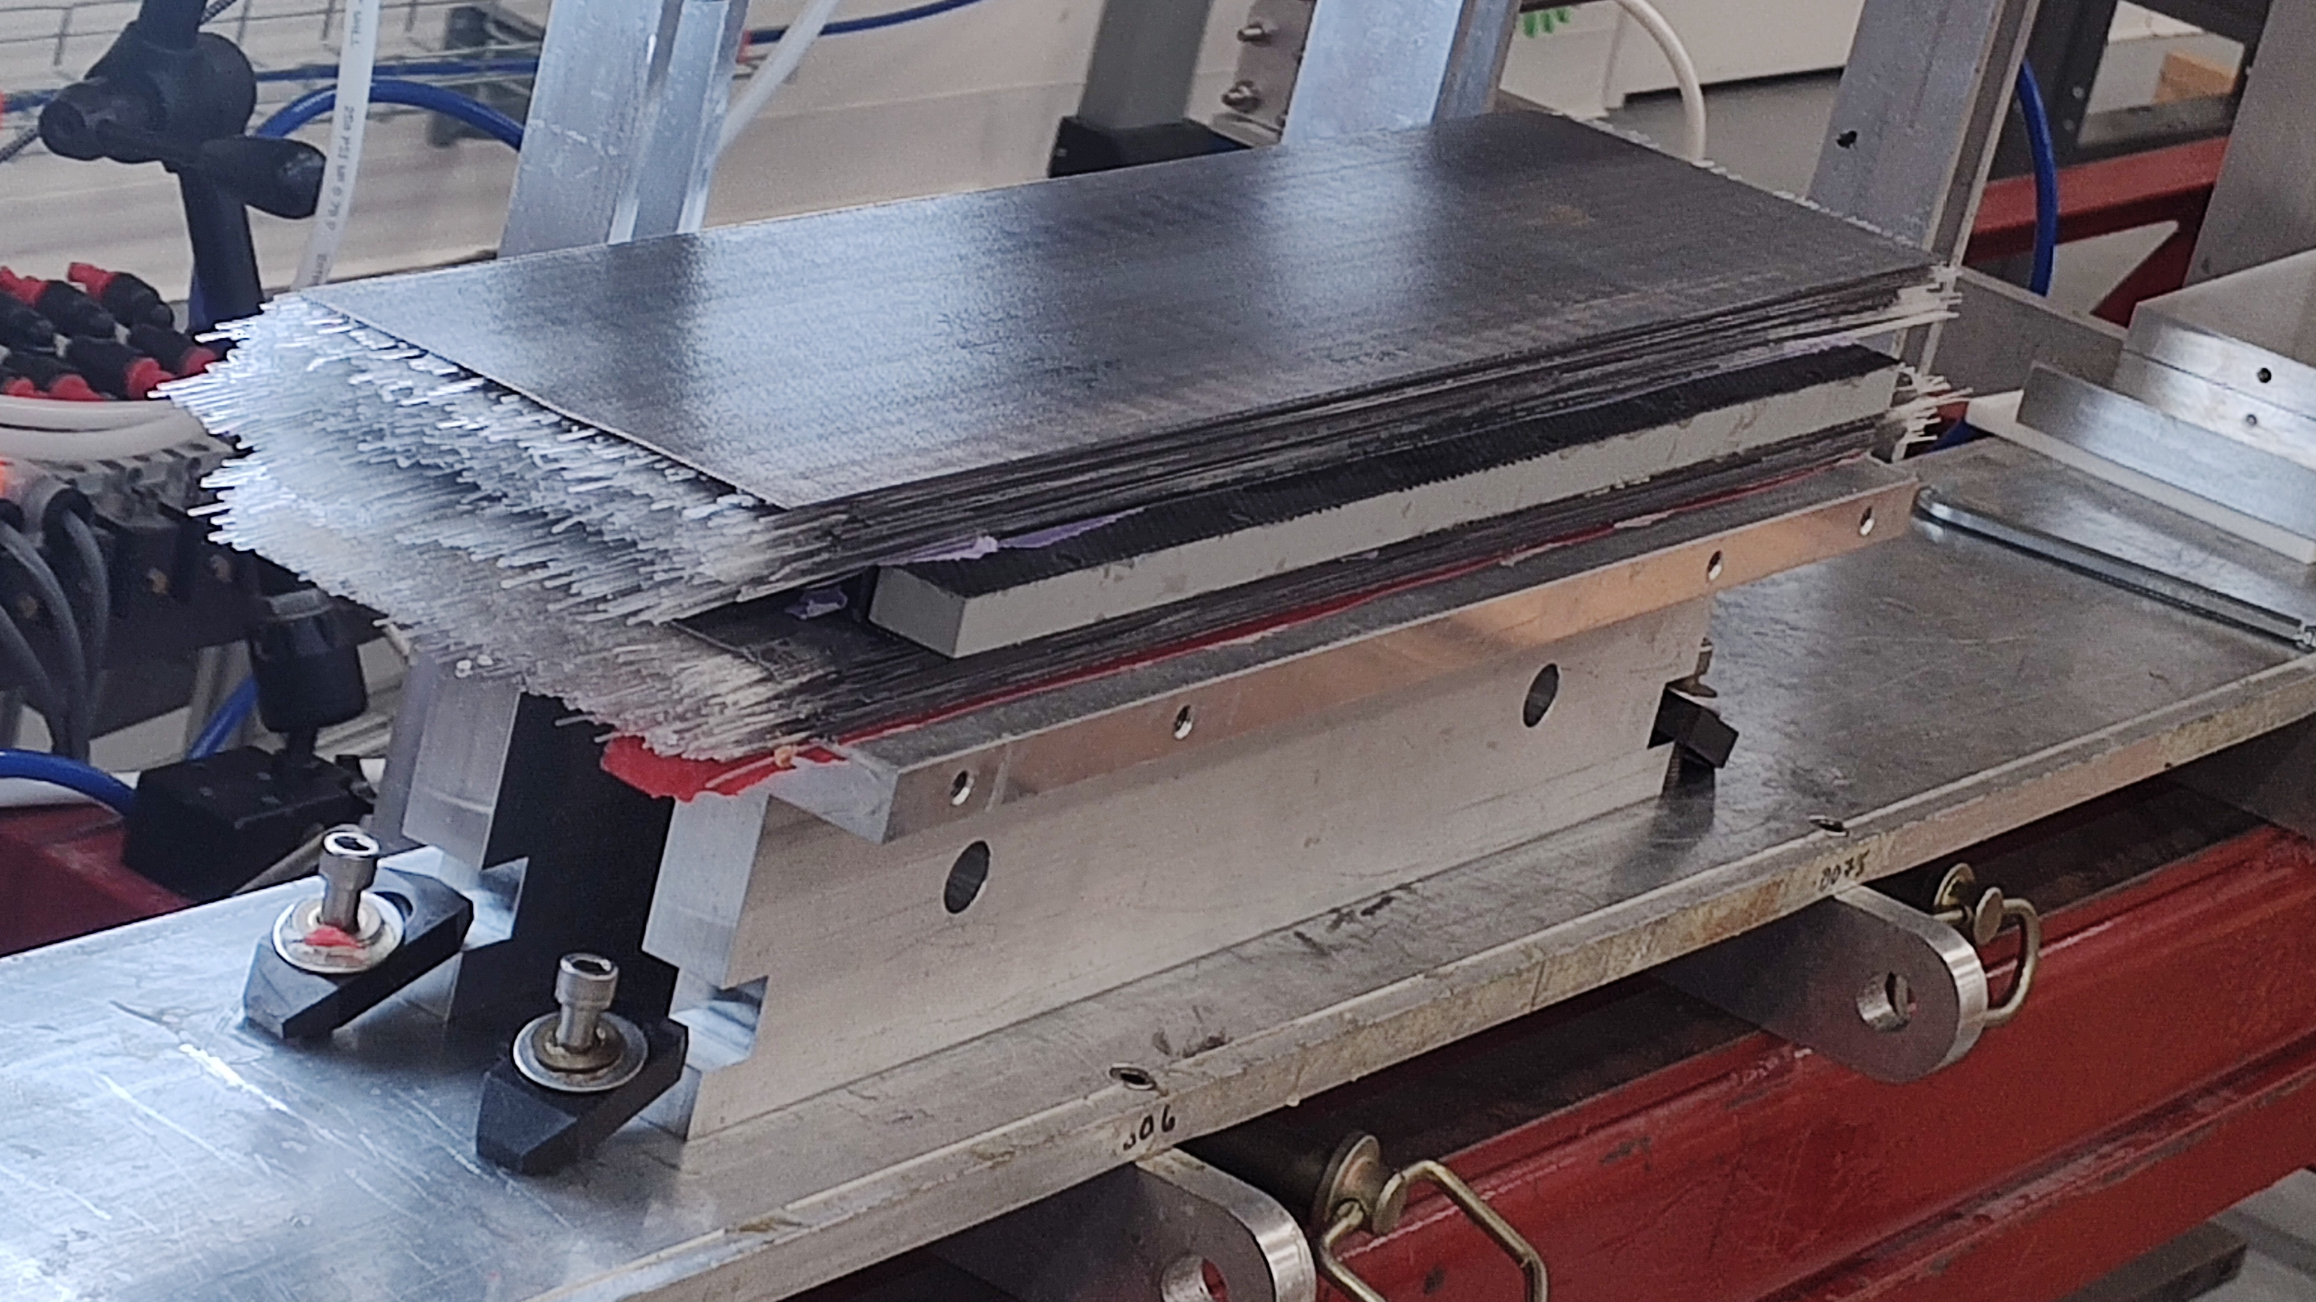
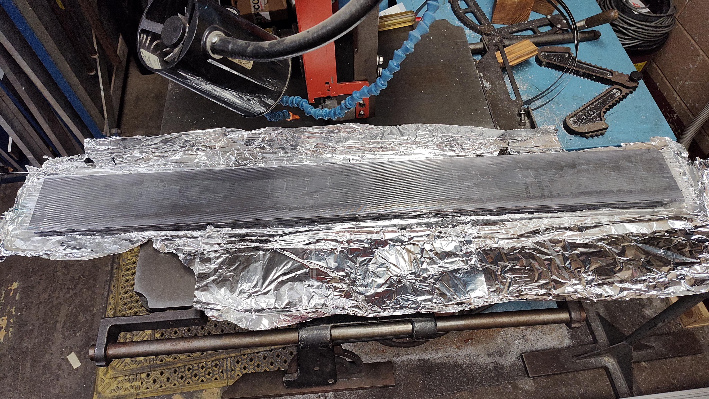
Updates
No updates on sector and ESB cooling
No update on sector FEA or lifting points
One promising reply from machine shop regarding sector machining
  More shops to contact
  Thank you for forwarding contact information!!
Test Article Construction
  0.5m SFIL/Drawer/SFIL construction compete.
    Plan to send to off site shop for machining
  1m SFiL completed using GlueX lead & active GlueX fiber
    Divided into two 0.5m segments for JLab beamtest
      Starting this week
Process Development and New Workspace
  Fiber Testing stations (2) are competed
  Operations moving to new space this week

