Slide 1
Far-Forward / Far-Backward
Detector Integration
Jonathan Smith (JLAB), Ron Lassiter (JLAB),
and India Krehbiel (JLab)
August 3, 2026

Slide 2
Primary Updates Outline
B0 Updates
ZDC Updates
Upcoming

Slide 3
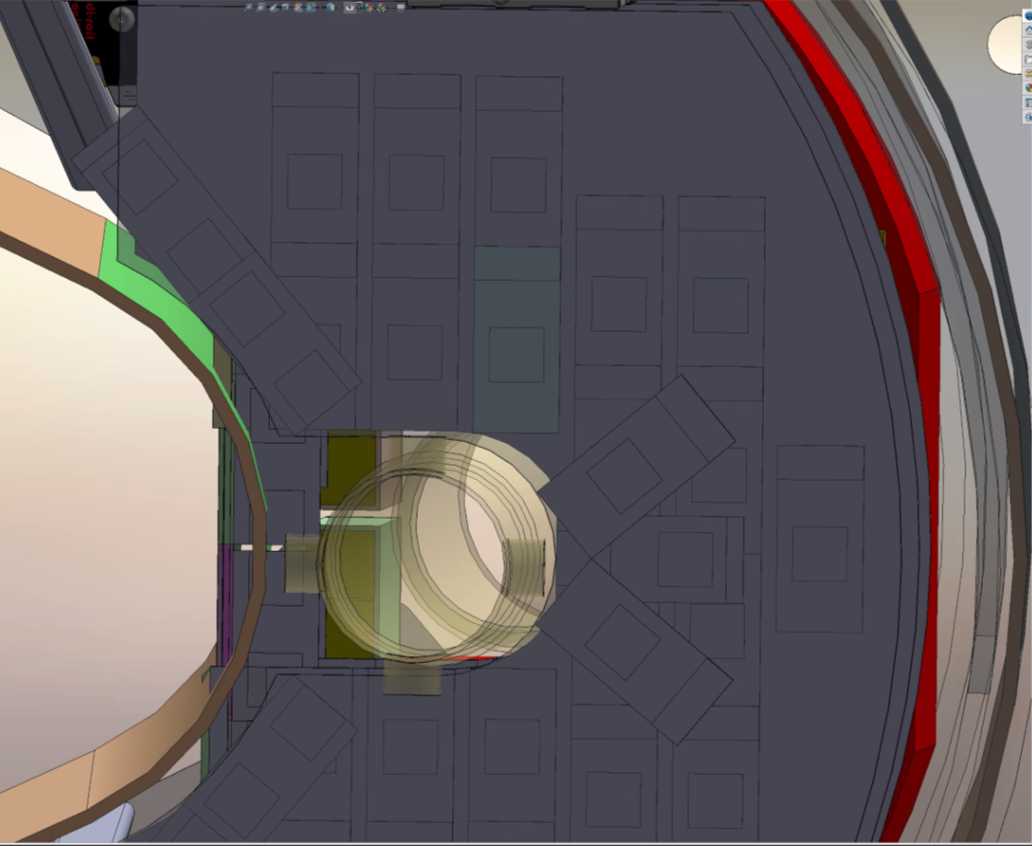
B0 – Detector Plane #1 Cryostat Foul
Detector Plane #1 is currently fouling the cryostat in the present position. We are investigating options on how to work around the issue. Alex Jentsch mentioned a possibility of using a smaller ASIC module for this unique position, but not official at the moment.
(Image courtesy of Avishay Mizrahi)

Slide 4
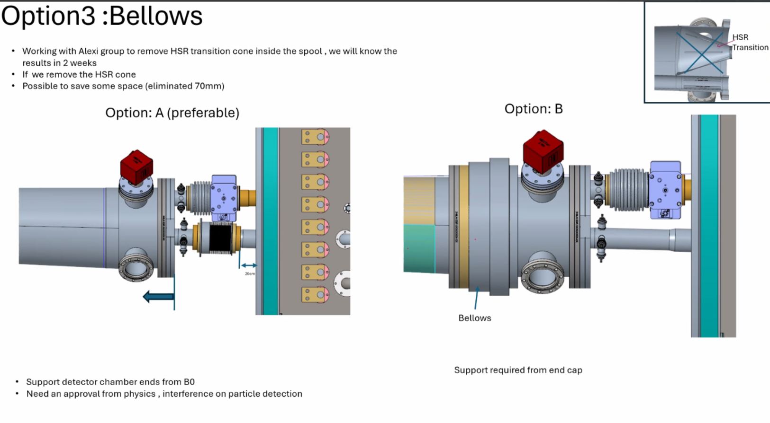
B0 – Bellows Questions & Order of Operations
Given the potential changes on the Hadron Beampipe to include a bellows in the front, there is a risk of needing to update the B0 Detector Planes geometry and external detector rail tooling.
Additionally, we are investigating what impacts may occur for the installation procedure (i.e. Installing Calorimeter supports prior to beam commissioning, installing crystals post commissioning, .etc).
There is a meeting scheduled with the Israeli Group and others for Thursday, August 6th
(Image courtesy of Guna and Charlie 7/28)

Slide 5
ZDC – Removing the maintenance railing
Background - We were recently directed to move away from the railing system for the Zero-Degree Calorimeter. It’s our understanding we may be able to isolate the beampipe in proximity and temporarily isolate the section for maintenance (not official). Applicable parties have been asked to investigate the impacts and advise.
Chia Ming Kuo, NCU Taiwan, EMCAL, has replied confirming the possibility for serviceability is acceptable, but has concerns about installation. We are having ongoing discussions with applicable parties to address issues.
Questions asked:
Will a crane be used to lift the EMCAL over the beam pipe and place it onto the ZDC table?
During cable connection and routing, will personnel be able to stand next to the beam pipe and access the relevant connectors?
After the installation is complete, will there be sufficient space around the ZDC-EMCAL to perform routine inspections, troubleshooting, component replacement, and other maintenance work?
HCAL Team has not had the opportunity to investigate at this time.

Slide 6
Ongoing/Upcoming Workload
ITPs – Submitted drafts to Yulia last Friday to review
Continuing B0 design
  Meeting Thursday to discuss potential beampipe bellows impacts
Lumi Dipole discussion scheduled for Wednesday to discuss installation/Removal procedure.
Addressing installation concerns for ZDC maintenance impacts

