Slide 1
Barrel Outer Tracker / MPGD (μRWELL)
Triple I Engineering Meeting Update (08/24/2026)
Seungjoon Lee (Jlab)

Slide 2
Update - Facility
Jlab MPGD Facility is moving foreword.
Major progress
  Ultrasonic water bath – Transformer (220V) Installed, no water yet (working on DI water system).
  Sanding station for detector frame – Installed, protocol (dust control) accepted by ES&H.
  - Fume hood for vacuum gluing – Installed, outside vent fan must be verified by 3rd party.
  - Nitrogen box for GEM foil test – Assembled.
  Deliver N₂ gas into Cleanroom – N₂ bottle space outside, delivered into clean room.
  GEM stretcher - Installed. preparing mockup test.
  Ultrasonic bath water - Distilled water system will be installed.
  Still waiting for final approval from ES&H for equipment/process

Slide 3
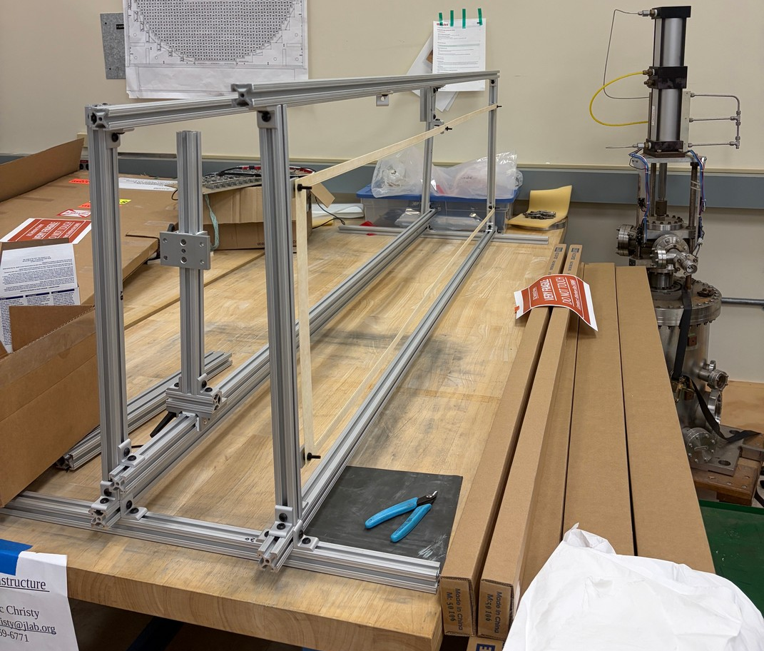
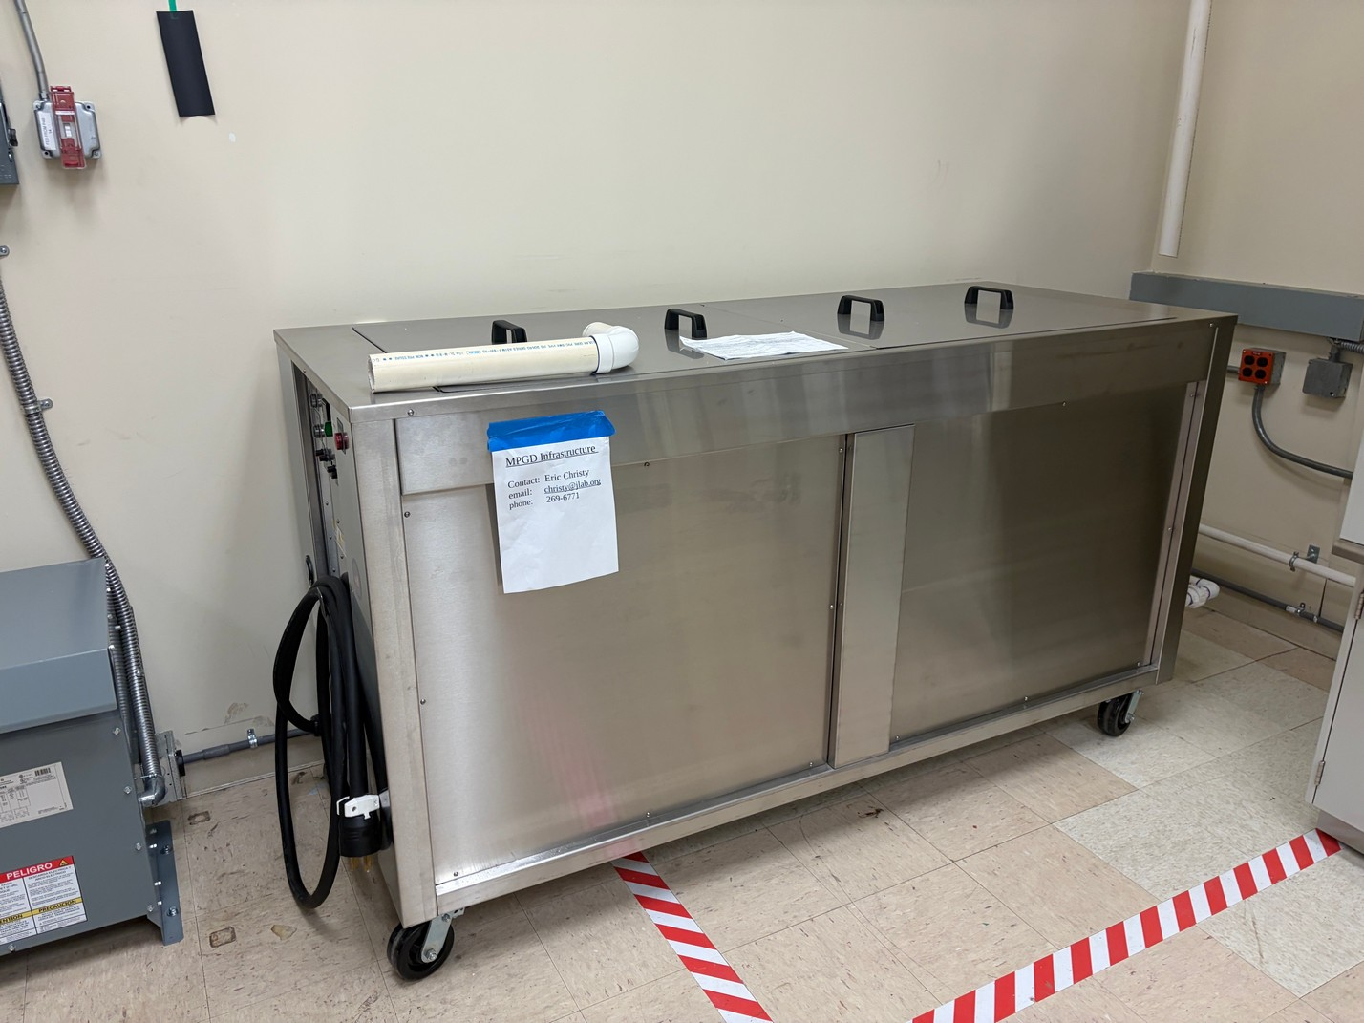
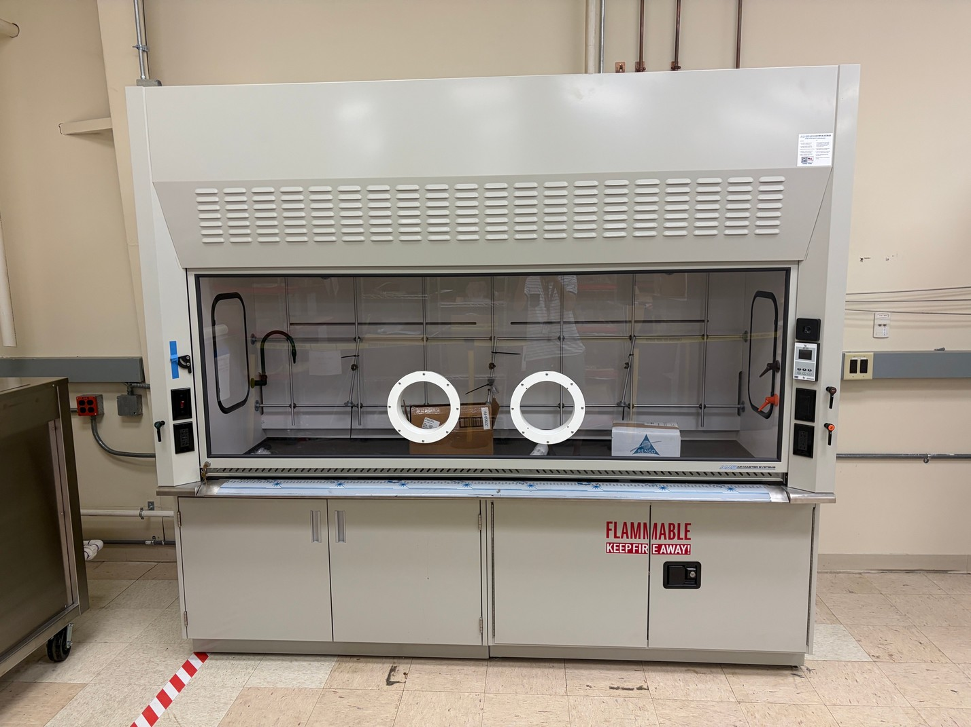
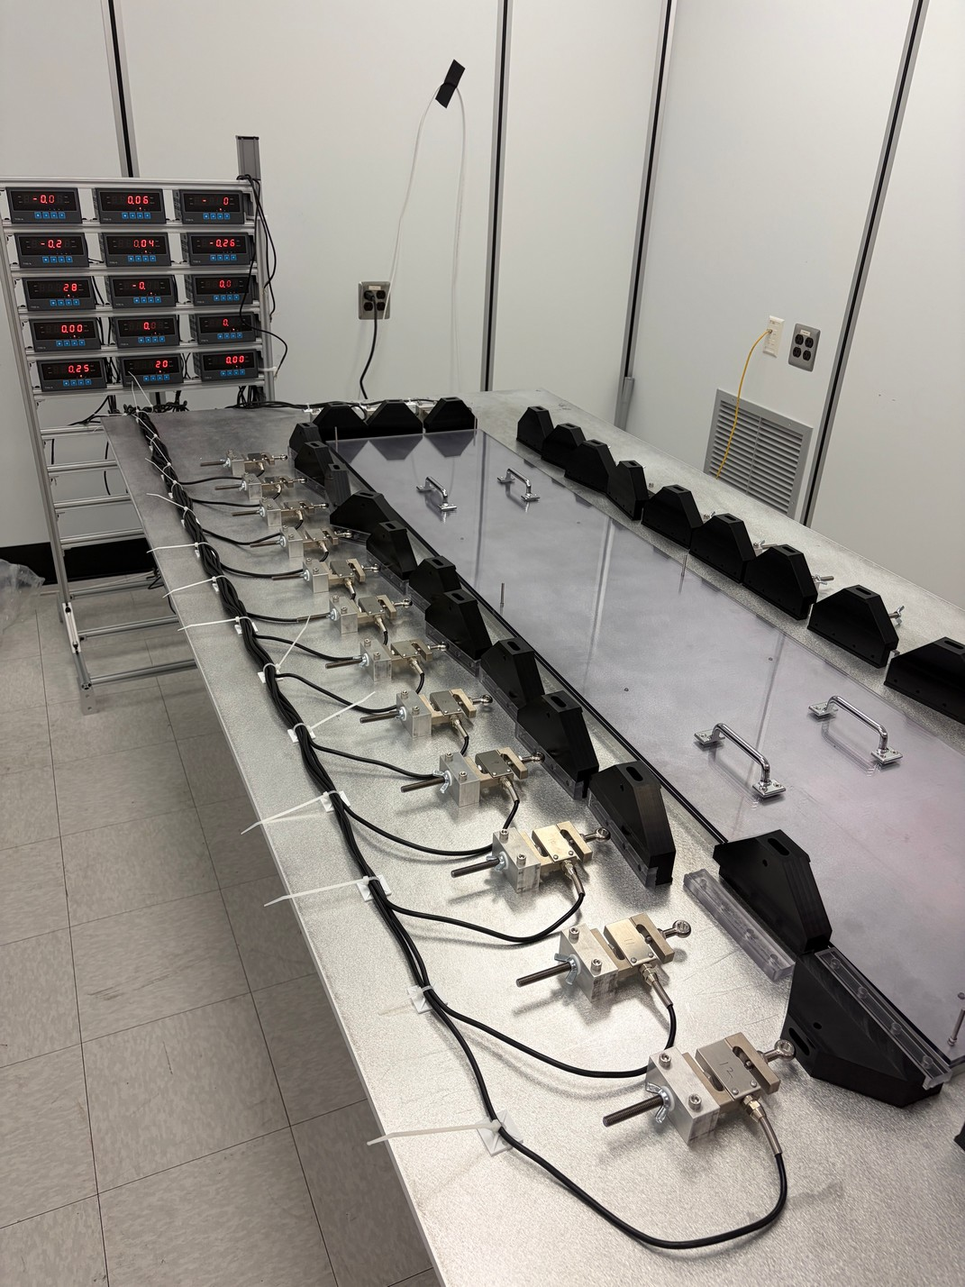
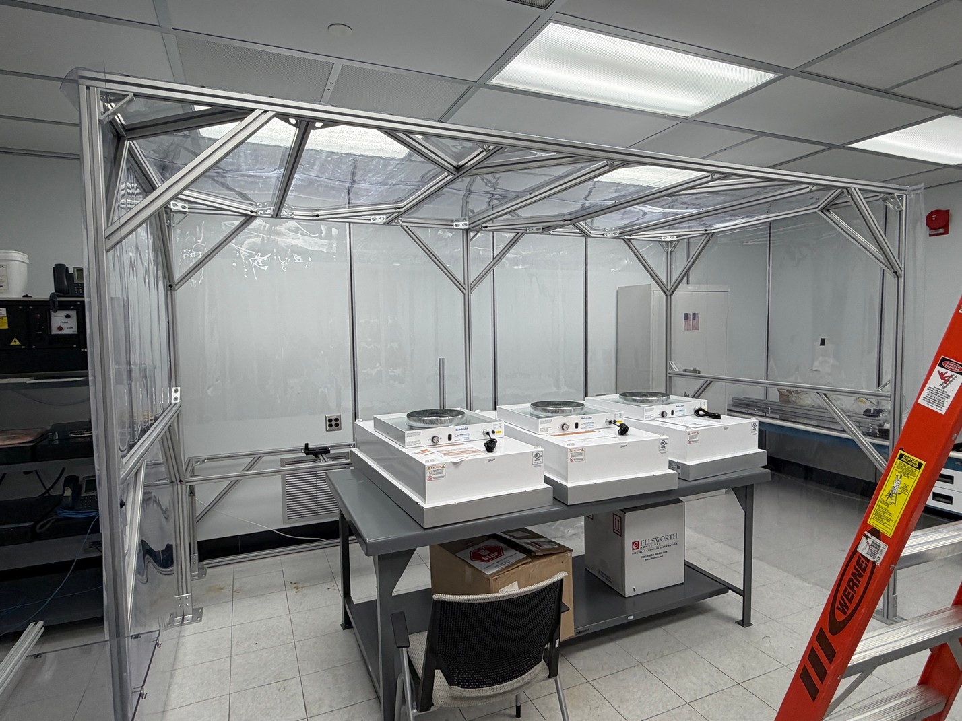
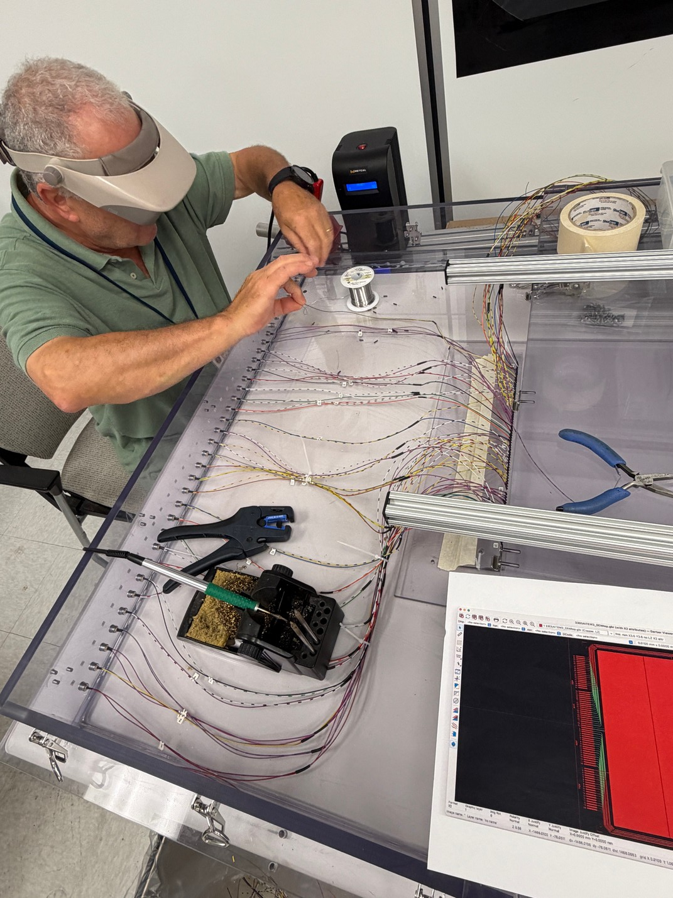
Photos
Sanding station
Ultrasonic Bath
Fume hood for Vacuum gluing
N₂ box for GEM foil test
GEM stretcher
URWELL assembly station (in progress)

Slide 4
Update – Thermal study
We will stop thermal simulation at this point.
We will continue to update when FEB components are made/updated.
There was an update on SALSA power estimation and power supply scheme.
Power consumption from 15.5 W to 18.5 W per FEB (20% increase)
Overall cooling scheme has not been changed.
Thermal simulation will be done with new numbers.
Working on the module on West side
Working on combined cooling scheme (14 FEBs instead of 7 FEBs)

Slide 5
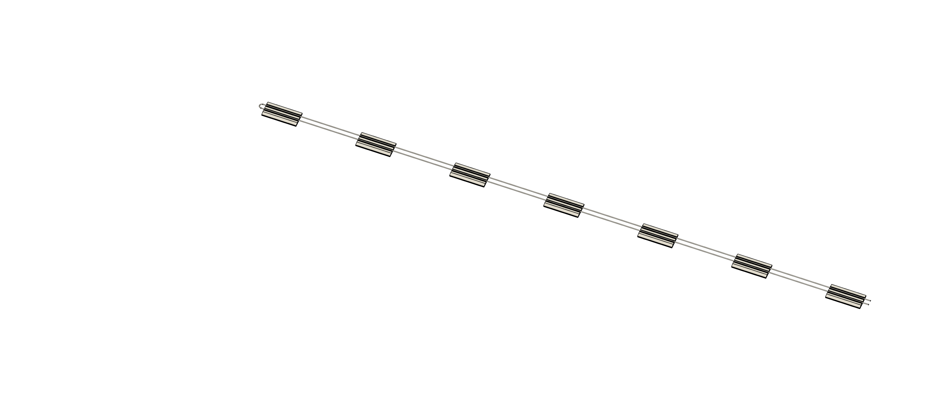
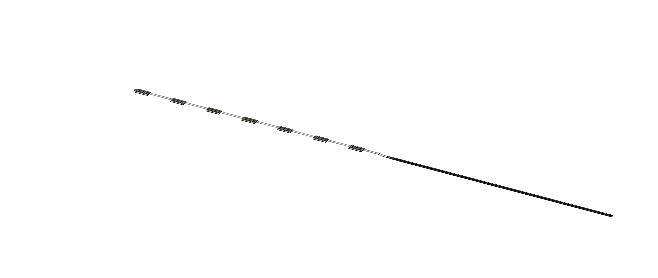
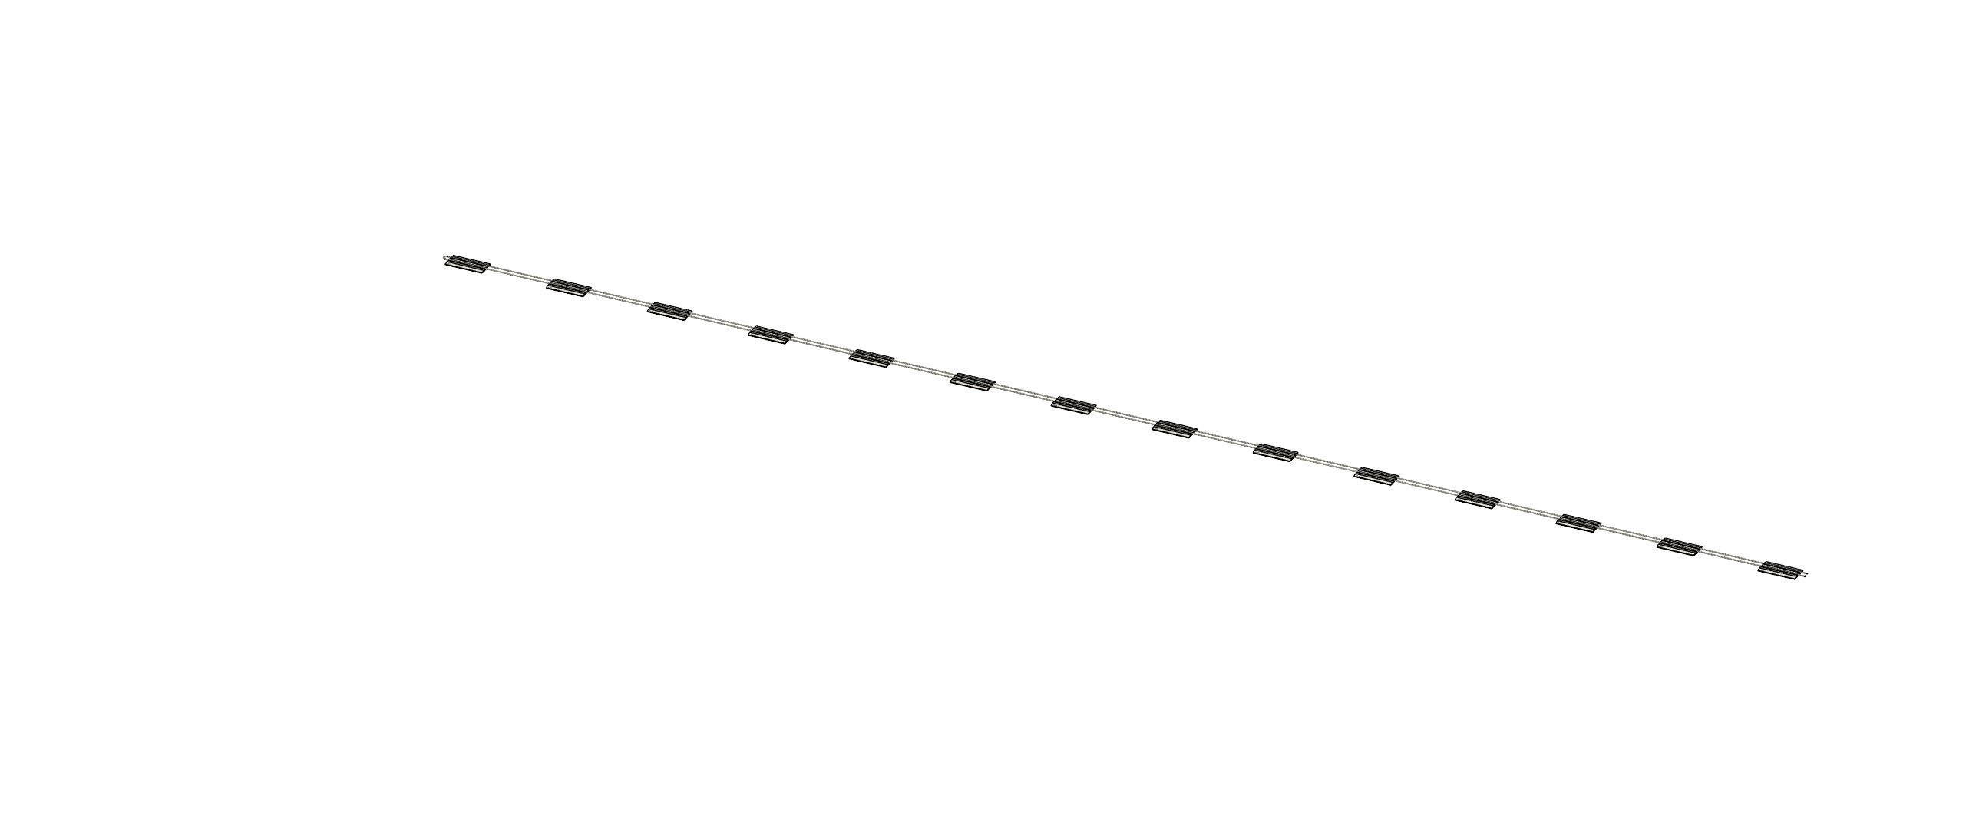
Update – Thermal study
Base model 7 FEB (done)
Westside model
(added pressure drop + temperature rise)
14 FEB model
½ cooling line
FEB temp. variation increase

Slide 6
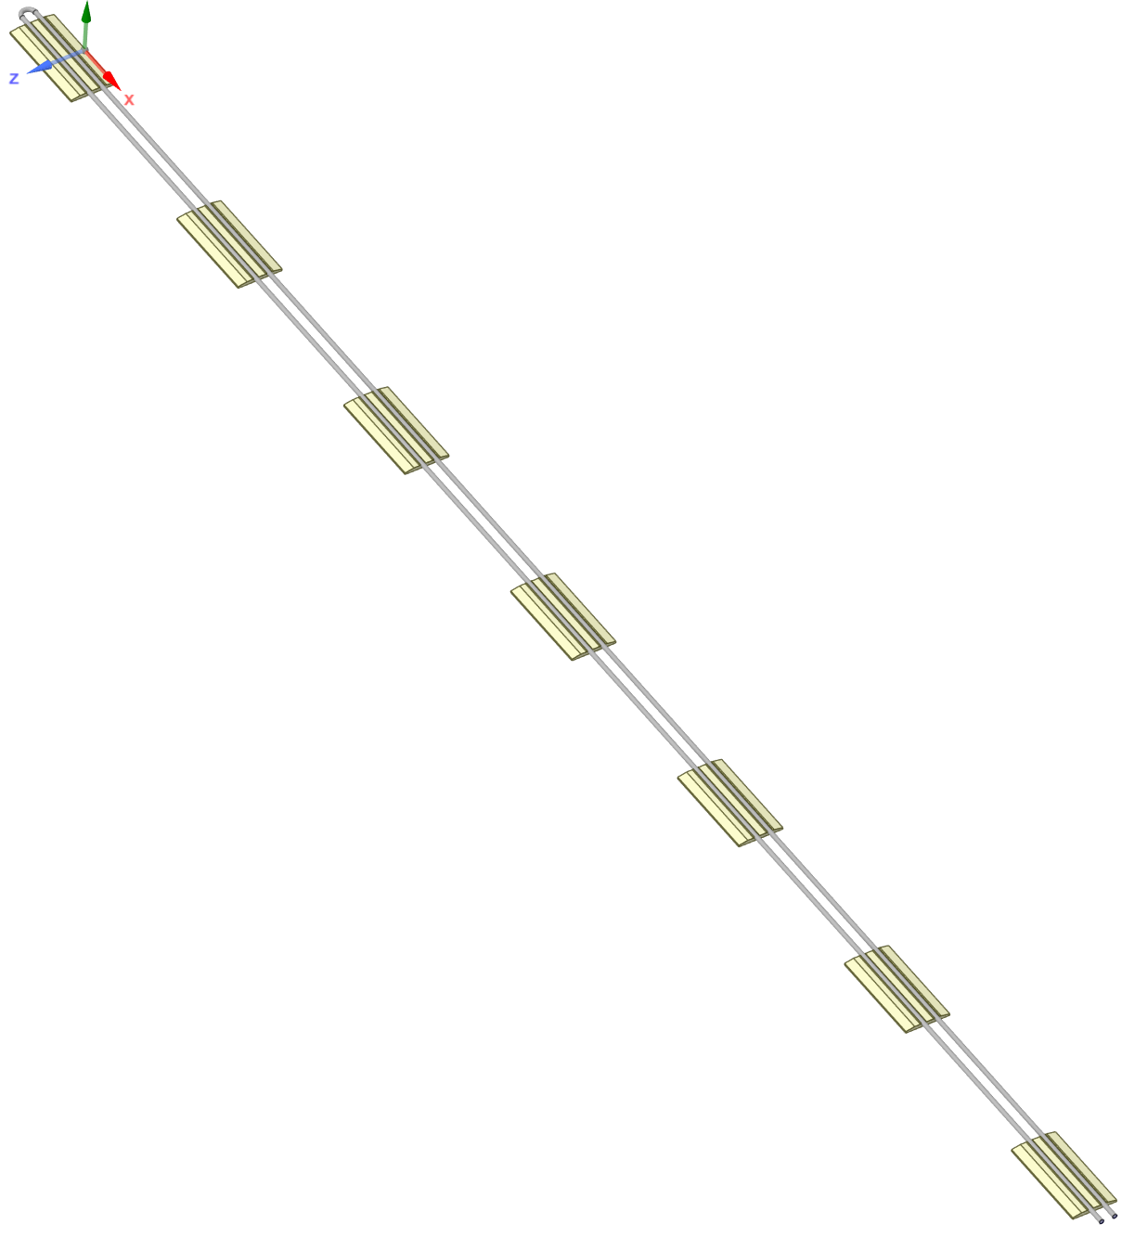
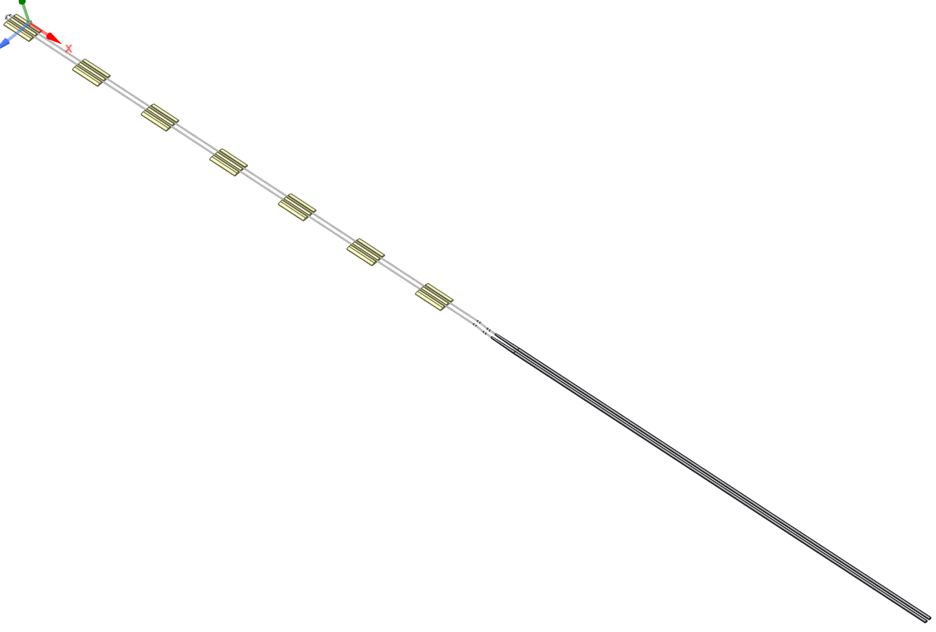
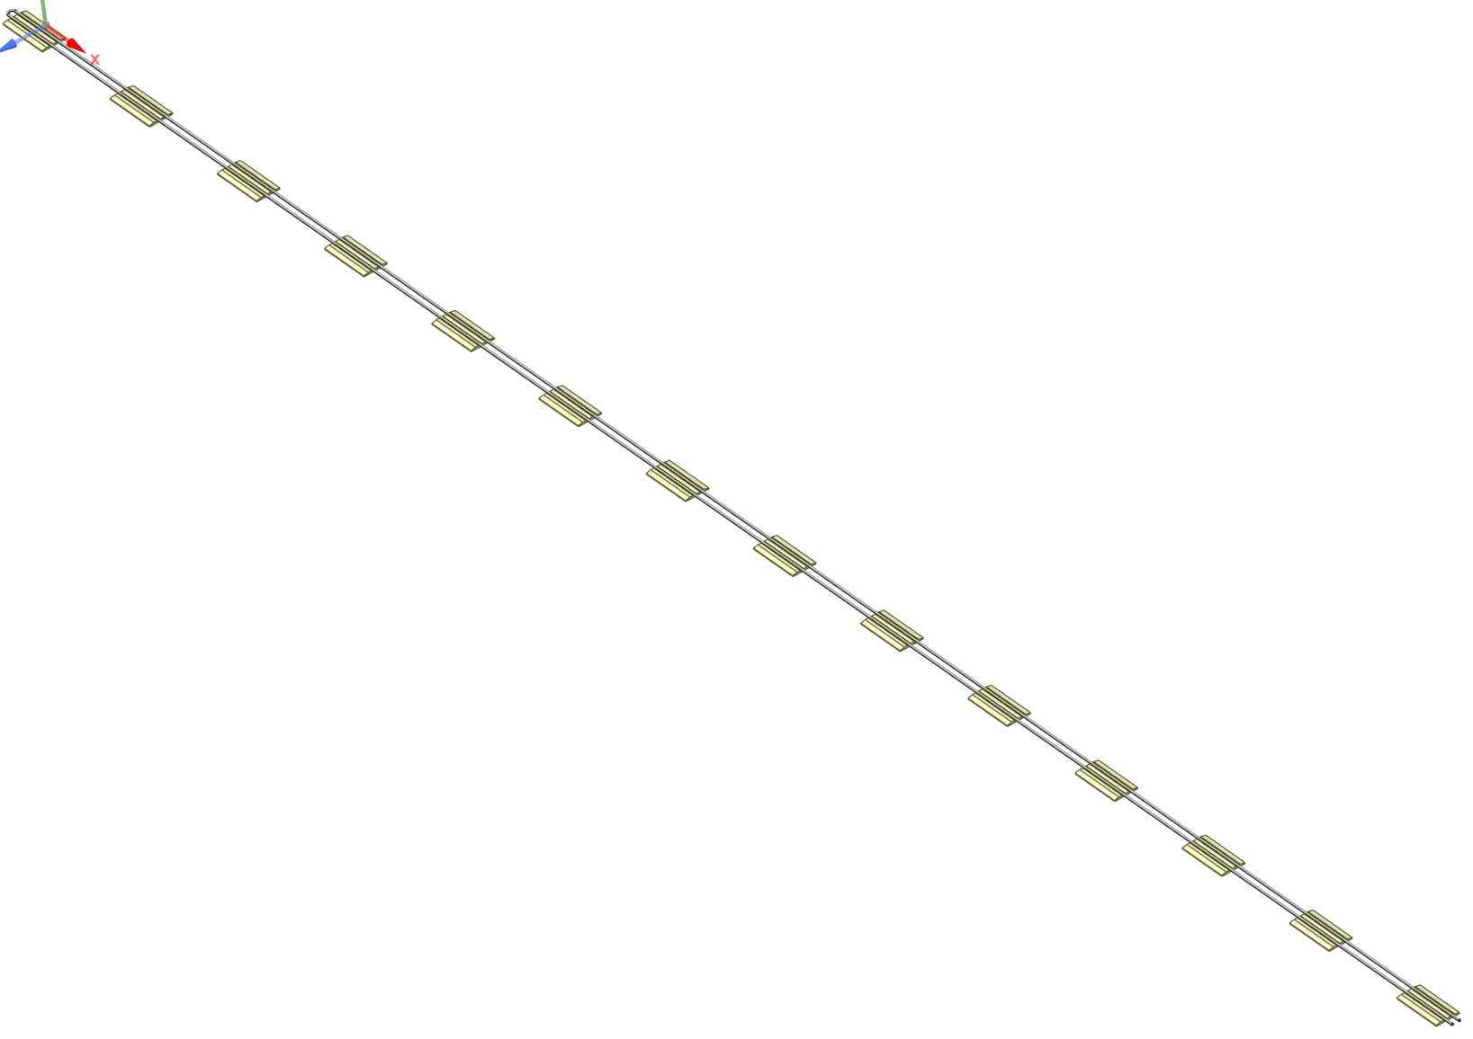
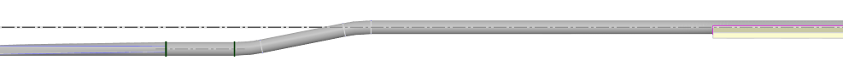
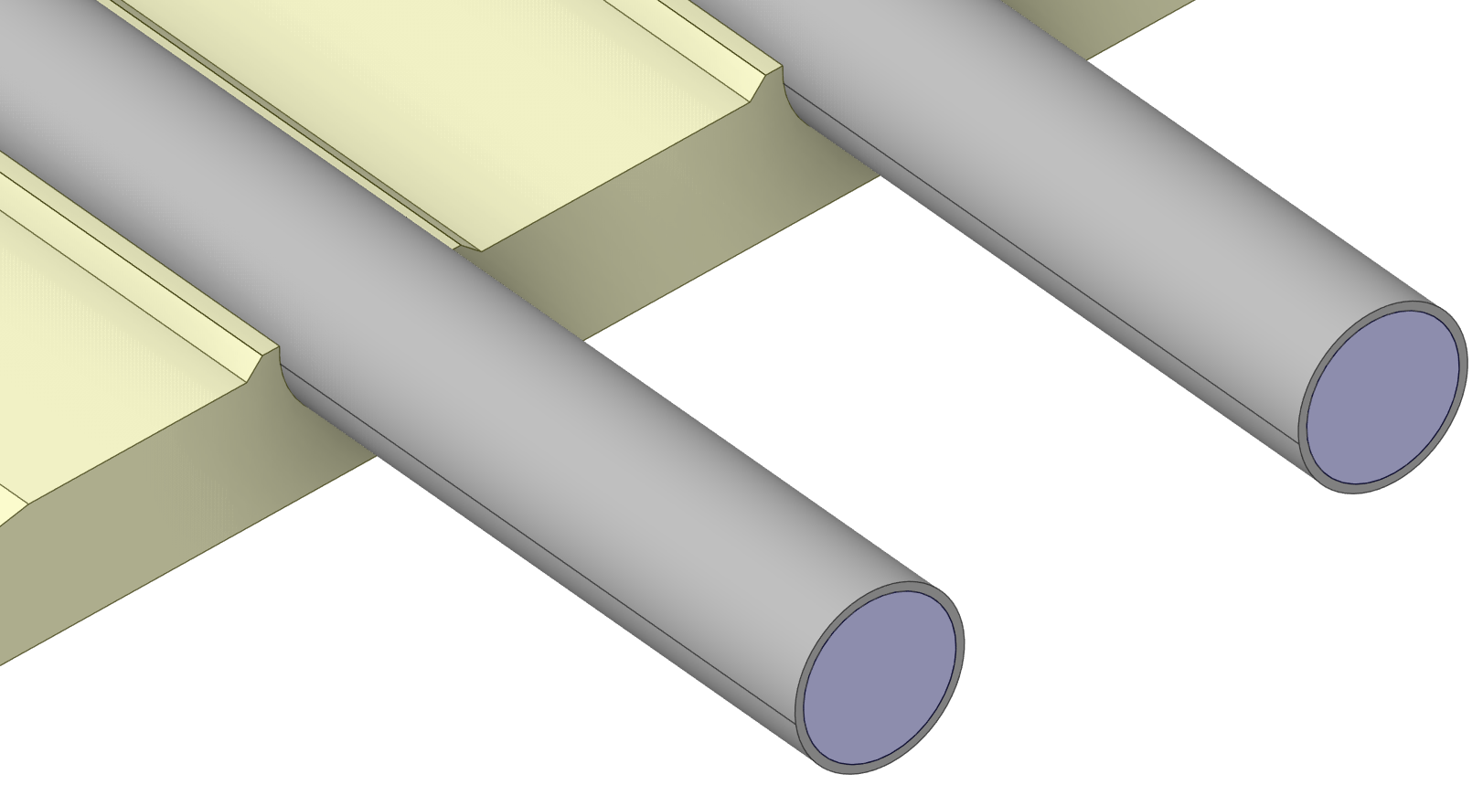
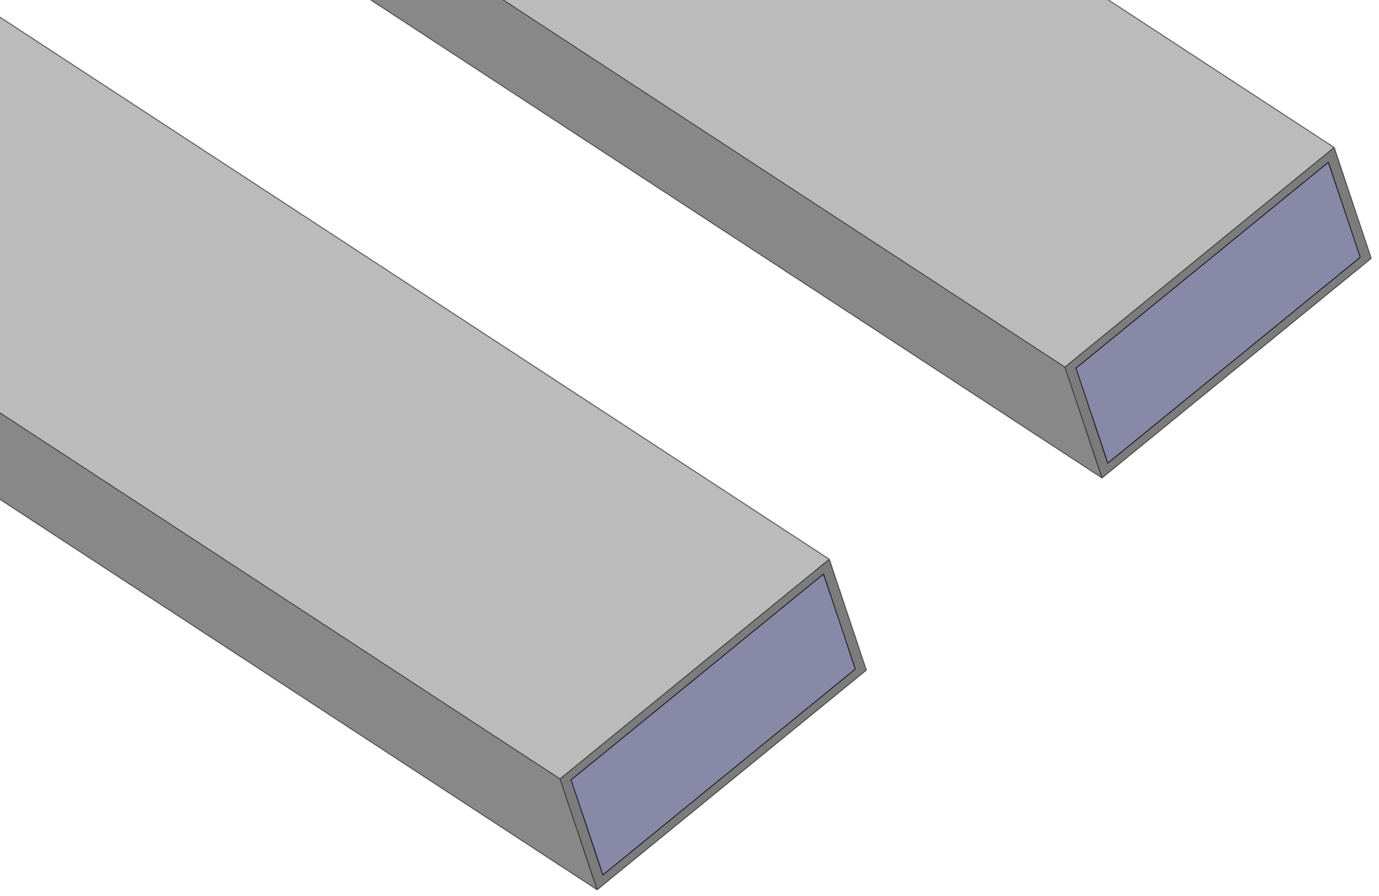
ePIC Detector – Outer MPGD
7 FEBs
enlarged view
14 FEBs
7 FEBs
Upstream rectangular cross section inlet tube tapered to circular cross section approaching FEB in cooling loop2 due to services constraints. Need to study the effect of pressure drop of this arrangement
enlarged view
enlarged view
enlarged view
outlet
outlet
outlet
rectangular cross section
inlet
inlet
circular cross section
inlet
circular cross section
Cooling loop1 half module
Cooling loop2 half module
Combined - Full module

Slide 7
ePIC Detector – Outer MPGD Comparison
Component | Cooling loop1 half module | Cooling loop1 half module | Cooling loop2 half module | Combined - Full module | Combined - Full module
Number of FEBs | 7 | 7 | 7 | 14 | 14
Single FEB Heat (W) | 15.206 | 15.206 | 15.206 | 15.206 | 15.206
Total FEB Heat (W) | 106.442 | 106.442 | 106.442 | 212.884 | 212.884
Temperature Rise (C) | 2 | 2 | 2 | 2 | 4
Flow (lpm) | 0.76 | 0.54 | 0.76 | 1.52 | 0.76
Reynolds Number | 3765 (Transition Flow) | 2662 (Transition Flow) | 2535 (Transition Flow) | 7531( Turbulent Flow) | 3765 (Transition Flow)
Pressure drop (bar) | 0.083 | 0.055 | 0.15 | 0.78 | 0.167
Cooling media | Water
Inlet Temperature | 22 | C
Ambient Temperature | 23 | C
Tube inner diameter | 4.5 | mm
Tube outer diameter | 5 | mm
Tube material | Stainless Steel
Min Temperature of Detector | 25 | C
Max Temperature of Detector | 35 | C
Temperature stability | ± 3 | C

Slide 8
ePIC Detector – Outer MPGD Comparison
Pressure drop is significant for the module at west side or single looping.
For the optimized design, hard limit for pressure drop is required (i.e. 0.25 bar).
Further thermal/fluidic simulation is required.
Still preliminary until SALSA/FEB design is finalized.
Current cooling design at service line (from Chiller to Detector) unknown.

Slide 9
GST FEA study
There was discussion for deformation of GST related to hp-DIRC and BOT
BOT tolerance < 50 μm/ft., while GST deformation is about 2 mm max.
Due to the detector design (stretched GEM foil, HV to thin gaps) small deformation will damage the whole detector or make the detector non-functional.
Decoupling of GST is ideal.
Waiting for further simulation of GST to identify level of deformation for design of decoupling mount.

Slide 10
Backups

Slide 11
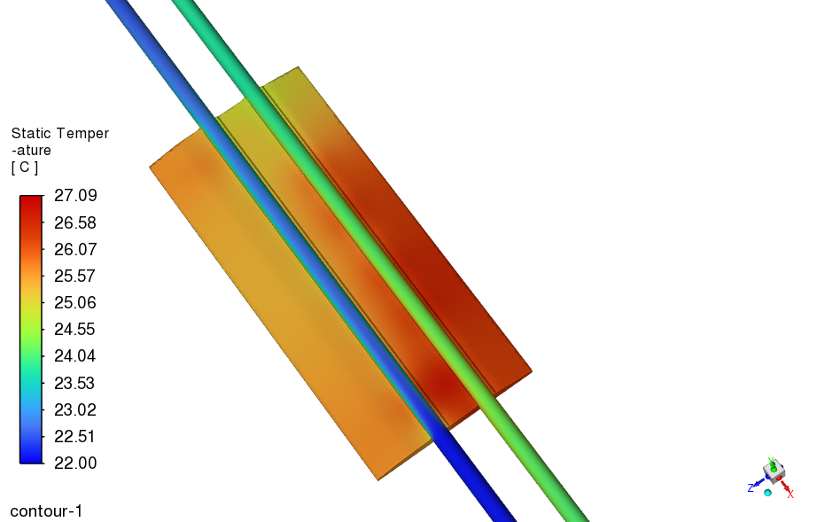
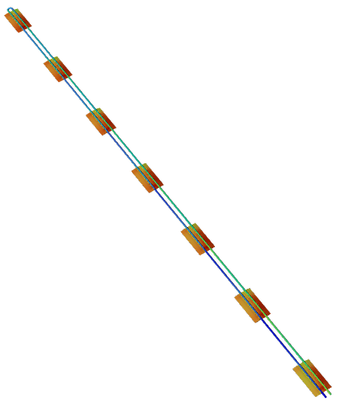
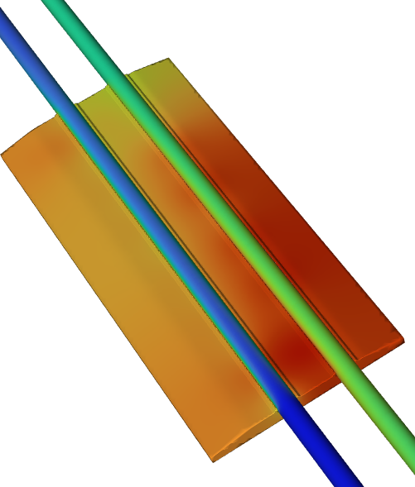
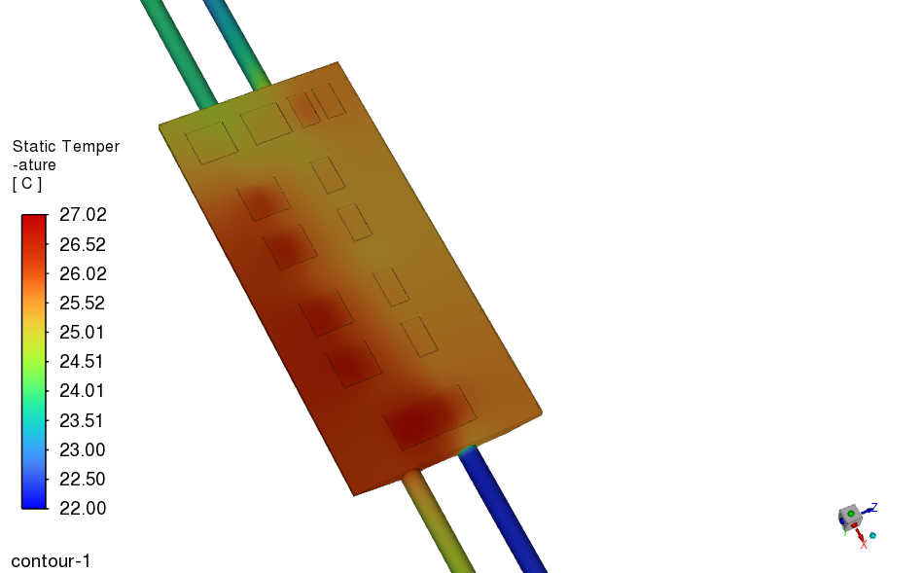
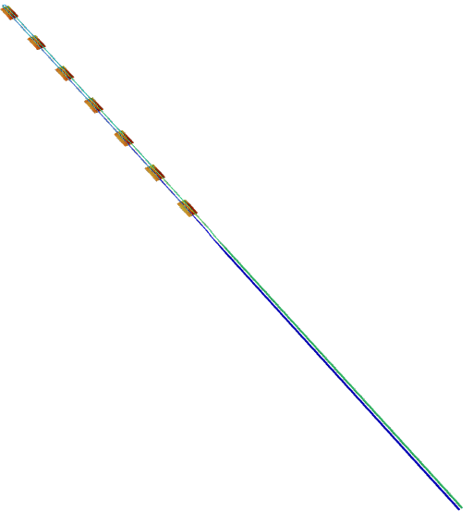
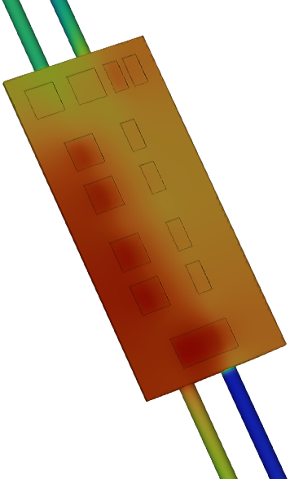
ePIC Detector – Outer MPGD - Results
Cooling loop1 half module
Cooling loop2 half module

Slide 12
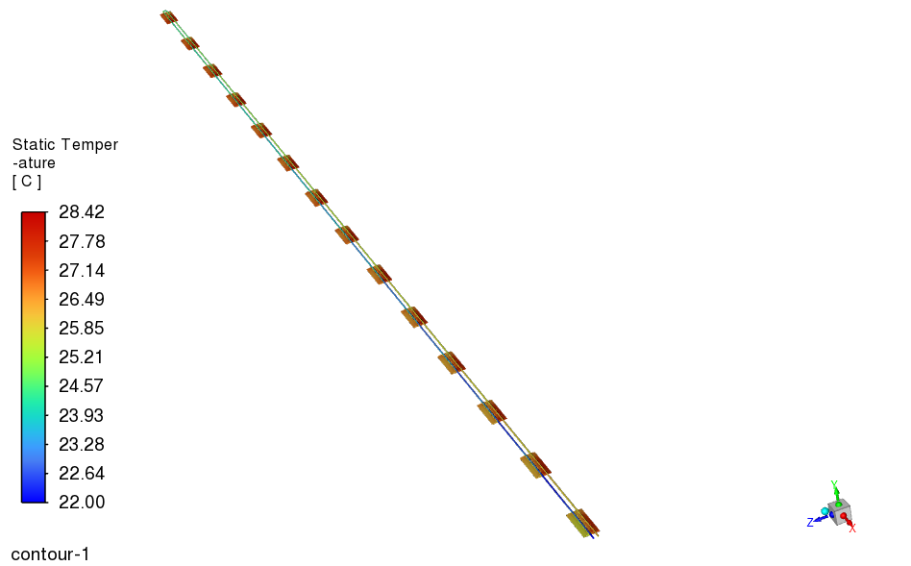
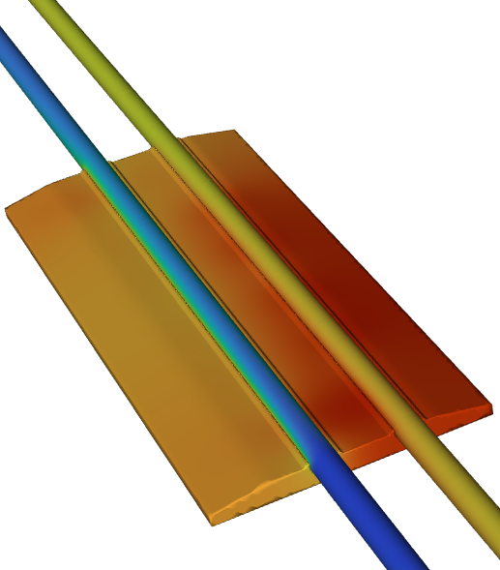
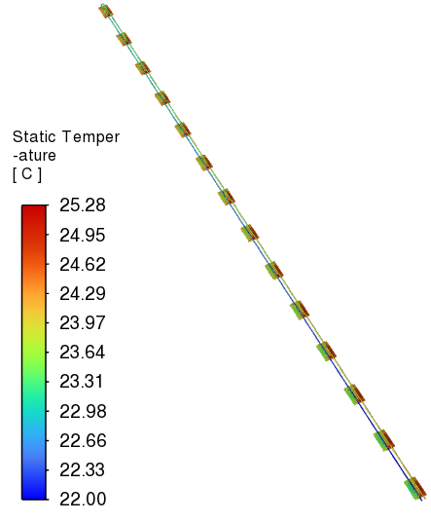
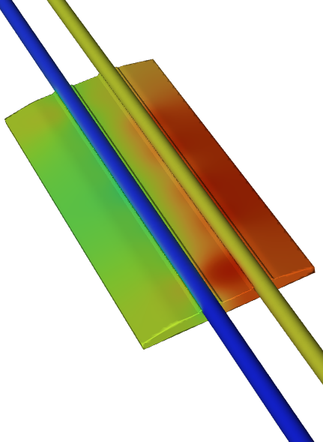
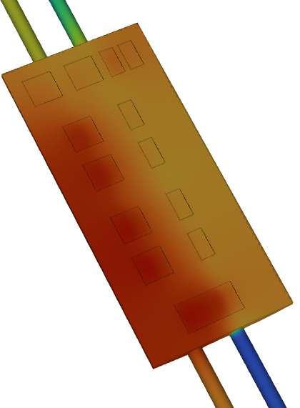
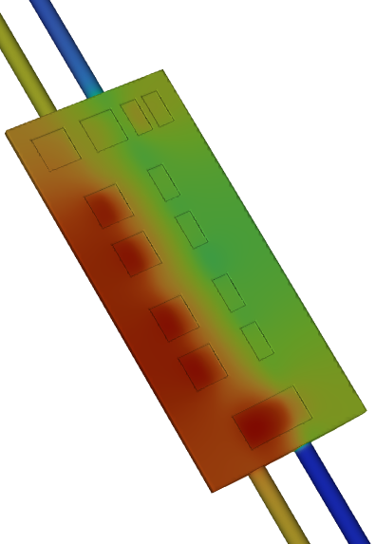
ePIC Detector – Outer MPGD - Results
Combined - Full module
Flow – 0.76 lpm, dT – 4C
Combined - Full module
Flow – 1.52 lpm, dT – 2C

Slide 13
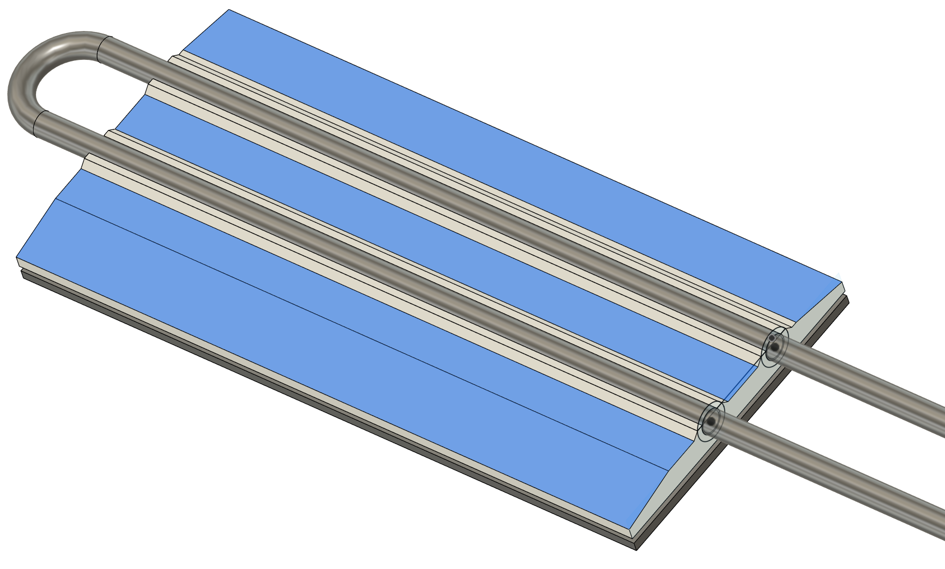
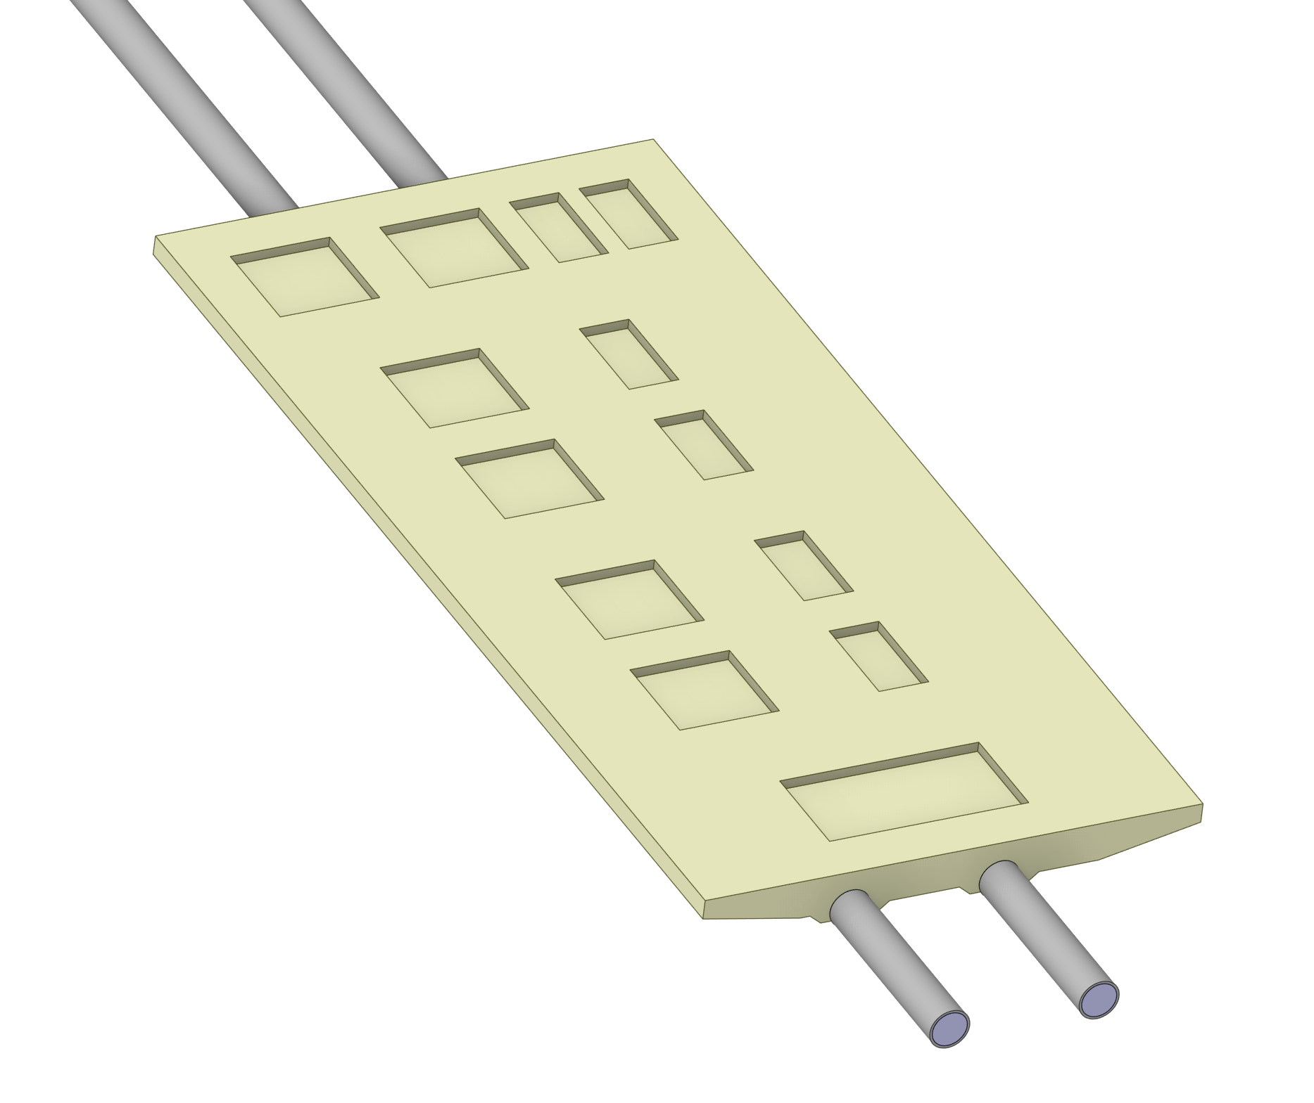
Update – Thermal study
Baseline thermal study is done.
Cooling plan
- 7 FEBs per one cooling loop
- 2 cooling loops per detector module
- 4 cooling loops per section (out of 12)
- all cooling service from east side
- 16W per FEB, 112W per cooling loop
- T_{in} = 22 ºC, T_{out} = 23.9 ºC
- Pipe ID = 3.5 mm, OD = 4 mm SS.
- Flow rate = 13.4 ml/s, Speed = 1.4 m/s
Pressure drop = 1.5 psi/m
6.3 W heat to the ambient air
Heat Load
Analytical calculation | 112 | W
CFD calculation | 105.7 | W
Difference | 6.3 | W

Slide 14
7 FEB Heat Load – modified design – without insulation
Temperature rise 2 C
Analytical calculation
CFD calculation
Number of FEB | 7
Single FEB | 15.5 | W
with margin | 16 | W
Total FEB | 112 | W
dT | 2 | C
Cp | 4181 | J/kg C
m | 0.01339 | kg/s
m | 0.01339 | l/s
m | 13.39 | ml/s
m | 0.013285 | kg/s
Cp | 4181 | J/kg C
inlet | 22 | C
outlet | 23.903 | C
dT | 1.903 | C
Total FEB heat load | 105.7 | W
Heat Load
Analytical calculation | 112 | W
CFD calculation | 105.7 | W
Difference | 6.3 | W
Tapered design
Velocity | 1.392 | m/s
Re | 5145 | Turbulent
Tube ID changed from 4.5 mm to 3.5 mm
OD changed from 5 mm to 4 mm
Inlet water Temperature | 22 | C
Ambient Temperature | 23.3 | C

