Slide 1
EIC Project Update
– J. Yeck
My Interpretations and Relevance to the BNL/EPIC work – EO’B
Jim Yeck
July 1, 2026

Slide 2
EIC Project – Past Schedule/Near Future
  The EIC Project Team’s goal is to deliver the Electron Ion Collider at a Total Project Cost (TPC) to DOE of ~$3,000,000,000 including contingency, all overheads and inflation.
  The driving question the EIC Project needs to answer is what can be delivered for $3B, and on what schedule ?
  Past Schedule
    CD-1 Approved June 2021
    NYS-funded EIC Buildings - Feb 2024 ($100M)
    CD-3A - Mar 2024 ($90M)
    CD-3B - Jan 2026 ($67M)
    RHIC R&R begins – Apr 2026
  Near Future
    DOE Independent Project Review, Sept 15-18, 2026.
    At IPR will request CD-3C (<$100M)
    NYS Infrastructure CD-2/3 (<$100M).
2

Slide 3
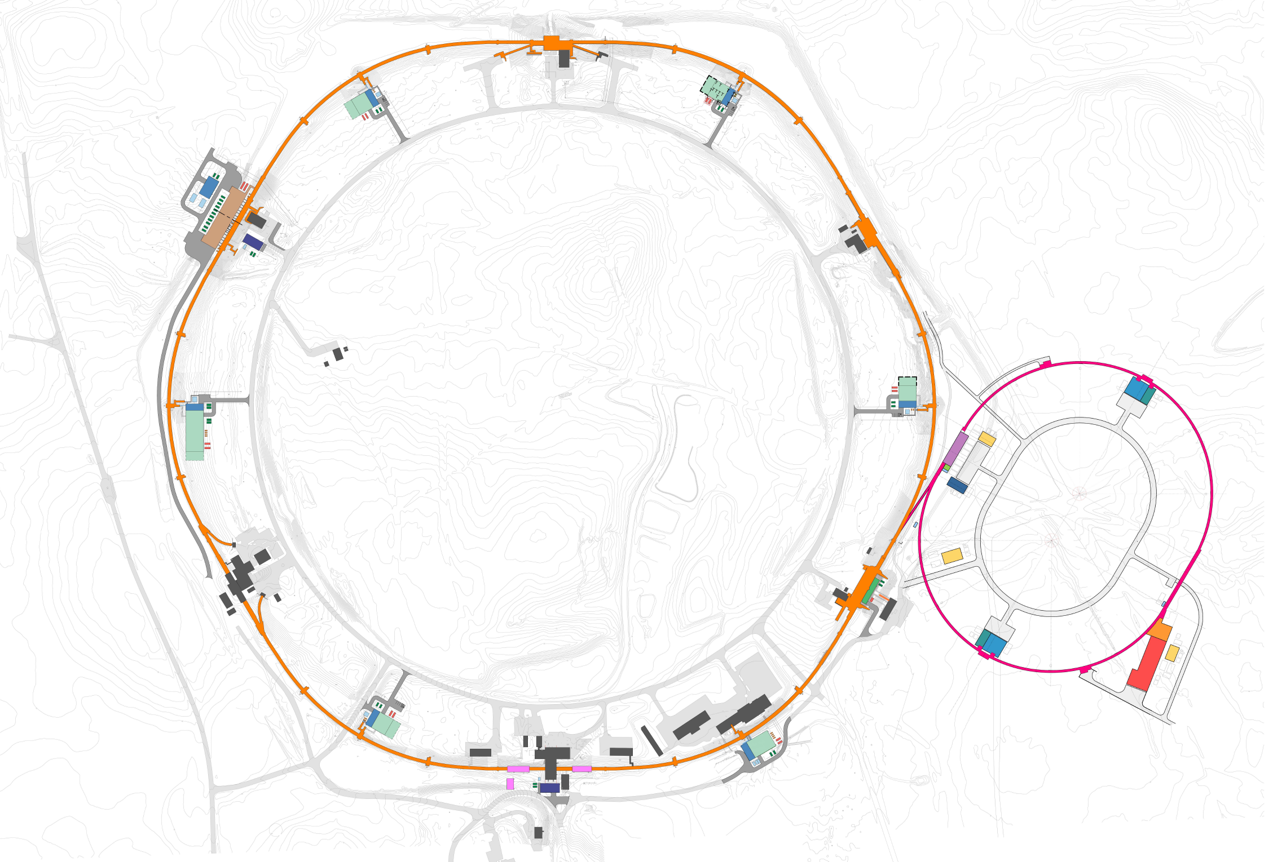
EIC Infrastructure Full Scope & Cost
34 New Buildings
366,000 Square Feet
70 MVA Peak Demand
42 Electrical Unit Substations
6 Miles 13.8kV Lines
60 MW Heat Rejection
15 Cooling Towers
5 Miles Cooling Piping
28 Chiller Units
CAD currently has
~100 Buildings
RHIC to EIC
1,180m
3,870 ft.
EIN
Sept 2026 review
Will ask approval to begin NYS funded portion of Infrastructure
DOE: $575.2M
NYS: $86.5M
3:20’ Animation Flyover Video
3

Slide 4
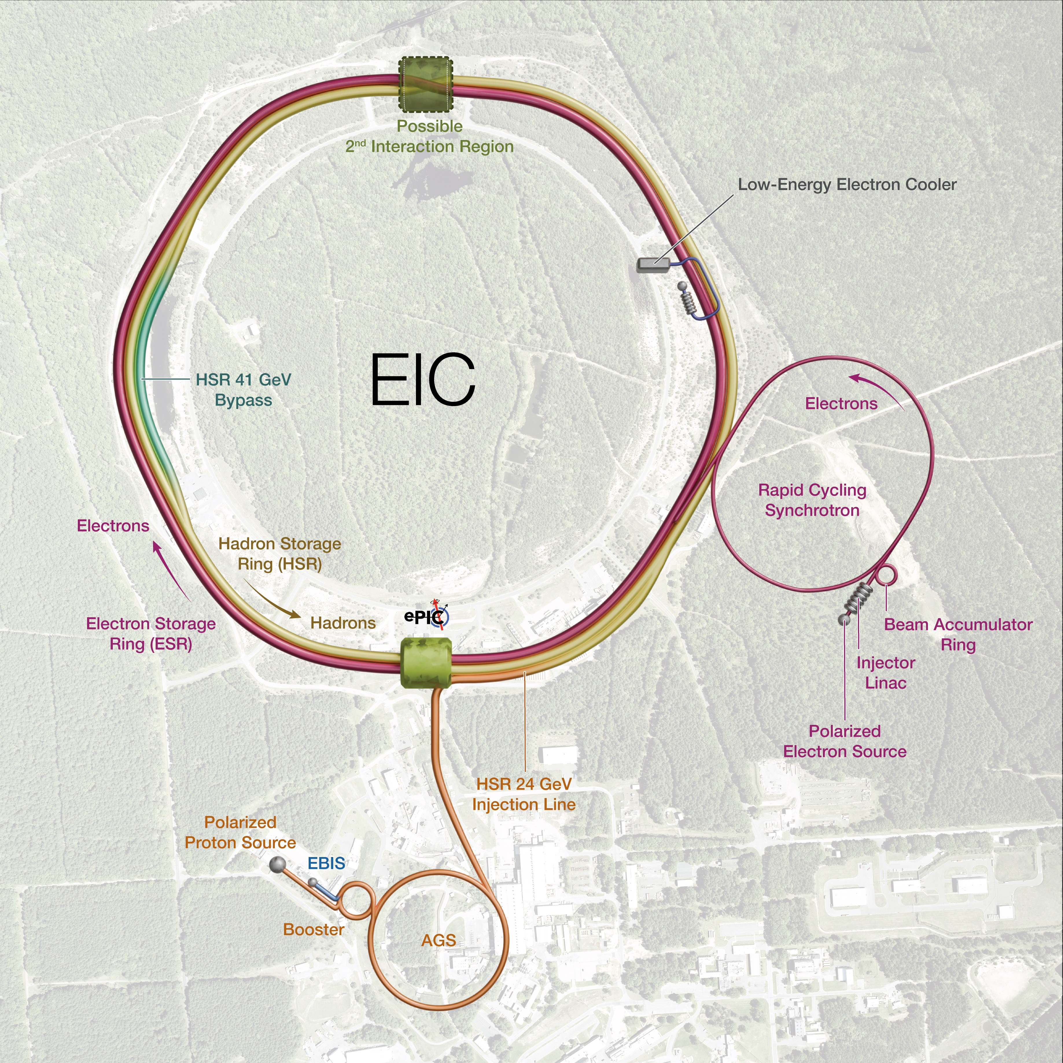
EIC Scope
EIC Scope
A single integrated line-item construction project.
Scope includes well-defined deliverables, interfaces, and draft KPPs.
EIC Line-Item Project Scope:
Infrastructure
Collider Accelerator Storage Rings and Interaction Region
Electron Injector
Detector
EIC Portfolio (Off-Project Scope)
NP Operations scope, including initial EIC Ops
Host Laboratory Infrastructure
4

Slide 5
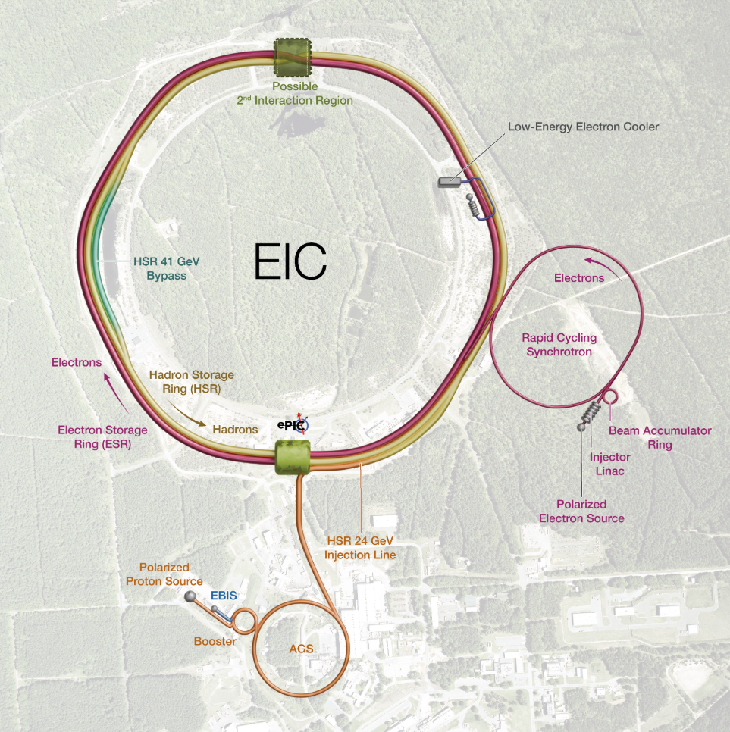
EIC + Dependencies Full Portfolio
The EIC Portfolio aligns the project, DOE programs, and Host-Laboratory capabilities to deliver the infrastructure, scope, and readiness needed for the Electron-Ion Collider.
The Portfolio Office connects the work that must be defined, funded, delivered, and monitored across the enterprise.
$3B (DOE)
$800-900M (DOE)
$200-300M(BNL)
EIC Line-Item
Project
SC Program
Engagements
SC Host Lab
Engagements
Capabilities, infrastructure, and operational readiness provided by way of DOE-SC HENP funding
RHIC Removal & Repurposing
Hardon maintenance & infrastructure
AGS Cooling modernization
SRF Test Facility
Cryo Plant reliability improvements
Infrastructure and services provided by
way of SC Host Laboratory funding opportunities.
Electrical power
Fire protection
Potable water
Storm & Sanitary Drain
Additional scope opportunities under consideration
Design, construction, and commissioning of the Electron-Ion Collider using a sub-project methodology including:
Infrastructure
Collider
Electron Injector
Detector
5

Slide 6
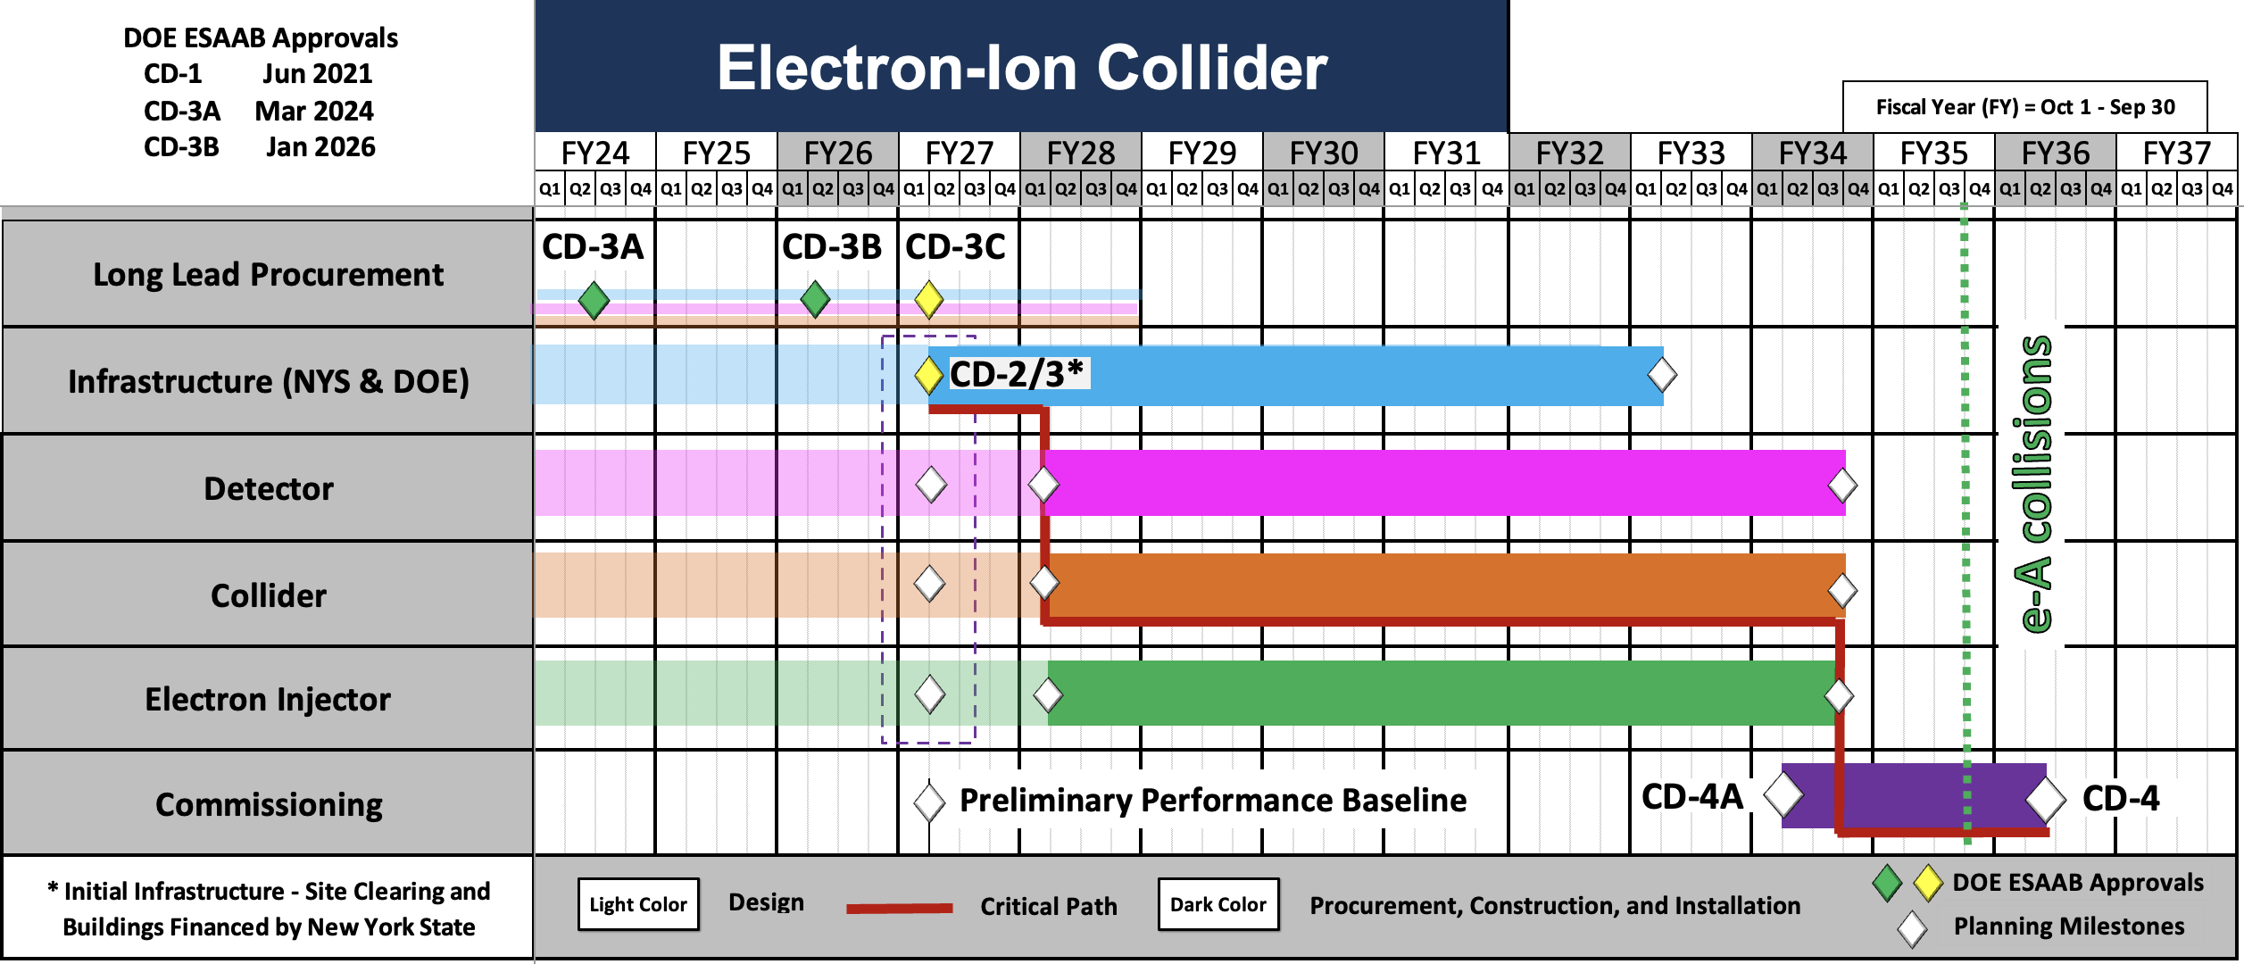
Proposed EIC Technically Driven Schedule
6

Slide 7
What Are the Challenges to Meet the Proposed EIC Schedule?
In order to meet the proposed schedule and obtains CD-2/3 approval simultaneously for the balance of the Infrastructure, Detector, EI and Collider one would need to do the following in the next 15 months:
Complete all final drawings to the 90%+ level for all EIC (New Buildings, Detector, EI, Collider)
Identify 90% of the vendors for everything to be ordered and obtain budgetary quotations from them
Build and test 90% of all preproduction, large prototype or first article items (magnets, RF, controls, subdetectors…)
Complete 90% of all “chain” and ”slice” tests for detector and accelerator systems
Have a fully resource-loaded and leveled P6 plan based on the designs, drawings, budgetary quotes and tests of the EIC deliverables (New Buildings, Detector, EI, Collider)
It is a lot of work but is required to successfully complete a project, especially one as unique as the EIC

