Slide 1






EICROC update
F. Bouyjou, H. Chanal, F. Dulucq, M. El Berni, S. Extier, M. Firlej, T. Fiutowski, K. Guillossou, F. Guilloux, M. Idzik, N. Kachkachi, B.-Y. Ki, C. de La Taille, J. Moron, D. Marchand, L. Royer, N. Seguin-Moreau, L. Serin, A. Shama, A. Soulier, K. Swientek, D. Thienpont, A. Verplancke

Slide 2
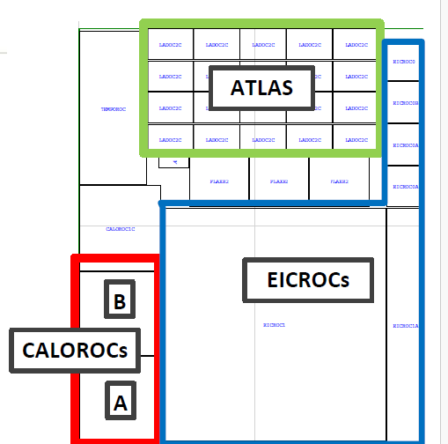
EICROC prototypes
EICROC0 : 4x4 pixels with simple readout (2022)
EICROC OA/0B 1/1B fabricated in 2025 « ATLAS/ EIC » engineering run TSMC 130n
  EICROC0A/B : 4x4 with improved blocks and testability
  EICROC1/1A : 32x32 and 4x32
EICROC2 will be fabricated Q1 2027
  Should be the final chip…

Slide 3
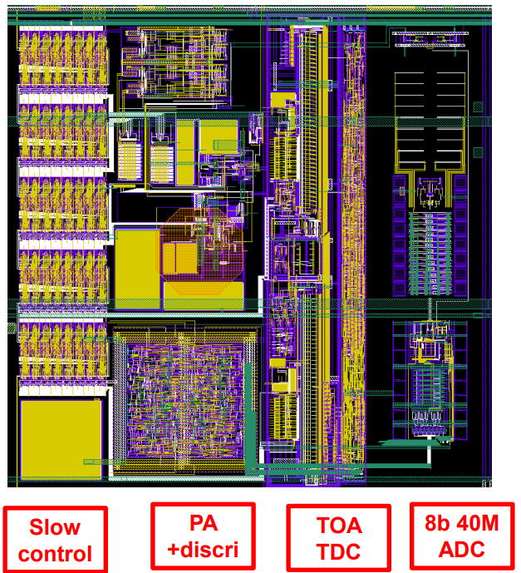
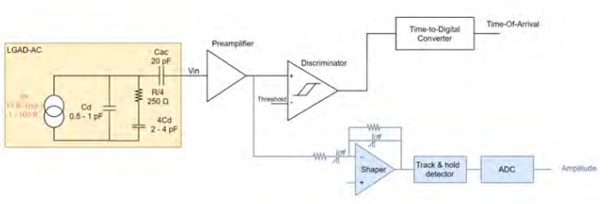

EICROC0
Analog frontend similar to ATLAS ALTIROC
  Cd = 1 pF (max 3 pF)
Need ADC instead of ToT for charge measurement : 8bit 40 MHz from AGH Krakow
TDC taken from HGCROC by CEA Saclay
Simple digital readout but SEE-proof I²C slow control
~2 mW/pixel
Fabricated in spring 2022 in TSMC 130nm

Slide 4
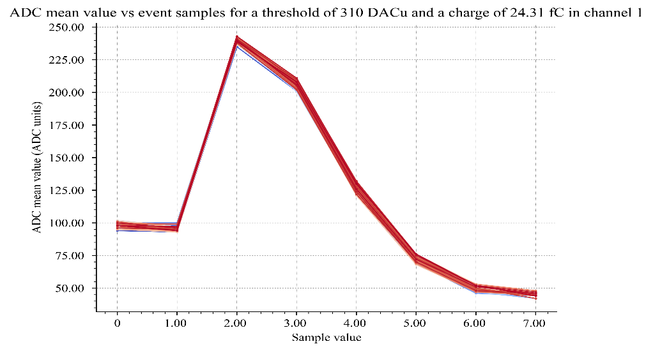
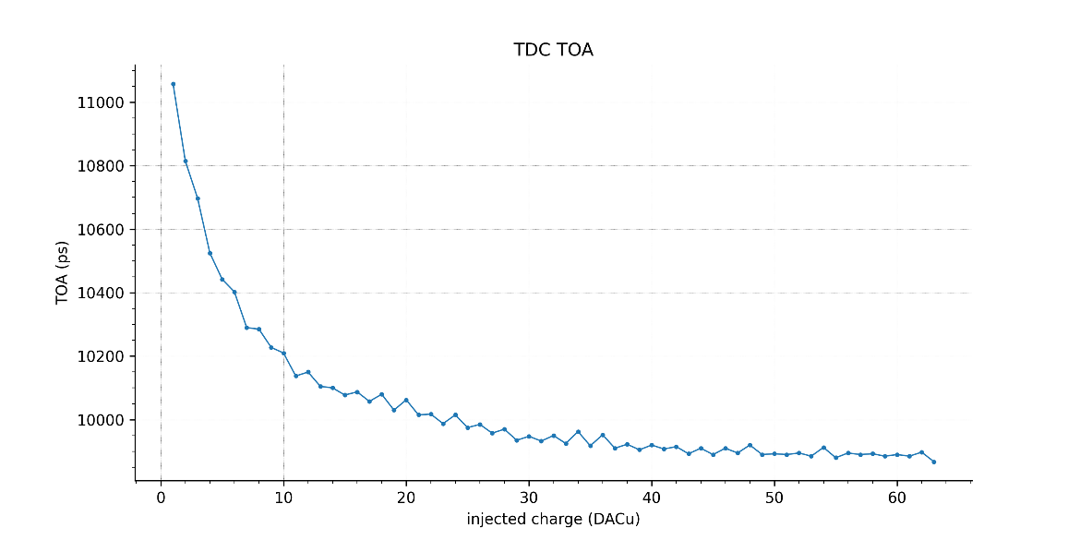
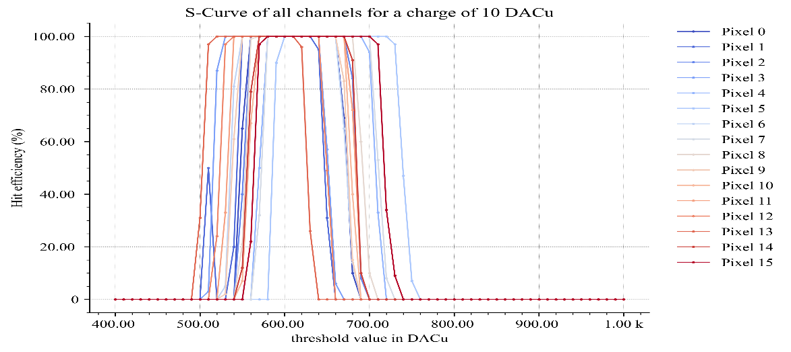
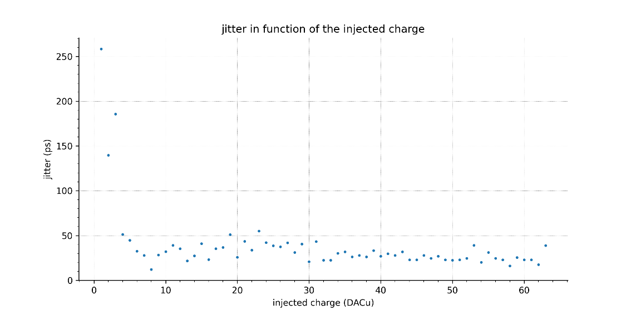
First measurements of EICROC0A (ASIC alone)
Only partial configuration is possible : look at ADC data and s-curves
  Improved ADC baseline, similar minimum threshold (3 fC)

Slide 5
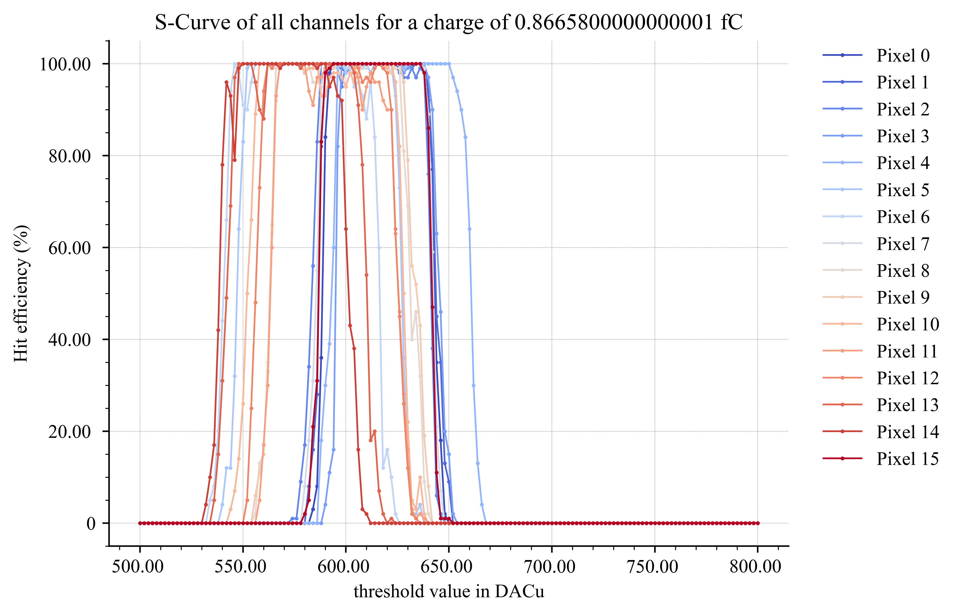
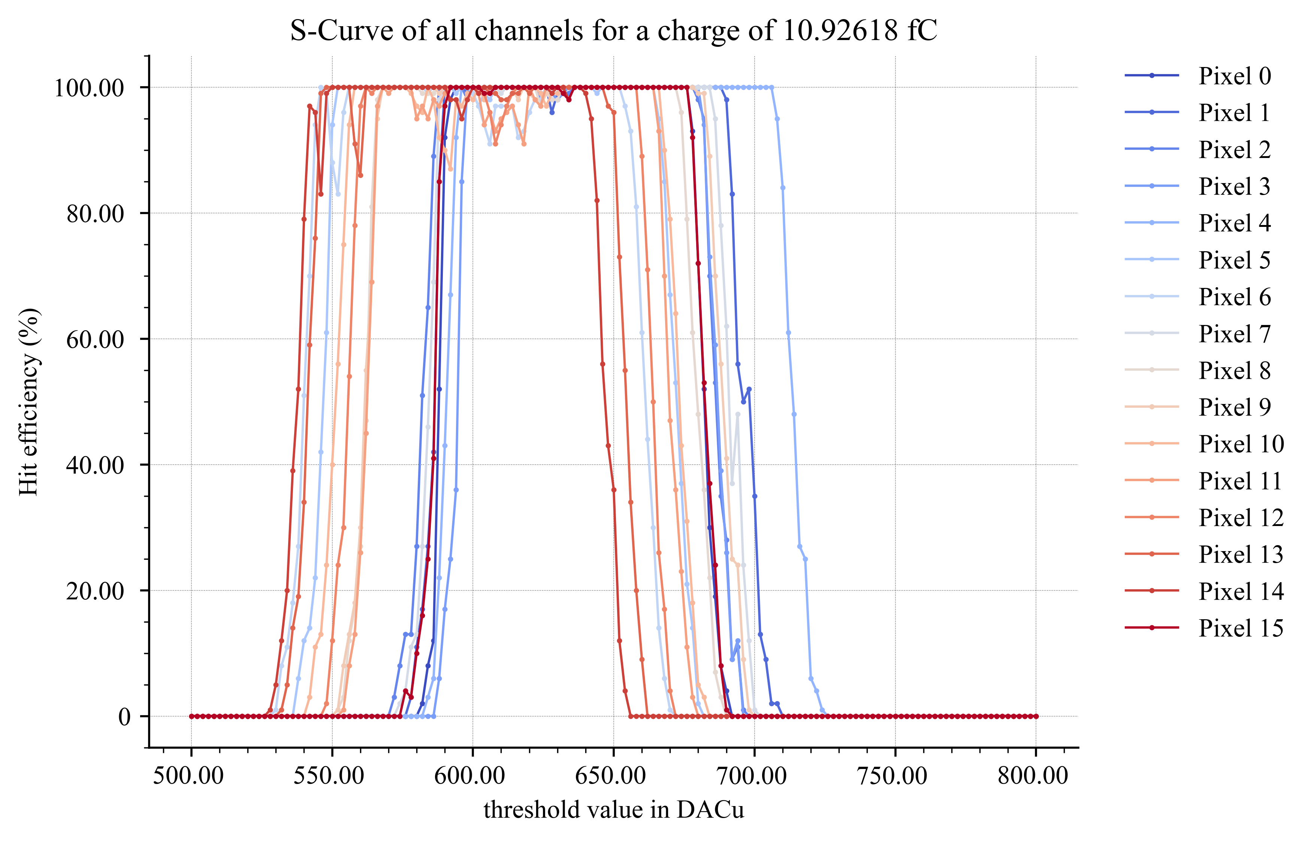
EICROC0A + sensor : S-Curves
S-Curve with 0 DACu
S-Curve with 10 DACu (5 fC)

Slide 6
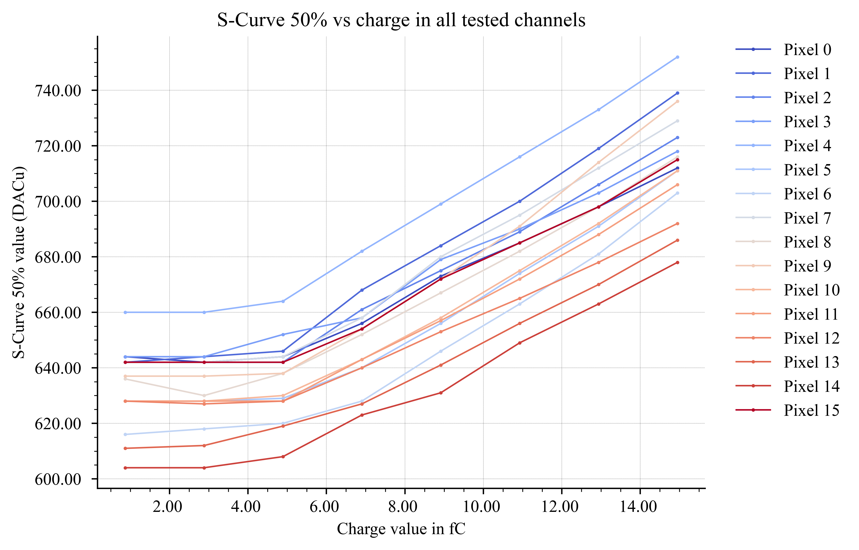
EICROC0A + sensor : S-Curve 50% vs charge
Lowest charge detected with discriminator around 5-6 fC.
Results are consistent between simultaneous and separate injections.

Slide 7
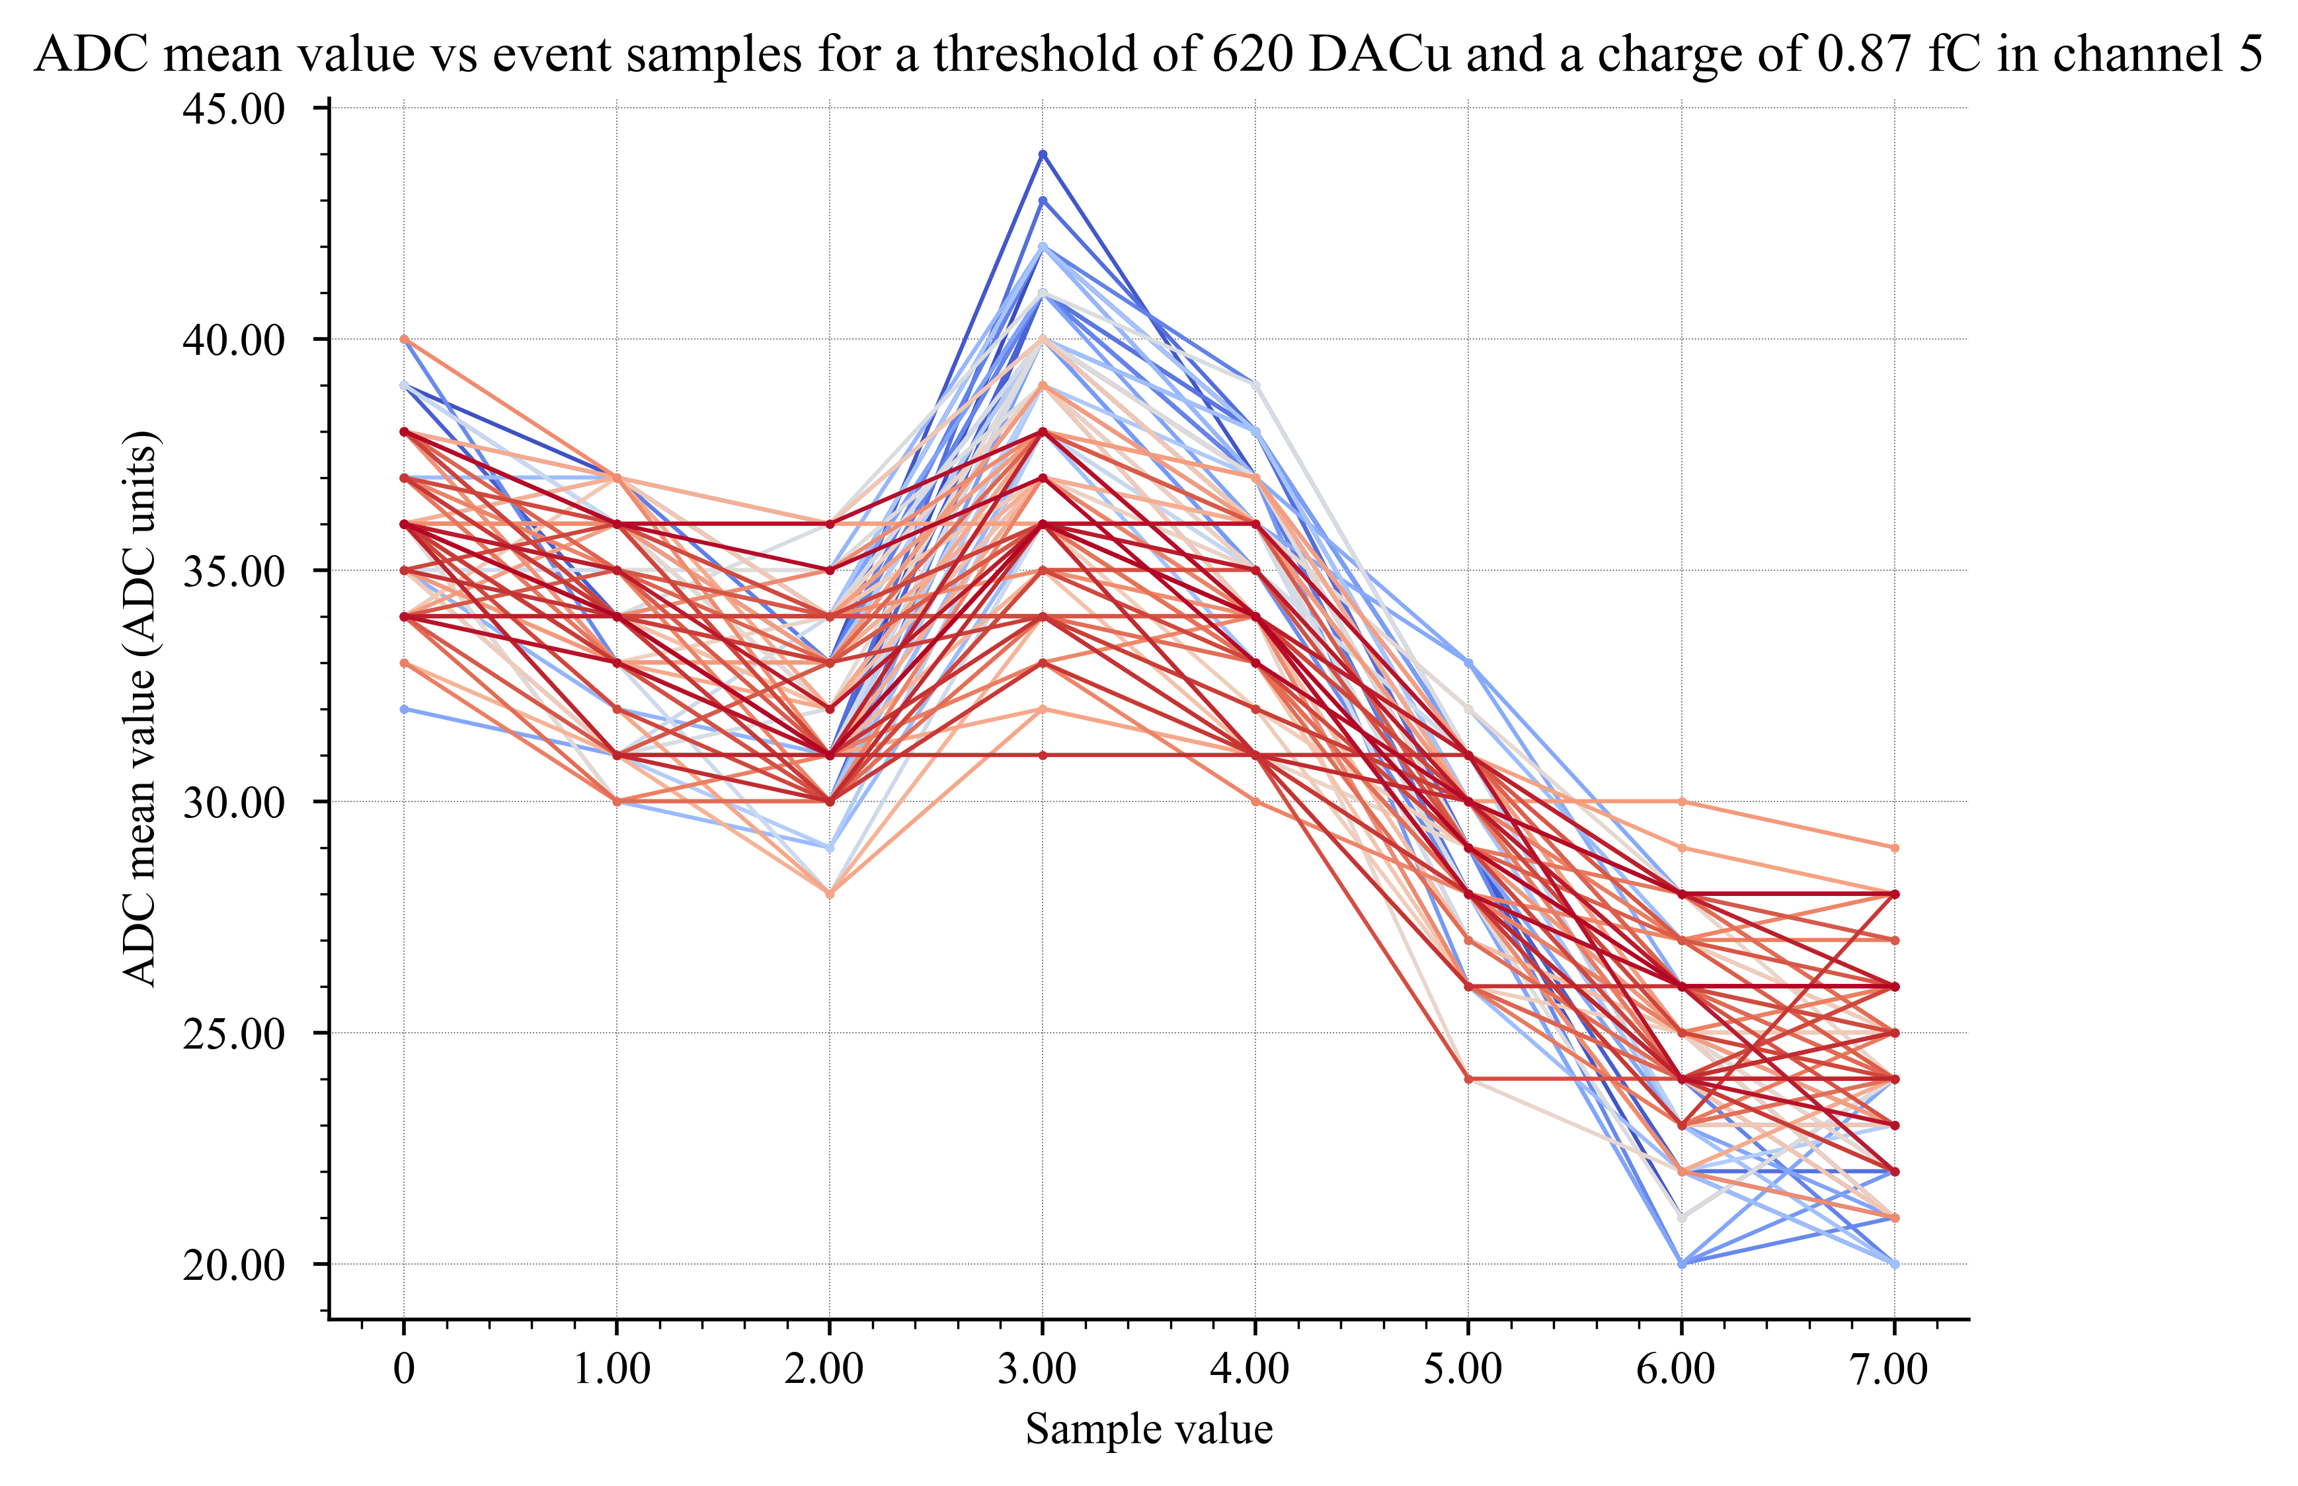
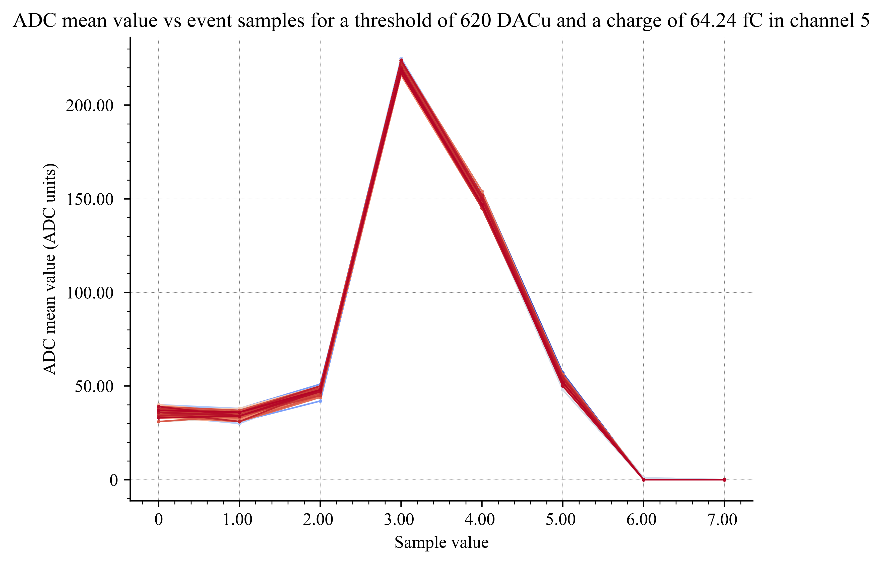
EICROC0A + sensor : ADC Signal reconstruction
Signal reconstruction at lowest charge
Same signal as ASIC alone
Signal reconstruction at highest charge
Same signal as ASIC alone
Tests done with no threshold writing to avoid ADC signal errors (probably a software issue)

Slide 8
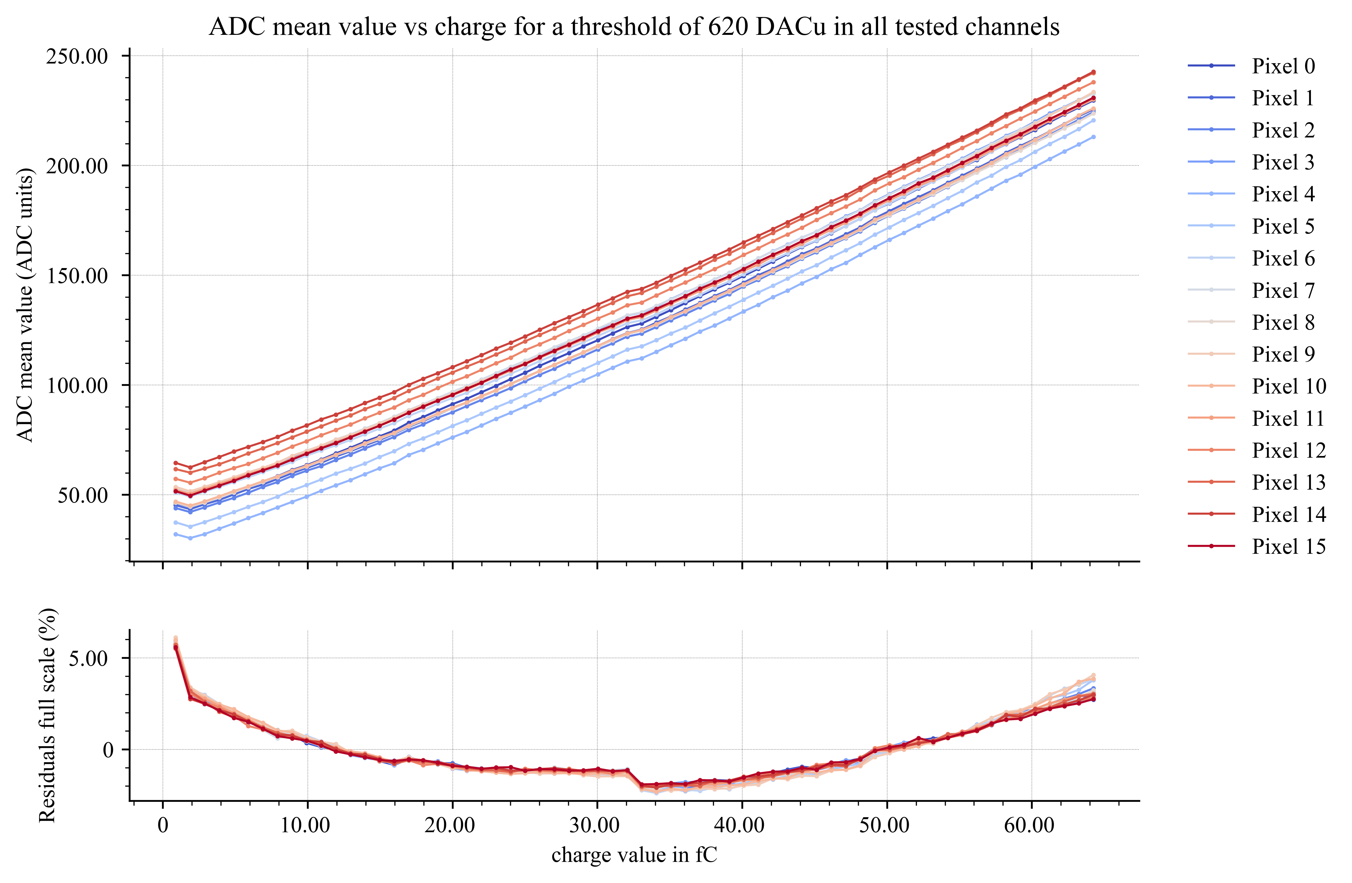
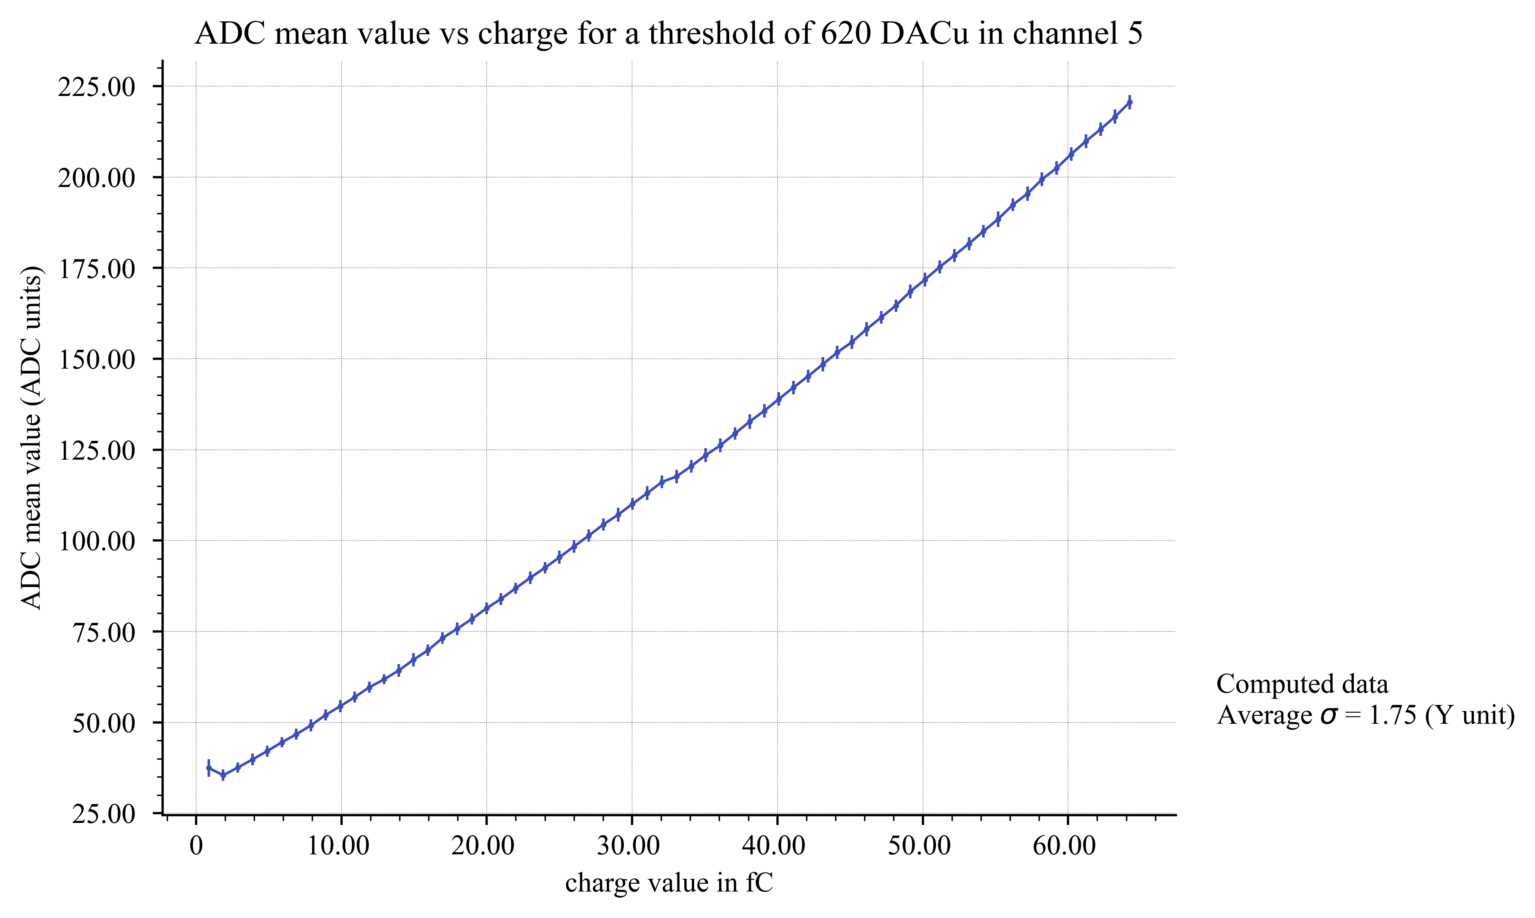
EICROC0A + sensor : ADC linearity
Zoom on channel 5, RMS of 1.8 ADCu
Non-linearity is similar to ASIC alone + cD = 11; difference to linear regression between +/- 2.5%

Slide 9
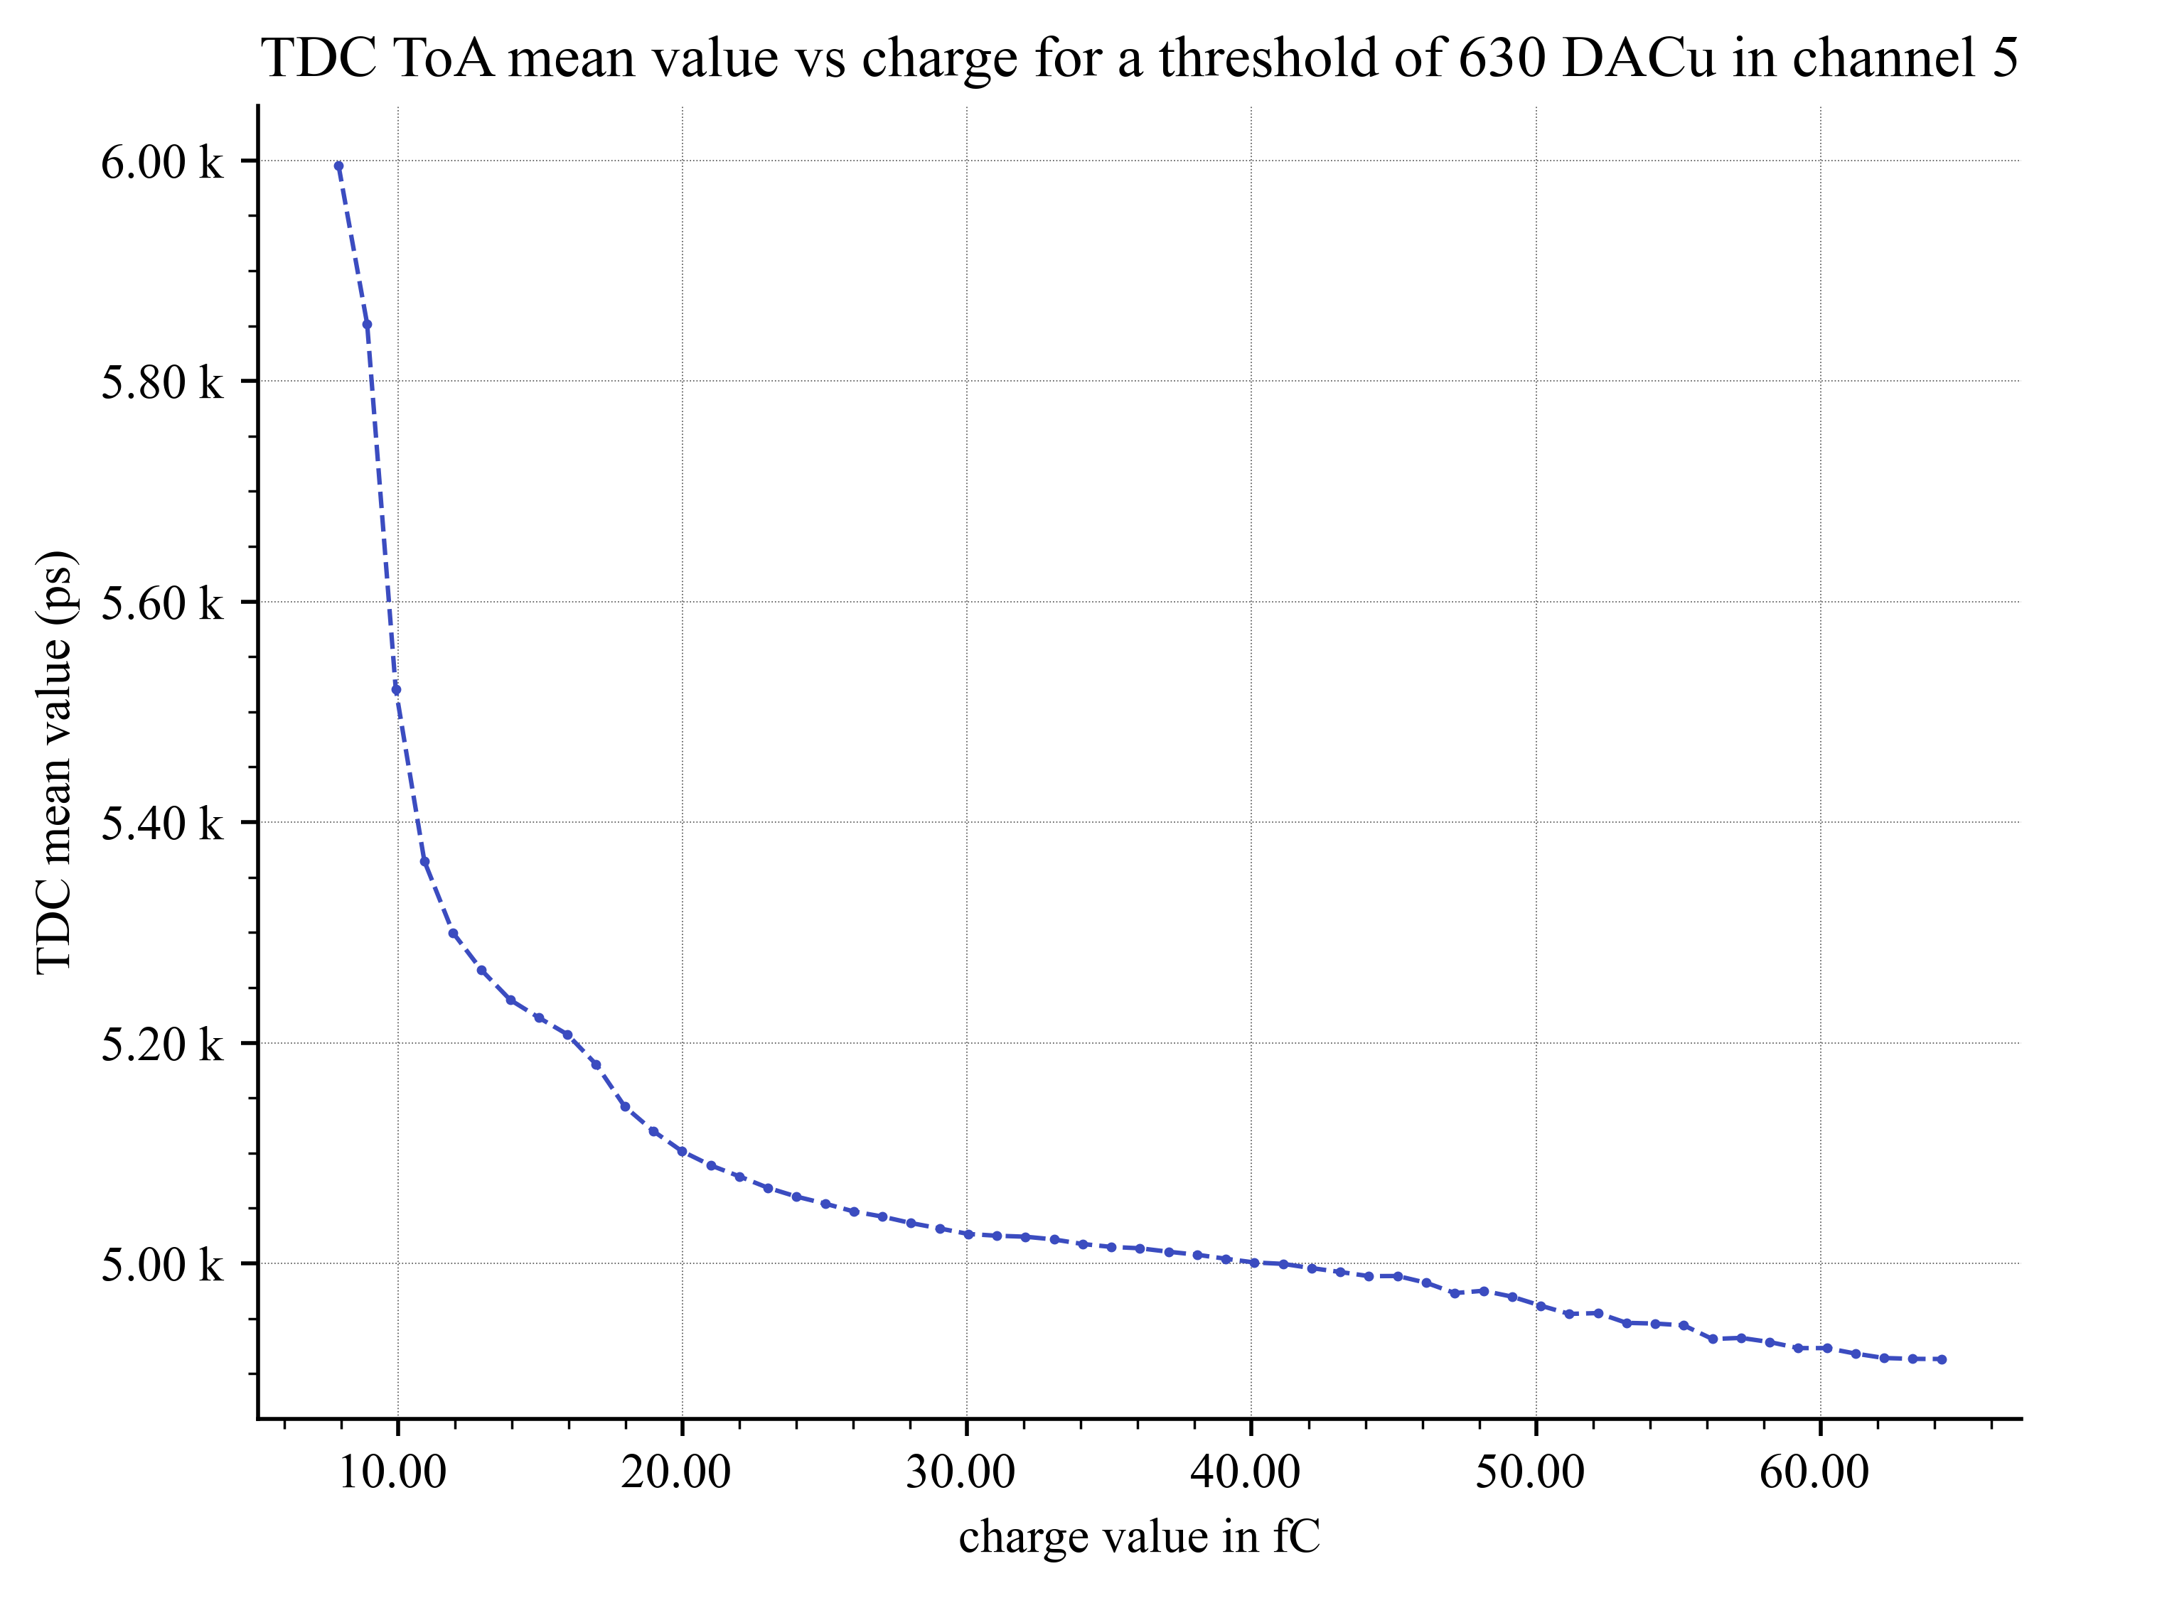
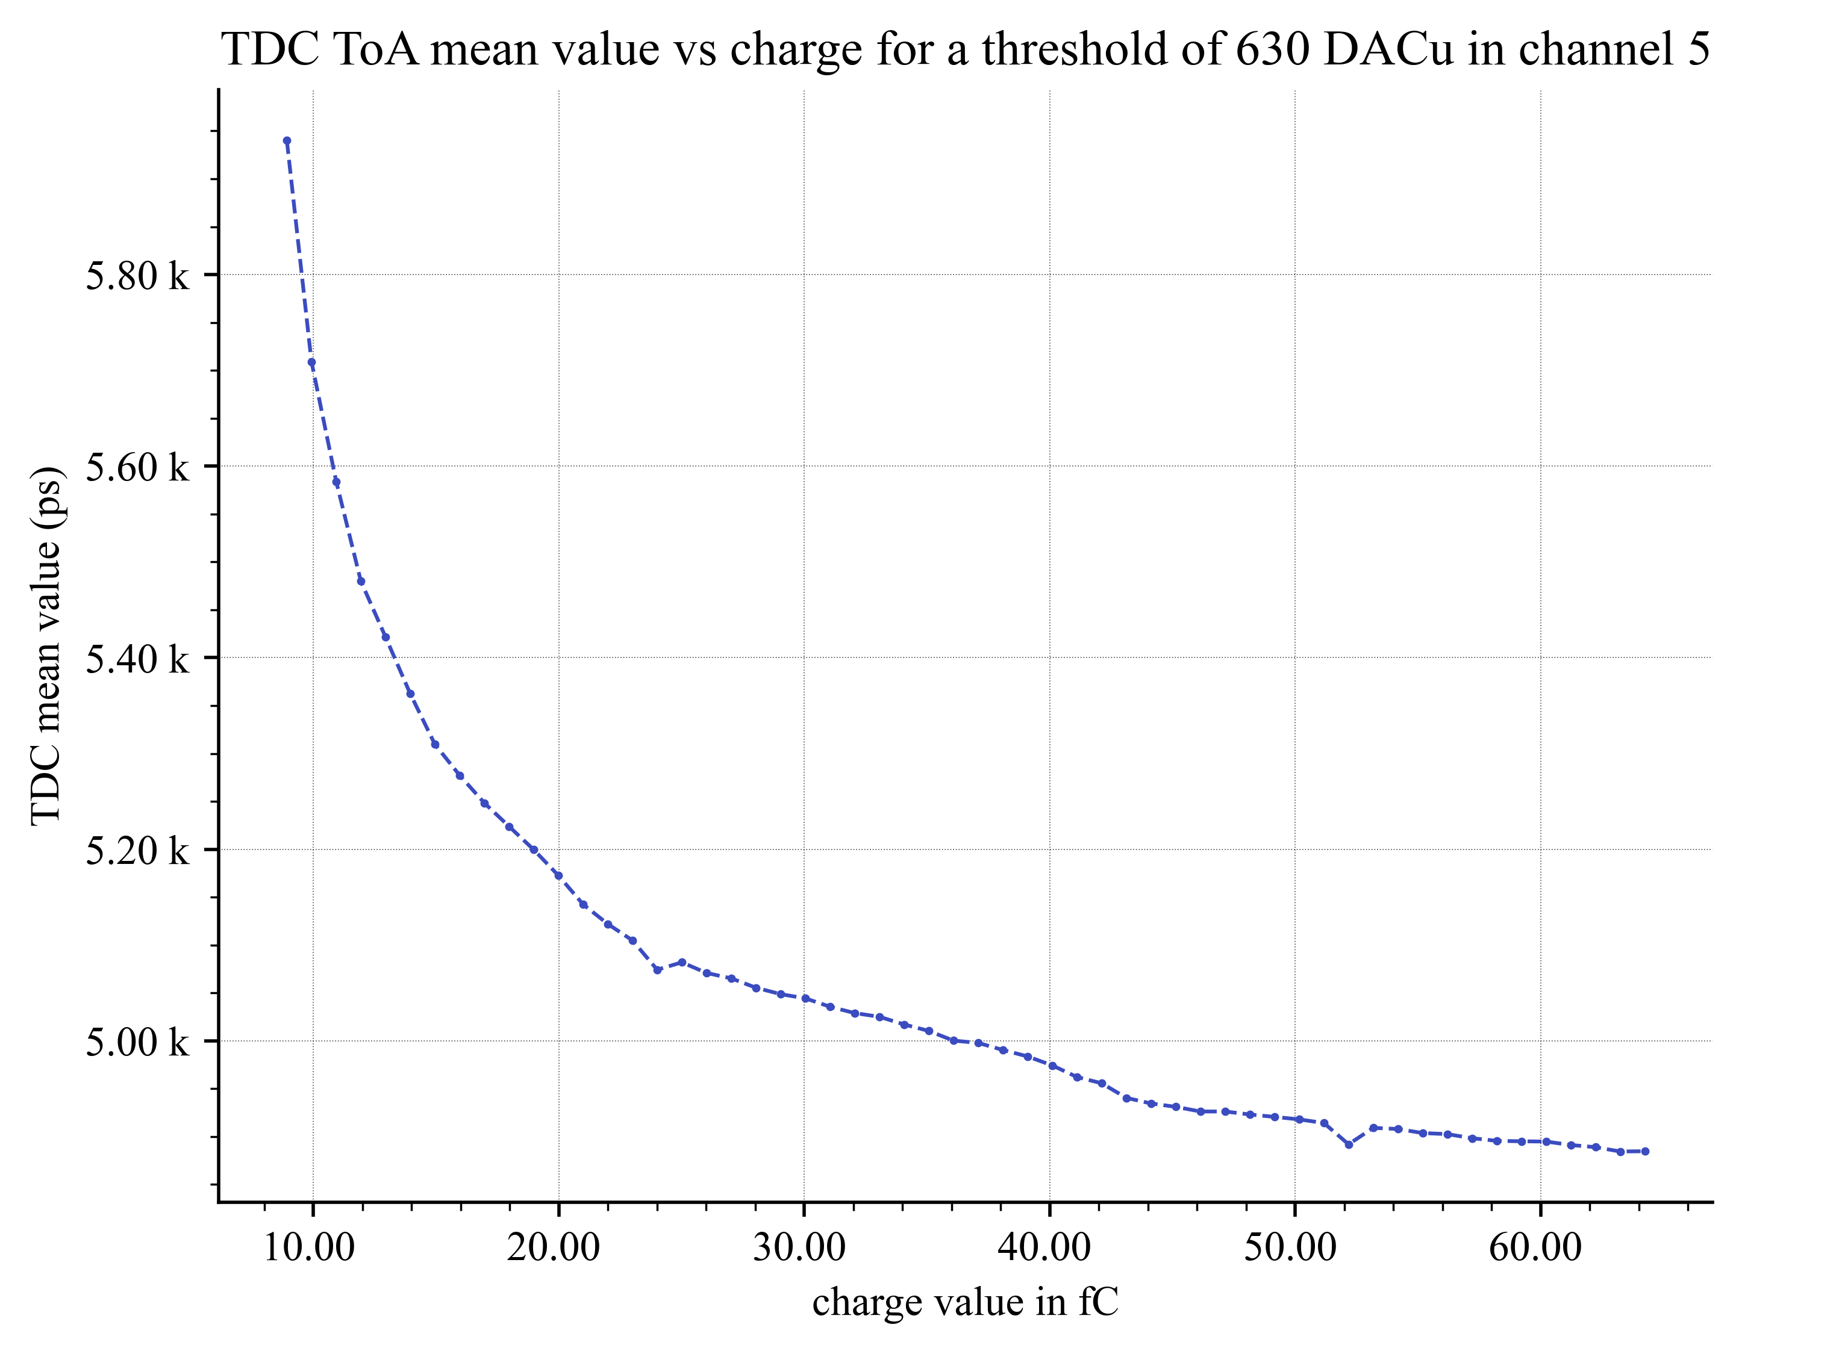
EICROC0A + sensor : TDC ToA
Injection only in channel 5
Injection only in channel 5 with all other discriminators disabled
Range is 1 charge value smaller than plot on the left

Slide 10
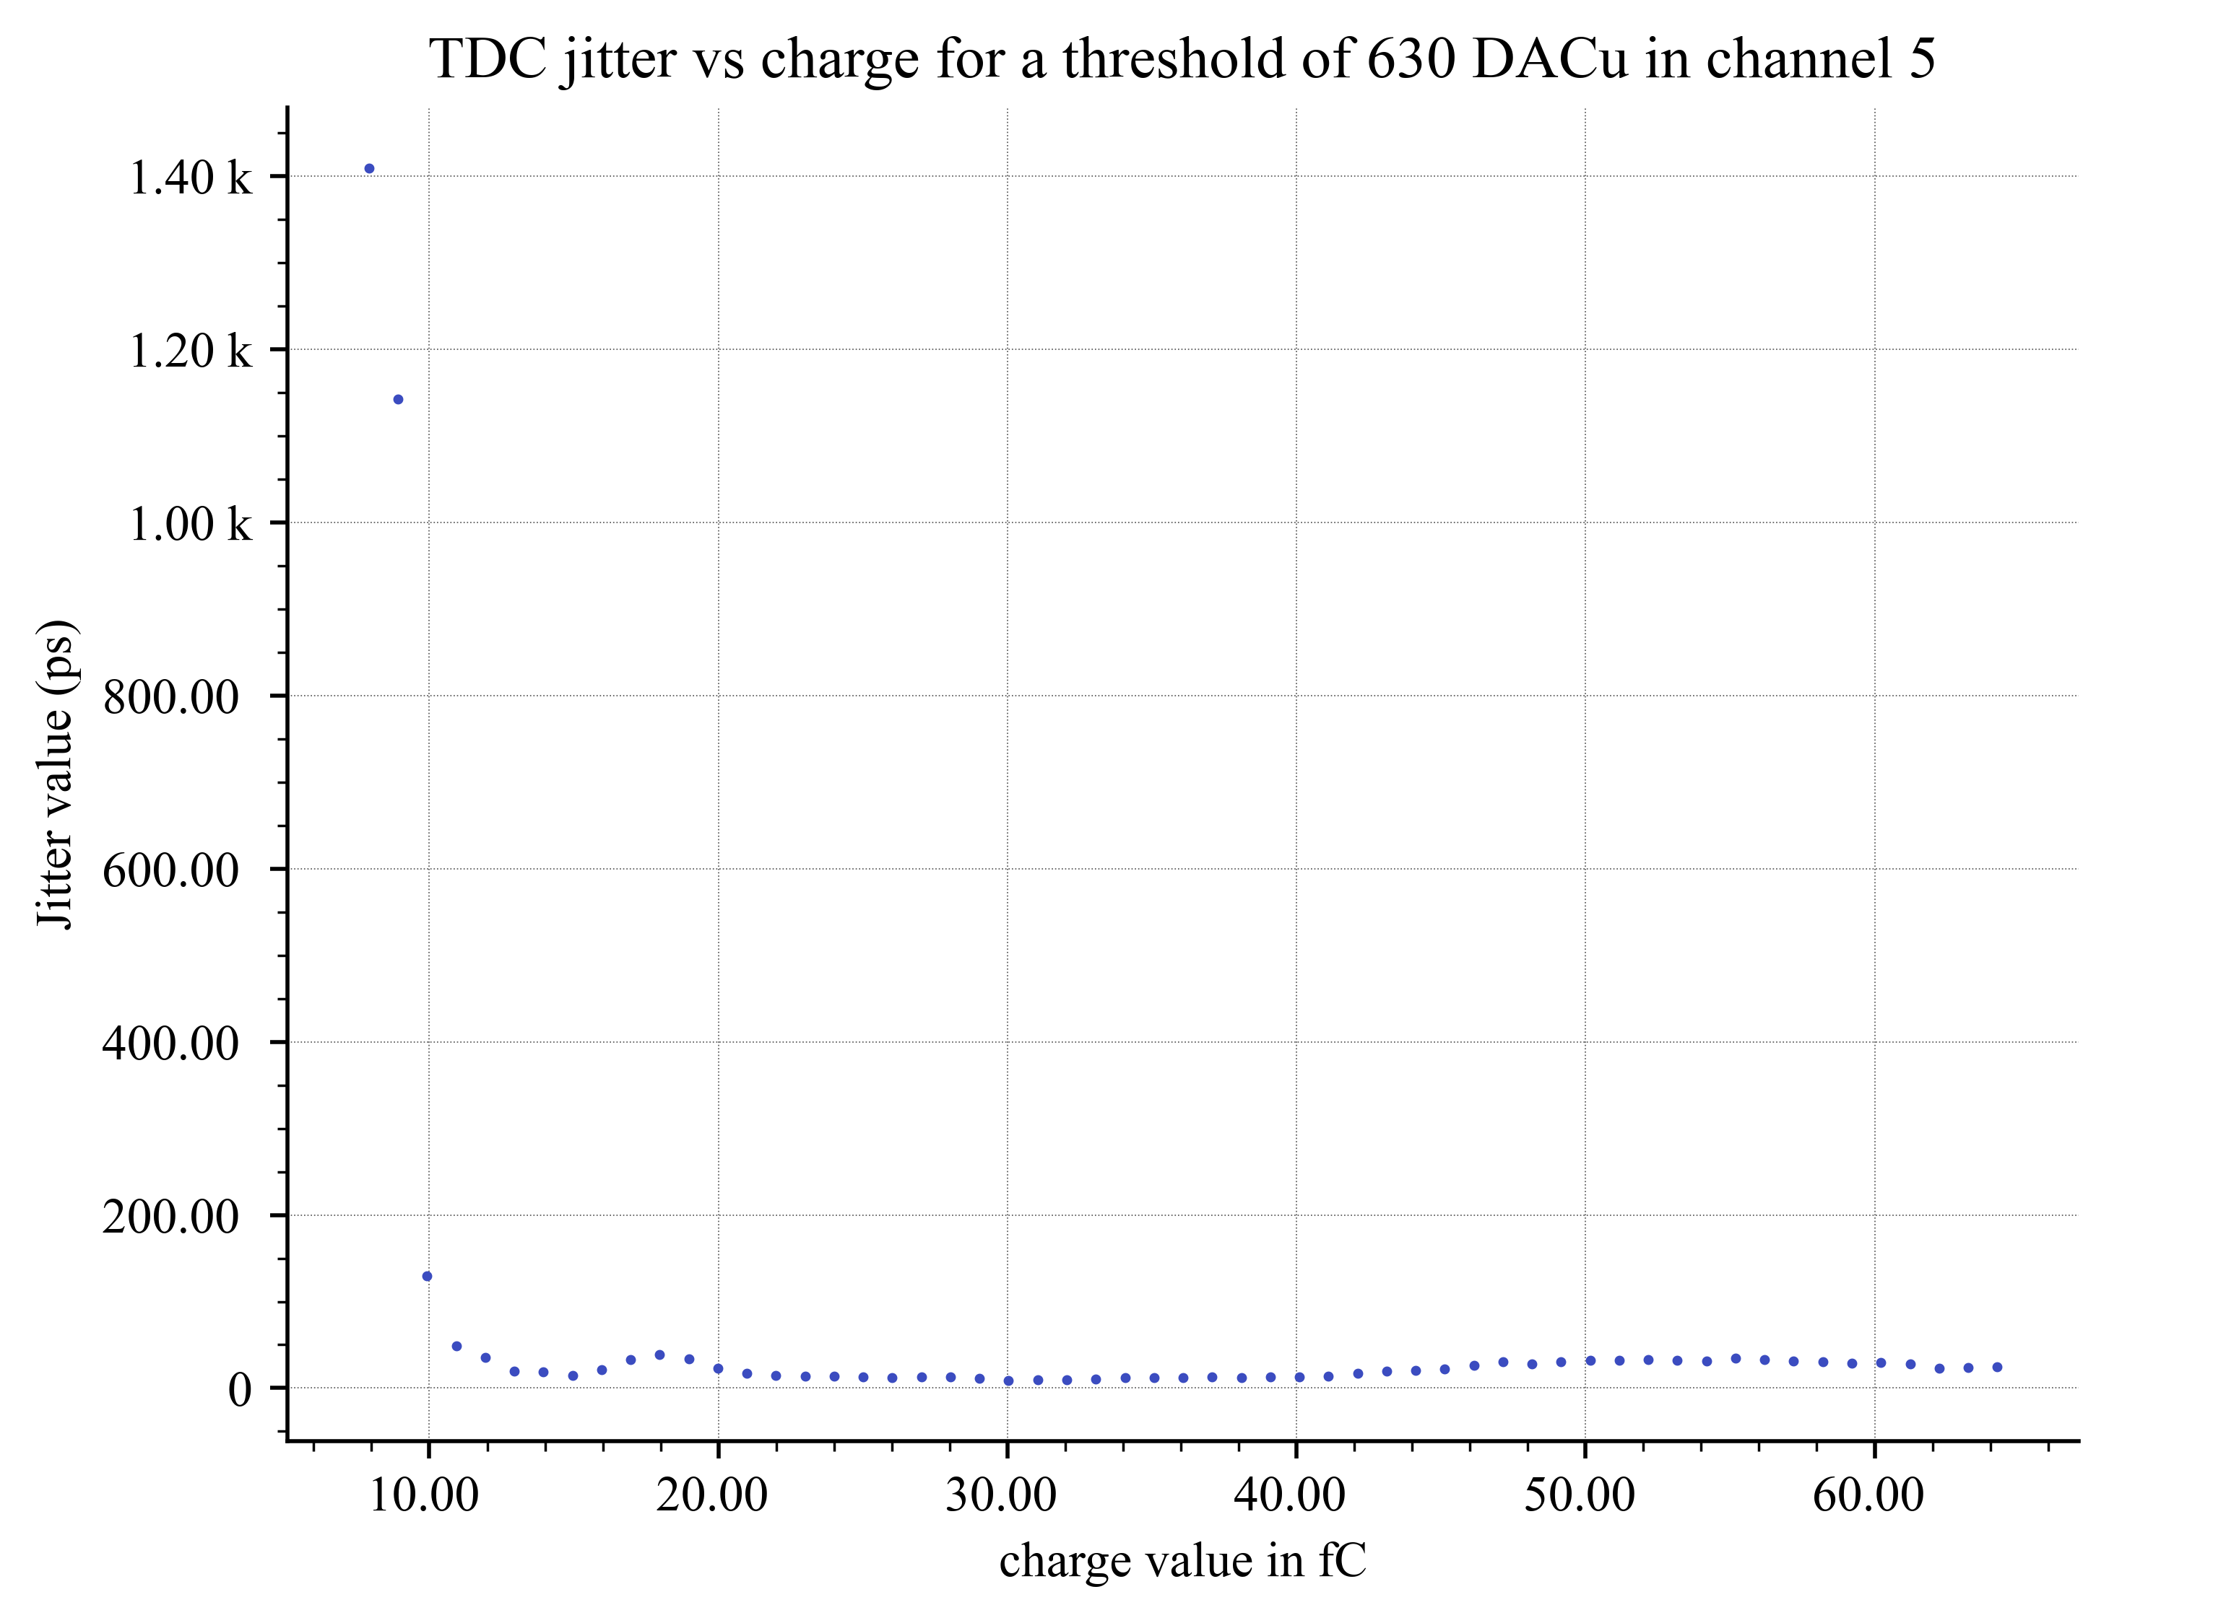
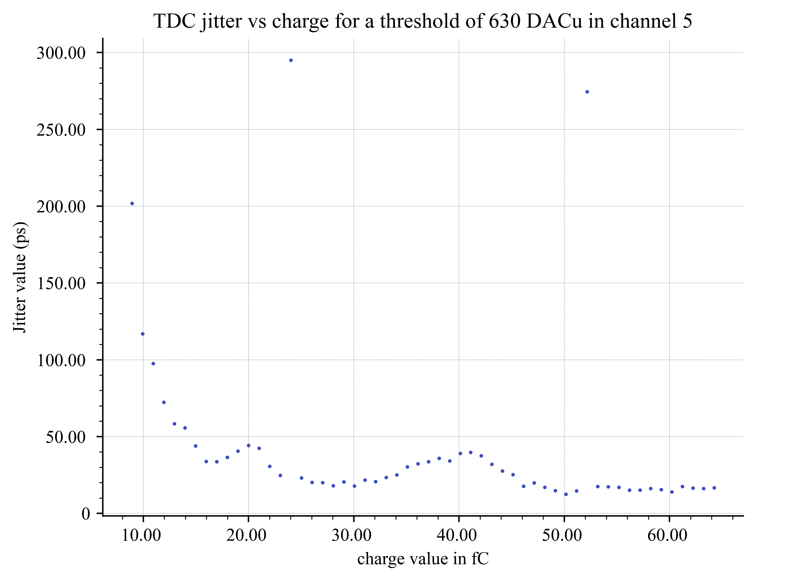
EICROC0A + sensor : TDC Jitter
Injection only in channel 5
Injection only in channel 5 with all other discriminators disabled
Proper TDC calibration is needed...

Slide 11
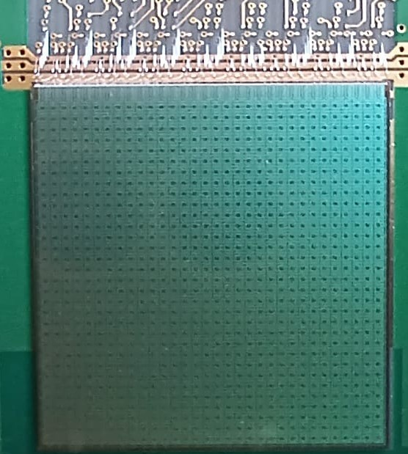
EICROC1
32x32 chip : final dimensions
Goal :
  test full-scale chip analog performance (IR drops)
  Allow final sensor characterization
  Test interface with DAQ : fast commands and 320 Mb/s data output
  Progress on module/front-end boards
Caveats :
  Not (yet) zero-suppressed data
  Still 2mW/ch
  Still analog-on-top

Slide 12
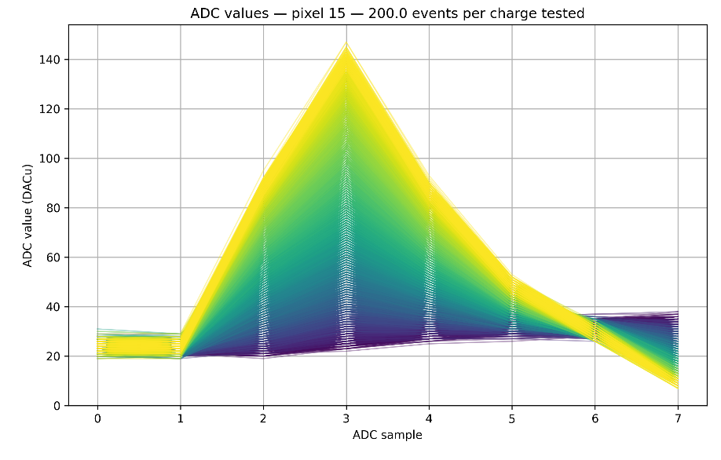
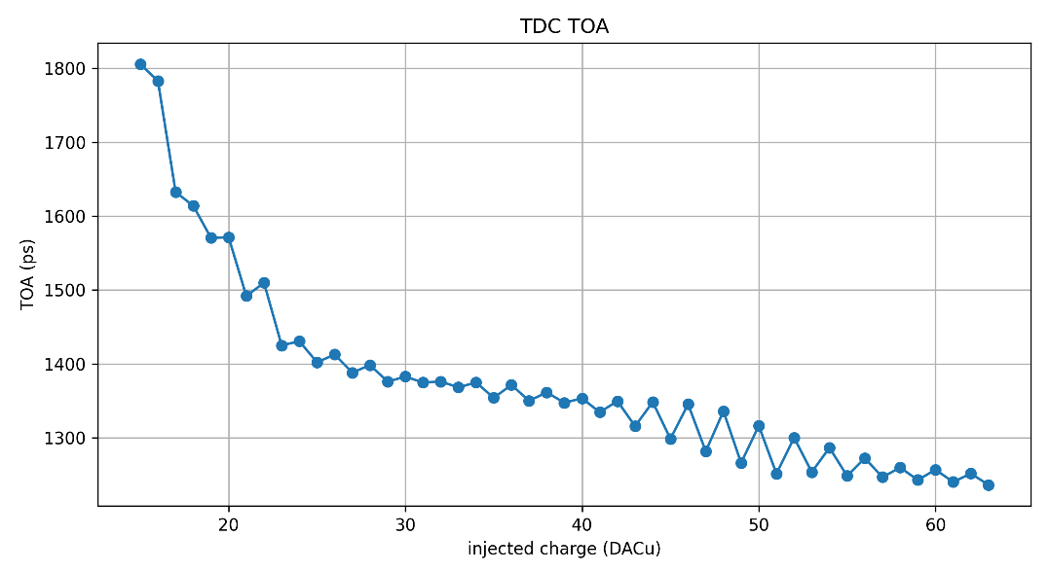
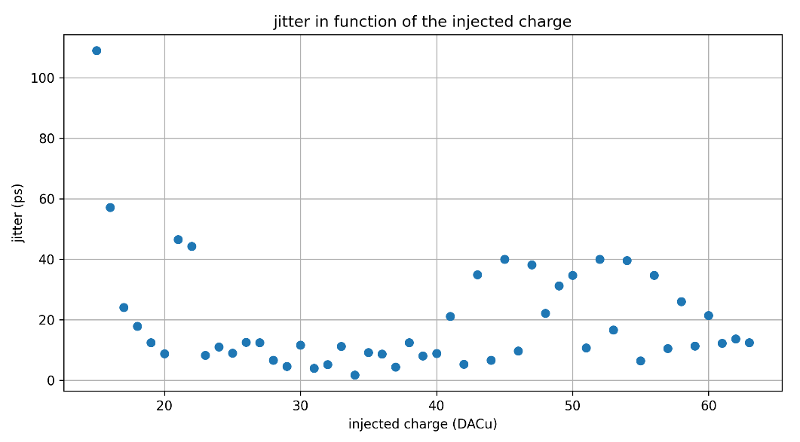
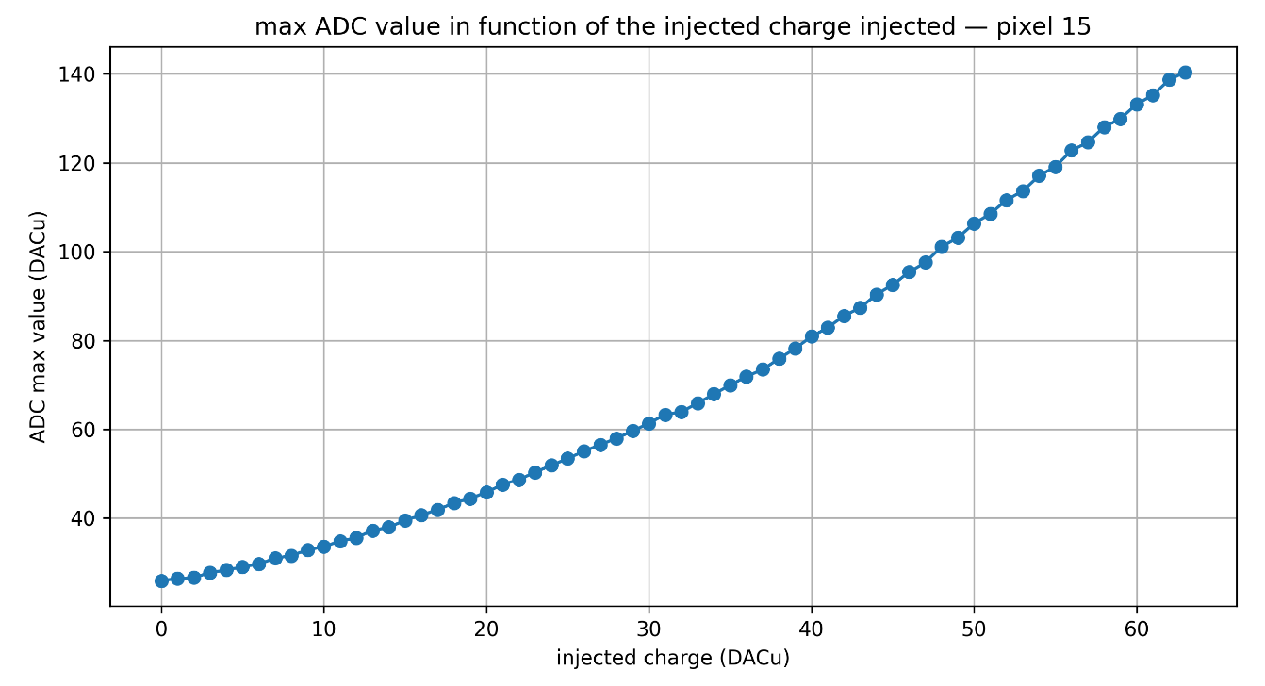
First measurements of EICROC1 ADC&TDC

Slide 13
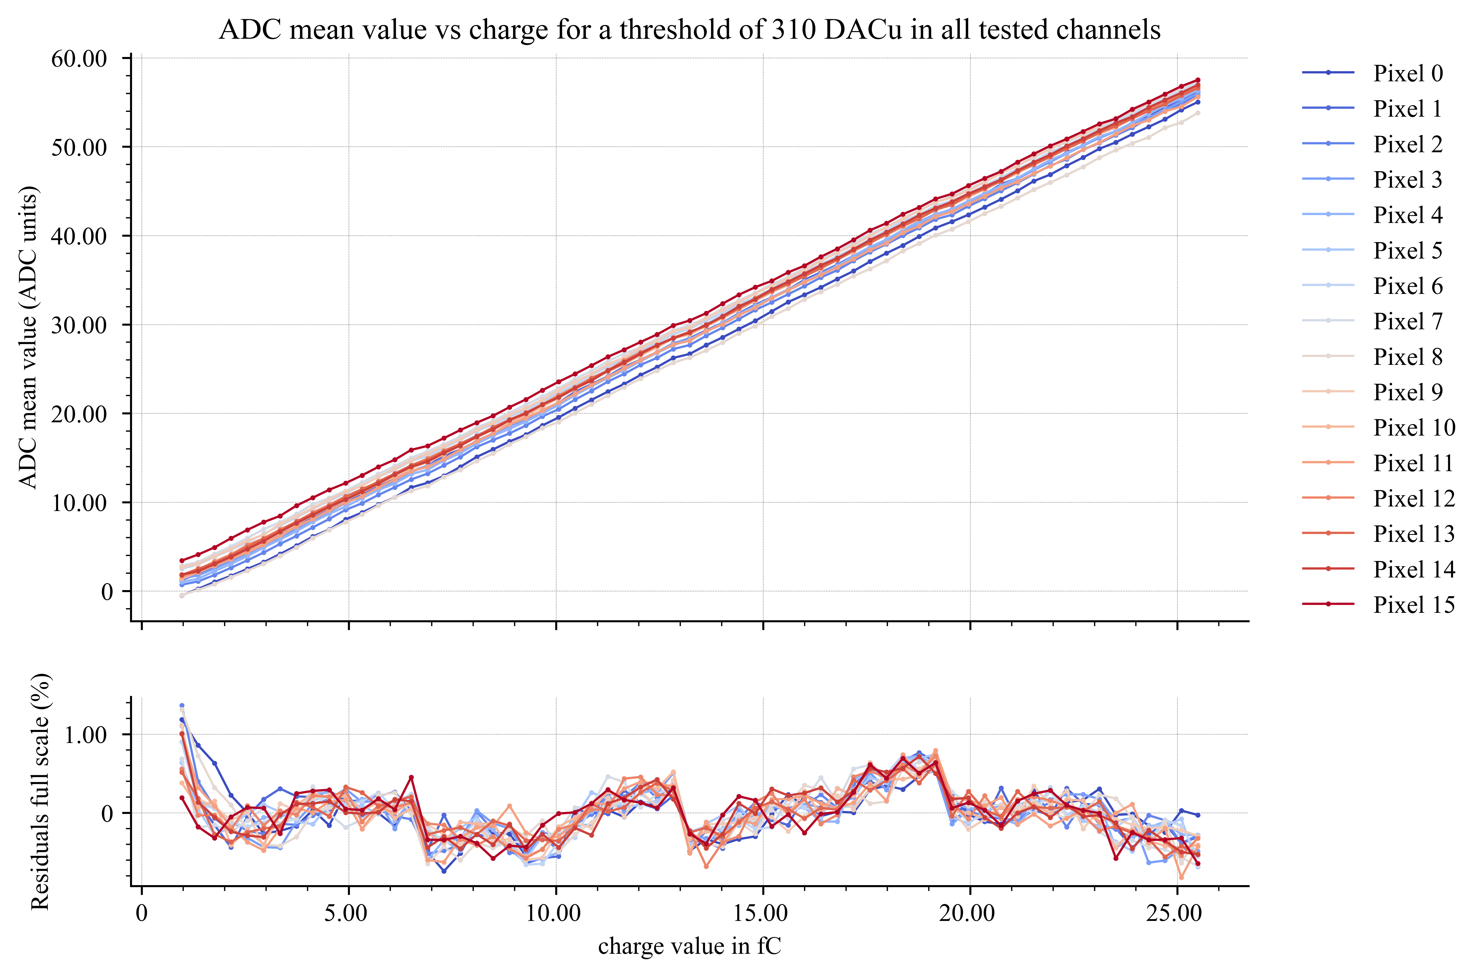
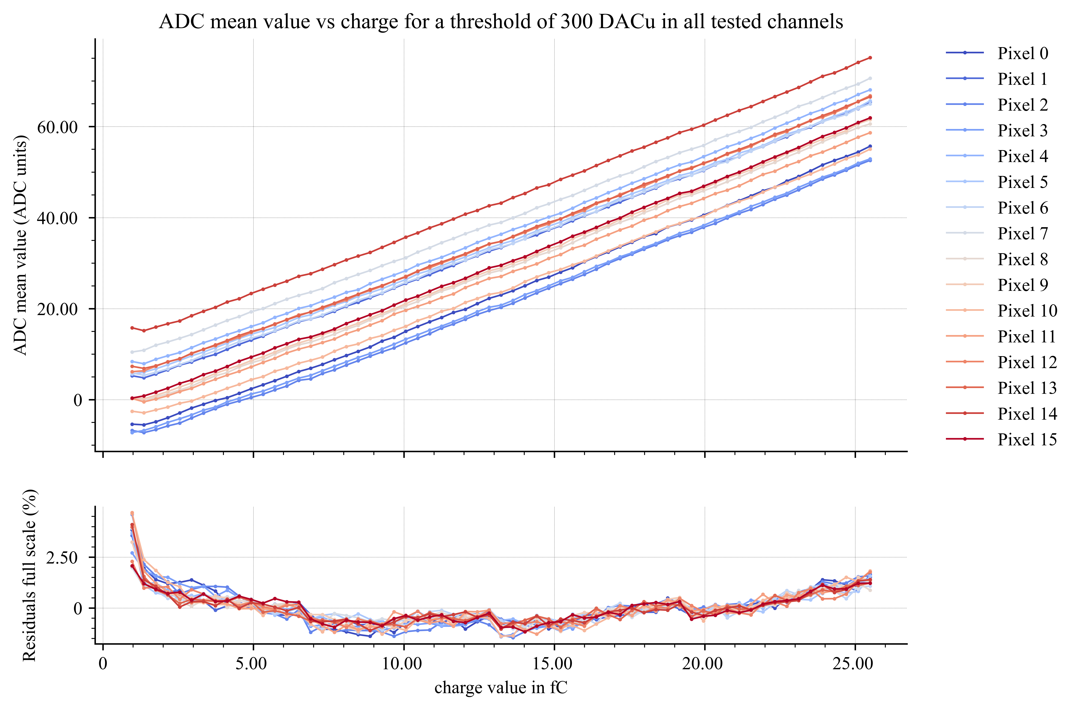
EICROC0 measurements : ADC linearity
8 bit 40 MHz SAR ADC [Krakow]
  Noise ~1 UADC but large common mode noise (here substracted)
  Signal 50 UADC ~500 um => 1 UADC ~10 um
ADC mean & residuals – no sensor
ADC mean & residuals – BNL Flipchip sensor

Slide 14
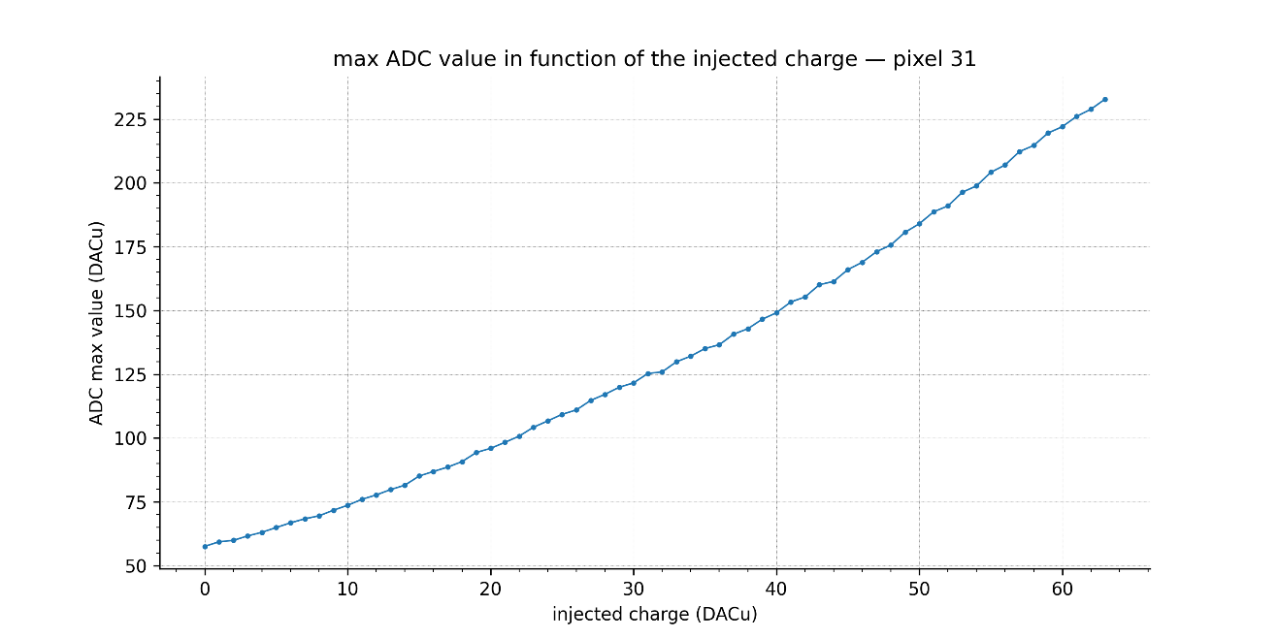
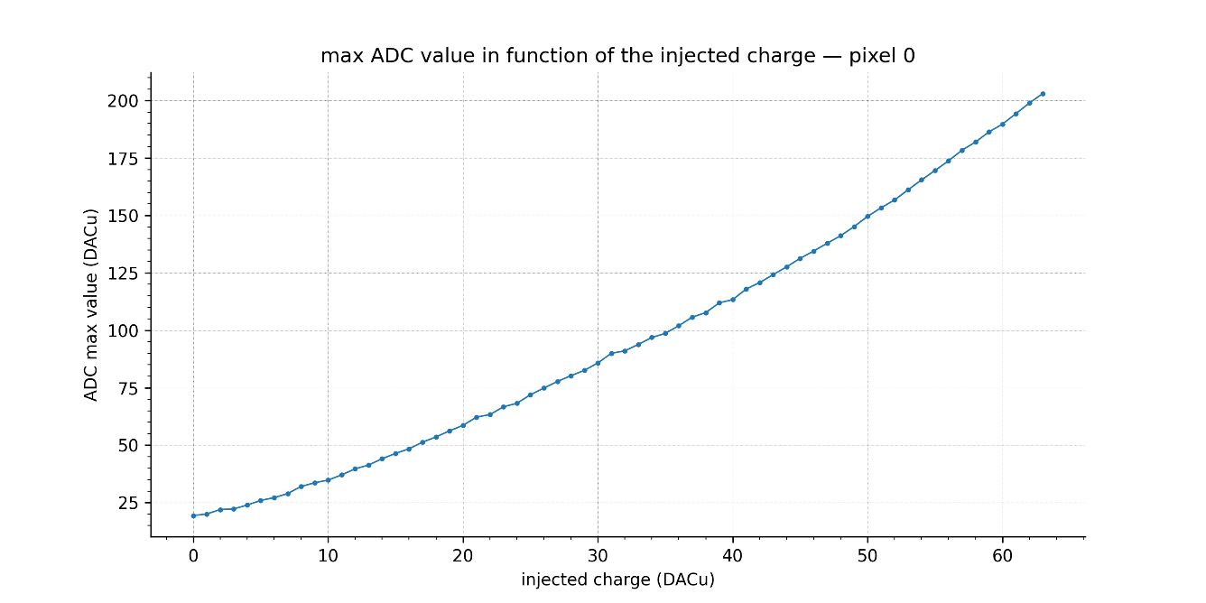
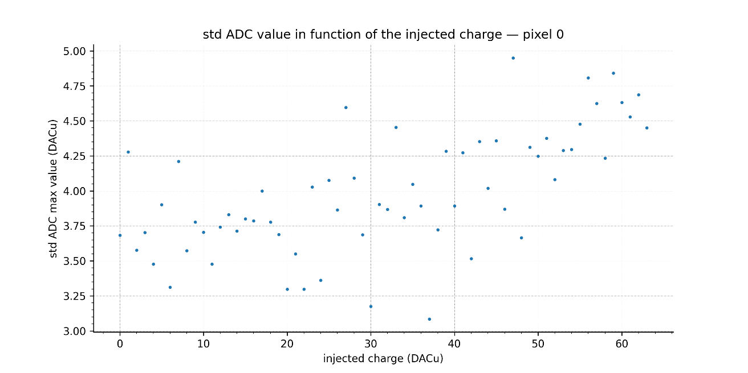
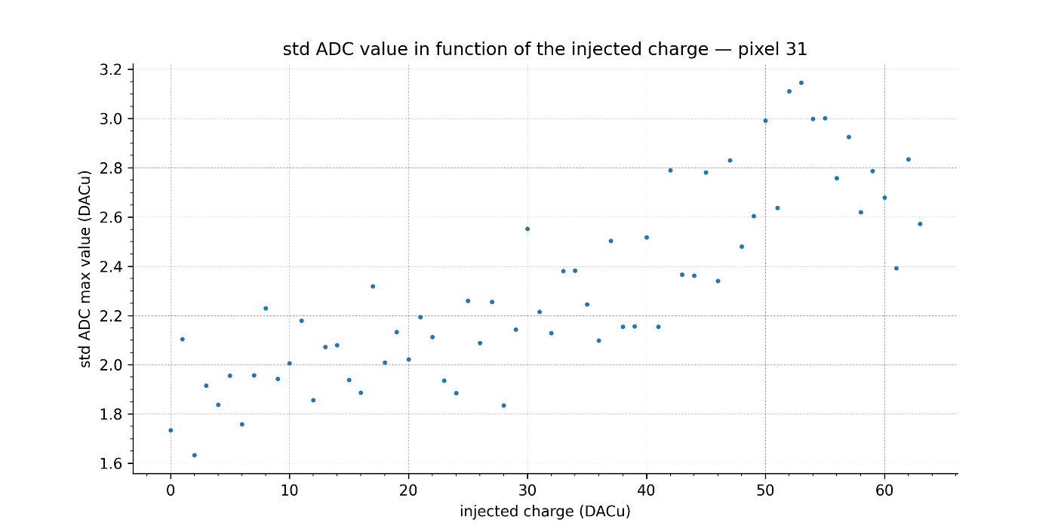
EICROC1 linéarity ADC pixel 0 vs 31 [Kinann]

Slide 15
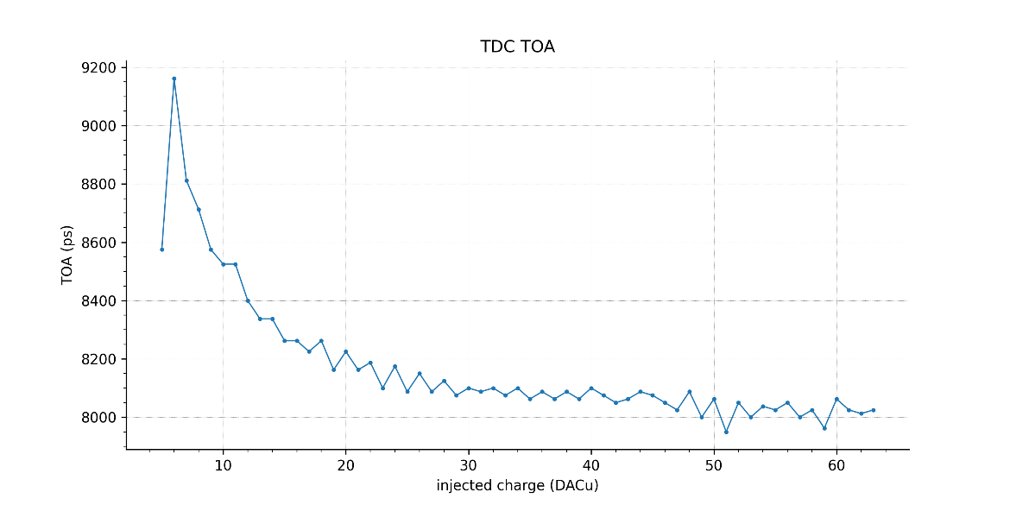
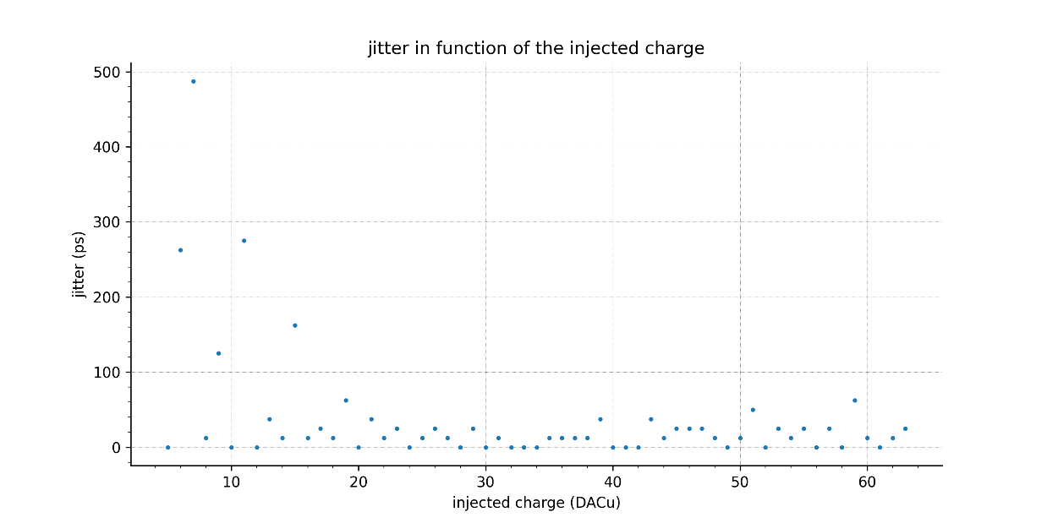
EICROC1 TDC TOA and jitter pixel 0 vs 31

Slide 16
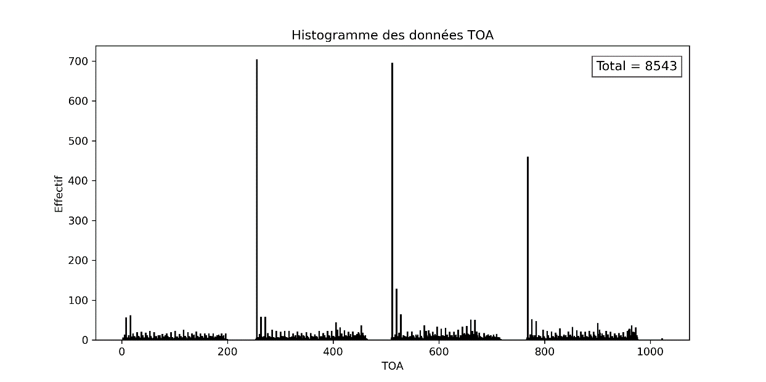
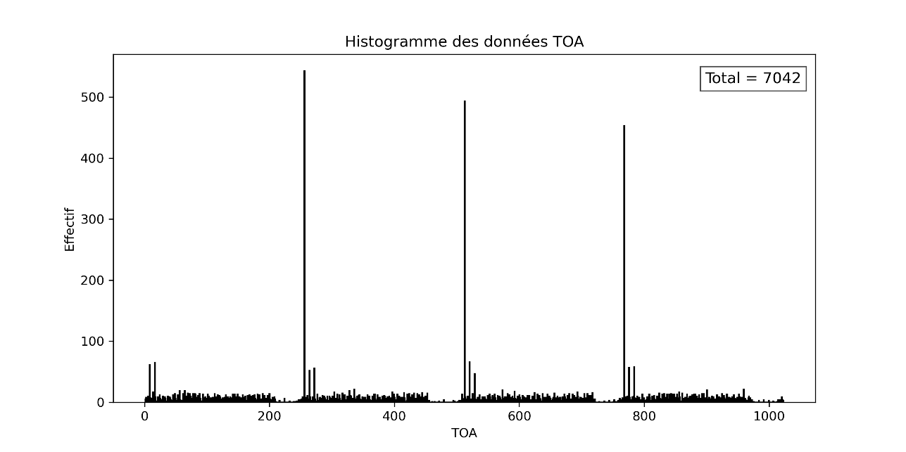
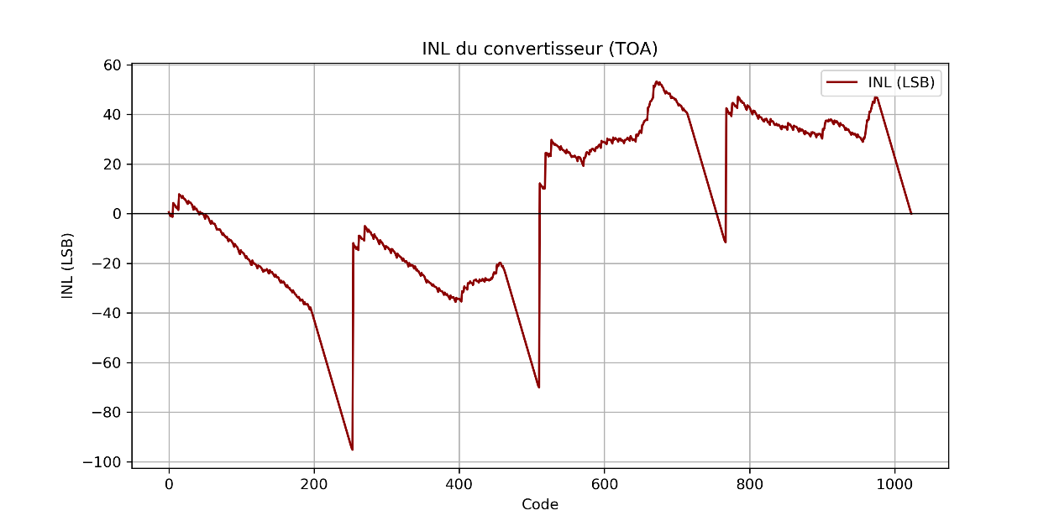
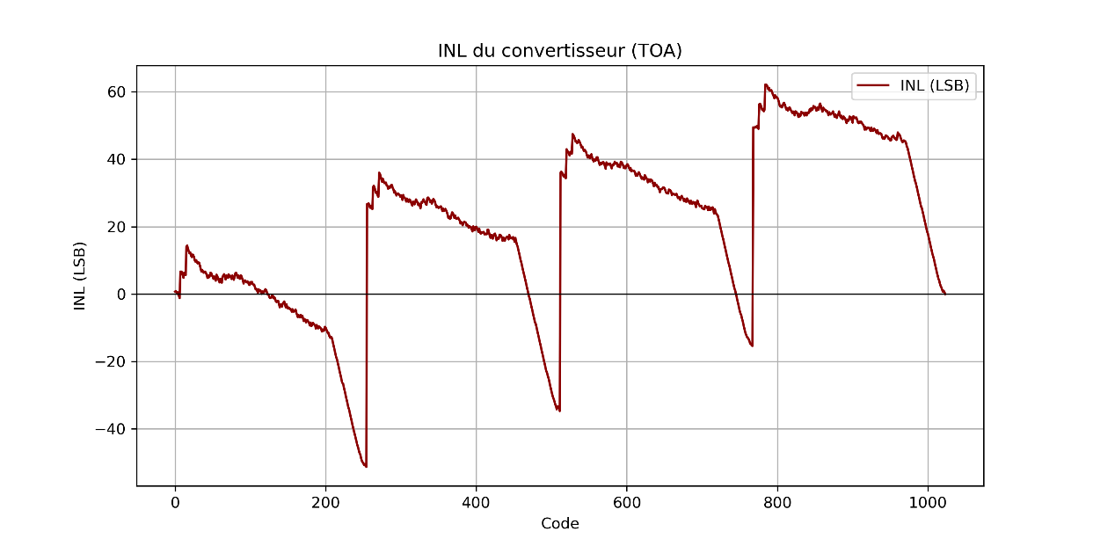
TDC uniformity
Random injuection : should be flat !
=> Leakage current in 1000 pixels is degrading the charge pump performance

Slide 17
Next steps
Continue test bench measurements on EICROC1 ASIC alone
  Understanding TDC misconfiguration
Start laser tests with EICROC0A and sensor at IJCLAB
Study TSMC130 replacement
Proceed with EICROC2 digital design at Clermont (relatively techno independant)

Slide 18
summary
EICROC now reached full scale 32x32 with EICROC1
  Important for analog performance and sensor test
  Also allows to progress on system design
Small scale EICROC0s 4x4 still under test to improve performance and reduce power
  Tests to start soon with sensors
EICROC2 now needs its digital design DoT : ~6 months design time from now
  Responsibility of Clermont Ferrand lab
  Main driving specification is power minimization and low hit rate (< 100 Hz/pixel)
  Submission in Engineering run in TSMC130n Q1 2027
System tests will be (as always) an important input for chip(s) finalization

Slide 19
backup

Slide 20
Technology choice
TSMC130 | TSMC65 | UMC110 | XFAB130 | VIS130
5M 1T 1U RDL C4 | 5M 2T 1U RDL C4 | 5M 1T 1U no C4? |  | As TSMC130
Radhard 200 Mrad | Radhard 200 Mrad | Bump @ 5 Mrad | N/A | Which fab ?
ER : 300 k$ | ER : 750 k$ | ER : 300 k$ ?
EIC | EIC, LHCb | EIC, LHCb, ALICE
AGH, Lisbon,SLAC | FNAL,BNL,CERN | Torino
Discontinued | Perenity ? | Low volume | 6-9 months fab | Available when ?
 | ADC
DNW, HiR, CMIM | DNW, HiR, CMIM

Slide 21
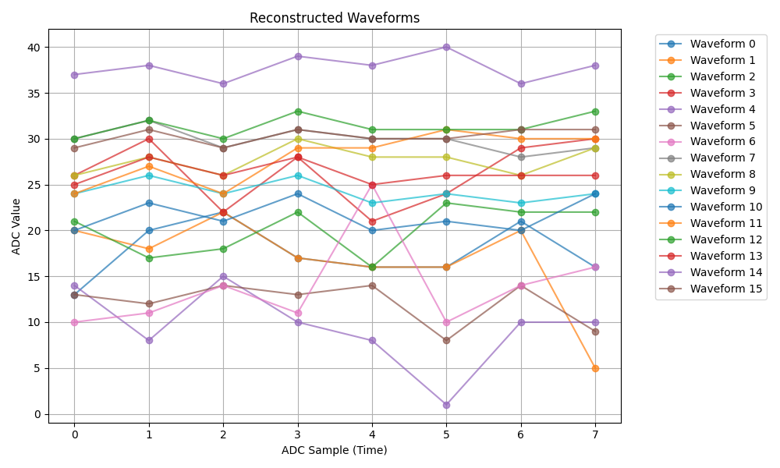
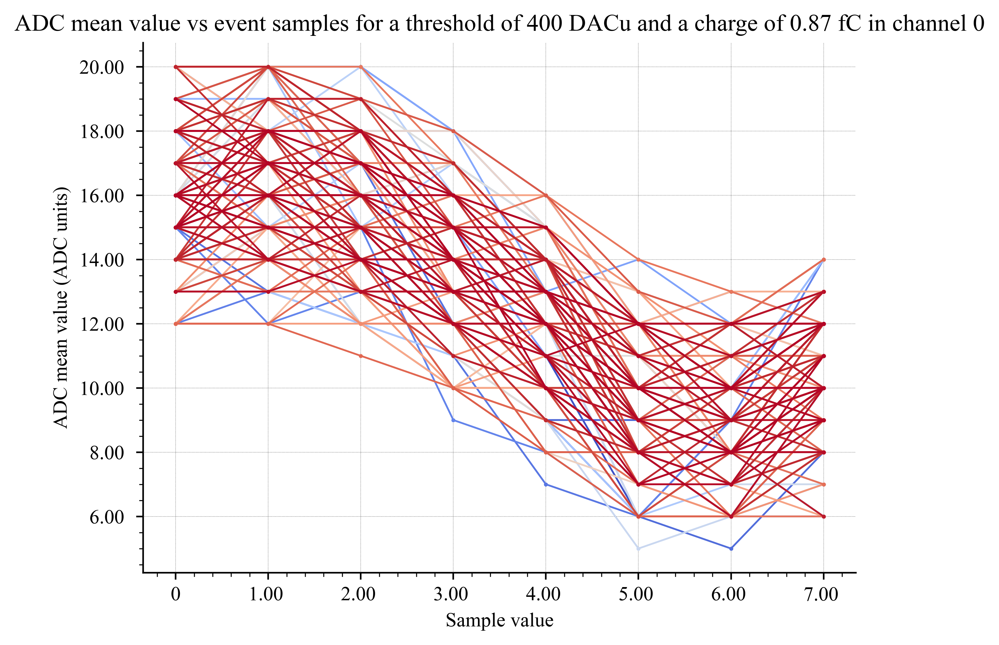
PCB1 – 10/04/2026 : Test results
ADC signals
External inj.
Internal Inj.
Test with external injection used no command pulse, no ctest was wired to the front ends.
Internal injection was obtained with FPGA cmdpulse, no ctest was wired to the front ends and 0 DACu as input charge.
Only 1 event could be captured with the external injection, but the waveform doesn’t show the linear decreasing behavior seen in the plot with the internal injection. We might be seeing some internal cmdpulse interference in the signal?

Slide 22
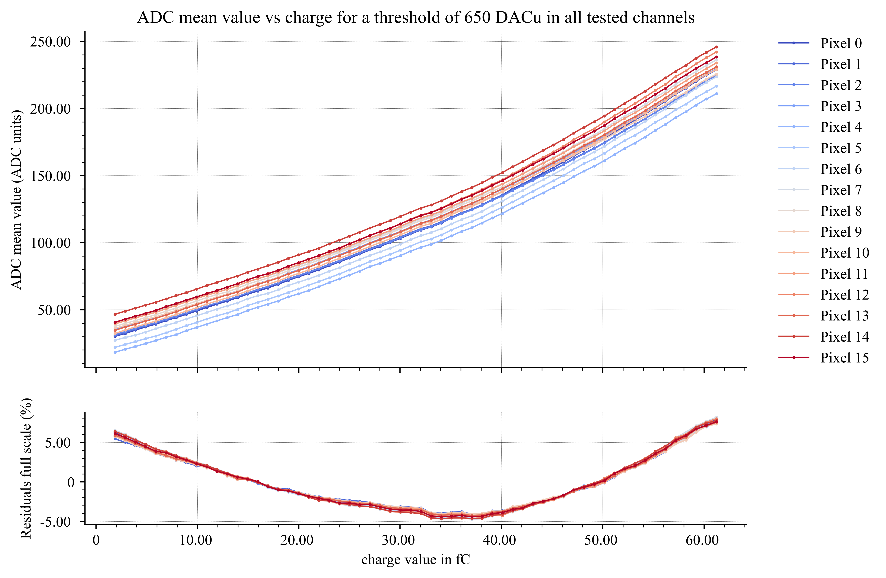
PCB1 – 27/04/2026 : Test results - ADC
ADC linearity (all channels injected sim.)
ADC linearity is very similar between channels. The range also seems to be quite similar between all channels.
We can see two different “parts” to the linearity, with 2 different slopes.
Slope 1 (from 0 to 32 fC) is around 2.6 ADCu / fC
Slope 2 (from 32 to 38 fC) is around 3.2 ADCu / fC
Slope 3 (from 38 to 62 fC) is around 4.4 ADCu / fC

Slide 23
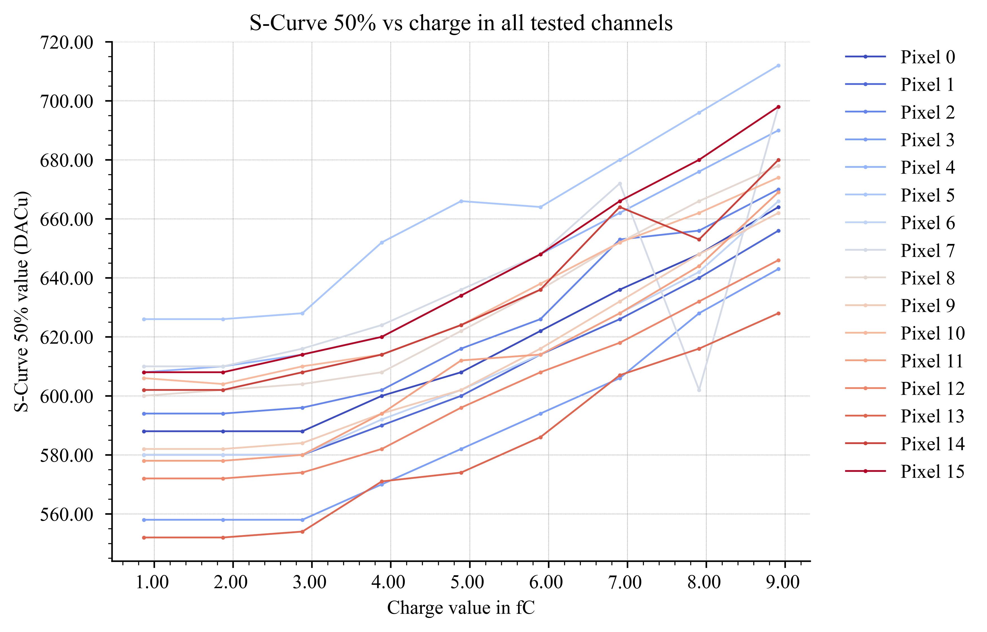
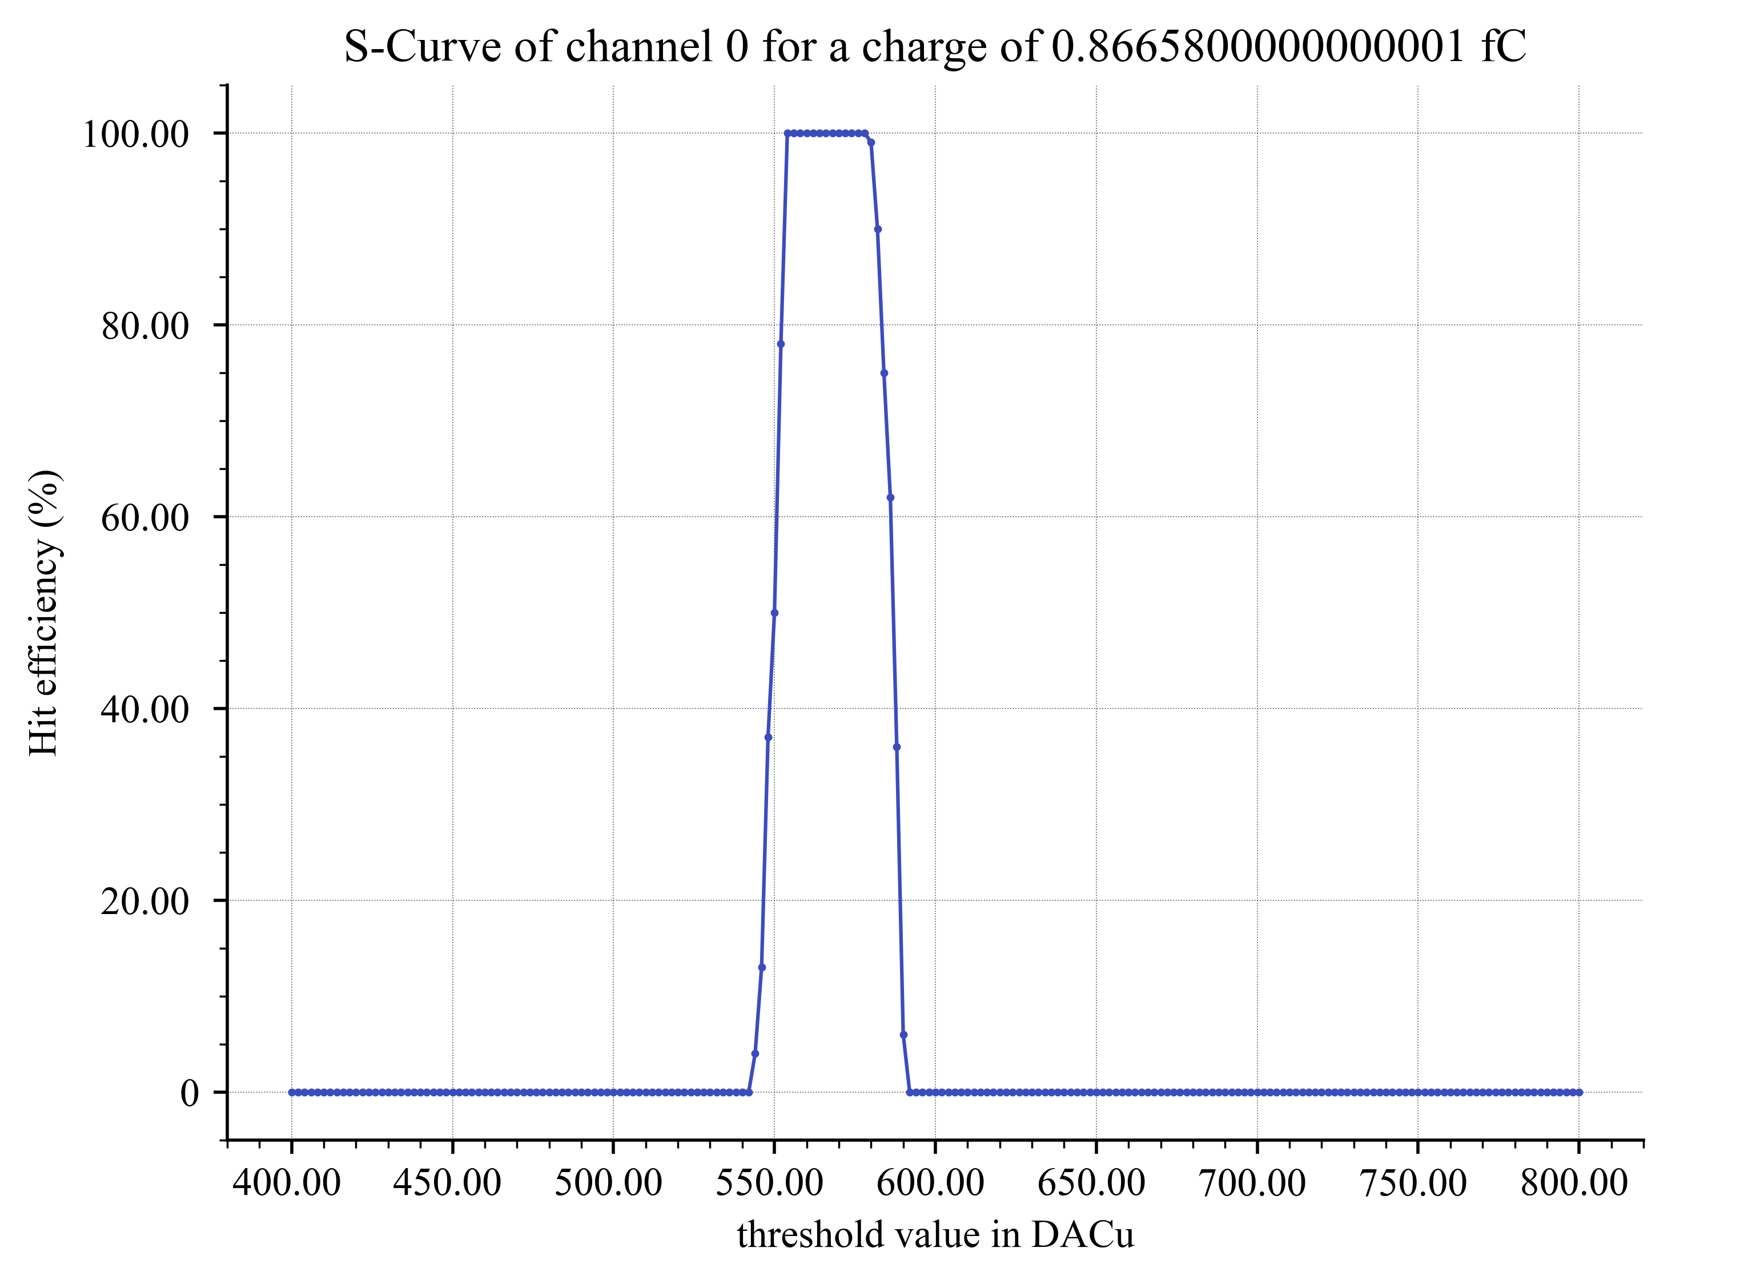
PCB1 – 27/04/2026 : Test results - Hit
S-Curve 50% vs charge
Minimum charge detected is around 4 fC.
The noise enveloppe at 1 fC is around 40 DACu (20 mV), as seen on plot (see plot under).
Slope from 4 fC to 9 fC is around 12.2 DACu / fC, or 6.1 mV / fC

Slide 24
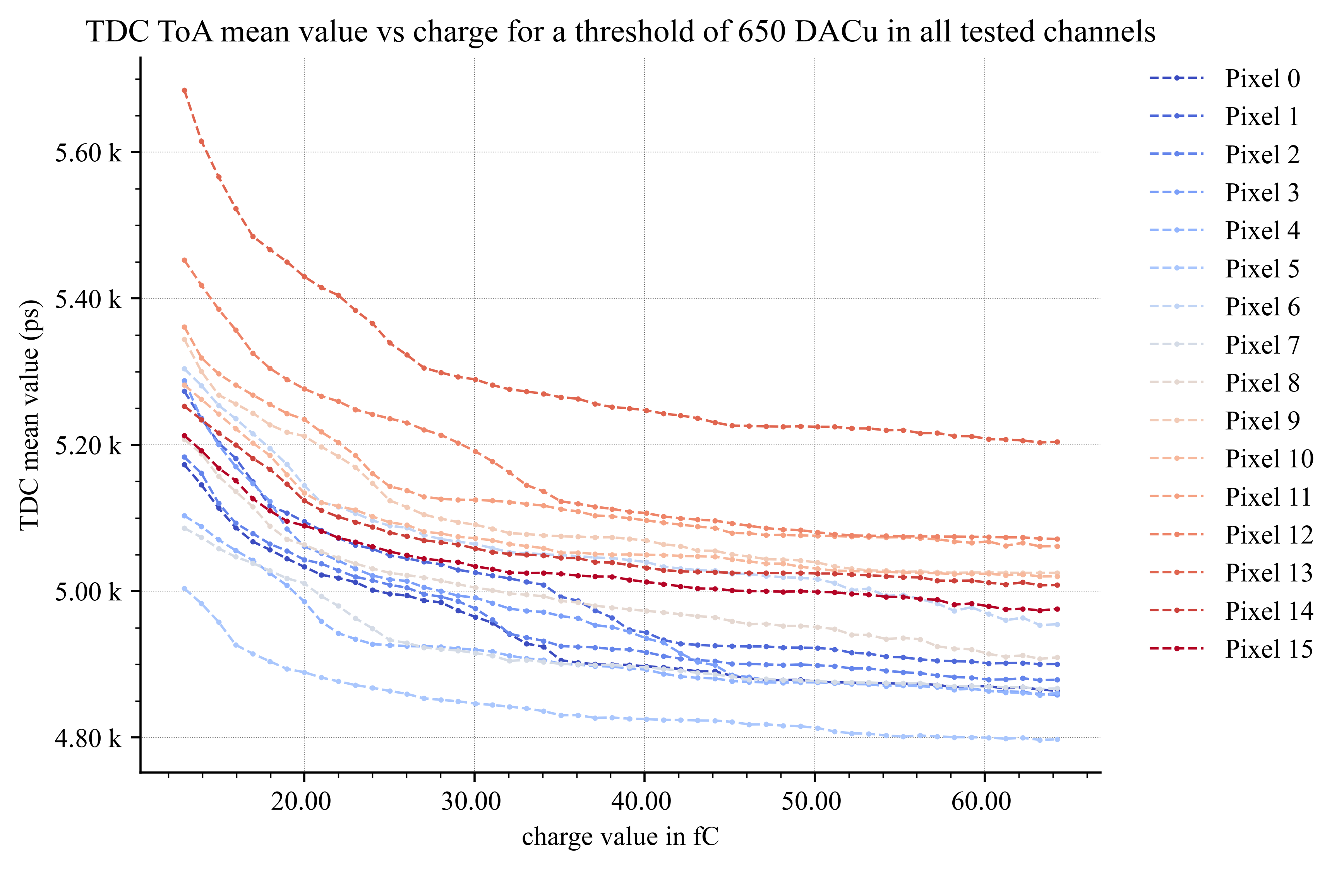
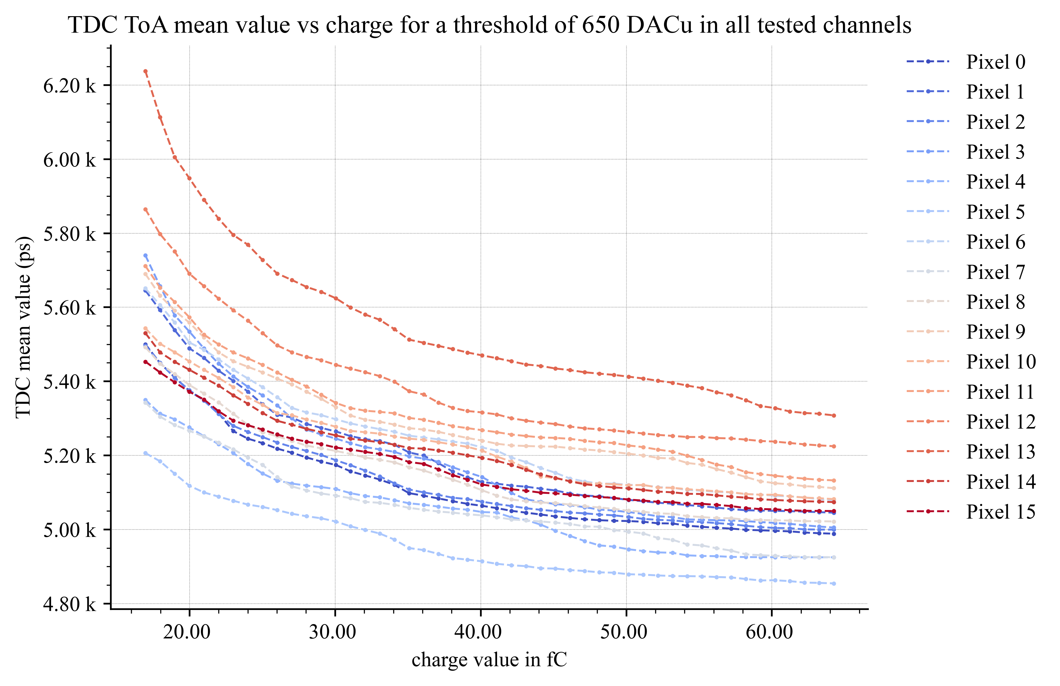
PCB1 – 07-09/04/2026 : Test results
TDC ToA for cD = 00 and cD = 11
cD = 00
cD = 11
There is a visible effect of cD on ToA results, with the ToA being higher when the capacitance is enabled. The range is different on the plots because of the additional capacitance which restricted the “usable” charge range in the results to a smaller interval.
In our restricted range, we find a ToA range around 500ps for cD = 00 and 850ps for cD = 11.

Slide 25
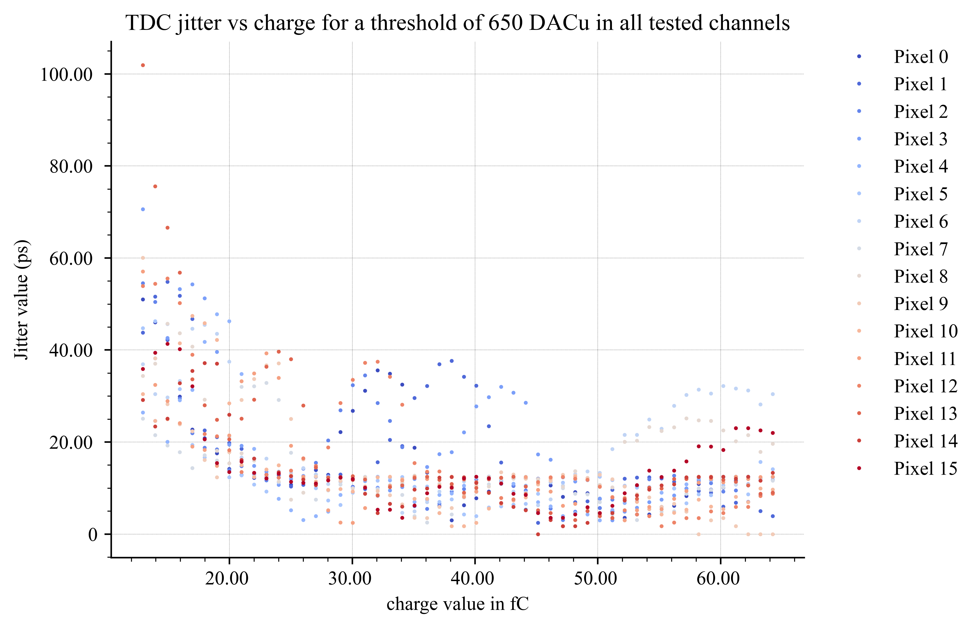
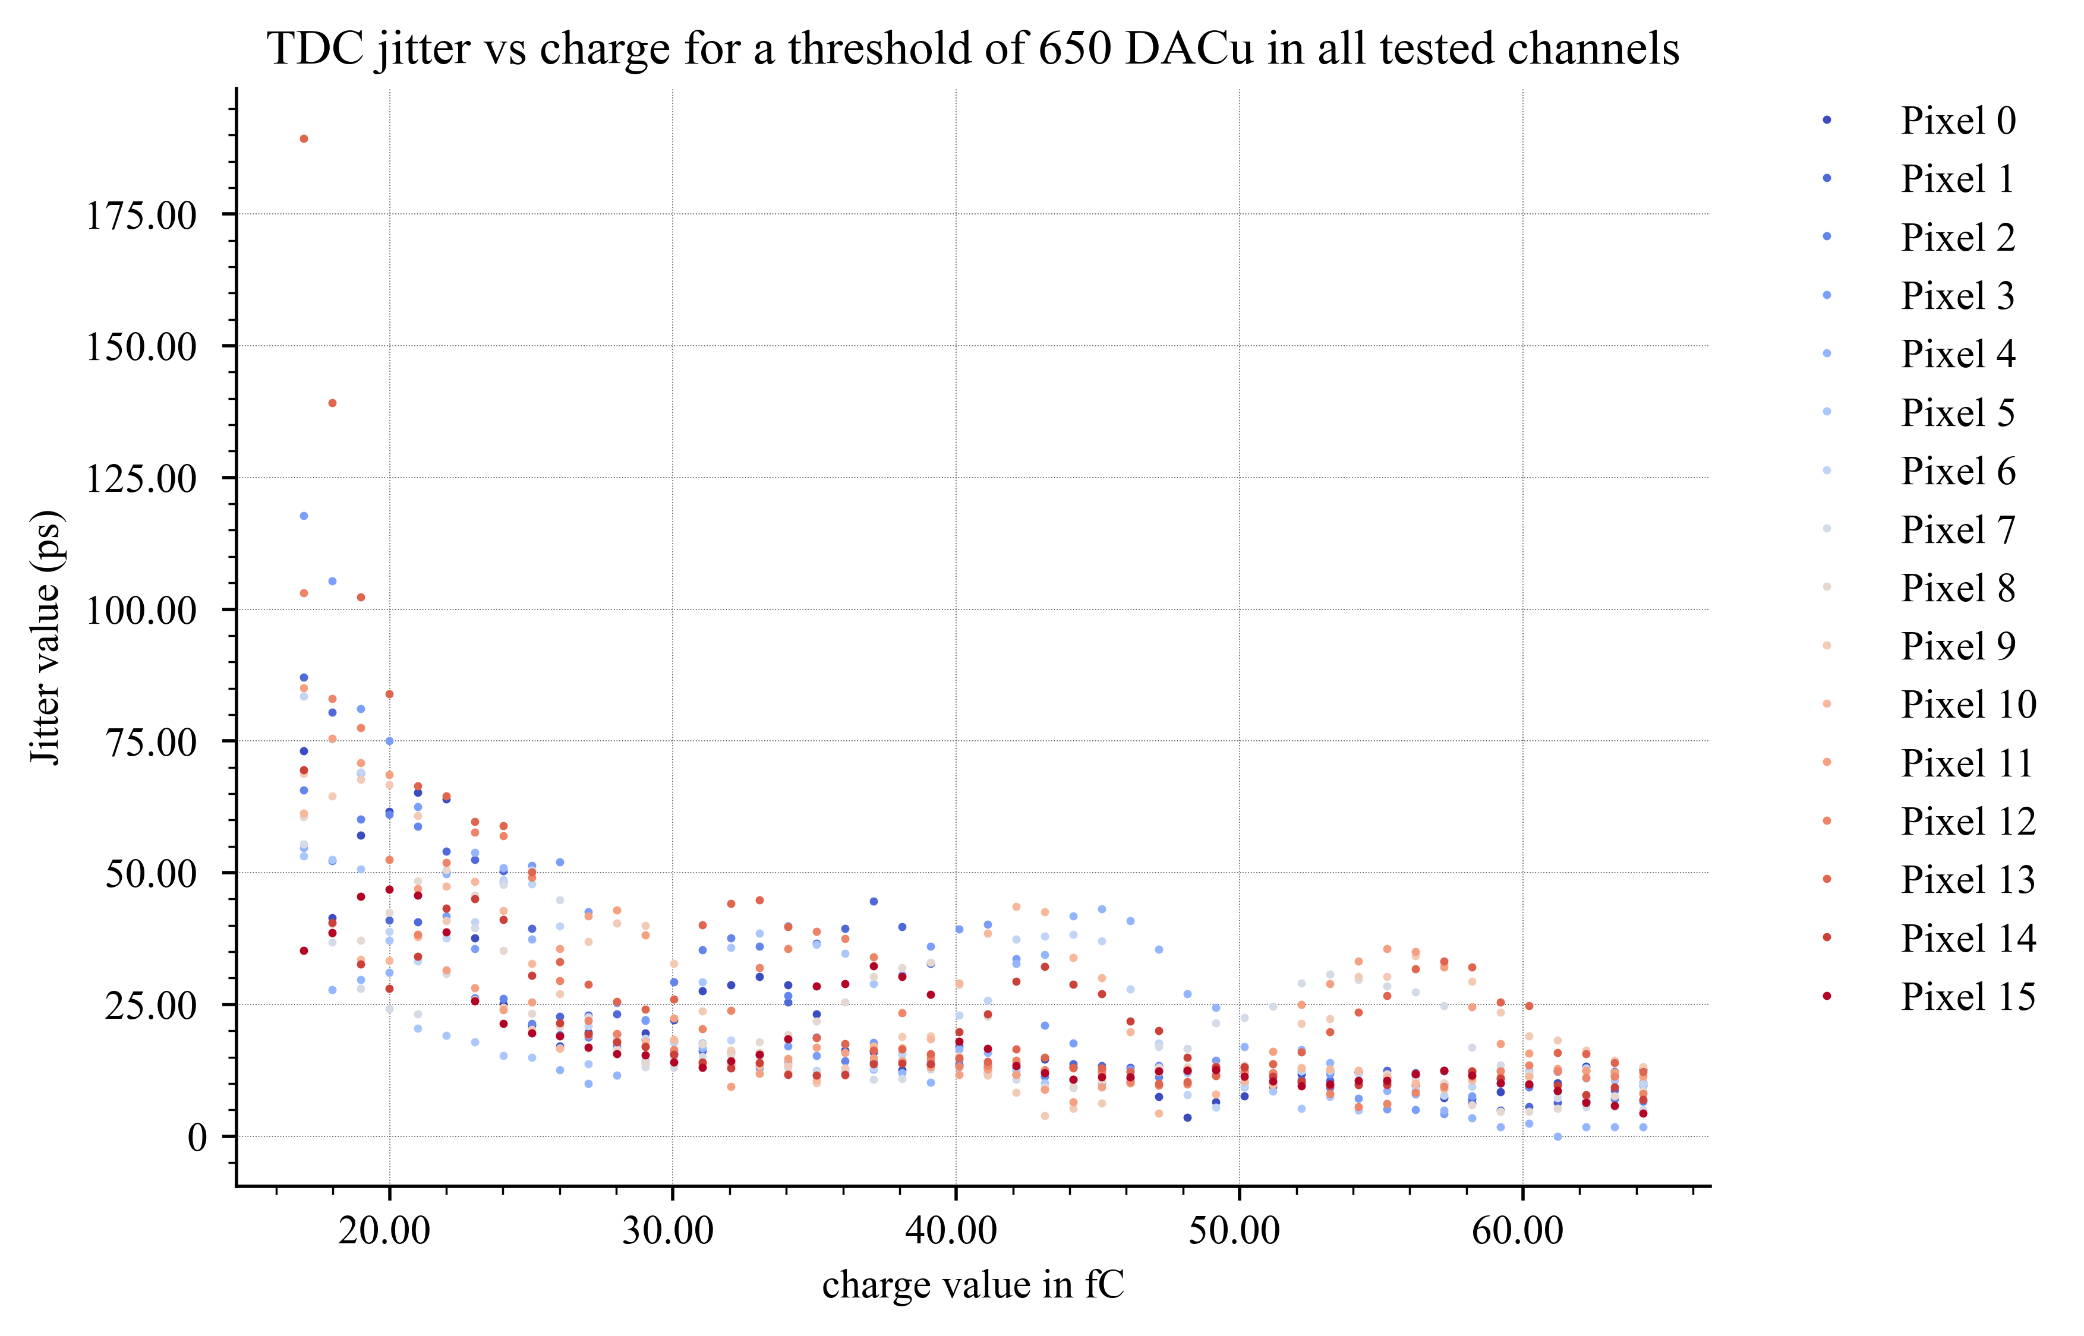
PCB1 – 07-09/04/2026 : Test results
TDC jitter for cD = 00 and cD = 11
cD = 00
cD = 11
Jitter plots exhibit a very good jitter floor, which indicates better performance with regards to EICROC0. The “bumps” seen in the TDC values could be from an incorrect TDC configuration.

Slide 26



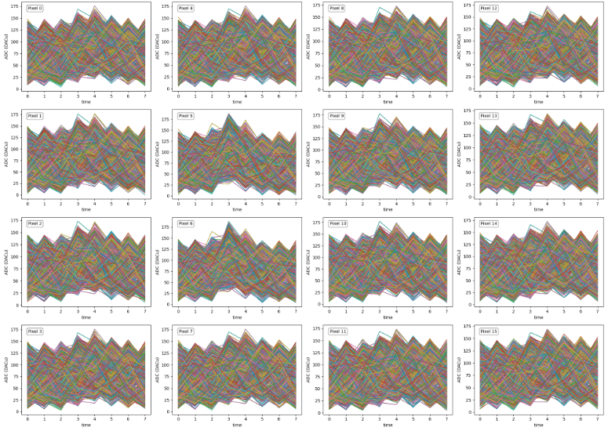
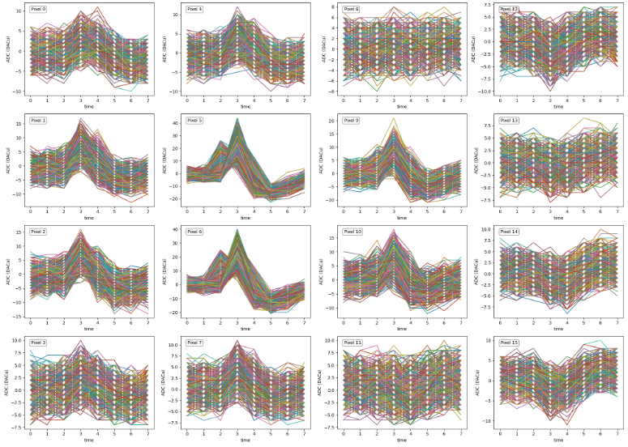
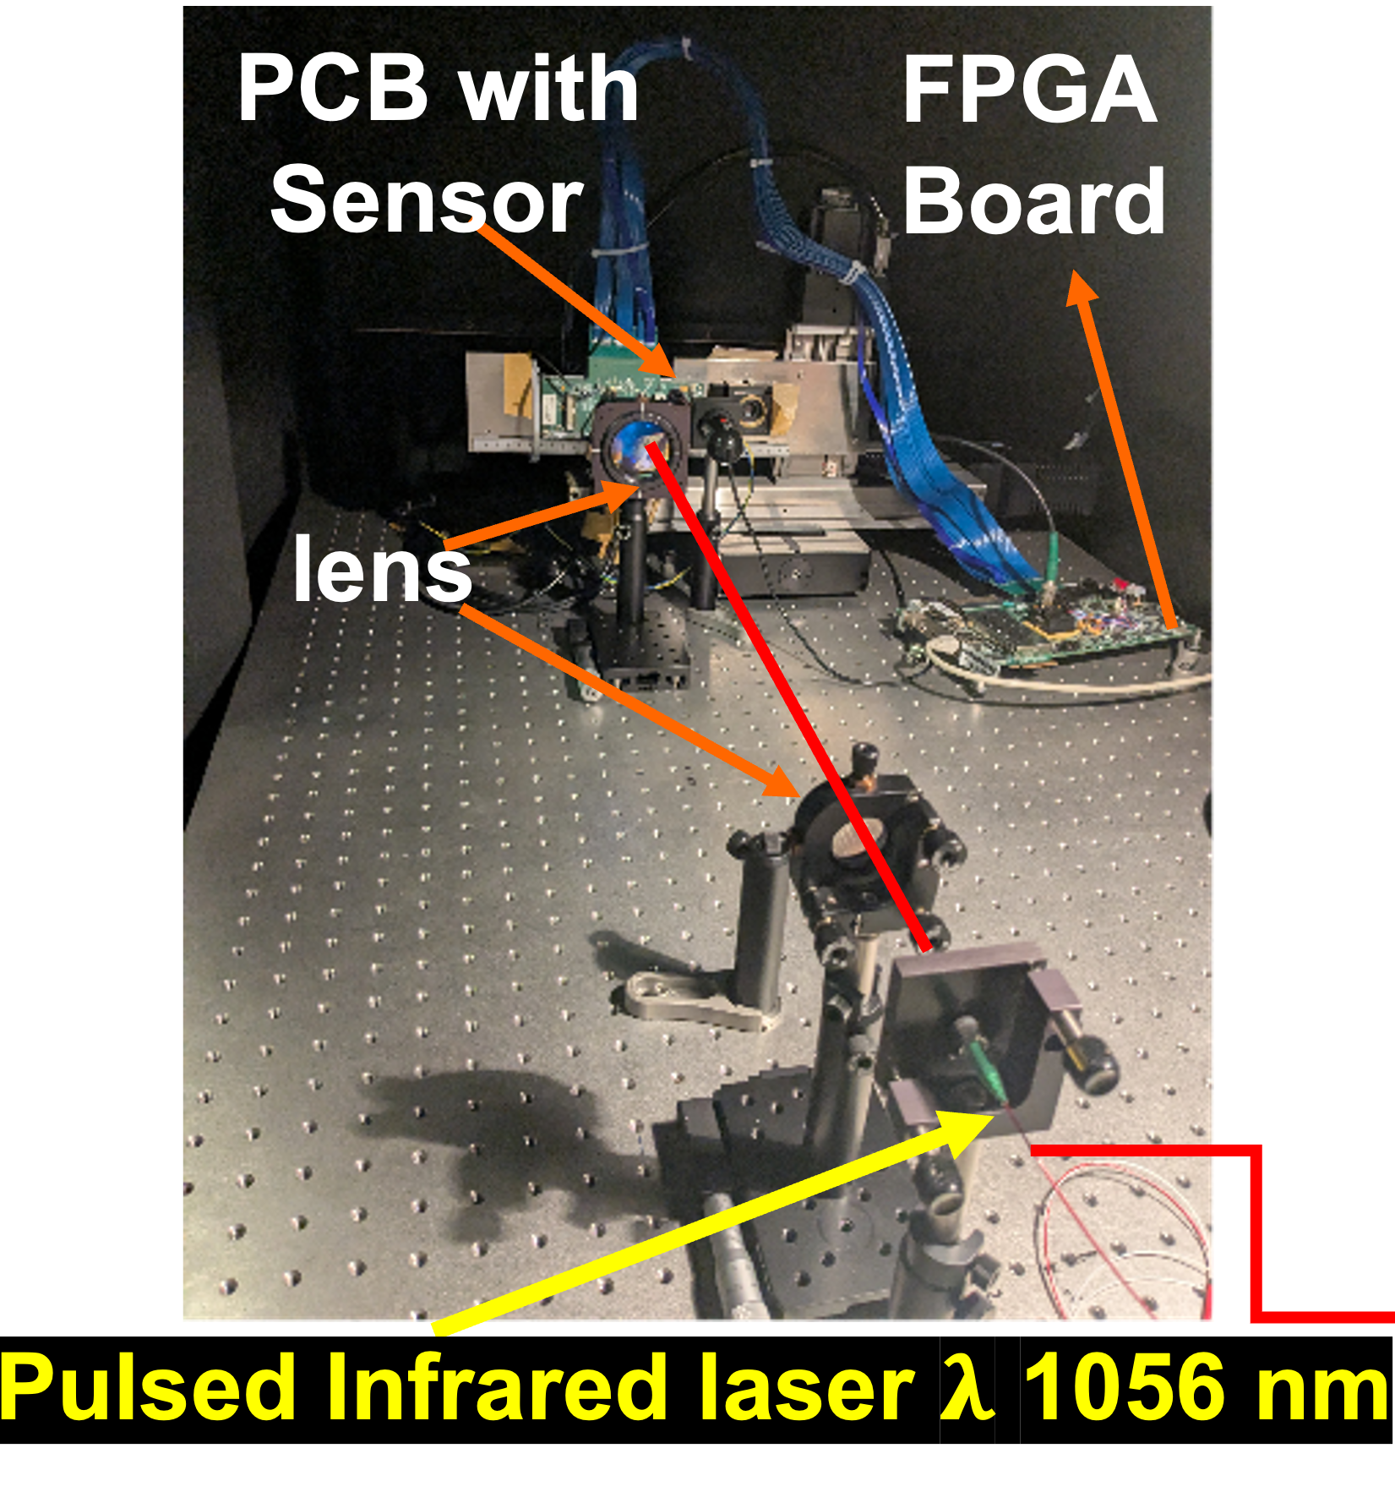
Pixelated AC-LGAD read-out characterization
Preliminary results with Infrared Laser (1/2)
ADC waveforms (8 time samples = 8 points/event): BEFORE & AFTER pedestal subtraction (based on « far » pixel evt by evt)
A. Sharma & D. Marchand

Slide 27
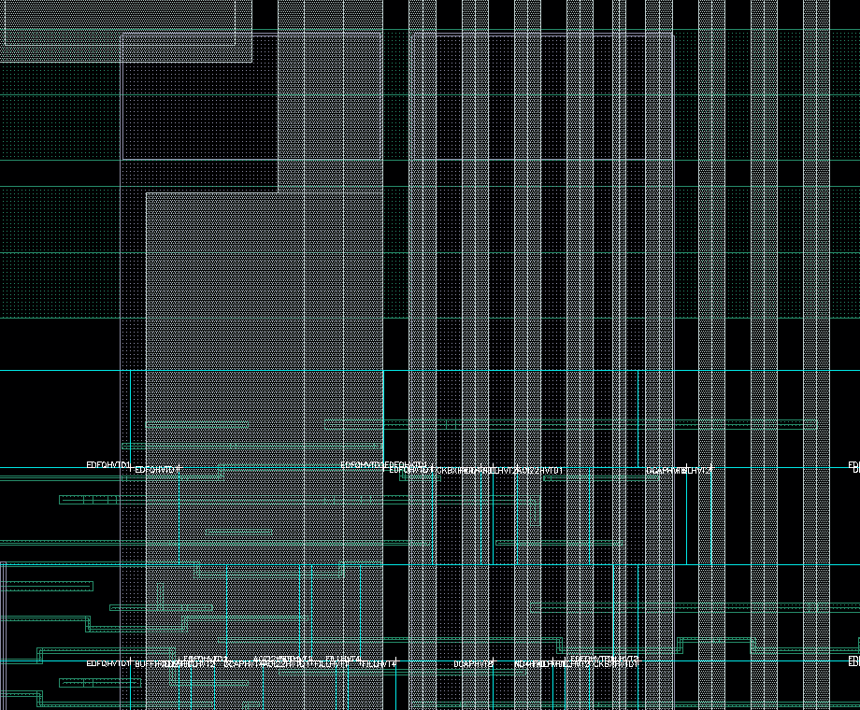
EICROC0 Coupling investigation
Large coupling seen on the ADC data which was completely hiding the signal up to 20 fC
Large coupling capacitance between local (pixel) digital block and preamp / shaper bias lines
Layout improved by adding exclusion zones and a shield between bias lines and digital
Bias / digital block layout in new EICROC ASICs

Slide 28

EICROC1 description
Designed as 8 blocks of 4x32
  Read out sequentially, like EICROC0
  Pixel similar to EICROC0A
  8 CLPS outputs at 40 MHz
  Clock tree for isochronous calib_pulse distribution
Common balcony (End of column)
  Biases and slow control
  New : fast command decoder (clock, calib_pulse, enable_acquisition, start_readout)
  Backup clock and cmd_pulse inputs available
  320 MHz serializer for 1 CLPS output : to be used for systèm tests

Slide 29
next EICROC2 (2027)
What is missing in EICROC1 ?
  Larger rate compatibility ?
  Derandomizer for successive events (how many ?)
  Digital on Top (DoT) design for digital power reduction and timing verification on large area : more powerful tools available (UVM)
  Auto-trigger and zero_suppressed data
  Power reduction if possible below 2 mW/ch
Clermont Ferrand lab has joined to take responsibility for the DoT
  Already participated in ATLAS ALTIROC
  The design and verification should take ~9 months from now
Technology choice
  Seems to converge to 130n provided rate remains low enough

Slide 30
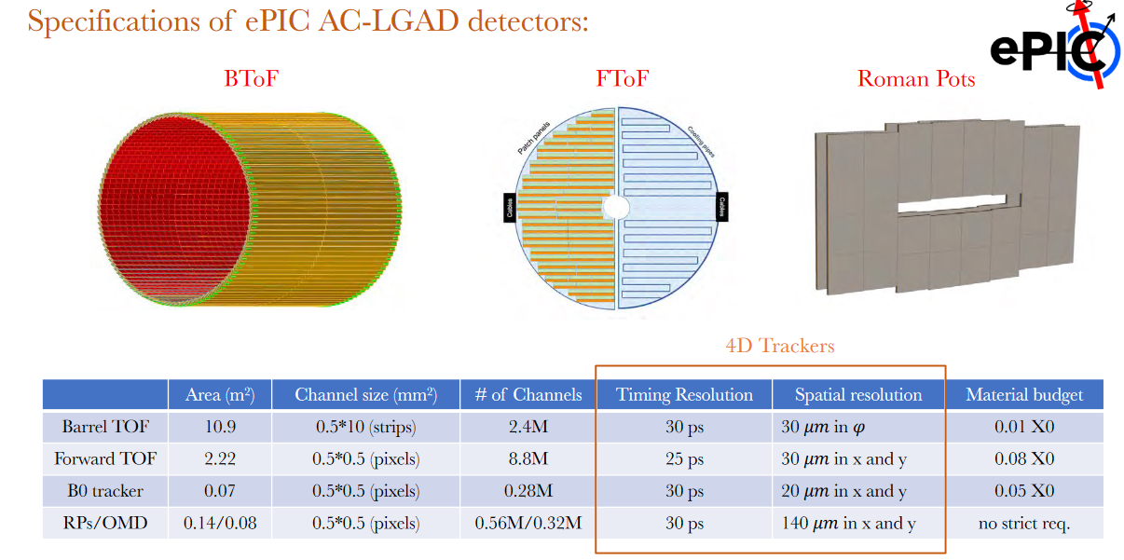
ePIC AC-LGAD detectors

Slide 31

Architecture proposal [A. Soulier et al.]
Goals
  Less digital logic possible inside pixel/matrix
  Less signals possible between matrix and periphery
  Triplication of sensitive circuits (configuration registers for example)
    No triplication on data path
  Complexity on periphery side, simple logic inside pixel
Proposal : Based on clusters of 4 pixels, controlled by the periphery
  Some logic shared at cluster level
  Shared data bus between 2 columns
First iteration of this architecture is ready at RTL level, some debug in progress
➔ Physical implementation can reveal new constraints, architecture may change
Triggered Pixel (TP)
Neighbor pixel (TL1)
Busy cluster
Cluster waiting for hit

Slide 32

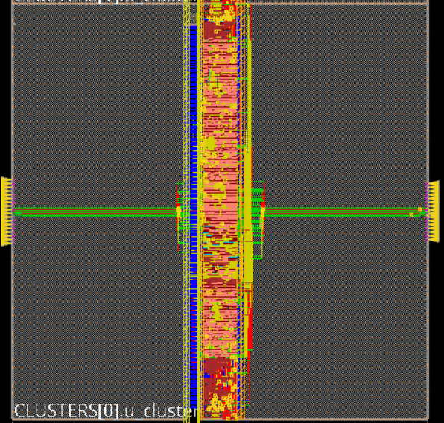
Physical implementation
First physical implementation done in 130nm
  Check if we manage to fit digital readout inside pixel
Preliminary layout of the cluster of 4 pixels and the column
Triplication of cluster (probably need some refinement)
Using a pixel_analog_dummy macro, not the real analog front-end
Need more time to validate that this architecture can fit using 130nm technology
Cluster of 4 pixels
Double column

Slide 33

Path towards production and QC
For roman pots ~500 chips would be needed (500 k ch) = 6 wafers
For FToF 10k chips ~100 wafers
EICROC2 should be a final version (all features implemented)
  Schedule accomodates a possible EICROC3 to fix bugs in EICROC2
  ~1 year after EICROC2 tests and system tests complete
Wafer probing station and test setup will be needed
  Can be inspired from ALTIROC setup

Slide 34


EICROC0 measurements : S-Curves
6-bit DAC for channel-wise threshold alignement
Correction of channels for a charge of 5 fC (ASIC alone)

Slide 35


EICROC0 measurements : TDC ToA
Time walk measurement :~400 ps
TDC ToA – no sensor
TDC ToA – BNL Flipchip sensor
500 ps

Slide 36


EICROC0 measurements : TDC jitter
TDC jitter – no sensor
TDC jitter – BNL Flipchip sensor
30 ps
30 ps
Charge range degraded with sensor, still need to properly calibrate the TDC for each channel and remove correlated noise

Slide 37


ePIC experiment far-forward region
Roman Pots for ePIC experiment
          Used in the far forward tracking of particle collisions, mandatory for exclusive reactions
2 stations ~2m apart
  2-3 layers of sensors per station
  Square pixels of (500µm)²
Stringent requirements
  AC-LGAD sensors will be used because of their capability to provide excellent resolution in timing and spatial resolution.
EIC Conceptual Design Report, 2021

Slide 38
EICROC0 performance on testbench
Charge #3
Qin = 5 fC
500 ps
More in backup
Noise ~1 LSB
30 ps

