Slide 1




Strip-Type AC-LGAD
Test, Status, and Plan
Satoshi YANO
Hiroshima University and RIKEN
The ePIC Collaboration meeting @ Glasgow

Slide 2
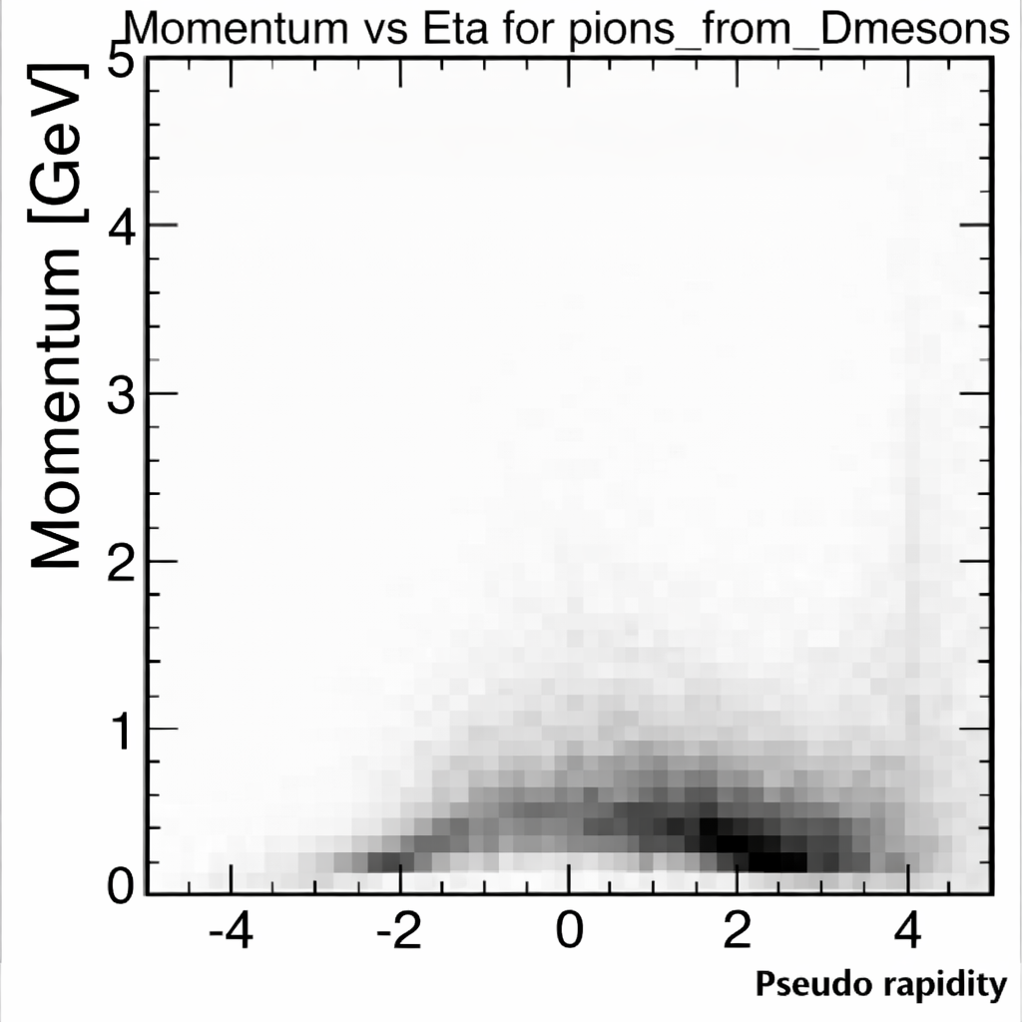
”Required” Sensor Performance
BTOF PID focuses on low-momentum particles at mid-rapidity
Continuous PID coverage requires seamless operation in conjunction with other PID detectors, avoiding PID gaps
  Minimum timing required for the sensor to eliminate the PID gap is ~95 ps
A stretch goal of sensor ~40 ps would provide substantial overlap (Δp ≈ 0.5 GeV/c) for robust cross-calibration
hpDIRC
dRICH
pfRICH
FTOF
HRPPD
BTOF
Decay products from D-meson in ep DIS @ √s = 141 GeV

Slide 3
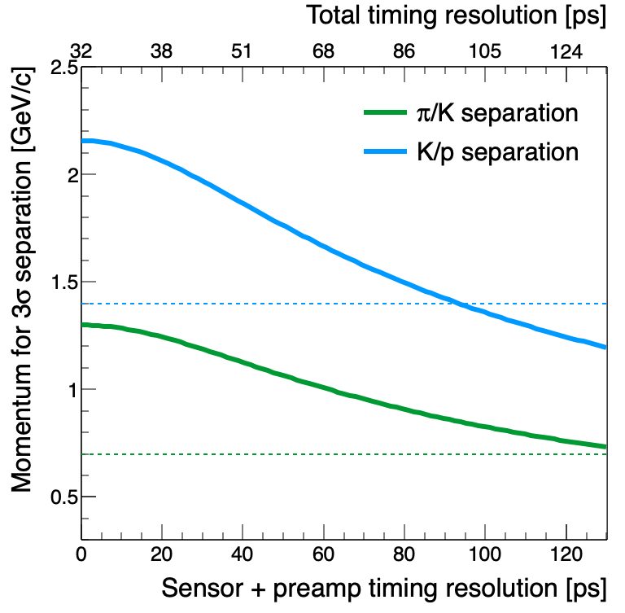
”Required” Sensor Performance
BTOF PID focuses on low-momentum particles at mid-rapidity
Continuous PID coverage requires seamless operation in conjunction with other PID detectors, avoiding PID gaps
  Minimum timing required for the sensor to eliminate the PID gap is ~95 ps
A stretch goal of sensor ~40 ps would provide substantial overlap (Δp ≈ 0.5 GeV/c) for robust cross-calibration
hpDIRC
dRICH
σ_{elec} = 20ps
σ_{T0} = 25ps
pfRICH
Overlap
~ 0.5 GeV/c
Overlap disappear
point
hpDIRC limit
FTOF
Overlap
~ 0.5 GeV/c
HRPPD
BTOF
hpDIRC limit
~95 ps
Decay products from D-meson in ep DIS @ √s = 141 GeV

Slide 4
”Required” Sensor Performance
BTOF PID focuses on low-momentum particles at mid-rapidity
Continuous PID coverage requires seamless operation in conjunction with other PID detectors, avoiding PID gaps
  Minimum timing required for the sensor to eliminate the PID gap is ~95 ps
A stretch goal of sensor ~40 ps would provide substantial overlap (Δp ≈ 0.5 GeV/c) for robust cross-calibration
hpDIRC
dRICH
σ_{elec} = 20ps
σ_{T0} = 25ps
pfRICH
Overlap
~ 0.5 GeV/c
Overlap disappear
point
hpDIRC limit
FTOF
Overlap
~ 0.5 GeV/c
HRPPD
BTOF
hpDIRC limit
~95 ps
Decay products from D-meson in ep DIS @ √s = 141 GeV

Slide 5
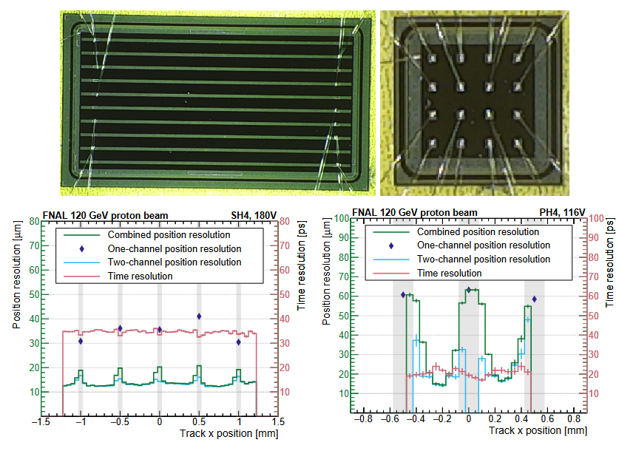
Strip-Tyle AC-LGAD Sensor
eRD112 FY23
10mm
5 mm
SH2
400Ω/◻︎ (C-Type)
240 pF/mm²
SiO₂ 50nm
SH3
400Ω/◻︎ (C-Type)
600 pF/mm²
SiO₂ 50nm
SH4
1600Ω/◻︎ (E-Type)
240 pF/mm²
SiO₂ 50nm
SH5
1600Ω/◻︎ (E-Type)
600 pF/mm²
SiO₂ 50nm

Slide 6
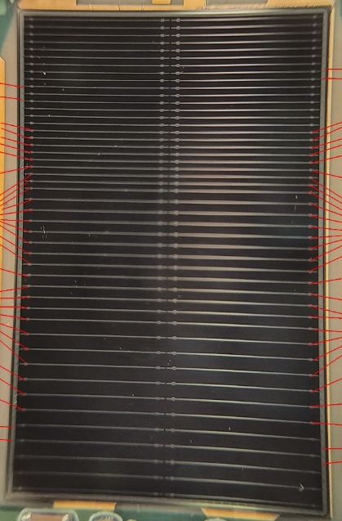
Strip-Tyle AC-LGAD Sensor
eRD112 FY23
eRD112 FY24
20 mm
10mm
5 mm
SH2
400Ω/◻︎ (C-Type)
240 pF/mm²
SiO₂ 50nm
SH3
400Ω/◻︎ (C-Type)
600 pF/mm²
SiO₂ 50nm
32 mm
SH4
1600Ω/◻︎ (E-Type)
240 pF/mm²
SiO₂ 50nm
SH5
1600Ω/◻︎ (E-Type)
600 pF/mm²
SiO₂ 50nm
1600Ω/◻︎ (E-Type)
600 pF/mm²
SiO₂ 50nm

Slide 7
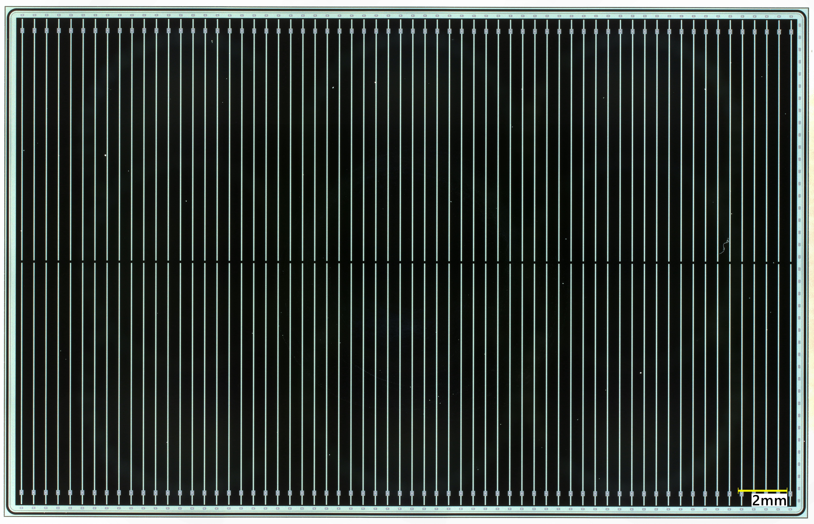
Strip-Tyle AC-LGAD Sensor
eRD112 FY23
eRD112 FY24
EIC-JPN JFY25
20 mm
10mm
5 mm
32 mm
SH2
400Ω/◻︎ (C-Type)
240 pF/mm²
SiO₂ 50nm
SH3
400Ω/◻︎ (C-Type)
600 pF/mm²
SiO₂ 50nm
32 mm
20 mm
Row1 ~ 64
SH4
1600Ω/◻︎ (E-Type)
240 pF/mm²
SiO₂ 50nm
SH5
1600Ω/◻︎ (E-Type)
600 pF/mm²
SiO₂ 50nm
col1
col2
1600Ω/◻︎ (E-Type)
600 pF/mm²
SiO₂ 50nm
1600Ω/◻︎ (E-Type)
240 pF/mm²
SiO₂ 50nm + SiN 200nm

Slide 8
Strip-Tyle AC-LGAD Sensor
✔︎ Test Beam
✔︎ Test Beam
eRD112 FY23
eRD112 FY24
EIC-JPN JFY25
20 mm
10mm
5 mm
32 mm
SH2
400Ω/◻︎ (C-Type)
240 pF/mm²
SiO₂ 50nm
SH3
400Ω/◻︎ (C-Type)
600 pF/mm²
SiO₂ 50nm
32 mm
20 mm
Row1 ~ 64
SH4
1600Ω/◻︎ (E-Type)
240 pF/mm²
SiO₂ 50nm
SH5
1600Ω/◻︎ (E-Type)
600 pF/mm²
SiO₂ 50nm
col1
col2
1600Ω/◻︎ (E-Type)
600 pF/mm²
SiO₂ 50nm
1600Ω/◻︎ (E-Type)
240 pF/mm²
SiO₂ 50nm + SiN 200nm

Slide 9
Sensor Design Strategy in JFY25
Result of eRD112 FY23
C-Type
C-Type
E-Type
E-Type

Slide 10
Sensor Design Strategy in JFY25
Result of eRD112 FY23
C-Type
C-Type
E-Type
E-Type
No capacitance of oxide layer dependence
Thick oxide layer was preferred because we faced sensor damage by wire-bonding
Assume SiO₂ 50nm + SiN 200nm (240 pF/mm²) is the same performance as SiO₂ 50nm (600pF/mm²)
  Detector capacitance: 12 pF (240pF/mm²) v.s. 12.4 pF (600pF/mm²)

Slide 11
Sensor Design Strategy in JFY25
Result of eRD112 FY23
C-Type
C-Type
E-Type
E-Type
No capacitance of oxide layer dependence
Thick oxide layer was preferred because we faced sensor damage by wire-bonding
Assume SiO₂ 50nm + SiN 200nm (240 pF/mm²) is the same performance as SiO₂ 50nm (600pF/mm²)
  Detector capacitance: 12 pF (240pF/mm²) v.s. 12.4 pF (600pF/mm²)

Slide 12
Sensor Design Strategy in JFY25
Result of eRD112 FY23
C-Type
C-Type
E-Type
E-Type
No capacitance of oxide layer dependence
Thick oxide layer was preferred because we faced sensor damage by wire-bonding
Assume SiO₂ 50nm + SiN 200nm (240 pF/mm²) is the same performance as SiO₂ 50nm (600pF/mm²)
  Detector capacitance: 12 pF (240pF/mm²) v.s. 12.4 pF (600pF/mm²)

Slide 13
Japan-Led Test Beam Campaigns JFY25+JFY26
DESY, Germany (Dec. 15–21, 2025)
  Electron beam (up to 5.6 GeV)
  Position resolution measurement using the DESY telescope
KEK PF-AR, Japan (Feb. 19–25, 2026)
  Electron beam (below 5.8 GeV)
  Timing resolution measurement of baseline sensor
RARiS, Tohoku University, Japan (Mar. 3–6, 2026)
  1 GeV electron beam
  Timing resolution measurement of alternative sensors
KEK PF-AR, Japan (June 1, 2026)
  Electron beam (below 5.8 GeV)
  Temperature dependence of timing performance (baseline sensor)

Slide 14
Japan-Led Test Beam Campaigns JFY25+JFY26
DESY, Germany (Dec. 15–21, 2025)
  Electron beam (up to 5.6 GeV)
  Position resolution measurement using the DESY telescope
KEK PF-AR, Japan (Feb. 19–25, 2026)
  Electron beam (below 5.8 GeV)
  Timing resolution measurement of baseline sensor
RARiS, Tohoku University, Japan (Mar. 3–6, 2026)
  1 GeV electron beam
  Timing resolution measurement of alternative sensors
KEK PF-AR, Japan (June 1, 2026)
  Electron beam (below 5.8 GeV)
  Temperature dependence of timing performance (baseline sensor)

Slide 15
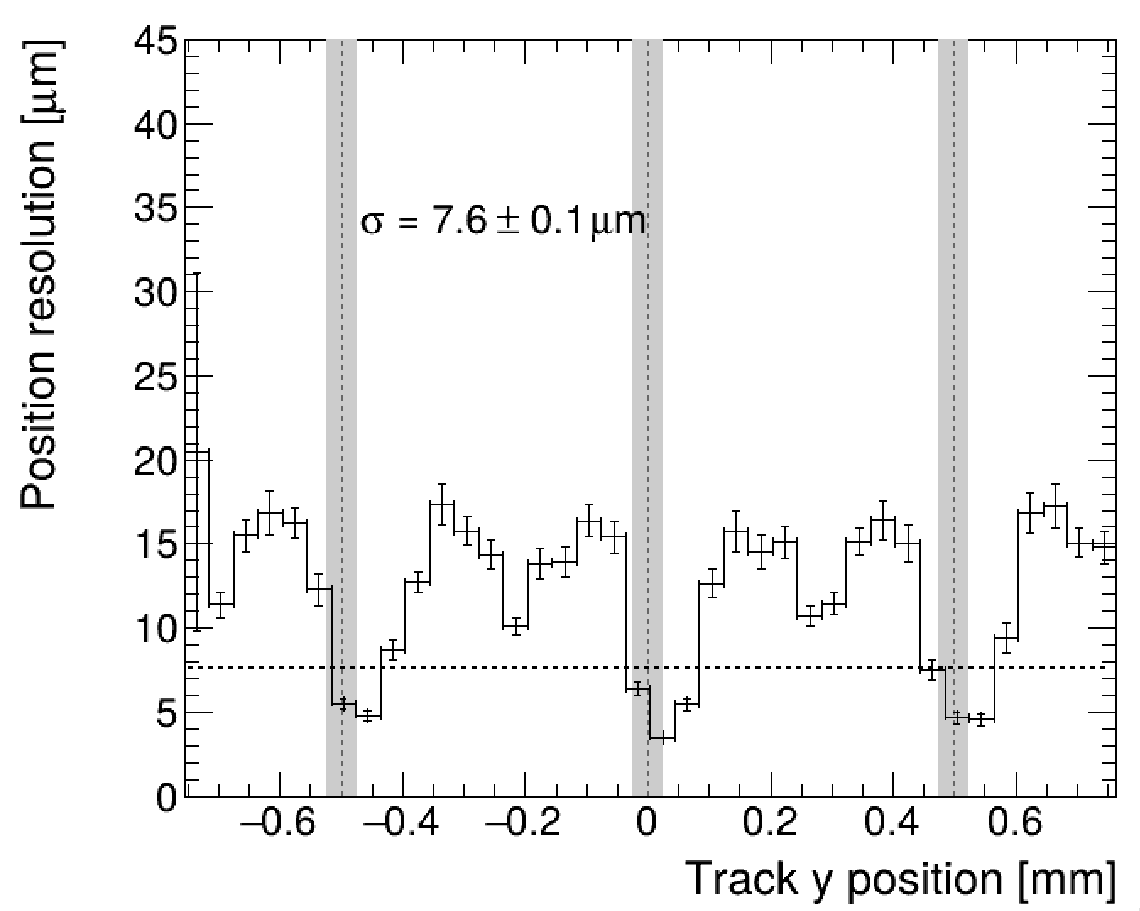
Hit Position Resolution
Similar or better positioning resolution than eRD112 FY23 sensor
  Different algorithm is used
eRD112 FY23
EIC-JPN JFY25

Slide 16
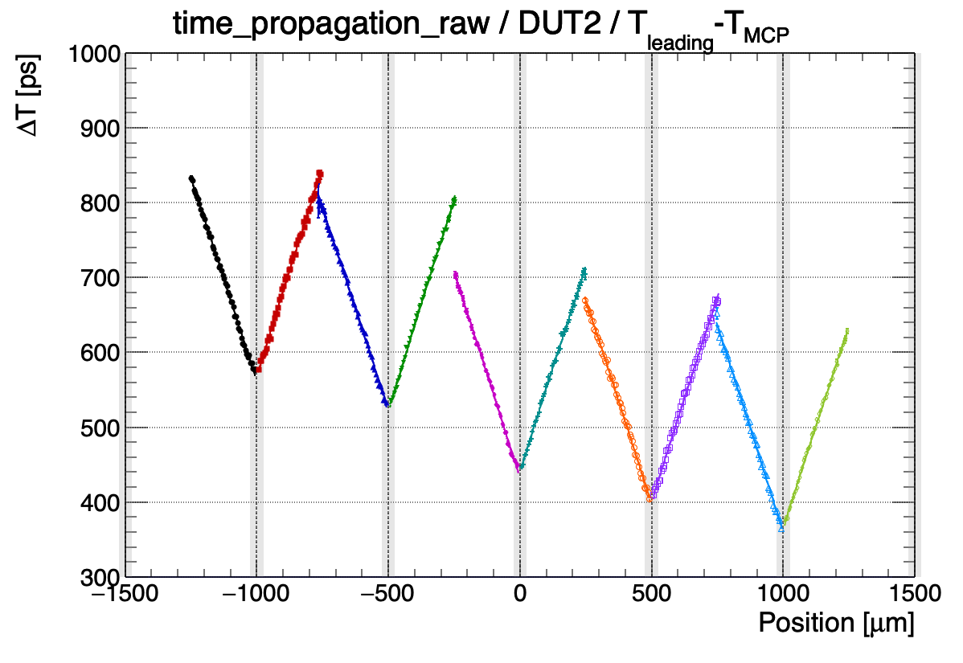
Signal Propagation Time
σ²_{total} =σ²_{jitter} + σ²_{Landau} + σ²_{tw} + σ²_{delay}
V_{eff} ~ 0.92 um/ps
Strip#1
Strip#2
Leading – MCPPMT time [ps]
Δt₁
Δt₂
True hit time t_{hit}
T_{s1} = t_{hit} + Δt₁
T_{s2} = t_{hit} + Δt₂
Hit position accuracy connects to timing resolution via σ_{delay} ~ σ_{pos}/v_{eff}
  σ_{delay} = 5 ~ 16 ps @ σ_{pos} = 5 ~ 15 μm (self determination)
  σ_{delay} = 33 ps @ σ_{pos} = 30 μm (5-bit ADC scenario)
  σ_{delay} = 109 ps @ σ_{pos} = 100 μm (track information)

Slide 17
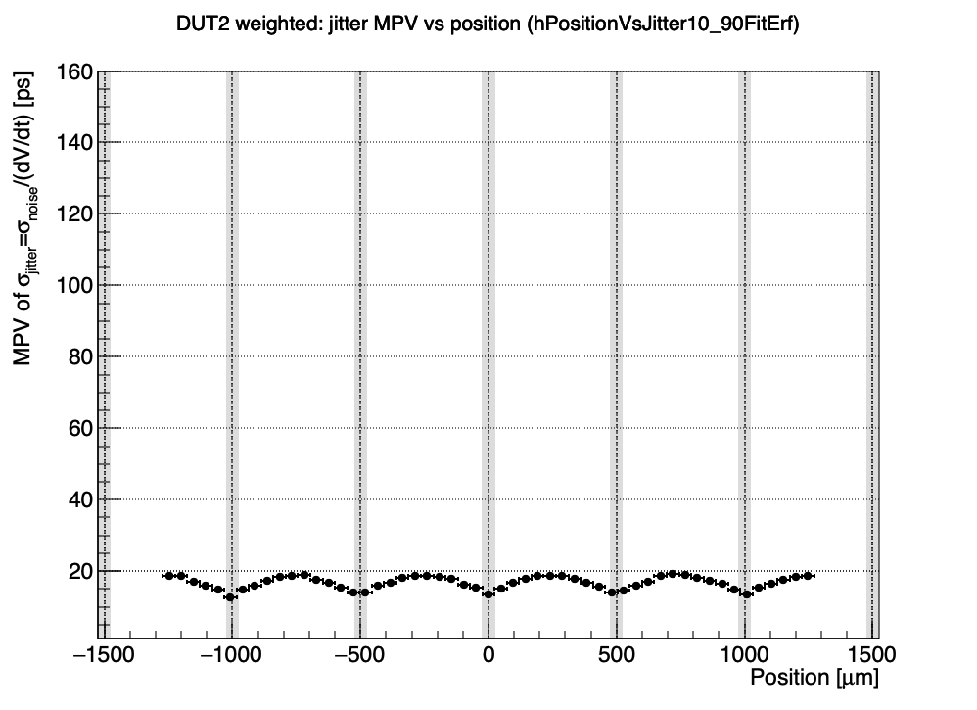
Jitter
σ²_{total} =σ²_{jitter} + σ²_{Landau} + σ²_{tw} + σ²_{delay}
eRD112 FY23
EIC-JPN JFY25
Weighted
(leading & subleading)
Jitter definition: σ_{jitter} = σ_{noise} / (dV/dt)
EIC-JPN JFY25 result is the same as eRD112 FY23, 15~20 ps

Slide 18
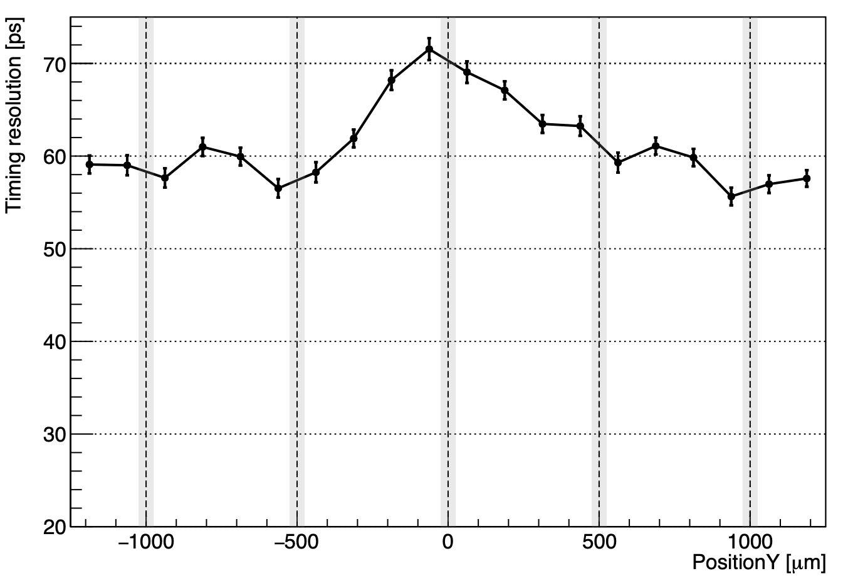
Total Timing Resolution
eRD112 FY23
EIC-JPN JFY25
σ²_{total} =σ²_{jitter} + σ²_{Landau} + σ²_{tw} + σ²_{delay} + σ²_{unknown}
60~70 ps
15~20 ps
25~30 ps
~5 ps
~10 ps
45~58 ps

Slide 19
Summary of Test Beam
Hit position can be measure very precisely
  σ_{pos} ~ 7.6 μm in average
Non-negligible signal propagation time has been observed
  v_{eff} ~ 0.92 μm/ps
Accuracy of hit position estimation affects on timing resolution, but it can be controlled
  Hit position resolution of tracking O(100) μm is insufficient to get a few tens of ps timing resolution
Jitter result is the same as the previous eRD112 prototype 15~20ps, but the total timing resolution is 60~70ps due to unknown source of ~50ps
  It may come from timing reference reconstruction (MCP-PMT)
Excellent results have been measured by TCT-scan (see next presentation)
  We are investigating the “unknown” source by the new weapon

Slide 20
Summary of Test Beam
Hit position can be measure very precisely
  σ_{pos} ~ 7.6 μm in average
Non-negligible signal propagation time has been observed
  v_{eff} ~ 0.92 μm/ps
Accuracy of hit position estimation affects on timing resolution, but it can be controlled
  Hit position resolution of tracking O(100) μm is insufficient to get a few tens of ps timing resolution
Jitter result is the same as the previous eRD112 prototype 15~20ps, but the total timing resolution is 60~70ps due to unknown source of ~50ps
  It may come from timing reference reconstruction (MCP-PMT)
Excellent results have been measured by TCT-scan (see next presentation)
  We are investigating the “unknown” source by the new weapon

Slide 21
Summary of Test Beam
Hit position can be measure very precisely
  σ_{pos} ~ 7.6 μm in average
Non-negligible signal propagation time has been observed
  v_{eff} ~ 0.92 μm/ps
Accuracy of hit position affects on timing resolution, but it can be controlled
  Hit position resolution of tracking O(100) μm is insufficient to get a few tens of ps timing resolution
Jitter result is the same as the previous eRD112 prototype 15~20ps, but the total timing resolution is 60~70ps due to unknown source of ~50ps
  It may come from timing reference reconstruction (MCP-PMT)
Excellent results have been measured by TCT-scan (see next presentation)
  We are investigating the “unknown” source by the new weapon

Slide 22
Summary of Test Beam
Hit position can be measure very precisely
  σ_{pos} ~ 7.6 μm in average
Non-negligible signal propagation time has been observed
  v_{eff} ~ 0.92 μm/ps
Accuracy of hit position affects on timing resolution, but it can be controlled
  Hit position resolution of tracking O(100) μm is insufficient to get a few tens of ps timing resolution
Jitter result is the same as the previous eRD112 prototype 15~20ps, but the total timing resolution is 60~70ps due to unknown source of ~50ps
  It may come from timing reference reconstruction (MCP-PMT)
Excellent results have been measured by TCT-scan (see next presentation)
  We are investigating the “unknown” source by the new weapon

Slide 23
Summary of Test Beam
Hit position can be measure very precisely
  σ_{pos} ~ 7.6 μm in average
Non-negligible signal propagation time has been observed
  v_{eff} ~ 0.92 μm/ps
Accuracy of hit position affects on timing resolution, but it can be controlled
  Hit position resolution of tracking O(100) μm is insufficient to get a few tens of ps timing resolution
Jitter result is the same as the previous eRD112 prototype 15~20ps, but the total timing resolution is 60~70ps due to unknown source of ~50ps
  It may come from timing reference reconstruction (MCP-PMT)
Excellent results have been measured by TCT-scan (see next presentation)
  We are investigating the “unknown” source by the new weapon

Slide 24
Future Plan
Short-term:
  Main event is the next review which will be held on Oct. to Dec. 2026
  Unknown source existing in the only test beam must be understood
    No test beam before the review
    Building a block with the test beam, TCT-scan, and Sr90 results to convince reviewers
Middle-term:
  Test beam for compatibility with FCFDv1.2 will be planned at Nov. to Dec. 2026
  EIC-JPN JFY25 sensor detector capacitance is expected to be 12 pF @ 1GHz (eRD112 FY23 sensor is 12.4 pF @ 1GHz)
Long-term:
  Strategy of sensor production in JFY26 (until March 2027) should be fixed
  The deadline for finalizing design is August to receive sensors in the JFY26
  The sensor will be used for several tests planed in 2027

Slide 25
Future Plan
Short-term:
  Main event is the next review which will be held on Oct. to Dec. 2026
  Unknown source existing in the only test beam must be understood
    No test beam before the review
    Building a block with the test beam, TCT-scan, and Sr90 results to convince reviewers
Middle-term:
  Test beam for compatibility with FCFDv1.2 will be planned on Nov. to Dec. 2026 @ KEK
  EIC-JPN JFY25 sensor detector capacitance is expected to be 12 pF @ 1GHz (eRD112 FY23 sensor is 12.4 pF @ 1GHz)
Long-term:
  Strategy of sensor production in JFY26 (until March 2027) should be fixed
  The deadline for finalizing design is August to receive sensors in the JFY26
  The sensor will be used for several tests planed in 2027

Slide 26
Future Plan
Short-term:
  Main event is the next review which will be held on Oct. to Dec. 2026
  Unknown source existing in the only test beam must be understood
    No test beam before the review
    Building a block with the test beam, TCT-scan, and Sr90 results to convince reviewers
Middle-term:
  Test beam for compatibility with FCFDv1.2 will be planned at Nov. to Dec. 2026 @ KEK
  EIC-JPN JFY25 sensor detector capacitance is expected to be 12 pF @ 1GHz (eRD112 FY23 sensor is 12.4 pF @ 1GHz)
Long-term:
  Strategy of sensor production in JFY26 (until March 2027) should be fixed
  The deadline for finalizing design is August to receive sensors in the JFY26
  The sensor will be used for several tests planed in 2027

Slide 27
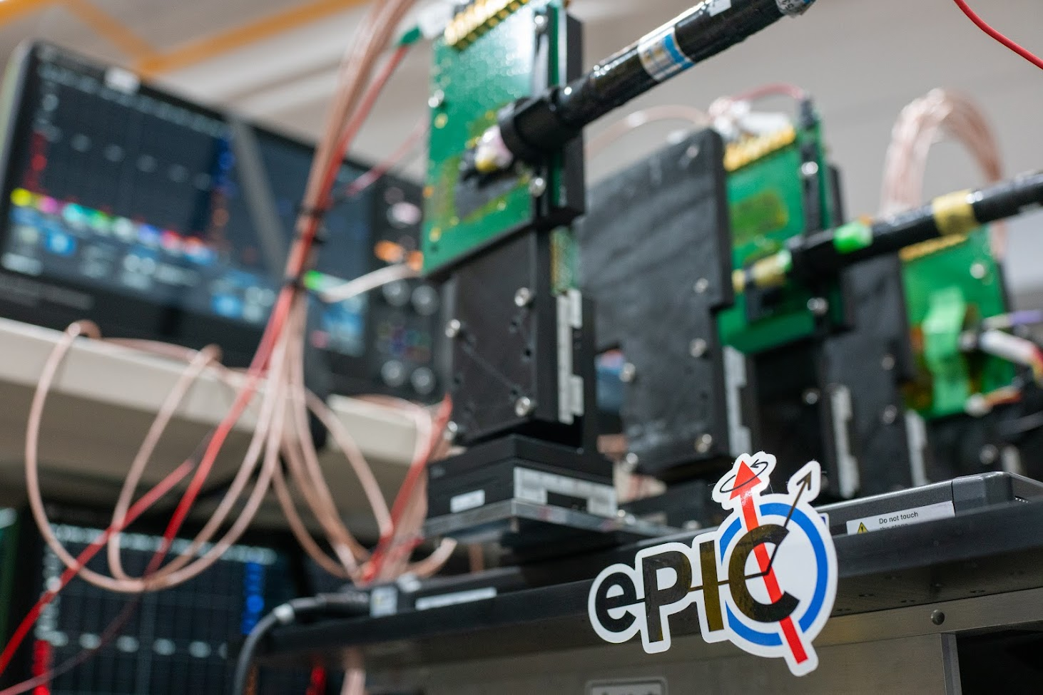
Extra

Slide 29
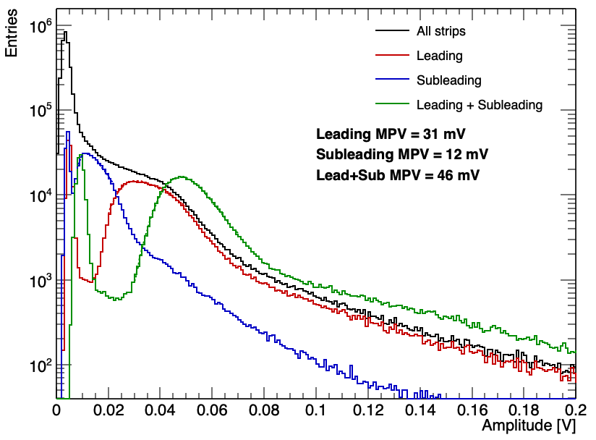
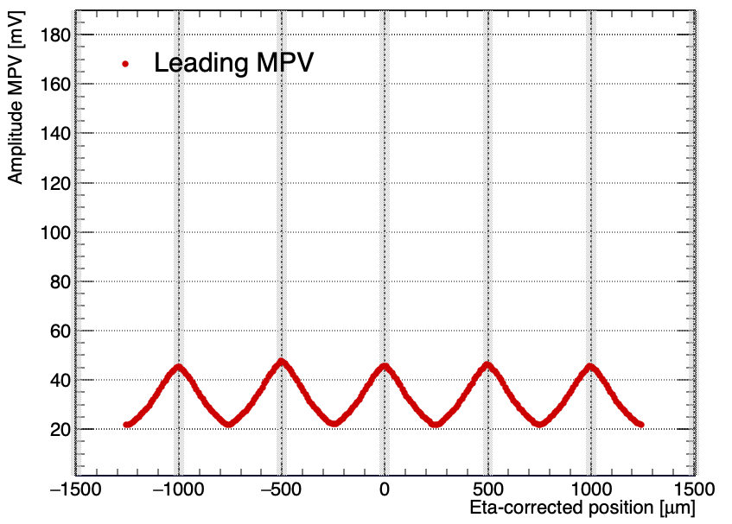
Signal Strength
Readout board designed by FNAL and UCSC was used
EIC-JPN JFY25 sensor should be the same as SH4/5 but it looks similar to SH2/3
eRD112 FY23
EIC-JPN JFY25
HV= - 185 V
EIC-JPN JFY25
HV= - 185 V
- 204 V
- 200 V
- 180 V
- 190 V
EIC-JPN JFY25 signal strength is about half the height of the eRD112 FY23

Slide 30
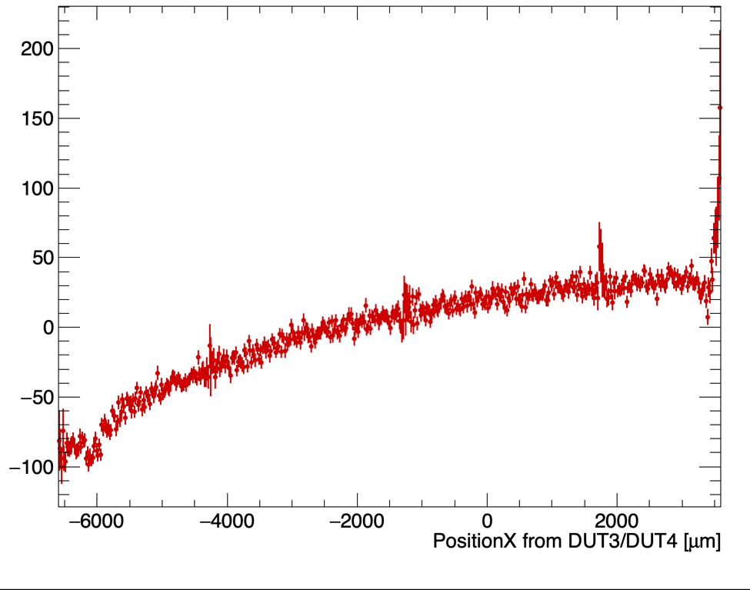
信号伝搬速度
V_{eff} ~ 100 um/ps
Readout pad
Leading – MCPPMT time [ps]
ストリップ方向への遅延が生じているが速く伝搬する

Slide 31
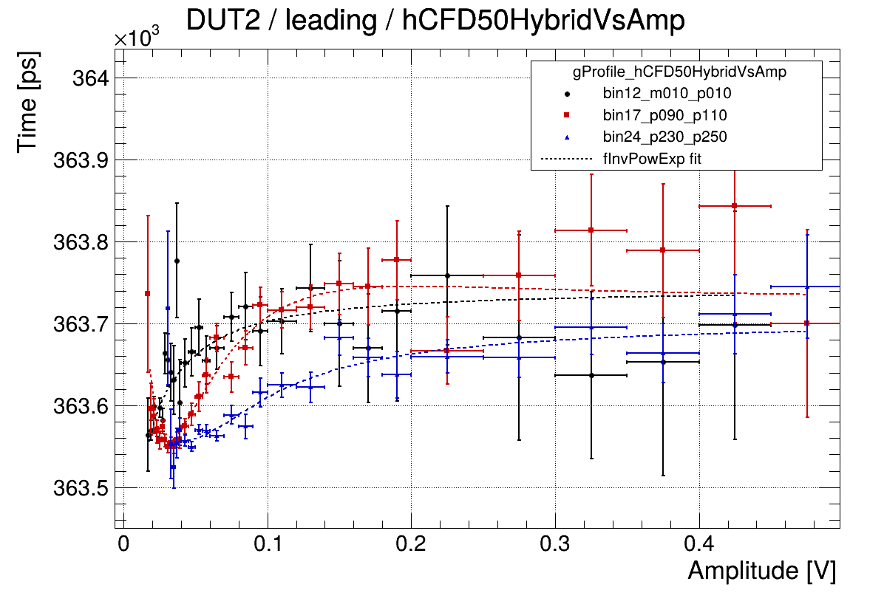
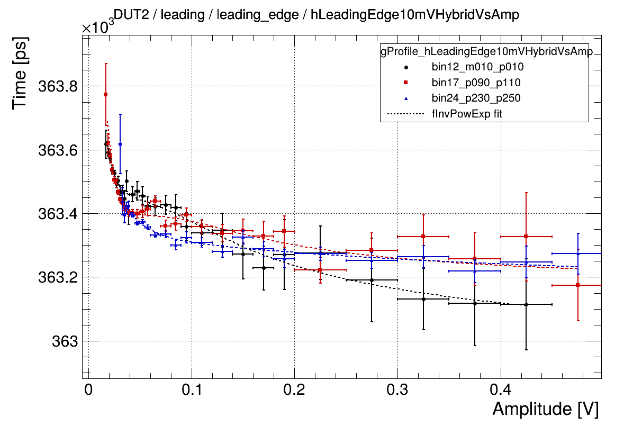
タイムウォーク
Strip#1
Strip#2
CFDでもarrival時間の信号高依存性を確認
  波形が同じ場合のみCFD時間は同じ
  CDFで残留タイムウォークがある＝波形が一定ではない
bin12
bin17
bin24
CFD 50%
Leading-edge 10mV

Slide 32
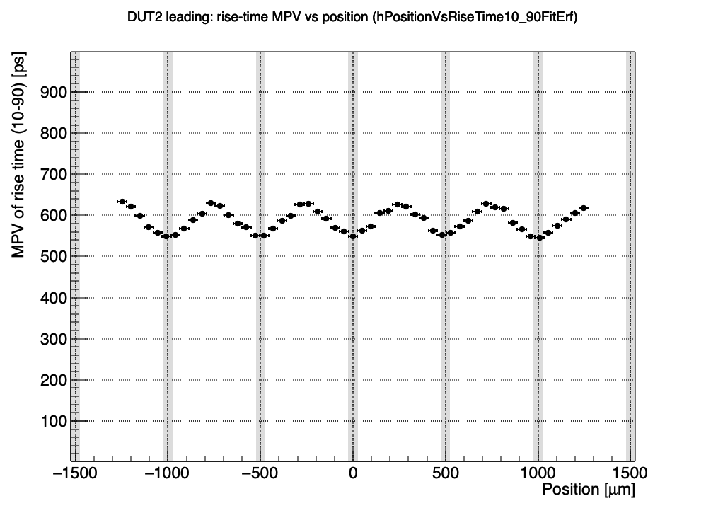
Risetime（10 - 90%）
eRD112 FY23
EIC-JPN JFY25
eRD112 FY24
EIC-JPN JFY25 sensor’s risetime is faster than eRD112 FY23 by ~50 ps
  Due to small signal strength?
eRD112 FY24は極端に短い400ps @ ストリップ直上
  TCTを用いているのでLandau揺らぎがないことが原因か

