Slide 1
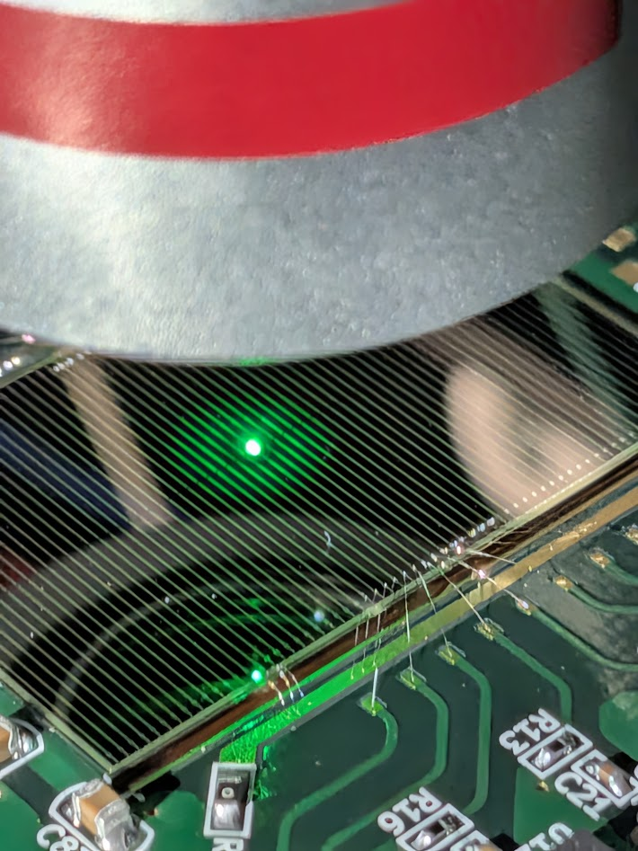
AC-LGAD sensor QA in Japan: new infrastructure & first laser results
An IR laser spot (λ = 1064 nm, ⌀ ≈ 4 µm) on the AC-LGAD strips — Hiroshima laser bench
Notes:
[0:00-0:30]
• Handoff from Satoshi: beam told us how the sensor performs - now the bench side
• Today: (1) new QA infrastructure in Japan, (2) first results from the Hiroshima laser bench
• Punch line: the bench already reproduces the beam-test results

Slide 2
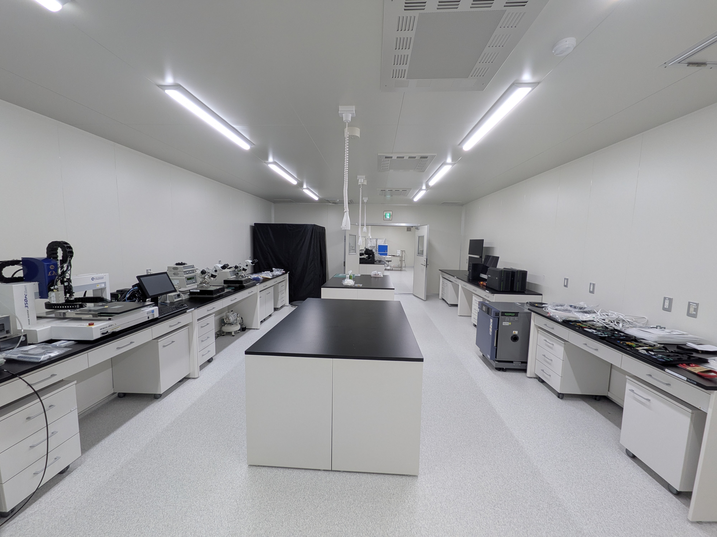
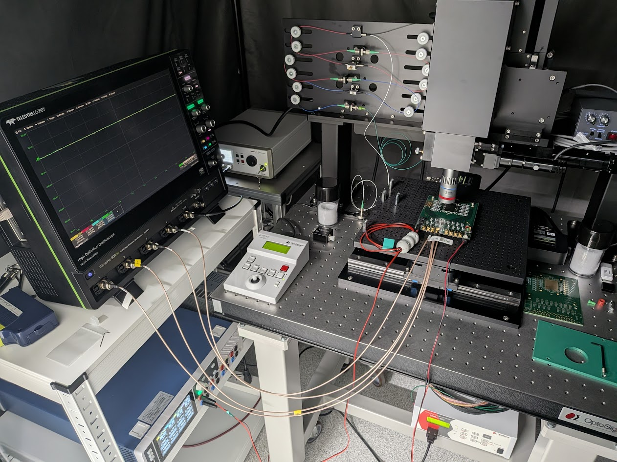
Sensor QA infrastructure is now running at two sites
INFRASTRUCTURE STATUS
Hiroshima University — WPI-SKCM²
RIKEN
2 sites · 1 standard
twin laser evaluation lines
≈ 50 m² clean room in preparation
Automatic wire bonder already in place
Twin laser line — one common QA standard
Clean rooms > 100 m² — commissioned spring 2026
READY — laser TCT bench running, first data in July
Japan will run BTOF sensor QA as a coordinated two-site operation.
Notes:
[0:30-1:05]
• Two sites. Hiroshima: > 100 m2 of new clean rooms, commissioned spring 2026 - READY (bench running, first data July)
• RIKEN: ~50 m2 clean room in preparation; automatic wire bonder ALREADY in place
• Message: Japan runs BTOF sensor QA as a coordinated two-site operation

Slide 3
Equipment at the two sites
INFRASTRUCTURE STATUS
Hiroshima University — WPI-SKCM²
RIKEN
IN PLACE
IN PLACE
TCT laser bench · manual wire bonder · bond tester · dispenser robot · inspection microscopes · high-performance oscilloscopes · digitizer · source meter · LCR meter
Hiroshima Site equipments + automatic wire bonder · network analyzer
PLANNED FY2026
IN PREPARATION
Automatic wire bonder · probe station
≈ 50 m² clean room
TCT laser QA System
Procured through RIKEN funding — we gratefully acknowledge RIKEN's support.
This toolbox enables high-precision sensor QA
— down to microns and picoseconds.
2
Notes:
[1:05-1:45]
• Hiroshima IN PLACE: TCT laser bench, manual wire bonder, bond tester, dispenser, microscopes, high-end scopes, digitizer, source meter, LCR meter
• PLANNED this FY: automatic wire bonder + probe station
• RIKEN: same set + automatic bonder + network analyzer in place; clean room + TCT laser QA system in preparation
• All RIKEN funding (written acknowledgement - no need to read)
• Message: this toolbox enables high-precision QA - microns & picoseconds

Slide 4
The laser test bench (TCT system)
INFRASTRUCTURE · HIROSHIMA
LASER
NKT Photonics PiLAS DX — 1064 nm IR (MIP-like bulk injection)
PULSE
50 ps width · spot radius ≈ 2 µm · up to 40 MHz
TRIGGER SYNC
< 3 ps rms jitter to the reference output
POSITIONING
Motorized XYZ stage (OptoSigma), µm-level steps
READOUT
Teledyne LeCroy WavePro HD — 4 AC-LGAD channels + reference
First light in July!
AUTOMATION
One-click scans — laser, stage & scope via control GUI
A state-of-the-art bench: 2 µm spot · 50 ps pulses · < 3 ps sync · 40 MHz
— micron & picosecond precision on demand.
Notes:
[1:45-2:40]
• High-spec TCT bench: 1064 nm IR (bulk injection, MIP-like), 50 ps pulses, 2 um spot, up to 40 MHz, < 3 ps trigger sync
• Motorized XYZ stage, um-level steps; fully automated one-click scans
• I developed the entire system myself; first data taken in July
• Today: analysis of that first campaign

Slide 5
A BTOF strip sensor under the laser
FIRST LASER CAMPAIGN
Device under test (DUT) :
BTOF-type strip AC-LGAD · 500 µm pitch · 4 strips read out · bias −185 V
1
Full-sensor 2D raster
2
Position × intensity grid
9.3 mm × 2.5 mm map, 300 µm × 10 μm steps across the strips
61 positions × 10 laser intensities — resolution and calibration stability as a function of signal size.
500 um
10 mm
C5
C4
C3
C2
C1
C0
C5
C4
C3
C2
C1
C0
Notes:
[2:40-3:25]
• DUT: BTOF-type strip AC-LGAD, 500 um pitch, 4 strips read out, bias -185 V (same family as Satoshi's beam test)
• Scan 1: full-sensor 2D raster, 9.3 x 2.5 mm, 10 um steps across strips
• Scan 2: cross-strip line scan x 10 laser intensities (results vs signal size)

Slide 6
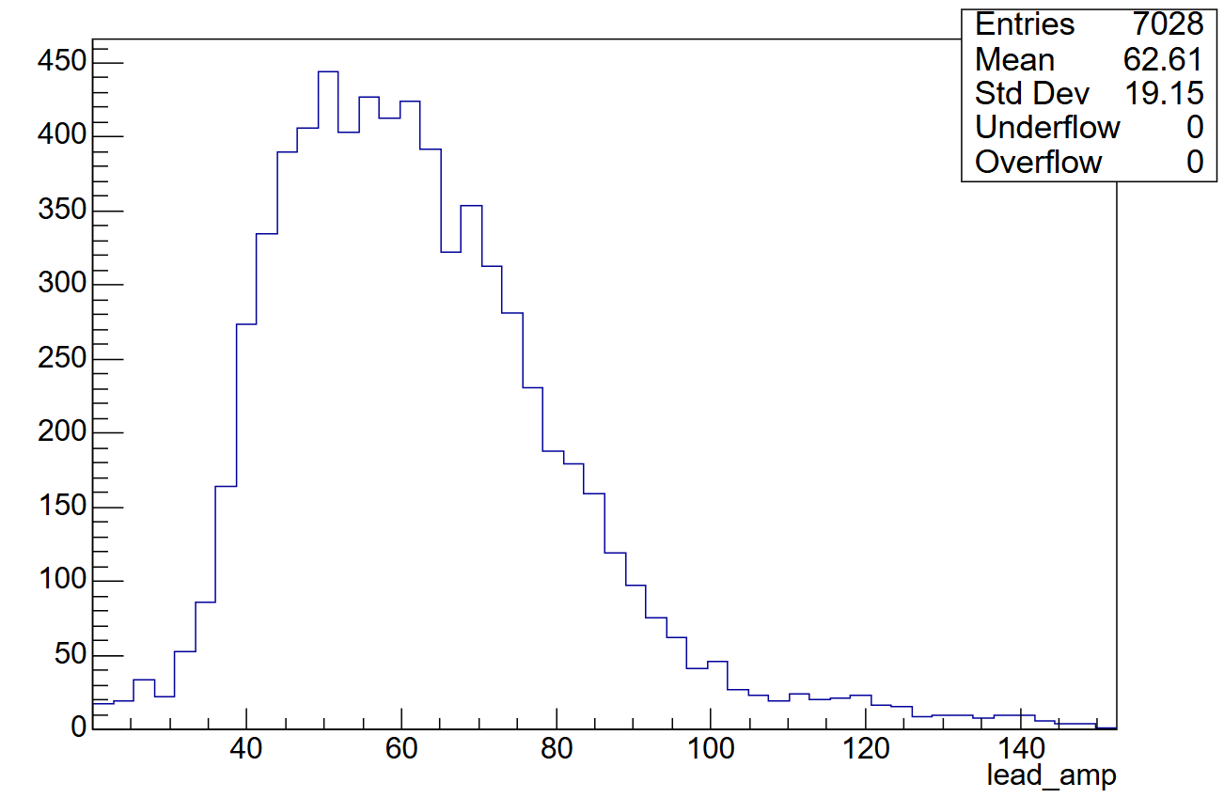
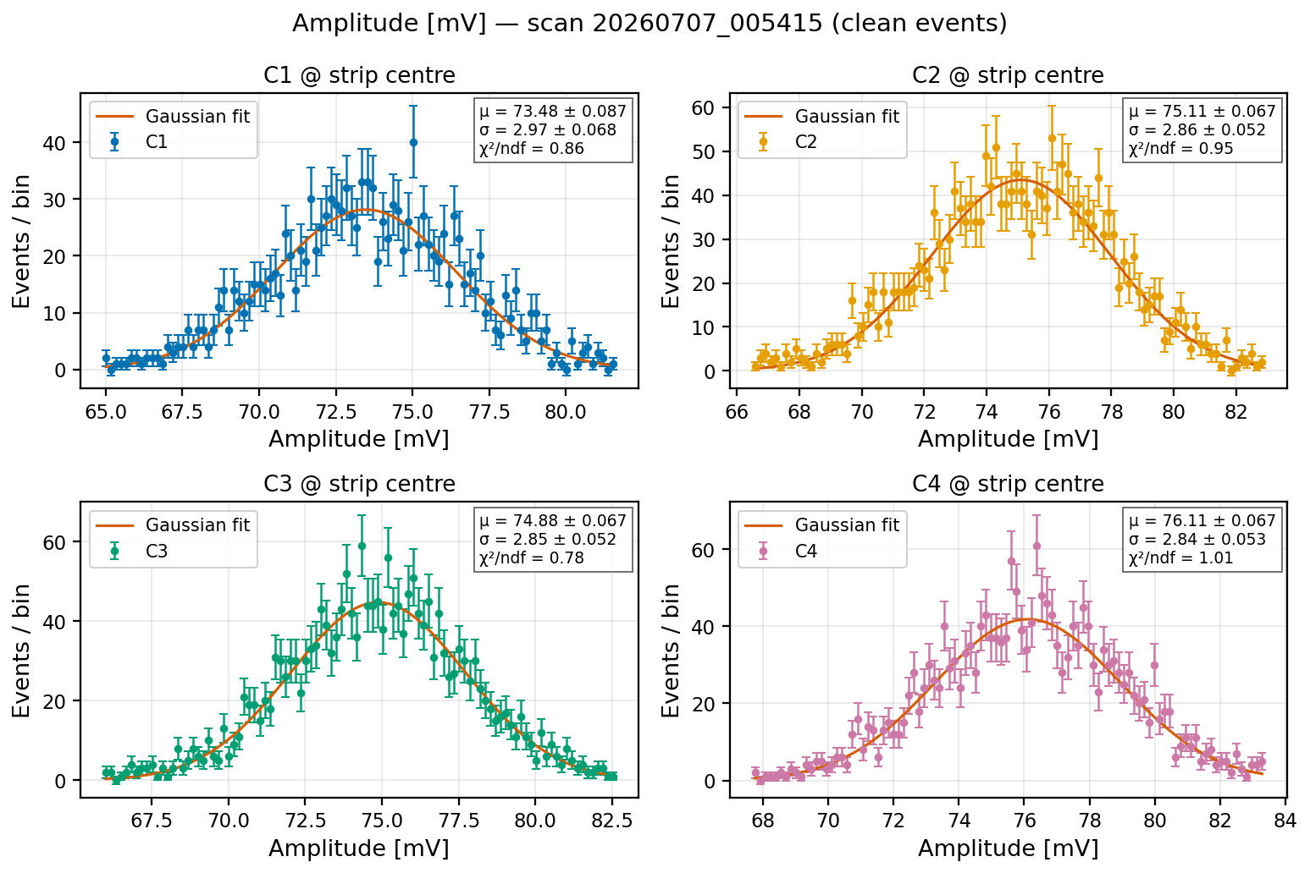
Beam energy vs laser energy reproduced MIP
FIRST LASER CAMPAIGN
Laser intensity anchored to the MIP scale:
$$beam ⟨A⟩ ≈ 63 mV ⟷ laser µ ≈ 73–76 mV$$
KEK beam test
— 2 GeV electrons (MIP), leading strip
Laser
— strip center, clean events
σ/µ ≈ 4 % — no Landau smearing
Notes:
[3:25-4:05]
• Laser energy anchored to the MIP scale: KEK 2 GeV e- pulse height <A> ~ 63 mV vs laser 73-76 mV at strip centre
• sigma/mu ~ 4 % - no Landau smearing in laser light
• ALL results that follow are at this MIP-equivalent energy

Slide 7
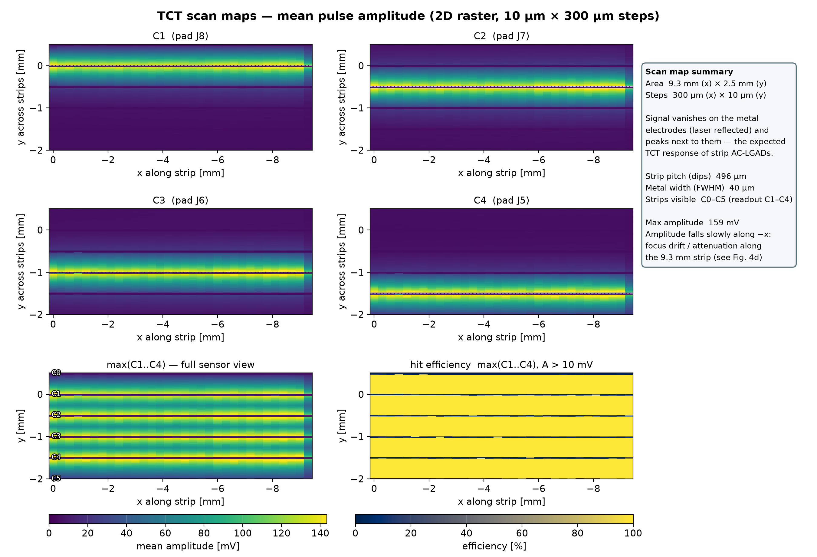
X-Y Scan Results – TCT Scan map
FIRST RESULTS · RESPONSE
S/N ≈ 90
textbook response across the whole sensor
3.1 %
uniform gain across channels
100 %
hit efficiency (A > 10 mV) everywhere on the sensor
Notes:
[4:05-5:00]
• Mean-amplitude maps: signal peaks next to electrodes, vanishes on metal (IR reflected) - textbook strip AC-LGAD response
• Reconstructed pitch 496 um (design 500) / S/N ~ 90
• Gain uniformity: 3.1 % channel-to-channel
• Hit efficiency 100 % everywhere on the sensor - emphasize!

Slide 8
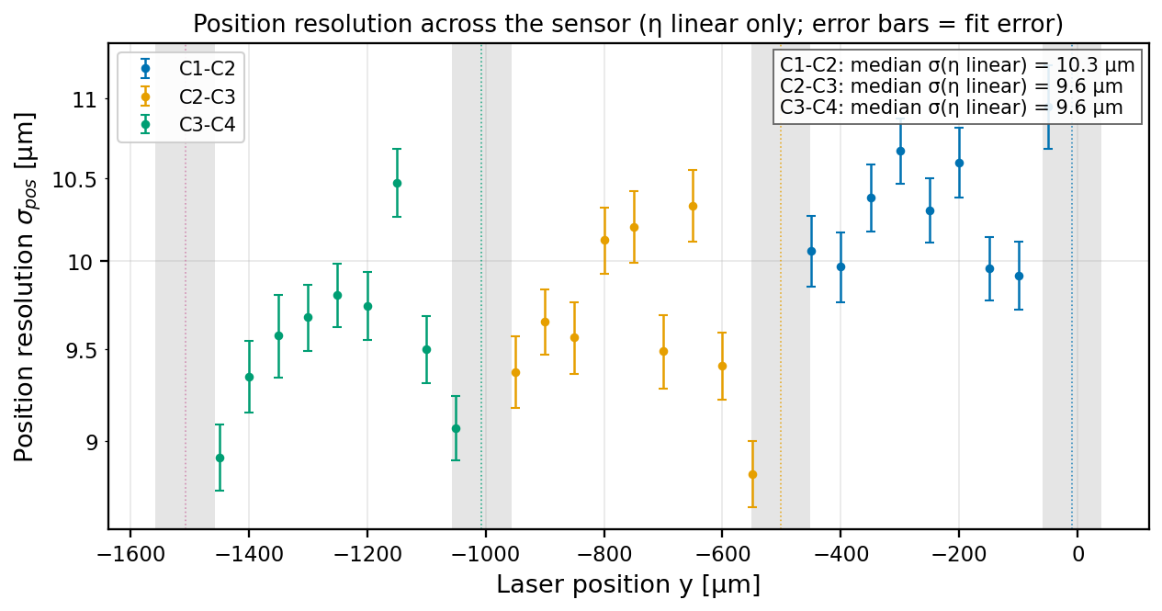

Position resolution from charge sharing
FIRST RESULTS · POSITION
$$σ_{pos}≈ 10 µm$$
= 2 % of the 500 µm pitch
η-linear reconstruction, mid-gap region
At MIP-equivalent energy
No Landau term
— sharing + noise limit of the sensor
Laser radius and stage position instability are included
Nearly identical to the beam-test result
— bench and beam give the same position resolution.
Notes:
[5:00-6:05]
• sigma_pos = residual of amplitude-weighted (eta) position vs true stage position, mid-gap region
• ~ 10 um = 2 % of the 500 um pitch, at MIP energy
• Still INCLUDES laser-spot size + stage instability -> intrinsic resolution even better; will improve with position calibration & spot tuning
• Nearly identical to the beam-test result - bench and beam agree

Slide 9
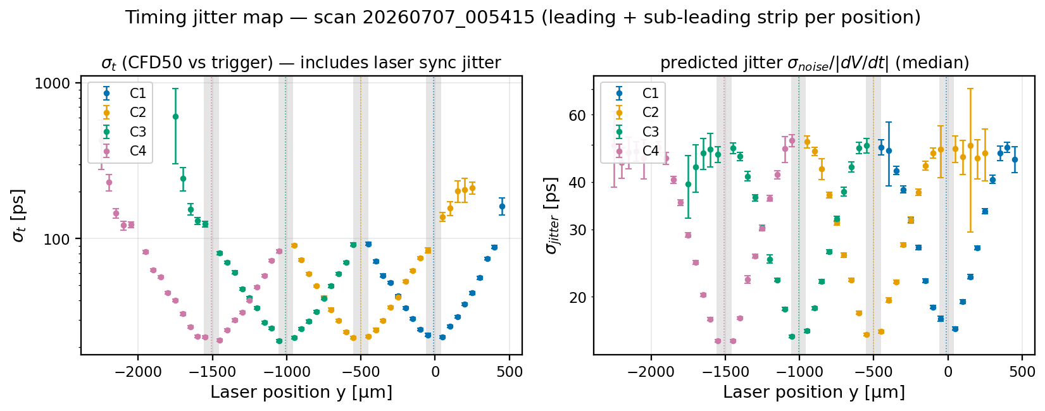



Timing resolution and jitter
FIRST RESULTS · TIMING
$$≈ 15 ps$$
$$20 –35 ps$$
$$σ_{noise}/|dV/dt|$$
jitter at the strip center
rising towards mid-gap (MIP)
matches the jitter prediction
30 ps
Notes:
[6:05-7:10]
• sigma_t = CFD50 arrival time vs laser trigger, at every position
• Jitter prediction = sigma_noise / (dV/dt), computed per strip independently
• ~ 15 ps at strip centre; 20-35 ps towards mid-gap (amplitude falls, MIP energy)
• Measured sigma_t tracks the jitter prediction point by point - reproduces the test-beam jitter

Slide 10
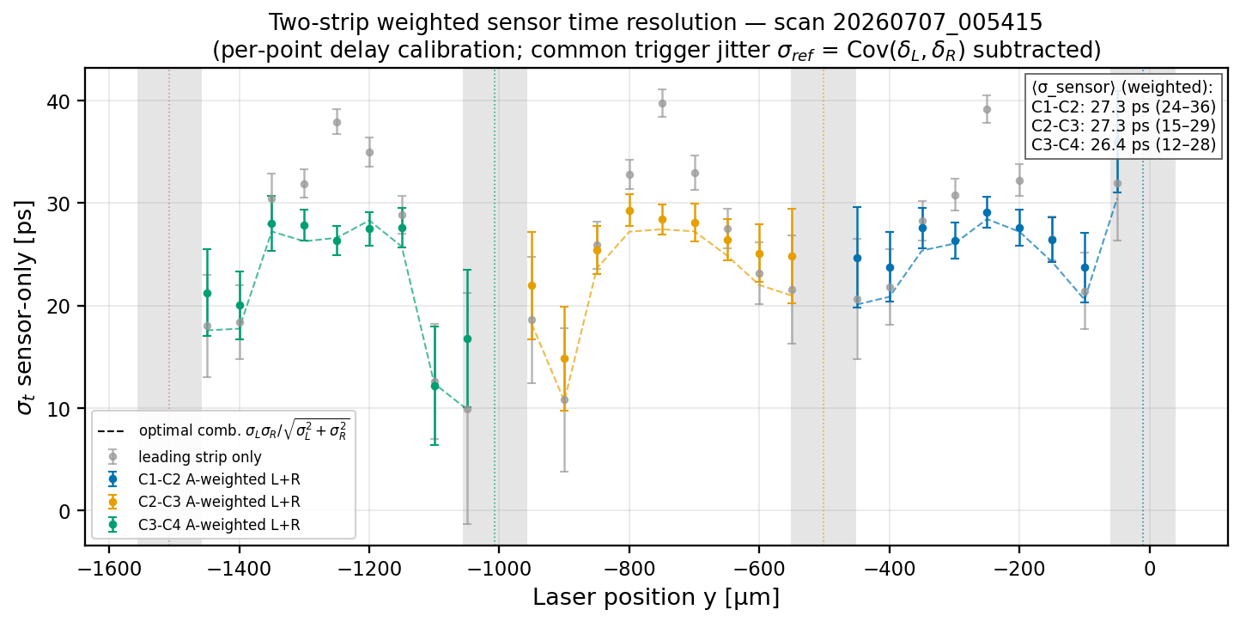
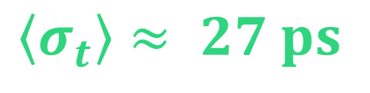
Sensor timing resolution
FIRST RESULTS · TIMING
Sensor-entire resolution
— per strip pair, A-weighted two-strip combination
$$\left\langle σ_{t}\right\rangle ≈ 27 ps$$
= reached <30 ps in all sensor region
C1–C2 27.3 ps
C2–C3 27.3 ps
C3–C4 26.4 ps
at MIP-equivalent energy
Notes:
[7:10-8:05]
• Sensor as a whole: amplitude-weighted combination of leading + sub-leading strip
• Trigger jitter subtracted; per-point propagation-delay calibration applied
• <sigma_t> ~ 27 ps for ALL three pairs (27.3 / 27.3 / 26.4 ps)
• Below 30 ps at MIP - emphasize: meets BTOF needs

Slide 11
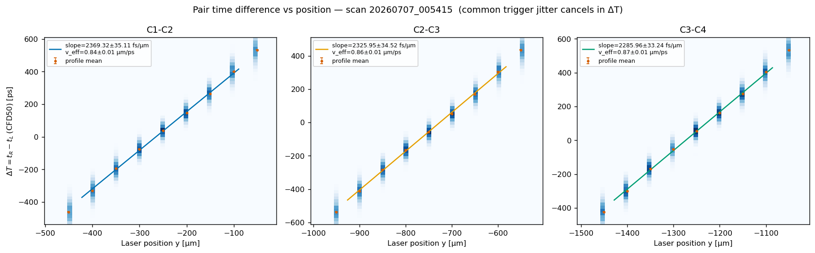
Propagation timing delay
FIRST RESULTS · TIMING
$$v_{eff}= 0.84 − 0.87 µm/ps$$
— signal propagation measured on all three gaps
$ΔT = t_{R}− t_{L}$: common trigger / laser-sync jitter cancels — a pure propagation measurement
Linear $ΔT(y)$ → per-point delay correction, used in the sensor-resolution analysis (previous slide)
Notes:
[8:05-8:55]
• Physics: mid-gap hits arrive significantly LATER than on-strip hits (signal travels through resistive n+ layer)
• dT = t_R - t_L is linear in position -> v_eff = 0.84-0.87 um/ps
• Consistent with the beam-test extraction
• This is exactly the delay correction used in the previous slide

Slide 12
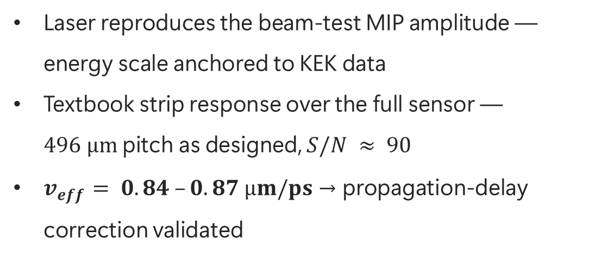


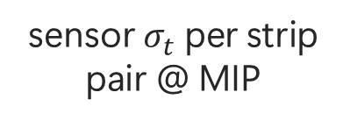


Hiroshima & RIKEN are ready for BTOF sensor QA
SUMMARY
$$2 sites$$
$$≈ 10 µm$$
$$≈ 27 ps$$
$$100 \%$$
clean rooms + laser benches in Japan
position resolution @ MIP (2 % of pitch)
sensor $σ_{t}$ per strip pair @ MIP
hit efficiency over the full sensor
Laser reproduces the beam-test MIP amplitude — energy scale anchored to KEK data
Textbook strip response over the full sensor — $496 µm$pitch as designed, $S/N ≈ 90$
$v_{eff}= 0.84 –0.87 µm/ps$→ propagation-delay correction validated
NEXT
Peltier temperature control — map ePIC‘s 20–40 ℃ operating window on the bench
Readout board update ; full-strip readout
Routine one-click QA workflow for production sensors
First light in July — and the laser bench already reproduces the beam-test results with high precision. Beam and bench validate each other.
Notes:
[8:55-9:50]
• 2 QA sites; Hiroshima fully operational
• At MIP energy: ~10 um position, ~27 ps sensor timing, 100 % efficiency, v_eff validated - all consistent with KEK beam test
• Next: Peltier temperature control (ePIC 20-40 C window), readout update / full-strip readout, routine one-click QA workflow
• Closing: first light in July - already reproduces the beam. Beam and bench validate each other.

Slide 13





Thank you
ACKNOWLEDGEMENTS
The QA infrastructure presented today — the clean-room equipment and the twin laser evaluation systems at Hiroshima University and RIKEN — was procured through RIKEN funding.
We gratefully acknowledge RIKEN's support, which made this platform possible.
16 July 2026
12
Notes:
[9:50-10:00]
• Infrastructure funded by RIKEN (written acknowledgement - just show)
• Thank you / questions

Slide 14
Back up

Slide 15

Why a laser bench, right after a beam test?
MOTIVATION
1
Micron-scale control
What a beam test cannot tell you
A 2 µm laser spot steered in 10 µm steps — probe any point of the sensor at will, on strips, between strips, along strips.
$$σ_{beam}^{2}= σ_{jitter}^{2}+ σ_{TW}^{2}+ σ_{delay}^{2}+ σ_{Landau}^{2}$$
2
Statistics on demand
The beam test measures the sum. The laser bench measures every term except Landau — so it can tell us where the resolution actually comes from, and whether a production sensor is good, without a beam.
Pulsed IR laser at up to 40 MHz: millions of waveforms overnight, in the lab, with zero beam time.
3
Clean decomposition
Laser light has no Landau fluctuations — jitter, time-walk, propagation delay and reference terms can be isolated one by one.
Goal: establish laser TCT as the certification standard for ePIC BTOF sensor QA in Japan.

Slide 16
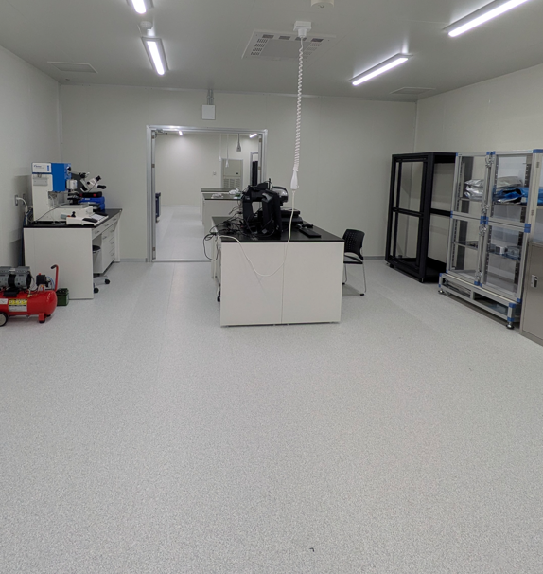
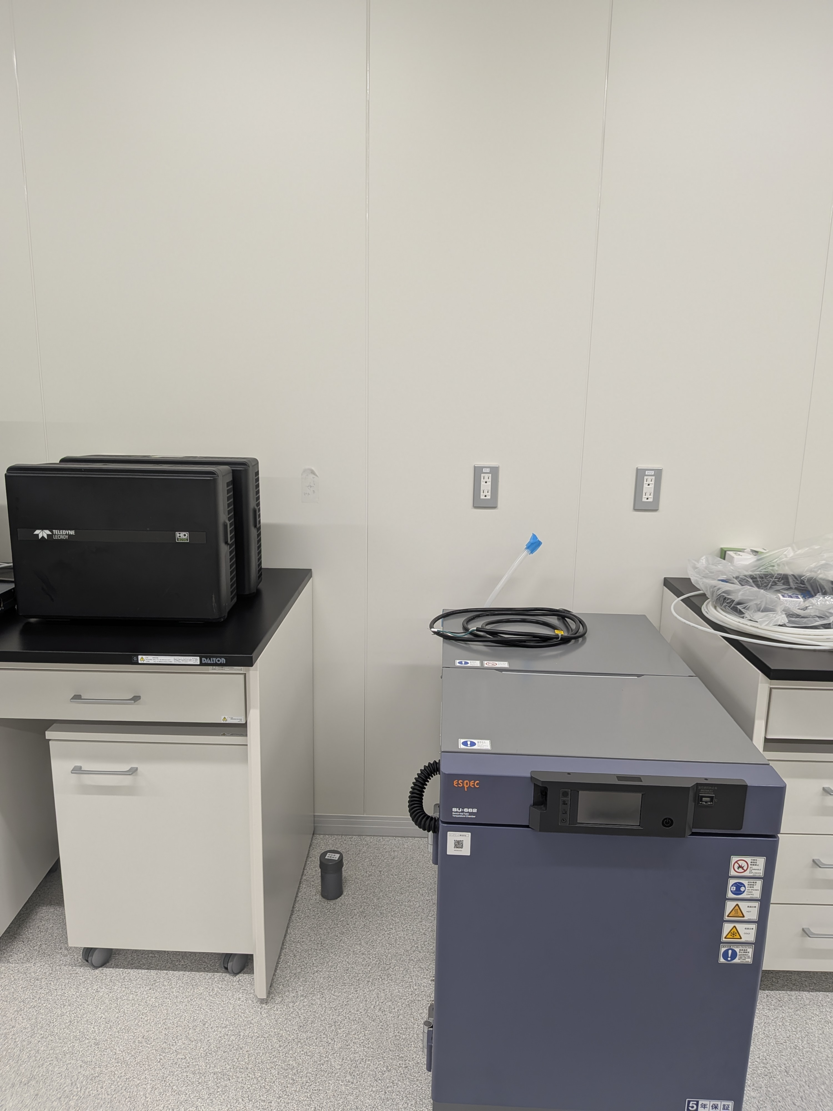
Inside the WPI-SKCM² clean room
INFRASTRUCTURE · HIROSHIMA
Bonding & QA benches
Inspection / Storage area
Bench-top temperature chamber
Dispenser robot · optical inspection microscopes · ESPEC temperature chamber · Teledyne LeCroy HD oscilloscopes · ESD-safe benches — receive, assemble and qualify sensors entirely in-house.

Slide 17
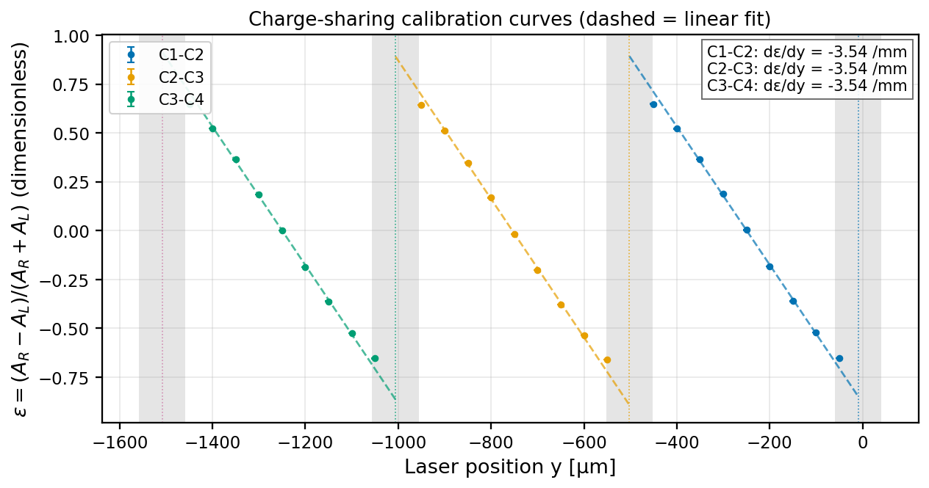
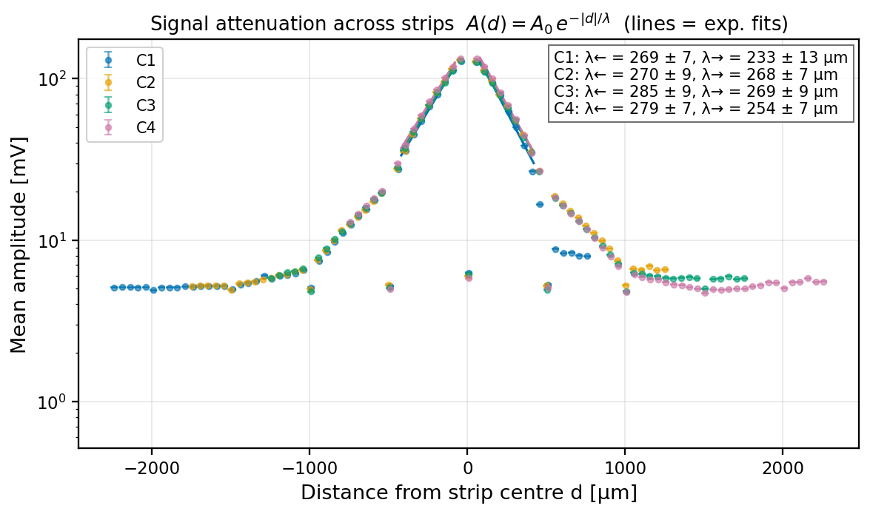
Charge sharing & signal spread
BACKUP
Exponential signal spread in the resistive n⁺ layer: λ ≈ 260–270 µm, all strips, both sides, every intensity
η(y) monotonic across each gap, 50 % at mid-gap → basis of the position reconstruction

Slide 18
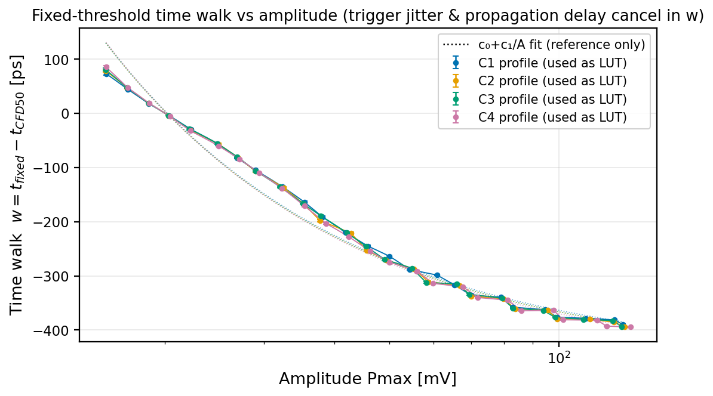
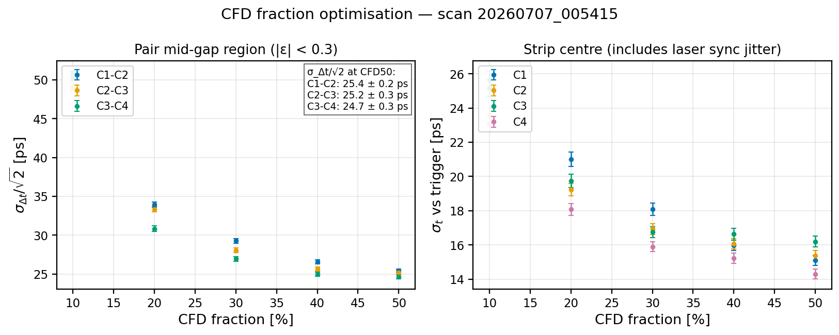
Time pick-off: CFD vs fixed threshold
BACKUP
CFD50 is optimal: ≈ 29 ps vs ≈ 40 ps fixed threshold (pair Δt/√2, mid-gap)
Time-walk vs amplitude measured (≈ 0.5 ns span) → correction LUT directly applicable to fixed-threshold beam data

Slide 19
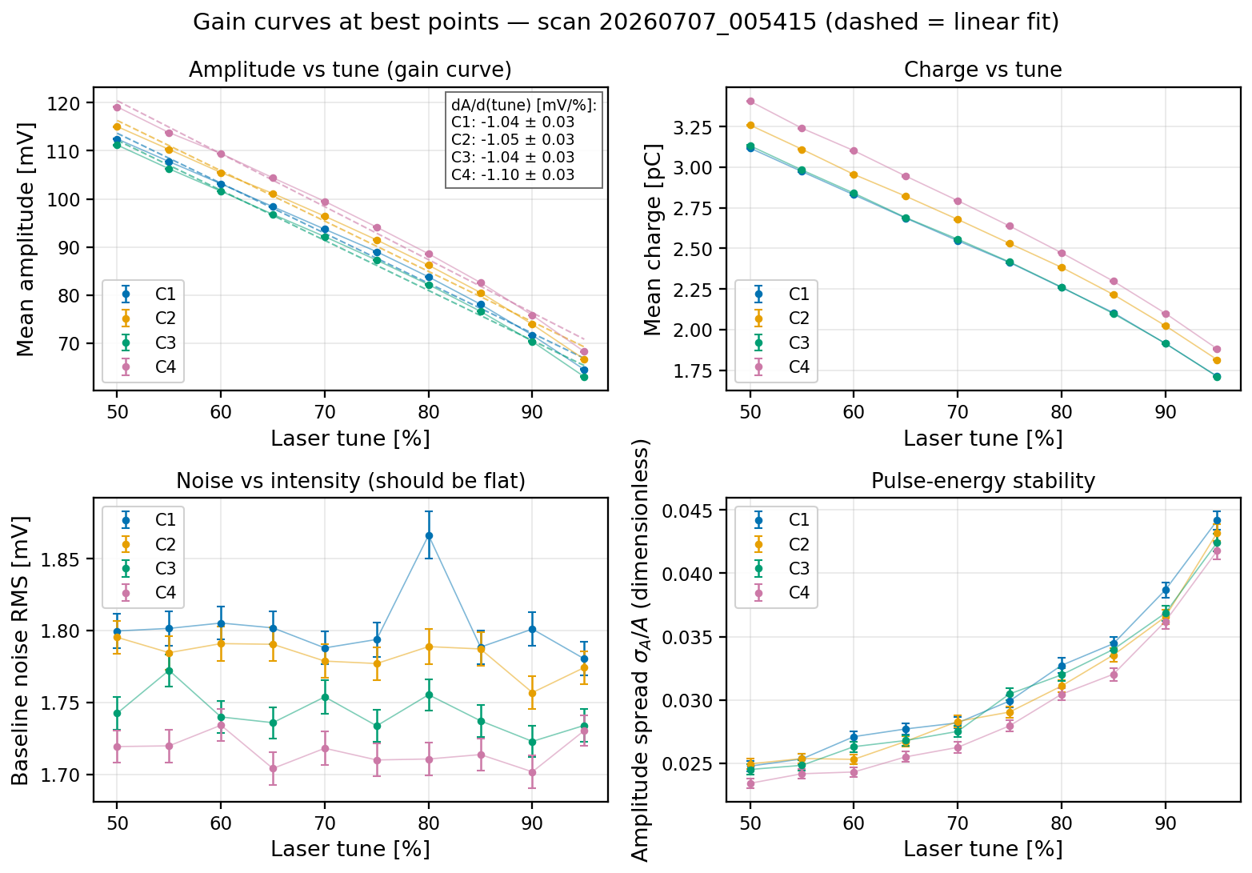
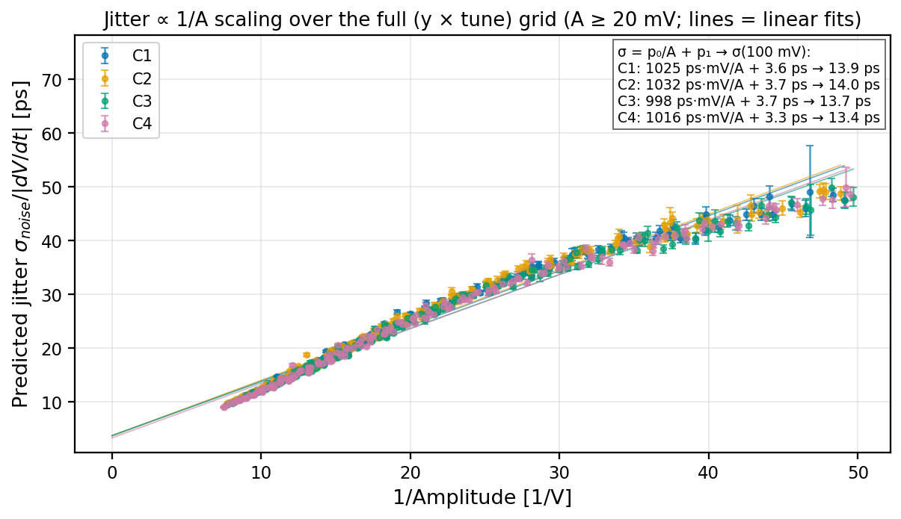
Laser intensity scans: gain & jitter scaling
BACKUP
Amplitude linear in laser tune (non-linearity ≈ 2 %); profile shape invariant to < 0.7 % → one calibration serves all energies
Jitter follows σ = (1.0 ns·mV)/A + 3.5 ps over the whole position × intensity grid → resolution predictable at any energy

Slide 20
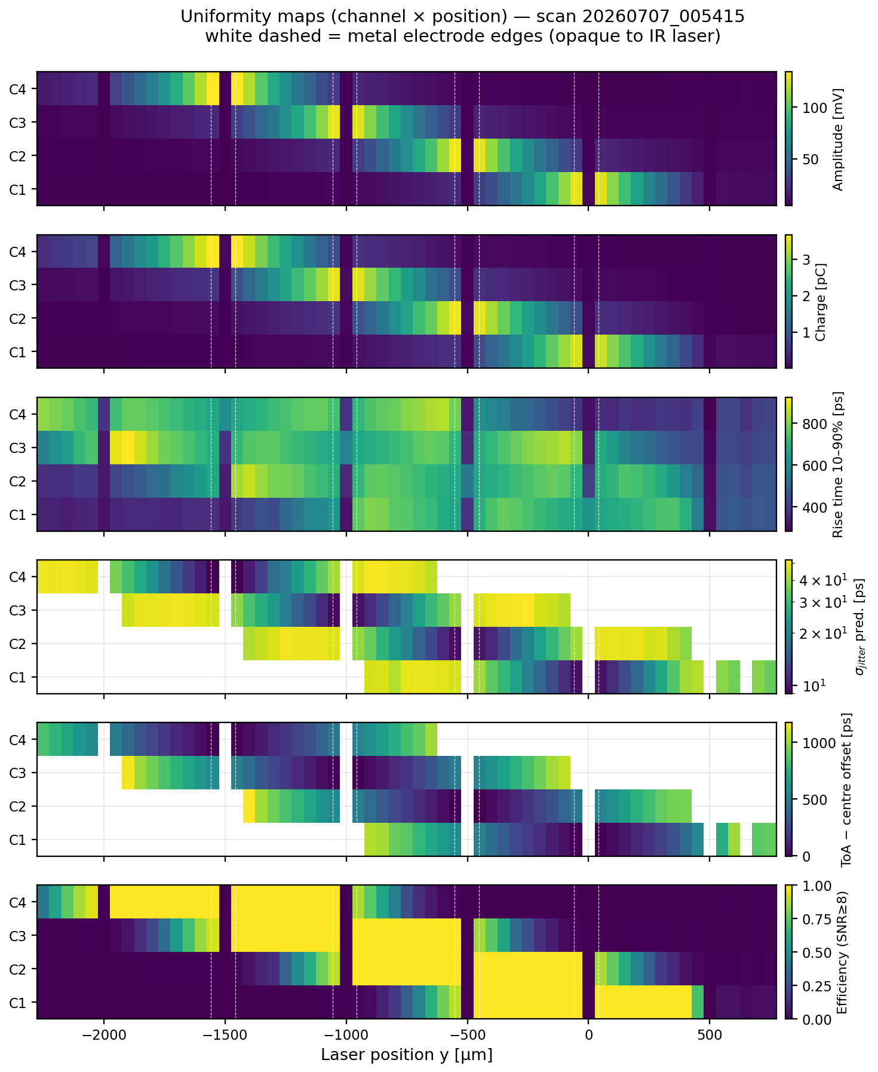
Channel uniformity
BACKUP
Gain spread 3.1 %
noise 1.7–1.8 mV
rise time ≈ 670 ps
hit efficiency 100 %
Channel time offsets σ = 39 ps (cable / amplifier paths) — calibrated out in the Δt analysis

Slide 21
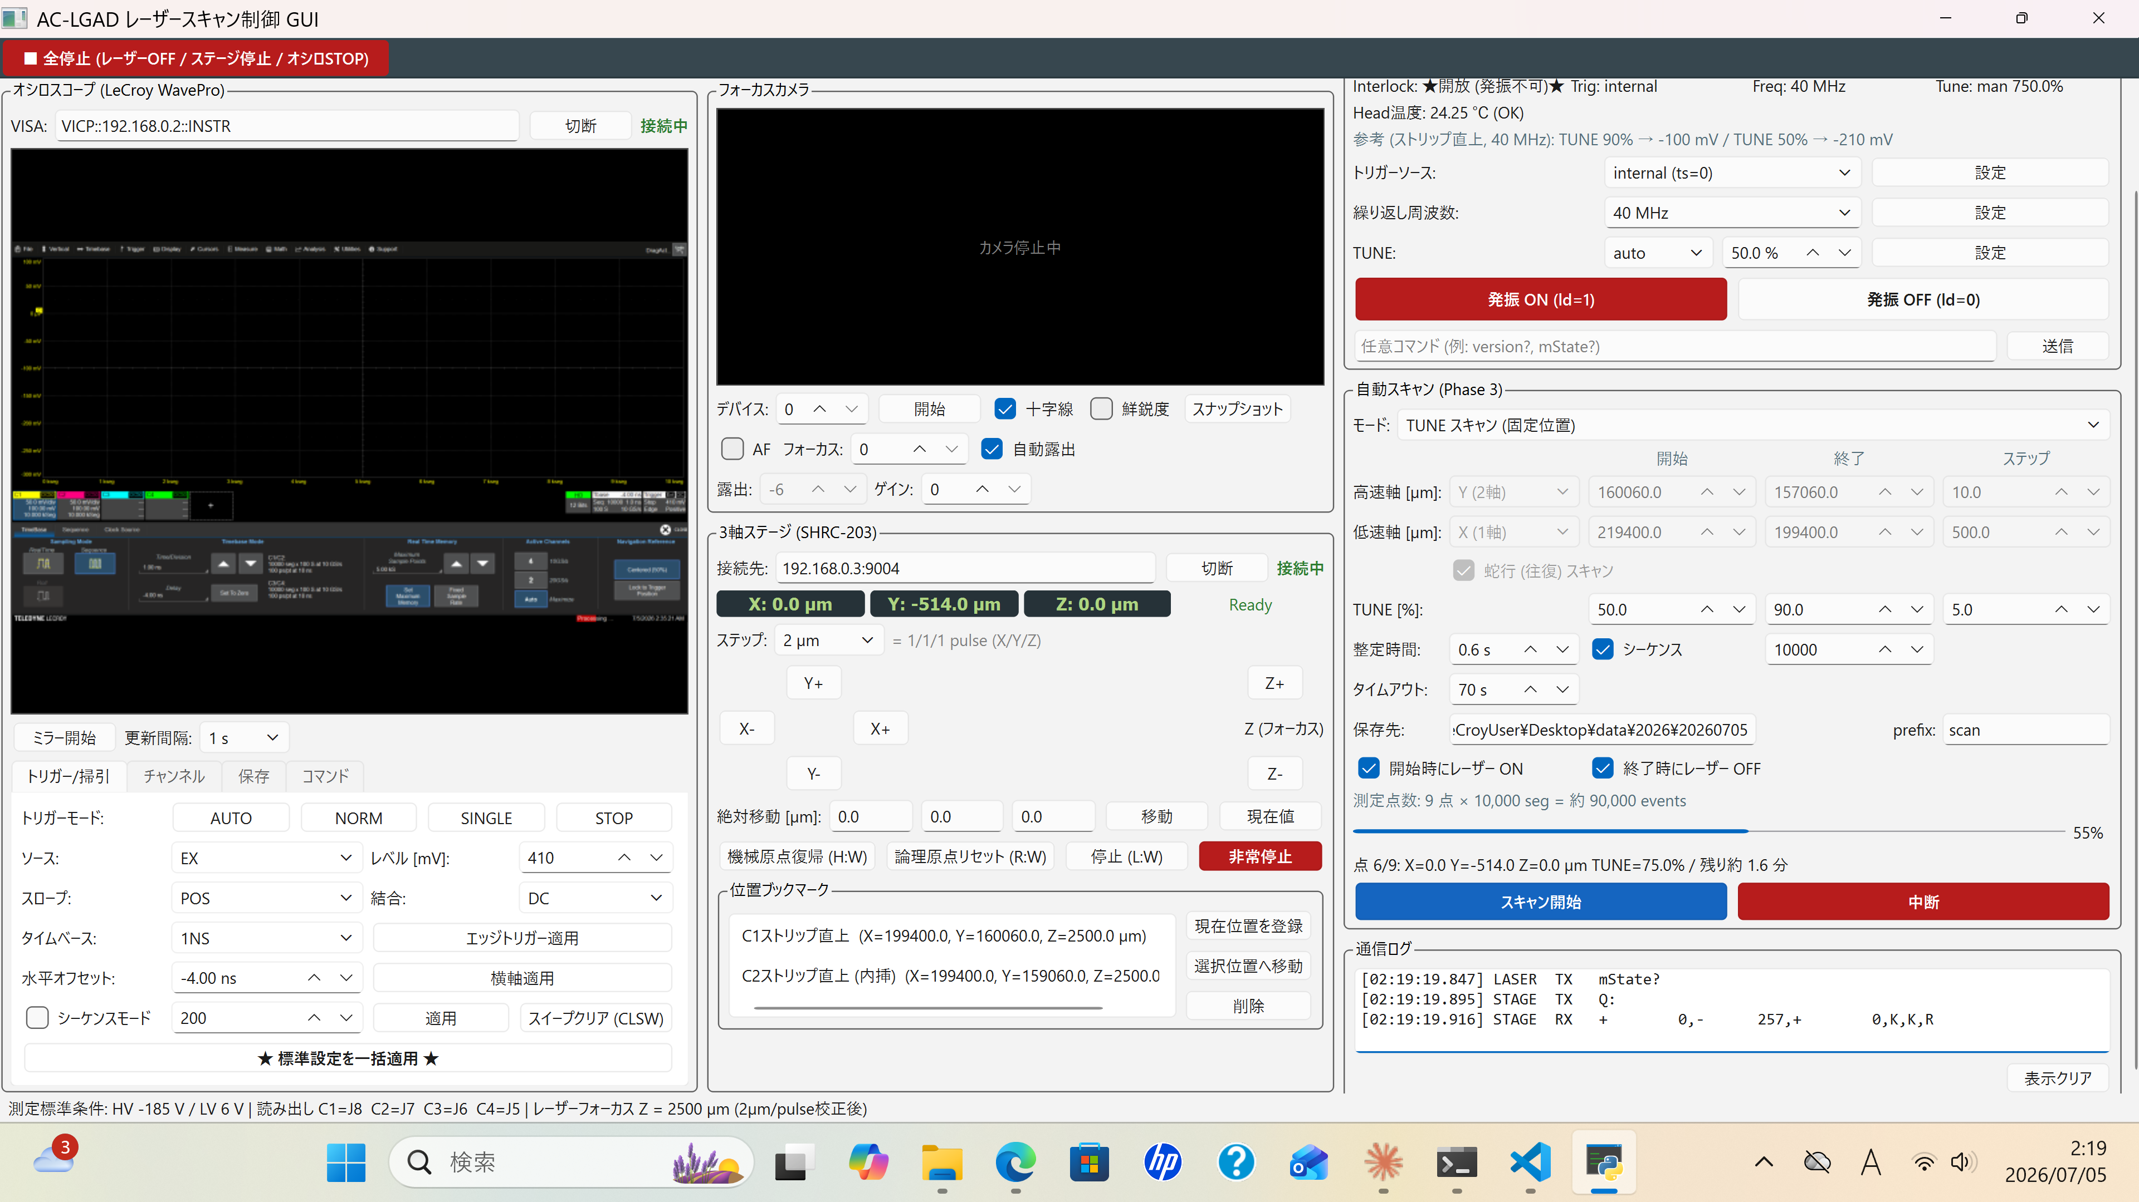
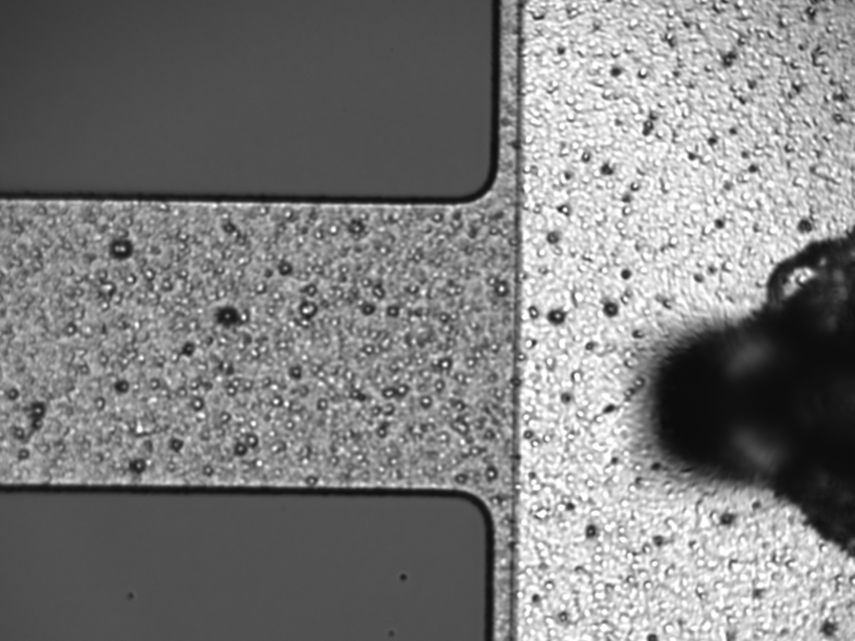
Contorol GUI
BACKUP
LASER
oscilloscope
Focus camera
Scan
XYZ stage

