Slide 1
Electronics and DAQ WG Meeting (7/23/26)
Coming up…
July 30 – Likely no E&DAQ meeting
July 30-31 Echelon 0-Echelon1 mini-workshop
  https://indico.bnl.gov/event/33467/
Sept 15-18 DOE IPR of EIC project status
  Page turns week of July 27th
  Dry Runs Week of August 10th
Agenda
Review from Collaboration Meeting
Action Items from Collaboration Meeting

Slide 2
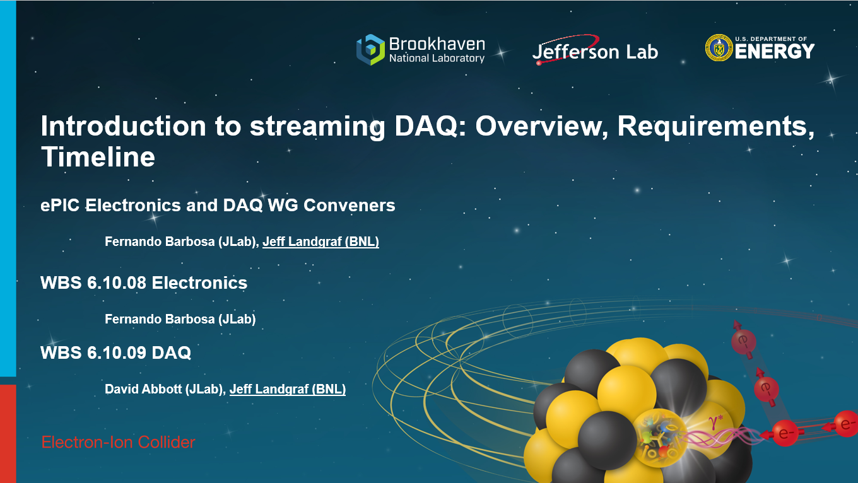
Wednesday Morning #1
Summary of system/progress would be well know to people following E&DAQ WG
Discussed meaning of timing requirements
  ASICs generally will report times with two integers:
    Detector’s clock measured from the REVTIC/SYNC
    Fine discrete clock within clock cycle
  Generally we are less sensitive to phase shifts than triggered detectors (because offsets can be added offline) but…
    BX based shutters (dRICH) require clock phase control
    Phase wrt. BX can lead to ADC corrections
    Some detectors sum readouts (e.g. calorimeter layers) to produce channel values
    Detector groups responsible to communicate needs / calibration methoeds to E&DAQ, but we need to support needs with ability to control clock phases to FEB / beyond.
  DAQ/Echelon1 need to collaborate to provide a function combining header info, ASIC info, and calibrations to convert local time definitions in to a global time (measured in fractional bunch crossings)
    This function to provide time of hit, rather than time of event
AI Requirements
  AI is often discussed but not in project requirements
  Strategy is to treat as a tool for satisfying requirements rather than as a requirement
  Specifics:
    Task specific ML alogirthms (ie. dRICH)
    Export (monitoring/slow control/RunLog etc…) via AI enabled interfaces (e.g. MCP)

Slide 3
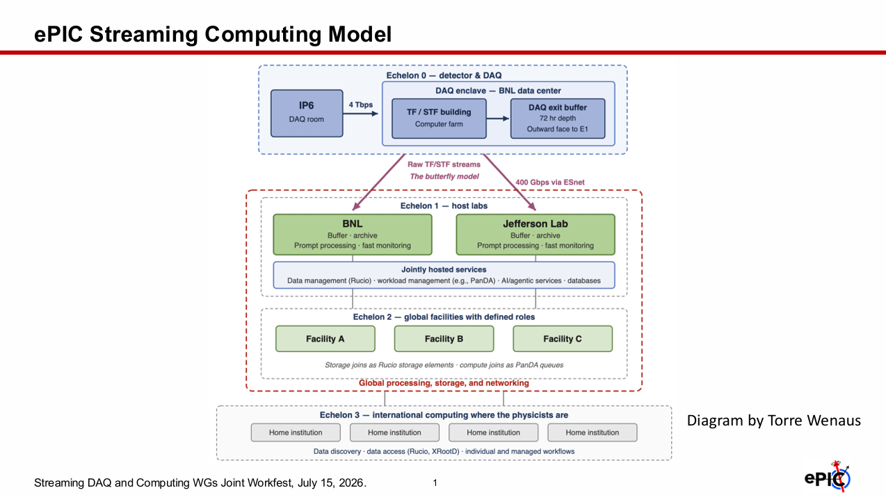
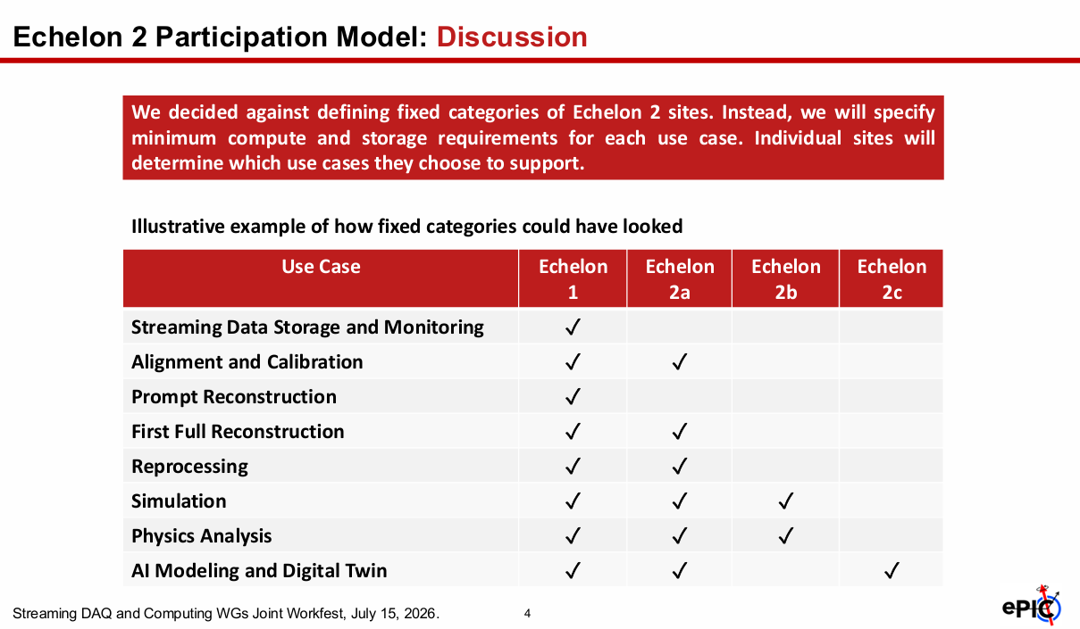
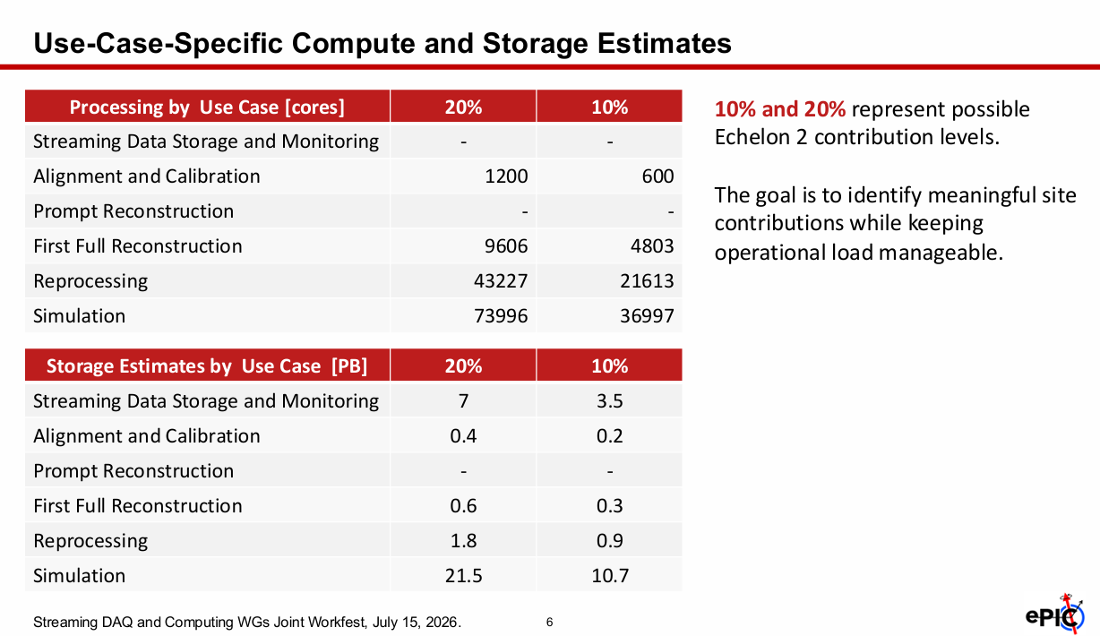
Wednesday Morning #2/#3
Two Discussions led by Markus Diefenthaler regarding:
  Streaming computing model
  Echelon 2 participation model
A lot of the discussion regarding the computing model centered on calibrations, and the challenge of the 3-week / single pass goal for reconstruction.
  Re-itteration of need for detectors to consider the calibration needs early
    Statistics needed
    Dependence on calibration of other detectors
    Frequency / mode of calibration
  Discussion of “methodological” vs “debug” modes of calibration
  Value of infrastructure for executing / monitoring calibations to be available
Echelon 2 Participation Model
  Issues are
    Encouraging echelon2 participation
    Ensuring echelon2 resources are sufficient
  Facilities to list use-cases // Percentages
  These must be linked to storage / processing

Slide 4
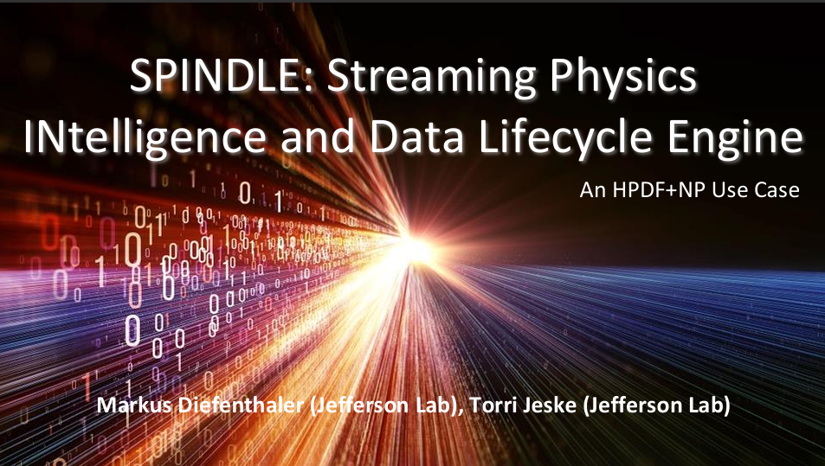
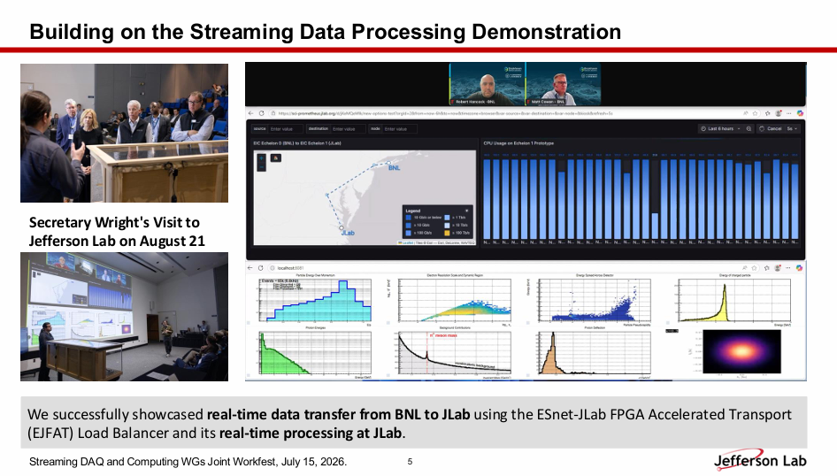
Wednesday Morning #4
Markus presented capabilities and plans for of HPDF at JLAB
Including specific support for streaming DAQ in NP (SPINDLE)
  EJFAT
  Data lifecycle tools
    Data capture
    Data transfer / processing
    Storage
    Visualization
    AI readiness
    Calibrations

Slide 5
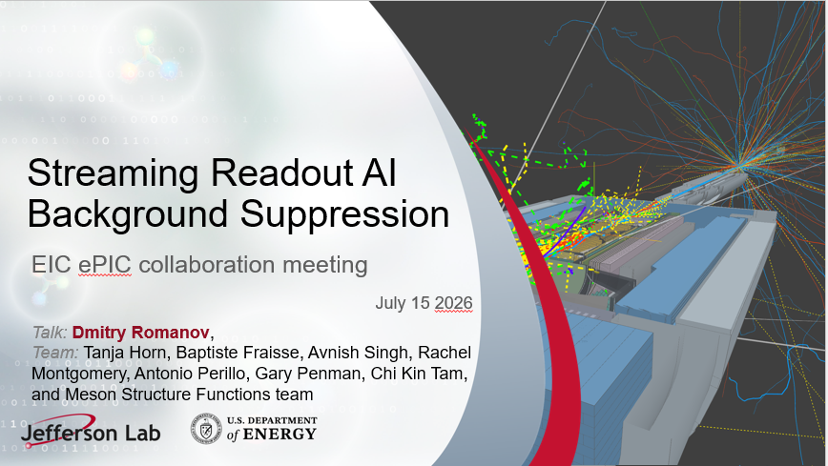
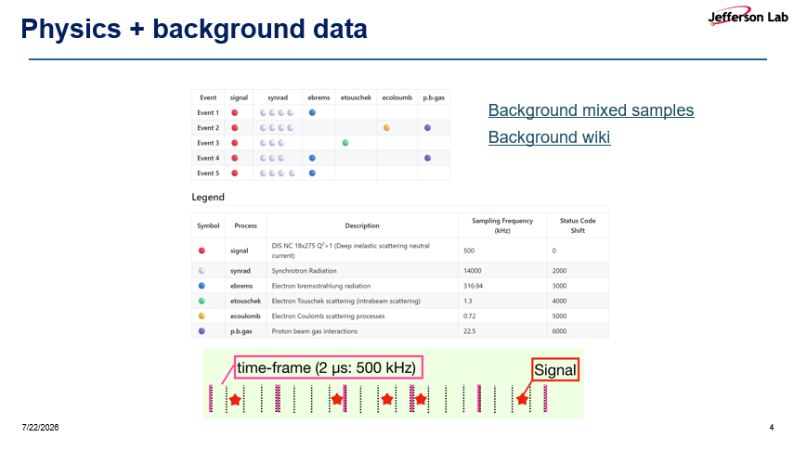
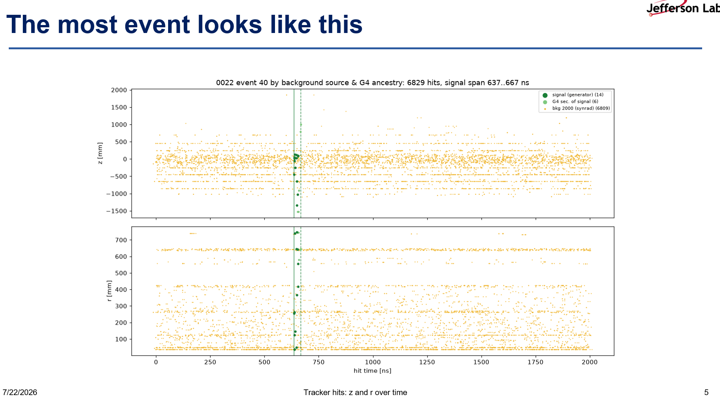
Wednesday Morning #5
Dmitry Romanov:
Background suppression / Event Selection
Intention is to do this from echelon1 data to reduce tracking effort rather than raw data sizes…

Slide 6
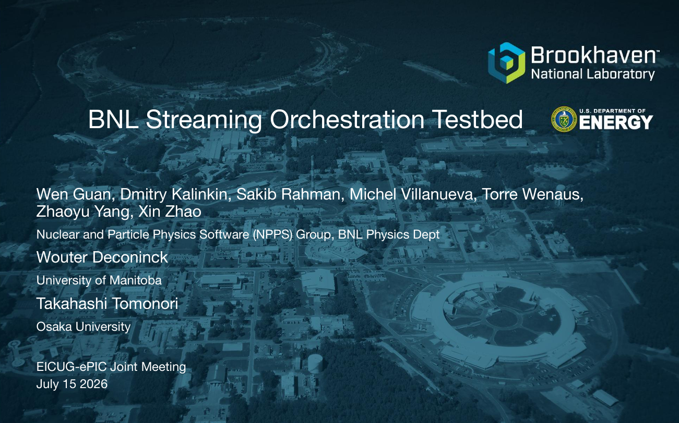
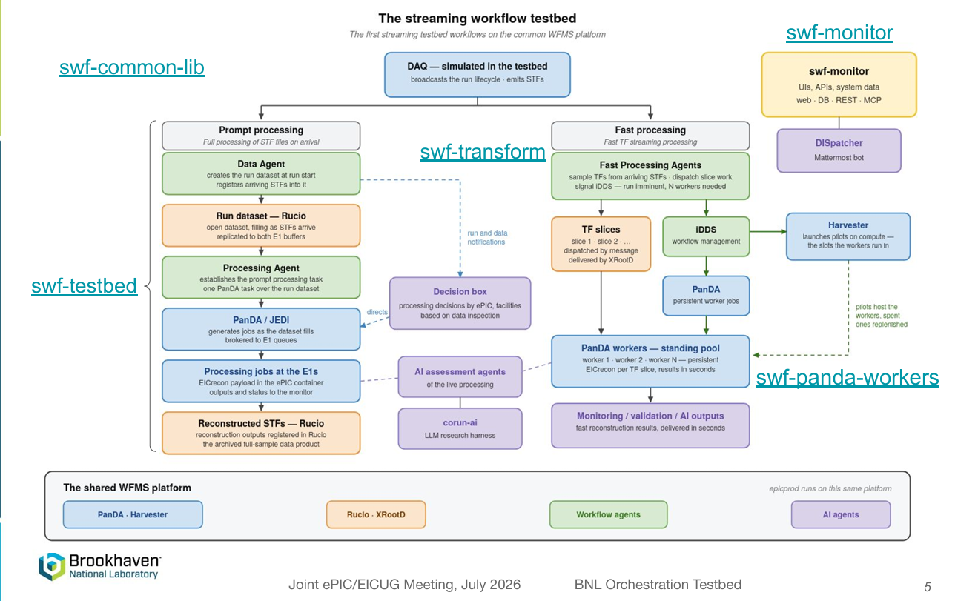
Wednesday Morning #6
Dmitry Kalinkin Presented the BNL Streaming Orchestration testbed
Handles data / process execution after data is written to bufferboxes
Combines:
Panda for initiating jobs
Ruccio for data management
Snakemake for evaluating tasks & dependencies
ActiveMQ agents to with interface via command lines or MCP control
DAQ emulator with simplified state-model
“Prompt” tasks are on full reconstruction tasks
“Fast” tasks are on partial STF for rapid turn-around (monitoring) purposes

Slide 7
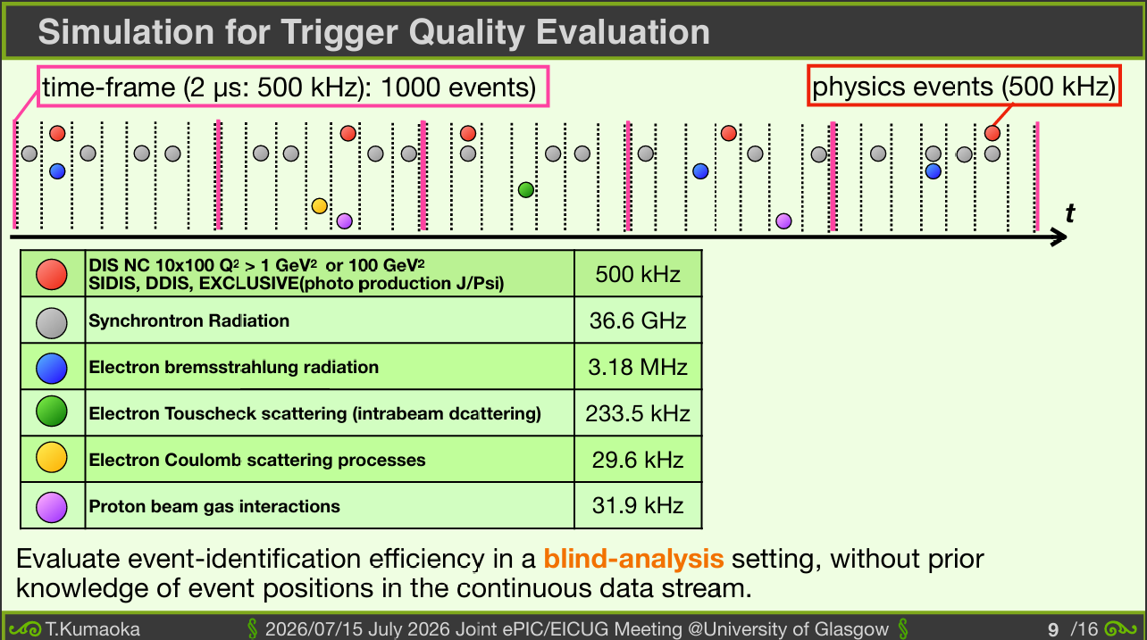

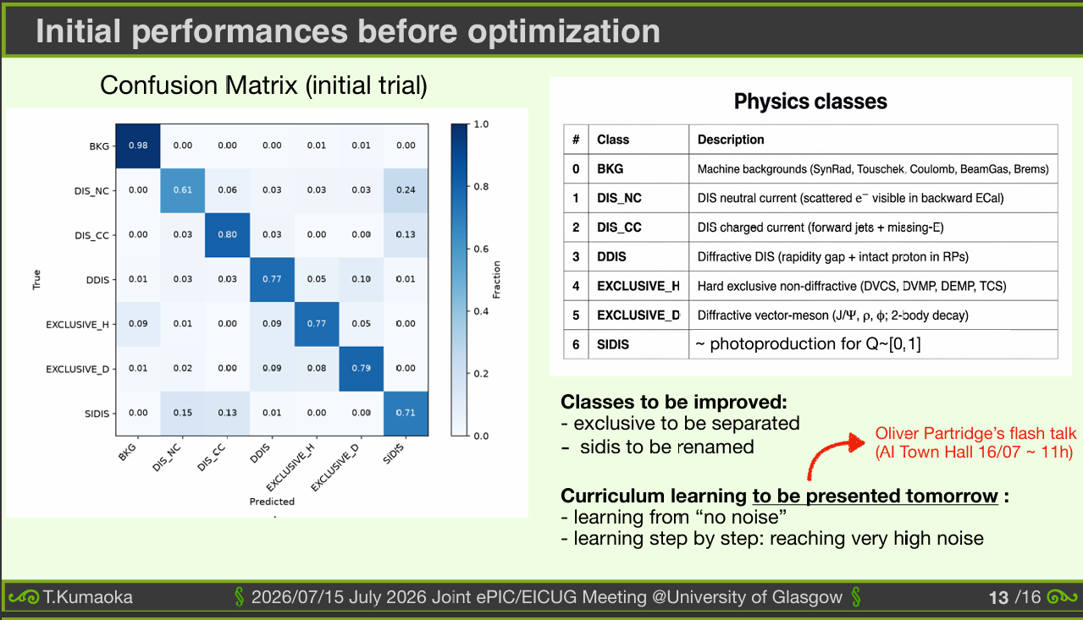
Thursday Morning #1
Takuya Kumaoka presented streaming reconstruction:
Time splitting / pre-event identification
Event identification via ML

Slide 8
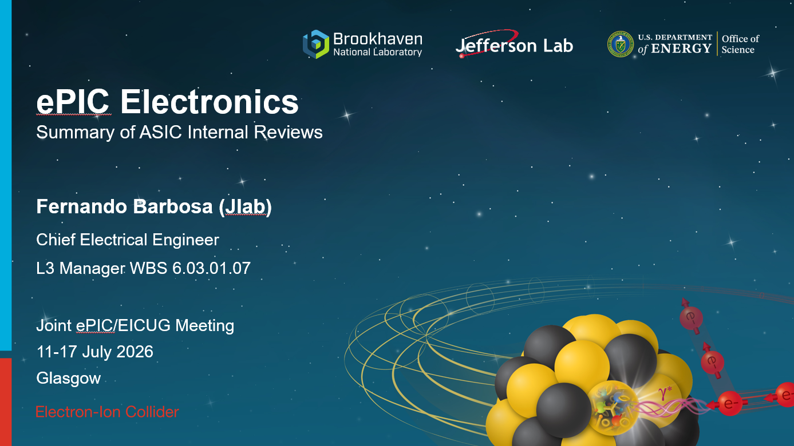
Thursday Morning #2
I presented a talk from Fernando summarizing the ASIC reviews

Slide 9

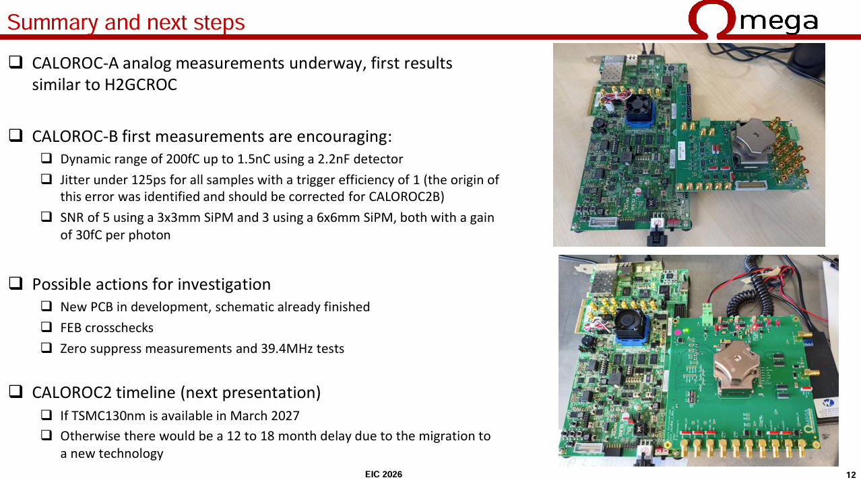
Thursday Morning #3
Pedro Pablo Dumas Ziehlmann presented many measurements of the new CALOROCs
High Gain / Gain switching
Linearity
Charge Resolution
Timing
Time to baseline
Crosstalk
SiPM measurements
Single Photo-electron measurements
Discussed some issues seen and possible solutions to consider
  Digitial noise
  Double peaks

Slide 10

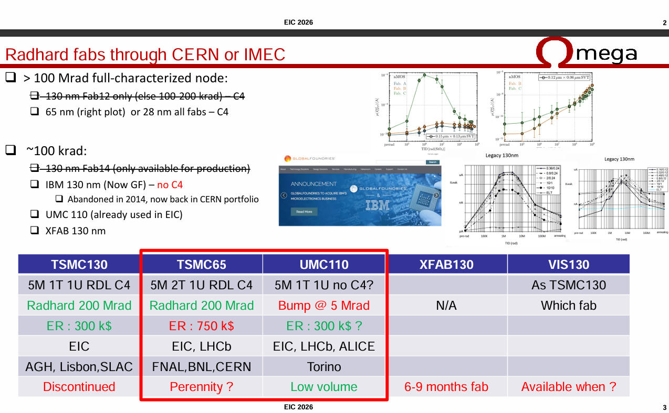
Thursday Morning #4
Frederic Dulacq discussed the fabrication issues with TSMC stopping the 130 nm production line
Very informative as regards steps towards changing the fabrication chain
Discussion about moving to 65 nm regardless of the availability of 130 nm lines due to the risk of losing them in the future
There is recent announcement of continuation of the 130 nm line, which may make this discussion obsolete…

Slide 11

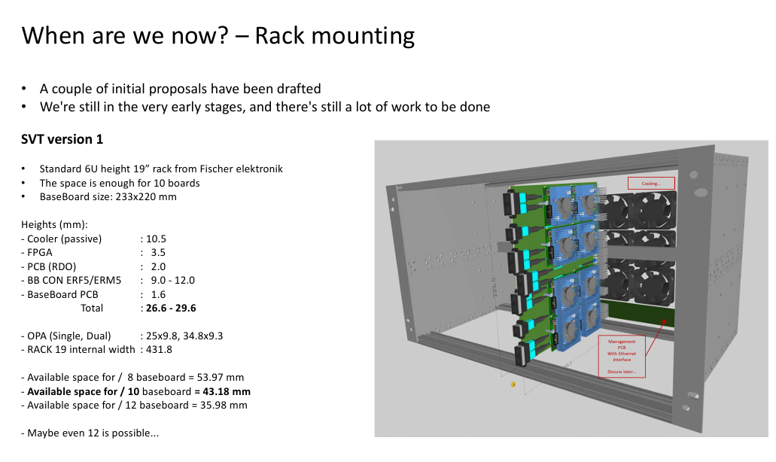
Thursday Morning #5
Miklos Czeller presented the generic RDO status.
The daughter board & supported FPGAs
The generic motherboard containing potential FMC, SFP+,FRIFELYU, PCIex4, and clock signals
Ideas for rack mounting of 8 generic RDO’s per slot presented.
Status is that production of test articles is ready to go when contract finalized

Slide 12
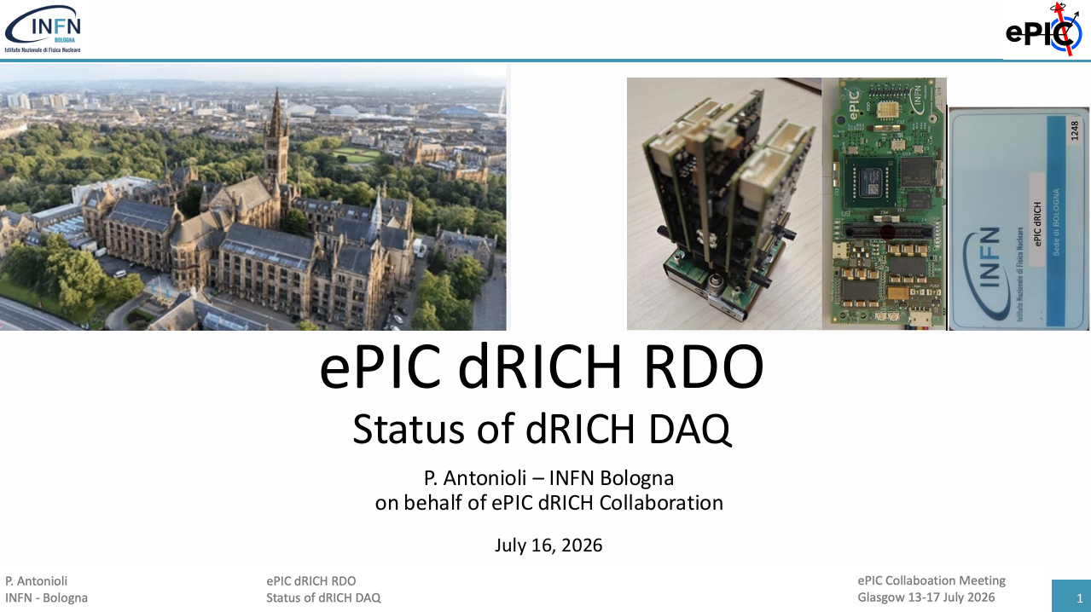
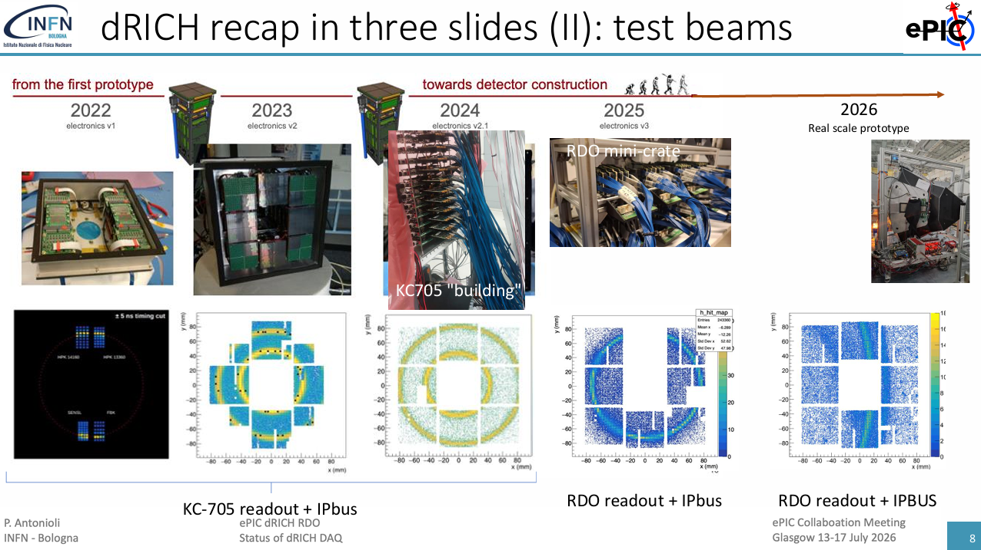
Thursday Morning #6
Pietro Antonioli presented the status of the dRICH RDO and associated hardware.
Recap of progress
  Electronics
  Test beams
  RDO
  RDO/DAM development / test setup
Many questions / to do items
  Recovered clock phase stability questions…
  Protocols & data formats
Next steps…

Slide 13
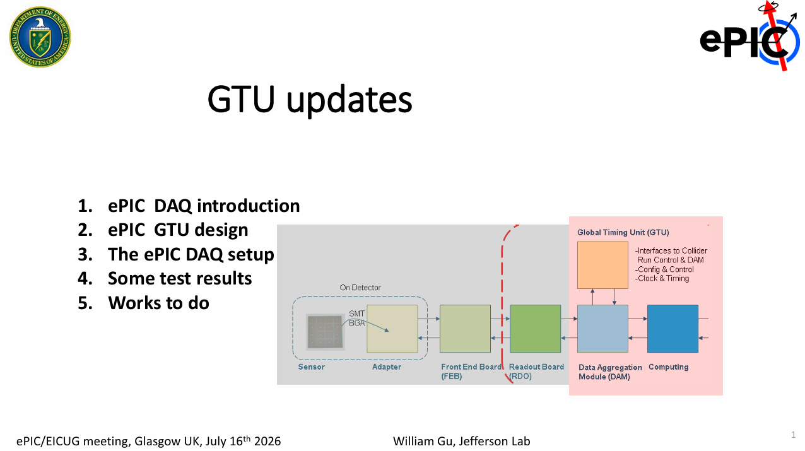
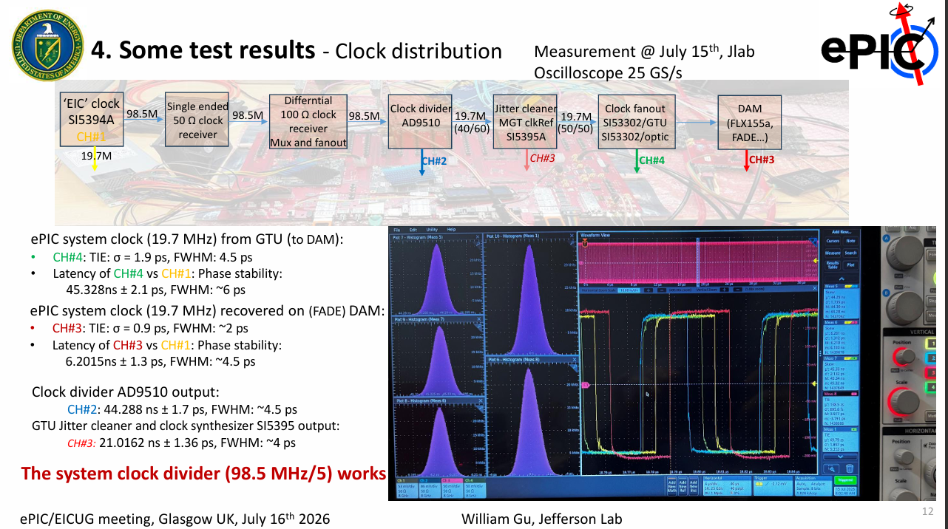
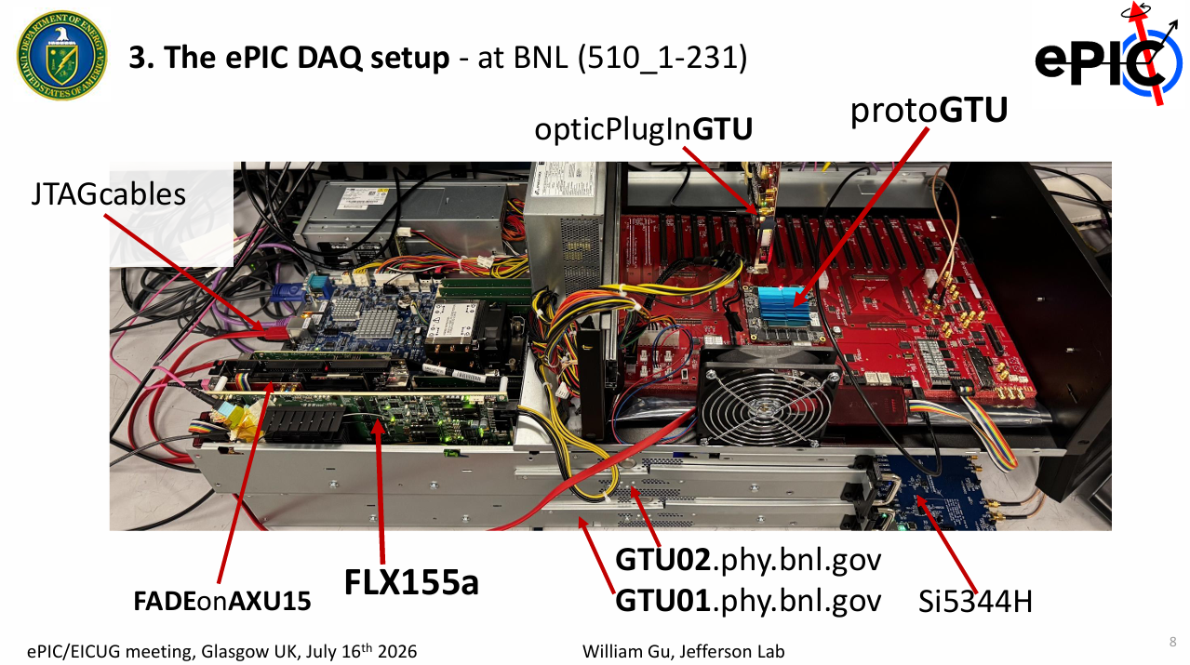
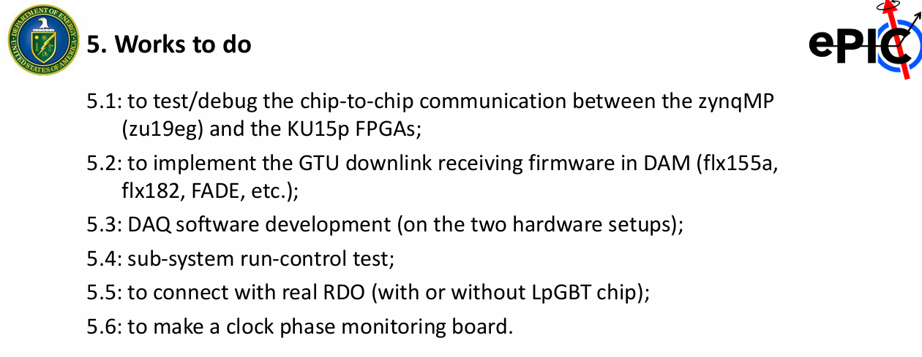
Thursday Morning #7
William Gu presented progress on the GTU

Slide 14

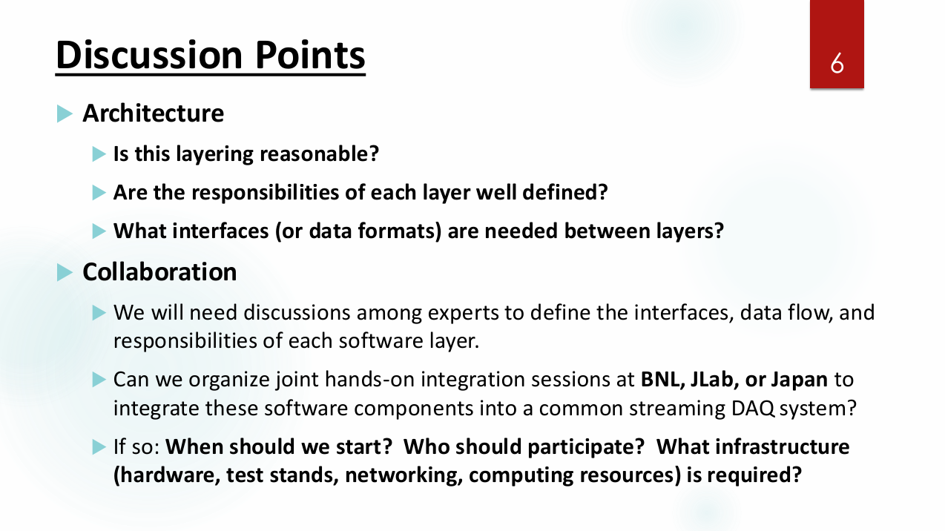
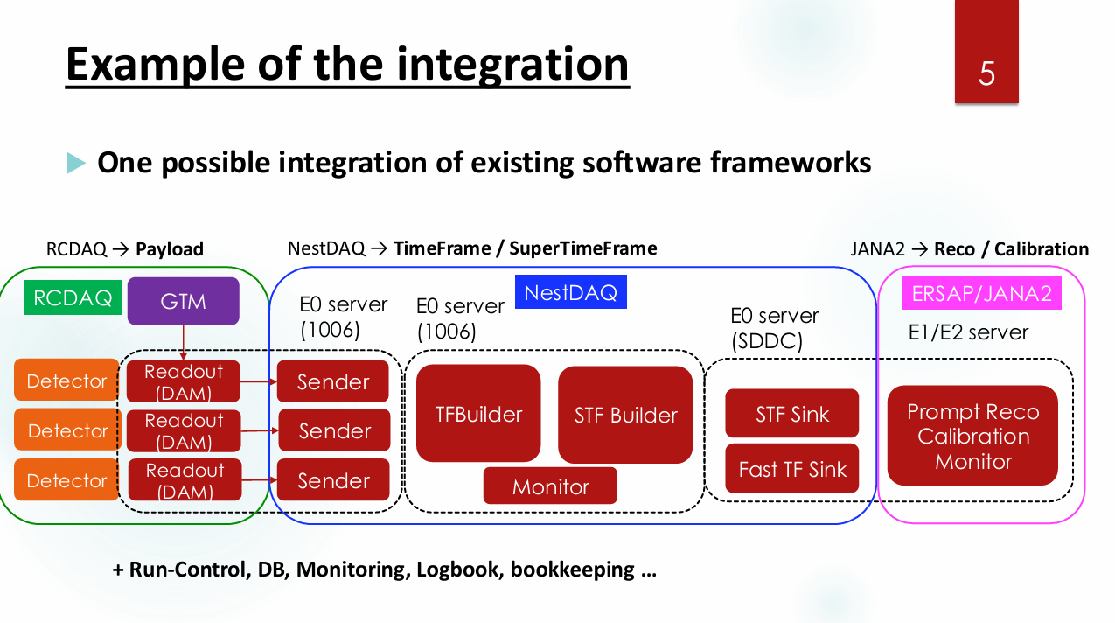
Thursday Morning #8
Taku Gunji Discussed collaboration plans with Japan
We’ve set up meetings (at first with conveners) to try to detail what the collaboration will look like

Slide 15

Thursday Morning #9
We intended to have a discussion of the efforts in the SRO working group towards developing streaming calibrations. Marco Battaglieri gave a short introduction to these plans, but the discussion was cut short due to time. This discussion will be picked up in the SRO working group meetings in the near future

Slide 16
Impressions and Specific Tasks:
AI was a big focus of the collaboration meeting. There were plenaries and 2 sessions on AI:
  David Lawrence gave a expansive plenary AI talk
  Session of flash talks with specific projects (overlapping the Thursday E&DAQ session)
  Overview / Discussion session on Friday
    Policy discussion (consensus for a minimal policy to be put in place)
      Disclosure of AI coding part of GITHUB check-in procedure
      Responsibility for debugging/verification of AI coding on developers. (AI NOT an entity)
TIC Goals
  preTDR and Subsystem papers still a goal
    preTDR to be ready for September Review
    Subsystem papers for NIM-A
      Single NIM-A Issue
      October submissions for those able to make them (but to preprint servers)
      Early next year full submission…
    Data Volumes (needed for NIM-A)
    Chain tests using closest ASICs possible. (Silvia expressed goal for SAMPA/SALSA for MPGD testing)

Slide 17
To Do Tasks:
  Person to handle DAM Board programming scheme and interface to detectors
  Specific protocol definitions for RDO/DAM interfaces
  DAQ Data file format
  Metadata formats for configuring detector
  Availability of DAM / Felix
    Will get small number of FLX-155 soon
    Will have O(20) FLX-712, but will need to develop ePIC support for them
  Specific fiber routing needed to be considered
    Connectors / patches
    Keep number of connections within specs
  More detailed requirements / definition of echelon 0 processes including timeframe building

