Slide 1
EIC Project News
E.C. Aschenauer (BNL), R. Ent (JLab)
Co-Associate Directors for the EIC Experimental Program
ePIC Bi-Weekly General Meeting
July 14th, 2026

Slide 2
CD-3C Preliminary Package - DET
Subproject | WBS | Long Lead Procurement Description | $M | FDR
DET | 6.03 | Lead tungstate crystals (cont. CD-3A/B) – 830 remaining | 2.09 | Done
DET | 6.03 | fECal Scintillating Fibers (cont. CD-3A/B) – 1185 km remaining; Barrel SciFi → Korea In-Kind | 0.49 | Done
DET | 6.03 | Steel towers for forward HCal (cont. CD-3A/B) – 288 towers remaining | 1.57 | Done
DET | 6.03 | Flux return steal rear endcap | 3.26 | Done
DET | 6.03 | High-Rate Picosecond PhotoDetectors (HRPPDs) | 4.82 | 09/01/2026
DET | 6.03 | SiPMs for all the other subsystems and mounting on the SiPMs boards & QA | 6.5 | Done
 |  | Total | 18.32
CD-3C will complete:
the PbWO4 crystal procurement
the fiber procurement of the fECAL
the steel towers for the lfHCal
the flux return steel for the electron and hadron endcap
all the HRPPDS for the pfRICH and the DIRC
all SiPMs for the bEcal, the Barrel-ECAL, the fECal, the Barrel Hcal, the fHCal and all the auxiliary detectors
(without contingency)

Slide 3

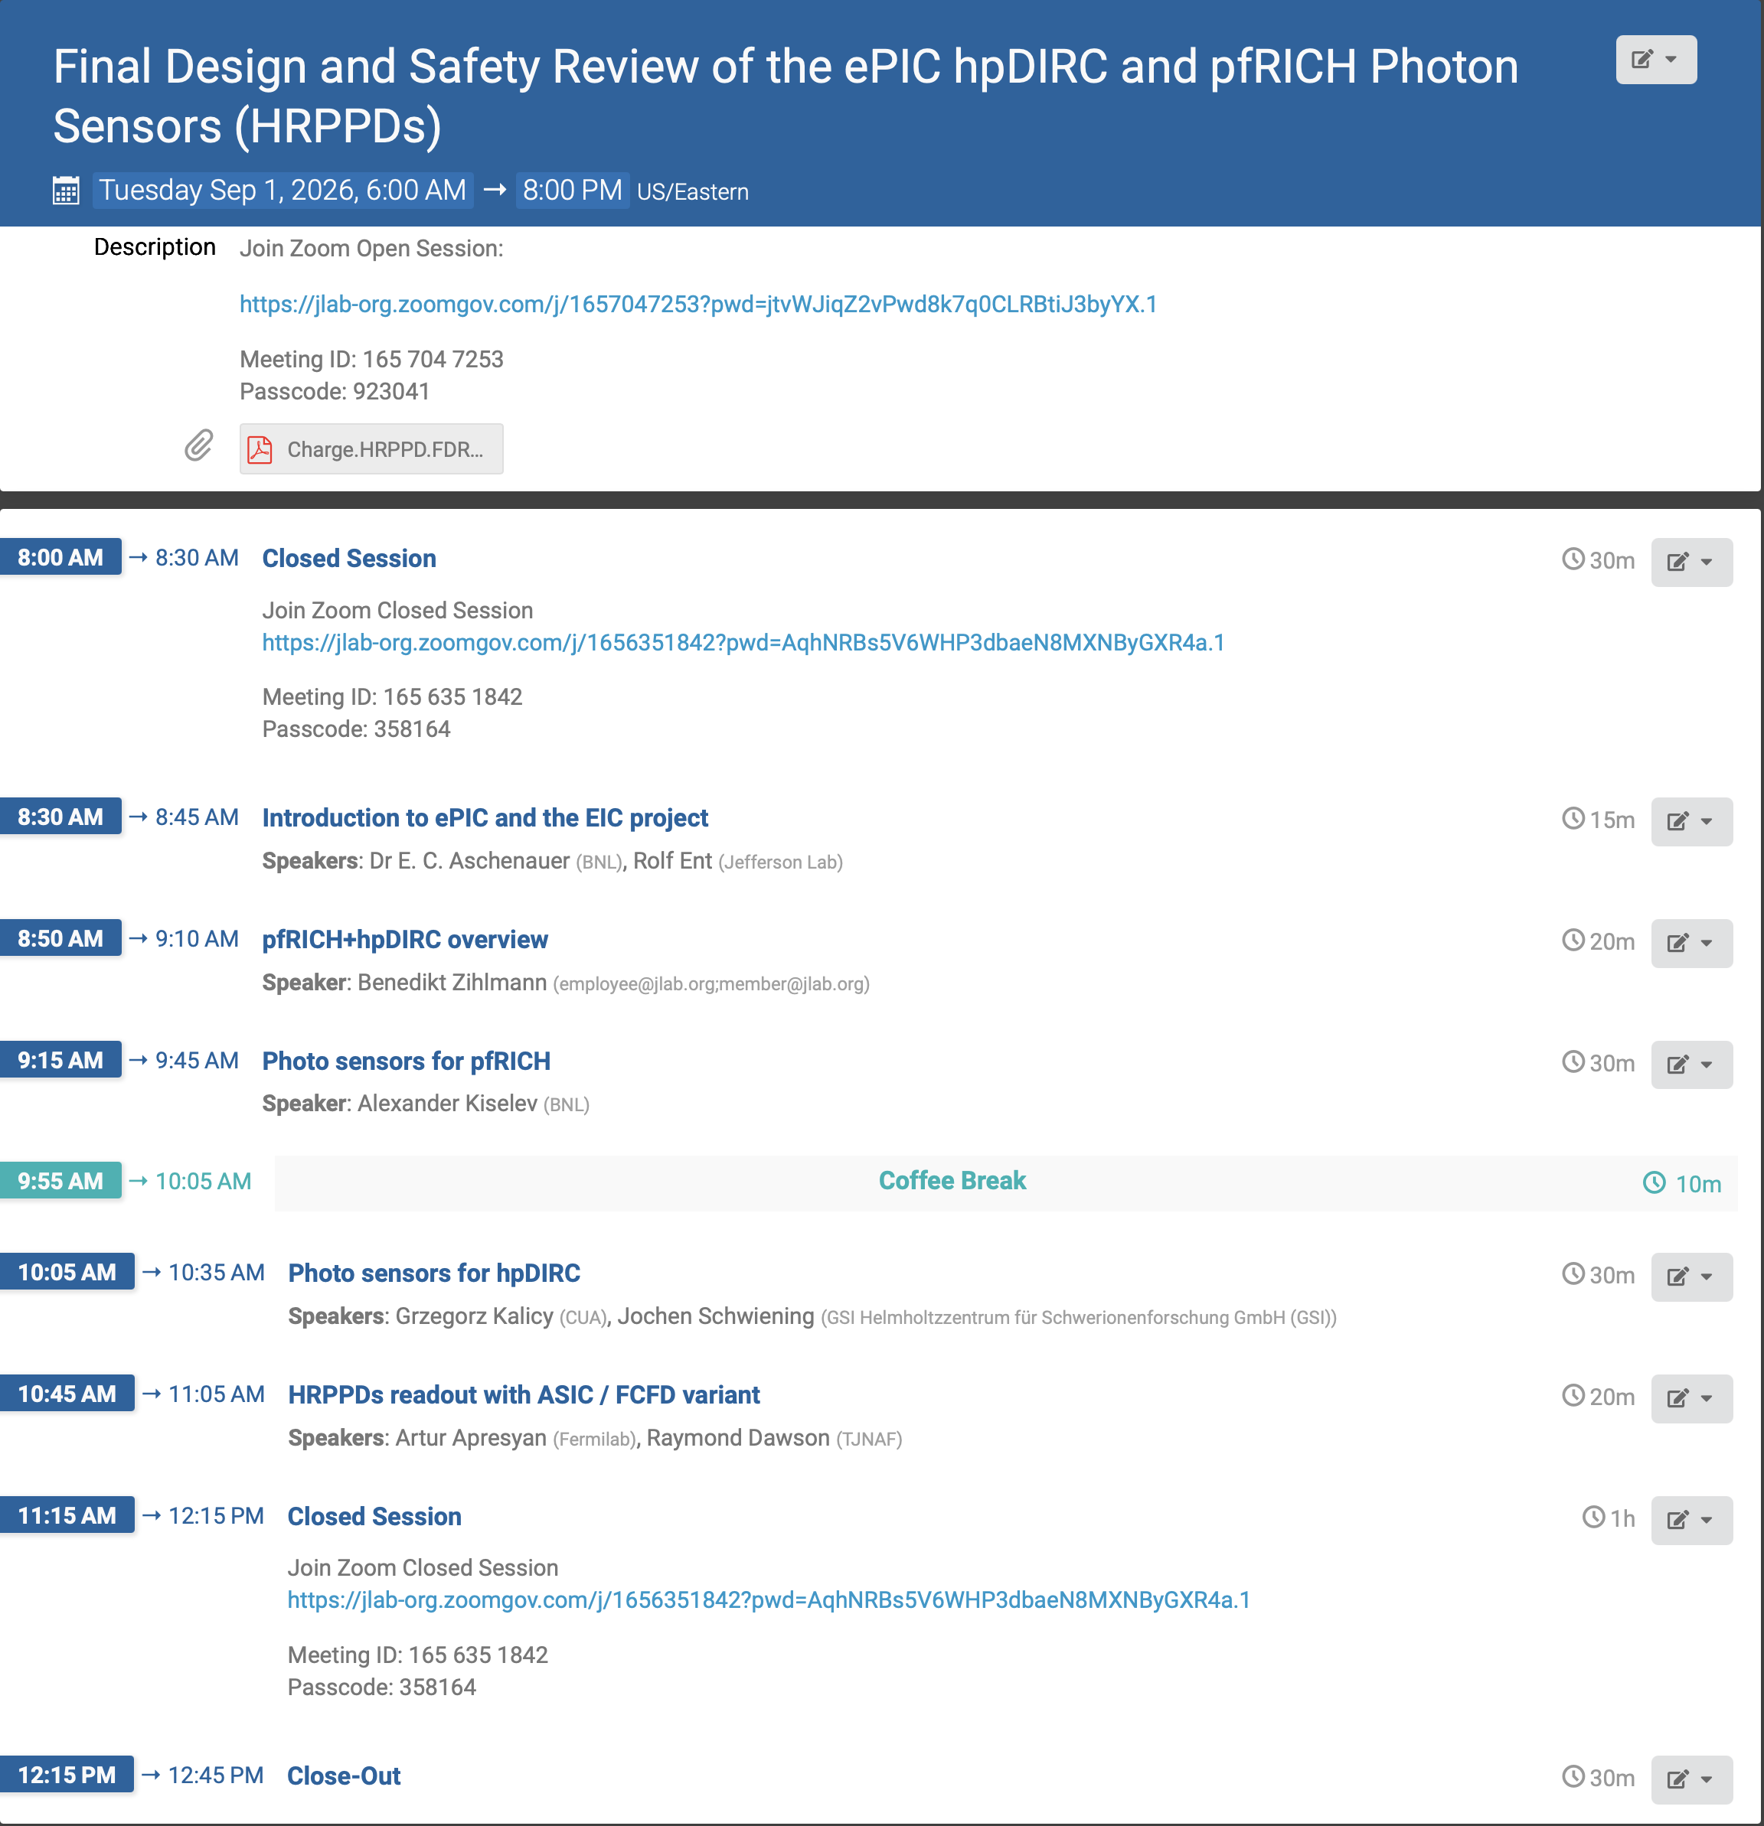
FDR for HRPPDs
Review 1st of September
Reviewers: Peter Križan (IJS, Ljubljana), Floris Keizer (CERN), Jack McKisson (JLab)

Slide 4
Compensating Loss of UK In-Kind Contribution – Phase-I
UK In-Kind contribution to
Lumi detector $1.5M: Is required for any EIC science
Low-Q2 Detector $3.5M: This detector was assumed as fully UK in-kind
Silicon Vertex Tracker $15.6M: Critical towards ITS3/LAS design and L3/L4 of SVT barrel
  $5.3 M hardware and $9.8M labor
Assumption: It is critical that all ePIC Detector Sub-Systems can continue beyond PDR-level to full E&D completion (90% design-maturity FDR-level) to allow to bring back the scope as early as possible and seek further in-kind.
Mitigation needs to ensure we can baseline the detector and stay “DOE cost-neutral”
(<200M$ DOE cost-to-go):
DOE Cost increase is compensated by
  Delay forward TOF construction → $2.86M
  Delay backward HCal construction → $3.8M
  Delay Low-Q2 Detector → $0.223M
  Delay electronics (HV, LV, FEB) that accompanies these systems → $1.3M
→ Absorb as DOE Cost
→ Defer
→ Move all non-labor UK In-Kind of SVT to DOE

Slide 5
Compensating Loss of UK In-Kind Contribution - Phase-II
Recent further developments in the UK force us to also remove the assumption for $9.8M Inkind labor for the SVT → Will follow the same strategy the mitigation has to remain cost neutral for DOE cost
In the L3 cost, following scope is considered:
  design efforts for EIC-LAS V1, EIC-LAS and AncASIC, Some % of PED testing efforts
  Global mechanics, local support and cooling
L4 cost covers mainly production/construction phase cost
Remaining cost to offset: $8.45M
Recent development: EIC Japan consortium will contribute $5M to the SVT-Disks – Thank You
Mitigation possibilities to offset the remaining $3.5M:
Defer Construction of 50% of forward ECal $6.5M for blocks and $1.2M Readout → $7.7M (Total)
Do not built out all of SVT: defer L4 and one disk ($1.5M / disk) or defer 2-3 disks
 | L3 Cost | L4 Cost | Cost can be removed
In-Kind UK Labor | $6M | $2.4M | $1.35M (test setups & wafer probing station in UK)

Slide 6
How easy is it to install components
of the SVT or fECal later

Slide 7
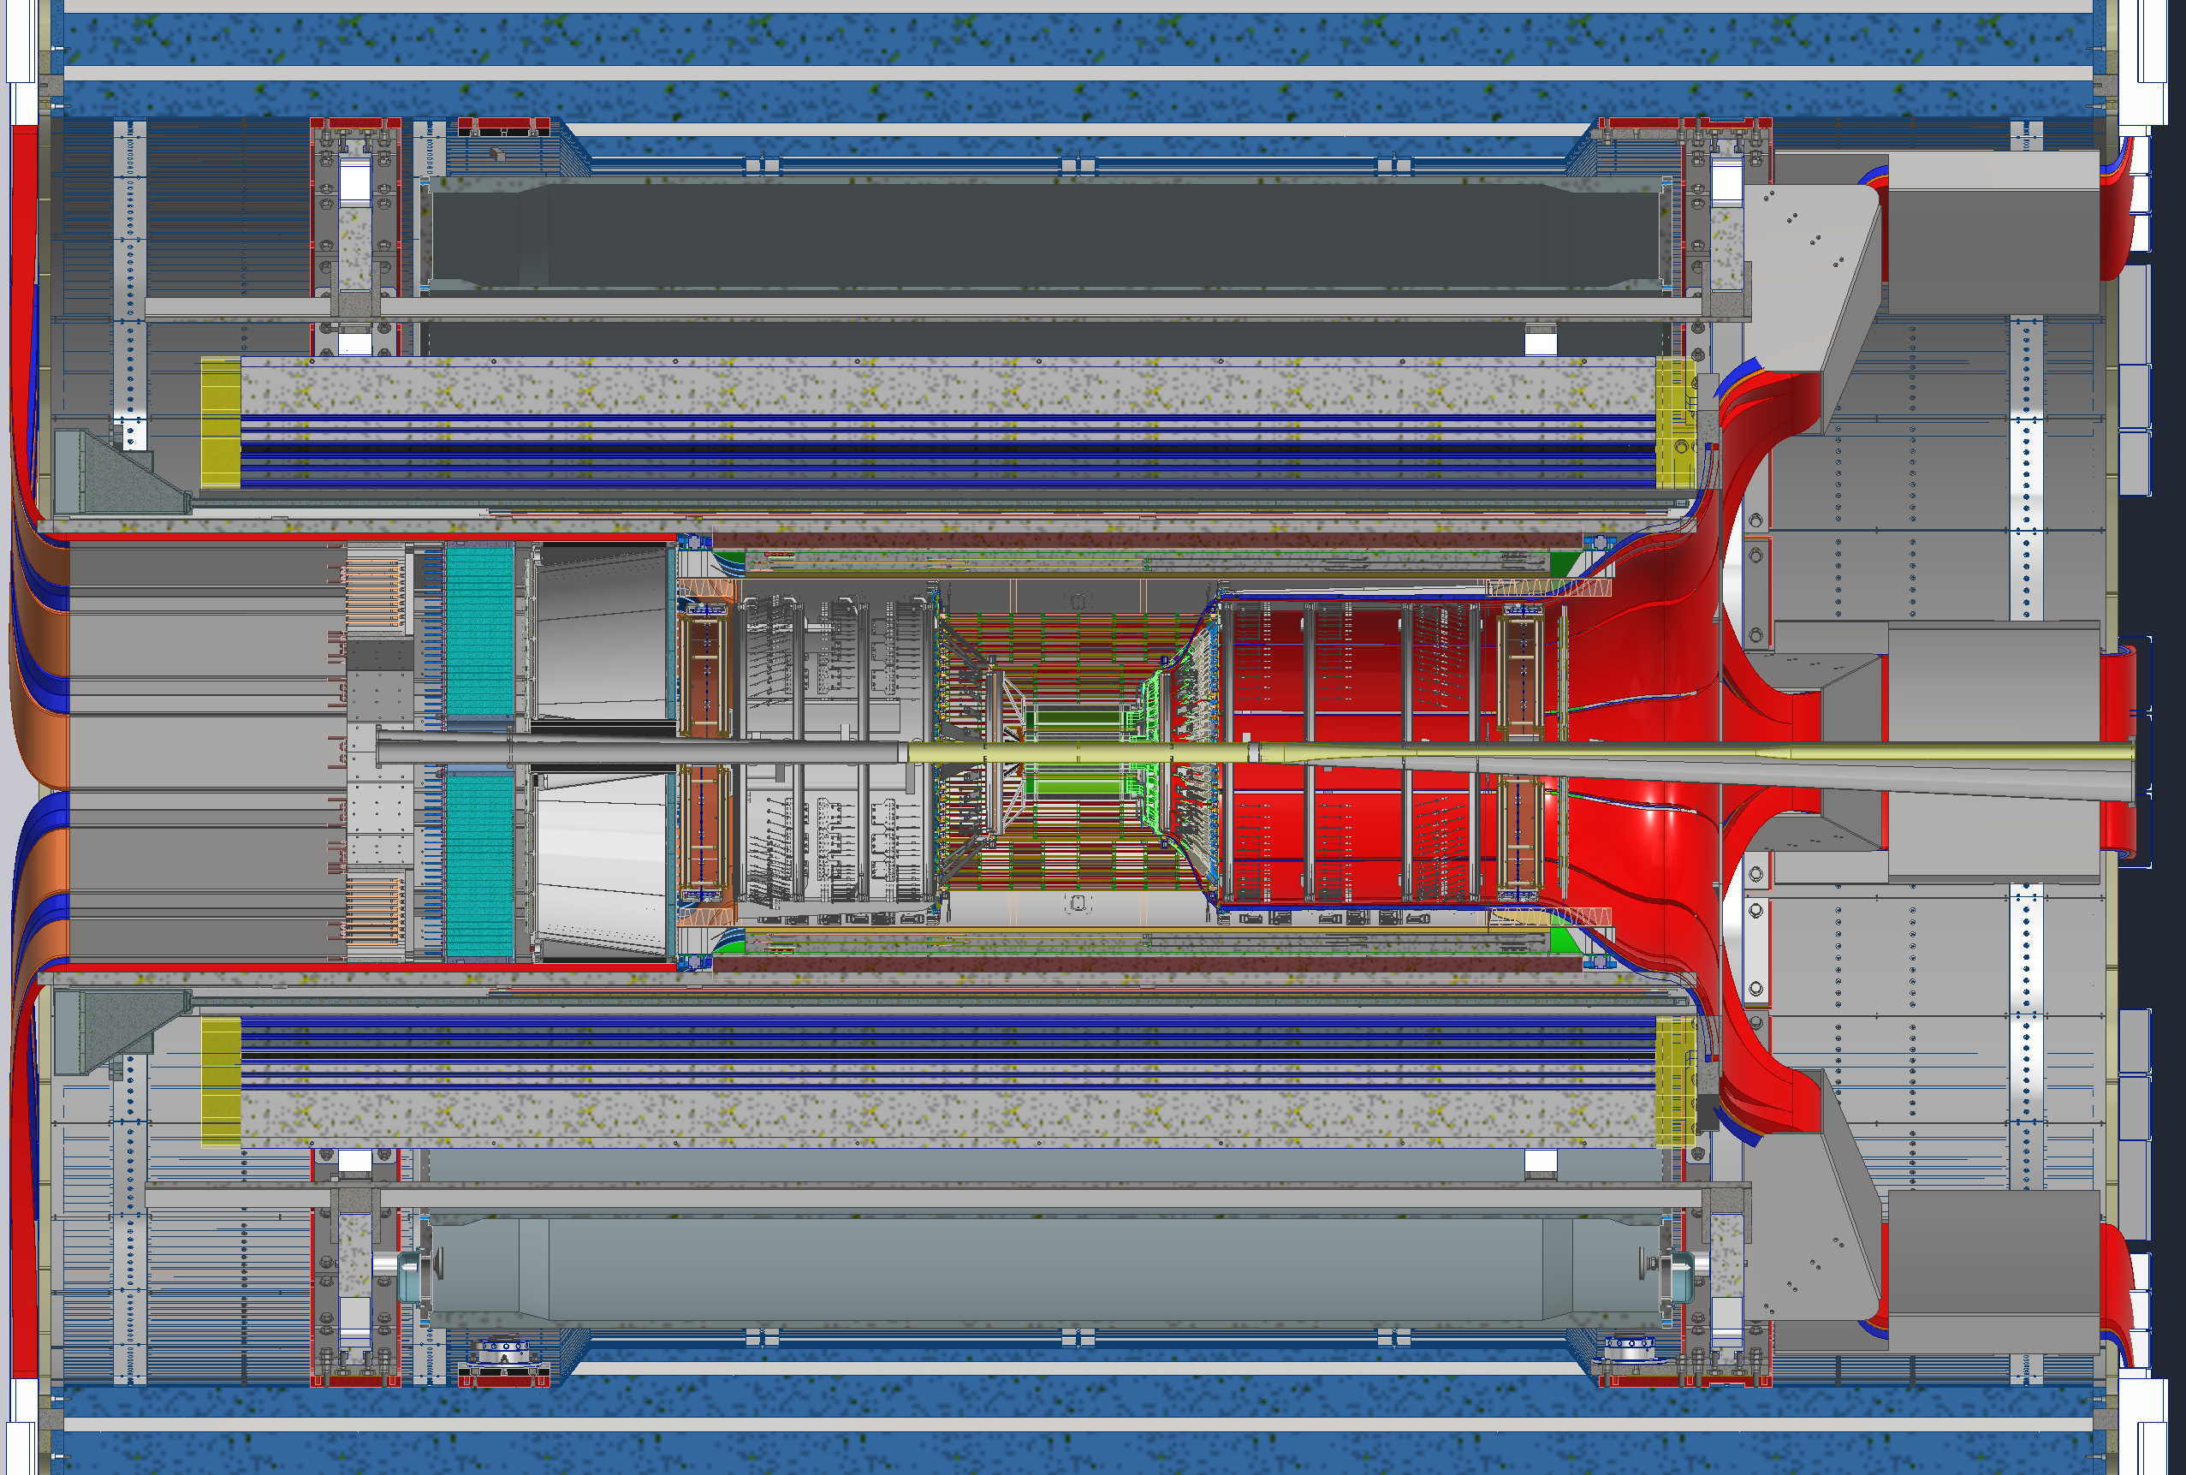
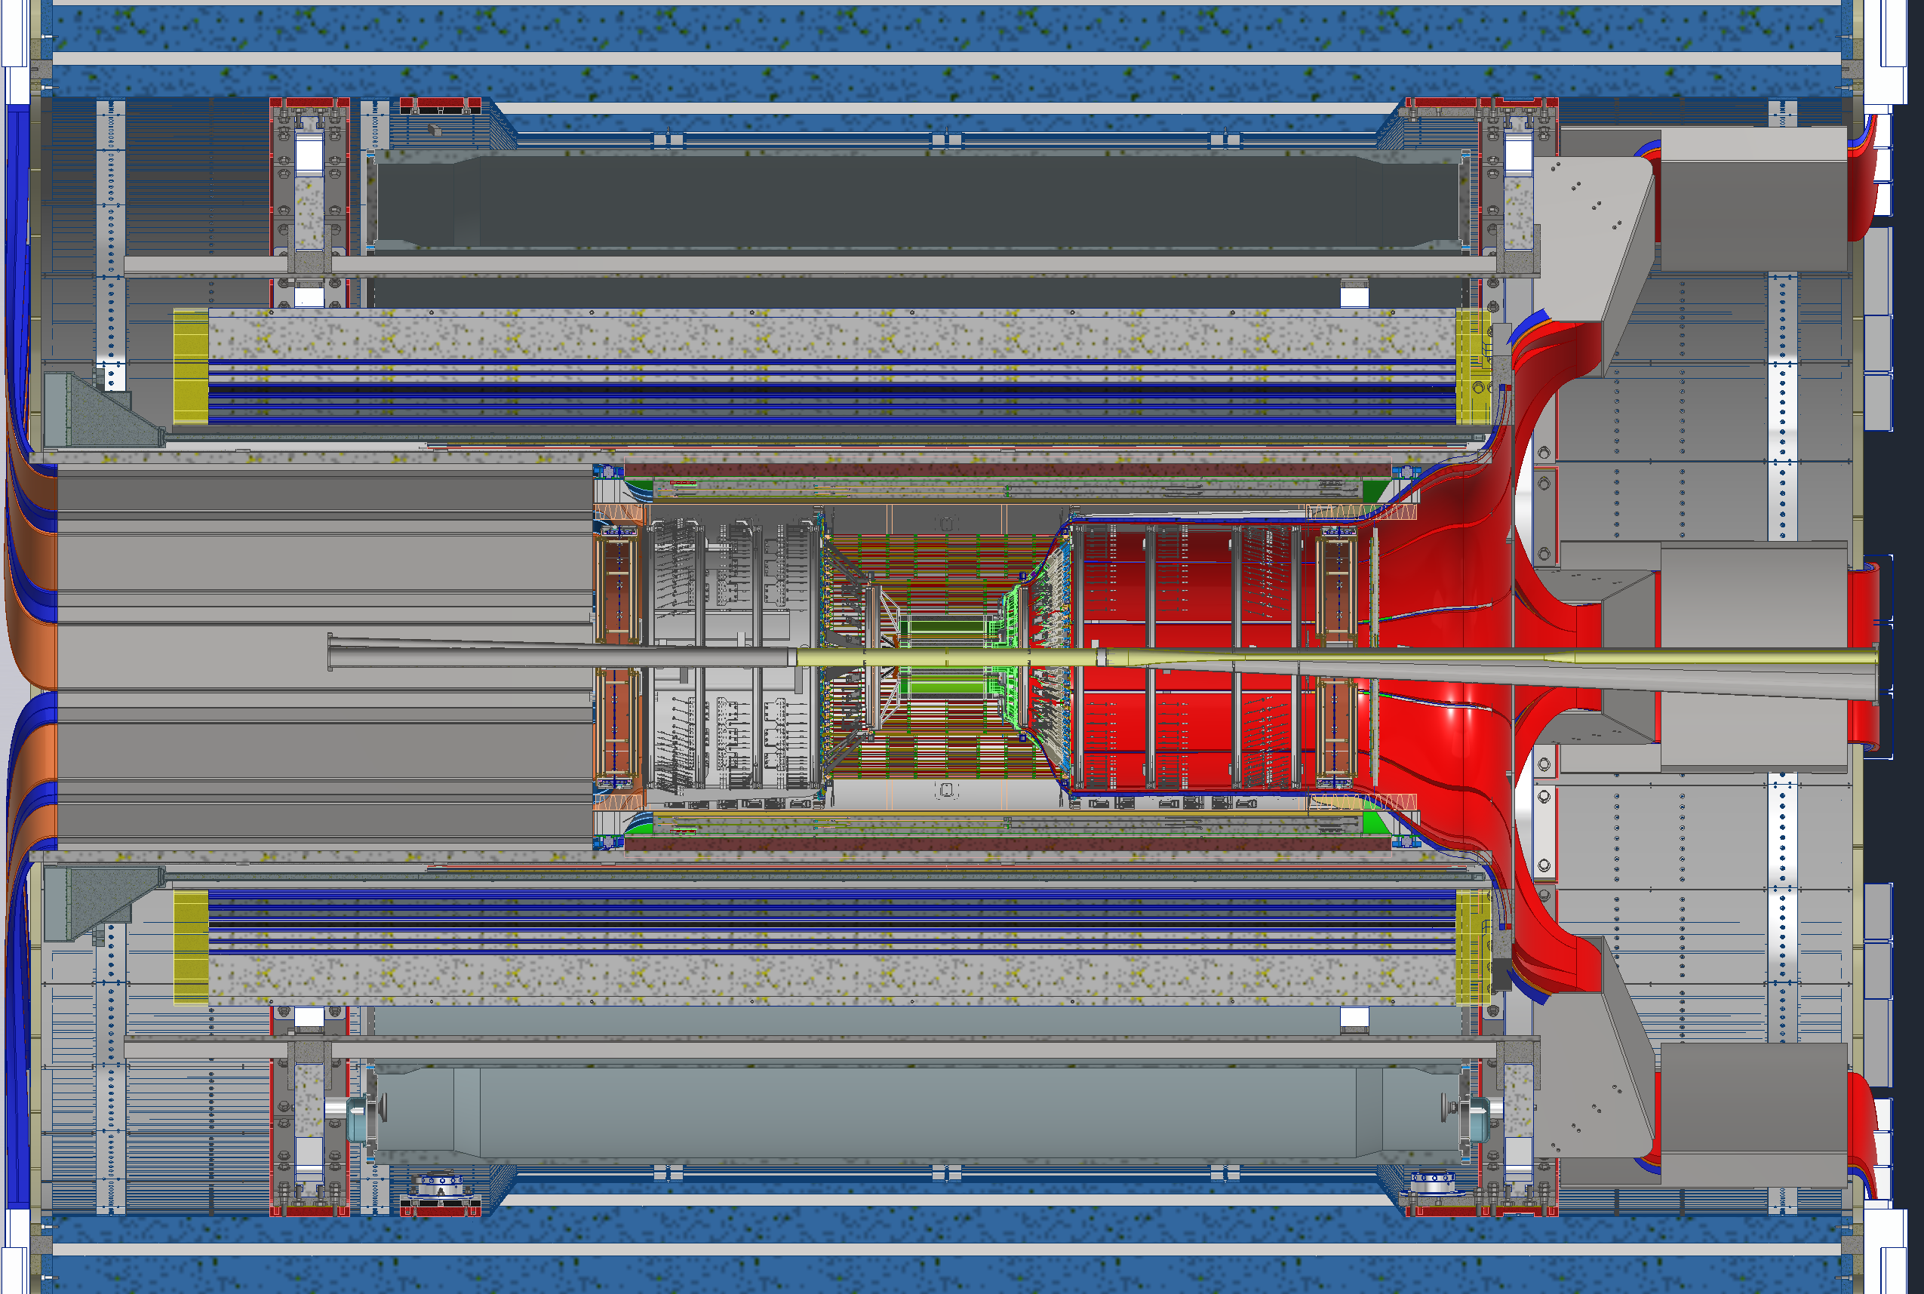
SVT Layer-4 Access Process
Open Endcaps
Break Vacuum
De-cable dRICH
Uninstall dRICH
De-cable EEEMCal & pfRICH
Uninstall EEEMCal & pfRICH
Roll out into assembly hall
→ can also happen after 2

Slide 8
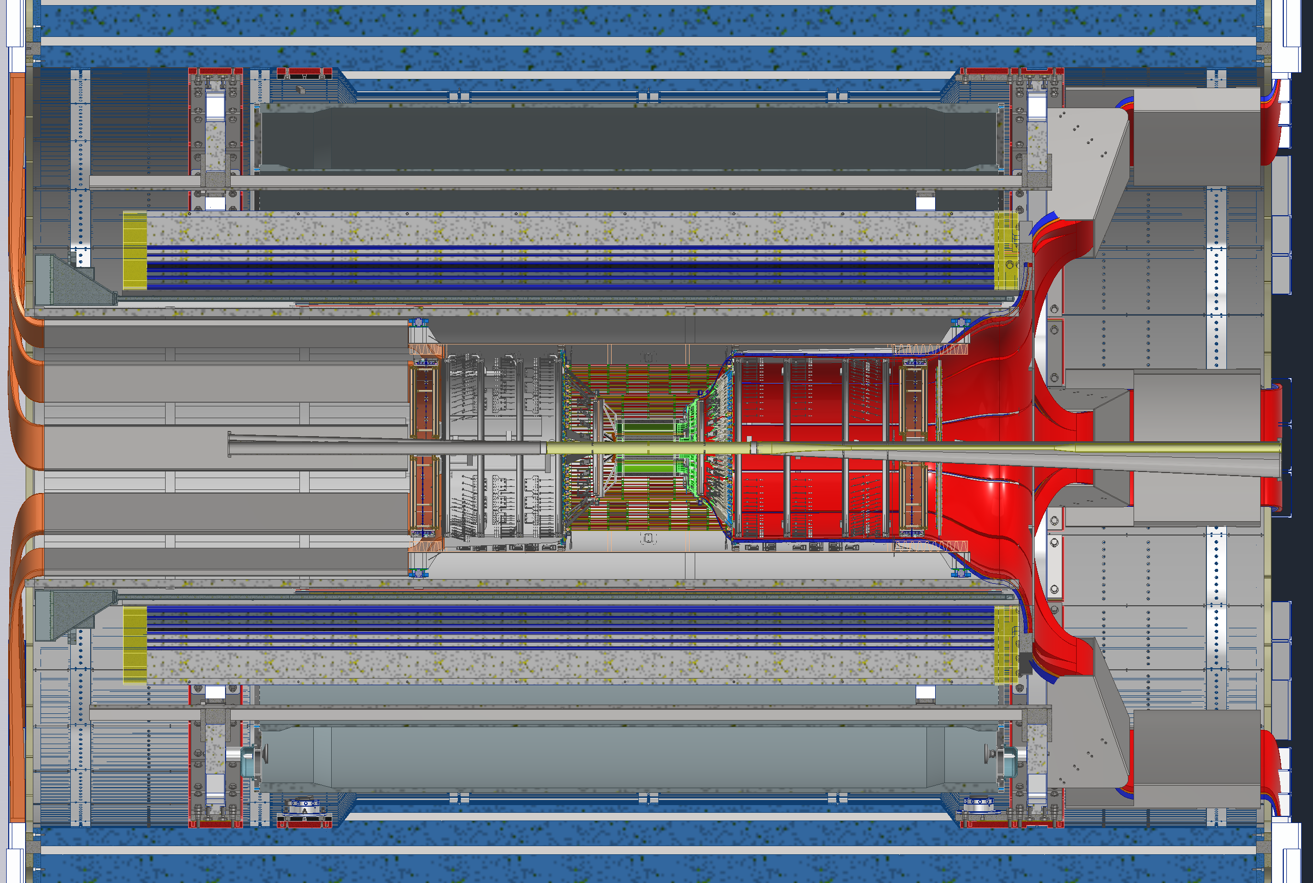
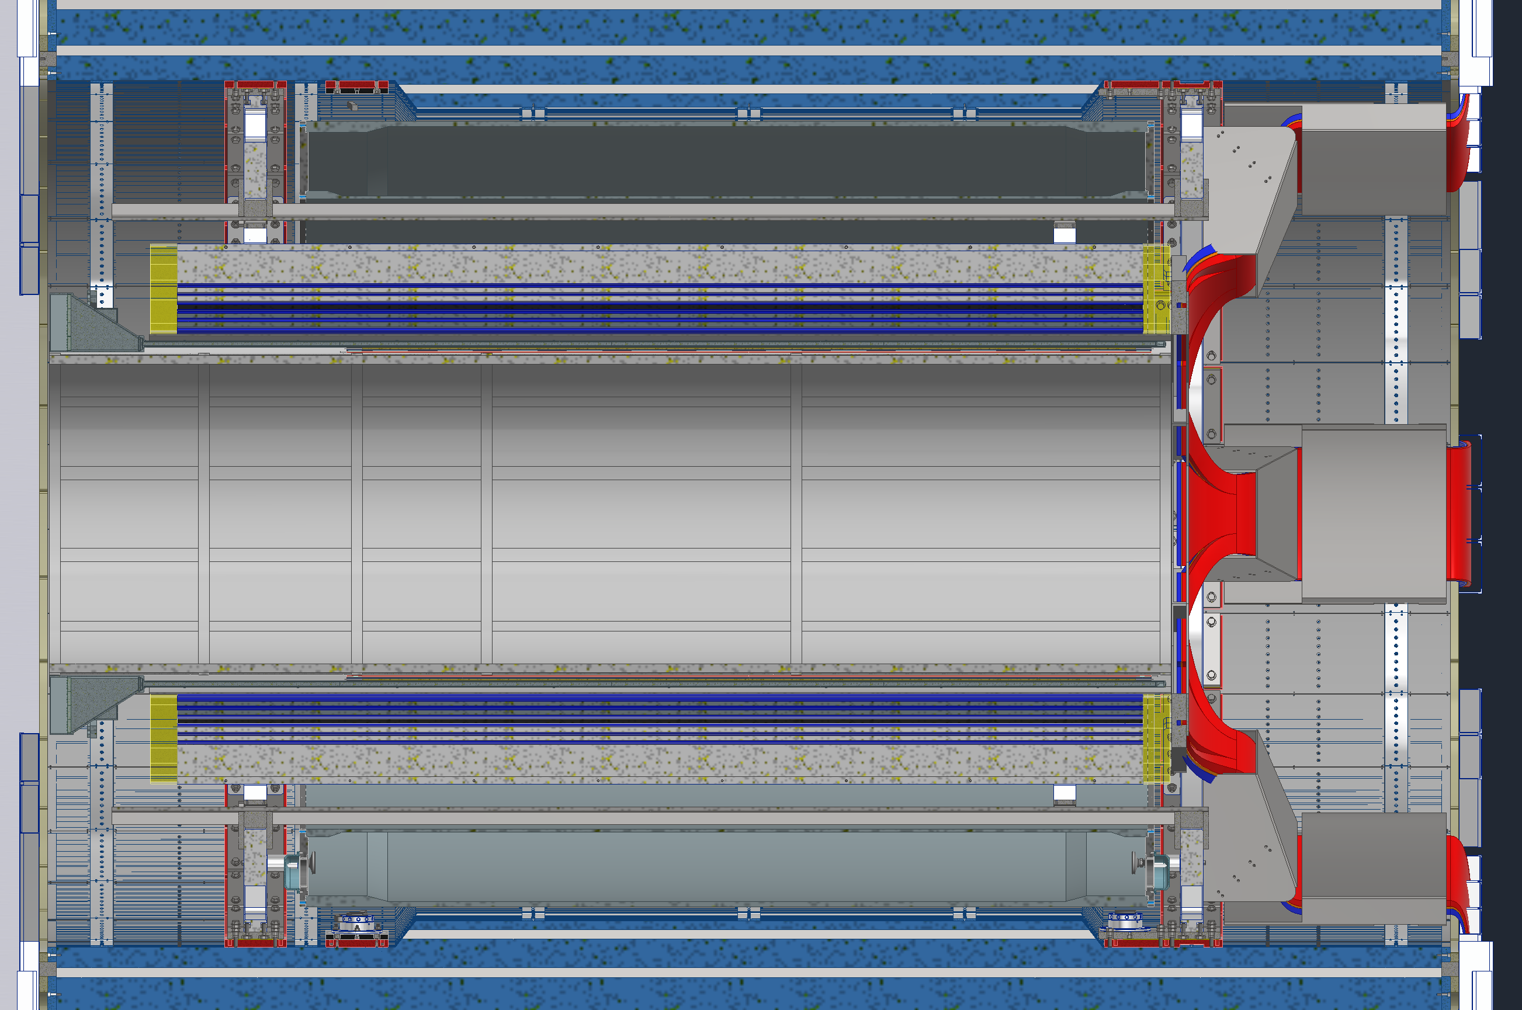
SVT Layer 4 Access Process
Roll out into assembly hall
De-cable SVT, MPGD disks,
(& Forward ToF disk)
De-cable all of ToF & CYMBAL
Uninstall ToF & CYMBAL
Uninstall PST

Slide 9
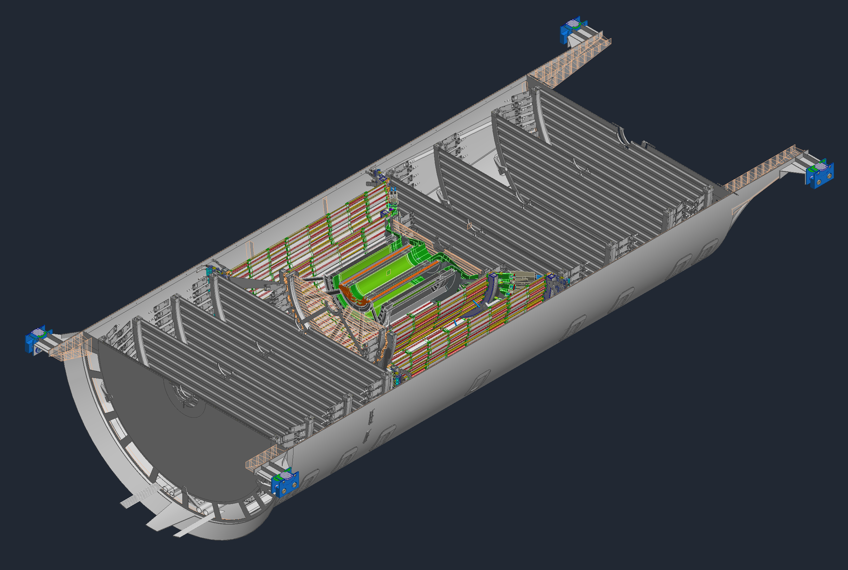
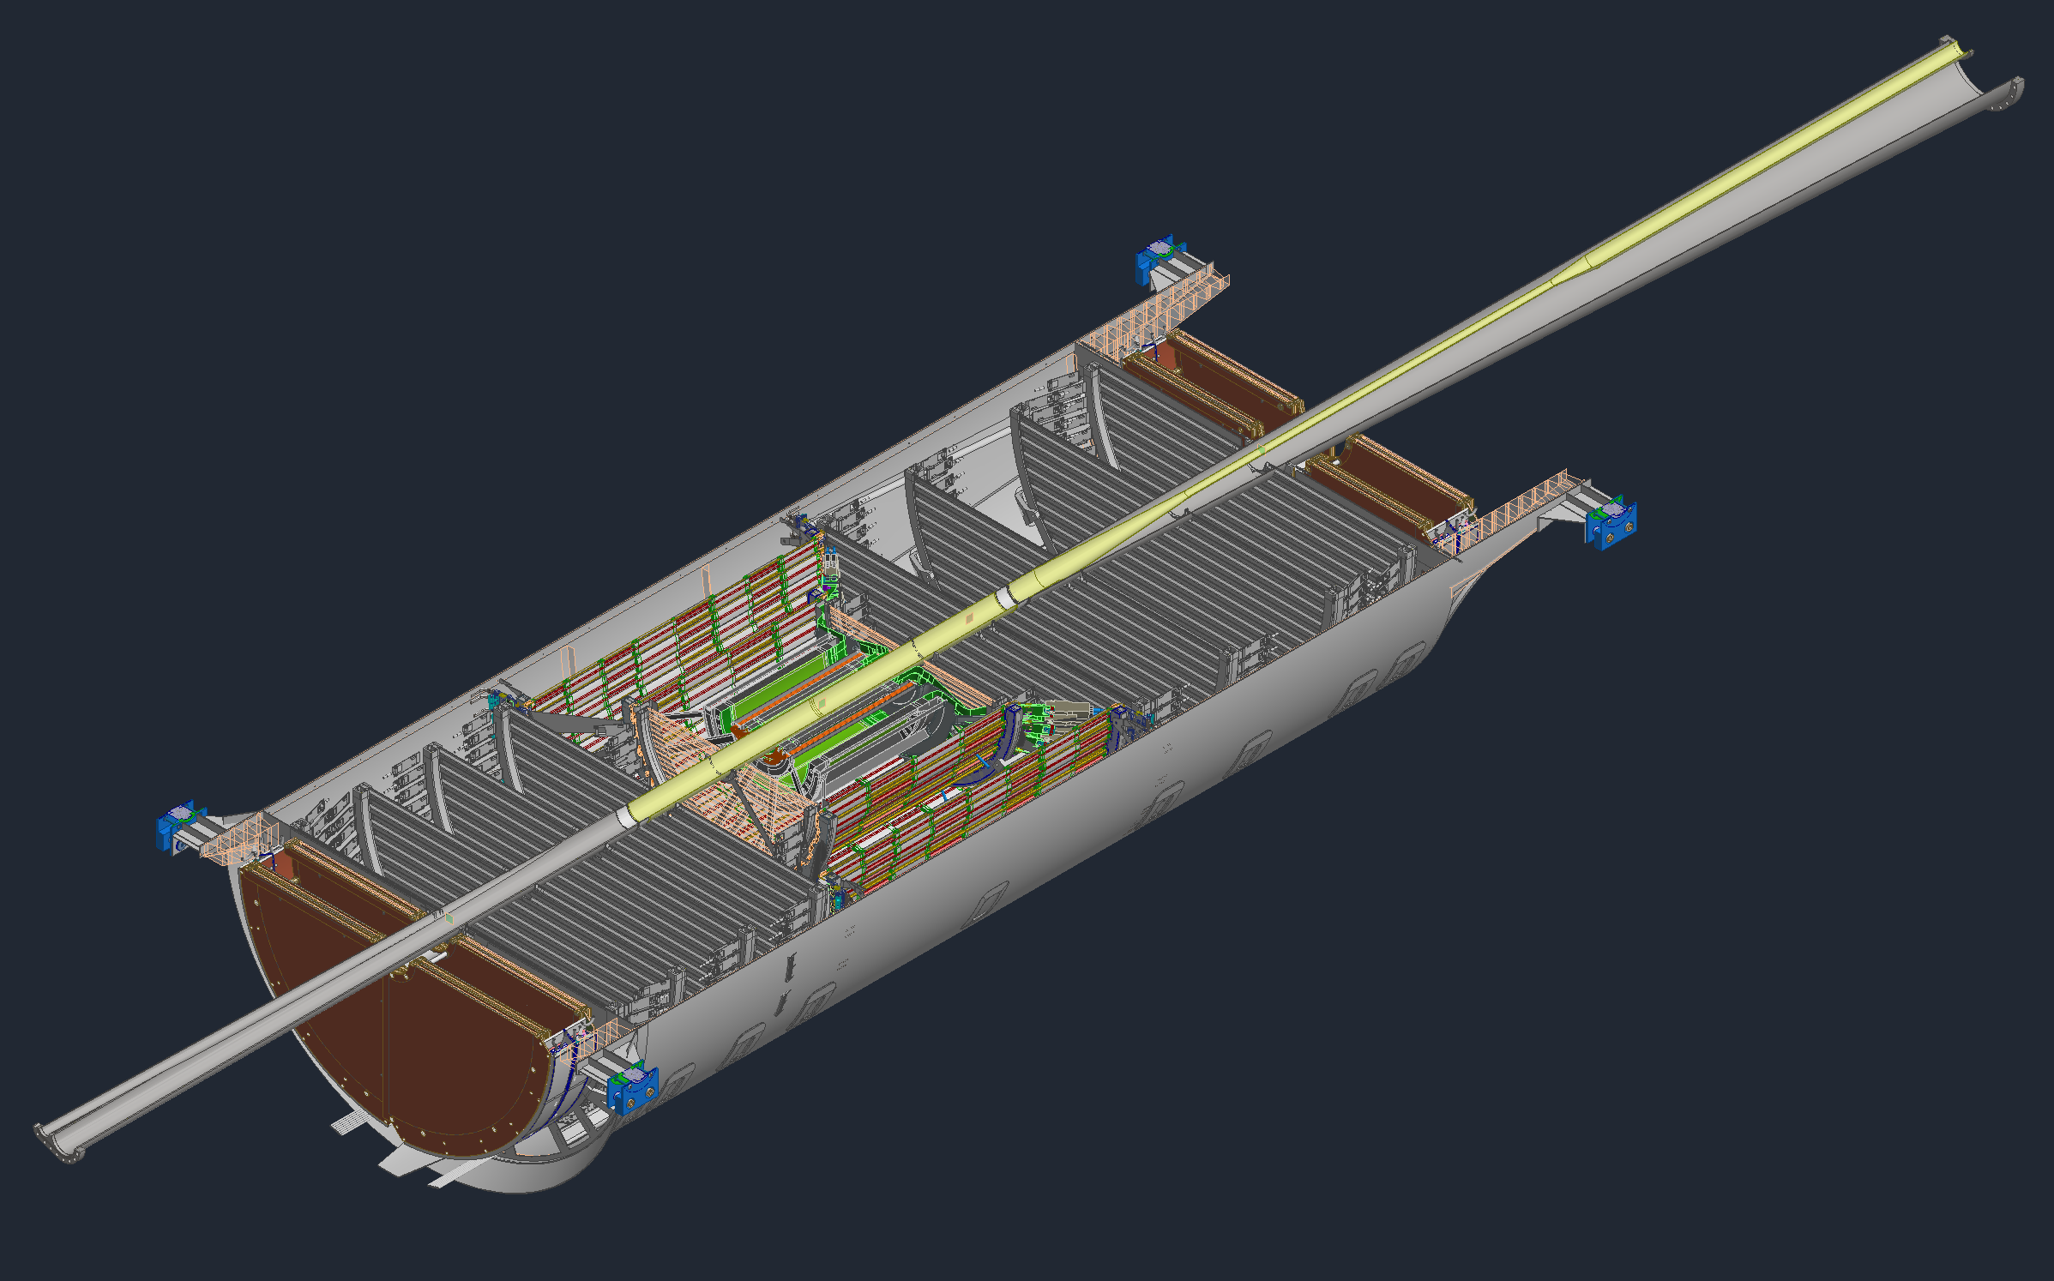
SVT Layer 4 Access Process
De-cable the SVT, MPGD disks,
(& Forward ToF disk)
Split the PST in half
Uninstall the Beampipe from the lower half
Uninstall MPGD & ToF disks from both PST halves

Slide 10
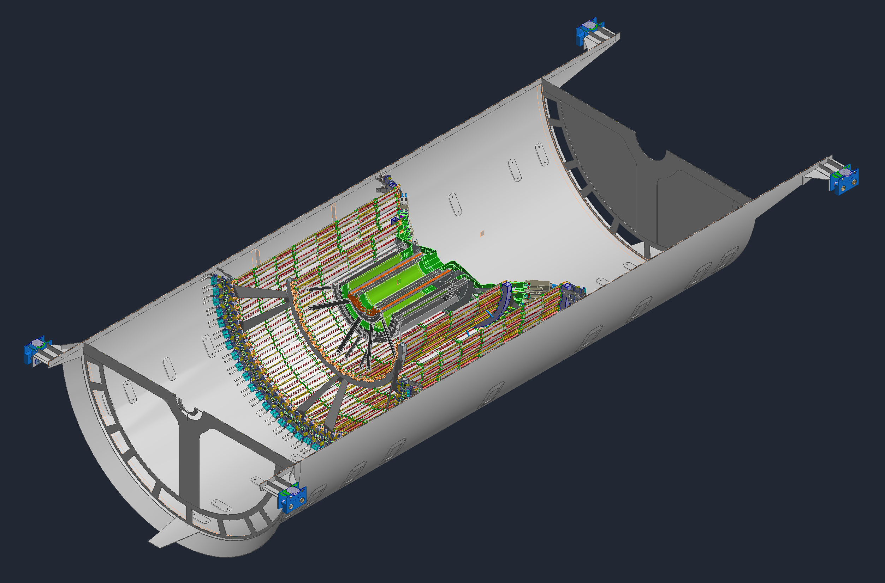
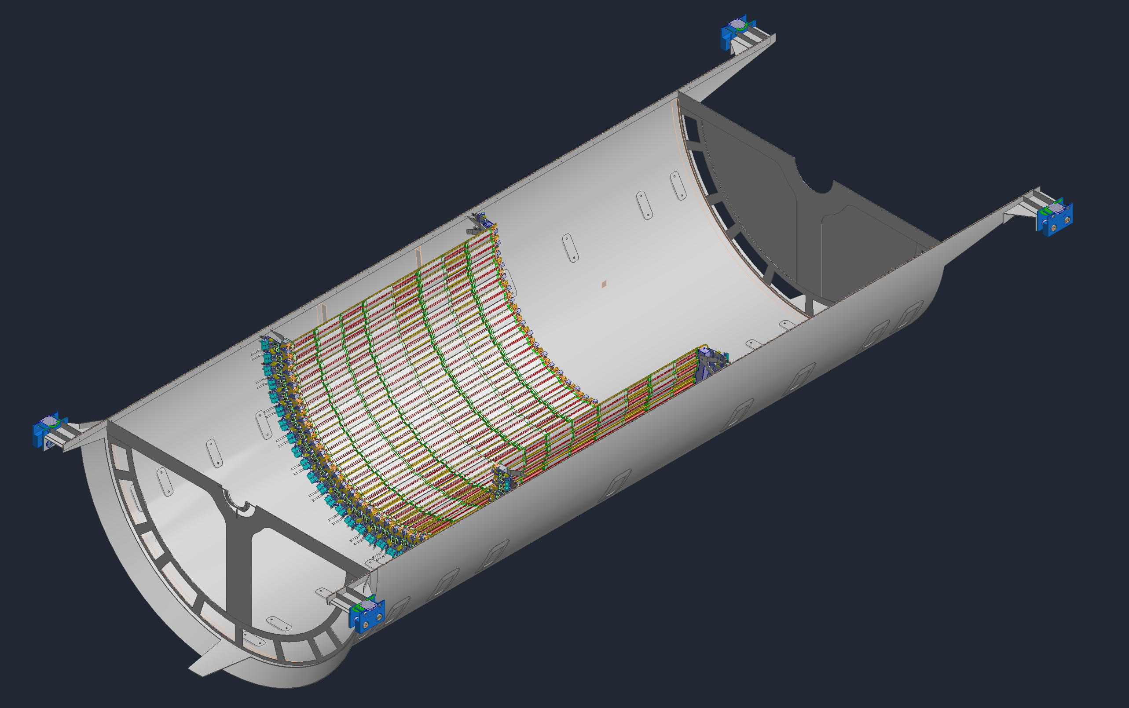
SVT Layer 4 Access Process
Uninstall the SVT disks, starting with the outer most ones, removing the services from each along the way
Uninstall the inner SVT layers, starting at L0, removing the services and supports from each along the way.
You may now access L4 from each half

Slide 11
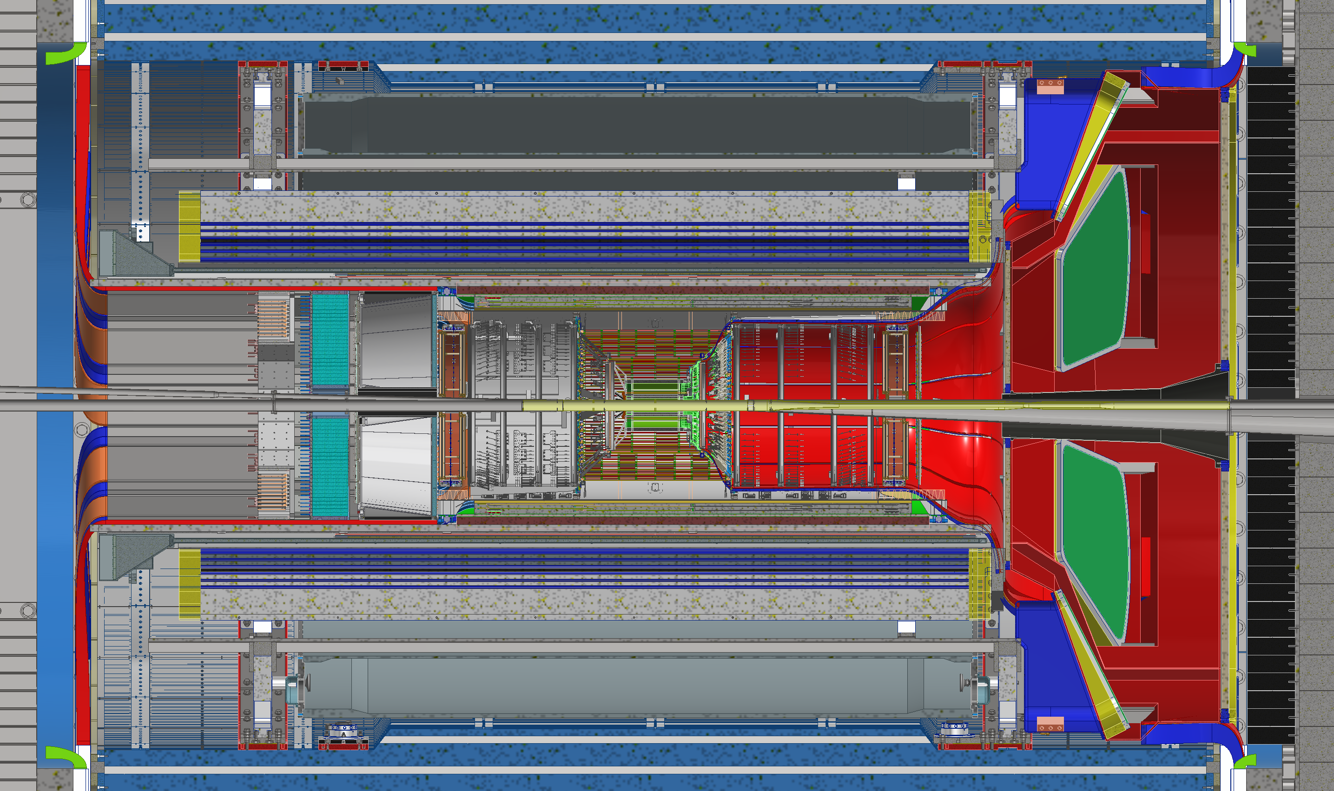
SVT Access Process
Basic steps
Steps 1 through 16 on the previous slides all apply to get access to anything inside the PST
Summary:
Remove and de-cable all the detectors inside the GST, and the dRICH
Remove and de-cable the PST
Split the PST
Remove the beampipe
Gain access

Slide 12
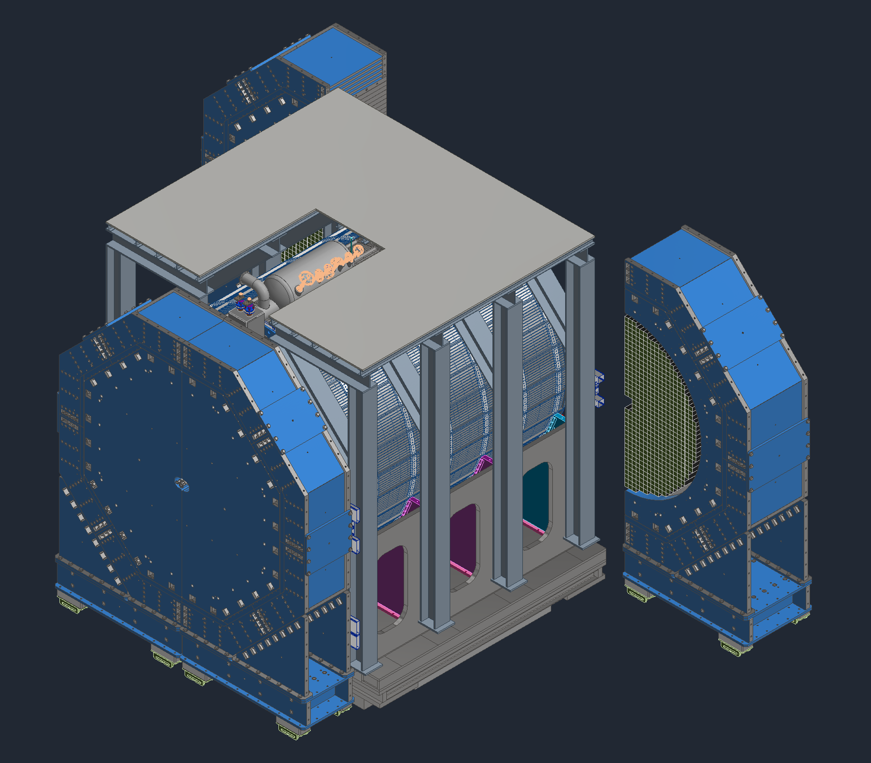
fEMCal Access Process
Open the forward Endcaps
Get access to the fEMCal from the North and South Platforms
  If access from the platforms is too limited:
  Investigating the rails can extended to the far north and south ends of the hall to allow for access
  Alternatively, the barrel detector will need to be rolled out into the assembly hall.

Slide 13
Summary: Pros & Cons for both Options
SVT Layer 4 |  | fEMCal
Pros | Cons | Pros | Cons
Dummy staves can be installed initially such that the SVT support structure can remain the same | Requires major disassembly of the EPIC detector | Can add EMCal blocks in waves over the years or in one standard 6-month shutdown | May require the detector to be rolled out into the assembly hall to get access
 | Requires major de-cabling of ~10,000 services
 | Adding L4 will most likely require at least a full year of shutdown
 | Significant risk of breaking components during disassembly
 | Need to break vacuum
Removing 2 -3 disks needs step 1 to 16 and an extend shutdown 9 to 12 month

Slide 14
Need Your Help to take a Decision
Need to understand the science impact of different mitigation strategies
Only 50% of fECal:
  overall science impact
  how does one want to distribute the 50% left right, top bottom or in rings around the beam pipe
  during the early science years can the lfHCal be used for photon, π⁰ and electron detection in the region without fECal, of course with reduced performance
No SVT Layer-4 and one MAPS disk less
  which disk to remove
  impact on tracking performance and background rejection
Keep L4, but remove 2-3 Si-disks
  which disks to remove
  impact on tracking performance and background rejection
  Please help us to find the mitigation with the smallest science impact

Slide 15


