Slide 1

Spokesperson’s Introduction
John Lajoie, Silvia Dalla Torre
August 14, 2026

Slide 2
Hey John, start the recording….

Slide 3
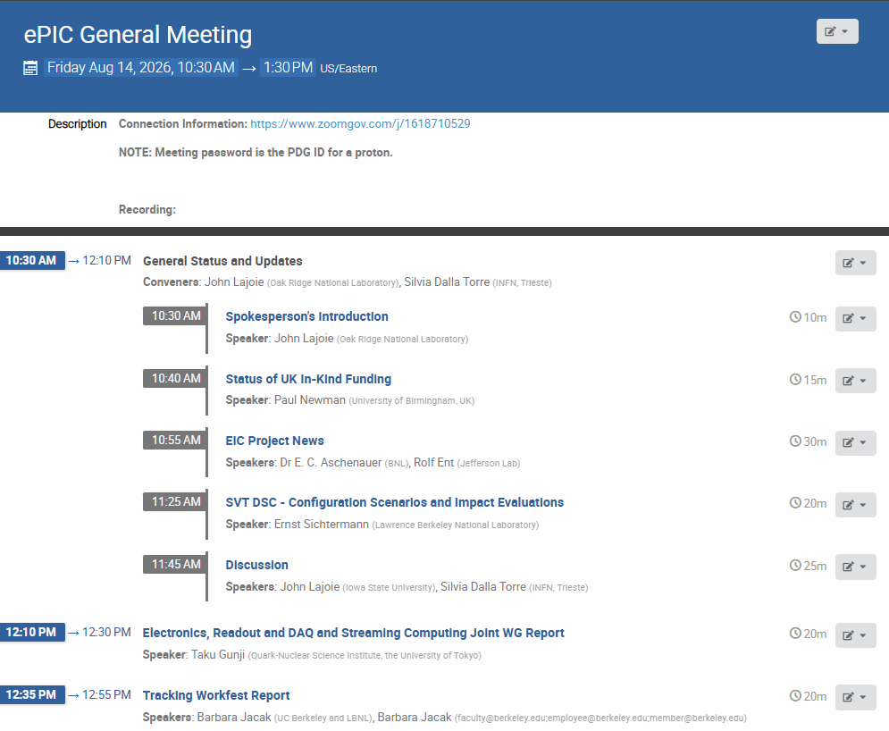
Agenda
Collaboration update on important issues surrounding UK funding.
Workfest summaries.

Slide 4
Main Reason for this General Meeting
Recall that earlier this year UKRI funding for several projects was withdrawn (including the ePIC SVT).
  While this mostly affected hardware contributions, there was a hope that support for UK personnel working on the SVT could be recovered.
At the collaboration meeting it became clear that UK support for personnel through STFC was unlikely.
  In the intervening time there were efforts to find alternatives, and time was needed to notify the RRB and DOE.
  This affects the UK in-kind contributions, not research support.
This places additional cost burdens on the EIC project detector.
The purpose of this General Meeting is to:
  Communicate and discuss the scope of the problem as well as new opportunities.
  Discuss options and the strategy to evaluate those options.
  Help the EIC project prepare to discuss this challenge at the upcoming OPA review.

Slide 5
Important Principles
We do not rush important decisions. The collaboration is responsible for evaluating the physics impact and forming conclusions.
  However, we should proceed efficiently and come to crisp conclusions.
In the coming days follow-up studies will be organized by the Technical and Physics and Analysis Coordinators.

Slide 6


Slide 7

ePIC Resources
Public Website - https://www.bnl.gov/eic/epic.php
Mailing Lists – https://lists.bnl.gov/mailman/listinfo
Indico Agenda - https://indico.bnl.gov/category/402/
  ePIC Software and Computing: https://indico.bnl.gov/category/435/
Wiki - https://wiki.bnl.gov/EPIC
ePIC Software Training:
  Landing Page: https://eic.github.io/documentation/landingpage.html
  Tutorials: https://eic.github.io/documentation/tutorials.html
Mattermost: https://chat.epic-eic.org
ePIC Zenodo Community: https://zenodo.org/communities/epic

Slide 8


EICUG Membership
The EICUG is a vital organization to promote the interests of the EIC community!
  Without the EICUG we would never have gotten far enough to form ePIC!
Please register your institution!
Check with your EICUG IB representative to get registered as a member
https://www.eicug.org/content/join.html

Slide 9
How to register a team at CERN for
The starting point is the CERN secretariat (info.recognized-experiments@cern.ch), tell them that you want to establish a new team under RE47 (ePIC).
They will send you a form that requires signatures from a team leader and deputy team leader, and a representative from your institution’s administration.
Send the signed form to the Spokesperson for a signature
Once the completed form is registered with the secretariat, your team is formed, and the team leader can add team members, etc.

