Slide 1
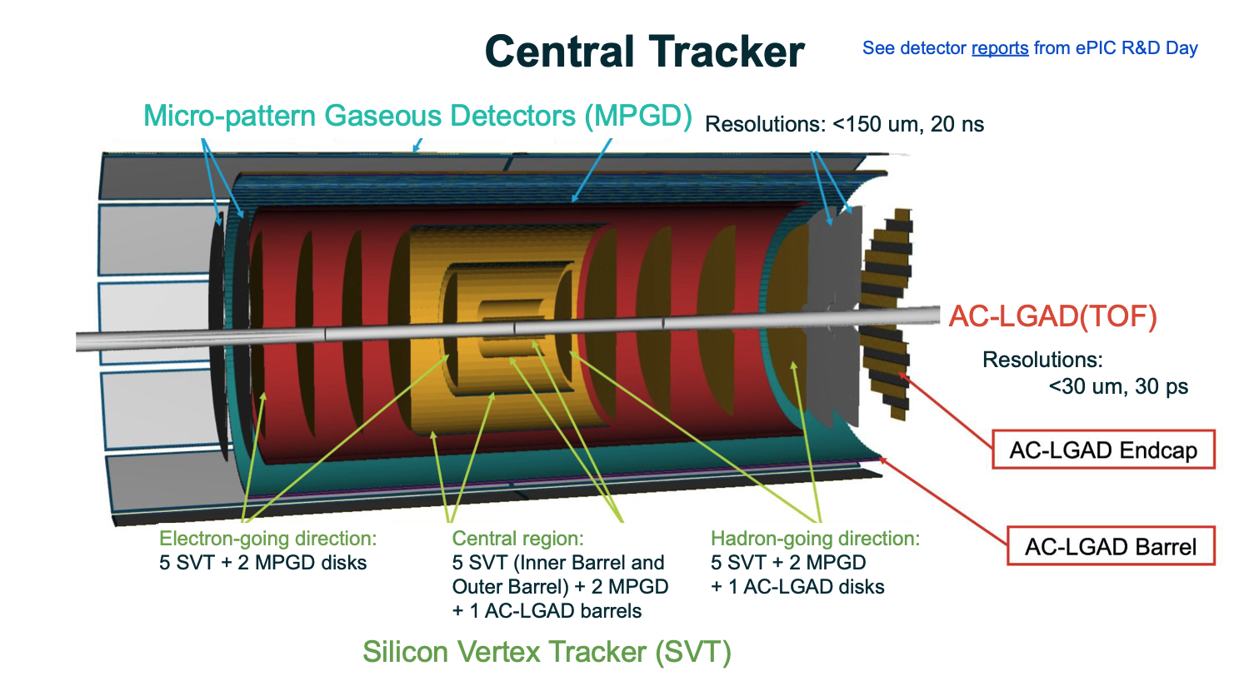
July 2026 ePIC Tracking Workfest
Barbara Jacak and Barak Schmookler
August 5, 2026

Slide 2
Agenda
MPGD: geometry, timing, efficiency, purity, resolution effects – Matt Posik
SVT noise simulation and reconstruction effects – Shuji Li
ACTS-related plans – Wouter Deconinck
TOF impact on tracking efficiency, purity, resolution – Kentaro Kawade
Muon ID with tracking + calorimetry – Alex Smith
Low-momentum particles studies and pathlength & position resolution – Barak Schmookler
Benchmark development for tracking with backgrounds – Jeetendra Gupta
Electron finding with tracking + calorimetry – Stephen Maple
Particle finders & particle flow – Derek Anderson
Next steps – Barbara, all

Slide 3
Interesting and useful workfest
Good collaborative discussion with Physics and Detector working groups!
Will keep communication to demonstrate that ePIC can do the science

Slide 4
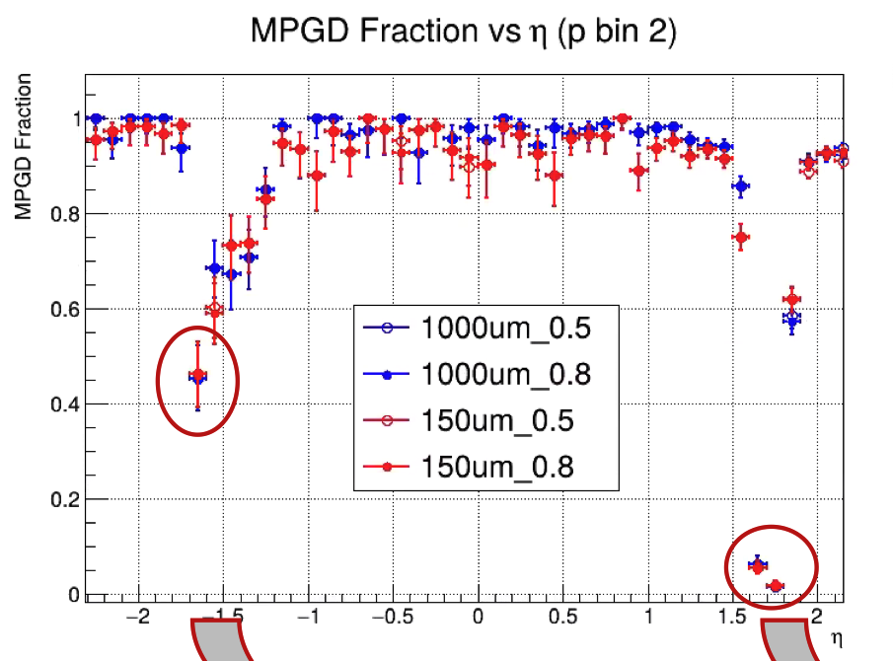
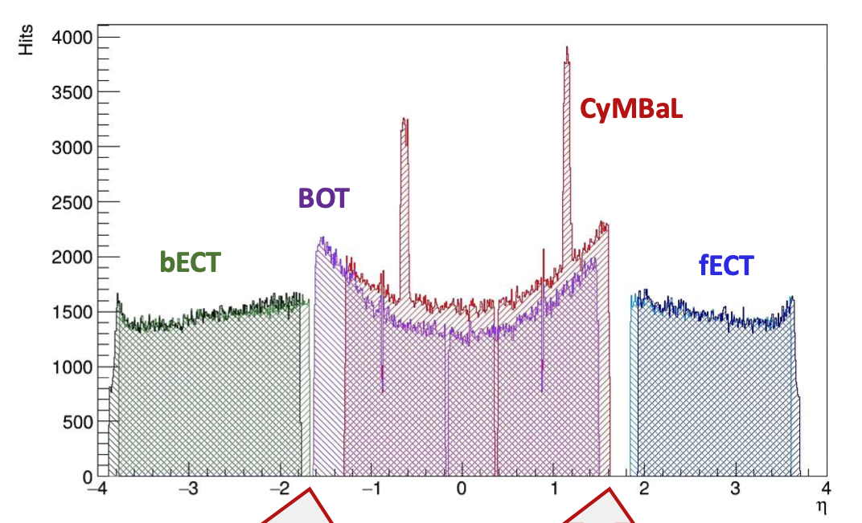
MPGD in tracking
>90% of reconstructed tracks have an MPGD hit
Helps performance at high momentum & large η
MPGD has significant acceptance holes
Matt Posik

Slide 5
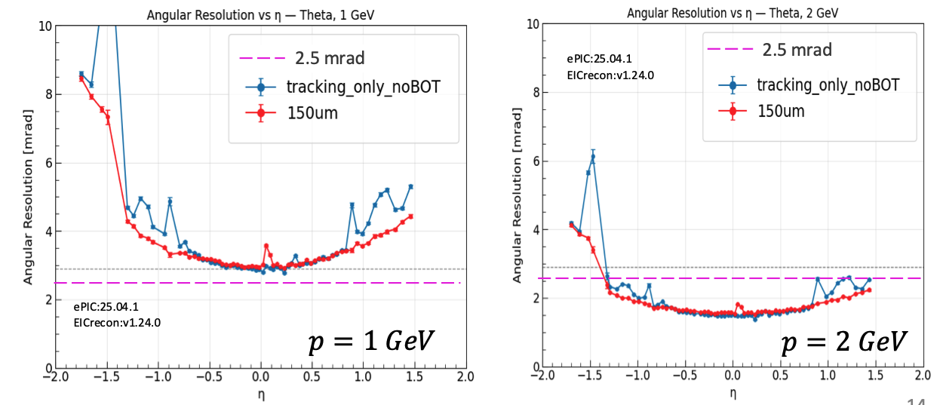
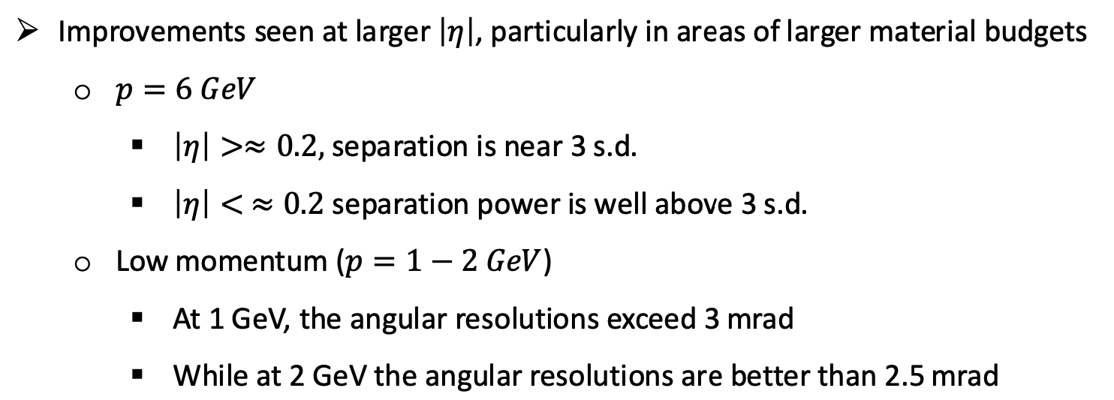
Angular resolution at hpDIRC
Matt Posik
e/π separation

Slide 6
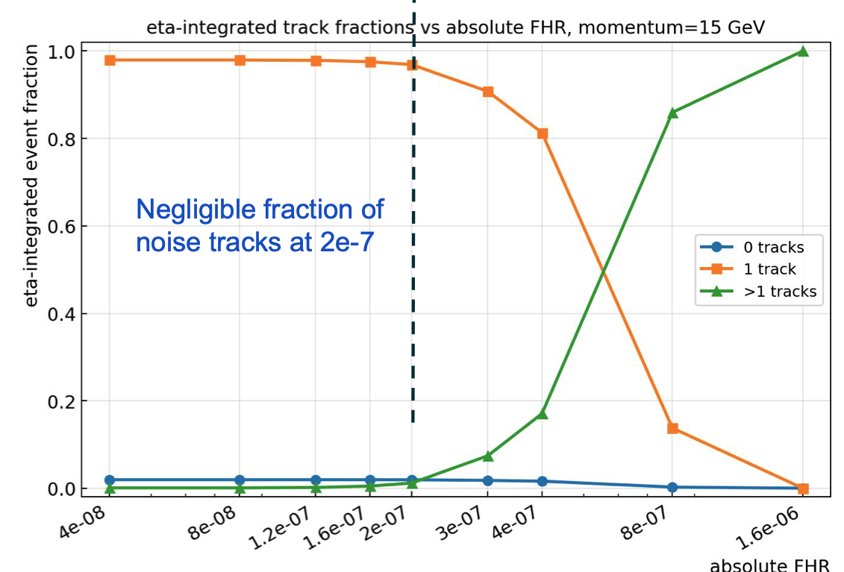
Study of noise hits in SVT
FHR =
Fake hit rate
NB: for large R layers, noise hits exceed the background hits
Shujie Li

Slide 7
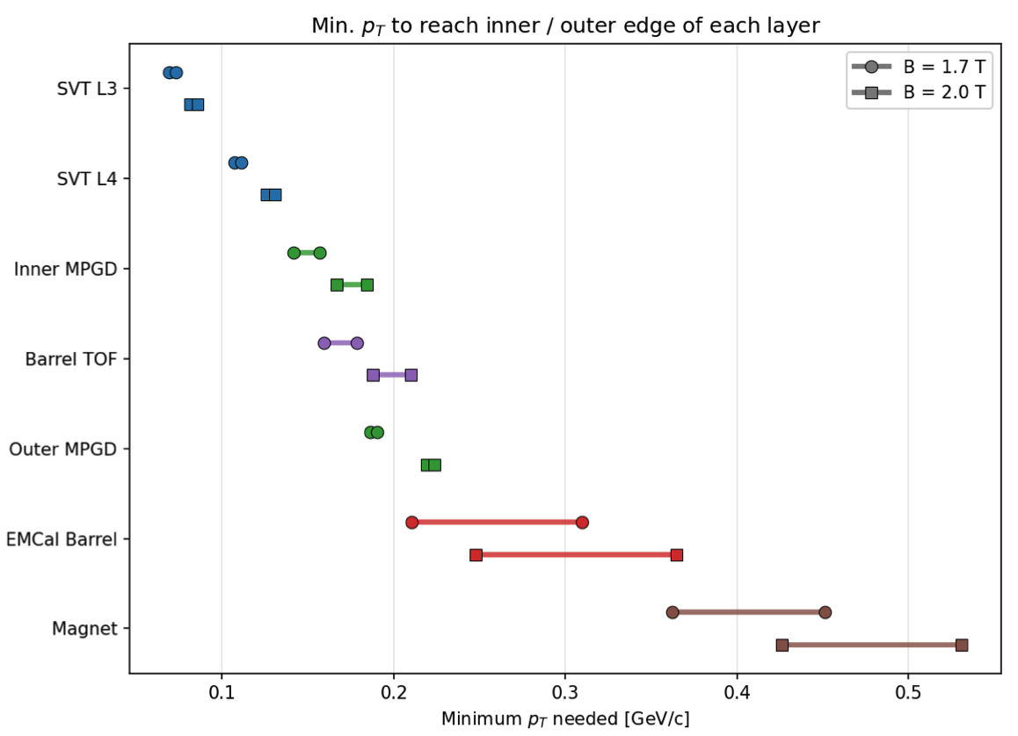
Tracking Software Plans
Need 150-200 MeV/c
to reach MPGD
Efficiency here is poor
Will test
new seeding
second tracking pass
Will also calculate pathlength uncertainty
Ignores energy loss
Minimum 4 hits per track: removes most backgrounds
Minimum 5 hits per track: track purity increases by 15%
reaches ~ 1
Barak Schmookler, Jeetendra Gupta, Austin Baty

Slide 8
ACTS-related developments
Wouter summarized numerous ACTS developments
  Some break backward compatibility
  EICrecon updates at a reasonable (not breakneck) rate
New seeding software now available (Seeding2)
  Interesting for us, for low momentum track efficiency
Geometry handling improvements
Alignment support using Millepede-II
Wouter is ePIC Liaison to ACTS
ACTS developer meetings open to all
  Tuesdays, 5pm Zurich time
Wouter Deconinck

Slide 9
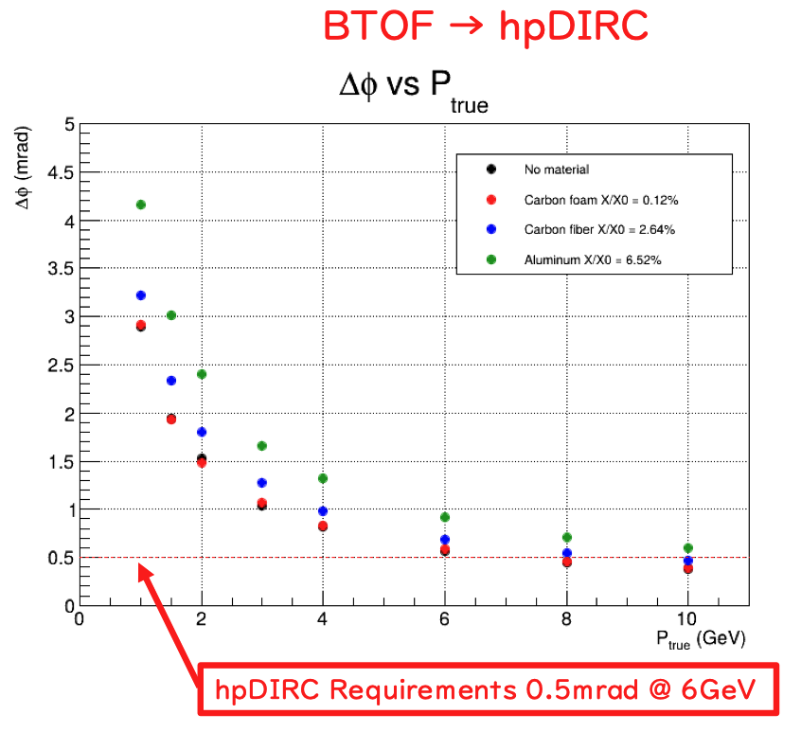
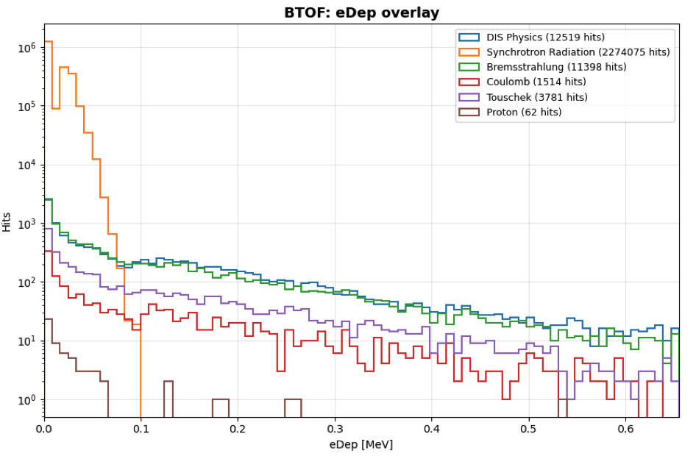
TOF and tracking
Synchrotron
radiation
Suppress with energy deposition cut
Timing cut helps somewhat, but not enough on its own
TOF material impact to degrade pointing into hpDIRC
FTOF helps momentum resolution at high momentum
BTOF position resolution in beam test ~ 8 μm!
Kentaro Kawade

Slide 10
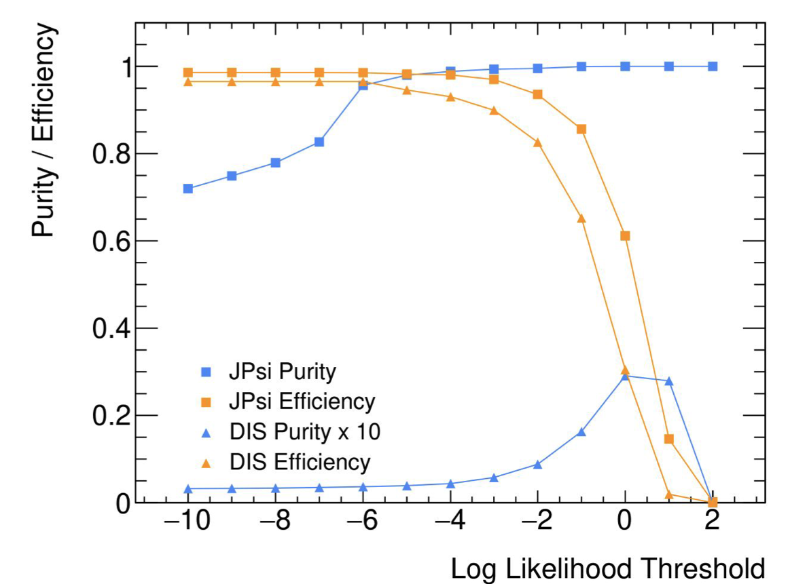
Muon ID
A challenge, since ePIC has no dedicated muon detectors outside the calorimeters
  Need good pion rejection
  Testing use of E/p and calorimeter cluster size
Other info & cuts, boosted decision trees to be studied
midrapidity
Alex Smith

Slide 11
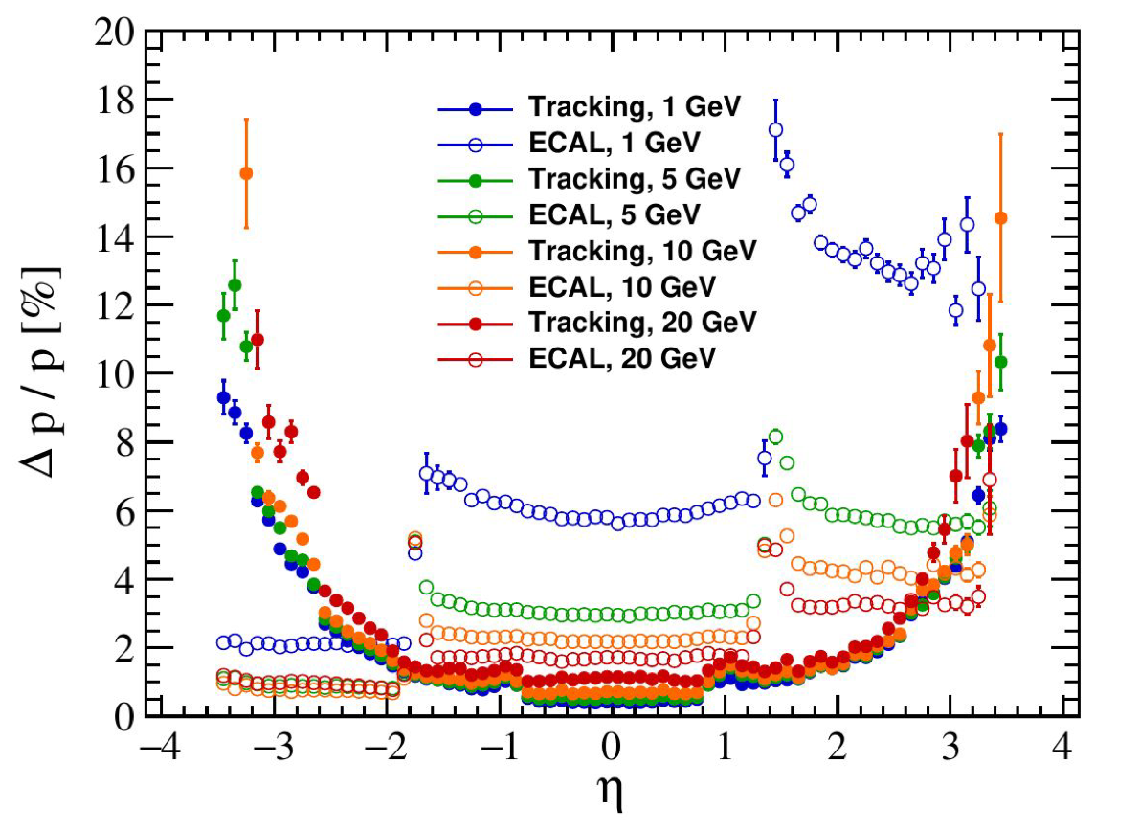
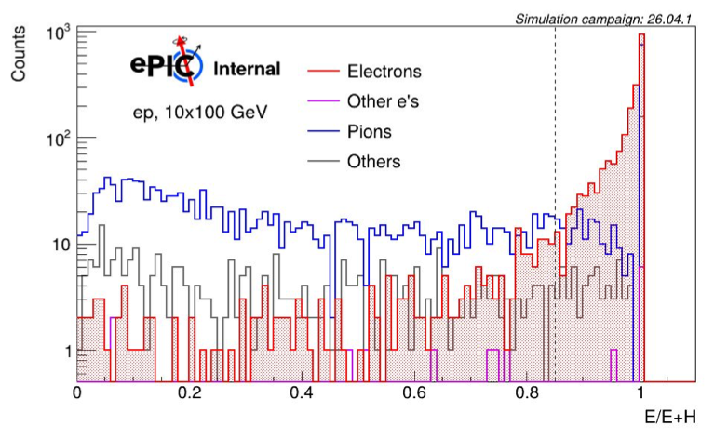
Electron ID
For pion rejection:
Use E/p
+ Ecal/Ecal+Hcal
+ RICH
+ …
For DIS electrons:
Identify the electrons
Cut on E-P_{z}
isolation, etc.
Stephen Maple & Win Lin

Slide 12
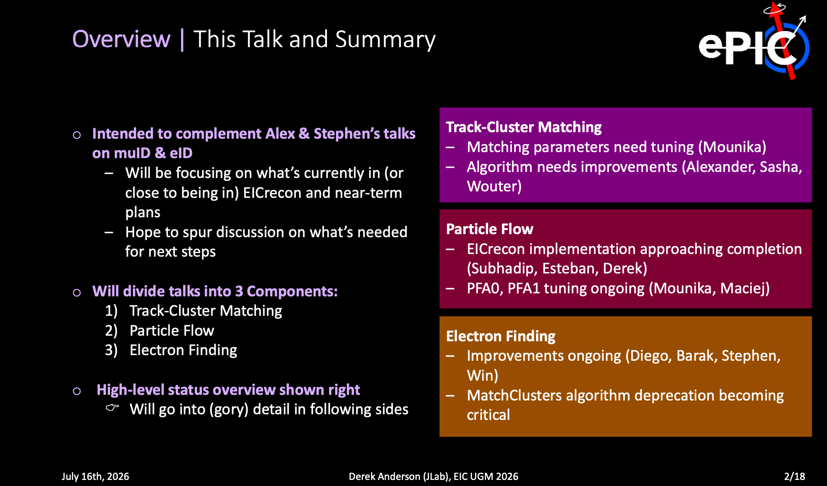

Slide 13
Action items
1. finish implementing BIC hits into tracking
Barak, with help from Wouter
2. add BIC to Matt's angular resolution studies
Matt or someone from PID PWG?
3. repeat physics performance studies with realistic MPGD resolutions.
Will this come automatically from future simulation campaigns?
Is the MPGD resolution now properly implemented in the software?
Shujie & Barak to include this in the automated workflow
4. plot chi-square distributions from events with noise hits; tune chi-square cut
low priority as Shujie already used expected upper limit
5. optimize seeding for low momentum & transition regions
Vassu; using seeding2 by switching the flag
6. check improvement from second pass of seeding & tracking for low momentum particles
who can do this?
7. check DIRC-track match (Derek is working on track-cluster matching, so should include this)

Slide 14
Action items, page 2
8. debug tracking benchmarks & implement additional features to find performance changes (i.e. are resolutions OK?)
Ask Dmitry about adding automated regression testing
9. check, fix, optimize primary vertex reconstruction & its implementation
Currently 3D fit w/o crossing angle in the beam constraint; some
hadron offset remains after crab cavities. Low priority for now.
<10. implement crossing angle into primary vertex reconstruction>
Who? Initially was Joe Osborne + student working on benchmarks
11. update TOF information in simulation software to include TOF position and timing resolutions (TOF group)
12. implement Ecal and Hcal mip requirements into muon ID
muon working group
13. check effect of separate layer calorimeter information in muon ID
14. repeat Shyam’s single particle studies with updated geometry and track reco
scripts for single particle studies exist. Need before August 12. who?
15. plot of electron energy resolution vs. eta using both tracking & Ecal info (Stephen Maple, with help from Barak)

Slide 15
Action items, page 3
16. Implement reconstructed tracks instead of truth tracks into particle flow algorithm
Derek Anderson
17. Finalize optimized definition of particle-to-track matching
Jeet & Barak
18. Remove L4 from the geometry and evaluate efficiency, purity and resolution for DIS events including background
Start by keeping everything else untouched; needed by August 11
Shujie
19. Reduce the number of silicon disks in the hadron direction by 1 and evaluate performance impact
Shujie

