Slide 1
Summary of MPGD beam test campaign at CERN SPS
Kondo Gnanvo On behalf of MPGD-DSC
ePIC TIC Meeting, August 24, 2026

Slide 2
Outline
MPGD-BOT in 2026 DRD1 Beam Test @ the CERN SPS H4 Beam Line
MPGD ENDCAP Trackers (ECT) for ePIC - Test Beam 2026 @H4 CERN

Slide 3
ePIC MPGD Barrel Outer Tracker (MPGD-BOT)
MPGD-BOT in 2026 DRD1 Beam Test @ the CERN SPS H4 Beam Line (sort of…)
Crew @ 2026 DRD1 beam test
JLab: Xinzhan Bai, Kondo Gnanvo, Seung Joon Lee, John McKisson, Surabhi Tarafdar
UVa: Jacob McMurtry, Huong Nguyen
ePIC TIC Meeting, August 24, 2026

Slide 4
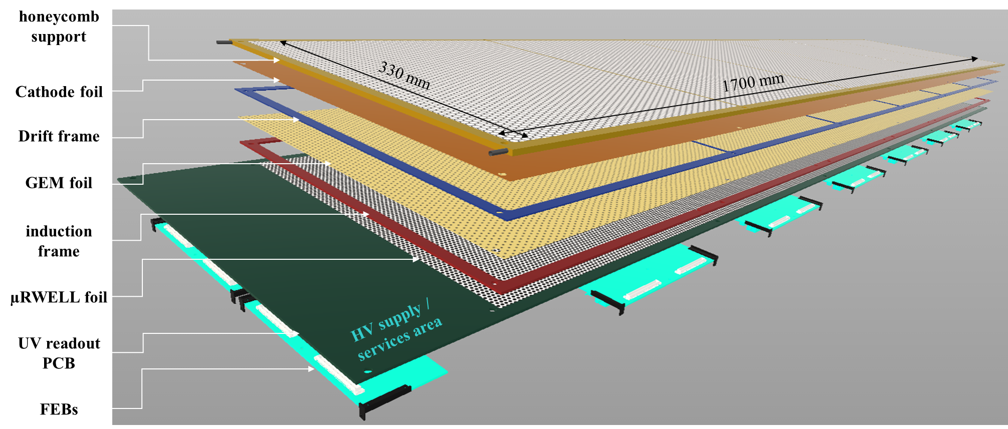
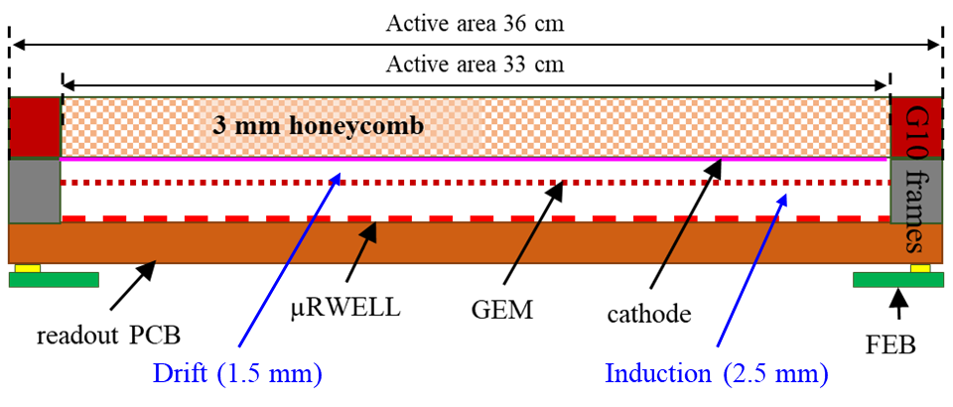
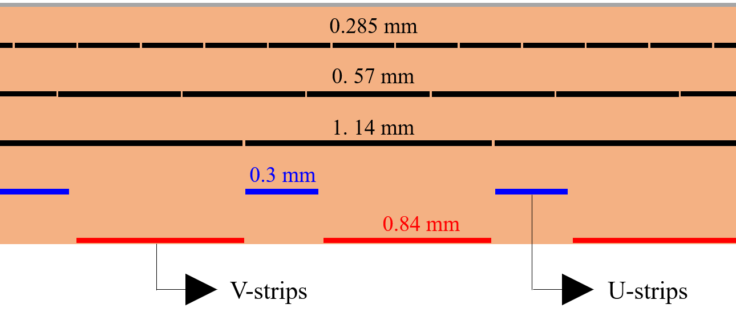

ePIC Gaseous Barrel Outer Tracker (MPGD-BOT): Thin Gap GEM-μRWELL Hybrid
MPGD-BOT module:
Technology: Thin-gap GEM-µRWELL hybrid detector
Active area: 1700 mm × 330 mm
Double amplification: hybrid GEM & μRWELL
Gas gaps: drift gap: 1.5 mm & transfer gap: 2.5 mm
Readout plane: Capacitive-sharing 2D strips readout
  X & Y strips rotated 45º strip pitch = 0.8 mm
Readout electronics:
Front End Boards (FEBs) based on SALSA chips
14 FEBs / module (4 SALSA chips i.e 256 e-ch / FEB)
CAD design of the MPGD-BOT module
Cross section view of thin-gap GEM-μRWELL
Capacitive-sharing U-V strip readout – baseline design
1.14 mm
V-Strips
U-Strips
0.8 mm
90º
https://doi.org/10.1016/j.nima.2022.167782

Slide 5
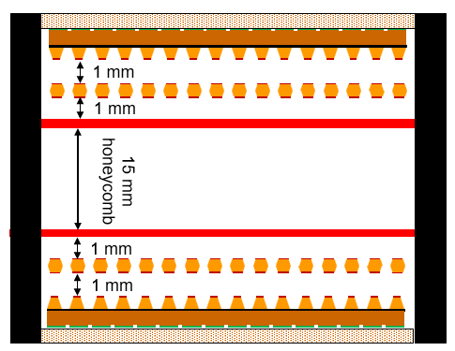
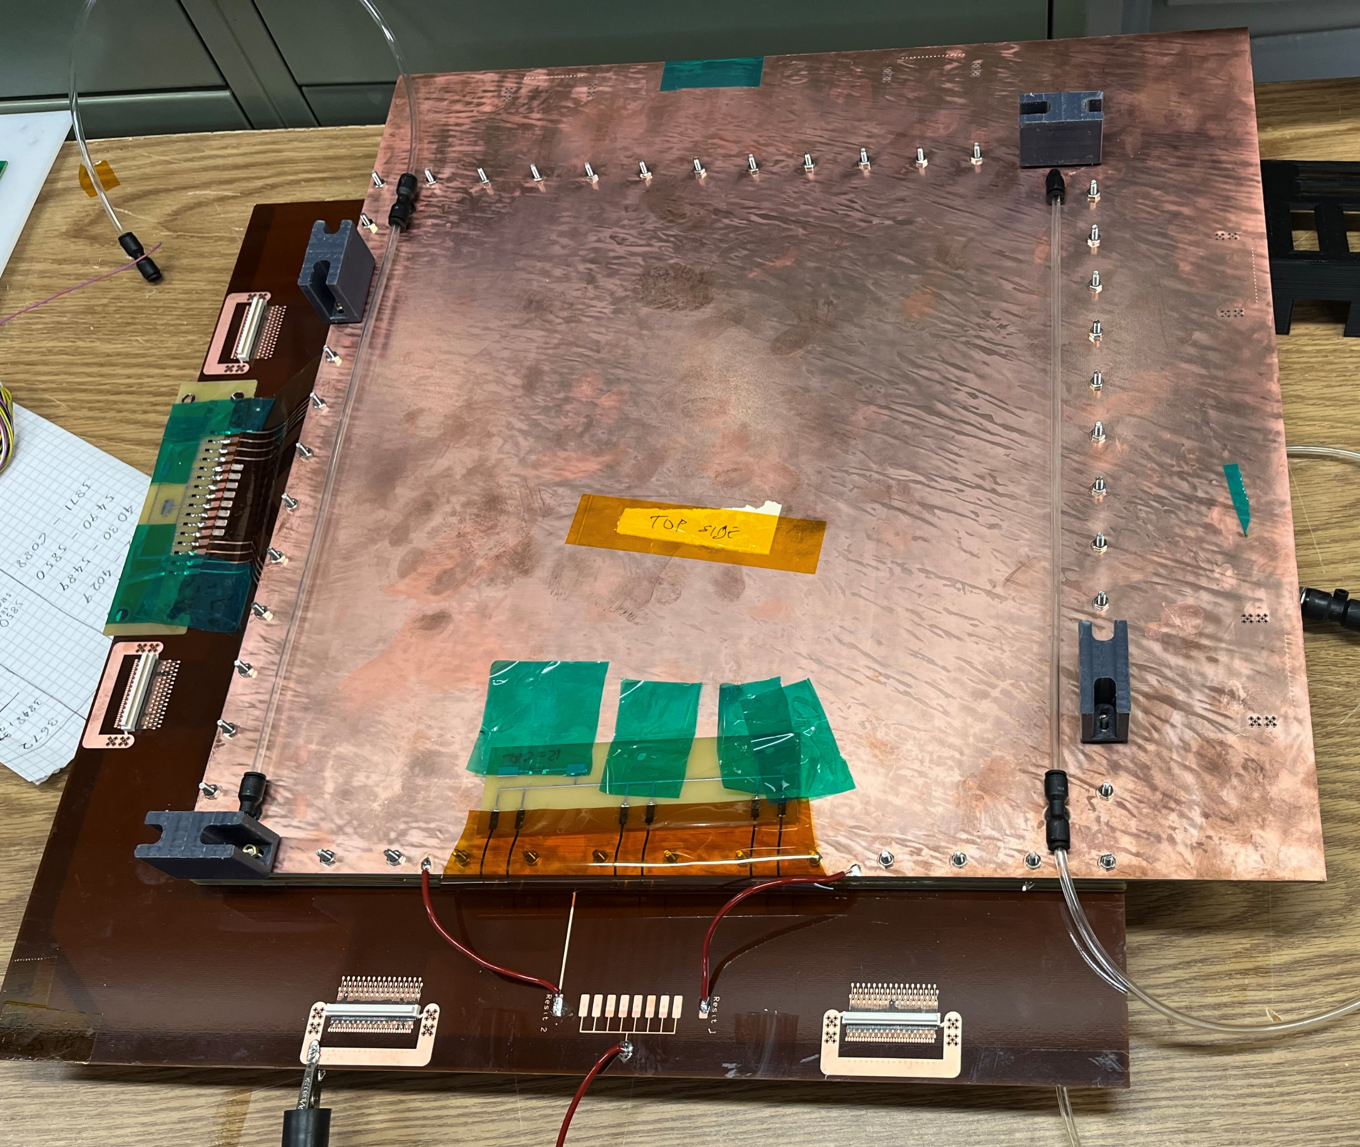
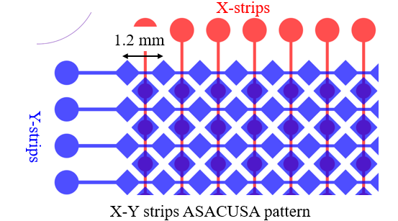
Development of Double Thin Gap GEM-μRWELL Hybrid Detectors (DTGH)
EIC Generic Detector R&D Program: https://wiki.bnl.gov/eic/index.php?title=File:20230714_eRD_tgMPGD_Proposal_FY23_Final.pdf
Medium size (30.72 cm x 30.72 cm) DTGH prototype: Two sensitive volume with 2D readout each sharing one gas volume
Detector sensitive volume: hybrid GEM & μRWELL amplification with 1 mm drift gap & 2 mm transfer gap
2D readout strips: 1.2 mm pitch 256 X-strips and 256 Y-strips ➔ Only 512 total channels for the two detectors
  Strip has ASACUSA pattern ➔ ensure de facto equal X/Y charge sharing
  3 Capacitive layers ➔ to maintain good position resolution with large pitch strip readout
307.2 mm
TOP LAYER
307.2 mm
BOT LAYER
Cross sectional view of DTG Hybrid
30 cm x 30 cm DTGH prototype

Slide 6
Synergy between DTGH prototype and ePIC MPGD-BOT test article
 | 30 × 30 DTGH prototype | ePIC MPGD-BOT module | Comment
Technology | Double thin gap GEM- μRWELL hybrid | Single thin gap GEM- μRWELL hybrid
Gap in gas volume | Drift: 1 mm – transfer: 2 mm | Drift: 1.5 mm – transfer: 2.5 mm
Active area | 307.5 mm × 307.5 mm | 1700 mm × 330 mm
2D strip readout scheme | X-Y: Pitch 1.2 mm ASACCUSA design 3 capacitive layers | X-Y: Pitch 0.8 mm COMPASS design 3 capacitive layers Strips 45^{O} w,r,t detector sides | DTGH: Larger pitch = less readout channels DTGH: ASACUSA design: de facto X / Y equal charge sharing but more challenging to manufacture
@ July Beam test | Serves as a proxy for MPGD-BOT performance study | MPGD-BOT module not ready ➔ Assembly was delayed | DTGH performance directly applicable to MPGD-BOT DTGH total active area is ~ ¼ of MPGD-BOT Good performance with ASACUSA readout will be implemented in MPGD-BOT subsequent versions

Slide 7
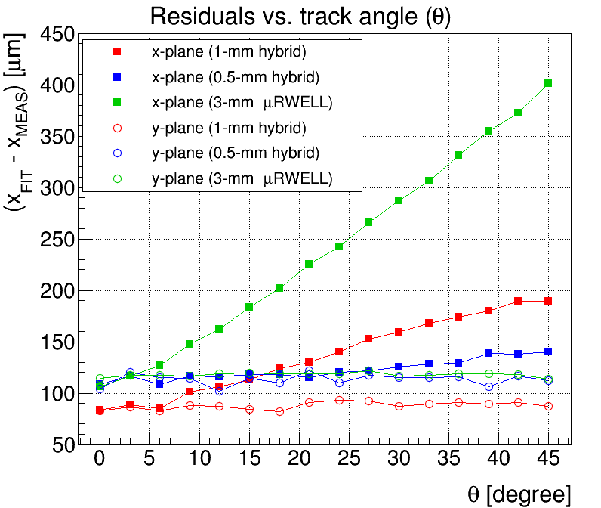
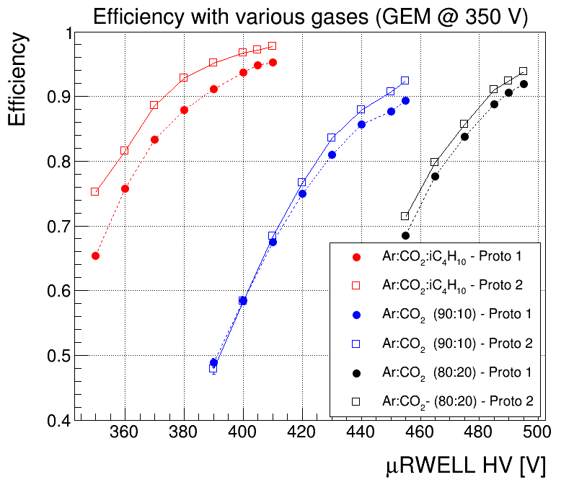
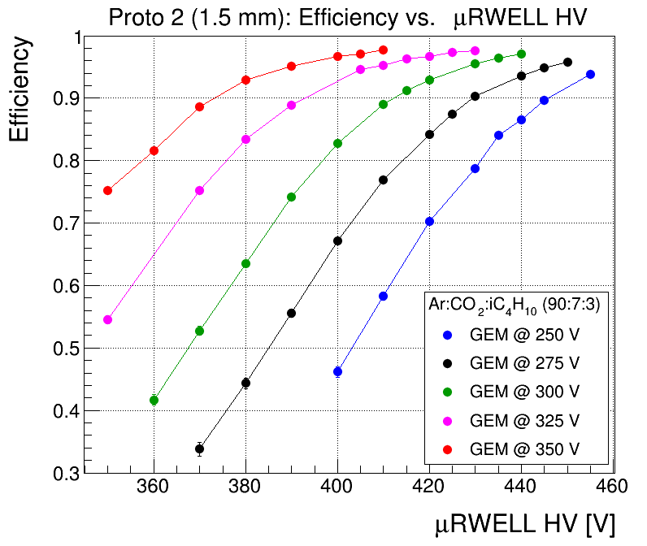
Small Thin-gap GEM-μRWELL Hybrid prototypes in past beam test
FNAL 2023 beam test results
JLab 2025 beam test with small prototypes
Significant improvement of spatial resolution for large angle tracks with thin-gap GEM-μRWELL hybrid detector
Proto-1 (1-mm) proto 2 (1.5 mm) gap
With Ar:CO₂:C₄H₁₀ , full efficiency is achieved at lower voltages on both GEM and μRWELL
Hybrid GEM & μRWELL allows flexibility on operation working point
Full efficiency reached at different GEM & μRWELL HVs combination
Ar:CO₂:C₄H₁₀
Ar:CO₂ 90:10
Ar:CO₂ 80:20
PRELIMINARY
PRELIMINARY
Ar:CO₂:C₄H₁₀
Position resolution vs. track angle
https://doi.org/10.1016/j.nima.2025.170791
Efficiency vs. HV for different gas mixtures
Efficiency vs. HV with Ar:CO₂:C4H₁₀

Slide 8
DTGH setup in GOLIATH Magnet @ CERN SPS H4 – Beam test goals
  The two main motivations for DTGH prototype (aka ePIC MPGD-BOT proxy) at the July DRD1 beam test
  Performance and operation stability of Thin-Gap GEM-μRWELL detectors with Ar:CO₂:iC₄H₁₀ gas mixture
    Demonstrate that the ePIC MPGD-BOT could operate with the same gas mixture used by CyMBaL and MPGD-ECT
    Optimization of position, time resolution and efficiency through HV scans in different regions of the detector
  Study the performance and operation stability in a magnetic field up to 1.5 T field (similar to ePIC B-field)
    Dedicated runs in the GOLIATH magnet with pion beam ➔ scan from 0 to 1.5 T with different gas mixtures
  We were able to successfully complete the beam test program which includes various the HV scans, B-field scan for different gas studies during the two and half weeks of the beam test.
  Large amount of data (> 200kEvts) were collected for each data point to allow clean data analysis with small statistical error

Slide 9
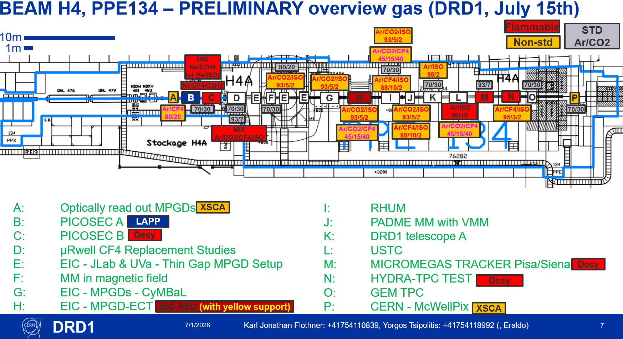
DRD1 Beam Test Layout – July 15th to August 3rd
16 setups
2 ePIC related

Slide 10
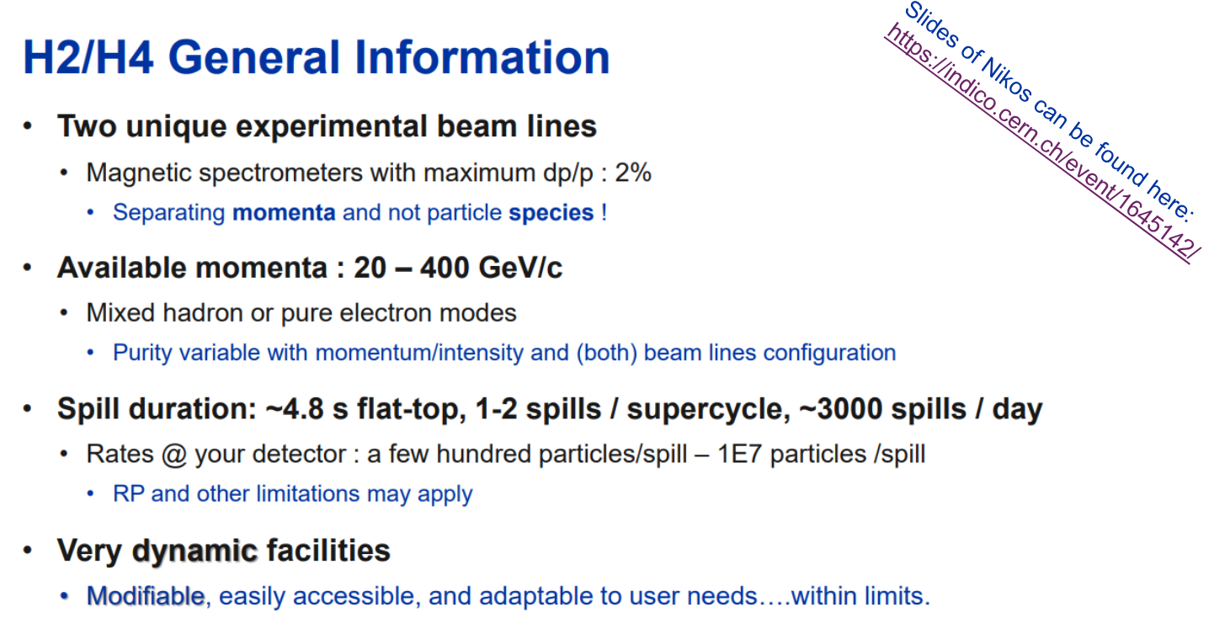
DRD1 Beam Test @ CERN SPS H4 Beam Line (PPE134): July 15th to Aug. 3rd
Contact Persons: Yorgos Tsipolitis, Karl Flöthner

Slide 11
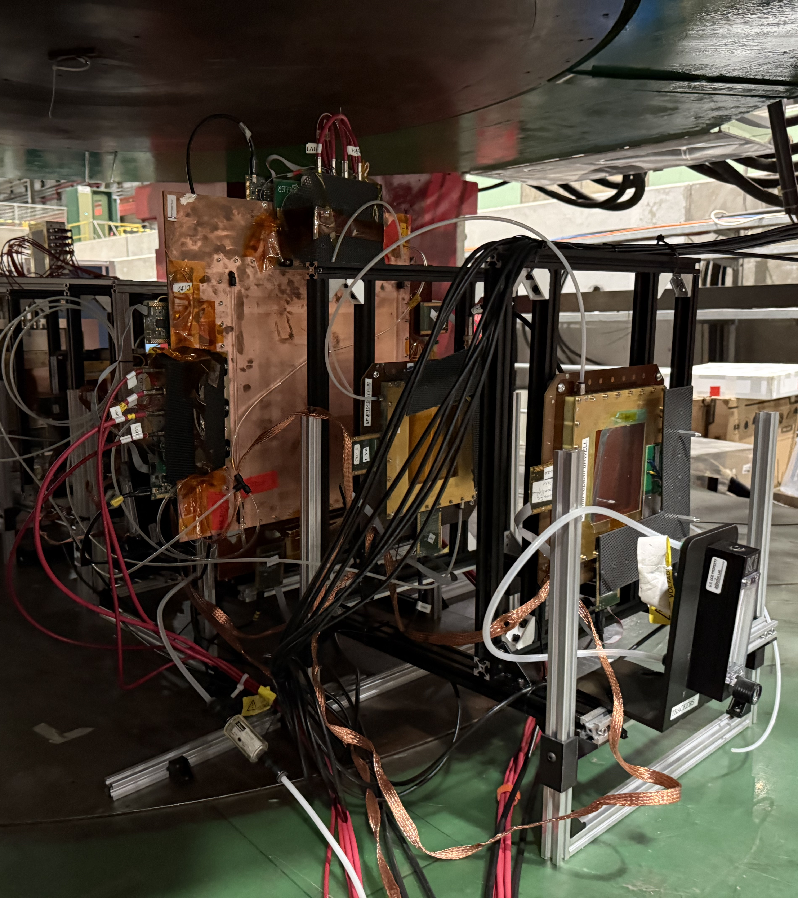
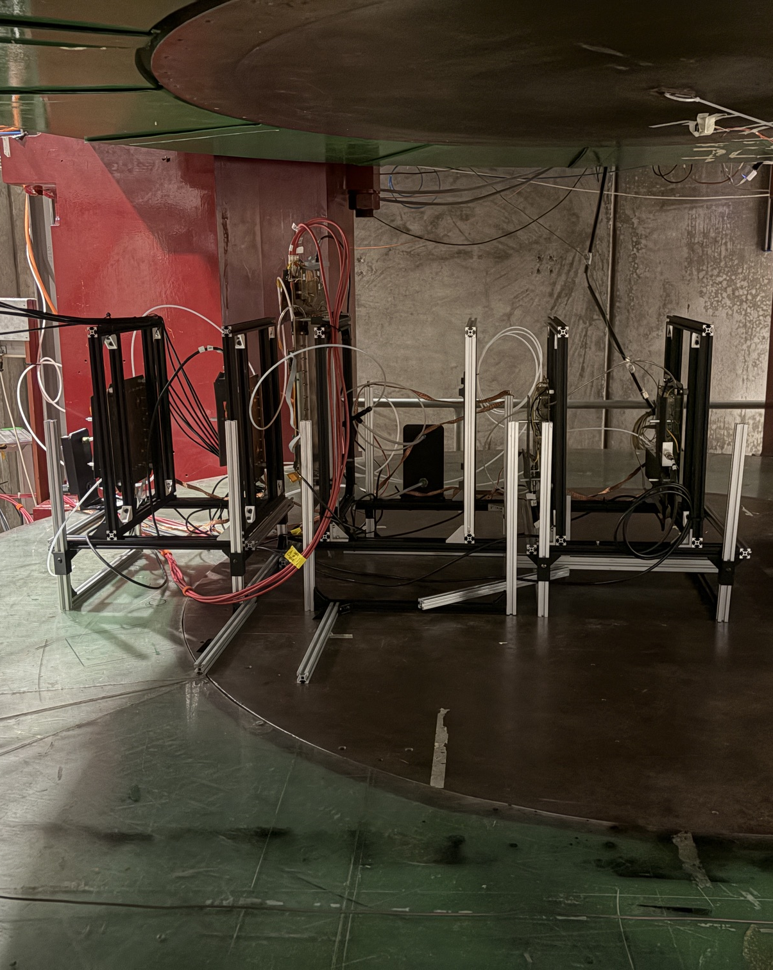
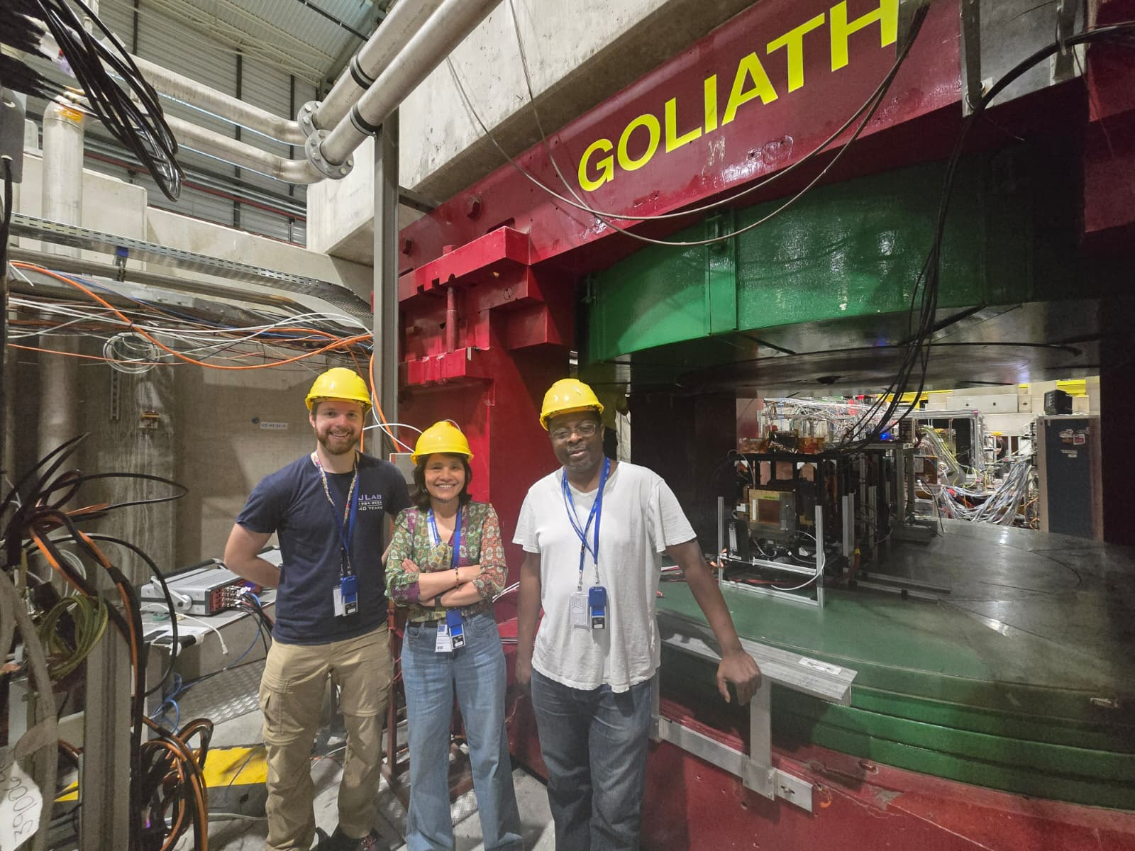
Double Thin Gap GEM-μRWELL Hybrids (DTGH) setup in GOLIATH Magnet
DUTs: DTGH prototypes
Trackers: 2 upstream & 2 downstream
  Downstream trackers: small Thin-Gap GEM-μRWELL Hybrids
APV-SRS readout + CODA (DAQ)
Ar:CO₂ (80:20) & Ar:CO₂:iC₄H₁₀ (93:5:2)
& Ar:CO₂:iC₄H₁₀ is the adopted common gas mixture by all 3 ePIC MPGD trackers
DTGH
DUT 1
DUT 2
Ref. tracker 1
Ref. tracker 2
Ref. tracker 3
Ref. tracker 4
Ref. tracker 2
Ref. tracker 1
beam
Side view

Slide 12
DTGH setup in GOLIATH Magnet - ArCO₂ (80:20) runs
https://docs.google.com/spreadsheets/d/18fzHT8VrBVvGst_2utNJ0KWm9WRms5FTCQ0ZwbAe5EM/edit?gid=18034894#gid=18034894
Date | Runs | Beam | Magnet | Comment
07 / 25 07 / 23 07 / 24 | μRWELL scan (400 V – 485 V) @ GEM 350 V μRWELL scan (380 V – 470 V) @ GEM 360 V μRWELL scan (400 V – 480 V) @ GEM 370 V | Muon | OFF | Drift field 2kV /cm; transfer field 2.5 kV / cm
07 / 20 | GEM scan (250 V – 400 V) @ μRWELL 450 V | Muon
07 / 21 | Transfer field scan 1 kV / cm – 2.5 kV / cm | Muon |  | Drift 2 kV /cm; GEM @ 360 V; μRWELL @ 460 V
07 / 22 | Drift field scan 1 kV / cm – 6 kV / cm | Muon |  | Transfer 2.5 kV /cm; GEM @ 360 V; μRWELL @ 460 V
07 / 23 | B field scan from 0 to 1T (1.5 T to be confirmed) | Pion | ON | Drift 2 kV /cm; GEM @ 360 V; μRWELL @ 460 V; Transfer @ 3 kV / cm
07 / 24 | μRWELL scan (410 V – 480 V) @ GEM 360 V μRWELL scan (410 V – 480 V) @ GEM 370 V μRWELL scan (410 V – 480 V) @ GEM 360 V | Pion | OFF | Drift field 2kV /cm; transfer field 2.5 kV / cm Drift field 2kV /cm; transfer field 3 kV / cm

Slide 13
DTGH setup in GOLIATH Magnet – Ar:CO₂:iC₄H₁₀ (93:5:2) runs
https://docs.google.com/spreadsheets/d/18fzHT8VrBVvGst_2utNJ0KWm9WRms5FTCQ0ZwbAe5EM/edit?gid=18034894#gid=18034894
Date | Runs | Beam | Magnet | Comment
07 / 25 07 / 26 07 / 27 08 / 02 | μRWELL scan (300 V – 400 V) @ GEM 325 V μRWELL scan (300 V – 400 V) @ GEM 340 V μRWELL scan (300 V – 390 V) @ GEM 350 V μRWELL scan (300 V – 420 V) @ GEM 340 V | Muon | OFF | Drift field 2kV /cm; transfer field 2.5 kV / cm Drift field 2kV /cm; transfer field 3 kV / cm
07 / 26 | Transfer field scan 1 kV / cm – 4.2 kV / cm | Muon |  | Drift 2 kV /cm; GEM @ 325 V; μRWELL @ 390 V
07 / 26 | Drift field scan 1 kV / cm – 4.2 kV / cm | Muon |  | Transfer 2.5 kV /cm; GEM @ 325 V; μRWELL @ 390 V
07/ 27 08 / 02 | GEM scan (260 V – 370 V) @ μRWELL 360 V GEM scan (260 V – 360 V) @ μRWELL 370 V GEM scan (260 V – 360 V) @ μRWELL 385 V | Muon |  | Drift field 2kV /cm; transfer field 2.5 kV / cm Drift field 2kV /cm; transfer field 3 kV / cm
07 / 27 | B field scan from 0 to 1.55 T | Pion | ON | Drift 2 kV /cm; GEM @ 340 V; μRWELL @ 490 V; Transfer @ 3 kV / cm
07 / 28 | Drift field scan 2 kV / cm – 4 kV / cm | Pion | OFF | Transfer 2.5 kV /cm; GEM @ 325 V; μRWELL1 @ 390 V and μRWELL @ 370 V

Slide 14
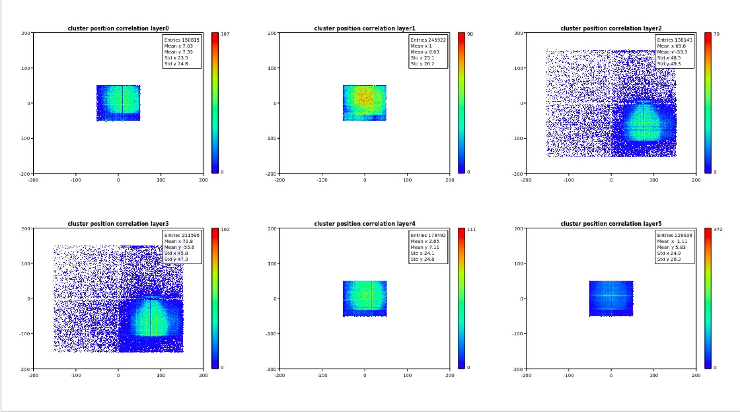
Preliminary results – 2D hit Map
DTGH2 - DLC resistivity: 40 - 55 MΩ
μRWELL hole
  Pitch = 100 µm
  OD = 70 µm
  ID = 40-50 μm
Tracker 1
Tracker 2
DTGH side 1
DTGH2
PRELIMINARY
DTGH1
DTGH1 - DLC resistivity: 70 - 95 MΩ
μRWELL hole
  Pitch = 100 µm
  OD = 70 µm
  ID = 40-50 μm
DTGH side 2
Tracker 3
Tracker 4
Reconstructed 2D muon beam profile in each detector in the setup

Slide 15
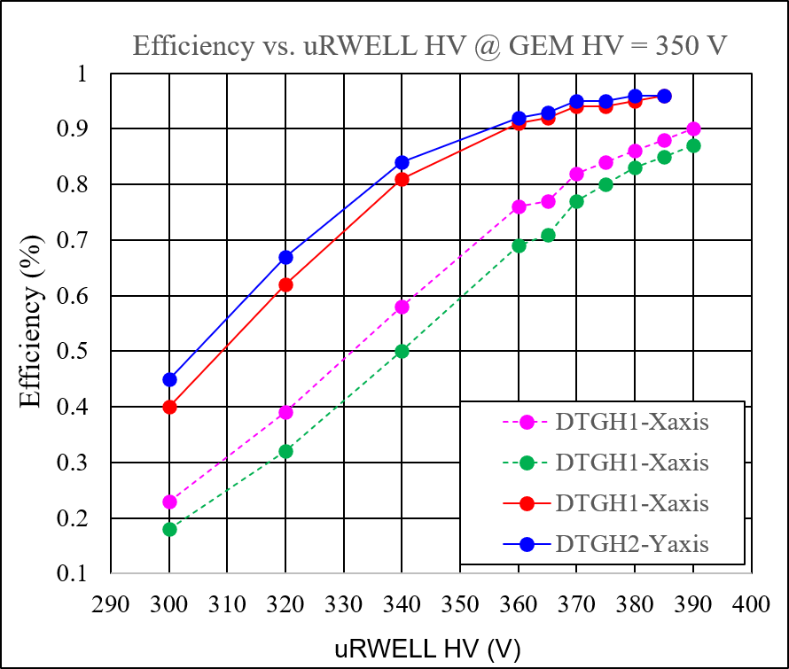
Preliminary results – Efficiency plots
DTGH2 - DLC resistivity: 40 - 55 MΩ
μRWELL hole
  Pitch = 100 µm
  OD = 70 µm
  ID = 40-50 μm
μRWELL parameters (i.e. DLC resistivity, hole parameters, thicknesses etc …) all critically impact detector performance.
This prototype has a different DLC resistivity for each side.
DTGH1 resistivity higher than DTGH2 but the two μRWELLs have the same hole parameters
Preliminary results shows that DTGH2 with lower resistivity has a significantly higher gain than DTGH1
DTGH2 efficiency ~97% while DTGH1 ~89%
DTGH2
PRELIMINARY
Ar:CO₂:iC₄H₁₀ (93:5:2)
DTGH1
DTGH1 - DLC resistivity: 70 - 95 MΩ
μRWELL hole
  Pitch = 100 µm
  OD = 70 µm
  ID = 40-50 μm

Slide 16
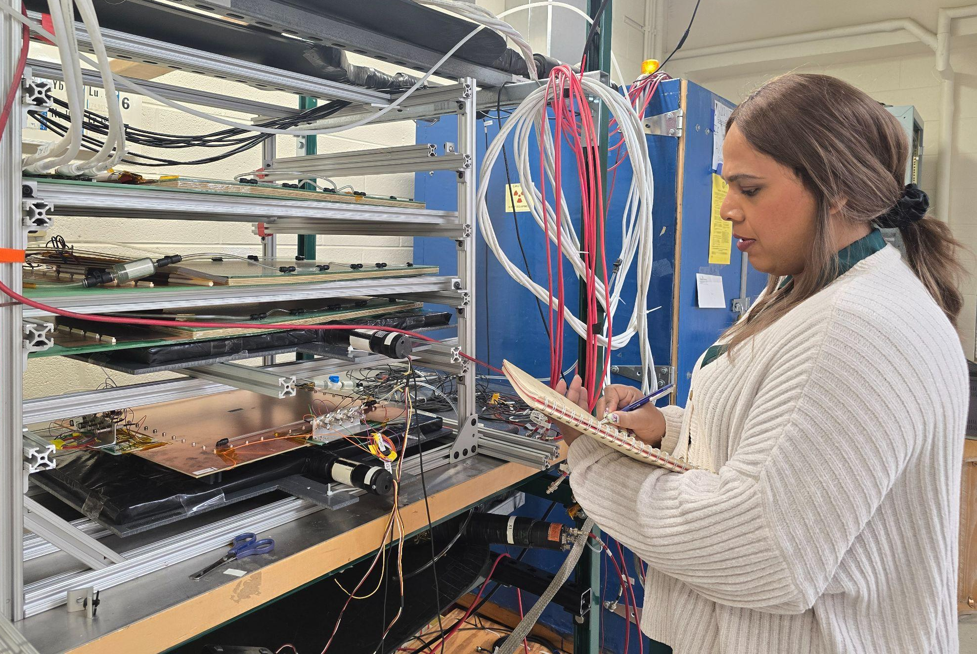

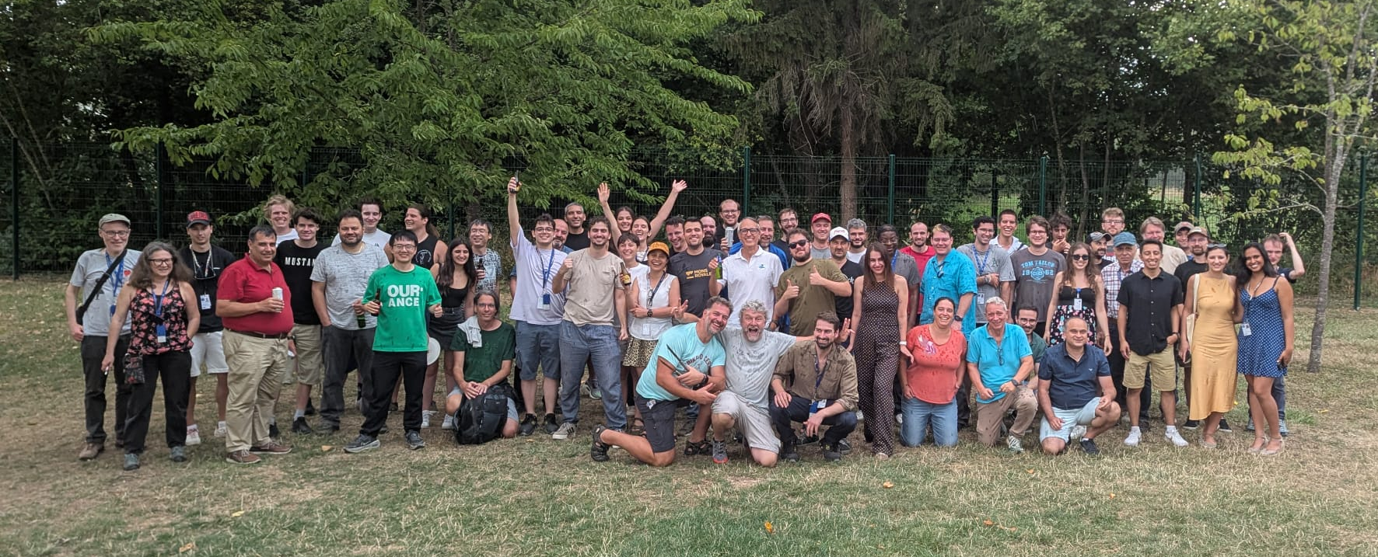
DTGH Team
Surabhi @ UVa
Kondo Jacob & Seungjoon
Jacob, Huong & Kondo
Seungjoon, Jacob, John & family, Huong & Kondo
DRD1 Group @ CERN + 16 participating groups @ End of beam test barbecue

Slide 17

MPGD ENDCAP Trackers (ECT) for ePIC
Test Beam 2026 @H4 CERN
On behalf of the ECT project group: C. Ammendola, R. Ammendola, M. Bondì, A. D’Angelo, R. Di Salvo, A. Fantini, S. Gramigna, L. Lanza, G. Nobili, E. Sidoretti, E. Tusi
In collaboration with: G. Bencivenni, M. Giovannetti, M. Poli Lener, G. Morello
Temple University: M. Posik, B. Surrow

Slide 18
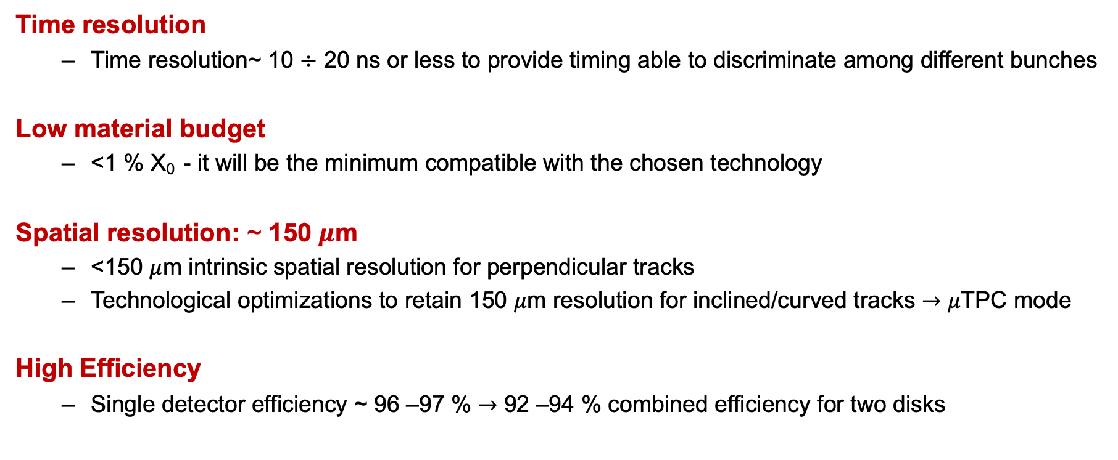
MPGD-ECT Technical Performance Requirements
Time resolution
  Time resolution~ 10 $÷$ 20 ns or less to provide timing able to discriminate among different bunches
Low material budget
  <1 % X₀ - it will be the minimum compatible with the chosen technology
Spatial resolution: ~ 150 $μ$m
  <150 $μ$m intrinsic spatial resolution for perpendicular tracks
  Technological optimizations to retain 150 $μ$m resolution for inclined/curved tracks $→$ $μ$TPC mode
High Efficiency
  Single detector efficiency ~ 96 –97 % $→$ 92 –94 % combined efficiency for two disks

Slide 19
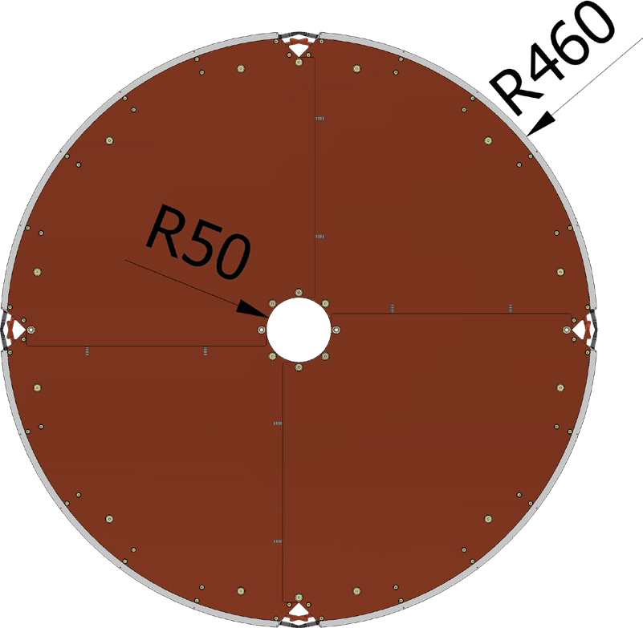
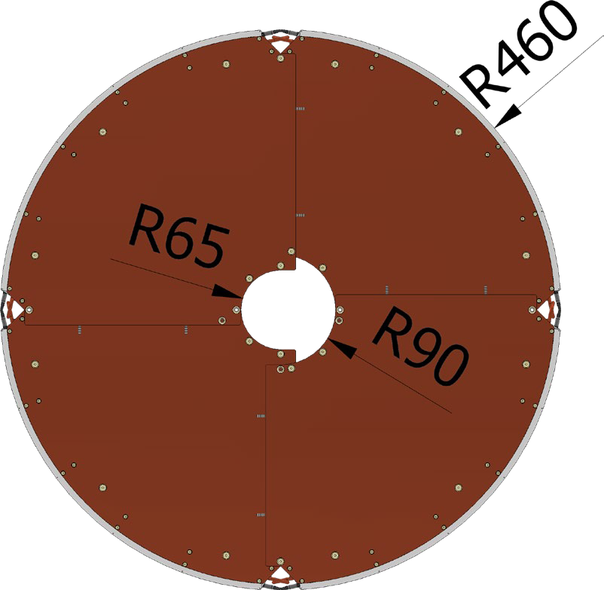
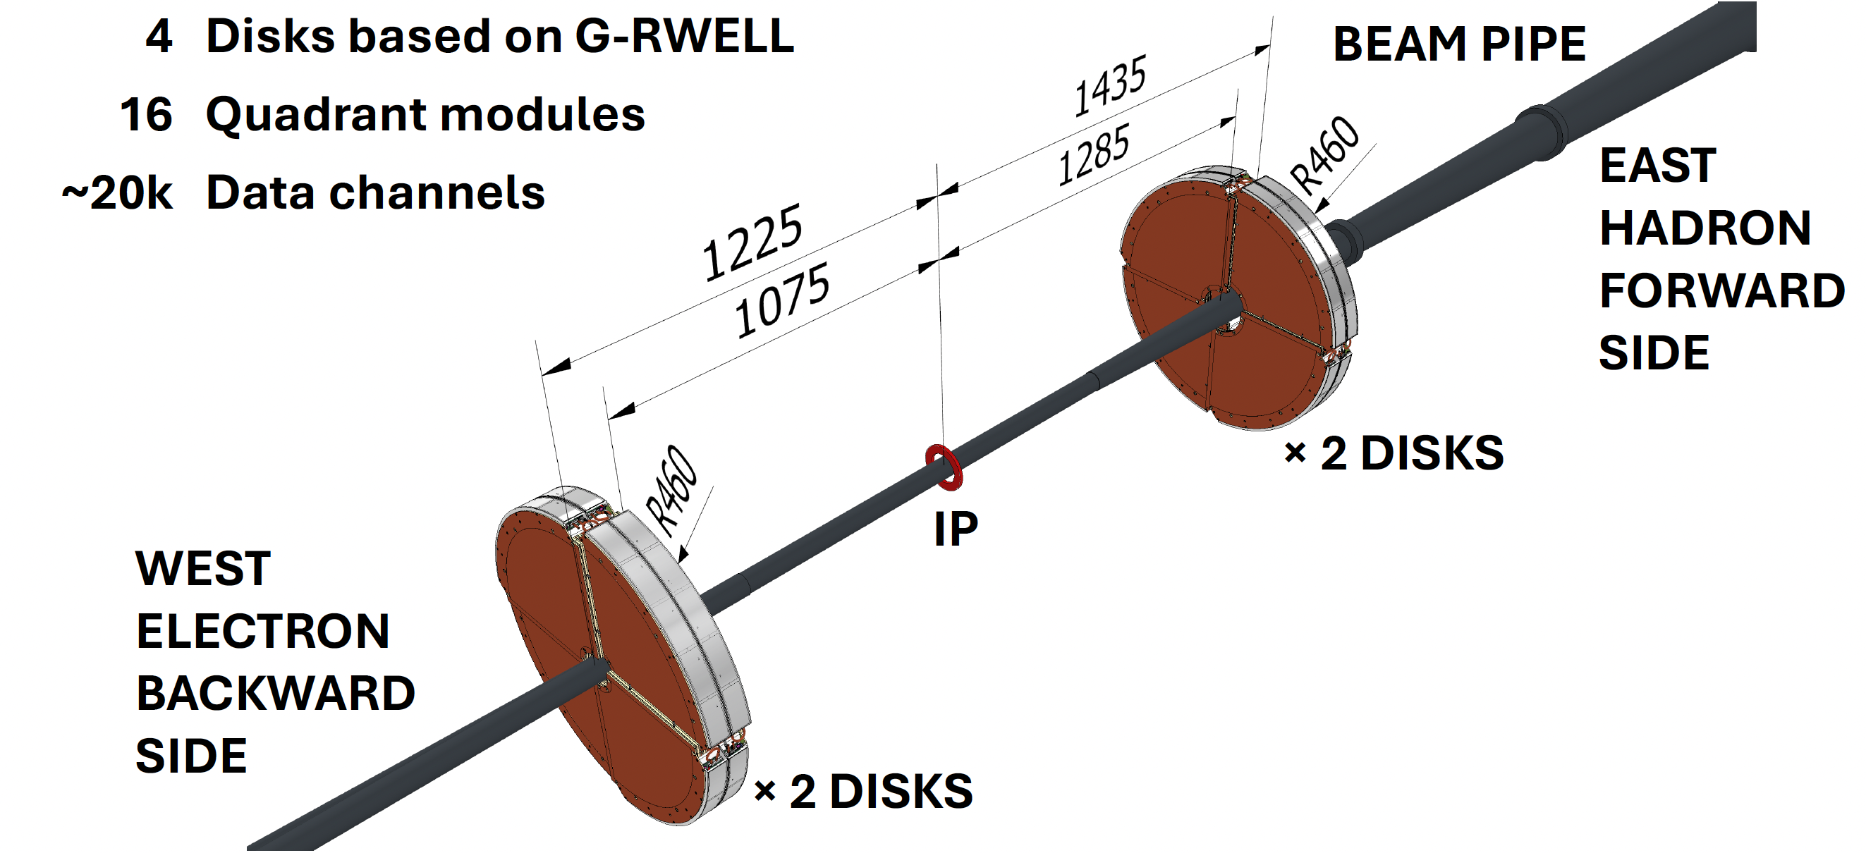
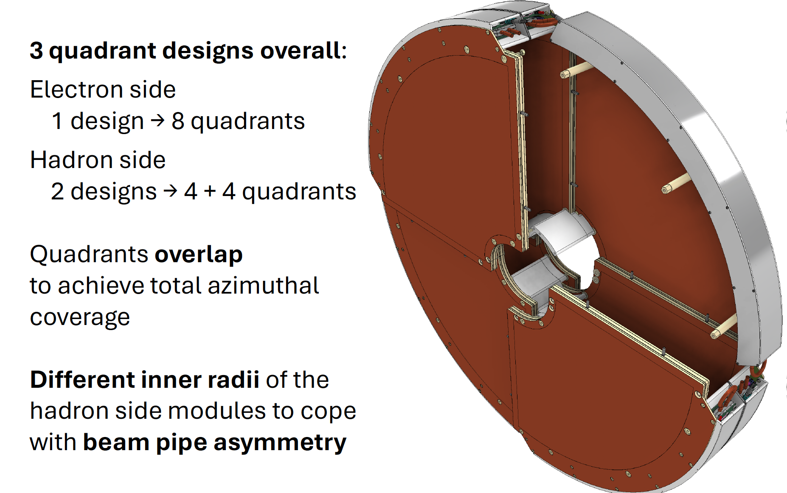
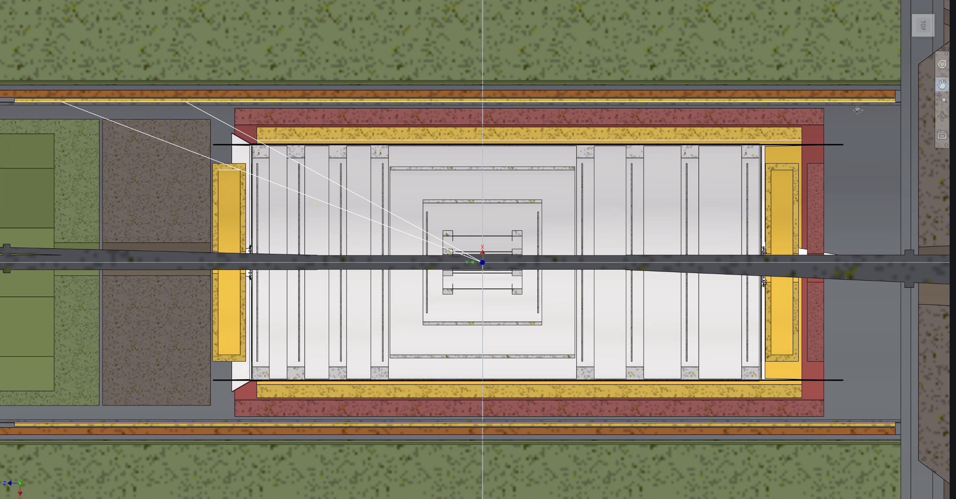
GEM-µRWELL ECT Project Update: updated geometry
Quadrants envelope updated to optimize integration
Lepton disks
Hadron disks
Hadron disks have been located closer to the IP
Outer radius has been reduced: 50 cm to 46 cm to leave space for SVT services
By Stefano Gramigna

Slide 20
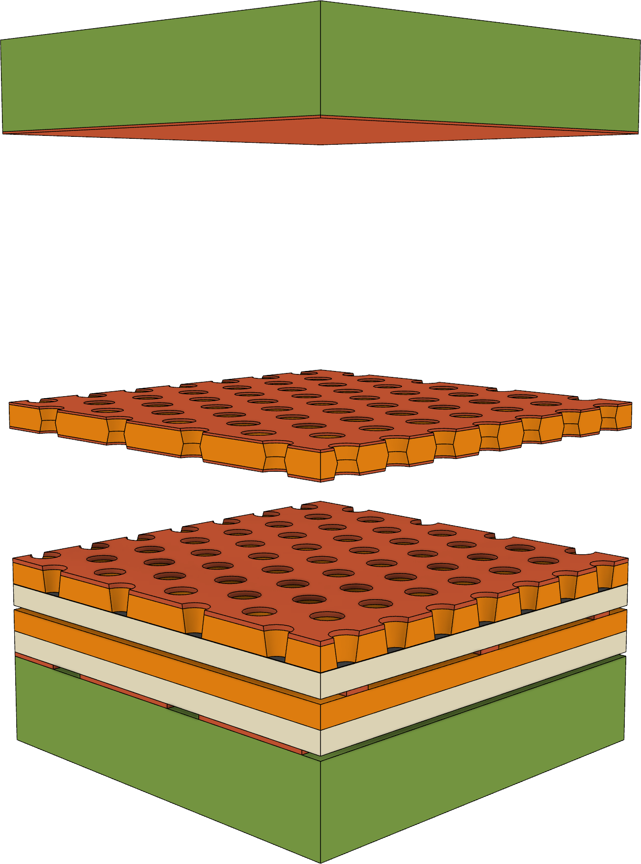
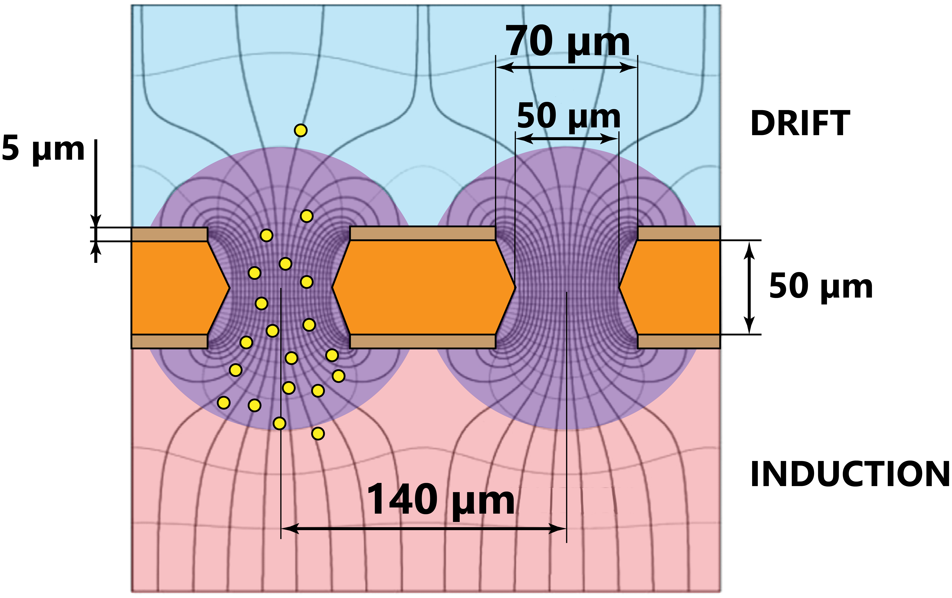
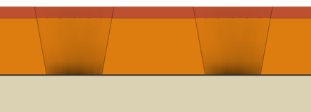

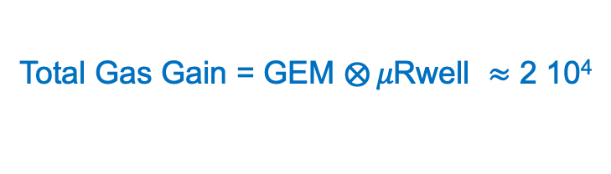

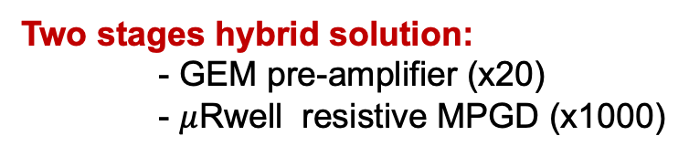
New MPGD Technology: - GEM-μRWELL Hybrid Detector
CATHODE
~ 3 mm lightweight support
5 µm copper
DRIFT
6 mm
GEM
5 µm Copper
50 µm Kapton
5 µm Copper
TRANSFER
3 mm
R/O
2D strip layout, 600 µm pitch
~ 3 mm lightweight support
Two stages hybrid solution:
- GEM pre-amplifier (x20)
- $μ$Rwell resistive MPGD (x1000)
Total Gas Gain = GEM $⨂{μ\text{Rwell} }≈$ 2 10⁴
600 $μm$ pitch guarantees 150 $μ$m spatial resolution
µ-RWELL
10 µm copper
50 µm Kapton
~ 100 nm DLC
×20
Strips
×1500
NOT IN SCALE
All R&D Studies for EIC disks performed in synergic collaboration with INFN-LNF and JLAB

Slide 21
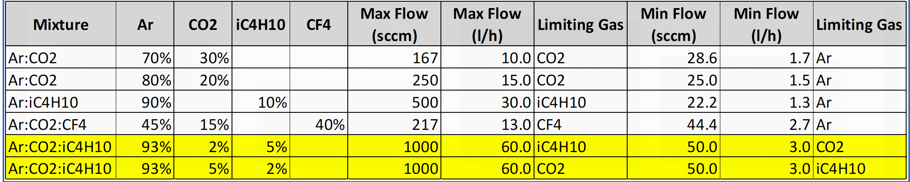
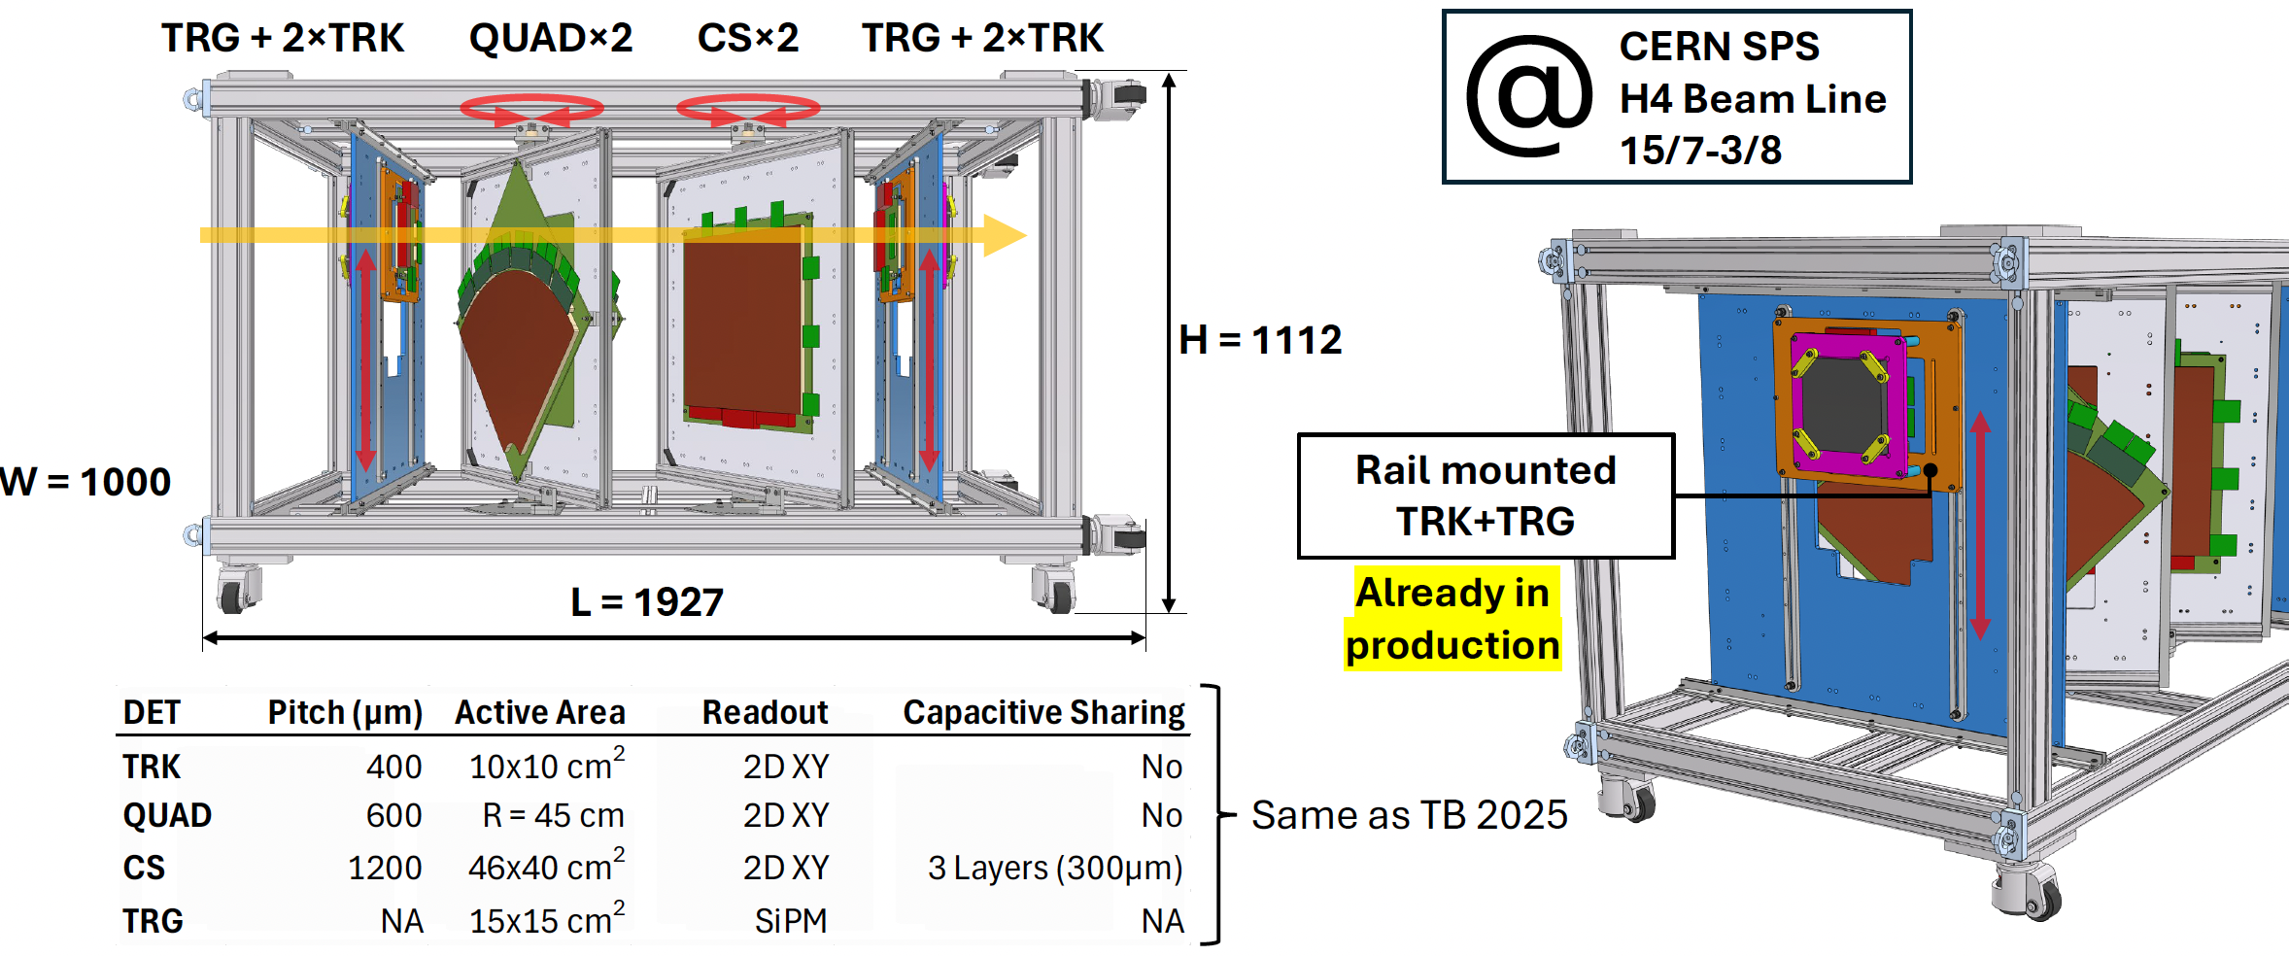
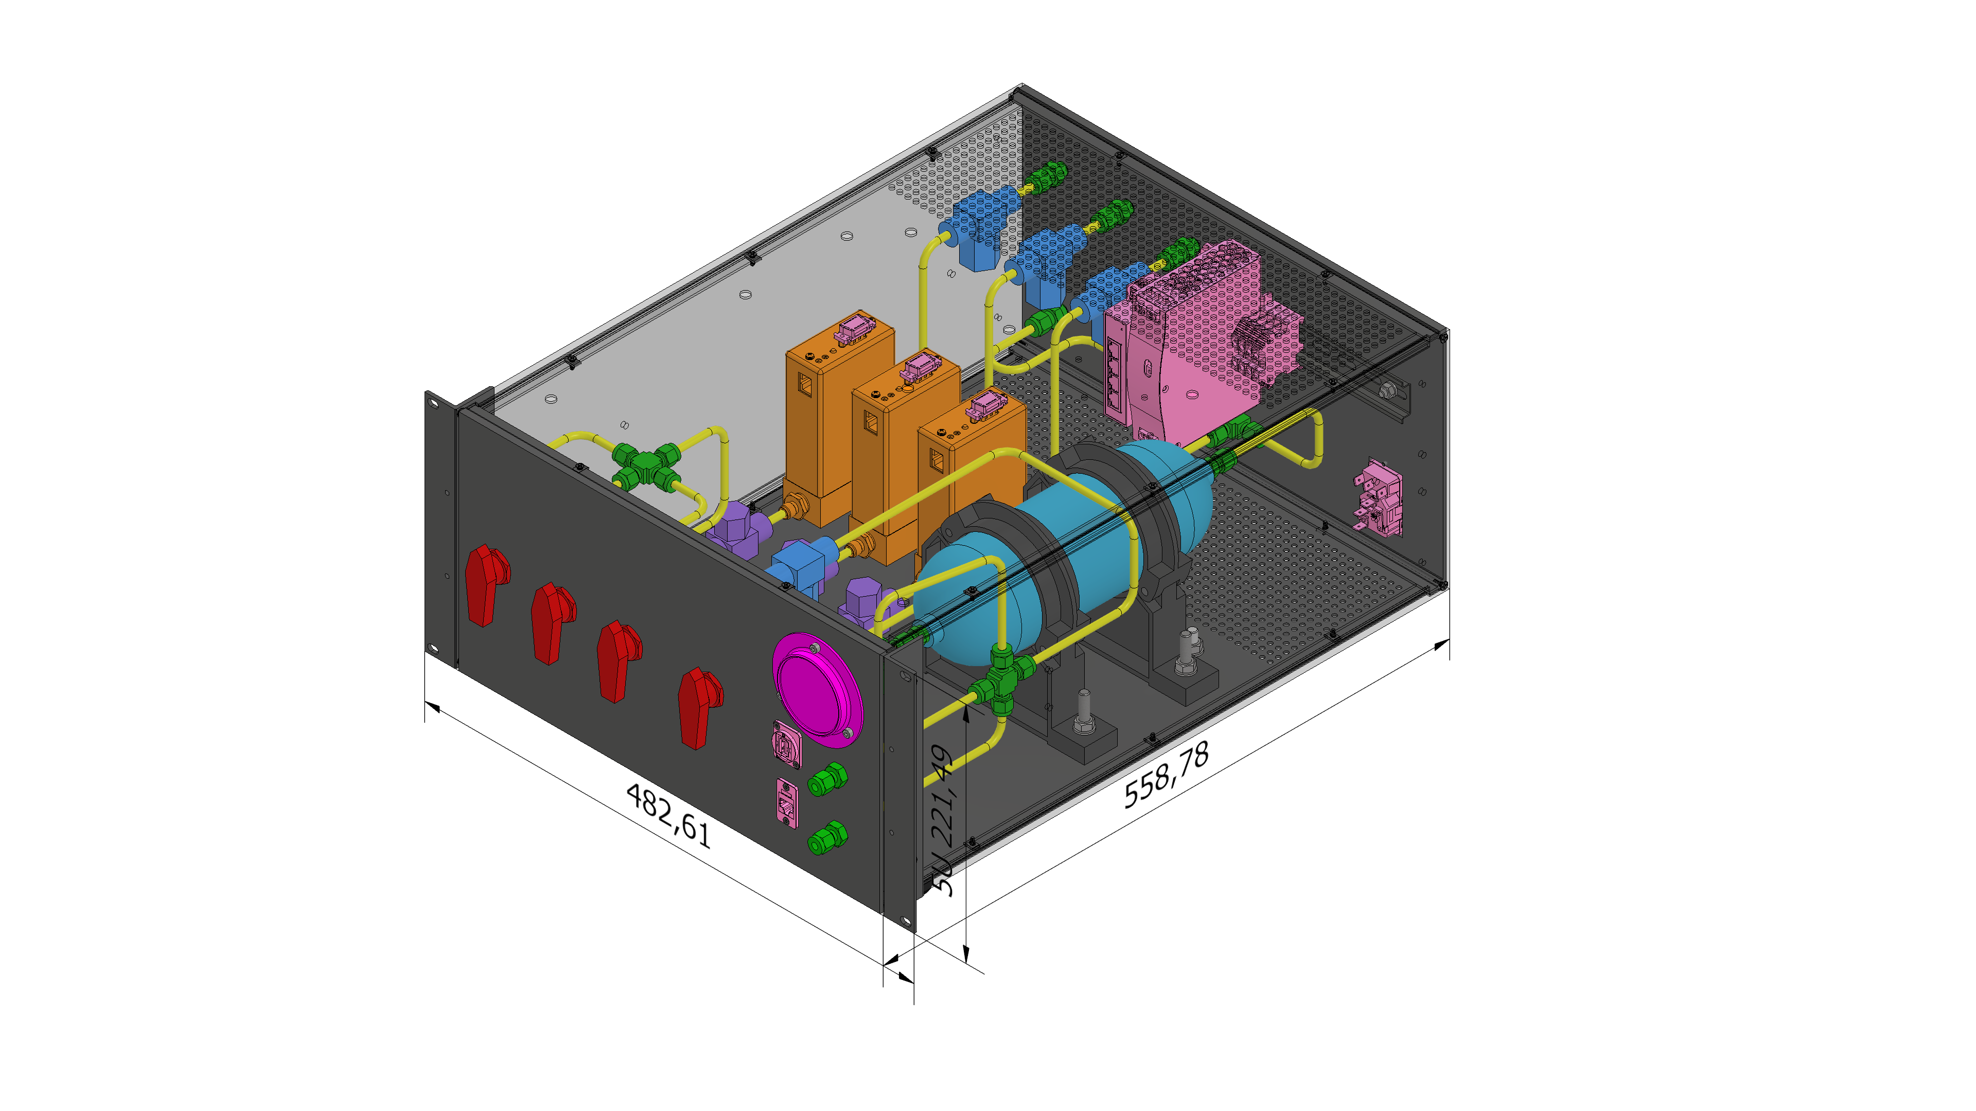
MPGD endcap - 2026 Test Beam
Scope:
Study detectors performances (position and time resolutions, efficiency) using different gas mixtures
Optimization of the drift gap
Uniformity studies
Understand if all MPGD
detectors can find a common gas mixture
Gas mixing unit
By Stefano Gramigna

Slide 22
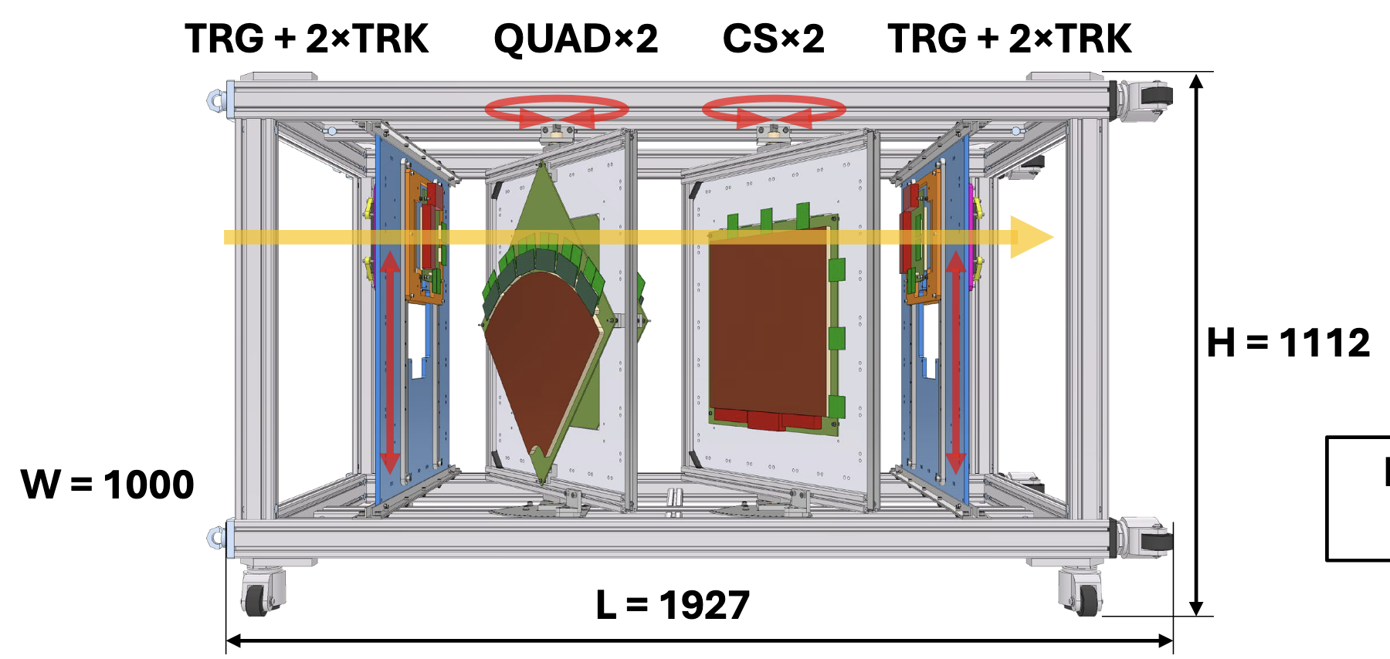
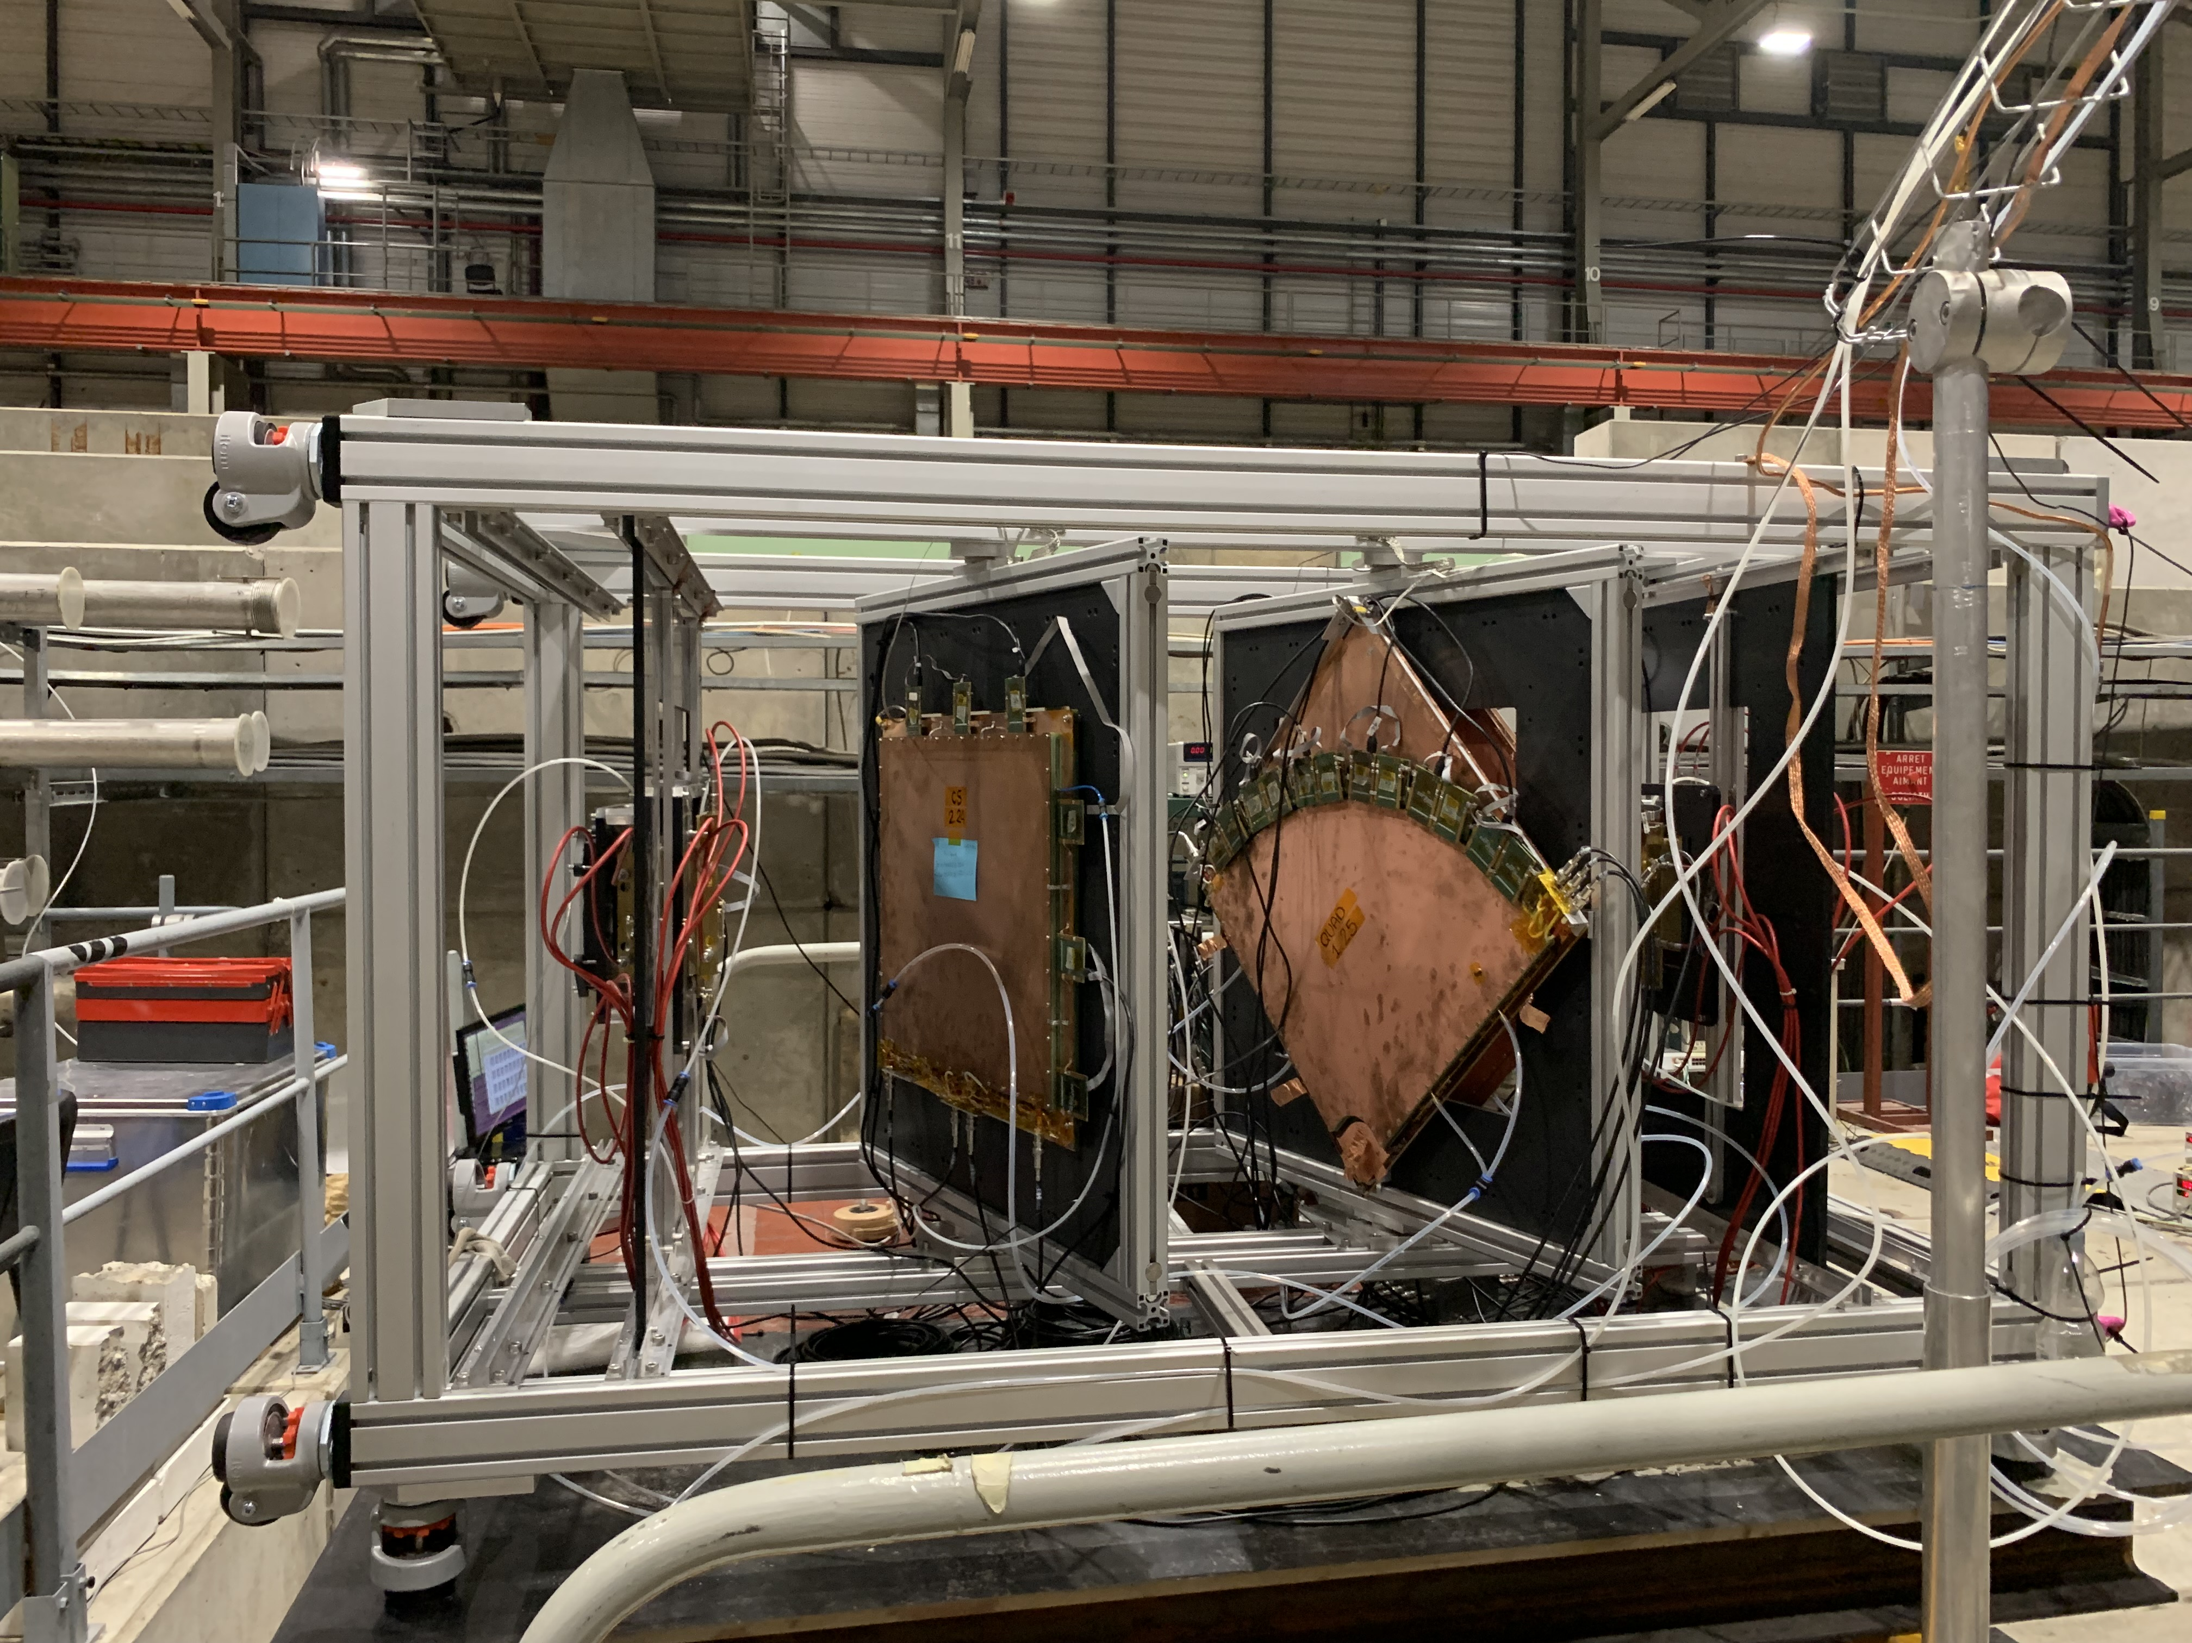
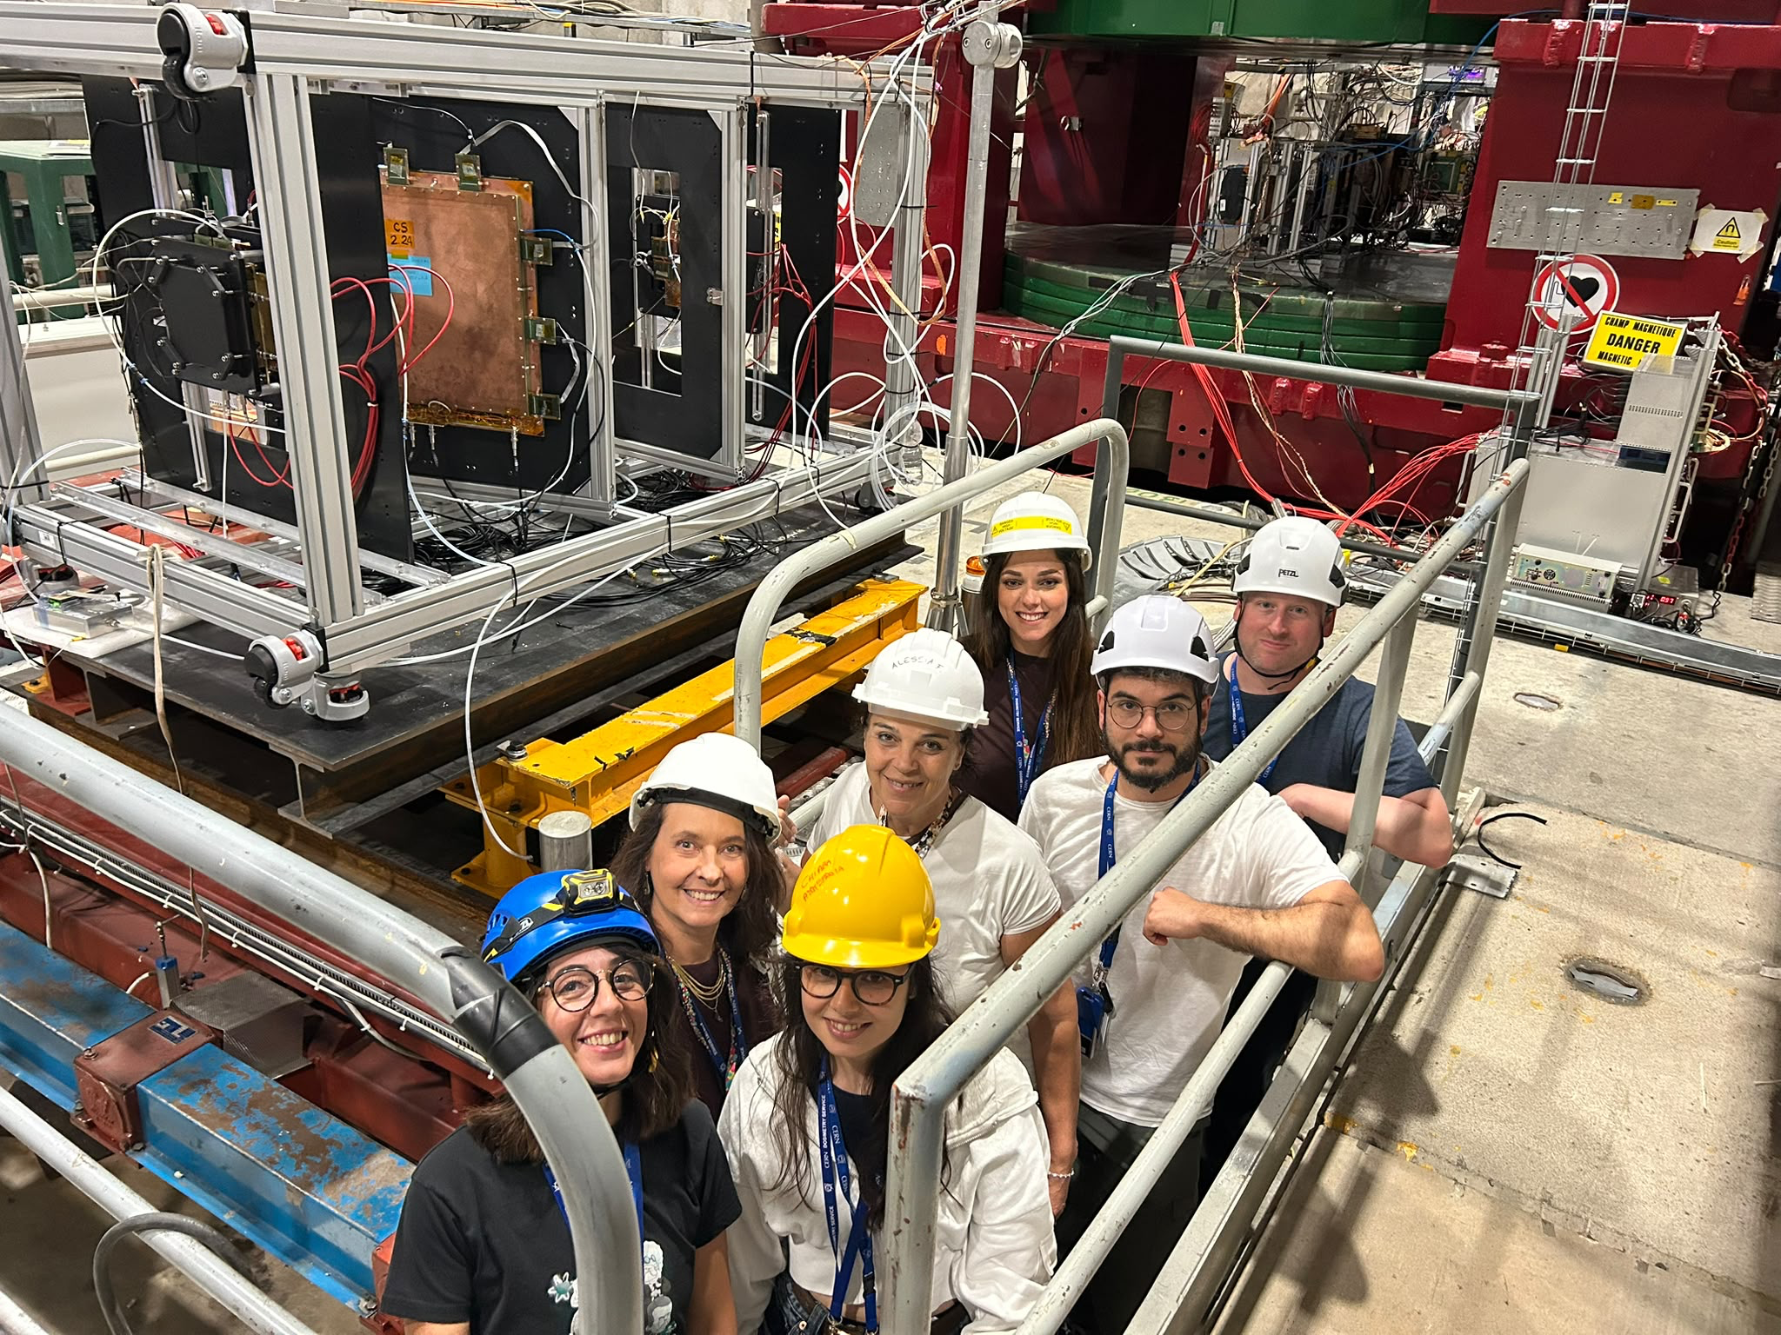
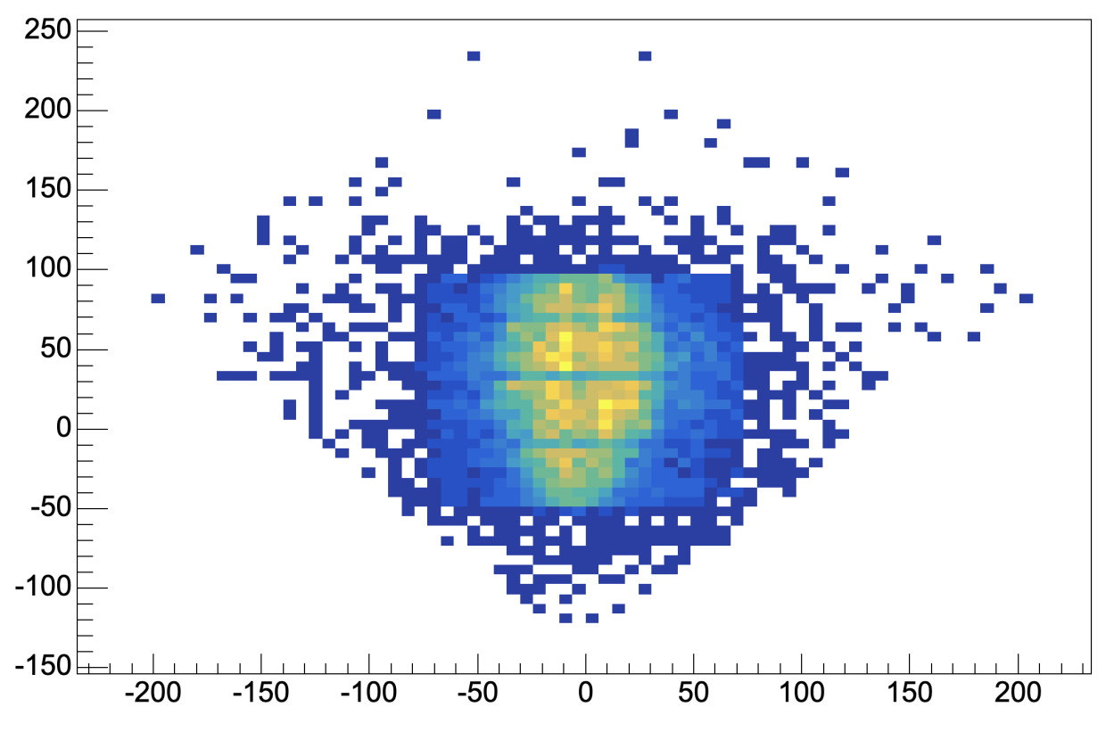
GEM-μRWELL ECT- ETA 2026 Test Beam
Beam
Hit Map
2026
Here We Are!!

Slide 23
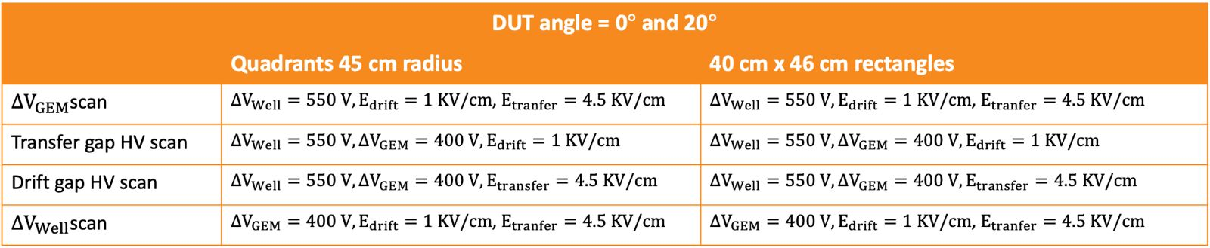
Data taking plan
Gas mixture 1: Ar:CO₂:CF₄ (45:15:40)
Similar scans were taken with gas mixture 2 Ar:CO₂ :iC₄H₁₀ (93:5:2)
The data analysis is ongoing!

Slide 24
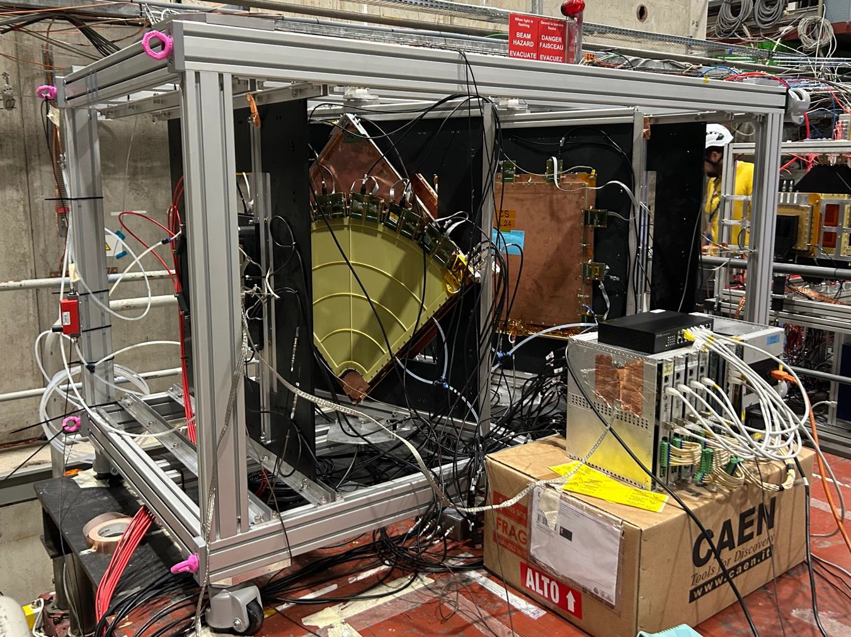
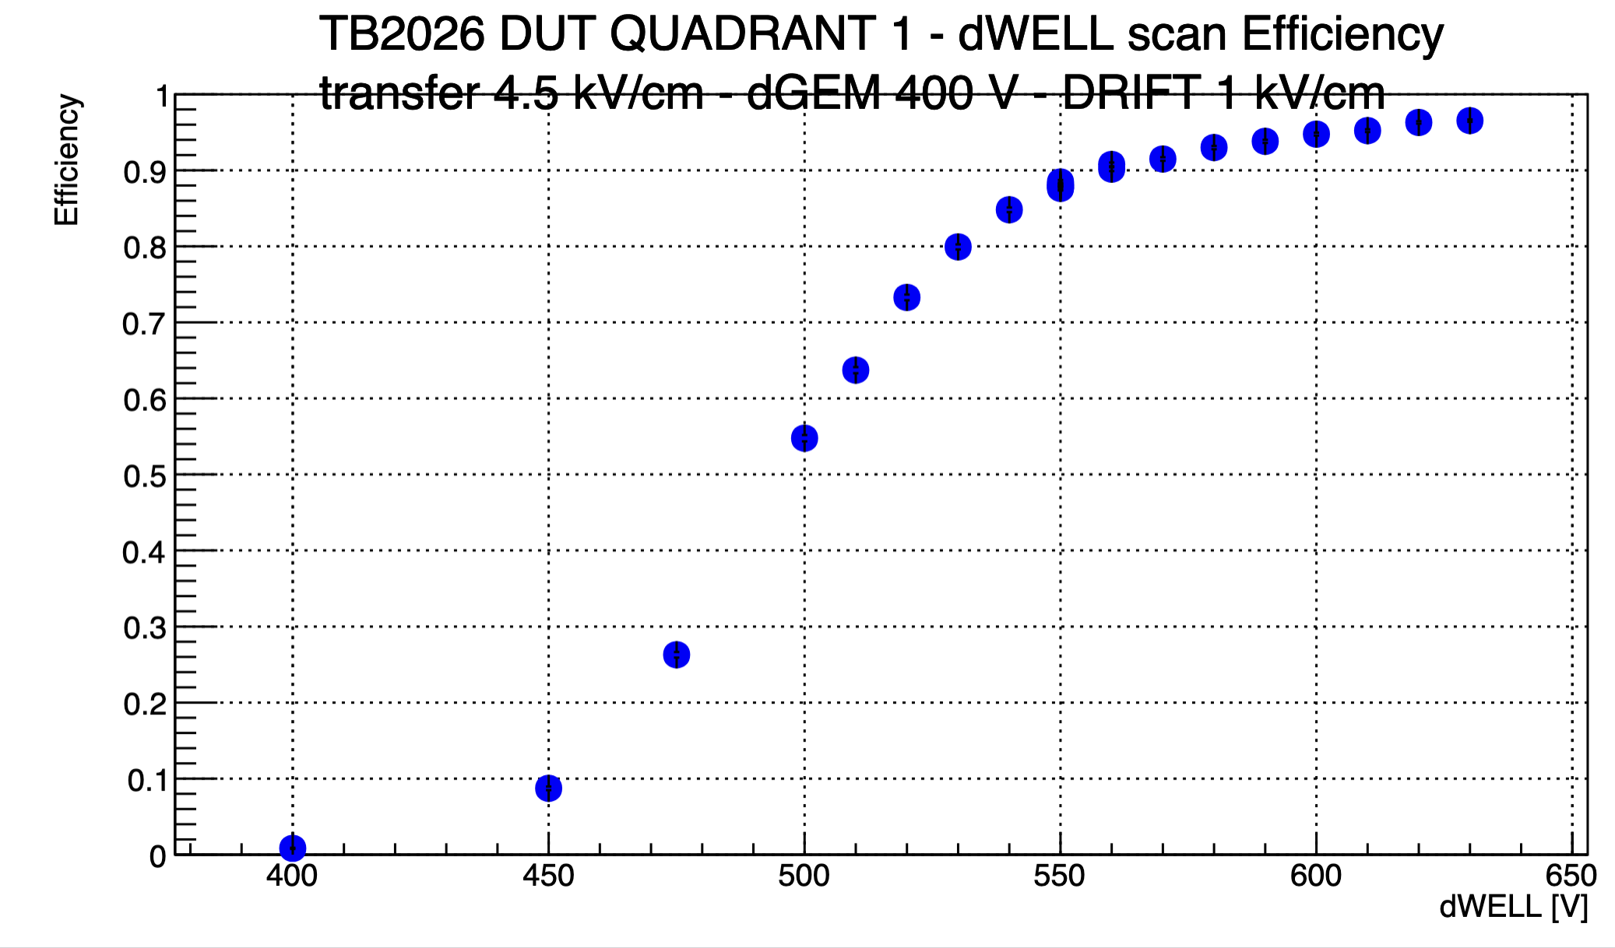
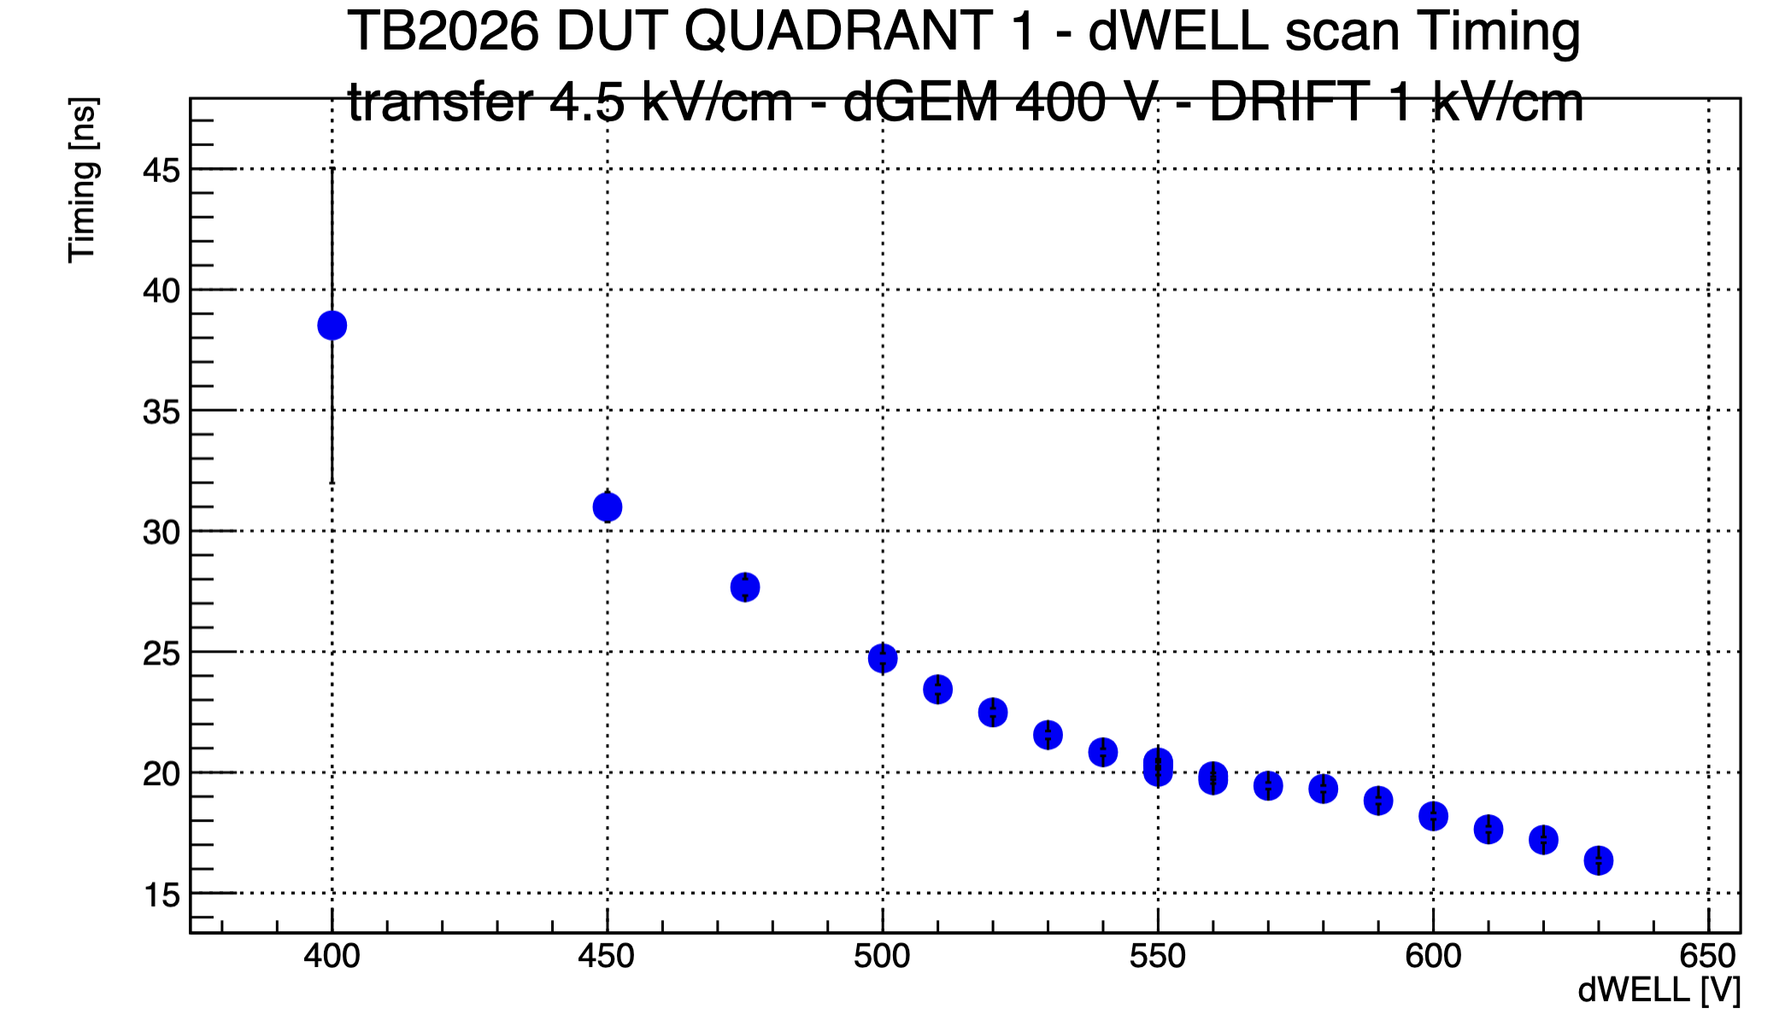
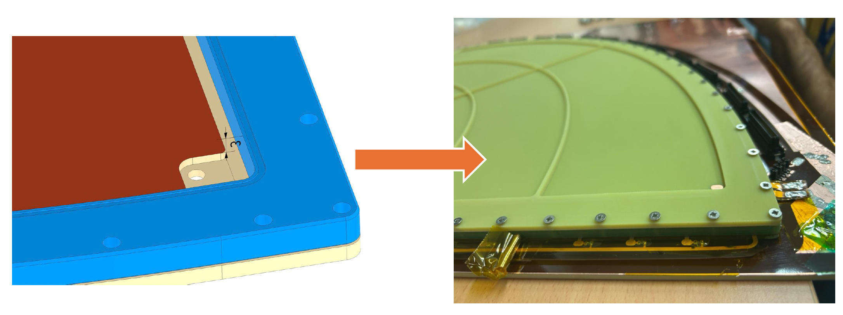
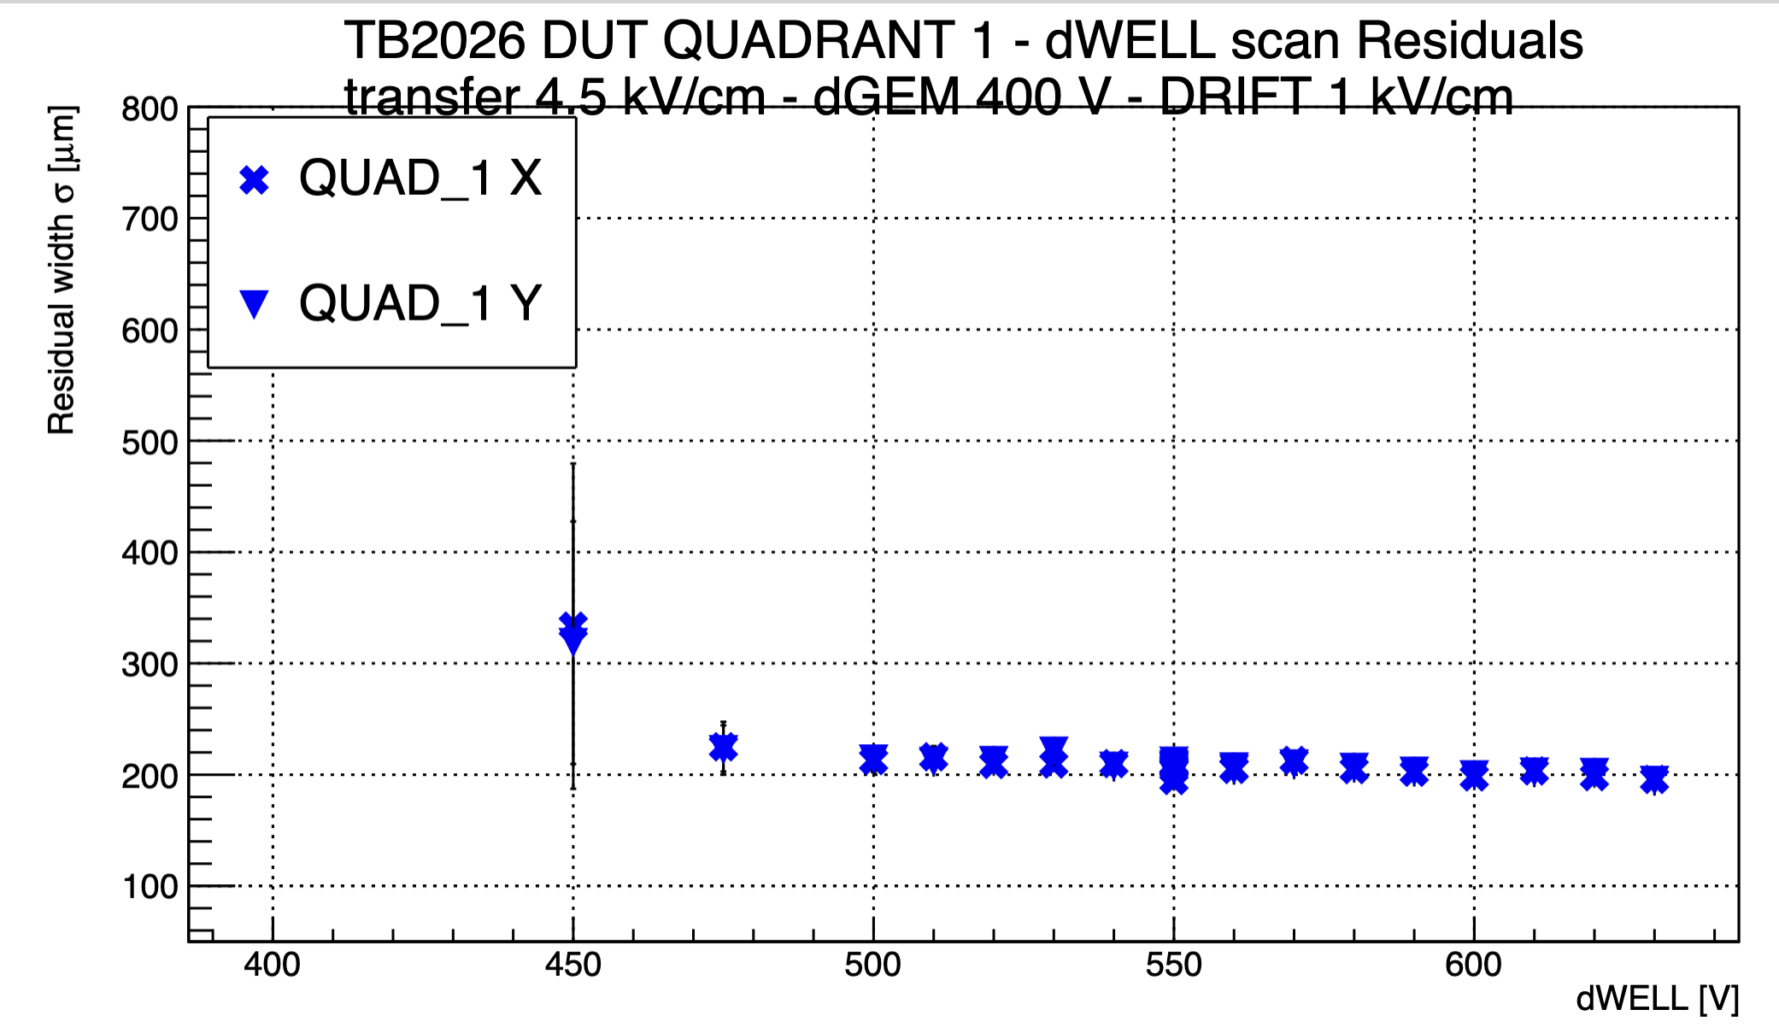
GEM-μRWELL ECT- ETA 2026 Test Beam: On-line results!
Preliminary Results: QUAD1 – reduced drift gap 6 mm $→$ 3 mm
Gas Mixture: Ar:CO₂:CF₄ 45:15:40
Plateau
Time resolution
Efficiency
PRELIMINARY
PRELIMINARY
Detector performances in the rotated reference frame Is compatible with the average performances for X and Y strips obtained in 2025.
The Plateau is shifted at higher HV working point
Position resolution
PRELIMINARY
Modified QUAD1
Drift Gap: 3 mm
By Elena Sidoretti

Slide 25
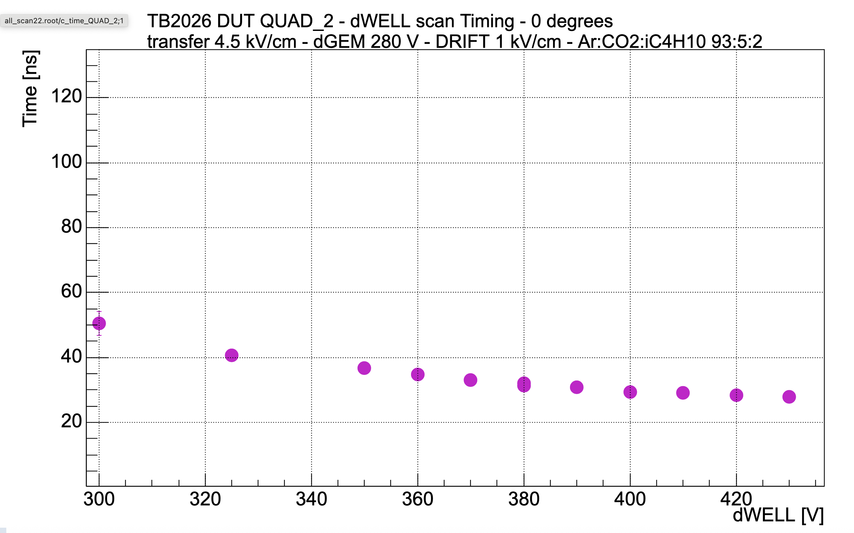
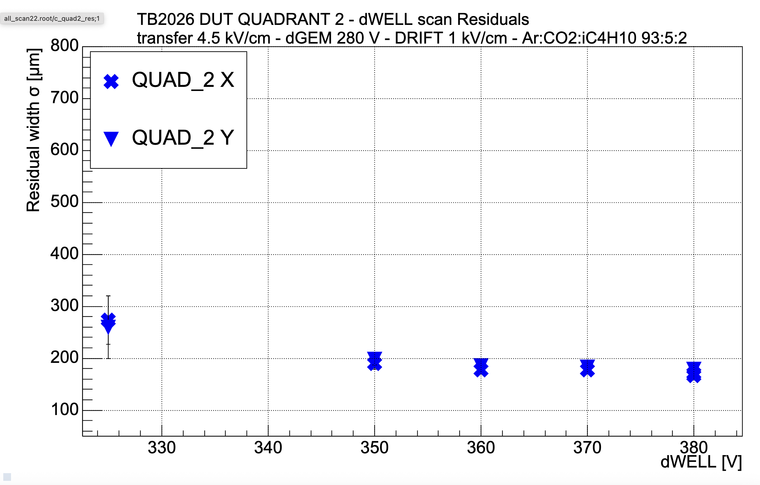
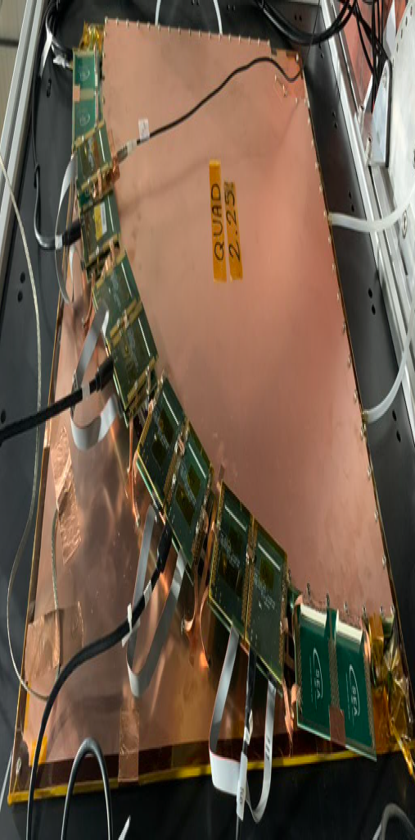
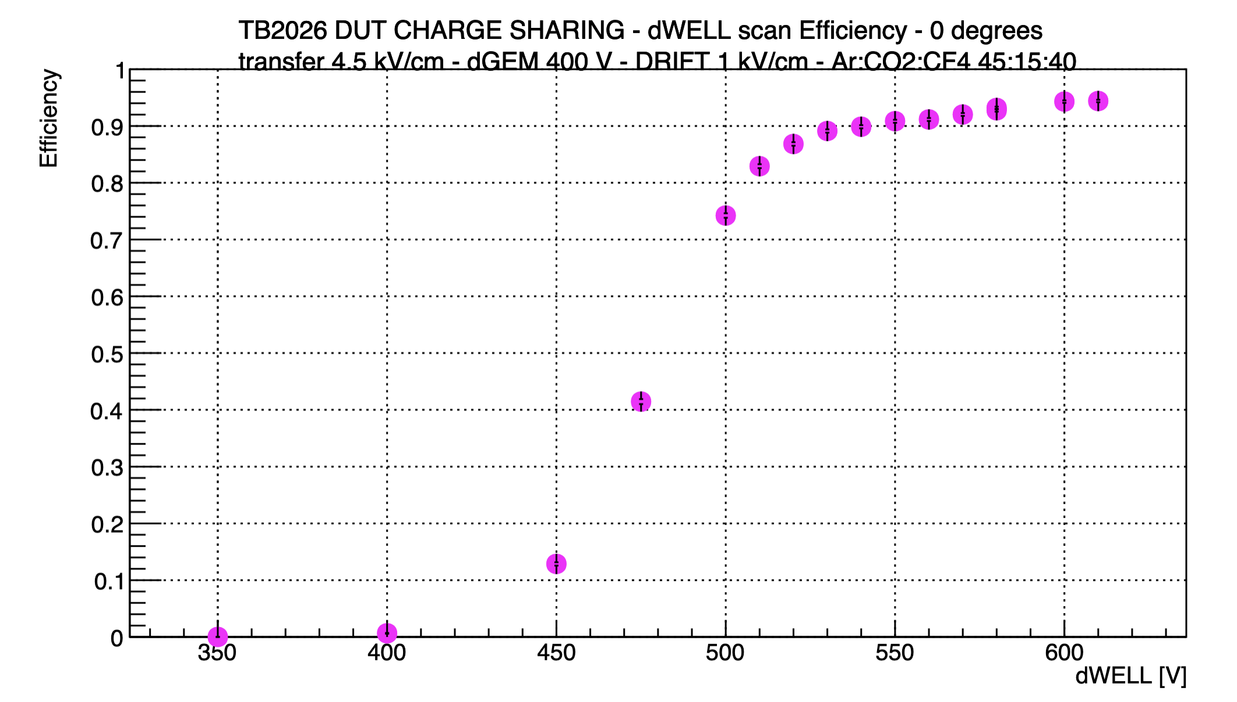
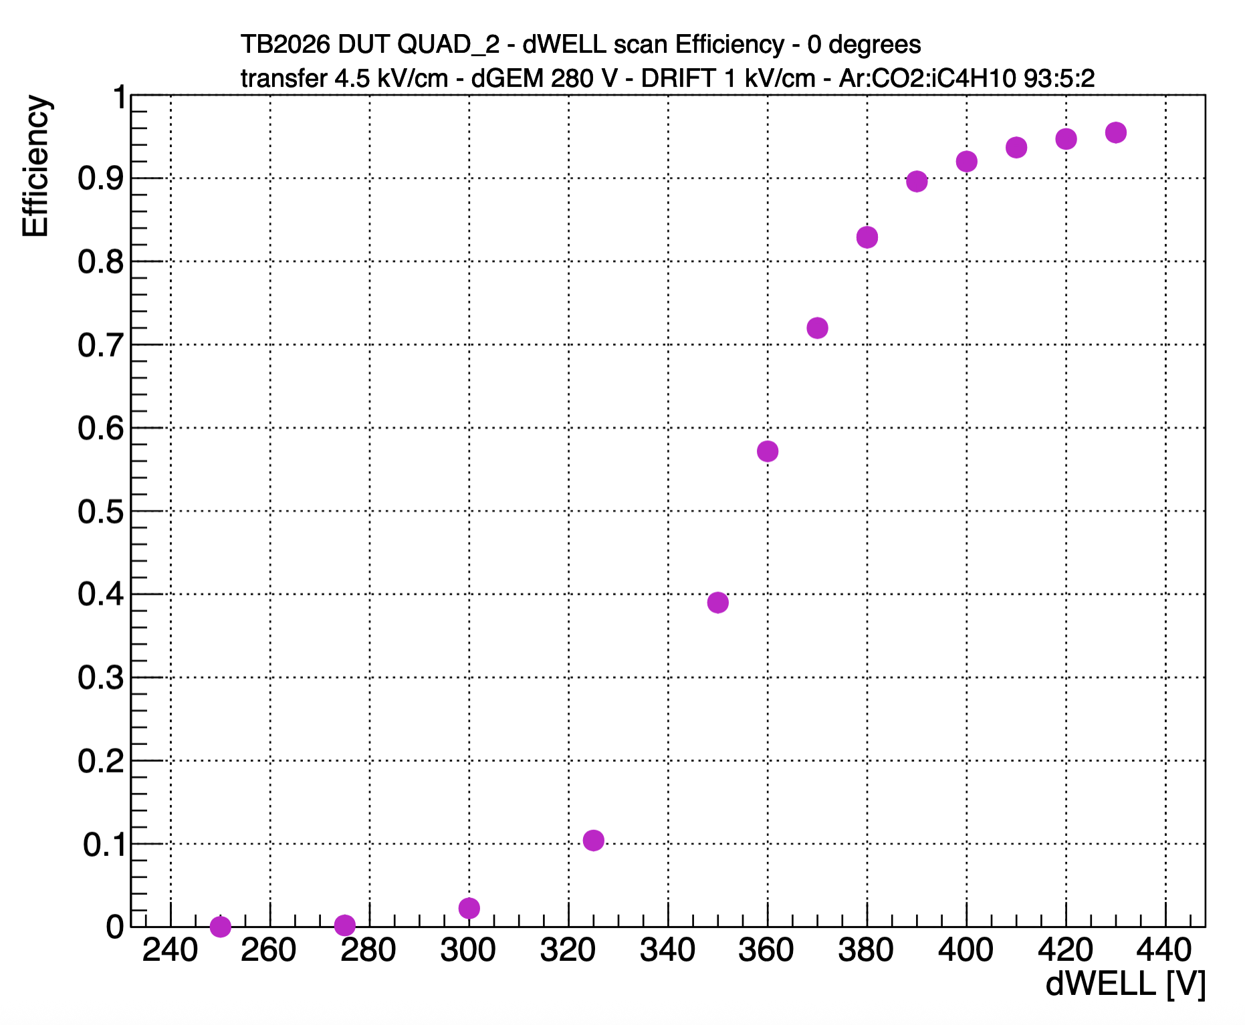
GEM-μRWELL ECT- ETA 2026 Test Beam: On-line results!
Preliminary Results: QUAD2 – 6 mm drift
Time resolution
Position resolution
PRELIMINARY
PRELIMINARY
Gas Mixture: Ar:CO₂:CF₄ 45:15:40
Gas Mixture: Ar:CO₂:iC4H₁₀ 93:5:2
Timing detector performances reduced with Ar:CO₂:iC4H₁₀ compared with Ar:CO₂:CF₄
Position resolution performances are comparable
The Plateau is shifted at lower HV working point
Plateau
PRELIMINARY
Plateau
Efficiency
Efficiency
PRELIMINARY
By Elena Sidoretti

Slide 26
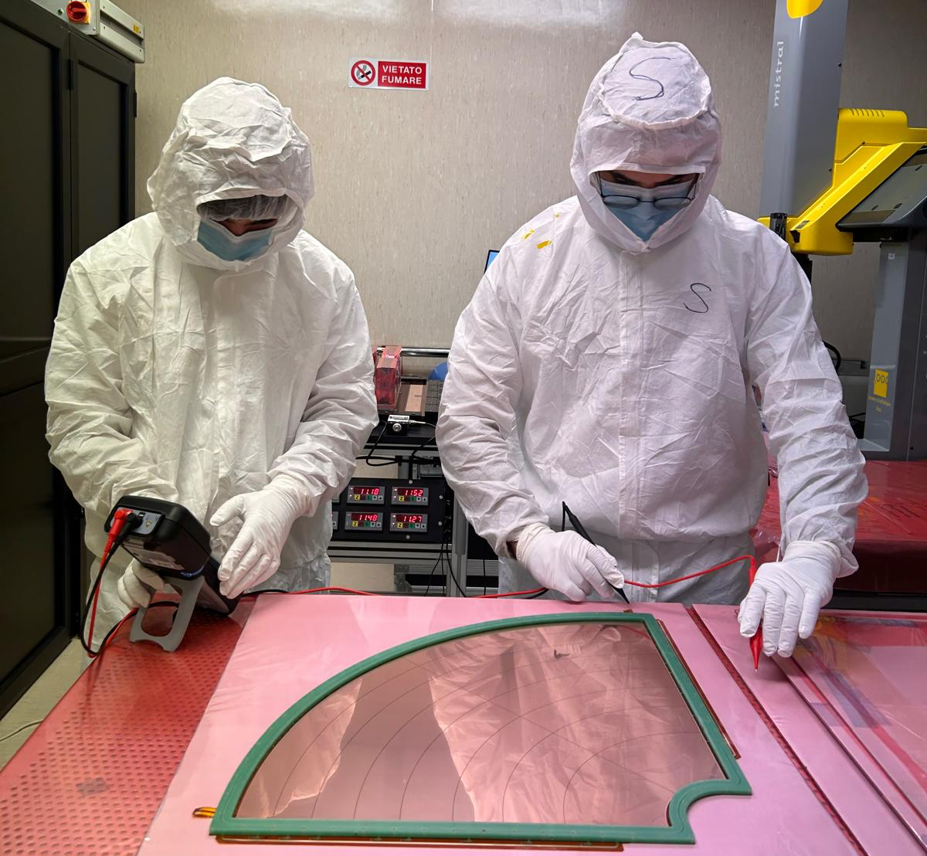
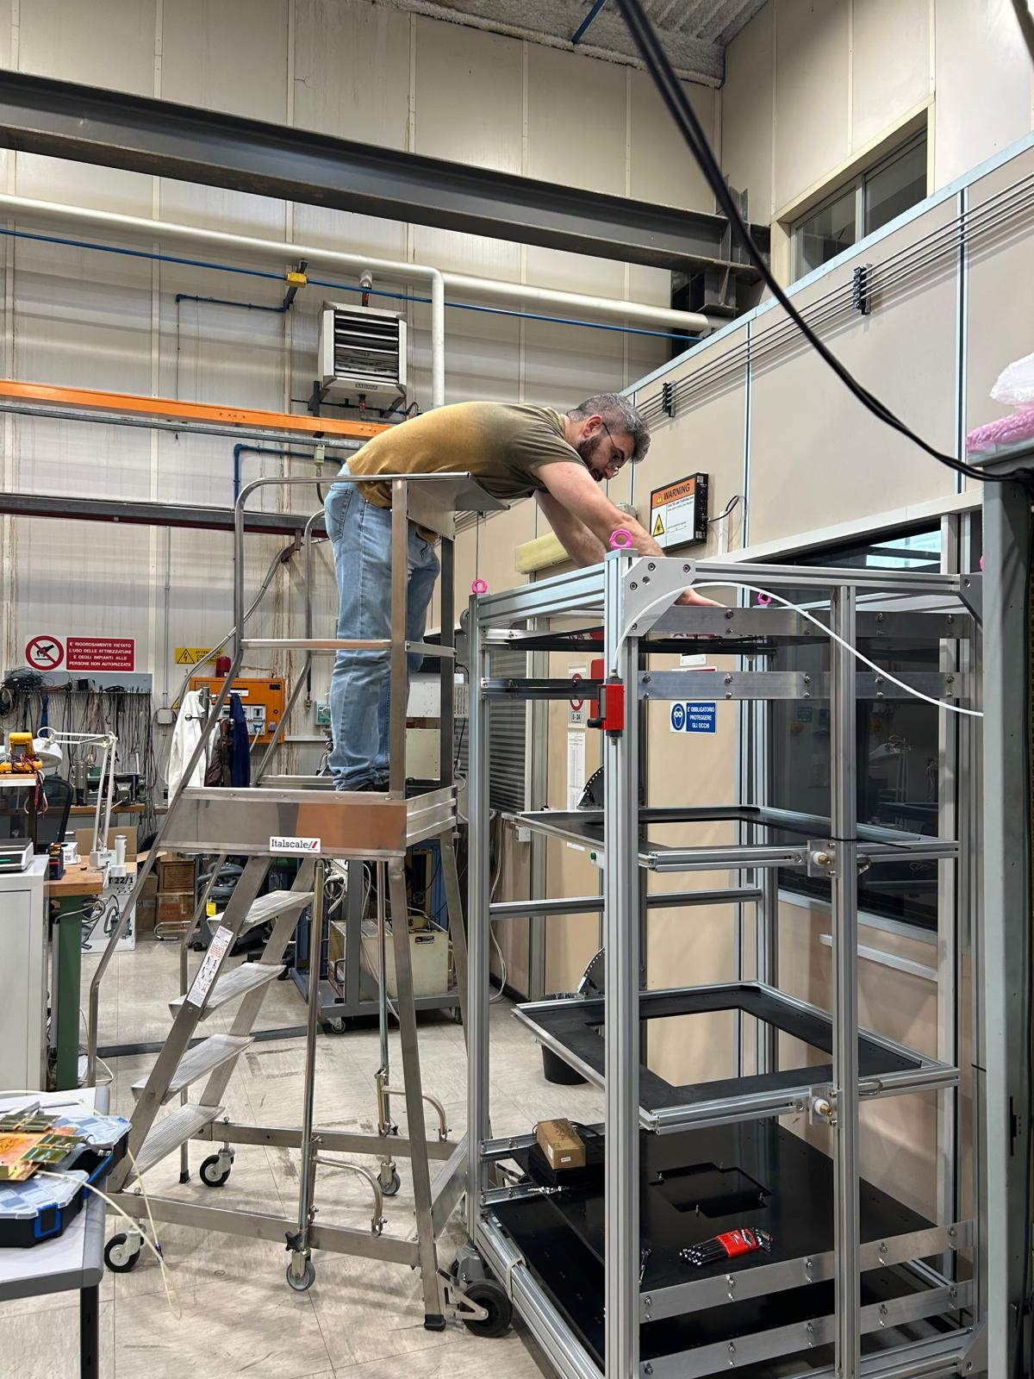
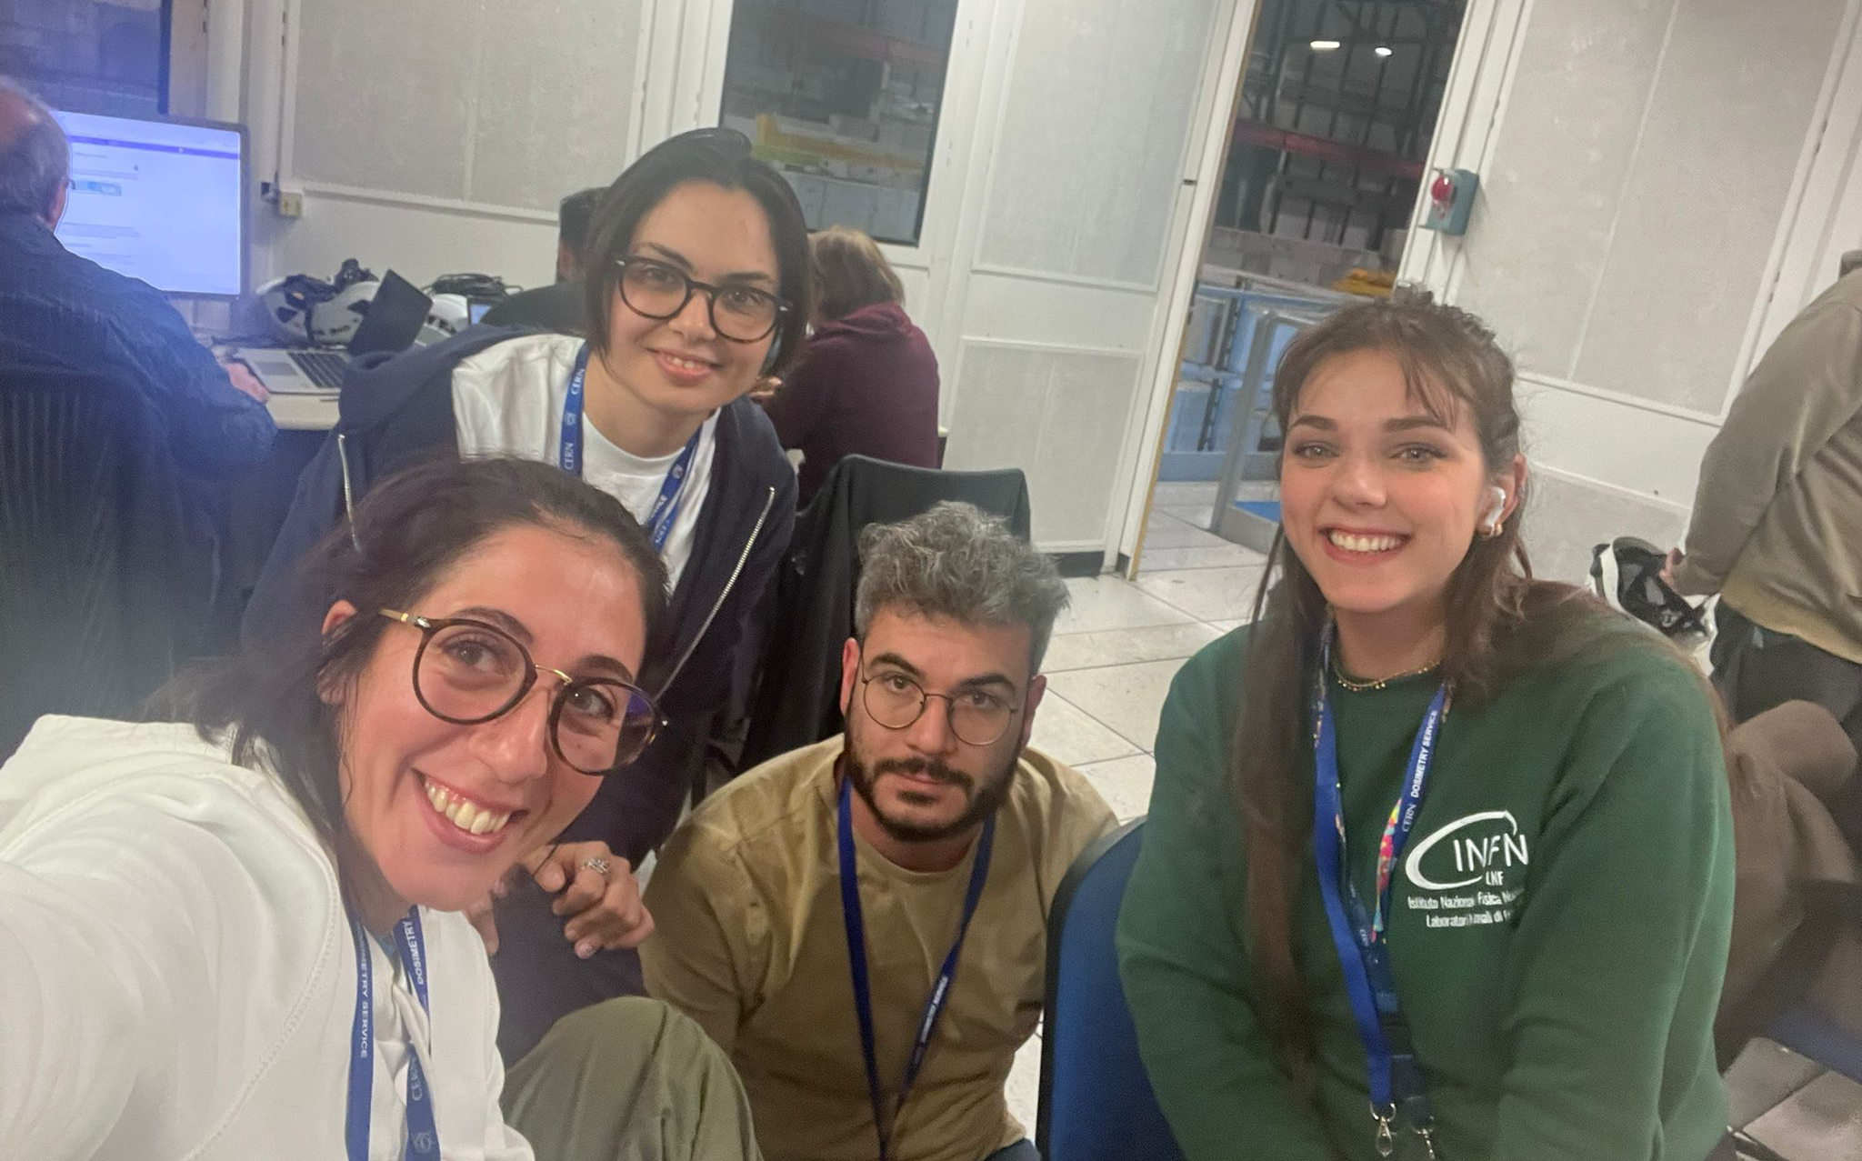



Thank you!

Slide 27
Summary - What’s next
ePIC MPGD Trackers beam test program at CERN I July 2025 was very successful
Both MPGD-BOT and MPGD-ECT were able to complete their program and achieve their goals with large statistic data
We demonstrate that the two subsystem could operate with the same gas mixture anticipated to be used by CyMBaL
Thin Gap Hybrid Detectors operates flawlessly in 1.5T field in the GOLIATH magnet providing a critical information for the MPGD in ePIC magnetic field
The data analysis will take over now in the next few months and we anticipate to publish the beam test results in a peer-review journal with one year
Great thanks for all the CERN DRD1 colleagues for the wonderful organization and execution of the beam test campaign accommodating 16 different program

Slide 28
Backup

Slide 29

Preliminary results – APV-SRS raw data
DTGH2 - DLC resistivity: 40 - 55 MΩ
μRWELL hole
  Pitch = 100 µm
  OD = 70 µm
  ID = 40-50 μm
Tracker 1
Tracker 2
DTGH2
Tracker 3
Tracker 4
DTGH side 1
DTGH1
DTGH1 - DLC resistivity: 70 - 95 MΩ
μRWELL hole
  Pitch = 100 µm
  OD = 70 µm
  ID = 40-50 μm
DTGH side 2
Raw hit in the APV25 frame of each detector in the setup

