Slide 1
Update on Meson Structure Functions Analysis
Campaign blockers status · Λ → p π⁻ reconstruction: seeding fix, classic cuts, ML selection
Dmitry Romanov
Jefferson Lab · August 26, 2026
Notes:
Two halves: (1) status of the three issues blocking use of the monthly campaigns for meson structure, who owns what; (2) our Lambda -> p pi- reconstruction work: the B0 seeding fix, the classic V0 selection, and the ML selection.

Slide 2
Campaigns produce our data — three issues block using it
• The monthly EIC simulation campaigns (26.07: ep Sullivan K⁺Λ at 5x41 … 9x275) now include meson-structure samples
• Meson-structure studies are NOT yet possible on these files — three blocking issues, all filed on GitHub
1. ZDC HCAL response changed (hex → square tiles) eic/EICrecon#2737 · filed Jul 8
Fewer, much larger HCAL clusters in 26.07 → π⁰ → γγ separation collapses; Λ → n π⁰ channel unusable
NO FIX YET
2. B0 tracker: zero tracks for Λ → p π⁻ daughters eic/EICrecon#2746 · filed Jul 14
B0 hits exist, the chain stops at seeding: truth seeder rejects secondaries, real seeder has central-tracker geometry
PARTIAL(very) FIX
3. ZDC 269 ns tmax cut rejects background-merged events eic/EICrecon#2802 · filed Jul 29
Cut applied in absolute event time; SignalBackgroundMerger shifts interactions by µs → valid ZDC hits thrown away
IN REVIEW
GitHub states as of Aug 27, 2026
2
Notes:
The three blockers from the Aug 20 list to Markus; his Aug 24 reply confirmed the same status reading. Each gets a slide next. Weekly follow-ups with Markus agreed until campaigns are usable for meson structure.

Slide 3
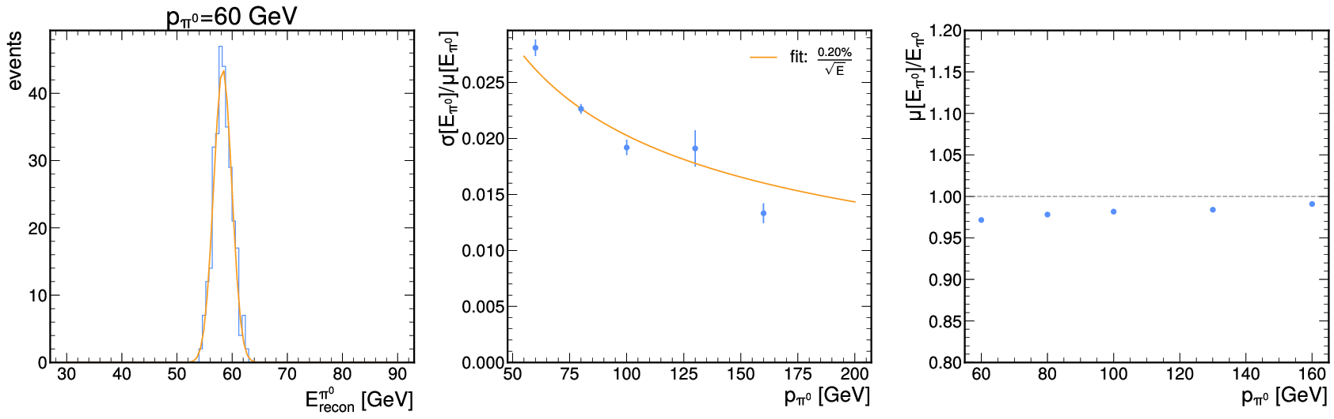
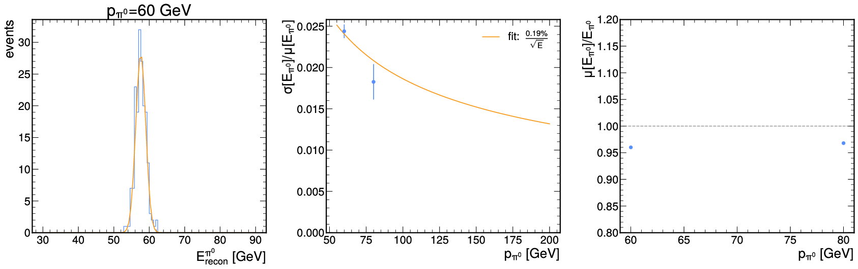
Blocker 1 — ZDC HCAL response change (#2737)
ZDC HCAL, first 1000 events | 26.02 (hex) | 26.07 (square)
events with ≥1 HCAL cluster | 84.4% | 46.3%
HCAL clusters / event | 1.03 | 0.51
γ-like clusters / event | 0.34 | 0.15
median cluster energy | 26 GeV | 131 GeV
median RecHits / cluster | 127 | 1023
26.04 benchmark: π⁰ energy resolution scan reaches 160 GeV
• Same EICrecon, same generator — the geometry switch (>26.05) changed the response
• Fewer and much bigger clusters → two-photon separation gone; Λ → n π⁰ analysis blocked
• Open: clustering retune or intrinsic to the new segmentation? Next: hex vs square comparison at SimHit / RecHit / cluster level
• Sebouh Paul (HEXPLIT author) is now at ODU; willing to train a successor (Sean Preins suggested). ZDC reconstruction needs an owner
26.05: same benchmark — π⁰ points above 80 GeV are gone
OPEN since Jul 8, no assignee · GitHub states as of Aug 27, 2026
3
Notes:
Numbers from Baptiste's issue body. Right: single-pi0 benchmark panels posted by Dmitry Kalinkin in the thread — 26.04 resolution scan has points to 160 GeV, in 26.05 everything above 80 GeV fails. Open question is clustering-tuning vs segmentation physics; Markus proposed SimHit/RecHit/cluster-level controlled comparison.

Slide 4
Blocker 2 — B0: Λ daughters get zero tracks (#2746)
• B0 has hits in nearly every event and zero tracks in every campaign file. The chain stops at seeding
– Root cause A (truth seeding): generatorStatus == 1 hard-coded + |vertex z| < 200 mm; Λ daughters are displaced secondaries
– Root cause B (real seeding): B0TrackerSeeds registered with the central-tracker seeding volume (zMax 1.7 m, rMax 0.44 m) — B0 sits at z ≈ 5.7—6.7 m
B0 RecHits
Measurements
Seeds
CKF tracks
collection | objects | events > 0
B0TrackerRecHits | 3588 | 98/99
B0TrackerMeasurements | 3588 | 98/99
B0TrackerSeeds | 0 | 0/99
B0TrackerCKFTracks | 0 | 0/99
CentralCKFTracks (control) | 900 | 99/99
B0 truth-seeded (patched ctrl) | 89 | 63/99
Where the fixes stand
MERGED
PR #2797 merged Aug 18 — truth seeder accepts secondaries
IN REVIEW
PR #2901 in review — relaxed B0 truth-seeding mode (z cut relaxed, perigee at vertex)
OPEN
Real B0 seeding: still zero seeds — needs a B0-specific seeder config; owner needed
Stock EICrecon main, full chain from sim (NC-DIS 10x275). Truth-seeded control uses our patch → geometry/CKF are healthy.
Consequence: no π⁻ candidates in campaign files → no complete p π⁻ pairs.
GitHub states as of Aug 27, 2026
4
Notes:
Census numbers load from reports/stock_b0_check.json (99 events, scripts/33_stock_b0_check.py). Both root causes verified in EICrecon source. #2797 (ours) merged; #2901 (Dmitry Kalinkin, Aug 26) continues it for B0TrackerTruthSeeds; real seeding needs the orthogonal-seeder config done properly — Korover's group per Yulia's email.

Slide 5
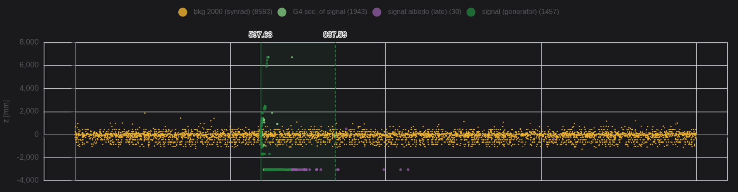
Blocker 3 — ZDC 269 ns cut vs merged frames (#2802)
• HEXPLIT rejects ZDC hits with t > 269 ns in ABSOLUTE event time (ZDC.cc: tmax = 269 ns)
• SignalBackgroundMerger places the interaction anywhere in a 1000—5000 ns frame → late-t0 events lose their ZDC, even with zero background
• No hardware basis for 269 ns (Yulia checked); working theory: it was meant to remove late albedo hits (purple, below)
• Fix PR #2892: keep the physics window, but measure it relative to the truth interaction t0 (via calo hit links); parameter renamed tmax → max_time_to_truth_t0 (breaking)
hit time vs z: signal burst (green), late albedo (purple), continuous background (yellow) — the time window must follow t0
#2802 understood · fix PR #2892 open, review required, needs a t0 ≠ 0 regression test · GitHub states as of Aug 27, 2026
5
Notes:
Issue by Baptiste (Jul 29). PR #2892 by Dmitry Kalinkin (Aug 24), high urgency 'for meson structure group'. Still open: review + a regression test exercising non-zero t0; also whether a hit-time-difference cut (simonge) should replace absolute windows long-term. Plot from our comment in the issue (illustrative frame, not ZDC itself).

Slide 6
Who owns what, and how this gets resolved
blocker | fix in flight | contact / owner (per Yulia, Aug 26) | state
#2737 ZDC HCAL response | none yet — needs the hex/square study | ZDC-HCAL: David Ruth (NMSU) · ZDC-EMCAL: Yuji Goto + Ming Kuo (NCU) · Sebouh Paul (ODU) trains a successor — Sean Preins suggested | needs owner
#2746 B0 tracking | #2797 merged · #2901 in review · real seeding open | B0 tracking layers: Igor Korover (TAU), cc Zvi Citron · B0-EMCAL: Zvi Citron | partial
#2802 ZDC tmax | #2892 in review (needs t0 ≠ 0 regression test) | PR by Dmitry Kalinkin; review by ZDC/calorimetry | in review
• Process agreed with Markus (Aug 24):
- every blocking problem gets a GitHub issue
– weekly status review after the JLab group meetings until meson-structure studies run on the monthly campaigns
– detailed reco/sim discussion goes to the DSC WG meetings; Baptiste and Dmitry keep contributing to the GitHub threads
– ZDC reconstruction algorithm needs owner
• Goal: a clearly identified software owner for each blocker — the ZDC ownership question is with the ZDC DSC now
GitHub states as of Aug 27, 2026
6
Notes:
Contacts from Yulia's Aug 26 email: ZDC-EMCAL requests -> Yuji Goto and Ming (cmkuo@phy.ncu.edu.tw); ZDC-HCAL -> David Ruth; B0 tracking layers -> Igor Korover cc Zvi; B0-EMCAL -> Zvi. Sebouh Paul has an ODU postdoc on other projects but will train someone on ZDC sim/reco.

Slide 7
Λ → p π⁻ reconstruction for EICrecon
Notes:
Port of the cut-based V0 selection from the ai-comb-lam study into EICrecon proper, as a PR-ready algorithm with tests and validation. Deliverables: patch, issue text, PR text.

Slide 8
Sullivan Λ kinematics: decay meters downstream, daughters far-forward
The central detector sees only e' and whatever in K⁺ . The Λ-s go to the far-forward
p
Roman Pots · off-momentum · B0
IP
e p → e' K⁺ Λ
Λ flight
γβ ≈ 40—100
no detector signal
π⁻
B0 tracker only (5.5—20 mrad, z < 6 m)
64%
branching ratio Λ → p π⁻
3.1 m
median decay z at 9x130
938/2000
events with Λ → p π⁻, z < 30 m
channel | algorithm | output collection | status
Λ → n π⁰ (BR 36%) | LambdaReconstruction (ZDC) | ReconstructedLambdas | exists
Λ → p π⁻ (BR 64%) | — | — | missing
2
Notes:
At 9x275 the median decay z grows to ~7 m. The pi- acceptance is the bottleneck: essentially only B0, and only for decays before it.

Slide 9
ChargedLambdaReconstruction: inputs, V0 cut chain, outputs
ReconstructedChargedParticles
pair + select
p pool: charge > 0 + all RP/OffM
π⁻ pool: charge < 0
all passing pairs kept
output
ReconstructedChargedLambdas
+ TruthSeeded twin
PDG 3122, daughters linked
ForwardRomanPotRecParticles
ForwardOffMRecParticles
cut | default | cut | default
opening angle | < 34 mrad | vertex-z proxy | −1.5 — 32 m
pair θ | < 57 mrad | momentum asymmetry | > 0.47
line-line DCA | < 90 mm | mass window | ±25 MeV
Defaults from the ai-comb-lam baseline (99% marginal signal efficiency per cut); every value is a factory parameter. Pointing cut present, disabled by default.
4
Notes:
DCA and vertex proxy come from the closest approach of the two straight track lines (referencePoint + momentum). Pointing is degenerate while RP legs are transfer-matrix lines through the origin, hence disabled.

Slide 10
Implementation: 5 new files, 15 changed lines, 4 unit tests
file | role
algorithms/reco/ChargedLambdaReconstruction.h/.cc | the algorithm
algorithms/reco/ChargedLambdaReconstructionConfig.h | 8 cut parameters
factories/reco/ChargedLambdaReconstruction_factory.h | JOmniFactory wrapper
global/reco/reco.cc (+12 lines) | real + truth-seeded registrations
services/io/podio/JEventProcessorPODIO.cc (+2) | output list
tests/algorithms_test/reco_ChargedLambdaReconstruction.cc | 4 catch2 cases
• Tests: exact two-body decay reconstructed at the right mass and vertex; wide-angle pairing rejected; charge routing enforced; mass window follows the configuration.
• Full algorithms_test suite: 699 assertions in 53 cases, all pass.
• clang-format at the pre-commit pin (v22.1.8); style mirrors LambdaReconstruction.
5
Notes:
Working tree deliberately left uncommitted; the transportable copy is reports/charged-lambda-reconstruction.patch, verified to apply on pristine main.

Slide 11
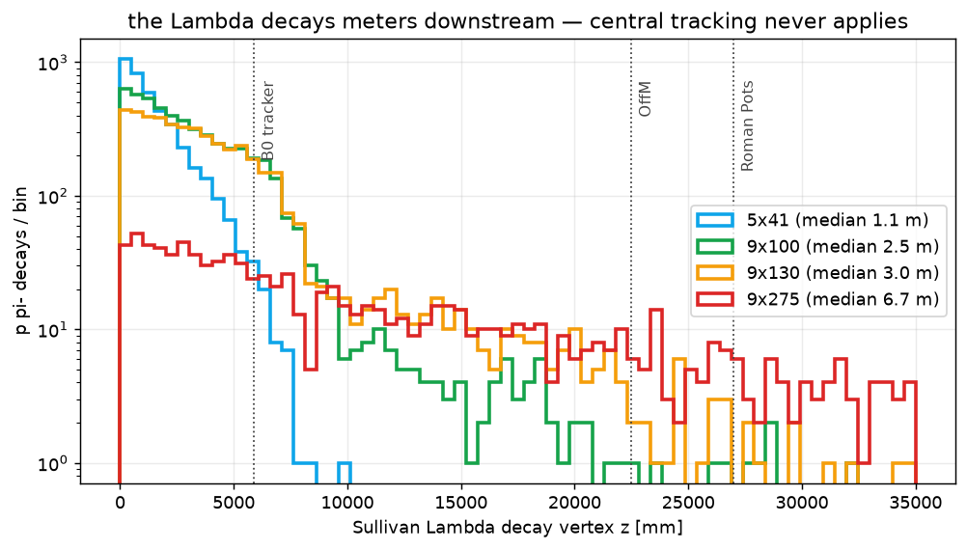
Our analysis: Λ → p π⁻ is a far-forward problem
• Sullivan Λ decays METERS downstream (median 1.1 m at 5x41 → 6.7 m at 9x275) — central V0 finding never applies
• π⁻ is only ever visible in B0; the proton migrates B0 → RP/OffM as beam energy grows; central detector sees just e′ and K⁺
energy | p in B0 | π⁻ in B0 | p RP/OffM | pair ceiling
5x41 | 30% | 19% | 0.4% | 9%
9x100 | 64% | 55% | 7% | 44%
9x130 | 51% | 45% | 10% | 36%
9x275 | 0% | 5.5% | 25% | 0.6%
Truth-level acceptance (≥4 tracker hits). Pair ceiling = both daughters inside FF trackers — the physics lives at 9x100 / 9x130.
decay_z_all.png
7
Notes:
M0 survey, reports/01_m0_data_survey.md. The acceptance matrix fixes which collections supply which leg and shows 9x275 has almost no fully-contained p pi- signal.

Slide 12
Validation setup: 2000 Sullivan events at 9x130, two seeding configurations
• Data: msf_9x130_1000evt_0001/0002.edm4hep.root (dd4hep sim level), epic_craterlake_9x130, full EICrecon chain re-run with the new algorithm.
• B0 real seeding produces zero tracks on main → the π⁻ leg exists only in the truth-seeded chain.
• Truth seeding accepts secondaries since #2797, but its default vertex acceptance (MaxVertexX/Y = 8 cm, MaxVertexZ = 20 cm) rejects daughters born meters downstream.
configuration | truth-seed vertex acceptance | covers Λ decays?
stock | 8 cm / 8 cm / 20 cm (defaults) | z < 0.2 m only
relaxed | 1 m / 1 m / 30 m | yes
Both configurations run both output collections → four measurements per event sample.
6
Notes:
dd4hep-unit parameters are raw cm: MaxVertexZ=3000 means 30 m. Runs: scripts/10_run_eicrecon_9x130.sh, one working dir per job (concurrent jobs race on the calibrations/ symlink tree).

Slide 13
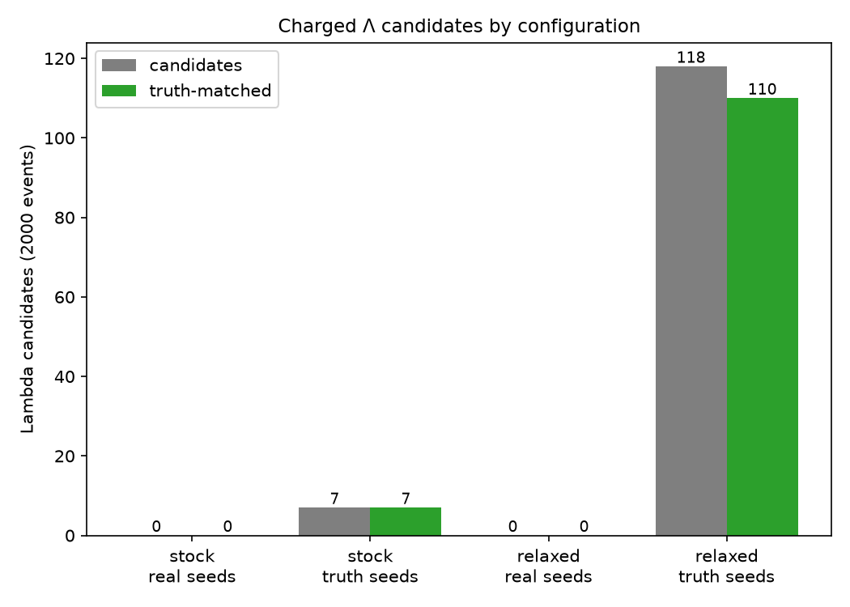
Yield: 118 candidates, 110 truth-matched, in 938 decaying events
11.7%
event-level efficiency (acceptance chain predicts ≈ 14%)
93%
candidate purity before any mass fit
• stock truth seeding: 7 candidates (decays inside 20 cm)
• real-seeded collection: 0 — B0 seeding gap (slide 9)
stock_vs_relaxed.png
7
Notes:
Truth-matched: candidate momentum within 10% of the generated Lambda momentum vector. The efficiency denominator counts p pi- decays with z < 30 m; most of the loss is pi- geometric acceptance and CKF efficiency, as measured in the ai-comb-lam acceptance table.

Slide 14
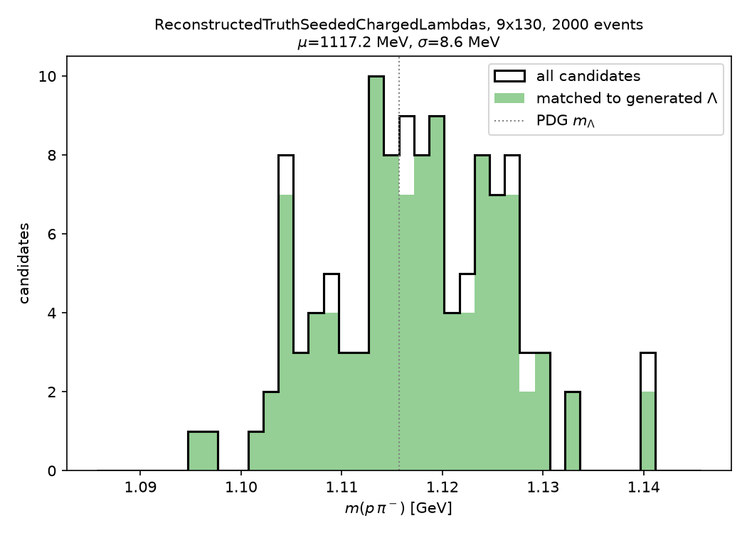
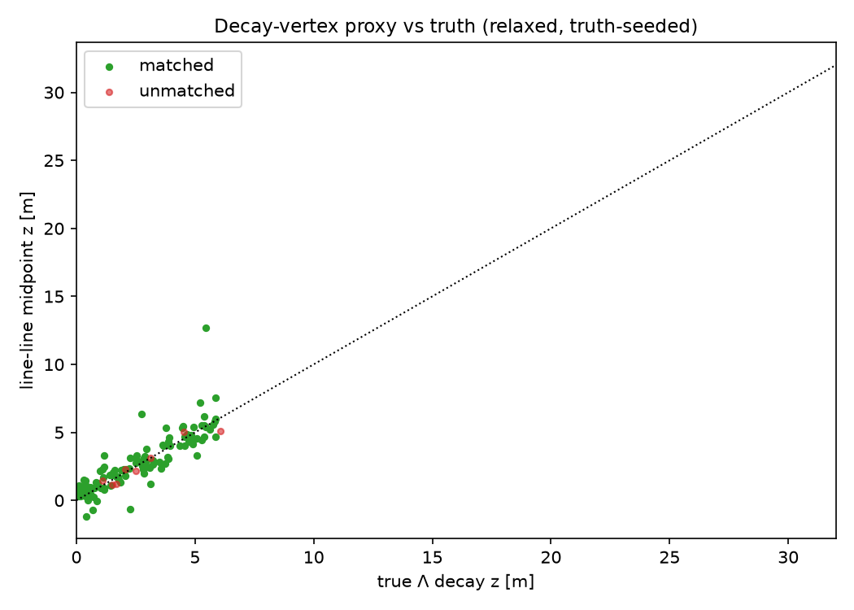
Mass peak at 1117 MeV (σ = 8.6 MeV) and vertex proxy tracking true decay z
mass_spectrum.png
decay_vertex.png
Left: truth-matched candidates shaded green. Right: line-line midpoint z vs true decay z — the proxy follows truth to the ~6 m B0 reach.
8
Notes:
Mu is a moment estimate inside the ±25 MeV window; the +1.5 MeV shift vs PDG is consistent with truth-seed momentum smearing (10%) plus window truncation. The standalone study's Gaussian fit gave 1115.9 MeV.

Slide 15
How we fixed the seeding volume (truth-seeder chain)
B0 RecHits
Measurements
Seeds
CKF tracks
p π⁻ pairs
stock campaign chain: hits in 30—73% of events, then zero from the seeder on — the seeding VOLUME excludes B0 physics
# stock TrackParamTruthInit (truth seeding)
generatorStatus == 1 # hard-coded
|vertex z| < 200 mm # IP-sized volume
|vertex x,y| < 80 mm
# our patch + parameters (dd4hep raw cm)
TrackerTruthSeeds:AcceptSecondaries=1
TrackerTruthSeeds:MaxVertexZ=3000 # 30 m
TrackerTruthSeeds:MaxVertexX=100 # 1 m
TrackerTruthSeeds:MaxVertexY=100
• ~6-line EICrecon patch (default-off flag) + seed volume opened from IP-sized to 30 m — Λ daughters get seeded; CKF fits real B0 hits
• Validation (9x100, 200 events): 80 B0 tracks; Sullivan p tracked in 54 events, π⁻ in 20, both in 13
• Upstream: PR #2797 merged Aug 18; PR #2901 (in review) makes it a proper relaxed B0 mode
• REAL seeding still open: our parameter scan of the orthogonal seeder (zMin/zMax/rMax/impactMax/…) gives 0 seeds — its barrel-triplet assumptions don't fit B0; needs a dedicated config
Re-reco recipe: strip the dead B0 chain + Measurements from a file copy (stored ACTS surface IDs don't survive a geometry rebuild), re-run patched EICrecon → truth-SEEDED B0 CKF tracks: real hits, real fit, only the seed position comes from MC.
8
Notes:
notes/lesson-b0-tracking-dead-in-campaign.md. The farm config (config-msf-26-07.yaml) carries the same flags; stock images silently ignore AcceptSecondaries (only an 'unused parameter' warning) so farm runs must use the patched build.

Slide 16
Two seeding gaps cap the production yield
Gap 1 — B0 real seeding
B0TrackerSeeds runs the central-tracker
seeding geometry → 0 seeds, 0 tracks.
ReconstructedChargedLambdas stays
empty in production.
Gap 2 — truth-seed vertex cuts
#2797 accepts secondaries, but defaults
(8 cm / 20 cm) reject the decay region.
Validation needed 1 m / 30 m.
• proposed: file the B0-seeding defect as its own issue (draft exists: zero_p0_PR.md), reference it from the feature issue
• proposed: document the far-forward truth-seeding parameters; a preset can follow working-group feedback
• the factories are wired now — the real-seeded collection fills as soon as seeding is fixed, with no algorithm change
amber = pending upstream fix
9
Notes:
Gap 1 verified again on latest main in all four validation runs. Gap 2 cost estimate for wide-open defaults (fakes, CKF time) is untested; hence documentation first, preset second.

Slide 17
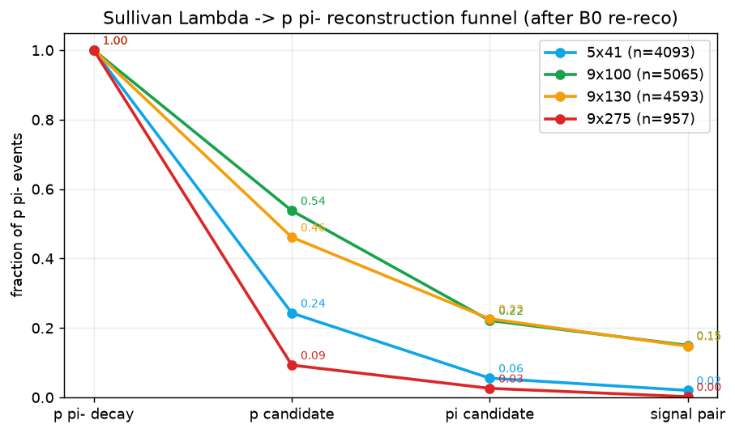
Recovered pipeline: campaign files → candidate pairs
• Re-reco of all 30 campaign files (8x 5x41, 10x 9x100, 10x 9x130, 2x 9x275) with the patched truth-seeded B0
• Candidates: central(±), B0(±), Roman Pots, OffMomentum; every (positive, negative) combination in an event is a pair — no truth used in pairing
• Split BY EVENT 70/10/20; truth only for labels; RP/OffM labeled via kinematic match (no MC associations there)
39,177
candidate pairs (30 files)
1,522
true Λ → p π⁻ signal pairs
per energy: p π⁻ events → p candidate → π⁻ candidate → complete signal pair
9
Notes:
Dataset v2 numbers load from reports/phase1_baseline.json. The funnel shows the pion leg is the bottleneck everywhere; 9x275 contributes ~nothing.

Slide 18
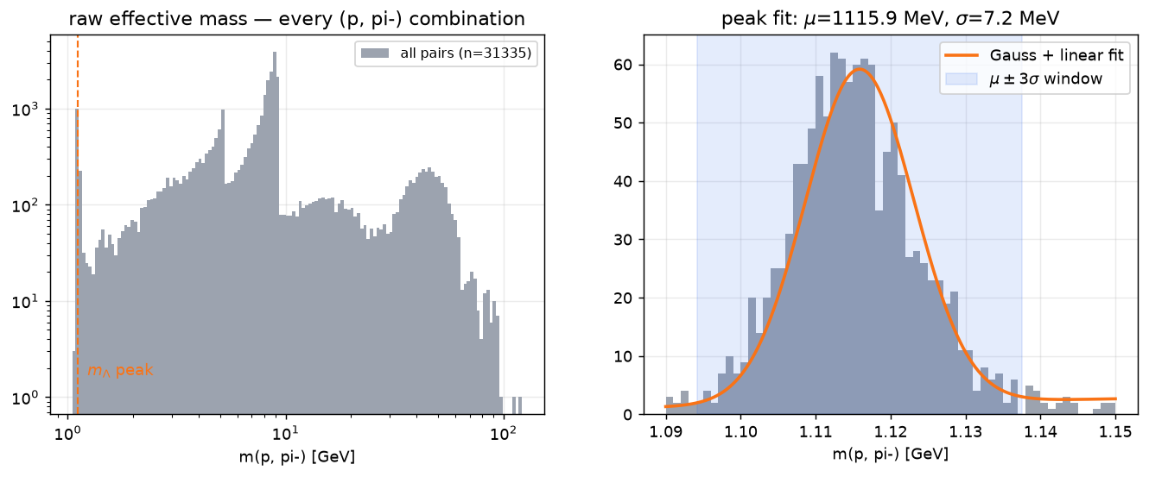
Classic reconstruction, step 1: the Λ peak exists
• Invariant mass of EVERY (p, π⁻) pairing under the (m_p, m_π) hypothesis — combinatorial spectrum runs to ~100 GeV (central × forward mispairings)
• A Λ peak at the PDG value proves momenta, labels and the recovered B0 tracks consistent end-to-end
1115.9
fitted μ [MeV] (PDG: 1115.7)
7.2
σ [MeV] — mass resolution of
B0 + Roman Pot reco
left: full combinatorial spectrum (log—log); right: zoom on the Λ peak with Gauss+linear fit
10
Notes:
scripts/25_baseline_v0.py; fit on train+val, test untouched. Numbers load from baseline_cutflow.json.

Slide 19
Step 2: the V0 cleaning cuts and why each exists
cut | value | physics logic
opening angle | < 33.8 mrad | boosted Λ collimates daughters into a ~m/p cone
pair θ | < 56.6 mrad | the Λ itself goes far-forward
track—track DCA | < 90 mm | daughters of one decay must meet in space
vertex z | -1.4 to 32 m | decay after IP, before the FF trackers
pointing to IP | < 3.14 rad (no-op) | Λ momentum should point back to IP — ill-defined while RP legs are optics lines
momentum asymmetry | > 0.47 | the proton carries ~84% of the Λ momentum
mass window | 1.094 — 1.138 GeV | μ ± 3σ of the fitted peak
• Each threshold fixed on TRAIN at ~99% marginal signal efficiency, then frozen — makes the later ML comparison fair
• Vertex cuts are weak: an RP 'track' is an IP-optics line through the origin, so line—line vertexing carries little information; B0 track-state vertexing would restore them
11
Notes:
Cut values load live from reports/baseline_cutflow.json — slides cannot go stale against the pipeline.

Slide 20
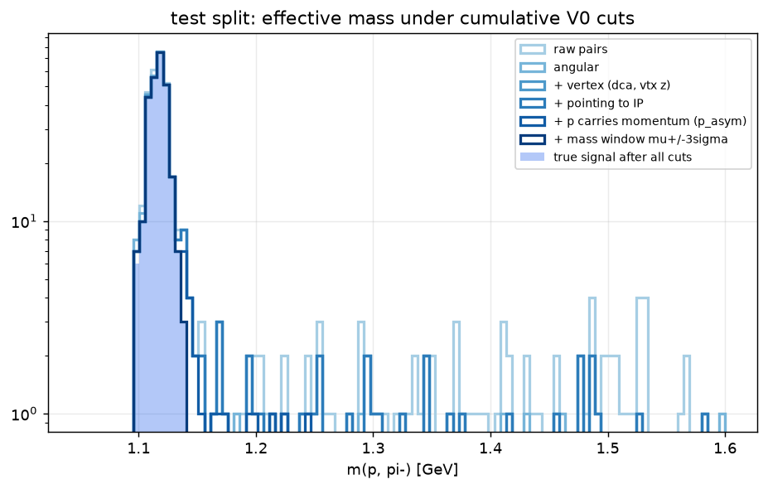
Step 3: how many Λ we find — and keep after cuts
stage (cumulative) | signal | bkg | sig eff
raw pairs | 306/306 | 7536/7536 | 1.000
angular | 296/306 | 51/7536 | 0.967
+ vertex (dca, vtx z) | 287/306 | 47/7536 | 0.938
+ pointing to IP | 286/306 | 47/7536 | 0.935
+ p carries momentum (p_asym) | 281/306 | 9/7536 | 0.918
+ mass window mu+/-3sigma | 267/306 | 3/7536 | 0.873
• Test split: 306 true Λ pairs among 7536 combinatorial pairs
• Angular cuts alone do nearly all the work: 7536 → 51 background at 96.7% signal
• All cuts w/o mass: 281/306 signal kept, 9 bkg · + mass window: 267/306, 3 bkg
• Background quoted as ABSOLUTE pairs kept — rejection ratios like 0.999 vs 1.000 hide the comparison
• Today's background is central×forward mispairing (easy); it will get harder once real seeding adds fake tracks
test-split mass spectrum under cumulative cuts; filled = surviving true Λ
12
Notes:
Cutflow loads from baseline_cutflow.json. Full-dataset scale: 1522 signal pairs of 39177 total (30 files).

Slide 21
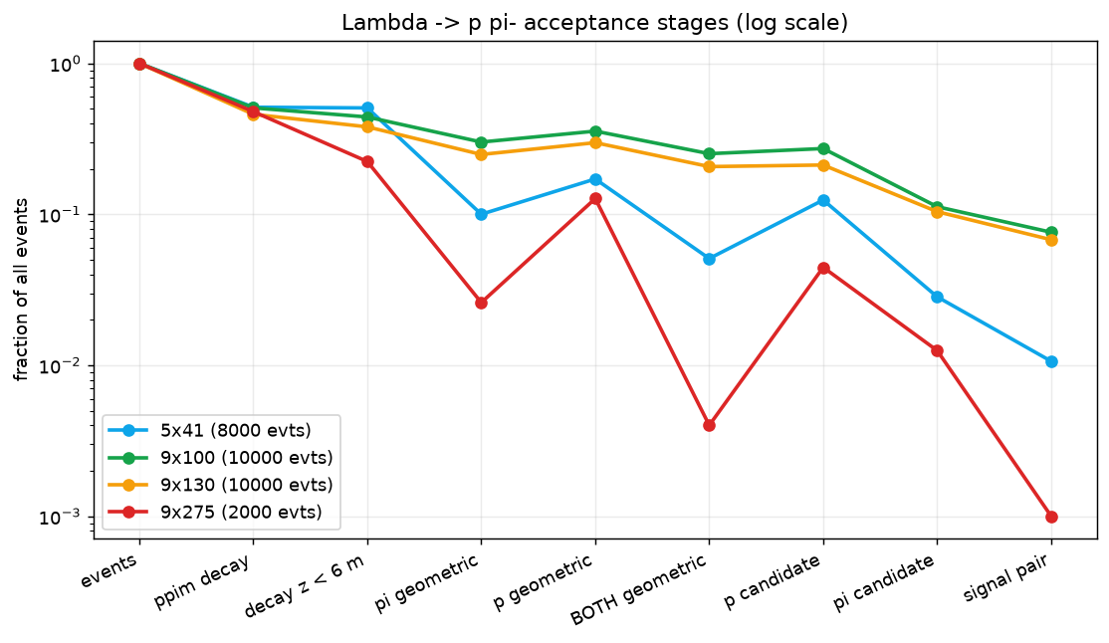
Efficiency ledger: where the Λ actually go
• Three multiplicative losses; only the last one is ours to fix:
– branching + Λ surviving to decay in flight: ×0.5
– geometry (π⁻ needs decay < 6 m AND 5.5—20 mrad): ×0.50 at 9x100, ×0.10 at 5x41, ×0.008 at 9x275
– tracking: CKF finds only 37% of pions that left ≥4 B0 hits (protons: 77%) — the biggest FIXABLE loss
• Net: 7.6% of 9x100 events give a complete signal pair; 0.1% at 9x275
37%
π⁻ CKF efficiency,
hit-ceiling events (9x100)
7.6%
of 9x100 events
yield a signal pair
0.1%
of 9x275 events
yield a signal pair
per-beam survival by stage (log): events → decay → geometry → candidates → pair
13
Notes:
reports/acceptance_table.{md,json}, full 30-file statistics; numbers computed from the JSON at build time. Geometric = >=4 tracker hits.

Slide 22
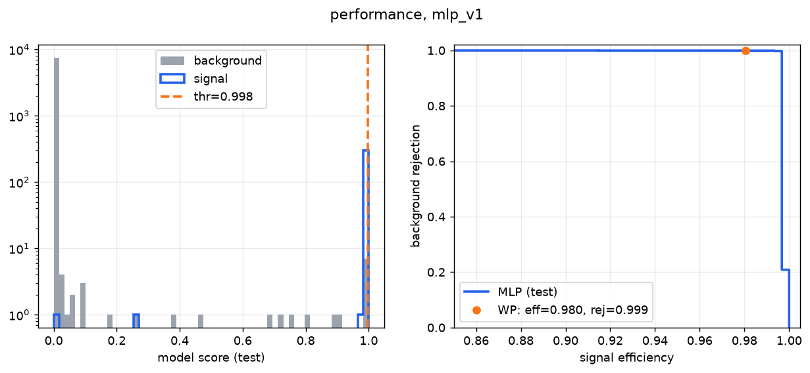
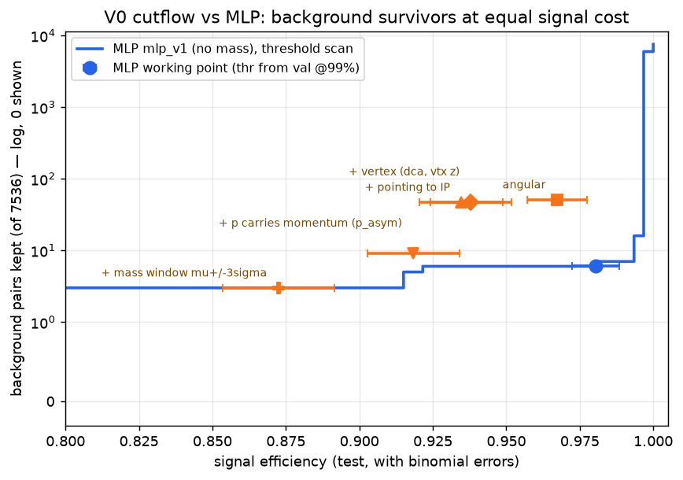
The selector: a small MLP pair classifier
33 features
per-leg kinematics, fit quality,
origin; pair geometry
MLP 64·64·32
ReLU, normalized inputs
(scripts/30_train.py)
pair score
threshold from validation
at 99% signal eff
ONNX, 35 kB
~0.3 µs/pair, 1 CPU core
deployable in EICrecon
Invariant mass is excluded from the inputs — a model given the mass sculpts a fake peak into combinatorics. Features are whitelisted in one module (comblam/features.py).
test score distribution; efficiency / rejection curve with the fixed working point
background survivors vs signal efficiency: cut stages vs MLP threshold scan
14
Notes:
Architecture from scripts/30_train.py: normalize -> 64 -> 64 -> 32 -> 1. Threshold fixed on validation at 99% signal efficiency. Right plot: at any matched efficiency the MLP keeps equal or less background than the cutflow stages.

Slide 23
ML result: small MLP beats the cuts without using mass
selector | signal kept | bkg kept | uses mass?
raw combinatorics | 306/306 | 7536/7536 | —
V0 cuts, no mass window | 281/306 | 9/7536 | no
V0 cuts + mass μ±3σ | 267/306 | 3/7536 | YES
MLP @ 99%-val working point | 300/306 | 6/7536 | no
MLP at eff matched to V0+mass | 267/306 | 3/7536 | no
MLP + mass window | 278/306 | 2/7536 | YES
Event level: pick ONE pair per event
0.980 ± 0.008
MLP top-score — event efficiency
(purity 0.977)
0.876 ± 0.019
V0 cuts + closest-mass — event efficiency
(purity 0.989)
• Every row: tuned on train + validation, quoted on the untouched test split
• At matched efficiency the MLP keeps equal or less background everywhere; today's background is the easy kind
Per-beam at the single global threshold: 9x100 0.987, 9x130 0.993, but 5x41 only 0.833 → per-energy working points are a phase-2 item.
15
Notes:
Scoreboard loads from baseline_cutflow.json / phase1_eval.json. Protocol: every row tuned on train(+val), quoted on the untouched test split.

Slide 24
Read the numbers with care — and what comes next
Caveats (they change the reading)
Next, by expected value
• All B0 tracks are truth-SEEDED: real hits and fits, but the candidate pool has NO fake tracks.
• Statistics: 1,522 signal pairs total — 99%-level working points carry real uncertainty
• Re-reco uses the local geometry build; campaign geometry may drift slightly
• 1. real B0 seeding — everything else is downstream of it
• 2. statistics: farm production, ~1M events/energy
• 3. B0 track-state vertexing to restore pointing / DCA / IP cuts
• 4. per-energy working points; OffMomentum recovery for the 9x275 proton side
area | where it stands
B0 seeding volume | fixed for truth chain; merged upstream (#2797), relaxed B0 mode in review (#2901)
classic Λ selection | 281/306 signal at 9 bkg pairs (no mass); 267/306 at 3 with mass window
ML selection | 300/306 at 6 bkg — no mass input; event-level 0.980 vs 0.876 for cuts
blockers | all three filed upstream; 2 fixes in flight; ZDC ownership is the open ask
Asks: an owner for ZDC reconstruction · review of #2892 and #2901 · green light for the 1M-event farm production
16
Notes:
Closing slide doubles as the summary: caveats left, priorities right, one-line takeaways below. The ask to the room: owners for ZDC reco and B0 real seeding, review for #2892 and #2901, green light for the 1M-event farm production.

