Slide 1
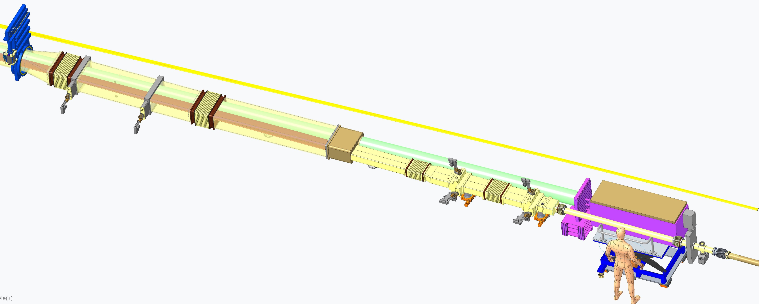
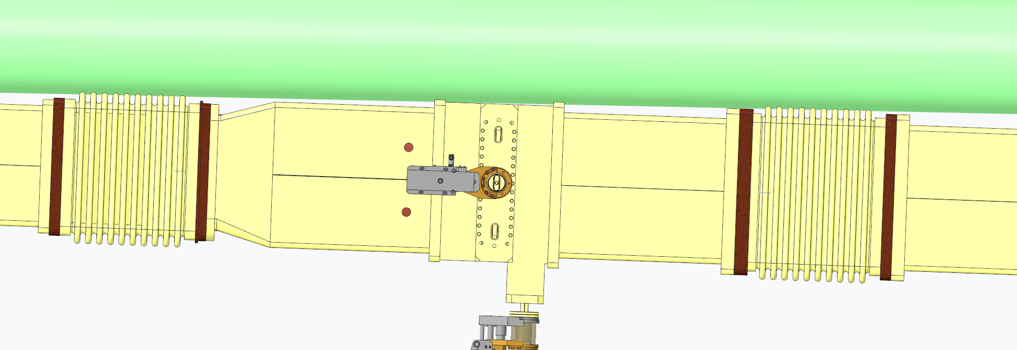
FAR FORWARD DETECTORS
Credit: Guna Kuppan
OMD
NEUTRON BEAM
Roman Pot

Slide 2
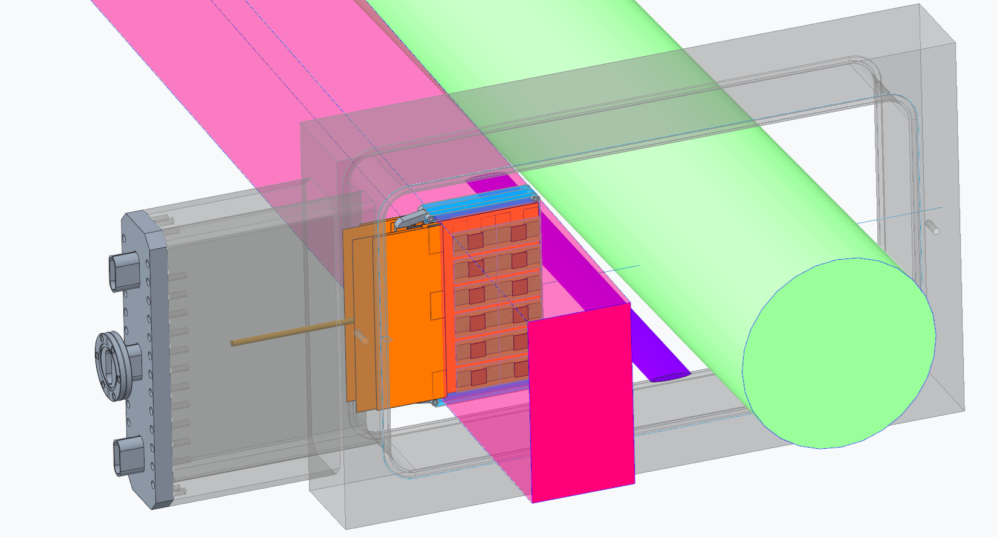
Credit: Guna Kuppan
Neutron
275 GeV beam 10σ envelope
Off momentum particles envelope

Slide 3
Cable layout
Bend R

Slide 4
Some RF shielding options to consider
1
2
3

Slide 5
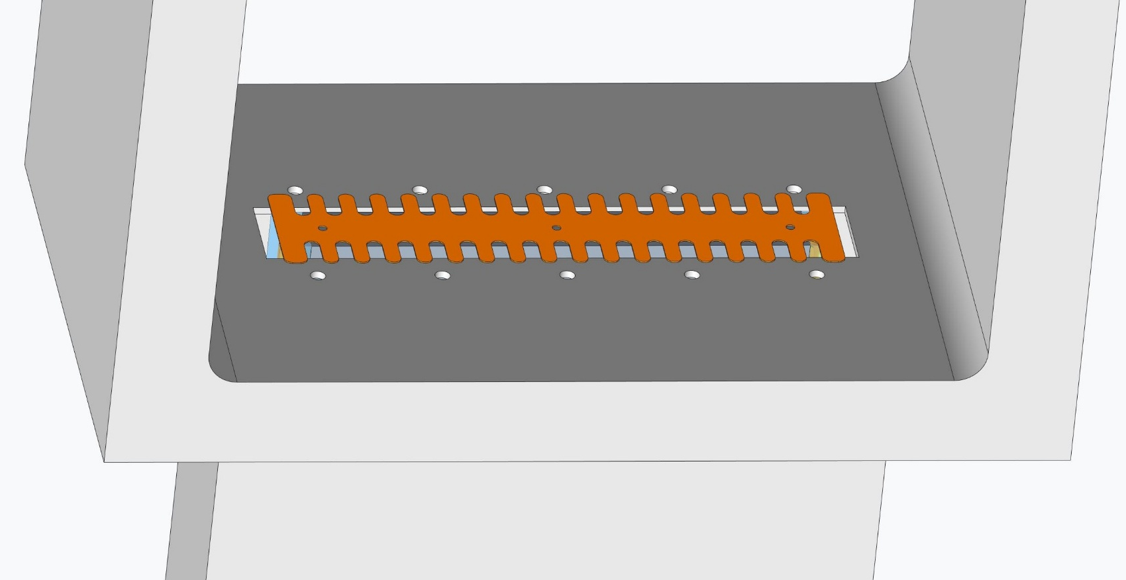
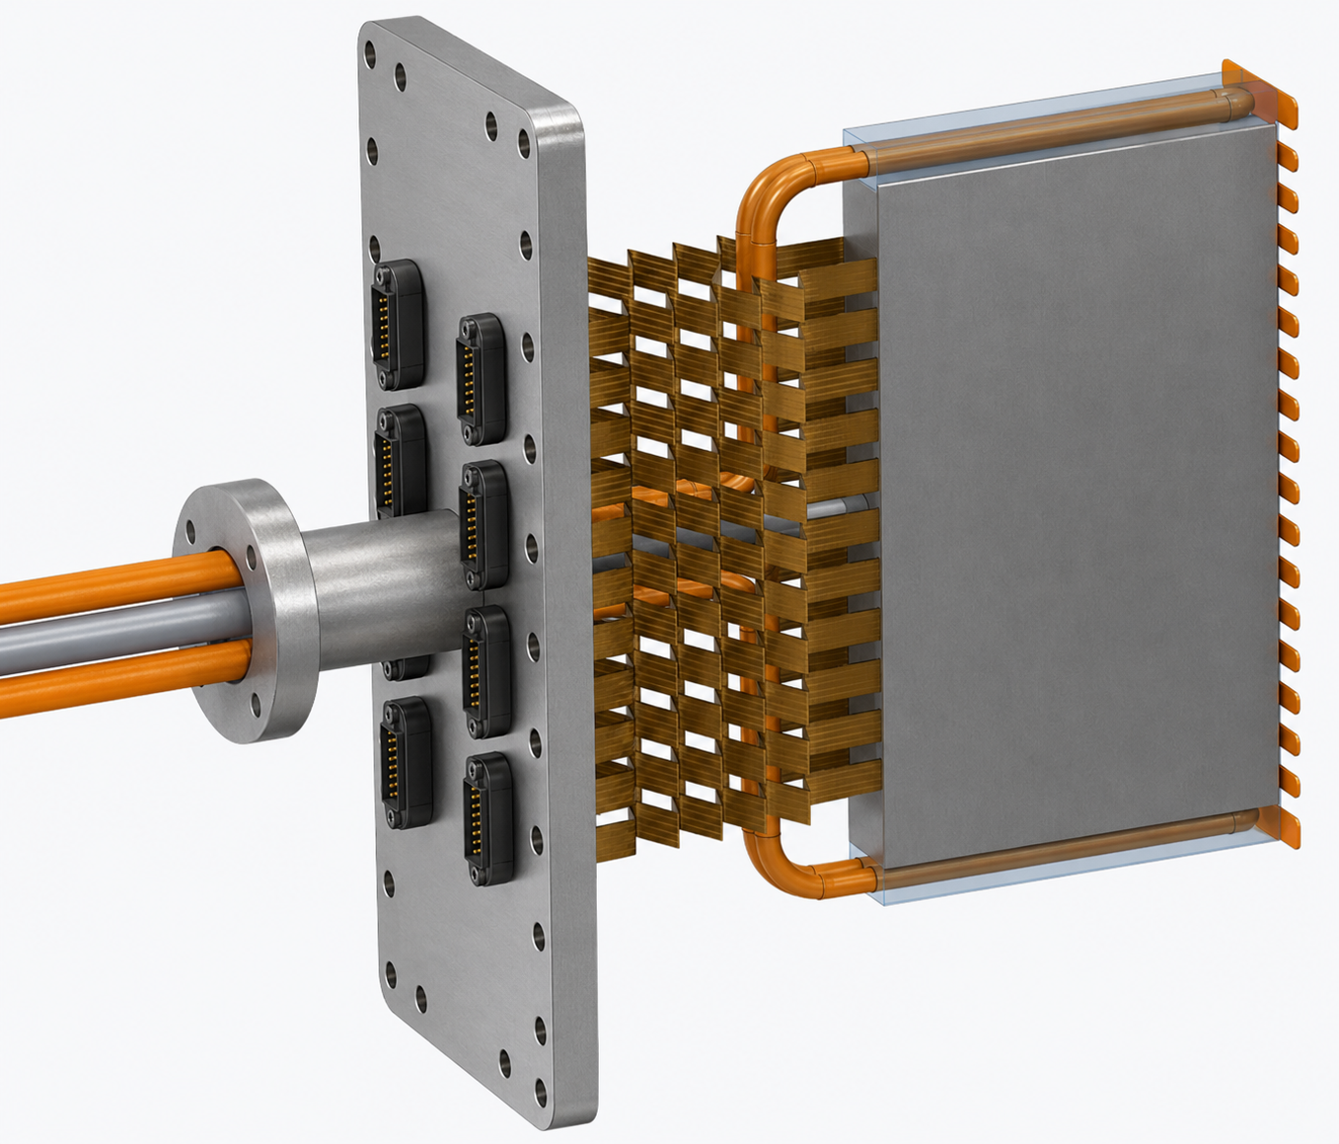
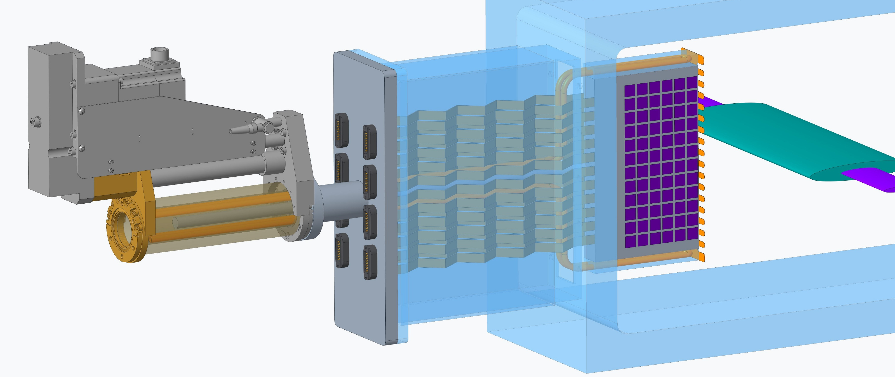
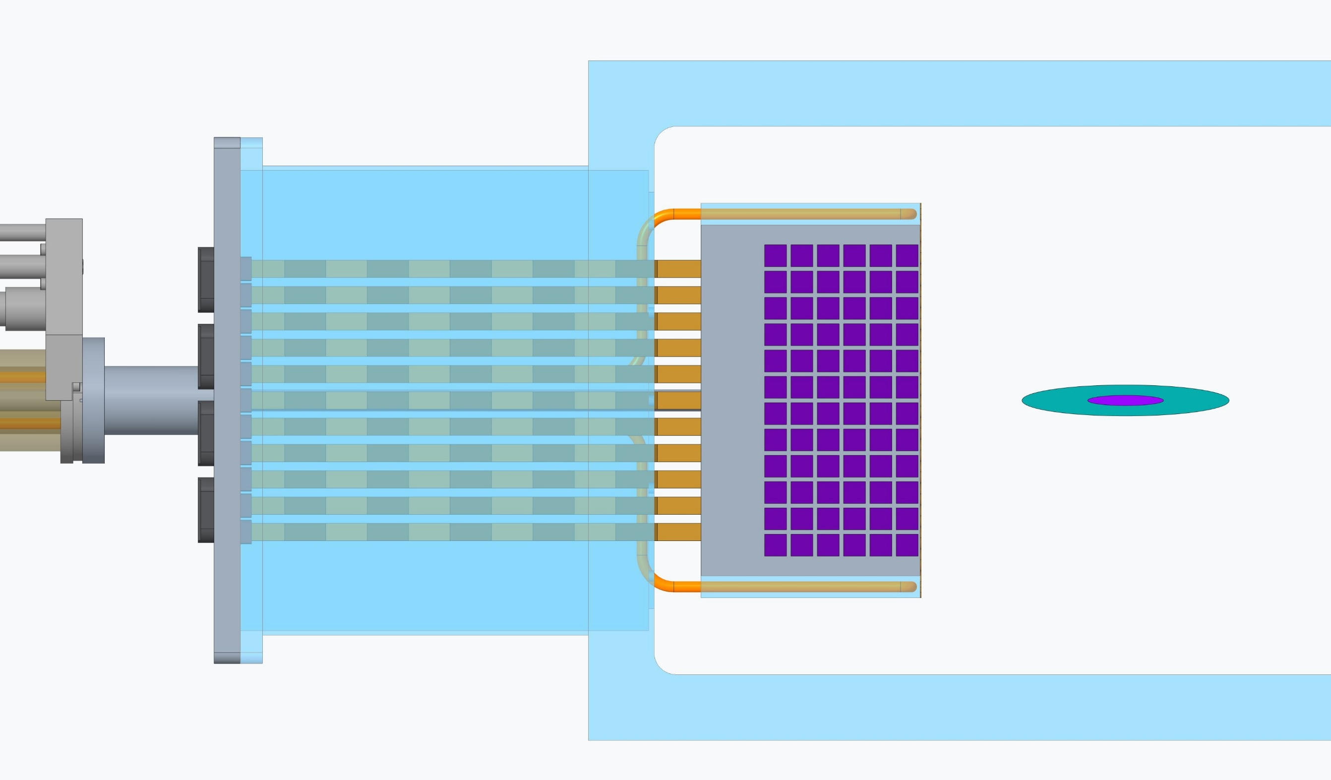
Cooling
Peltier preferred
(other options liquid/evaporative)
concept
Connectors
RF shield at injection mode
RF shield
~.2mm thk.
Kapton cables
(Electronic Liquid FC-40?)

Slide 6
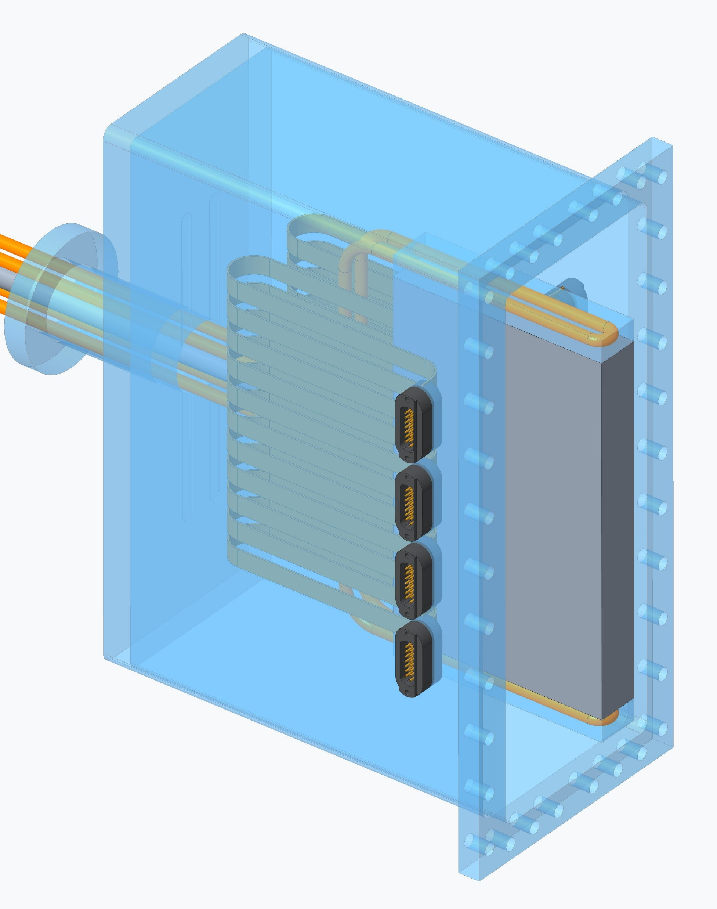
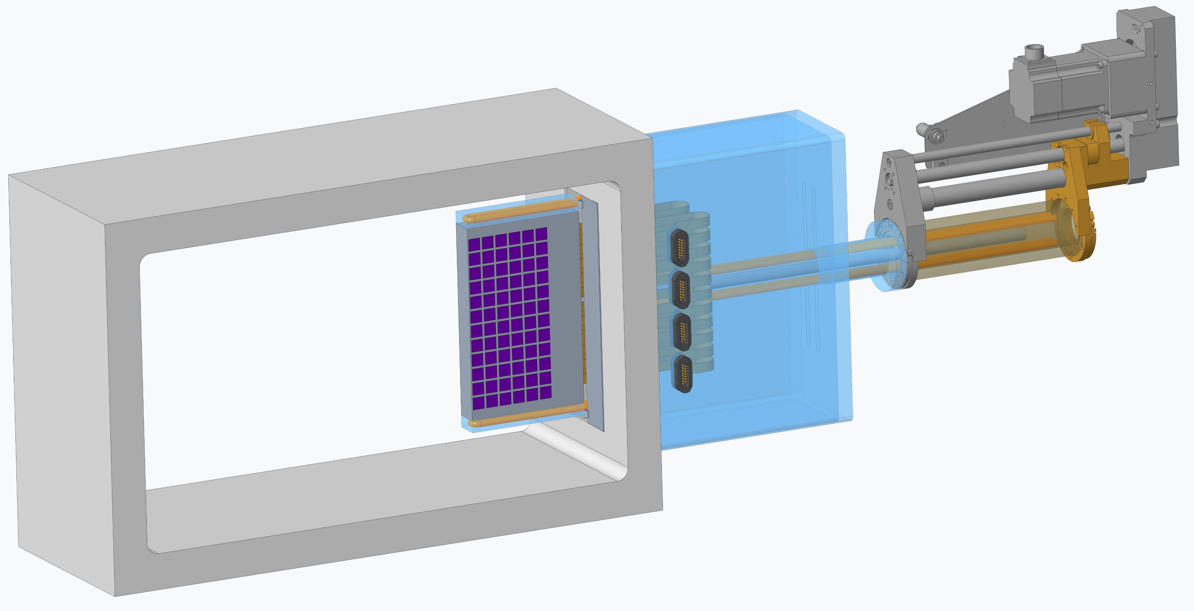
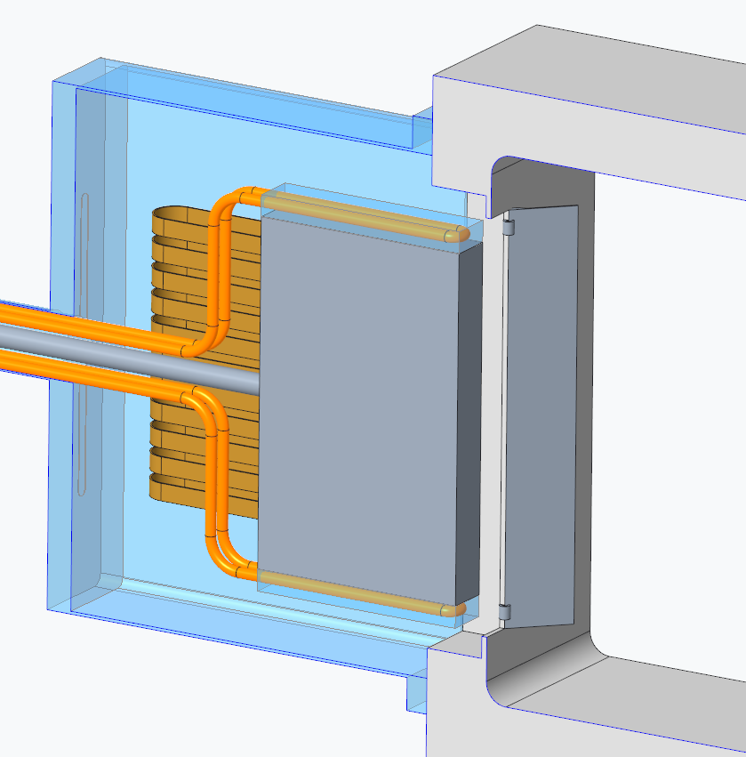
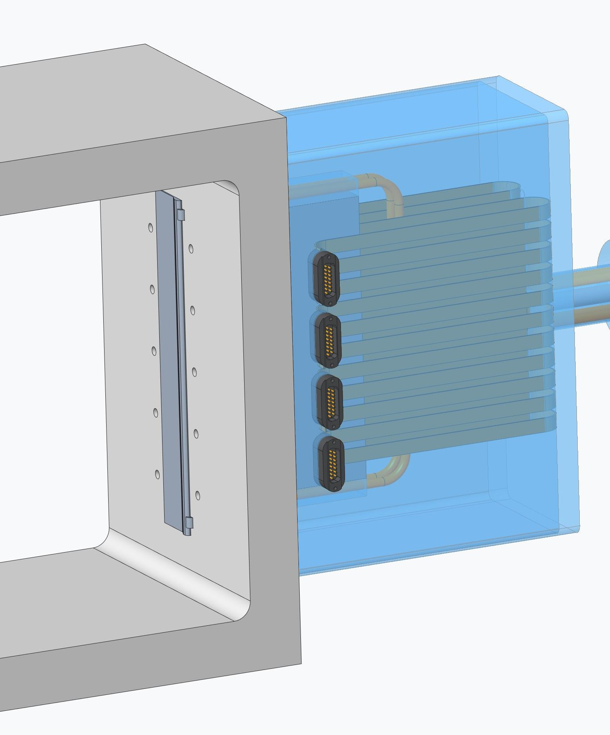
Cooling solution TBD
Sensors in extended position
concept
RF trap door
(reliability concerns)
outgassing
Pumping ?
Separable detector module

Slide 7
Status update:
 |  | status | Person in charge
1 | Sensor | Stave (power/signal) 32 Kapton cables, # channels? Connectors? | Jack (BNL)
2 | RF shield Neutron transition | Brush seal – bristle – rf fingers – trap doors | Gang Wang / Alexei simulation
3 | Cooling | 1.Peltier 2.Liquid (single phase) 3.Evaporative cooling | IJC lab
4 | Vacuum | Vacuum Chambers | Guna
5 | Mechanical | RF shields – motion – cable management - | Chang/Karim?

Slide 8
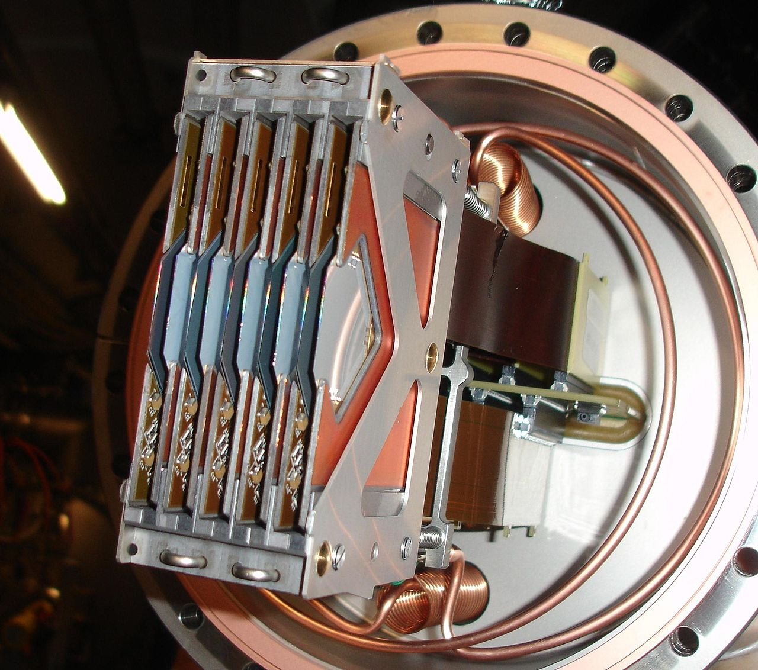
Reference:
TOTEM RomanPot
CERN

