Slide 1
BIC Analysis (mlp)
I still had a few items to be improved on my desk
Improving some quirks in the standard decoder (the only one we have been using so far)
Coming through with the event pool that stitches the broken-up waveforms back again
I have not yet installed my fixes in anyone’s orbit yet (carbon, Jlab ifarm etc)
Didn’t want to change anything behind your back without you knowing about it.

Slide 2
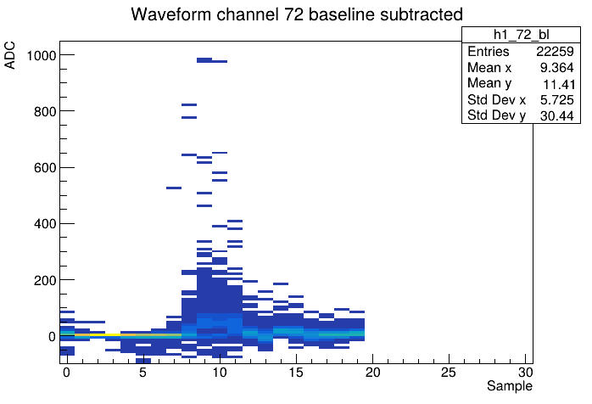
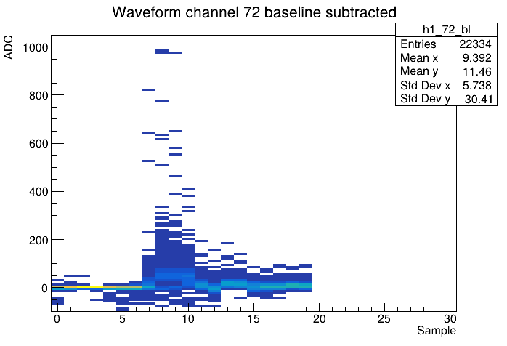
Bug fix
Norbert and I had long suspected that a sample of another waveform would “spill over”
That turned out to be correct. (It was a hell of debugging session…)
But more importantly, the “misplaced sample” would take one away from waveform 0

Slide 3
Bug fix
In addition, the “misplaced sample” would take one sample away from waveform 0
19
20
20
Number of Waveforms: 17
----- Waveform 0 Samples: 19 Timestamp: 0x40c40129
----- Waveform 1 Samples: 20 Timestamp: 0x40c40d55
----- Waveform 2 Samples: 20 Timestamp: 0x480bfa19
----- Waveform 3 Samples: 20 Timestamp: 0x4b711521
----- Waveform 4 Samples: 20 Timestamp: 0x509ce755
----- Waveform 5 Samples: 20 Timestamp: 0x5890bae1
----- Waveform 6 Samples: 20 Timestamp: 0x5dedce0d
----- Waveform 7 Samples: 20 Timestamp: 0x6248b7b9
Number of Waveforms: 17
----- Waveform 0 Samples: 20 Timestamp: 0x40c40129 1086587177
----- Waveform 1 Samples: 20 Timestamp: 0x480beded 1208741357
----- Waveform 2 Samples: 20 Timestamp: 0x4b7108f5 1265699061
----- Waveform 3 Samples: 20 Timestamp: 0x509cdb29 1352457001
----- Waveform 4 Samples: 20 Timestamp: 0x5890aeb5 1485876917
----- Waveform 5 Samples: 20 Timestamp: 0x5dedc1e1 1575862753
----- Waveform 6 Samples: 20 Timestamp: 0x6248ab8d 1648929677
----- Waveform 7 Samples: 20 Timestamp: 0x63c2288d 1673668749
Fixed

Slide 4
SRO packets chop where they chop
Streaming data have their individual channels’ hit data interleaved
There is no place where a crossing’s data (or even a hit) of multiple channels end
We simply say “stop” when a size limit is reached.
Some waveforms are cut off in the middle as we saw before:
Packet boundary
We are chopping the streaming detector data into conveniently-sized packets for storage
There is no place in the data where all data structures end at the same time
and they are all interleaved
No matter where we cut, we will always cut off a hit between packet boundaries.
A packet has the purview of, well, its own data. It has no ability to look back or look forward in the data stream.

Slide 5
You can see this easily
Here is an example of a “broken up” waveform
----- Waveform 14 Samples: 20 Timestamp: 0x73db98d1 1943771345
----- Waveform 15 Samples: 20 Timestamp: 0x7b7bbbd9 2071706585
----- Waveform 16 Samples: 13 Timestamp: 0x83be2cbd 2210278589
>>>>> packet boundary <<<<<<
Number of Waveforms: 2
----- Waveform 0 Samples: 6 Timestamp: 0x83be35b5 2210280885
----- Waveform 1 Samples: 19 Timestamp: 0x8715cdd5 2266353109
It looks like waveform 16 of one packet with 13 samples has its continuation in the next packet with 6 samples
Ok, it should be 20, not 19… different issue..
Let’s look at the clock start (2210278589) of WF 16 with 13 samples 0..12
It ends with 2210278589 + 12*164 = 2210280557
Then we are still missing one sample (13)
And sample 14 is 2210278589 + 14*164 = 2210280885
So we continue with sample 15…20
(still, sample 13 is missing. I’m in the process of “pencil-decoding” the data to see if I disregard the last one somehow.)

Slide 6
Enter the pool
The pool is putting together again the pieces that were cut into packets, as if that packetizing had never happened
Of course it cannot put together a 200GB structure again in memory
But it provides a sliding window across the data timeline large enough that all data from one crossing are in that window
Drop data / BCOs that have been processed, fill in new data
One pool / packet id ( 2 pools for 2 KCUs)
Go through the data without excessive memory usage (I used 64 packets depth, can be tuned)
Instead of the “keyhole” actual packet, you use the pool instead
Keep throwing in packets until prescribed depth is reached
APIs are (by design) very similar to the packet itself, iValue, lValue etc etc
I’m still working on fine-tuning this, next week more
Packet boundary

Slide 7
Summary for today
The bug fix will lead to
The waveforms being correct (no more wrong sample 0)
Fewer waveforms with a non-nominal length being thrown out
Be aware though that this shifts the WF ”left” by one sample
The pool will lead to
Even fewer waveforms with non-nominal lengths
We have built in some ad-hoc cuts (such as throwing out waveforms with non-nominal lengths) that we should revisit (although that one is still useful)
I’m sure we will find more pathologies as go through more data
Still some more debugging expected as we go through larger datasets.
I will git-push and install the fix around {carbon, ifarm} tomorrow. Norbert should also update his installation
(MLP’s next project: finalizing the combining of data from 2 KCUs and also AP + CAEN later. Olaiya and I had started this. )

