Slide 1
Overview of ZDC Requirements for the EIC
Alex Jentsch, Brookhaven National Lab
ajentsch@bnl.gov
ePIC TIC Meeting
Sept. 23rd, 2024

Slide 2
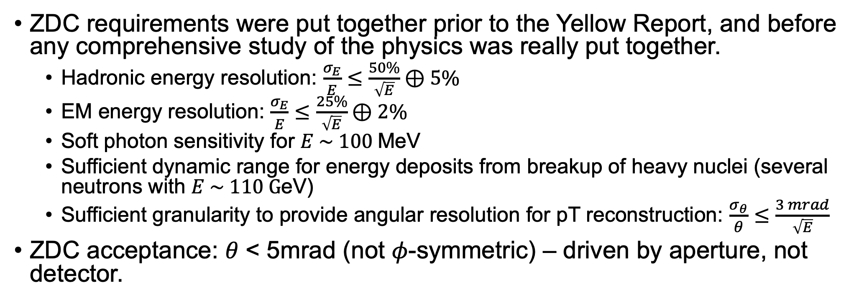
Basic “Requirements”
ZDC requirements were put together prior to the Yellow Report, and before any comprehensive study of the physics was really put together.
  Hadronic energy resolution: $\frac{σ_{E}}{E}≤\frac{50\%}{\sqrt{E}}⊕5\%$
  EM energy resolution: $\frac{σ_{E}}{E}≤\frac{25\%}{\sqrt{E}}⊕2\%$
  Soft photon sensitivity for $E \sim 100$MeV
  Sufficient dynamic range for energy deposits from breakup of heavy nuclei (several neutrons with $E \sim 110 G$eV)
  Sufficient granularity to provide angular resolution for pT reconstruction: $\frac{σ_{θ}}{θ}≤\frac{3 mrad}{\sqrt{E}}$
ZDC acceptance: 𝜃 < 5mrad (not 𝜙-symmetric) – driven by aperture, not detector.
General NB: Previous and current studies and extracted resolutions all assume “perfect” ZDC performance, except for transverse and longitudinal leakage. They do not include effects of backgrounds, electronics, light collection, etc.

Slide 3
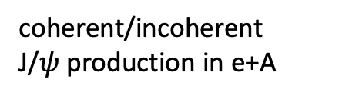
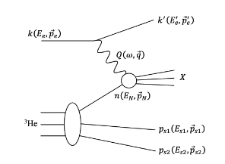
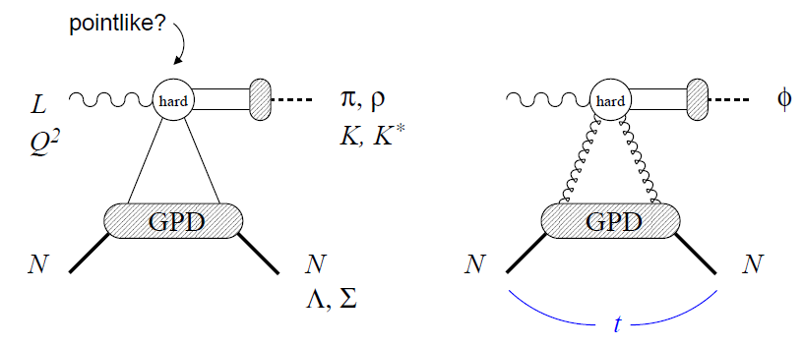
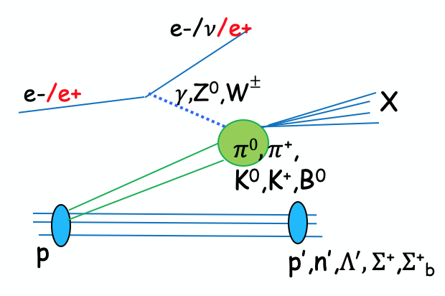
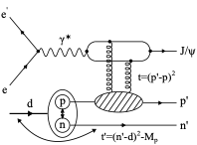
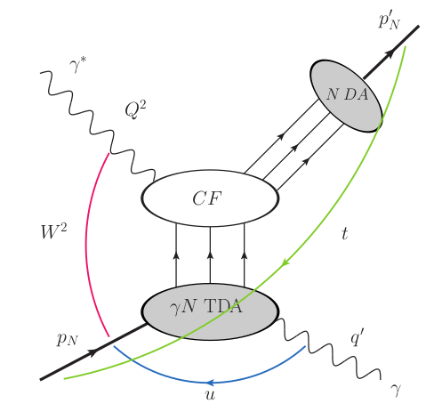
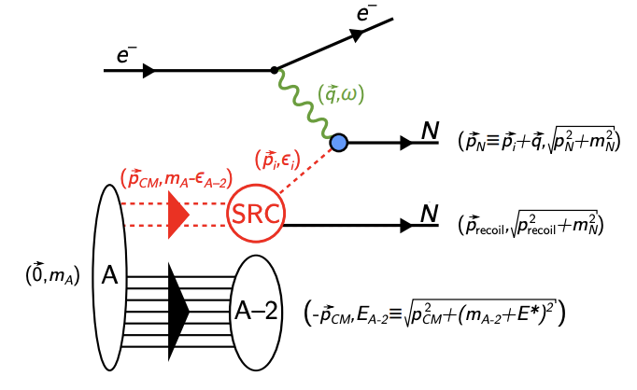
(some) Physics channels relying on ZDC
Sullivan process
e+d exclusive J/Psi with p/n
tagging
spectator tagging in light nuclei
J/Ψ
u-channel backward exclusive electroproduction
Quasi-elastic electron scattering

Slide 4
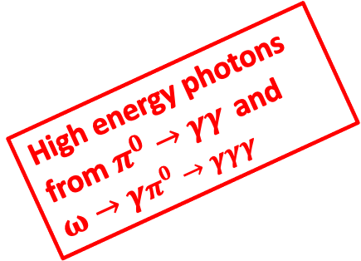
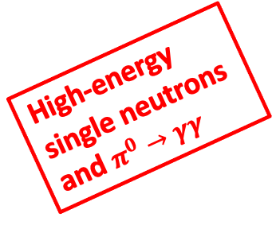
(some) Physics channels relying on ZDC
Sullivan process
e+d exclusive J/Psi with p/n
tagging
spectator tagging in light nuclei
J/Ψ
High-energy single neutrons and $π^{0}→γγ$
High-energy single neutrons
High-energy single neutrons
Multiple high-energy neutrons; soft photons
u-channel backward exclusive electroproduction
Quasi-elastic electron scattering
In every case, we will only have *one* of the possible final state options (e.g. either neutrons or photons, not both).
High-energy single neutrons
High energy photons from $π^{0}→γγ$ and $ω→γπ^{0}→γγγ$

Slide 5
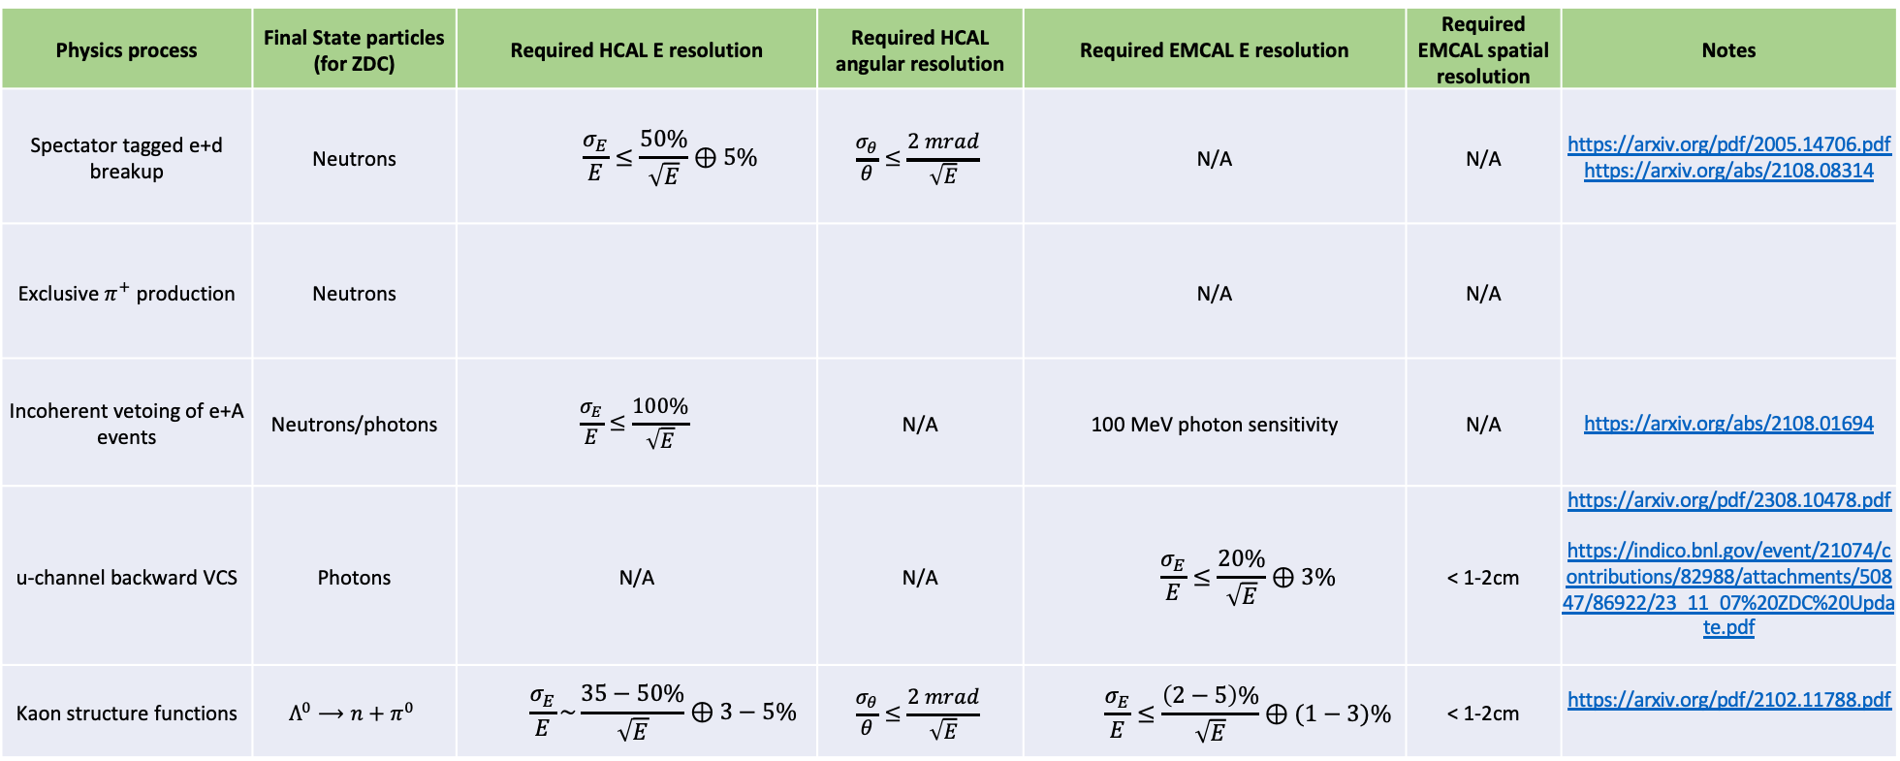
Top-level Summary of Requirements
Physics process | Final State particles (for ZDC) | Required HCAL E resolution | Required HCAL angular resolution | Required EMCAL E resolution | Required EMCAL spatial resolution | Notes
Spectator tagged e+d breakup | Neutrons | $$\frac{σ_{E}}{E}≤\frac{50\%}{\sqrt{E}}⊕5\%$$ | $$\frac{σ_{θ}}{θ}≤\frac{2 mrad}{\sqrt{E}}$$ | N/A | N/A | https://arxiv.org/pdf/2005.14706.pdf https://arxiv.org/abs/2108.08314
Exclusive $π^{+}$ production | Neutrons |  |  | N/A | N/A
Incoherent vetoing of e+A events | Neutrons/photons | $$\frac{σ_{E}}{E}≤\frac{100\%}{\sqrt{E}}$$ | N/A | 100 MeV photon sensitivity | N/A | https://arxiv.org/abs/2108.01694
u-channel backward VCS | Photons | N/A | N/A | $$\frac{σ_{E}}{E}≤\frac{20\%}{\sqrt{E}}⊕3\%$$ | < 1-2cm | https://arxiv.org/pdf/2308.10478.pdf https://indico.bnl.gov/event/21074/contributions/82988/attachments/50847/86922/23_11_07%20ZDC%20Update.pdf
Kaon structure functions | $$Λ^{0}⟶n+π^{0}$$ | $$\frac{σ_{E}}{E}\sim \frac{35−50\%}{\sqrt{E}}⊕3−5\%$$ | $$\frac{σ_{θ}}{θ}≤\frac{2 mrad}{\sqrt{E}}$$ | $$\frac{σ_{E}}{E}≤\frac{\left(2−5\right)\%}{\sqrt{E}}⊕(1−3)\%$$ | < 1-2cm | https://arxiv.org/pdf/2102.11788.pdf

Slide 6
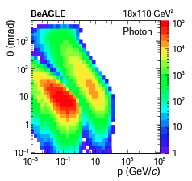
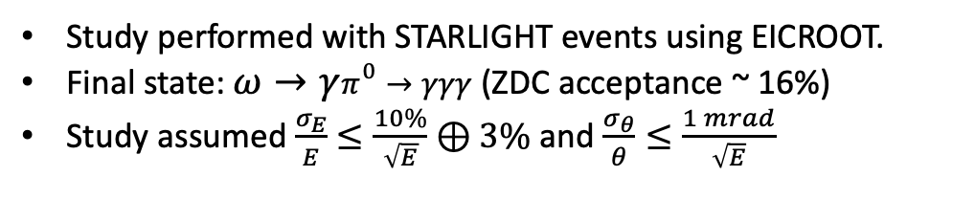
Photons
Soft photon tagging important for vetoing of incoherent e+A events (about 3.25% of events produce *only* soft photon).
Backward u-channel 𝜔 production.
Study performed with STARLIGHT events using EICROOT.
Final state: $ω→γπ^{0}→γγγ$ (ZDC acceptance ~ 16%)
Study assumed $\frac{σ_{E}}{E}≤\frac{10\%}{\sqrt{E}}⊕3\%$ and $\frac{σ_{θ}}{θ}≤\frac{1 mrad}{\sqrt{E}}$
Figure from: W. Chang, E.C. Aschenauer, M. D. Baker, A. Jentsch, J.H. Lee, Z. Tu, Z. Yin, and L.Zheng, Phys. Rev. D 104, 114030 (2021)

Slide 7
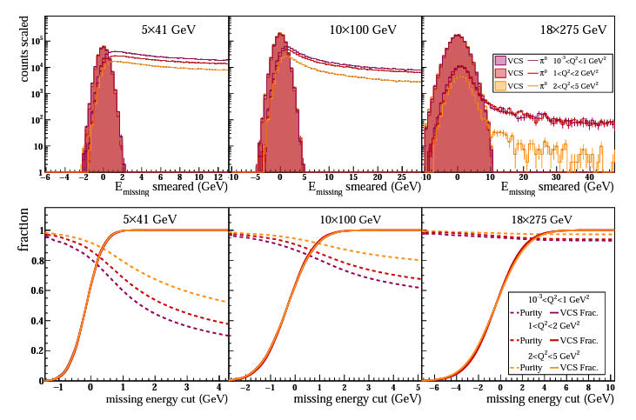
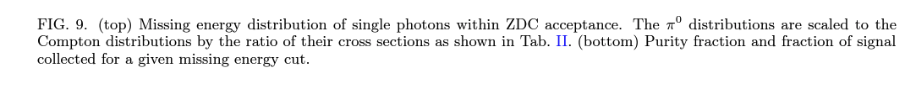
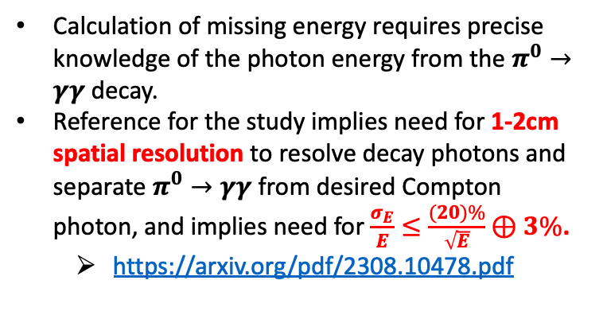
Photons
Calculation of missing energy requires precise knowledge of the photon energy from the $π^{0}→γγ$ decay.
Reference for the study implies need for 1-2cm spatial resolution to resolve decay photons and separate $π^{0}→γγ$ from desired Compton photon, and implies need for $\frac{σ_{E}}{E}≤\frac{(20)\%}{\sqrt{E}}⊕3\%$.
  https://arxiv.org/pdf/2308.10478.pdf

Slide 8
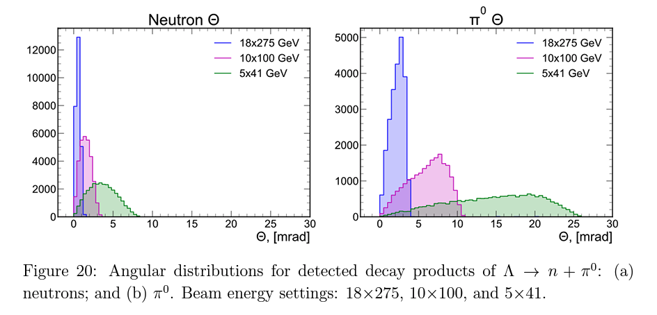
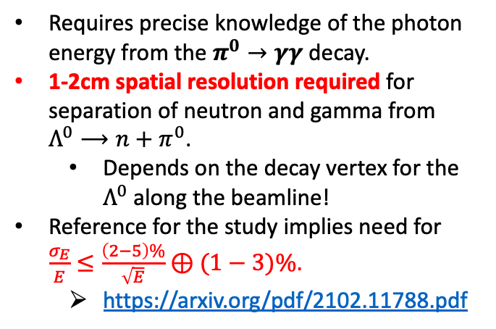
Photons
Requires precise knowledge of the photon energy from the $π^{0}→γγ$ decay.
1-2cm spatial resolution required for separation of neutron and gamma from $Λ^{0}⟶n+π^{0}$.
  Depends on the decay vertex for the $Λ^{0}$ along the beamline!
Reference for the study implies need for $\frac{σ_{E}}{E}≤\frac{\left(2−5\right)\%}{\sqrt{E}}⊕(1−3)\%$.
  https://arxiv.org/pdf/2102.11788.pdf

Slide 9
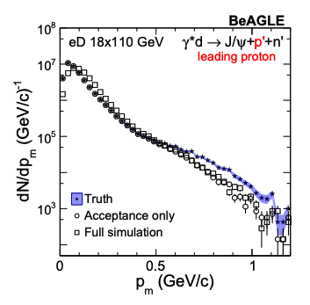
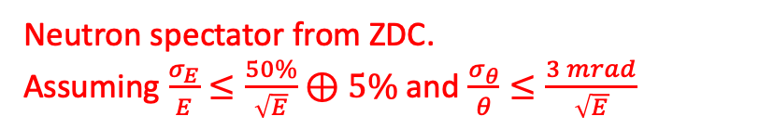
Single Neutrons
From: Z. Tu, A. Jentsch et al., Phys. Lett. B, 811 (2020)
e+d spectator tagging to study short-range correlations.
Proton spectator from OMD.
Neutron spectator from ZDC.
Assuming $\frac{σ_{E}}{E}≤\frac{50\%}{\sqrt{E}}⊕5\%$and $\frac{σ_{θ}}{θ}≤\frac{3 mrad}{\sqrt{E}}$

Slide 10
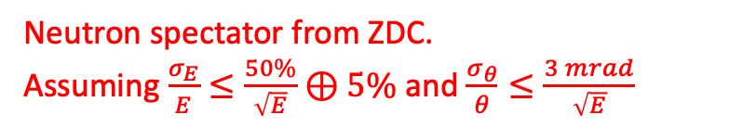
Single Neutrons
From: A. Jentsch, Z. Tu, and C. Weiss, Phys. Rev. C 104, 065205, (2021)
e+d spectator tagging to study neutron structure functions → focus on very small angle neutrons near $θ \sim 0 mrad.$
Baseline ZDC assumption is problematic here – would benefit from improved neutron energy and angular resolution.
Proton spectator from OMD.
Neutron spectator from ZDC.
Assuming $\frac{σ_{E}}{E}≤\frac{50\%}{\sqrt{E}}⊕5\%$and $\frac{σ_{θ}}{θ}≤\frac{3 mrad}{\sqrt{E}}$

Slide 11
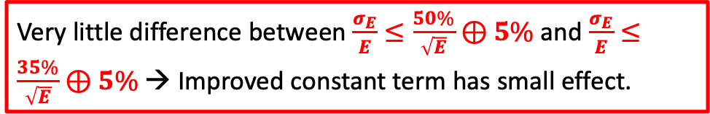

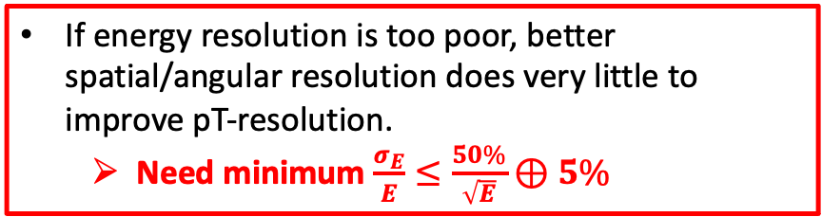
Single Neutrons
If energy resolution is too poor, better spatial/angular resolution does very little to improve pT-resolution.
  Need minimum $\frac{σ_{E}}{E}≤\frac{50\%}{\sqrt{E}}⊕5\%$
To get pT resolution competitive with the tagged-proton case would require $\frac{σ_{θ}}{θ}≤\frac{2 mrad}{\sqrt{E}}$
Very little difference between $\frac{σ_{E}}{E}≤\frac{50\%}{\sqrt{E}}⊕5\%$ and $\frac{σ_{E}}{E}≤\frac{35\%}{\sqrt{E}}⊕5\%$→ Improved constant term has small effect.

Slide 12
Single Neutrons (better constant term)
If energy resolution is too poor, better spatial/angular resolution does very little to improve pT-resolution.
  Need minimum $\frac{σ_{E}}{E}≤\frac{50\%}{\sqrt{E}}⊕5\%$
To get pT resolution competitive with the tagged-proton case would require $\frac{σ_{θ}}{θ}≤\frac{2 mrad}{\sqrt{E}}$
Very little difference between $\frac{σ_{E}}{E}≤\frac{50\%}{\sqrt{E}}⊕5\%$ and $\frac{σ_{E}}{E}≤\frac{35\%}{\sqrt{E}}⊕5\%$→ Improved constant term has small effect.

