Slide 1
GST – BOT meeting
08052026
Seungjoon Lee

Slide 2
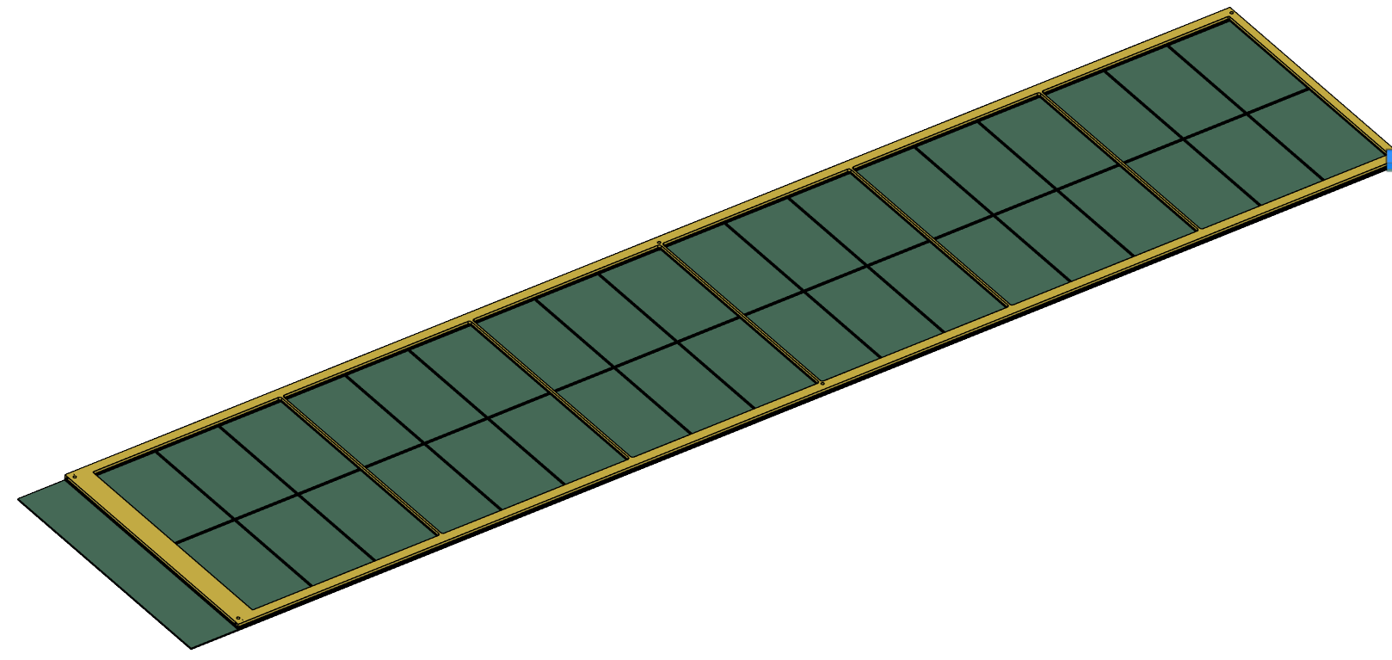
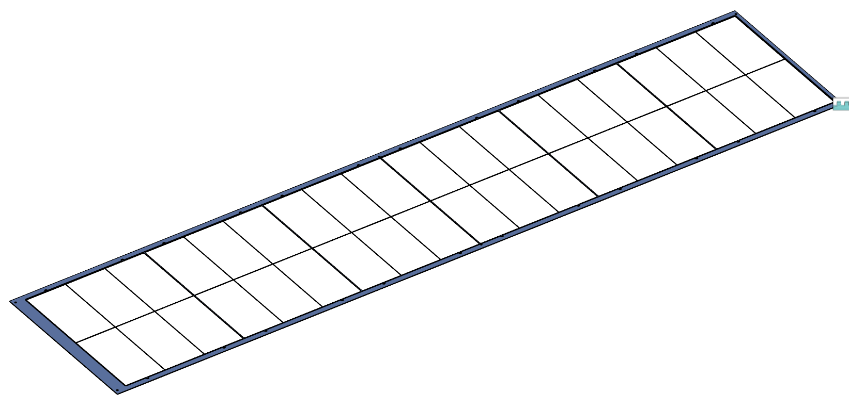
Structure of BOT
Overall Frame Structure
Yellow honeycomb + Green PCB are the main mechanical structure
GEM foil is glued only perimeter of spacer
Ribs are not for mechanical support.

Slide 3
Structure of BOT
Honeycomb Window
Cathode
GEM Foil (~1 kg/cm tension)
URWELL
URWELL PCB
Electrostatic Pressure
Foil sagging is negligible
If foil loose tension by deformation, Electrostatic pressure will pull foil, causing spark/damage/degrade detector performance

Slide 4
Effect of deformation
Honeycomb Window
Cathode
1.5 mm
2.5 mm
GEM Foil (~1 kg/cm tension)
URWELL
URWELL PCB
Electrostatic Pressure
Detector itself may survive with small deformation.
Detector performance uniformity will change.

Slide 5
Mathematics (not simulation)
Electrostatic pressure based sagging < 5 um
Gravity based sagging < 1 um
Safety margin (~ 5% of 1.5 mm gap) = 75 um
Young’s modulus ~ 6 Gpa
Max width (for GEM foil) change to get safety margin
~ 1.4 mm
=> Any deformation causing 1.4 mm width reduction will be an issue.

Slide 6
Type of deformation
OK
??
Any deformation that can cause foil sagging is not good.
GEM foil has high Young’s modulus (~6GPa). => small displacement = high tension loss.

Slide 7
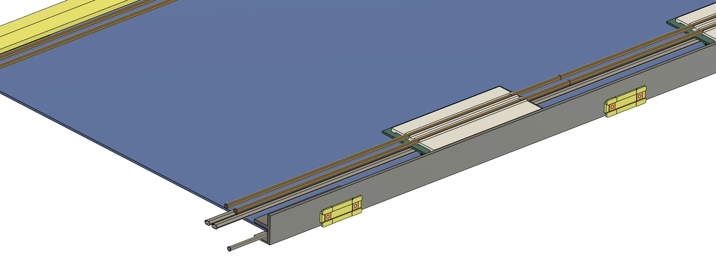
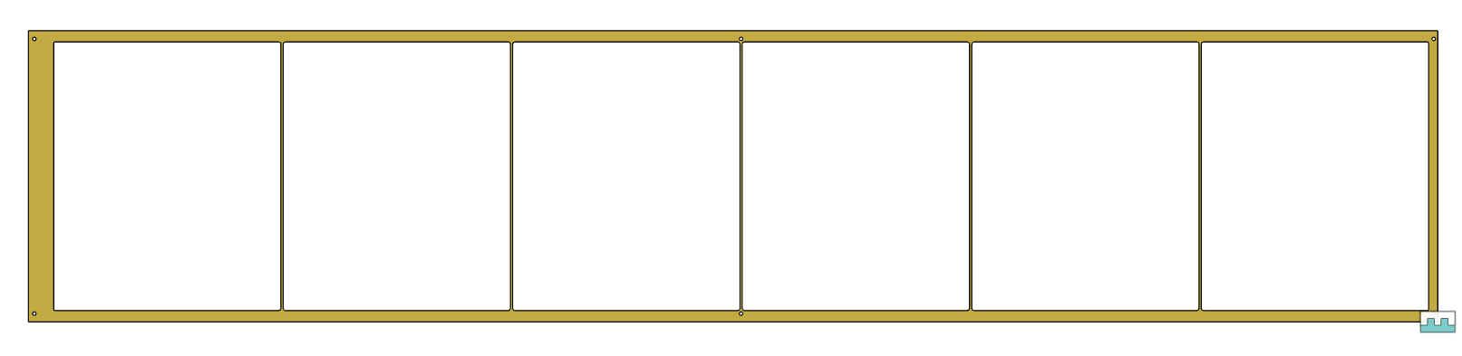
Position of slide insert

Slide 8
Overall
It is unclear how GST deformation propagate to BOT frame and GEM foil sagging.
BOT frame may be able to handle some deformation but Foil sagging and detector performance will be evaluated.
Other than top-bottom that may be symmetric, side module may have shear stress.
Ideal solution may be compensating guide rail then slide 2 BOT modules.

