Slide 1
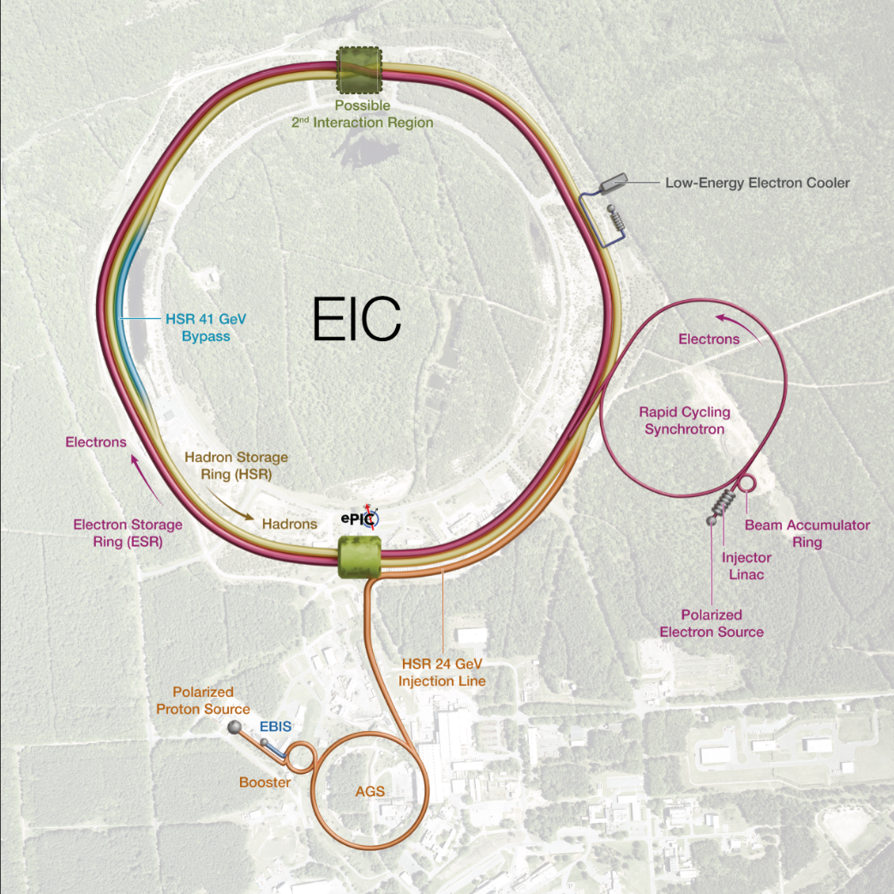
EIC Scope
EIC Scope
A single integrated line-item construction project.
Scope includes well-defined deliverables, interfaces, and draft KPPs.
EIC Line-Item Project Scope:
Infrastructure (subprojects, INF-1, …)
Collider - Accelerator Storage Rings and Interaction Region (subprojects)
Electron Injector (subproject)
Detector (subproject)
EIC Portfolio (Off-Project Scope)
NP Operations scope, including initial EIC Ops
Host Laboratory Infrastructure
1

Slide 2
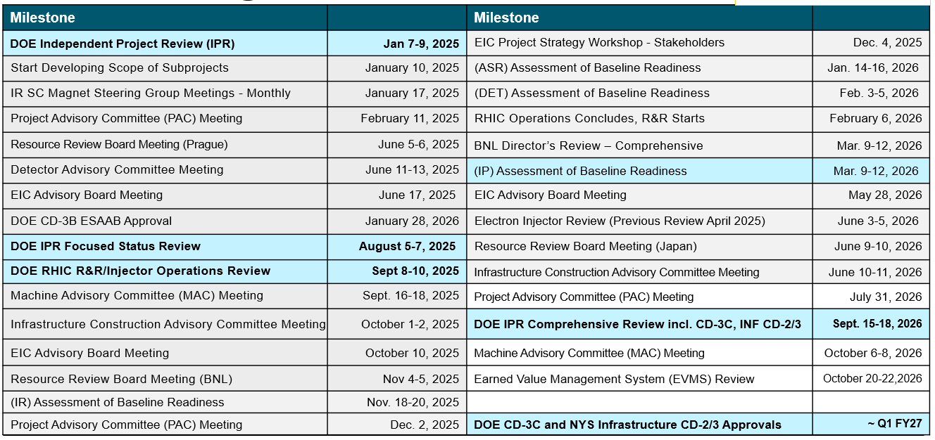
EIC Planning Dates
EIC received CD-3B Approval January 28, 2026!

Slide 3
Director’s Review March 2026 – Key Messages
Strong technical progress across all subprojects – Designs are maturing and long-lead procurements are generally proceeding well, indicating solid advancement toward project goals.
The project cost estimate exceeds the $3B cost cap – The absence of a complete, resource-loaded schedule limits confidence in cost, schedule, and execution credibility.
Completion of an integrated, resource-loaded preliminary baseline is the top priority – This preliminary baseline is essential to support cost reduction efforts, validate schedule feasibility within annual funding constraints, assess risks, and support future Critical Decision approvals.
Cost reductions must be systematically evaluated against impacts to Key Performance Parameters (KPPs) and mission need – Cost, schedule, scope, and performance are tightly coupled and require disciplined trade-offs.
Affordability depends in part on funding priorities following the conclusion of RHIC operations – A combined operations and project funding plan.
3

Slide 4
DOE Sept. IPR Charge
Charge items 1-3, out of 8:
Has the project team developed a complete, technically credible preliminary performance baseline for this stage of the project and begun to effectively execute against it? Is the project positioned to complete approved long-lead procurements within the established schedule and cost baseline? Are technical issues appropriately and proactively addressed?
Is each proposed subproject scope defined well and logically? Are the subprojects ordered and phased optimally? Does the roll-up of the subprojects’ scope unambiguously compose a complete and responsive EIC facility? Are the key performance parameters well documented and justifiable? Are subproject interfaces understood and delineated? Are the schedules and cost estimates and associated contingency plans credible for the current stage of each subproject?
Are the proposed CD-3C long-lead procurements appropriate and do they support project risk mitigation? Have the proposed CD-3C long lead procurements attained final design?

Slide 5
DOE Sept. IPR Charge (Cont.)
Charge items 4-8:
Are the schedule and cost for the first infrastructure subproject complete and credible? Do they include adequate scope, schedule, and cost contingency? Will the first infrastructure subproject likely achieve its performance baseline?
Has the first infrastructure subproject met all the CD-2 and CD-3 prerequisites and is the project team ready to request CD-2/3 approval?
Are ES&H and QA properly addressed given the project’s current stage of development?
Is the project properly managed? Are risks being effectively managed? Is a management team in place to successfully execute the project including long-lead procurements? Are roles and responsibilities documented and understood?
Has the project team satisfactorily addressed recommendations from previous DOE SC reviews?

Slide 6
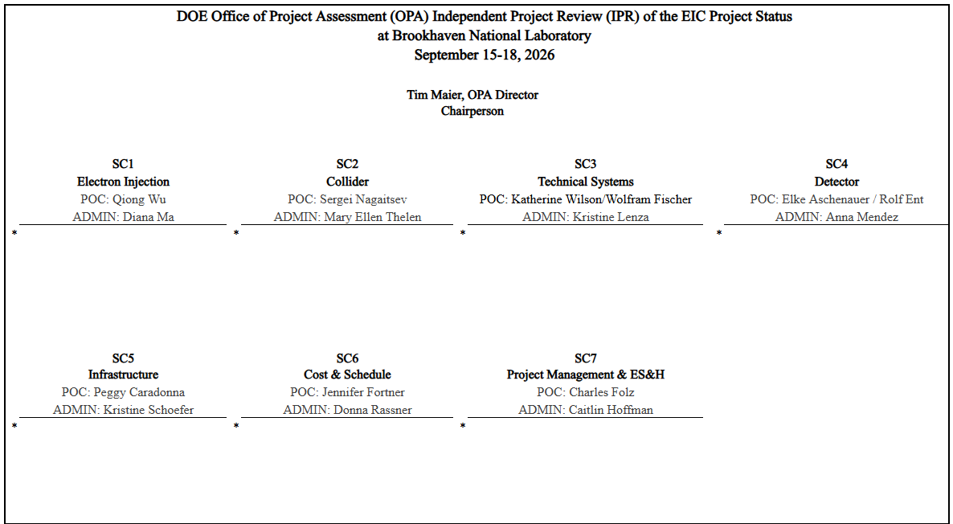
DOE OPA IPR Subcommittee Structure

Slide 7
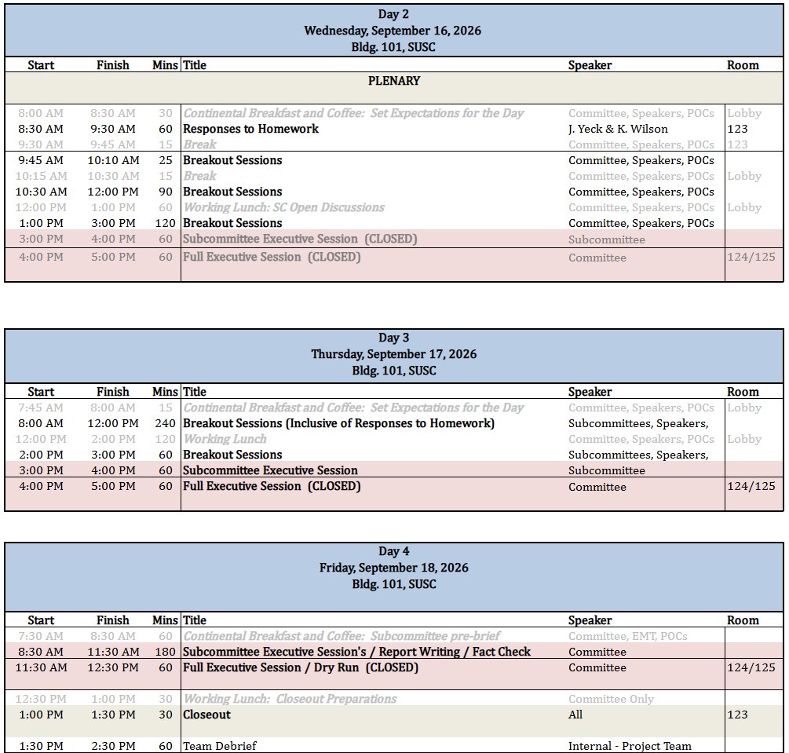
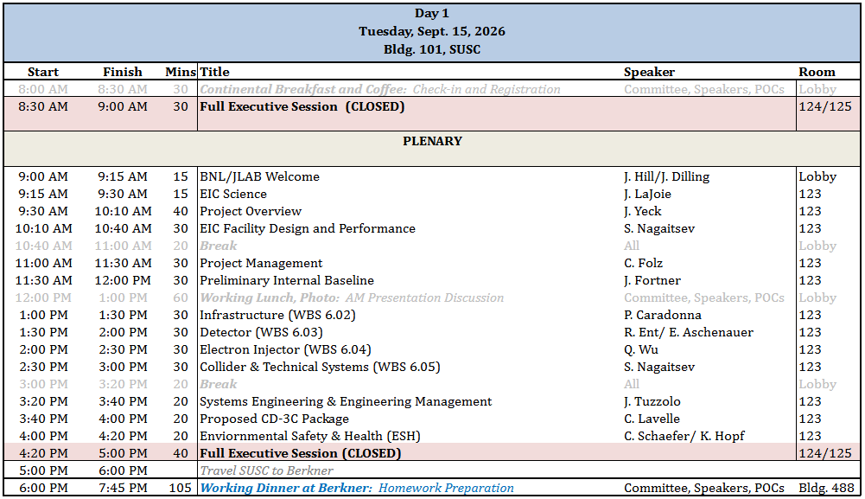
Review Agenda Overview – Day 1

Slide 8
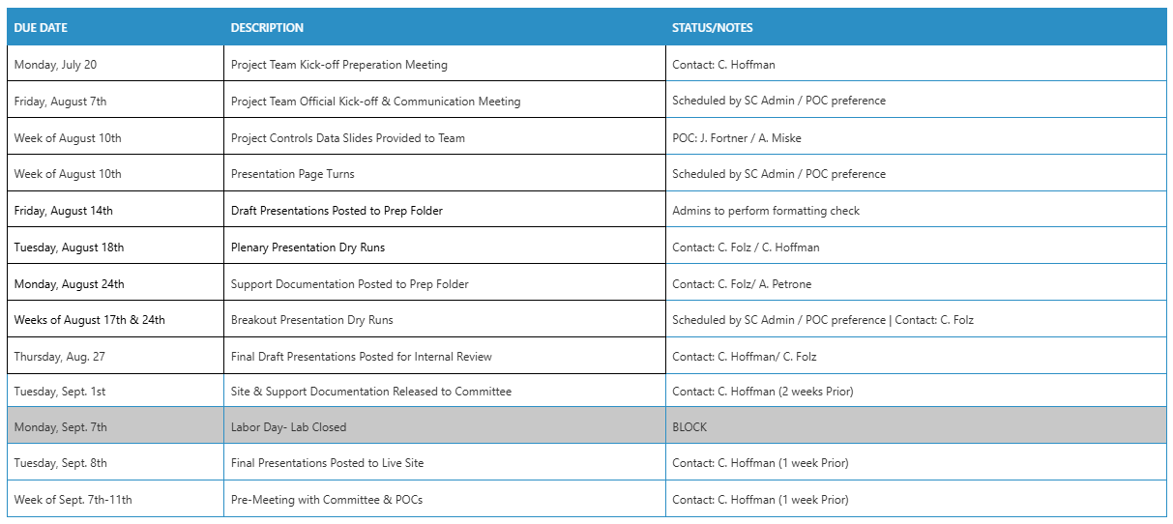
Prep Schedule

Slide 9
Summary

