Slide 1
Block DIagrams
Few Cooling block diagrams to start things off

Slide 2
Layout – ePIC Infrastructure
ePIC Infrastructure
Air Conditioning for Wide Angle Hall or Experimental Hall
Ambient Temperature – 70 F
RH ≤ 65 F
Air Conditioning for Assembly Hall
Ambient Temperature – 75 F
RH ≤ 75 F
Facility Water System
Modified Chilled Water – MCW
Flow Rate – 400 GPM
Inlet Temperature – 18C
Technology Cooling System
- ePIC Detector
- Cooling Distribution Unit CDU

Slide 3
Layout – ePIC Infrastructure
ePIC Infrastructure
Total Heat - 471644 W
Facility Water System
Modified Chilled Water – MCW
ePIC Detector
Heat - 81744 W
Detectors Liquid Cooling
Heat - 46436 W
Cooling Distribution Unit
CDU
Platform Electronics and Racks
Heat - 80000 W
Air Compressor
Or
Blower
Active Air Cooling
Heat – 9248 W
Detectors Air Cooling
Heat - 15240 W
DAQ Room
Heat - 250000 W
Passive Air Cooling
Heat - 5992 W
Air Conditioning
Magnet Power Supply
Heat - 20000 W
Silicon Oil Cooling
Heat - 19968 W
Detectors Special Cooling
Heat - 20068 W
After Cooler for SVT
Heat - 40000 W
Novec Cooling
Heat - 100 W
Network Equipment Room
Heat - NA

Slide 4
Layout – ePIC Detector Cooling
Novec Cooling
Heat – 100 W
ePIC Detector
Total Heat - 81744 W
Passive Air Cooling
Heat – 5992 W
Silicon Oil Cooling
Heat – 19968 W
Barrel HCAL
Heat - 1280 W
Liquid Cooling
Heat – 46436 W
Forward HCAL
Heat - 1656 W
Forward Emcal
Heat - 2633 W
Barrel Emcal
Heat - 2300 W
Barrel Emcal
Heat - 2260 W
Forward Emcal
Heat – 796 W
hpDIRC
Heat - 749 W
EEEMCAL
Heat - 100 W
Outer MPGD
Heat - 5380 W
Barrel TOF
Heat -21614 W
Cymbal
Heat - 2300 W
EEEMCAL
Heat - 1000 W
pfRICH
Heat - 707 W
MPGD Endcap Disks
Heat -1280 W
SVT Disks
Heat - 655 W
SVT Outer
Heat - 301 W
SVT Inner
Heat - 412 W
Forward TOF
Heat - 7105 W
dRICH
Heat - 19968 W
SVT Disks
Heat - 5819 W
SVT Outer
Heat - 3218 W
SVT Inner
Heat - 211 W
Active Air Cooling
Heat – 9248 W

Slide 5
Layout – ePIC Detector Liquid Cooling
Detectors Liquid Cooling
Total Heat - 46436 W
Cooling Distribution Unit
CDU
Forward Emcal
Heat - 2633 W
Source – FEB
Temp – ±2C
Barrel Emcal
Heat - 2300 W
Source – SiPM
Temp – ±2C
hpDIRC
Heat - 749 W
Source - Sensors
Outer MPGD
Heat - 5380 W
Source – FEB
Temp – ±2C
Cymbal
Heat - 2300 W
Source – FEB
Temp - ±2C
Barrel TOF
Heat -21614 W
Source – ASIC, PB
EEEMCAL
Heat - 1000 W
Source – FEB
Temp – ±2C
pfRICH
Heat - 707 W
Source - Sensors
MPGD Endcap Disks
Heat -1280 W
Source – FEB
Temp - ±2C
SVT Disks
Heat - 655 W
Source – FIB, FPC CB
Temp - ±5C
SVT Inner
Heat - 412 W
Source – SIB,SCB,DPB
Temp - ±5C
SVT Outer
Heat - 301 W
Source – FIB,FPC CB
Temp - ±5C
Forward TOF
Heat - 7105 W
Source – ASIC, PB

Slide 6
Layout – ePIC Detector Air Cooling
Detectors Air Cooling
Total Heat - 15240 W
Active Air Cooling
Heat – 9248 W
Passive Air Cooling
Heat – 5992 W
SVT Disks
Heat - 5819 W
Source – ED,HD disk
Temp - ± 5C
SVT Outer
Heat - 3218 W
Source – L3, L4 staves
Temp - ±1 C
Barrel HCAL
Heat - 1280 W
Source – SiPM
Barrel Emcal
Heat - 2260 W
Source – Astropix Sensors
Temp – ±3 C
SVT Inner
Heat - 211 W
Source – L0, L1, L2 staves
Temp - ± 5C
Forward Emcal
Heat – 796 W
Source – SiPM
Temp – ±2C
Forward HCAL
Heat - 1656 W
Source – PCB Insert
SVT Air Options requires an after cooler to bring the air to desired temperature.​
The after cooler itself requires cooling, on the order of 30-40 kW, probably by facility water. ​From SVT slides

Slide 7
Layout – ePIC Detector Special Cooling
Detectors Special Cooling
Total Heat - 20068 W
dRICH
Heat - 19968 W
Source – Photon Detection Unit
Temp – Cooling : -60C
Heating : 110C
EEEMCAL
Heat - 100 W
Source – SiPM Crystals
Temp – ±0.1 C

Slide 8
Status of developing a global thermal model and cooling of ePIC
Girish Gowda
Mechanical Engineer
Integration, Installation and Infrastructure
July 31st, 2026

Slide 9
Outline
Detector Cooling Scope of Work
Detector Cooling Overview
Detector Cooling Water Treatment
Detector Cooling Plan and Guidelines
Detector Heat Load
Cooling Circulator – Negative Pressure Water
Detector Global Thermal Model
Detector Cooling Systems
Summary / Next Steps

Slide 10
ePIC Detector – Cooling Scope of Work
Global Cooling – BNL Scope
Define Facility primary loop, Technology Secondary loop and heat transfer interface for cooling between them
Identify Leak risk Mitigation Cooling Approach
Selection of Water Treatment
Selection of Cooling Type – Liquid, Air, Special Cooling
Identify Climate control requirements – Building 1006
Global Thermal Model Development
Finalize Manifold Sizing locations
Consider cooling interface details
CFD Thermal Analysis for detectors - Forward Emcal, Forward Hcal
Detector Groups Cooling – External Collaborators Scope
Confirm power estimates
Confirm temperature, flow, tubing requirements
CFD Thermal Analysis for their respective detectors

Slide 11
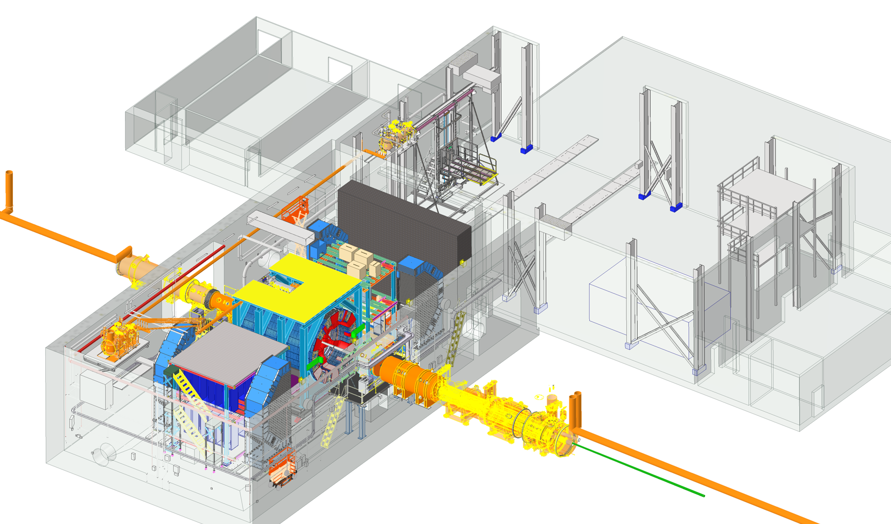
Detector Cooling Overview
Air Conditioning for Wide Angle Hall (WAH) – Building 1006
Existing HVAC upgrading for environmental control demands of the detector
System must maintain ambient temperature between 70F to 74F
RH should be below 65 %
Air Conditioning for Assembly Hall – Building 1006
Climate control requirements of ambient temperature between 65F to 75F
RH should be below 75 %
Control Room
Ring Inside
DAQ Room
Assembly Hall
Facility Water System
Main loop that takes in cool water from cooling towers, circulates through chillers, heat exchangers and then sends it back out.
Generate and manage bulk of facility's chilled water supply efficiently.
Operates with constant-speed pumps and maintains a consistent temperature
Rear
Wide Angle Hall
Clean Room
Pump & Elec Rooms
Technology Cooling System
Secondary Loop is directly connected to equipment. Heat from the detector components is transferred to the primary loop via an intermediary device Cooling Distribution Unit (CDU).
To provide precise cooling for equipment.
Variable speed pumps used to precisely match the cooling demand and heat is ultimately rejected to the primary loop.
Cooling Distribution Unit (CDU)
Ring Outside
Forward
Cooling Distribution Unit (CDU)
Using negative pressure water circulators to mitigate leak concerns (draws air into lines instead of leaking water out)
This two-loop design allows primary loop to remain more stable while secondary loop can be dynamically adjusted to meet the varying cooling needs.

Slide 12
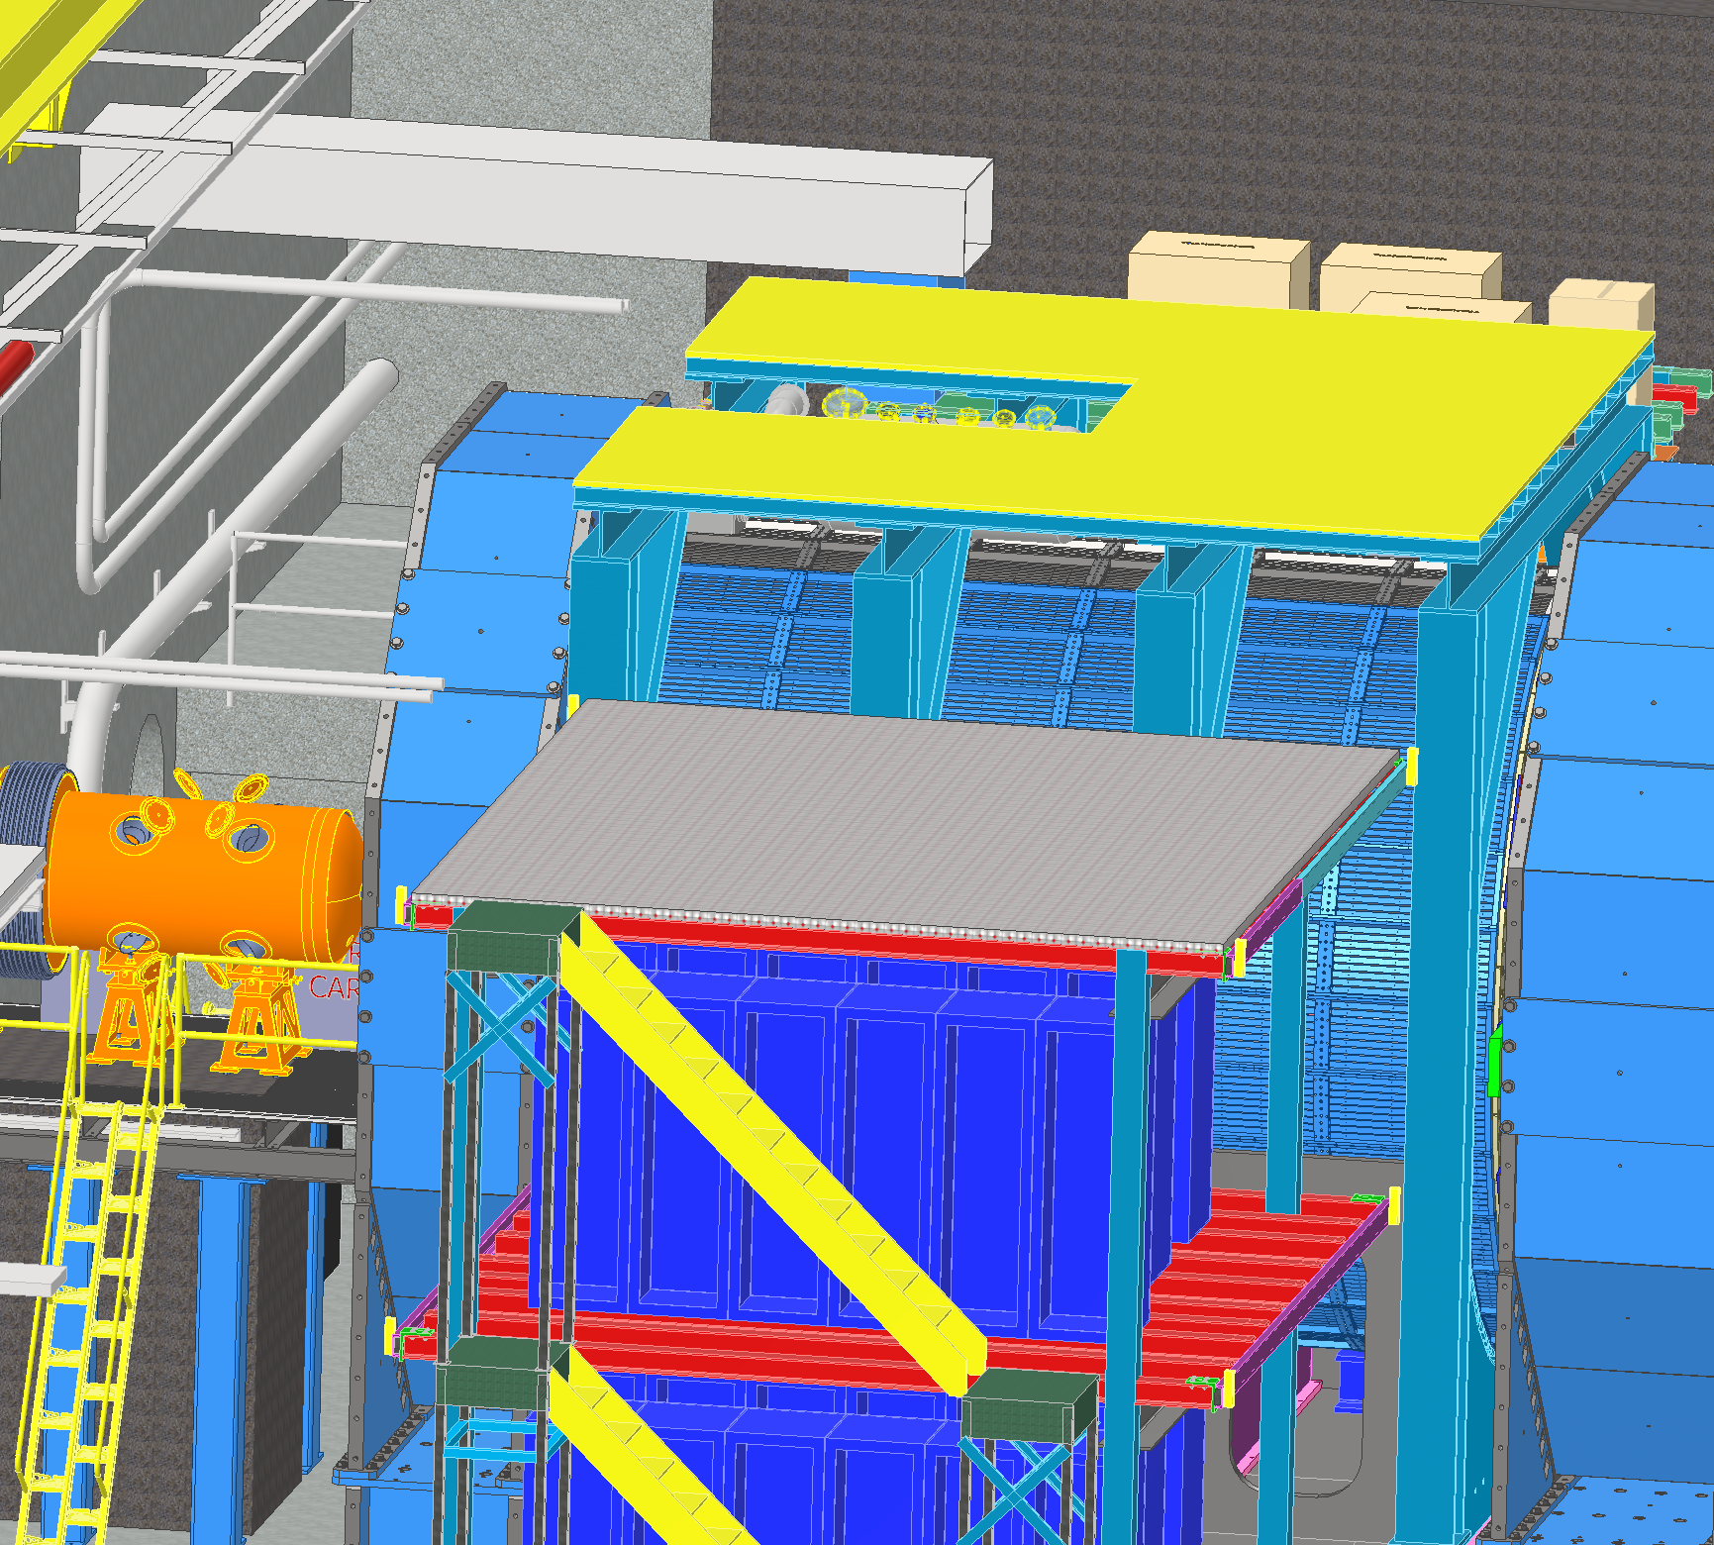
Detector Cooling – Water Treatment
Modified Chilled Water
Cooling Lines on Ring Inside
Modified Chilled Water - 400 gpm (MCW)
Delivers water at temperature of 64 F (18 C)
RH considered is 65 %
Used for sub detector cooling, electronic rack cooling and manifolds made of material other than Aluminum
Cool the Cooling Distribution Unit (CDU)
Primary Facility Cooling loop for Support Infrastructure
Modified Chilled Water
Cooling Lines on Ring Outside

Slide 13
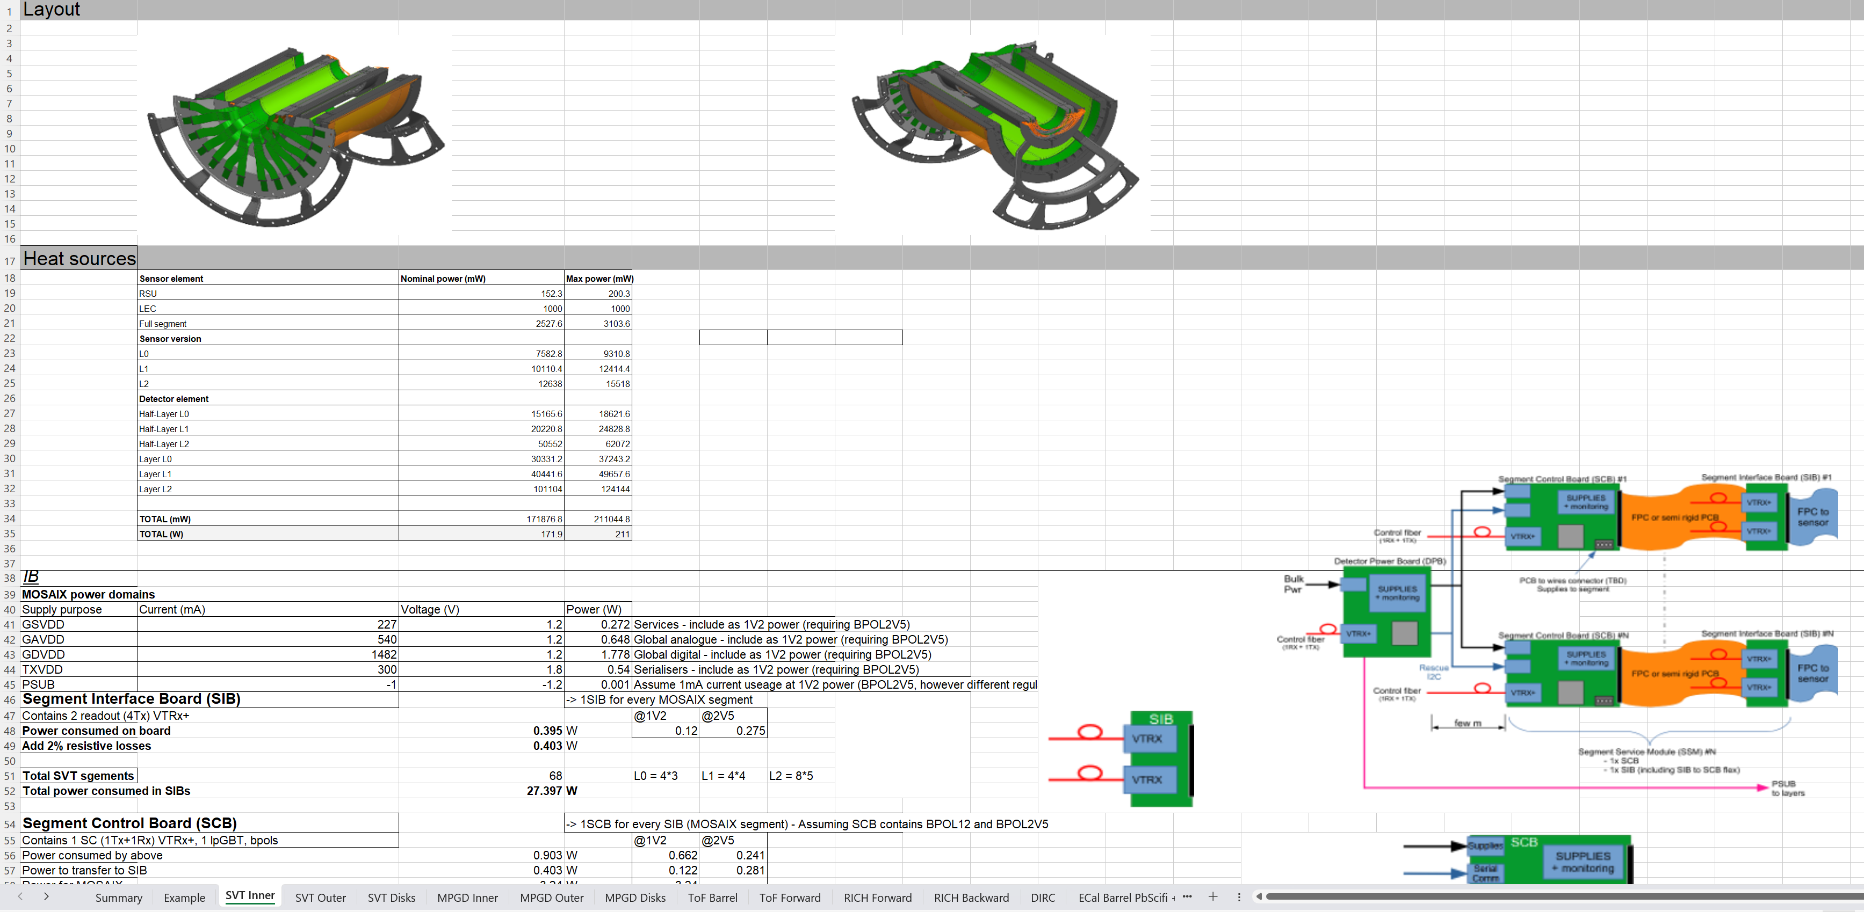
ePIC Detector – Cooling Requirements
Cooling spreadsheet of detectors updated

Slide 14
ePIC Detector – Cooling Plan
Detector | Cooling Method | Design Tasks | Description | Status
 |  | Cooling system | Cooling requirements, Calculation of heat load, flow rate, pressure drop, | In Progress
Forward Emcal | Water Cooling |  | dew point temperature for condensation, Tubing diameter, Insulation requirement.
 |  | Modeling of Cooling system | CAD Model of the 1/4 inch copper tubing with heat sink integrated with board assembly | Completed
 |  | Cooling of FEB | Thermal simulation of FEB's | Completed
 |  | Active cooling of the SiPM's to be assesed | Design change with and without thermal pad downstream of SiPM board | Completed
 |  | Optimisation of cooling system design | Reduce FEB temperatures to 3C above dew point | In Progress
Barrel Emcal | Water Cooling | Cooling system for Barrel Pb/Scifi | Cooling requirements, Calculation of heat load, flow rate, pressure drop | In Progress
 |  | ESB Cooling of Astropix heat removal | Thermal simulation of Astropix through PbScifi to assese need for active cooling | Completed
 |  | ESB Cooling for SiPM stability | Thermal simulation of cold plate design optimisation as per temperature specification | Completed
Forward Hcal | Convective Cooling | Cooling system | Cooling requirements, Calculation of heat load, flow rate, pressure drop | In Progress
 |  | Cooling of PCB | Thermal Simulation of Insert Assembly | In Progress
Barrel Hcal | Convective Cooling | Assese the need for Active Cooling | Cooling requirements, Calculation of heat load, flow rate, pressure drop | In Progress
EEEMCAL | Water Cooling | Cooling system | Cooling requirements, Calculation of heat load, flow rate, pressure drop | In Progress
 |  | Cooling of SiPM | Thermal Simulation of of SiPM in contact with crystals | Completed
 |  | Cooling of FEB | Thermal Simulation of FEB | In Progress

Slide 16
ePIC Detector – Cooling Guidelines
Guiding Principles
Sub detectors should maintain minimum water temperature at 64 F (≥18 C) to avoid insulation
Insulation on respective sub detectors impacts services on ePIC
Operating temperatures of the sub detectors should be above dew point temperature to prevent condensation
Cooling Design Considerations
Minimize potential damage from cooling system (since inner detectors are difficult to service)
Using negative pressure water circulators to mitigate leak concerns (draws air into lines instead of leaking water out)
Make manifolds and cooling services disconnects as accessible and serviceable as possible.
Has Aluminum compatible loop still there?

Slide 17
ePIC Detector – Heat Load
Liquid Cooling System
Air Cooling System
% Change From January
77%
74%
118%
188%
240%
242%
 |  | Units
Cooling media | Water
Forward EMCAL | 2,633 | W
Barrel EMCAL | 2,300 | W
Cymbal | 2,300 | W
Outer MPGD | 5,380 | W
pfRICH | 707 | W
DIRC | 749 | W
EEEMCAL | 1,000 | W
Barrel TOF | 21,614 | W
Forward TOF | 7,105 | W
SVT Outer | 301 | W
SVT Disks | 655 | W
SVT Inner | 412 | W
MPGD Endcap Disks | 1,280 | W
Total Heat Load | 46,436 | W
 |  | Units
Cooling media | Air
Barrel HCAL | 1,280 | W
Forward HCAL | 5,500 | W | Up 3.8kW
SVT Inner | 211 | W
SVT Disks | 5,819 | W
SVT Outer | 3,218 | W
Barrel Emcal | 2,260 | W | Astropix sensors
Forward Emcal | 796 | W | SiPM boards
Total Heat Load | 19,084 | W
Glycol
Platform Electronics & Racks
Special Cooling System
 |  | Units
Cooling media | Silicon Oil
dRICH | 19,968 | W
 |  | Units
Cooling media | Water
Platform | 80,000 | W
DAQ Room | 250,000 | W
Total Heat Load | 330,000 | W
 |  | Units
Cooling media | Novec
EEEMCAL | 100 | W
Overall Up 15%

Slide 18
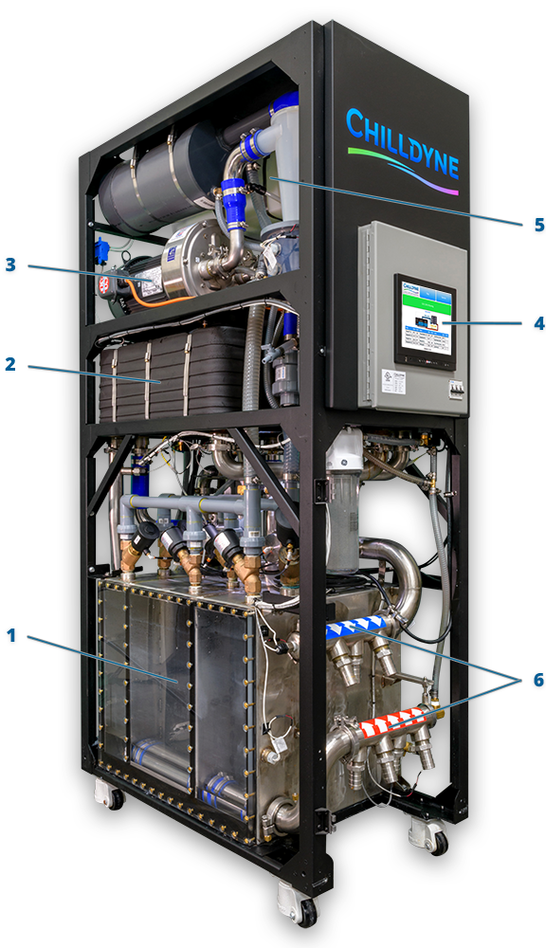
Negative Pressure Water – Cooling Circulator
Chilldyne CDU 300 Components
1. Pump Chambers
The pump chambers control the flow of fluid into and out of the CDU. The proprietary three-chamber arrangement allows the CDU to pull fluid through the loop while maintaining a steady flow.
2. Heat Exchangers
The heat exchangers move heat from the technology cooling system to the facility water system. The two series heat exchangers allow the CDU to move up to 300 kW of heat even on hot and humid days.
3. Liquid Ring Pump
Liquid ring pumps use water as a seal that never needs to be replaced. The CDU’s liquid ring pump provides the vacuum used to pull the coolant through the load.
4. Microprocessor Control
The intelligent, network-enabled core of the CDU automatically manages coolant temperatures, flow rates, water quality, and more. The Cool-Flo Software allows the CDU to be easily integrated into popular DCIM and BMS systems.
5. Water Quality Control
The CDU automatically monitors and controls the quality of the water in the technology cooling system. The water quality system dispenses coolant additives as-needed to prevent corrosion and biological growth.
6. Coolant Handling Manifolds
Up to 4 cooling loops exit either the top or bottom of the CDU to support both raised floor and overhead configurations.
Product Line: CF-CDU300
Cooling Capacity: Up to 300kW with 15 °C rise.
Flow Rate: Up to 300 LPM at 0.5 bar differential
sPHENIX Detector is using Chilldyne Cooling Circulator

Slide 19
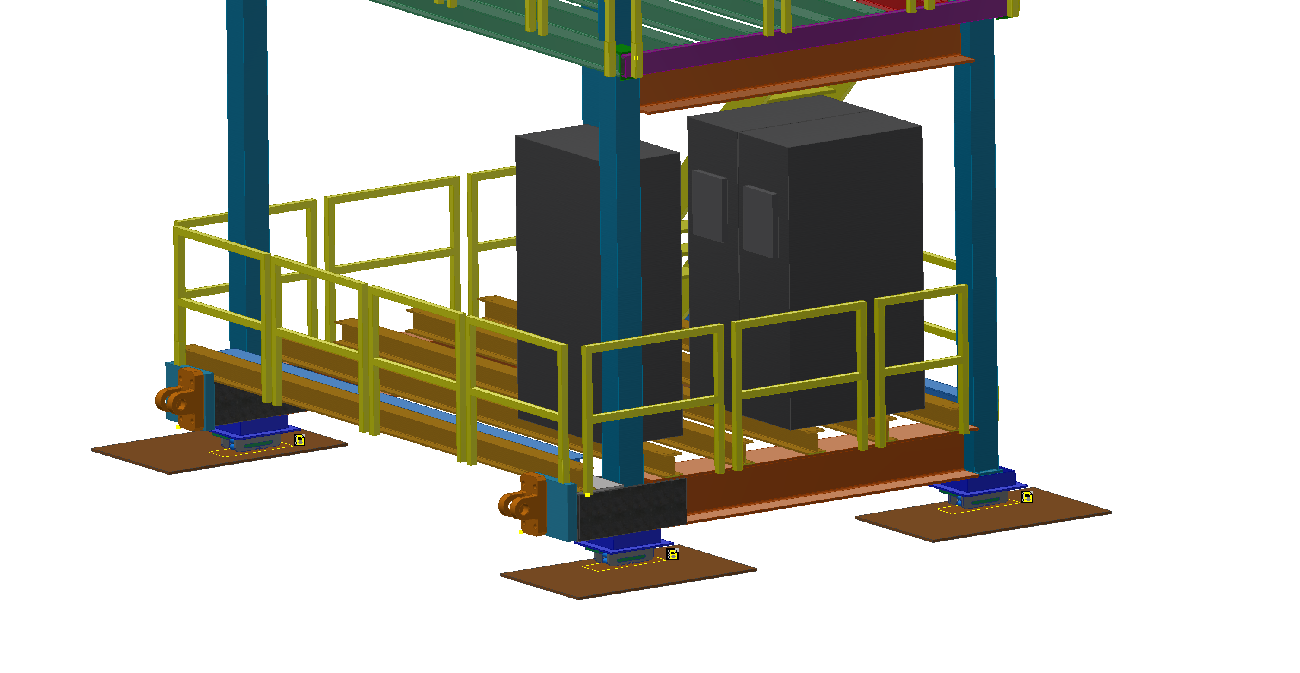
ePIC Detector – Cooling Distribution Unit - CDU
Chilldyne Option 1
 |  | Units
Cooling media | Water/Glycol
Total Heat Load of Electronics | 46 | kW
CDU Cooling Capacity | 40 | kW
Number of CDUs required | 1.15 | 2
Single CDU | 57.50 | %
Margin CDU | 3 | CDUs
density | 1000 | kg/m^3
Specific Heat | 4186 | J/kg C
Temperature rise, ΔT | 2 | C
Pressure available | 0.5 | bar
Pressure available | 50000 | Pa
Mass flow rate | 5.49 | kg/s
Volumetric flow rate | 0.00549 | m^3/s
Volumetric flow rate per unit | 0.00275 | m^3/s
Volumetric flow rate per unit | 164.84 | lpm
Volumetric flow rate per unit | 43.52 | gpm
CDUs
Cooling Distribution Units on Ring Inside
Each CDU will operate at 23 kW – 57.5 percent of it’s rated capacity
Active CDUs – 2, Standby CDU – 1 for backup
Dimensions (L*W*H) inches : 45’’ * 24’’ * 80’’
Decrease in temperature rise decreases CDU cooling capacity
Decrease in temperature rise increases flow rate at given pressure
:40kW for a 2C rise?
We saw a 2C rise with ~12kWatts on the unit
Our flow was about 150lpm input temp 8C

Slide 20
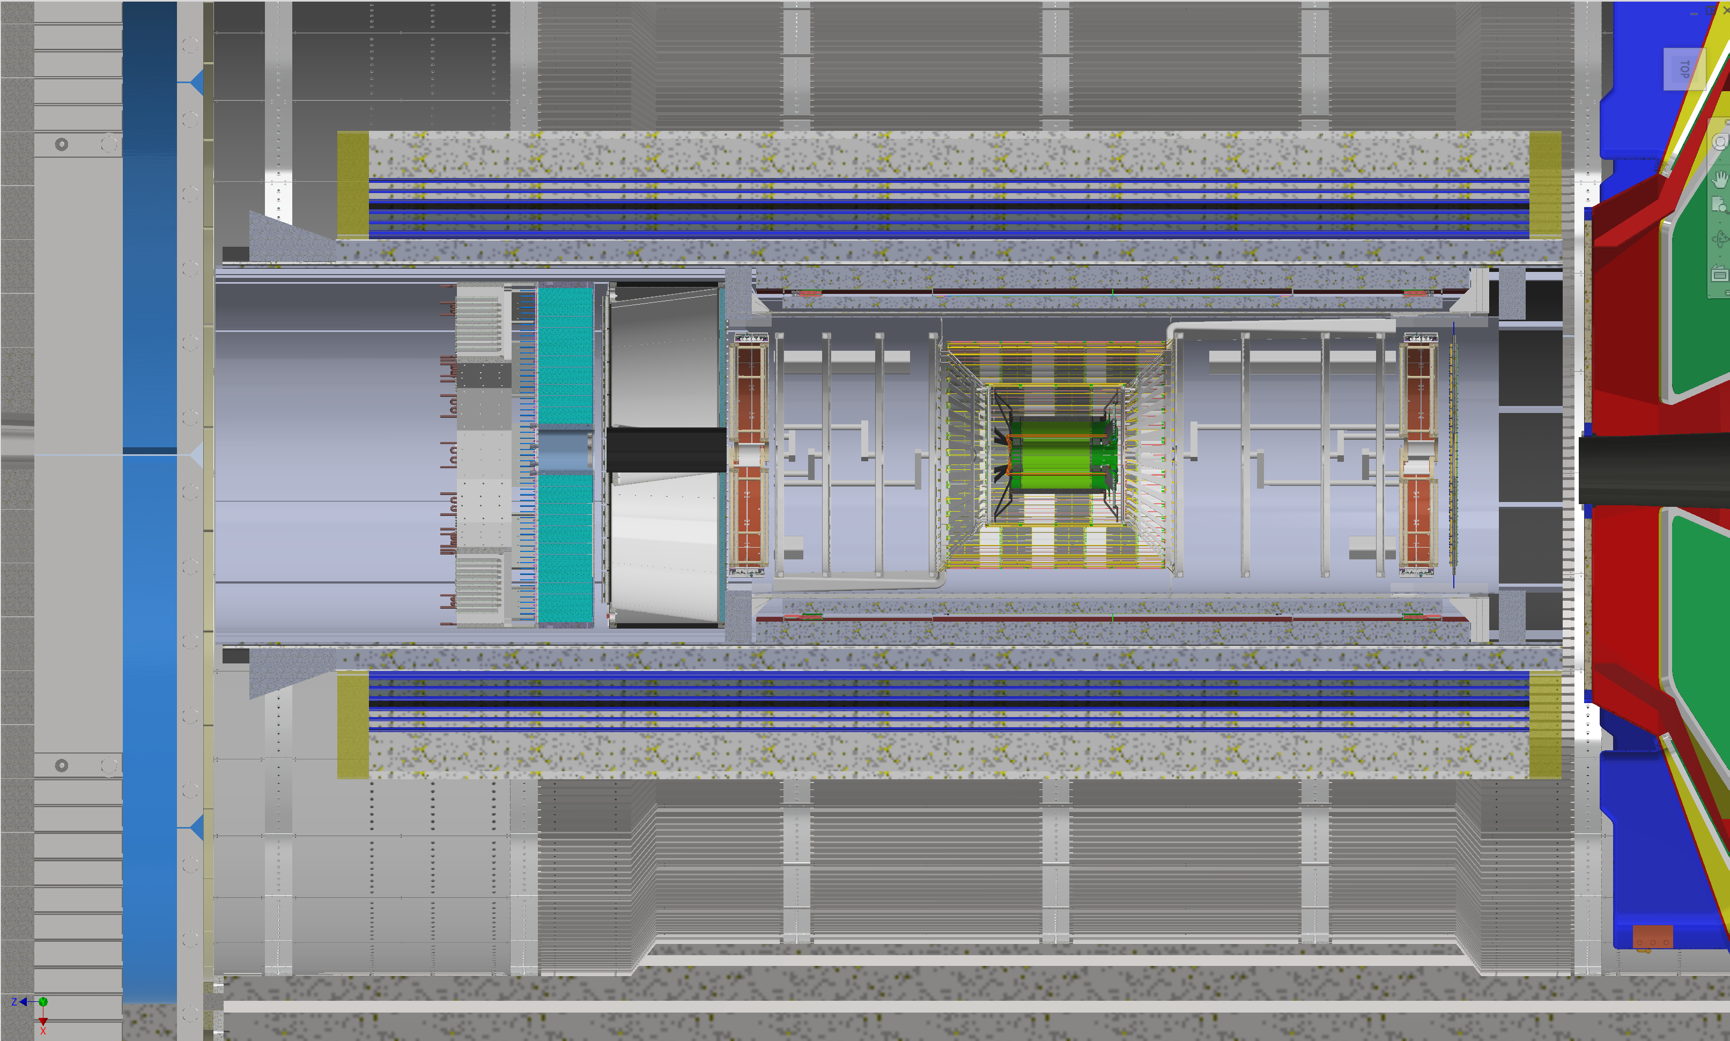
Layout – ePIC Detector Cooling
Barrel HCAL - Passive Air Cooling - Heat - 1280 W
Barrel EMCAL – Liquid Cooling – Heat - 2300 W
Passive Air Cooling – Heat - 2260 W
Forward EMCAL
Liquid Cooling
Heat
2633 W
Passive Air
Heat
796 W
Forward HCAL
Passive Air Cooling
Heat 5500 W
hpDIRC – Liquid Cooling – Heat - 749 W
Outer MPGD – Liquid Cooling – Heat 5380 W
EEEMCAL
Liquid Cooling
Heat -1000 W
Novec Cooling
Heat -100 W
pfRICH
Liquid Cooling
Heat
707 W
MPGD Disks
Liquid Cooling
Heat
1280 W
Cymbal – Liquid Cooling – Heat 2300 W
SVT Outer – Liquid – Heat -301 W
Active Air Cooling – Heat - 3218 W
Barrel TOF
Liquid Cooling
Heat - 21614 W
Forward TOF
Liquid Cooling
Heat
7105 W
dRICH
Silicon Oil Cooling
Heat
19968 W
SVT Inner – Liquid – Heat -385 W
Active Air Cooling – Heat - 211 W
SVT Disks – Liquid – Heat -655 W
Active Air Cooling – Heat – 5819 W

Slide 21
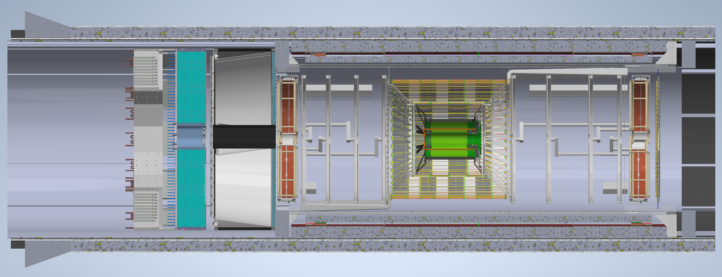
Layout – ePIC Inner Detectors Cooling
Outer MPGD – Liquid Cooling
Heat: 5380 W, Source: FEB
Temperature – Min: 25 C, Max: 35 C
Stability: ± 3 C
Cymbal – Liquid Cooling
Heat: 2300 W, Source: FEB
Temperature – Min: ? C , Max: ? C Stability: ± 3 C
EEEMCAL
Liquid Cooling
Heat : 1000 W
Source : FEB
Temperature
Min : ? C
Max: ? C
Stability ± 1 C
Novec Cooling
Heat :100 W
Source : SiPM
Temperature
Min : 15 C
Max: 25 C
Stability : ± 0.1 C
pfRICH
Liquid Cooling
Heat
707 W
Source HRPPD
Temperature
Min : ? C
Max: ? C
Stability
± ? C
MPGD Disks
Liquid Cooling
Heat
1280 W
Source
FEB
Temperature
Min : 25 C
Max : 35 C
Stability
± 3 C
SVT Disks
Liquid Cooling
Heat
655 W
Source
FIB, FPC CB
Temperature
Min : 18 C
Max : 25 C
Stability : ± 5 C
Active Air Cooling
Heat : 5819 W
Source
ED,HD Disks
Temperature
Min : 5 C
Max : 40 C
Stability : ± 5 C
SVT Inner
Liquid Cooling
Heat
385 W
Source SIB,SCB,PB
Temperature Min : 18 C
Max : 25 C
Stability : ± 5 C
Active Air Cooling
Heat
211 W
Source L0,L1,L2 Staves
Temperature Min : 5 C
Max : 40 C
Stability : ± 5 C
SVT Outer
Liquid Cooling
Heat
301 W
Source
FIB, FPC CB
Temperature
Min : 18 C
Max : 25 C
Stability : ± 5 C
Active Air Cooling
Heat
3218 W
Source
L3,L4 Staves
Temperature
Min : 5 C
Max : 40 C
Stability : ± 1 C
Barrel TOF
Liquid Cooling
Heat - 21614 W
Source
ASIC, PB, RDO
Temperature
Min : ? C
Max : ? C
Stability
± ? C
Forward TOF
Liquid Cooling
Heat : 7105 W
Source
ASIC, PB,RDO
Temperature
Min : ? C
Max : ? C
Stability
± ? C

Slide 22
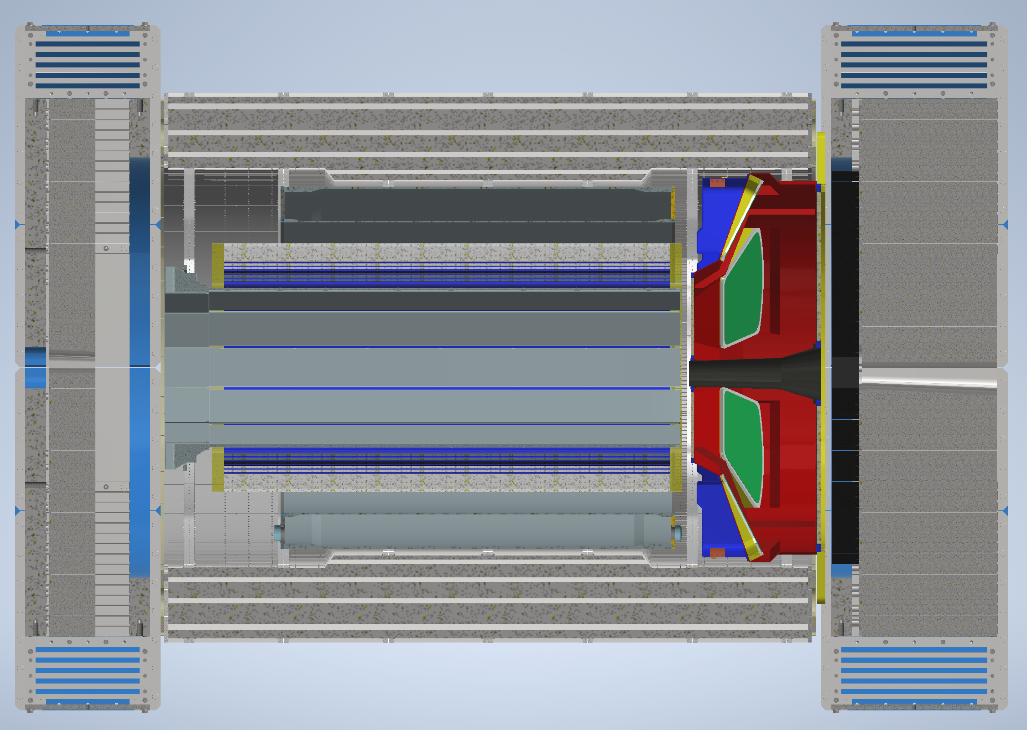
Layout – ePIC Outer Detectors Cooling
Forward EMCAL
Liquid Cooling
Heat
2633 W
Source
FEB
Temperature
Min: 22 C
Max: 30 C
Stability
± 2 C
Passive Air
Cooling
Heat
796 W
Source
SiPM
Barrel HCAL - Passive Air - Heat - 1280 W, Source - Caloroc
Temperature – Min: 22 C, Max: 40 C
Forward HCAL
Passive Air
Cooling
Heat
5500 W
Source
Insert
Barrel EMCAL – Liquid Cooling, Heat: 2300 W, Source: SiPM
Temperature – Min: 5 C, Max: 40 C, Stability: ± 2 C
Passive Air Cooling, Heat - 2260 W, Source: Astropix Sensors
Temperature – Min: 20 C, Max: 25 C, Stability: ± 3 C
dRICH
Silicon Oil
Heat
19968 W
Source
PDU
Temperature
Min: -60 C
Max: 110 C
hpDIRC – Liquid Cooling
Heat : 749 W, Source : HRPPD
Temperature – Min: ? C, Max: ? C
Stability: ± ? C

Slide 23
ePIC Detector – Heat Load for AC Sizing
Cooling Scope of Work :
 |  | Units | Comments
Cooling media | Air
Wide Angle Hall Ambient Temperature | 70 | F | Cooling requirements for Wide Angle Hall in Building 1006
Wide Angle Hall Ambient Temperature | 21.1 | C | Cooling requirements for Wide Angle Hall in Building 1006
Wide Angle Hall Relative Humidity | 65 | % | Cooling requirements for Wide Angle Hall in Building 1006
Assembly Hall Ambient Temperature | 75 | F | Cooling requirements for Assembly Hall in Building 1006
Assembly Hall Ambient Temperature | 23.9 | C | Cooling requirements for Assembly Hall in Building 1006
Assembly Hall Relative Humidity | 75 | % | Cooling requirements for Assembly Hall in Building 1006
Barrel HCAL Heat Load | 1,280 | W | Passive Air Cooling of Detector
Forward HCAL Heat Load | 1,656 | W | Passive Air Cooling of Detector
Barrel EMCAL Heat Load | 2,260 | W | Passive Air Cooling of Astropix Sensors
Forward EMCAL Heat Load | 796 | W | Passive Air Cooling of SiPM
SVT Heat Load to ambient | 16,000 | W | 10 percent After Cooler Heat, SVT Total Heat & Blower Heat dissipated to ambient considered
TOF Heat Load to ambient | 3,500 | W | 10 percent of TOF Total Heat considered
MPGDs Heat Load to ambient | 400 | W | Calculation based on actual heat dissipation to ambient
EMCAL Heat Load to ambient | 500 | W | 10 percent of EMCAL Total Heat considered
pfRICH, DIRC, EEEMCAL Heat Load to ambient | 300 | W | 10 percent of Total Heat considered
Electronic Racks Heat Load to ambient | 8,000 | W | 10 percent of Electronic Racks Total Heat considered
AC Power Transformers Heat Load to ambient | 3,000 | W | Transformers & Miscellaneous Electronics Heat considered
CDU Heat Load to ambient | 5,400 | W | 10 percent of CDU Total Heat considered
Cables Heat Load to ambient | 3,000 | W | Preliminary estimate of power losses from the cables
Cumulative Heat Load | 46,092 | W | Total Heat Load calculation for AC sizing
Margin | 13,828 | W | 30 percent margin on Cumulative Heat Load considered
Total Heat Load with Margin | 59,917 | W | Total Heat Load with margin calculation for AC sizing

Slide 24
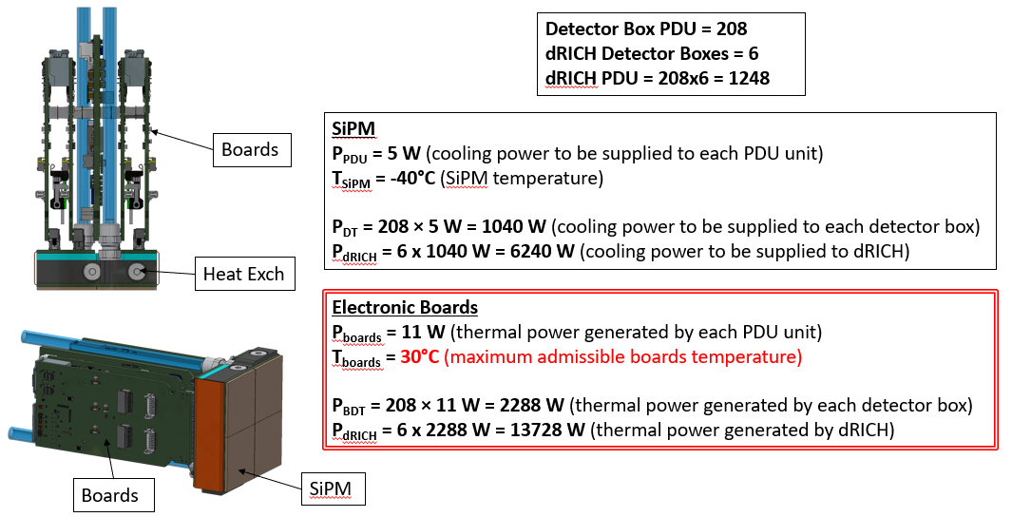
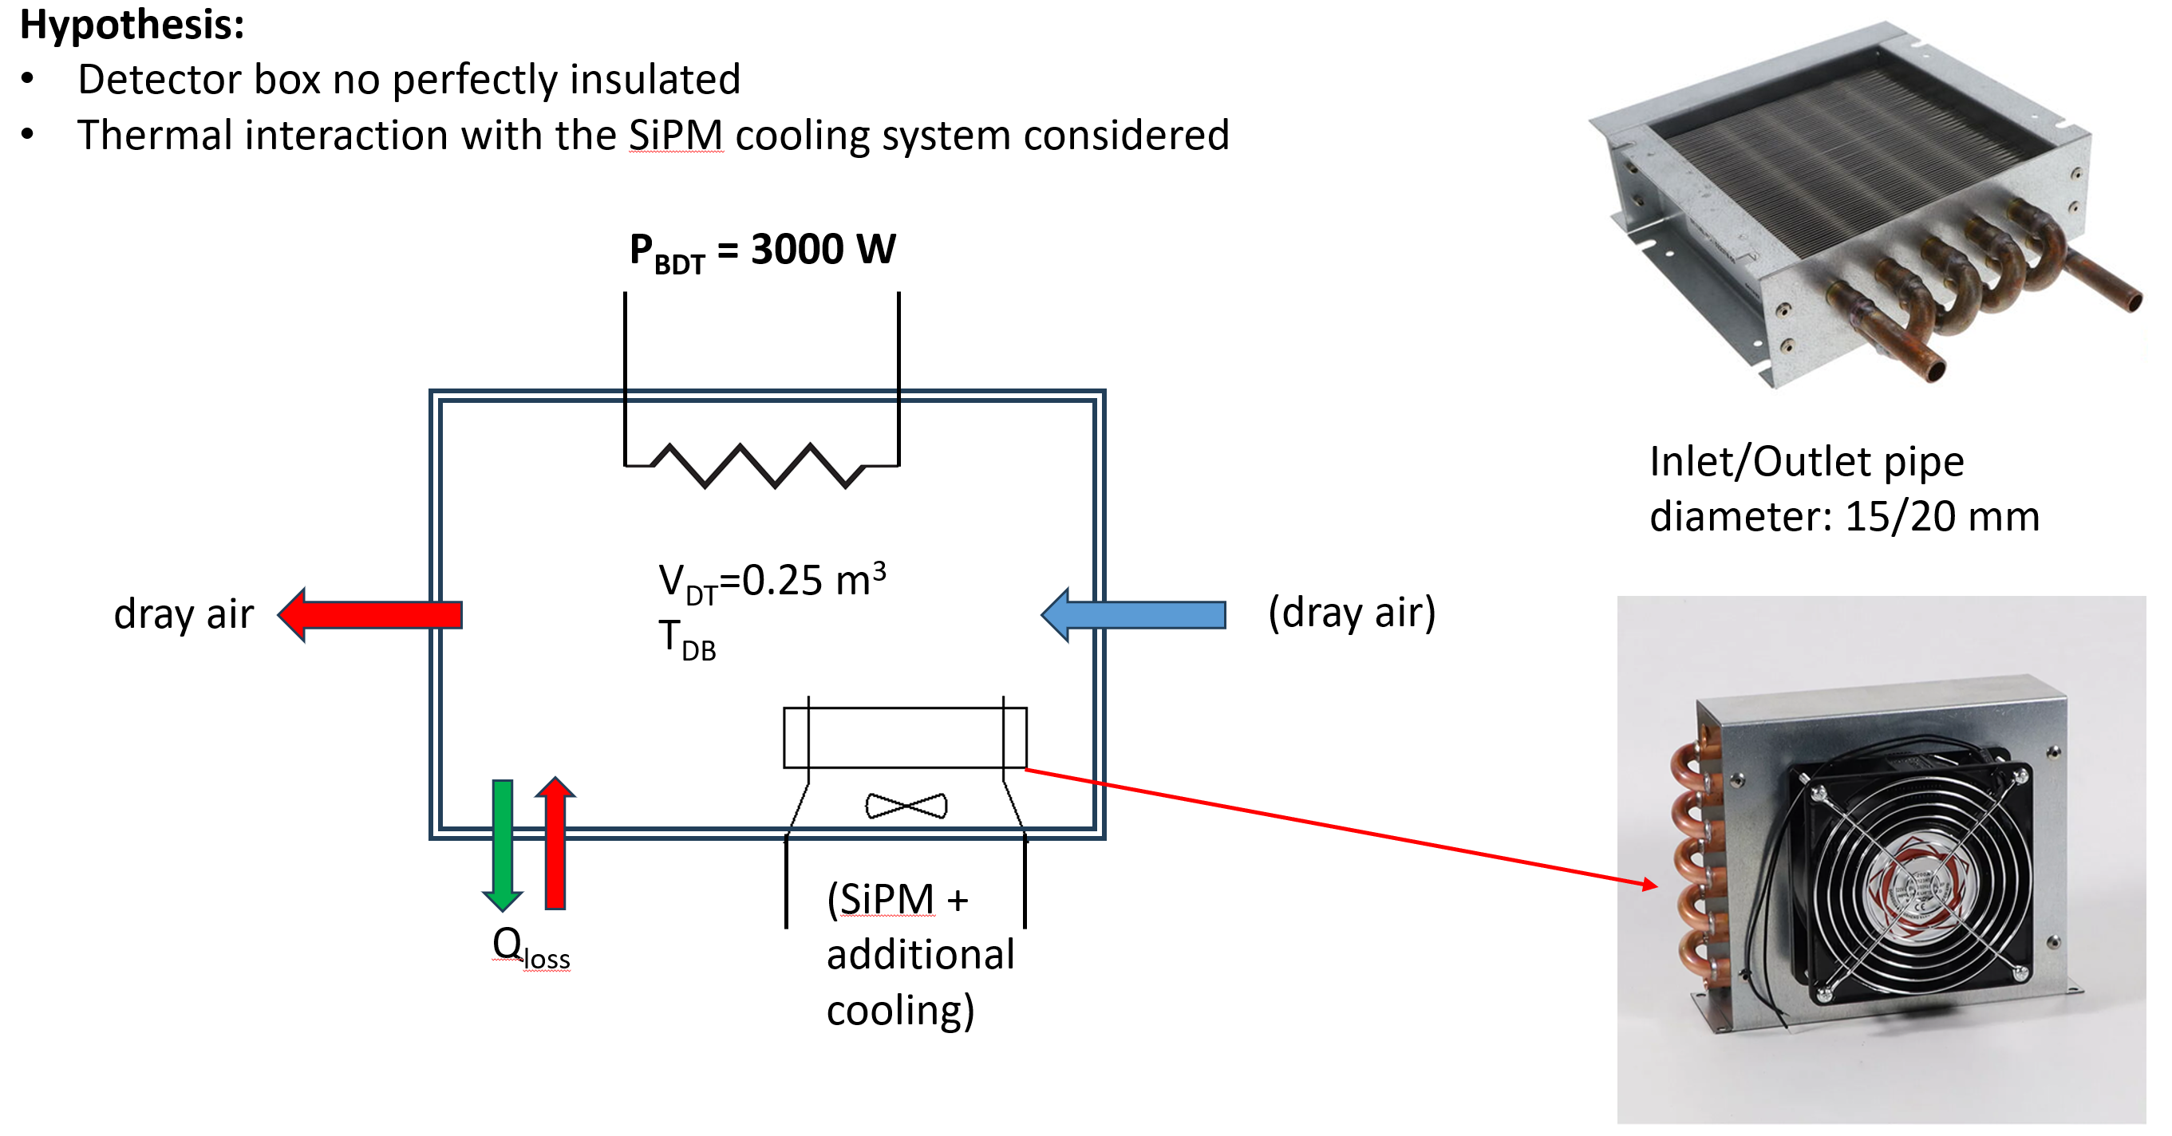
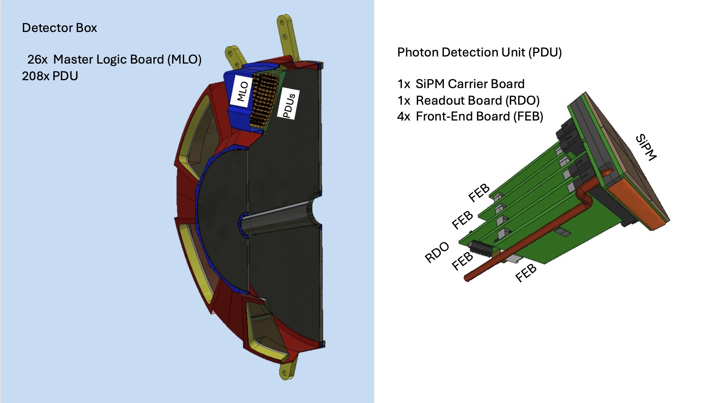
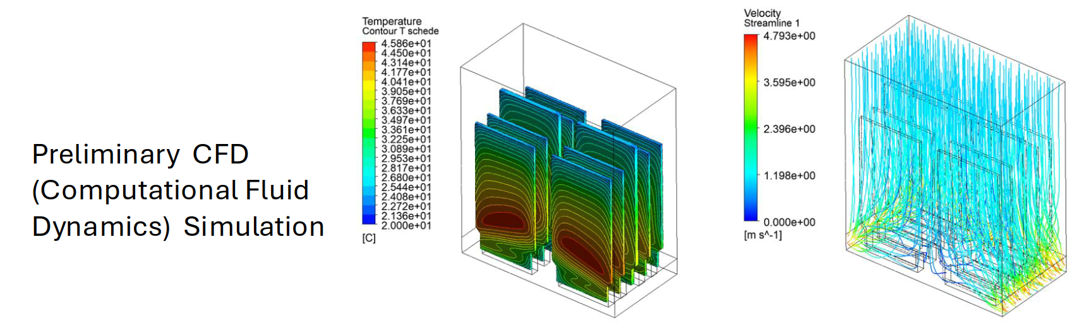
Special Cooling System – Detector
dRICH
Heat Sources – Primarily located in Photon Detector Box
Uniform distribution - Physics operation mode
Non-Uniform distribution - Annealing operation mode
Cooling/Heating System – Main Requirements
Heating mode (annealing): Maximum temperature 100 °C
Cooling mode: Minimum temperature –40 °C
Coolant options: Glycol, Silicone oil, or HFE 7100
Cooling system type: Closed-loop system with freeze protection, ideal for both cooling and heating operations, and designed to prevent leakage.
Detector box air cooling

Slide 25
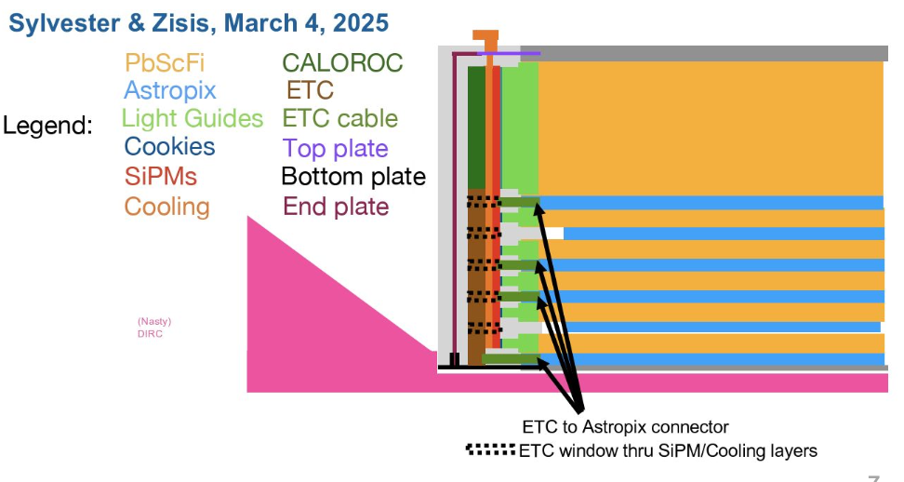
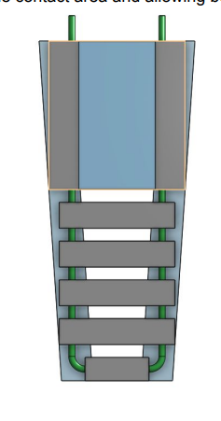
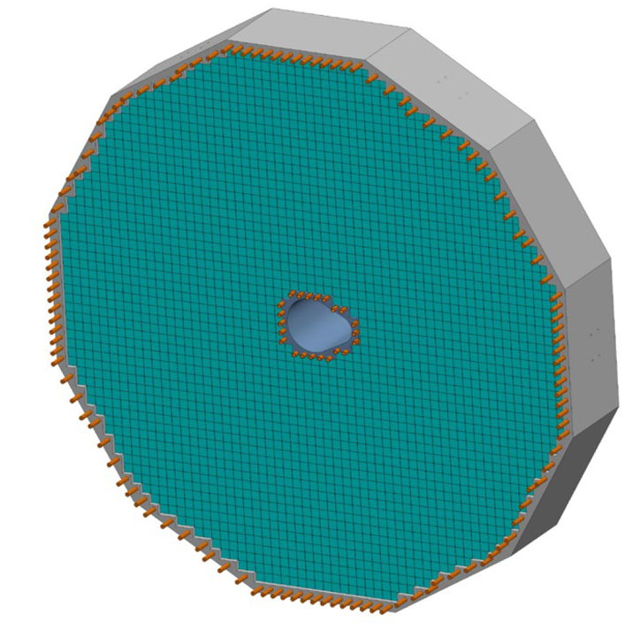
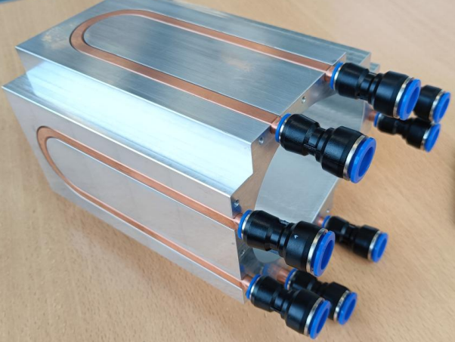
Liquid Cooling – Detectors
Forward EMCAL
Electronics : FEB, SiPM
Temperature : 2 to 3C above dew point
Barrel EMCAL
Electronics : SiPM, Astropix, ETC, Caloroc, Astrolinx
Temperature : SiPM : +/- 2 C (7C on SiPM’s)
Astropix, Astrolinx : 20 +/- 3 C, ETC, Caloroc: below 40 C
DIRC
Electronics : ASIC
Temperature : ASIC: +/- 2 C
Outer MPGD
Electronics : FEB
Temperature : ASIC : 30 +/-3C, Operation : 22 to 25C
Cymbal
Electronics : FEB, DC-DC Converters
Temperature : FEB : +/- 2C, Detector Operation : 15 to 25 C
pfRICH
Electronics : ASIC
Temperature : ASIC : +/- 2 C
EEMCAL
Electronics : FEB, SiPM
Temperature : +/- 0.1 C on crystals, Crystal temperature : 15 to 25 C
Cold plate, double-sided cooling:
- Side 1: ESB PCB with SiPMs
- Side 2: CALOROC and AstroPix ETC
Barrel Emcal
EEmcal
Internal Structure - Copper Tubes

Slide 26
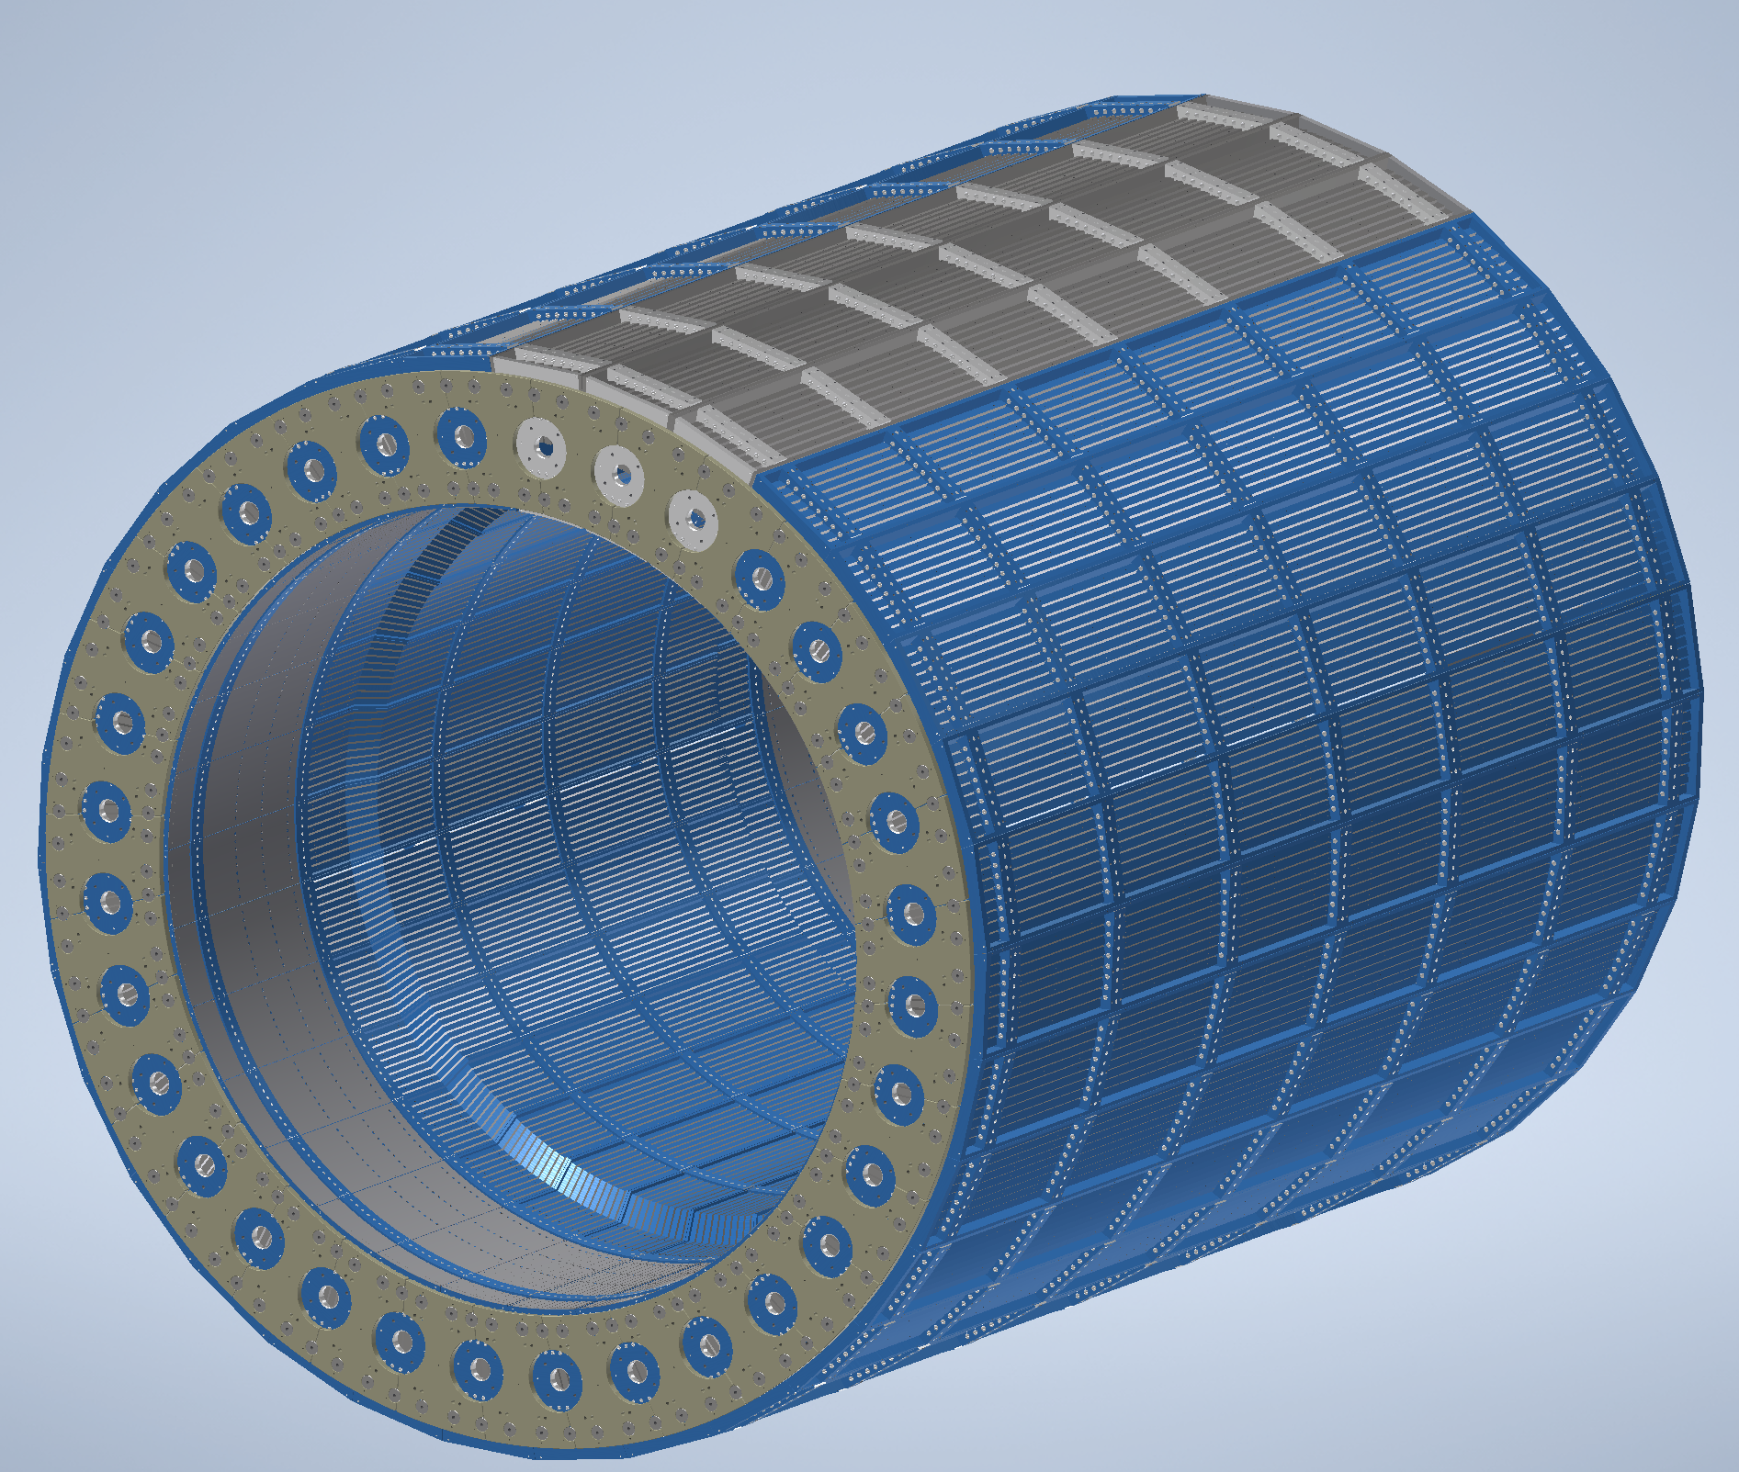
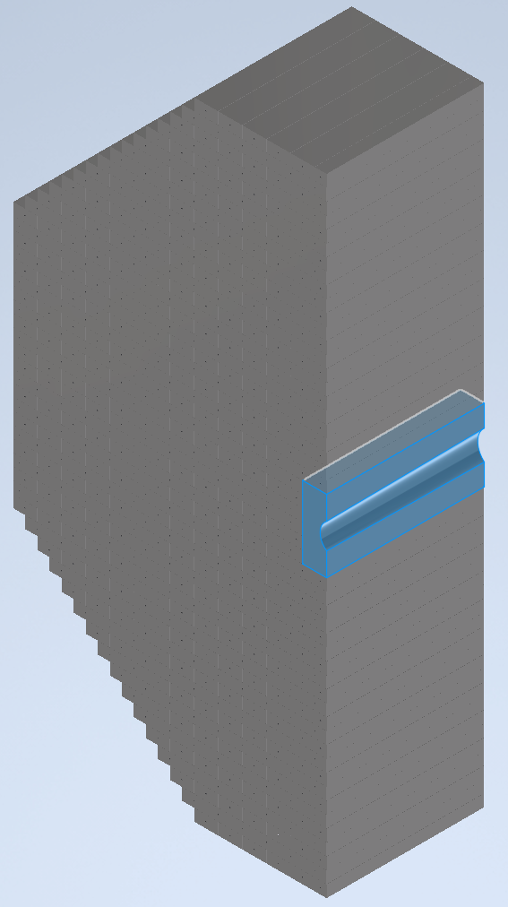
Air Cooling – Detectors
Barrel HCAL
Convective Cooling : Electronics : SiPM
Operating Temperature : 25C
Forward HCAL
Convective Cooling : PCB
Operating Temperature : <40C
SVT Outer
Air Cooling : L4 and L3 staves
Temperature : +/- 1 C for stability
SVT Inner
Air Cooling : L0, L1 and L2 staves
Temperature : <5C for stability, Detector Operation : Sensors <30C
SVT Disks
Air Cooling : ED and HD
Temperature : <5C for stability, Detector Operation : Sensors <30C
Electronics is placed on outside surface in the middle of each sector at z=0
Barrel Hcal
Insert Layers of PCB Carbon Steel thermal analysis under progress to predict air temperature on cone shaped beam pipe
Forward Hcal

Slide 27
Summary & Next Steps
Summary
Existing MCW, ACW and Cooling circulator with number of CDUs is sufficient to cool the heat load of the various detector components which are liquid cooled.
Convective Cooling is used to cool other detector components which are air cooled.
Special Cooling systems such as Glycol is used to cool the dRICH detector.
Global Thermal model development is in progress for various detectors.
Next Steps
Refine cooling calculations
Decide manifolding sizes and locations
Work with detector groups to determine temperatures, tube sizes, flow rates
Consider cooling interface details

Slide 28
QUESTIONS?

Slide 29
Backup Slides

Slide 30
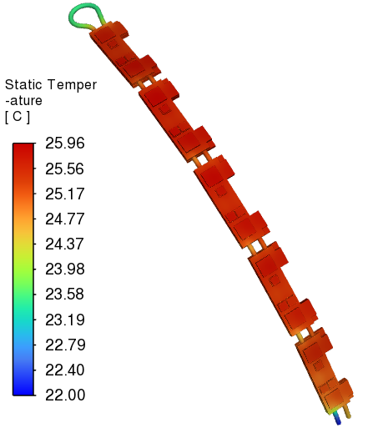
ePIC Detector – MPGD Endcap Disks
Analytical calculation
CFD calculation
Single FEB Heat | 15.675 | W
Number of FEBs | 5
Total FEB Heat | 78.375 | W
Ambient Temperature | 23 | C
Inlet Water Temperature | 22 | C
Water Flow rate | 0.5 | lpm
Cp | 4181 | J/kg C
m | 0.0083 | kg/s
m | 0.0083 | l/s
m | 8.33 | ml/s
Tube diameter | 0.004 | m
dT | 2.25 | C
Velocity | 0.663 | m/s
Re | 2772 | Transition Flow
Single FEB Heat | 15.675 | W
Number of FEBs | 5
Total FEB heat | 78.375 | W
m | 0.007978 | kg/s
Cp | 4181 | J/kg C
Ambient Temperature | 23 | C
Inlet Water Temperature | 22 | C
dT | 2.32 | C
Velocity | 0.663 | m/s
Air Heat Transfer Coefficient | 5 | W/m^2 C
Pressure drop | 3200 | Pa
Heat Load
Analytical calculation | 78.375 | W
CFD calculation | 78.375 | W
Heat loss to ambient | 0.98 | W
Ambient: 23C case
Temperature distribution

Slide 31
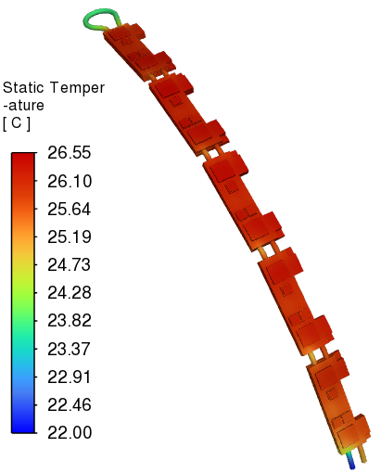
ePIC Detector – MPGD Endcap Disks
Analytical calculation
CFD calculation
Single FEB Heat | 15.675 | W
Number of FEBs | 5
Total FEB Heat | 78.375 | W
Ambient Temperature | 40 | C
Inlet Water Temperature | 22 | C
Water Flow rate | 0.5 | lpm
Cp | 4181 | J/kg C
m | 0.0083 | kg/s
m | 0.0083 | l/s
m | 8.33 | ml/s
Tube diameter | 0.004 | m
dT | 2.25 | C
Velocity | 0.663 | m/s
Re | 2772 | Transition Flow
Single FEB Heat | 15.675 | W
Number of FEBs | 5
Total FEB heat | 78.375 | W
m | 0.007978 | kg/s
Cp | 4181 | J/kg C
Ambient Temperature | 40 | C
Inlet Water Temperature | 22 | C
dT | 2.69 | C
Velocity | 0.663 | m/s
Air Heat Transfer Coefficient | 10 | W/m^2 C
Pressure drop | 3202 | Pa
Heat Load
Analytical calculation | 78.375 | W
CFD calculation | 78.375 | W
Heat gain from ambient | 11.39 | W
Ambient: 40C case – Effect of SVT
Temperature distribution

Slide 32
ePIC Detector – MPGD Endcap Disks
Cooling Scope of Work :
Detailed Power Estimates :
Cooling media | Water
Inlet Temperature | 22 | C
Ambient Temperature | 23 | C
Tube inner diameter | 4 | mm
Tube outer diameter | 6 | mm
Tube material | Copper
Minimum Temperature of Detector | 25 | C
Maximum Temperature of Detector | 35 | C
Temperature rise | 2 | C
Temperature stability | ± 3 | C
Flow rate of single module | 0.5 | lpm
Pressure drop of single module | 0.03 | bar
Heat dissipation to ambient from single module | 0.98 | W
Total Heat dissipation to ambient | 16 | W
Cooling loops | Parallel
Insulation requirement | No
Neighboring detectors | SVT, pfRICH, TOF
Component | Power | Power
 | mW | W
DC/DC | 2500 | 2.5
DC/DC | 2500 | 2.5
SALSA | 1800 | 1.8
SALSA | 1800 | 1.8
SALSA | 1800 | 1.8
SALSA | 1800 | 1.8
LDO SALSA | 900 | 0.9
LDO SALSA | 900 | 0.9
LDO lpGBT | 200 | 0.2
LDO VTRX | 875 | 0.875
lpGBT | 600 | 0.6
FEB Heat Load | 15,675 | 15.675
FEB Heat Load in a single module | 78,375 | 78.375
Total Detector Heat Load | 1254 | 1254
Number of FEBs in a module | 5
Total Number of Modules in detector | 16

Slide 33
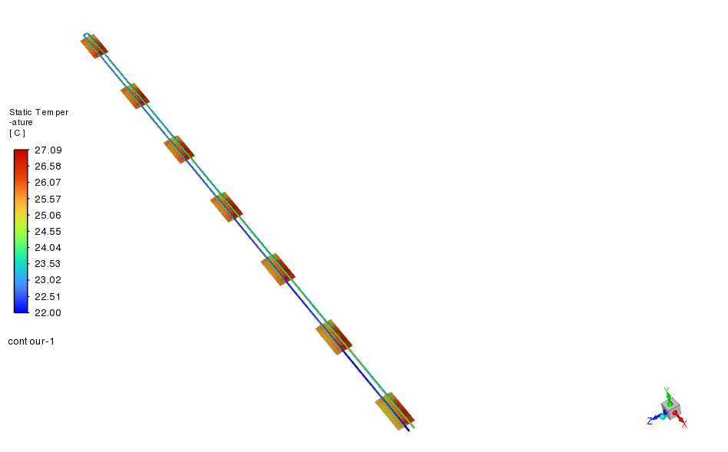
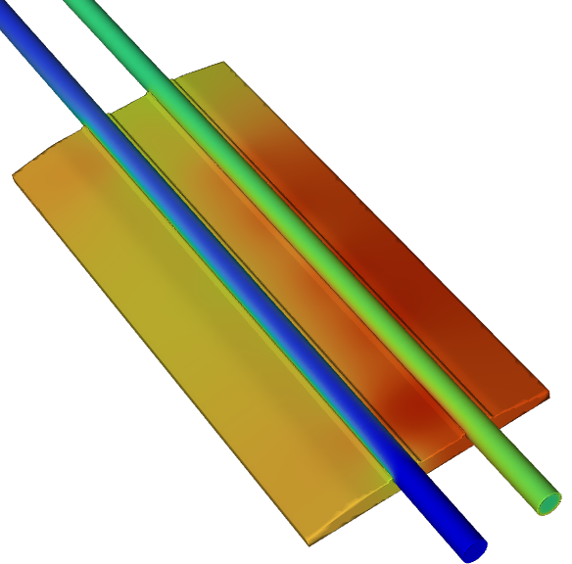
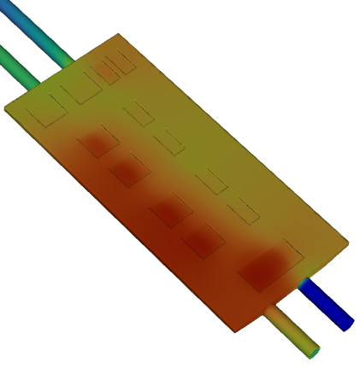
ePIC Detector – Outer MPGD
Outer MPGD Thermal Simulation :
Analytical calculation
CFD calculation
Single FEB Heat | 15.206 | W
Number of FEBs | 7
Total FEB Heat | 106.442 | W
Ambient Temperature | 23 | C
Inlet Water Temperature | 22 | C
Water Flow rate | 0.76 | lpm
Cp | 4181 | J/kg C
m | 0.01273 | kg/s
m | 0.01273 | l/s
m | 12.7292 | ml/s
Tube diameter | 0.0045 | m
dT | 2 | C
Velocity | 0.8 | m/s
Re | 3765 | Transition Flow
Single FEB Heat | 15.206 | W
Number of FEBs | 7
Total FEB heat | 106.442 | W
m | 0.012525 | kg/s
Cp | 4181 | J/kg C
Ambient Temperature | 23 | C
Inlet Water Temperature | 22 | C
dT | 2.03 | C
Velocity | 0.8 | m/s
Air Heat Transfer Coefficient | 5 | W/m^2 C
Pressure drop | 8319 | Pa
Heat Load
Analytical calculation | 106.442 | W
CFD calculation | 106.442 | W
Heat loss to ambient | 0.15 | W
Front View Enlarged
Rear View Enlarged
Temperature distribution

Slide 34
ePIC Detector – Outer MPGD
Detailed Power Estimates :
Cooling Scope of Work :
Component | Power | Power
 | mW | W
DC/DC | 4,400 | 4.4
SALSA | 1,800 | 1.8
SALSA | 1,800 | 1.8
SALSA | 1,800 | 1.8
SALSA | 1,800 | 1.8
LDO SALSA | 450 | 0.45
LDO SALSA | 450 | 0.45
LDO SALSA | 450 | 0.45
LDO SALSA | 450 | 0.45
LDO lpGBT | 156 | 0.156
LDO VTRX | 875 | 0.875
lpGBT | 600 | 0.6
VTRX | 175 | 0.175
FEB Heat Load in half module | 15,206 | 15.206
Total Detector Heat Load | 5,380,000 | 5380
Cooling media | Water
Inlet Temperature | 22 | C
Ambient Temperature | 23 | C
Tube inner diameter | 4.5 | mm
Tube outer diameter | 5 | mm
Tube material | Stainless Steel
Minimum Temperature of Detector | 25 | C
Maximum Temperature of Detector | 35 | C
Temperature rise | 2 | C
Temperature stability | ± 3 | C
Flow rate of half module | 0.76 | lpm
Pressure drop of half module | 0.083 | bar
Heat dissipation to ambient from half module | 0.15 | W
Total Heat dissipation to ambient |  | W
Cooling loops | Parallel
Insulation requirement | Yes/No
Neighboring detectors | GST, hpDIRC
Number of FEBs in a single module | 14
Total Number of Modules in detector | 24

Slide 35
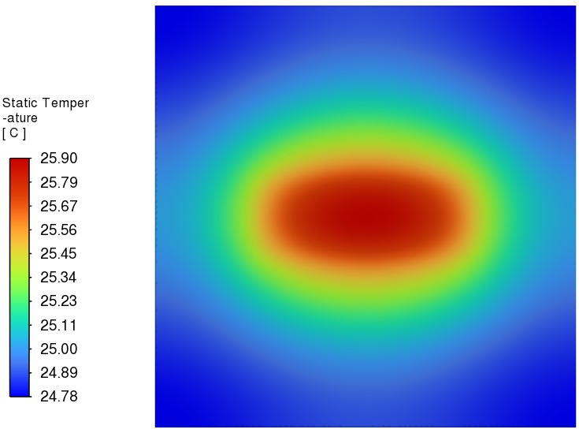
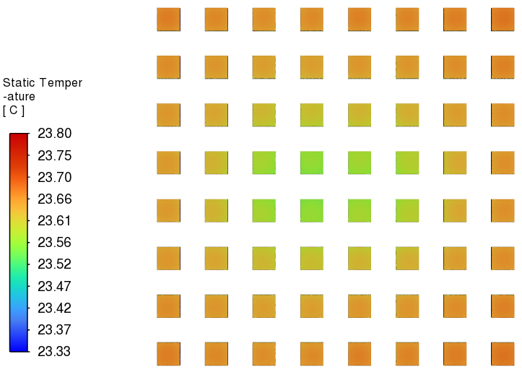
ePIC Detector – Forward EMCAL
Forward Emcal Thermal Simulation
FEB Temperature
SiPM Temperature
Ambient Temperature (C) | Flow velocity (m/s) | Half FEB Heat load (W) | SiPM Heat load (W)
20 | 0.76 | 2.25 | 0.17
Heat Transfer Coefficient (W/m^2 C) | Water Inlet Temperature (C) | FEB Temperature (C) | SiPM Temperature (C)
5 | 22 | 25.9 | 23.8

Slide 36
ePIC Detector – Global Thermal Model
Forward Emcal Detailed Calculation
Temperature rise ΔT | 2 | C
Required flow rate | 0.315 | kg/s
Required flow rate | 0.000315 | m^3/s
Required flow rate | 19 | lpm
Dynamic Viscosity | 0.001 | Ns/m^2
Copper Tube length | 1 | m
Maximum number of FEB per detector row | 10
Maximum number of SiPM per detector row | 76
Maximum total power per cooling loop | 58 | W
Maximum total power per cooling loop NS half | 116 | W
Number of cooling loops | 18
Cooling loops | Parallel
Required flow rate per loop | 1.38366E-05 | m^3/s
Required flow rate per loop | 0.83 | lpm
Required total flow rate | 15 | lpm
Velocity | 0.757 | m/s
Copper tube outer diameter | 0.25 | inch
Copper tube outer diameter | 0.00635 | m
Copper tube inner diameter | 0.19000 | inch
Copper tube inner diameter | 0.004826 | m
Area | 0.0000183 | m^2
Reynolds Number | 3652.349715
Pipe Absolute Roughness | 0.0000015 | m
Pipe Relative Roughness | 0.0003 | m
A | 7.76315E+15
B | 1.5449E+16
Pressure drop per loop | 0.0427 | bar
Pressure drop per loop | 4272.9558 | Pa
Pressure drop per loop | 0.6197 | psi
Friction factor | 0.0720
 |  | Units
Cooling media | Water
Chiller flow rate | 400 | gpm
Chiller flow rate | 1514 | lpm
Chiller flow rate | 0.02523 | m^3/s
Chiller flow rate | 25.23 | kg/s
density | 1000 | kg/m^3
Specific Heat | 4186 | J/kg C
RH | 65 | %
Ambient Temp | 74 | F
Ambient Temp | 23.3 | C
Dew Point Temp | 61.5 | F
Dew Point Temp | 16.4 | C
Inlet Temp | 64.4 | F
Inlet Temp | 18.0 | C
FEB Full Board Heat | 4.5 | W
FEB Half Board Heat | 2.25 | W
Number of FEB Full Board North half | 277
Number of FEB Half Board North half | 44
Total Heat Generation FEB Full Board North half | 1246.5 | W
Total Heat Generation FEB Half Board North half | 99 | W
Number of FEB Full Board South half | 274
Number of FEB Half Board South half | 24
Total Heat Generation FEB Full Board South half | 1233 | W
Total Heat Generation FEB Half Board South half | 54 | W
SiPM Board Heat | 0.17 | W
Number of SiPM Board North half | 2392
Number of SiPM Board South half | 2288
Total Heat Generation SiPM Board North half | 406.64 | W
Total Heat Generation SiPM Board South half | 388.96 | W
Total Heat Load | 2633 | W
Ambient temperature | 22 | C
RH | 65 | %
Dew point temperature | 15.5 | C
Minimum water temperature | 18 | C

Slide 37
Liquid Cooling – Detectors
Forward EMCAL
Electronics : FEB, SiPM
Temperature : 2 to 3C above dew point
Barrel EMCAL
Electronics : SiPM, Astropix, ETC, Caloroc, Astrolinx
Temperature : SiPM : +/- 2 C (7C on SiPM’s)
Astropix, Astrolinx : 20 +/- 3 C, ETC, Caloroc: below 40 C
DIRC
Electronics : ASIC
Temperature : ASIC: +/- 2 C
Outer MPGD
Electronics : FEB
Temperature : ASIC : 30 +/-3C, Operation : 22 to 25C
Cymbal
Electronics : FEB, DC-DC Converters
Temperature : FEB : +/- 2C, Detector Operation : 15 to 25 C
pfRICH
Electronics : ASIC
Temperature : ASIC : +/- 2 C
EEMCAL
Electronics : FEB, SiPM
Temperature : +/- 0.1 C on crystals, Crystal temperature : 15 to 25 C
Cold plate, double-sided cooling:
- Side 1: ESB PCB with SiPMs
- Side 2: CALOROC and AstroPix ETC
Barrel Emcal
EEmcal
Internal Structure - Copper Tubes

Slide 38
Air Cooling – Detectors
Barrel HCAL
Convective Cooling : Electronics : SiPM
Operating Temperature : 25C
Forward HCAL
Convective Cooling : PCB
Operating Temperature : <40C
SVT Outer
Air Cooling : L4 and L3 staves
Temperature : +/- 1 C for stability
SVT Inner
Air Cooling : L0, L1 and L2 staves
Temperature : <5C for stability, Detector Operation : Sensors <30C
SVT Disks
Air Cooling : ED and HD
Temperature : <5C for stability, Detector Operation : Sensors <30C
Electronics is placed on outside surface in the middle of each sector at z=0
Barrel Hcal
Insert Layers of PCB Carbon Steel thermal analysis under progress to predict air temperature on cone shaped beam pipe
Forward Hcal

Slide 39
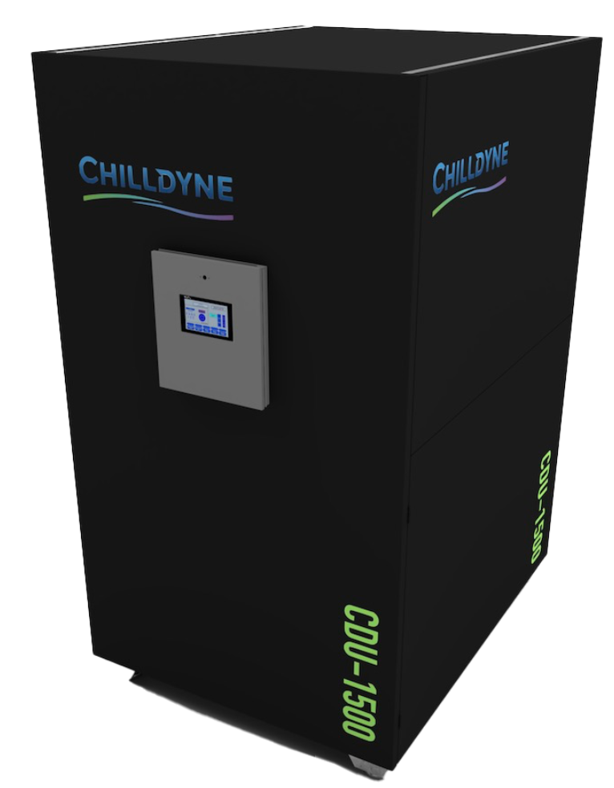
ePIC Detector – Cooling Distribution Unit - CDU
Chilldyne Option 2
Chilldyne CDU 1500
Cooling media | Water/Glycol
Total Heat Load of Electronics | 46
CDU Cooling Capacity | 200
Number of CDUs required | 0.23
Single CDU | 23.00
Margin CDU | 2
density | 1000
Specific Heat | 4186
Temperature rise, ΔT | 2
Pressure available | 0.5
Pressure available | 50000
Mass flow rate | 5.49
Volumetric flow rate | 0.00549
Volumetric flow rate per unit | 329.67
Volumetric flow rate per unit | 87.03
Rated Cooling Capacity (kW) : 1500 kW (1,500 lpm) @ 15°C ΔT
Primary (FWS) Loop: 400 GPM (1,500 lpm) or 25% more than TCS loop max 8 psi (55 kPa) ΔP
Secondary (TCS) Loop: 400 GPM (1,500 lpm) @ 10-29 psi (69-269 kPa) ΔP
Each CDU will operate at 46 kW - 23 percent of it’s rated capacity
Active CDUs – 1, Standby CDU – 1 for backup
Dimensions (L*W*H) inches : 60’’ * 48’’ * 74’’

Slide 40
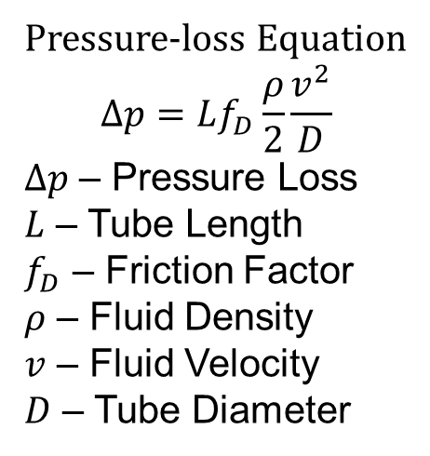
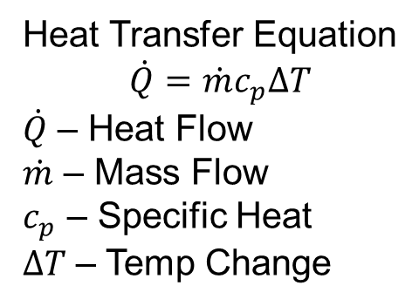
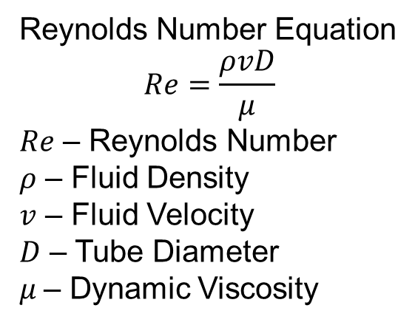
ePIC Detector – Cooling Calculation
Heat Transfer Equation
$$\dot{Q}=\dot{m}c_{p}∆T$$
$\dot{Q}$ – Heat Flow
$\dot{m}$ – Mass Flow
$c_{p}$ – Specific Heat
$∆T$ – Temp Change
Pressure-loss Equation
$$∆p=Lf_{D}\frac{ρ}{2}\frac{v^{2}}{D}$$
$∆p$ – Pressure Loss
$L$ – Tube Length
$f_{D}$ – Friction Factor
$ρ$ – Fluid Density
$v$ – Fluid Velocity
$D$ – Tube Diameter
Reynolds Number Equation
$$Re=\frac{ρvD}{μ}$$
$Re$ – Reynolds Number
$ρ$ – Fluid Density
$v$ – Fluid Velocity
$D$ – Tube Diameter
$μ$– Dynamic Viscosity

Slide 41
ePIC Detector – Detailed Calculation
Barrel EMCAL
Barrel HCAL
 |  | Units
Cooling media | Natural Convection
Caloroc Board Heat Load | 5 | W
Number of Caloroc boards in each sector | 8
Sector Heat Load | 40 | W
Total Number of Sectors | 32
Total Heat Load | 1280 | W
Density | 1.2 | kg/m^3
Specific Heat | 1005 | J/kg C
Temperature rise | 22 | C
Flow Rate | 0.0482 | m^3/s
Flow Rate | 102.22 | cfm
Heat transfer coefficient required | 5.87 | W/m^2- C
Read out box width | 0.2 | m
Read out box length | 0.4 | m
Read out box area | 0.08 | m^2
Number of electornics read out boxes | 8
Total Surface Area | 9.92 | m^2
Total Length | 6.2 | m
Total Width | 1.6 | m
 |  | Units
Cooling media | Water
Chiller flow rate | 400 | gpm
Chiller flow rate | 1514 | lpm
Chiller flow rate | 0.02523 | m^3/s
Chiller flow rate | 25.23 | kg/s
density | 1000 | kg/m^3
Specific Heat | 4186 | J/kg C
RH | 65 | %
Ambient Temp | 72 | F
Ambient Temp | 22.2 | C
Dew Point Temp | 60 | F
Dew Point Temp | 15.3 | C
Inlet Temp | 64.4 | F
Inlet Temp | 18.0 | C
Temperature rise ΔT | 0.029 | C
Outlet Temp | 18.029 | C
Astropix Chip | 43.5 | W
End of Tray Card | 7.2 | W
Astropix Module PCB | 10.9 | W
FEB | 3 | W
ESB Sector Heat load | 64.6 | W
Number of sectors | 48 | W
Total Heat Load | 3100.8 | W
Temperature rise ΔT | 2 | C
Required flow rate | 0.370 | kg/s
Required flow rate | 0.000370 | m^3/s
Required flow rate | 22 | lpm
Dynamic Viscosity | 0.001 | Ns/m^2
Length | 5 | m

