Slide 1
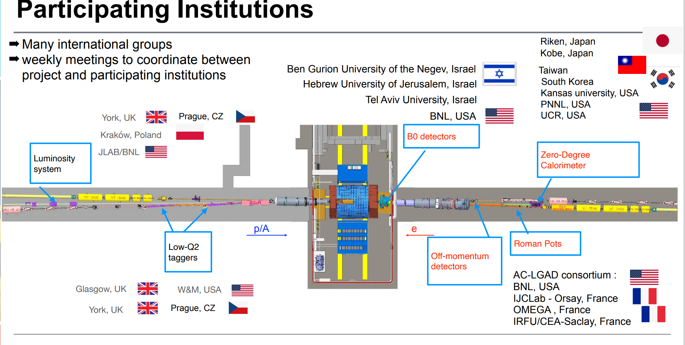

Slide 2
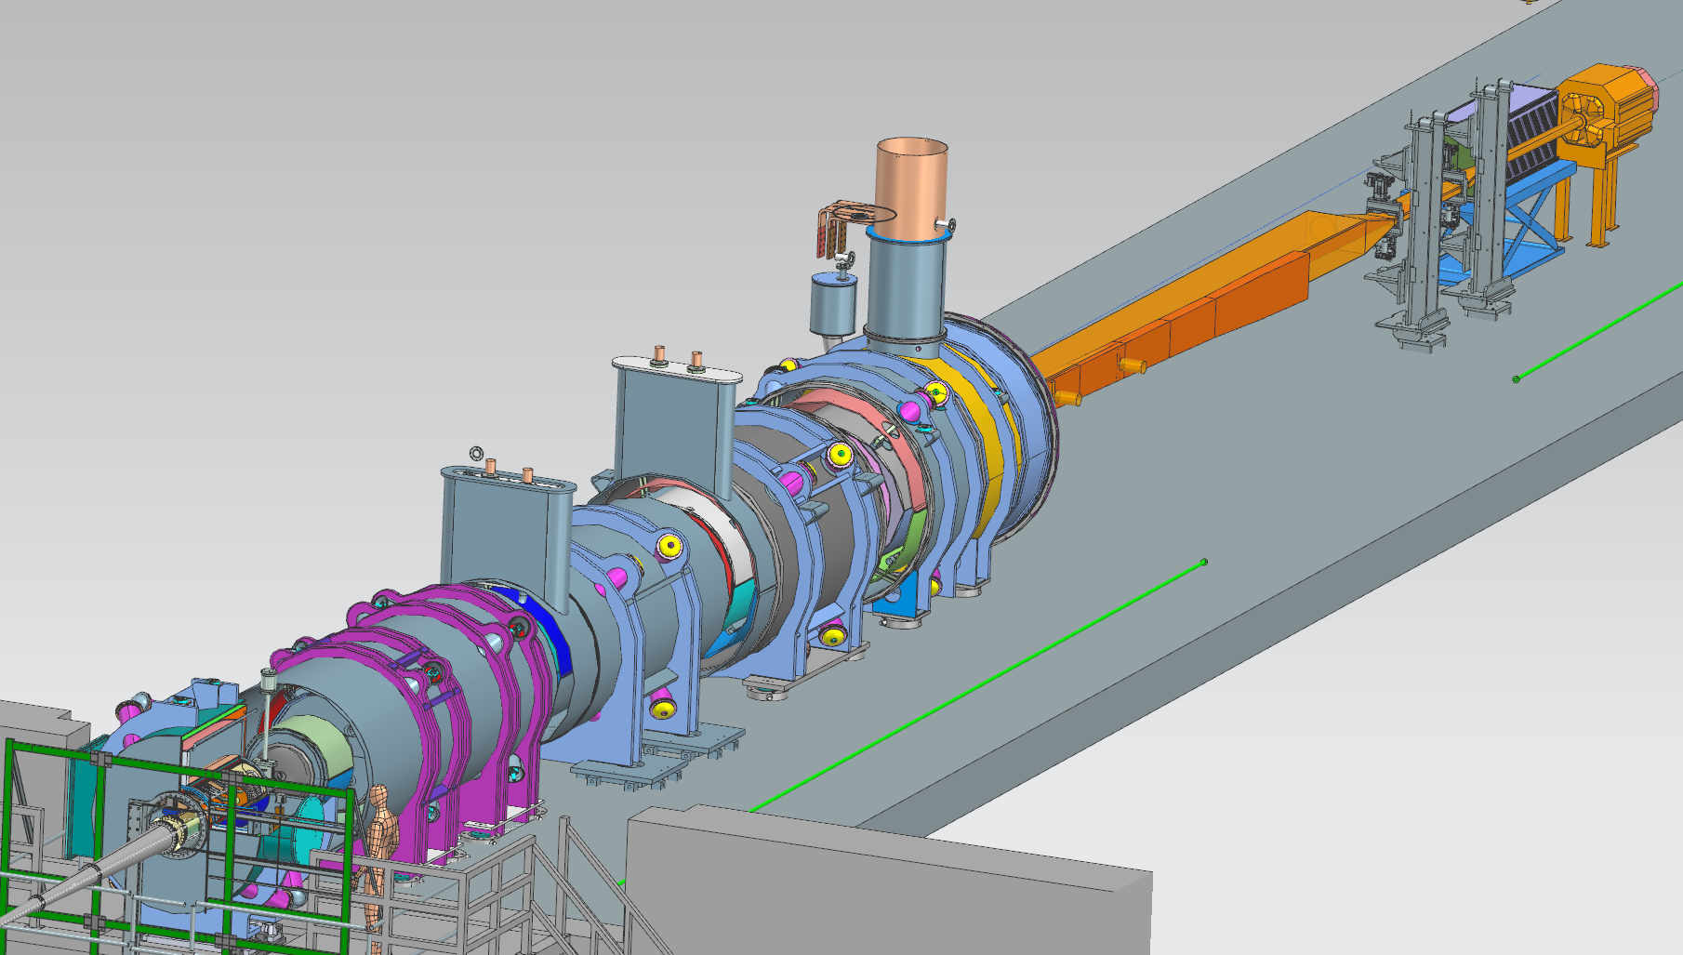
Far-Forward Integration
Zero-Degree
Calorimeter
B0 Detectors
Roman Pot Detectors
Off-Momentum Detectors
ePIC Collaboration Meeting, January 21, 2026

Slide 3
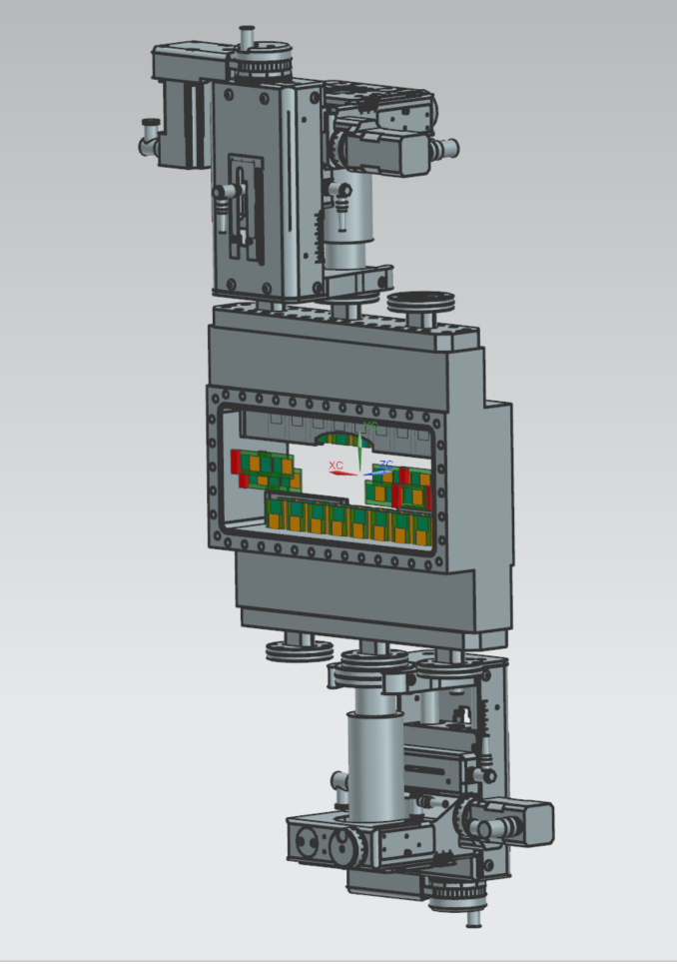
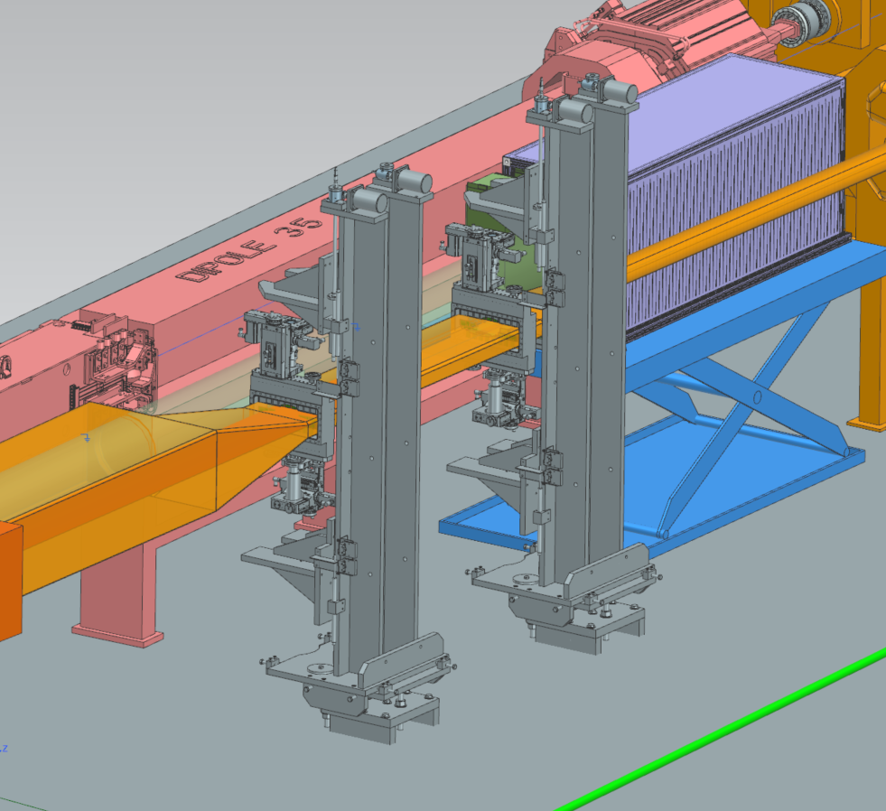
Roman Pots

Slide 4
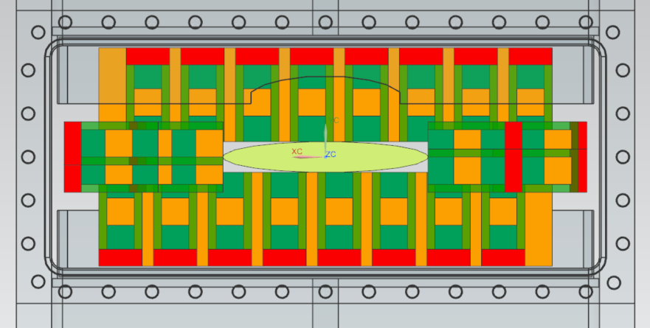
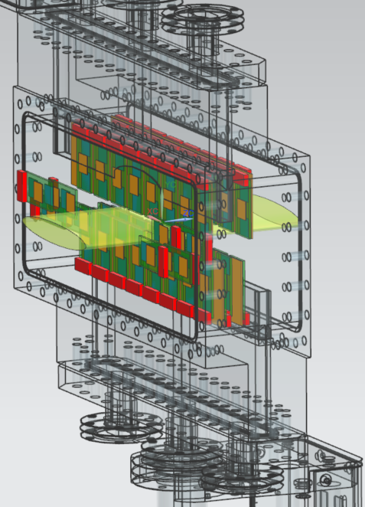
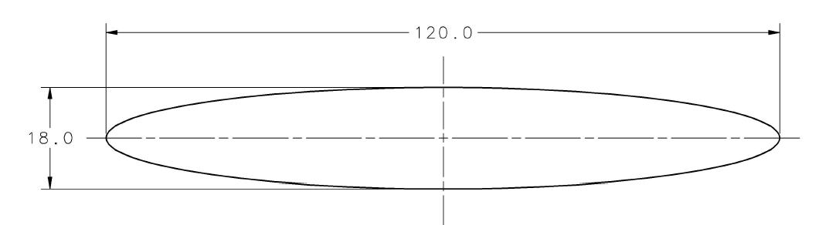
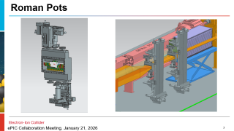
Roman Pot Detector Arrangement, Six Sigma - 100 GEV Beam Energy
Measurements are in MM
ePIC Collaboration Meeting, January 21, 2026
Notes:
Slicer: Orienting the print on the bed, Adjusting supports, Layer height/thickness, Infill pattern and density, Bed adhesion settings, Printing speed, Extrusion amount
.gcode: legible to the printer

Slide 5
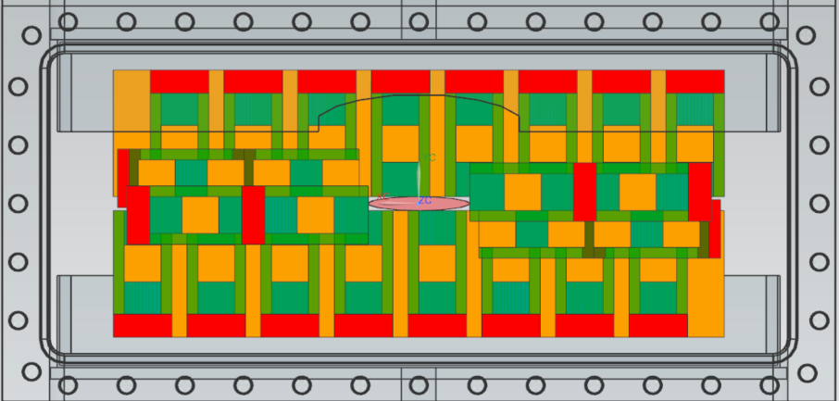
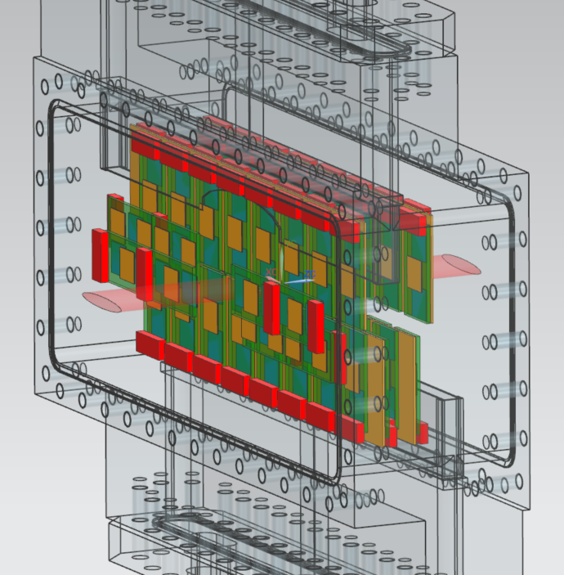
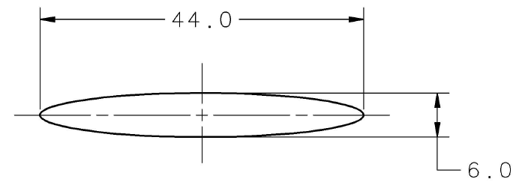
Roman Pot Detector Arrangement, Six Sigma - 275 GEV Beam Energy
Measurements are in MM
ePIC Collaboration Meeting, January 21, 2026
Notes:
Slicer: Orienting the print on the bed, Adjusting supports, Layer height/thickness, Infill pattern and density, Bed adhesion settings, Printing speed, Extrusion amount
.gcode: legible to the printer

Slide 6
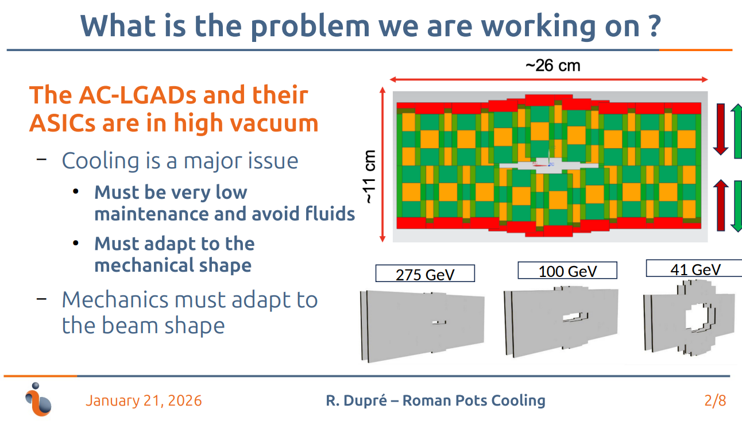

Slide 7
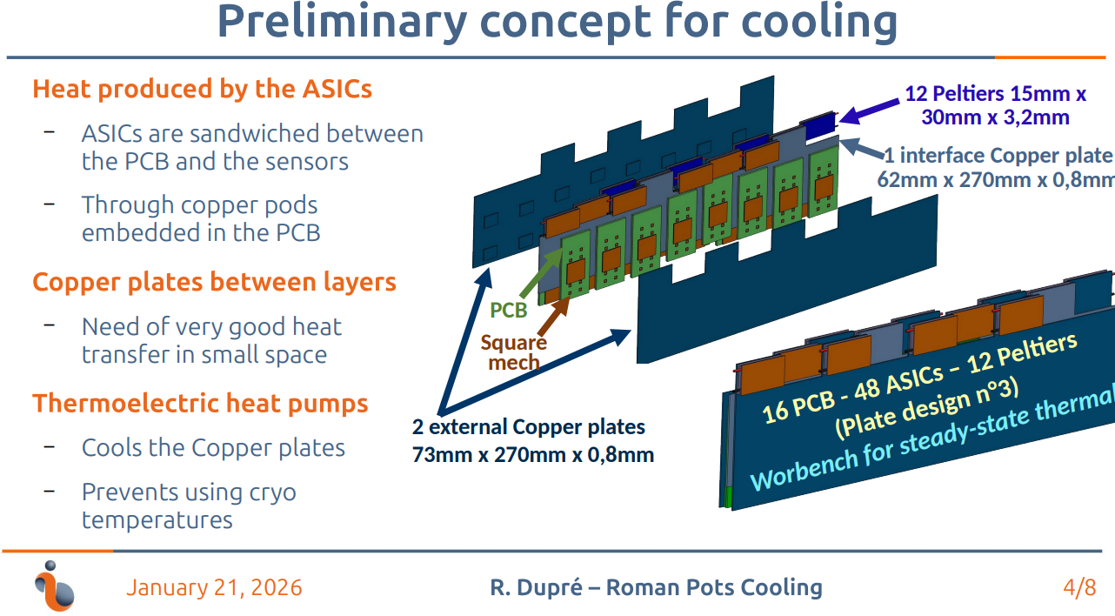

Slide 8
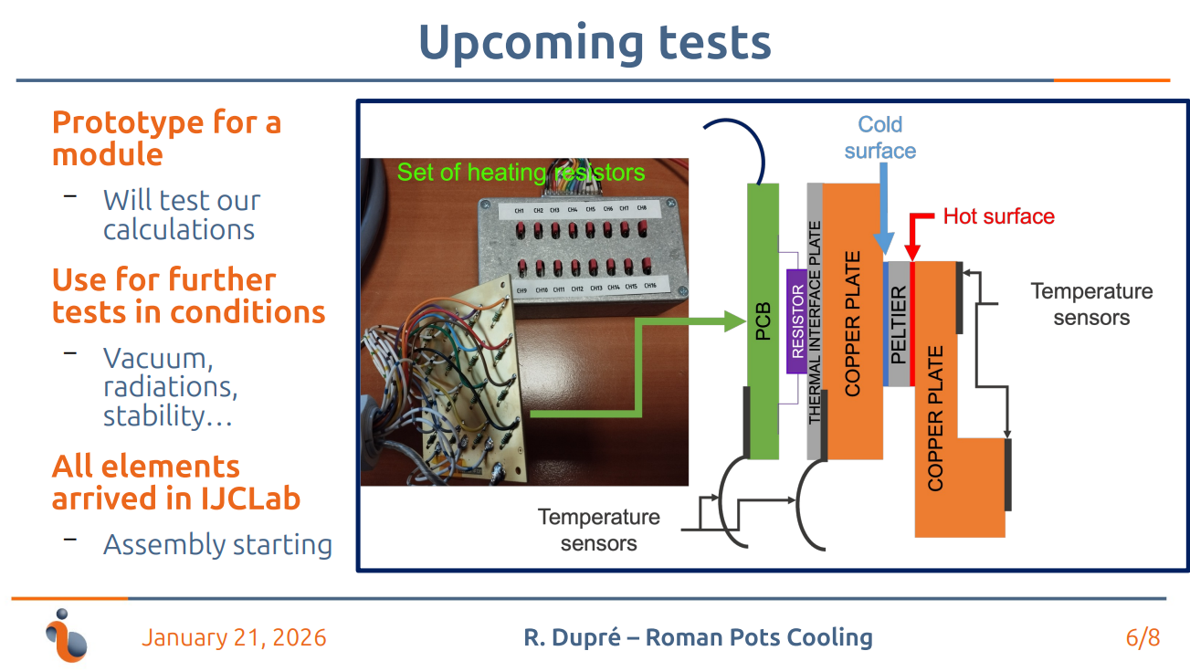

Slide 9
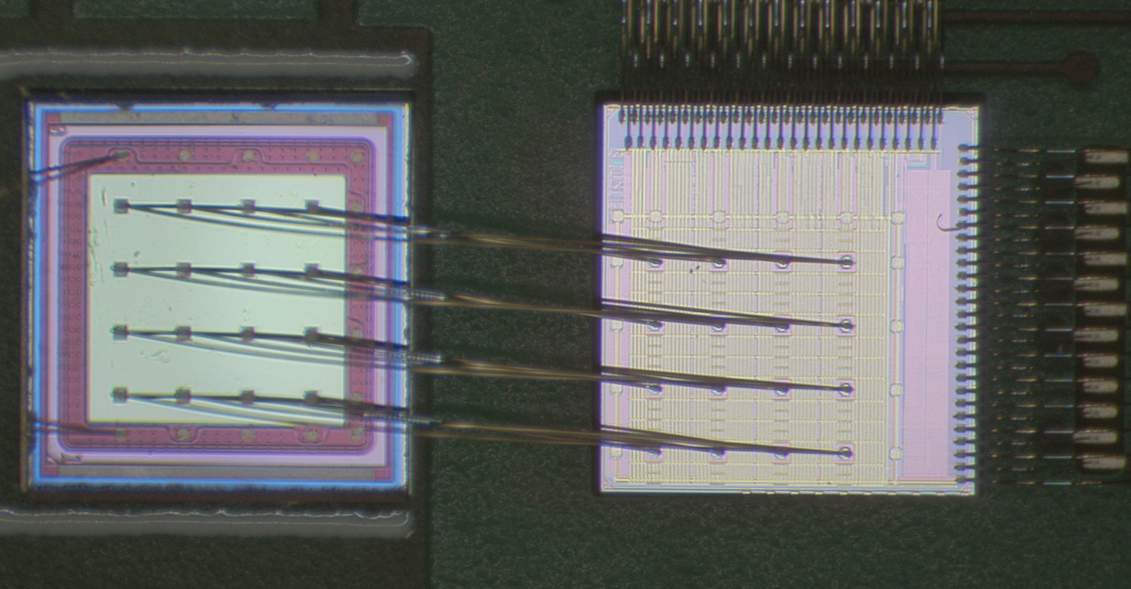
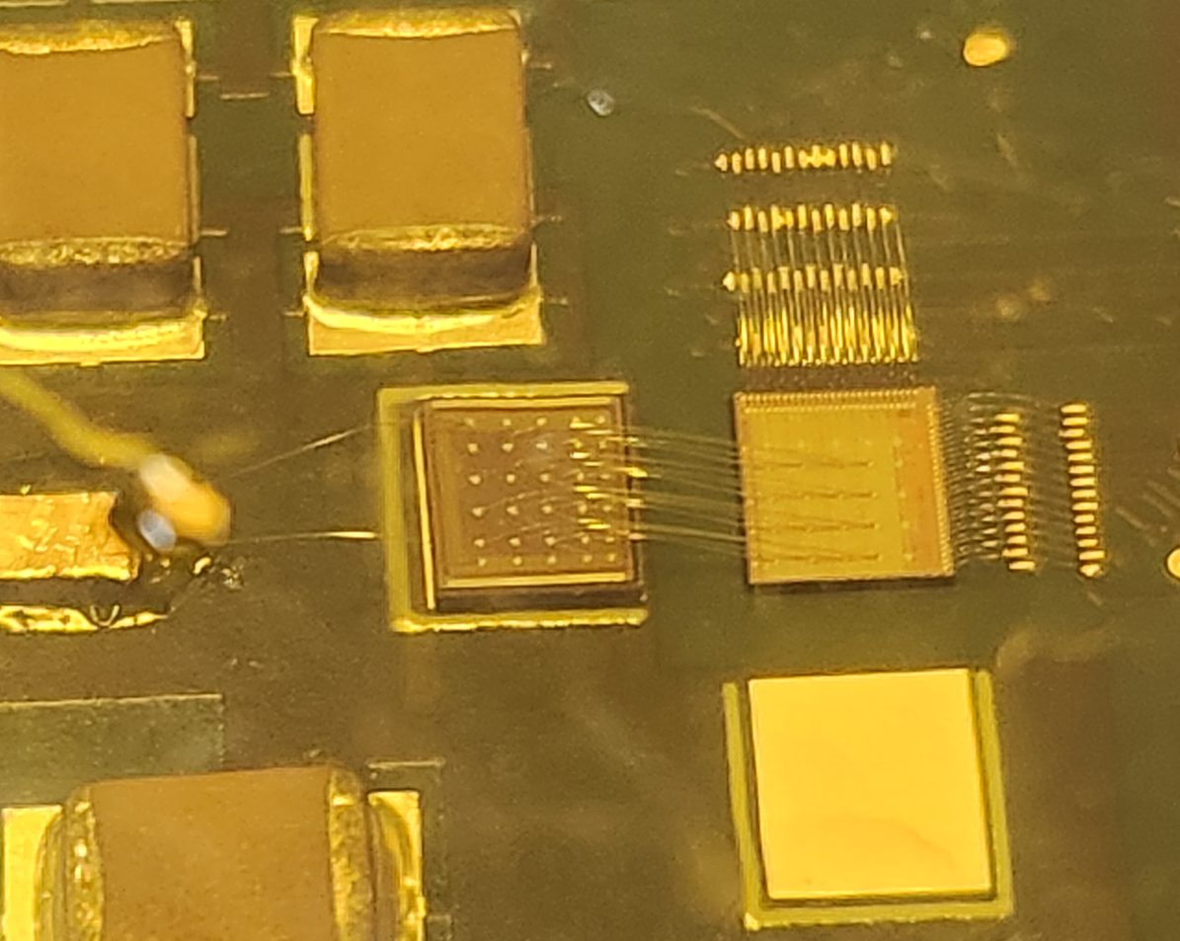
Implementation of AC-LGADs for FF Tracking
AC-LGAD
EICROC0
BNL AC-LGAD:
500x500 um² pixel pitch
100x100 um² metal electrode
30um active thickness
EICROC ASIC proposed for pixilated AC-LGADs.
  Uses infrastructure from ALTIROC (used for DC-LGADs in ATLAS) and HGCROC (I2C)
  Currently only 4x4 channel version exists, 32x32 (full channel count) in production (to arrive in Feb./March 2026).
  Also used in FTOF (or any pixilated AC-LGAD detector).

Slide 10
Some comments on needs for testbeam(s)
Current testbeam setups use sensors + analog boards w/ preamps, which are then read out by external digitizers.
Work needs to be done to test large pixel sensors to assess performance (some may be done in March testbeam, but need to solidify goals).
We have put in a request for SPS test beam → closer to real-life EIC beams (hadrons at high energy).
  Primary goal is to test AC-LGADs w/ ASICs to assess current full-chain performance (for example, EICROC1 + 32x32 HPK AC-LGADs + RBv1 FEB).
  This is ambitious to say the least → sensor performance goals still not met from other campaigns can still be achieved with this testbeam.
    Testing with 4x4 sensors + EICROC0?
  What other goals should we aim to achieve here?
Future (~ 2 weeks) AC-LGAD cross-cutting meeting will discuss goals, needed resources, institutional support, etc. to assure a successful SPS campaign (assuming SPS approves the beam time; still waiting to hear from them).

Slide 11
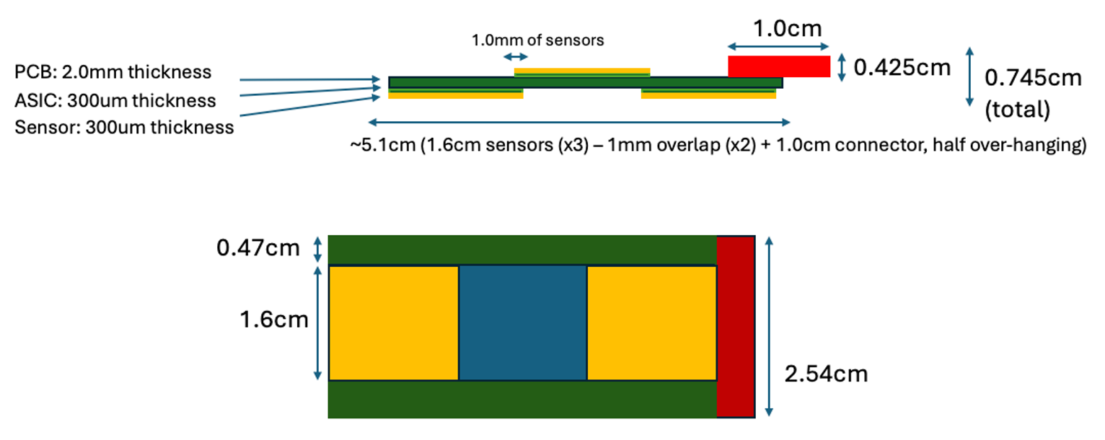
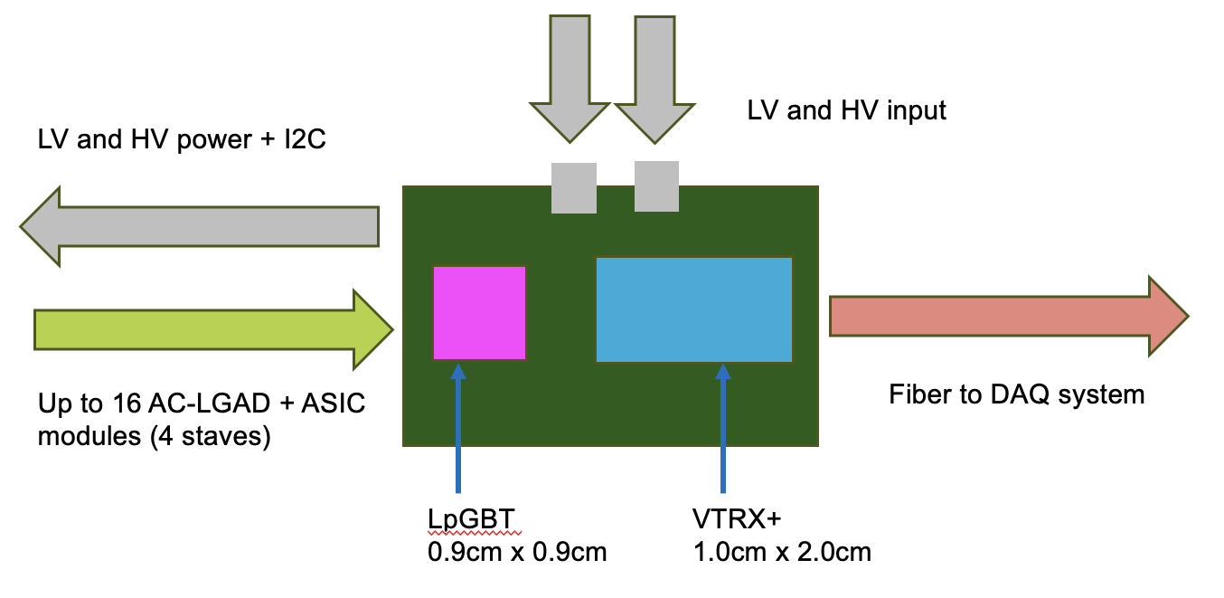
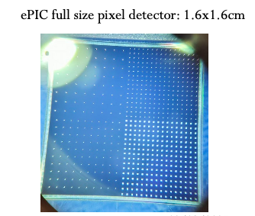
Implementation of AC-LGADs for FF Tracking
Readout needs to be separated from sensor/ASIC board to obey physical constraints for far-forward subsystems.
*Stave dimensions will be updated once EICROC1 schematic is in-hand.
Far-forward sensor “staves”
  (3) 1.6cm x 1.6cm AC-LGADs with 500um pixel pitch
  bump-bonded to EICROC1/2 ASICs
  staggered on a two-sided PCB to provide full active-area coverage.
  These sensors have 32x32 channels, matching the EICROC1/2.
    Currently have 32x32 channel sensors from HPK which are under test.

Slide 12
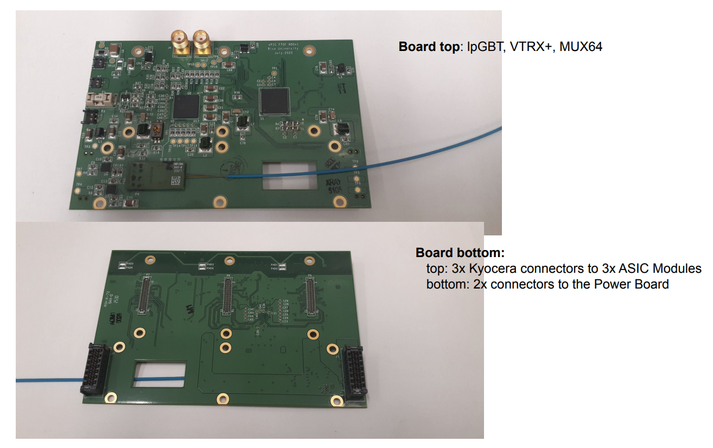
Implementation of AC-LGADs for FF Tracking
Tonko Ljubicic (Rice Univ.)
*Stave dimensions will be updated once EICROC1 schematic is in-hand.
Far-forward sensor “staves”
  (3) 1.6cm x 1.6cm AC-LGADs with 500um pixel pitch
  bump-bonded to EICROC1/2 ASICs
  staggered on a two-sided PCB to provide full active-area coverage.
  These sensors have 32x32 channels, matching the EICROC1/2.
    Currently have 32x32 channel sensors from HPK which are under test.
Strong synergy with TOF: front-end + power board will be the same as FTOF.
  Only difference is sensor stave/module, and the separation of the FEB for flexibility for FF detector needs.
Presently optimizing choice of readout board “flavor” which works best for auxiliary detector needs.

Slide 13
Broad timeline of AC-LGAD activities (non-exhaustive)
Action Item | Current Status | Dates (expected completion) | Notes
4x4 BNL and HPK sensors tested at Fermilab | Complete | 2020 to Summer 2022 | Established timing resolution ~ 20ps and spatial resolution ~ 20um (7x better than normal for pixel pitch due to charge sharing)
EICROC0 testing with charge injection | Mostly complete (jitter still under study) | Summer 2023 to now (Feb. 2026) | Tested analog and digital output, measured jitter, tested linearity of ADC Firmware does not support external trigger; will be updated to enable this with EICROC1
4x4 sensor testing with EICROC0 | Mostly complete (jitter still under study) | Summer 2023 to now (Feb. 2026) | Testing has been done with AC-LGADs wirebonded to EICROC0 – noise unacceptably high. Now using bump-bonded assemblies. Tested with TCT and Sr-90 source. Jitter from individual components small (10-15ps) – total jitter from analog output of EICROC0 testboard with AC-LGADs bump-bonded high – under study now.
Testing of full-size 32x32 channel HPK sensors | In-progress | Summer 2025 to now (Summer 2026) | IV curves measured and breakdown voltages identified; production yield > 90%; first test beam @ DESY in December 2025; hope for test beam @ SPS in Summer 2026; Lab testing underway (laser, source)
RBv1 setup and initial tests | In-progress | Summer 2025 to now (Spring 2026) | Work done to validate setup at Rice; setup being established at BNL to test EICROC1 with two different readouts after receipt of ASIC
Testing of EICROC1 | Not started | March 2026 to Fall 2026 | Will test with FPGA setup as done with EICROC0; aim is to test with RBv1 (lpGBT-based readout) as soon as EICROC1 is received.
Full-chain tests (32x32 sensor with EICROC1 and RBv1) | Not started | Late Spring 2026 – TBD (end of 2026) | Goal is to have initial full chain testing done by Summer if EICROC1 testing + RBv1 setup is successful.

Slide 14
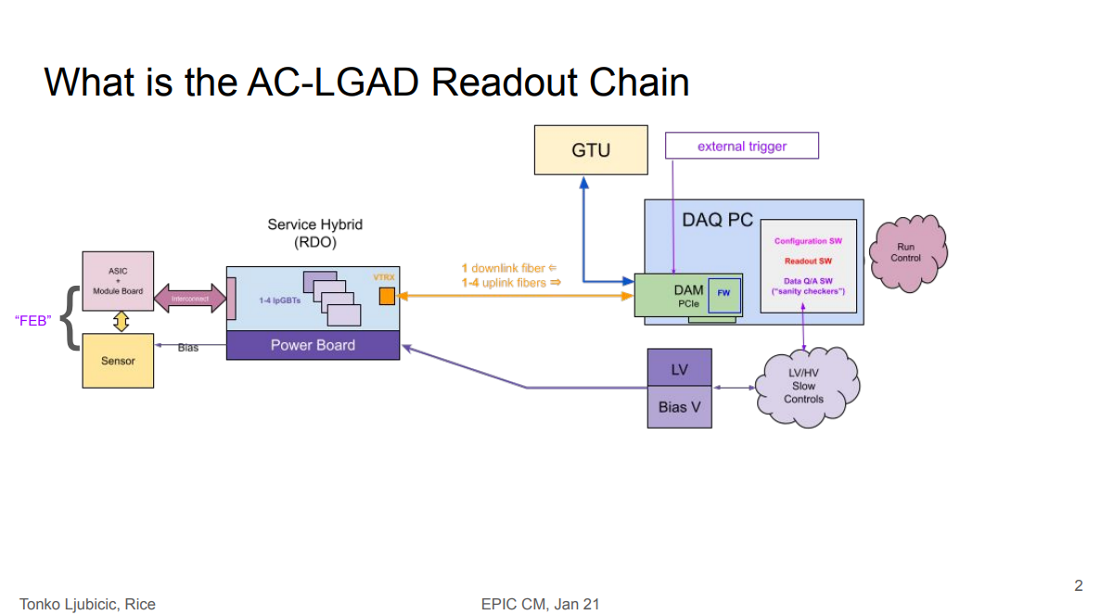

Slide 15
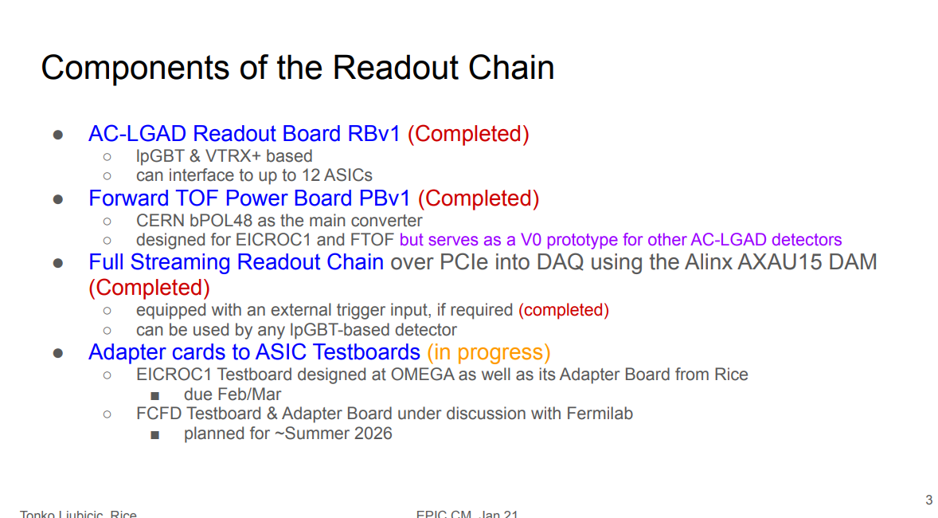

Slide 16
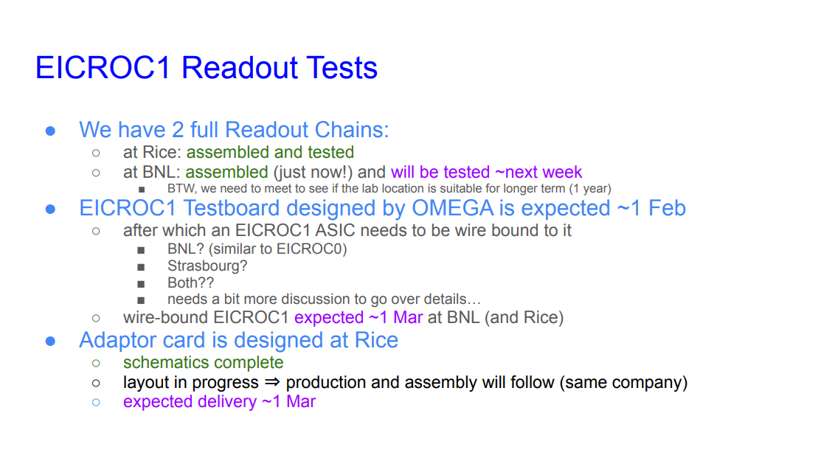

Slide 17
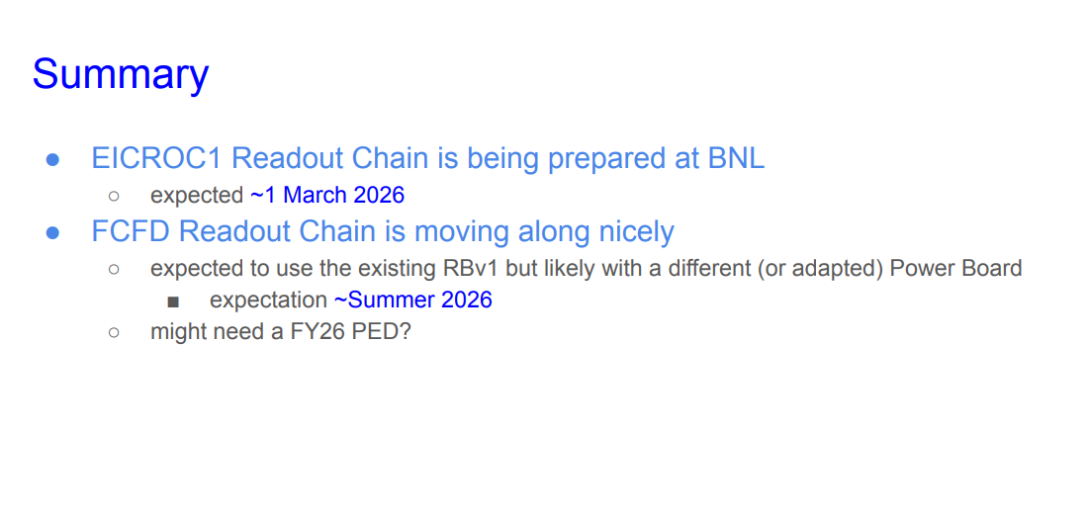

Slide 18
