Slide 1

SVT integration updates
SVT Working Meeting at Berkeley
2026-10-08
Joe Silber (LBNL) - mechanical engineer, presenting
Elaine Buron (LBNL) - CAD design

Slide 2
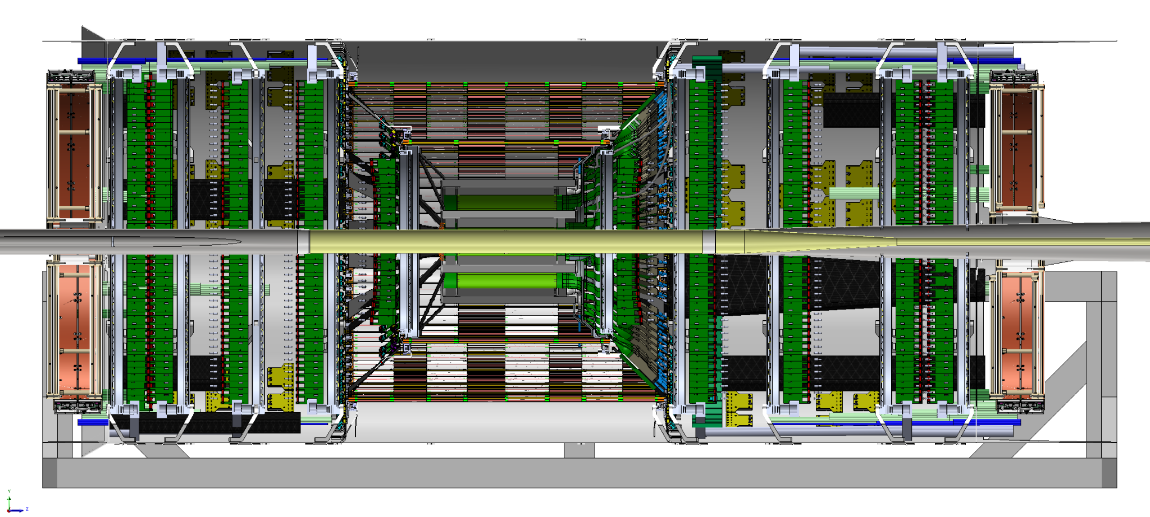
Current CAD model
(except IB, which is from March 2026 in this view)

Slide 3
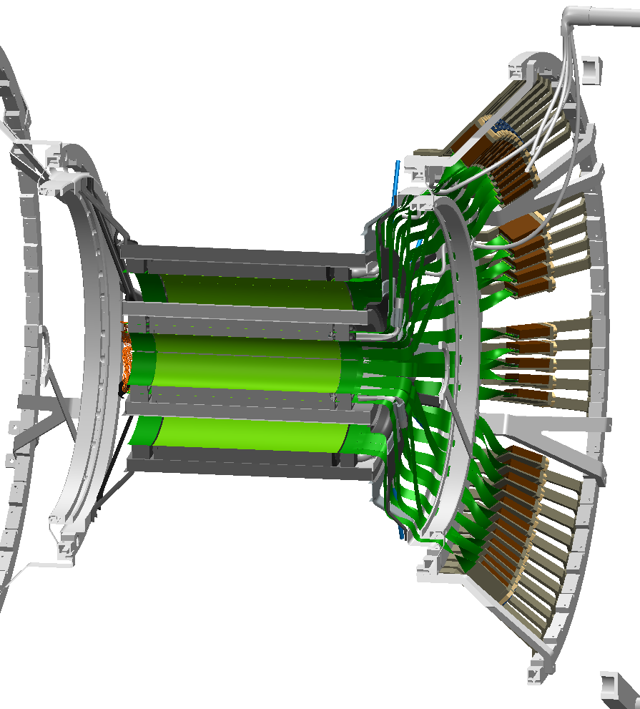
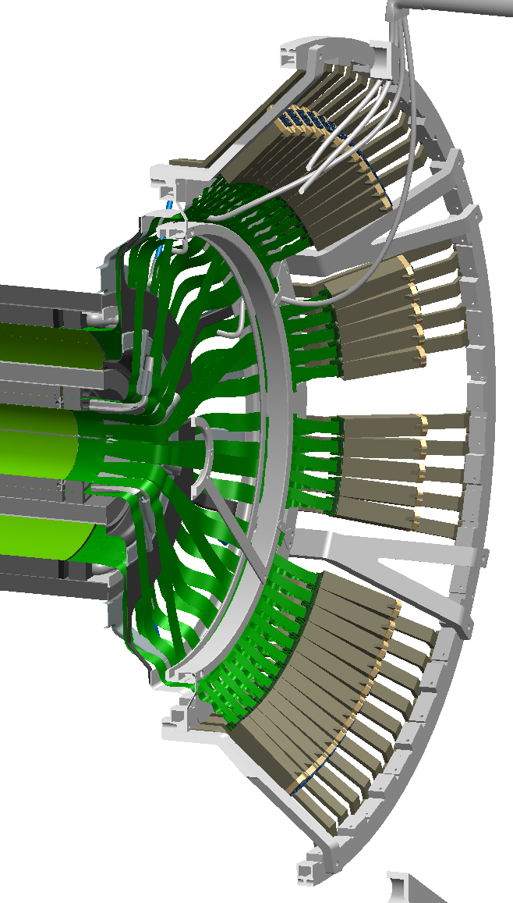
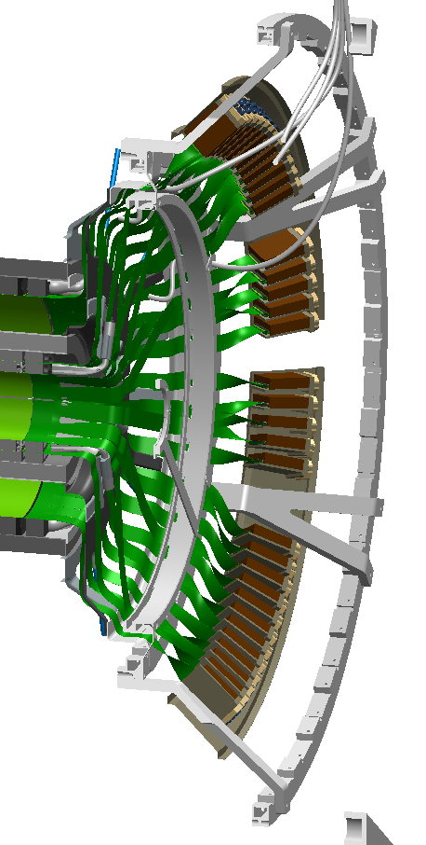
Inner Barrel
(three options from INFN-Padua, Sept 2026)
Option “A”
- many SIB support links
“B”
- many SIB support links
- no FPC twist
“C”
- single cone SIB support

Slide 4
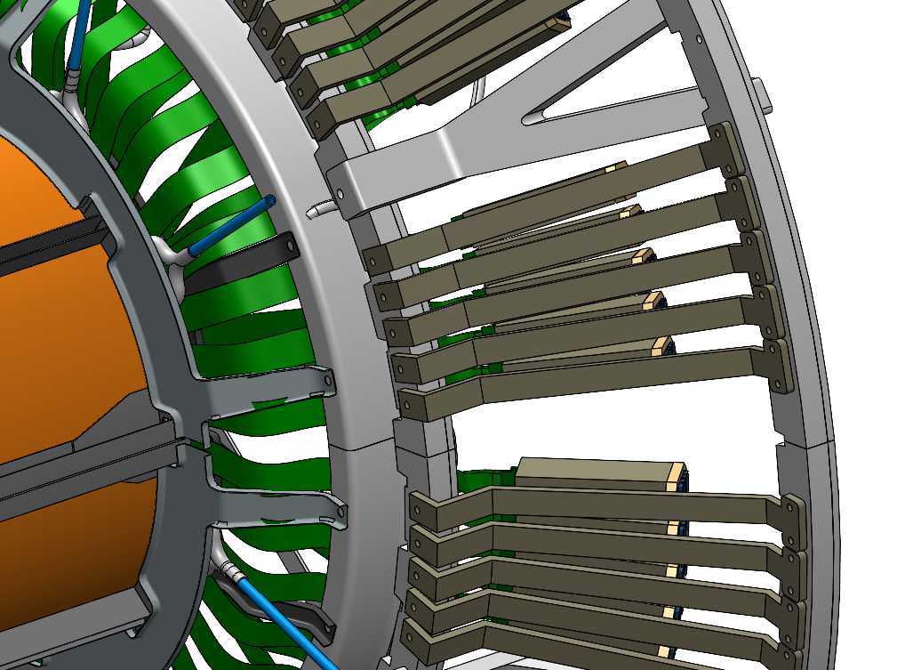
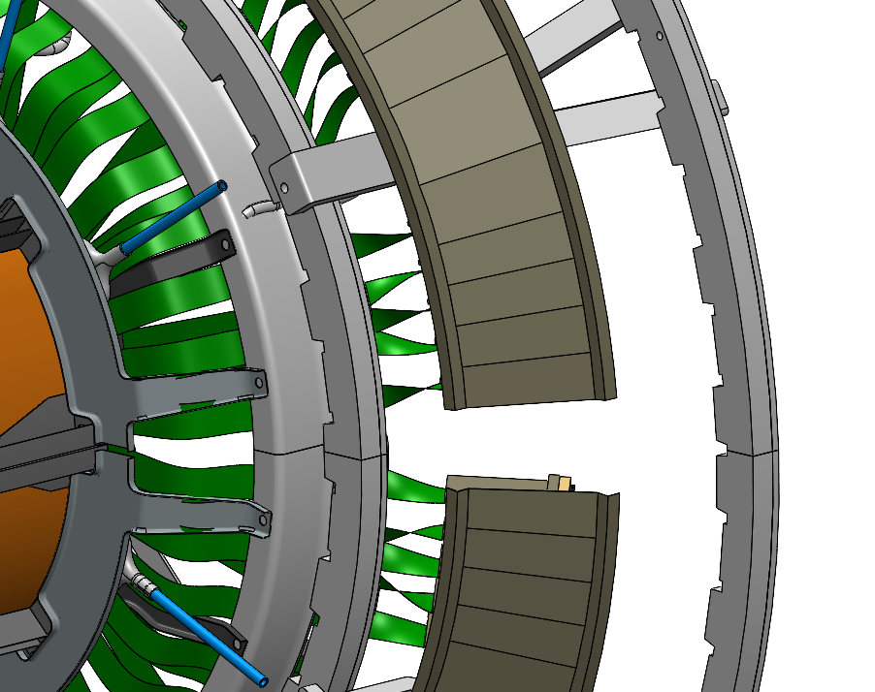
IB option B: many SIB support links
IB option C: unified cone SIB supports
(note how the links couple structurally)
(note how the cones do not couple)

Slide 5
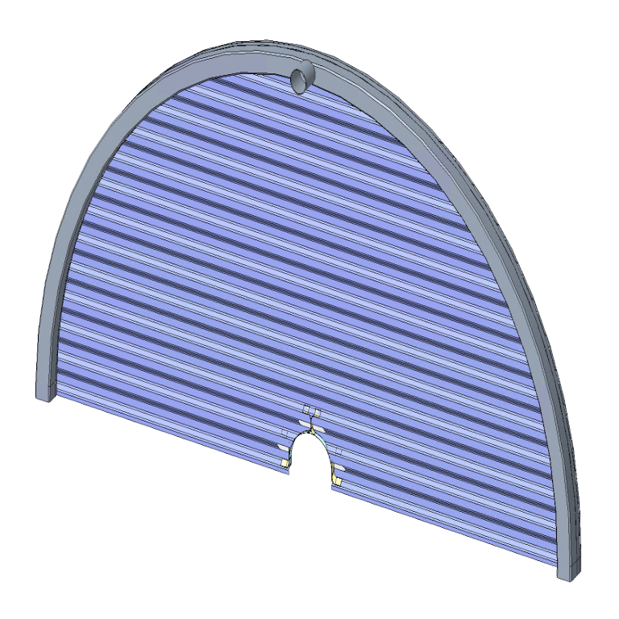
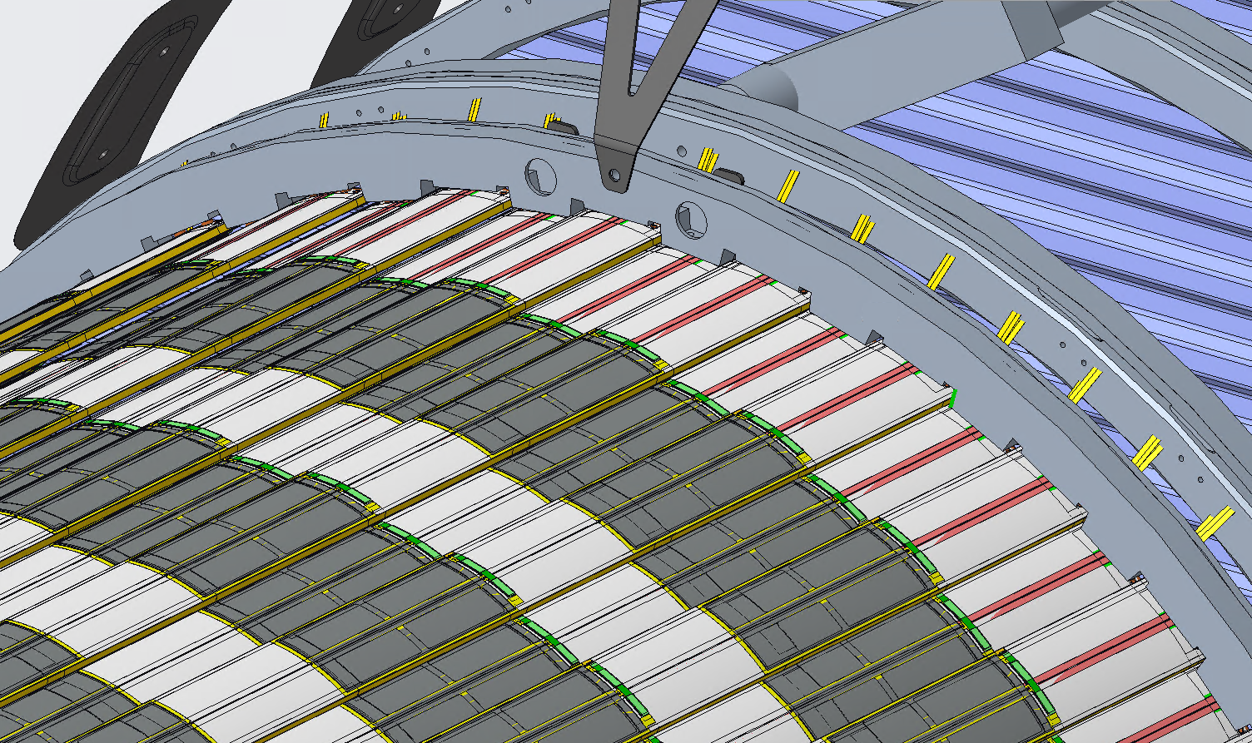
Rims support each disk or outer barrel layer
Rims are:
Stiff
Held at 3 points
Air manifold for many corrugations or staves
Always a half circle

Slide 6
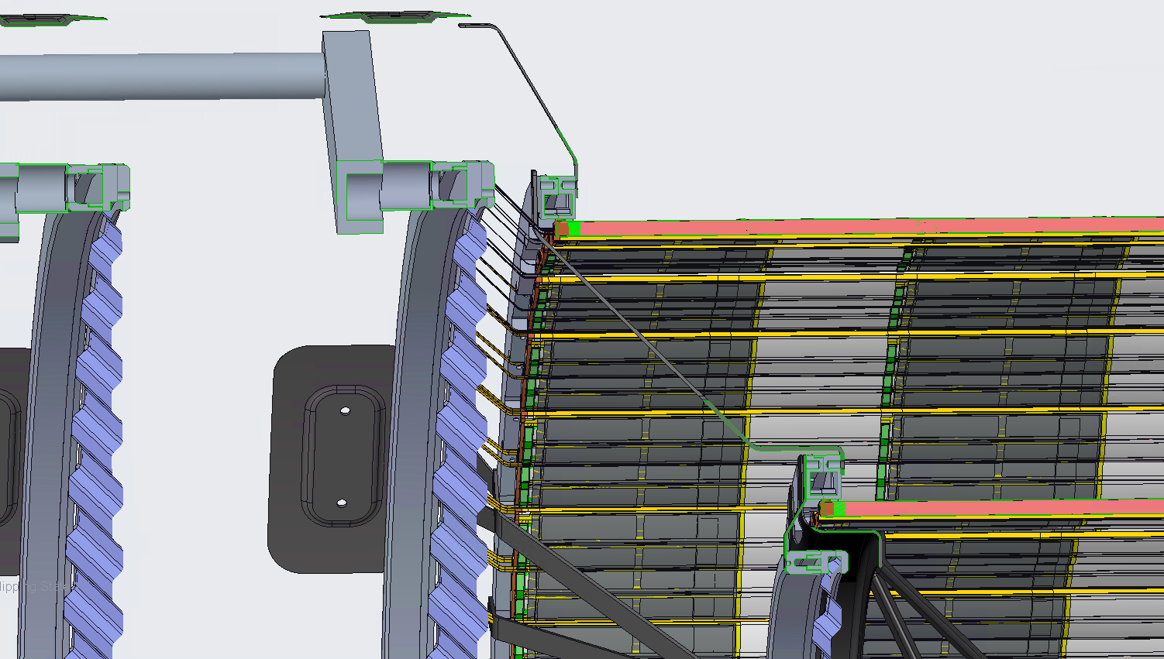
AIR INLET PIPE
D1 air passage
L4
L3
D0
SNORKEL

Slide 7
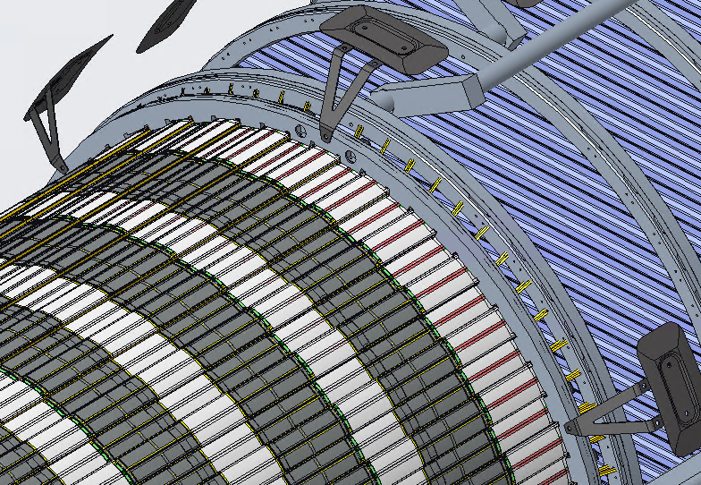
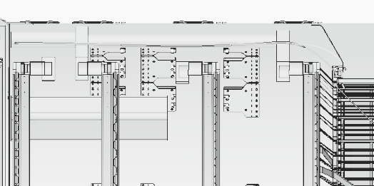
Bipods support large disks and L4
60°
60°
Z

Slide 8
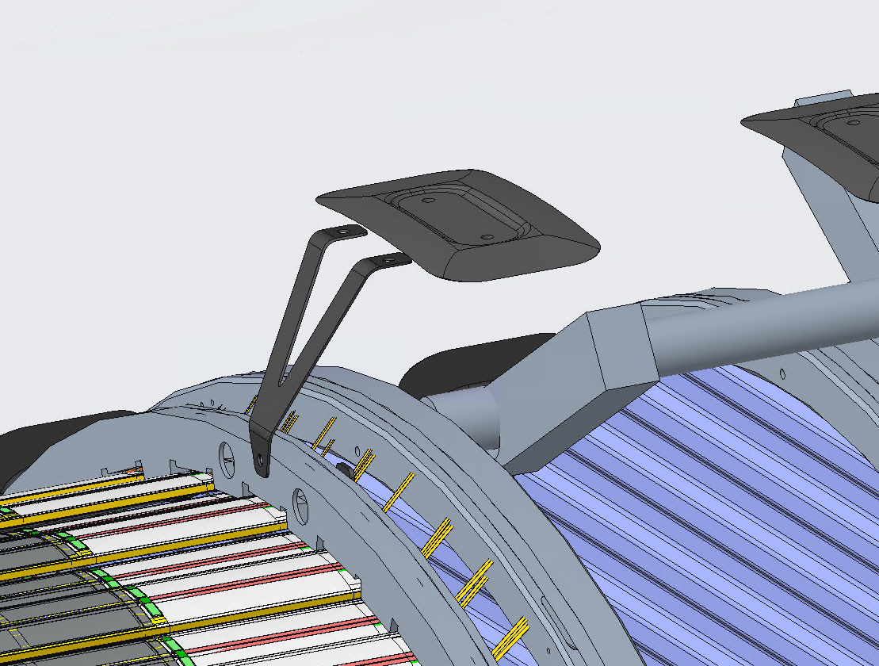
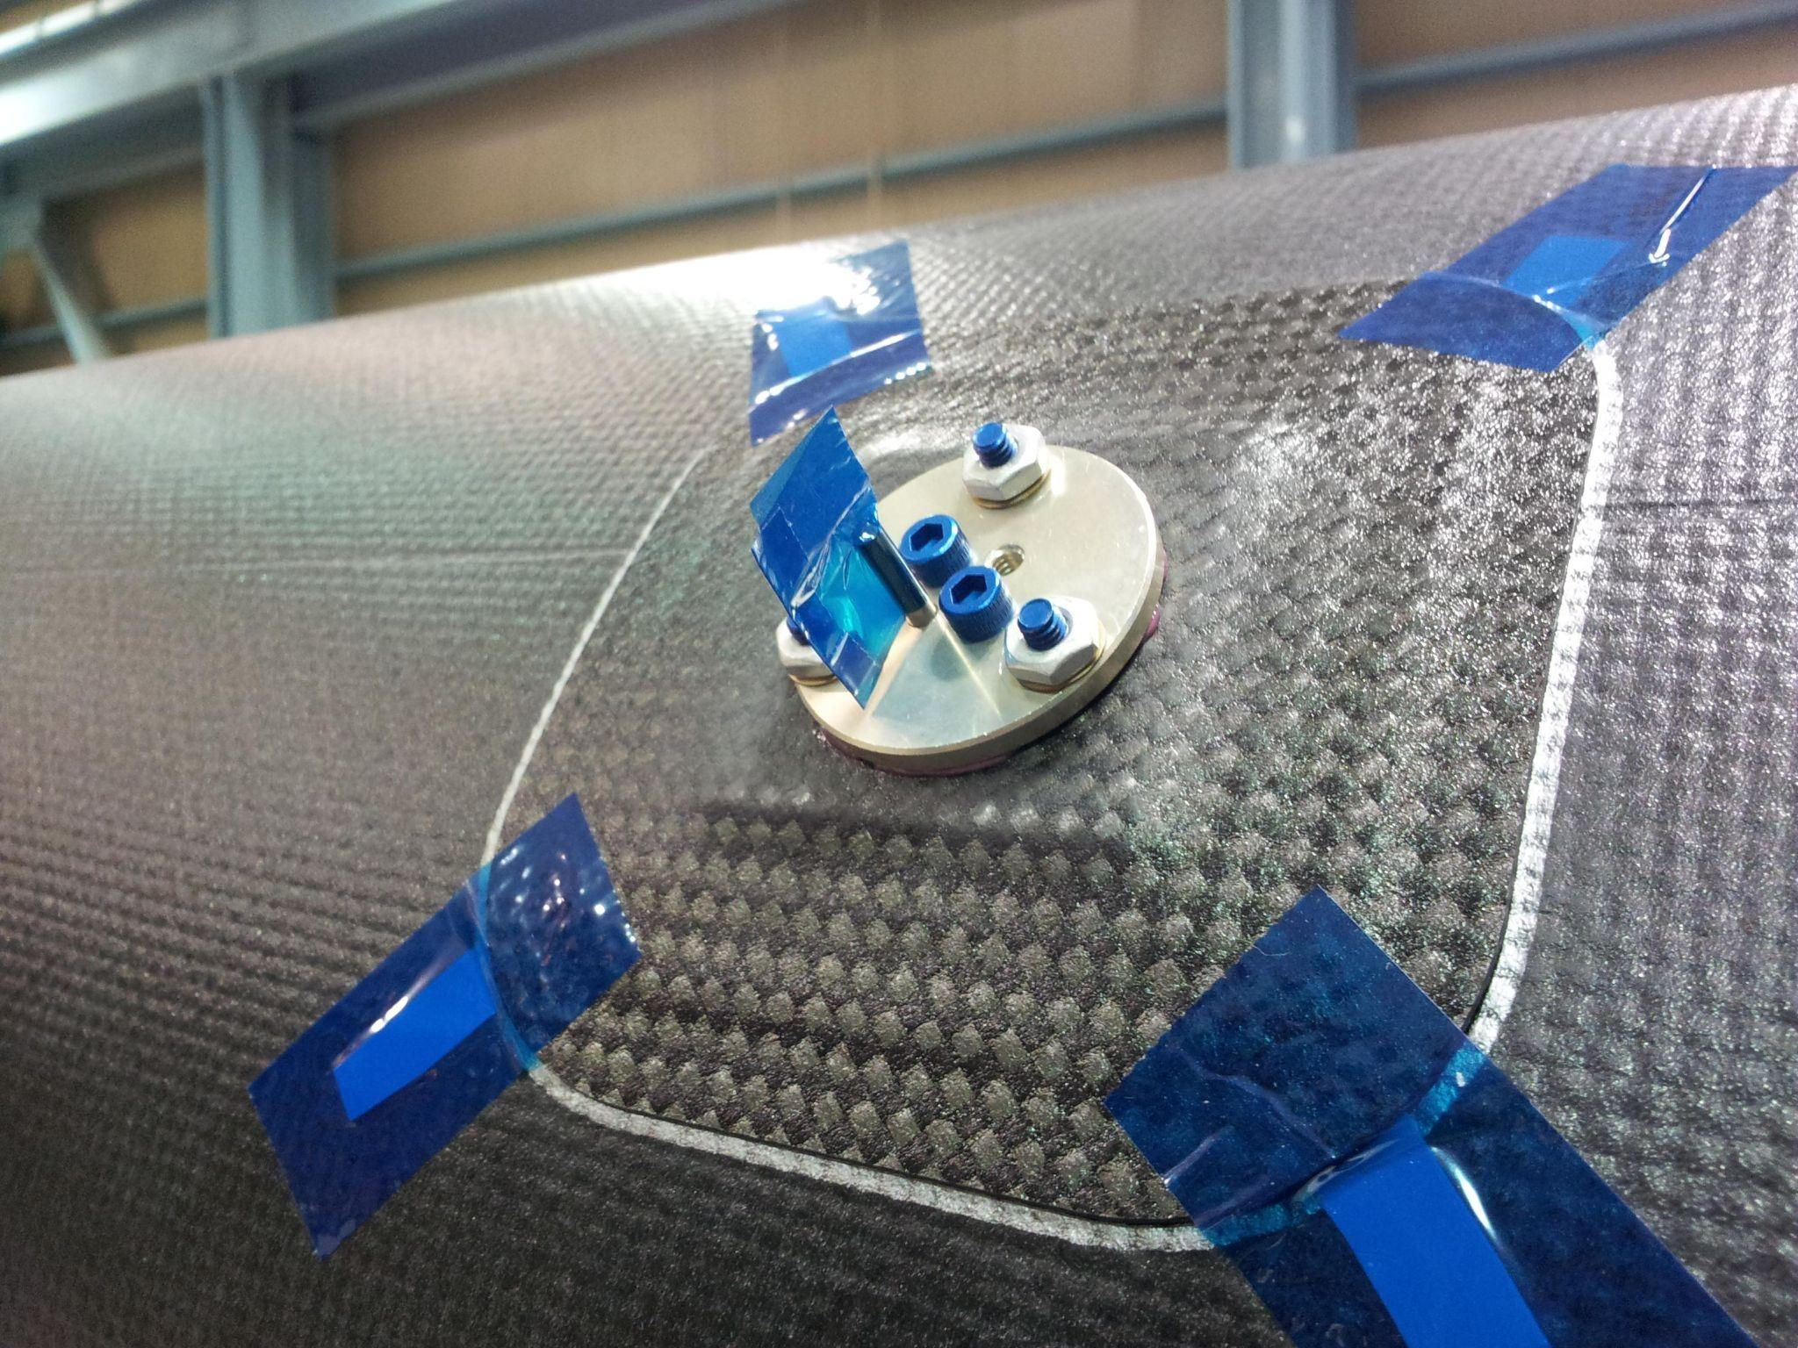
Mount pads are glued to outer surface of PST
Mount pads based on heritage designs from STAR-HFT, ATLAS
3 bipods per half-rim approximates kinematic support, while allowing some Z flexure
No structural analysis done yet, just laying out the concept in CAD
MOUNT PAD
BIPOD
L4 RIM
STAR-HFT example

Slide 9
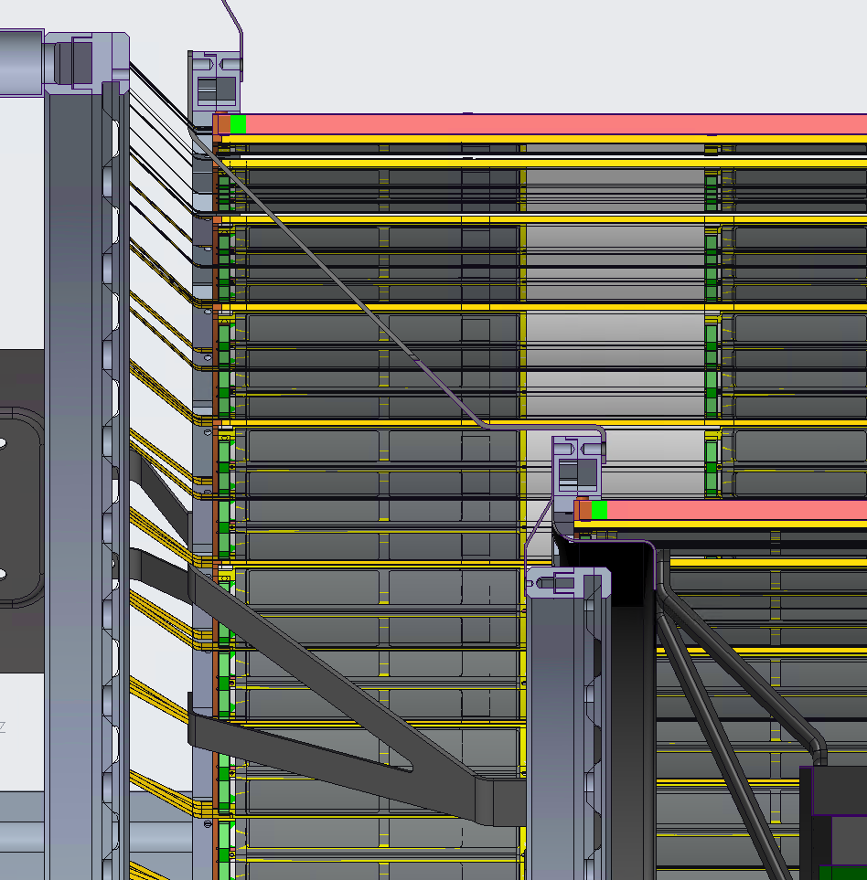
L0-L3 and D0 all supported via L4
PST to L4
This allows the baseline assembly sequence: L4, L3, IB, D0, D1, …
L4 to L3
L3 to D0
L3 to IB

Slide 10
“L4 last” alternative concept
Replacement BARREL-PST to L4
Split the PST support shell into 3 pieces (2x disk regions + 1x barrel region)
Assembly sequence: L3, IB, D0-D4, years go by…, L4
Original DISK-PST to L3
DISK-PST
BARREL-PST
DISK-PST
L3 to D0
L3 to IB

Slide 11
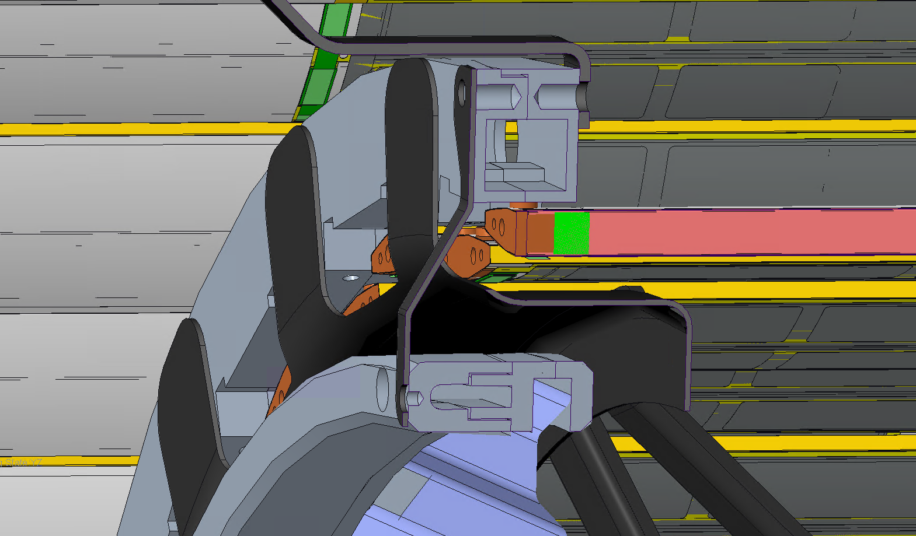
IB-L3 Support protects L3 staves when installing Inner Barrel services
IB-L3 Support

Slide 12
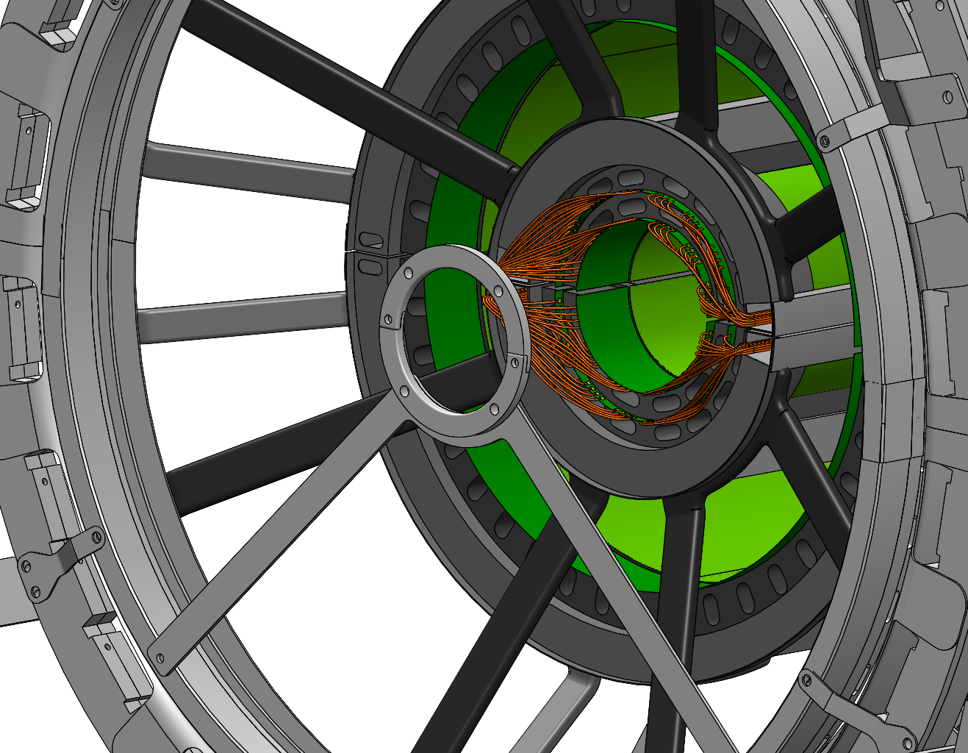
Interior beampipe support strategy
Current design we have a fixed position (though not rotation) constraint ring on either side of the IB
This is safest for assembly
BNL expresses desire to be able to adjust BP position after installation without moving SVT
This is an ongoing open discussion
We will not solve it today just by talking
Depends quantitatively on design details and req’ts at the ~0.5 mm scale, in particular details of the beampipe insulation, heat wrapping, deflection, clearance to IB sensors, PST halves alignment upon closure, flexibility of services at SVT exit, allowable flex of beampipe, beam dispersion, accuracy…

Slide 13
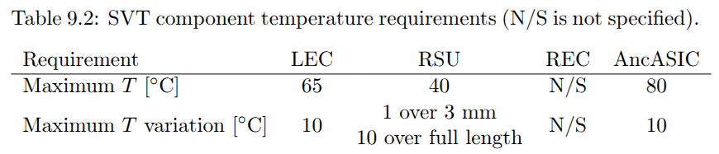
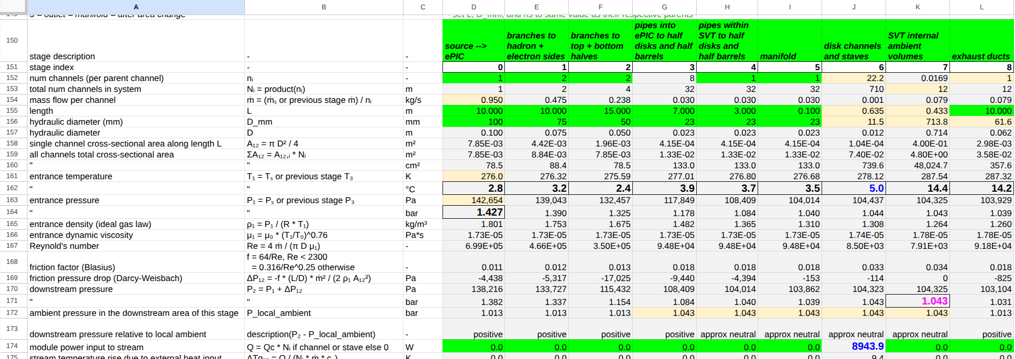
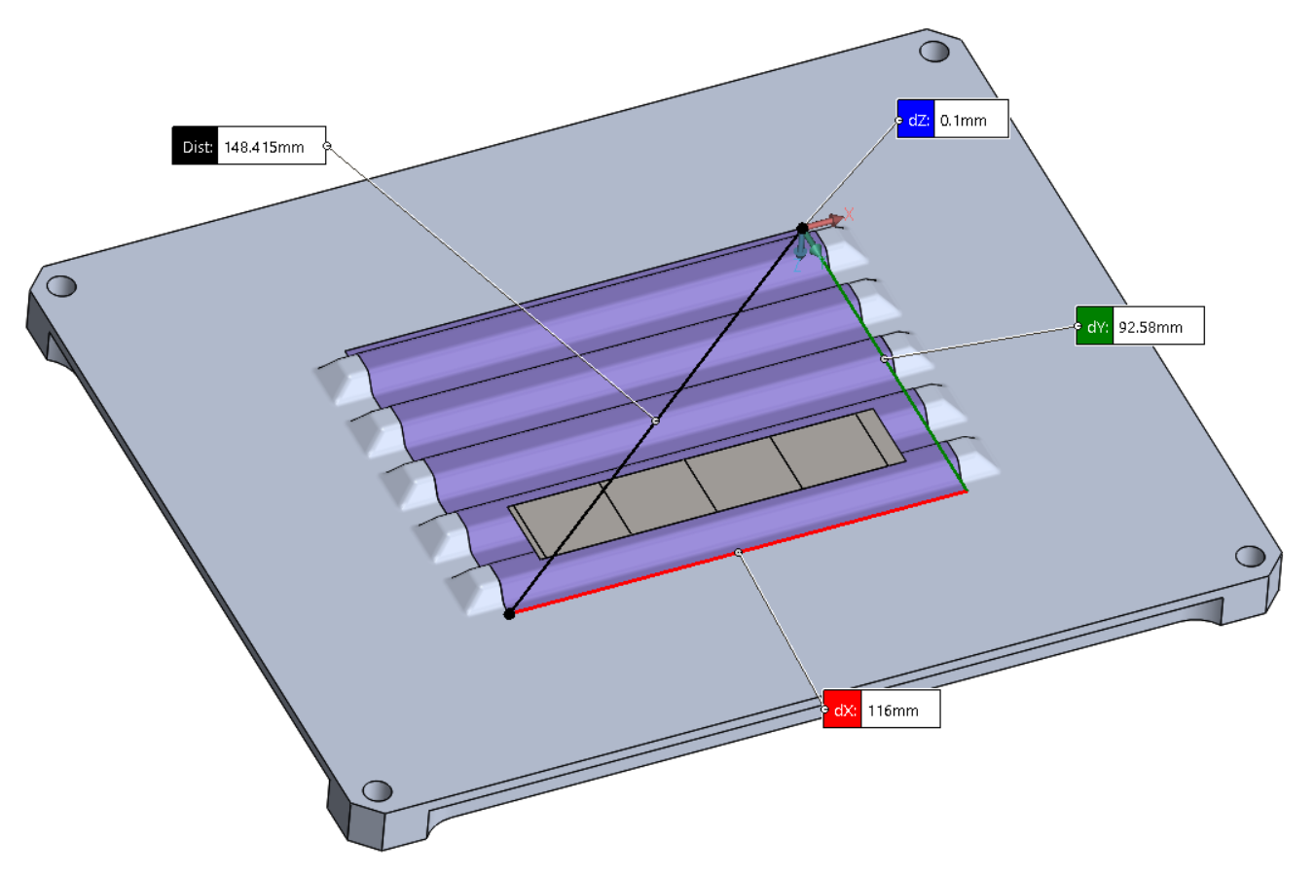
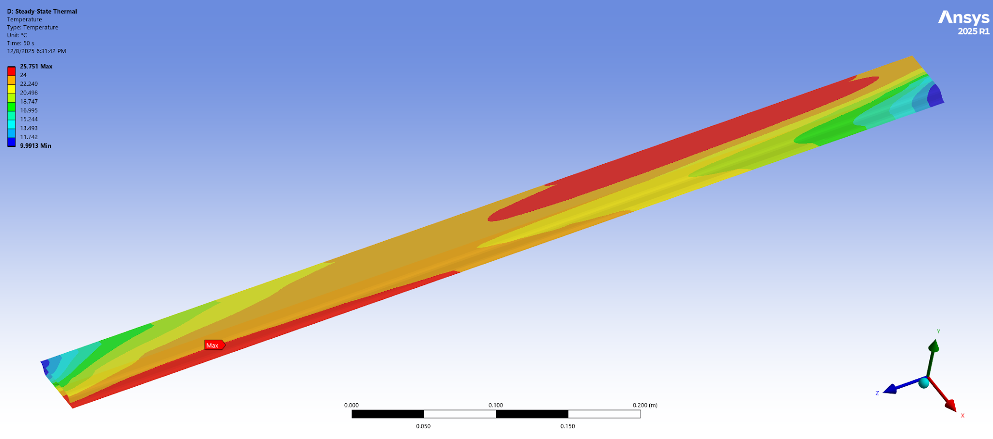
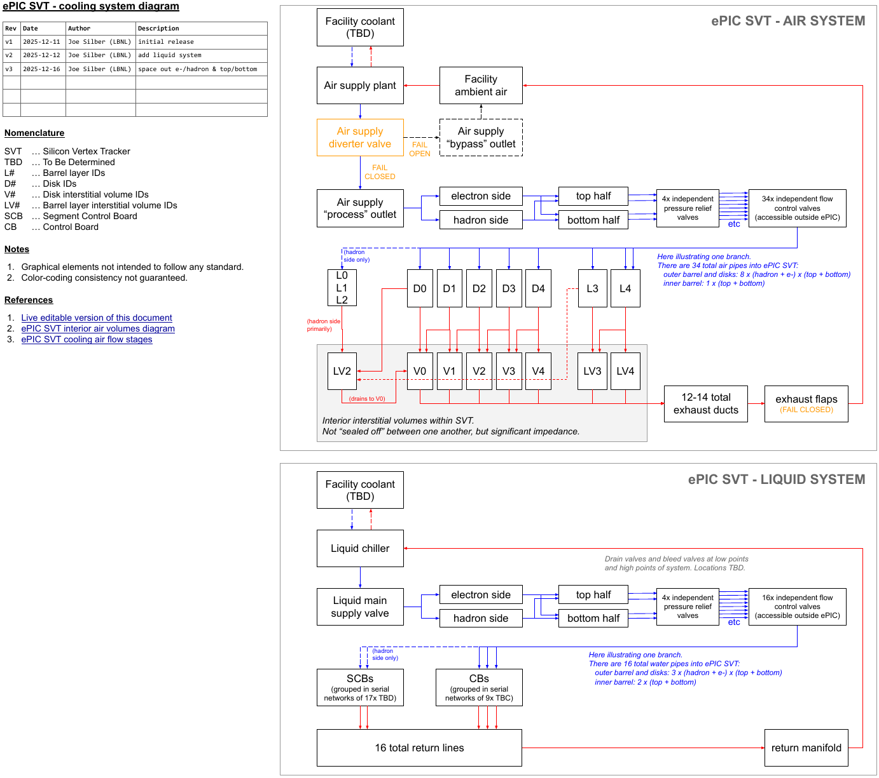
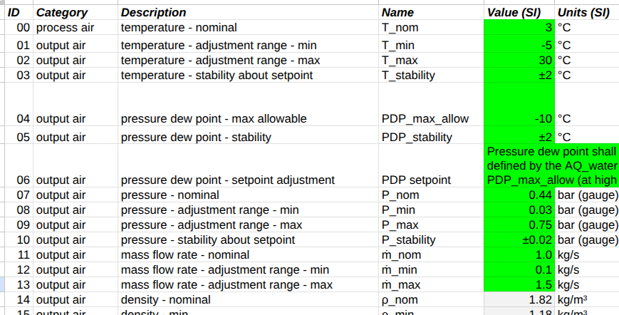
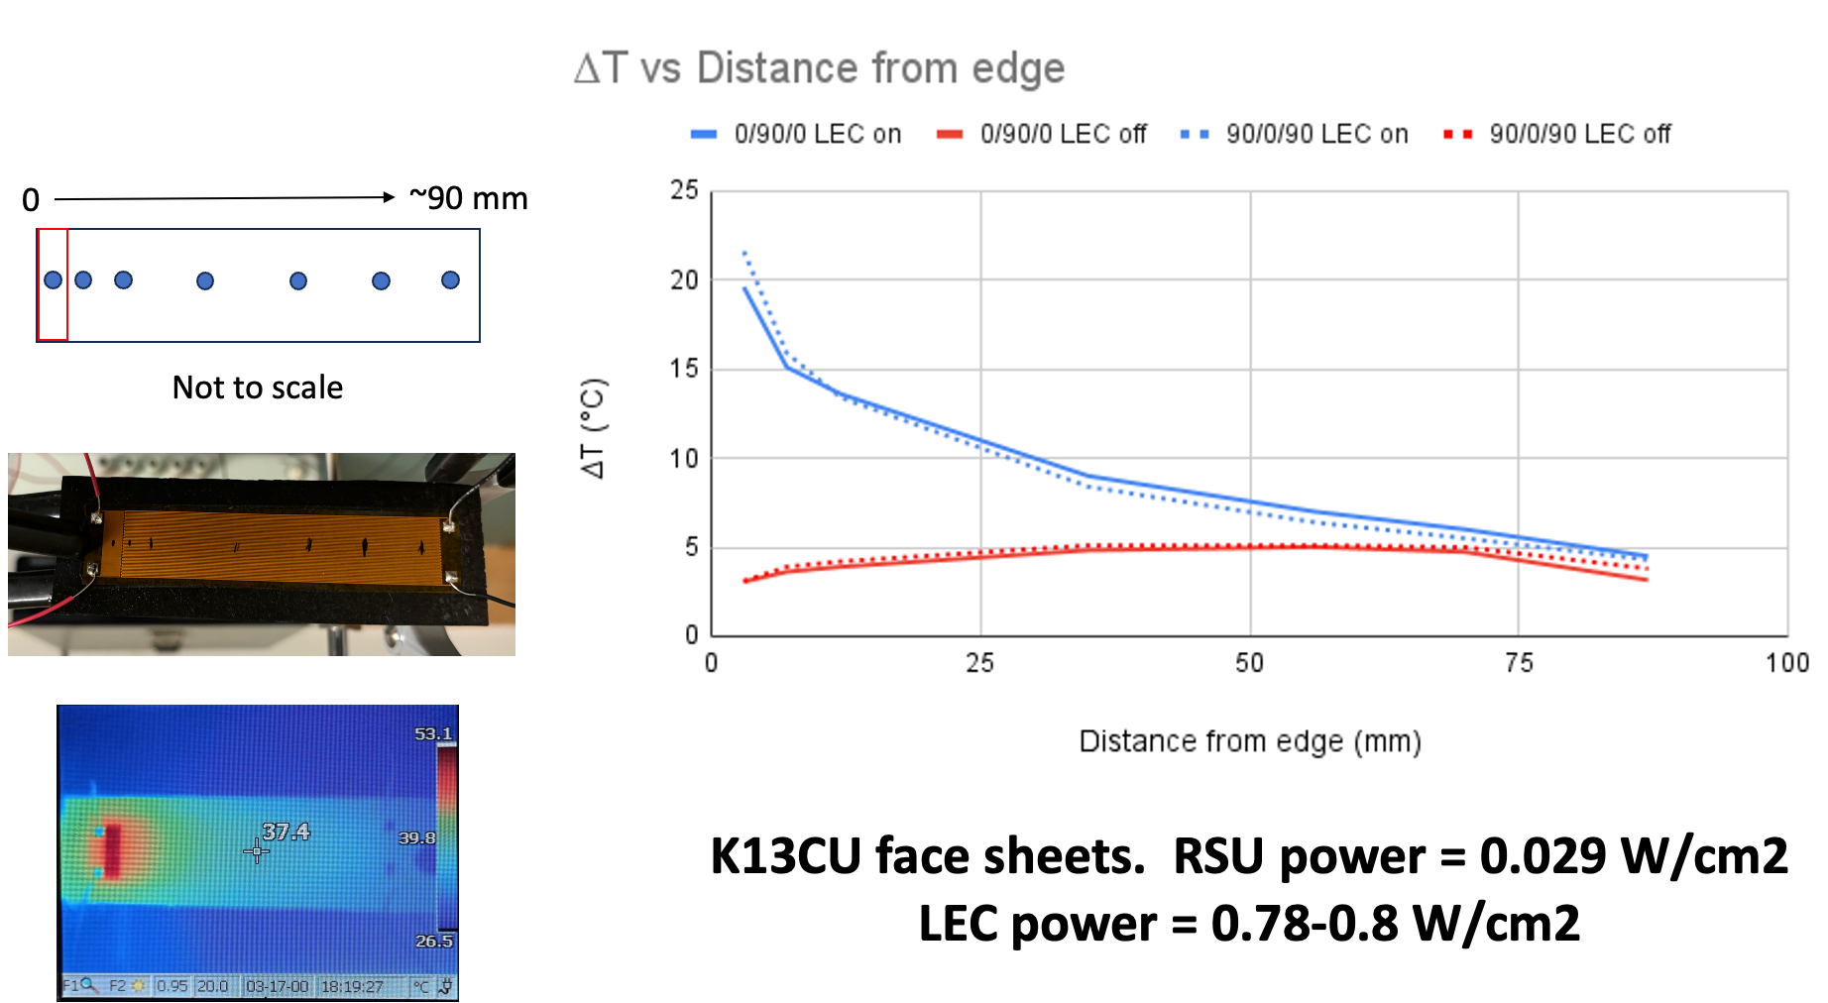
Design process from high level req’ts to detailed specs
High level requirements
End-to-end system performance calculation
Req’ts on silicon
T_{max}, ∇T
Constraints on ΔT_{cooling} = T_{Si}-T_{air}, ΔP, air speed
CAD design
Local supports heat transfer analysis
System architecture
Temperatures, pressures, flow rates
System layout
Detailed specs on cooling plant
Local supports physical test
Operational logic

Slide 14
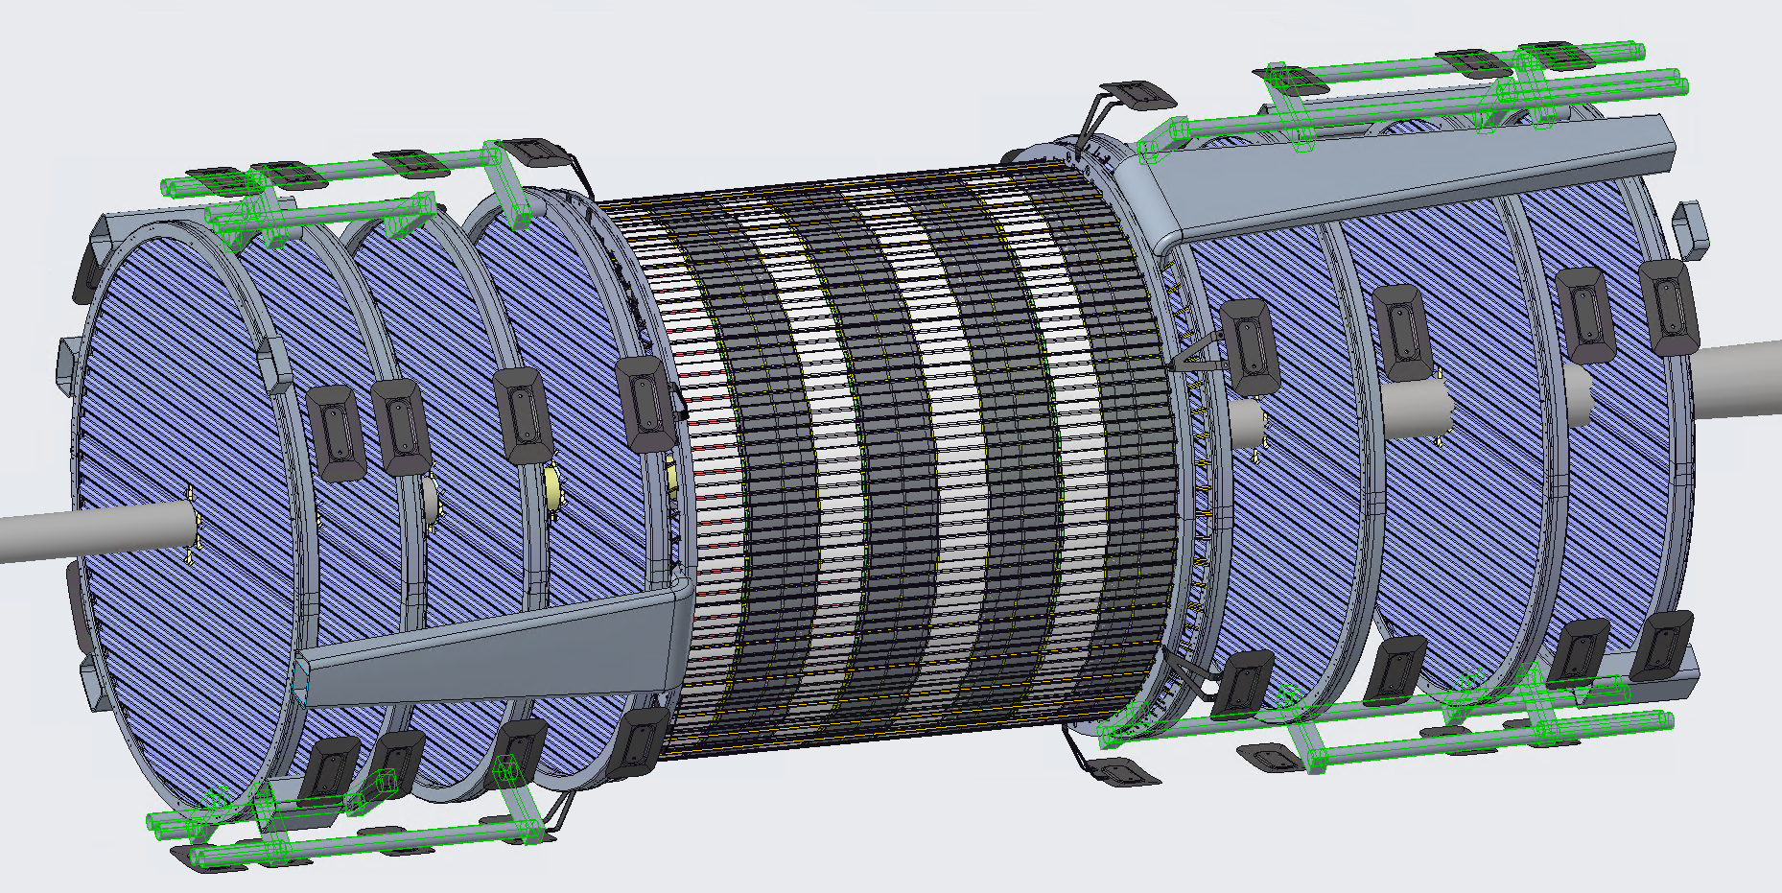
Air supply pipes

Slide 15
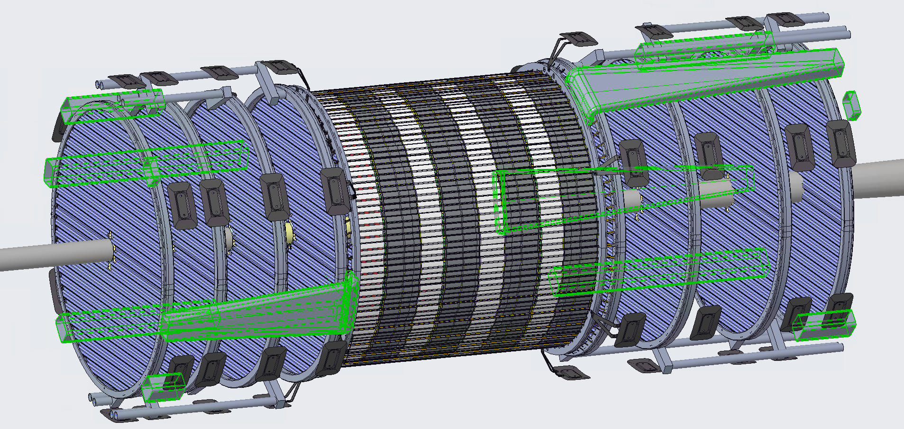
Air exhaust ducts

Slide 16
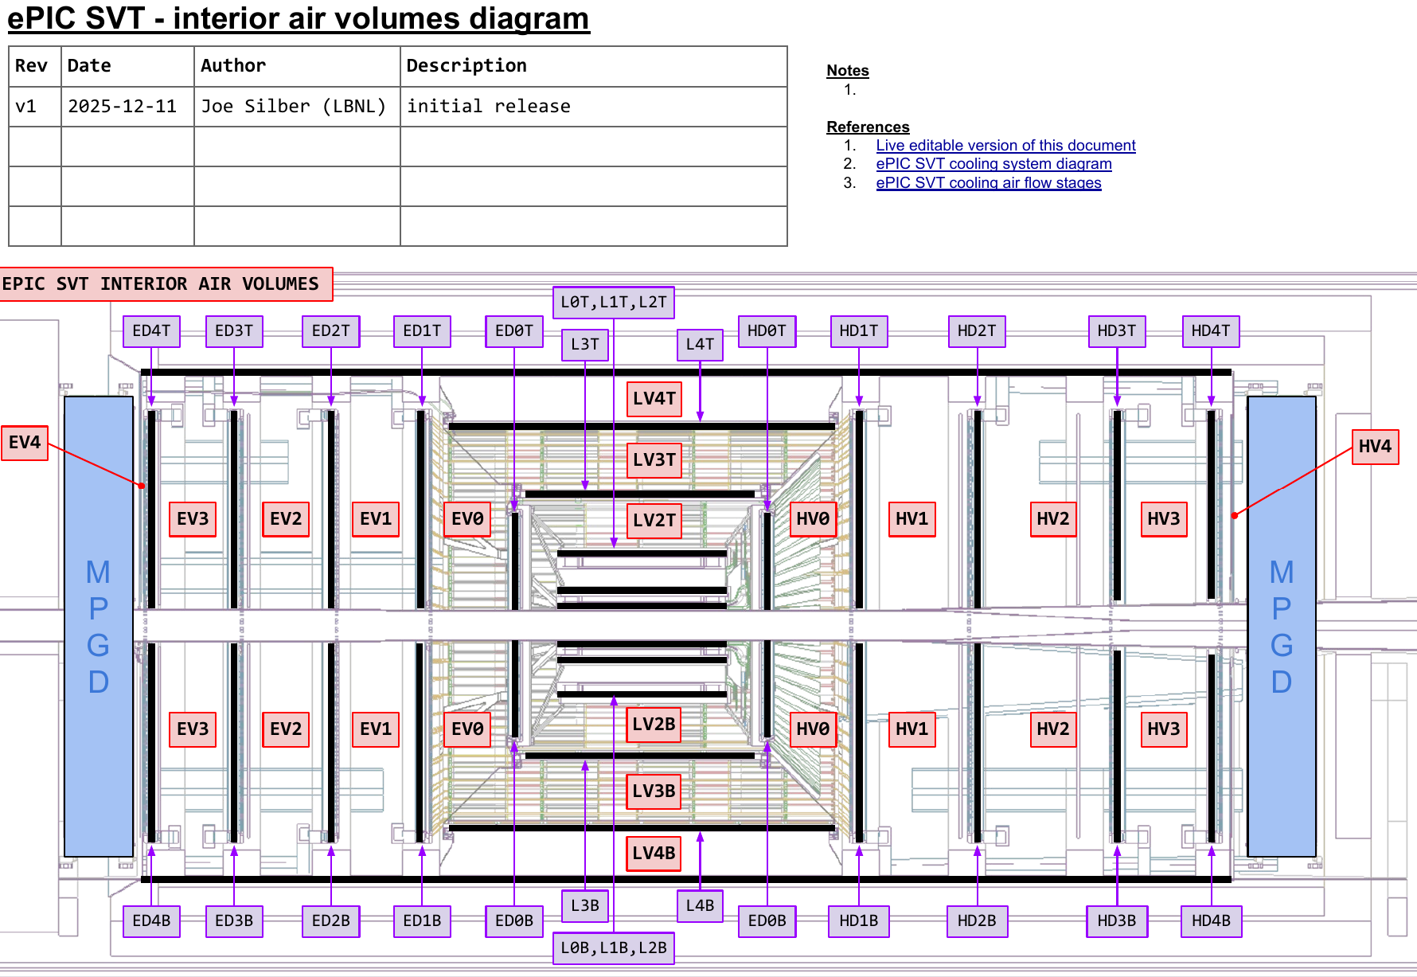
Air exhaust
Exhaust via 12-14 ducts
Duct hydraulic ⌀52 mm
  I.e. much greater cross-section than input pipes (4 x ⌀50 mm)
Ducts draw from interior volumes (see diagram)
These volumes aren’t “sealed” from each other, but significant impedance
Suction could be done but probably not necessary
Flapper valves at outlets to prevent ingress when flow off
Link: ePIC SVT interior air volumes diagram - v1.pdf

Slide 17
Link:
ePIC SVT cooling system diagram - v3.pdf
To-Do:
- decide with INFN whether L0/L1/L2 must be 2x input lines, one top and one bottom, for assembly logic

Slide 18
To-Do:
- add DPBs liquid cooling
- update liquid network sizes

Slide 19
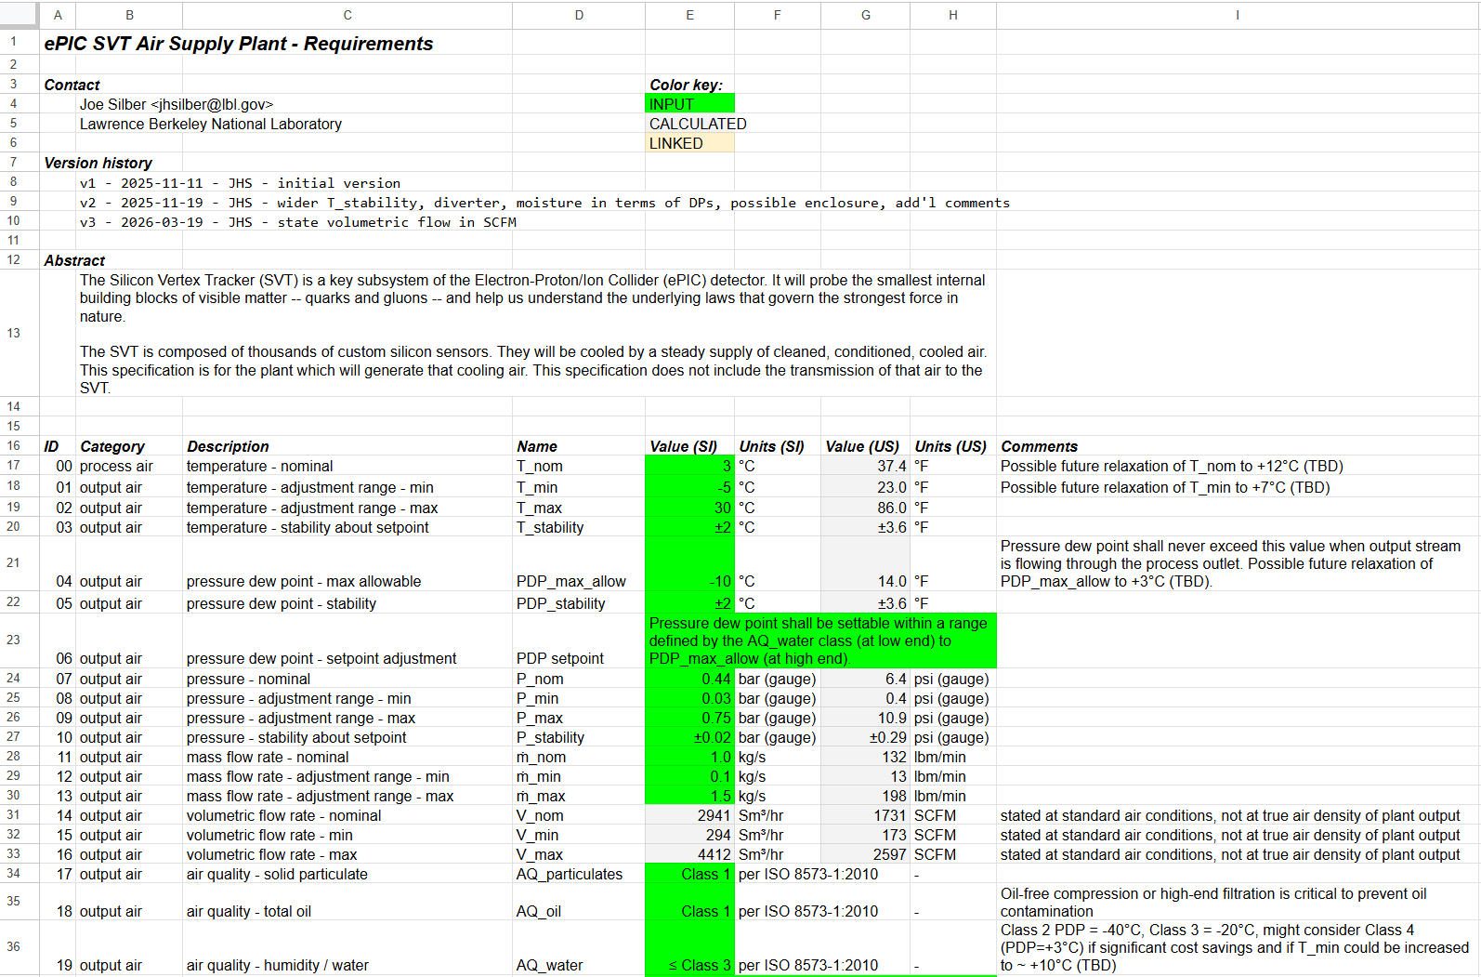
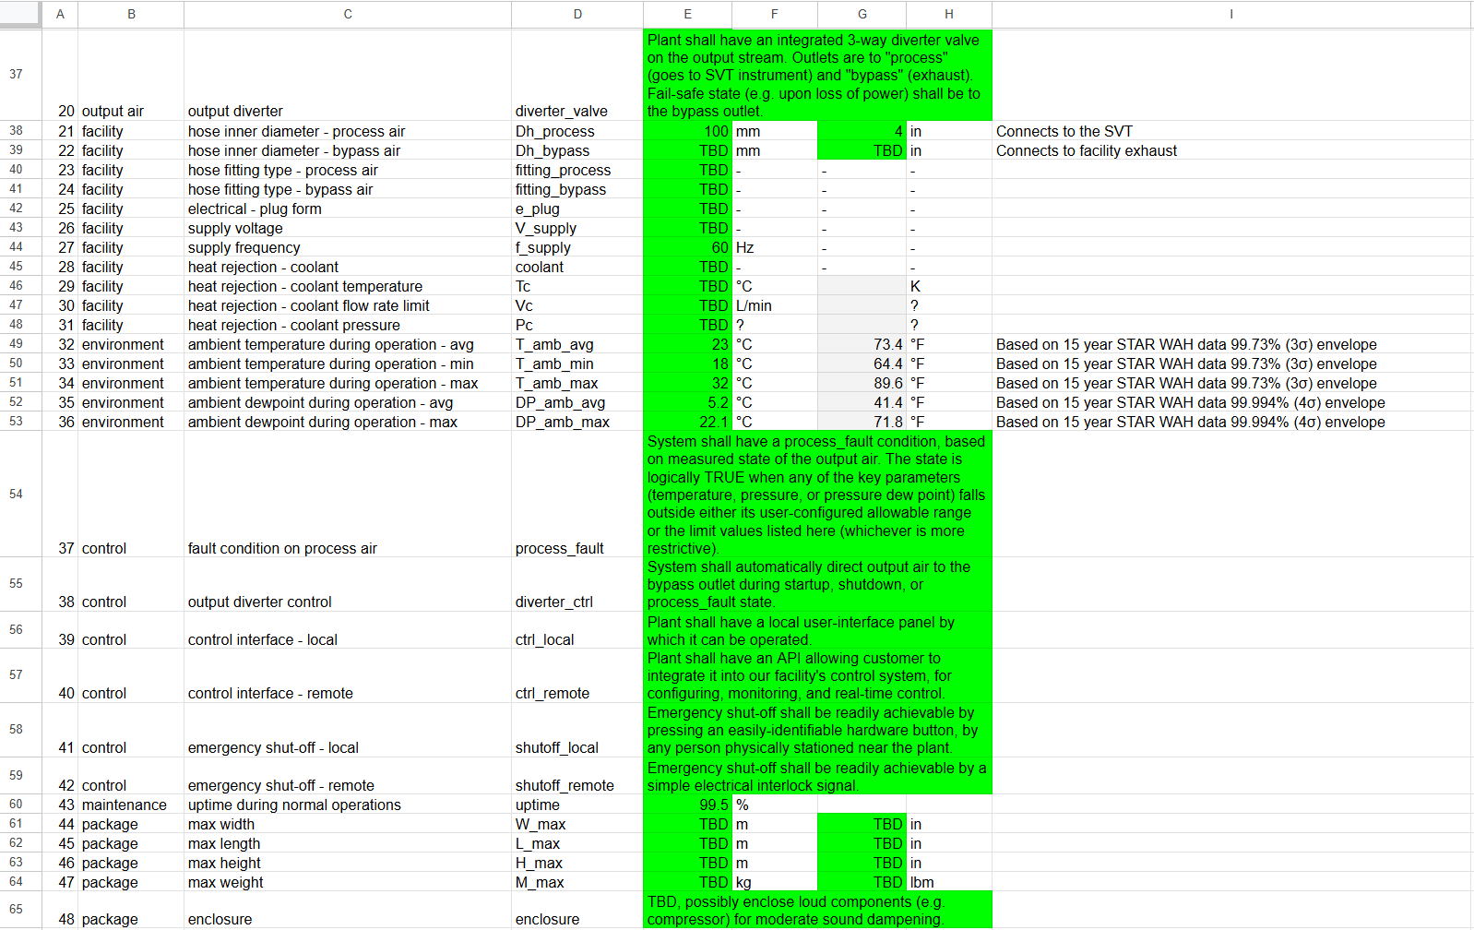
System calcs + humidity management + air quality + control considerations → detailed specs on air supply plant
Link: ePIC SVT air supply plant reqts - v3.xlsx

Slide 20
Compressors vs blowers
Key takeaways from numerous discussions with vendors during Dec 2025 - May 2026
Compressors
Blowers
Provide sufficient pressure to drive air through desiccant (adsorption) dryers that achieve -40°C dewpoint (Class 2)
Require large storage tank (~ 1 gallon storage per SCFM of system flow)
Large ones will provide ~ 1500 SCFM of flow, need more than one compressor in parallel to get more
Power consumption ~ 20 kW / 100 SCFM
  i.e. 320 kW @ SVT’s nom 1600 SCFM
~100 psi gauge, which must be regulated down to SVT’s nominal 6 psi
Refrigerated drying only, will achieve +3°C dewpoint (Class 4)
More compact system
Very high flow rates available
Power consumption ~ 5 kW / 100 SCFM
  i.e. 80 kW @ SVT’s nom 1600 SCFM
~10-20 psi gauge, depending on model
N.B. Either option requires an after cooler to bring the air to desired temperature.
The after cooler itself requires cooling, on the order of 30-40 kW, probably by facility water.

Slide 21
Four basic implementation options for air supply
https://indico.bnl.gov/event/31239/
 |  | Dec 2025 baseline | “80% of baseline” | “Slow & cold” | “Fast & warm”
Design targets | air speed thru detector channel | 10 m/s | 8 m/s | 3 m/s | 10 m/s
 | air temp at channel inlet | +5°C | +5°C | -10°C | +9°C
Air supply nominals* | pressure | 6 psig | 4 psig | 1 psig | 6 psig
 | flow rate | 1600 SCFM | 1300 SCFM | 500 SCFM | 1600 SCFM
 | dewpoint | -40°C | -40°C | -40°C | +3°C
 | air temp at supply | +3°C | +3°C | -12°C | +7°C
Source |  | double large compressor | single large compressor | single small compressor | blower
Approx system power draw |  | 400 kW | 300 kW | 150 kW | 150-200 kW
Rough size estimate | footprint | 1056 ft² | 740 ft² | 420 ft² | 512 ft²
 | height | 15 ft | 14 ft | 10 ft | 7 ft
Comments |  | generous operating margins | tighter margins on ΔT & ∇T, low T available | higher ∇T, more insulation, less vibration | narrower T oper range (limited by dewpoint)
* Real air supply plant will require margin on these nominal values.
Modification option on any of these: water cool L3+L4 → reduces air needs by 37%.

Slide 22
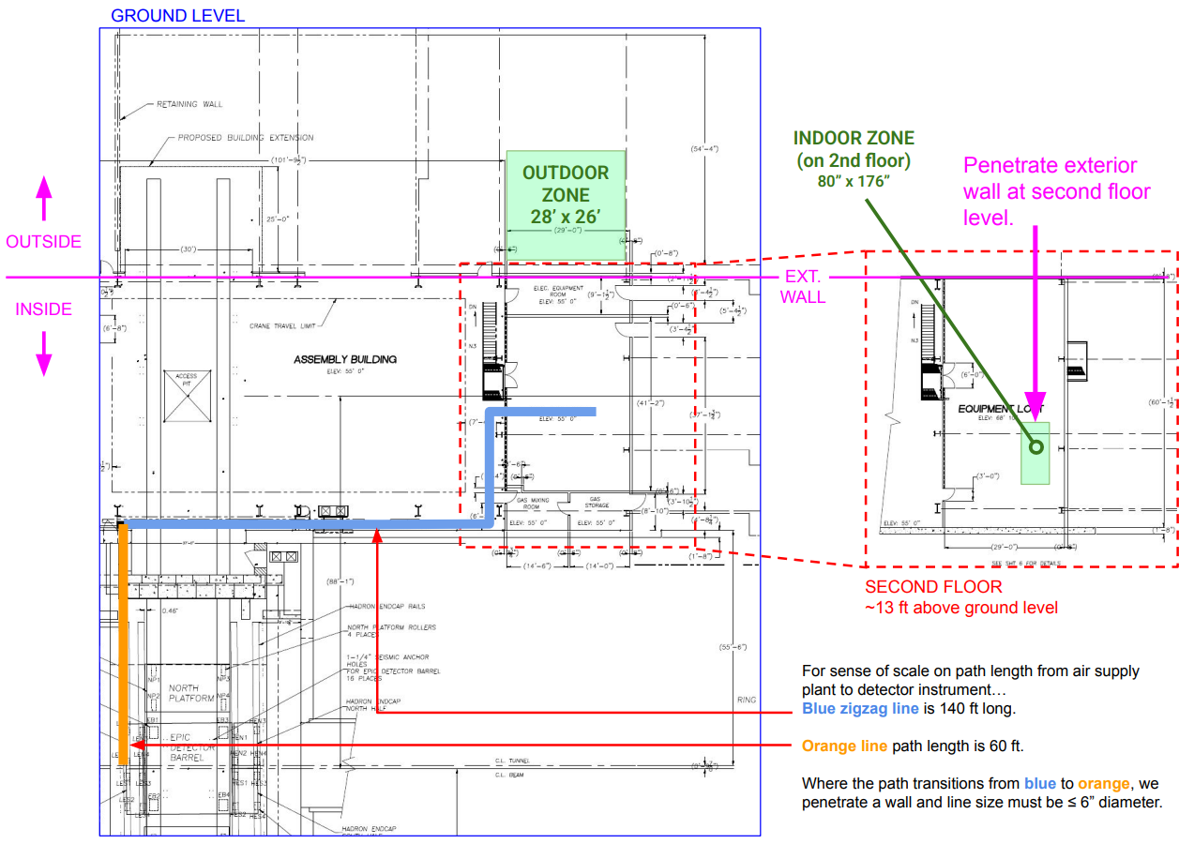
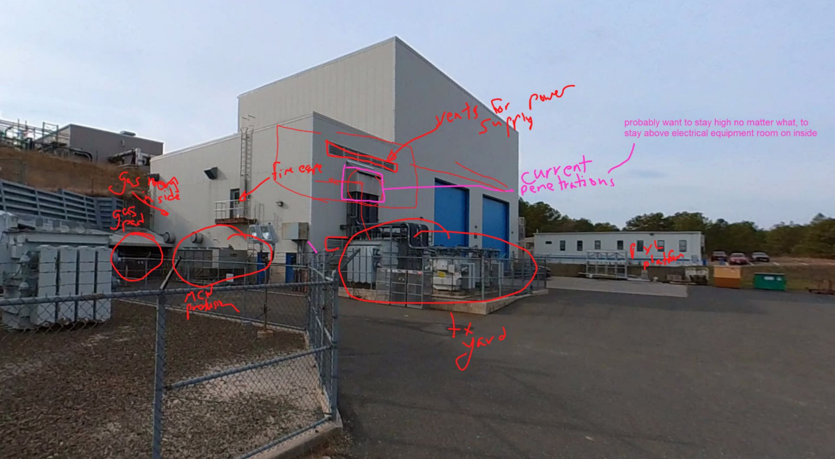
Air supply plant location
will not be small equipment
have worked out feasible plan for where to locate it on site with BNL engineers

Slide 23
Liquid cooling of CBs and SCBs
Will group CBs and SCBs into serial cooling networks
  assemble and test a network outside detector, prior to assembly
System thermodynamic and flow estimates completed
  see version 4 spreadsheet
Iterating parameters with BNL engineers now
  reduce ΔT_{water} from 3° to < 2°
  increase flow rate
ePIC SVT liquid cooling - v4
Key assumptions:
1. 18C input water temperature
2. max available pressure loss 0.5 bar
3. power per CB or SCB = 7.1 W
4. thus total input power = 1250 W
5. water flow rate 0.1 kg/s = 6.0 L/min
6. on the SVT side we shall design a decent but not technically aggressive custom internal heat exchange geometry for the cold plates
7. quantities and INNER diameters of water supply lines...
7a. from supply manifold to hadron + electron sides --> 2 lines total @ 19 mm ID each
7b. exterior branches to top + bottom halves --> 4 lines total @ 19 mm ID each
7c. interior branches to CB and SCB networks --> 16 lines total @ 5 mm ID each
8. identical quantities and sizes for return lines
Key ouputs:
9. water temperature rises from 18C to 21C
10. pressure drop is 0.14 bar = 2.0 psi
11. max cold plate temperature = 21.1C

Slide 24
Some current open discussion points
Inner barrel mechanical design options downselect, especially cone vs many-links?
Split the PST half-shells into disk vs barrel regions, to enable later L4 install?
Run air-cooled sensors “slow & cold”, i.e. 3 m/s @ -10C, to reduce air system size ~2-3x?
%Xo and development costs if water cool L3 + L4, to reduce air system size ~0.4x?
Supply top/bottom halves of IB with independent air lines, to simplify assembly logic?
Minimizing insulation thickness at air routes into SVT
Beam pipe support – post-assembly DOF of adjustability vs assembly interference derisk

