Slide 1
Developing Flexible Printed Circuits for SVT Disks
Zhengwei Xue, Zhenyu Ye
Lawrence Berkeley National Laboratory
October 9, 2026`
Monthly SVT WP3 meeting: https://indico.bnl.gov/category/548/
Mailing list: https://lists.bnl.gov/sympa/info/epic-svt-wp3-l

Slide 2
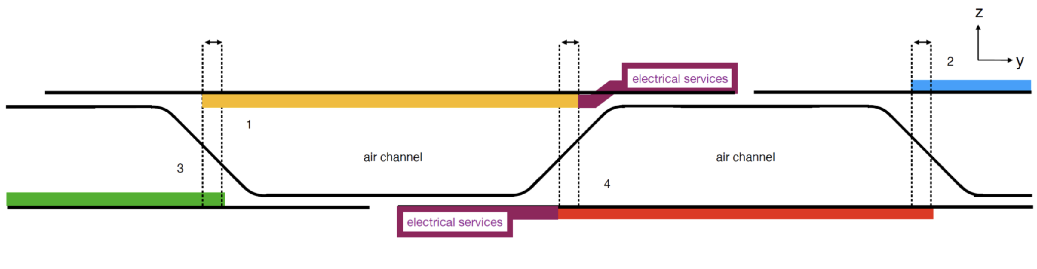
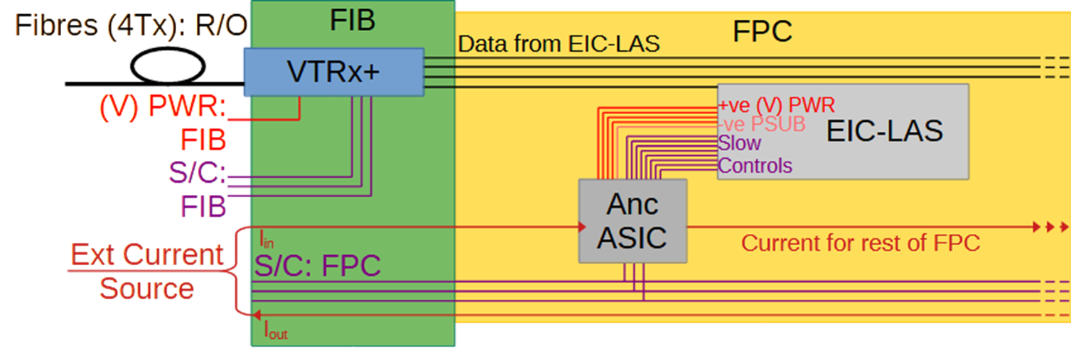
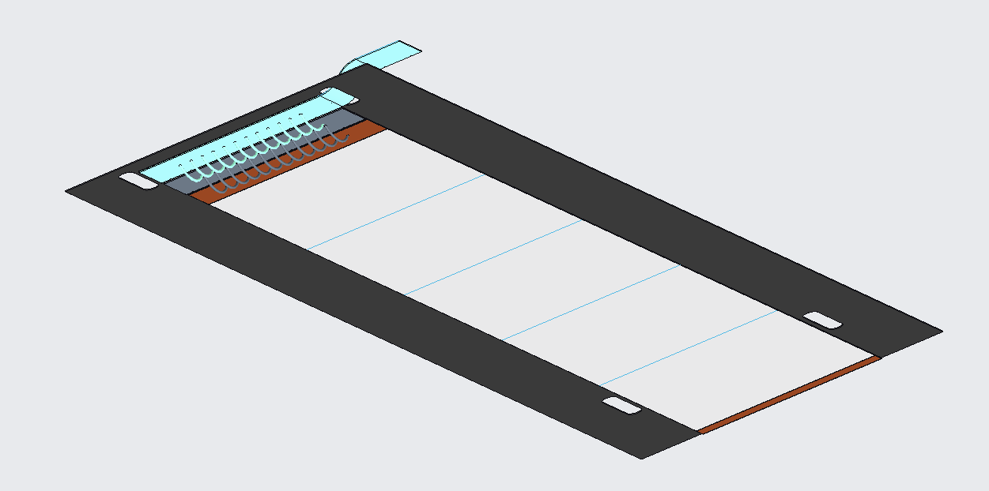
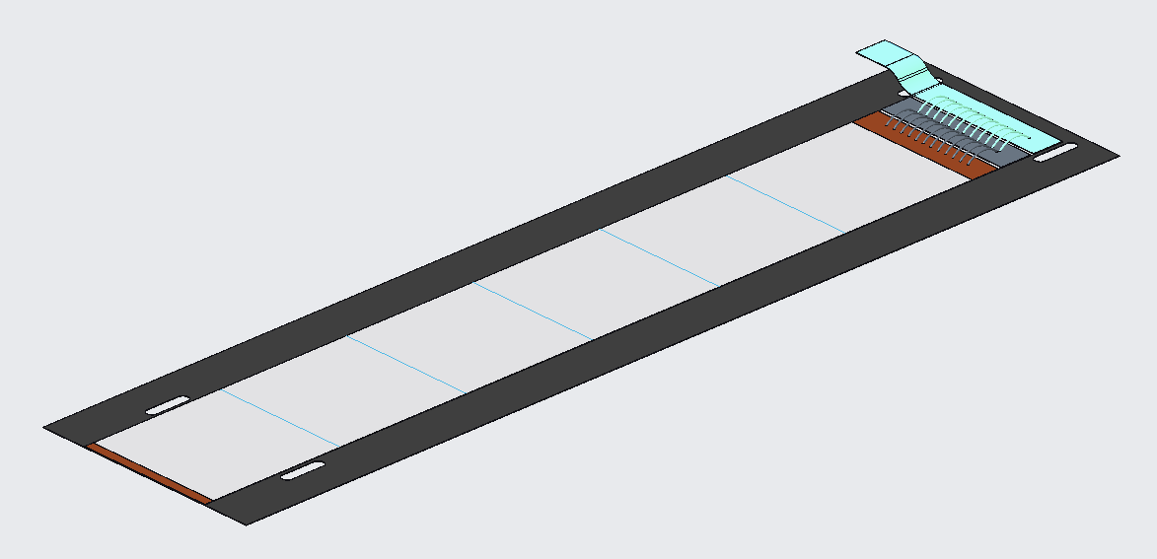
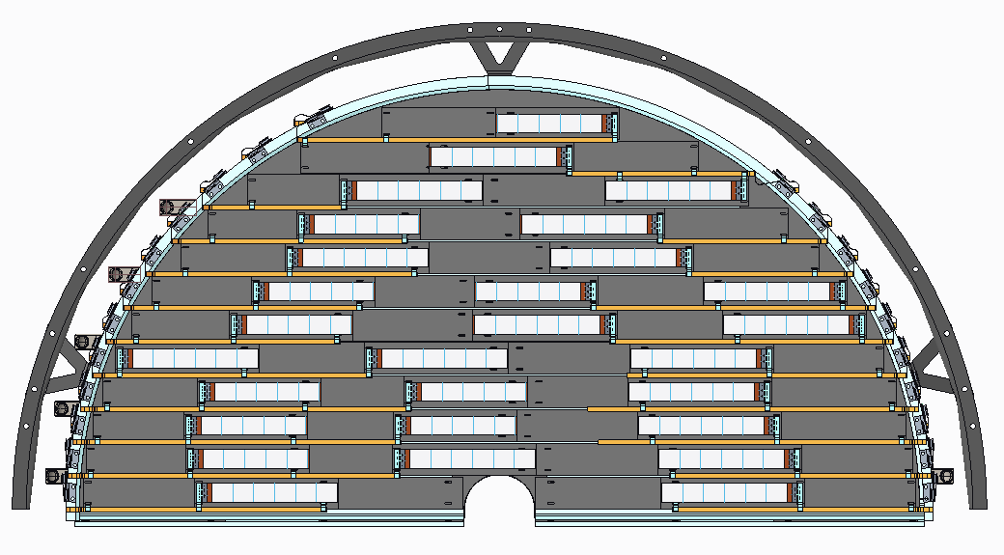
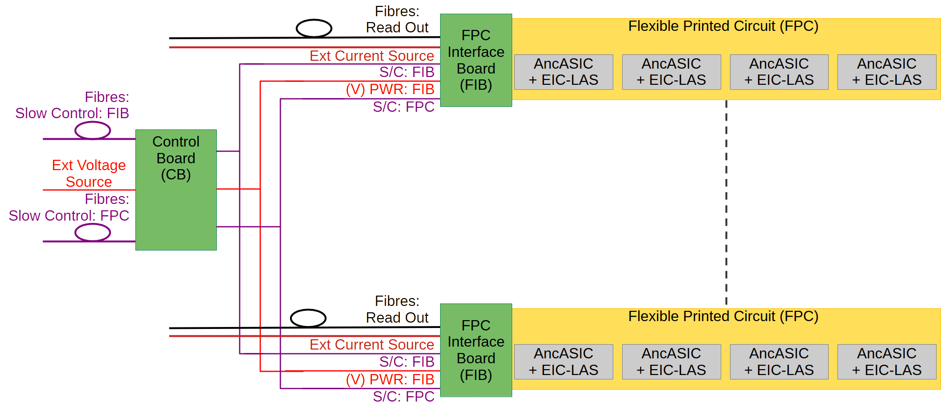
FPCs for SVT Disks
Requirements: provide electrical interfaces for low voltage power, slow control and high-speed data between sensor, AncASIC, and FPC Interface Board (FIB); transmit high-speed data up to 10.24 Gbps over 40 cm distance; minimum power loss; minimum material budget (Al-based FPC)
Sensor Inward Facing Module
Sensor Outward Facing Module
Bridge FPC(BFPC)
AncASIC
EIC-LAS
Main FPC(MFPC)

Slide 3
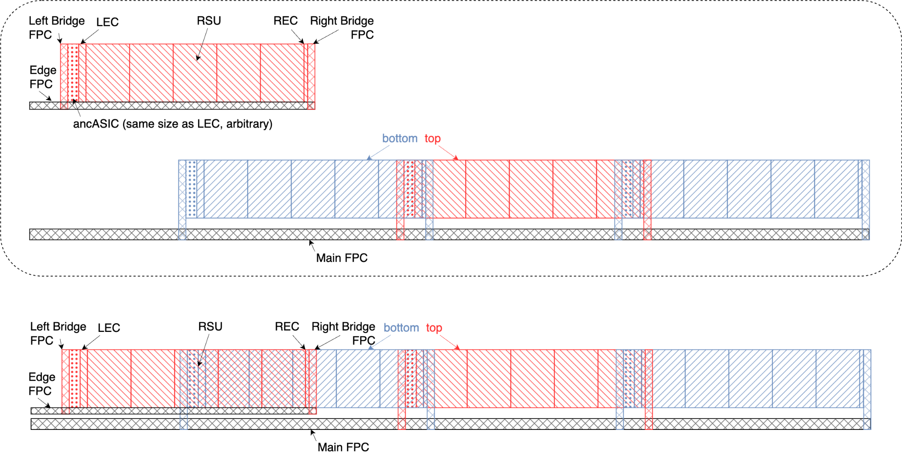
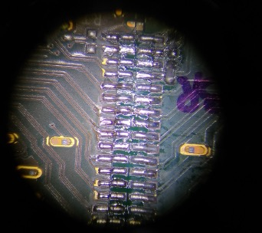
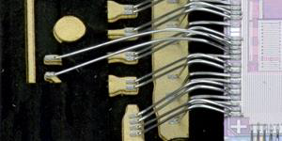

FPC Interconnections for SVT Disks
FIB
bold: preferred option
soldering
wire bonding
 | FIB | Main FPC | Bridge FPC | AncASIC
Main FPC | Connector, Soldering
Bridge FPC |  | soldering, wire/TAB-bonding
AncASIC |  |  | wire-bonding, TAB-bonding
EIC-LAS |  |  | wire-bonding, TAB-bonding | wire-bonding
TAB bonding

Slide 4
Mechanical Prototype FPCs for Disk Module Assembly
Considering the latest info about EIC-LAS and AncASIC dimensions and pad assignments

Slide 5

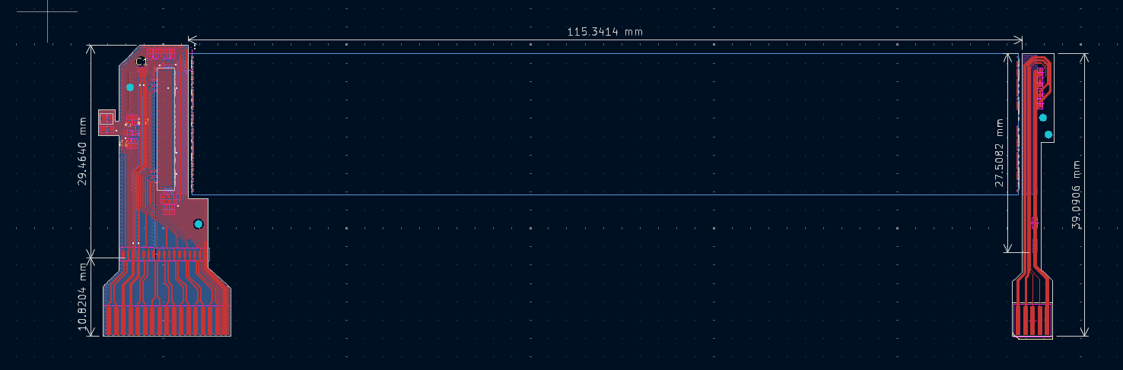
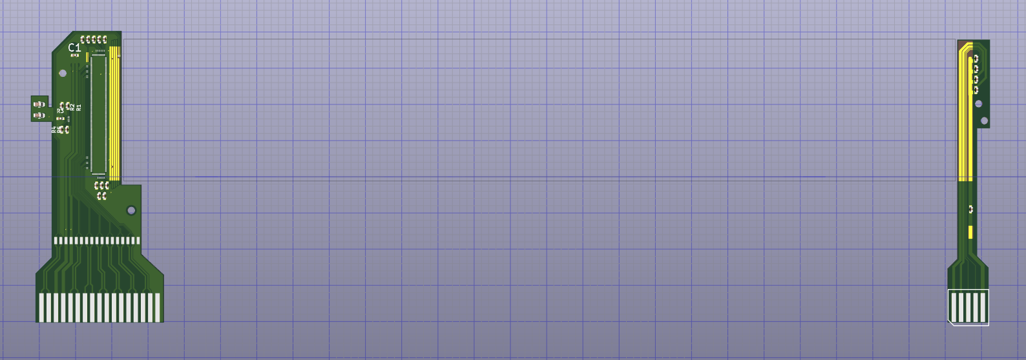
Bridge FPCs (JLCv1)
Left bridge FPC with AncASIC will handle EIC-LAS LEC power, slow control, high-speed data transmission.
Right bridge FPC with power buses connected to GND through decoupling capacitors will connect to the EIC-LAS REC.
 | Area (mm²) | Metal area (mm²) | Fill factor
Top Layer | 278.2 | 190 | 0.69
Bottom Layer | 278.2 | 260 | 0.94
 | Area (mm²) | Metal area (mm²) | Fill factor
Top Layer | 78.9 | 32.9 | 0.42
Bottom Layer | 78.9 | 0 | 0

Slide 6
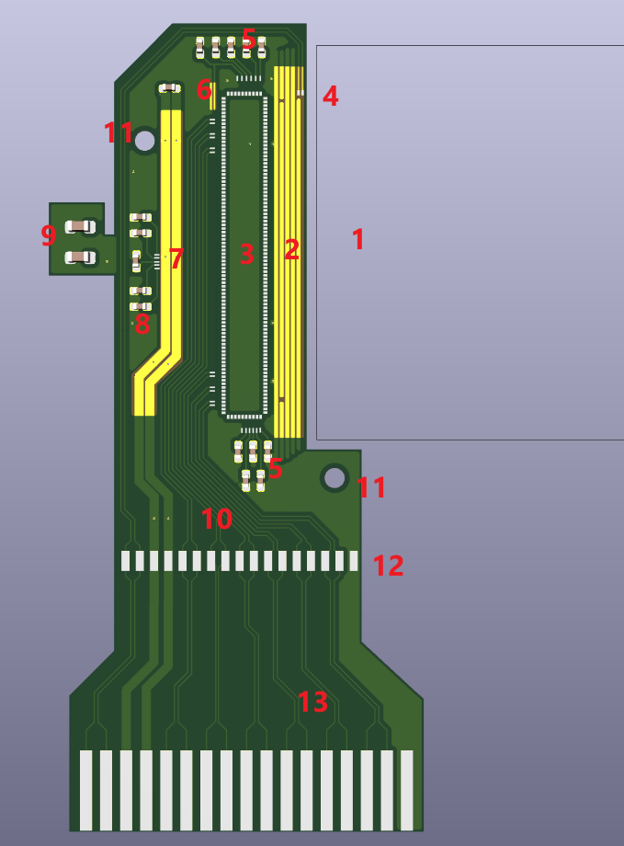
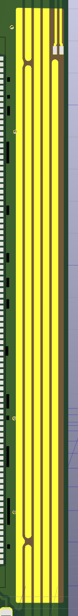
Left Bridge FPC (JLCv1)
1. Left side of EIC-LAS
The distance between LAS and the FPC is 0.508 mm. The size of the LAS is assumed as 114.330 * 19.564 mm.
2. Power Bus
Net name from left to right: GND, PSUB, TXVDD, GSVDD, GAVDD, GDVDD. Each trace is 8 mil width with 3 mil spacing.
3. AncASIC
The distance between the edge of AncASIC and LAS is 2.4 mm. The size of the ASIC is assumed as 16.434 mm × 2.388 mm.
4. Pads of the HSD
width/space = 55um / 140 um. Since the pads of the HSD on LAS haven't been confirmed, I choose the HS_DATA<0> of MOSAIX as the HSD pad in this design. Length of HSD_P = 48.4mm, HSD_N = 48.9mm.
5. Decoupling Capacitors
All of the Decoupling Capacitors are in the 0201 footprint.
6. AncASIC address
There is an open window on the soldermask, so the address pads of AncASIC can be wire-bonded to ABVDD or GND.
Note 1: The 55um / 140um dimensions are empirical parameters for achieving Zdiff =100Ω± 10Ω, which need to be validated through sample production and testing.
Note 2: The dimensions of the AncASIC are calculated as follows: (pad number - 1) × pitch (180 µm) + pad width (assumed to be 5 mil) + Corner Cell Width (300 µm) × 2. The theoretical dimensions are 16.385 mm × 2.345 mm. Due to the precision limitations of the design software, the final dimensions are 16.434 mm × 2.388 mm. These dimensions only serve solely as a reference for the placement and routing of other components on the FPC.
AncASIC/MOSAIX pad lists from Iain Sedgwick March 2026

Slide 7
Left Bridge FPC (JLCv1)
7. I_{in}/I_{out} bus
Width of Iin/Iout = 18 mil. To reduce the power consumption, there is another plane for each net on the bottom layer (see power consumption page)
8. SLDO Reference Current Resistor
All of the resistors are in the 0201 footprint.
9. Stiffener test
JLC suggested the FPC designer place a stiffener beneath the device that needs to be soldered. In this prototype, we placed a stiffener on this area to evaluate the impact of stiffener. There are two 0402 pads in this area, with a stiffener placed underneath one of them. We designed this structure to verify whether an FPC without a stiffener can withstand the high temperatures of soldering.
10. Slow control signals
Width/Spacing 55 um/140um.
11. Mounting hole
NPTH hole, diameter = 1 mm.
12. FPC Soldering Pads
The pads on the bottom edge are used to solder the bridge FPC to main FPC, pad width/spacing (0.4mm/0.3mm).
13. FPC wrapper
The FPC wrapper is designed to facilitate connecting this FPC to a test PCB with FPC connector such as 0522711779 Molex to facilitate module electrical test. The wrapper will be removed after QA.
AncASIC/MOSAIX pad lists from Iain Sedgwick March 2026

Slide 8
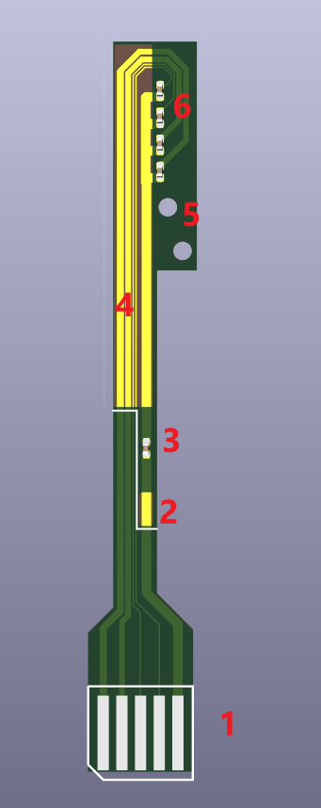
Right Bridge FPC (JLCv1)
1. FPC wrapper.
The FPC wrapper is designed to facilitate connecting this FPC to a test PCB with FPC connector such 2005280050 Molex | Connectors, Interconnects | DigiKey, to facilitate module electrical tests. The wrapper will be removed afterwards.
2. Solder pads
Solder to the GND net on the Main FPC.
3. AC coupling Capacitors
The ground is AC coupled to the ground on the main FPC.
4. Power/GND Trace:
From left to right, net names and widths are GDVDD (15mil), GAVDD (12 mil), GSVDD (3 mil), and PSUB (3mil).
5. Mounting hole:
NPTH hole, diameter = 1 mm.
6. Decoupling Capacitor:
All of the resistors are in the 0201 footprint.

Slide 9

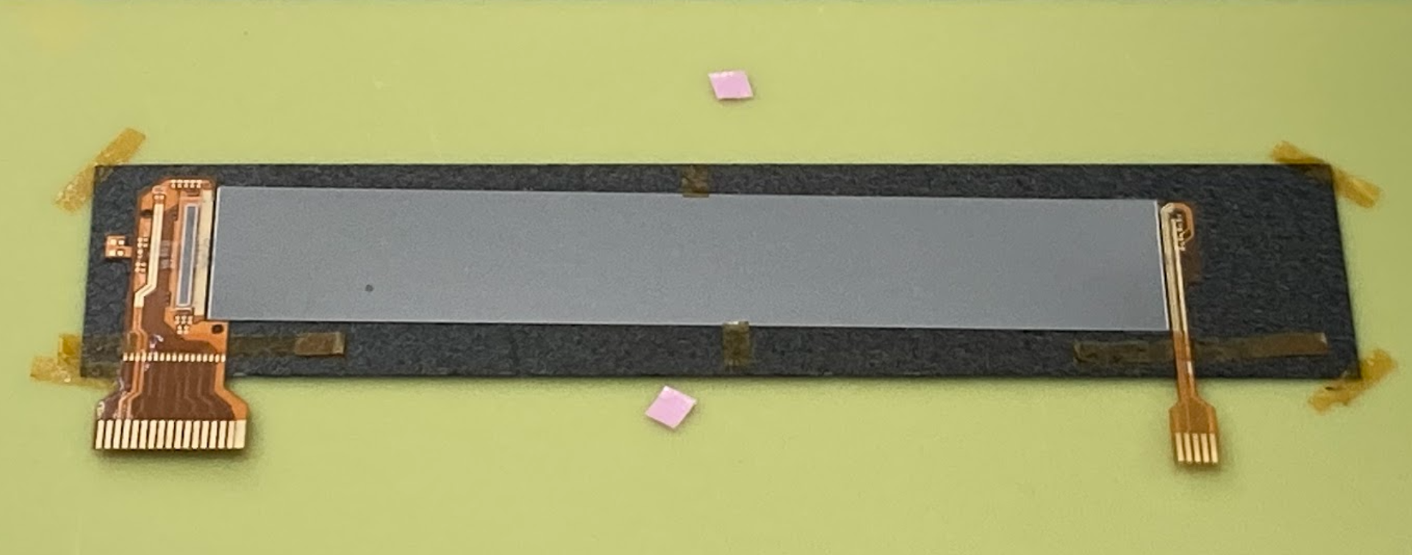
Bridge FPCs (JLCv1)
Dummy AncASIC
CF Flat Sheet
Dummy EIC-LAS
BFPC_left
BFPC_right

Slide 10
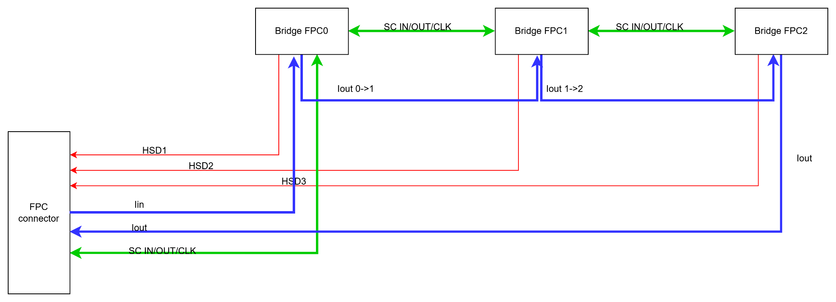
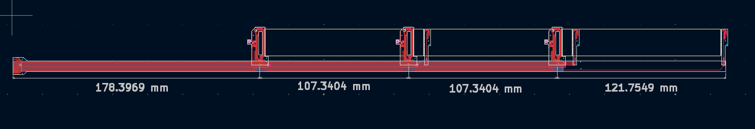
Main FPC (JLCv1)

Slide 11
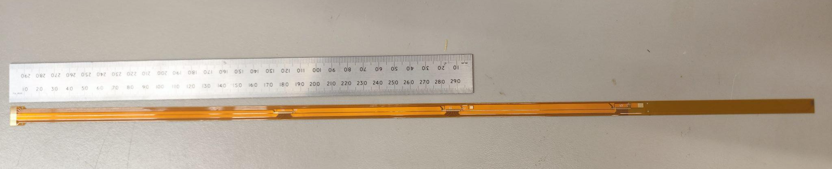
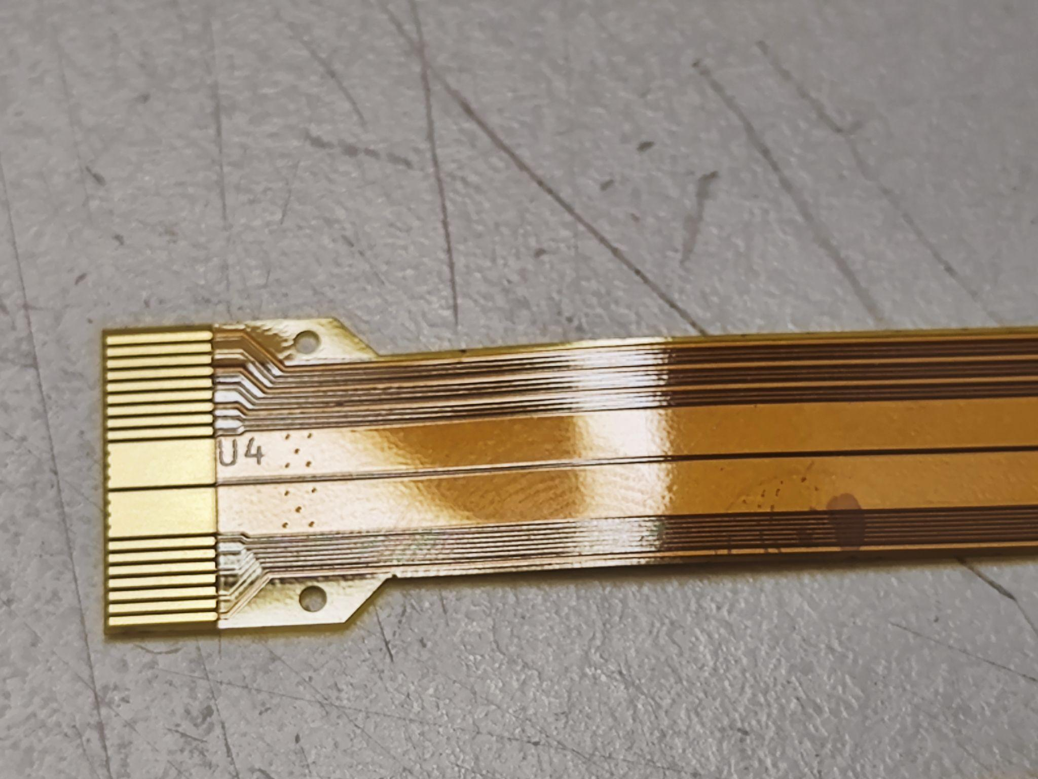
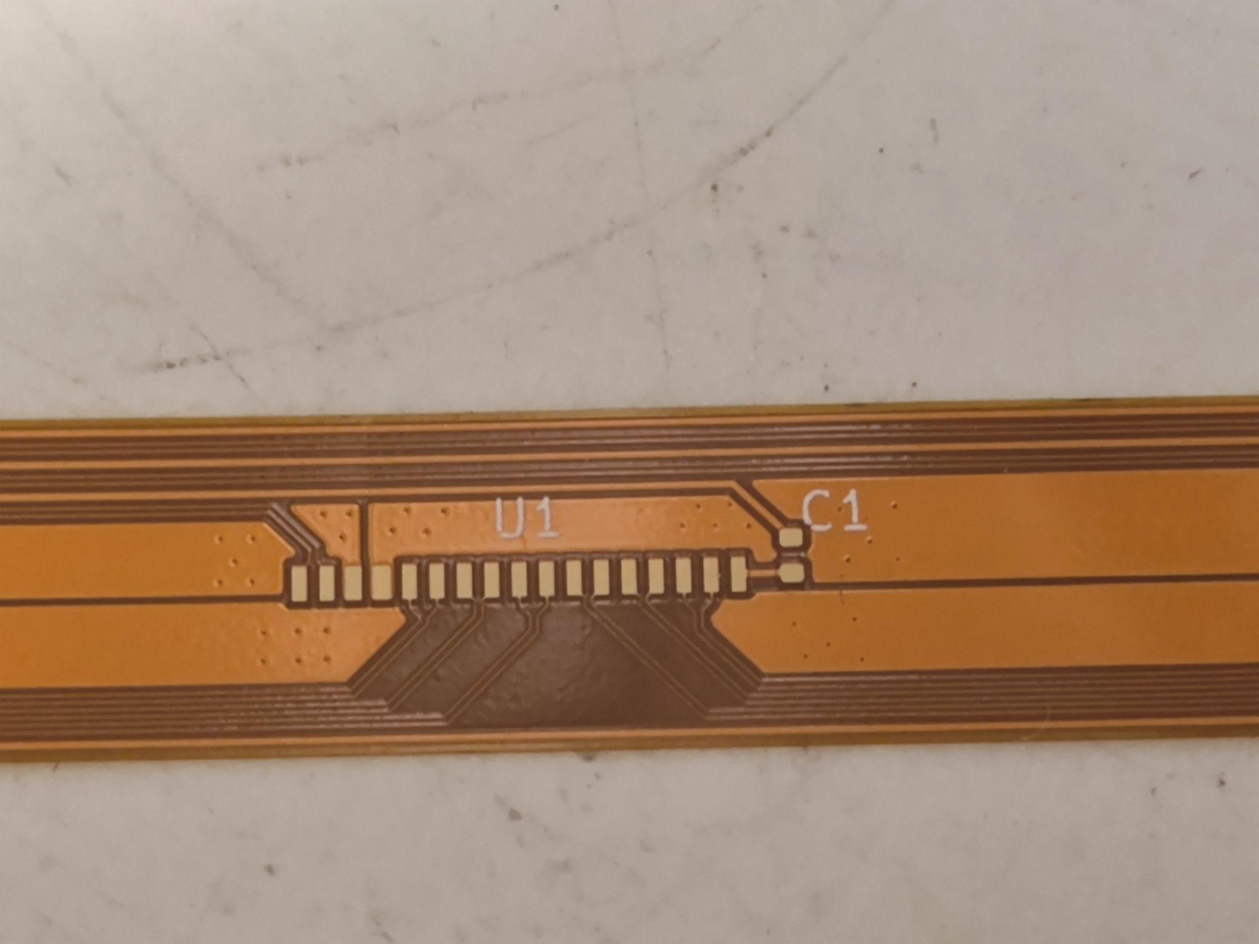
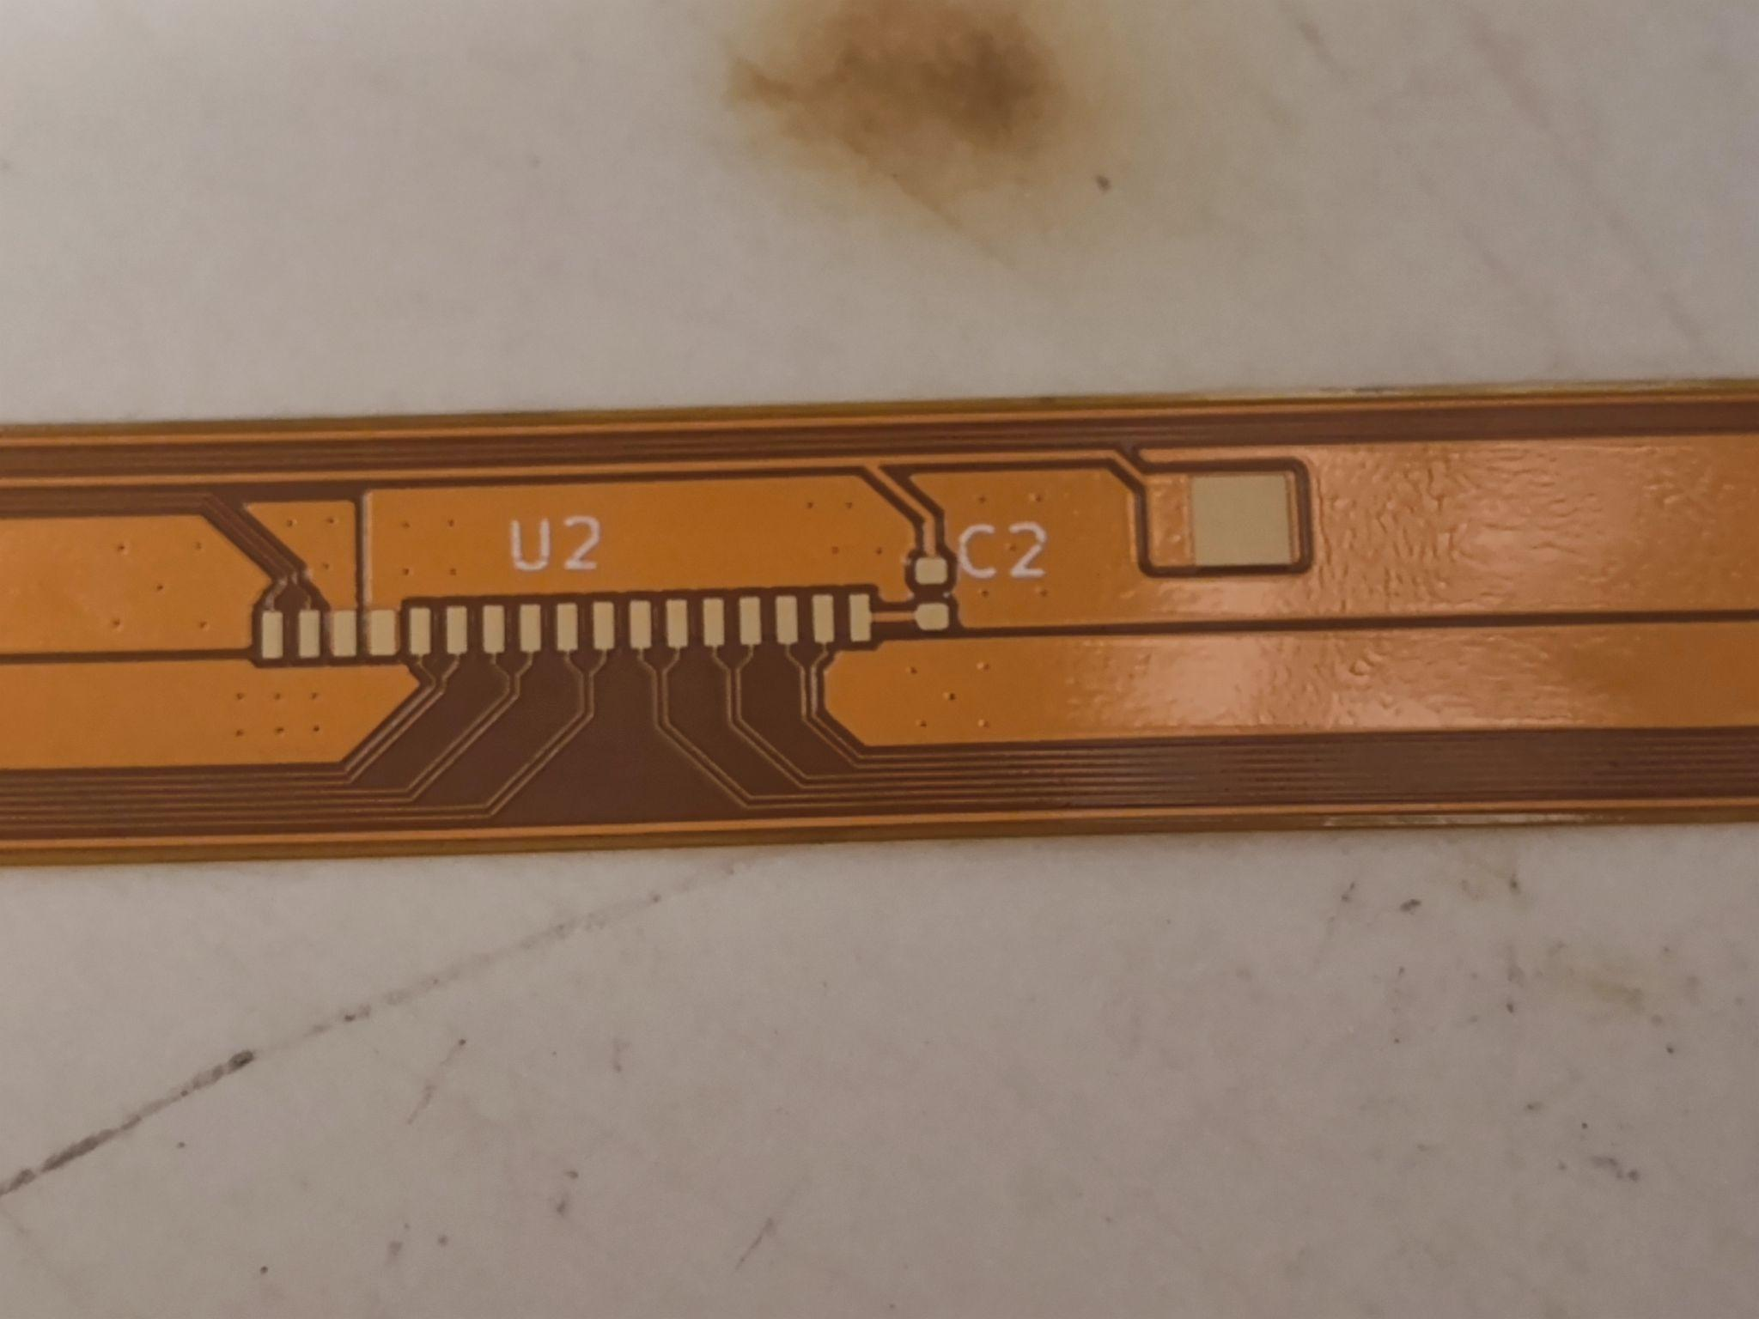
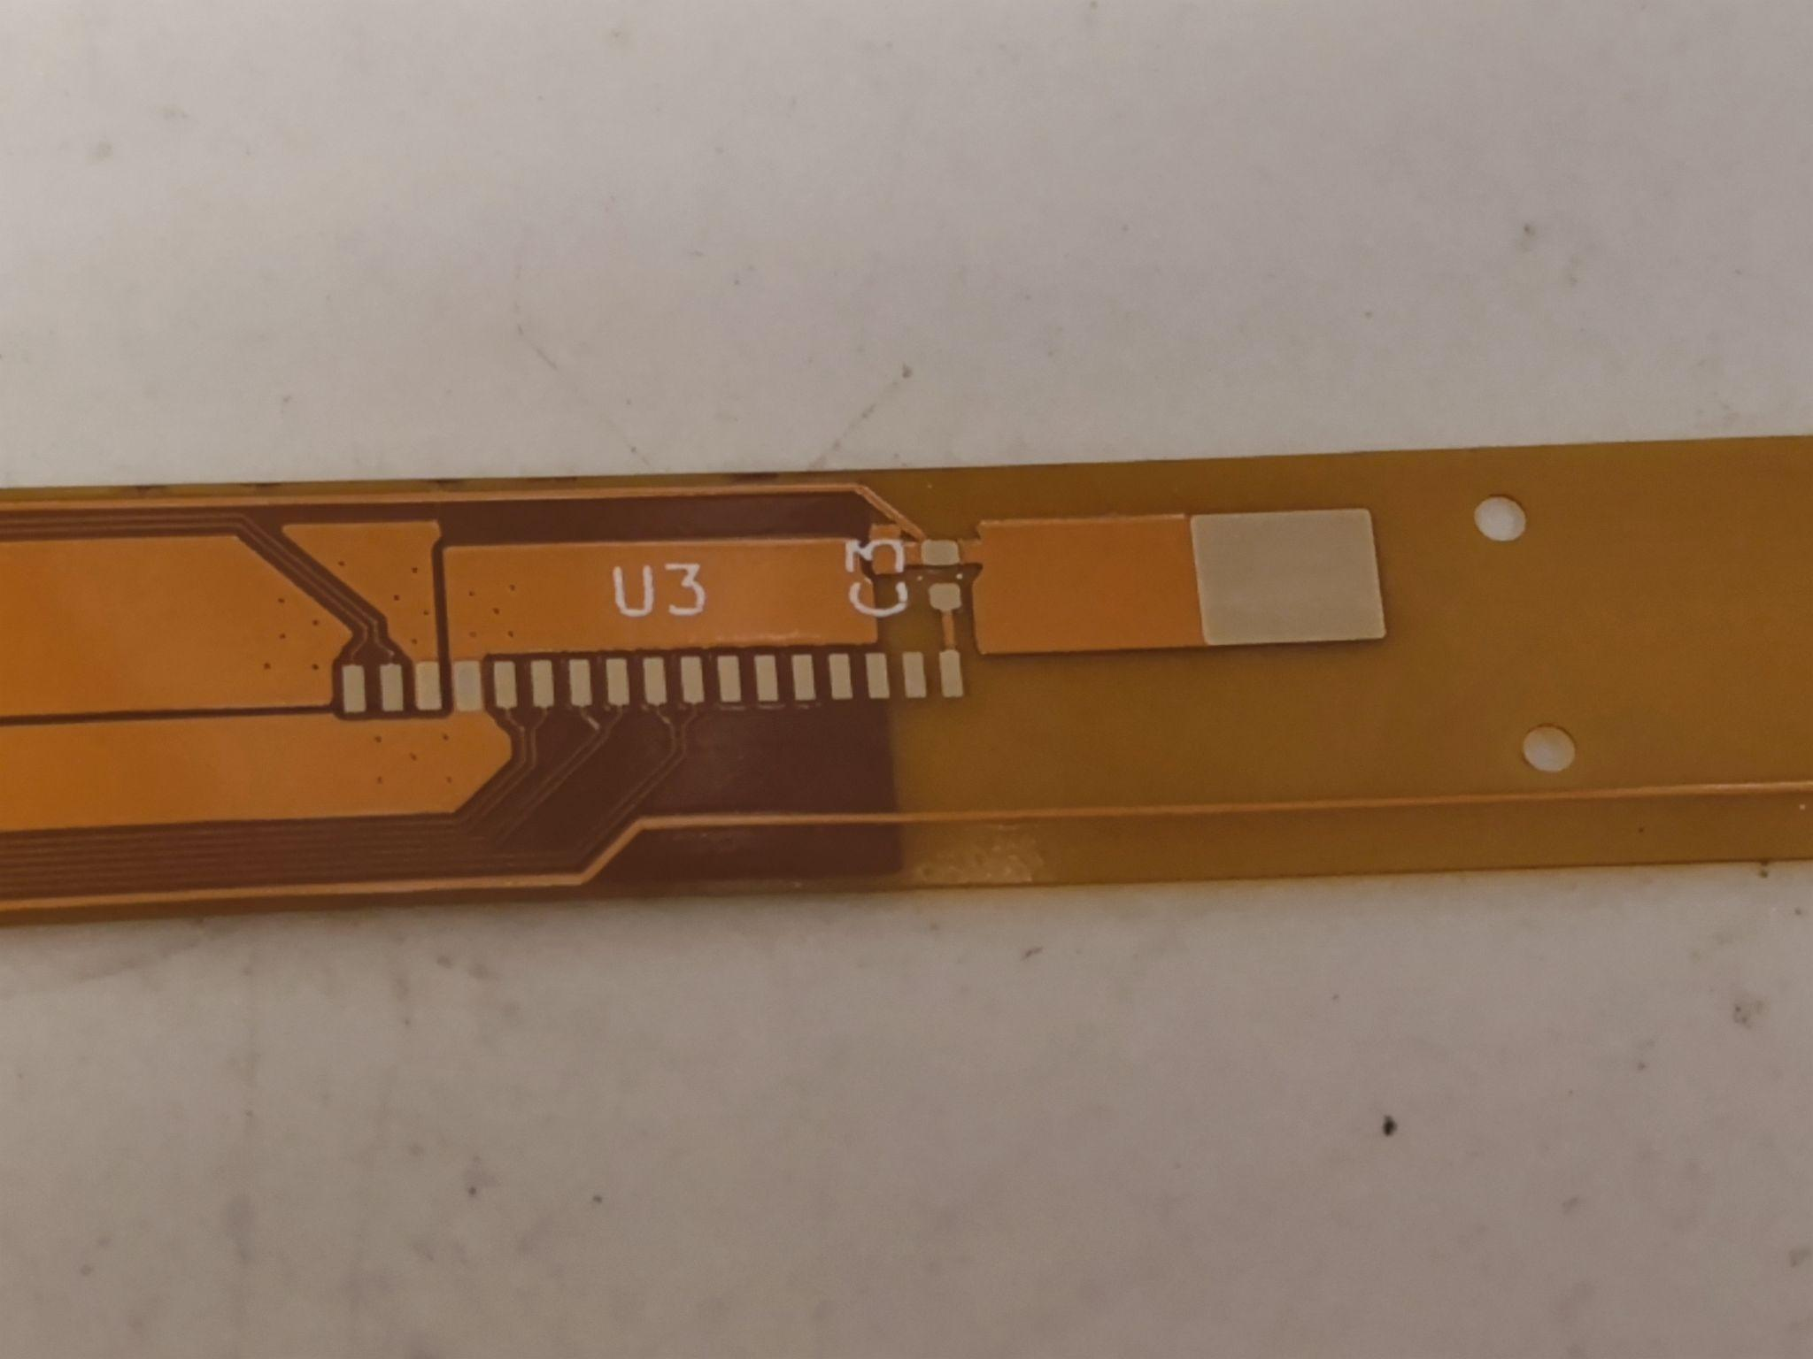
Main FPC (JLCv1)

Slide 12
Prototype FPCs for High-Speed Data Transmission
Test structures and simulation to quantify signal loss and cross-talks

Slide 13
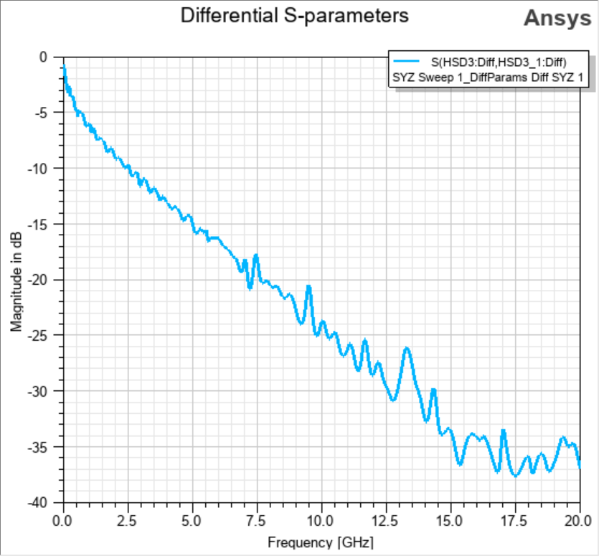
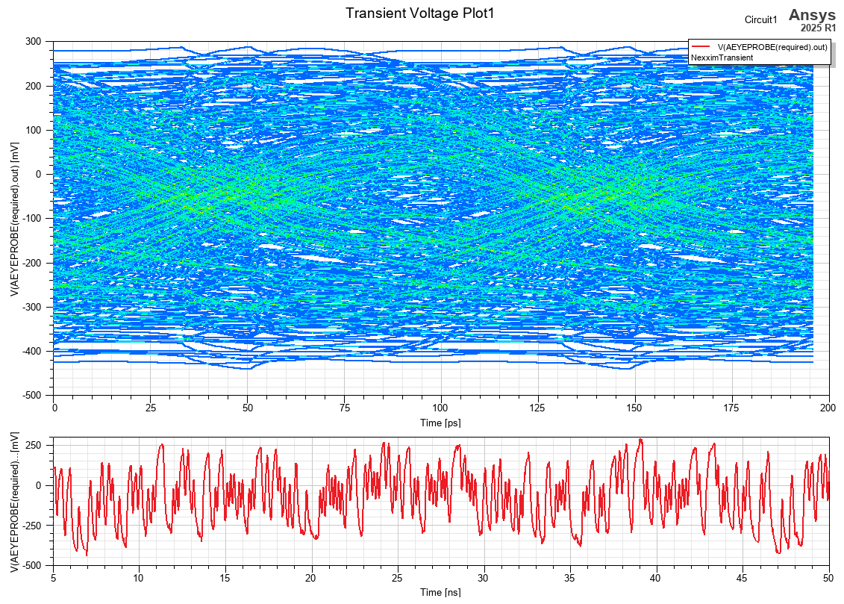
S-parameter for JLCv1 FPC
Significant signal transmission loss, eye diagram is unacceptable @10.24Gbps

Slide 14
Test Structures for HS Transmission (JLC)
Cover layer thickness (um) | 27.5 | 50 | 27.5 | 27.5
Copper thickness (um) | 12 | 18 | 12 | 12
Dielectric thickness (um) | 25 | 50 | 62.5 | 100
Copper thickness (um) | 12 | 18 | 12 | 12
Cover layer thickness (um) | 27.5 | 50 | 27.5 | 27.5
Total thickness (um) | 104 | 185 | 131.5 | 179
HSD trace width (um) | 55 | 93 | 110 | 190
HSD trace spacing (um) | 140 | 152 | 160 | 200
HSD perimeter (um) | 134 | 222 | 244 | 404
S/C trace width (um) |  |  | 70 | 80
S/C trace spacing (um) |  |  | 60 | 60
S/C perimeter (um) |  |  | 164 | 184
HSD and SC widths and spacings are calculated so that the impedance is around 100 Ohms

Slide 15
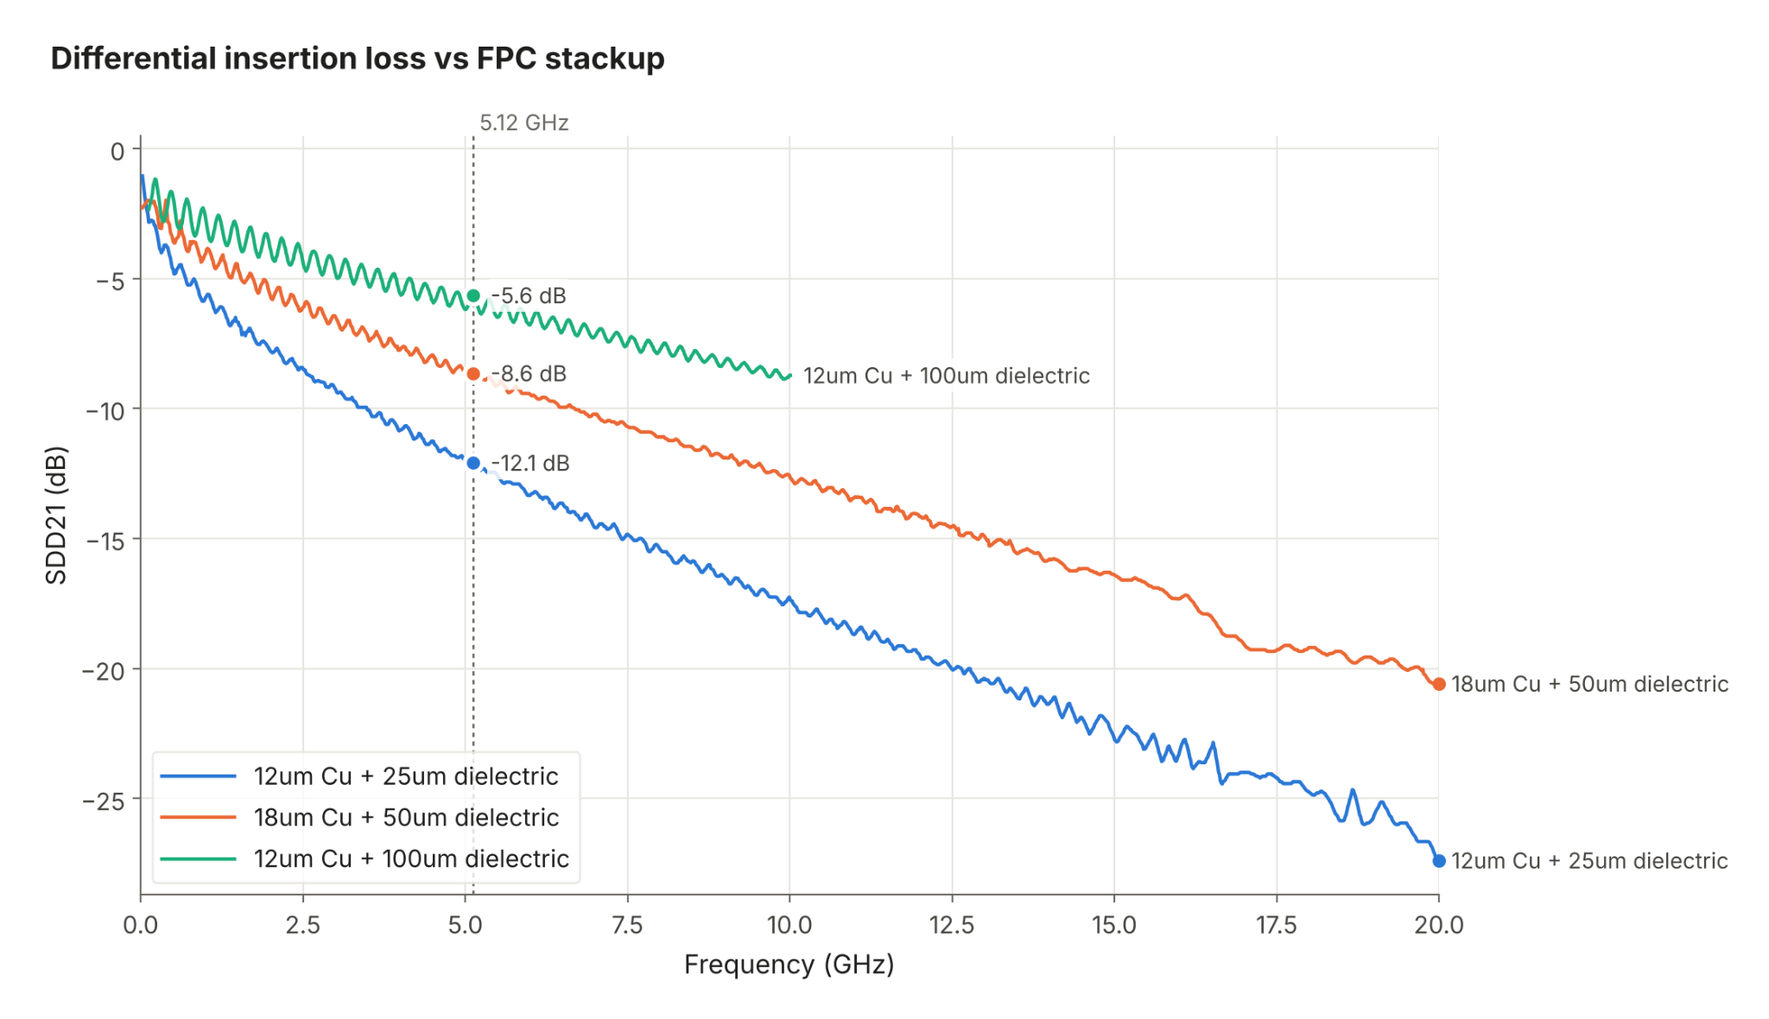
S-parameters from Simulation
Signal loss is reduced by increasing trace perimeter

Slide 16
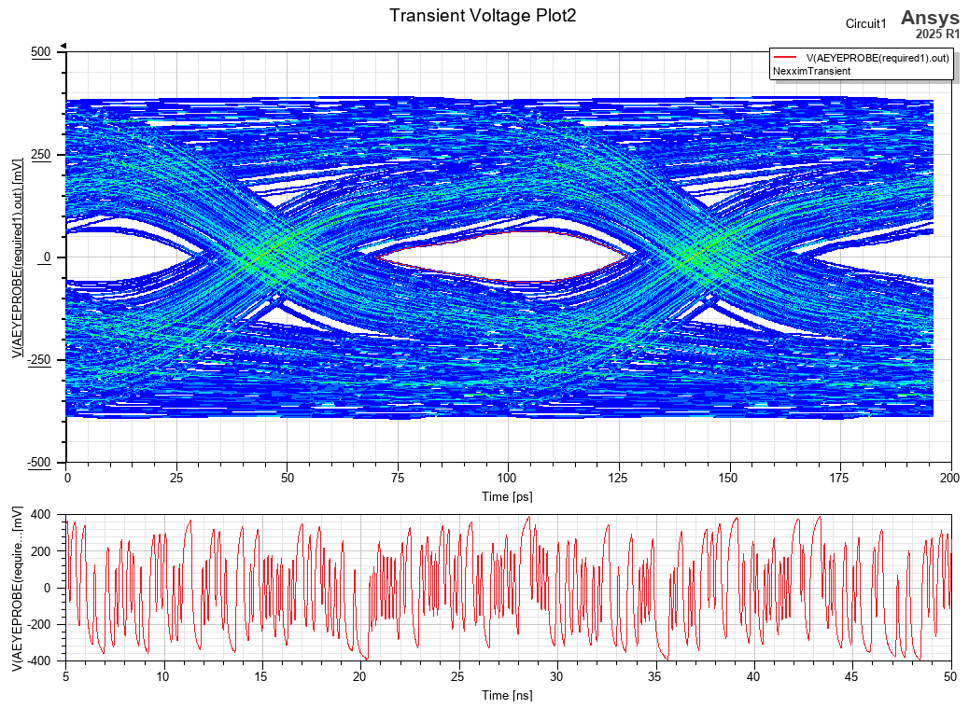
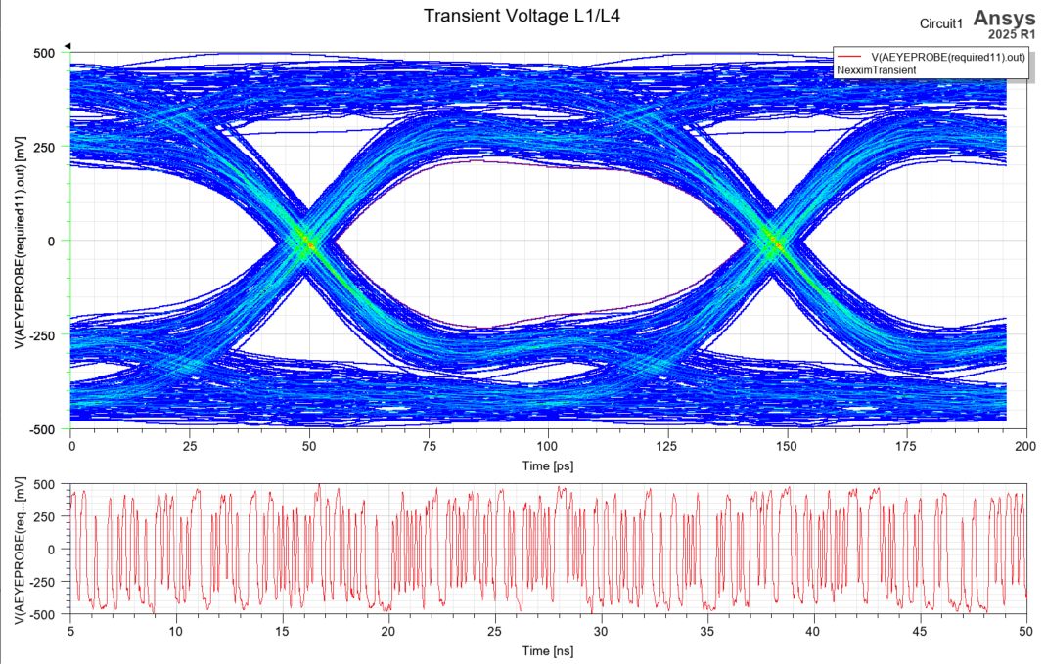
Eye Diagrams @ 10.24Gbps from Simulation
12 um Cu, 25 um dielectric
55 um trace width
In the same stack-up with the JLCv1(see page 13) and optimized the locations of the impedance discontinuities.
12um Cu, 100 um dielectric
190 um trace width

Slide 17
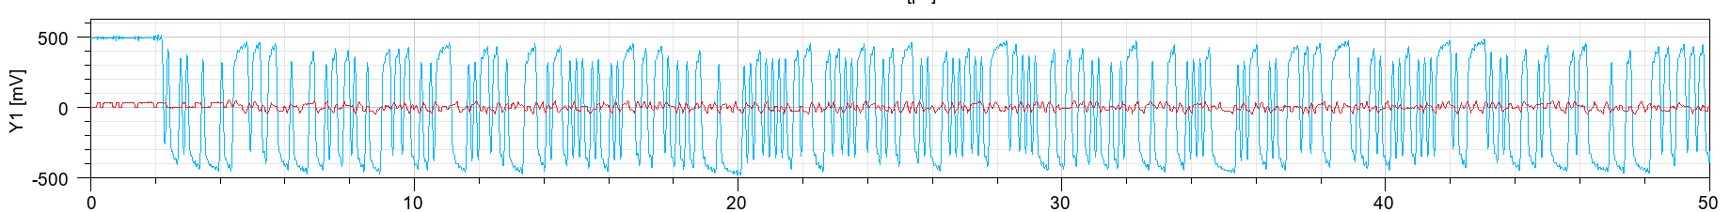
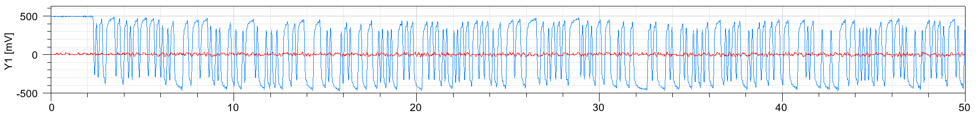
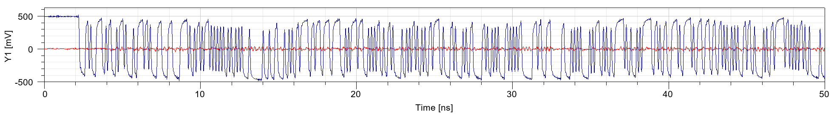
Cross-Talk vs Spacing from Simulation
Diff1&2 | W=190, S = 110
Diff3&4 | W=190, S = 200
Diff5&6 | W=190, S = 300
W: Trace width; S: Spacing between Differential paris

Slide 18
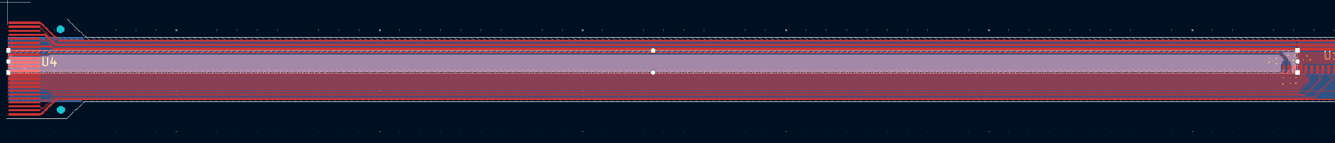
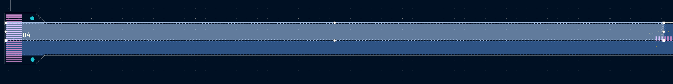
Main FPC Power Consumption (JLCv1)
I_{in01} net in the top and bottom layers
Net | From | To | Material | Resistivity@20℃ (ohm·m) | Thickness (m) | length (m) | Width on top (m) | Width on bottom (m) | Resistance Top | Resistance Bottom | Resistance
I_{in01} | FPC connector | Bridge FPC0 | Aluminum | 2.65E-08 | 1.50E-05 | 0.17 | 0.00196 | 0.00460 | 1.53E-01 | 6.53E-02 | 4.58E-02
I_{in12} | Bridge FPC0 | Bridge FPC1 | Aluminum | 2.65E-08 | 1.50E-05 | 0.107 | 0.00282 | 0.00460 | 6.70E-02 | 4.11E-02 | 2.55E-02
I_{in23} | Bridge FPC1 | Bridge FPC2 | Aluminum | 2.65E-08 | 1.50E-05 | 0.107 | 0.00371 | 0.00460 | 5.10E-02 | 4.11E-02 | 2.27E-02
I_{out} | Bridge FPC2 | FPC connector | Aluminum | 2.65E-08 | 1.50E-05 | 0.387 | 0.00228 | 0.00371 | 3.14E-01 | 1.84E-01 | 1.16E-01
Assume the Iin/Iout current is 1.5 A, The power consumption is estimated to be 473 mW.
Including the BFPC, roughly 20% of the total power is dissipated in the FPCs.

Slide 19
Summary and Outlook
Low-mass Al FPCs are needed to provide electrical interfaces for SVT disks.
Designed and fabricated mechanical prototype Cu FPCs to facilitate disk module assembly, considering the current info of EIC-LAS and AncASIC dimensions and pad placements.
Ongoing studies to optimize FPC design for high-speed data transmission.
  Simulation studies have indicated that larger perimeter traces have less signal loss.
  Producing prototype Cu FPCs to study signal transmission and cross-talk with different thickness/width/spacing to validate simulation results.
Next step: design and fabricate electrically functional Cu and Al FPCs to integrate with AncASIC MPW3 and ER2 sensors and measure the performance.

Slide 21
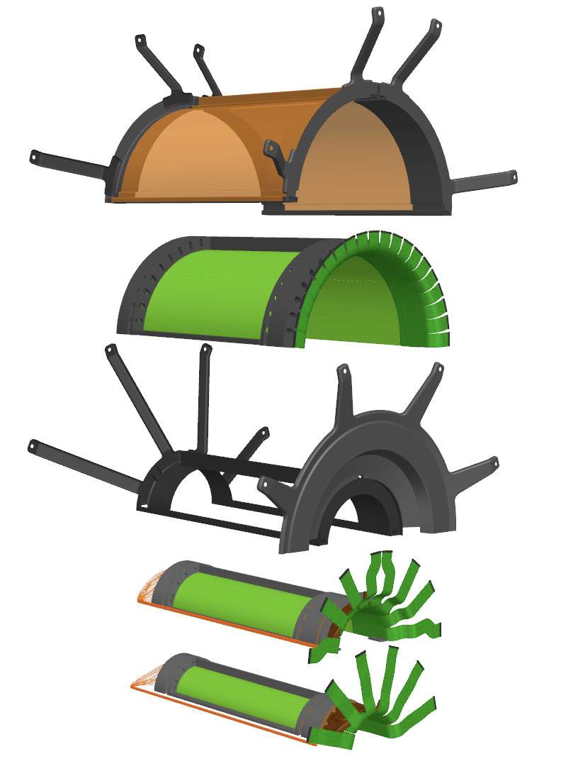
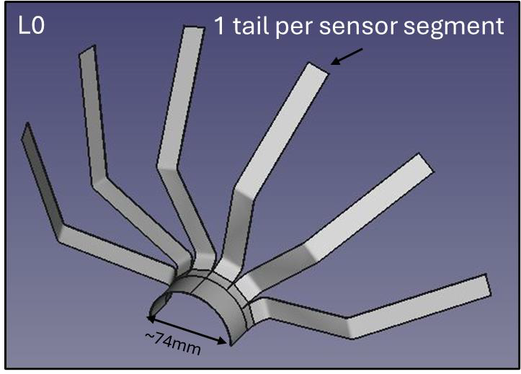
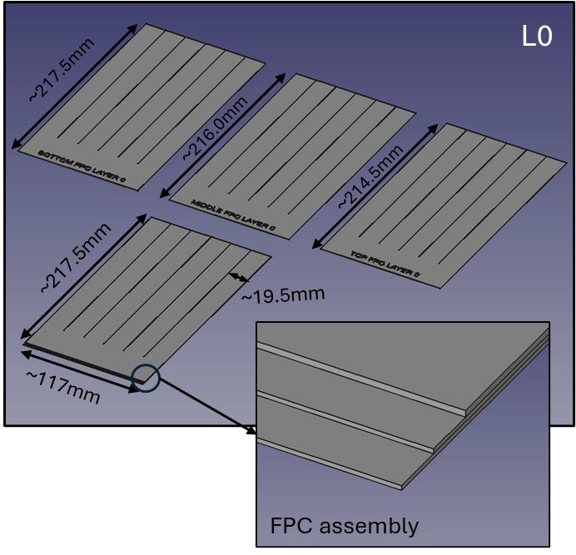
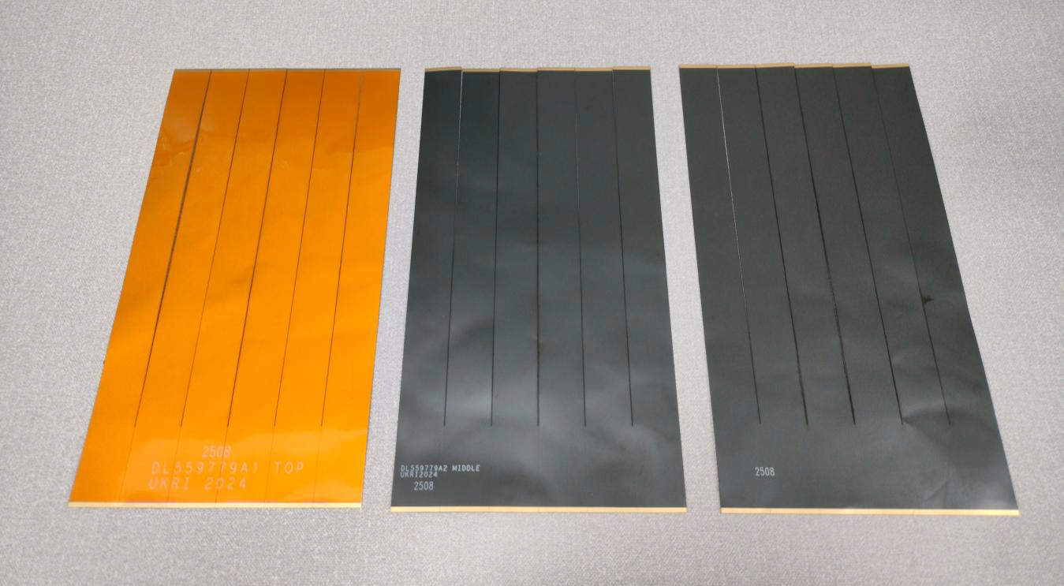
SVT-IB FPCs
L2 external shell
L2
Mechanical FPC prototypes for SVT-IB
L0-L1
external shell
L1
L0

Slide 22
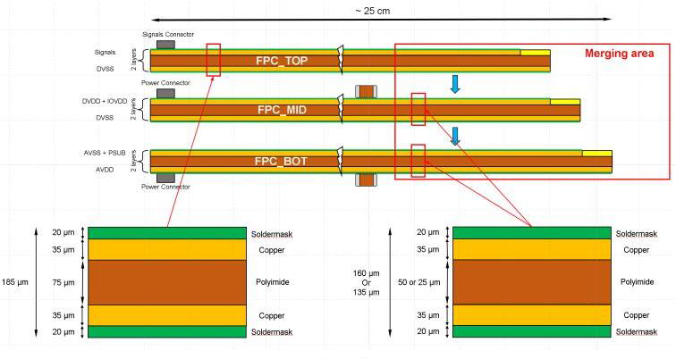
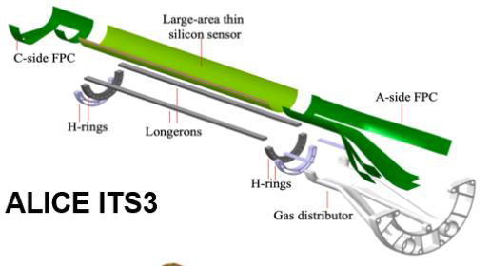
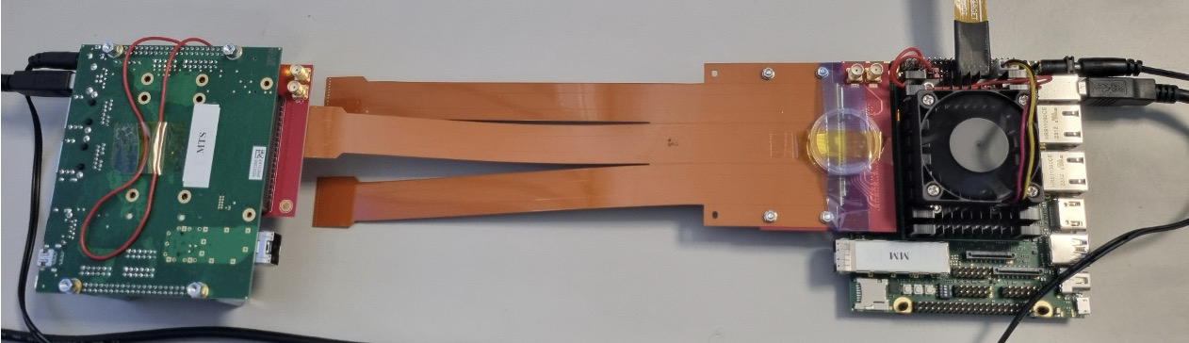
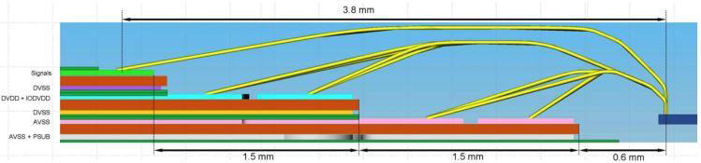
ITS3 FPCs
ITS3 test setup
Wire-bond Profile

Slide 23
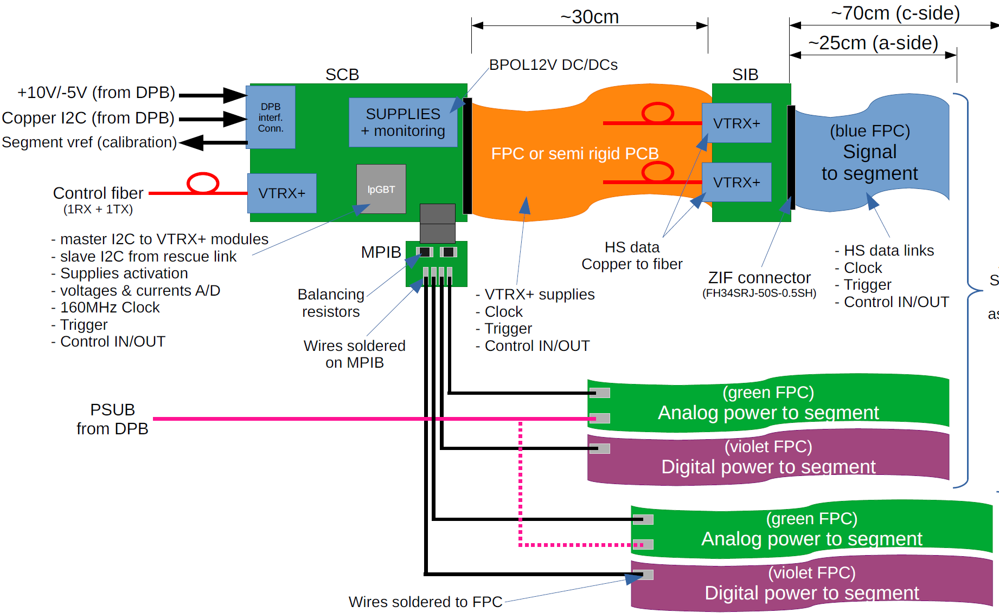
Power/Readout for SVT IB
Joachim Schambach (ORNL) link

Slide 24
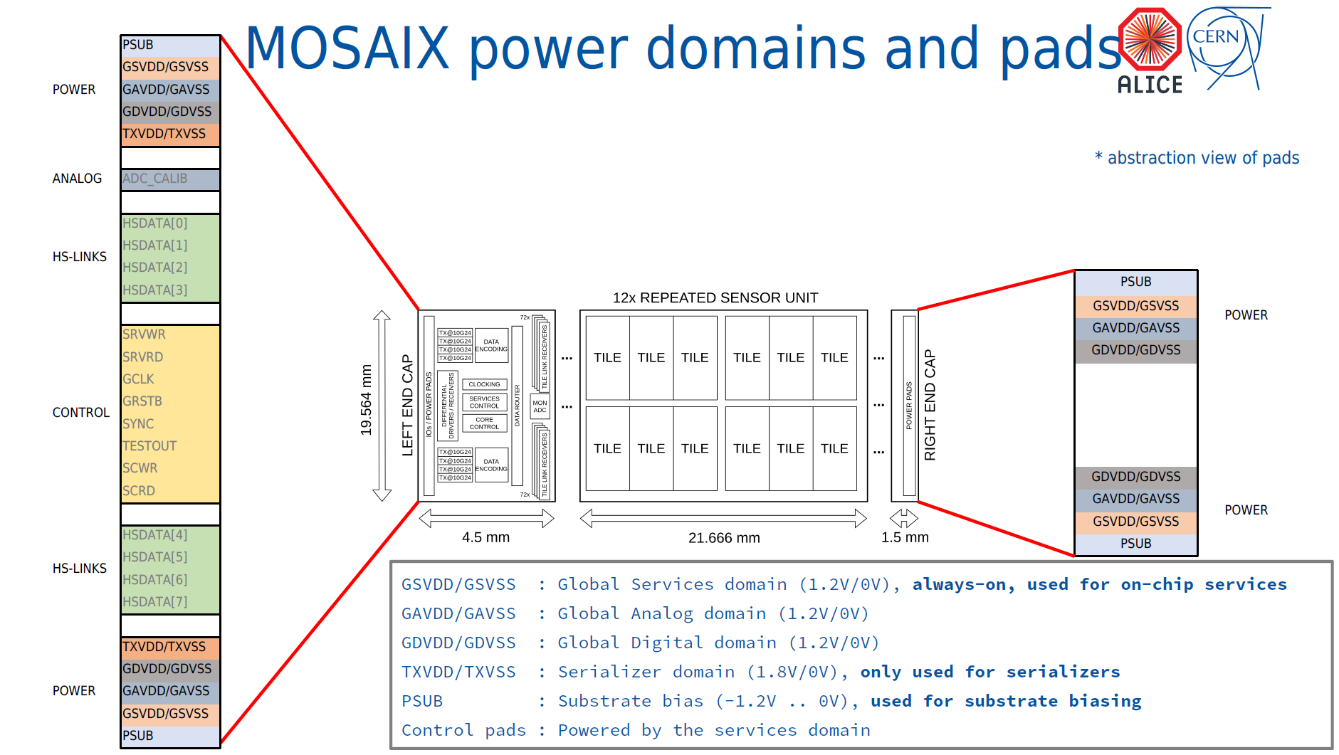
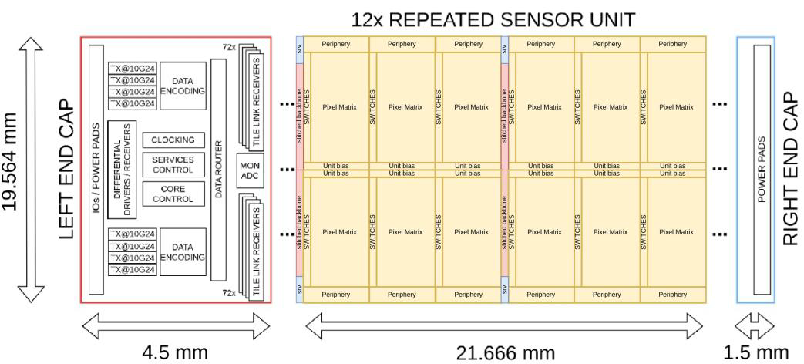
EIC-LAS for SVT OB/Disks
Supply | Typ (mA) | Max (mA)
PSUB (-1.2V)
GSVDD/GSVSS (1.32V/0V) | 40 | 60
GAVDD/GSVSS (1.32V/0V) | 170 | 270
GDVDD/GDVSS (1.32V/0V) | 526 | 816
TXVDD/TXSVSS (1.2V/0V) | 200 | 300
Signal | Frequency
GCLK | 80/160 MHz
SYNC | N/A
GRSTB | N/A
SRVWR/RD | 5 Mbps
SCWR/RD | 5 Mbps
HSDATA[0…7] | 5.12/10.24 Gbps
LEC
5-6 x REPEATED SENSOR UNITS
REC
1.2V/0V

Slide 25
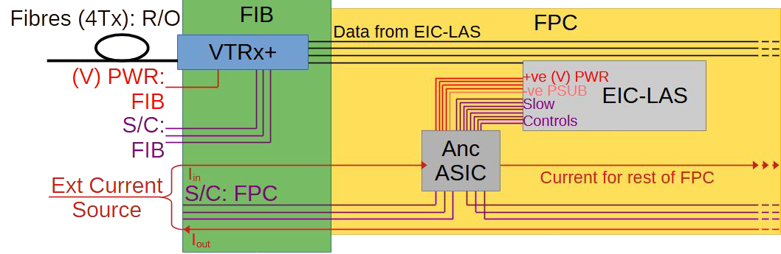
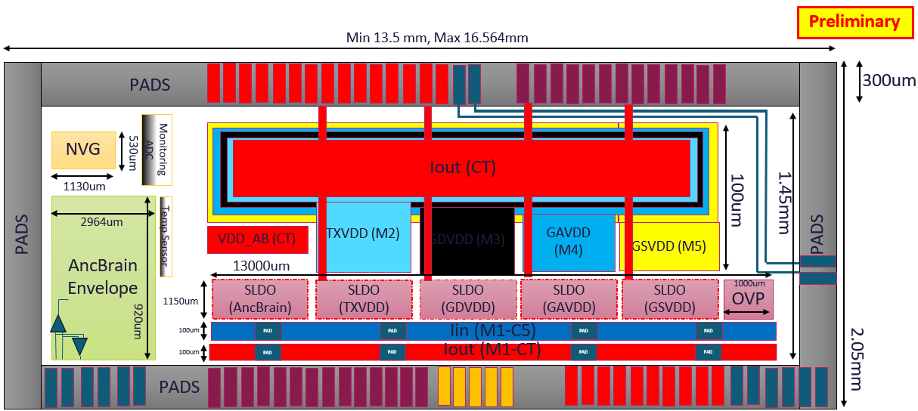
AncASIC and FIB for SVT OB/Disks
FPC Interface Board
DC Current for AncASIC to translate to 5 power domains for EIC-LAS.
S/C for AncASIC to translate to slow control signals for EIC-LAS.
VTRx+ to receive high-speed data from EIC-LAS and send out by optical fibre
AncASIC
AncASIC Main Building Blocks
Neg. Bias Voltage Generator (NVBG): frequency-controlled charge pumps
Shunt-LDO (SLDO): serial power with DC current through multiple AncASICs
Slow Control (AncBrain): Daisy-chained connection among multiple AncASICs to reduce the number of traces/cables

Slide 26
SVT OB/Disk Power/Readout Scheme

Slide 27
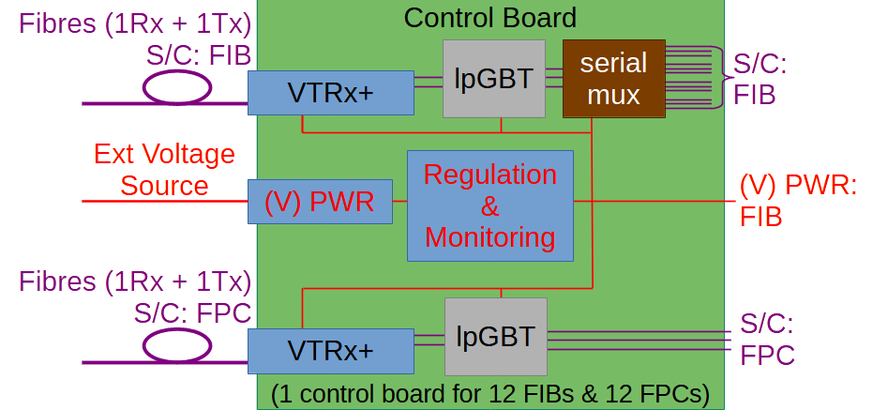

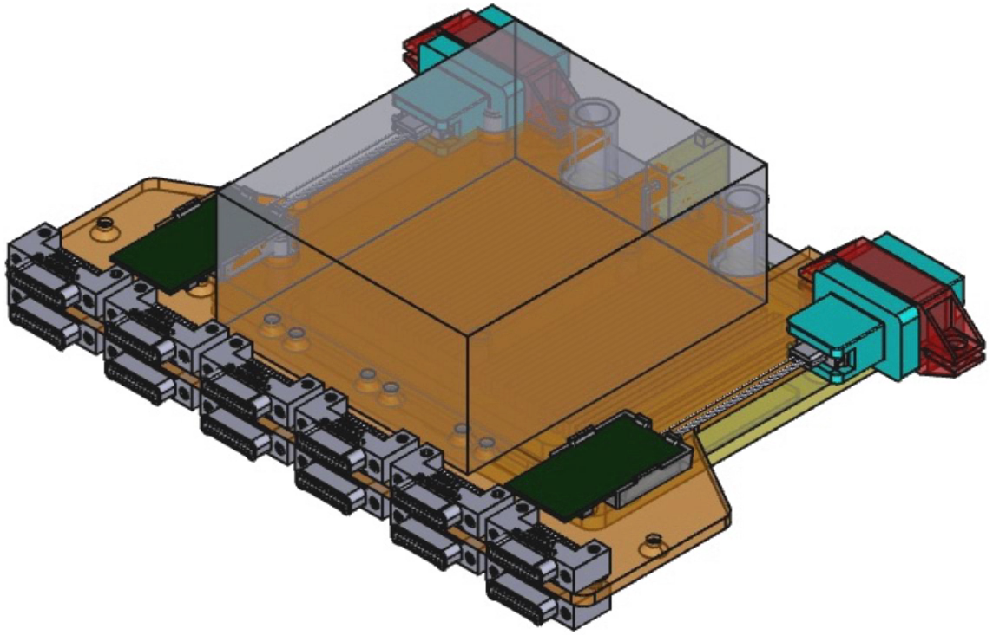
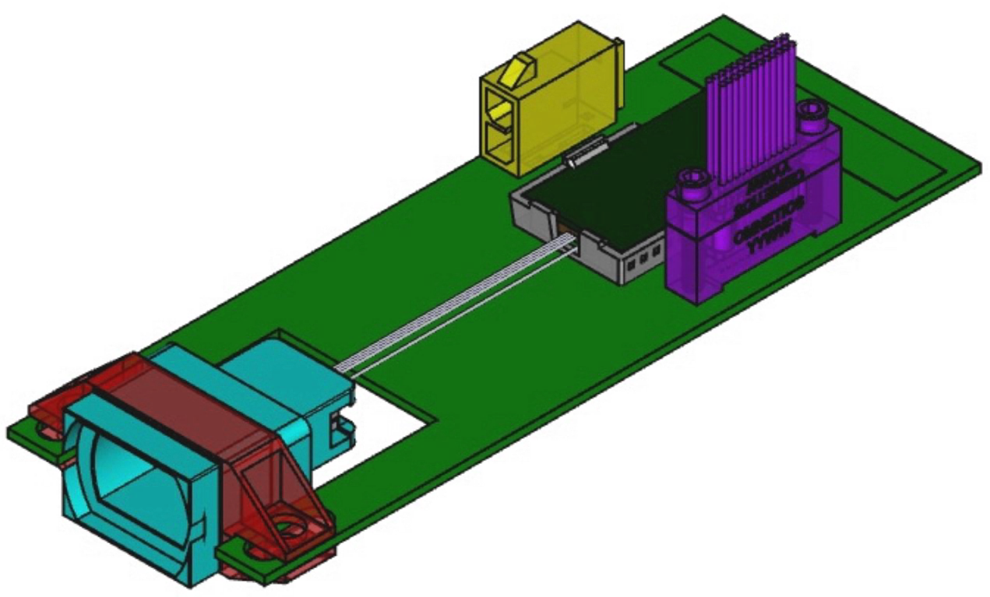
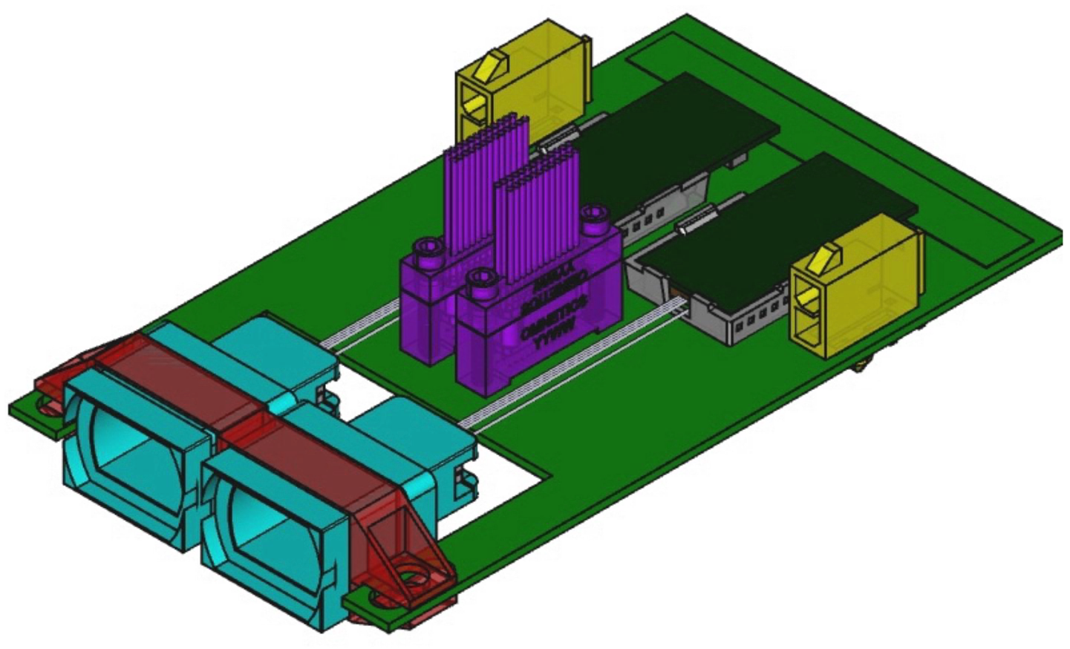
FCB and FIB for SVT OB/Disks
FPC Control Board
Use the lpGBT e-links for the FPC S/C commands.
Use the lpGBT I2C master connections for the FIB S/C commands.
FPC Interface Board
FIB PWR and S/C for the VTRx+ (EIC-LAS data).
FPC current supply and S/C for AncASIC to translate to 5 power domains (including NBVG) and slow control protocol for EIC-LAS.

Slide 28
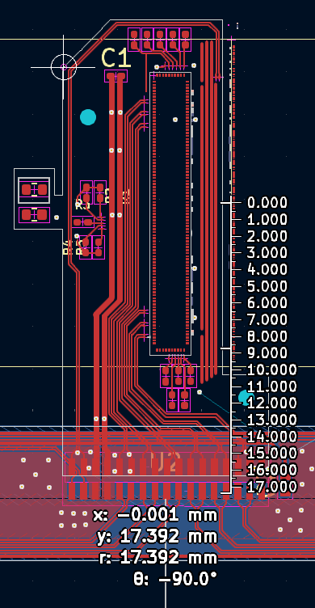


Main FPC - feature dimensions (JLCv1)
Connector end width | 12.5476mm
Body width | 9.1186mm
Total length | 514.83mm
Distance between Center of sensor and Main FPC | 17.392 mm
Overlap of RSU | 1mm
Area | 4747.6 mm²
Metal Fill factor Top | 0.45
Metal Fill factor Bot | 0.68

Slide 29

Main FPC - connector and nets (JLCv1)
Pin Number | Description
24,21,18,1 | GND trace, width = 0.2 mm
23,22 | High Speed Data, connect to Bridge FPC2, width/spacing = 3 mil, length = 387 mm.
20,19 | High Speed Data, connect to Bridge FPC1, width/spacing = 3 mil, length = 272 mm.
17,16 | High Speed Data, connect to Bridge FPC0, width/spacing = 3 mil, length = 160 mm.
12-15 | Iin (See following pages for details )
8-11 | Iout (See following pages for details)
7,6 | SC_CLK, width/spacing = 3mil,length = 162mm
5,4 | SC_OUT, width/spacing = 3mil, length =162 mm
3,2 | SC_IN, width/spacing = 3mil, length = 164 mm
Note: All GND traces are not interconnected on the main FPC; therefore, common grounding must be established externally (e.g. FIB) if needed.

Slide 30

Bridge FPC power consumption – I_{in}/I_{out} (JLCv1)
The resistance of Iin/Iout can be divided into two parts: Trace on FPC and bonding wire.
The estimated resistance and the parameters that used in the calculation is shown in the following:
Trace on FPC |  | Bonding wire
ρ:Resistivity@20℃ (ohm·m) | 2.65E-8 | ρ:Resistivity@20℃ (ohm·m) | 2.65E-8
H:Thickness (m) | 1.50E-5 | D:Diameter (m) | 2.54E-5
W:Width on top (m) | 0.0003084 (Iin/Iout) | L:Mean length (m) | 0.0029(Iin); 0.0023(Iout)
Width on the bottom (m) | 0.0022(Iin); 0,0027(Iout)
L:Mean length (m) | 0.017(Iin/Iout) | N:wire number | 27(Iin); 40 (Iout)
Resistance (ohm) | 0.0118 (Iin) 0.0098(Iout) | Resistance (ohm) | 5.6e-3(Iin);3e-3(Iout)
Assume the current is 1.5 A, The power consumption is estimated as 68 mW.
The main contribution is from the trace of Iin/Iout on FPC (~49 mW).

Slide 31


Bridge FPC power consumption – power nets (JLCv1)
The power consumption of TXVDD/GSVDD/GAVDD/GDVDD can be divided into two parts:1. From AncASIC to power bus; 2. From the power bus to the left edge of LAS (Power loss on the power bus is insignificant, as the current travels only a short distance on the it);
From AncASIC bonding to power bus |  | From power bus to left edge of LAS
ρ:Resistivity@20℃(ohm·m) | 2.65E-8 | ρ:Resistivity@20℃ (ohm·m) | 2.65E-8
D:Diameter (m) | 2.54E-5 | D:Diameter (m) | 2.54E-5
L(mm): | 0.8(TXVDD); 1.1(GSVDD); 1.4(GAVDD); 1.7(GDVDD) | L1(mm): | 1.9(TXVDD); 1.6(GSVDD); 1.3(GAVDD); 1(GDVDD)
Number of bonding wire: | 3 (TXVDD); 6(GSVDD); 4(GAVDD); 15(GDVDD) | Number of bonding wire: | 6 (TXVDD); 12(GSVDD); 8(GAVDD); 20(GDVDD)
Resistance: | 1.4e-2(TXVDD);9.6e-3(GSVDD); 1.8e-2(GAVDD);5.9e-3(GDVDD) | Resistance: | 1.7e-2(TXVDD);7.0e-3(GSVDD); 8.5e-3(GAVDD);2.6e-3(GDVDD)
Calculate the operating current for each power based on updated numbers form Chamonix:
The power consumption on power net is 6.3 mW

Slide 32


STFC-LTU FPC Prototypes
 | LTU FPC
Components | Thickness (um) | Material | X0(cm) | X0(%)
Metal layers | 15 + 15*0.69 | Aluminum | 8.897 | 0.028
Dielectric | 10+10+25+25 | Polyimide | 28.57 | 0.023
glue | 15 | TBC | 39.07 | 0.004
Total |  |  |  | 0.055

Slide 33



Connecting Bridge and Main FPCs (JLCv1)
Left Bridge FPC:
Right Bridge FPC:
The left bridge FPC will be soldered to the main FPC by 17 pairs of pads. Each pad has width 0.4mm, length 1mm, pitch 0.7mm.
The right bridge FPC will be soldered to the main FPC by 1 pair of pads.

Slide 34





spTAB vs wire-bonding on LTU FPCs
James Julian Glover link
Jian Liu link

Slide 35


S-parameters from Simulation
12um Cu + 100um Dielectric
18um Cu + 50um Dielectric
12um Cu + 25um Dielectric
Signal loss is reduced by increasing trace perimeter

Slide 36

Cross talk for HSD
Diff1&2 | W=190, S = 110
Diff3&4 | W=190, S = 200
Diff5&6 | W=190, S = 300
Diff7&8 | W=190, S = 420
Diff9&10 | W=190, S = 420+ GND Trace

