Slide 1
SVT – L4 Installation Procedure
E.C. Aschenauer (BNL)
ePIC SVT Meeting
October 2026

Slide 2
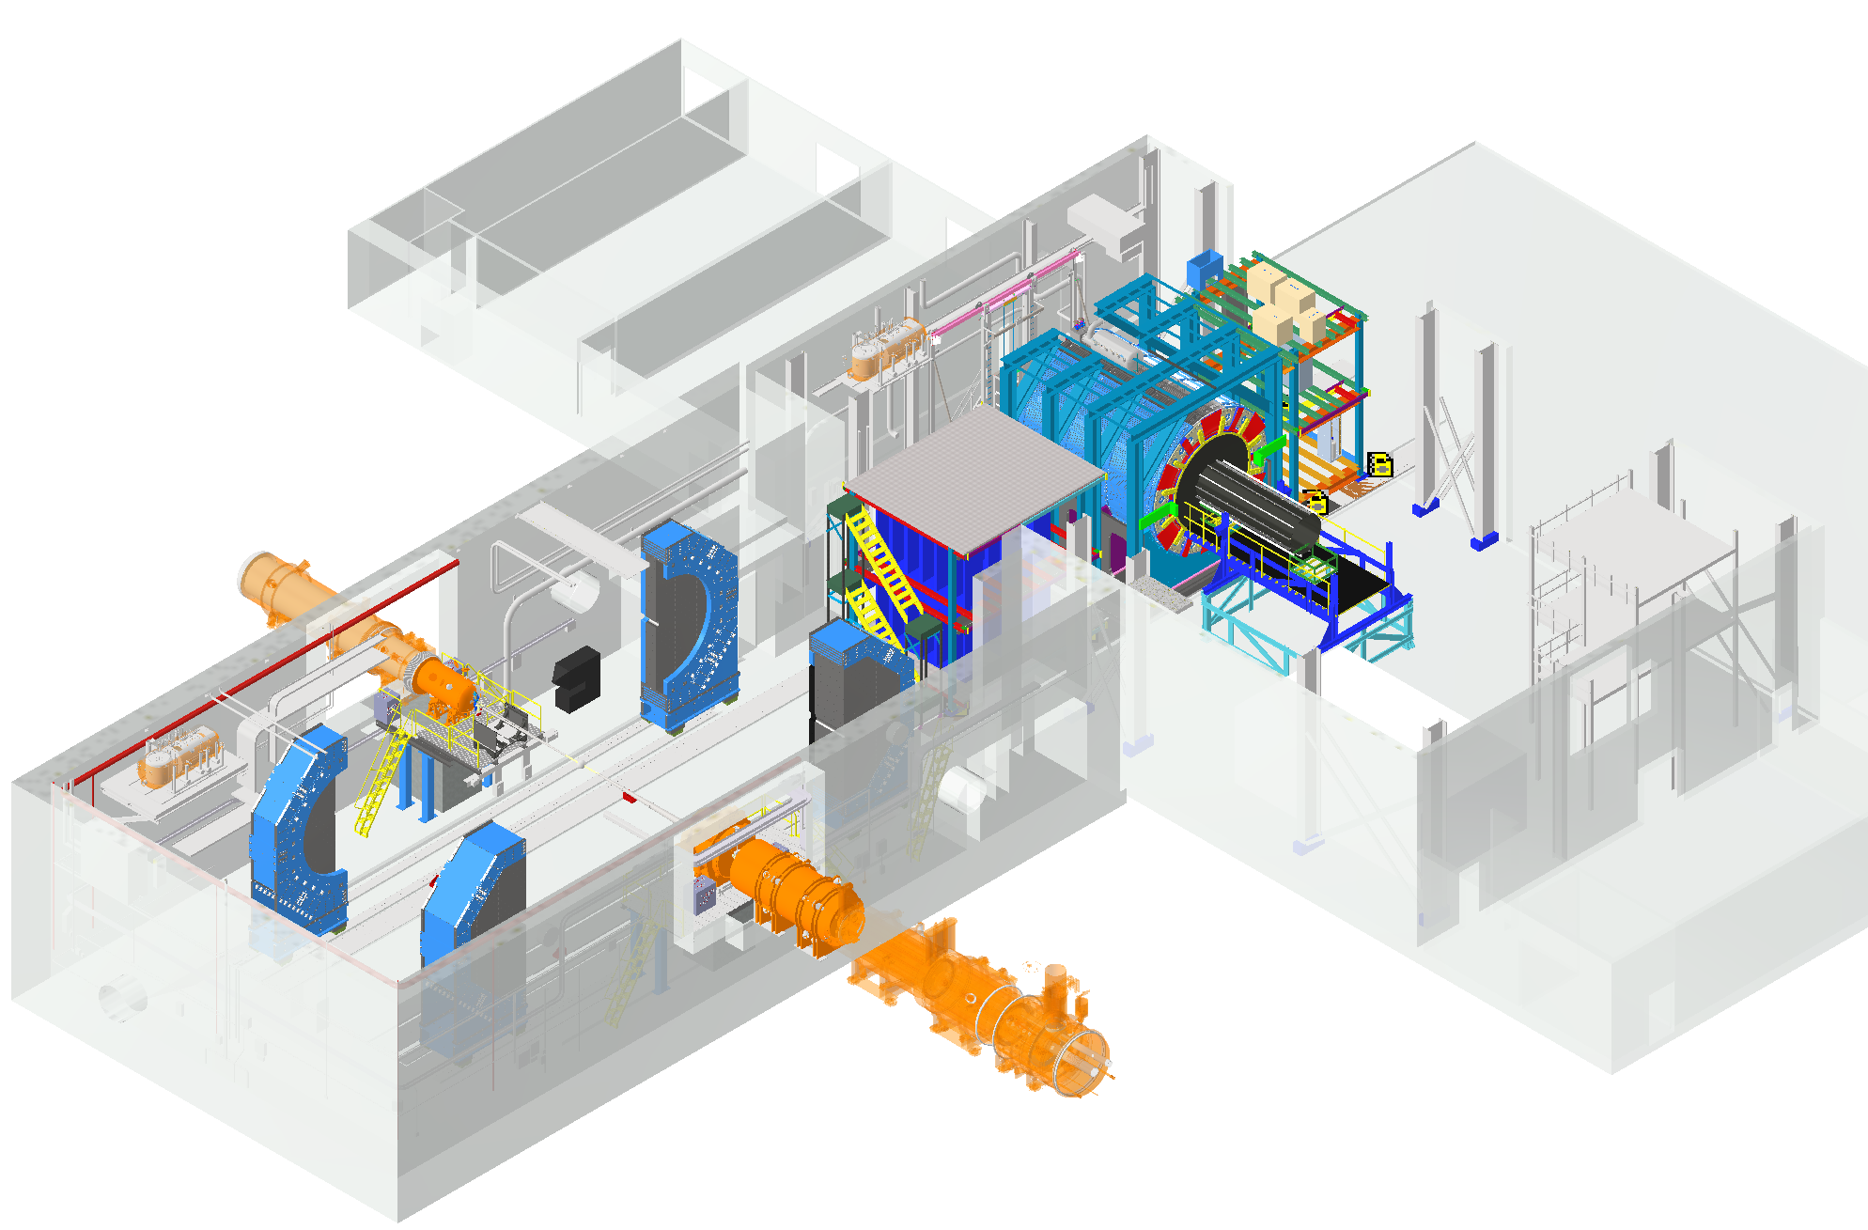
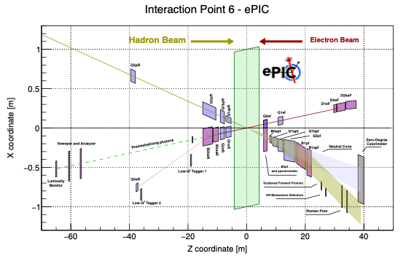
Guiding Principles for the Design
Space Constrains need to be obeyed:
-4.5 m – IP – +5m not negotiable
50 cm space to 1st IR-magnet occupied by vacuum pumps, valves, …..
IP moved 98 cm towards ring inside compared to RHIC;
y: 432 cm above floor
9.5 long detector does not fit through the door
  Door-Size: 823 cm x 823 cm
  endcap hadron calorimeters need to stay in collider hall, if detector rolls in assembly hall
Detector design needs to integrate the crossing angle
  align ePIC with electron beam axis
Maintenance capabilities in beam location are maximized
  endcap hadron calorimeters need to be split transverse to beam pipe to provide access to the detectors in the barrel
If maintenance requires to roll to assembly hall one needs to break the vacuum, which will increase the backgrounds → vacuum conditions will be worse afterwards → potential lower beam currents for some time

Slide 3
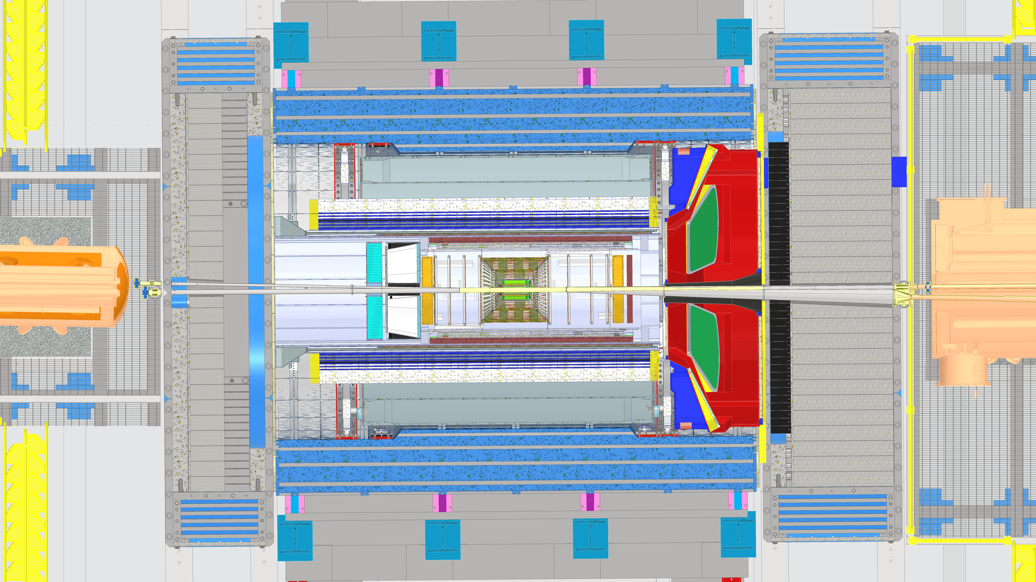
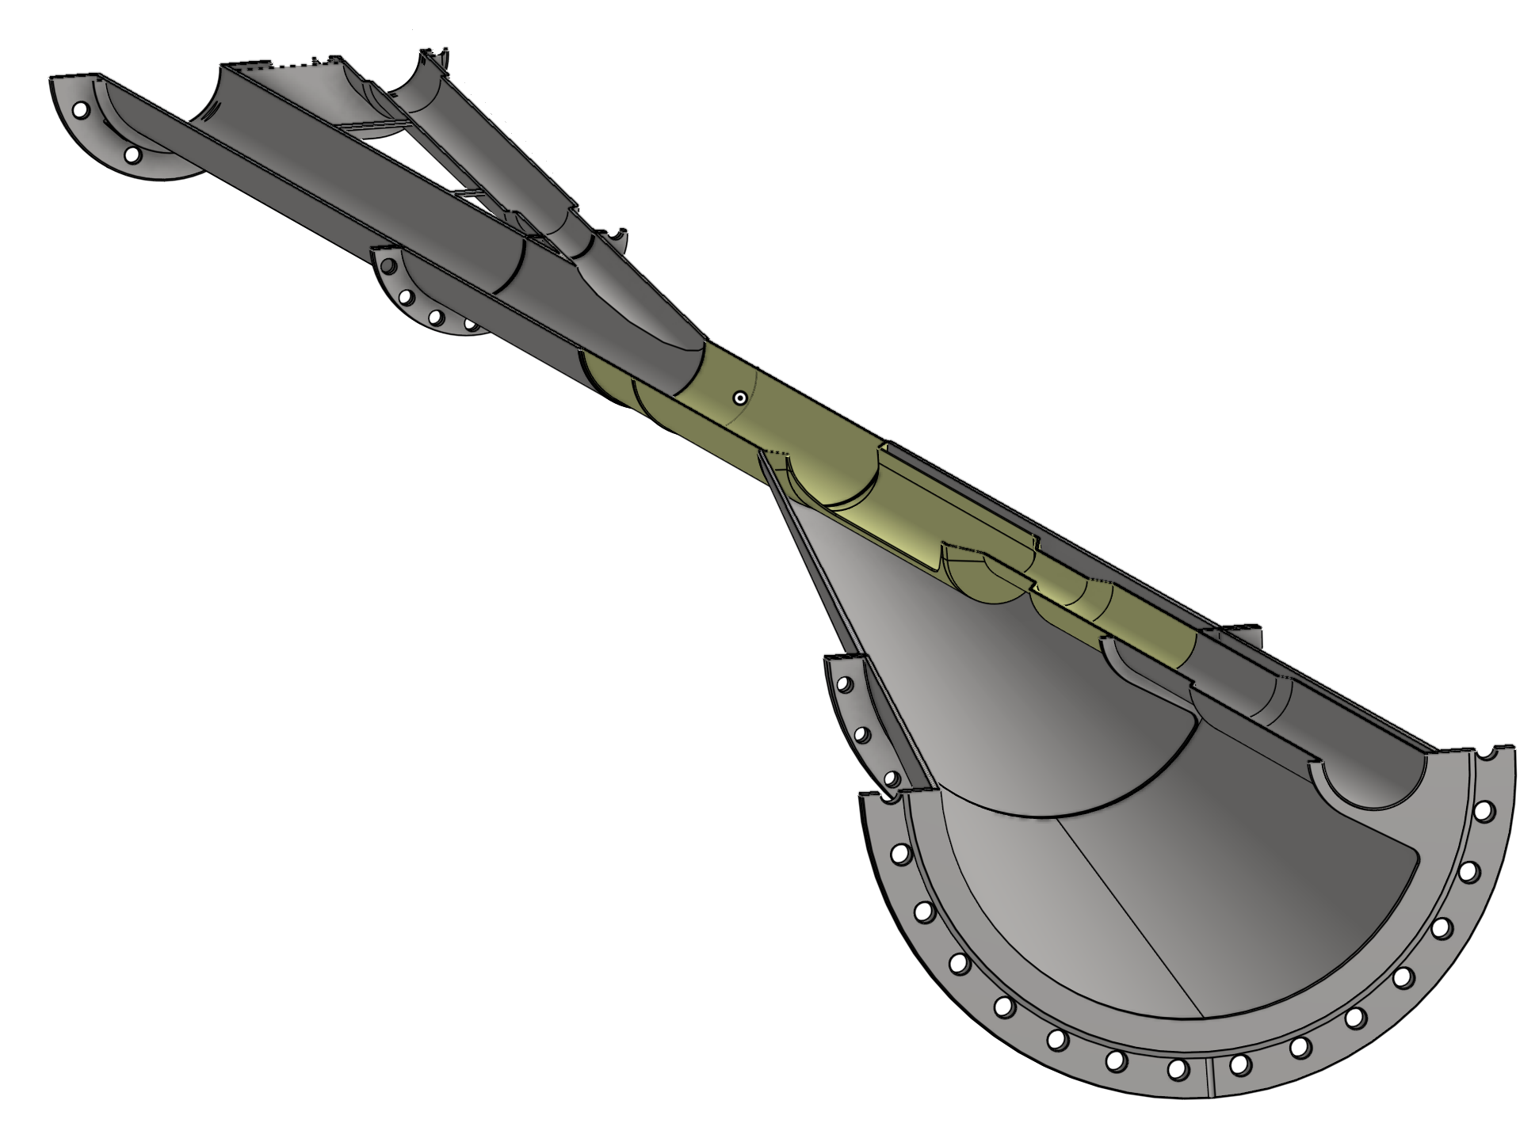
Guiding Principles for the Design
The beampipe is an integral part of the Tracker and moves with the barrel to the assembly hall
Top view:
Beryllium (~1.5m long) with gold (10 um thick) coating
HSR
Stainless steel with copper coating
IP6
ESR
Central Beam Pipe inside ePIC:
ESR: Designed to minimize SR load on the IP beam pipe (includes SR masks)
HSR: Designed to avoid interception of the outgoing hadron cone
Vacuum is broken here for roll out

Slide 4
How easy is it to install components
of the SVT or fECal later

Slide 5
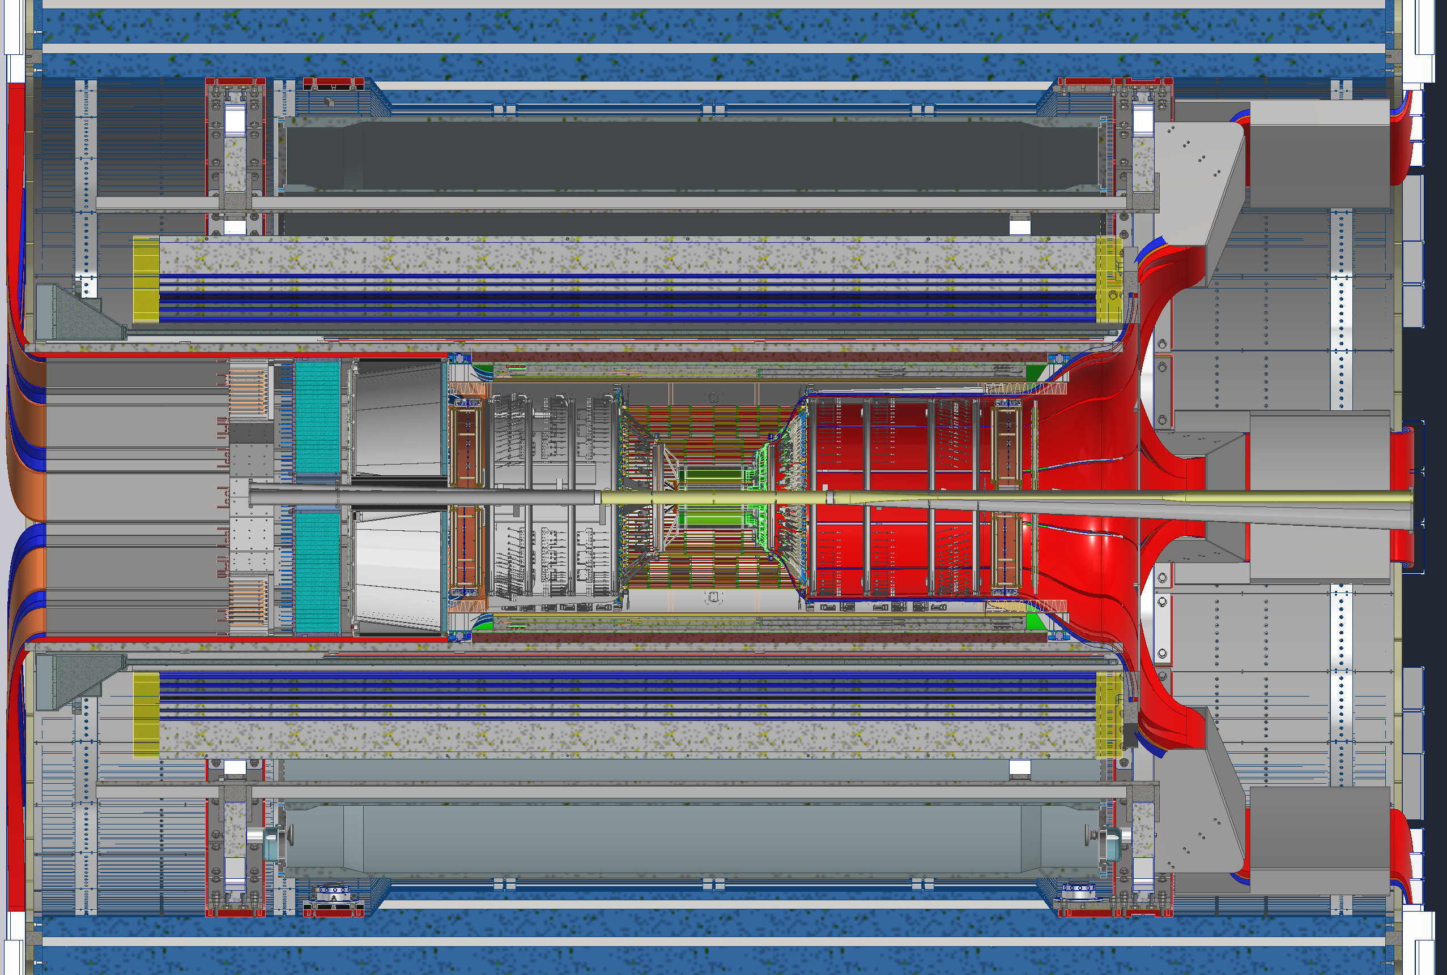
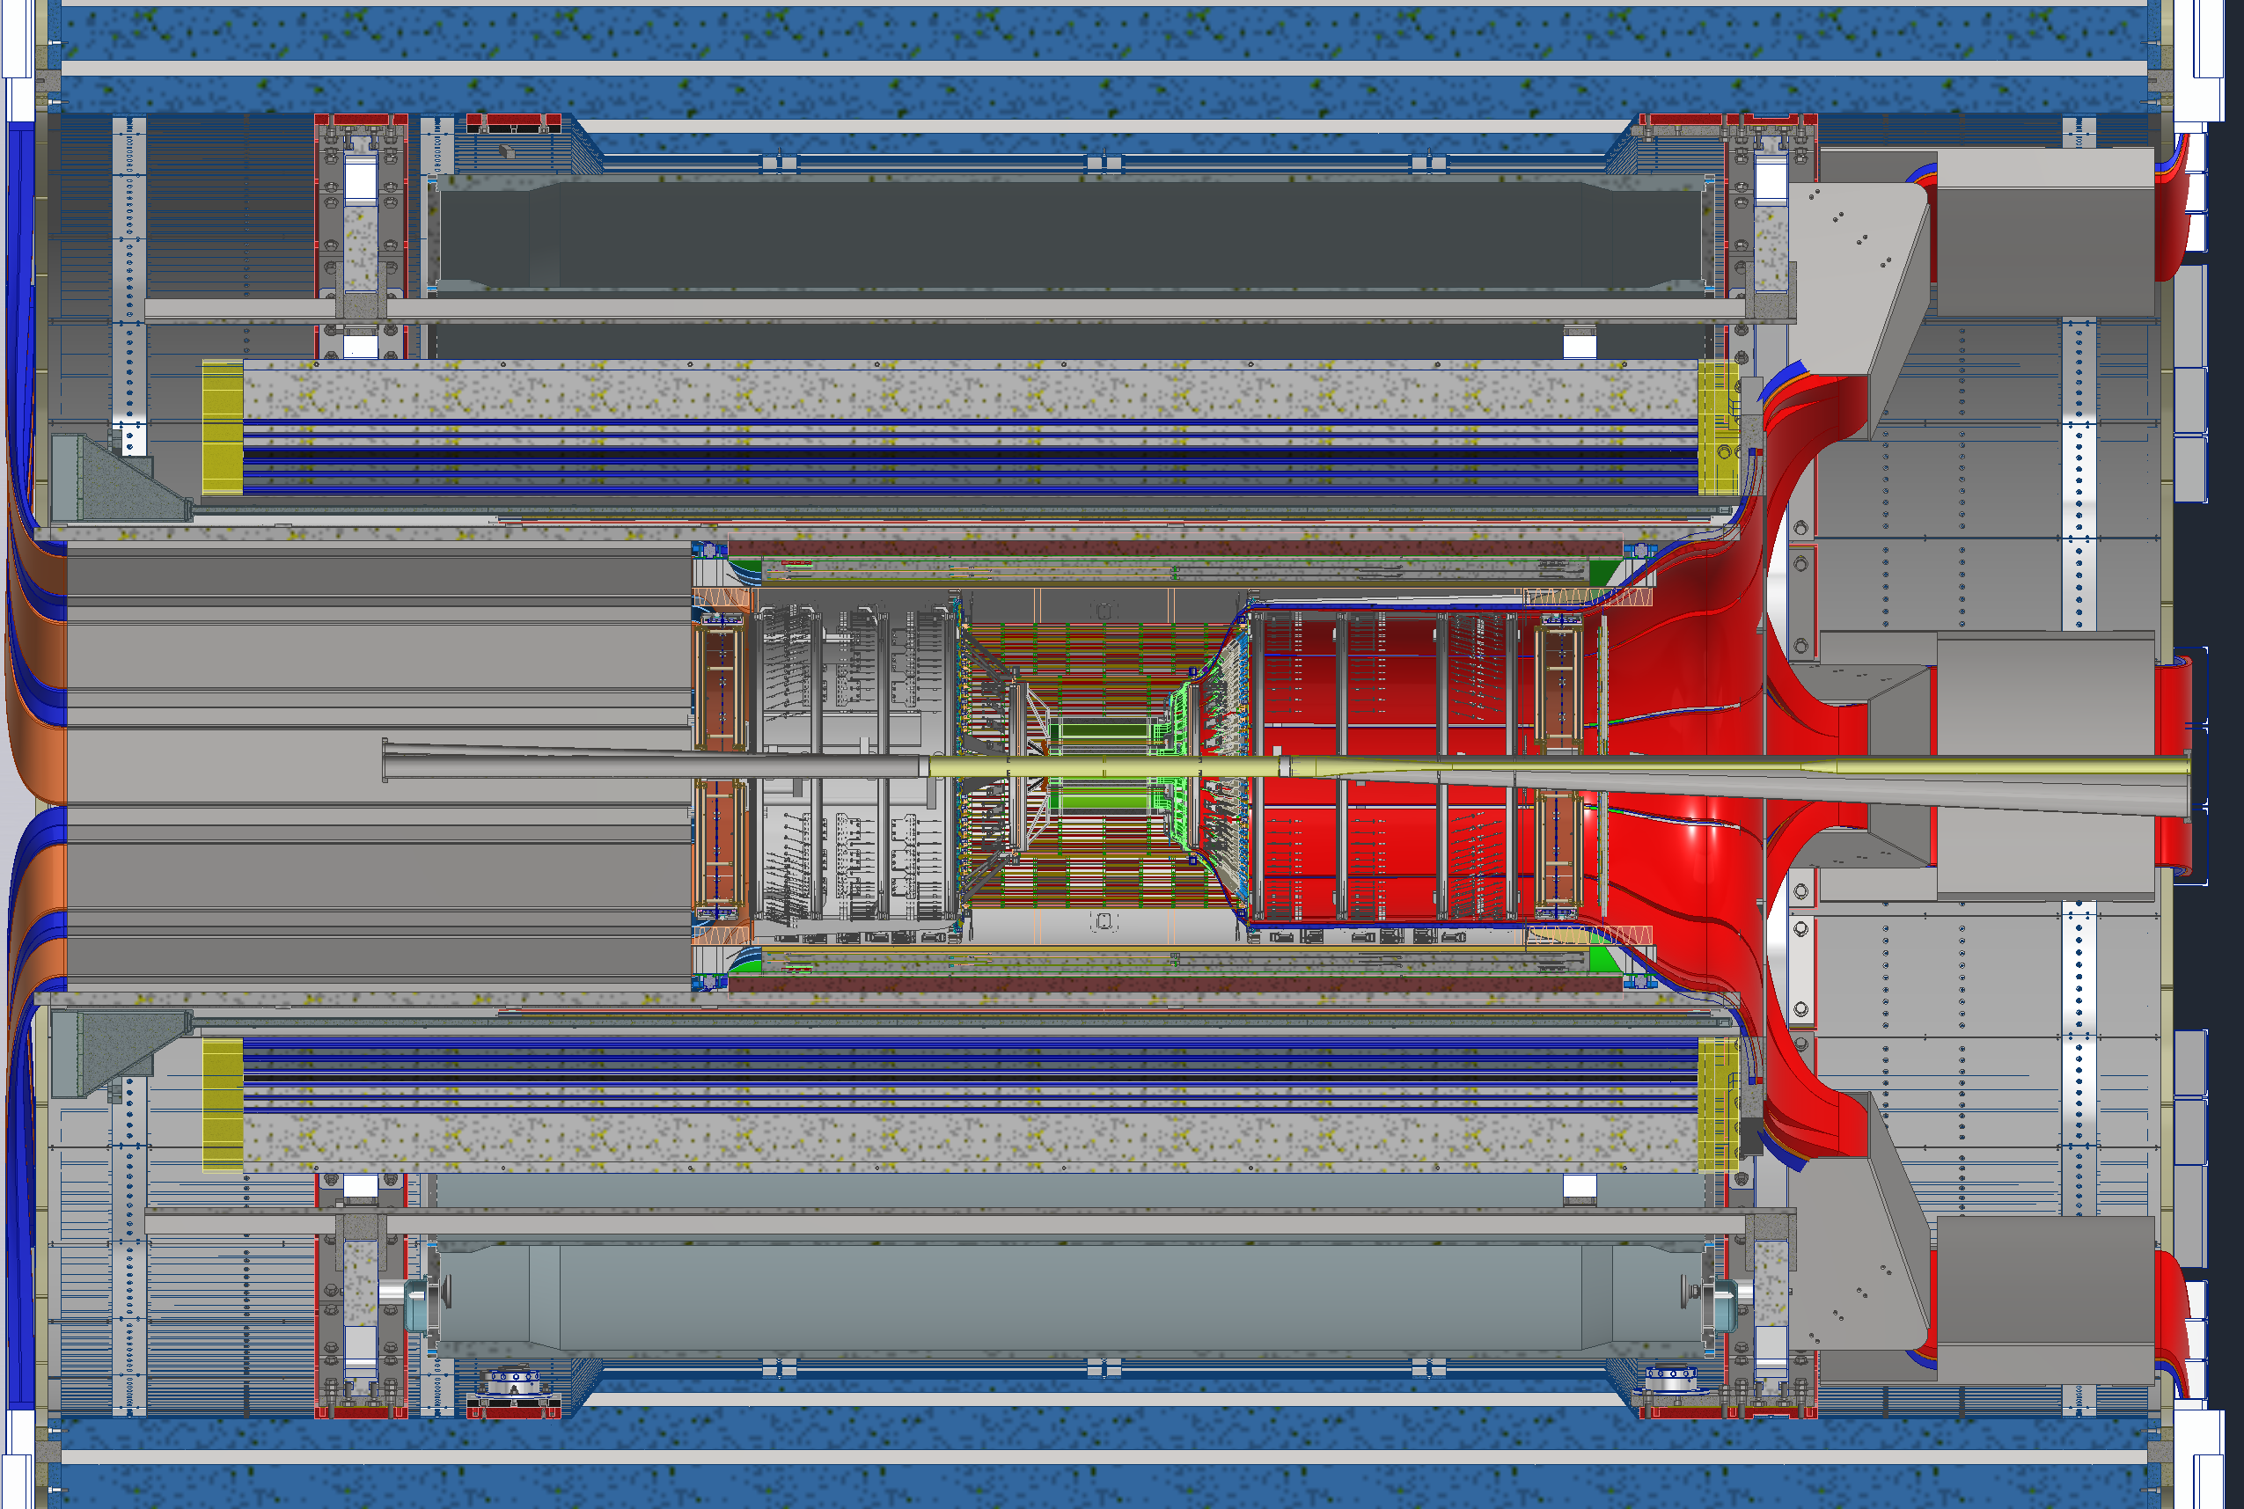
SVT Layer-4 Access Process
Open Endcaps
Break Vacuum
De-cable dRICH
Uninstall dRICH
De-cable EEEMCal & pfRICH
Uninstall EEEMCal & pfRICH
Roll out into assembly hall
→ can also happen after 2

Slide 6
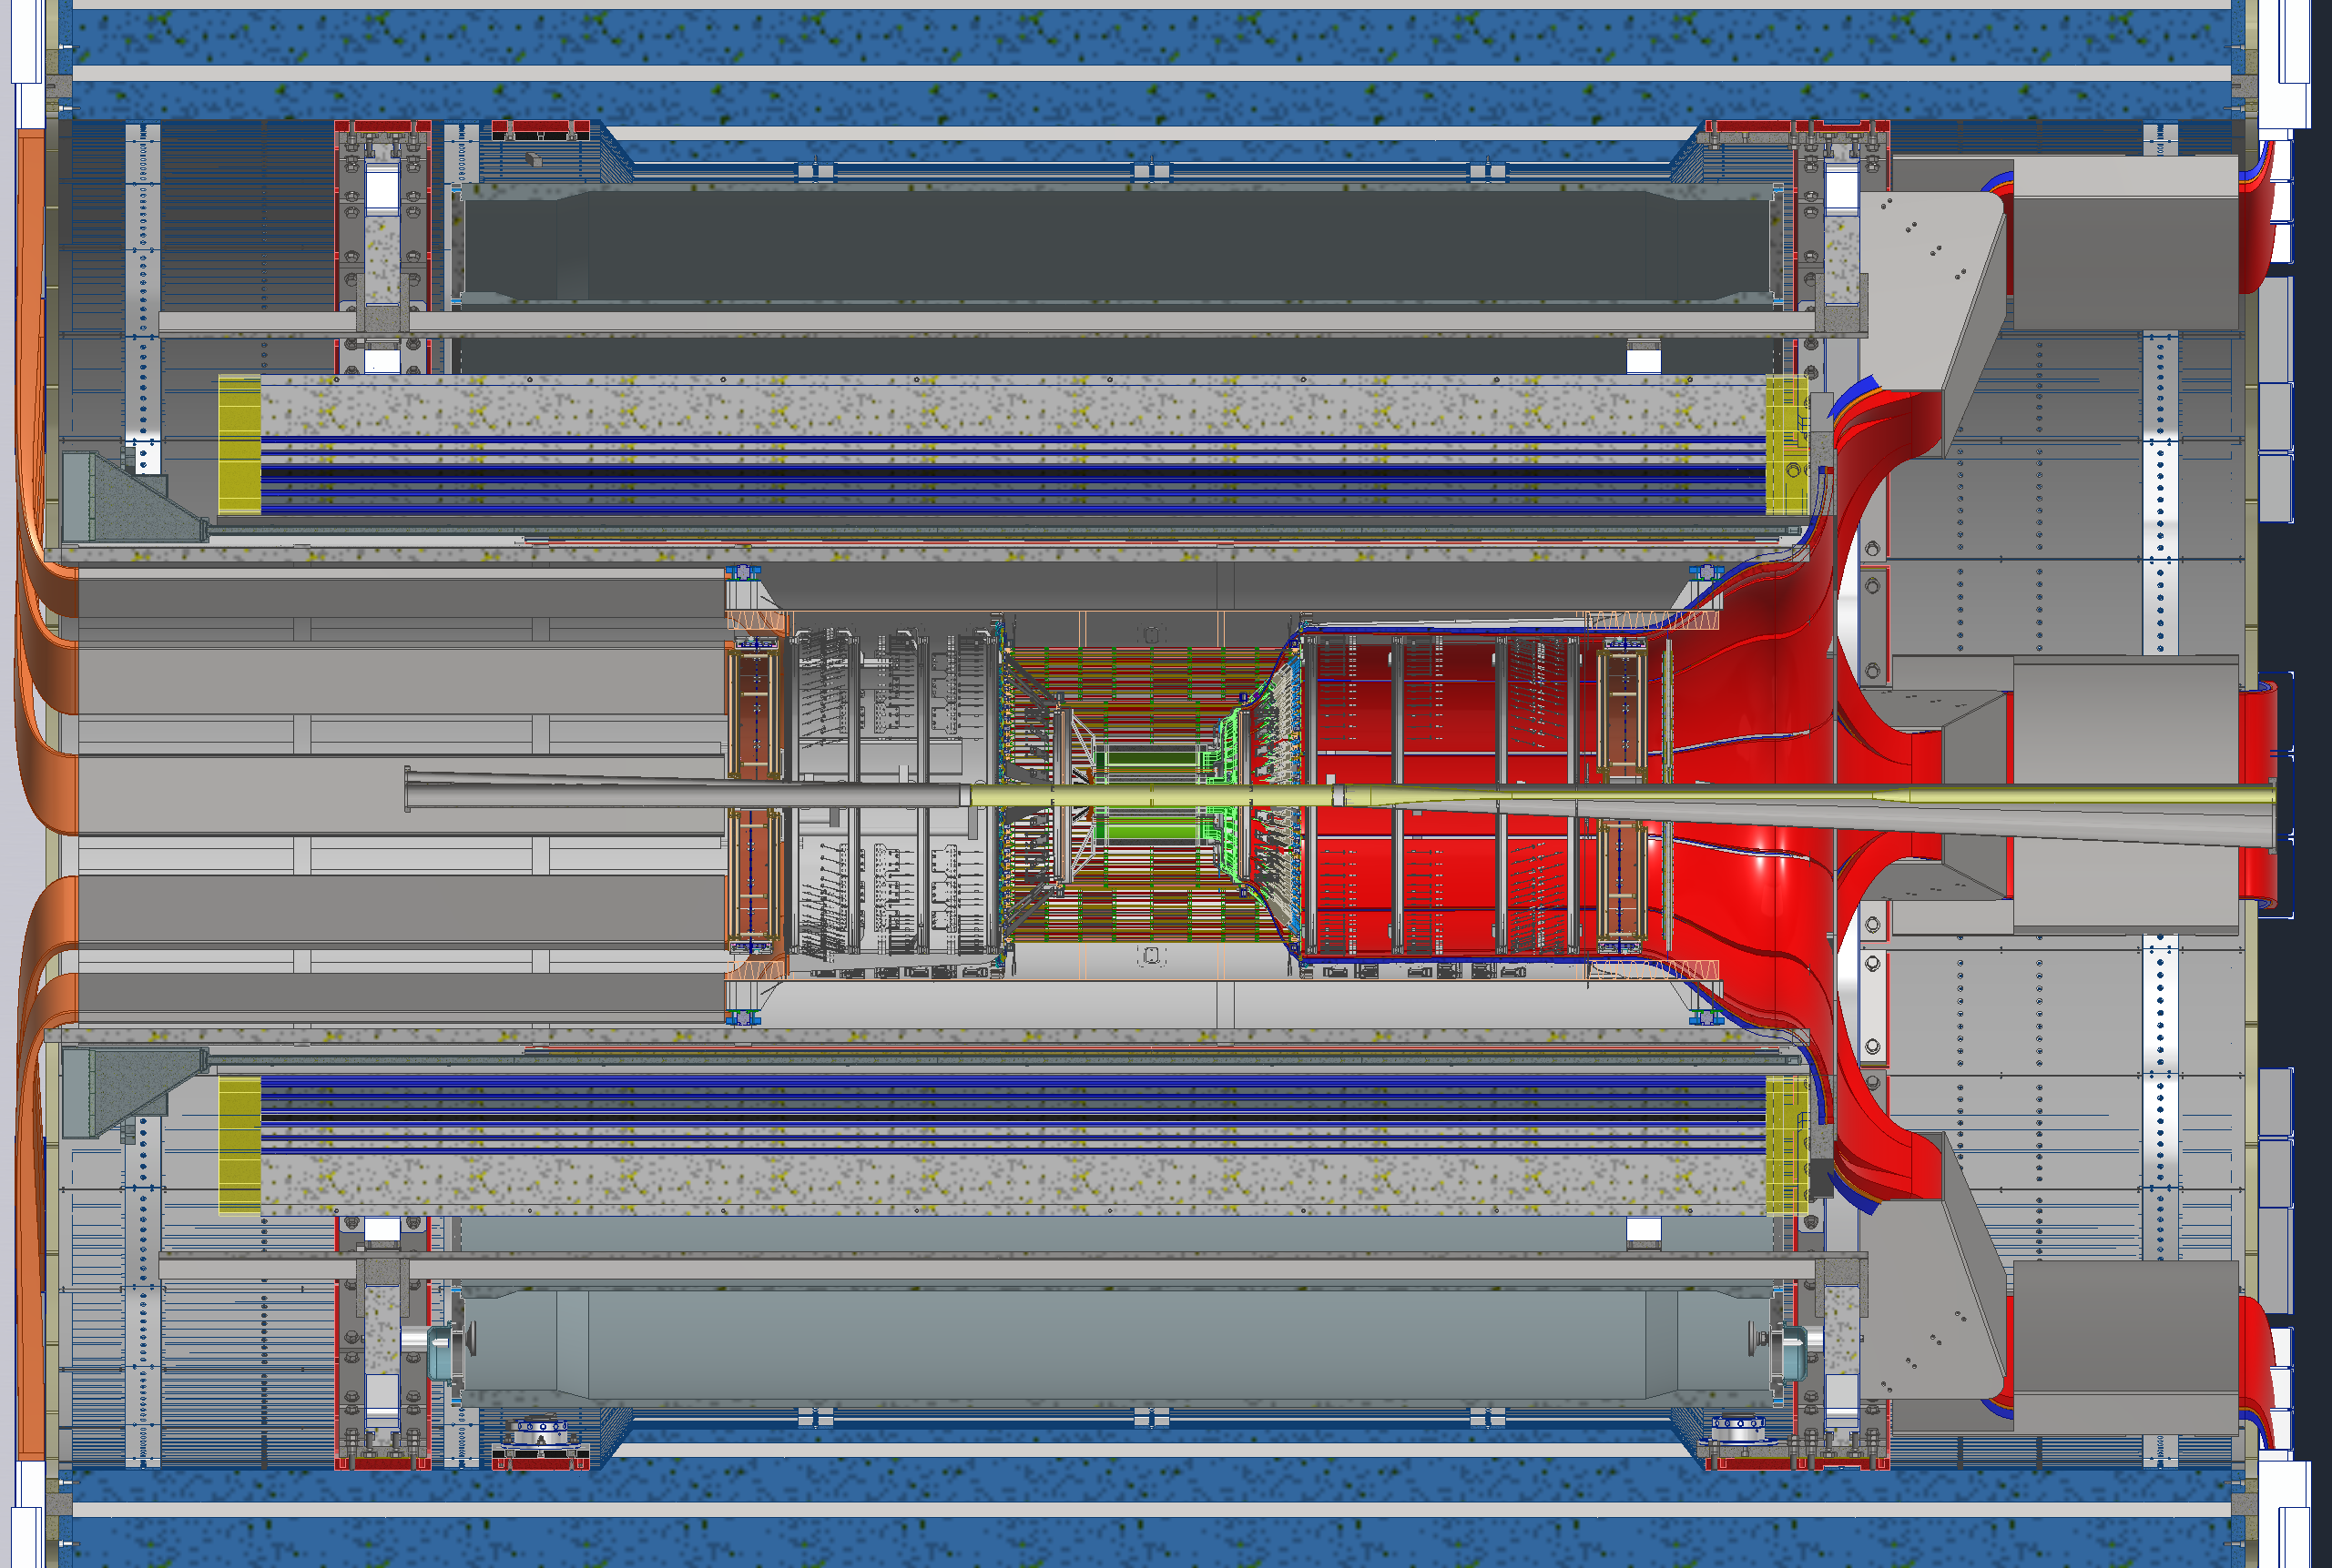
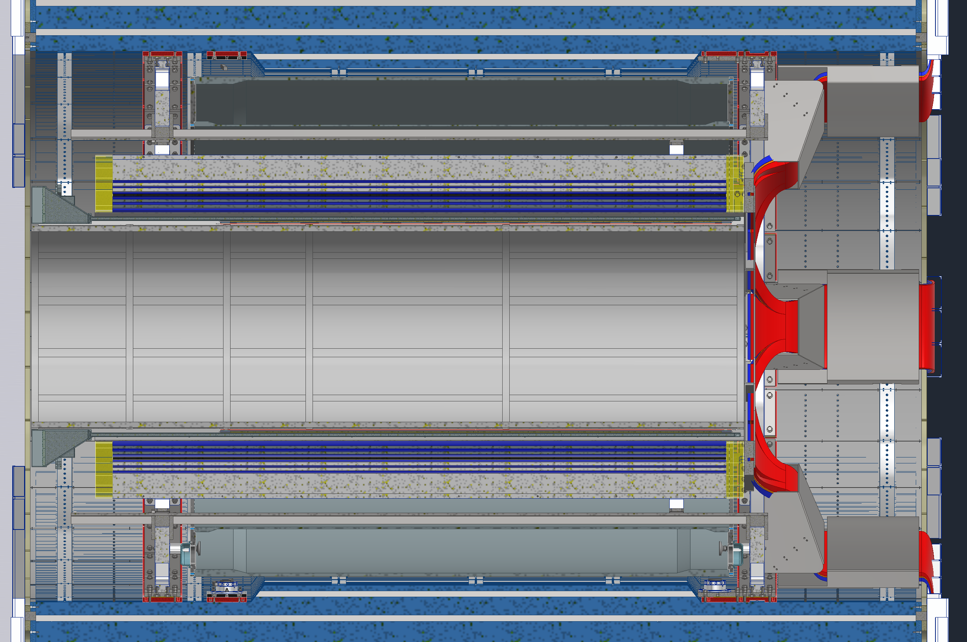
SVT Layer 4 Access Process
Roll out into assembly hall
De-cable SVT, MPGD disks,
(& Forward ToF disk)
De-cable all of ToF & CYMBAL
Uninstall ToF & CYMBAL
Uninstall PST

Slide 7
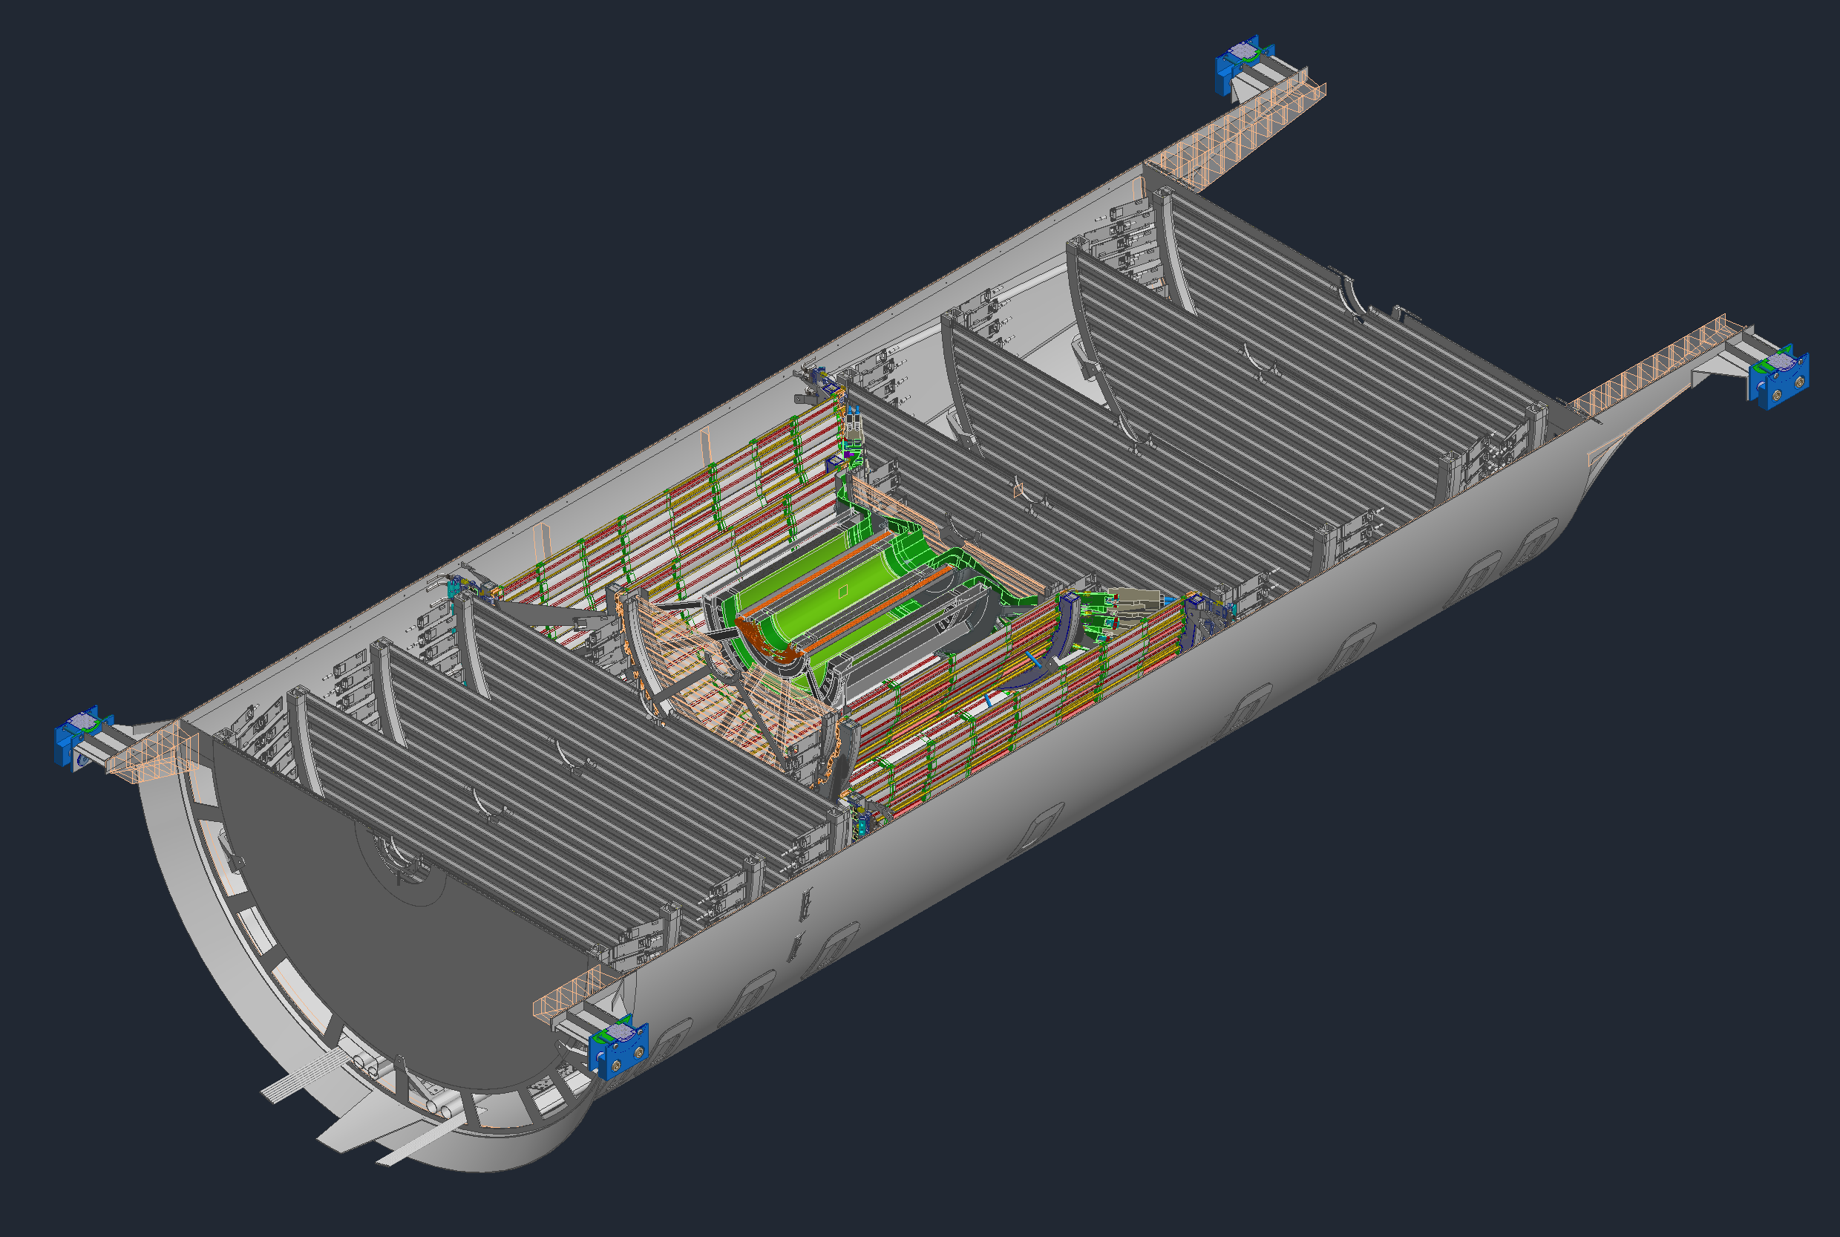
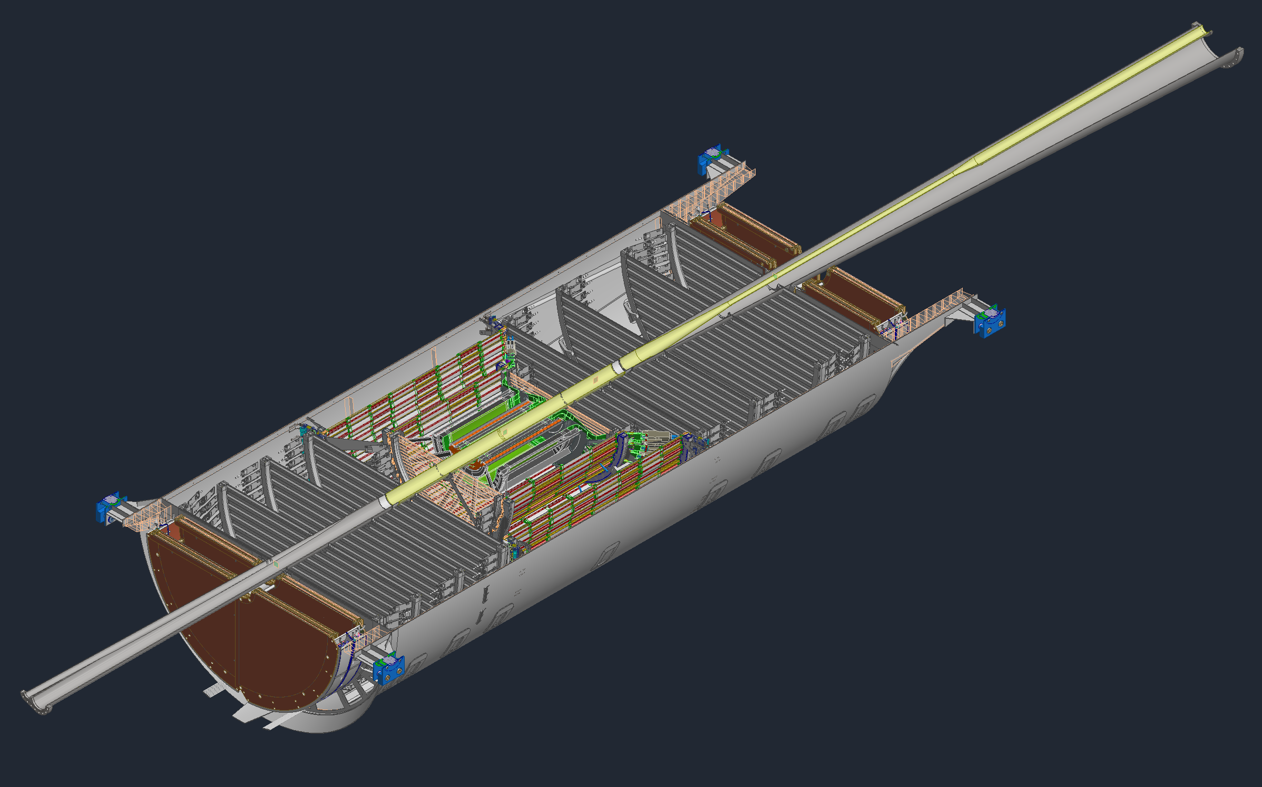
SVT Layer 4 Access Process
De-cable the SVT, MPGD disks,
(& Forward ToF disk)
Split the PST in half
Uninstall the Beampipe from the lower half
Uninstall MPGDs & ToF disk from both PST halves

Slide 8
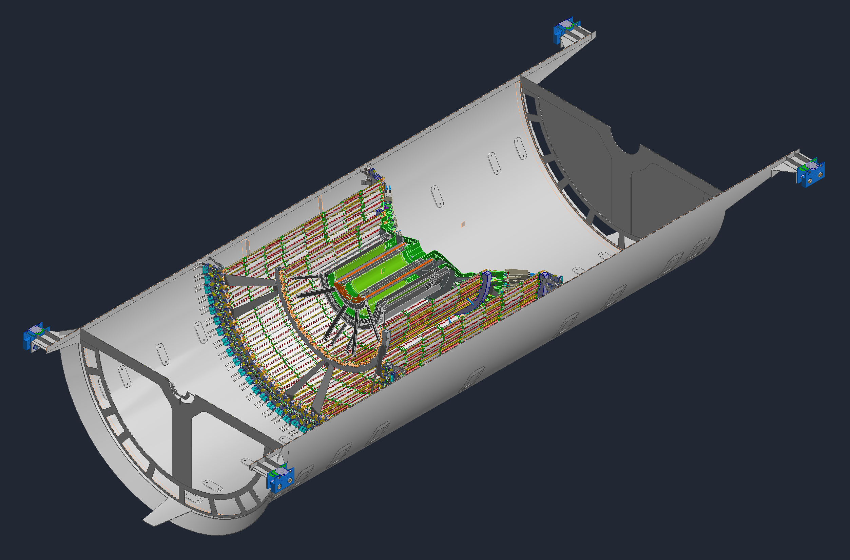
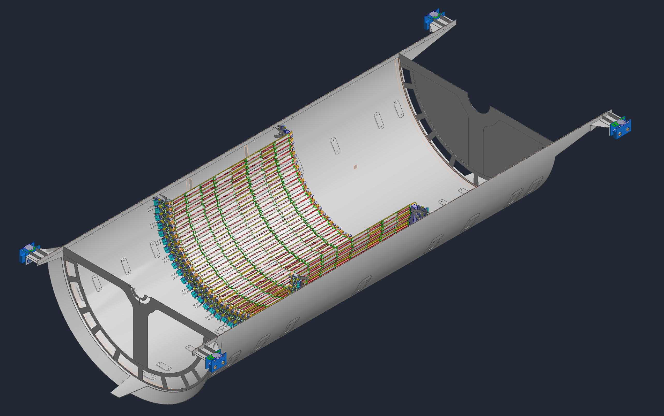
SVT Layer 4 Access Process
Uninstall the SVT disks, starting with the outer most ones, removing the services from each along the way
Uninstall the inner SVT layers, starting at L0, removing the services and supports from each along the way.
You may now access L4 from each half

Slide 9
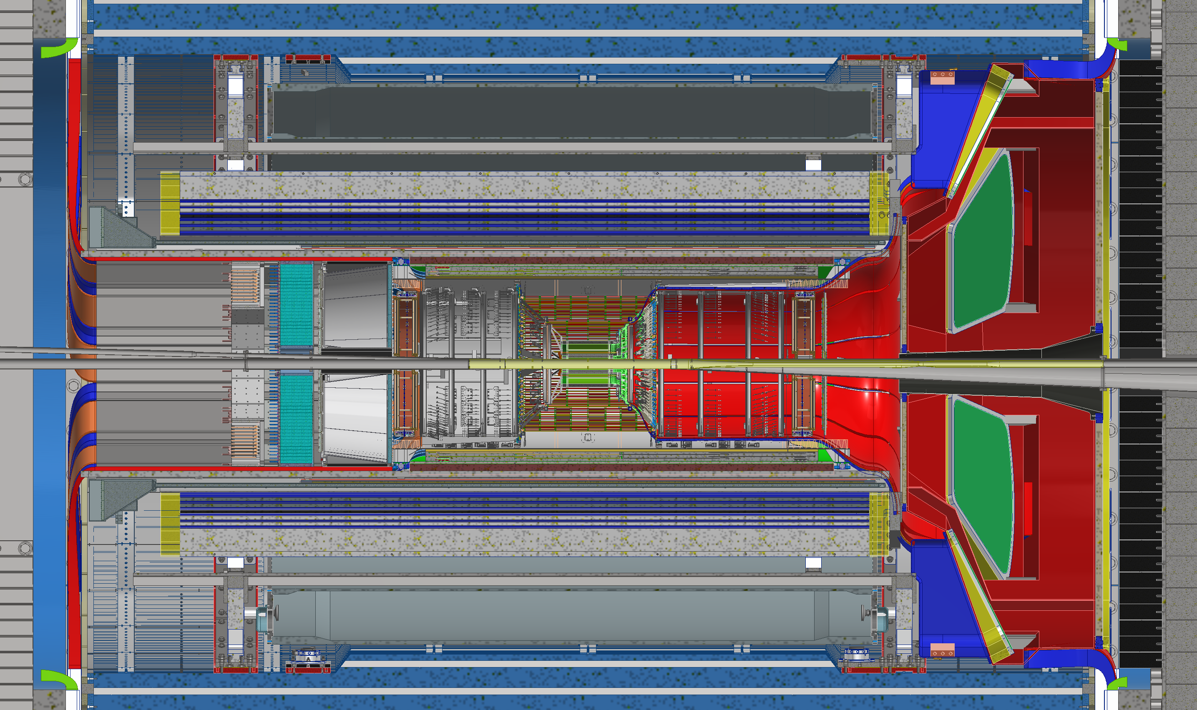
SVT Access Process
Basic steps
Steps 1 through 16 on the previous slides all apply to get access to anything inside the PST
Summary:
Remove and de-cable all the detectors inside the GST, and the dRICH
Remove and de-cable the PST
Split the PST
Remove the beampipe
Gain access

Slide 10
Time Estimate
(De-)Installing rolling into the Assembly Hall, dRICH, pfRICH, EEEMCal, bToF, Cymbal and PST
  → 5 + 7 month
dissemble PST to get access to L4 (remove MPGD-disks, fToF, MAPS disks, L0-L3)
  → 3 month
assemble PST with L4
  → 5 month
→ Total shutdown: 20 month

Slide 11
Summary: Pros & Cons for both Options
SVT Layer 4 |  | fEMCal
Pros | Cons | Pros | Cons
Dummy staves can be installed initially such that the SVT support structure can remain the same | Requires major disassembly of 70% of the EPIC barrel detector | Can add EMCal blocks in waves over the years or in one standard 6-month shutdown | May require the detector to be rolled out into the assembly hall to get access
 | Requires major de-cabling of ~10,000 services
 | Adding L4 will most likely require at least a l.6 year long shutdown
 | Significant risk of breaking components during disassembly
 | Need to break vacuum will have to run with lower beam currents till vacuum is improved
Removing 2 - 3 disks needs step 1 to 16 and an extend shutdown 12+ month

Slide 12


Slide 13
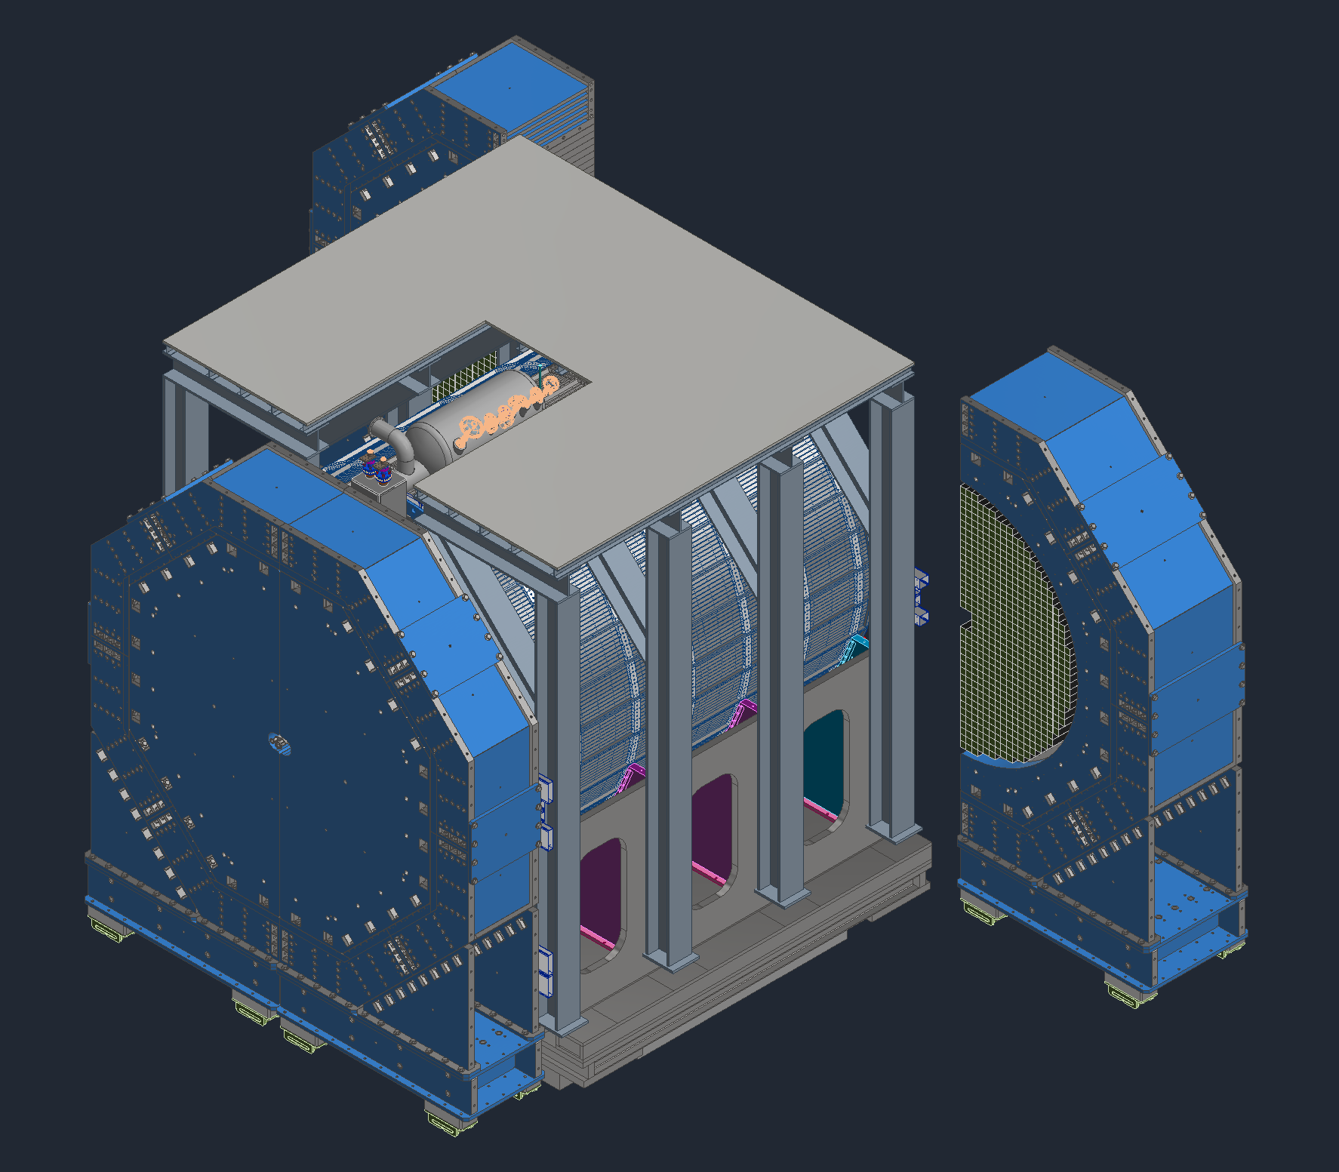
fEMCal Access Process
Open the forward Endcaps
Get access to the fEMCal from the North and South Platforms
  If access from the platforms is too limited:
  Investigating the rails can extended to the far north and south ends of the hall to allow for access
  Alternatively, the barrel detector will need to be rolled out into the assembly hall.

Slide 14
Compensating Loss of UK In-Kind Contribution – Phase-I
UK In-Kind contribution to
Lumi detector $1.5M: Is required for any EIC science
Low-Q2 Detector $3.5M: This detector was assumed as fully UK in-kind
Silicon Vertex Tracker $15.6M: Critical towards ITS3/LAS design and L3/L4 of SVT barrel
  $5.3 M hardware and $9.8M labor
Assumption: It is critical that all ePIC Detector Sub-Systems can continue beyond PDR-level to full E&D completion (90% design-maturity FDR-level) to allow to bring back the scope as early as possible and seek further in-kind.
Mitigation needs to ensure we can baseline the detector and stay “DOE cost-neutral”
(<200M$ DOE cost-to-go):
DOE Cost increase is compensated by
  Delay forward TOF construction → $2.86M
  Delay backward HCal construction → $3.8M
  Delay Low-Q2 Detector → $0.223M
  Delay electronics (HV, LV, FEB) that accompanies these systems → $1.3M
→ Absorb as DOE Cost
→ Defer
→ Move all non-labor UK In-Kind of SVT to DOE

Slide 15
Compensating Loss of UK In-Kind Contribution - Phase-II
Recent further developments in the UK force us to also remove the assumption for $9.8M Inkind labor for the SVT → Will follow the same strategy the mitigation has to remain cost neutral for DOE cost
In the L3 cost, following scope is considered:
  design efforts for EIC-LAS V1, EIC-LAS and AncASIC, Some % of PED testing efforts
  Global mechanics, local support and cooling
L4 cost covers mainly production/construction phase cost
Remaining cost to offset: $8.45M
Recent development: EIC Japan consortium will contribute $5M to the SVT-Disks – Thank You
Mitigation possibilities to offset the remaining $3.5M:
Defer Construction of 50% of forward ECal $6.5M for blocks and $1.2M Readout → $7.7M (Total)
Do not built out all of SVT: defer L4 and one disk ($1.5M / disk) or defer 2-3 disks
 | L3 Cost | L4 Cost | Cost can be removed
In-Kind UK Labor | $6M | $2.4M | $1.35M (test setups & wafer probing station in UK)

Slide 16
Need Your Help to take a Decision
Need to understand the science impact of different mitigation strategies
Only 50% of fECal:
  overall science impact
  how does one want to distribute the 50% left right, top bottom or in rings around the beam pipe
  during the early science years can the lfHCal be used for photon, π⁰ and electron detection in the region without fECal, of course with reduced performance
No SVT Layer-4 and one MAPS disk less
  which disk to remove
  impact on tracking performance and background rejection
Keep L4, but remove 2-3 Si-disks
  which disks to remove
  impact on tracking performance and background rejection
  Please help us to find the mitigation with the smallest science impact

