Slide 1
Howard A. Gordon An Introduction
Gordon-Fest
BNL, October 2, 2017
Berndt Mueller

Slide 2
Howard Gordon in Numbers
1970 – Ph.D. (UIUC) with Bob Eisenstein
1970 – BNL Research Associate
1972 – BNL Associate Physicist
1975 – BNL Physicist
1984 – BNL Senior Physicist
1981 – 2000 BNL Omega Group Leader
2000 – 2007 Phys. Dept. Associate Chair for HEP
2007 – 2017 Phys. Dept. Deputy Chair

Slide 3
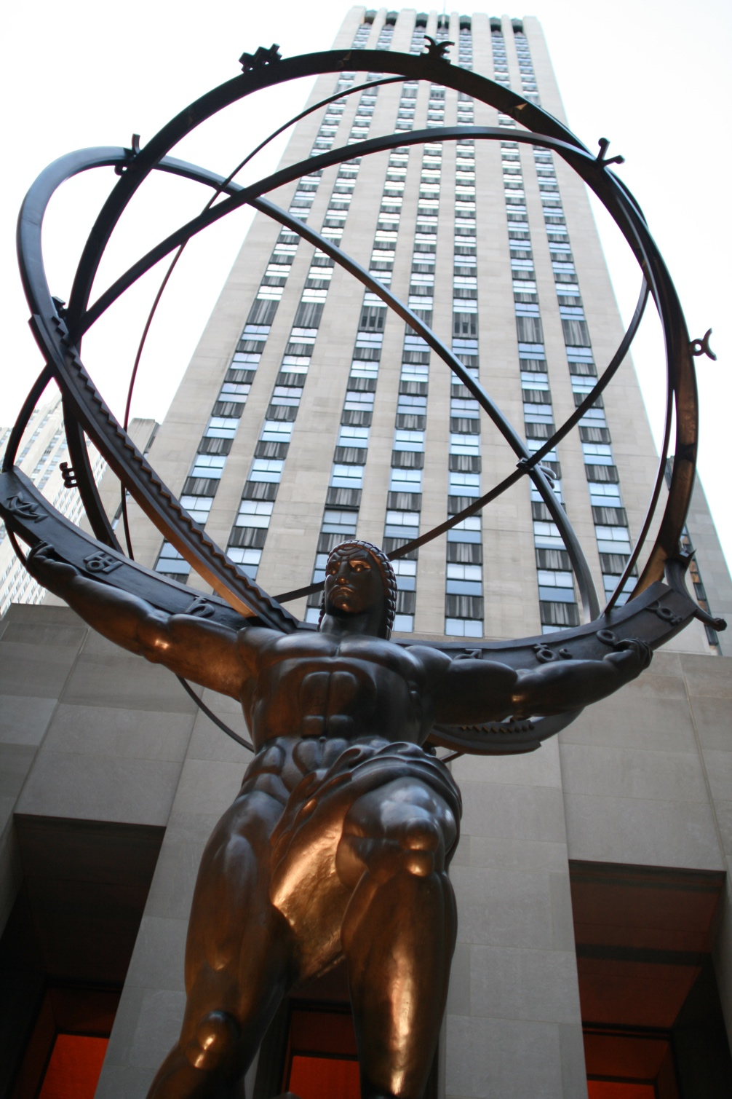
A Modern Day “Atlas”
1996 – 2012 Head US ATLAS PO
1996 – 2005 US ATLAS Deputy PM
2002 – 2012 US ATLAS Dep. OPM
2005 – 2008 US ATLAS Constr. PM
2009 DOE Achievement Award for US ATLAS
2012 Discovery of the Higgs
2013 – 2016 ATLAS Collaboration Board Chair
2015 US ATLAS Lifetime Achieve-ment Award

Slide 4
A Path through HEP
1970 Thesis on π⁺d → ppπ⁺π⁰
1970 – 74 Bubble chamber experiments at BNL, SLAC, LBL
1972 – 74 BNL K_{L} → μμ at AGS
1973 – 76 E268 at FNAL
1976 – 81 E686 at BNL
1976 – 82 Isabelle Detector at BNL
1979 – 82 ISR 807/808 at CERN (jets!)
1983 – 95 D0 Experiment at FNAL
1988 – 91 EMPACT Detector at SSC Lab
1991 – 93 GEM Detector at SSC Lab
1994 – ATLAS Experiment at CERN LHC

Slide 5
H.A. GORDON
RETIRED

