Slide 1

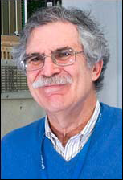
“Gordon Fest”
BNL: 2nd October 2017
Howard at CERN
Part 1: the 1980s
Norman McCubbin (Rutherford Appleton Lab)
With very valuable help and input from
Mike Albrow and Chris Fabjan
¹

Slide 2
Howard at CERN: outline
The Axial Field Spectrometer at the CERN Intersecting Storage Rings (ISR):
  Origins and concept;
  Uranium calorimetry;
  A castle on the French riviera;
  JETS
HELIOS, leptons and heavy ions
A view/advice from a retiree of several years’ experience, if I may be so bold....

Slide 3
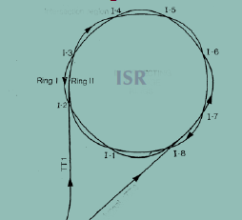
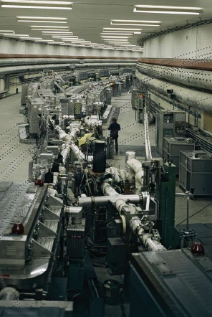
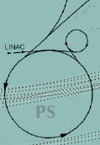
The CERN ISR (1971-1983)
Two counter-rotating rings.
√s=23, 31, 45, 63 GeV
Lumi up to a few10³¹

Slide 4
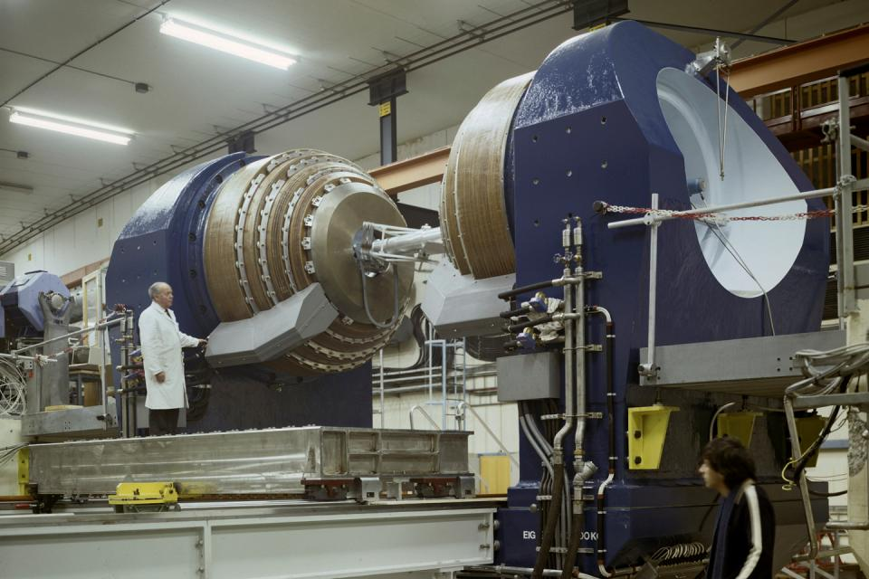
AFS: origin and concepts
ISR started operation in 1971.
Initially equipped mainly with ‘key-hole’ spectrometers...
.... as dictated by available detector technology and main physics interests.
By 1976, single-particle high-pt spectra, the 1974 ‘November revolution’, the SPEAR Mk1 detector, jets in e+e-, Willis idea of ‘impactometer’ etc. were all pushing towards something more ambitious. High-pt jet production in hadronic collisions was widely anticipated, but not yet established conclusively.
The Axial Field Spectrometer (AFS) was proposed to CERN in Jan 1977 by the CERN Willis group (leptons, photons,..) and the British-Scandinavian Collaboration (high-pt hadrons).
It was based on an ‘open’ axial field magnet

Slide 5
Uranium calorimetry
The open region was filled with a drift chamber (2π in azimuth) backed up by 2, then 3, finally 4 ‘walls’ of U/Cu/Scint calorimeter.
This was to be the first experiment-scale deployment of a (depleted) Uranium-based calorimeter, based on the pioneering studies of hadron calorimetry by the Willis group.
The initial CERN, UK, Scandinavian collaboration was soon joined by US groups (BNL – enter Howard , Penn, Pittsburgh) and others (Athens, Cambridge, Tel Aviv.)
The US participation was crucial to procuring (borrowing) the depleted U (from Oak Ridge), and for financial input.
Around this time (1979) I recall meeting Howard...

Slide 6
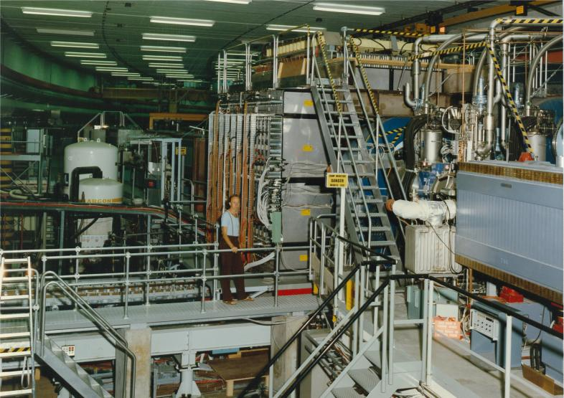
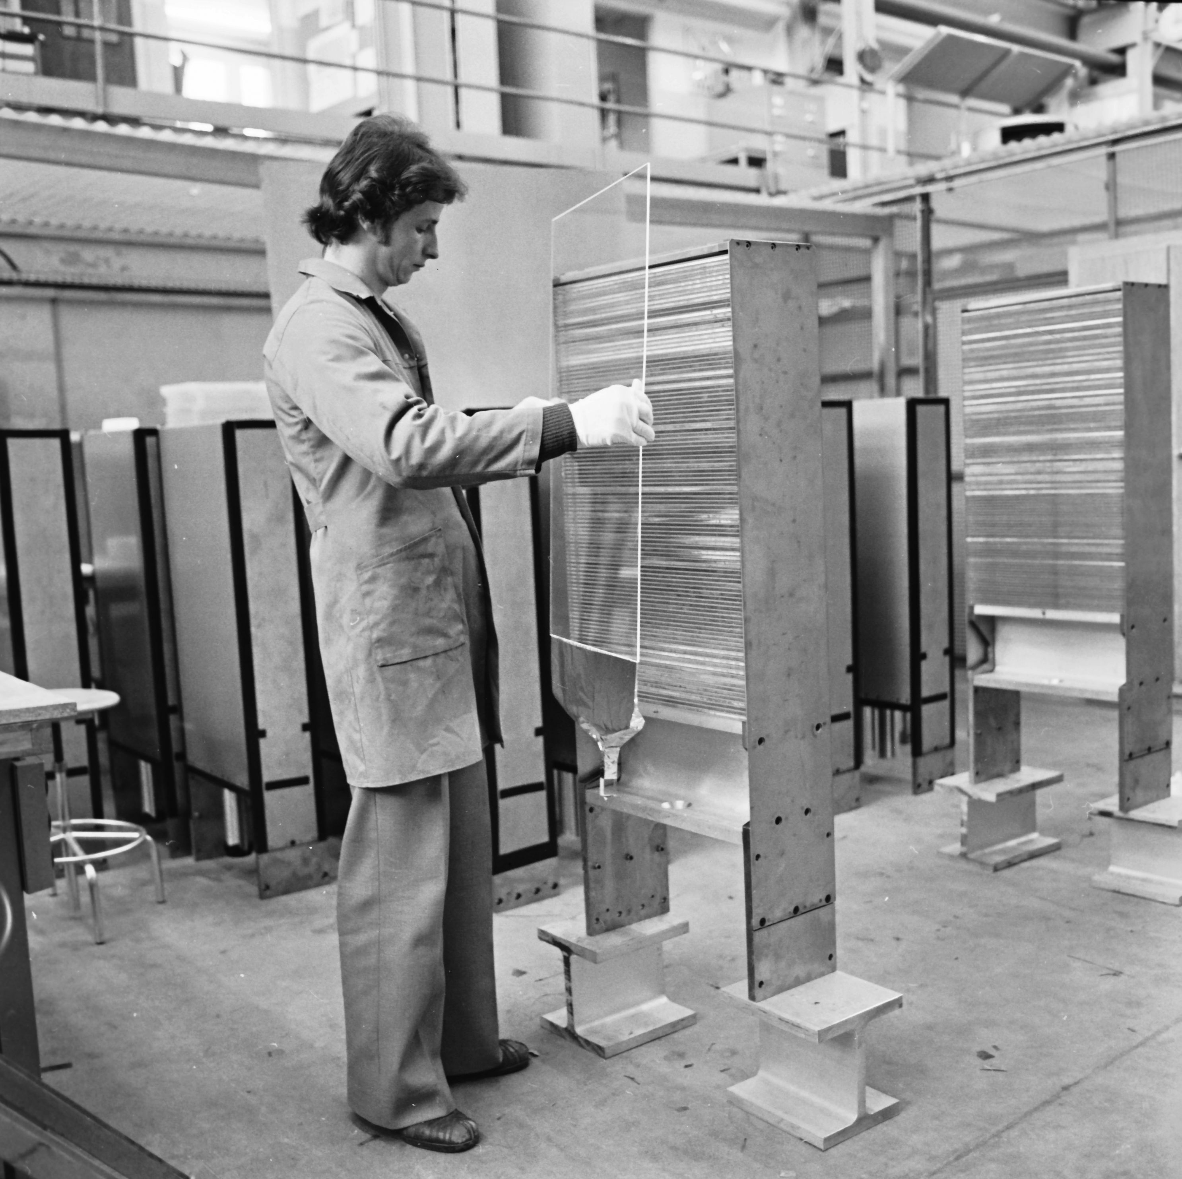
Uranium calorimetry

Slide 7
The Clews family and a castle on the French Riviera...
Henry Clews (1836-1937) was an artist and sculptor from a wealthy family.
Not appreciated in the USA, he moved to France, bought the ancient chateau at La Napoule (near Cannes) in 1918, rebuilt it, and used it as a home and museum for his art.
In 1974 the Clews family offered the chateau to the University of Pennsylvania, the only conditions being that:
  Some of the of works of Henry Clews should continue to be displayed;
  Franco-American amity should be promoted.
Happily, Penn was in the AFS collaboration, and so in 1981 we held our collaboration meeting there at the Chateau de La Napoule.

Slide 8
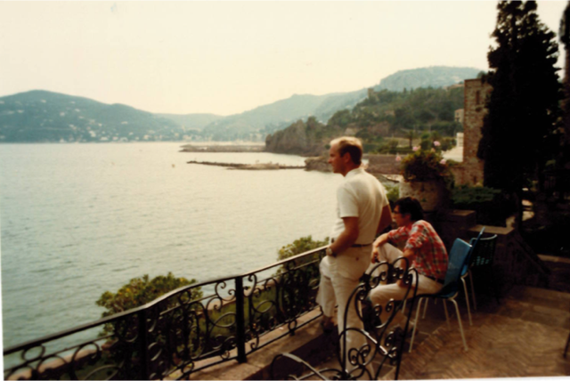
La Napoule 1981
Torsten
Akesson
Sherman
Frankel
Craig
Woody
Mike
Albrow
Bill
Molzon
Howard
Tom
Ludlam

Slide 9
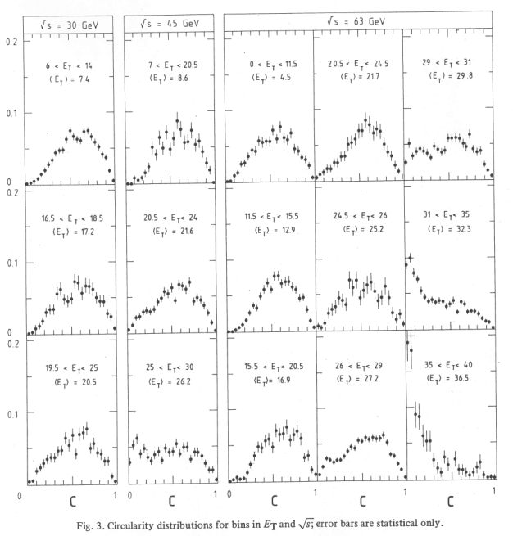
JETS (at last)
We reported clear evidence for hadronic jets at high pt at the Paris Conference in 1982, at the same time as UA2 and UA1.
With all 4 walls in place, and data taken over a range of sqrt(s) values, we published (1983) the text-book plot:

Slide 10
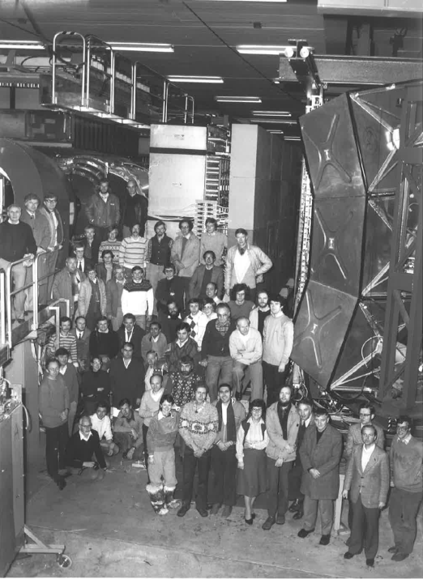
The AFS Collaboration 1983
Torsten
Akesson
Bill
Molzon
me
Craig
Woody
Suh Urk
Chung
Bill
Zajc
Dave
Rahm
Dave
Lissauer
Mike
Albrow
Chris
Fabjan

Slide 11
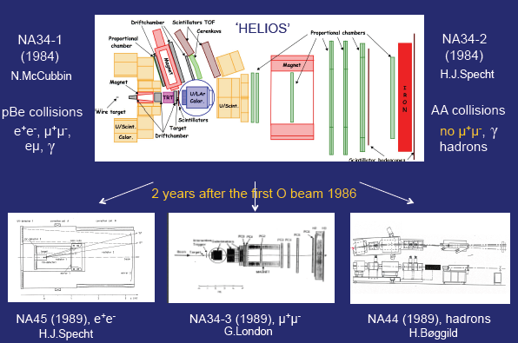
From ISR to SPS: leptons and ions

Slide 12
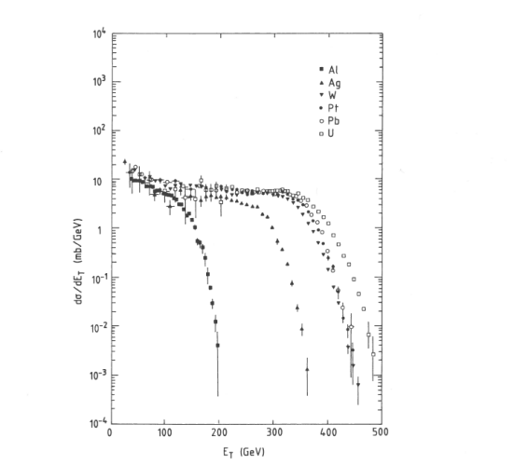
1986: first Heavy Ions at CERN
200 GeV/n S³²
HELIOS
First view of
what is now a
‘standard’
plot...

Slide 13
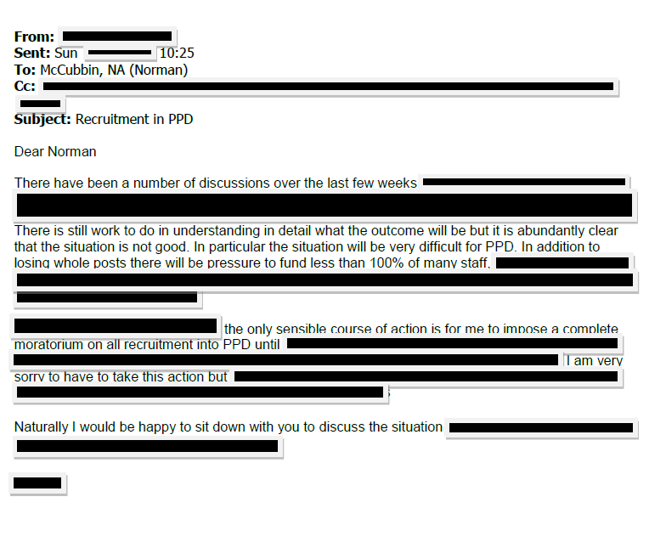
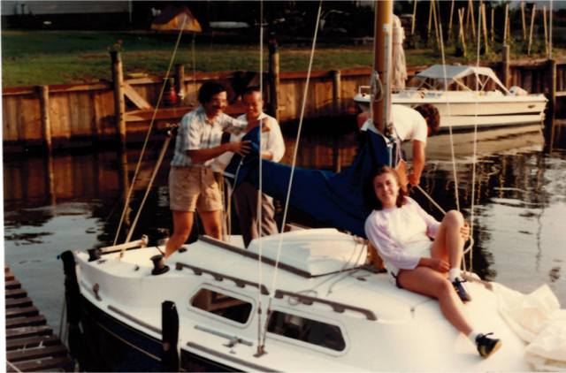
Advice to a new retiree...
Welcome!
You will have more time for family, friends and ... messing around on boats.
You will no longer have to deal with emails of which the following is a genuine, generic example..
You will have time to go to retirements ‘fests’ of friends and colleagues.
“Hold the bannister!”
From all your ISR friends:
a long, happy, healthy and
productive retirement.

