Slide 1
pfRICH Mirror and Sensor Plate Updates
Simon Snydersmith, Cadance Ormsby, Sushrut Karmarkar, Andreas Jung
17 August, 2026

Slide 2
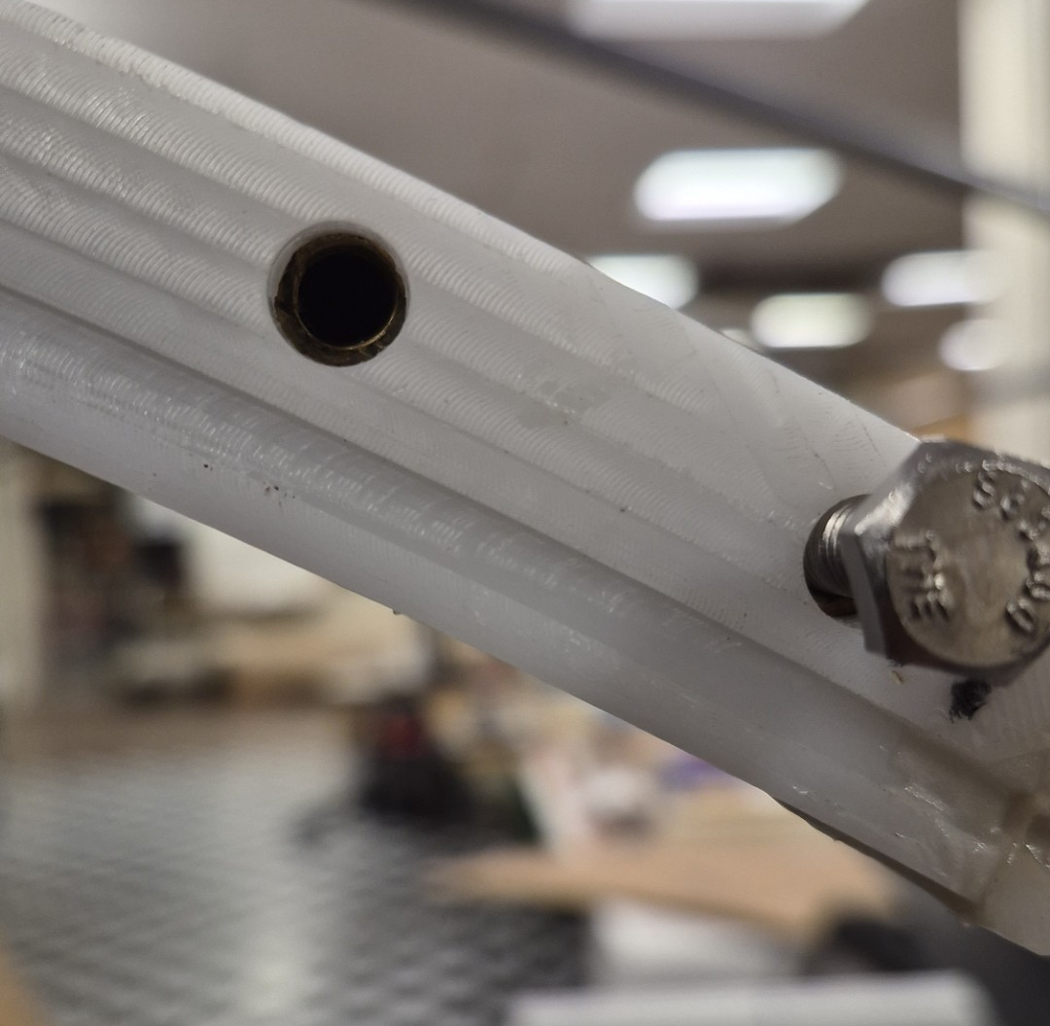
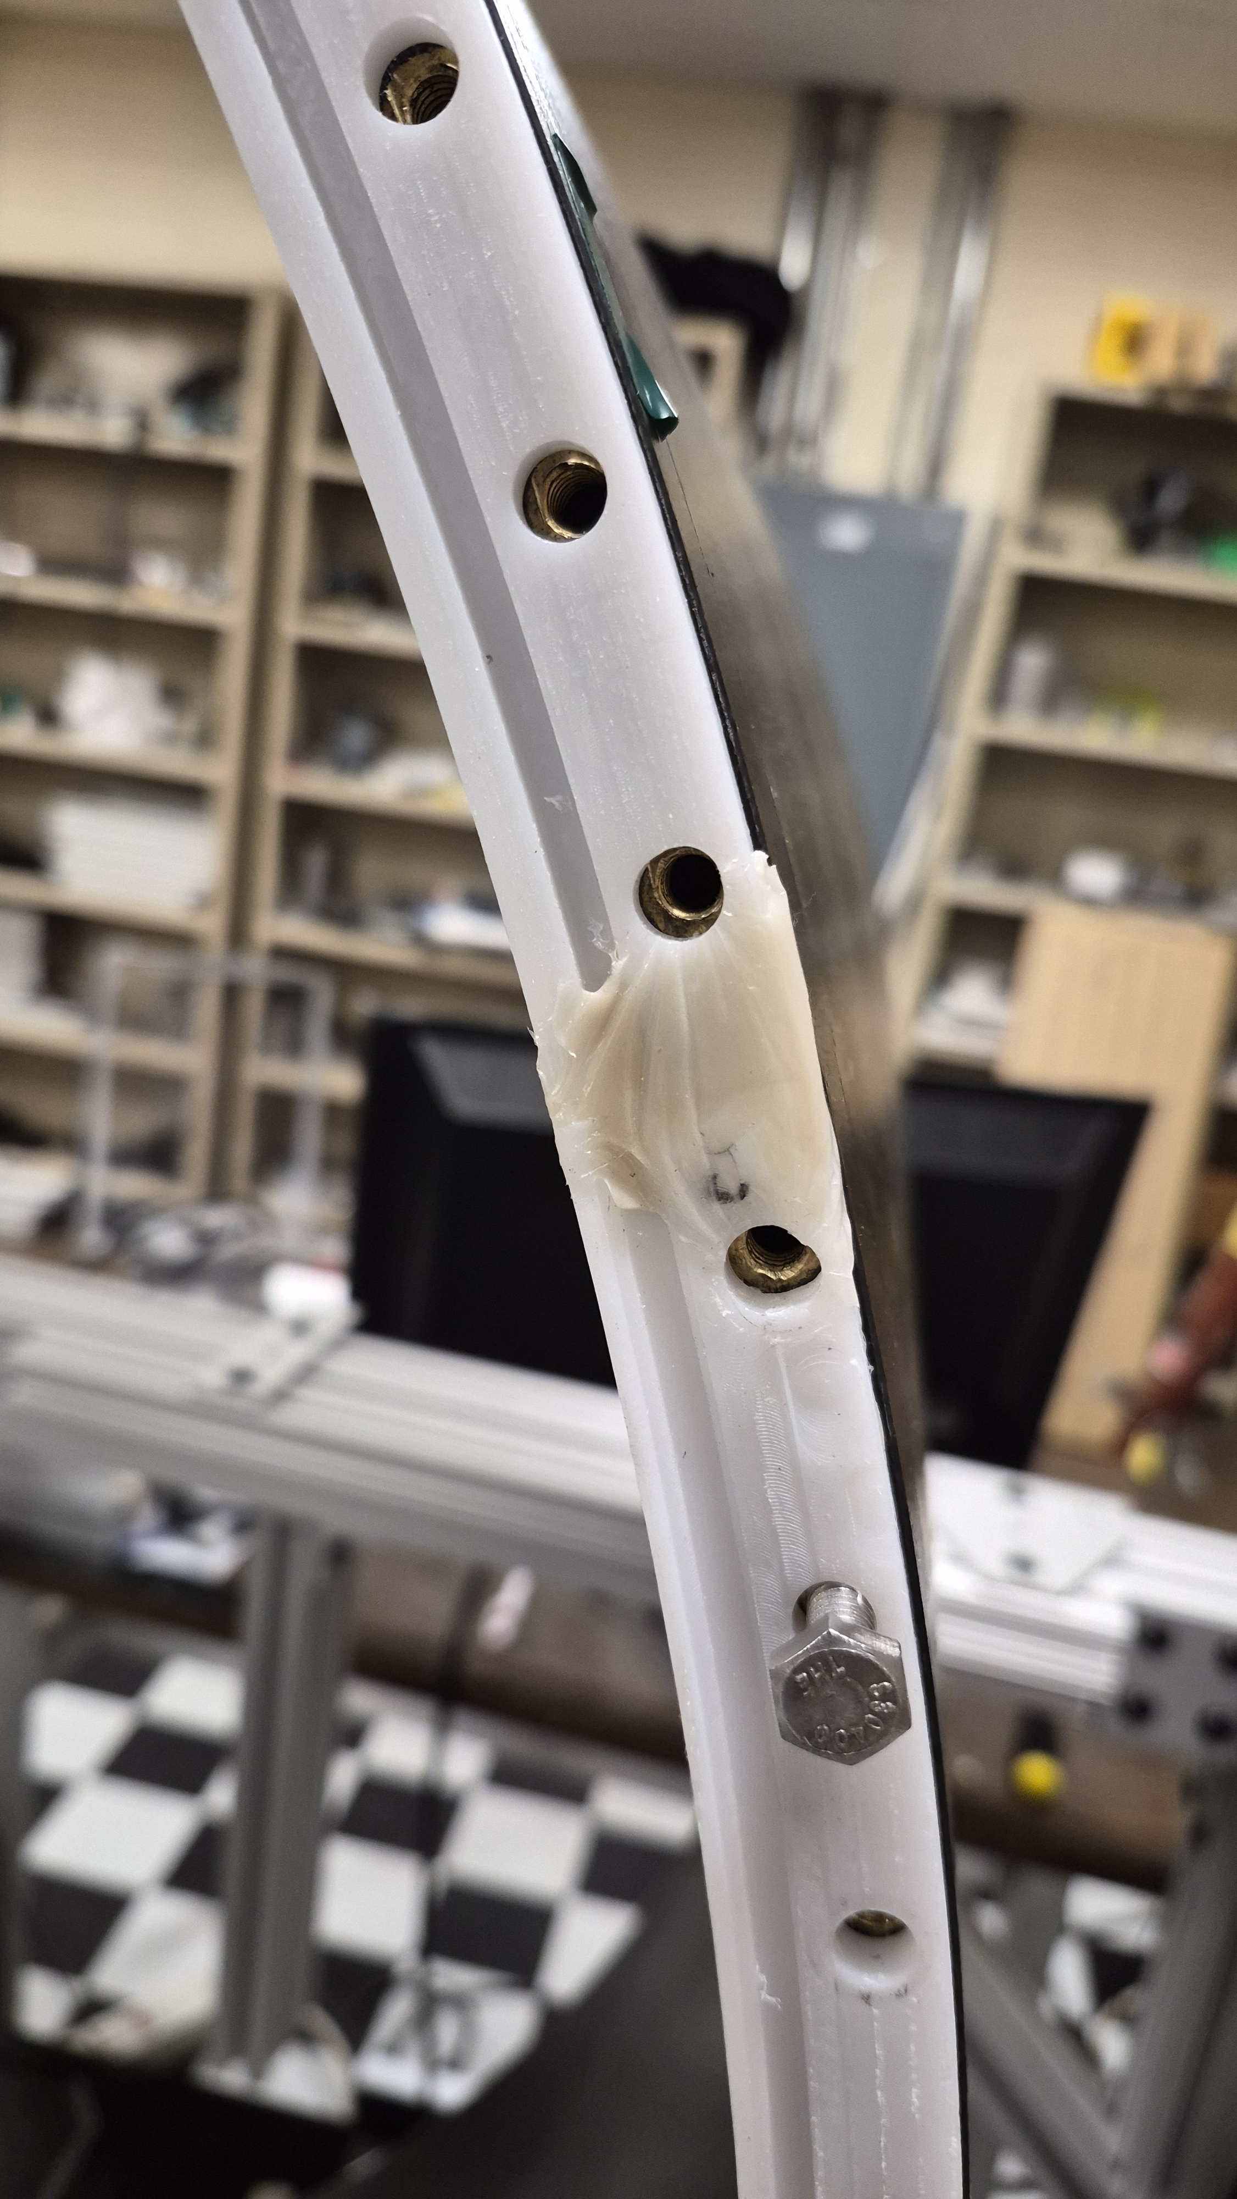
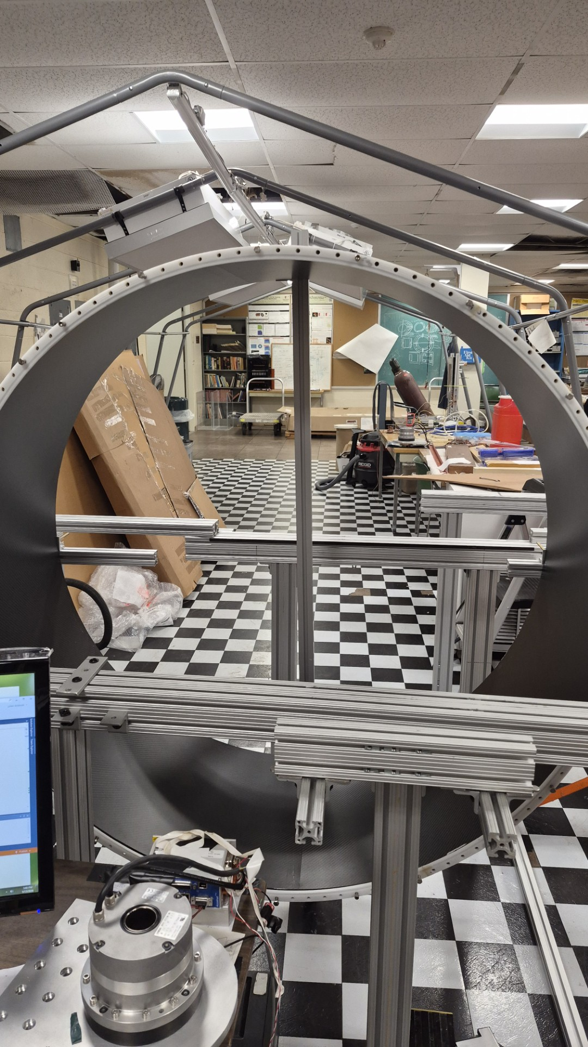
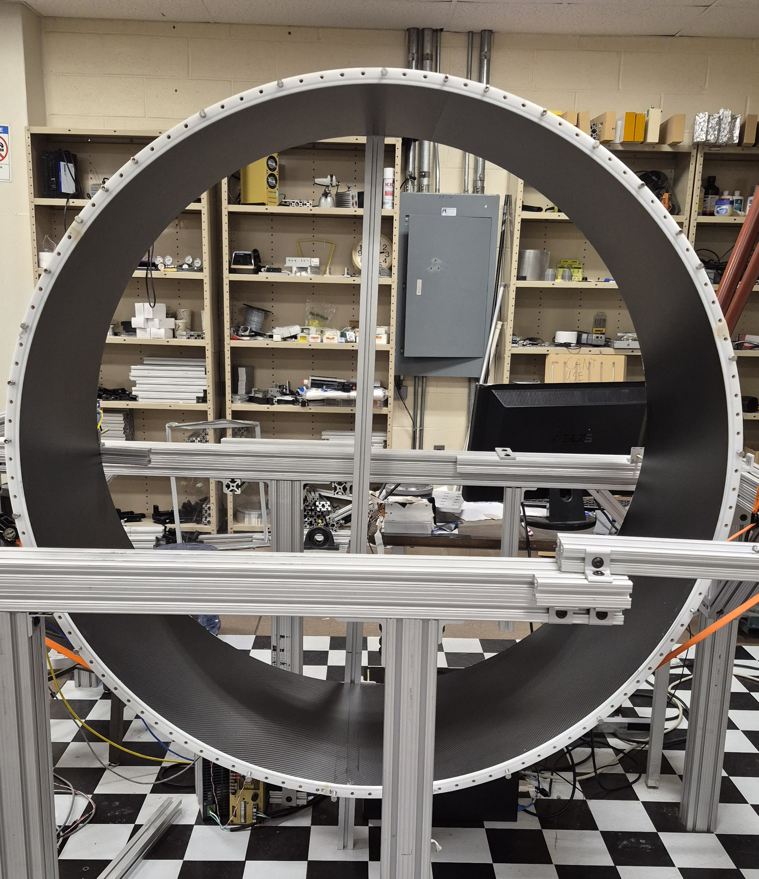
Test ring fit
Holes oversized to 7.65 mm (for 6.35 mm bolts)
Hole pattern radius from 643.09 to 642.35 mm
Tested fit on both sides
Hole pattern good to machine on sensor plate

Slide 3
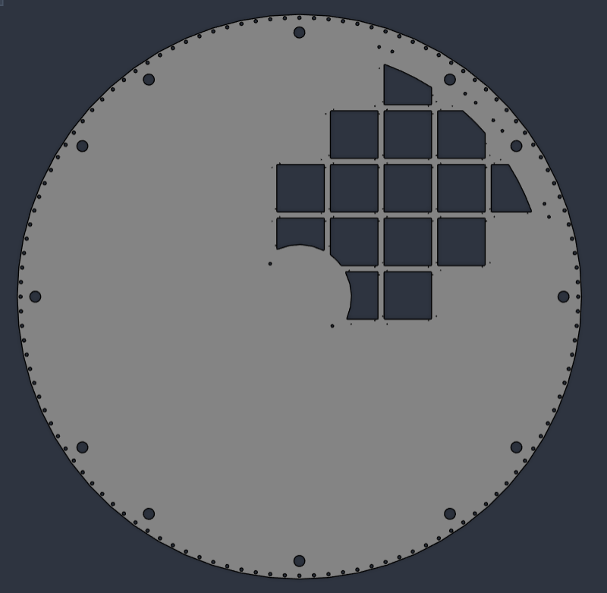
Sensor plate machining order of operations
Machine bolt holes
Machine other inside features
Adjust fixturing, use air port holes for clamping
Machine outer radius
1.
3.
2.
4.

Slide 4
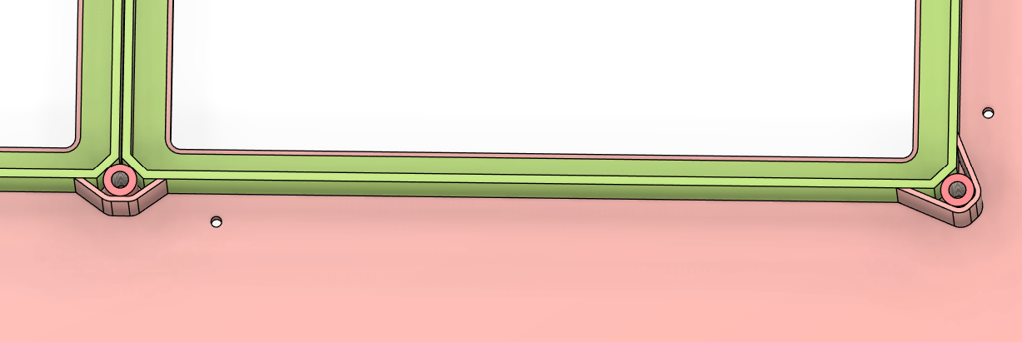
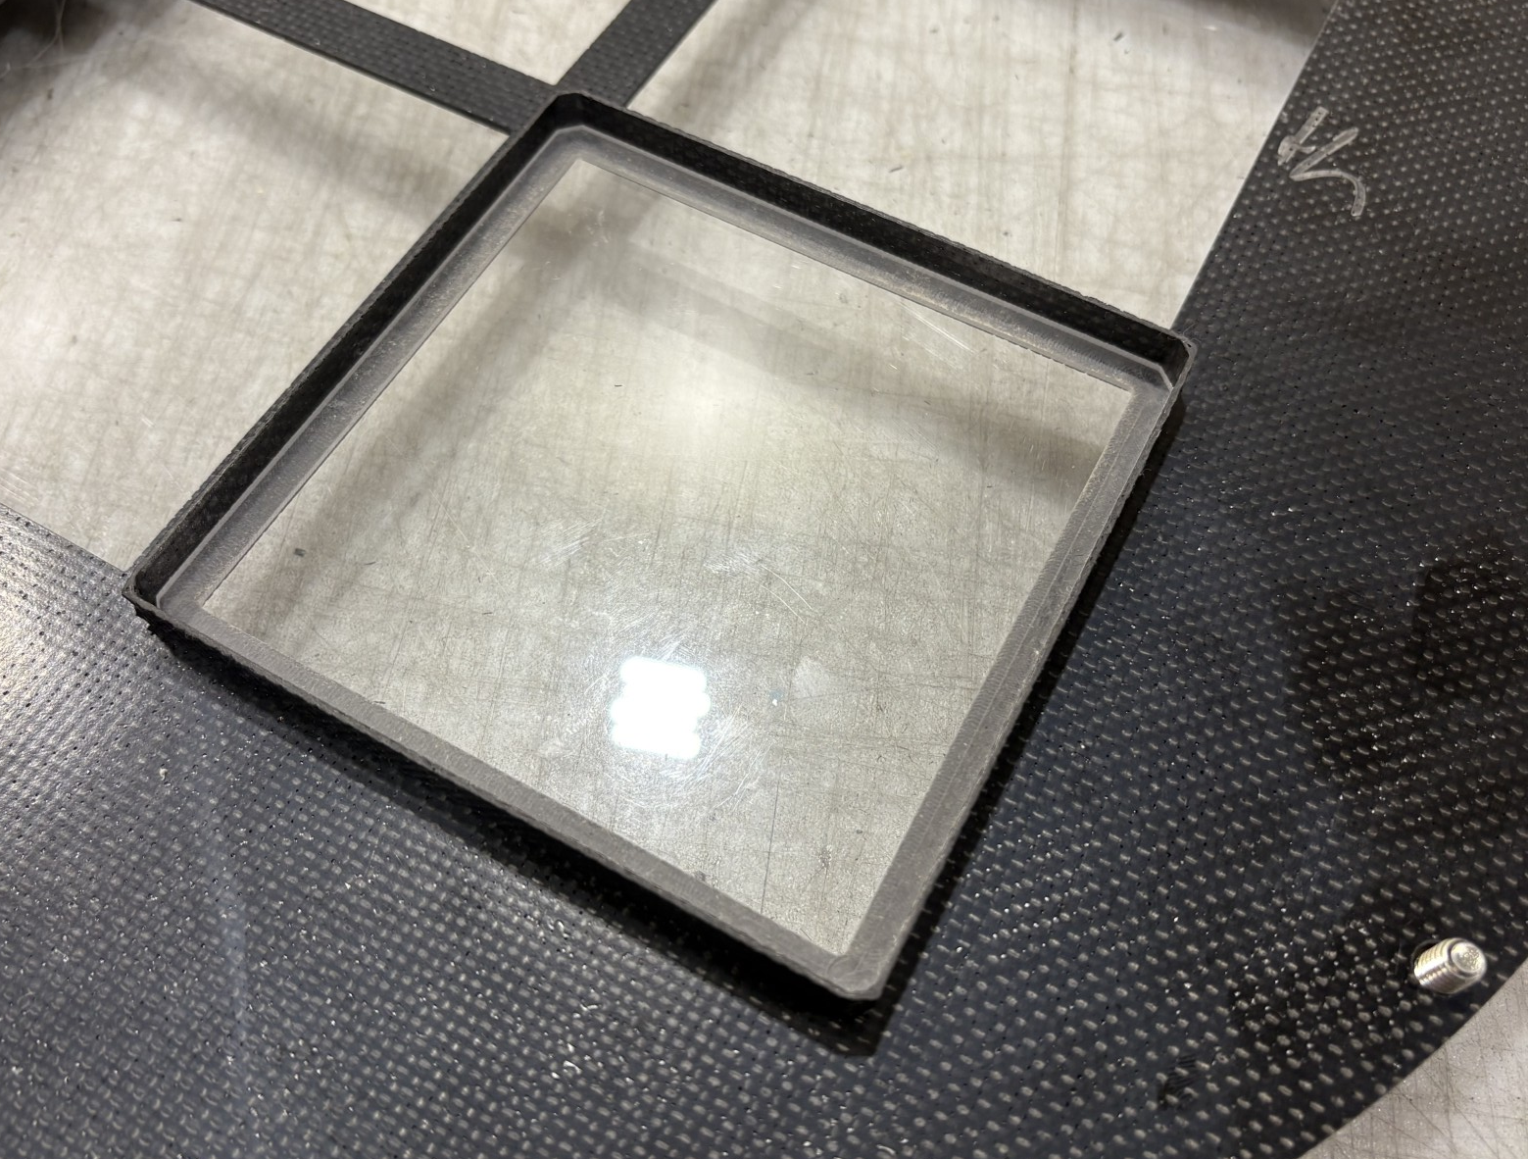
Assembly order of operations
Glue sensor frames and inserts onto sensor plate
  Square holes and inner frame edge are referenced
Machine down top edge of sensor frames
Bond T-beams
Mount triangle mirrors
Attach NPT inserts
Bolt outer and inner mirrors

Slide 5
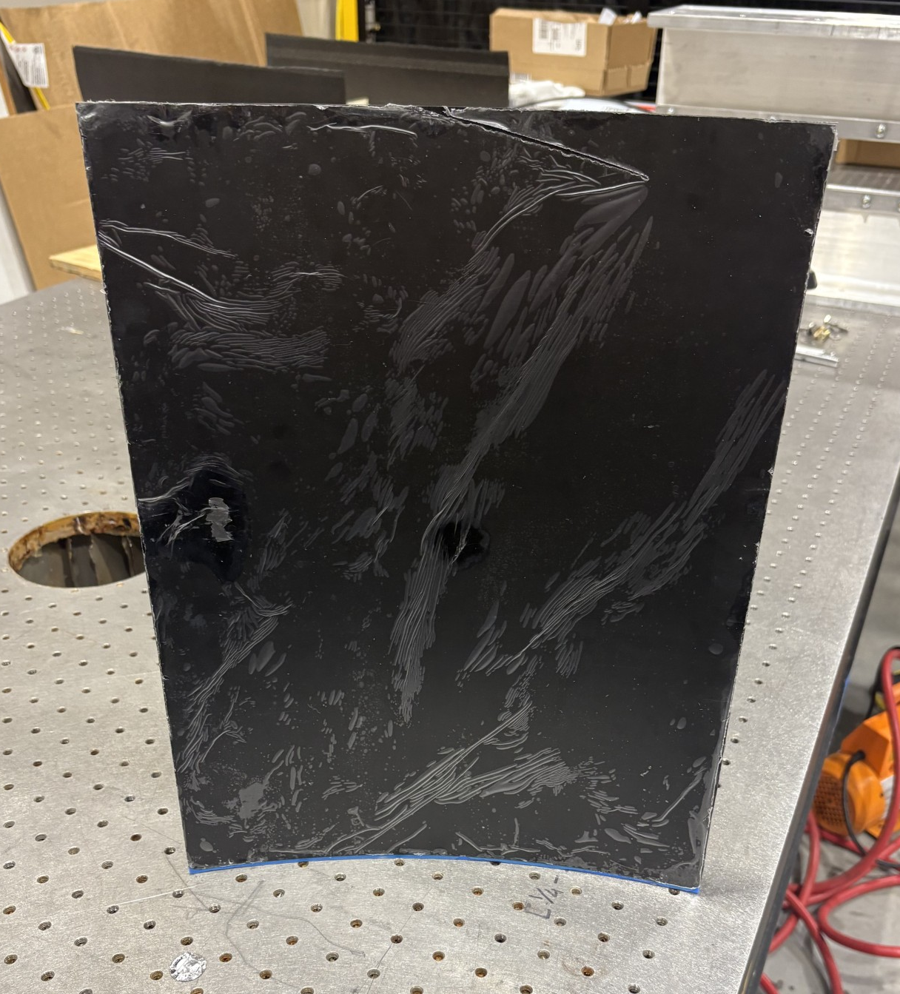
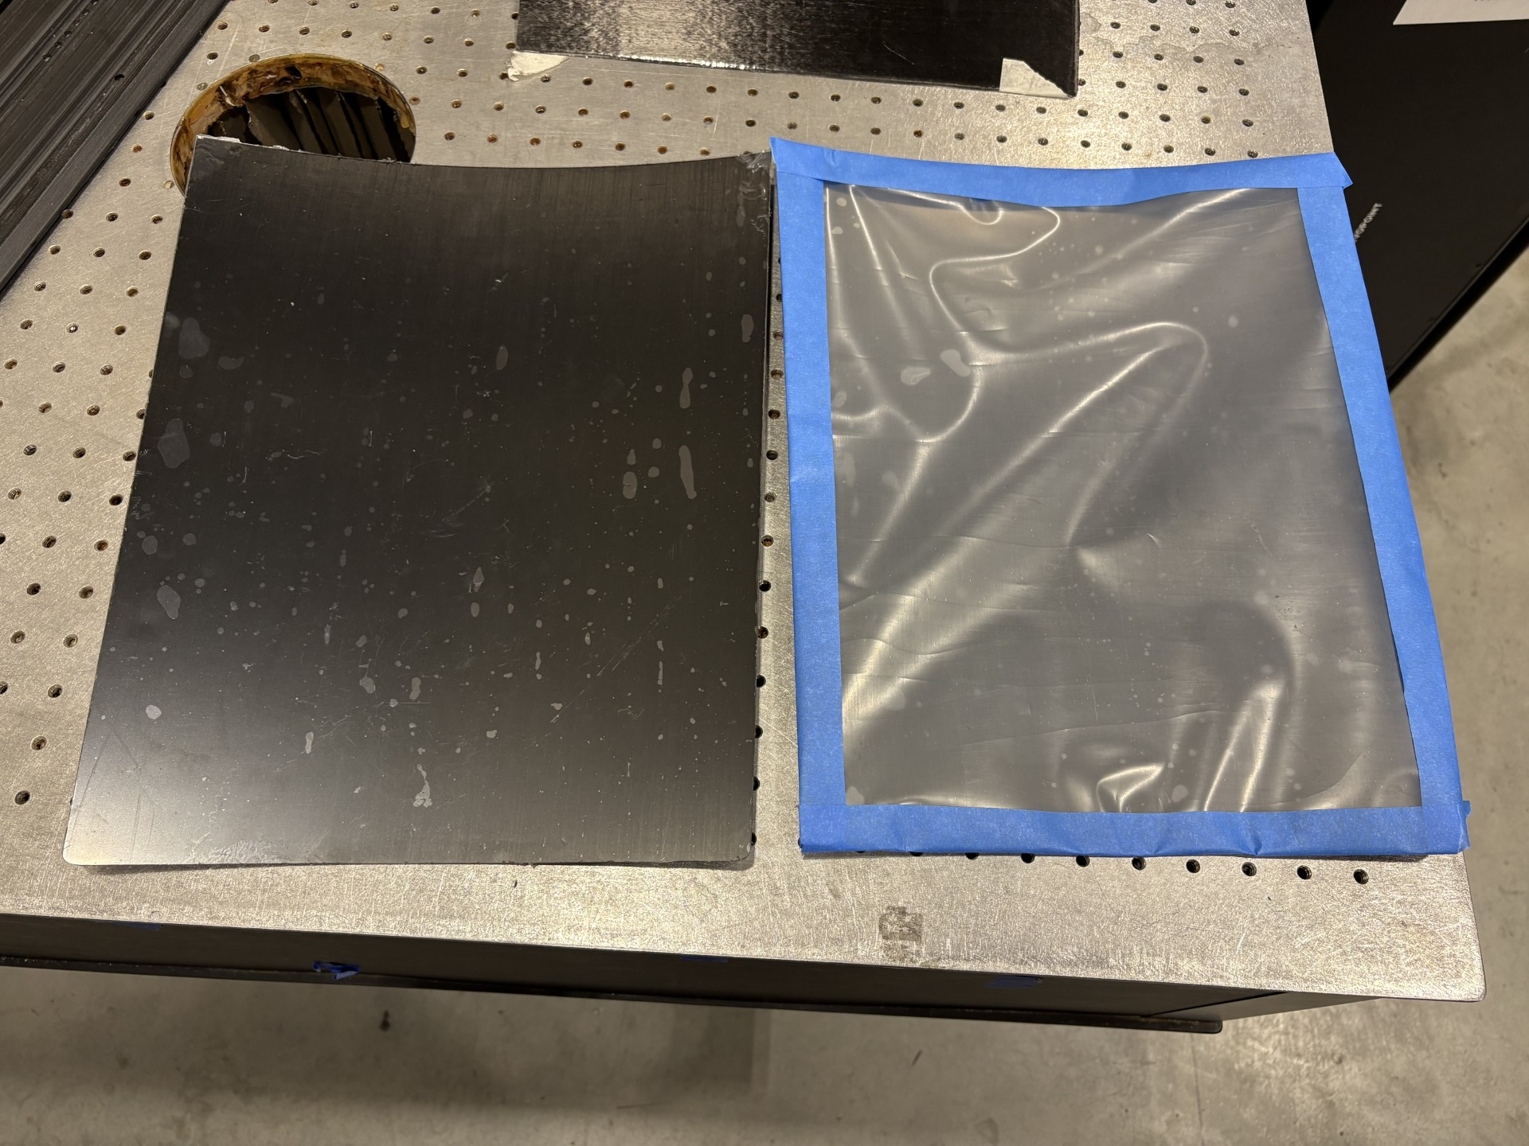
Mirror manufacturing updates
2 carbon-lexan mirrors made and machined
Still need backings bonded
Similar bond quality to beam test mirror
Beam test mirror protective film was peeling and torn in places

Slide 6
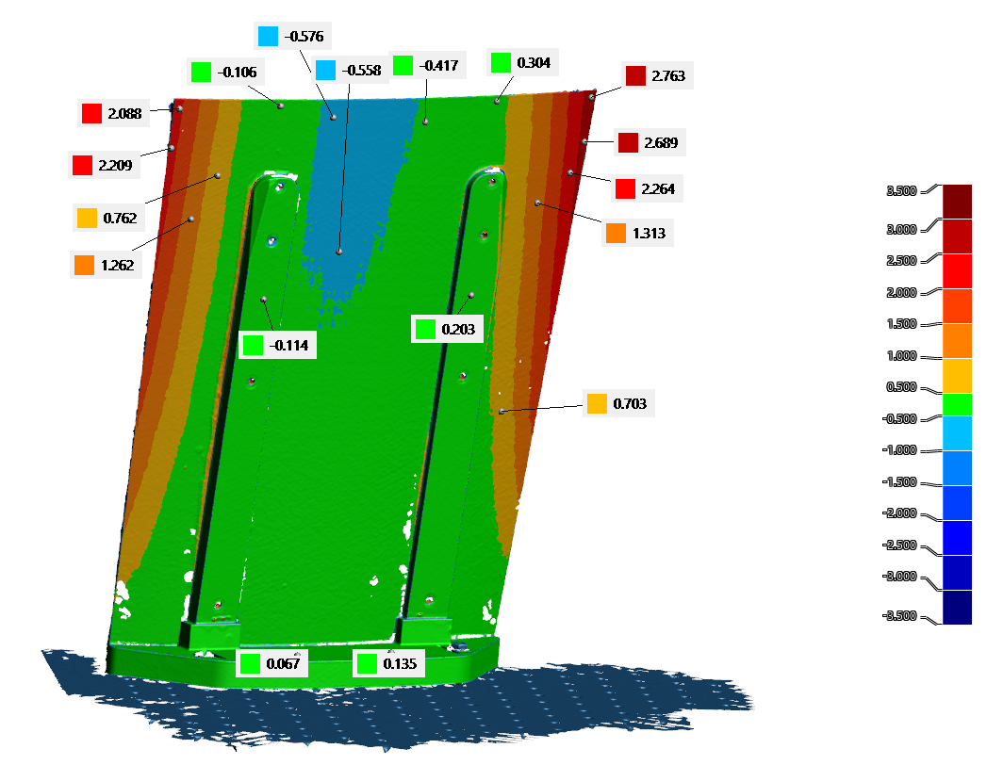
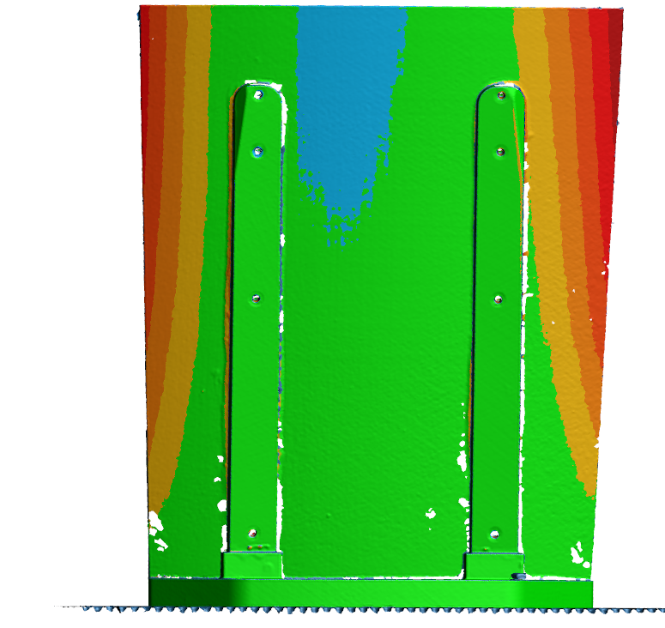
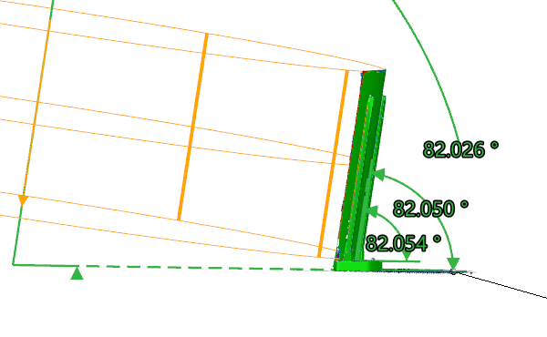
Test beam mirror scan
Upright planes
Cylinder axis to optical table
Upright plane to mirror foot
Upright plane to optical table
Nominal: 82.5

Slide 7
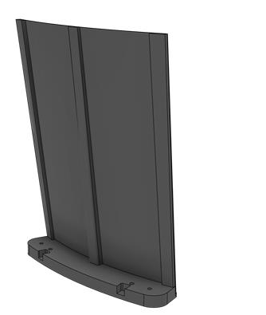
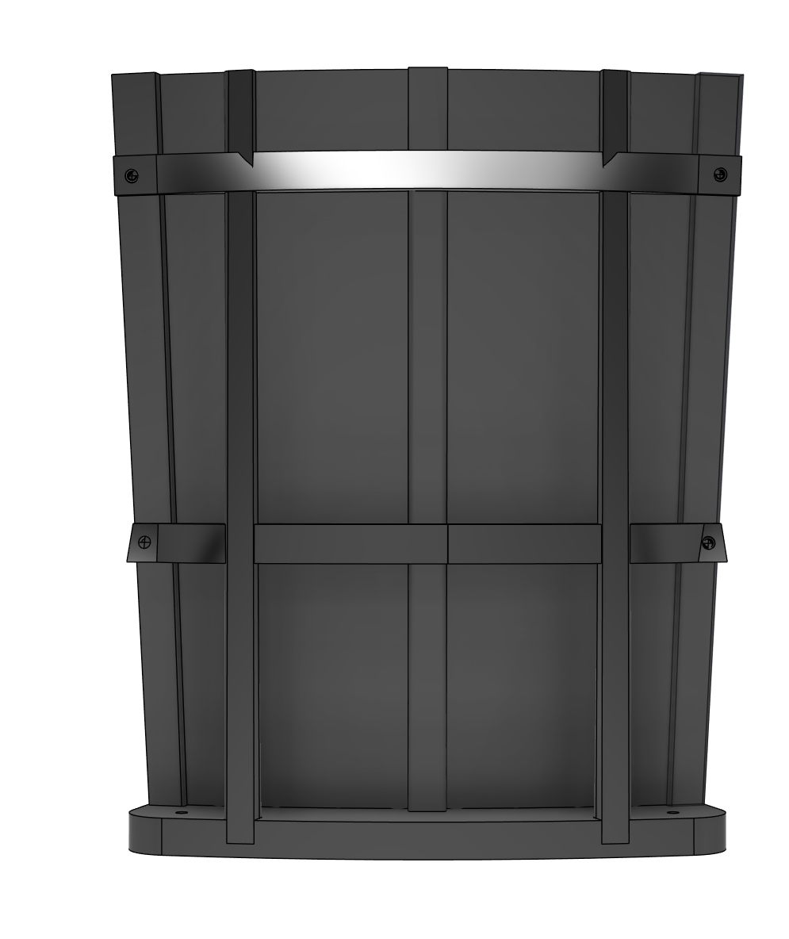
3 upright “test bed” mirror
Local adjustments to radius to correct sprung out shape could lead to warping
Stiff uprights at the center and edges will keep mirror curvature continuous along Z
Uprights at edge make connection of mirrors more straightforward
Array of inserts will allow testing of multiple shape correction apparatuses
And keeps flexibility in coater mounting method
Notes:
Interested in how much area at top and bottom is useful

Slide 8
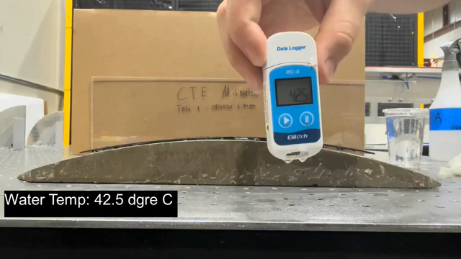
Deformation due to CTE mismatch
Noticed mirror deformed significantly when washed under warm water
Deformation due to much higher CTE of Lexan compared to carbon fiber
Once mirror is constrained to shape, what is currently reversible deformation could become wrinkling or disbonding

