Slide 1

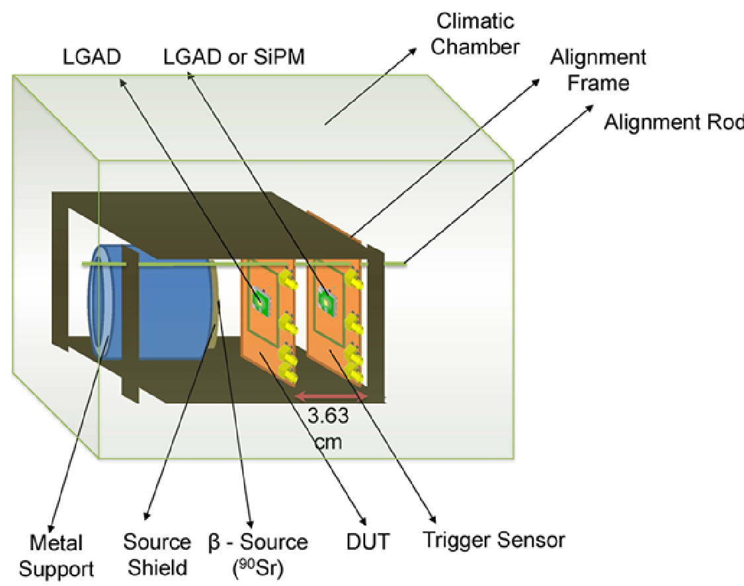
Sensor testing – Sr90 telescope
Details: S.M. Mazza et al. arXiv:1804.05449
  Two sensors are aligned with a beta source
    DUT (Device Under Test) to characterize
    Trigger with known performance
  Sensors mounted on fast amplifier boards (~2Ghz) and read out by a fast oscilloscope (2Ghz, 20Gs)
  Collected charge
  Time resolution: sigma of time difference between trigger sensor (with known time resolution) and DUT,
  Gain: collected charge divided by collected charge in same thickness PiN
  Signal to Noise ratio
Measured noise

Slide 2
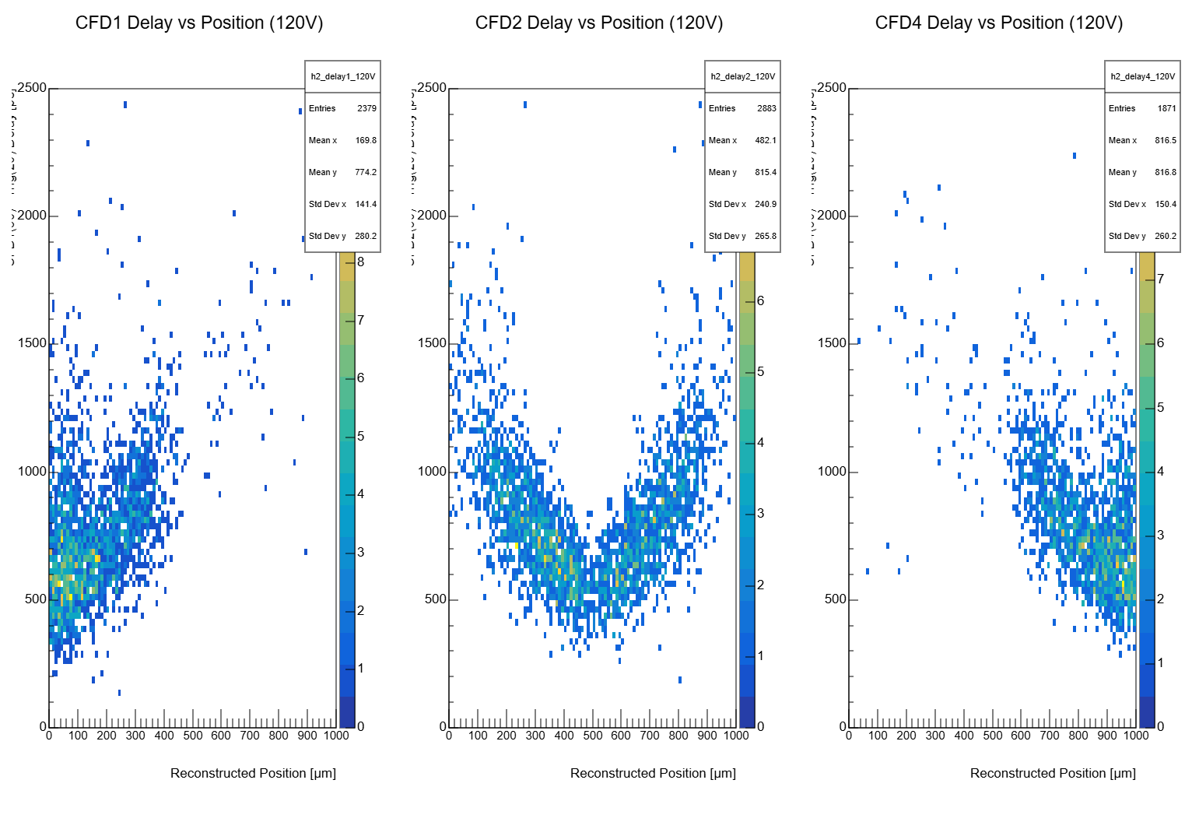

Slide 3
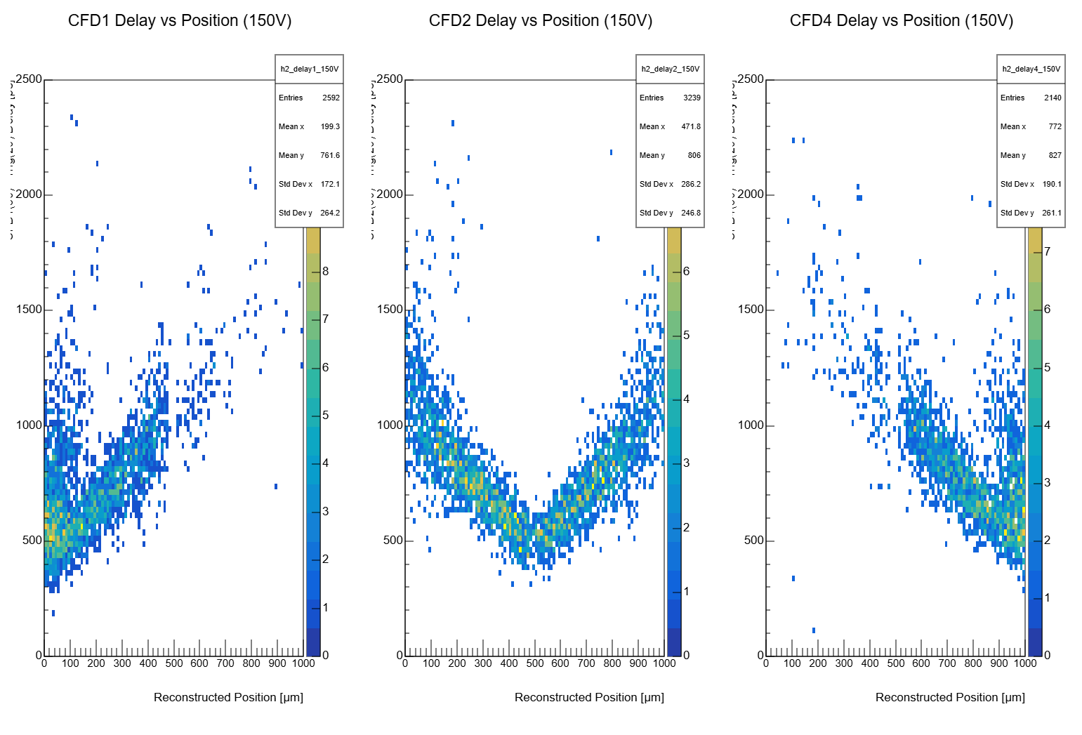

Slide 4
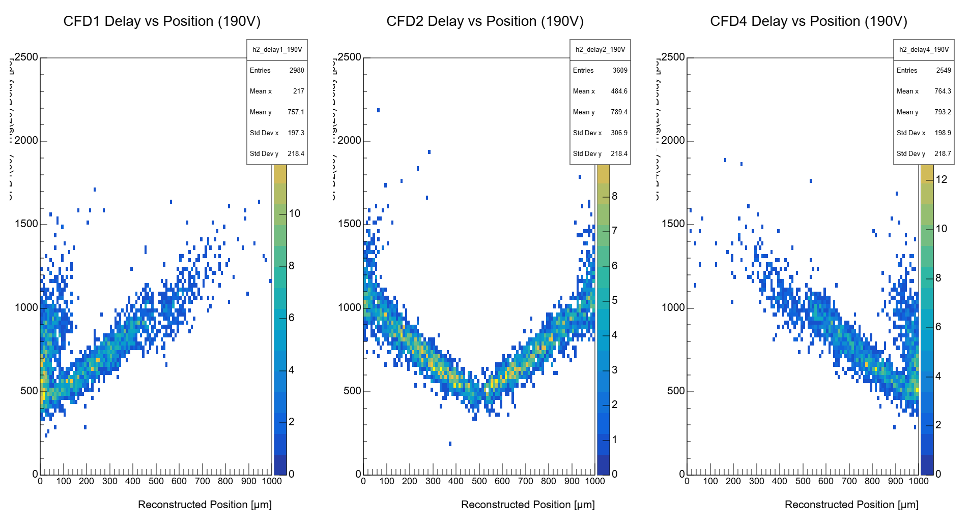

Slide 5
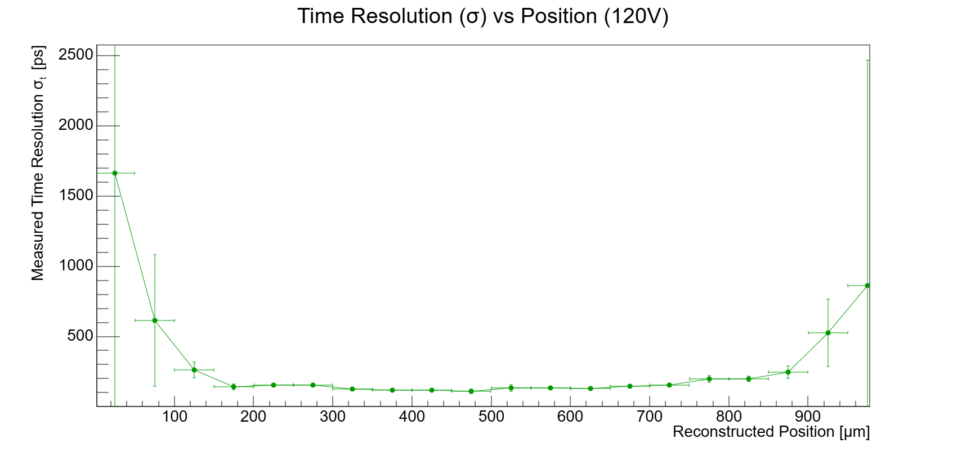
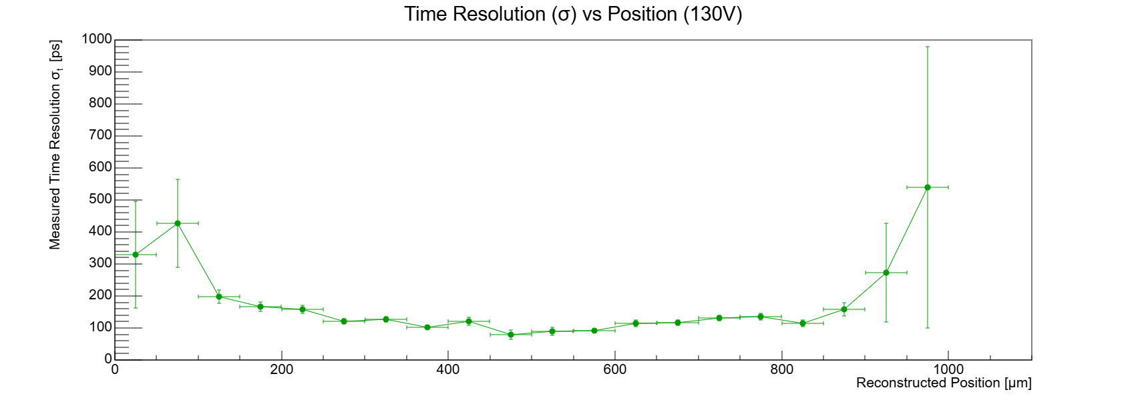
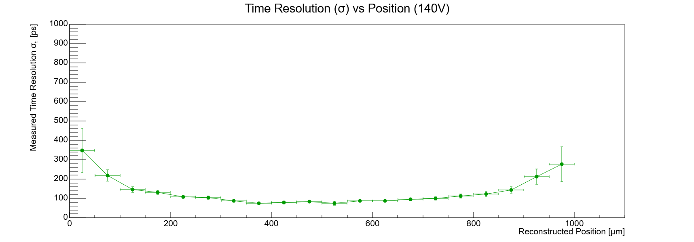
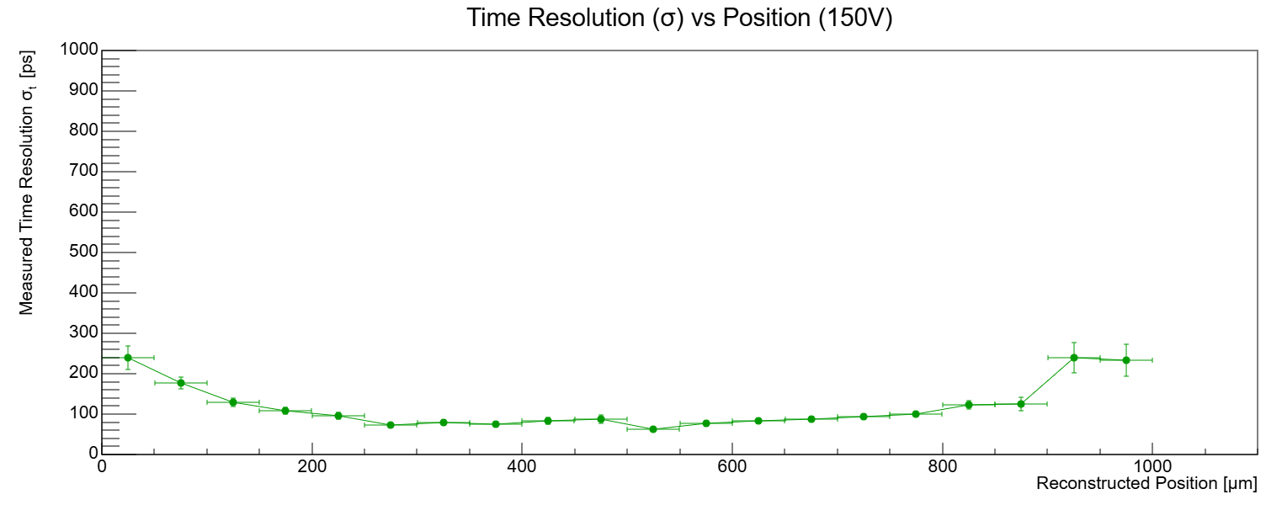
Mean Resolution (250-750µm): 132.204ps
Min: 110ps
Mean Resolution (250-750µm): 109.428ps
Min: 80ps
Mean Resolution (250-750µm): 87.26ps
Min: 74ps
Mean Resolution (250-750µm): 80.1727ps
Min: 62ps

Slide 6
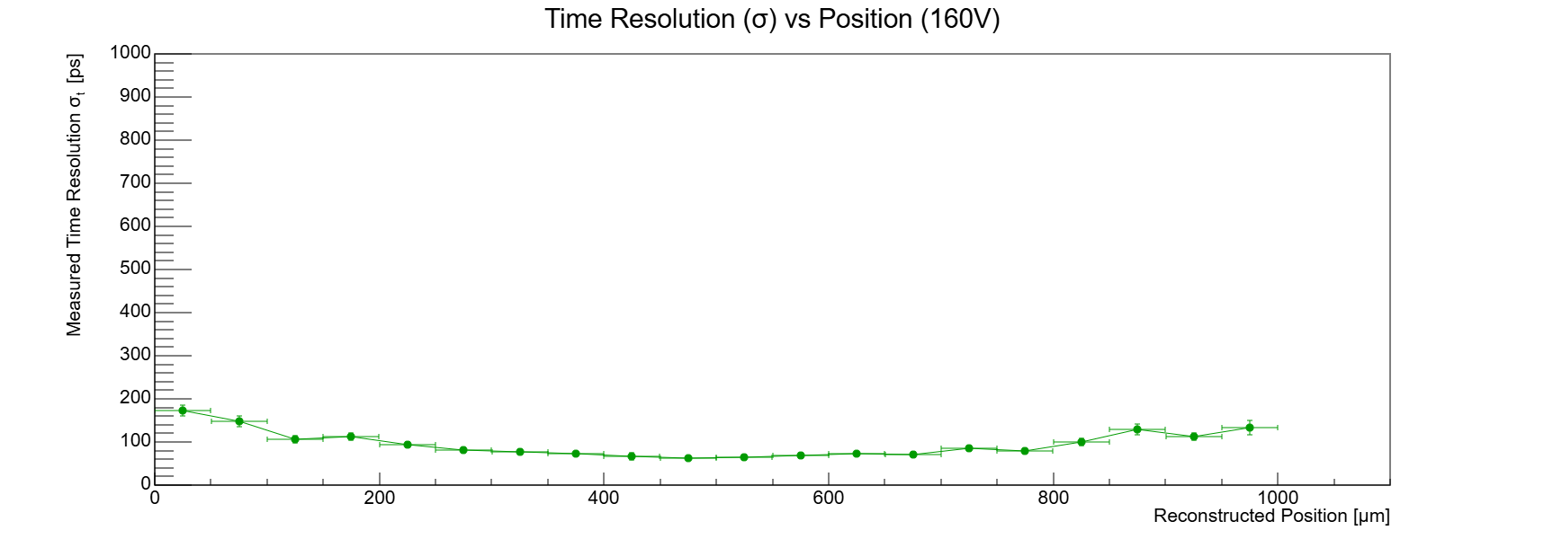
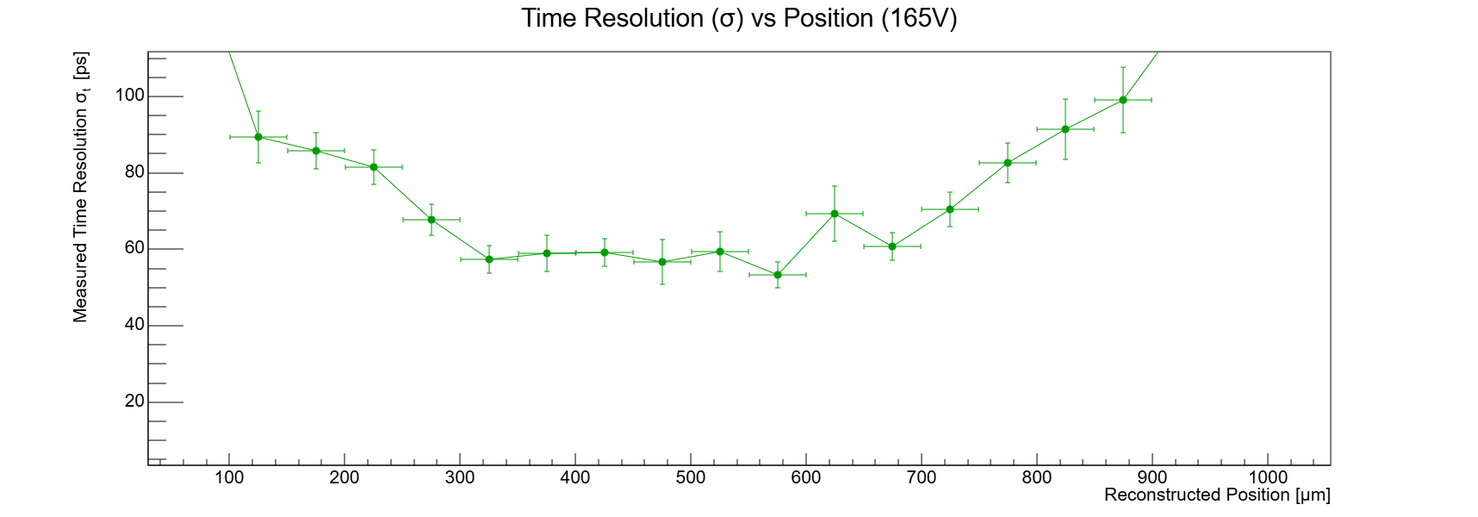
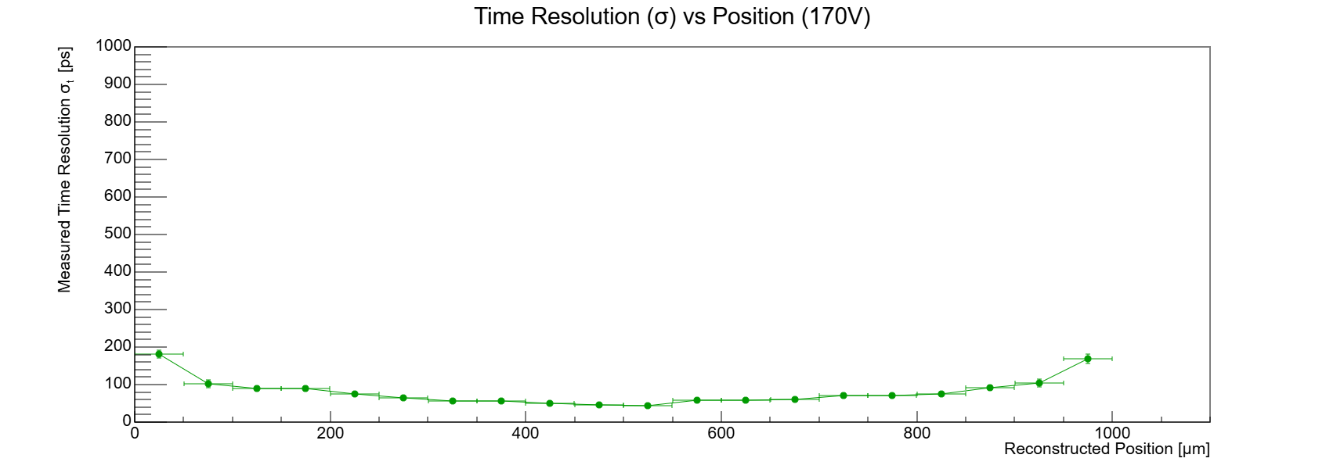
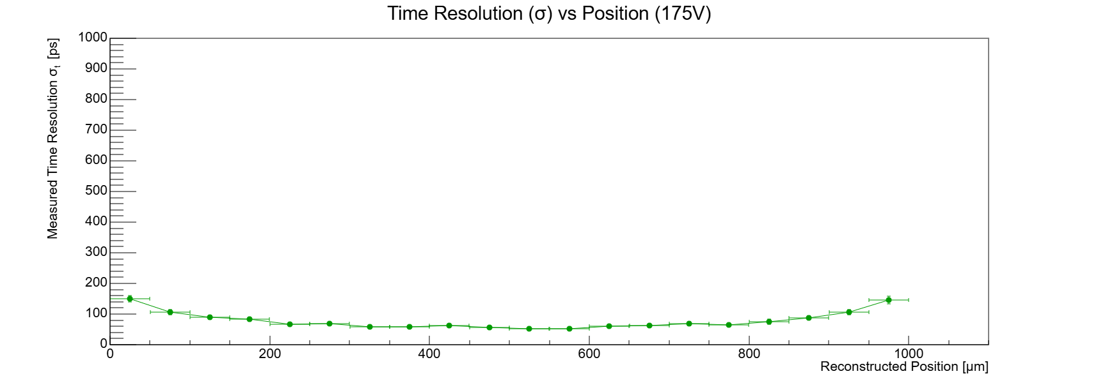

Mean Resolution (250-750µm): 72.016ps
Min: 62ps
Mean Resolution (250-750µm): 61.3132ps
Min: 53ps
Mean Resolution (250-750µm): 56.622ps
Min: 44ps
Mean Resolution (250-750µm): 55.502ps
Min: 45ps

Slide 7
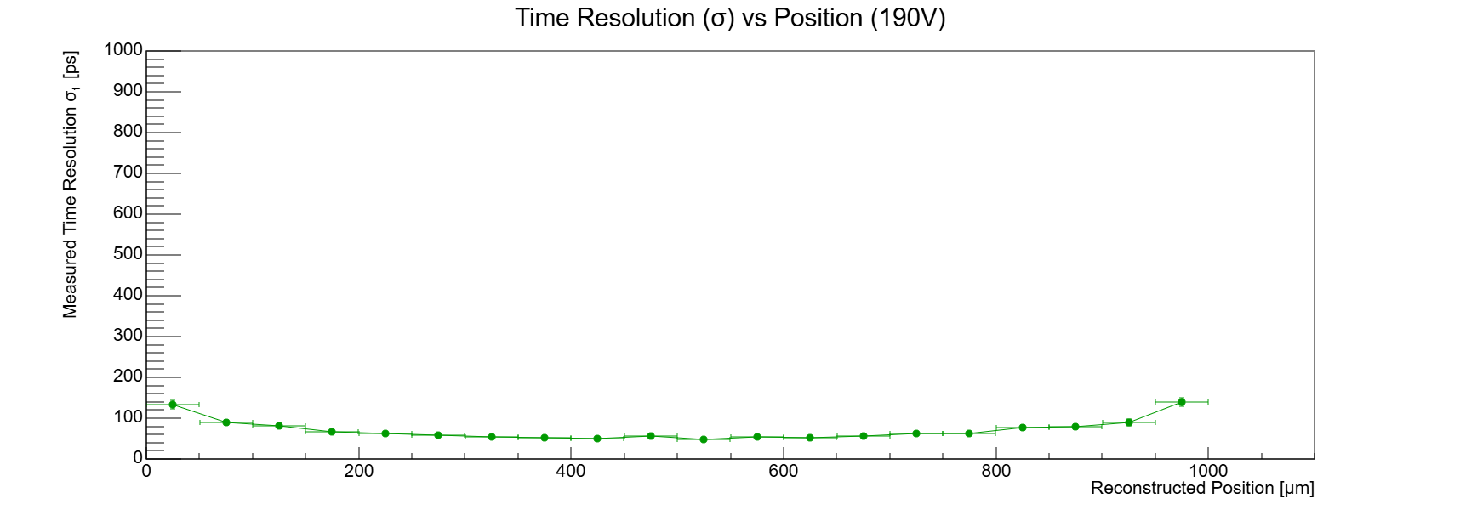
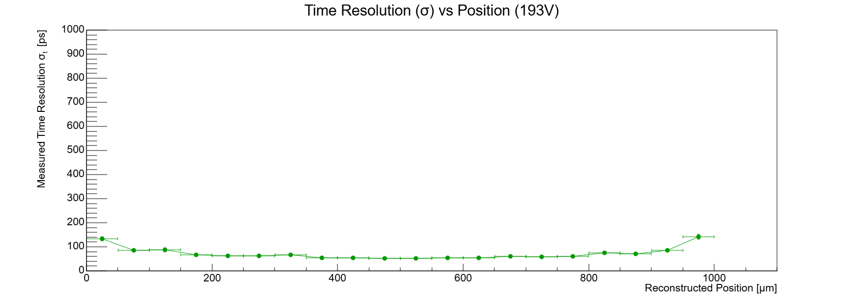
Mean Resolution (250-750µm): 54ps
Min: 47ps
Mean Resolution (250-750µm): 56.697ps
Min: 47ps

Slide 8
