Slide 1



HPK HGTD-2
Singles and 2x2
Simone Michele Mazza - HGTD sensor LHCC review
1
08/11/2020

Slide 2
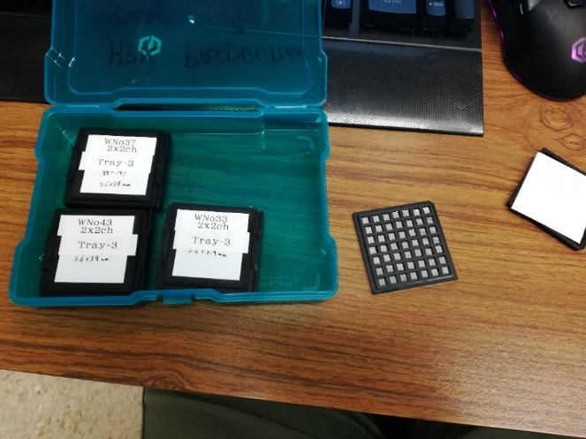

HPK new production received
1 box of 2x2 for 4 splits from CERN
W28/W33/W37/W43
Single pads for 4 splits
  W25/W31/W36/W42
Increasing doping for lower W numbers
1
Simone Michele Mazza - HGTD sensor LHCC review
08/11/2020

Slide 3
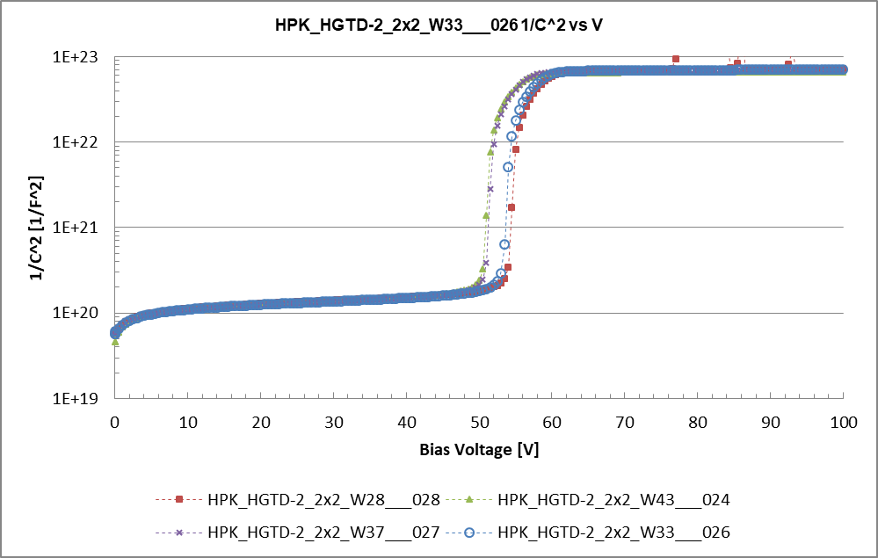
CV – foot increases with W28/W33/W37/43
1
Simone Michele Mazza - HGTD sensor LHCC review
08/11/2020

Slide 4
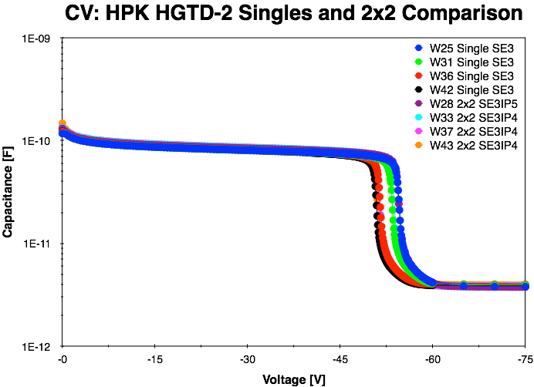
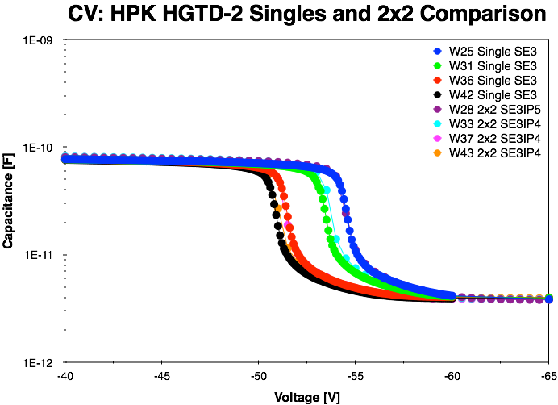
HPK Proto-2 C-V Singles vs 2x2
W25 SE3 single overlaps with W28 2x2 SE3IP5
W31 SE3 single overlaps with W33 2x2 SE3IP4
W36 SE3 single overlaps with W37 2x2 SE3IP4
W42 SE3 single overlaps with W43 2x2 SE3IP4
Eric Ryan "HGTD Proto-2 C-V ", Aug 7, 2020
CVs have the same shape for each split, i.e W25/W28, W31/W33, W36/W37, and W42/W43 have the same doping concentrations

Slide 5
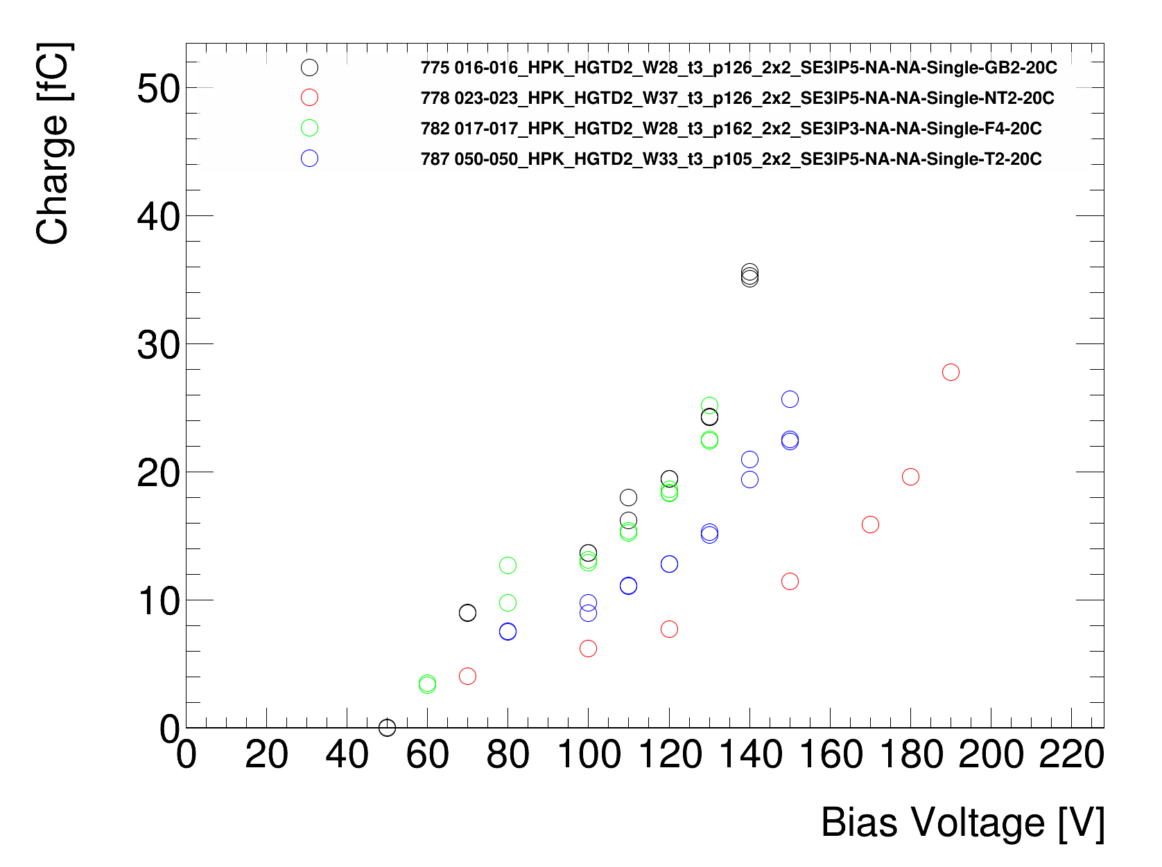
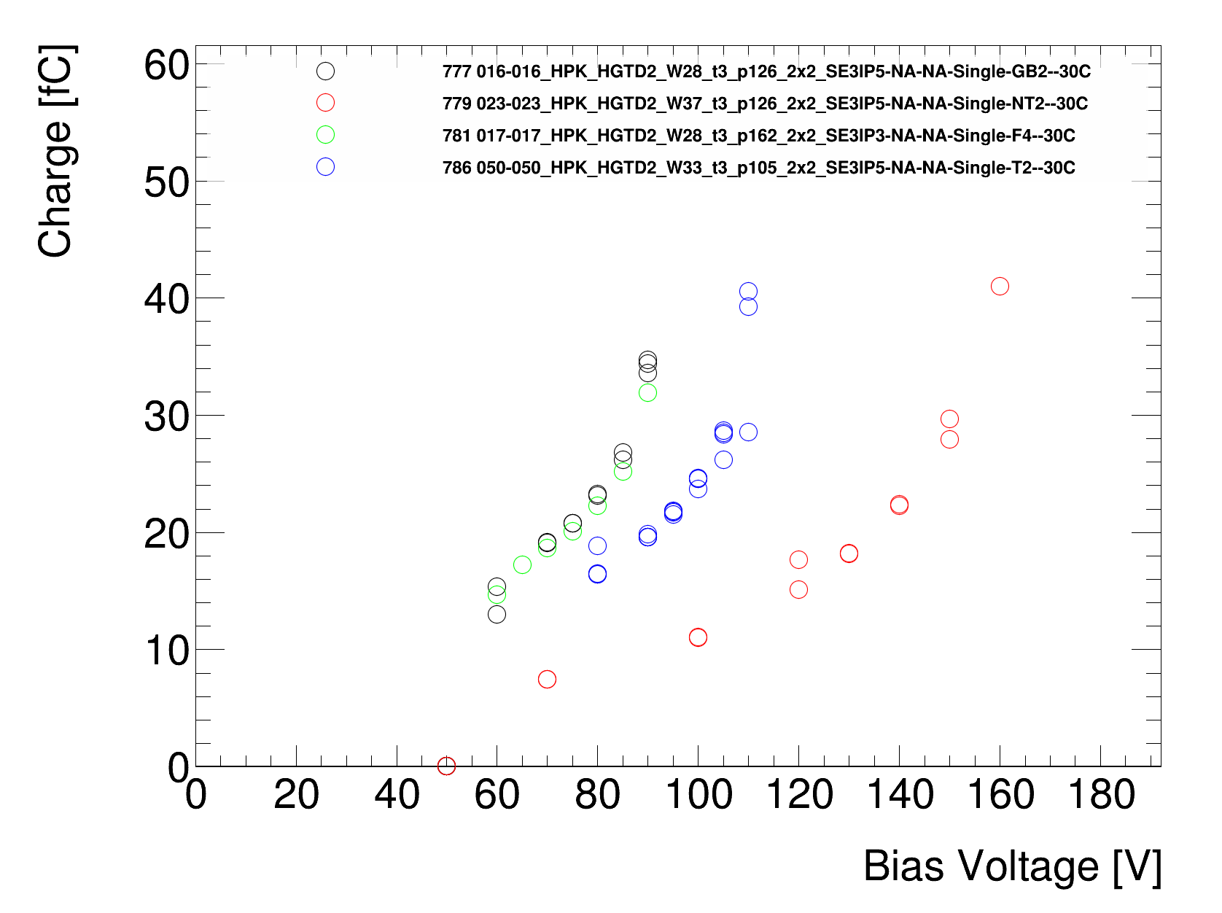
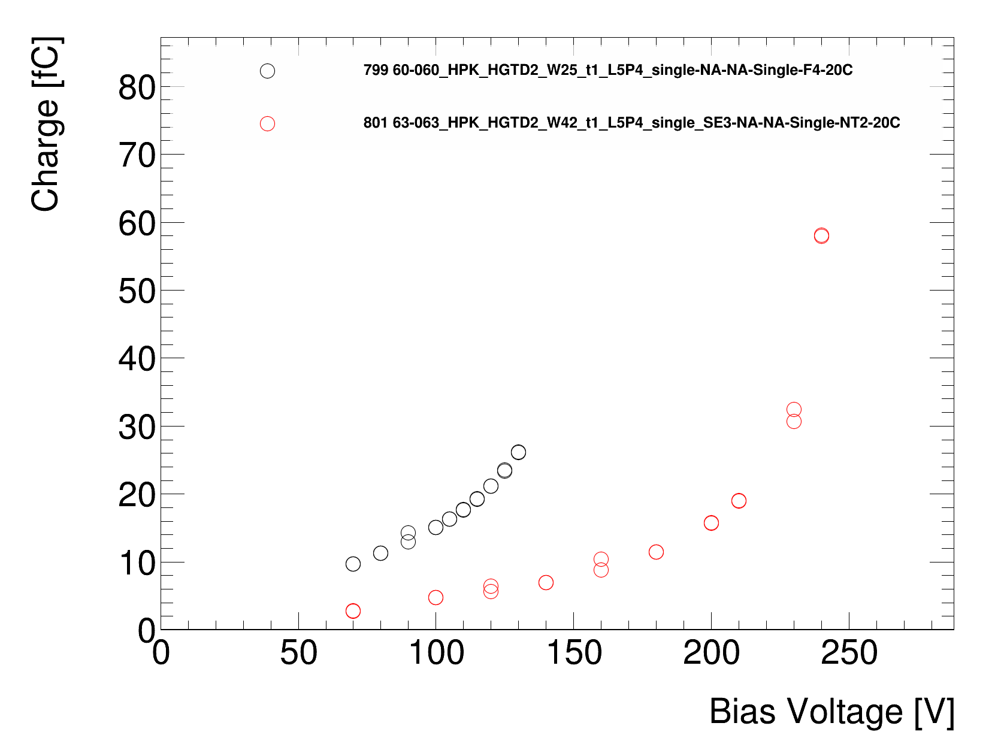
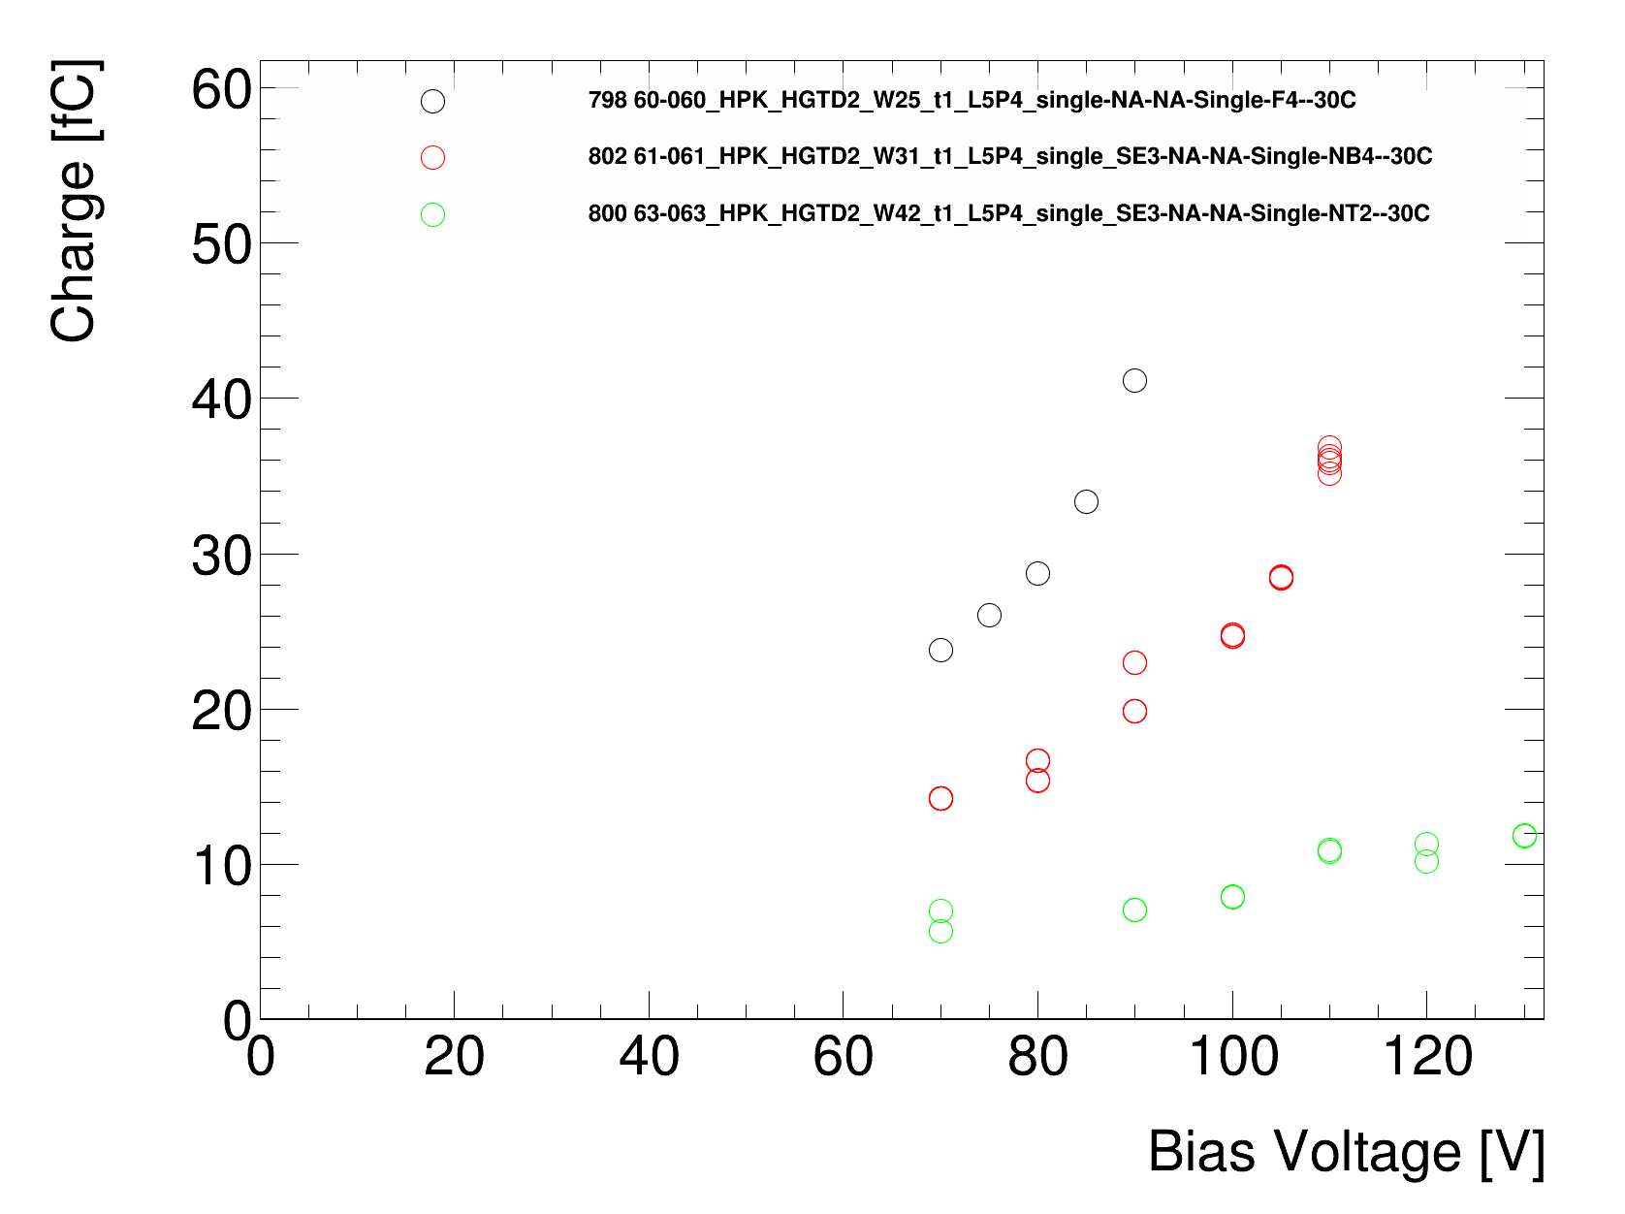
2x2 vs singles
<number>
Simone Michele Mazza - HGTD sensor LHCC review
08/11/2020

Slide 6
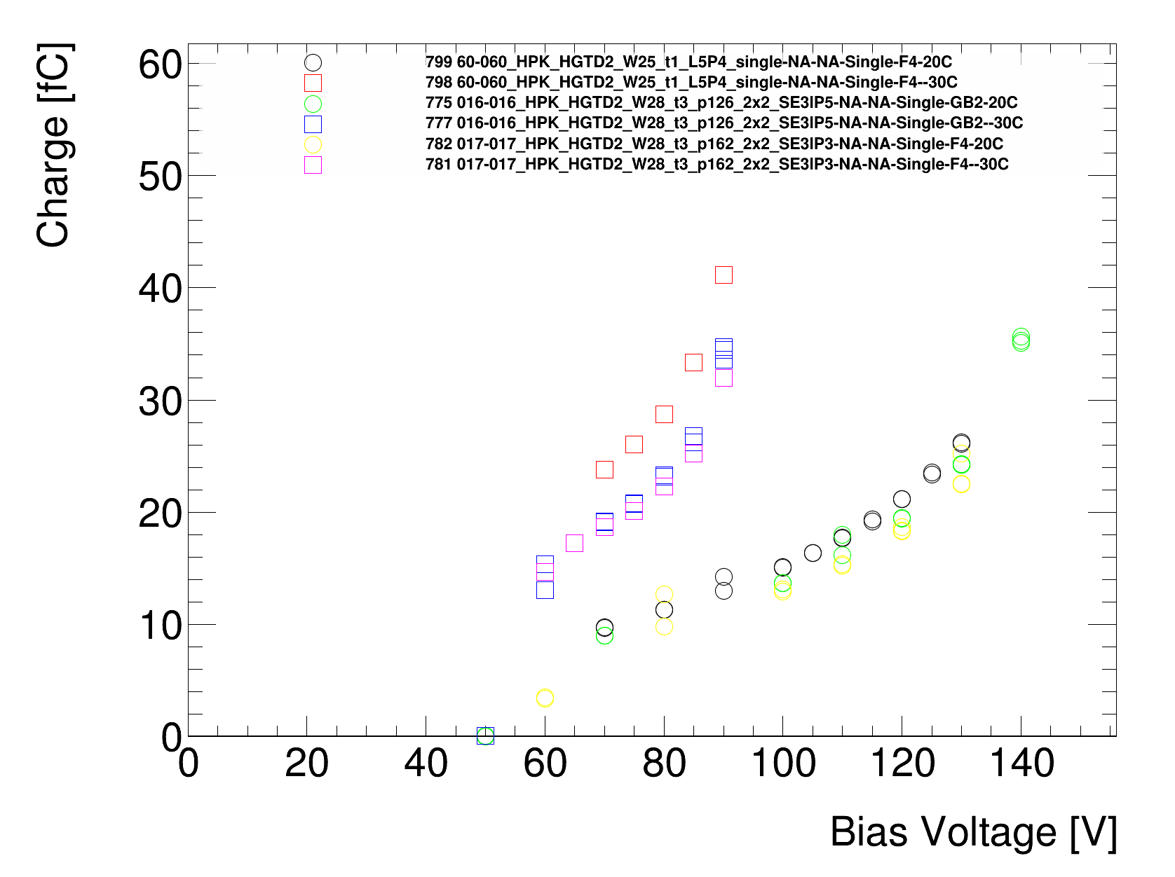
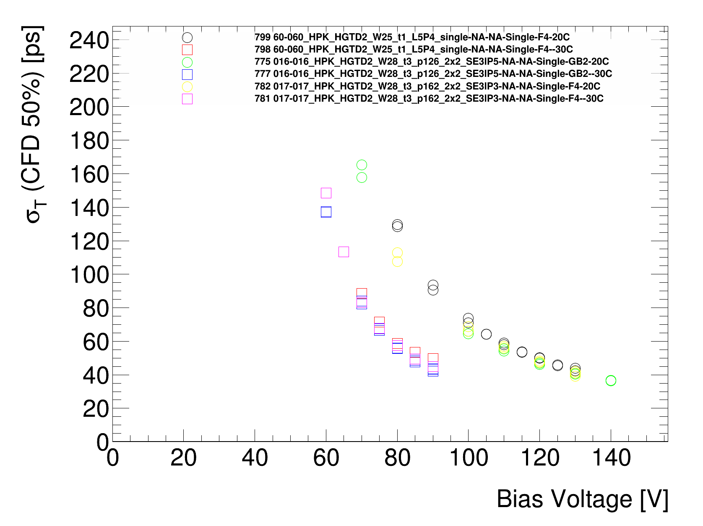
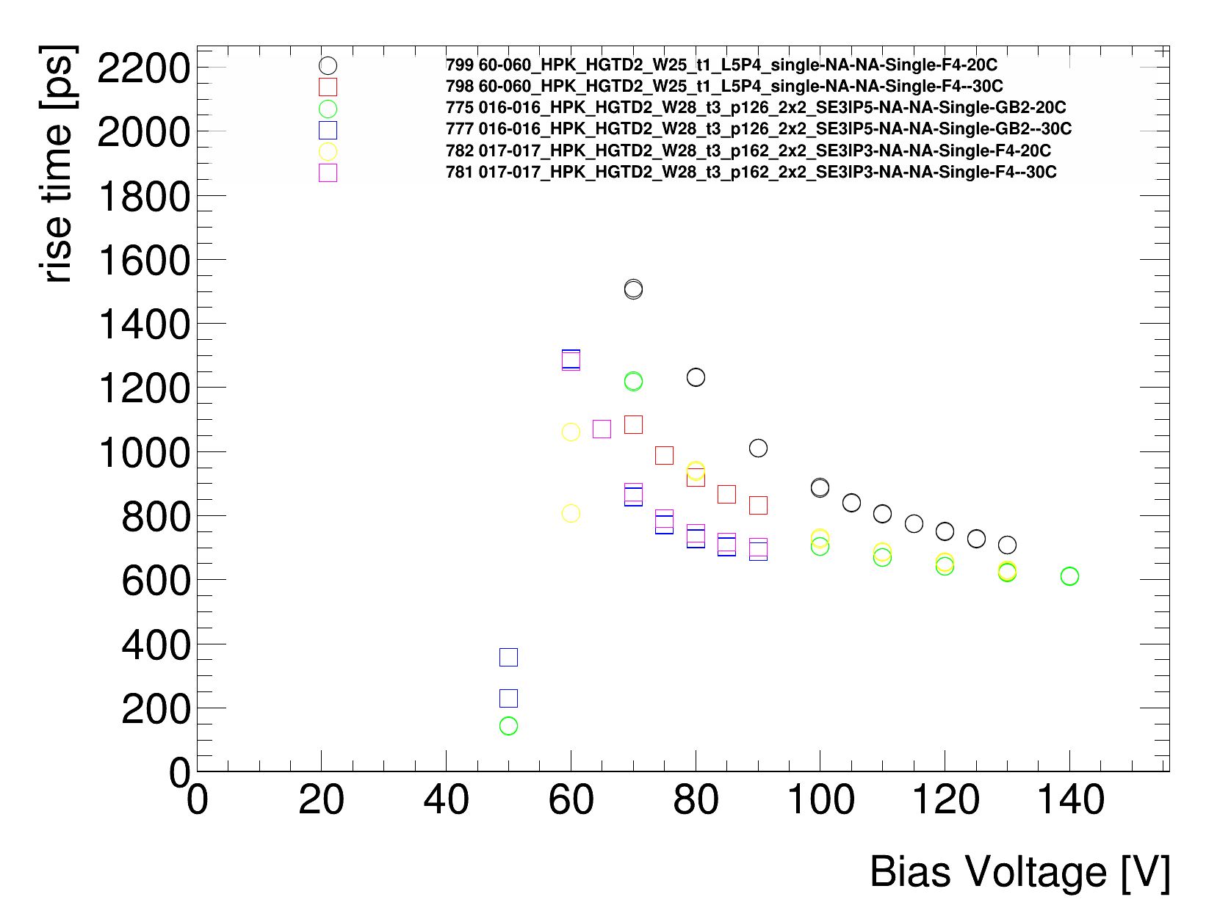
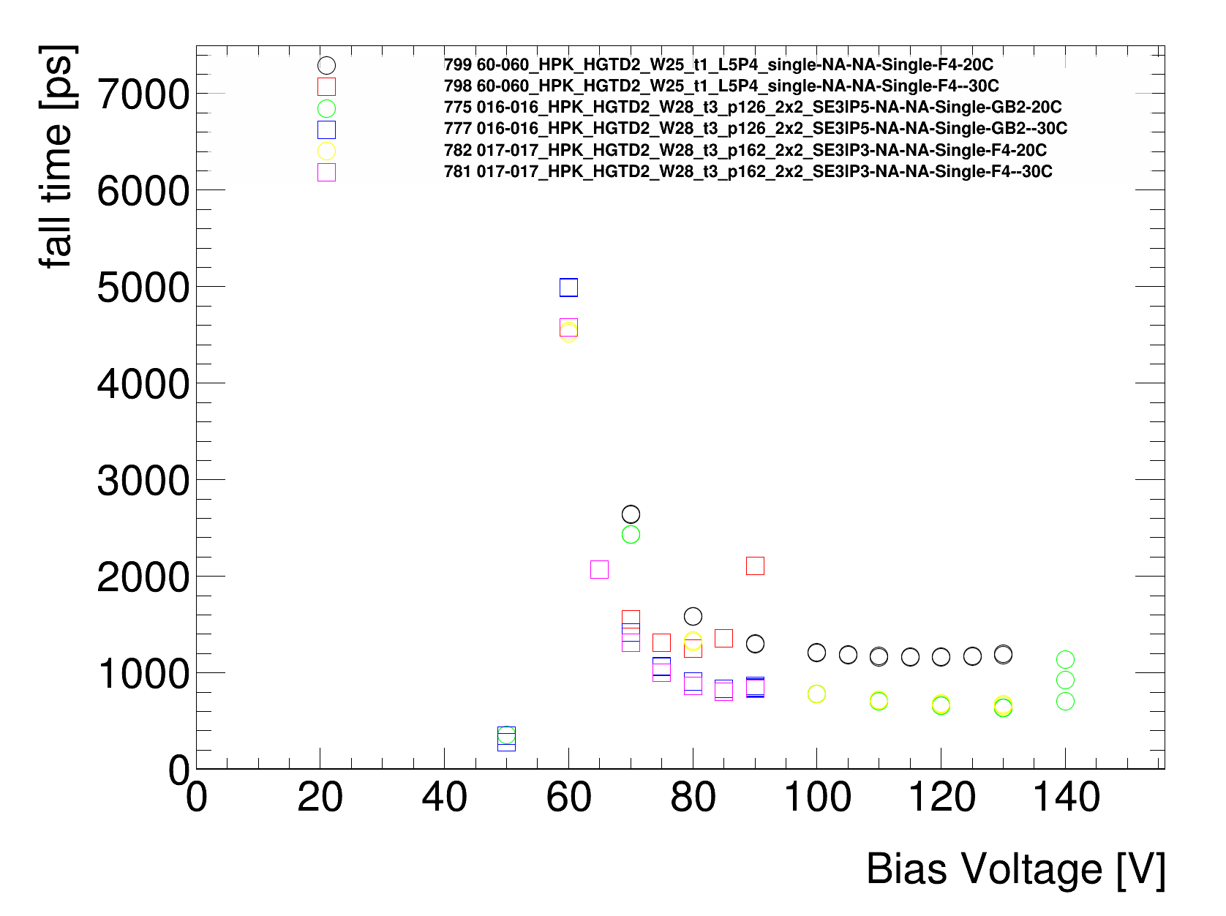
2x2 vs singles split 1
<number>
Simone Michele Mazza - HGTD sensor LHCC review
08/11/2020

Slide 7
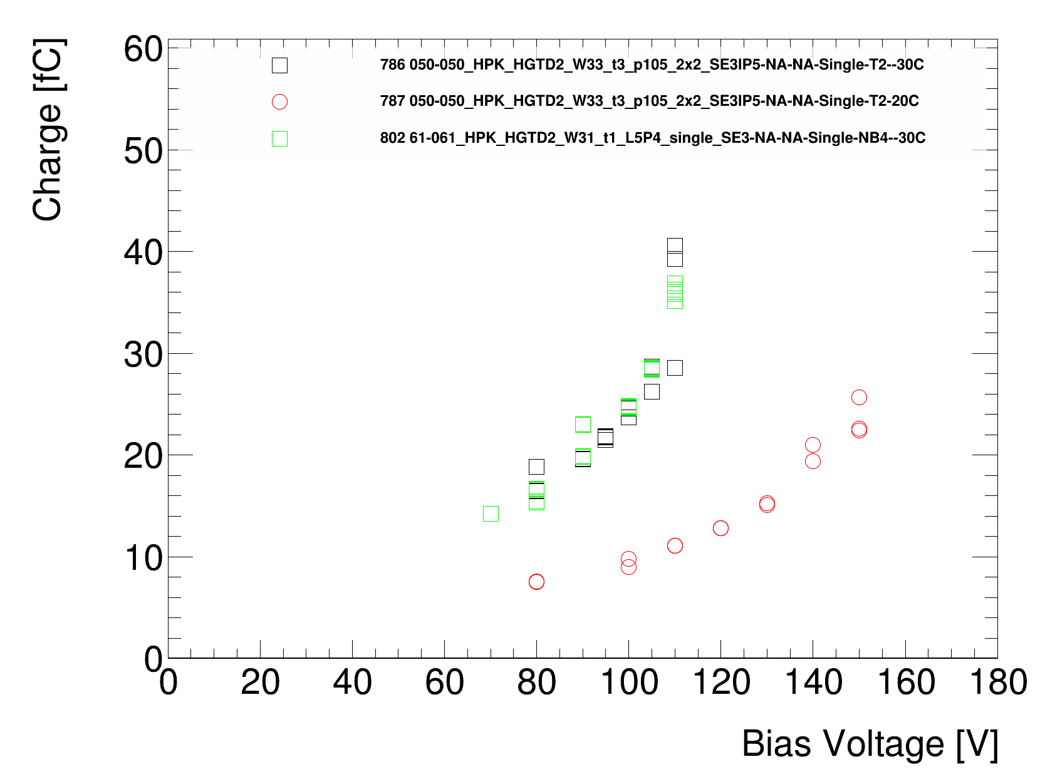
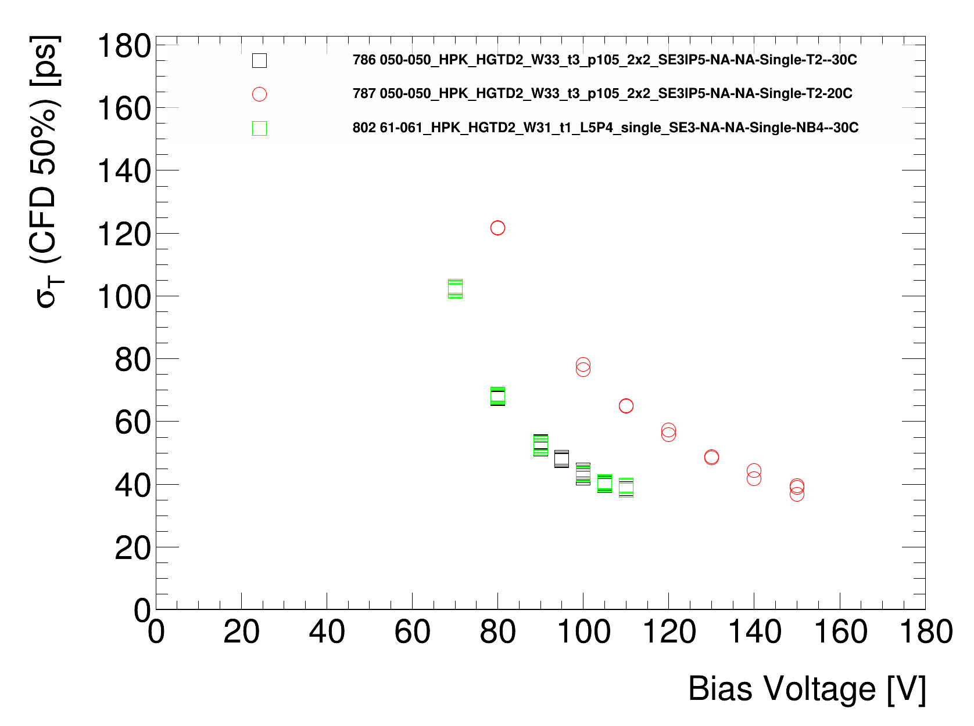
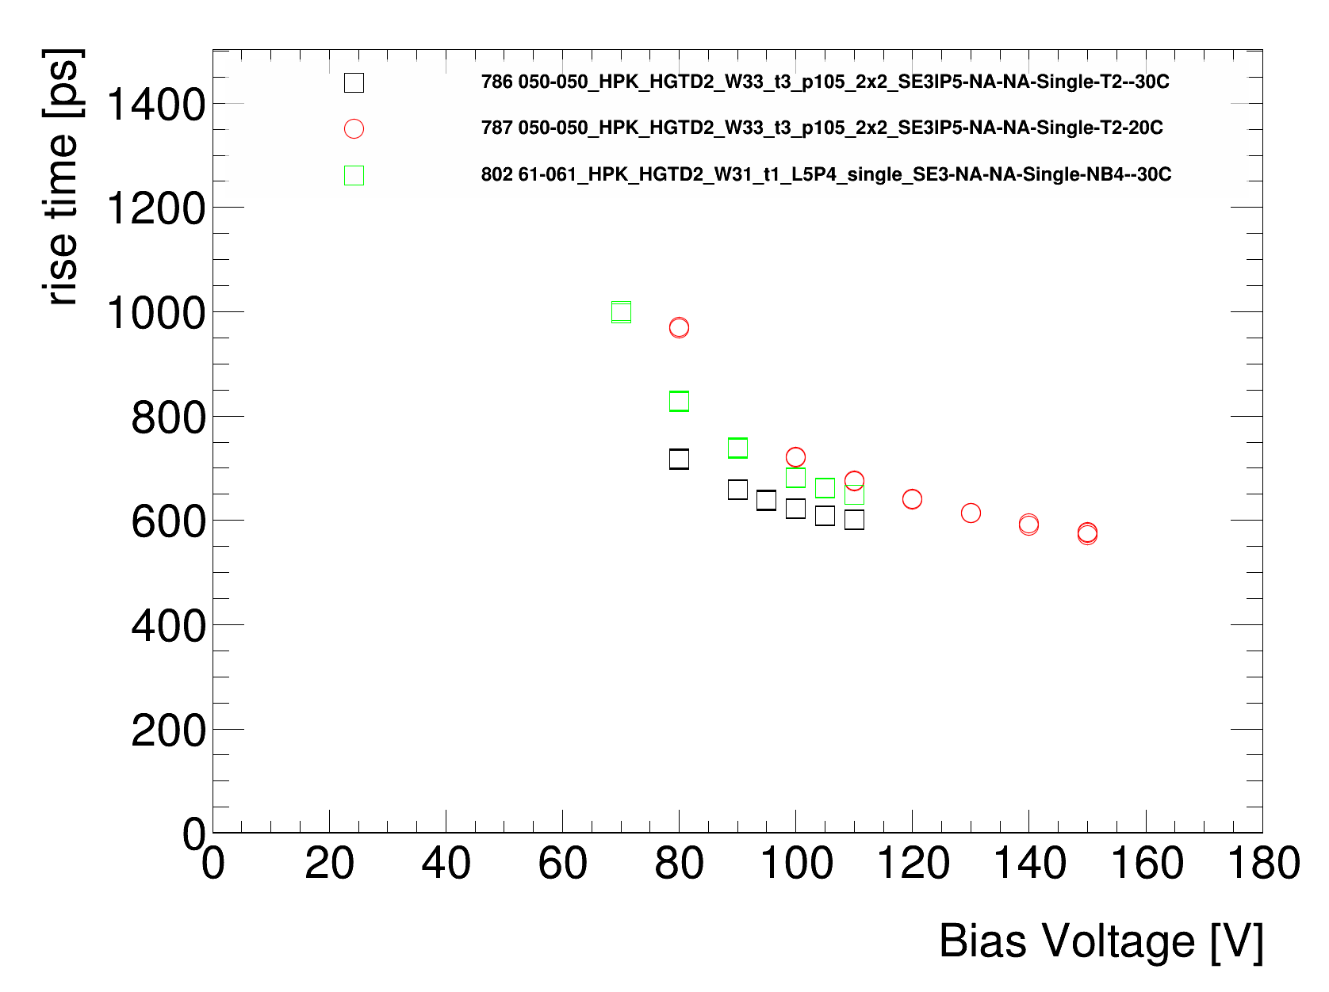
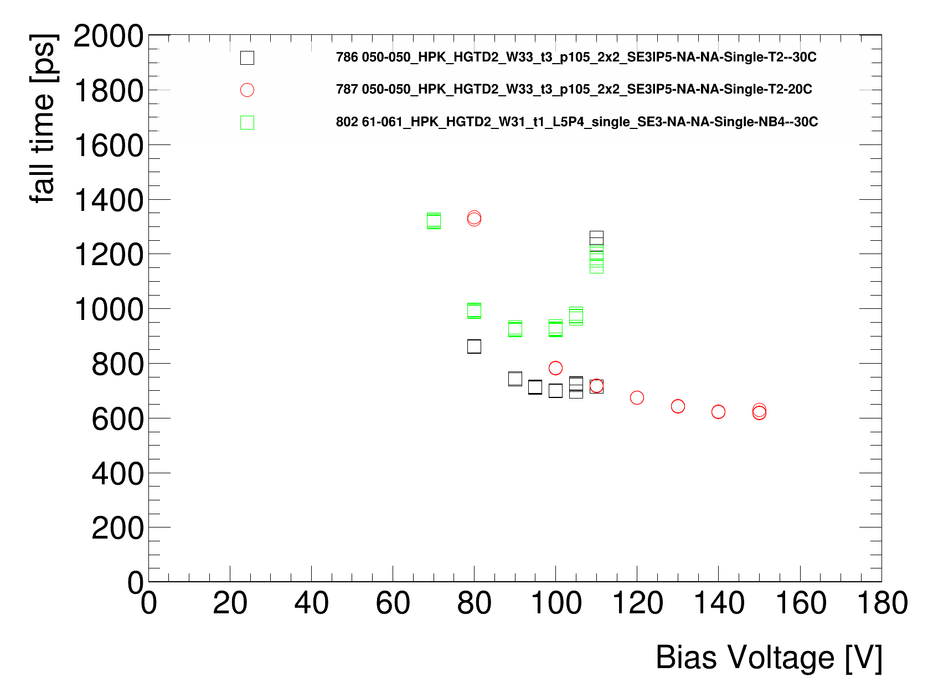
2x2 vs singles split 2
<number>
Simone Michele Mazza - HGTD sensor LHCC review
08/11/2020

Slide 8
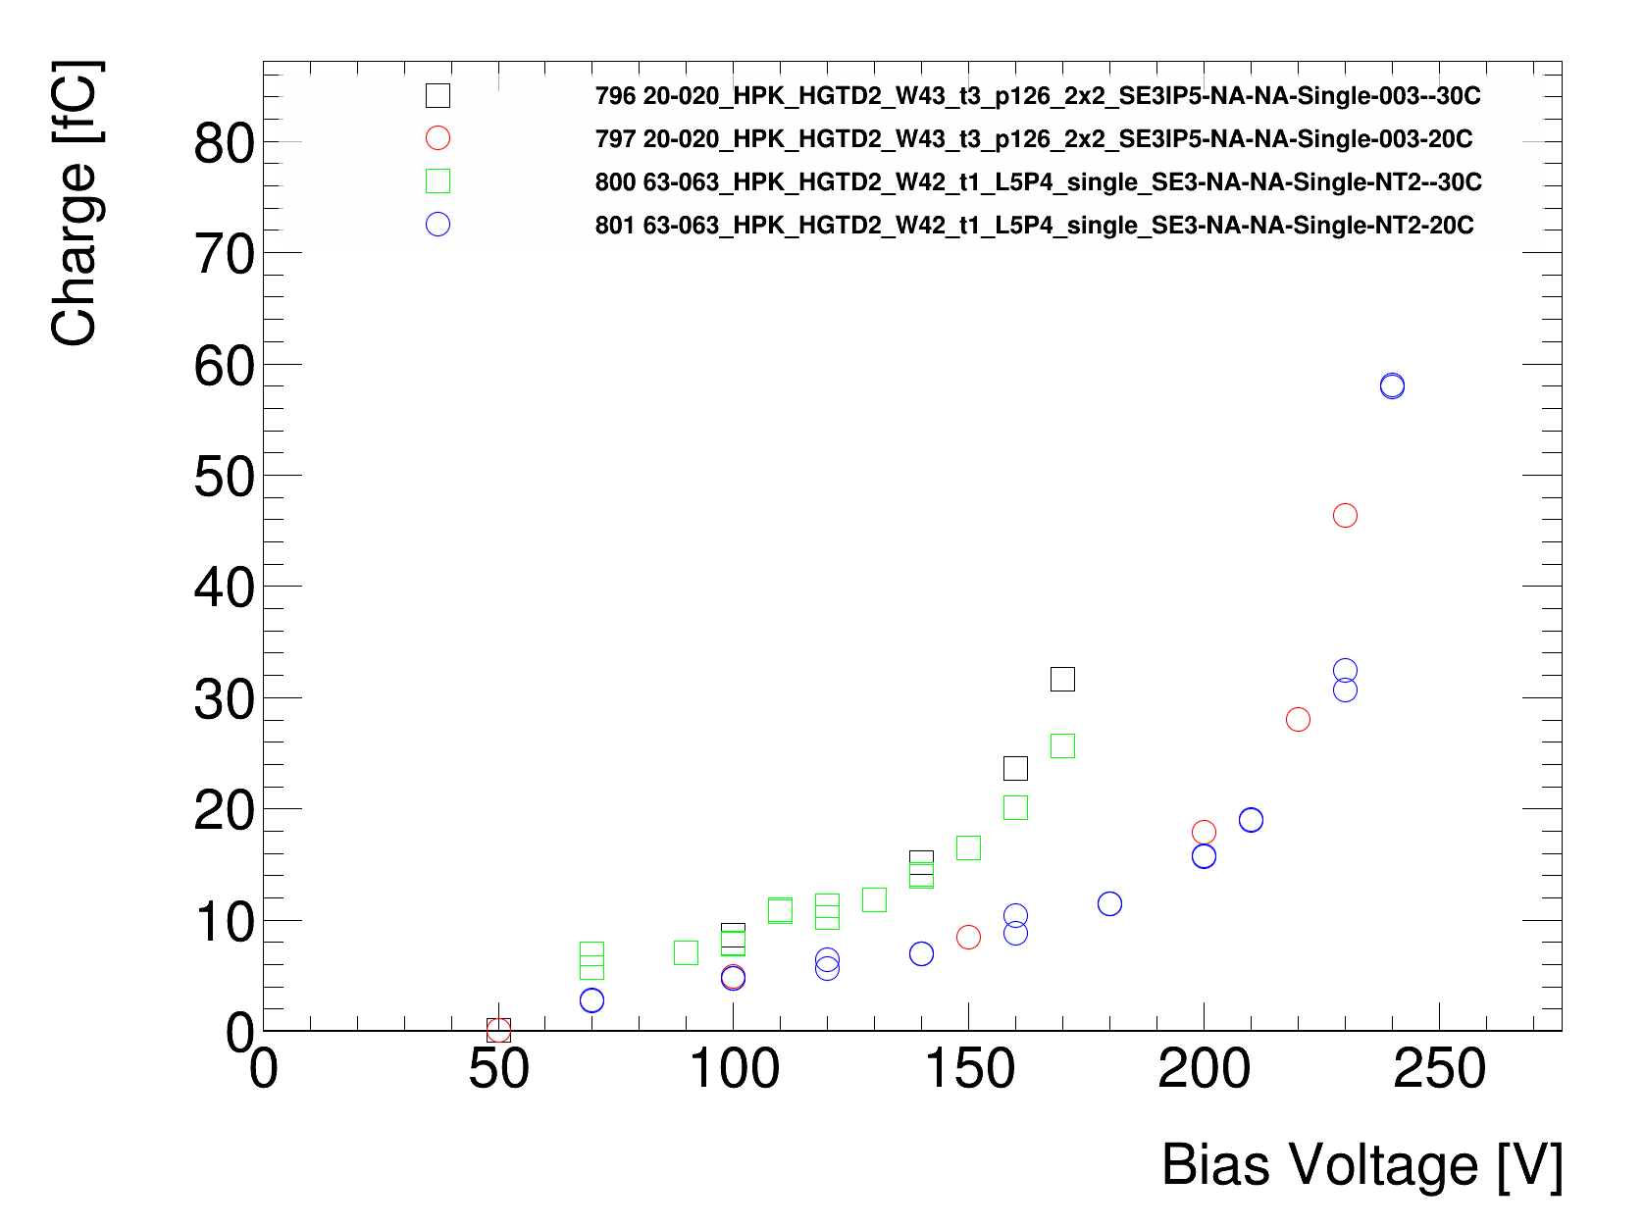
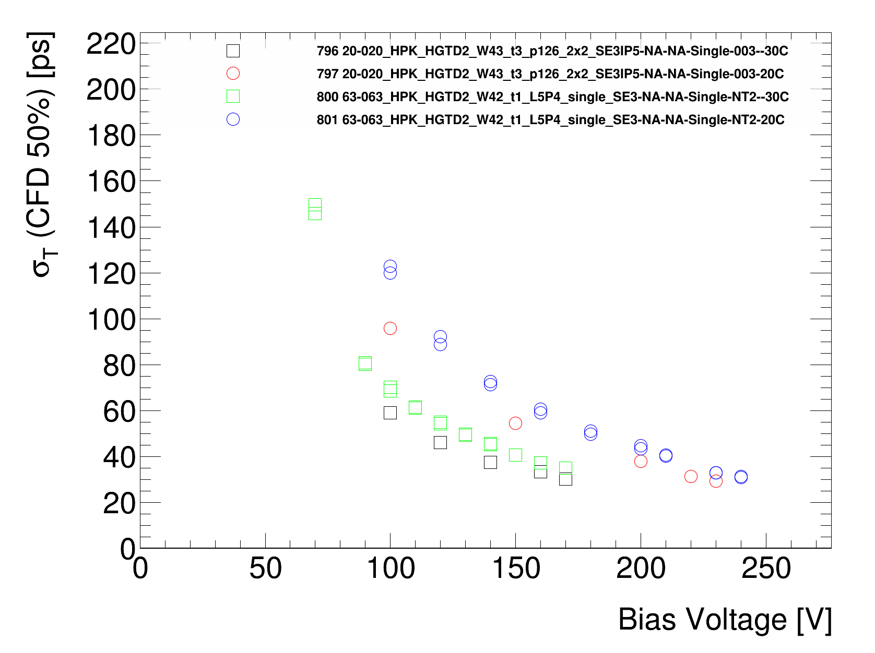
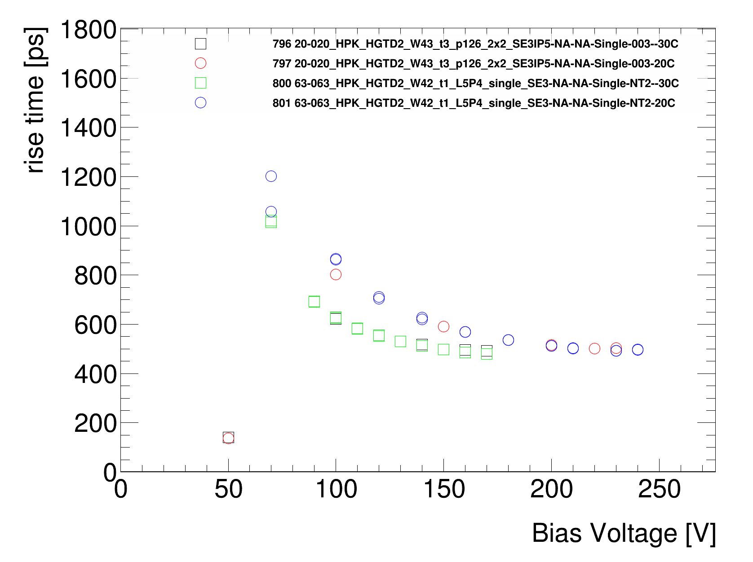
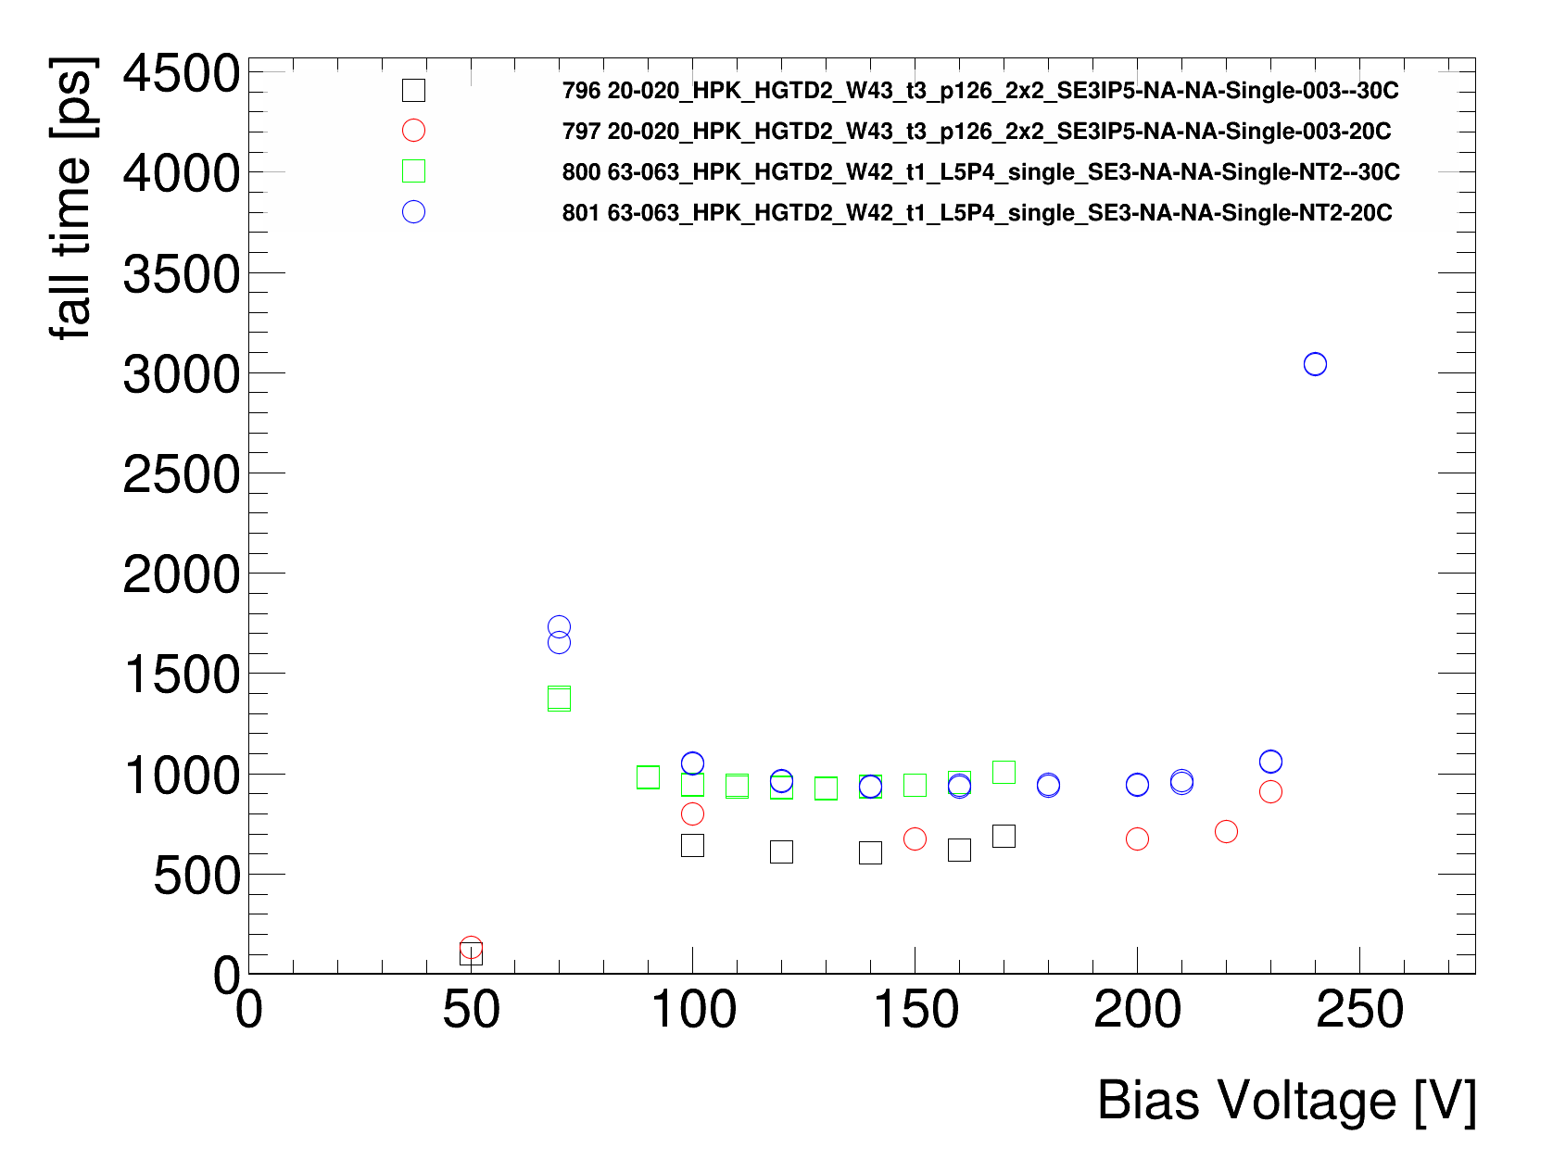
2x2 vs singles split 4
<number>
Simone Michele Mazza - HGTD sensor LHCC review
08/11/2020

