Slide 1
Electronics and DAQ WG Meeting (8/27/26)
Coming up…
Sept 3rd – ASICs & Electronics
Sept 10th – DAQ Software Issues (again)
Sept 17th – No meeting (DOE IPR of EIC project status 9/15-9/18)
Sept 24th – (I’m not available, Fernando may organize meeting)
Oct 1st – No meeting (SRO-XIV)
Oct 28-30 – EIC Detector 11th DAC Meeting
Agenda:
Introduction (Me)
RCDAQ use in ePIC (Martin)
Discussion (All)

Slide 2
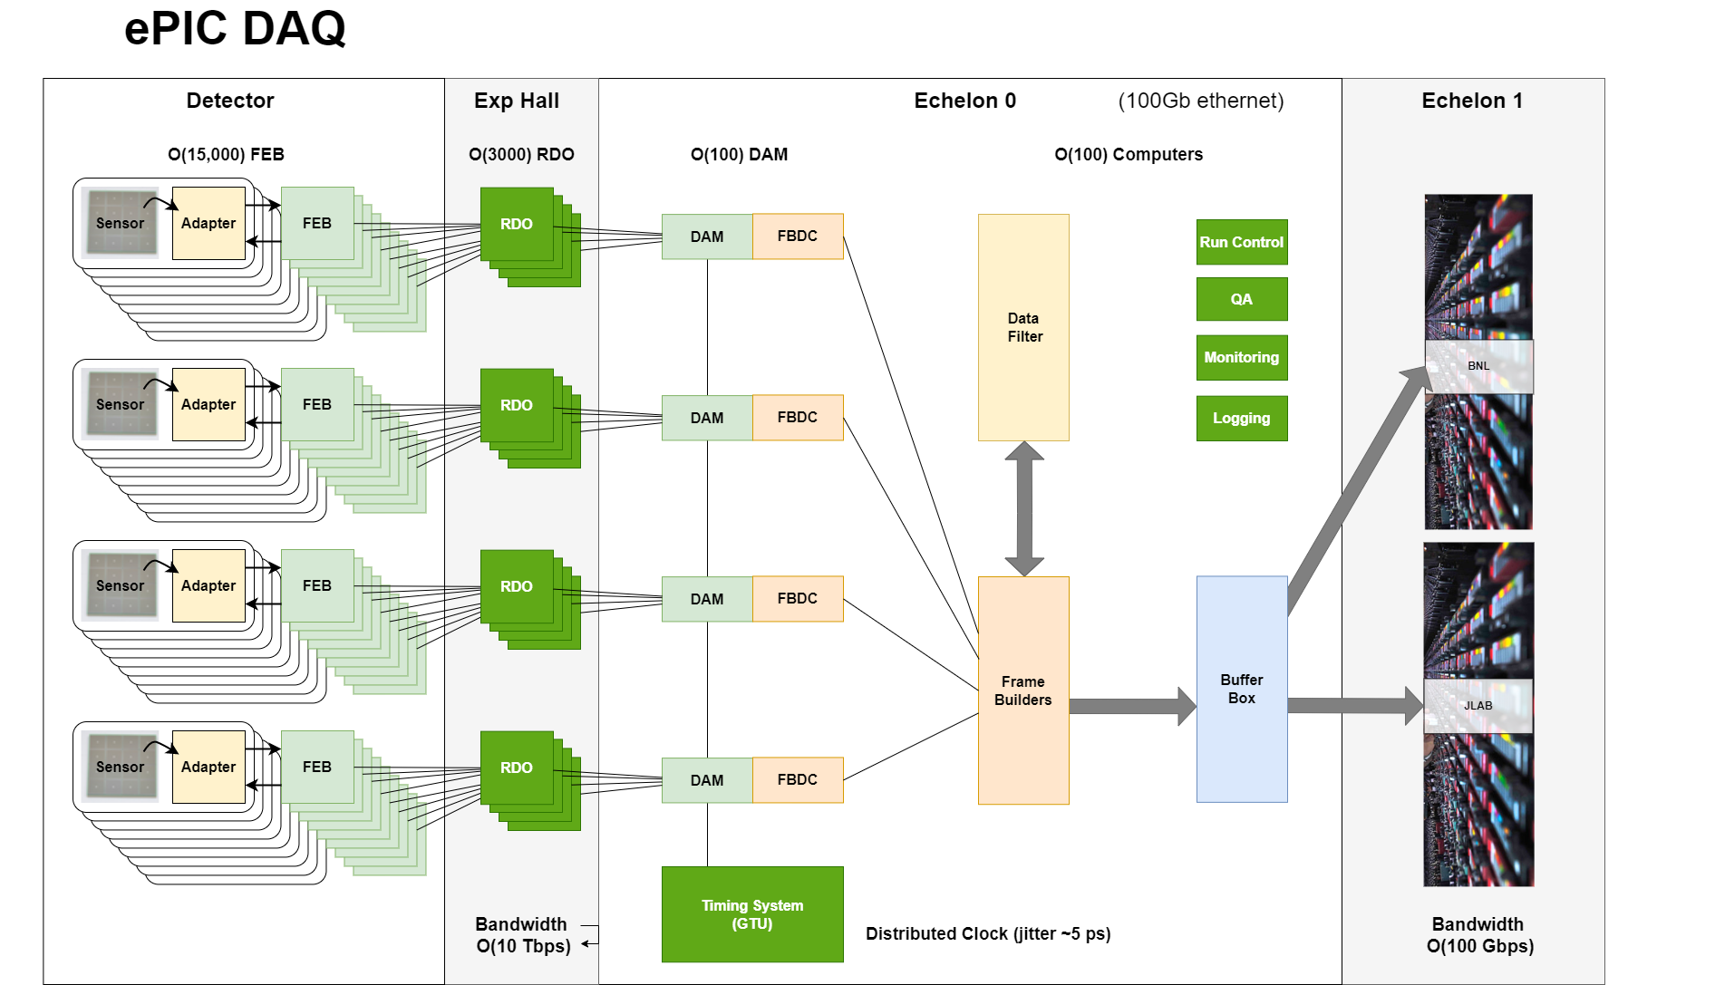
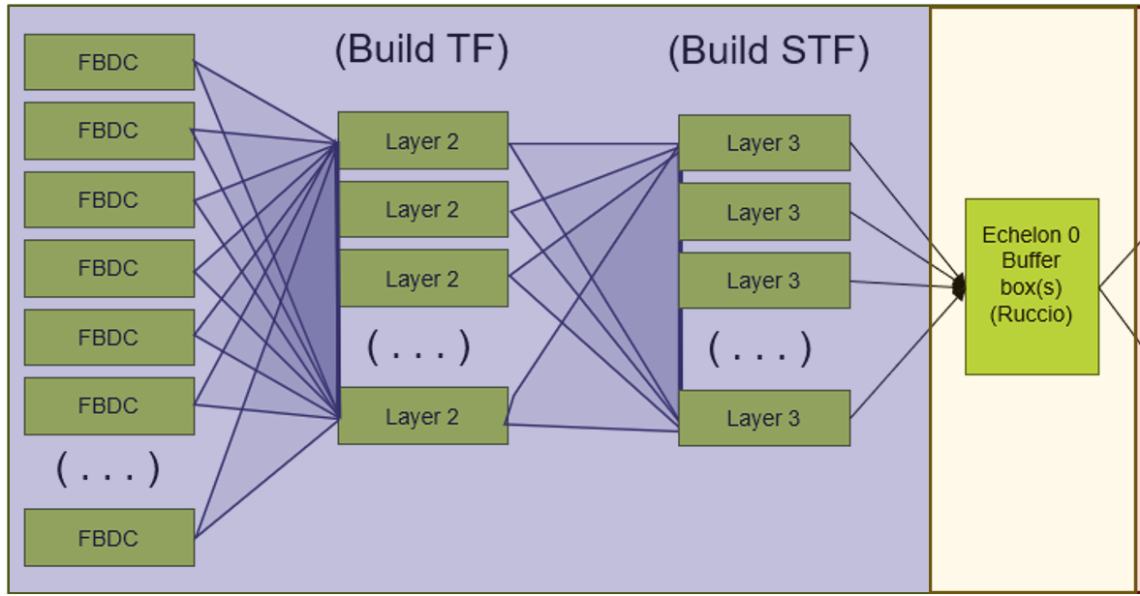
Echelon 0 software:
Data to Echelon 1 (STF) must preserve time frame order, likely requiring more structure in time frame builders
Buffer Box(s) to share software responsibility with Echelon 1 (Ruccio / Panda to manage transfer to echelon 1)

Slide 3
Echelon 0 software:
Today’s goal is to start defining how the details of the collaboration will work
  Requirements
  Understand components
  Start to define interfaces
  Start to define responsibilities
We have well developed components
  RCDAQ
  CODA
  nestDAQ
  STARDAQ
Need to build 1 system with needs (discussed over the years) of epic.
As a starting point for development propose:
RCDAQ
(Martin)
Coda / STAR
(Jeff / Dave)
nestDAQ
(Taku / Ken)
SRO WG / Computing

Slide 4
Key General Aspects of ePIC DAQ
O(30) detectors to be aggregated
  The operation of the DAQ software is independent of any details of the detectors themselves.
  For situations in which detectors specific treatment is required, there should be generic steps. For example, we should have “sanity checks” for data banks that check that the data is internally coherent.
    At the DAQ level this code should have a generic call
    Internal information (such as the bank name) should route it to detector specific code.
    It should be assumed that the detector specific code might be provide by external personnel
    There should be a method for testing the detector specific code separately from the operating DAQ using external data
The time frame is a well defined O(0.6ms) interval for the entire DAQ. There may be other important time references (such as the 2us integration time of the SVT, or the 12.4us revolution of given bunch, but the packets of experimental data passed through the TF builders correspond to a specific start/end time defined by the GTU and consistent for the whole detector.
All of the detector contributions for a given time frame are built into a single buffer (the time frame)
The STF is equivalent to a data file. The timeframes in the STF are ordered and have no gaps.

Slide 5
Key General Aspects of ePIC DAQ
Run control should be simple at the level of specific components
  potentially slow configure step / fast start step
  pause / restart
  At global level the run control might be significantly more complex (e.g.)
    Support continuous running systems
    Support run based detectors
    Support stand alone runs at same time.

Slide 6
Some key aspects of (FBDC)
Firmware filtering is a required feature
  Filtering will likely be a firmware feature, involving the DAM and GTU
  FBDC will need to be mechanism for awareness of rejected data. Presumably it would create a data bank describing scalers representing filtered data.
FBDC builds data from many contributions, needs to maintain status of data that doesn’t arrive / times out
Output of FBDC is ethernet messages containing timeframe data.
FBDC’s will have significant roles in configuration of it’s RDO’s/FEBs
Some key aspects of (TF Building)
Error handling / data consistency is key
  Well defined behavior for expected contributions that time out (create dummy bank indicating loss)
  Well defined behavior if get unexpected contributions (either previous timeouts or duplicates)
Need to be able to apply analysis
  Data format consolidation
  Data consolidation (cluster finding etc…)
  Background reduction

Slide 7
Message/Data passing
What system should we use
  ZeroMQ
  ActiveMQ
  Custom?
What common headers / format should we use. Passing data should use a simple uniform scheme
What data file format should we use:
  The underlying file format is less important than the programming interface we will provide for accessing the data:
    Get(TimeFrame, Detector, DataBank) (or)
    Get(TimeFrame, DAM, Port, DataBank) (or…)
    And how do we handle the issue of unifying the readers of all the various low level data banks?

Slide 8
Plan
Need more detailed documents:
PreTDR discusses many expected capabilities
Taku’s requirements ( https://docs.google.com/document/d/1JOOHCCjDQHqPvExxVhKfKK8vwut417imKBWmKuTFdHM/edit?tab=t.0#heading=h.mbjsiz6n6jlo )
  Iterate Taku’s document and ensure that it is consistent with preTDR and other discussions
  Develop interfaces between components
Data Formats:
  Define the software interfaces
  Gather details of existing formats & advantages / disadvantages of each

