Slide 1
BIC Update
Triple I Engineering Meeting Update
Kevin Bailey & Tom O’Connor
September 21, 2026
BIC Sector Development Update

Slide 2
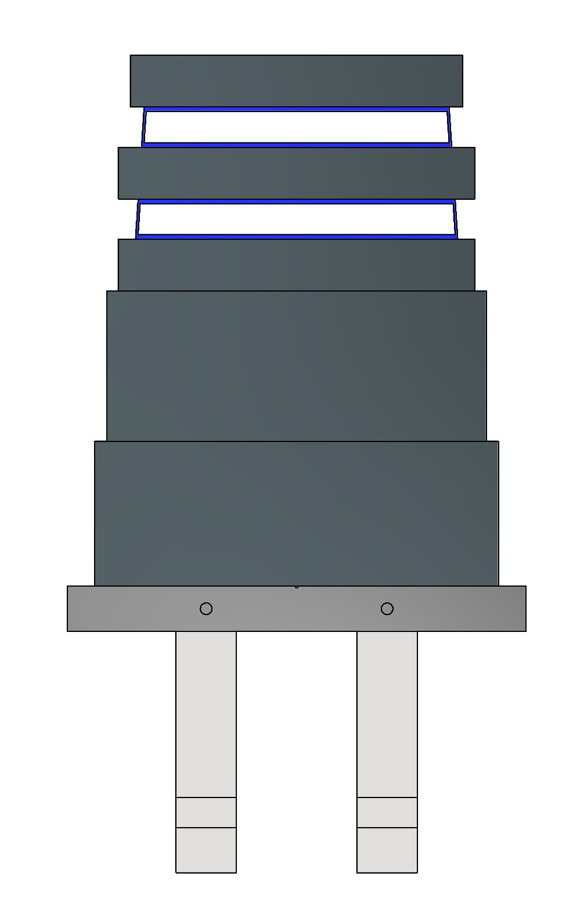
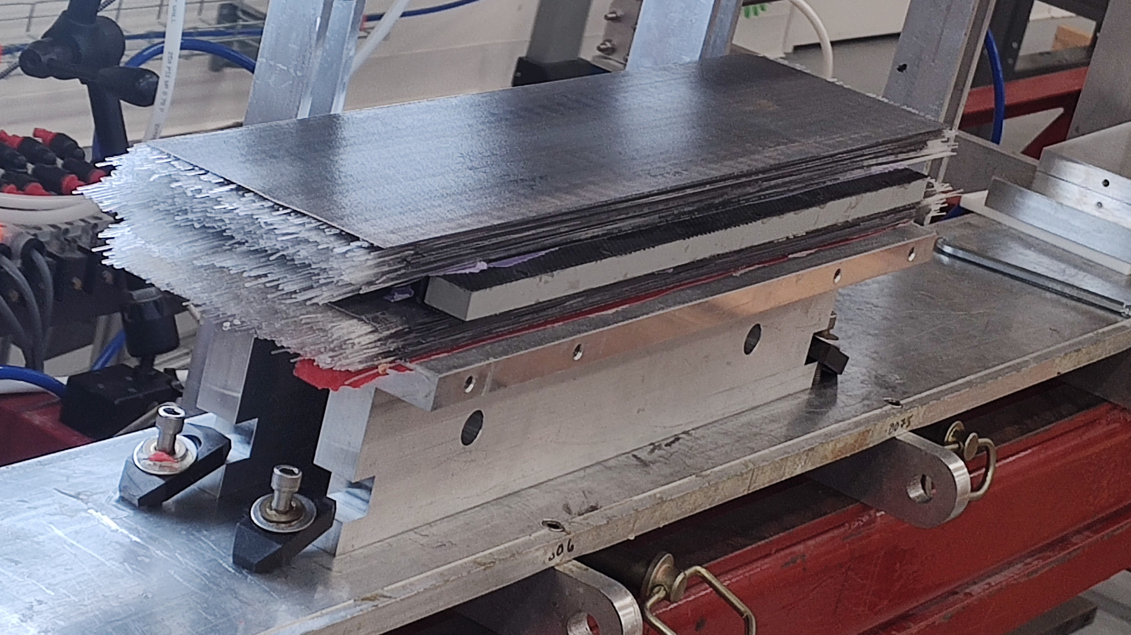
Test Article Construction
0.5m article with bulk section and drawers underway
  Measurement and alignment tooling under development
Swager improvements under discussion
0.5m article with 1 drawer (Hamberger) is being machined

Slide 3
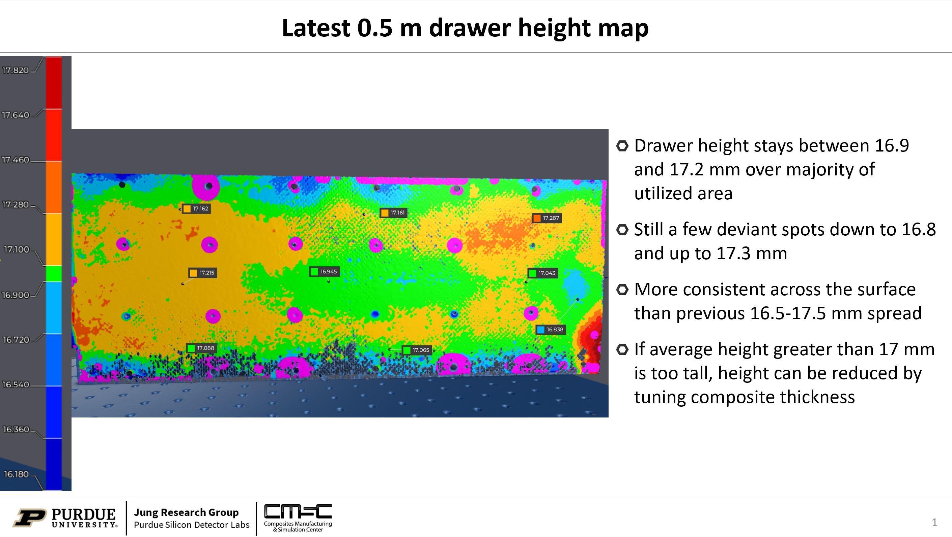
CMSC
Drawer construction continues to improve

Slide 4
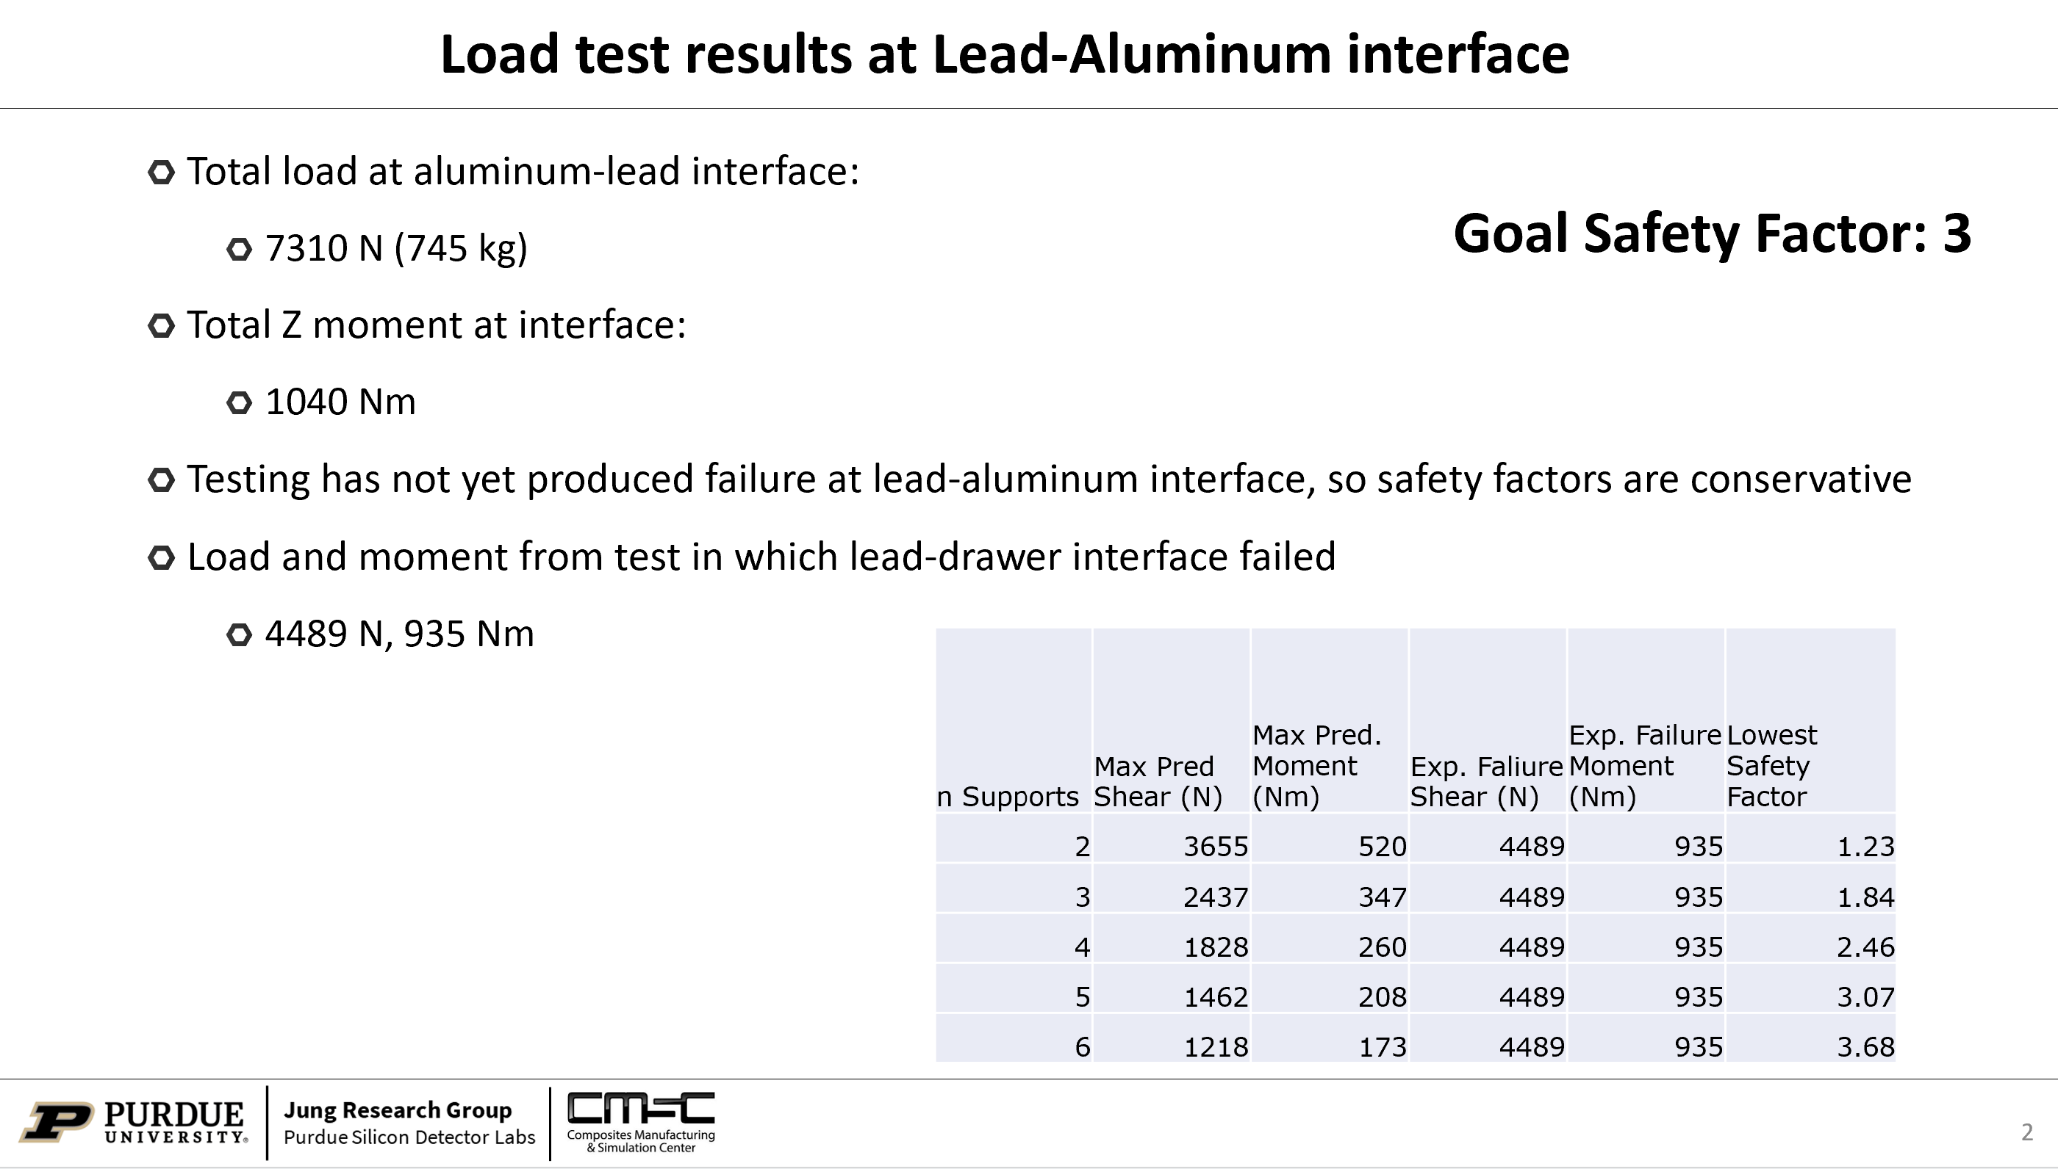
CMSC
Using existing test data - which is insufficient

Slide 5
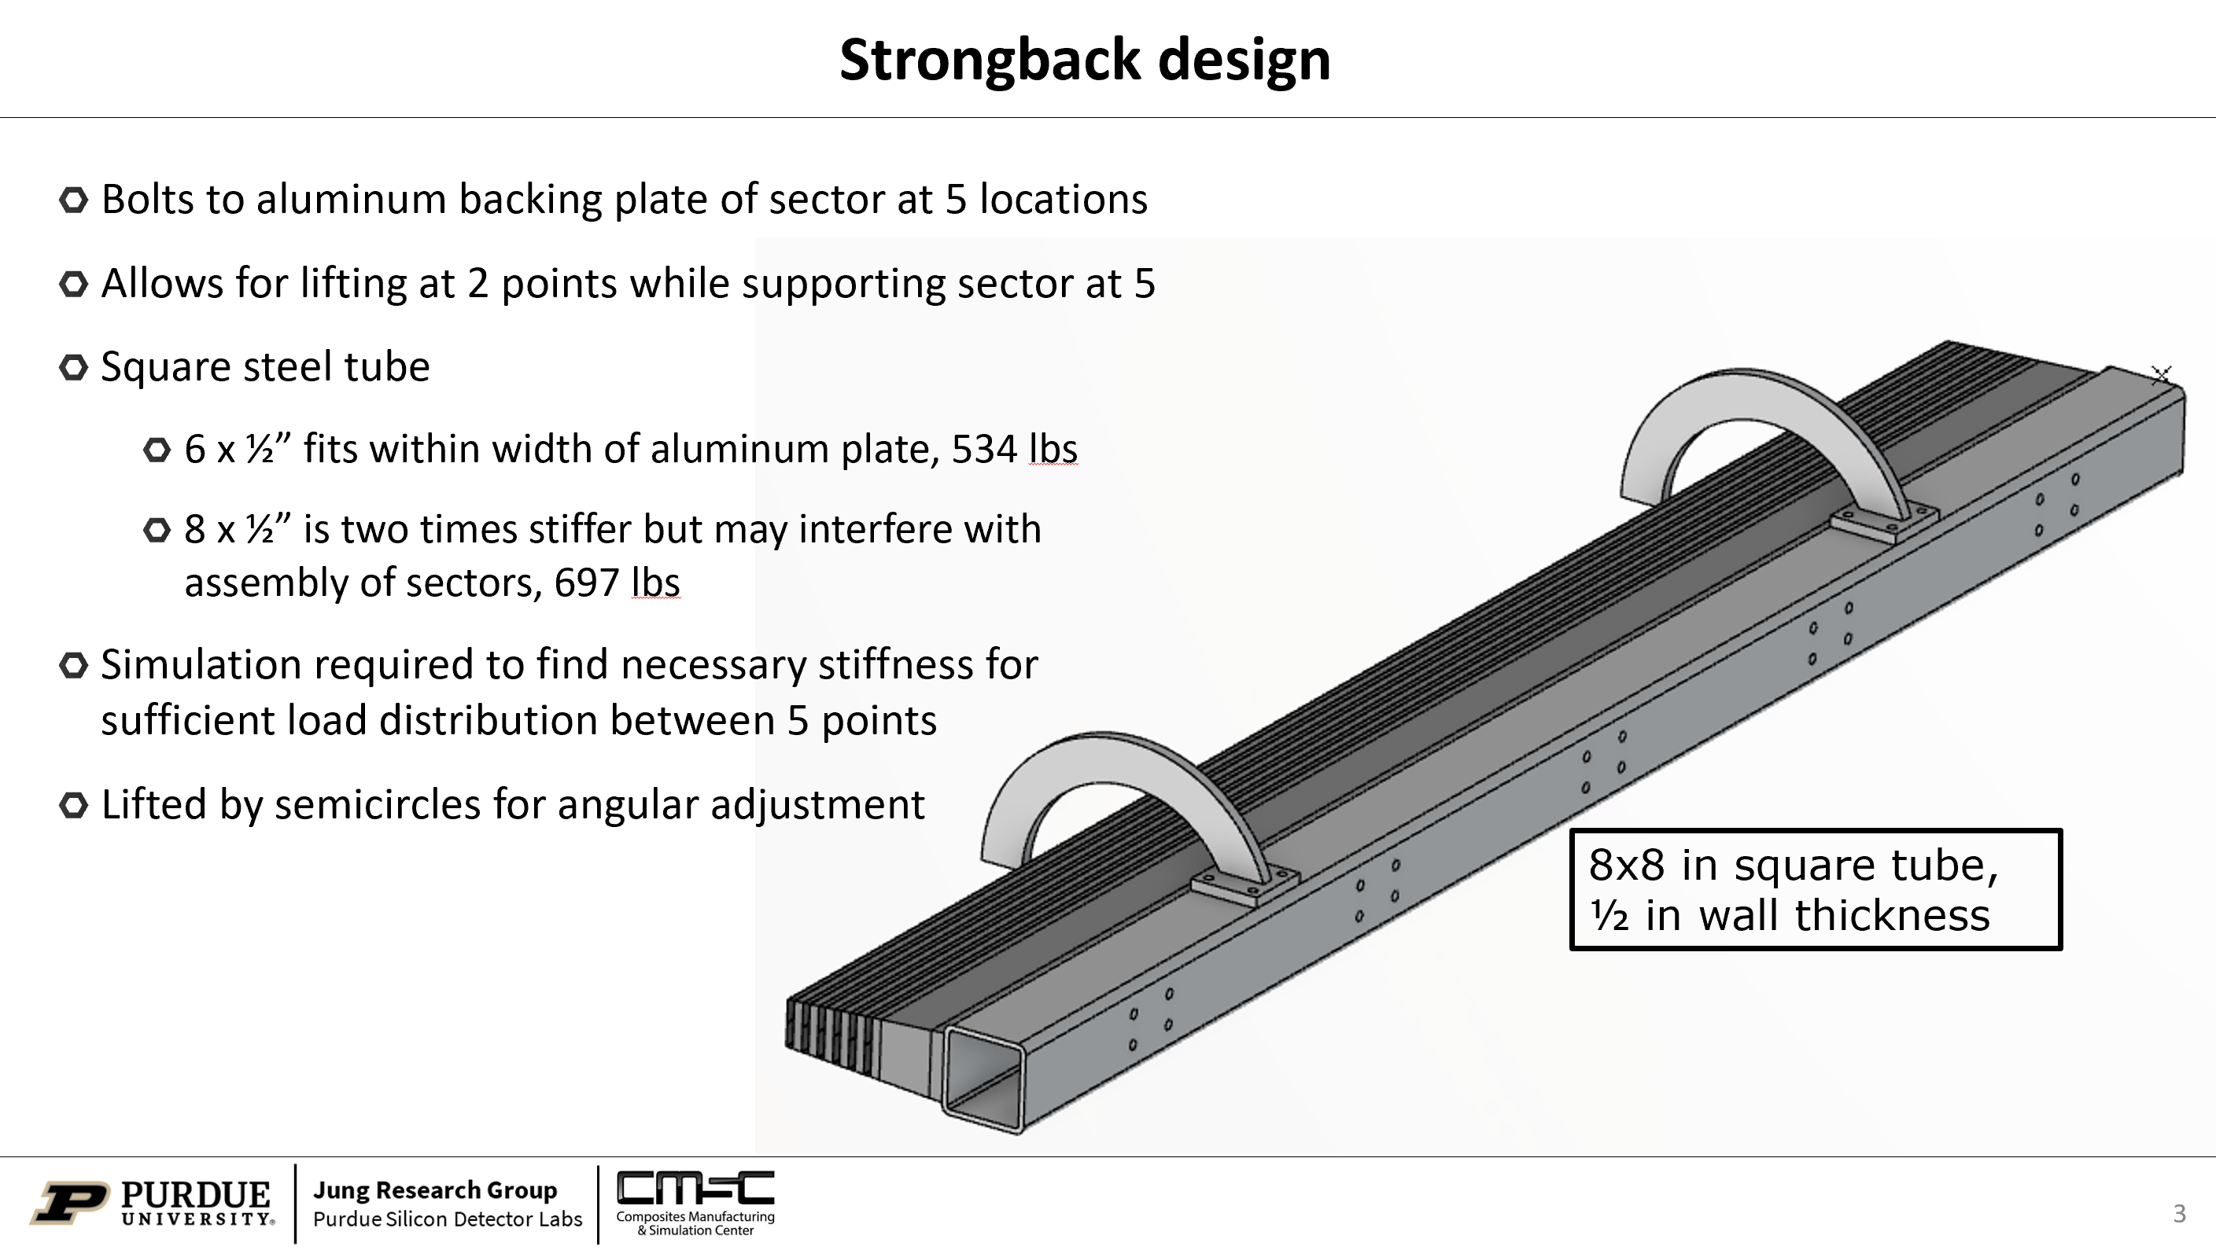
CMSC
Using existing test data - which is insufficient

