Slide 1
Far-Forward / Far-Backward
Detector Integration
Jonathan Smith (JLAB), Ron Lassiter (JLAB),
and India Krehbiel (JLab)
September 21, 2026

Slide 2
Primary Updates Outline
B0 Updates
Ongoing/Upcoming Workload & Handover

Slide 3
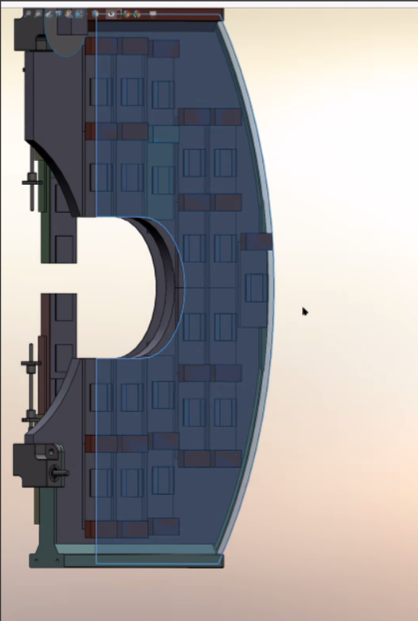
B0 – Detector Layer Update
The new detector layout now includes (2) thin aluminum surfaces on the front and back of the detector layer. In addition, the update provides an early concept for cooling.
(Image courtesy of Avishay Mizrahi)

Slide 4
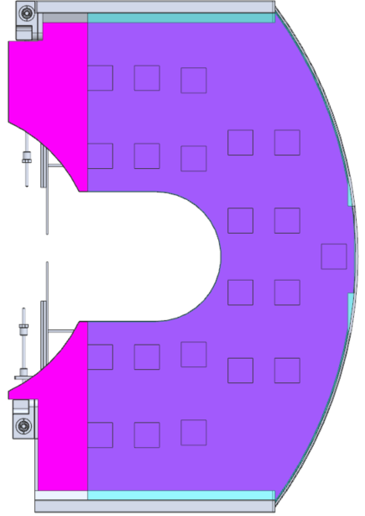
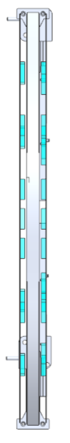
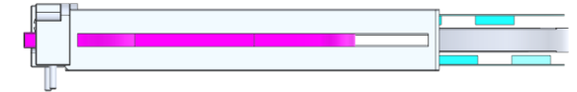



B0 – Detector Layer Update
Cooling lines
Top View
Open Space between layers

Slide 5
Ongoing/Upcoming Workload
Scheduled meeting with Stephen Kay (York, UK) to discuss design requirements for Lumi Conversion Foil – Updates will be coming in the near future
Ongoing updates to the B0 detector railing
Jonathan is departing Jefferson Lab September 26th. India and Ron will be taking over future responsibilities.

