Slide 1

Collaboration News
John Lajoie, Silvia Dalla Torre
September 25, 2026

Slide 2
Hey John, start the recording….

Slide 3
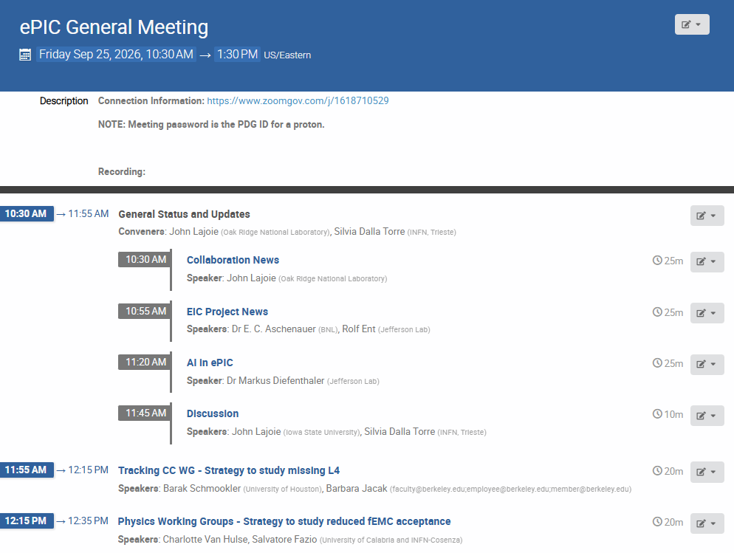
Agenda
Collaboration update on the EIC OPA review, AI in ePIC.
Reports on mitigation strategies.

Slide 4


Welcome New Institutions!
New Mexico State University
Lovely Professional University
announced 8/26

Slide 5
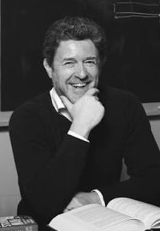
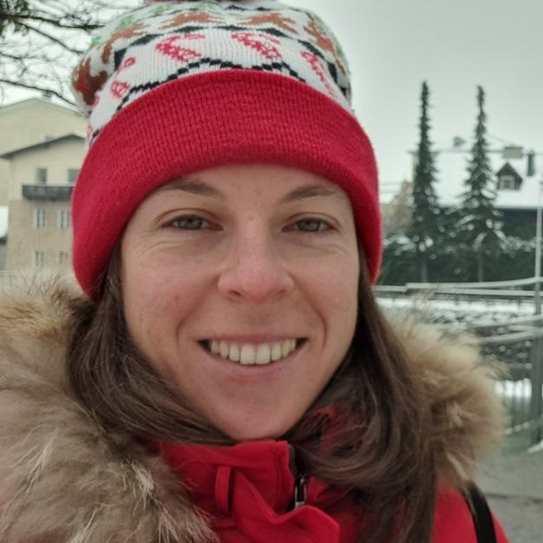

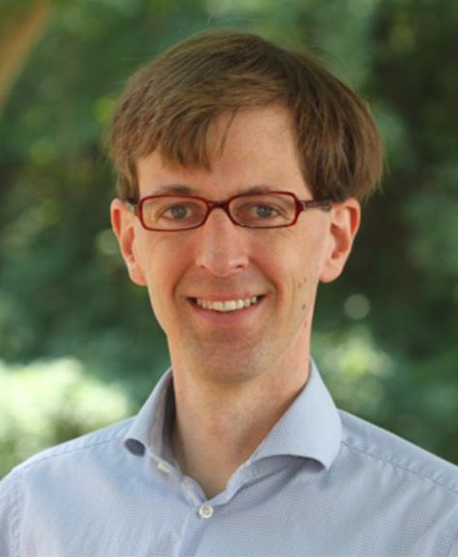
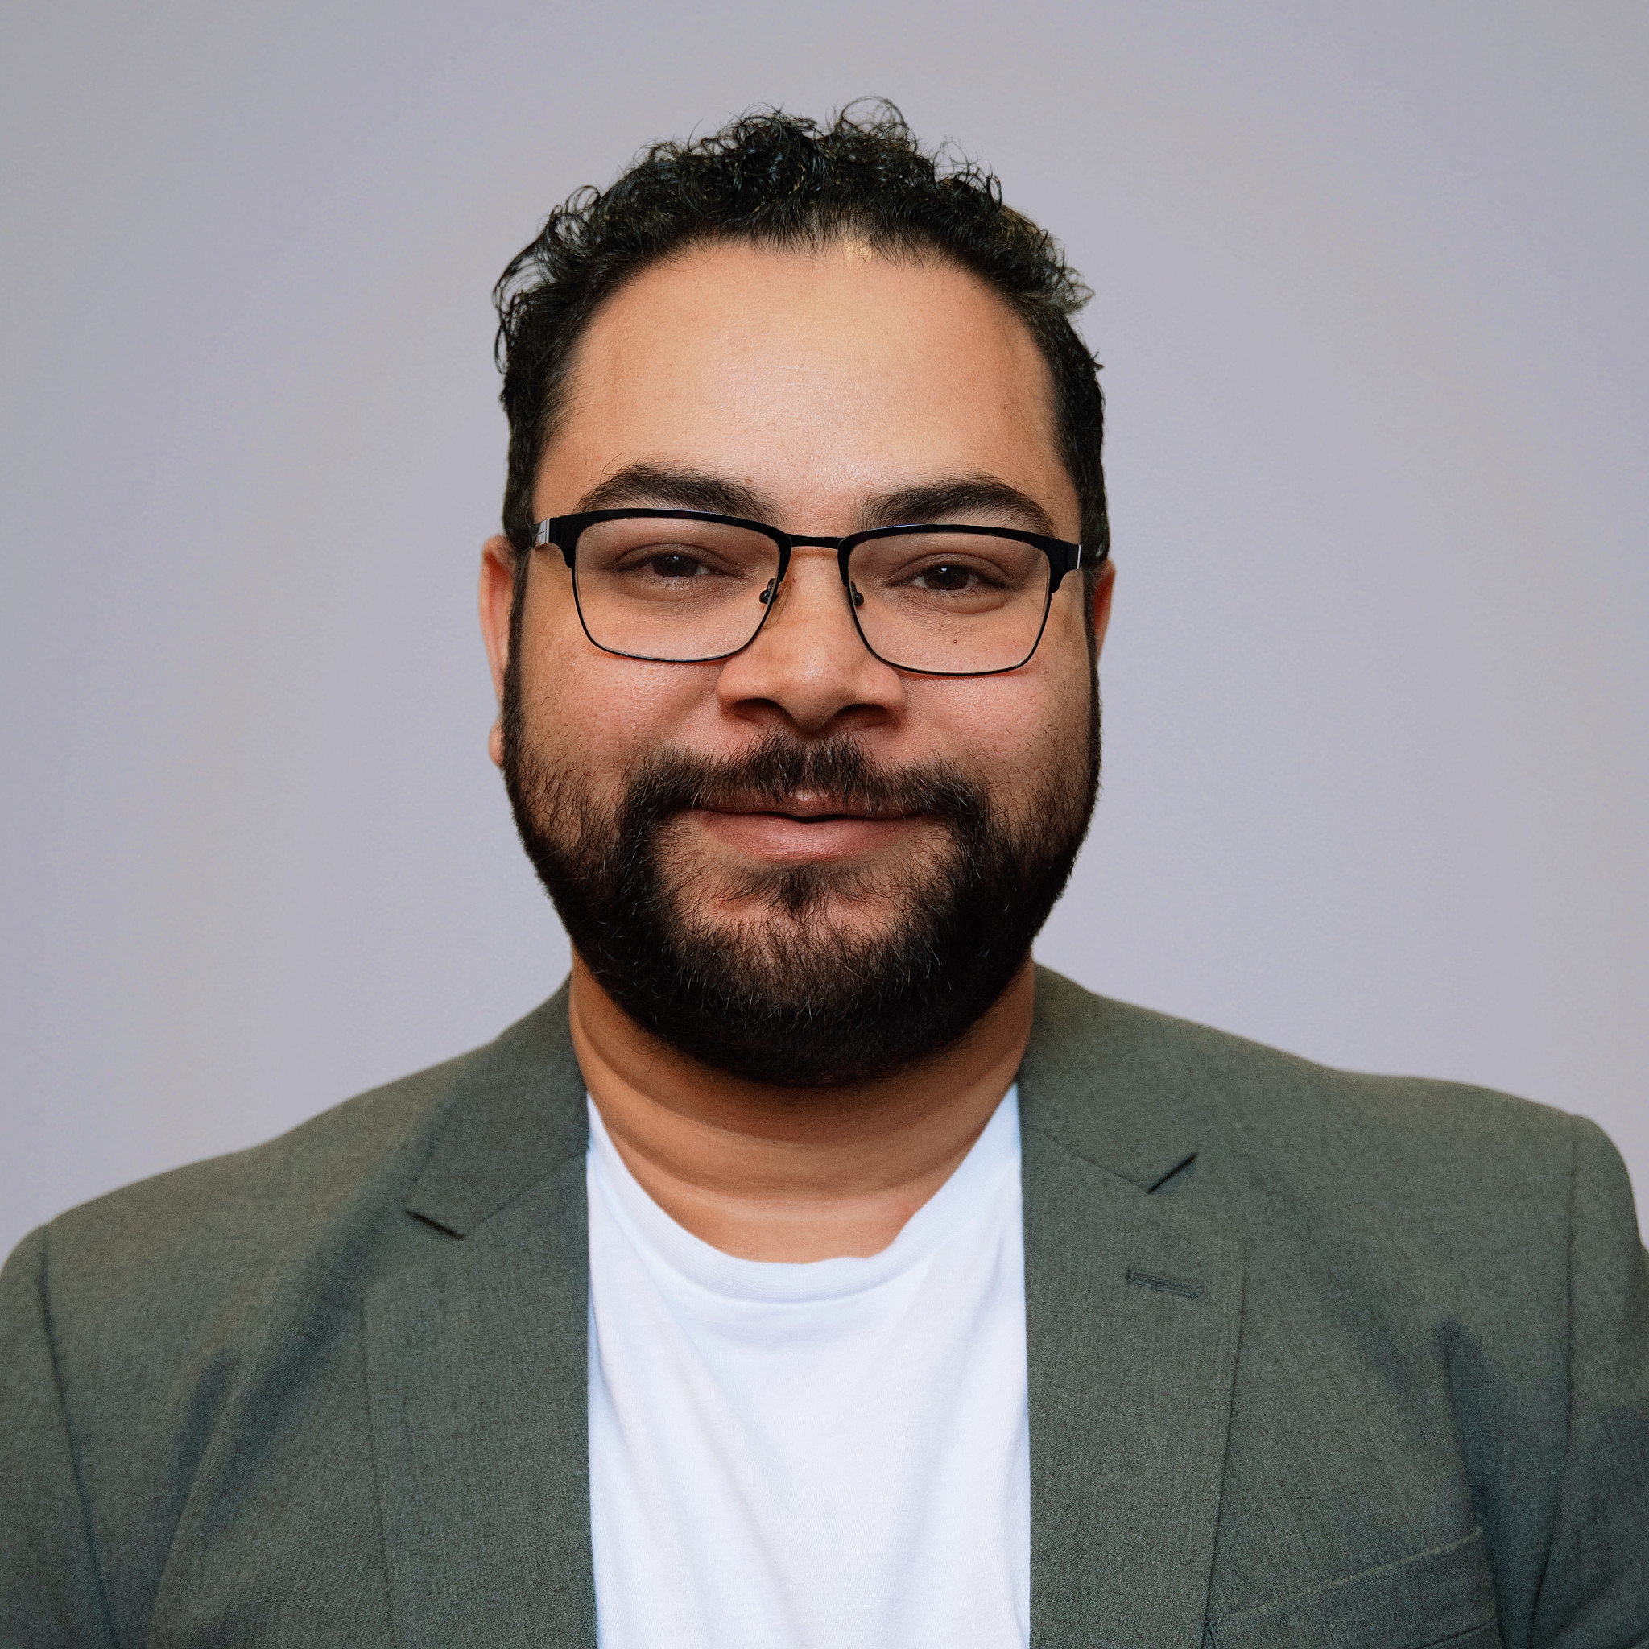
Elected by the ePIC Collaboration Council
Marco Radici
Collaboration Council Vice-Chair
Chiara Bonini
Collab. Culture Committee
Mariangela Bondi
Conference and Talks Vice-Chair
Wouter Deconinck
Membership Vice-Chair
Niseem Abdelrahman
Collab. Culture Committee

Slide 6
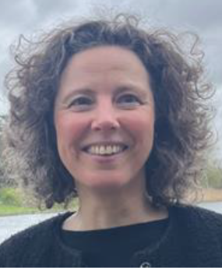
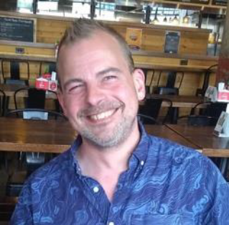



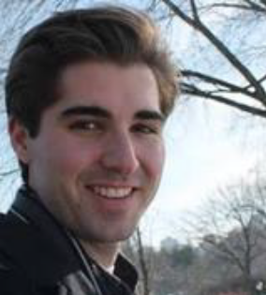


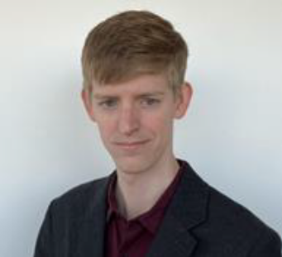
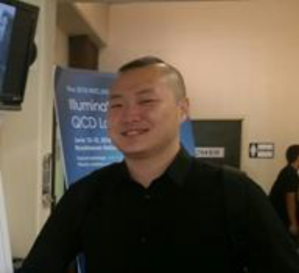
Confirmed by the ePIC Collaboration Council
Charlotte Van Hulse
Physics Analysis Co-Coordinator
Kolja Kauder
Simulation WG
Andy Buckley
Validation WG
New Nomination:
Anil Panta nominated to replace Thomas Britton in
Production WG
Tyler Kutz
Inclusive WG
Oleg Eyser
SIDIS WG
Jan Vanek
Exclusive, Diff. & Tagging
Austin Baty
Jets & HF
Jae Nam
BSM & EW

Slide 7
OPA IPR Review of the EIC Project – Sept. 15-18th
Comment on attendance:
  Limited attendance in rooms/Zoom @ request of DOE
  DSL’s invited to SC4 DET subproject session
  RRB members invited by DOE
  Future attendance/transparency discussed with new Project Director
Elke and Rolf will give the overview – just a few comments from me
  The EIC Project has done an outstanding job since earlier this year in developing a preliminary baseline that can be used for making decisions
  IMHO the ESR and pTDR were important input to this review and to the SCAC!
  The outcome of the review went as well as can be expected
    This is not a negative statement!
  The collaboration needs to be open-eyed and realistic when it comes to schedule

Slide 8
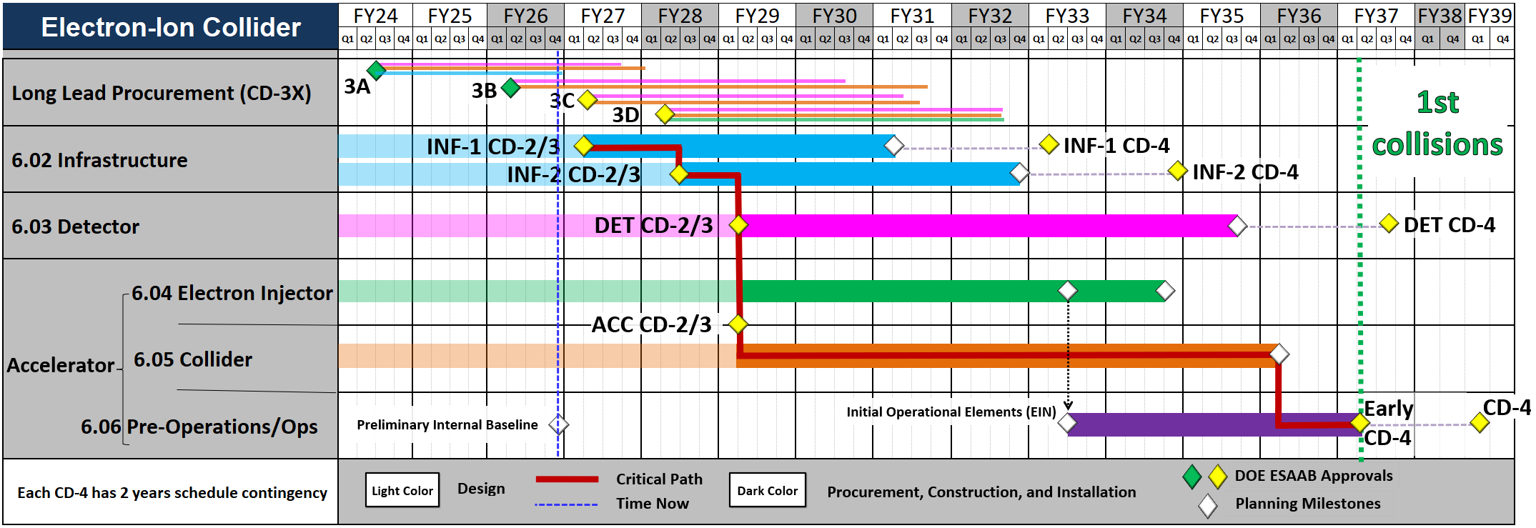
Strategic Schedule
The strategic schedule integrates subproject sequencing, key approvals, and the path to early operations.
Management tool that guides project planning efforts and is not currently supported by the P6 schedule
From Jim Yeck’s Presentation –
Strategic Schedule incorporates technical readiness with funding constraints, etc.
Charge 1, 7
8
Notes:
This is the strategic schedule that implements the phased execution strategy I just described. Infrastructure leads, Accelerator follows, Detector proceeds on its appropriate path, and the activities converge on early operations and first collisions.

Slide 9
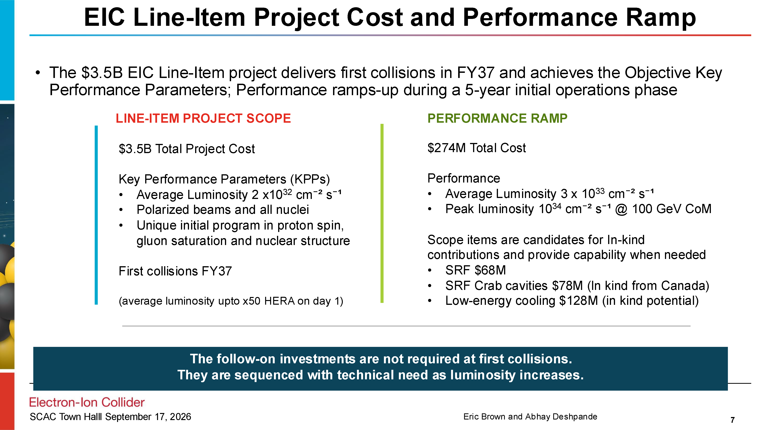
From Abhay and Eric’s SCAC Presentation.

Slide 10
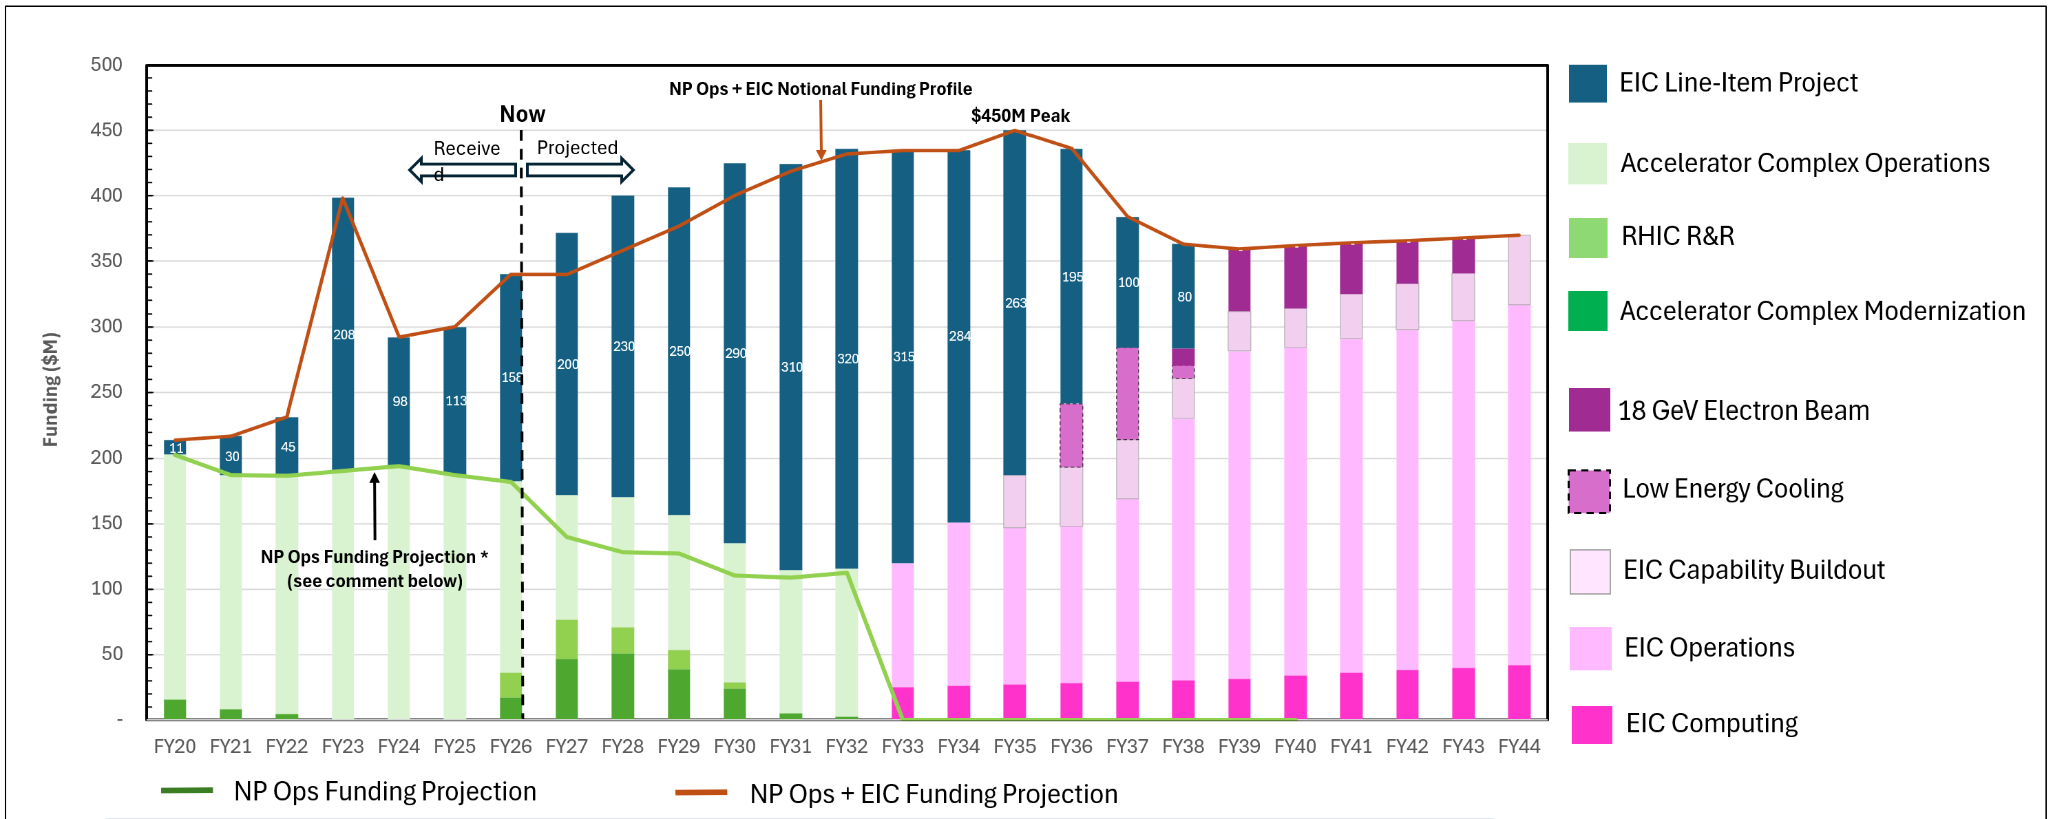
NP Operations + EIC Notional Cost and Funding Profile
Current NP Ops-funded EIC scope exceeds projected funding. Scope and dependencies
are being reviewed to reduce costs and align with available NP Ops funding.
A very important step – captures the full scope of not just the EIC project but everything that is required to achieve EIC mission need! (Very well received by DOE.)
Notes:
This is the notional profile behind the assumptions I just described. The combined envelope peaks at about $450 million annually. The immediate issue is on the NP Operations side: our current estimates for NP Ops-funded EIC scope exceed the projected funding. We are reviewing that scope and its dependencies now to bring cost and funding into alignment.

Slide 11
Emphasizing the Collaboration
SP Office has stressed the need to maintain engagement with the collaboration and the international community:
  Discussion w/Paul Mantica 8/19 (as schedule was developing)
  Discussion with Allen Weeks 9/17 (during OPA review)
It will be important for the collaboration to carefully consider its efforts to help maintain engagement in ePIC/EIC science.
I’ll stop here – much more from Elke and Rolf, keep this in mind during their presentation.
We will have time for discussion today, and we will revisit this in the October General Meeting(s) as well.

Slide 12
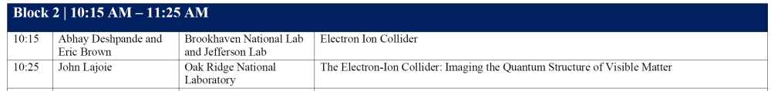
SCAC Facilities Subcommittee Community Town Hall
Held via Zoom Sept. 17th
  Solicited speaking opportunities and written input
EIC/NP was well-represented:
SCAC Facilities Subpanel report anticipated at SCAC meeting on Nov. 12th.

Slide 13

ESR -> NIM-A
The NIM-A version of the ESR - objectives:
      Resolve the beam-energy inconsistencies by basing all the plots on the project matrix shown in the same document (9 GeV electrons; up to 275 GeV protons)
      Try to work out full fits for most of the impact studies – avoid reweighting outside the phase space covered by current data
      Simulation: April campaign -> July campaign
  Goal: submission by end of October.
  July campaign: 594 physics configurations, with some unforeseen bumps in the road. Most of the files are now ready: 520M events, totaling 274 TB. For some studies, the required simulations are still missing, this is being resolved.
  see PACs report at the PA+SC joint meeting on Wed 23: https://indico.bnl.gov/event/34224/
Quick to run analyses on new data. Some fits take longer time
2 studies ready of the 15 total. A few more are already in the hands of fitters
PWGs are pushing full speed. Round table of status report at our next PAC meeting on Sep 29th

Slide 14
Conferences and Talks
“I’m sorry I’m posting this late, but here is a draft of my talk…”
  (Especially from senior people.)
  We have a conference and talks policy, we need to do better
  This has gotten particularly bad lately, with sometimes less than 24hrs for PACs to review and approve talks, or the PWG conveners being skipped altogether.
Discussed with Daniel and the PACs:
  CTC asked to keep track of late postings/requests (accountability)
  Reminder emails prior to major deadlines
  Move more quickly to an automated process for approvals
    Would be helped by the ability to post and track comments, might need development? Needs more discussion with developers and collaboration.

Slide 15

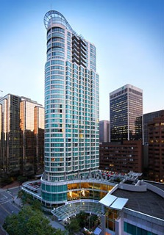
Jan 2027 Collaboration Meeting
https://indico.triumf.ca/event/859/
Marriott Vancouver Pinnacle Downtown
Registration available now!
Air Canada promo code available
  https://indico.triumf.ca/event/859/page/535-preferred-airline
Please register early, it really helps with the planning!
  Check visa/eTA requirements!
Buy your plane tickets early!!
Venue is the Pinnacle Hotel in downtown Vancouver.

Slide 16

Spokesperson Office Hours
Still planning to kick this off...
Looking at Oct 21st, two times:
  10:30-11:30AM ET
  8-9PM ET
Will distribute a Zoom link, people can join the discussion
  If you want to talk with me privately, happy to arrange a separate meeting.
If there is interest, we can consider more frequent/longer meetings

Slide 17
Upcoming Events
General Meeting – Sept. 25th
EICO Technical Forum Kickoff Meeting – Sept. 29th
Next EB Meeting – Oct. 1st
SVT Working Meeting (LBNL) – Oct 8th-9th
ECSAC Review – Oct 13th-14th
Echelon 0+1 Mini-Workshop – Oct 15th
11th DAC Meeting – Oct 28th-30th
Next General Meeting – Oct 22nd/23rd (note double dates)
Next Collaboration Council Meeting – November (date TBD)
SCAC Meeting – Nov. 12th
RRB Meeting – Nov. 16th-17th (virtual)
3rd ePIC/EIC Physics Readiness Workshop – Dec 1st-3rd
ePIC Collaboration Meeting in Vancouver – Jan 10th-15th 2027

Slide 18

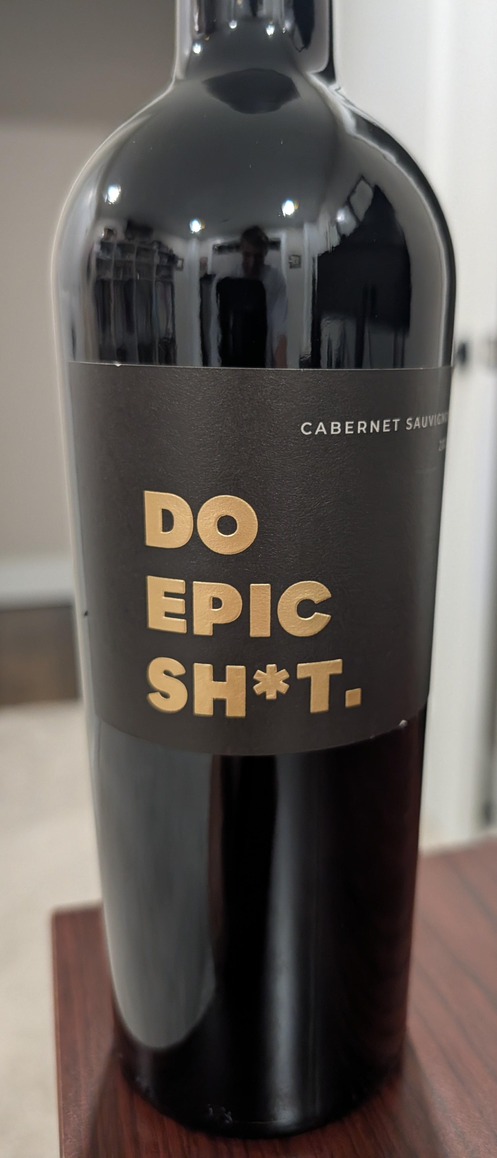
The Status of the ePIC Collaboration
The ePIC Collaboration is strong, active and growing!
  New faces in collaboration leadership
  The collaboration is making good progress on identified priorities
  Engagement remains strong and is growing
  The ePIC collaboration culture is growing and strengthening
The next six months are a time of uncertainty opportunity.
  The ePIC Collaboration is responsible for the EIC science program
  We need to communicate the importance of EIC science, and our readiness to pursue the exciting discoveries that the EIC offers
  We need to work on ways the collaboration can further its interests and promote the ePIC and the EIC:
    The TDR, ESR and NIM-A have been helpful to focus efforts
    Computing (and AI), DAQ and streaming, coordinated test beam activities,…

Slide 19


Slide 20
ePIC Resources
Public Website - https://www.bnl.gov/eic/epic.php
Mailing Lists – https://lists.bnl.gov/mailman/listinfo
Indico Agenda - https://indico.bnl.gov/category/402/
  ePIC Software and Computing: https://indico.bnl.gov/category/435/
Wiki - https://wiki.bnl.gov/EPIC
ePIC Software Training:
  Landing Page: https://eic.github.io/documentation/landingpage.html
  Tutorials: https://eic.github.io/documentation/tutorials.html
Mattermost: https://chat.epic-eic.org
ePIC Zenodo Community: https://zenodo.org/communities/epic

Slide 21
How to register a team at CERN for
The starting point is the CERN secretariat (info.recognized-experiments@cern.ch), tell them that you want to establish a new team under RE47 (ePIC).
They will send you a form that requires signatures from a team leader and deputy team leader, and a representative from your institution’s administration.
Send the signed form to the Spokesperson for a signature
Once the completed form is registered with the secretariat, your team is formed, and the team leader can add team members, etc.

Slide 22


EICUG Membership
The EICUG is a vital organization to promote the interests of the EIC community!
  Without the EICUG we would never have gotten far enough to form ePIC!
Please register your institution!
Check with your EICUG IB representative to get registered as a member
https://www.eicug.org/content/join.html

