Slide 1
EIC Project News
E.C. Aschenauer (BNL), R. Ent (JLab)
Co-Associate Directors for the EIC Experimental Program
ePIC Bi-Weekly General Meeting
September 25th, 2026

Slide 2
Detector Reviews 2026
Preliminary Design Reviews (60% design maturity equivalent, called PDR, PDR2 or PDR3, pending the subsystem)
  PDR2: Silicon Tracking Detectors (6.03.02.01) – Jan. 27-28, 2026
  PDR2: Polarimetry (6.03.11) – February 18, 2026
  Peer Review: DAQ-Slow Controls (6.03.08.02) – Summer 2026 – Slow controls integration separated from electronics/DAQ to ensure integration in collider common platform; the controls rely on scope in various areas
  PDR3: IR Integration and Auxiliary Detectors (6.03.10) – April 20, 2026 – Low-Q2, ZDC, includes 6.10.14 lumi detector
  PDR3: IR Integration and Auxiliary Detectors (6.03.10) – July → December 2026 – B0, RPs, OMDs – Postponed to have IR design more mature, exact dates TBD
  PDR2: AC-LGAD-based Particle Identification Detectors (6.10.04; BTOF, FTOF, common systems) – June 3-4, 2026
Final Design Reviews (FDR):
  FDR: Backward EM Calorimetry (6.03.04.01) – May 26, 2026
  FDR: High-Rate Picosecond Photo-Detectors (6.03.03.03/6.03.03.01) – September 1, 2026 (CD-3C item)
  More FDRs planning ongoing
Project Reviews:
  Detector Baseline Readiness Review Feb 3 – 5, 2026
  BNL Director’s Review – Comprehensive, Mar. 9-12, 2026
  PAC meeting – acts as Director’s Review, August 18-19, 2026 → Replaced by short PAC meeting (July 31) to collect strategy input followed by retreat @ BNL on August 3-4
  DOE Independent Project Review April 28-May 1, 2026 → September 15-18, 2026 (ICR not needed, INF-1 (DOE) and CD-3C scope both below $100M)
  DAC – October 28-30, 2026 – Act as next comprehensive review of the ePIC detector status: has progress since the June 2025 DAC comprehensive design review been satisfactory, have all recommendations that are relevant for detector CD-2 baselining been addressed, and give advice for the ePIC detector CD-3 production phase.
Other Meetings:
  7th RRB Meeting: June 9-10, 2026 – MEXT, Tokyo
  Annual Joint ePIC/EICUG Meeting, July 13-17 – Glasgow, https://indico.bnl.gov/event/31808/
  Echelon0/Echelon1 mini-workshop to discuss data and workflow orchestration, July 30-31, BNL, https://indico.bnl.gov/event/33467/
  ePIC Software and Computing Review: October 13-14, 2026 – BNL
  3rd EIC Echelon 0–1 Workshop: October 15 – BNL, https://indico.bnl.gov/event/34413/.
  8th RRB Meeting: November 16-17, 2026 (remote, mornings)

Slide 3






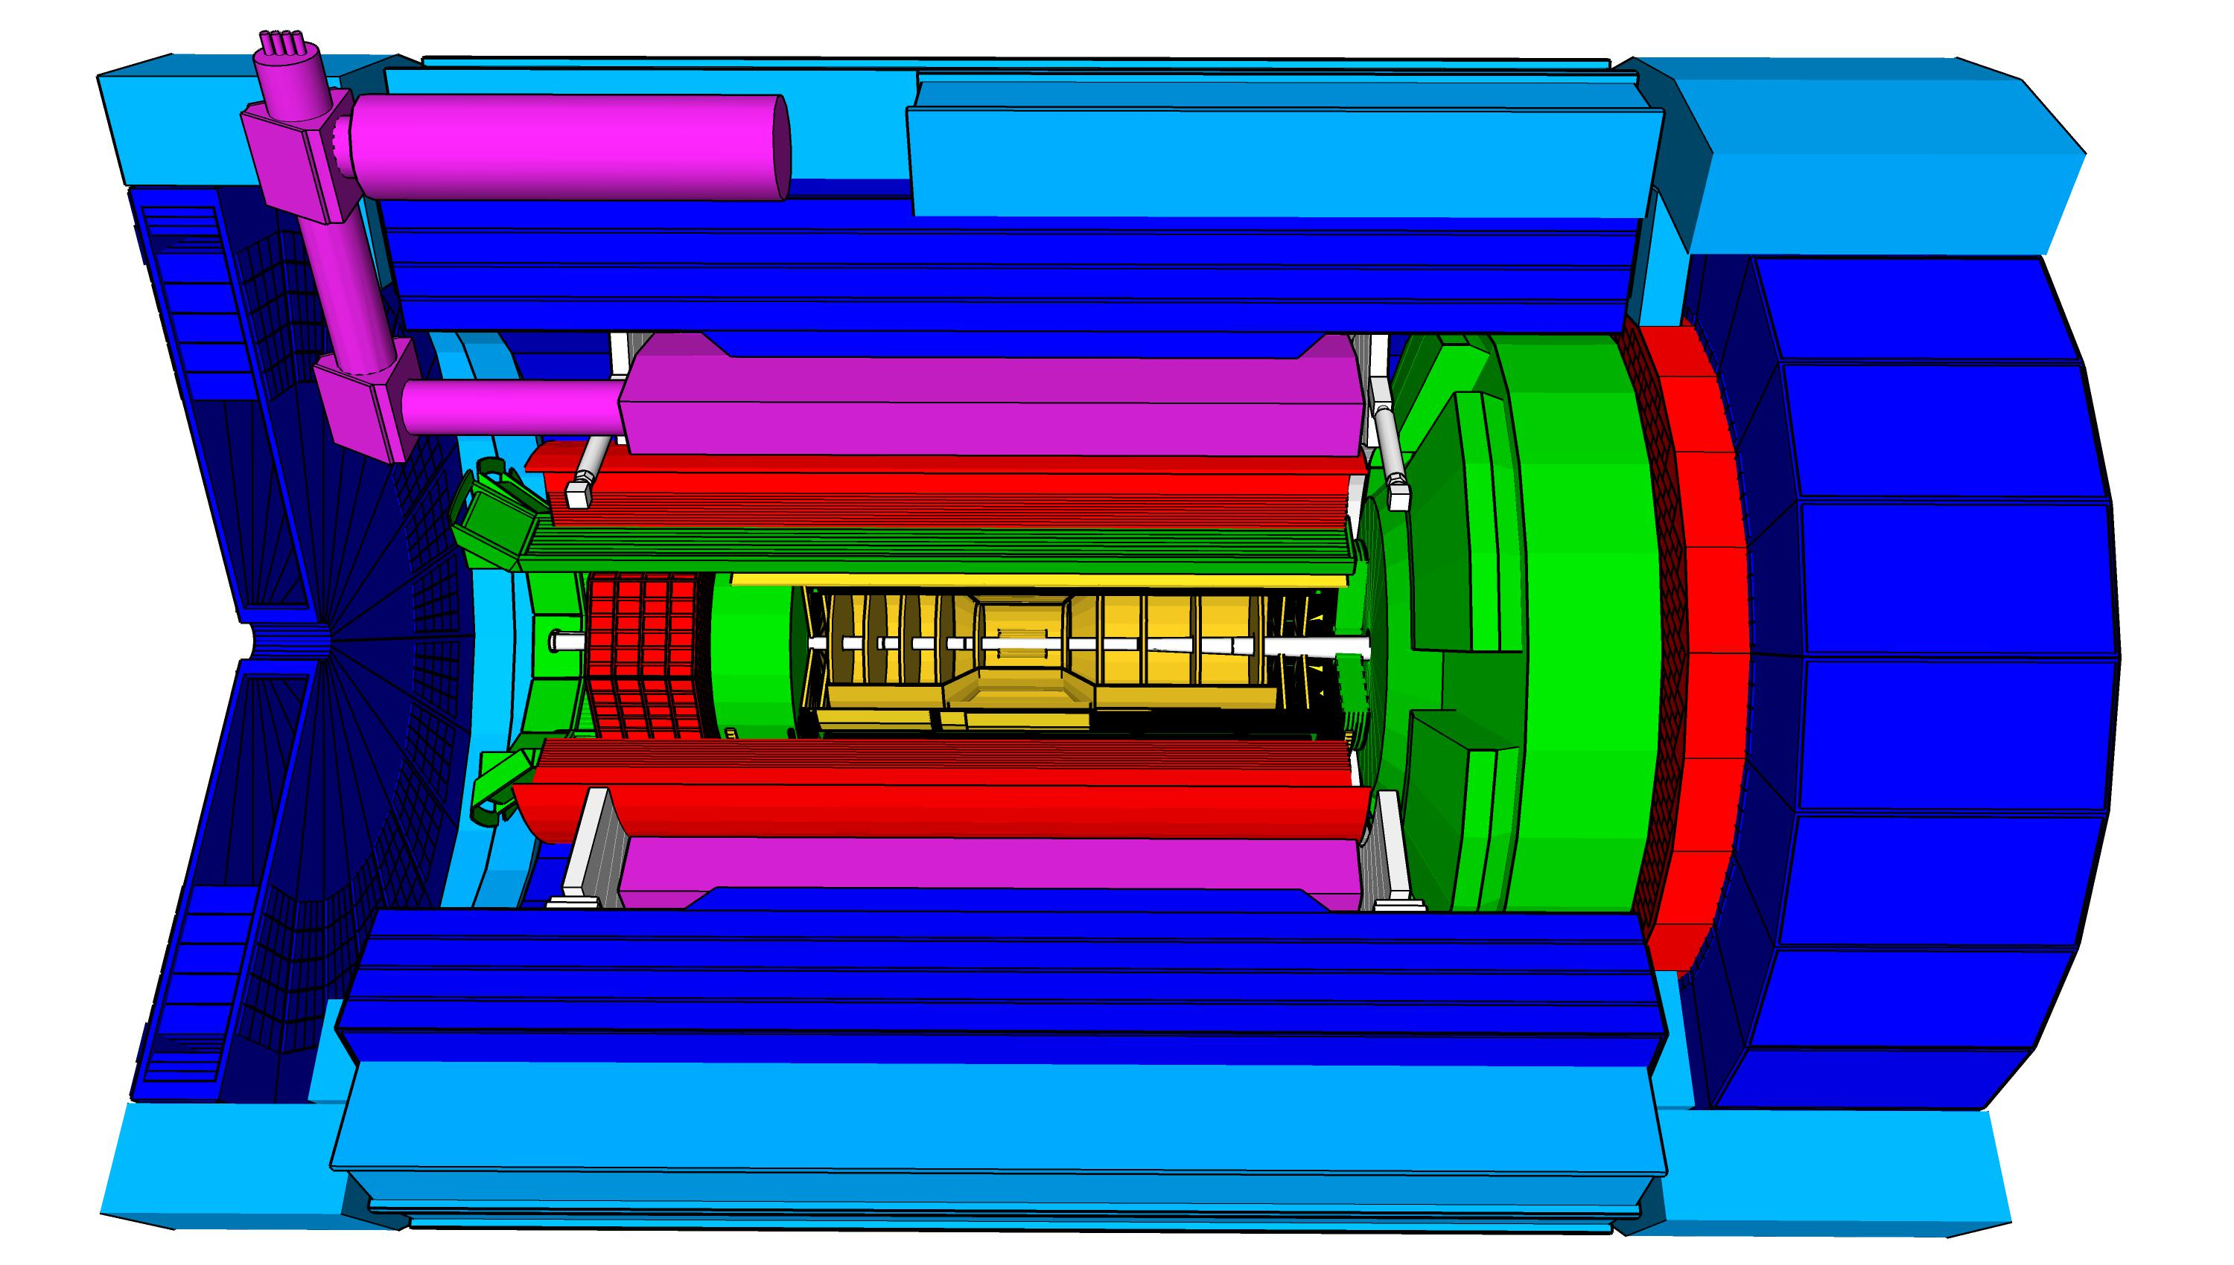


CD-3X and In-Kind Subsystem Summary
Superconducting
Solenoid
CD-3A
Dual-radiator
RICH
Barrel
ECal
CD-3B
MAPS Tracking
Detectors
CD-3A
CD-3B
MPGD Tracking
Detectors
hpDIRC
Forward
Time-of-Flight
CD-3C
HCal
hpDIRC
ToF
pfRICH
EMCal
SVT
ToF
dRICH
EMCal
HCal
Backward
ECal
MPGD
MPGD
EMCal
Barrel
Time-of-Flight
MARCO
CD-3A
CD-3B
HCal
CD-3C
Forward
HCal
CD-3A
CD-3B
CD-3C
Barrel
HCal
pfRICH
CD-3C
Forward
ECal
CD-3A
CD-3B
Data-Acquisition /
Electronics
CD-3B
CD-3C
CD-3C

Slide 4
High-Level CD-3A/CD-3B Status
7 CD-3A Items:
Two CD-3A contracts are fully complete (PbWO4 Crystals & Silicon Photomultipliers (SiPMs) – all received)
One more CD-3A contract is expected to be completed in September (Barrel ECal Scintillating Fibers (SciFi))
Solenoid Magnet becomes In-kind from INFN Italy – expecting to sign ICRADA in September December
  Preparations for an Italy-led tender are complete; magnet vendor oversight will be by expert JLab/CEA Saclay/INFN Genova team
Two contracts are progressing according to schedule (Forward ECal SciFi and Solenoid Conductor)
One contract had a > 2 cost increase → simplified specification and re-issued the RFP → vendor selected, contract to be awarded 09/2026, cost meets target
8 CD-3B Items:
4 contracts (SciFi x 2, PbWO₄-crystals, forward HCal towers) are continuations included as options in CD-3A
  3 options have been initiated; 4th is linked to CD-3A contract above → to be awarded 09/2026
DIRC bar refurbishment is in full swing – work on 3rd bar box ongoing
Solenoid magnet power supply contract awarded 3rd of September 2026
2 other contracts progressing through the procurement process (e.g., VTRx+/lpGBT with CERN)
  VTRx+/lpGBT contract received TJ Site Office approval September 14

Slide 5

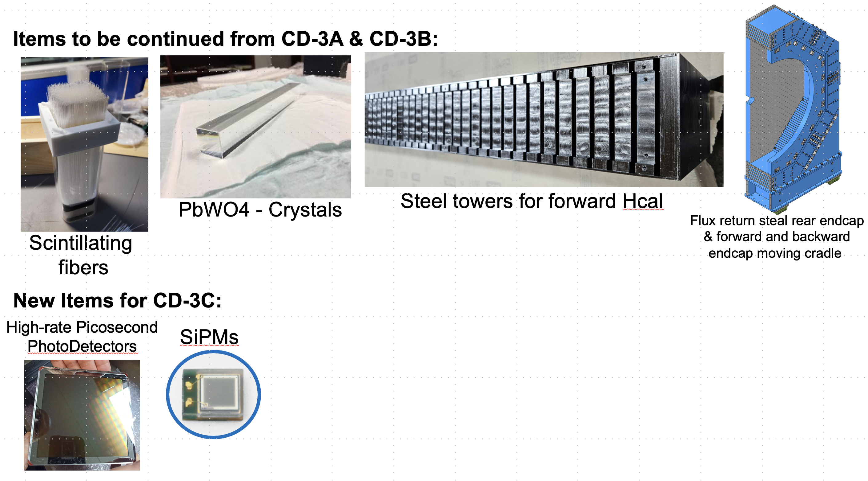
CD-3C Preliminary Package - DET
Subproject | WBS | Long Lead Procurement Description | $M | FDR
DET | 6.03 | Lead tungstate crystals (cont. CD-3A/B) – 830 remaining | 2.09 | Done
DET | 6.03 | fECal Scintillating Fibers (cont. CD-3A/B) – 935 km remaining; | 0.49 | Done
DET | 6.03 | Steel towers for forward HCal (cont. CD-3A/B) – 288 towers remaining | 1.57 | Done
DET | 6.03 | Flux return steal rear endcap | 3.26 | Done
DET | 6.03 | High-Rate Picosecond PhotoDetectors (HRPPDs) | 6.1 | 09/01/26
DET | 6.03 | SiPMs for all the other subsystems and mounting on the SiPMs boards & QA | 4.82 | Done
 |  | Total | 18.32
(without contingency)
CD-3C will complete:
the PbWO4 crystal procurement
the fiber procurement of the fECAL
the SiPMs and steel towers for the lfHCal
the flux return steel for the electron and hadron endcap
New Items:
all the HRPPDS for the pfRICH and the DIRC
all SiPMs for the bEcal, the Barrel-ECAL, the Barrel Hcal,
the fHCal and all the auxiliary detectors
5

Slide 6
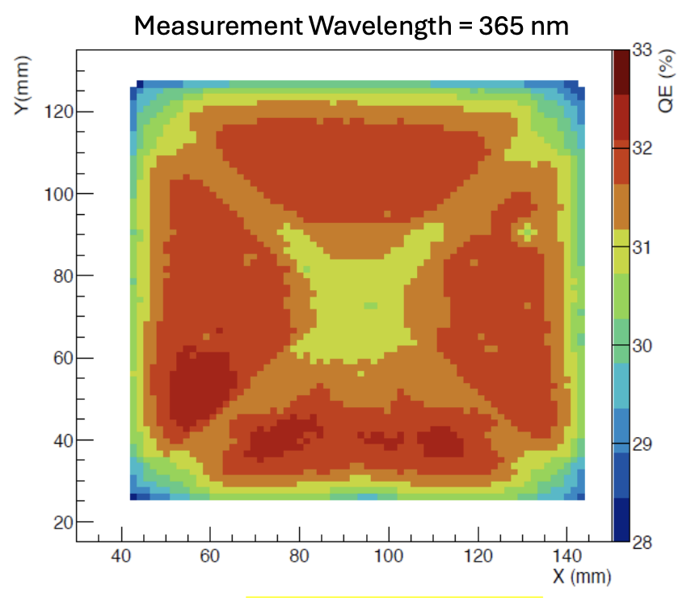
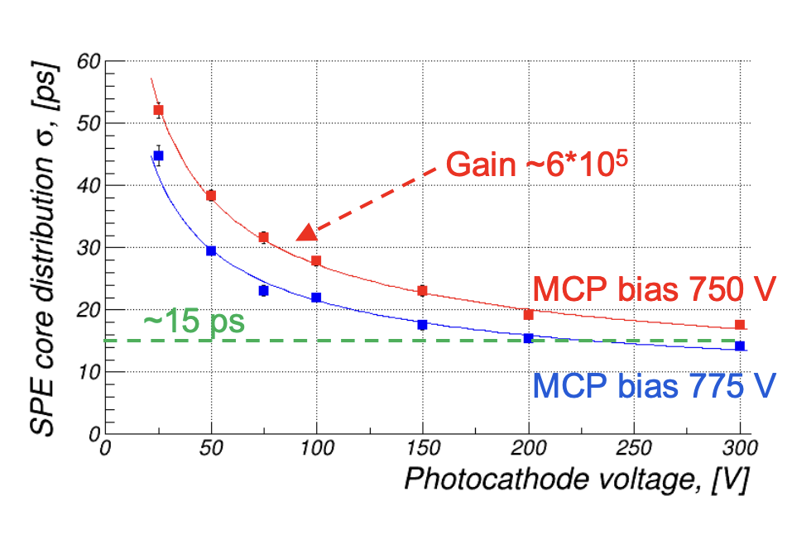
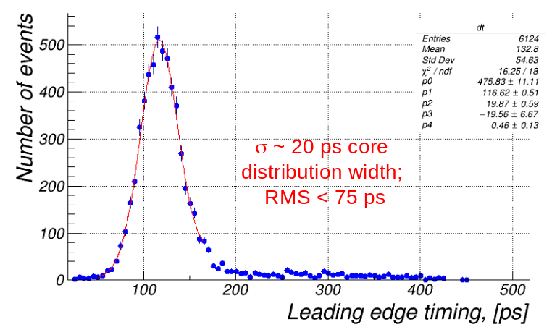
Technical Progress – PID Detectors
Slide from Surabhi Tarafdar
Specifications and status
Uniform Quantum Efficiency with 10% RMS. ✓
Dark current rate < 2 kHz/cm² ✓
Timing resolution of 100 ps or less ✓
Photon Detection efficiency ~ 25% ✓
Uniform gain with RMS within 20% of mean ✓
Magnetic Field tolerant up to 1.5T✓
Longevity of photo cathode established ✓
Minimal ringing at high occupancy ✓
FDR September 1st, 2026 (successful) ✓
HRPPD Path to CD-3C
HRPPD timing resolution
HRPPD QE uniformity
Conclusions :
HRPPD ready for CD-3C scope (Inspection and Test plan)
pfRICH require 68 and hpDIRC needs 72 HRPPDs
All the test stands are completely ready for evaluating HRRPDs under CD-3C scope
Technical details of HRPPD in prebrief files ePIC_TIC_mtg_HRPPD_BFIELD_studies_20260112.v10.pdf , HRPPD-evaluation.v05.pdf

Slide 7
HRPPD Final Design Review outcome
Charge Questions and response :
Technical performance requirements for the HRPPDs understood and documented ? Yes
HRPPD specifications meet performance requirements with low risk of cost increase ,
schedule delays and technical problems ? Yes
Fabrication assembly plan consistent with project and detector schedule ? Yes
Integration plans for HRPPD in relevant EIC detector subsystem mature enough for their procurement ? Yes
Incorporation of ES&H and QA in HRPPD designs and procurement planning ? Yes
Procurement approach sound and procurement schedule credible ? Yes
Conclusions :
The review committee concluded
  “The HRPPD design and procurement are sufficiently mature to initiate the CD-3C long-lead procurement”
4 recommendations , two for long term and two for long lead procurements readiness
Work has begun to address the following recommendations :
  Drafting SOW and sole source justification to submit to procurement
  Started folding in the suggested changes to the QA document relevant that the QA occurs at multiple sites and traceability.

Slide 8
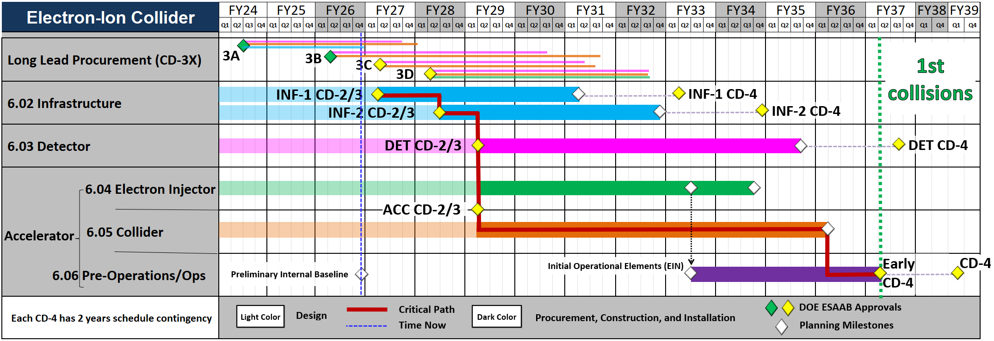
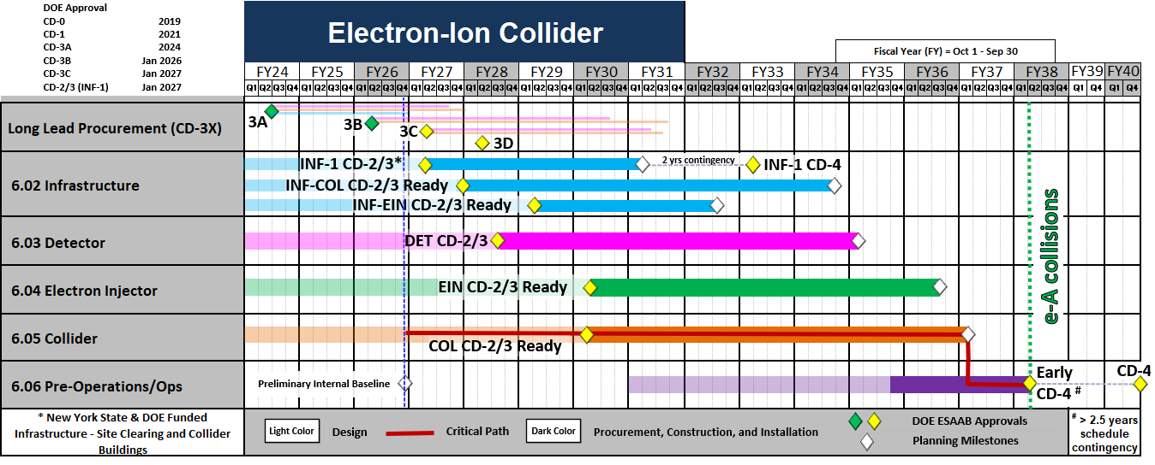
High Level Project Schedules
Strategic Schedule
The strategic schedule integrates subproject sequencing, key approvals, and the path to early operations (as shown at DOE Review)
  Management tool that guides project planning efforts and is not currently supported by the P6 schedule.
PIB Schedule – Path to CD-4
Schedule shown contains no funding limitations beyond FY26 and no resource leveling
  Detector ready for (CD-2 in Q1/FY27 and) CD-3 in Q3/FY28
  CD-2 and CD-3 dates fully constrained by activities in PIB
  PIB schedule stretched out due incomplete accelerator installation schedule.

Slide 9
Closeout Report on the
Status Review
Electron Ion Collider (EIC) Project
Brookhaven National Laboratory
September 15-18, 2026
Timothy P. Maier
Committee Chair
Office of Science, U.S. Department of Energy
http://www.science.doe.gov/opa/

Slide 10
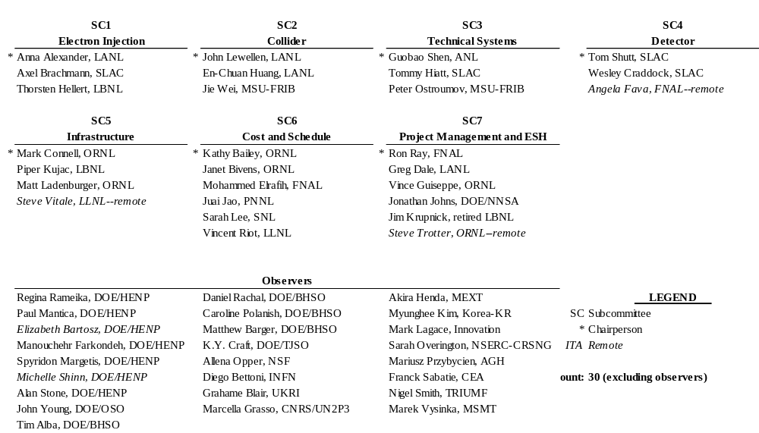
Review Committee Participants
Timothy P. Maier, DOE/SC, Chairperson
Intikhab Alam, DOE/FSO, Co-Chairperson

Slide 11
Charge Questions
Has the project team developed a complete, technically credible preliminary performance baseline for this stage of the project and begun to effectively execute against it? Is the project positioned to complete approved long-lead procurements within the established schedule and cost baseline? Are technical issues appropriately and proactively addressed?
Is each proposed subproject scope defined well and logically? Are the subprojects ordered and phased optimally? Does the roll-up of the subprojects’ scope unambiguously compose a complete and responsive EIC facility? Are the key performance parameters well documented and justifiable? Are subproject interfaces understood and delineated? Are the schedules and cost estimates and associated contingency plans credible for the current stage of each subproject?
Are the proposed CD-3C long-lead procurements appropriate and do they support project risk mitigation? Have the proposed CD-3C long-lead procurements attained final design?
Are the schedule and cost for the first infrastructure subproject complete and credible? Do they include adequate scope, schedule, and cost contingency? Will the first infrastructure subproject likely achieve its performance baseline?
Has the first infrastructure subproject met all the CD-2 and CD-3 prerequisites and is the project team ready to request CD-2/3 approval?
Are ES&H and QA properly addressed given the project’s current stage of development?
Is the project properly managed? Are risks being effectively managed? Is a management team in place to successfully execute the project including long-lead procurements? Are roles and responsibilities documented and understood?
Has the project team satisfactorily addressed recommendations from previous DOE/SC reviews?

Slide 12
2.4 Detector
Tom Shutt (SLAC), Angela Fava (FNAL), Wes Craddock (SLAC), / Subcommittee 4
Has the project team developed a complete, technically credible preliminary performance baseline for this stage of the project and begun to effectively execute against it? Yes, although performance tracking is still limited because historical data are only now emerging with the newly established PIB. Is the project positioned to complete approved long-lead procurements within the established schedule and cost baseline? Yes. Are technical issues appropriately and proactively addressed? Yes
Is each proposed subproject scope defined well and logically? Yes Are the subprojects ordered and phased optimally? No. The current plan for CD2/3 for the detector subproject introduces a costly and potentially damaging delay - see recommendation. Does the roll-up of the subprojects’ scope unambiguously compose a complete and responsive EIC facility? Yes Are the key performance parameters well documented and justifiable? Yes, though see comments. Are subproject interfaces understood and delineated? Yes. Are the schedules and cost estimates and associated contingency plans credible for the current stage of each subproject? Yes, with the uncertainties inherent at this stage.
Are the proposed CD-3C long-lead procurements appropriate and do they support project risk mitigation? Yes Have the proposed CD-3C long-lead procurements attained final design? Yes.
Has the project team satisfactorily addressed recommendations from previous DOE/SC reviews? Yes, apart from the long-standing recommendation about in-kind agreements.

Slide 13
2.4 Detector
Tom Shutt (SLAC), Angela Fava (FNAL), Wes Craddock (SLAC), / Subcommittee 4
Comments
We commend the Detector team for being highly motivated and well organized in their work on this very complex detector system. Significant and coherent progress is being made on a wide range of subsystems.
Given the current momentum, organizational alignment, and reliance on broad domestic and international scientific contributions, delaying CD‑2/3 approval beyond the PIB introduces substantial risks—including increased costs, potential pauses in work due to limited PED funds, erosion of workforce, misalignment with in‑kind partners, and loss of critical community engagement.
The establishment of KPPs for this sub-project based on cosmic ray data alone is an appropriate and thoughtful approach. Because ultimate success depends on detector performance on-beam, the committee encourages beginning the development of a Transition to Operations document early to capture commissioning, calibration campaigns, and handoff planning.
In light of earlier experiences where contract specifications required multiple rounds for simplification, it would be beneficial for the project to integrate a formal “lesson learned” by introducing additional schedule duration during contract preparation phases to accommodate potential iterations.
The project currently relies on a single foundry for nearly all ASIC chip production, which represents a critical and inherently unpredictable external dependency. This should be captured explicitly in the risk registry at a high level, linked to both schedule float and procurement contingencies, and monitored closely throughout execution.

Slide 14
2.4 Detector
Tom Shutt (SLAC), Angela Fava (FNAL), Wes Craddock (SLAC), / Subcommittee 4
Comments (cont’d)
International agreement approvals (e.g., DOE–CERN, INFN agreements) continue to be essential for enabling critical contributions and shared responsibilities. The committee encourages maintaining high‑visibility tracking of these approvals and ensuring that associated schedule risks remain clearly documented. We note that the current overall critical path goes through the EIC LAS ASIC, progress on which depends on the CERN agreement.
The progress in procurement documentation and QA planning are encouraging; continuing to expand quality assurance checkpoints for long‑lead items will further reduce risk and strengthen integration readiness.
The scope of CD3a,b and now CD3c for this subproject seem well justified. This scope was a combination of very long lead time procurements, critical procurements of single-vendor components, and components needed early in construction.
Much of the detector’s project-supported labor relies on the availability of student and other scientists in groups supported by the US research budget. The project should consider incorporating a potential loss of this labor availability in the risk register.
The detector consists of a large number different sub detectors to cover both particle types and the extensive range of momentum and rapidity that needs to be covered. Within this, the design has tried to maximize as much as possible the use of common components, such as SiPMs and ASICs. The various detectors are also mostly based on well established detectors currently in use.
The detector has a high level of complexity and strong space constraints in the interaction region, and as such integration of the detector will be challenging. This is recognized by the team, and we encourage them to maintain attention to careful planning of integration.

Slide 15
2.4 Detector
Tom Shutt (SLAC), Angela Fava (FNAL), Wes Craddock (SLAC), / Subcommittee 4
Comments (cont’d)
The overall experiment is sufficiently advanced that the detector design should not be affected by possible cost-driven changes in the accelerator, unless there are substantial changes in the driving requirements.

Slide 16
2.4 Detector
Tom Shutt (SLAC), Angela Fava (FNAL), Wes Craddock (SLAC), / Subcommittee 4
Recommendations
We recommend that the detector proceed to CD2/3 as allowed by progress within the detector sub-project, and not delayed by other considerations from the larger project, to prevent cost escalation and to safeguard the team from broader operational and organizational impacts - see comments.
Note some context to the recommendation on the next slide...

Slide 17
Detector Subcommittee - Comments
We commend the Detector team for being highly motivated and well organized in their work on this very complex detector system. Significant and coherent progress is being made on a wide range of subsystems.
Given the current momentum, organizational alignment, and reliance on broad domestic and international scientific contributions, delaying CD‑2/3 approval beyond the PIB introduces substantial risks—including increased costs, potential pauses in work due to limited PED funds, erosion of workforce, misalignment with in‑kind partners, and loss of critical community engagement.
Detector Subcommittee - Recommendations
We recommend that the detector proceed to CD2/3 as allowed by progress within the detector sub-project, and not delayed by other considerations from the larger project, to prevent cost escalation and to safeguard the team from broader operational and organizational impacts - see comments.
Context to the recommendation
Detector SC realized risk of detector delay
Cost and Schedule Subcommittee - Recommendations
PIB
  By end of Q2FY27, place the PIB under configuration management, improving coding accuracy and tracking performance against the PIB internally.
  By end of Q2FY27, complete development of the installation schedule, which is essential for a credible critical path and float determination to support project decision-making.
  Prior to any future Critical Decision reviews, ensure timely completion of the affordability analysis, scoping decisions and resource leveling, with subsequent updates to cost, schedule, and risks, to allow for an accurate and consistent baselining package.
There of course still will be other considerations from the larger project

Slide 18
4. Cost and Schedule
K. Bailey, J.Bivens - ORNL, M. Elrafih - FNAL, J. Jao - PNNL, S. Lee - SNL, V. Riot - LLNL / Subcommittee 6
Recommendations
INF-1 CD2/3
  Prior to ESAAB, update the P6 resource loaded schedule per comments (EVT code, work for other/BNL indirect), integrate with COBRA, advance successor logic for credible float in the PIB (storage and INF-2) and generate the draft baseline documents.
  Proceed to CD-2/3 approval.
CD-3C
  Prior to ESAAB, update the P6 resource loaded schedule per comments (EVT code, pull the WBS lower levels into a CD-3C WBS, escalation), integrate with COBRA, advance successor logic for credible float in the PIB (installation) and generate the draft baseline documents.
  Proceed to CD-3C approval.

Slide 19
4. 4. Cost and Schedule
K. Bailey, J.Bivens - ORNL, M. Elrafih - FNAL, J. Jao - PNNL, S. Lee - SNL, V. Riot - LLNL / Subcommittee 6
Recommendations
PIB
  By end of Q2FY27, place the PIB under configuration management, improving coding accuracy and tracking performance against the PIB internally.
  By end of Q2FY27, complete development of the installation schedule, which is essential for a credible critical path and float determination to support project decision-making.
  Prior to any future Critical Decision reviews, ensure timely completion of the affordability analysis, scoping decisions and resource leveling, with subsequent updates to cost, schedule, and risks, to allow for an accurate and consistent baselining package.

Slide 20
5. Project Management and Environment, Safety and Health
Ron Ray, FNAL / Subcommittee 7
Recommendations
Produce a preliminary performance baseline for the line-item project including a bottom-up contingency estimate by April 1, 2027.
Revise the Hazard Analysis Report (HAR) to demonstrate in-depth identification, investigation, and evaluation or planned evaluation of potential hazard events within the next year.
Proceed to CD-2/3 for INF-1 after finalizing the CD-2/3 required documents (Acquisition Strategy, Project Management Plan, Project Execution Plan, HAR).
Proceed to CD-3c for the proposed Accelerator and Detector scope.

Slide 21


