Slide 1





Sensor testing updates at UCSC
Simone Mazza (SCIPP, UC Santa Cruz)

Slide 2
Update on sensor testing at UCSC
Testing of new batch of FNAL irradiated devices
  Irradiated at FNAL with low to high fluence, full size sensors irradiated
  See next presentation
Comparison of HPK devices from 2023 ( n+ sheet resistance: 600 Ω/□ (C-type)) and 2024 (n+ sheet resistance: 1600 Ω/□ (E-type)) to check effects on pitch of 1mm
Comparison of HPK devices from 2023, 2024 and 2025 productions to investigate time resolution loss
  Laser TCT, beta source telescope, update next week
Test of new double metal HPK strip sensor
  Laser TCT, re-bonding in progress

Slide 3
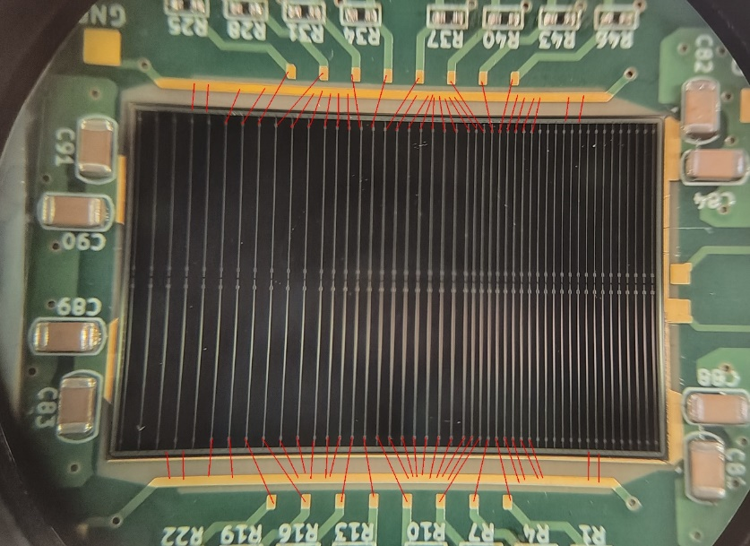
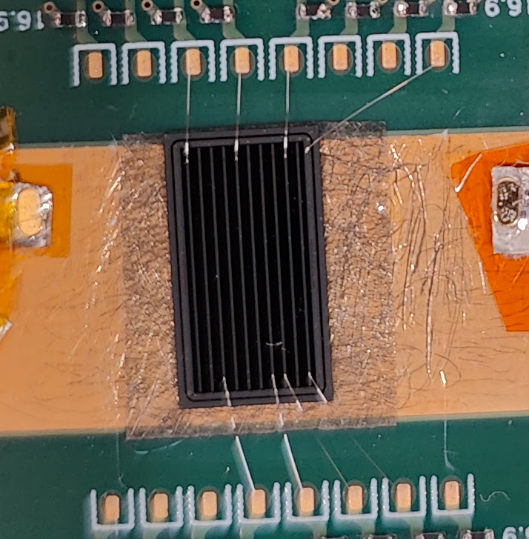
E-type vs C-type at different pitches
HPK 2024 s16694, 50um, (n+ sheet resistance: 1600 Ω/□ (E-type)), 50um strip width
HPK 2023, 50um, (n+ sheet resistance: 600 Ω/□ (C-type)), 100um strip width
Pitch in 2023 is simulated connecting every other strip

Slide 4
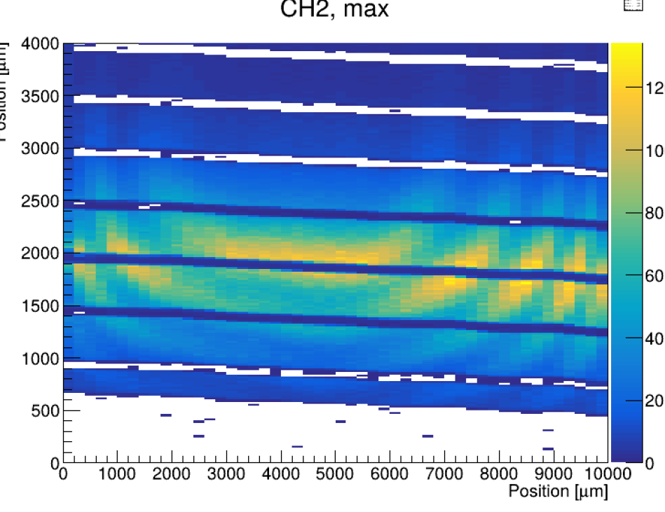
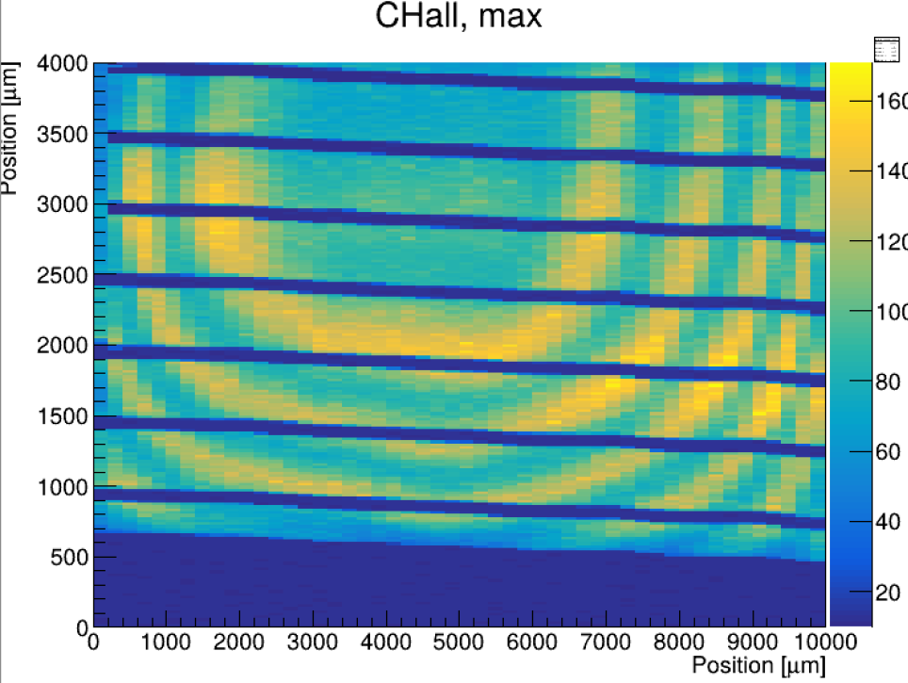
E-type vs C-type at different pitches
HPK 2023, 50um, (n+ sheet resistance: 600 Ω/□ (C-type)), 100um strip width
Weird ‘ripples’ in this production, suspected to be from laser reflection on the backside
Not sure if they were ever observed in test beam
Sum of 4 channels

Slide 5
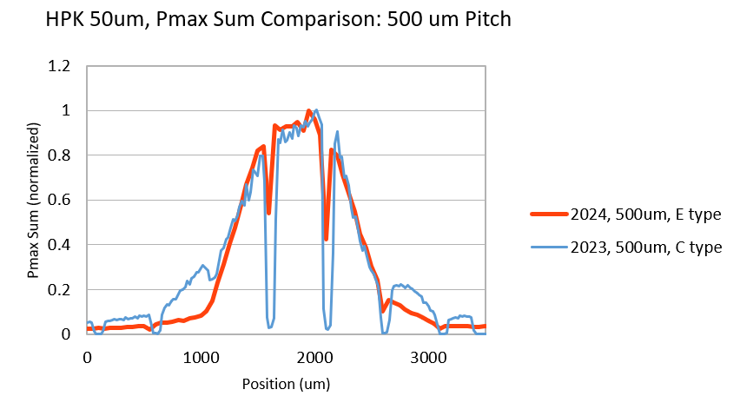
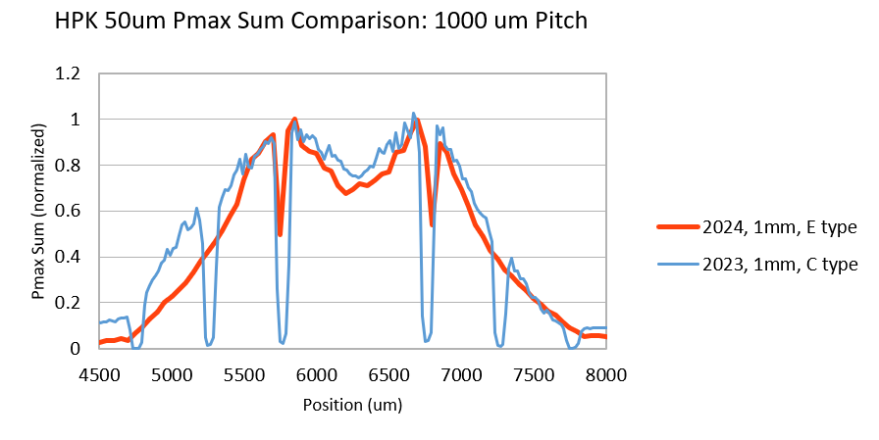
Comparison
Sum of two nearby channels (normalized to 1)
Not a lot of difference both for 500um and 1mm pitch
S/N loss for C-type slightly less for 1mm pitch

Slide 6
Backup

Slide 7
Irradiated full sensors

Slide 8
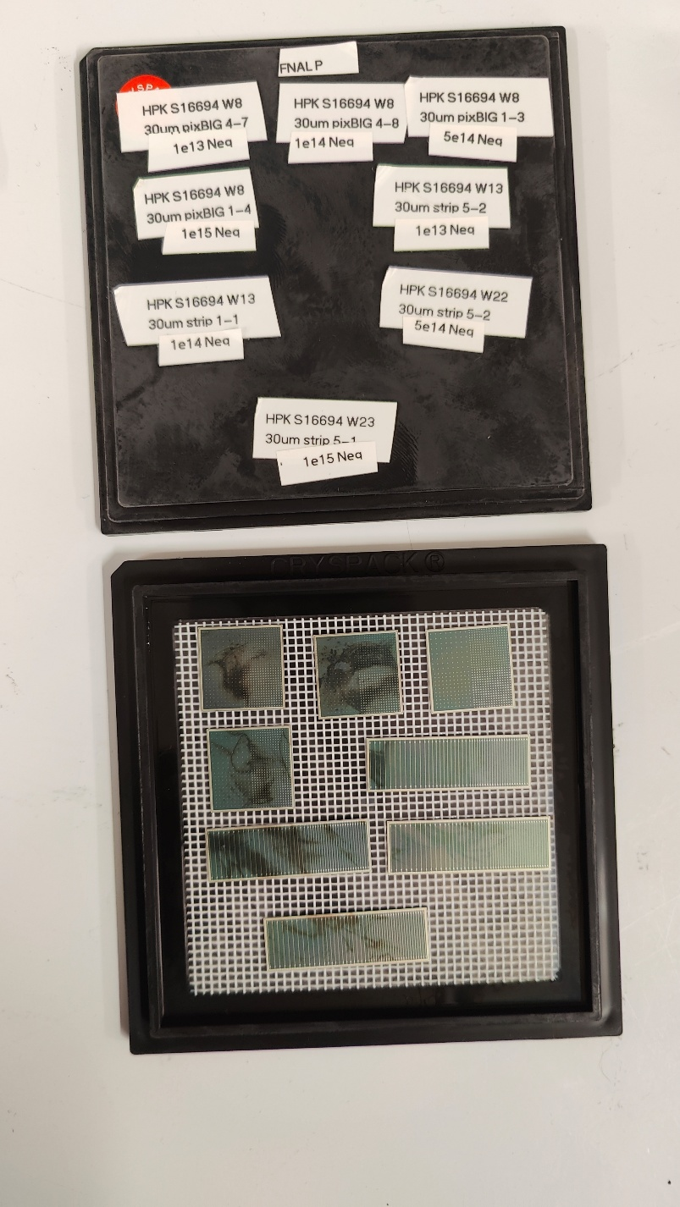
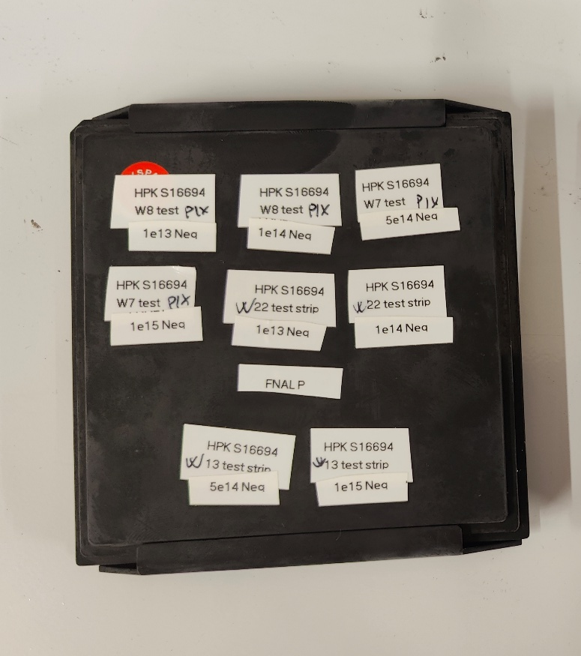
FNAL irradiated sensors
Irradiated full size sensors and test structures at FNAL
1e13, 1e14, 5e14, 1e15Neq
Important to check effect on large devices:
  Increase of leakage current (relevant)
  Performance change (likely not for ePIC)
  Secondary effects
Testing ongoing
  IV/CV almost done
  N+ resistivity from test structures
  Laser TCT
Also testing extremely irradiated devices
Not of interest for ePIC, towards FCC

Slide 9
Strip sensor 2023, 2024, 2025 comparison

Slide 10
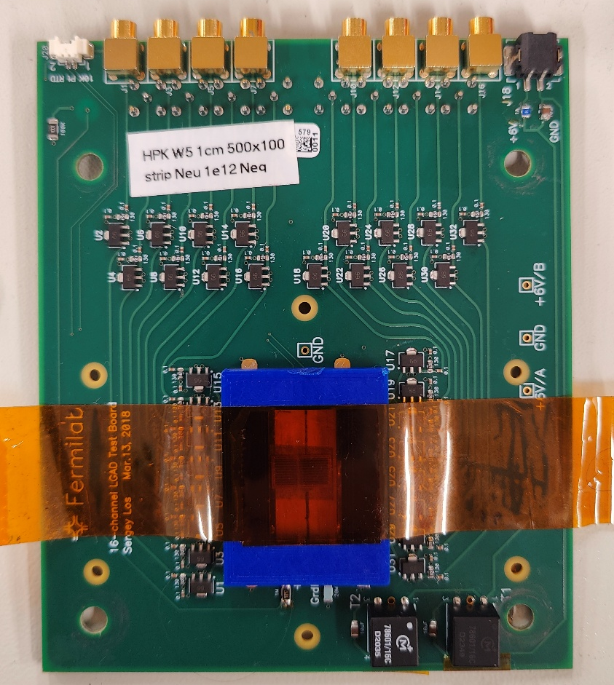
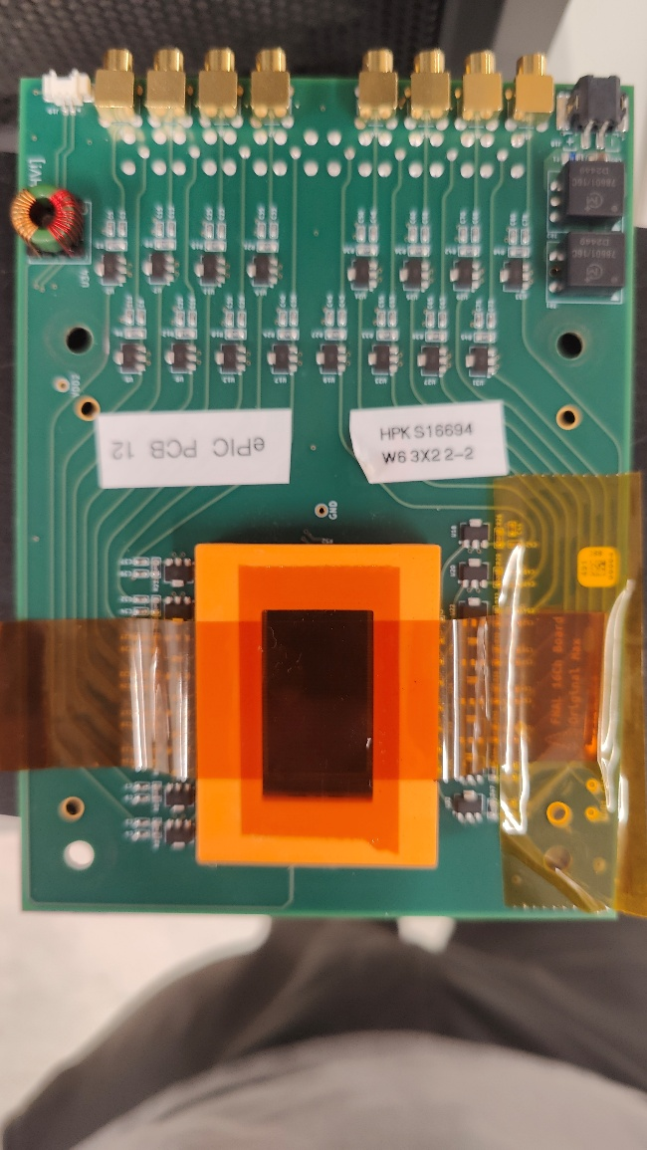

Comparison of HPK devices from 2023, 2024 and 2025
Laser TCT data comparison, using same laser power, maximum voltage
  Note: same laser power is not same injected charge (variations occur)
  Scans over a single strip electrode
2023 2024 (S16694) 2025 (ePIC1)

Slide 11
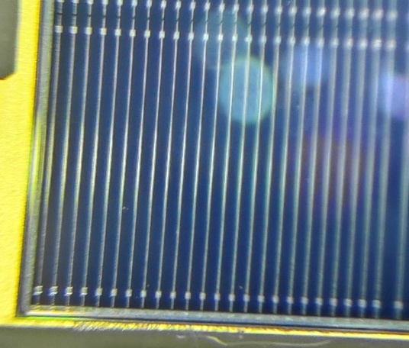
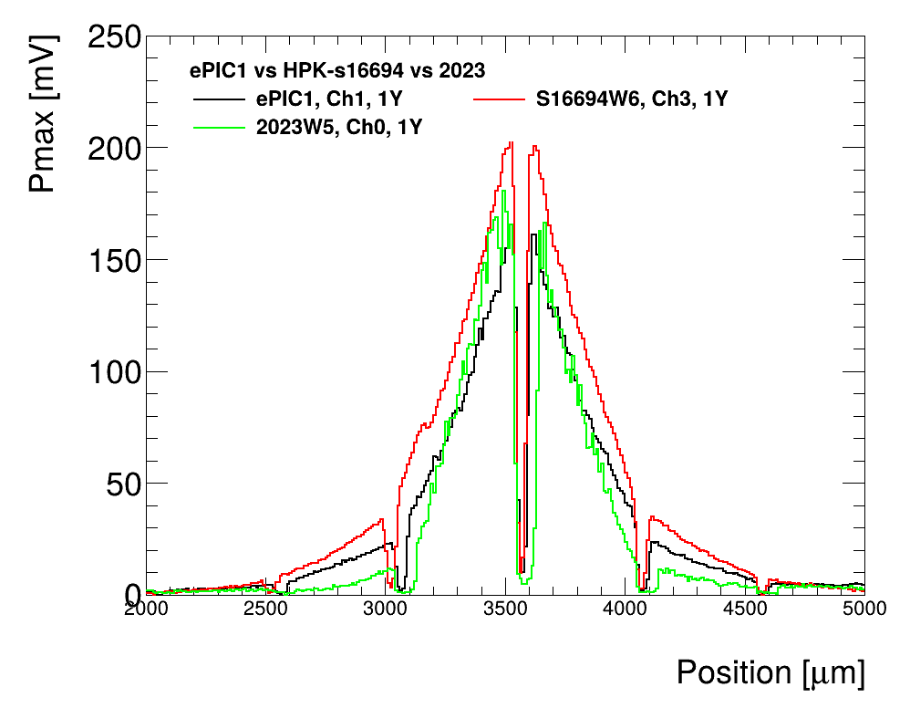
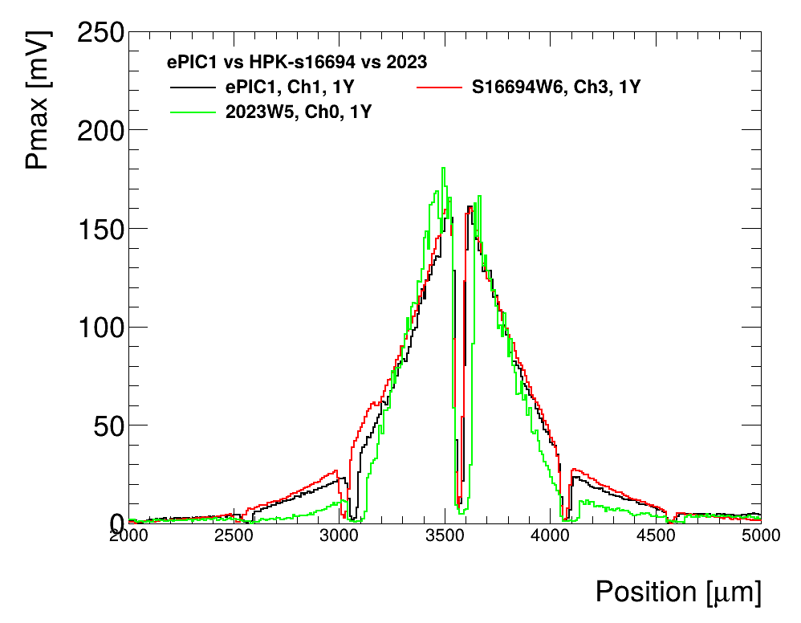
Comparison of HPK devices from 2023, 2024 and 2025
Laser TCT data comparison, using same laser power, maximum voltage
  Note: same laser power is not same injected charge (variations occur)
normalized

Slide 12
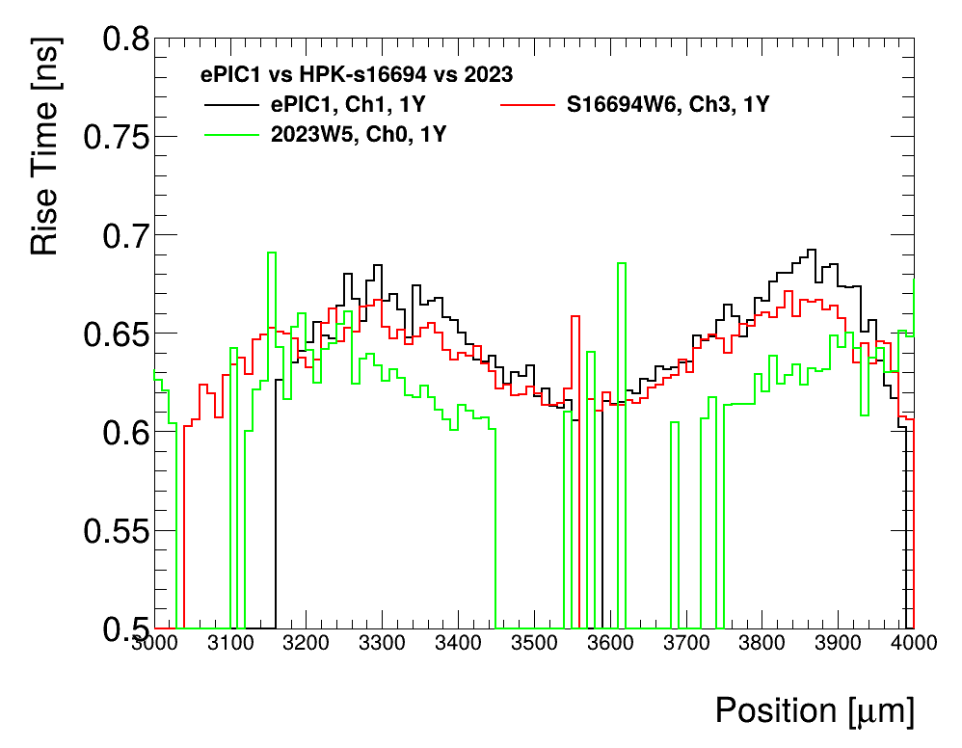
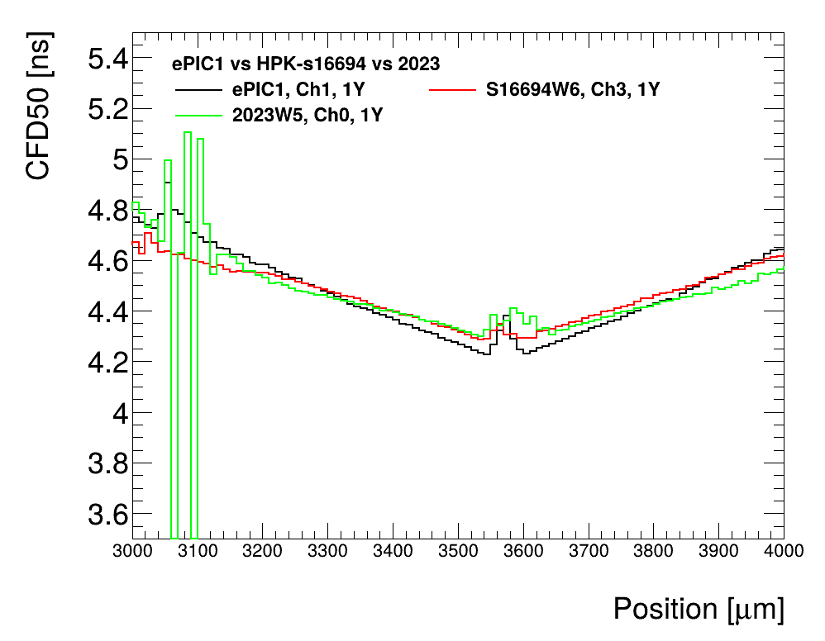
Comparison of HPK devices from 2023, 2024 and 2025
Laser TCT data comparison, using same laser power, maximum voltage
  Note: same laser power is not same injected charge (variations occur)

Slide 13
Comparison of HPK devices from 2023, 2024 and 2025
Laser TCT data comparison, using same laser power, maximum voltage
  Note: same laser power is not same injected charge (variations occur)
Comments:
  Using the same laser power we get roughly the same signal for the three devices
  Rise time is comparable
  Time of arrival correction is comparable
Notes:
  The 2023 sensor has the same thickness, N+ resistivity and oxide as S16694
  The 2025 has a different oxide thickness (thicker)
  The 2024 and 2025 sensors have the same geometry 500x50um
  The 2023 is 500x100um, I can’t find a 500x50um anymore
  The 2023 is also very lightly irradiated, but that should not affect performance

Slide 14
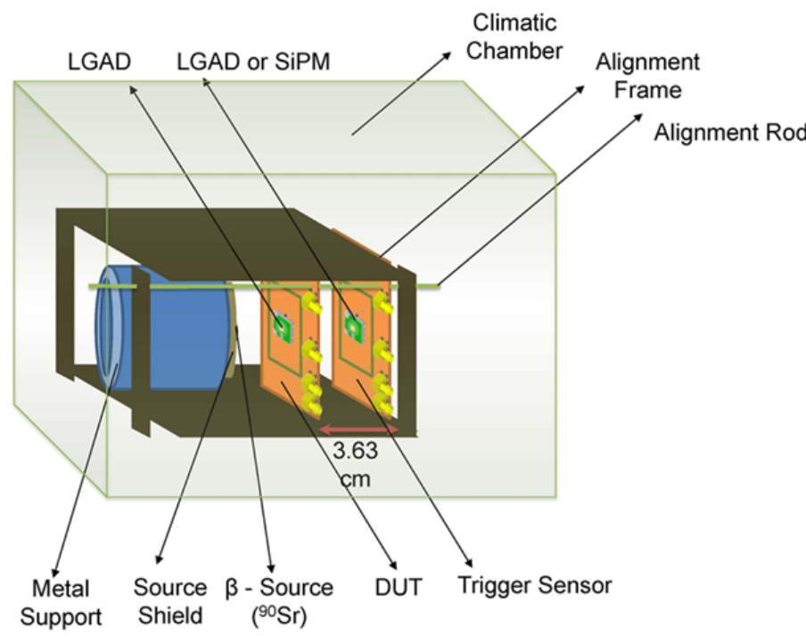

Sensor testing – Sr90 telescope
Details: S.M. Mazza et al. arXiv:1804.05449
  Same sensors tested with beta source with coincidence trigger
  Two sensors are aligned with a beta source
    DUT (Device Under Test) to characterize: on 16ch board, readout 3 strips. Use to reconstruct event position
    Trigger with known performance, 1mm size
  Sensors mounted on fast amplifier boards (~2Ghz) and read out by a fast oscilloscope (2Ghz, 20Gs)
  Collected charge
  Time resolution: sigma of time difference between trigger sensor (with known time resolution) and DUT,
  Gain: collected charge divided by collected charge in same thickness PiN
  Data taking still ongoing
  See next talk!
$$Δt$$
Measured noise

Slide 15
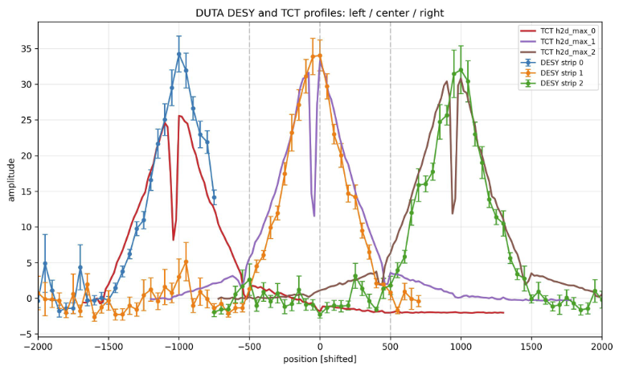
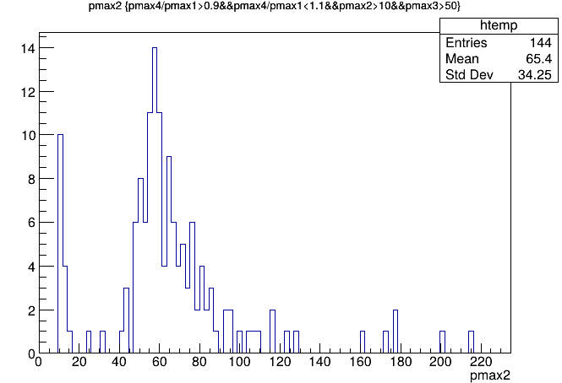
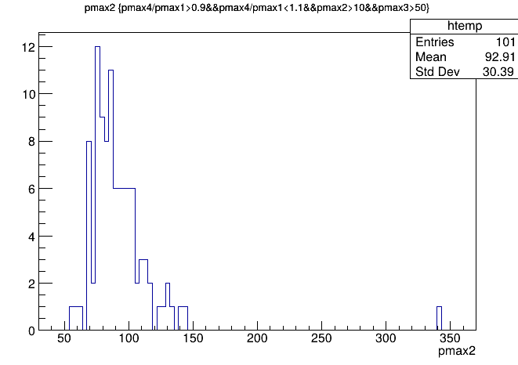
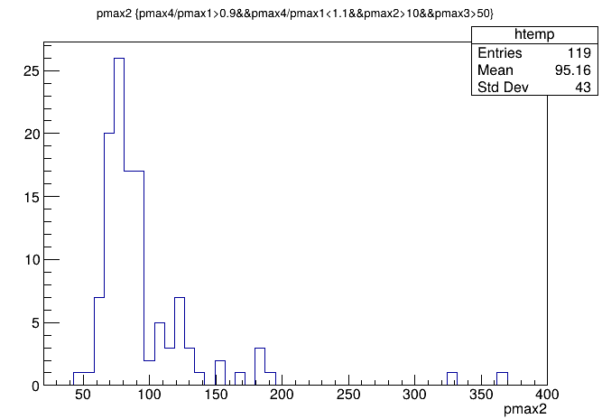
Pmax under center strip
1
2
3
“Dumb” quick analysis: select events under strip 2 by assuming same signal from Strip 1 and strip 3
Laser TCT was off by ~50% of 1 MIP
Signal for 2024 and 2025 ~same, 2023 has lower signal?
Trying higher voltage for 2023 (190V --> 210V) data taking ongoing
MIP
2023 2024 2025
Pmax3 is trigger

Slide 16
Double metal sensor

Slide 17
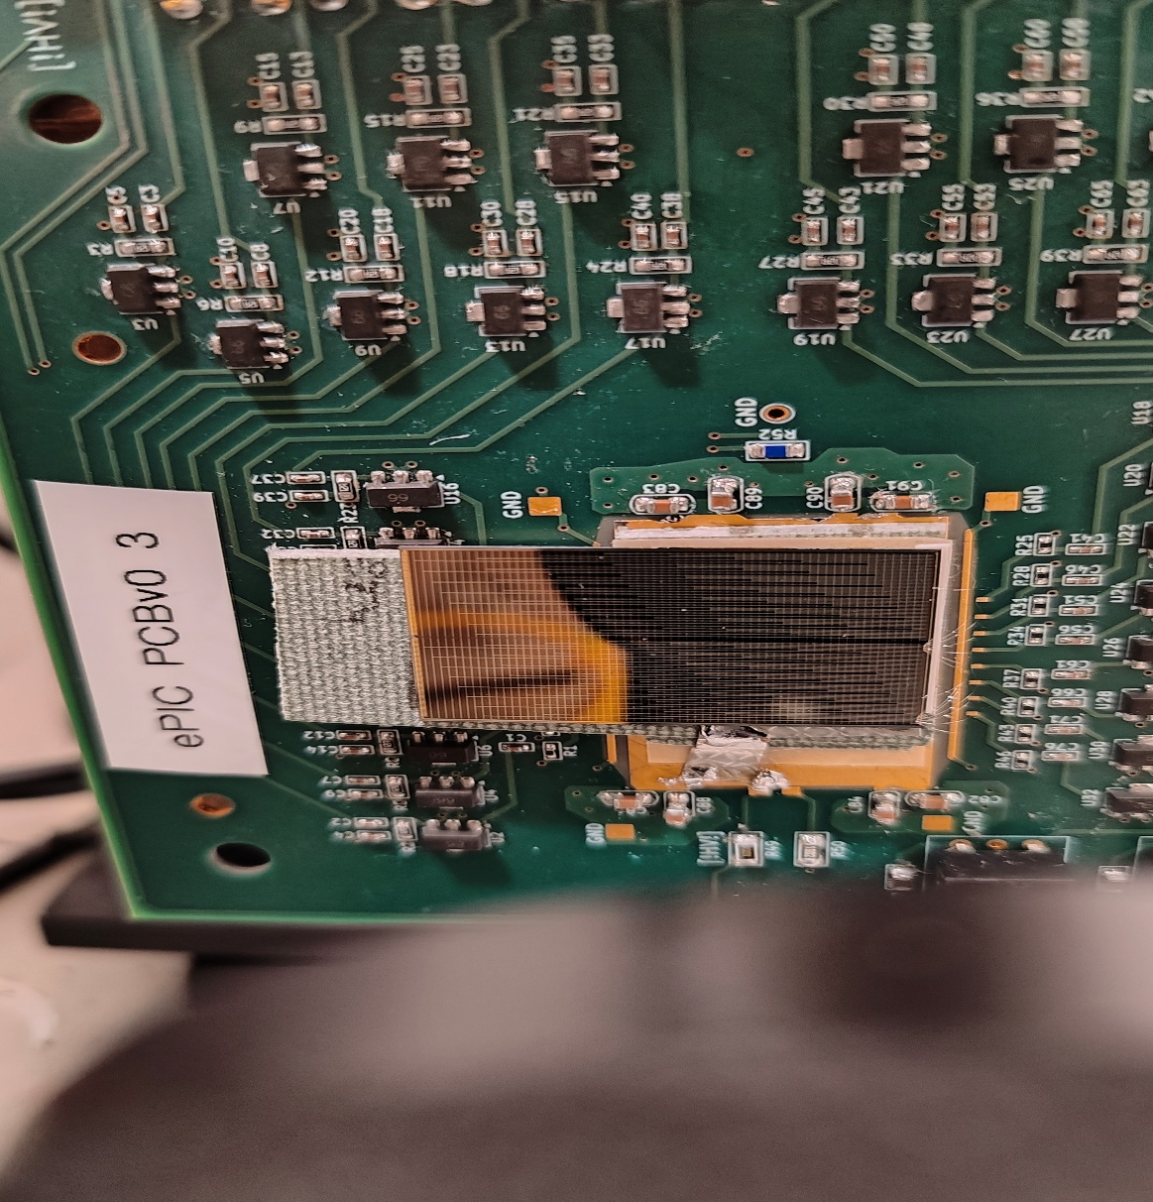
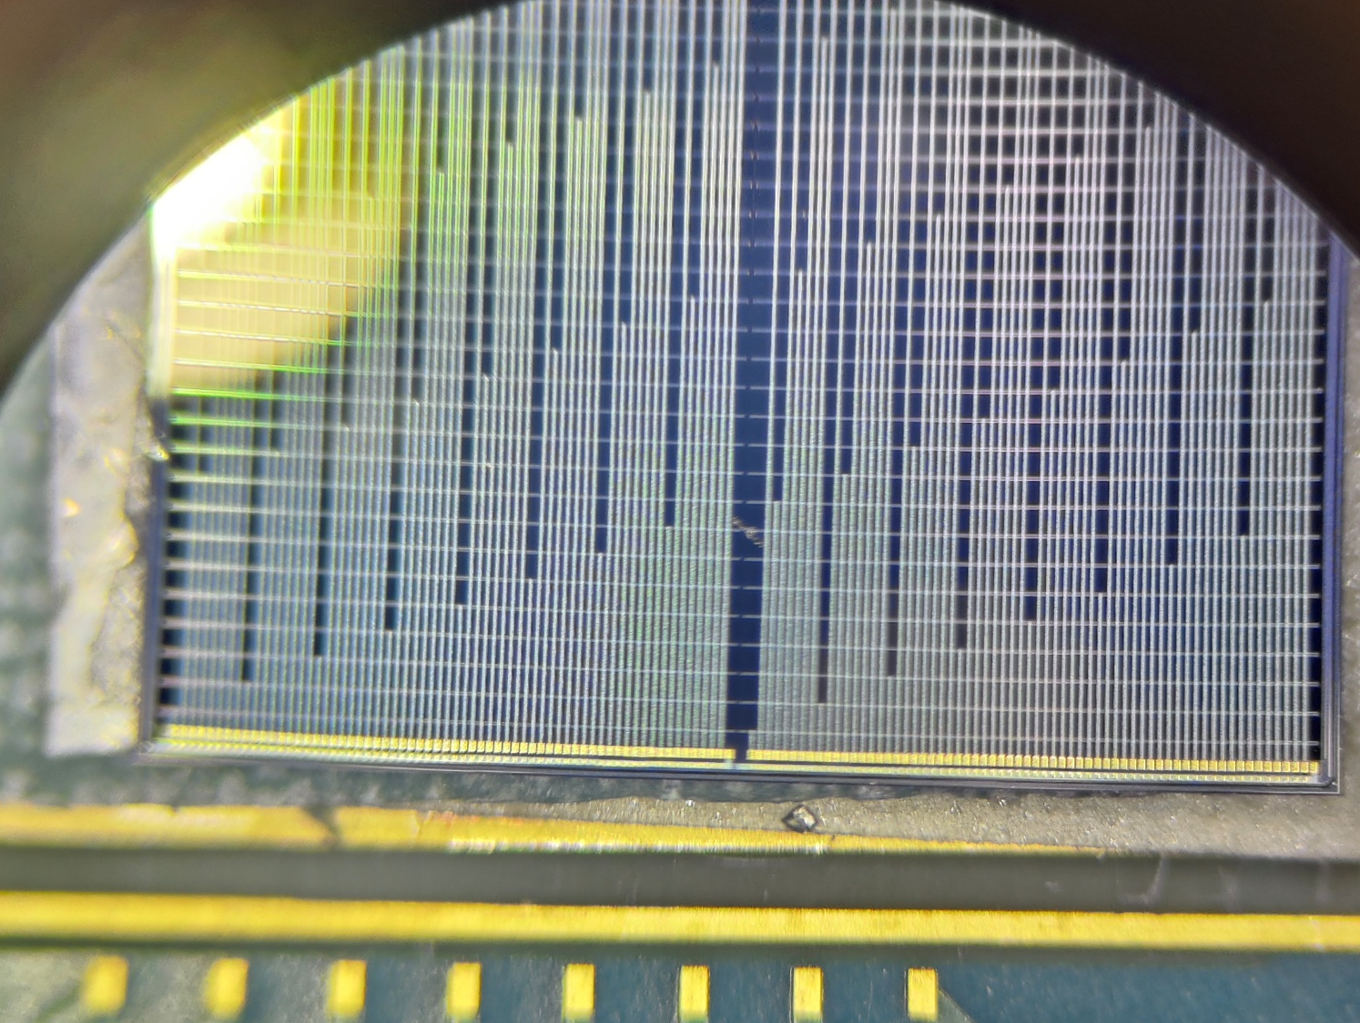
New double metal sensor

Slide 18

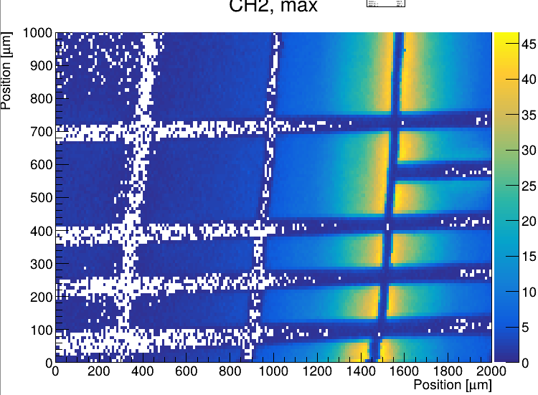
New double metal sensor

Slide 19
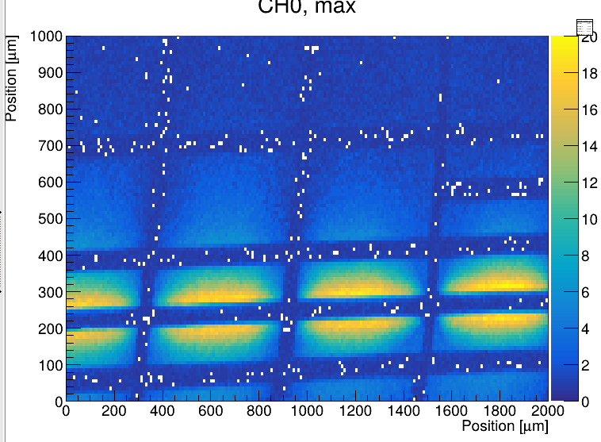
New double metal sensor

Slide 20
New double metal sensor
Transmission lines pick up a lot of signal, around ½ of real electrodes
Probably too wide or 2nd oxide too thin
BNL device had much less transmission line pickup (~4%)
Analysis ongoing, probably need better connection scheme

Slide 21
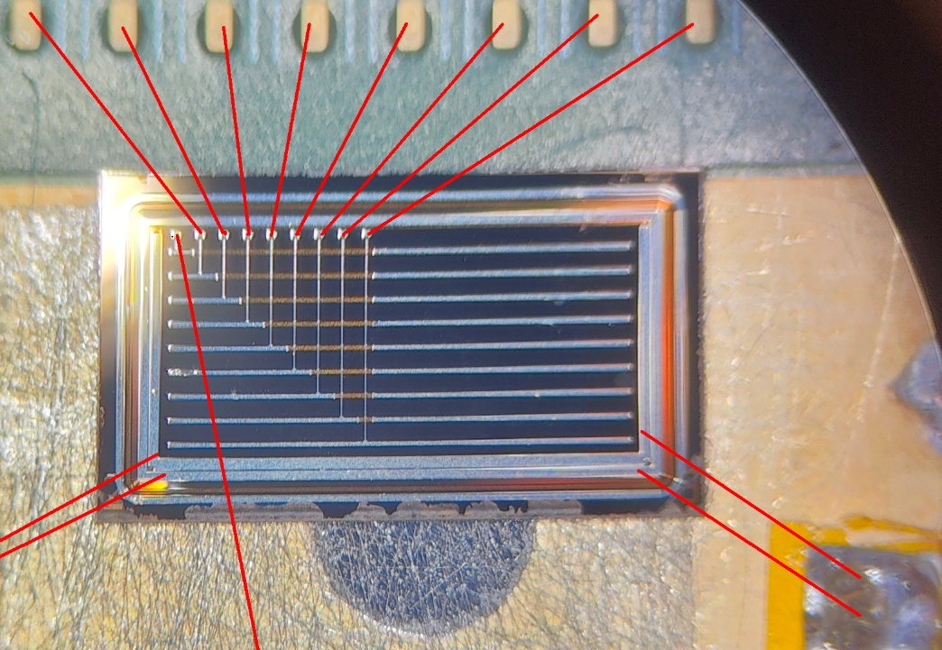
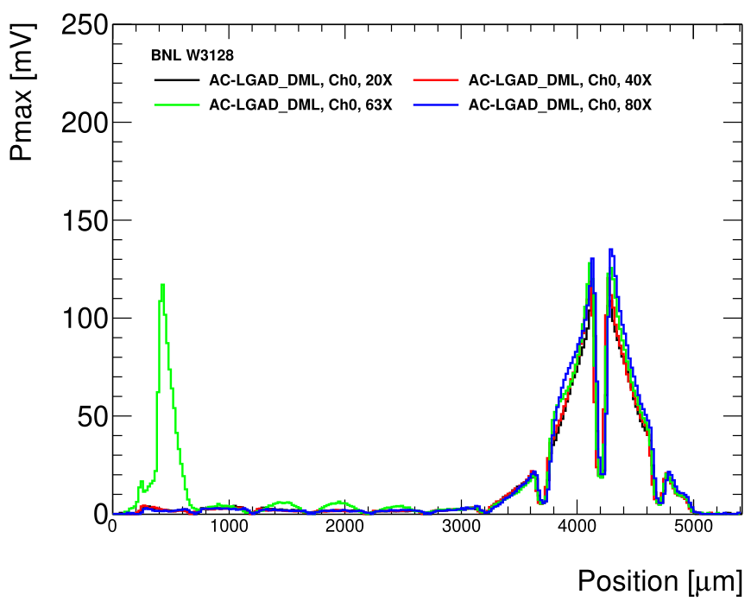
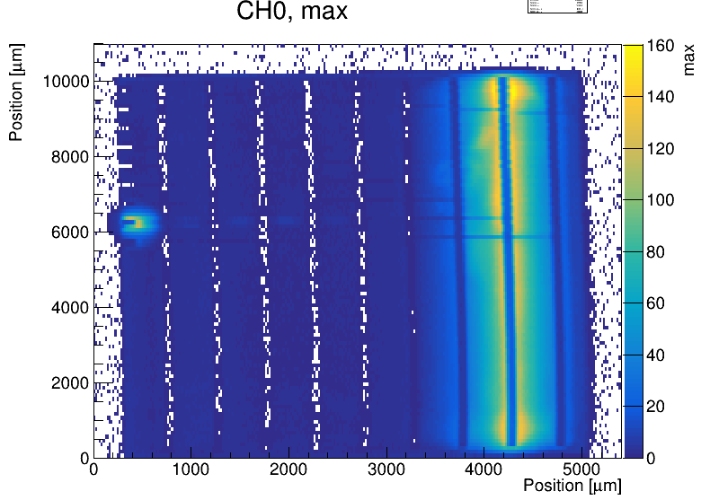
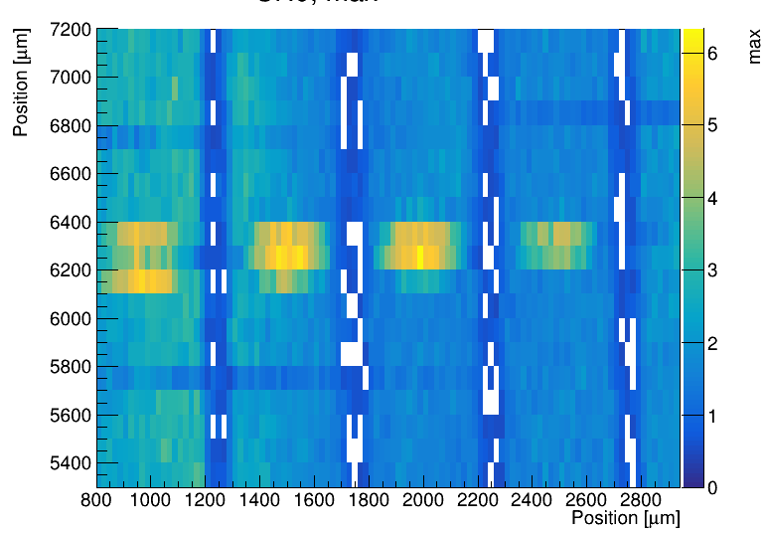
DML AC-LGADs
Proof of principle works! Behaves as standard AC-LGAD
Pickup of the cross strip is minimal, extra pickup at the bonding pad
  Pickup on the line is ~4%
  Cross talk with perpendicular strip hard to test with laser
Behavior across the strip is homogeneous
  Both Pmax and rise time are ok
Signal delays are complex to correct for
  Large delays due to transmission lines
  Signal propagation in strip and transmission line is different
Can’t test crosstalk under metal
Wire bond
Transmission line pickup
Student: A. Molnar, C. Altafulla

Slide 22
Backup

Slide 23
Laser TCT and testbeam comparison
Pretty good agreement!

Slide 24
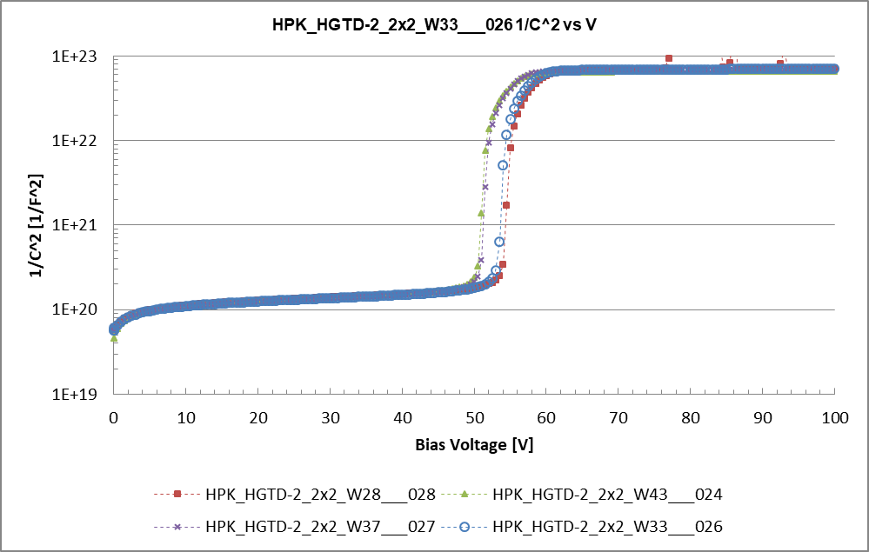
Sensor testing –probe station, charge collection
Probe station electrical testing
Current of voltage (IV) and Capacitance over voltage (CV)
CV is used to probe the doping profile of the gain layer
Laboratory charge collection
  Using MiP electrons from a Sr90 β-source (β-telescope)
    Signal shape, noise, collected charge, gain, time resolution
  Using Alpha source in vacuum (Am237), ~100 MIPs deposition
  Using X-ray gun
  Laser TCT studies
    IR laser mimics a MiP response and allows charge injection as a function of position
    Particularly useful to test arrays and AC-LGADs (see later)
  Test beam at facilities (CERN, DESY, FNAL)
    Allows the study of MiP response with position information through an external tracker
Min doping
Max doping

Slide 25
Sensor testing – IV/CV
Capacitance over voltage (CV)
  Study doping concentration profile and full depletion of the sensor
  Doping profile can be extracted from the 1/C² derivative
Study of the “foot” for LGADs on 1/C²
  1/C² is flat until depletion of multiplication layer because of the high doping concentration
  Proportional to gain layer active concentration
Bulk doping concentration proportional to the derivative of 1/C² before depletion
Full depletion
Multiplication
layer
P
N++
P++
Bulk
~45um sensor
P+

Slide 26
Sensor testing – Sr90 telescope
Details: S.M. Mazza et al. arXiv:1804.05449
  Two sensors are aligned with a beta source
    DUT (Device Under Test) to characterize
    Trigger with known performance
  Sensors mounted on fast amplifier boards (~2Ghz) and read out by a fast oscilloscope (2Ghz, 20Gs)
  Collected charge
  Time resolution: sigma of time difference between trigger sensor (with known time resolution) and DUT,
  Gain: collected charge divided by collected charge in same thickness PiN
  Signal to Noise ratio
$$Δt$$
Measured noise

Slide 27
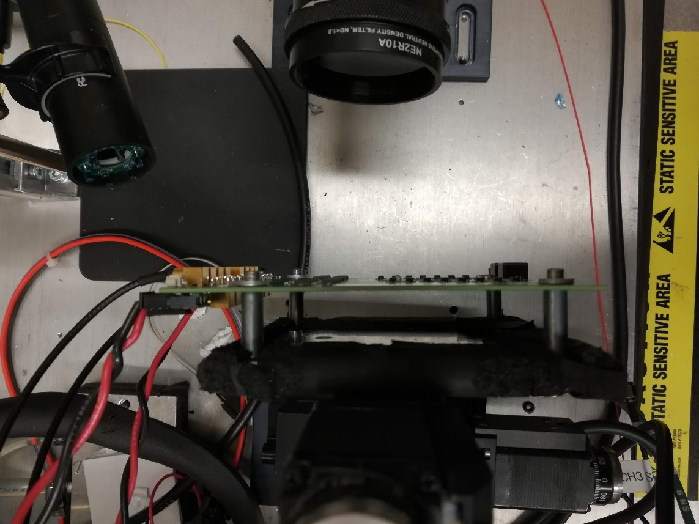

Sensor testing –Laser TCT setup
  Sensors are mounted on a multi-channel analog amplifier board with bandwidth ~1 GHz
    Response is readout by 2 GHz/20 Gs oscilloscope
  IR laser (1064 nm) mimics charge deposit of a Minimum Ionizing Particle (MiP)
    Focused laser beam with spot width ~20 um
  Amplifier board is mounted on X/Y moving stages
    Charge injection as a function of position
  Metal is not transparent to IR so no response can be seen when laser is on top of metal
    Only the sensor response in-between metal pads is visible
Focused laser
Sensor
Amplifier board
X/Y motors

Slide 28
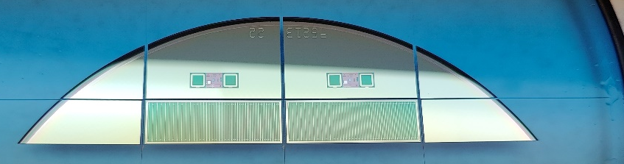
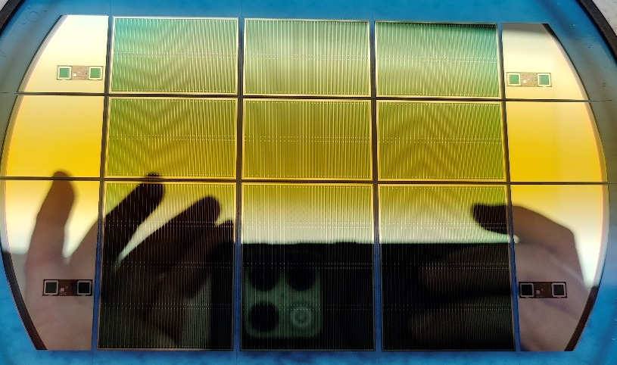
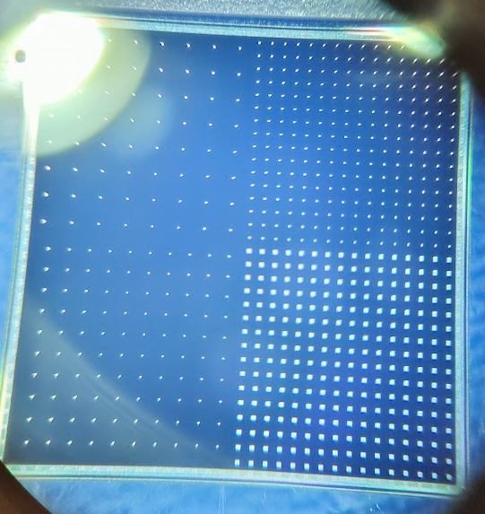
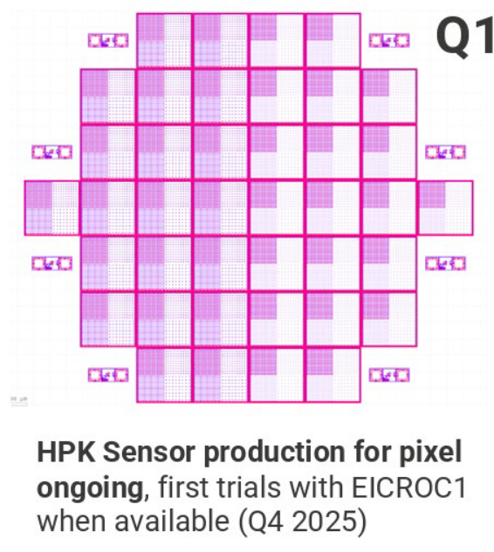
HPK s16694 production – 2024/2025
Half sensors
ePIC full-size production of HPK strip and pixel AC-LGADs
  Multi-pitch and multi-electrode size
8 strip wafers, 50um and 30um thick
4 pixel wafers, 30um and 20um thick
Fully tested electrically and sample tested with laser and test beams
  Measured parameters variation
Full sensors
Double sensors

