Slide 1




Measuraments of inclusive differential diffractive cross sections in DIS at ePIC
GRUPPO COLLEGATO COSENZA

Slide 2
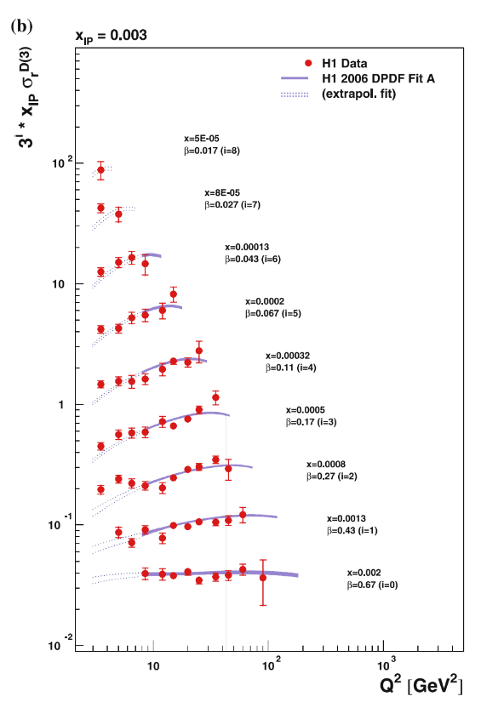
Motivation
Inclusive diffraction e+p:
Never studied in detail at ePIC detector.
Cross Section -> DPDF
DPDF -> Sensitive to gluon densities
Saturation
GRUPPO COLLEGATO COSENZA

Slide 3
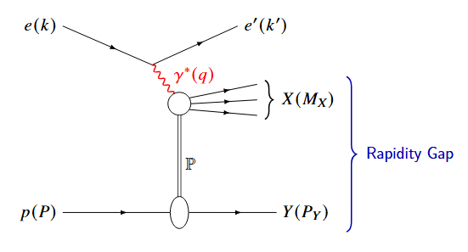
DIS Variables
INCLUSIVE
Q² = - q² = - (k - k’) ² = s y x
x_{Bj} = Q² / 2 (P · q)
y = P · q / P · k
W² = (q + P) ²
GRUPPO COLLEGATO COSENZA

Slide 4

DIS Variables
DIFFRACTIVE
t = (P − P’) ²
$β$ = Q² / (Q ² + M_{X}² − t) = x_{Bj}/x_{pom}
M_{X} ² = (q + P − P’) ² = E_{X}² - |P_{X}|²
x_{L} = P_{z}’/P_{z} = 1 - x_{pom}
x_{pom} = (Q² + M_{X} ² − t)/(Q² + W² − m²_{p})
GRUPPO COLLEGATO COSENZA

Slide 5

Diffractive DIS Differential Cross Sections
$$\frac{dσ^{ep→ eXY}}{dt}={\left.\frac{dσ^{ep→ eXY}}{dt}\right|}_{t=0}e^{−Bt}$$
$$Y_{+}=1+{\left(1−y\right)}^{2}$$
$$\frac{d^{3}σ^{ep→ eXY}}{dx_{pom}dβdQ^{2}}=\frac{2πα^{2}}{βQ^{4}}Y_{+} σ_{r}^{D\left(3\right)}\left(x_{pom},β,Q^{2}\right)$$
$$σ_{r}^{D\left(3\right)}\left(x_{pom},β,Q^{2}\right)=F_{2}^{D\left(3\right)}\left(x_{pom},β,Q^{2}\right) −\frac{y^{2}}{Y_{+}}F_{L}^{D\left(3\right)}(x_{pom},β,Q^{2})$$
GRUPPO COLLEGATO COSENZA

Slide 6
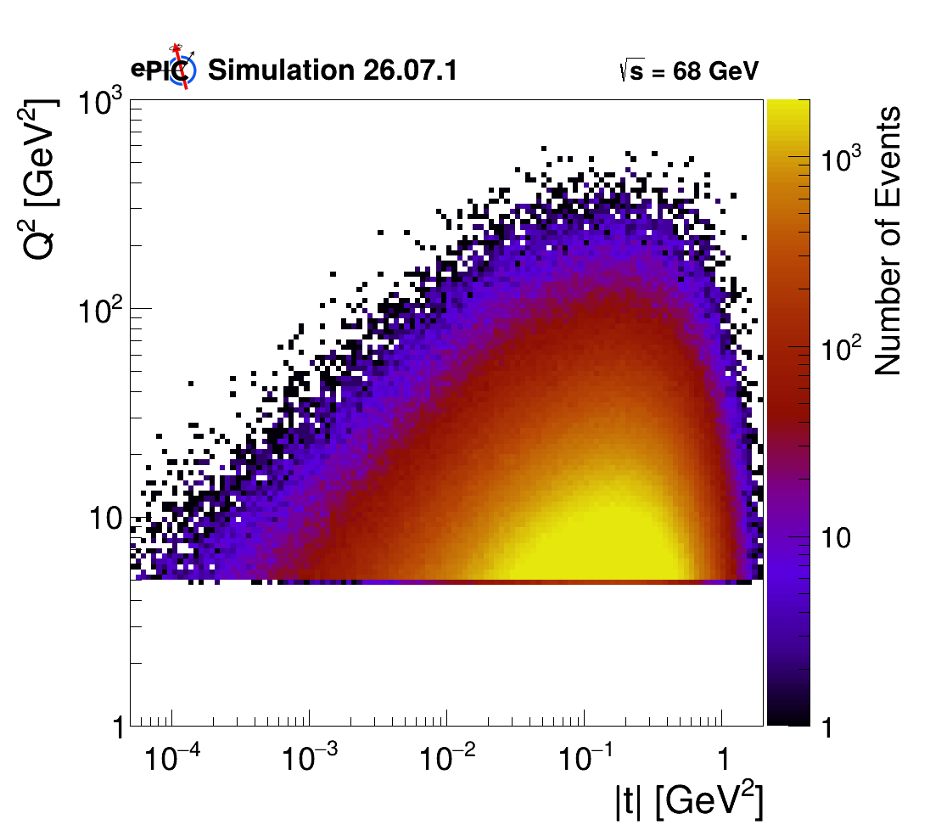
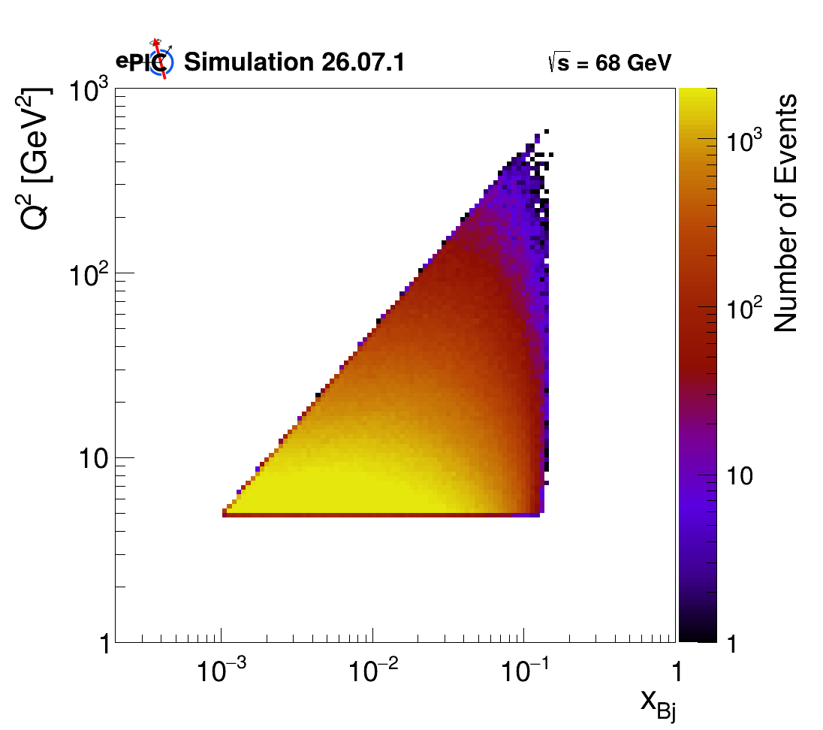
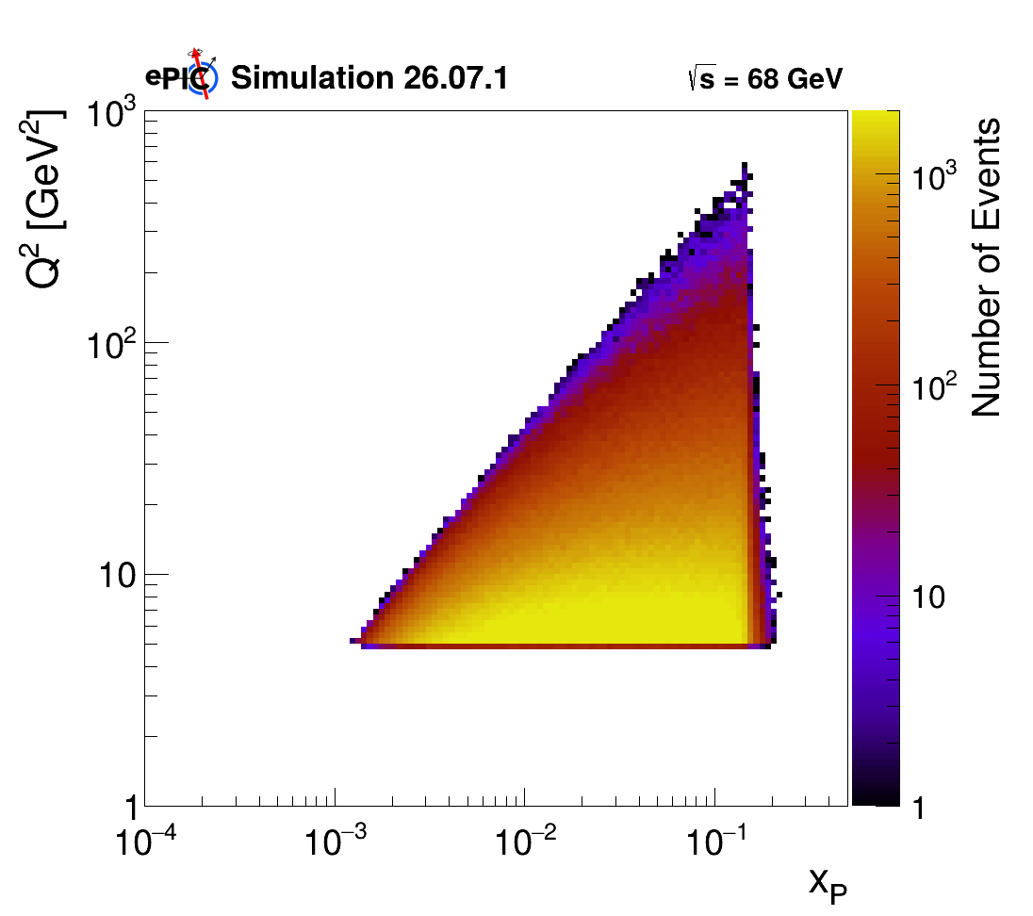
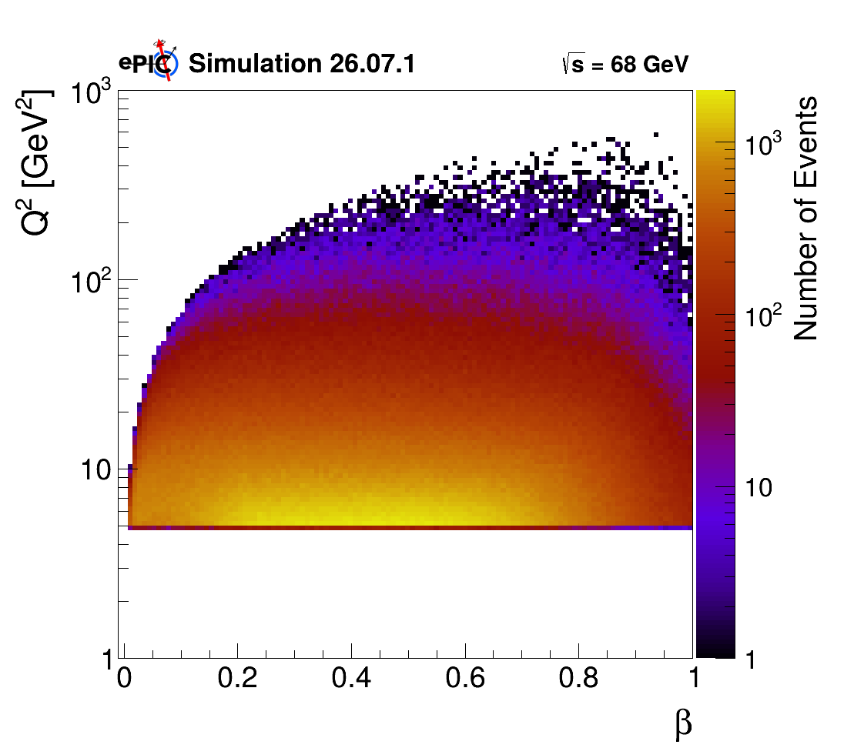

Simulation Campaign 26.07.1
Number of event: 2M
MC: Rapgap 3.10
Afterburner 0.1.3
NO ISR, 9 x 130($\sqrt{s}=68 GeV)$
Q² > 5 GeV²
10⁻³ < y < 1
10⁻³ < x_{Bj} < 0.15
7 x 10⁻⁶ < t < 2 GeV²
10⁻³ < x_{pom} < 0.2
8 x 10⁻³ < $β$ < 1
GENERATOR LEVEL PHACE SPACE:
GRUPPO COLLEGATO COSENZA

Slide 7
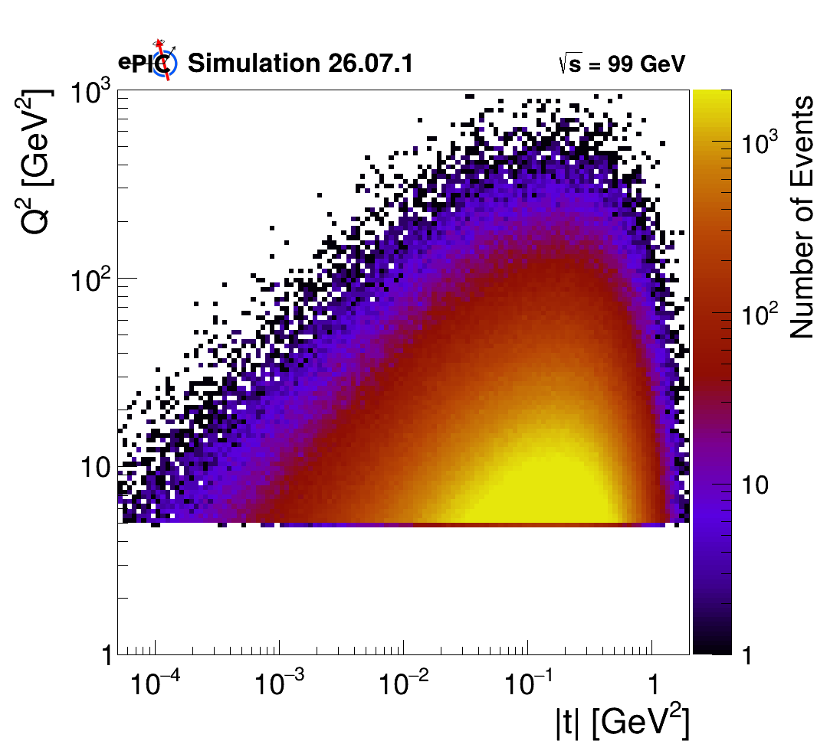
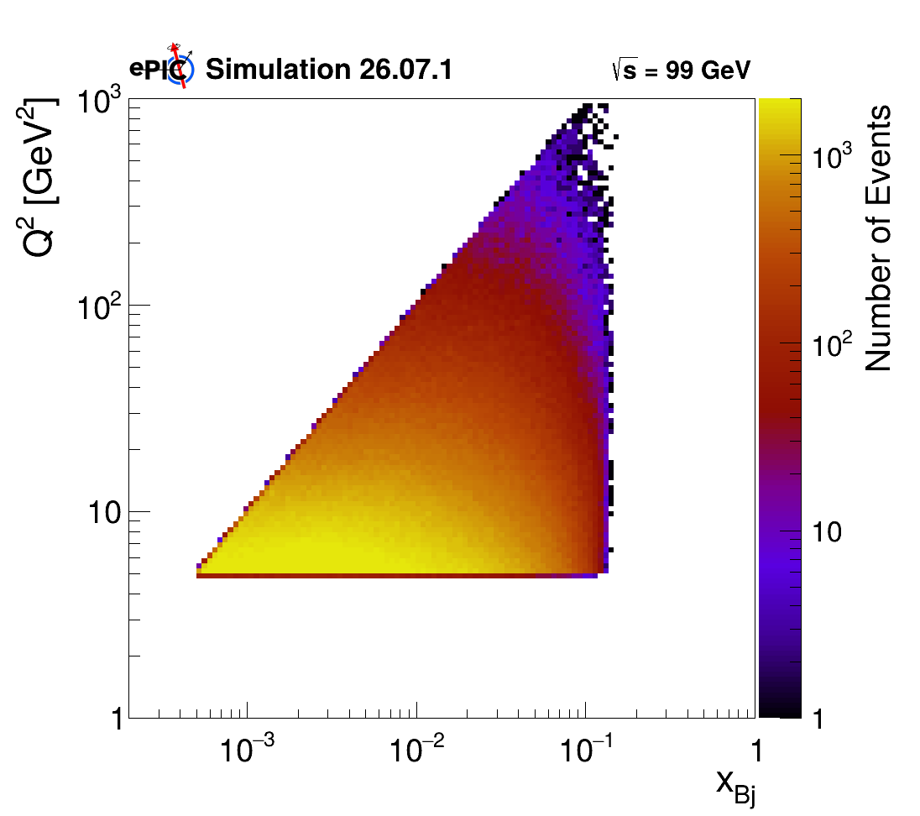
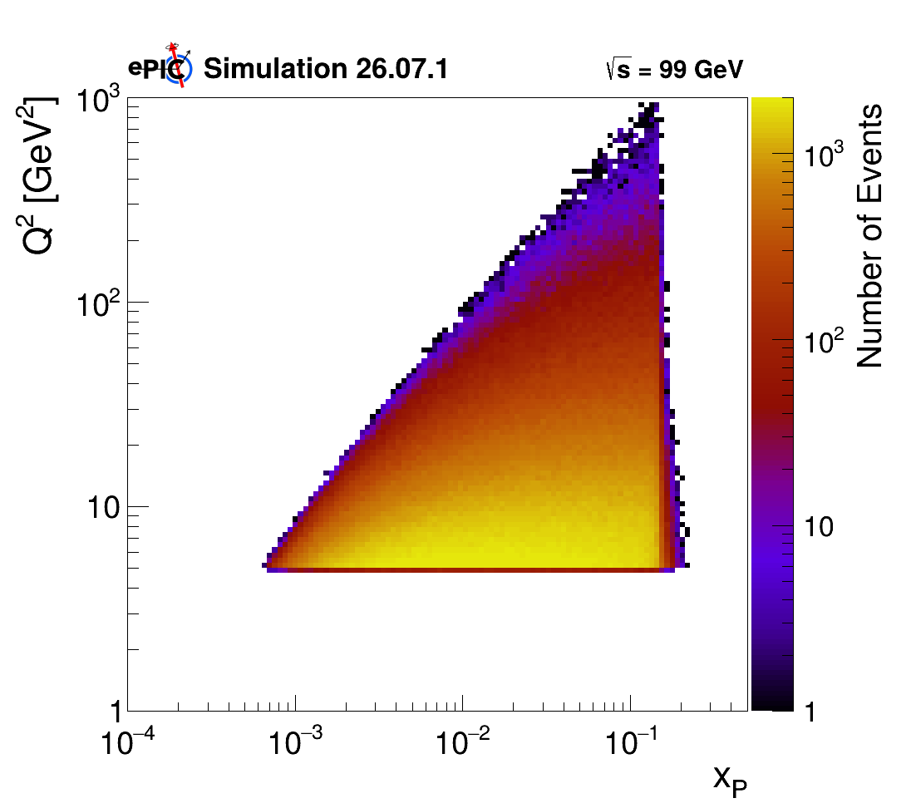
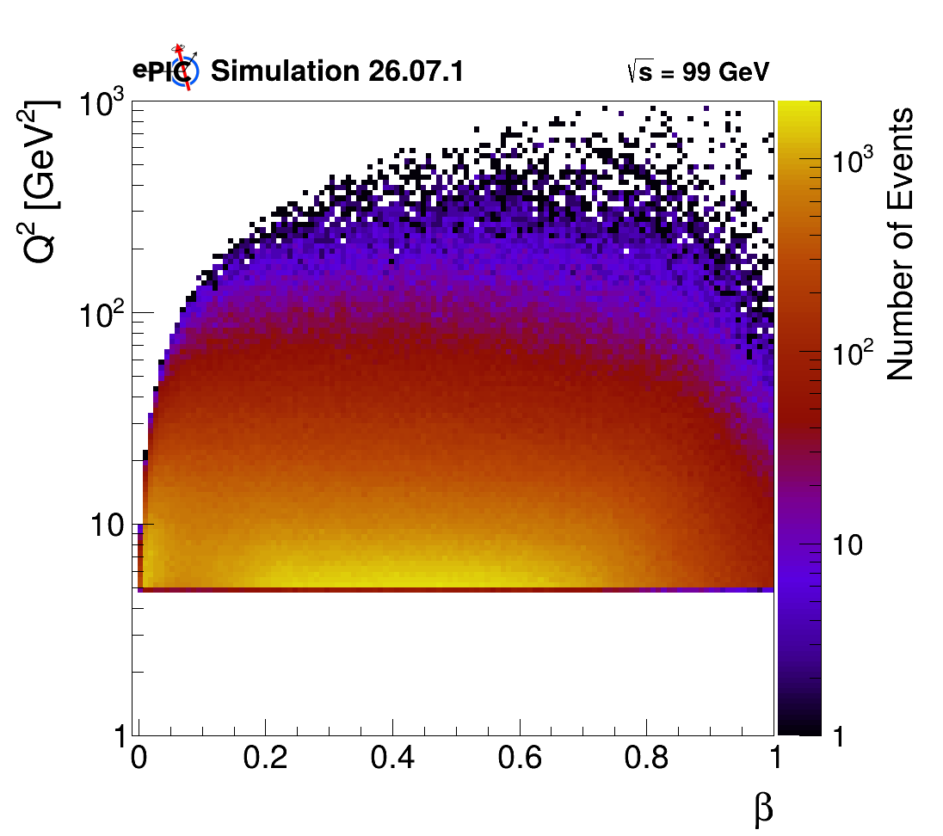

Simulation Campaign 26.07.1
Number of event: 2M
MC: Rapgap 3.10
Afterburner 0.1.3
NO ISR, 9 x 275 ($\sqrt{s}=99 GeV$)
Q² > 5 GeV²
10⁻³ < y < 1
5 x 10⁻⁴ < x_{Bj} < 0.15
5 x 10⁻⁵ < t < 2 GeV²
5 x 10⁻⁴ < x_{pom} < 0.2
8 x 10⁻³ < $β$ < 1
GENERATOR LEVEL PHACE SPACE:
GRUPPO COLLEGATO COSENZA

Slide 8
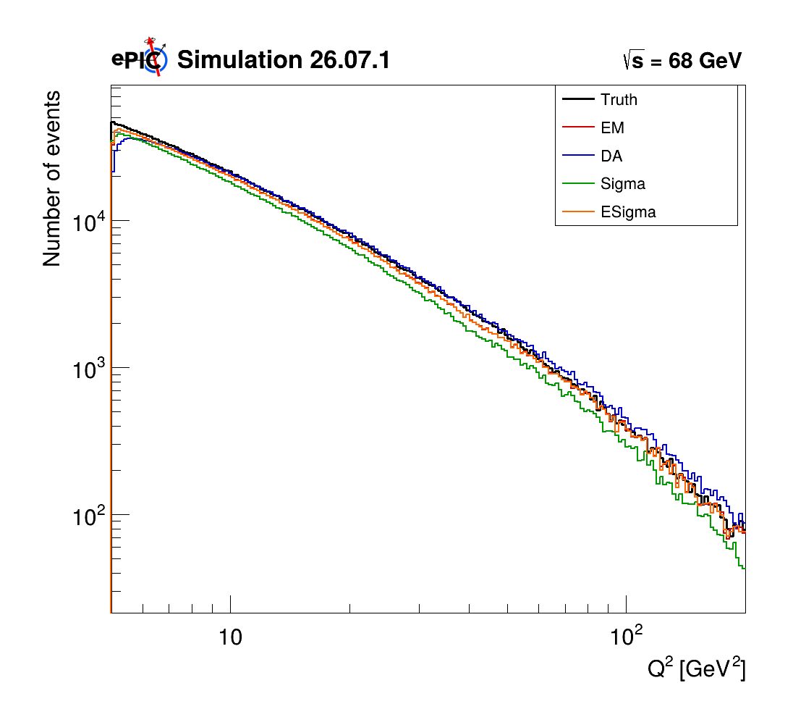
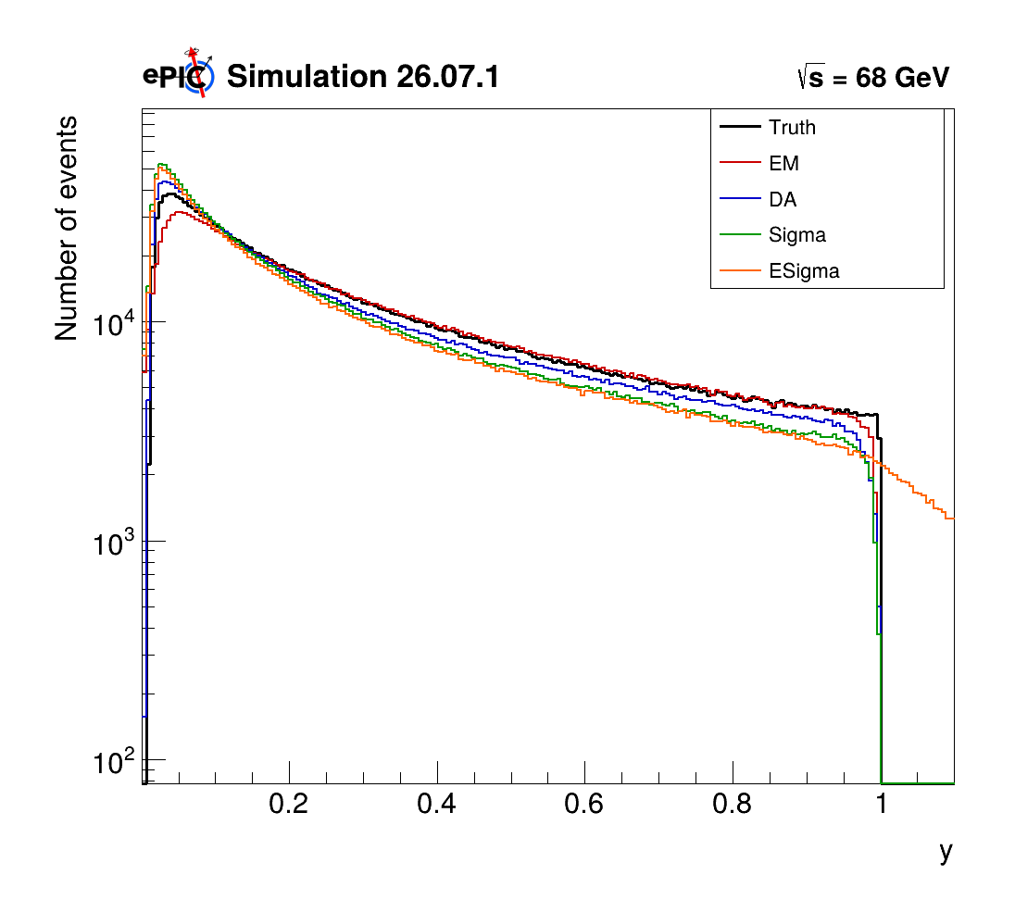
Q² and y distributions
GRUPPO COLLEGATO COSENZA

Slide 9
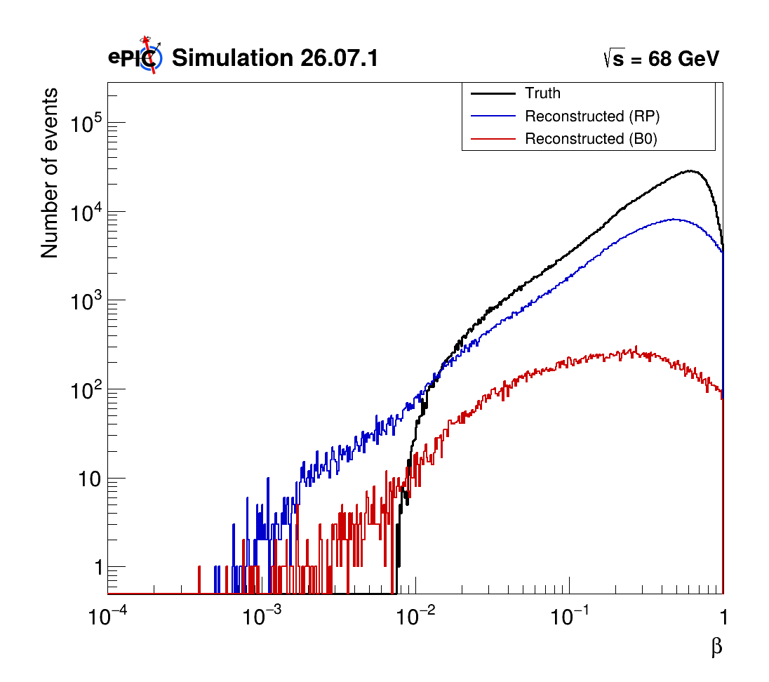
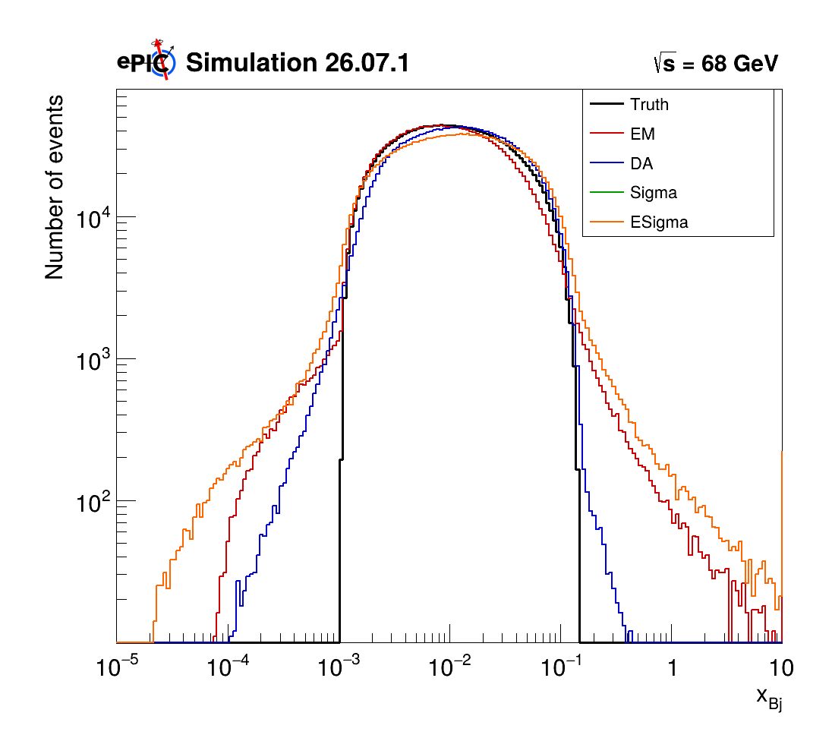

$β$ and x_{Bj} distributions
GRUPPO COLLEGATO COSENZA

Slide 10
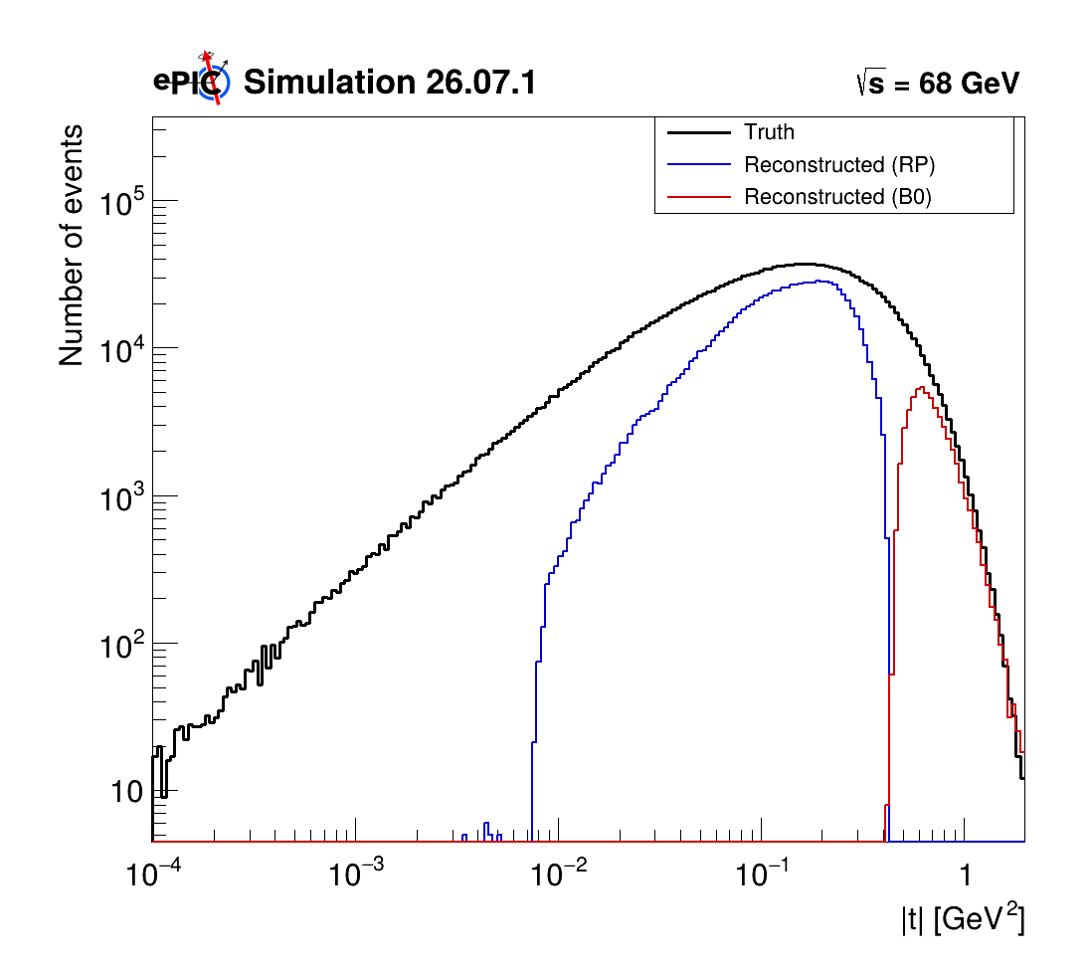
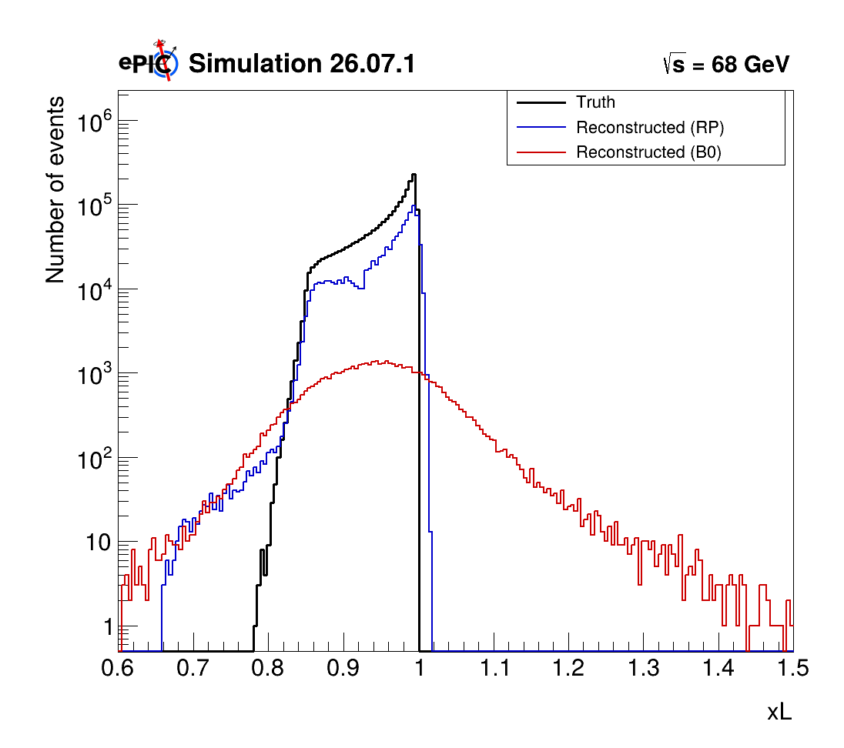
t and x_{L} distributions
GRUPPO COLLEGATO COSENZA

Slide 11
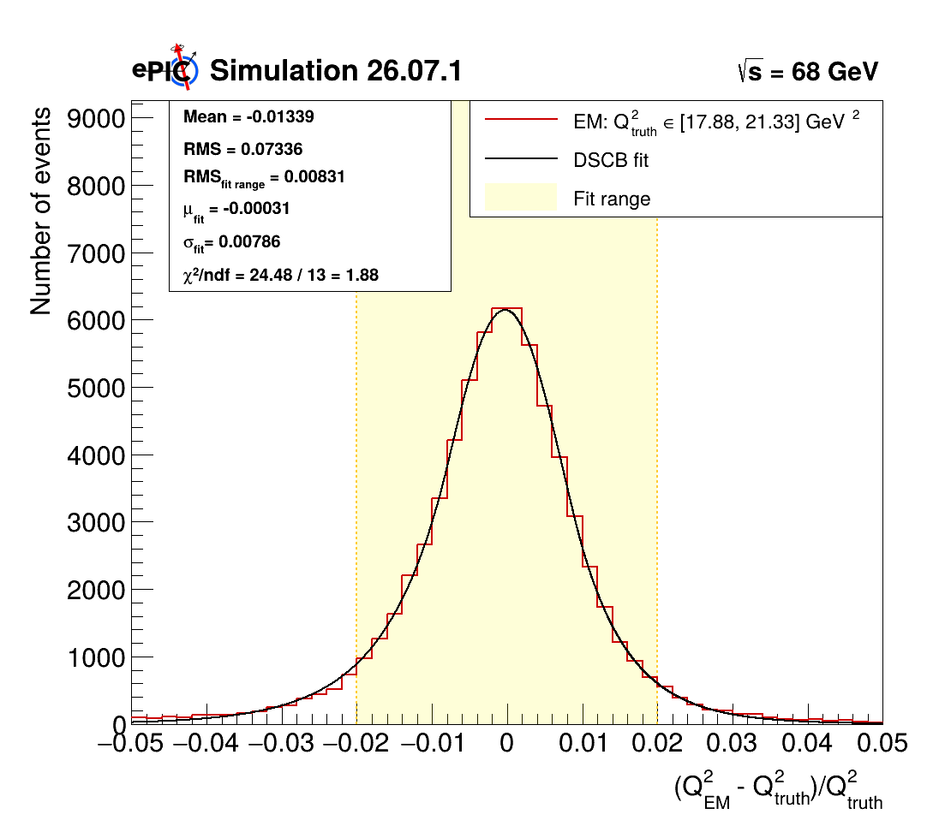
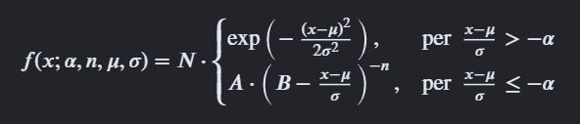

Resolution
Fitted with Double-Side Crystall ball:
RMS or $σ$ → dispersion
Mean or $μ$ → systematic bias
All plots HERE
GRUPPO COLLEGATO COSENZA

Slide 12
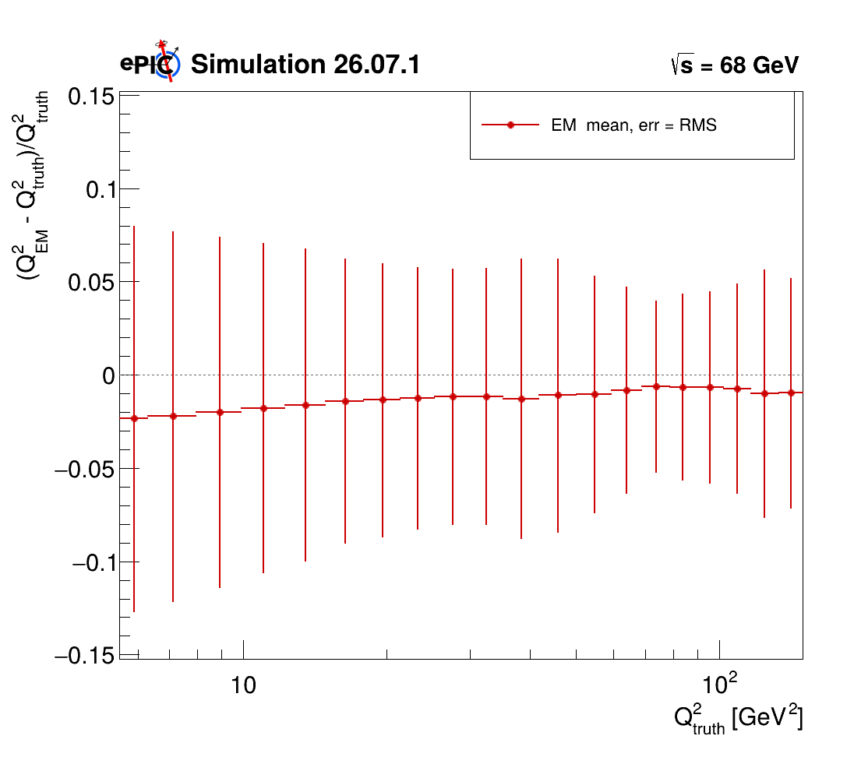
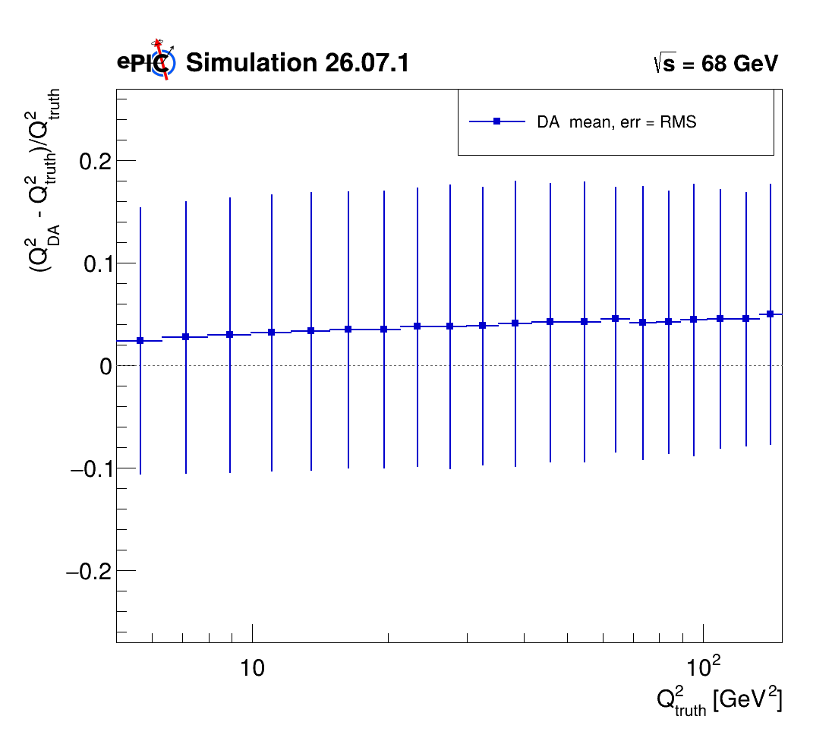
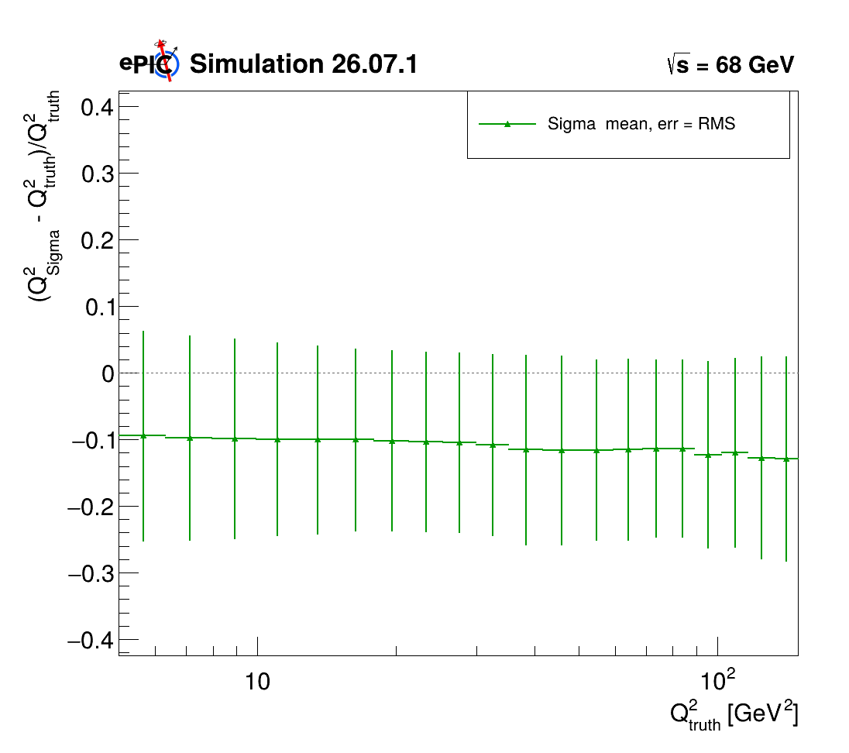
Q² Bin Resolution
ALL THE 9x130 RESOLUTIONS PLOTS HERE
ALL THE 9x275 RESOLUTIONS PLOTS HERE
GRUPPO COLLEGATO COSENZA

Slide 13
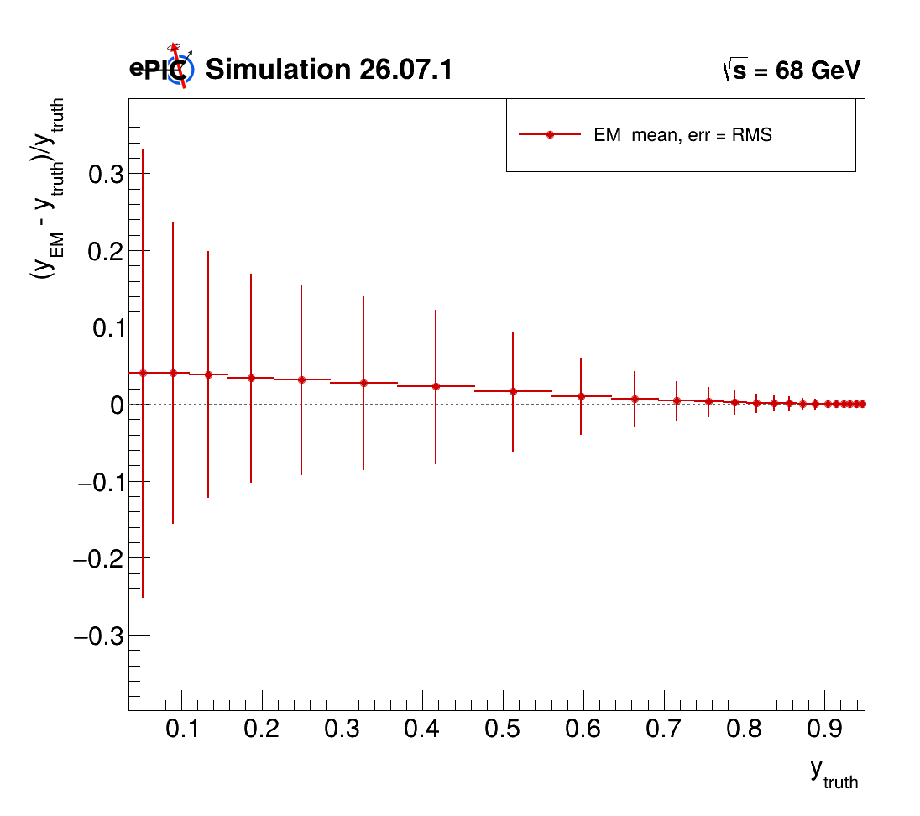
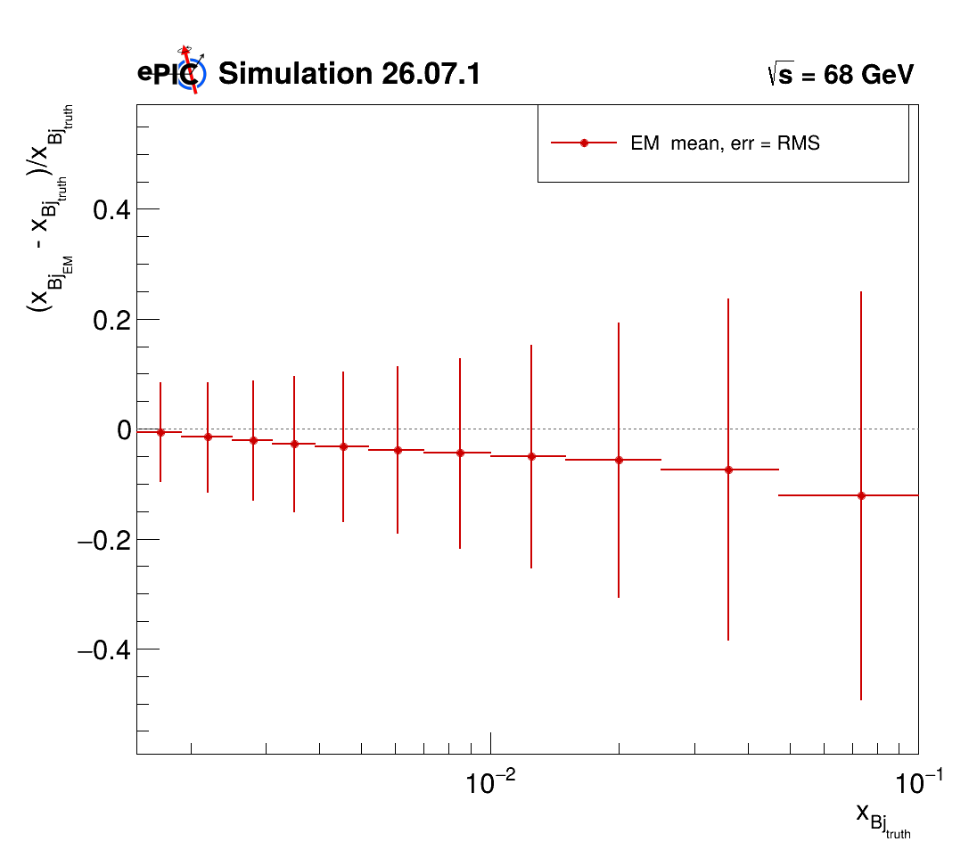
Q² , y, x_{Bj} : Bin Resolution e-Method
Q² Resolution plots 9x130
y Resolution plots 9x130
xbj Resolution plots 9x130
Q² Resolution plots 9x275
y Resolution plots 9x275
xbj Resolution plots 9x275
GRUPPO COLLEGATO COSENZA

Slide 14
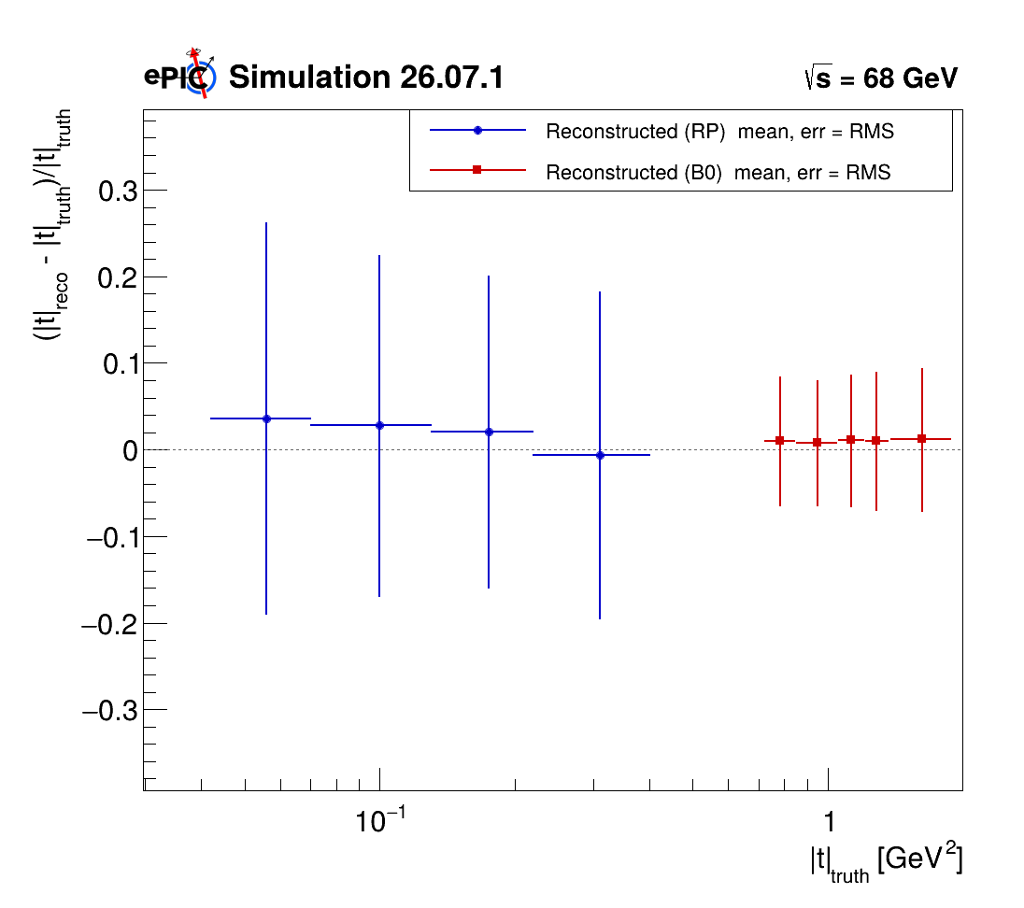
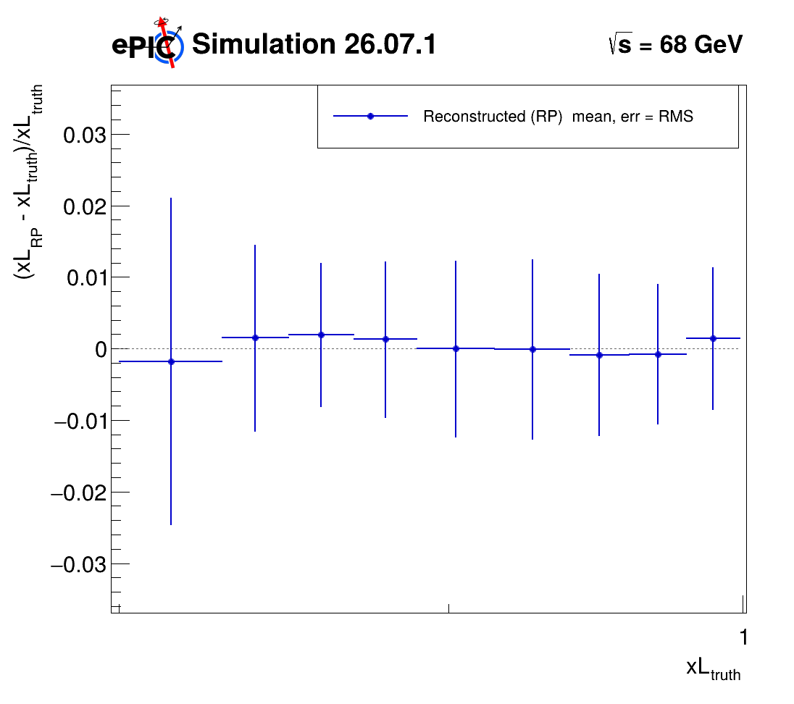
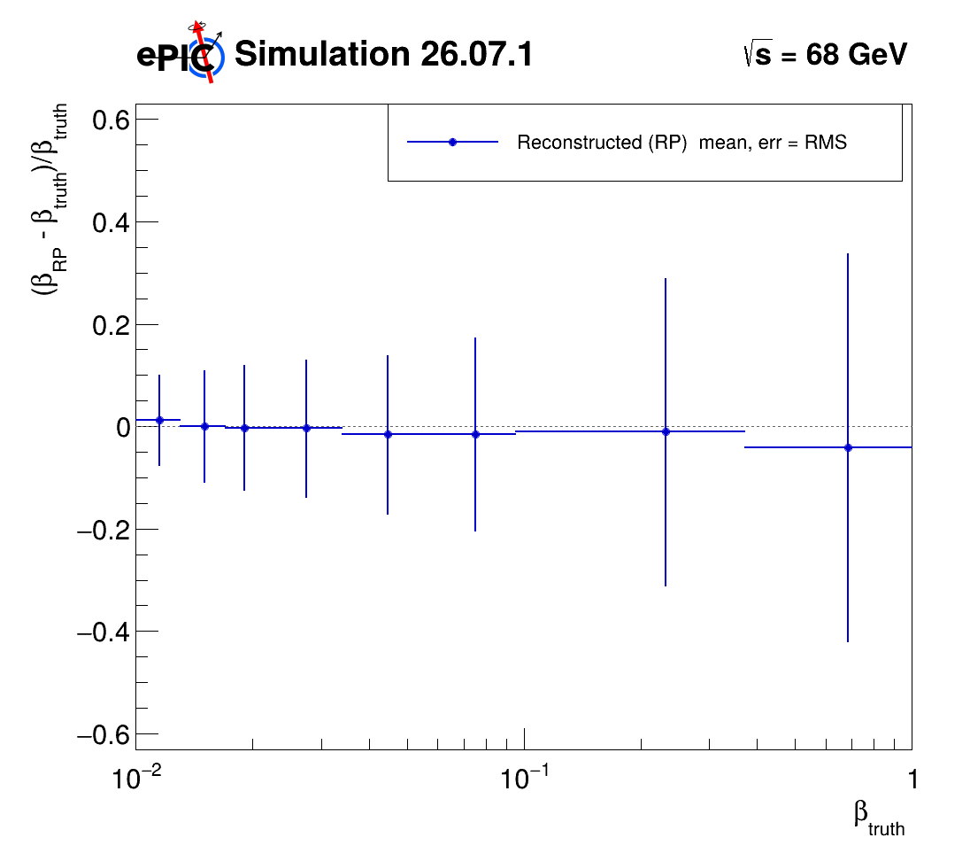

t, x_{L}, $β$ : Bin Resolution
t Resolution plots 9x130
xL Resolution plots 9x130
beta Resolution plots 9x130
t Resolution plots 9x275
xL Resolution plots 9x275
beta Resolution plots 9x275
GRUPPO COLLEGATO COSENZA

Slide 15
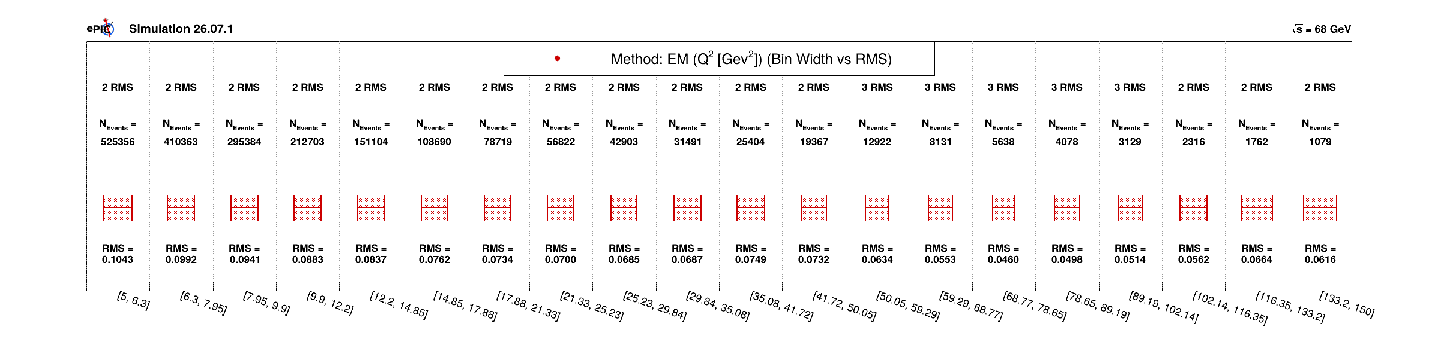
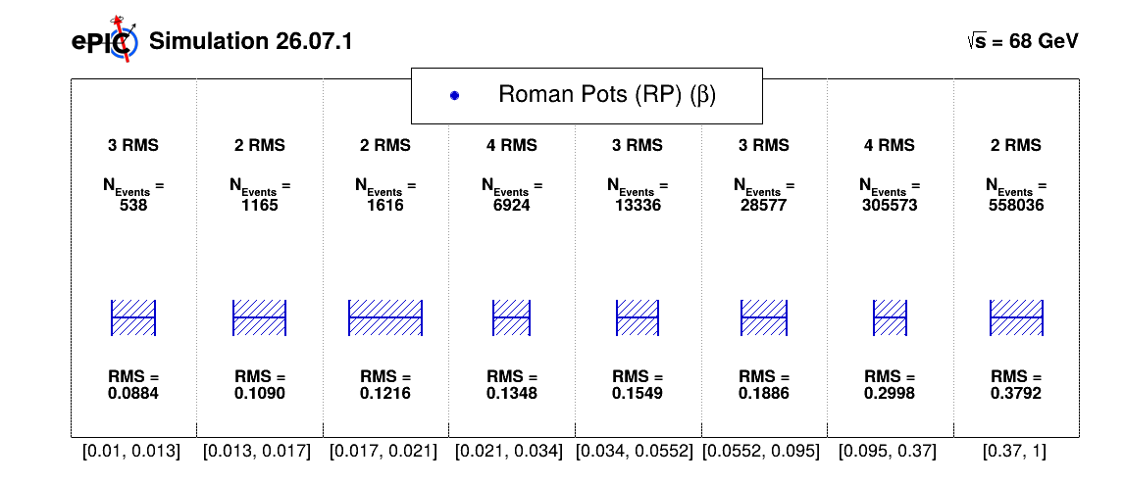

Bin Resolution-Q2 and $β$
GRUPPO COLLEGATO COSENZA

Slide 16
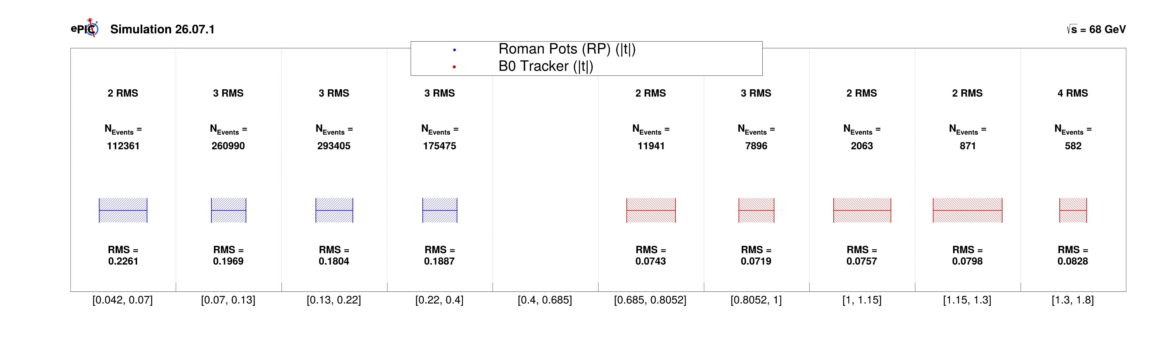
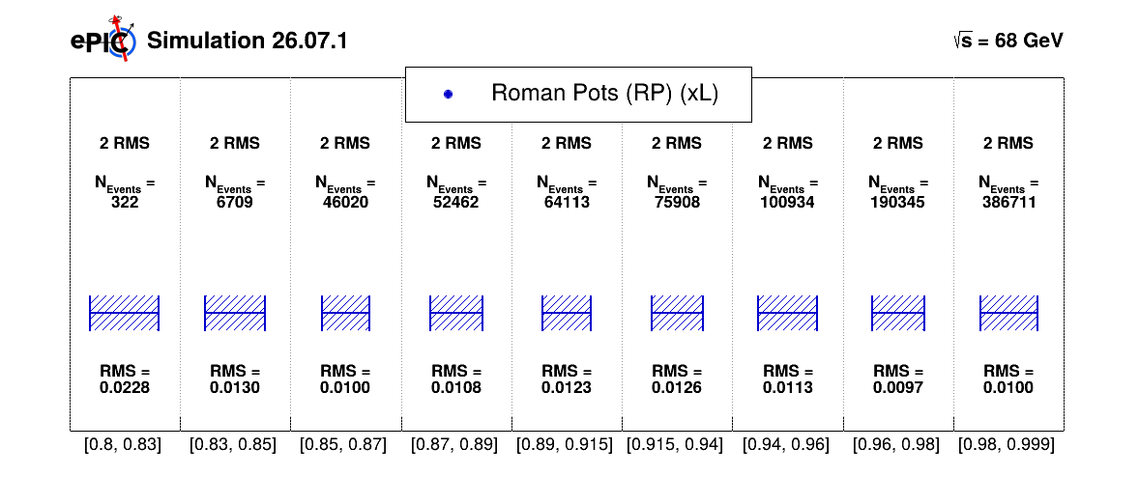
Bin Resolution-t and x_{L}
2D
3D
GRUPPO COLLEGATO COSENZA

Slide 17
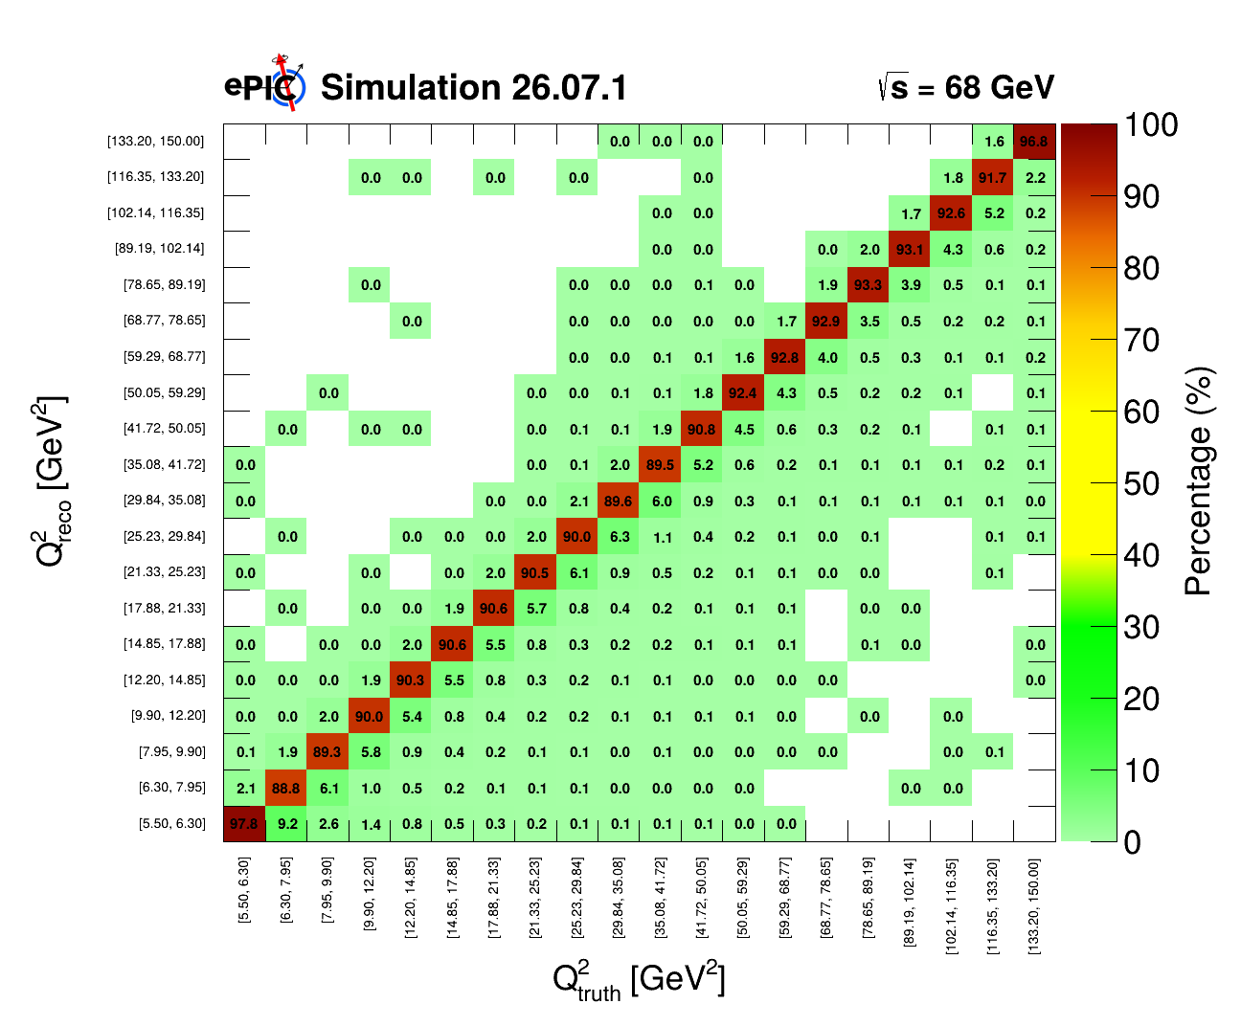
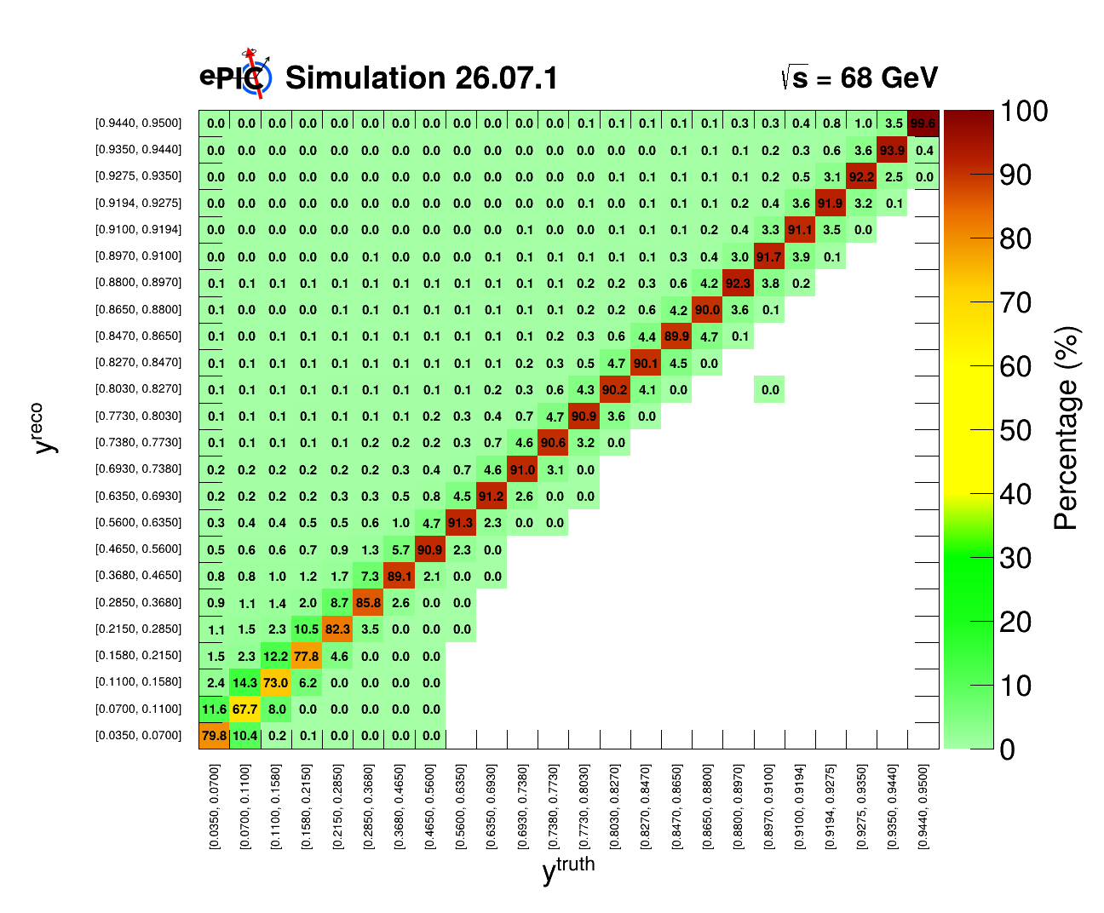
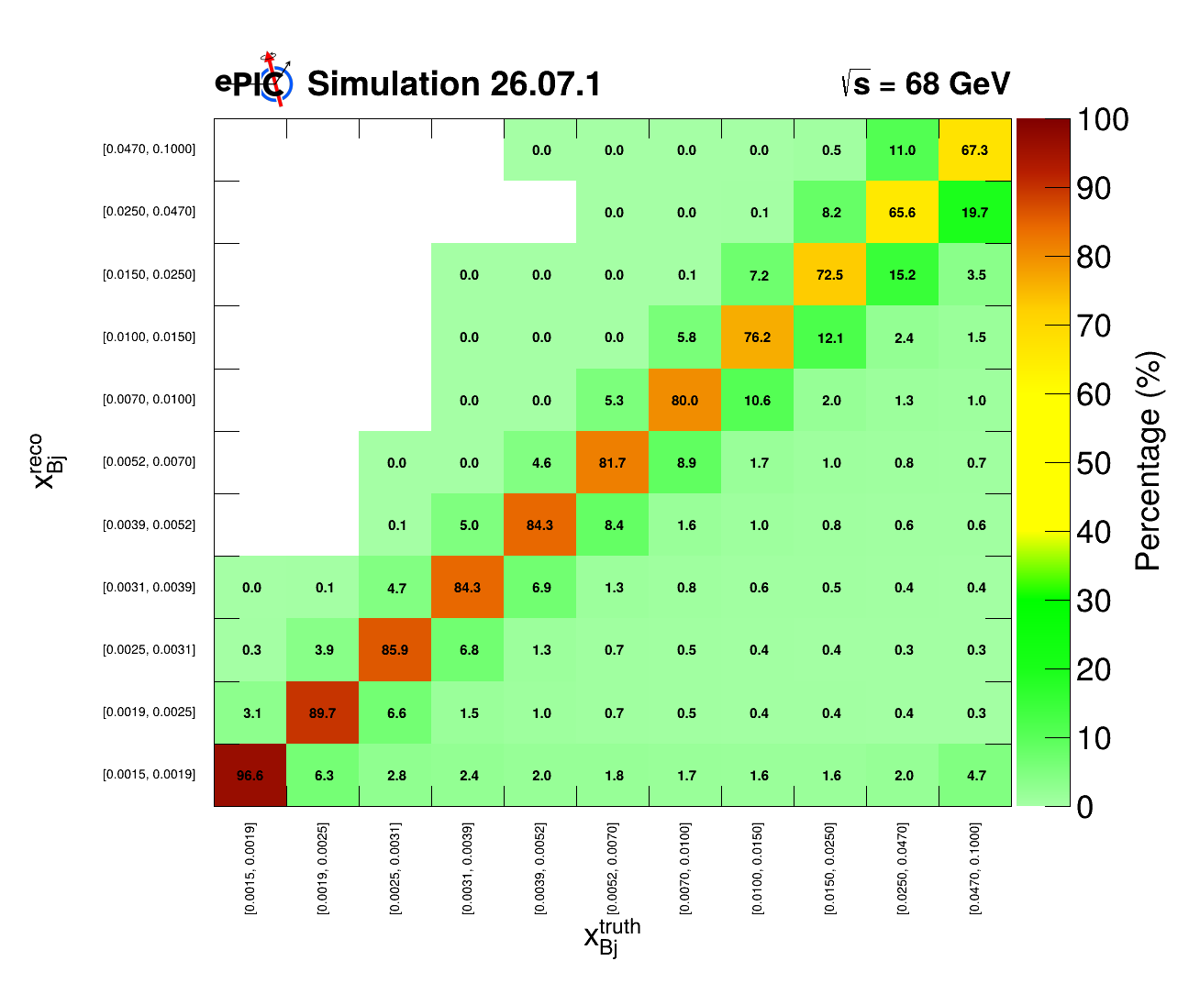
Q² , y, x_{Bj} : Migration Matrices
GRUPPO COLLEGATO COSENZA

Slide 18
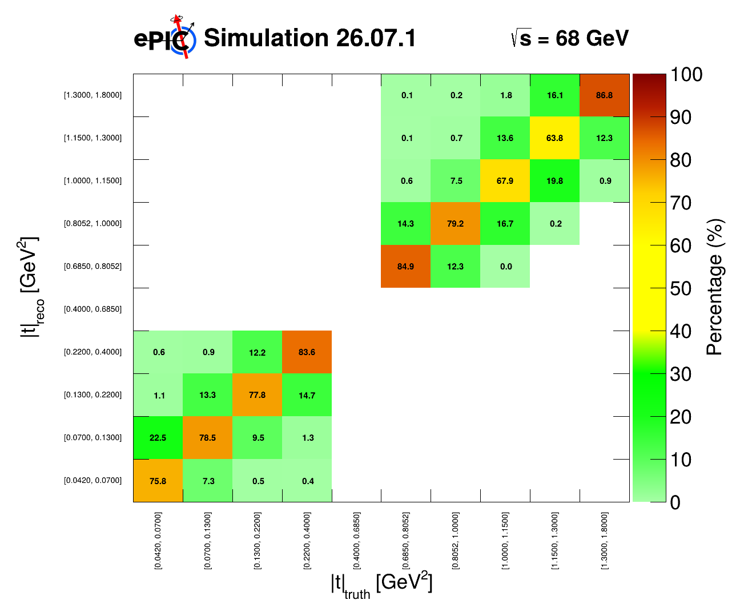
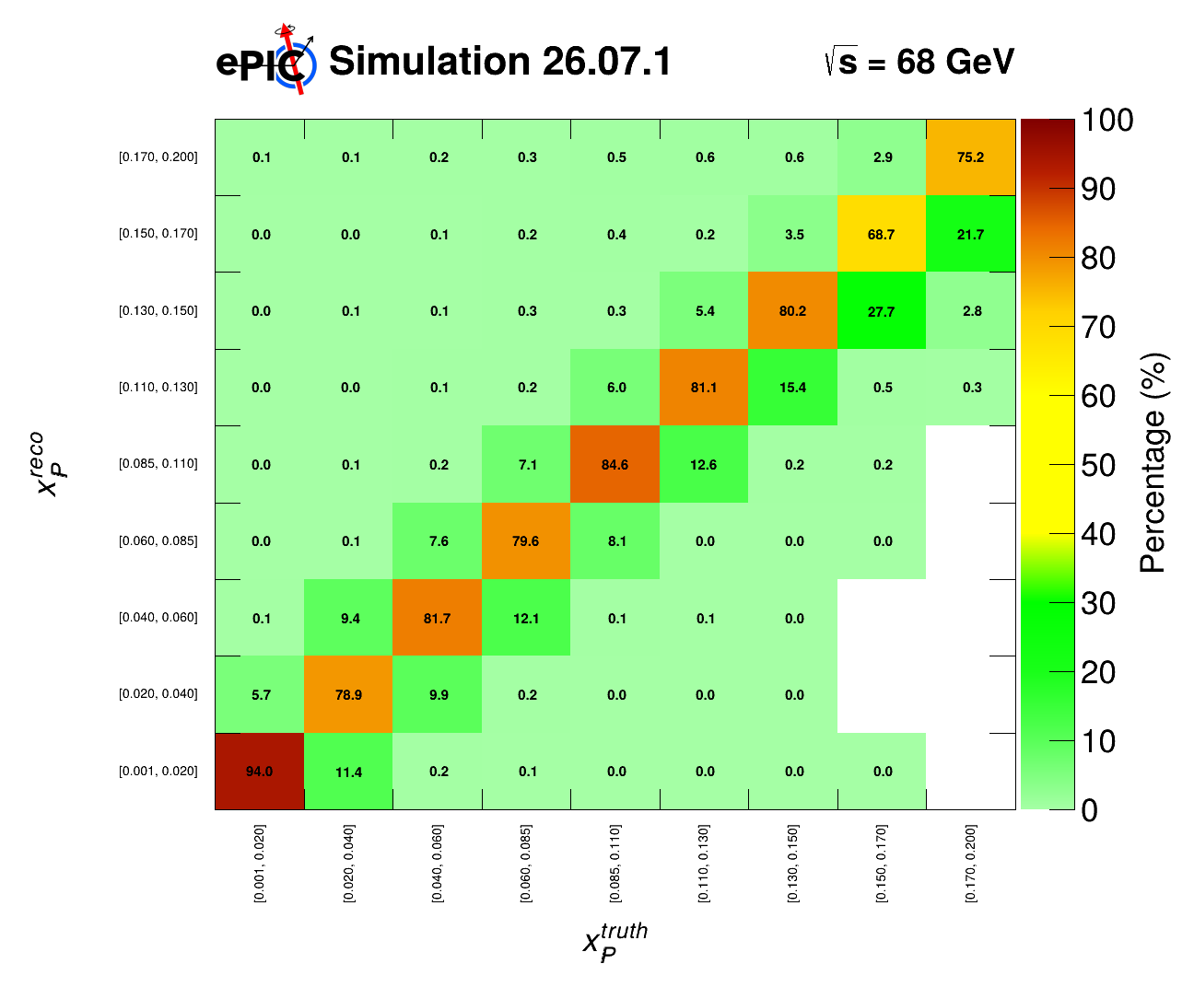
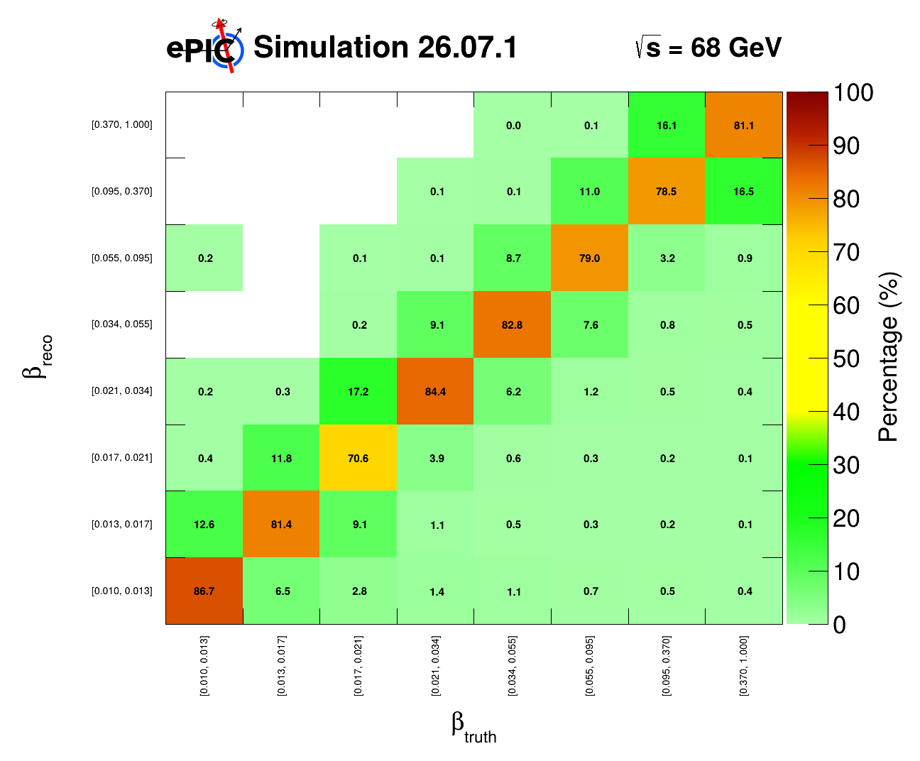

t, x_{pom}, $β$ : Migration Matrices
9x275 HERE
Also, with luminosity scaled to 1 fb⁻¹ HERE
GRUPPO COLLEGATO COSENZA

Slide 19
GRUPPO COLLEGATO COSENZA

Slide 20
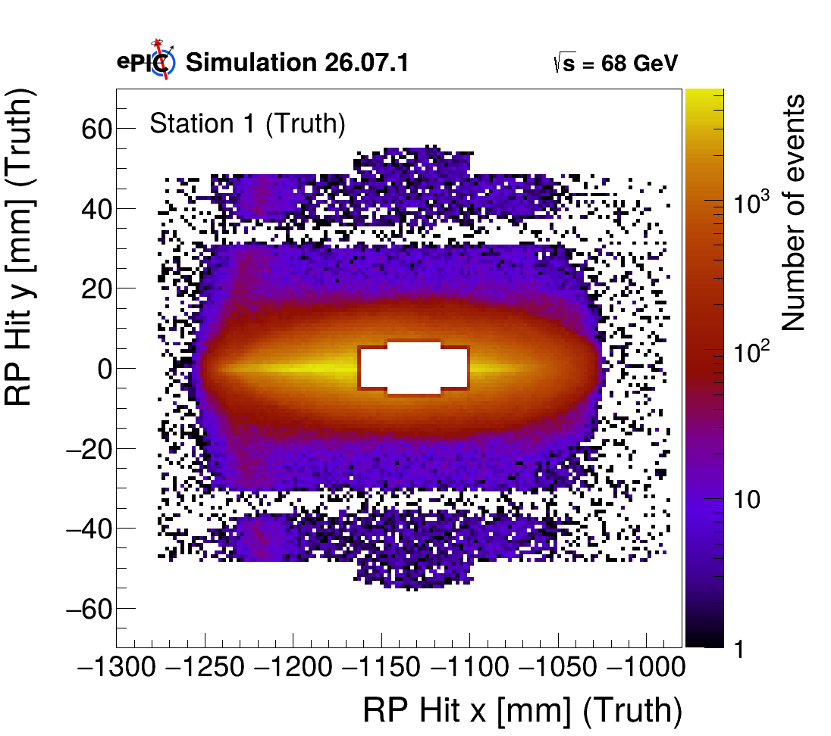

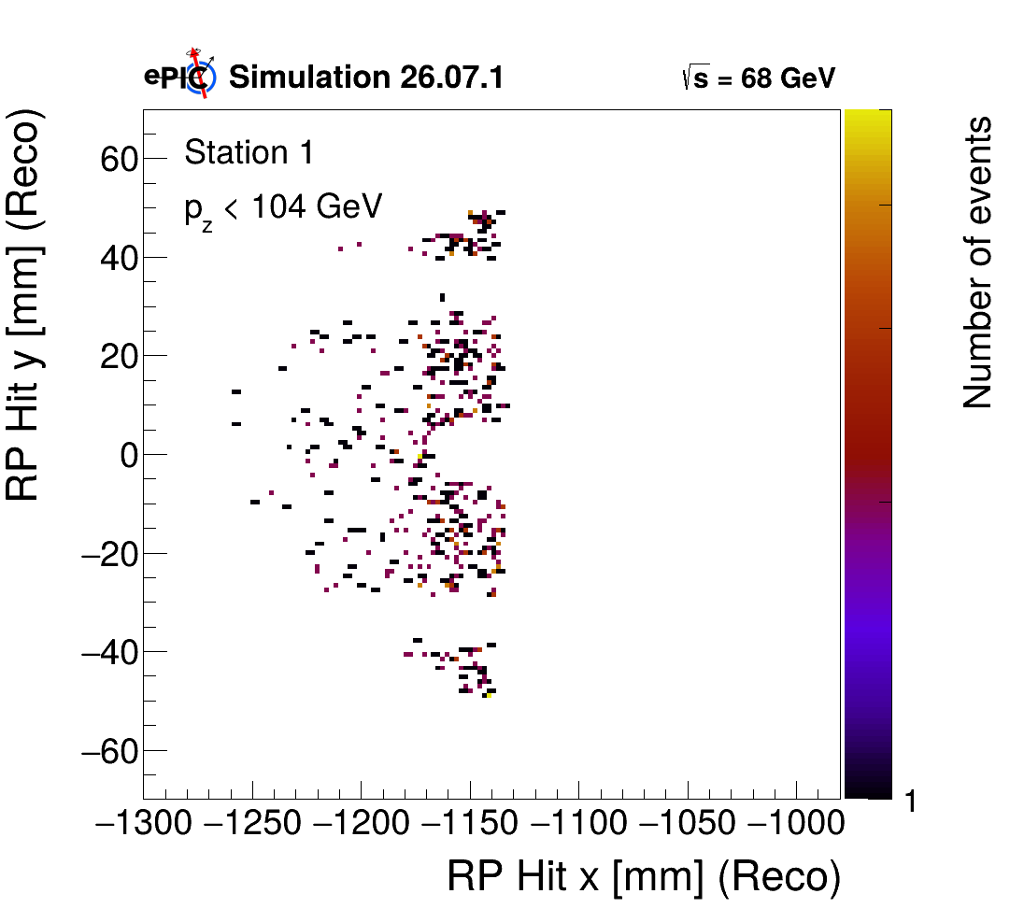
Hit and proton P_{z}
Correlations
GRUPPO COLLEGATO COSENZA

Slide 21

Event selection
Proton Tagged Cuts
Event Selection | Condition | Surviving Events (Single cut) | Surviving Events (Cutflow) | Single cut efficiency [%] | Cutflow efficiency [%]
No Selection | - | 1,999,998 | 1,999,998 | 100.00 | 100.00
Tagged Events | Tag RP || Tag B0 | 1,152,760 | 1,152,760 | 57.64 | 57.64
x_{L} Cut | $$0.75<x_{L}<1.0$$ | 911,623 | 911,149 | 45.58 | 45.56
$θ_{p}$ Cut | $$0<θ_{p}<5$$ $5.5<θ_{p}<20$mrad | 974,508 | 910,911 | 48.73 | 45.55
t Cut | $0.04<t_{RP}<0.22$/ $0.35<t_{B0}<1.0$ | 903,208 | 840,384 | 45.16 | 42.02
GRUPPO COLLEGATO COSENZA

Slide 22

Event selection
DIS Kinematics Cuts / Scattered Electron
Event Selection | Condition | Surviving Events (Single cut) | Surviving Events (Cutflow) | Single cut efficiency [%] | Cutflow efficiency [%]
Q² Cut | Q² > 5.5 GeV² | 1,659,799 | 697,884 | 82.99 | 34.894
y Cut | 0.01 < y < 0.95 | 1,886,048 | 681,532 | 94.30 | 34.077
E_{e} Cut | E_{e}' > 0.5 GeV | 1,520,210 | 538,493 | 76.01 | 26.925
$η_{e′}$Cut | -2.4 < $η_{e′}$ < 2.4 | 1,526,996 | 536,171 | 76.35 | 26.809
$Σ\left(E−P_{z}\right)$Cut | 15 < $Σ\left(E−P_{z}\right)$ < 22 GeV | 1,677,146 | 467,097 | 83.86 | 23.355
All DIS Cuts | Q² + y + E_{e’} + $η_{e′}$ + $Σ\left(E−P_{z}\right)$ | 1,117,553 | 467,097 | 55.88 | 23.355
GRUPPO COLLEGATO COSENZA

Slide 23
Event selection
Event Selection | Description | Surviving Events | Total Eff [%]
Total Generated Events | Initial simulation sample | 1,999,998 | 100.00
Proton tag (RP || B0) Roman Pots (RP Tag) B0 Tagger (B0 Tag) | Events tagged in RP or B0 Events tagged in RP Events tagged in B0 | 1,152,760 1,051,585 101,175 | 57.64 52.58 5.06
Roman Pots (RP Tag) Station 1 RP Station 2 RP | Events with hit in RP | 1,051,585 1,099,047 1,078,204 | 52.58 54.95 53.91
Station 1 & 2 Coincidence | Hits in both RP stations | 1,051,585 | 52.58
GRUPPO COLLEGATO COSENZA

Slide 24
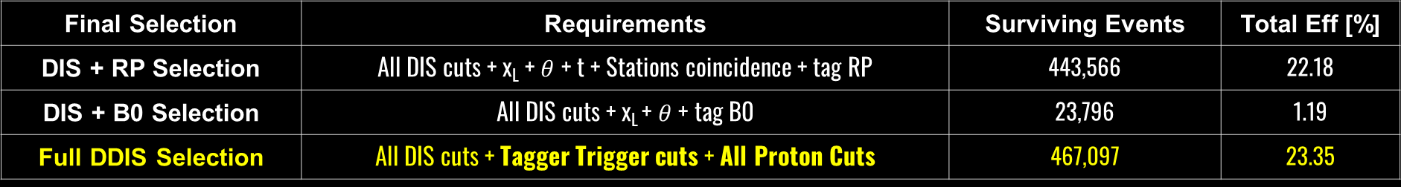
Event selection summary
Final Selection | Requirements | Surviving Events | Total Eff [%]
DIS + RP Selection | All DIS cuts + x_{L} + $θ$ + t + Stations coincidence + tag RP | 443,566 | 22.18
DIS + B0 Selection | All DIS cuts + x_{L} + $θ$ + tag B0 | 23,796 | 1.19
Full DDIS Selection | All DIS cuts + Tagger Trigger cuts + All Proton Cuts | 467,097 | 23.35
GRUPPO COLLEGATO COSENZA

Slide 25
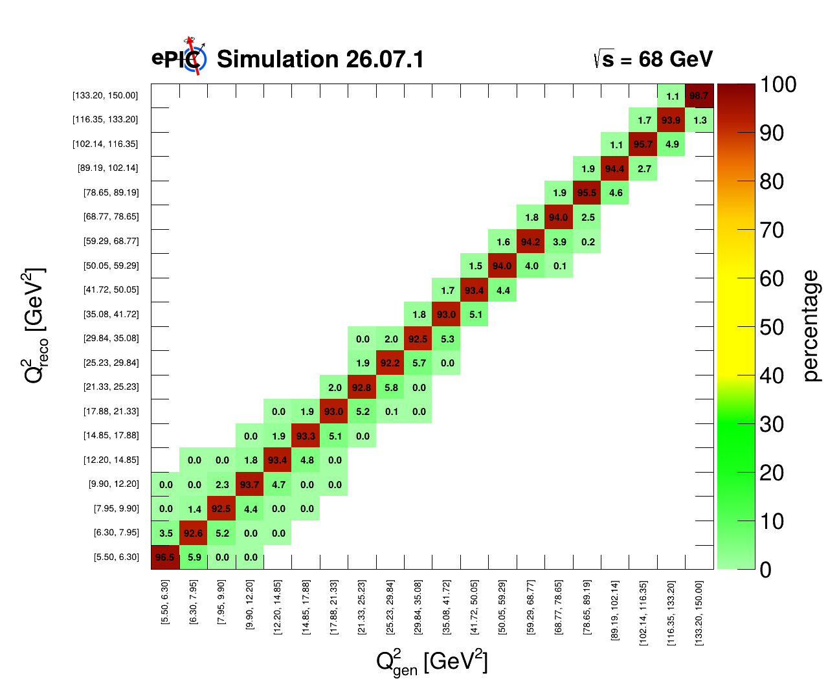
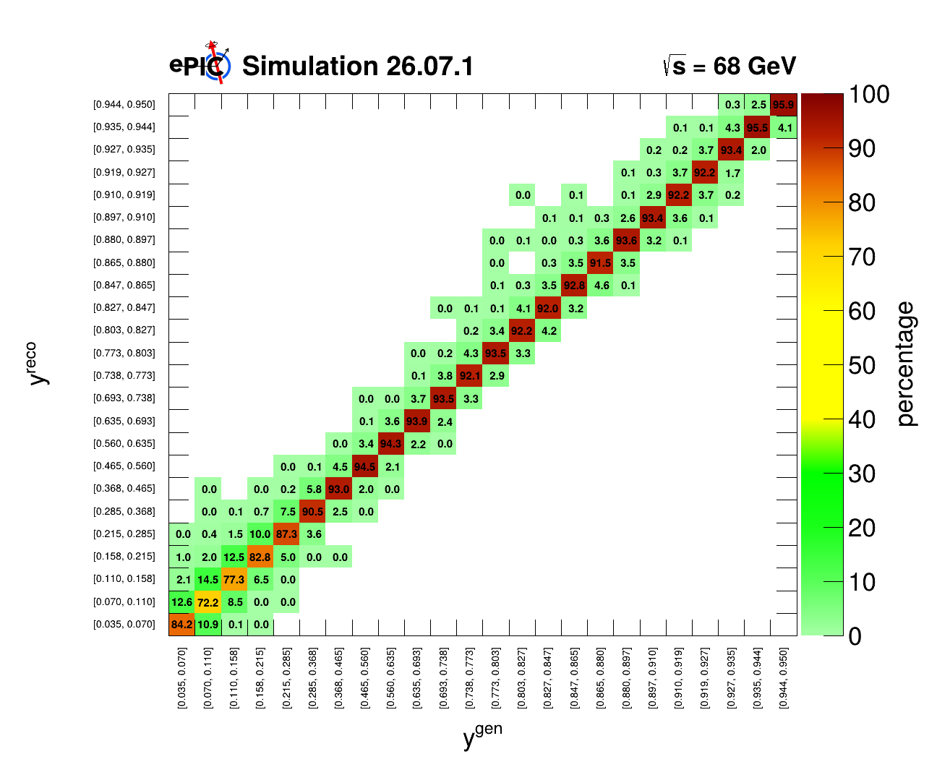
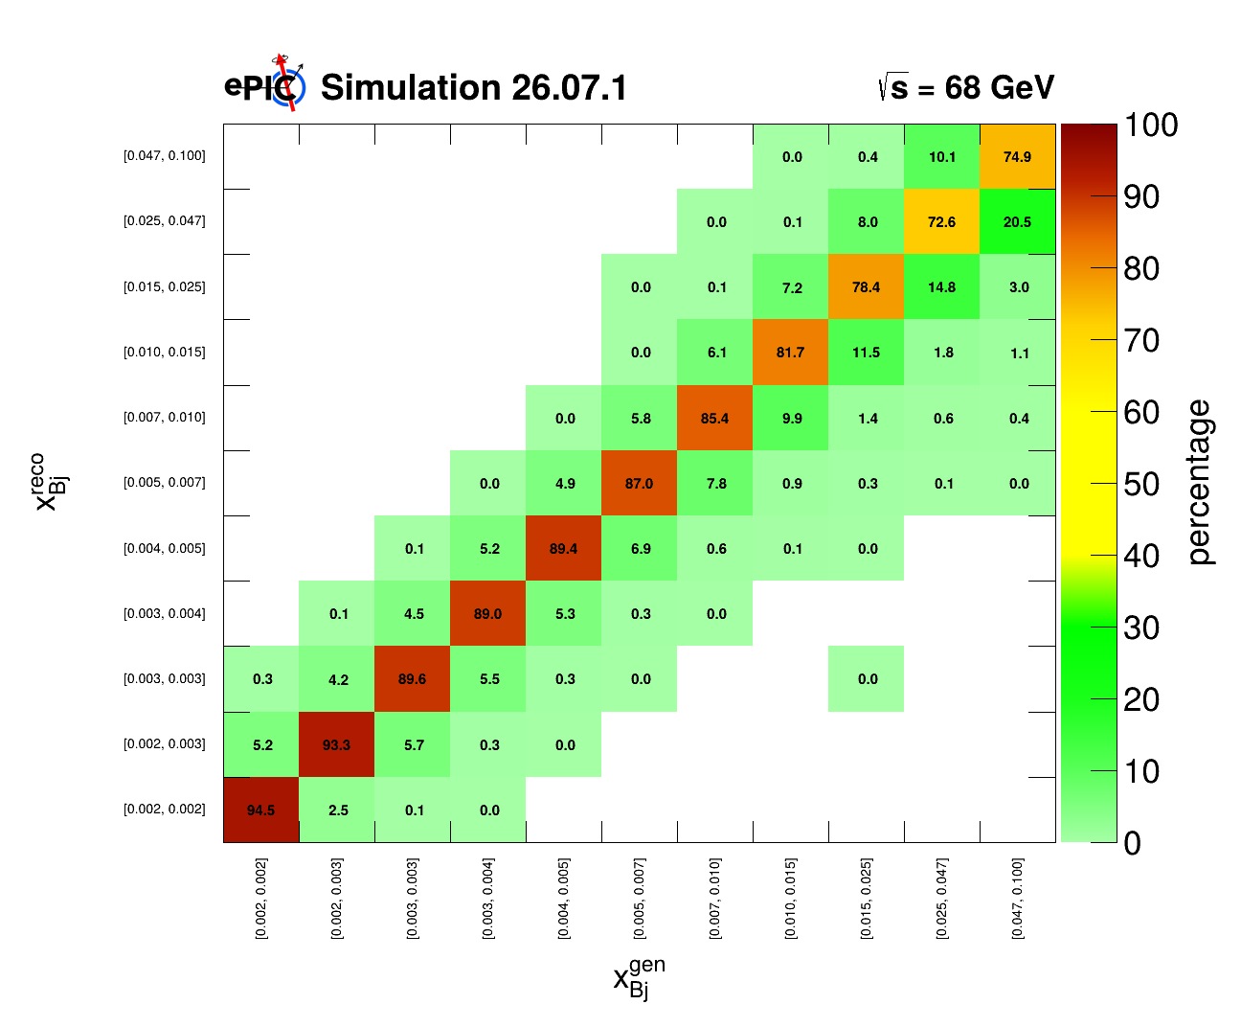
Migration Matrices with Cuts
GRUPPO COLLEGATO COSENZA

Slide 26
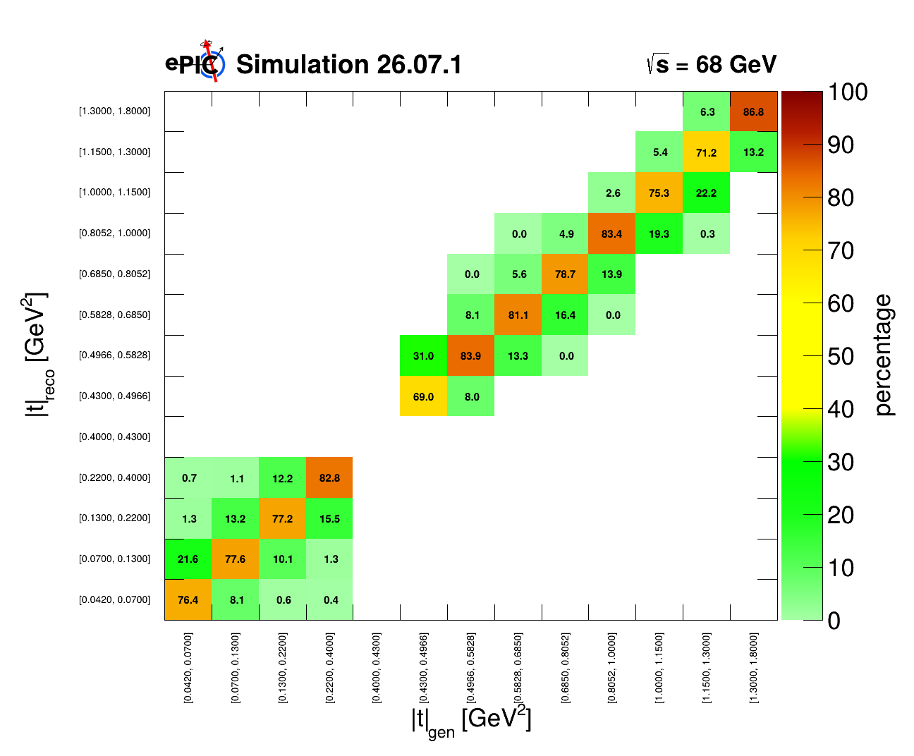
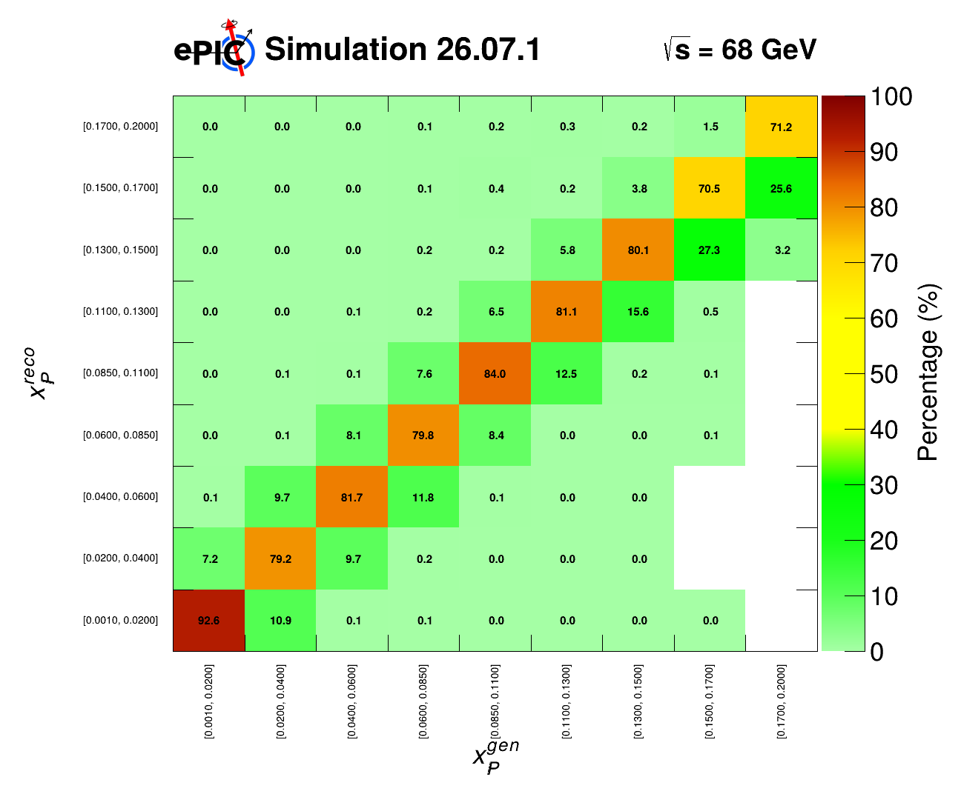
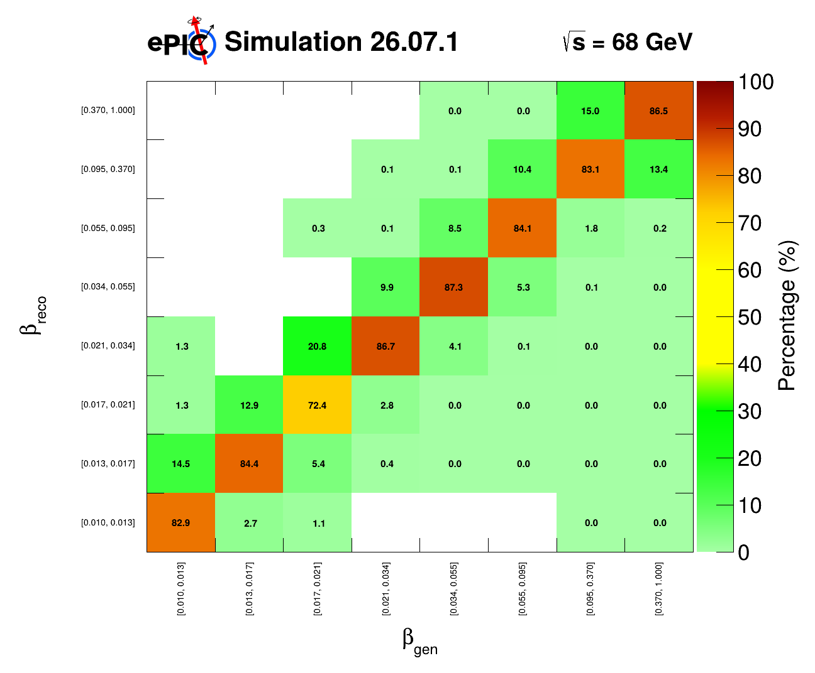
Migration Matrices after Cuts
9x275 HERE
GRUPPO COLLEGATO COSENZA

Slide 27





Control Plots
MC 1/2 dataset
Pseudodata 1/2 dataset
$\sqrt{s}=68 GeV$:
L_{MC} = 0.17 fb⁻¹
L_{data} = 0.17 fb⁻¹
$\sqrt{s}=99 GeV$:
L_{MC} = 0.11 fb⁻¹
L_{data} = 0.11 fb⁻¹
Expected luminosity:
$\sqrt{s}=68 GeV$: 1 fb⁻¹
$\sqrt{s}=99 GeV$: 2.5 fb⁻¹
9x130 All HERE
9x275 All HERE
GRUPPO COLLEGATO COSENZA

Slide 28




Differential Cross-Section in t
For each events in bin $i$:.
$N_{i}^{gen}$: truth-level generated events in the acceptance.
$N_{B0,i}^{reco,MC}$: reconstructed MC events in B0.
$N_{RP,i}^{reco,MC}$: reconstructed MC events in RP.
$N_{B0,i}^{reco,data}$: reconstructed data events in B0.
$N_{RP,i}^{reco,data}$: reconstructed data events in RP.
$L_{MC}=\frac{N_{MC}^{tot}}{σ_{tot}}$. $L_{target}=1 fb^{−1}$
$L_{data}=\frac{N_{data}^{tot}}{σ_{tot}}$.
$${\left(\frac{dσ}{dt}\right)}_{i} =\frac{(N_{B0,i}^{reco,data}+N_{RP,i}^{reco,data})}{L_{data} Δt_{i}}\frac{N_{i}^{gen}}{\left(N_{B0,i}^{reco,MC}+N_{RP,i}^{reco,MC}\right)}$$
$$C_{i}=\frac{N_{i}^{gen}}{\left(N_{B0,i}^{reco,MC}+N_{RP,i}^{reco,MC}\right)}$$
GRUPPO COLLEGATO COSENZA

Slide 29


Differential Cross-Section in t
GRUPPO COLLEGATO COSENZA

Slide 30

Reduced Inclusive Diffractive Differential Cross-Section
GRUPPO COLLEGATO COSENZA

Slide 31



Reduced Differential Cross-Section
${\left(\frac{dσ}{dQ^{2}dβ dx_{pom}}\right)}_{ijk} =$
$$\frac{(N_{B0,ijk}^{reco,data}+N_{RP,ijk}^{reco,data})}{L_{data} ΔQ_{i}^{2} Δβ_{j}Δx_{pom,k}}\frac{N_{ijk}^{gen}}{\left(N_{B0,ijk}^{reco,MC}+N_{RP,ijk}^{reco,MC}\right)}$$
HERE 9x130 as function of Q²
HERE 9x130 as function of beta
HERE 9x275 as function of Q²
HERE 9x275 as function of beta
GRUPPO COLLEGATO COSENZA
Notes:
Mettere 68

Slide 32


Reduced Differential Cross-Section
GRUPPO COLLEGATO COSENZA
Notes:
Link beta

Slide 33


Systematics
Deep Virtual Meson Production J/ψ Analysis Note
GRUPPO COLLEGATO COSENZA
Notes:
Link beta

Slide 34
Summary and outlook
Detail studies of reconstruction of proton tagged diffractive events;
Preliminary measuraments of single and triple diffractive differential cross section;
Plan to include systematic uncertanties;
Well on track for NIM-A publication.
GRUPPO COLLEGATO COSENZA

Slide 35
Thanks for the attention
GRUPPO COLLEGATO COSENZA

Slide 36
Backup
GRUPPO COLLEGATO COSENZA

Slide 37



Backup: Global resolution
GRUPPO COLLEGATO COSENZA

Slide 38



Backup: Global resolution
GRUPPO COLLEGATO COSENZA

Slide 39



Backup: Global resolutions
GRUPPO COLLEGATO COSENZA

Slide 40



xL, $β$ : Resolution with B0
GRUPPO COLLEGATO COSENZA

Slide 41


Backup: $\frac{dN}{d\left|t\right|}$
GRUPPO COLLEGATO COSENZA

Slide 42



Backup: Distributions after cuts
Cutted Q2 Resolution
Cutted y Resolution
Cutted xbj Resolution
GRUPPO COLLEGATO COSENZA

Slide 43



Backup: Distributions after cuts
Cutted t Resolution
Cutted xL Resolution
Cutted beta Resolution
GRUPPO COLLEGATO COSENZA

Slide 44


Backup: Distributions
GRUPPO COLLEGATO COSENZA

Slide 45


Backup: Distribution
GRUPPO COLLEGATO COSENZA

Slide 46


Backup: Distributions
GRUPPO COLLEGATO COSENZA

Slide 47

Q² binned
GRUPPO COLLEGATO COSENZA

Slide 48


x_{Bj} and |t| binned
GRUPPO COLLEGATO COSENZA

Slide 49



$β$ and x_{L} binned
GRUPPO COLLEGATO COSENZA

Slide 50



Diffrective Differential Cross Section
GRUPPO COLLEGATO COSENZA

Slide 51


Diffrective Differential Cross Section
GRUPPO COLLEGATO COSENZA

Slide 52



Diffrective Differential Cross Section
GRUPPO COLLEGATO COSENZA

Slide 53



Diffrective Differential Cross Section
GRUPPO COLLEGATO COSENZA

Slide 54



Diffrective Differential Cross Section
GRUPPO COLLEGATO COSENZA

Slide 55



Diffrective Differential Cross Section
GRUPPO COLLEGATO COSENZA

Slide 56


Diffrective Differential Cross Section
GRUPPO COLLEGATO COSENZA

