Slide 1
Roman pots stave design updates
Speaker: Jack Fried, on behalf of the BNL Instrumentation Team

Slide 2
Roman pots stave design
Adhesiveless Kapton construction for the final Roman Pot stave design
Current prototype: 12-layer PCB
  6 signal layers
  6 power/ground layers
Extensive filtering included in the prototype for testing and design verification
  Filtering and other unnecessary circuitry will be removed after testing
FMC connector provides compatibility with:
  Current EICROC test boards and RVB1
Current design is intended as a test and verification platform before optimization of the final stave design

Slide 3
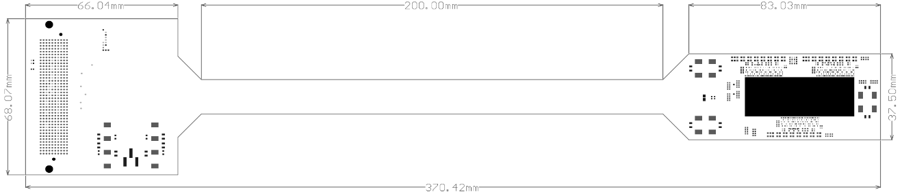
Current Roman pots stave dimensions
Current board dimensions: approximately 370.4 mm overall length, with a 200 mm long stave section; connector end is approximately 66.0 × 68.1 mm, and detector end is approximately 83.0 × 37.5 mm.

Slide 4
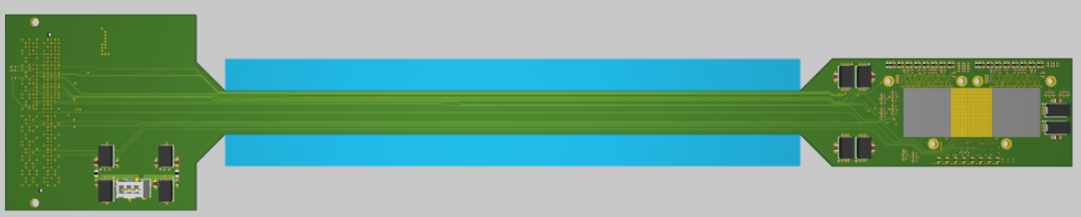
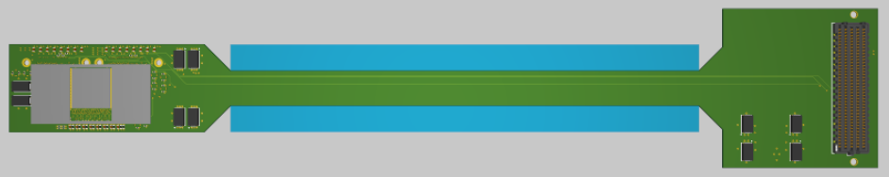
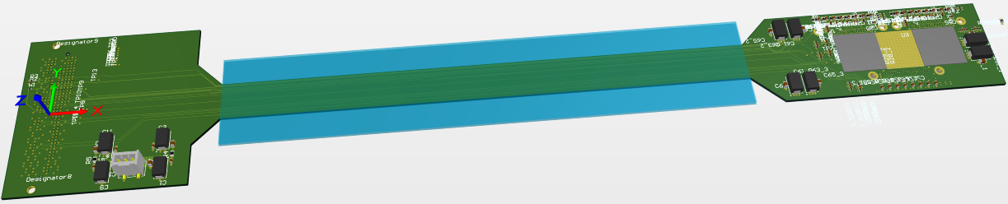
Stave Design Status
Top
Bottom

Slide 5
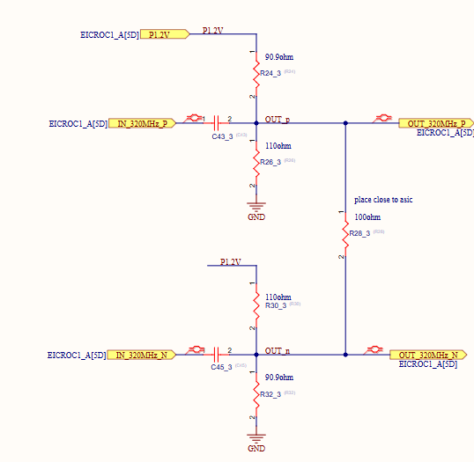
Questions
High-voltage bias
  Determine how the HV bias for the AC-LGAD sensors will be brought onto the stave, including the HV connector/feedthrough
Differential signals (clocks)
  Is external baseline restoration required after AC coupling

Slide 6
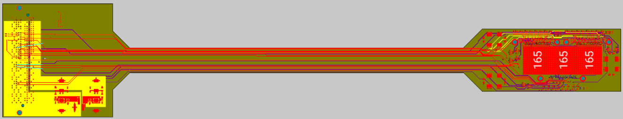
Current Status
PCB routing is mostly complete.
High-voltage bias delivery: Finalize how the AC-LGAD sensor bias will be brought onto and distributed across the stave.
Test points and pads: Finalize locations and accessibility for testing and verification.
Design cleanup: Complete remaining routing, component placement, and general layout cleanup.
Next step: Complete final design review and prepare the board for fabrication.

