Slide 1
Charge sharing and EICROC2 readout architecture implications
Alex Jentsch (BNL)
AC-LGAD electronics meeting
Friday, Sept. 4th, 2026

Slide 2
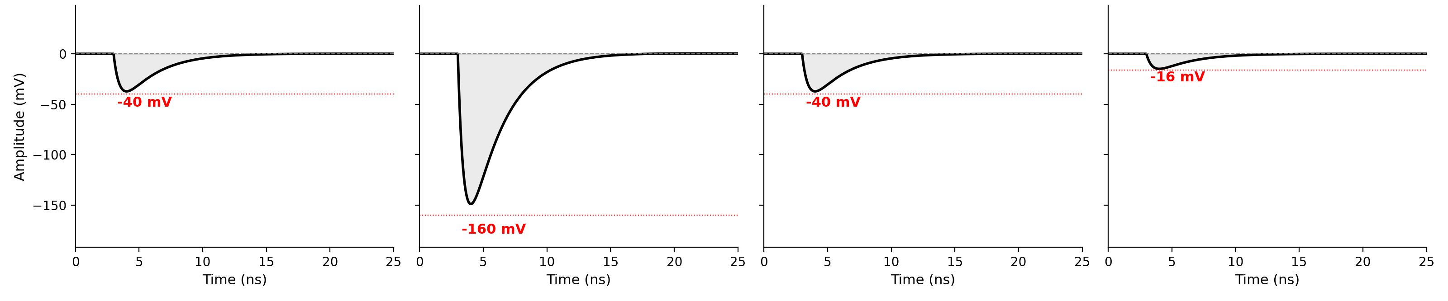
Preliminaries
AC-LGADs use capacitive coupling to enable deposited charge to share signal across neighboring readout pads.
Incident particle
A 30um “active layer” in an AC-LGAD has around 0.35 fC of charge from an average MIP.
  Gain of the device is around 50 → avg. MIP charge is ~ 17.5 fC (Landau fluctuations will obviously provide a range of values)
  EICROC0A + sensor has minimum threshold ~ 5-6 fC
backplane
AC-LGAD
EICROC0
PCB
Corner neighbor
Adjacent neighbor
Corner neighbor
Adjacent neighbor
Primary “pixel”
adjacent neighbor
Corner neighbor
Adjacent neighbor
primary pixel
Adjacent neighbor
Corner neighbor
Adjacent neighbor
Corner neighbor

Slide 3
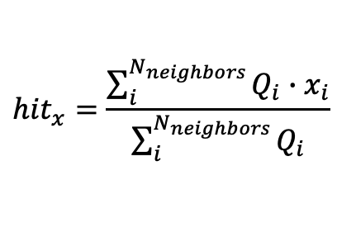

How does charge sharing affect resolution?
Improved timing resolution using combined timing information in same sensor from neighboring pixels.
Significant improvement in spatial resolution compared to a standard pixel device.
    500 um pixel pitch nominally gives ~ 144um spatial resolution, AC-LGADs have been shown to deliver ~ 20um spatial resolution using charge sharing.
$${hit}_{x}=\frac{\sum_{i}^{N_{neighbors}}{Q_{i}∙x_{i}}}{\sum_{i}^{N_{neighbors}}{Q_{i}}}$$
Hit position resolution limited to ~ pitch/$\sqrt{12}$
Refined hit position resolution using barycenter/center of gravity

Slide 4
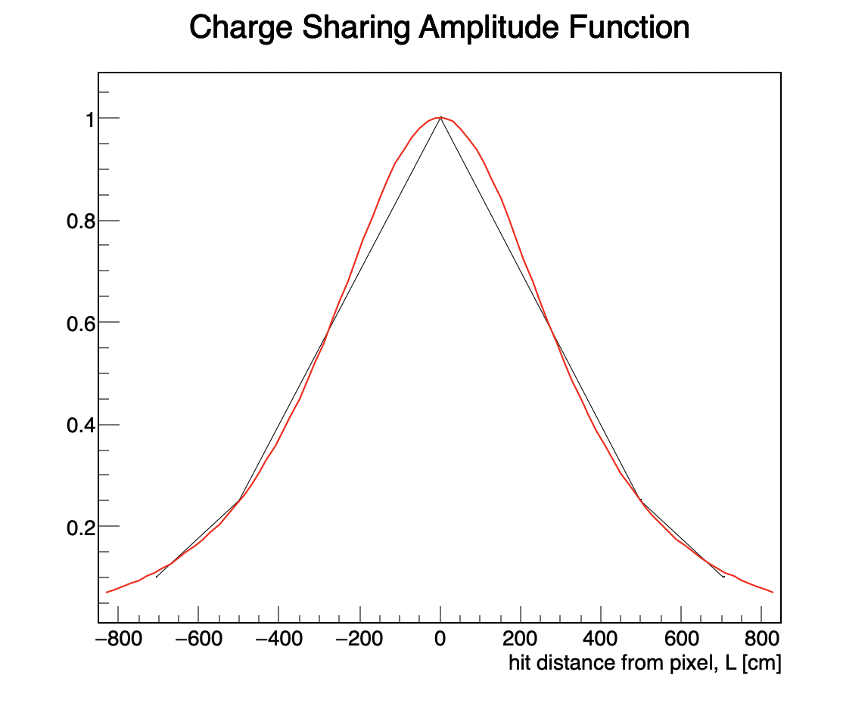
Resolution vs. neighboring pixels used
Assume average MIP is ~ 20fC → leads to an amplitude (preamp) ~ 160mV from a 30um device biased to -170V.
Simple toy MC → use Lorentzian to mimic charge falloff in neighboring pads as a function of distance from hit.

Slide 5
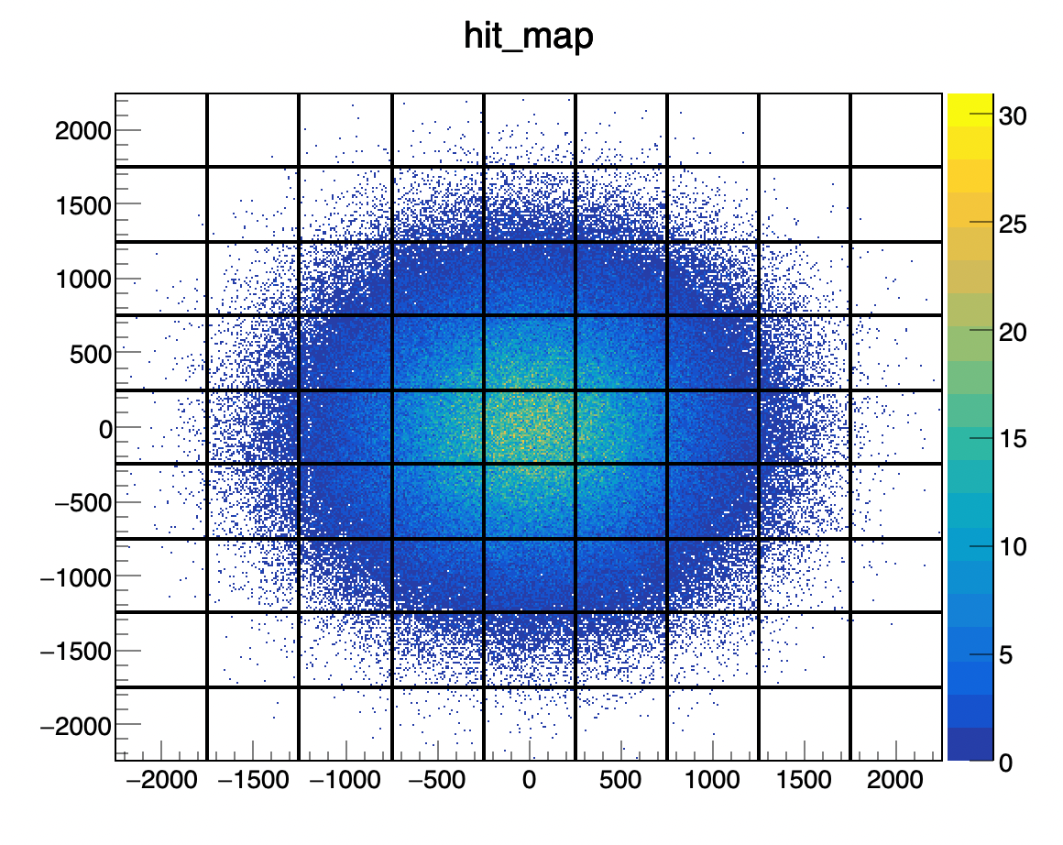
Resolution vs. neighboring pixels used
Assume average MIP is ~ 20fC → leads to an amplitude (preamp) ~ 160mV from a 30um device biased to -170V.
Simple toy MC → use Lorentzian to mimic charge falloff in neighboring pads as a function of distance from hit.
Produce random hits sampled from a Gaussian.

Slide 6
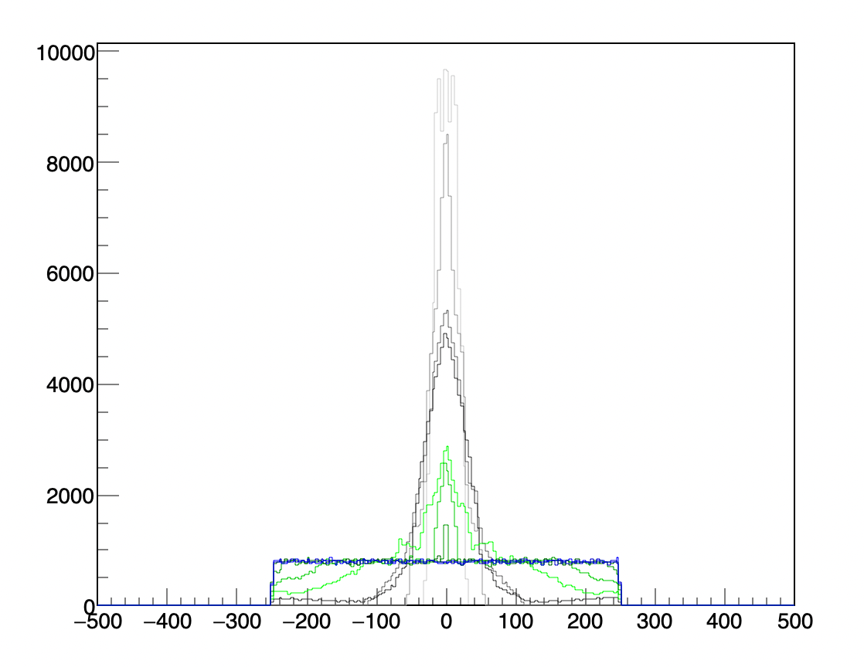
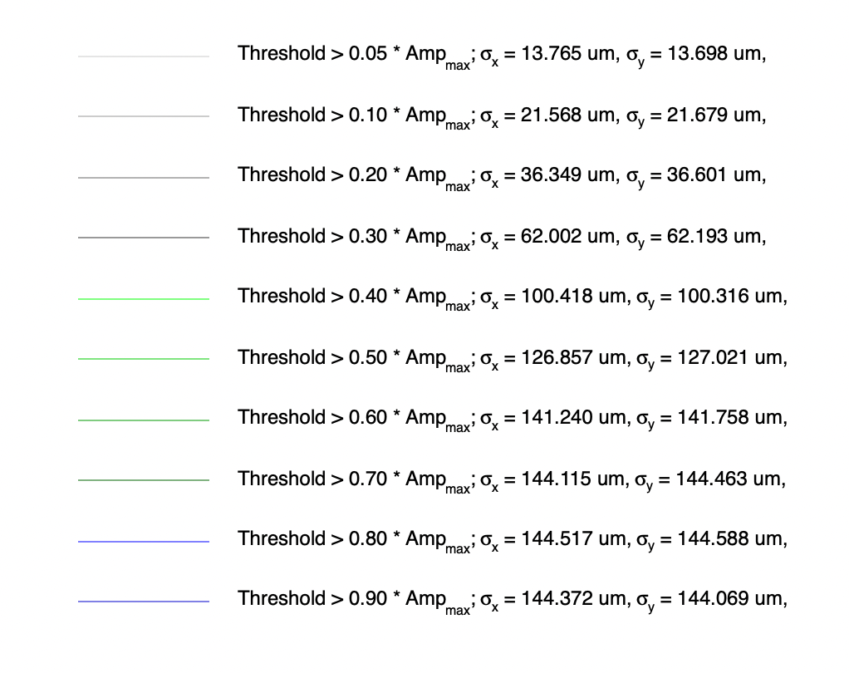

Resolution vs. neighboring pixels used
Assume average MIP is ~ 20fC → leads to an amplitude (preamp) ~ 160mV from a 30um device biased to -170V.
Simple toy MC → use Lorentzian to mimic charge falloff in neighboring pads as a function of distance from hit.
3x3 readout
Using RMS values
Cross readout
Essentially no use of charge sharing
$${hit}_{reco}−{hit}_{MC} [μm]$$

Slide 7
Summary
Assuming average MIP (with gain of 30um AC-LGAD) is around 20 fC, 3x3 readout necessary to be able to meet requirements of the B0 tracking detector.

