Slide 1
Position resolution of BTOF
9/10/2026

Slide 2
Charge sharing and digitization work-flow
Start
Geant hit
Edep in cells
Charge sharing
Pulse Generation
Pulse Combiner
ADC and TDC values
Pulse Digitization
Pulse Discretization
Clustering
Calibration
Measurement2D
Cluster
Association
Tracking

Slide 3
Charge sharing and digitization work-flow
Challenges:
Efficiency lost due to digitization not yet understood.
  Thresholds, dynamic range, etc not realistic yet.
Truth-hit association not implemented
Start
Geant hit
Edep in cells
Charge sharing
Pulse Generation
Pulse Combiner
ADC and TDC values
Pulse Digitization
Pulse Discretization
Clustering
Calibration
Measurement2D
Cluster
Association
Tracking

Slide 4
Proposed update: Bypass all digitization routine
Without digitization steps,
Hit lost due to thresholds minimized.
Truth association is easy to implement.
Start
Geant hit
Charge sharing
Pulse Generation
Pulse Combiner
Edep in cells
ADC and TDC values
Pulse Digitization
Pulse Discretization
Clustering
Calibration
Measurement2D
Cluster
Association
Tracking

Slide 5
Clustering algorithm
Clustering: weighted average of neighbors.
  Group contiguous neighbors.
    Hits are contiguous in time if Δt < 1ns.
  Weighted by Edep.
  Time of a cluster = time of the earliest hit.
  No Edge correction.
Time axis not shown
Cluster 1
Cluster 2
Cluster 3

Slide 6
Settings for performance study
BTOF sensor
Pictorial illustration
MC particle gun:
  0.8 < theta < 2.3 rad
  2pi azimuth uniform
  |p| = 1 GeV/c
  e- only
Thresholds:
  Edep > 6 keV hits only.
Charge sharing profile:
  2D gaussian, with principal axis aligned with local sensor coordinates.
Pixel pitch
sigmax
x
Z (beam axis)

Slide 7
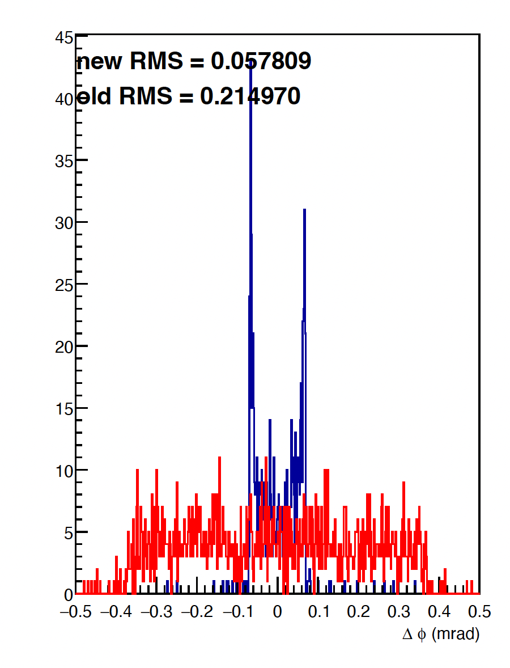
Position resolution (Delta Phi)
Delta between cluster position and TOFBarrelHits position (i.e. Geant4 exact hit position on BTOF)
Red (old): No clustering algorithm (Use pixel center)
Blue (new): With clustering algorithm
Sigmax=0.5*pixel width

Slide 8
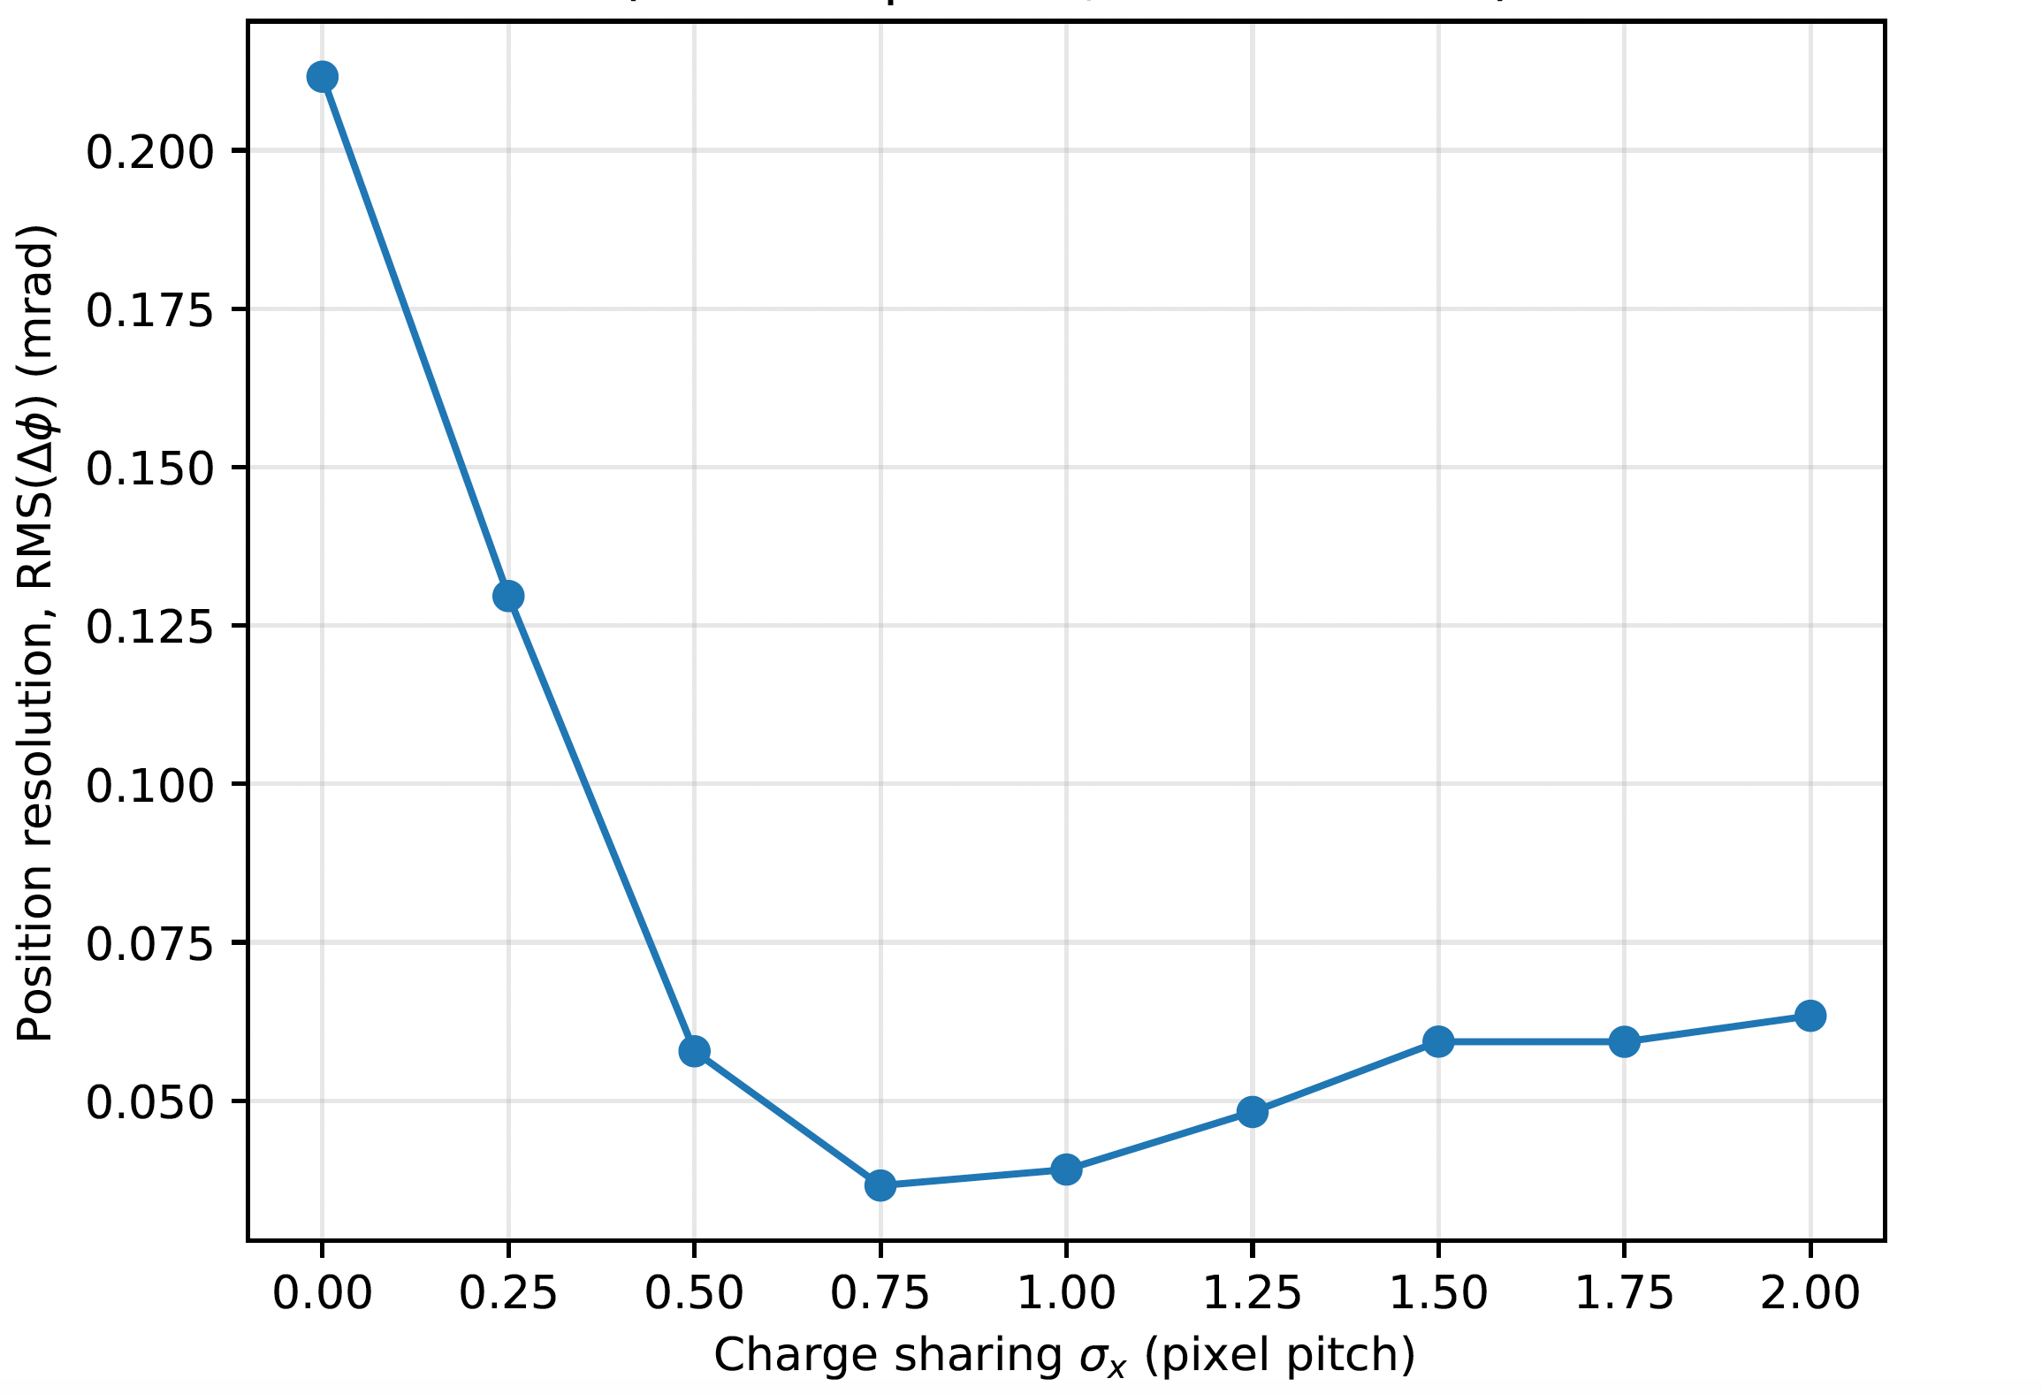
Position resolution vs charge sharing magnitude

